Slide 1
NormalForm for MAD-X
NormalForm techniques have been provided to MAD-X via the PTC Code.
Apparently, under certain conditions, we are finding deviations from what has been expected. We are studying a number of cases with MAD-X, the external Map and NormalForm DALIE suite and the analytical SOOD module. Even more relevant is to determine directly by simulation runs both the Detuning with Amplitude and the Distortion or F Function. The latter is achieved by the analysis of the simulation data via the SUSSIX code.
We find a potential reason for the deviations and in particular the NormalForm transformations seems to save the 4th order F & H terms for a 5-cell LHC model.
We end with some recommendations about best ways to calculate the NormalForm order by order and how to avoid those deviations.

Slide 2
Contents
Minimal Overview of the NormalForm Approach
5-Cell LHC FODO example with sextupoles:
https://cernbox.cern.ch/index.php/apps/files/?dir=/for_CERN&#
Expected Results of the NormalForm
Prediction of NormalForm Terms using Simulations
Deviations and Solution
Recommendations

Slide 3
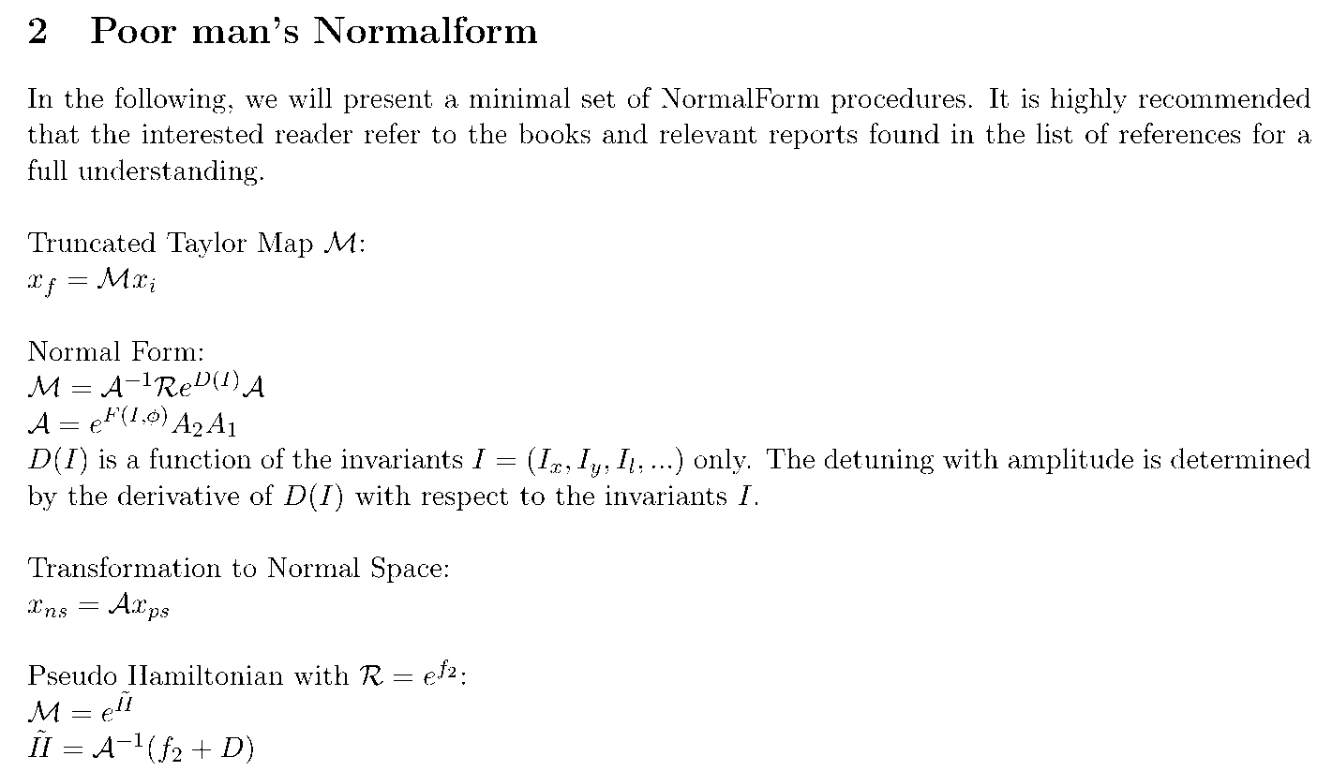
Minimal Overview of the NormalForm Approach

Slide 4
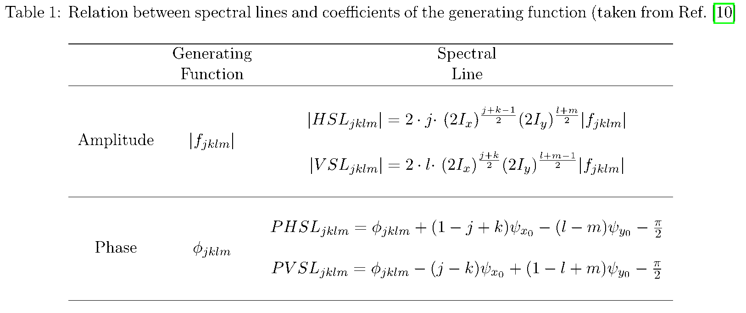
Coefficients of F versus Spectral Lines 1/2
Major effort of refactoring the code in SUSSIX! Avoiding Substractions of Lines.

Slide 5
Coefficients of F versus Spectral Lines 2/2
Sufficiently small and equal sized Hor .& Ver. Amplitudes ~1e-4:
THIRD ORDER CONJUGATING FUNCTION COEFFICIENTS, CASE: 1
jklm Amplitude Phase Cos Sin
3000 0.8486522458906E+00 0.4064365704793E+03 0.5848547905312E+00 0.6149435002079E+00
2100 0.3060276949223E+01 -0.6846195565300E+02 0.1123485636830E+01 -0.2846590070555E+01
1200 0.1993840305001E+01 -0.3217104303269E+03 0.1564943690620E+01 0.1235455546361E+01
0300 0.8486522458906E+00 -0.4064365704793E+03
Same Hor. Amplitude very small Ver. Amplitudes ~1e-4/1e-12:
3000 0.8486726673187E+00 0.4064371266004E+03 0.5848628952033E+00 0.6149639746101E+00
2100 0.1993830150680E+01 -0.3828850585300E+02 0.1564958659122E+01 -0.1235420197747E+01
1200 0.1993822992803E+01 -0.3217115433456E+03 0.1564954101722E+01 0.1235414418781E+01
0300 0.8486726673187E+00 -0.4064371266004E+03
Explanation: The “2100” F-term is found as the (0, 0) spectral line which is excited by both the
“2100” and the “1011” terms or in other words these 2 terms are excited by the (1, 0) resonance for the
horizontal and mixed transverse planes. Keeping the horizontal amplitude the same with an negligible
vertical amplitude takes out the “1011” contribution. The calculation of these F terms are typically
very stable since they are normalized by the amplitudes.

Slide 6
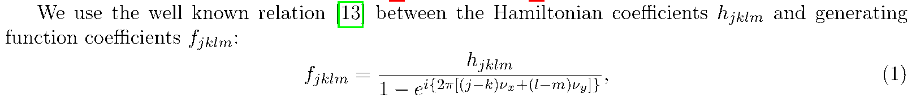
Words of Caution and Recommendataions Ref. [10]
It has to be mentioned that the approximation ... that leads to Tab. 1, is only valid for the resonances due to sextupoles in first order of their strengths. For each additional multipole order, one has to add one Poisson bracket which in the table will lead to corresponding higher order contribution of the |fjklm |to the spectral lines. In the next section we discuss how to overcome this problem.
followed by:
... allows to derive the sextupole related terms considering the first Poisson bracket only. ... When
octupoles are examined, the second Poisson bracket is also needed because terms second order in the sextupoles strengths will contribute to the spectral lines with the same amplitude dependence as the octupoles. Two approaches seem appropriate: either one calculates these second order Poisson brackets with the knowledge of the previously determined third order terms or one takes out the third order terms from the raw tracking data. The latter implies that after this third order transformation the frequency analysis has to be redone for the transformed data.
In this report one also finds Etienne Forest’s scaling law between F and H

Slide 7
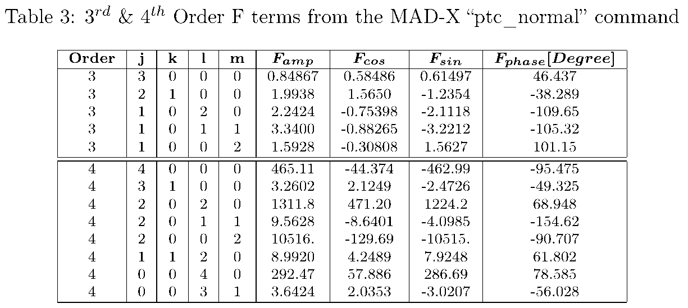
Expected Results of the NormalForm 1/2
F-Terms
Table 3 show the expected F terms in 3rd and 4th orders. These terms are predicted identically with “SODD” and the external DALIE Normal Form suite.

Slide 8
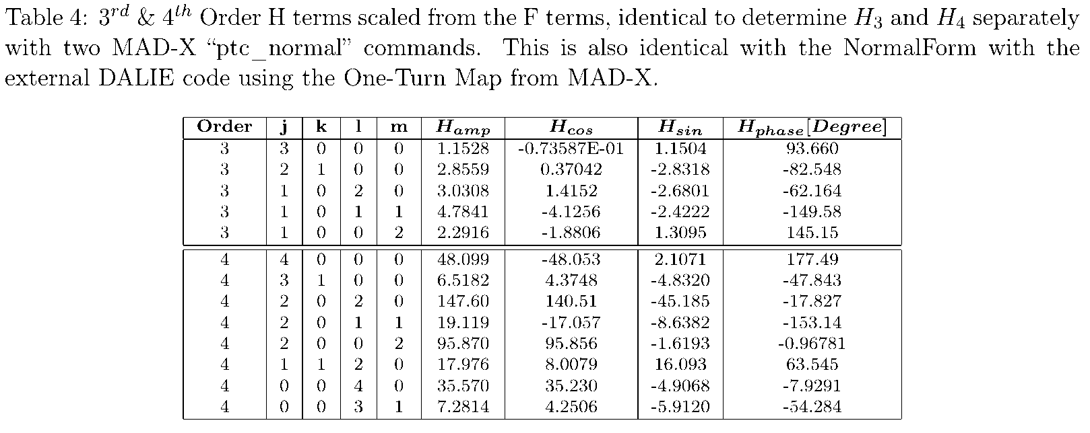
Expected Results of the NormalForm 2/2
H-Terms
Table 4 shows the expected H terms in 3rd and 4th orders. These terms are predicted identically either by the F/H scaling law, by “SODD” or by the external DALIE Normal Form suite.

Slide 9
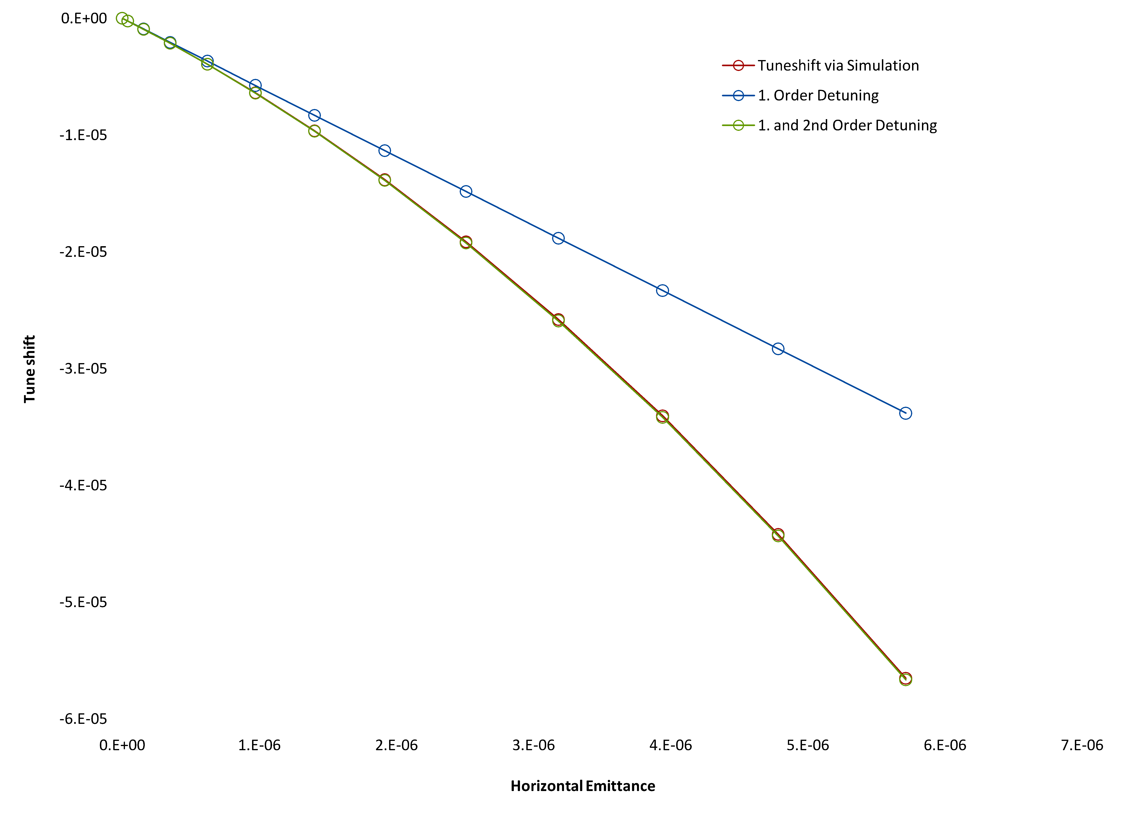
Detuning with Amplitude from Simulations

Slide 10
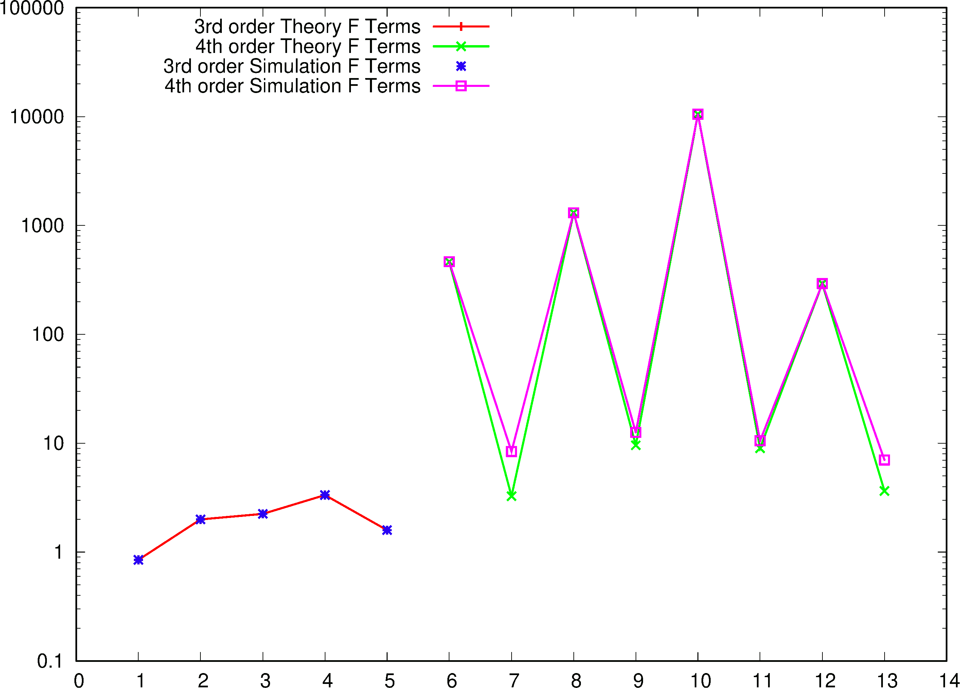
SUSSIX Predictions of F Terms

Slide 11
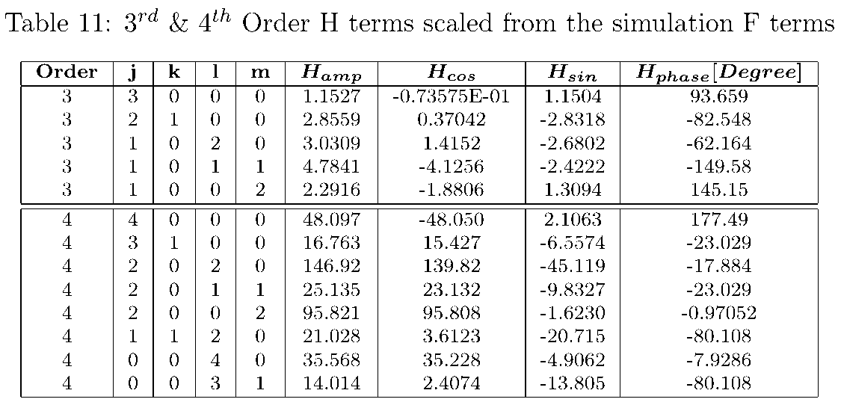
Simulation Results H-Terms via Scaling
Table 11 show the H terms in 3rd and 4th orders calculated by simulations, the refined “SUSSIX” analysis and then using the scaling law.

Slide 12
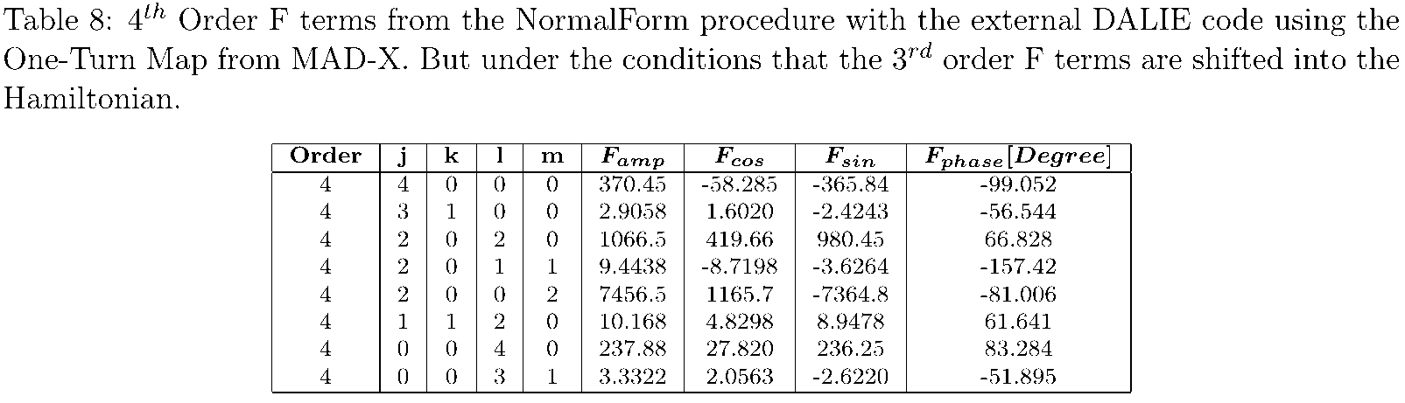
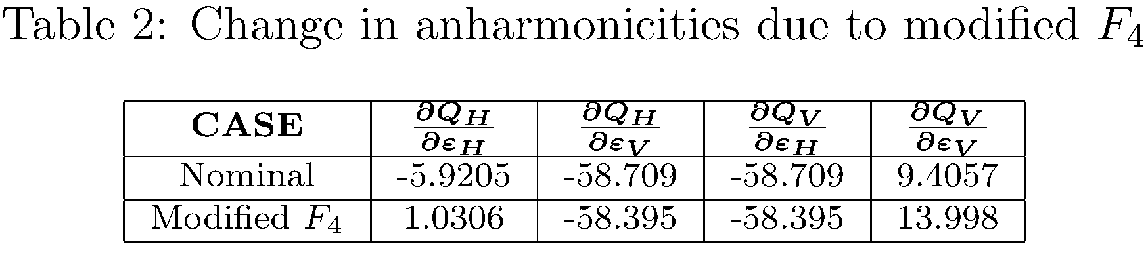
F₄-Terms and Detuning with Amplitude as a side-effect of 3rd order H₃ Calculation
Table 8 shows the effect on F₄ when H₃ is calculated in the external DALIE NormalForm. We expect the same happening internally in MAD-X.
Table 2 holds the effect on the detuning with amplitude for the modified F₄. The effect is substantial and one even finds a change in sign! This is clearly in contradiction with the excellent agreement between the standard results with simulations.

Slide 13
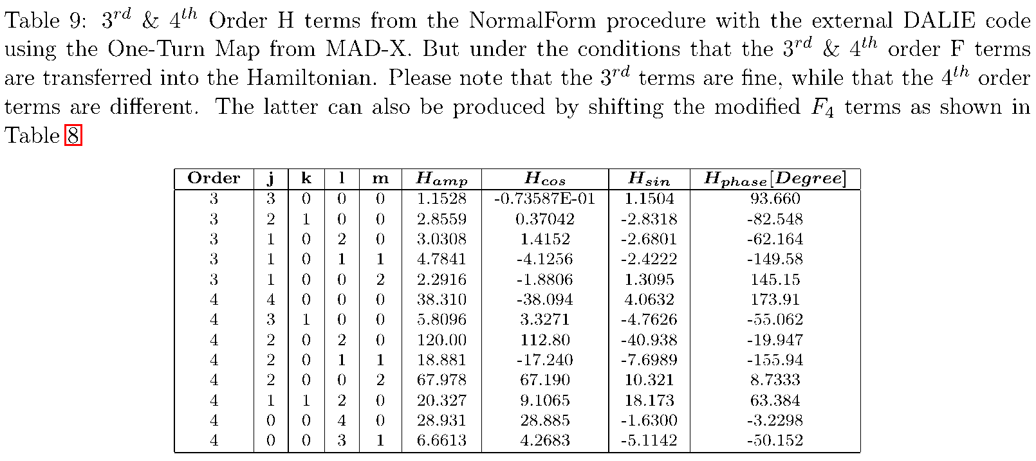
H₄-Terms as a side-effect of 3rd order H₃ Calculation
Table 9 shows the effect on H₄ when H₃ is calculated in the external DALIE NormalForm. We expect the same happening internally in MAD-X. The H₃ terms are fine. The H₄ may come either from a scaling of the modified F₃, the external DALIE NF or MAD-X

Slide 14
|H4000| Terms in comparison with Simulations
F&H Standard NF |4000| : 465.11, 48.099
F&H Simulation NF |4000|: 465.09, 48.097
F&H modified NF |4000| : 370.45, 38.310
One finds that for one of the 4 large terms that the simulations strongly support the
standard NormalForm value.

Slide 15
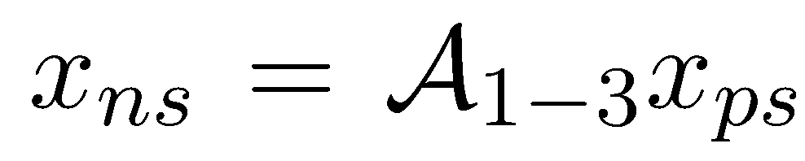
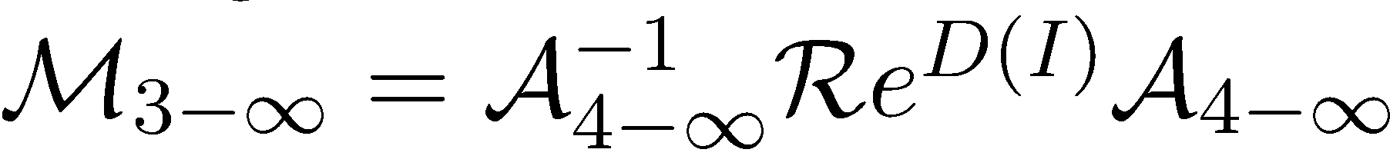
Solution 1/2
In the above discussion in Ref. [10] on the relation between the F terms and the spectral lines, it was stressed that there are 2 ways of dealing with the next higher
Order:
Either one deals with more Poisson brackets
Or one removes the lowest order terms, in this case order 3, from the map altogether.
Having a full blown map manipulation tool kit (DALIE) we decided to use option 2.

Slide 16
Solution 2/2
The next steps are:
A)
In this case the NormalForm is up to and including order 3. We are then using this transformation and let it work on the simulation data using the “DATRACK” code
which is part of the DALIE suite. The resulting data, where the third order terms have been removed, are then the input of SUSSIX. We observe that the 4 strong terms remain unchanged, while the much smaller terms do change but still do not fully agree with the theoretical F terms. This certainly needs some follow-up! On the other hand, we observe that the workaround of the line substraction seems not the work anymore, but it is also less needed. This also requires more studies.
B)
The new map freed from third order terms has terms of third order and higher except for the rotational terms which remains present. This map is being used for the 4th order NormalForm.
➔ the F₄, H₄ terms are back to the expected values and the detuning with amplitude as well.
C) We would continue in the very same way if we would consider 5th order F & H terms.

Slide 17
Recommendations 1/2
• Anyone is welcome to use the very old DALIE suite which has been kept alive for several decades. However, we strongly recommend to switch to the FPP tools in PTC which are quite superior to the old tools, albeit the fact that the old one’s still work fine.
• We think that the problem found both in the old MAD-X(2016) and a more recent one MAD-X(2021) are due to the fact that attempts to calculate several orders at the same time leads to artificially changed F & Detuning with Amplitudes Terms. As a consequence, the H terms are changed as well: direct calculation and scaling F to H terms arrive at the same slightly false results.
• We see the following solutions in rising effectiveness:
– One can simply ignore the problem and do the calculations of the H terms for one order only.
– One may avoid the calculation of the H terms altogether and use the well-known simple scaling law that turns F into the H terms.
– There is a more elegant and only slightly more complicated technique , i.e. one needs a map manipulations tool kit, to concatenate the One-Turn map with the lower order F terms such that only the desired higher order F terms are left in the resulting map.

Slide 18
Recommendations 2/2
• Equally relevant is to find the proper simulation tools to verify the theoretical results. This has been successfully demonstrated in this talk both for the Detuning with Amplitude (anharmonicities) and the F terms. Obviously, in the analysis of the simulation data higher order normalization procedure and frequency analysis are welcome techniques to compare with the theoretical results. This also provides a convincing check that both the analytical and simulation tools are based on the same physics.

Slide 19
References
[1 M. Berz. “Differential Algebraic Description of Beam Dynamics to Very High Orders”. In: Part. Accel. 24 (1989), pp. 109–124.
[2] Etienne Forest, Martin Berz, and John Irwin. “Normal form methods for complicated periodic systems: A complete solution using differential algebra”. In: Part. Accel. 24 (Jan. 1989).
[3] Alex Dragt. “Lie methods for nonlinear dynamics with applications to accelerator physics”. In: 2020.
[4] T. Persson, L. Deniau, and G. Roy. “The MAD-X Program (Methodical Accelerator Design), Version 5.07.00”. In: (May 2021). url:http://cern.ch/madx/releases/5.07.00/madxuguide.pdf.
[5] Etienne Forest. “Beam Dynamics: A New Attitude and Framework”. In: 1998.
[6] F Schmidt, E Forest, and E McIntosh. Introduction to the polymorphic tracking code: Fibre bundles, polymorphic Taylor types and "Exact tracking". Tech. rep. Geneva: CERN, July 2002. url: http://cds.cern.ch/record/573082.
[7] Étienne Forest. “From Tracking Code to Analysis, Generalised Courant-Snyder Theory for Any Accelerator Model”. In: 2016.
[8] Frank Schmidt. SODD:A Computer Code to calculate Detuning and Distortion function Terms in First and Second Order. Tech. rep. Geneva: CERN, Jan. 1999.url:http://cds.cern.ch/record/702510.
[9] Frank Schmidt. “SODD: A Physics Guide”. In: (May 2001). url: http : / / cern . ch / Frank .Schmidt/report/sodd_phys.pdf.
[10] R. Bartolini and F. Schmidt. A Computer Code for Frequency Analysis of Non-Linear Betatron Motion. Tech. rep. Geneva: CERN, Feb. 1998. url: https://cds.cern.ch/record/702438.
[11] Etienne Forest. “The Dalie Code”. In: (1986). url:http://frs.web.cern.ch/frs/Source/other_tools/dalie/documentation/dalie.manual.
[12] R. Bartolini and F. Schmidt. “Normal form via tracking or beam data”. In: Part. Accel. 59 (1998),pp. 93–106.
[13] Étienne Forest. “A Hamiltonian-free description of single particle dynamics for hopelessly complexperiodic systems”. In: Journal of Mathematical Physics 31.5 (1990), pp. 1133–1144. doi: 10.1063/1.528795. eprint: https://doi.org/10.1063/1.528795. url: https://doi.org/10.1063/1.528795.

