Slide 1
Advanced Particle Therapy center in the Baltic States
Maurizio Vretenar (CERN)
*Prof. Toms Torims (Riga Technical University)
*Kristaps Palskis (Riga Technical University, CERN)
* presenting

Slide 2
Mandate
On April 12th 2022 within CERN Baltic Group 9th general meeting at CERN
the Advanced Particle Therapy Center in Baltic States Working Group
has been established

Slide 3
Acknowledgments
CERN NIMMS
Thankful to all of the NIMMS collaboration and especially to Maurizio Vretenar, Elena Benedetto, Giovanni Bisoffi and Mariusz Sapinski for sharing their knowledge and experience and providing us with invaluable inputs

Slide 4

Acknowledgments
CERN NIMMS
Next Ion Medical Machine Study
NIMMS
Scientific collaboration for development of next generation particle accelerators for cancer treatment with ion therapy
  Building on experience of PIMMS
  Federating large number of partners for key technology development
  Partners can use the NIMMS technologies to assemle their own optimized facility

Slide 5
Outline of the presentation
I Concept and technical aspects
Reasoning and rationale for particle therapy
Particle therapy: why helium ions?
Overall perspective of the conceptual design
Not just a clinical facility
II The present and future outlook
Beyond clinical aspects
Current status of the project
Future steps of the project

Slide 6
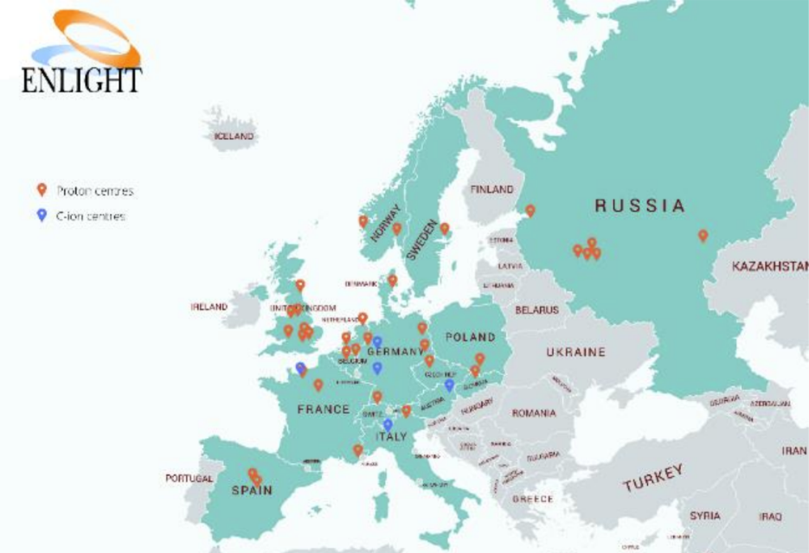
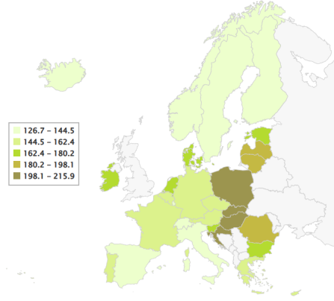
Reasoning: Cancer mortality and particle therapy in Europe
In 2018 – 4.23 million new cases in Europe
By 2040 – estimated 5.2 million new cases
More than 50% of cancer patients require radiation therapy BUT
1 in 4 patients do not receive the treatment
One of the main causes – lack of technology
Particle therapy centre geography in Europe, ENLIGHT 2020
Cancer mortality rate in Europe per 100000 inhabitants, data of 2020

Slide 7
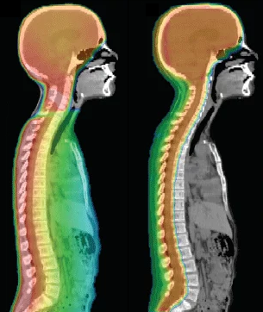
Reasoning: Particle therapy
Physical interactions of protons and positively charged ions with matter create more favourable dose distributions compared to conventional radiotherapy with high energy photons – the Bragg peak
In clinic, particle therapy has already shown benefits in treatment of
  paediatric oncological malignancies
  brain and head and neck region tumors
  other localizations in vicinity of critical vital organs
Heavy ions – possibility to treat tumors that are otherwise radioresistant to conventional radiation therapy, such as gliomas and sarcomas.

Slide 8
Reasoning: Facility options
Possibilities for a particle therapy center
A new advanced facility with different ions and new treatment techniques
Commercially available system for proton therapy
as carbon ion therapy not economically feasible for region
A circular particle accelerator in development by NIMMS collaboration
Acceleration of protons and helium ions to treatment energies
Higher energy protons for ion radiography purposes
Possibility for heavy ion acceleration (carbon, oxygen) for biophysics research
Possibility of ultra-fast dose rate delivery (FLASH)
Possibility of parallel production of therapeutic and diagnostic radioisotopes
On initial design: M. Vretenar, E. Benedetto, M. Sapinski, M. E. Angoletta, G. Bisoffi, J. Borburgh, L. Bottura,
K. Paļskis, R. Taylor, G. Tranquille: A Compact Synchrotron for Advanced Cancer Therapy with Helium and Proton Beams
OR
Local industry involvement for construction
Scientific research on novel cancer therapy techniques
Attraction of researchers and patients from all Europe, not just Baltic States
HELIUM SYNCHROTRON

Slide 9
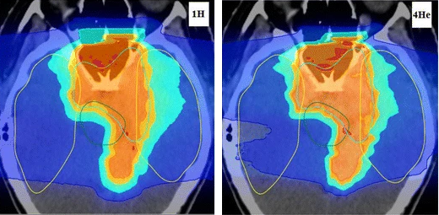
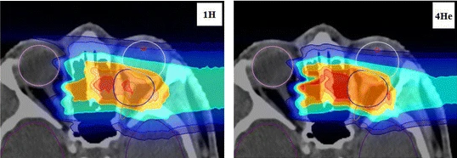
Clinical perspective:
Why helium ion therapy?
Helium ions are «returning» to the horizon of novel particle therapy treatments
Why helium-4 ions over protons?
Decreased lateral scattering and range straggling – better conformality
Increased radiobiological effect
Increased LET – possibilities to overcome low-level hypoxia
From physics perspective – lower neutron dose associated risks

Slide 10
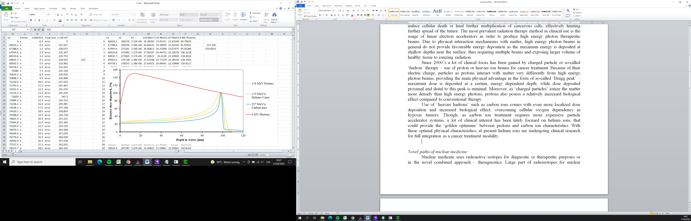
Clinical perspective:
Why helium ion therapy?
Helium ions are «returning» to the horizon of novel particle therapy treatments
Why helium-4 ions over carbon ions?
Deacreased neutron production
LET does not result in cell overkill
Decreased distal dose due to decreased fragmentation
Decreased uncertainties for biological effect estimations
Under research – better suited for FLASH

Slide 11
Clinical perspective:
Why helium ion therapy?
Among the different particles considered for ion therapy
  Heavier particles result in an increased biological effect
  BUT with the increase of nuclear fragmentation – dose conformality is decreased
Helium ions stand as a candidate for compromise between biological effect and dose conformality

Slide 12
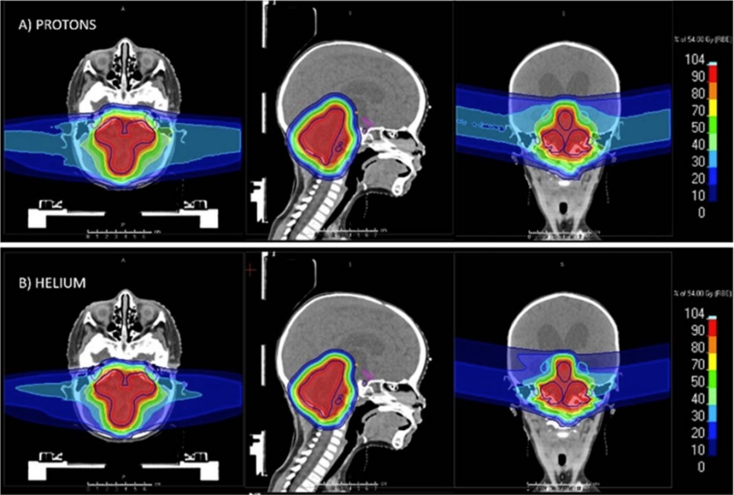
The overall clinical perspective
Why helium-4 ions?
Novel treatment option with research opportunities, as currently used only at Heidelberg Ion Therapy center and being commisioned at other ion therapy centres
Clinically helium-4 ion beams offer better normal tissue sparing and lower integral dose compared to proton beam therapy, proving highly beneficial in treatment of tumors in vicinity of critical organs and applications in paediatric cancer treatment

Slide 13
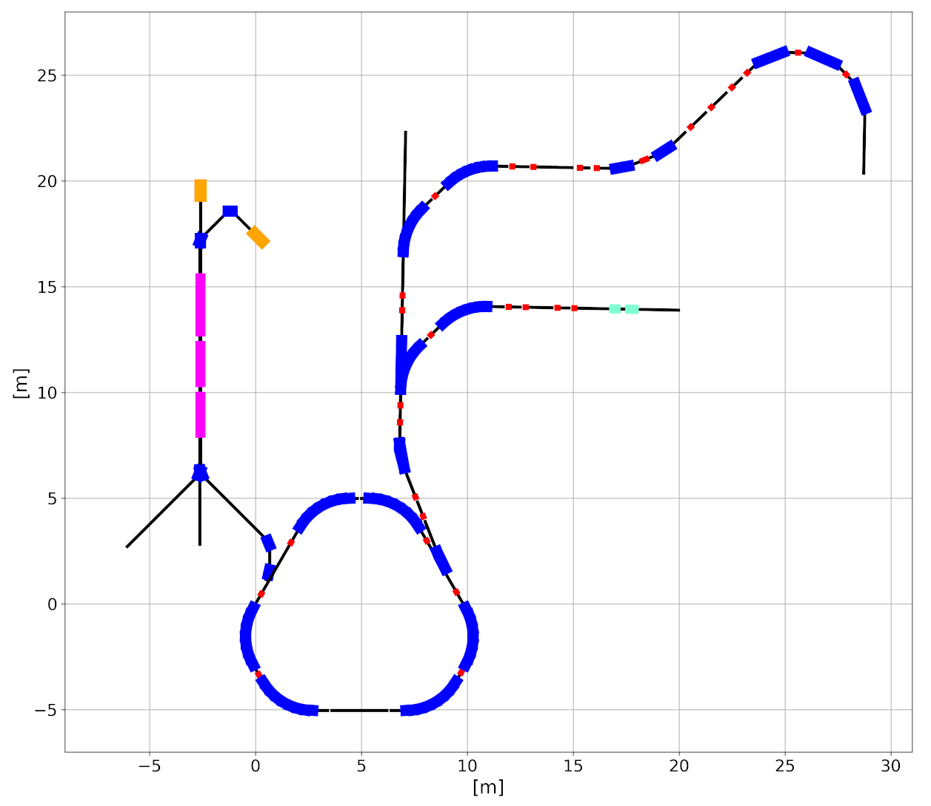
The overall technical concept
Ion sources providing both protons and helium-4 ions, option to use heavier ions (carbon, oxygen) for biophysical research in the future (EBIS or ECRIS type source)
Linear accelerator for particle injection: (presented by L. Nikitović tomorrow)
  10 MeV for protons
  5 MeV/u for He-4 ions
Possibility for parallel radioisotope production (investigated – 7 MeV/u alphas)
Design by Mariusz Sapinski, Elena Benedetto and Maurizio Vretenar

Slide 14
The overall technical concept
The helium synchrotron
Design by Mariusz Sapinski, Elena Benedetto and Maurizio Vretenar

Slide 15
The overall technical concept
The helium synchrotron
6 dipoles of 60º bend with magnetic field strength of 1.65 T
Beam rigidity of 4.5 T*m:
He-4 ions: max 220 MeV/u
(30 cm treatment range)
He-4 ions: max around 700 MeV
(possibilities for proton radiography)
Three straight sections – injection, extraction and RF
Design by Mariusz Sapinski, Elena Benedetto and Maurizio Vretenar

Slide 16
The overall technical concept
One static horizontal beam-line, for possibility of expanding with rotating couch/chair system + vertical CT
One rotating gantry beam-line, for multiple angle delivery (next presentation by L. Piacentini) – decreasing to 2.8 T superconducting magnets
One beam-line dedicated for research
Design by Mariusz Sapinski, Elena Benedetto and Maurizio Vretenar

Slide 17
The overall technical concept
Initially:
50 % treatment with protons +
50 % research with He ions
All research efforts for full scale helium therapy
Initially:
25 % treatment with protons +
50 % treatment with He ions +
25 % research with He ions
Design by Mariusz Sapinski, Elena Benedetto and Maurizio Vretenar

Slide 18
Novel clinical perspectives:
Radioisotope production
Why linear accelerator based production?
Compared to conventional cyclotron production, linear accelerators could offer more efficient and less demanding (decreased beam losses and lower shielding neccessities) especially for production with alpha and deuteron beams
The need to couple particle therapy with nuclear medicine …
Diagnostics capabilities essential for modern cancer therapy ([¹⁸F]-FDG) and possibilities of providing novel treatment techniques – dose painting, selective avoidance of functionally active organ-at-risk regions, tumor hypoxia estimation and incorporation in treatment planning etc.

Slide 19
Novel clinical perspectives:
Radioisotope production
Radioisotope | Usage of radioisotope
Scandium-43 | Diagnostic – PET
Scandium-44 | Diagnostic – PET
Cobalt-57 | Diagnostic – SPECT
Copper-64 | Theranostic (β⁻)
Copper-67 | Theranostic (β⁻)
Indium-111 | Diagnostic – SPECT
Tin-117m | Theranostic (β⁻)
Samarium-153 | Theranostic (β⁻)
Rhenium-186 | Theranostic (β⁻)
Astatine-211 | Therapeutic (α)
Theranostic and therapeutical radioisotopes
Main possible radioisotope options for linear accelerator based production have been identified by NIMMS group also for targeted therapies (alpha and Auger electron) and theranostics approaches
«Large room» for research opportunities

Slide 20
Not just a clinical facility:
Proposed research directions
All necessary clinical and pre-clinical research for helium therapy
Ion therapy treatment associated research directions:
  Medical physics aspects and dosimetry, radiobiology
  Material science, nuclear physics
  Accelerator technology and physics
  Novel treatment technique development activities
Other research directions:
  Radioisotope production, radiation chemistry
  Material science for target design of radioisotope production

Slide 21
Not just a clinical facility:
Industry sector involvement
First ever infrastructure in the Baltic States for accelerator technologies
Involvement of relevant industry sectors in delivering the center itself, working in close collaboration with CERN and expanding capacity and know-how in accelerator technology field within the Baltic States
Infrastructure provides future options for technological innovations of medical accelerators and associated equipment, addressing the needs of particle therapy community

Slide 22
Partnership
Center would be done following NIMMS main idea – using the developed technologies within NIMMS collaboration in order to create a unique treatment center
Project has been already started in a framwork of working in close collaboration with NIMMS and CERN together in delivering the facility
The proposed project would be one of the leading in Baltic States porfolio of collaborations with CERN

Slide 23
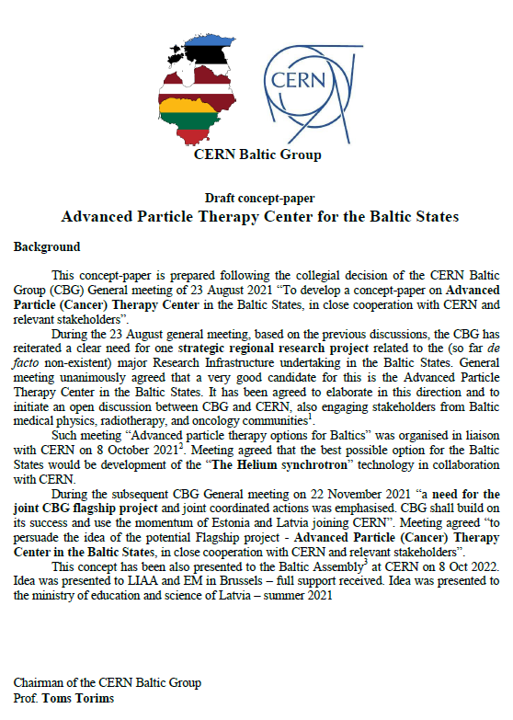
Current status of the project
A dedicated concept paper has been developed

Slide 24
Current status of the project
A dedicated concept paper has been developed
Presented:
21st meeting of the TIARA Collaboration Council (March 29th , 2022)
Internally within CERN NIMMS collaboration, with approval of collaboration lead
Stakeholder support gained in the Baltic States.
Baltic scientific community: 9th CERN Baltic Group General Meeting
Baltic political stakeholders: Meeting of the Health, Welfare and Family Committee of the Baltic Assembly.
Baltic Assembly letters adressed to prime ministers of Baltic States
Baltic States ambassadors within EU COREPER I
Investment and innovations agencies within the Baltic States

Slide 25
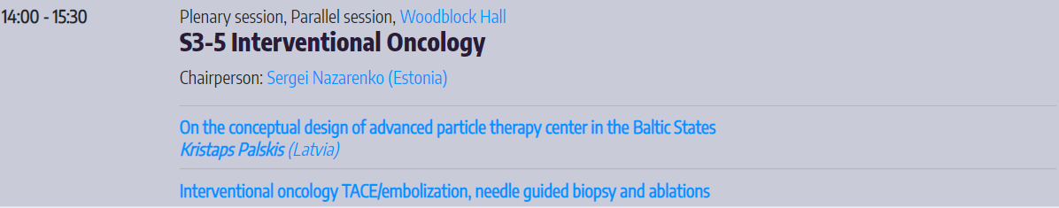
Further steps of the project
Addressing the medical community
7th of October – presentation at 8th Baltic Congress of Radiology
  Planning CERN Baltic Group Project working group bilateral meetings with radiation oncologists, radiologists, medical physicists and research institutions from each of the Baltic States.

Slide 26
Further steps of the project
Addressing the medical community
  First of these meetings – 18th October in Riga
  To hold these meetings in Estonia and Lithuania by the end of 2022, preferably – November
  With one of the main goals - identifying the community representatives for the future of the project development

Slide 27
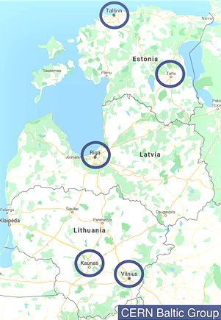
Criteria for site selection
Clear and undivided support to the project from the national medical community
Strong and continuous political support
Sustained stakeholder engagement and participation
Integral part of the major oncology hospital
Physical proximity and access to the existing infrastructure critical
Proximity to the international airport – maximum of 50 km distance
Accessibility to all Baltic countries and beyond – accessible from the RailBaltica and major roads
Direct hosting facilities for the patients
EC support for the chosen site

Slide 28
Take-away messages
Creating visionary and long term goals for the Baltic States
Flagship project for the Baltics and leading collaboration with CERN
Idea supported by both CERN, EU and relevant communities
Corresponding to development strategies of the Baltics and overall EU priorities
Comercially viable option for a novel cancer treatment
Project would prevent brain-drain from the Baltics and increase scientific capacity within the region
An exciting and uniting opportunity not to be missed…

Slide 29
Thank you for your attention!

