Slide 1


PRISMAP Survey
Radionuclide and Radiopharmaceutical
Industrial and clinical collaboration
Maija Radzina
11.10.2022

Slide 2
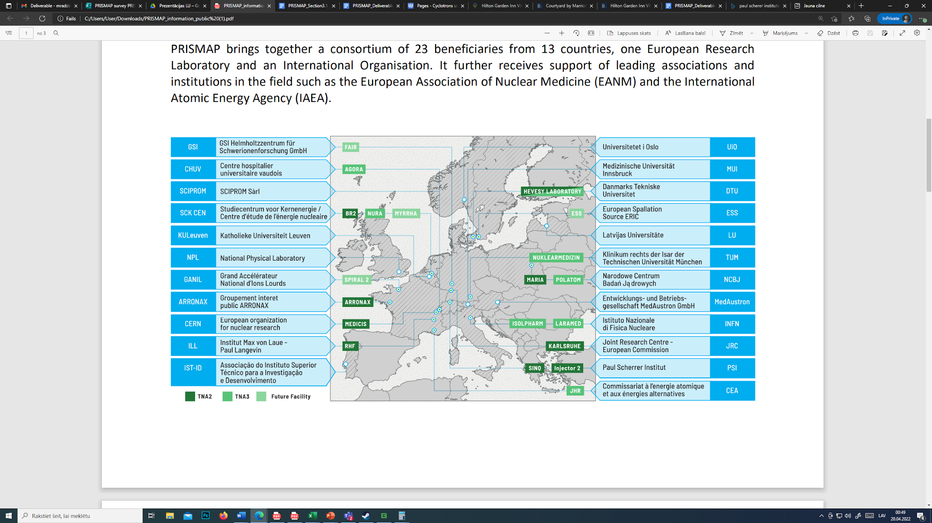

Slide 3
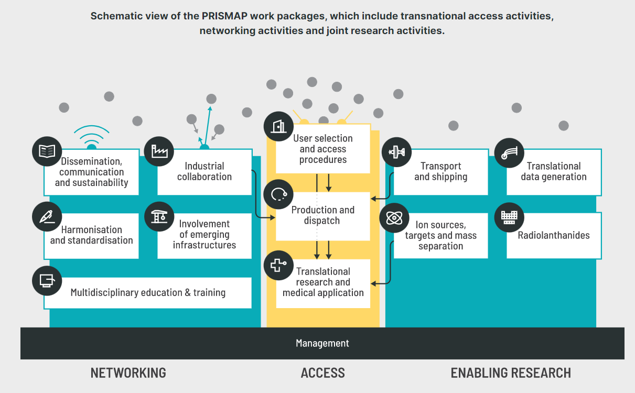

NETWORKING – dependencies on other WPs
From the Survey responses we can confirm the necessity of PRISMAP
not only as a web-based entry platform for the production and dispatch of non-conventional radionuclides, but also as a long-term platform for aiding an advancement in, at the moment, emerging radionuclide distribution and use in research and nuclear medicine
Excellent collaboration with :
ILL, DTU, KULeuven, CERN, SCIPROM, MUI, PSI
For survey design, responses, target groups etc.
New research and industry contacts needed!
Notes:
According to the low survey response activity, the acquired survey data may not fully reflect the situation in broad spectrum, nevertheless, the data are sufficient to estimate tendencies in Europe, suggesting the need for reaching out to more responders from Balkan region, Scandinavian countries and Eastern regions
Radionuclides that would be of interest to use in the next 2-5 years Terbium radionuclide “family” (55%) and ⁶⁴Cu (45%) and demand for alpha emitters, such as ²²⁵Ac (82%) amongst research institutes will increase significantly in the following years
The data also confirmed needed improvements for preclinical/clinical users - unified licensing and registration of available radionuclides and kits in Europe, specified equipment/technology (e.g. collimators etc.) and information about transport and logistics networks in Europe
The data confirmed common aspects in all respondents: the biggest challenge for the producers is the availability of target materials, which goes hand-in-hand with their purity/enrichment grade. Because of the need for higher isotopic purity the availability decreases and price increases drastically

Slide 4
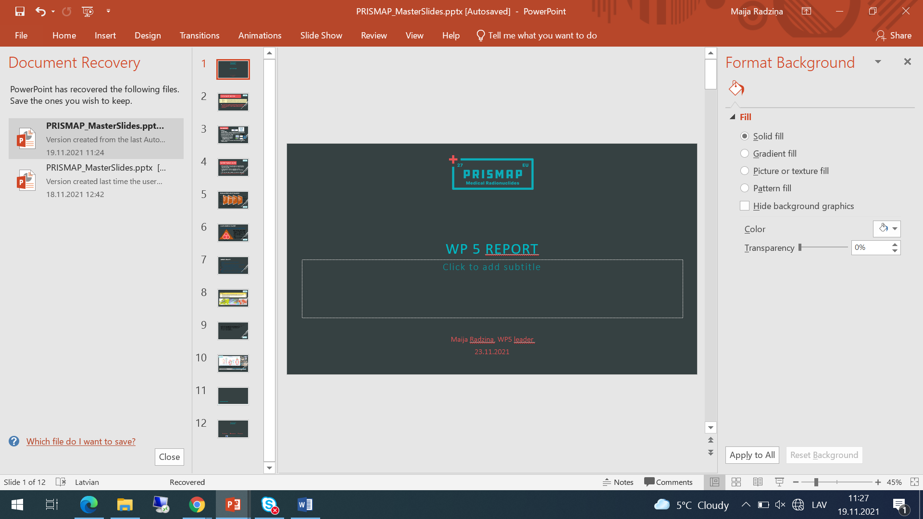
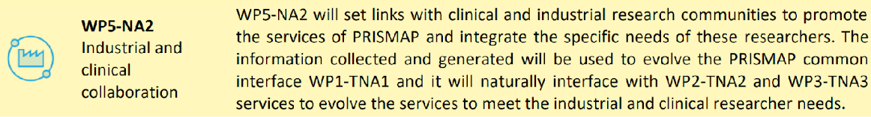
What are the objectives for WP5?
WP5-NA2 strives to foster the industrial and clinical collaboration, identifying the needs of industrial and clinical end-users to enrich and adapt the PRISMAP product and service portfolio accordingly

Slide 5

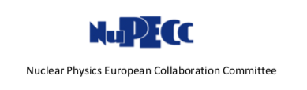
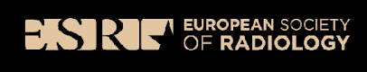
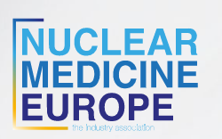
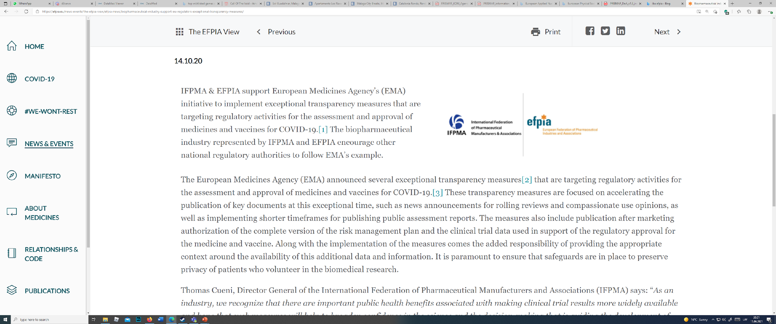
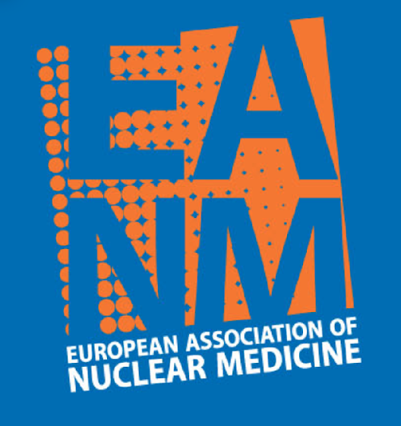
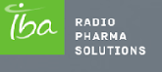
NETWORKING
Universities
University hospitals
Reasearch Laboratories, Institutes – radiopharma, radiochemistry, radiophysics
International professional organizations (EANM, ESR, ESHI etc.)
International authorities - IAEA, NuPECC etc.
Industrial authorities (NMEU, EFPIA, IBA etc.)
  Reactor, Cyclotron manufacturers
  Radiopharmaceutical companies
  Detector manufacturers
End users – nuclear medicine, molecular imaging and radioisotope specialists, researchers, students
Notes:
Director General, International Federation of Pharmaceutical Manufacturers and Associations
Business Developer at IBA RadioPharma Solutions. Expertise in competition analysis in the field of PET and SPECT integrated production system. Representative for NMEU, the European Industrial Association for Nuclear Medicine and Molecular Healthcare
ADACAP?

Slide 6
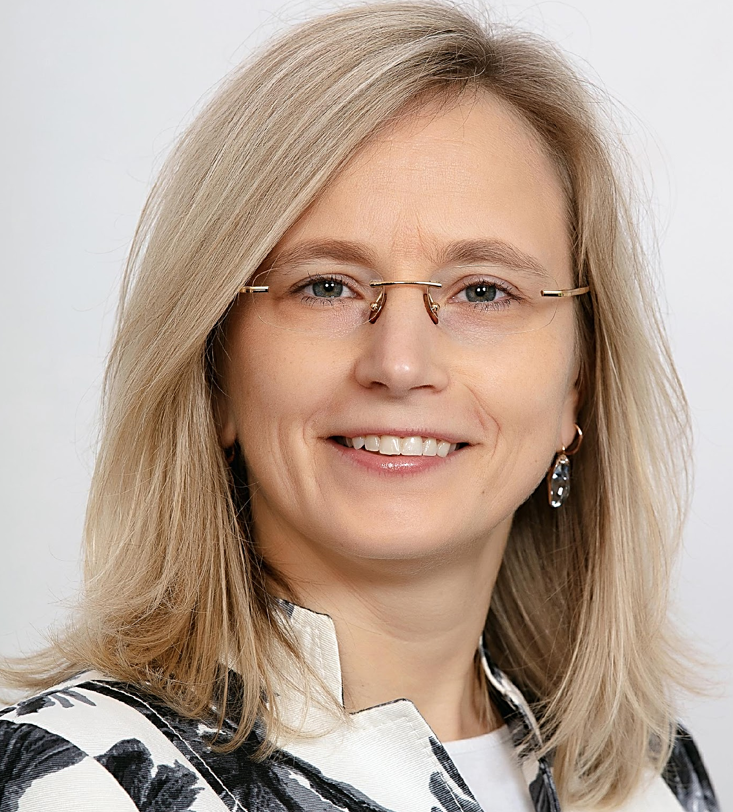
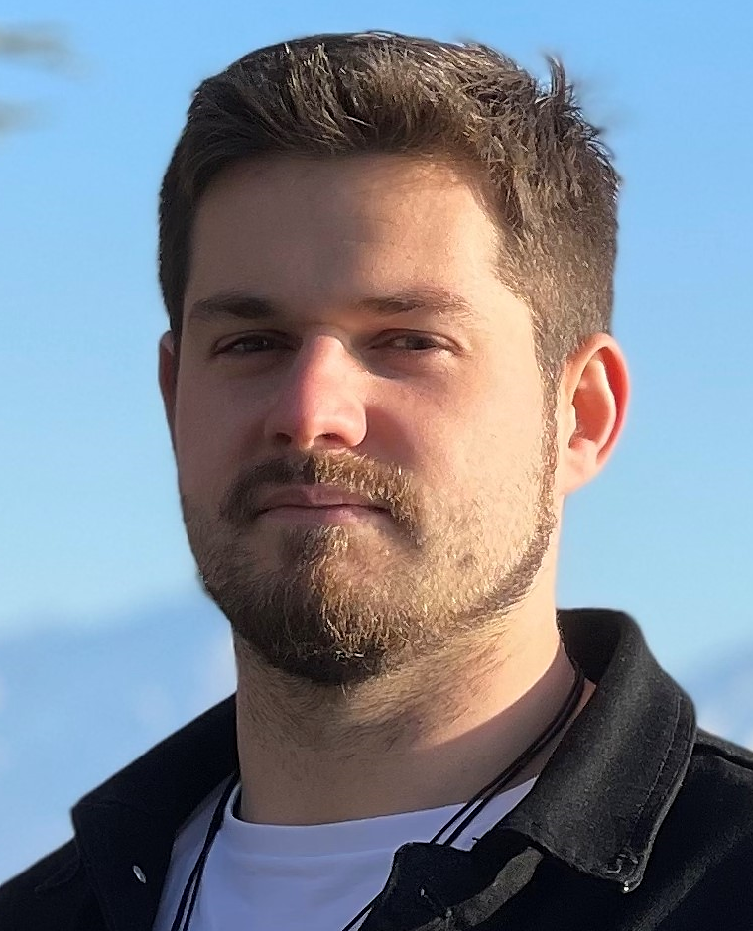

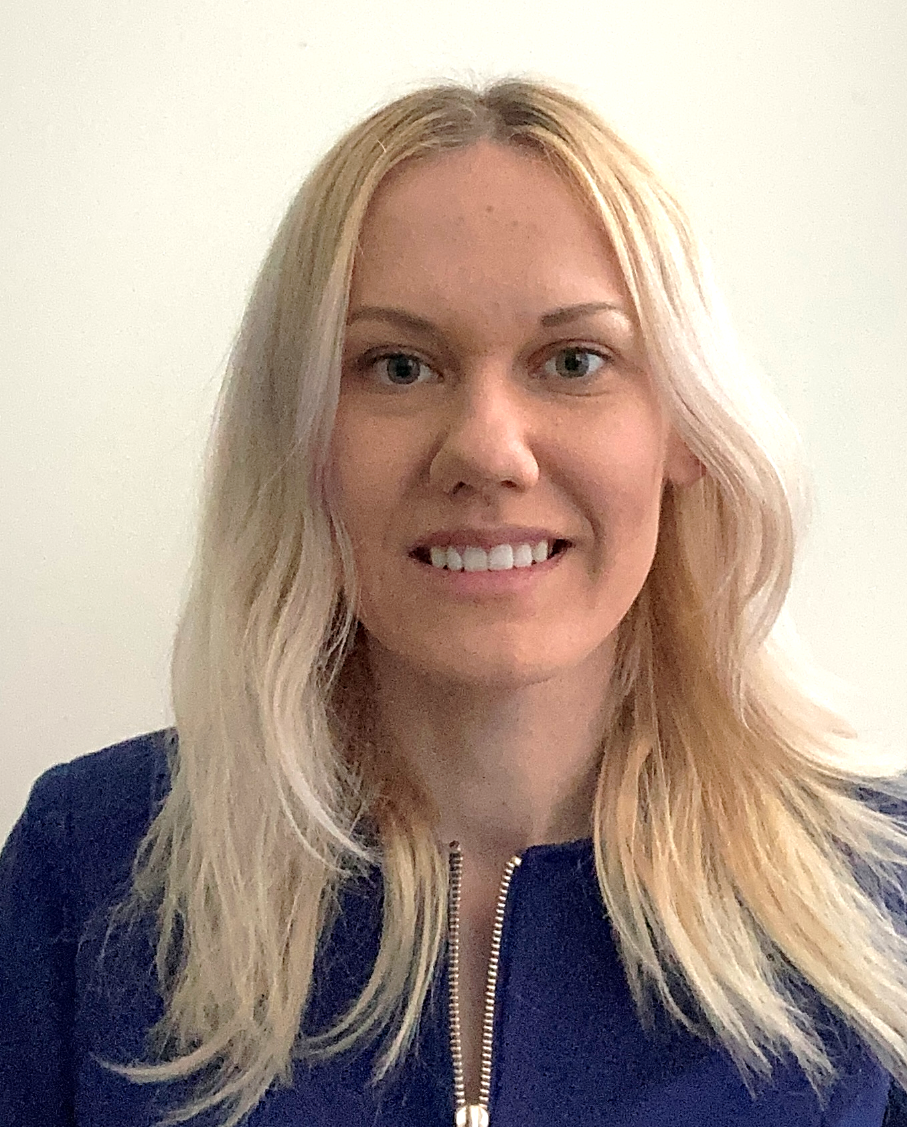

Team within PRISMAP - LU
Assoc. Prof. Maija Radzina, Radiologist, President of Latvian Radiology Association (NM included)
PhD student Edgars Mamis, MSc in Chemistry, experience in RN cyclotrone production
Assoc. Prof. Elina Pajuste, Institute of Chemical Physics, Chief of Radiochemistry lab
Dr. Laura Saule, Paula Stradina clinical university hospital, Radiology resident
Dr. Marika Kalnina, Paula Stradina clinical university hospital, Radiologist, Nuclear Medicine specialist, National representatie at EANM

Slide 7
SURVEY GENERAL CONCEPT
Foster the industrial and clinical collaboration, identifying the needs of industrial and clinical end-users to enrich and adapt the product and service portfolio accordingly
Goal of the surveys is to identify industrial, research and clinical partners and their:
Geographical location (for the map)
Capabilities (infrastructure, current profile, competences, licensing and other relevant matters)
Further vision (R&D activities, overall goals)
Needs to achieve the goals (including interaction with other target groups, education)
Industry
Regulatory institutions
Professional organizations
Research
Medicine
Target groups

Slide 8
TASK NO1 = SURVEY (M6-M12)
Identify key players in the industrial and clinical communities in the context of PRISMAP and investigate the needs of industrial and clinical end users
Source, availability, limitations, registration, licence, developments, necessity, future perspectives, confidentiality NDA, education
WP1, WP2, WP3 - CERN, SCIPROM, KULeuven, PSI, ARRONAX, ILL etc.

Slide 9
OVERALL STRUCTURE OF THE SURVEY
Aim of the overall project
Aim of particular survey,
Link to the Prismap web page
Possiblity to leave a comment and an a chekcbox if interested to receive further information related to the survey and its results
General information
  Name
  Address
  Type
  Size
  etc
Profile
  Infrastructure
  Competences
  etc
Vision
  Growth
  Directions
  R&D
  etc
Needs
  Related to the interaction with other groups, education
Confidentiality was assured to the responder, respected and included in the structure of the survey

Slide 10
SURVEY FOR NUCLEAR AND PHARMA INDUSTRY
Target - Head of Production, Quality, R&D director, secretaries
Profile - hot cells, accelerators, reactors, cyclotrone, RN generators, synthesis modules, QC equipment, RFP precursors, purity, availability,GMP, GDP (manufacturing and distribution), licences, sterility
Vision - extension of portfolio,registration, QC, novel production
Needs - labeling, targets, logistics
Radionuclide producers
Radionuclide and/or radiopharmaceutical producers
Notes:
hot cells, accelerators, RN generators, synthesis modules, QC equipment, measurement equipment, RFP precursors
Purity, availability, GMP, GDP (manufacturing an distribution), licences, sterility,
Vision - Extension of portfolio, registration, QC, novel production,
Needs - labeling, targets, logistics

Slide 11
SURVEY FOR SCIENCE & RESEARCH
Target audience - Leading researchers, institute directors
Profile - Infrastructure, irradiation source, unique know-how, main radionuclides, pre-clinical, clinical
Needs - supply, projects, human resources
Vision - 5-10 years, expand research, new drugs, plans for infrastructure
Small research facility
Large research facility
Notes:
Infrastructure, irradiation source, unique know-how, main isotopes, pre-clinical, clinical,
Vision 5-10 years, expand research, new drugs, plans to build cyclotrone etc
Needs - supply, projects, human resources

Slide 12
SURVEY FOR NUCLEAR MEDICINE
Target audience - Physician, doctor, principal investigators, clinic administration
Profile - clinical, pre-clinical, in-house RP, applications, RN, methods SPECT, PET, etc.
Vision - clinical future perspecives, specialist training, cooperation, supply chains
Needs - access to supplieres, logistics, licences, competences, partners, infrastructure, patient data pooling
Diagnostics
Therapy
Theranostics

Slide 13
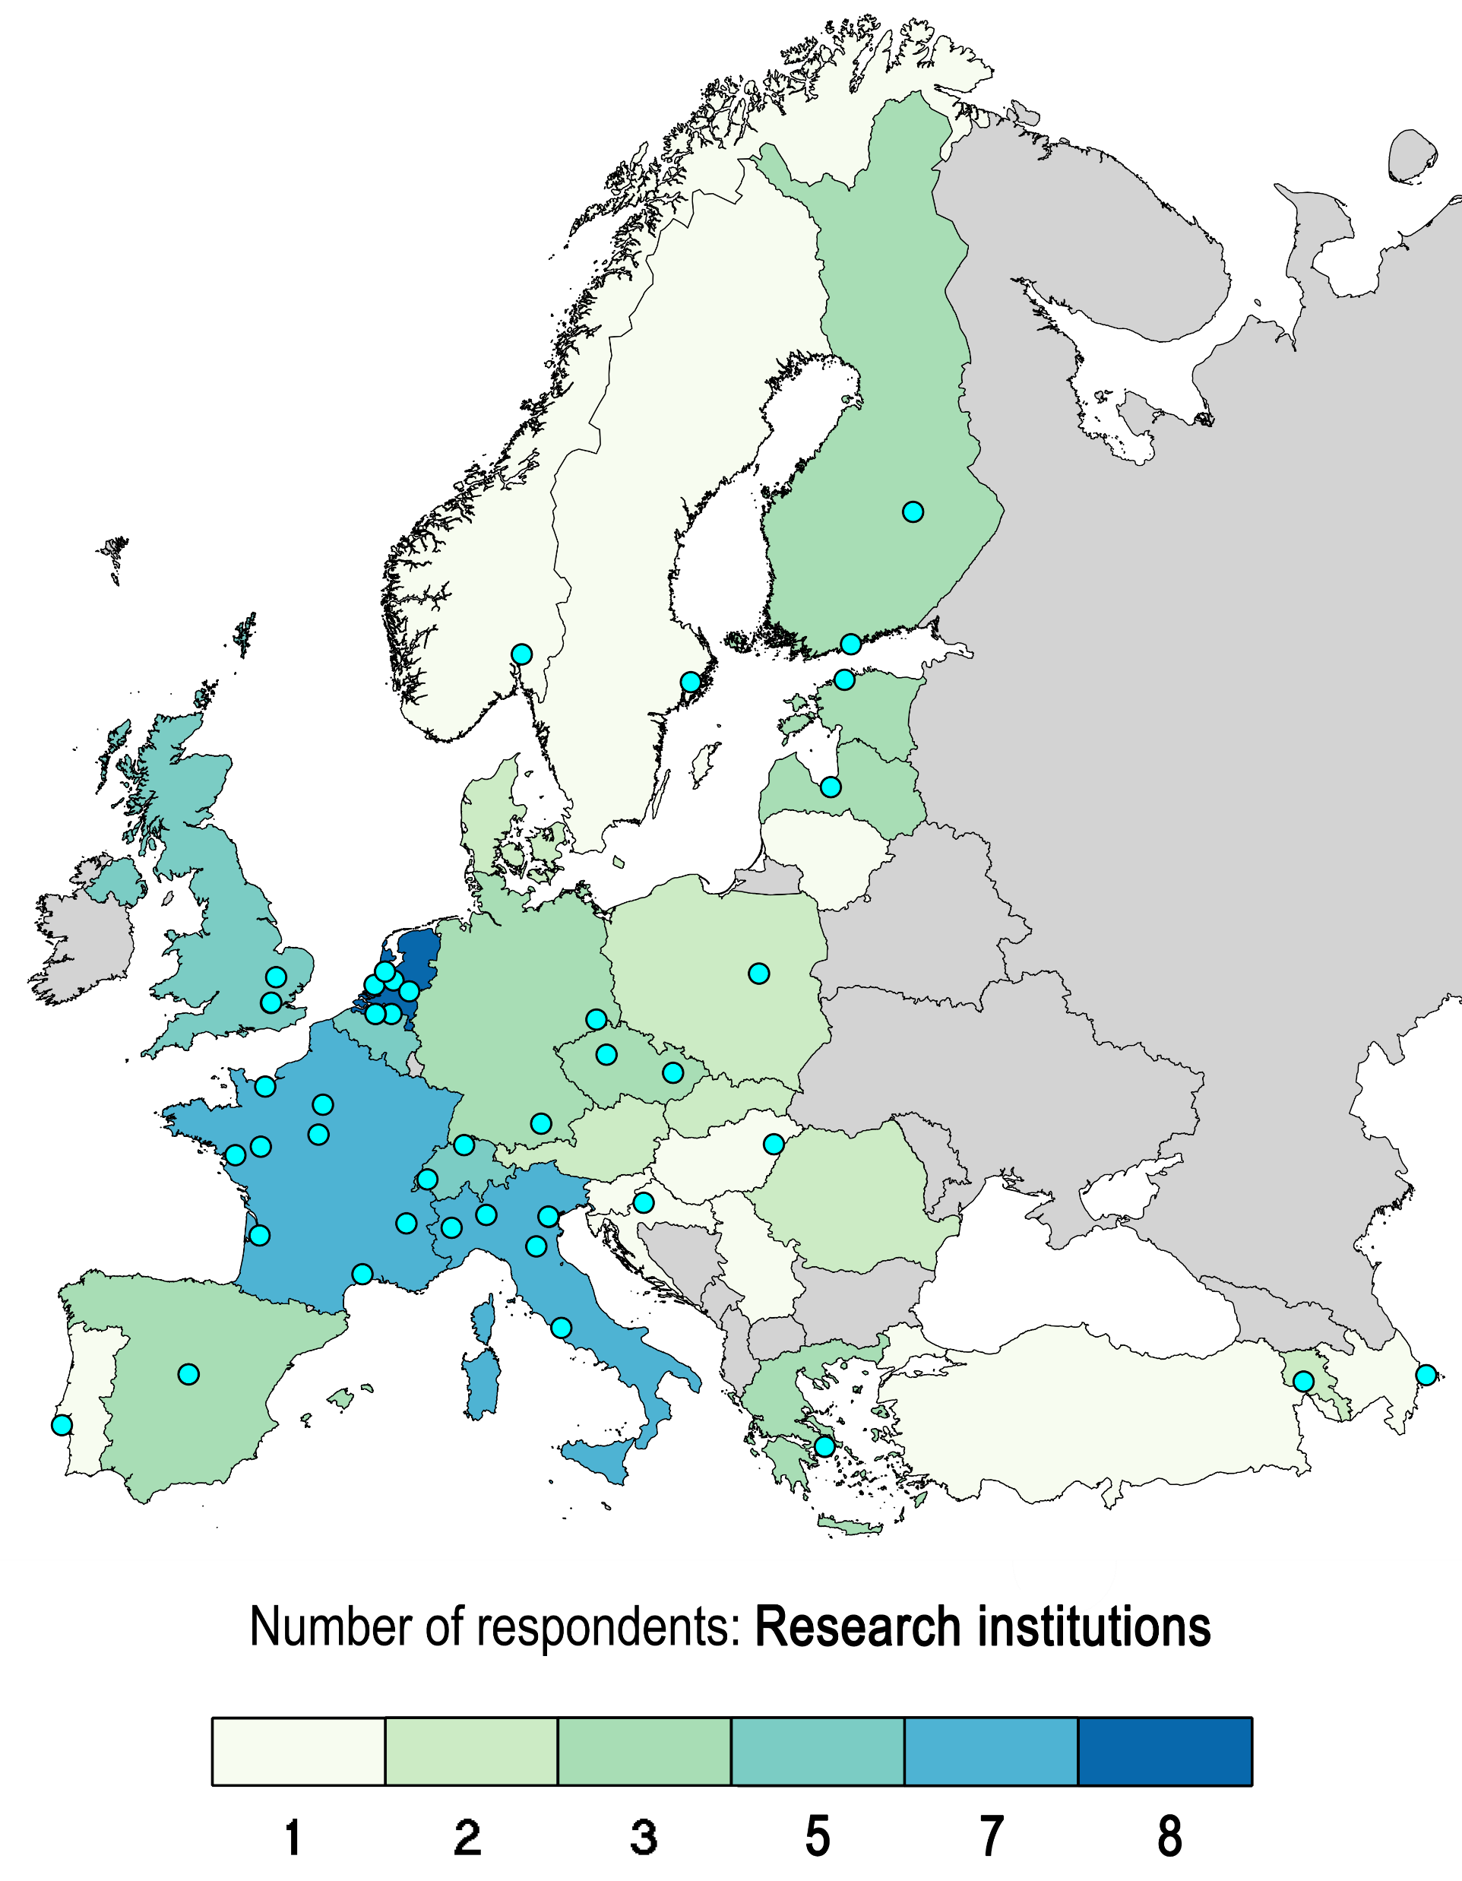
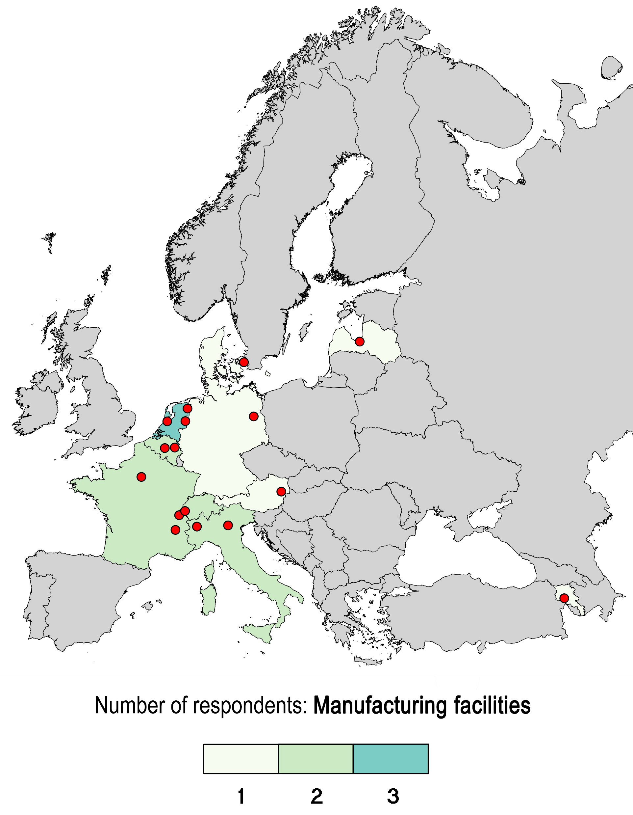
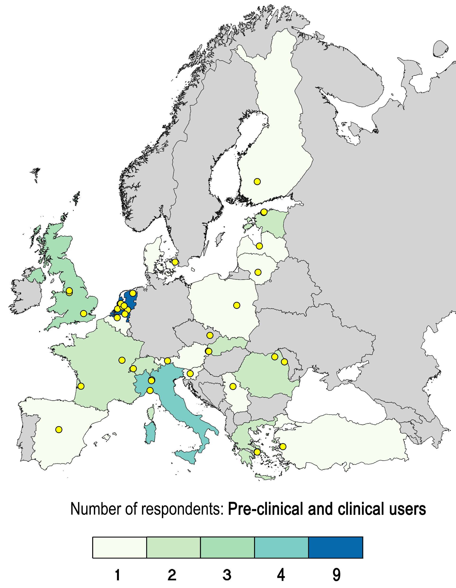
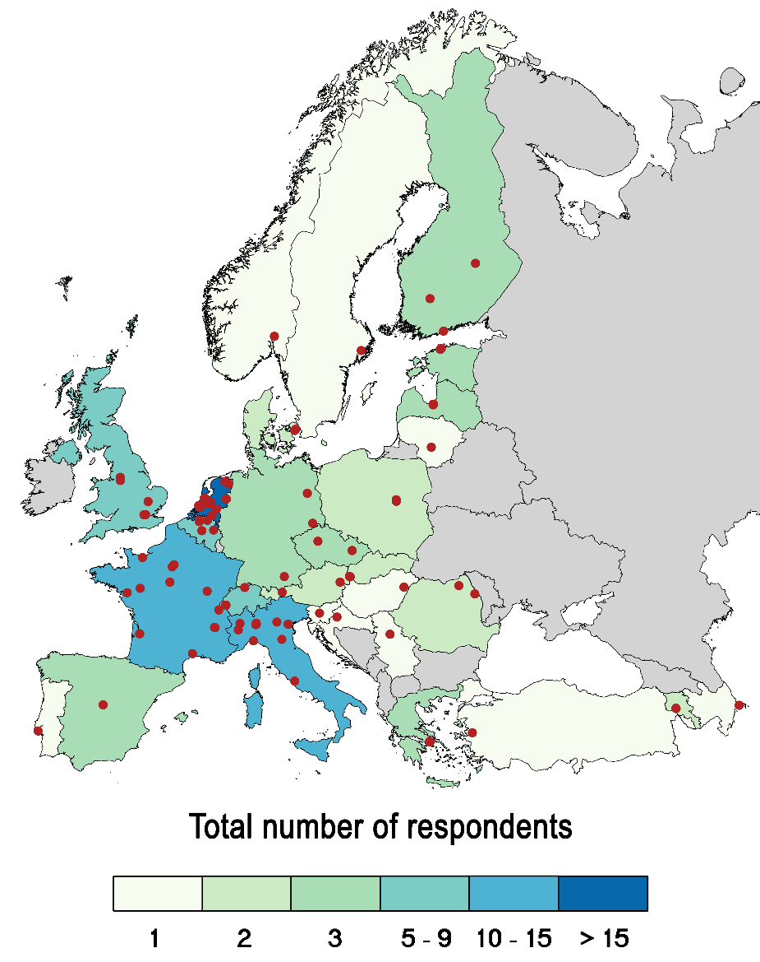
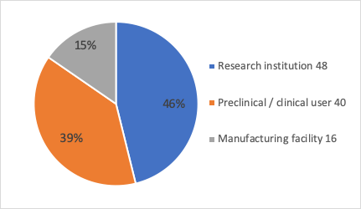
114 respondents from 30 countries
104 institution respondents

Slide 14
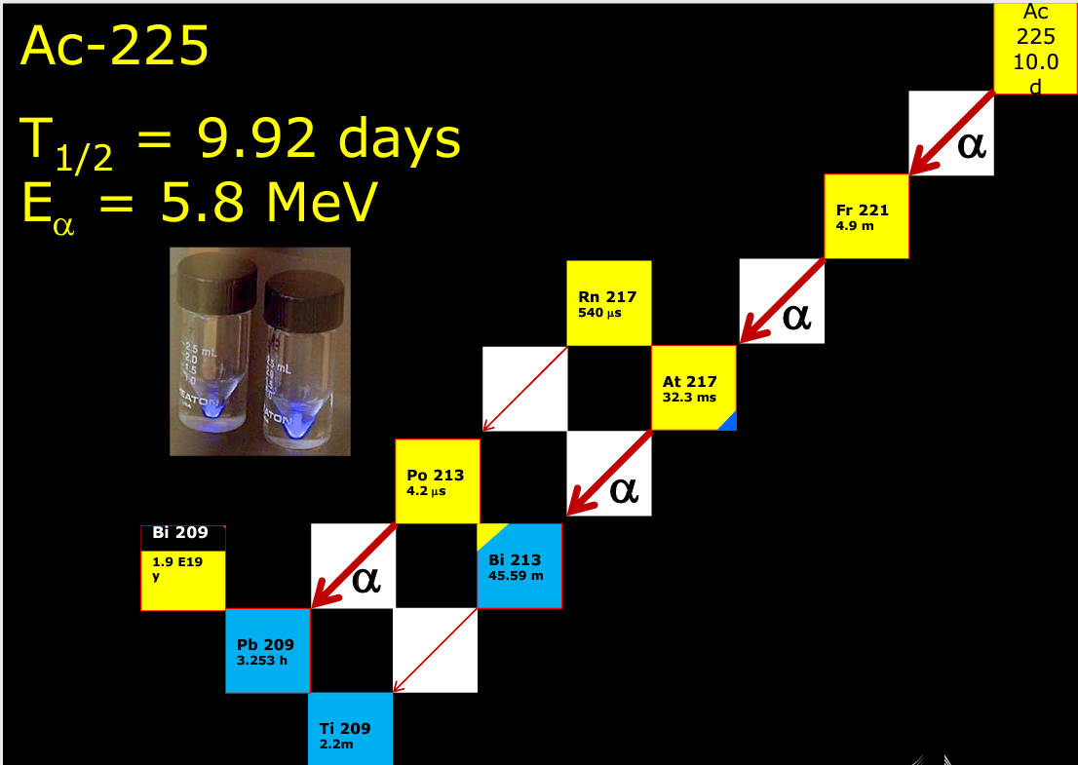
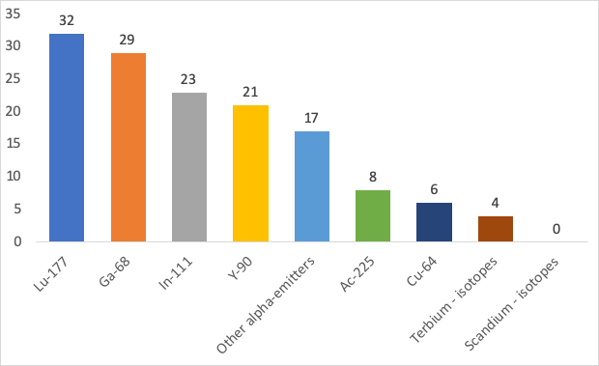
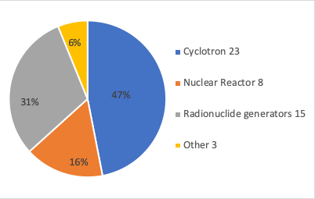
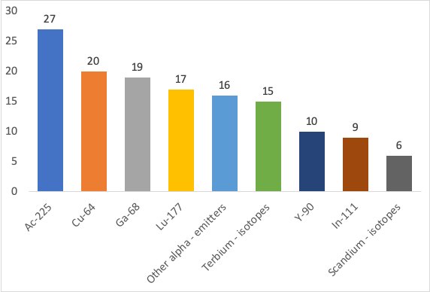
PRODUCTION OF RADIONUCLIDES
Novel radionuclides used by end users
Proven by the end-user questionnaire, recently amongst the research user community there has been an increasing demand for the alpha emitting radionuclide ²²⁵Ac, which has been indicated by only one of the production respondents (CERN-MEDICIS)
The aim to indicate more sites that would offer such increasing demand for radionuclides is still an open objective with high importance
Radionuclides that are interested to use in the next 2-5 years
Other:
123I,
124I,
161Tb , 188W, 195mPt, 211At , 225Ac, 135La, 53Mn, 54Mn, 155Tb, 188W, 47Ca/47Sc, 103Pd, 103Ru, 111Ag, 129mXe, 131mXe, 143Pr, 149Pm, 153Sm,
165Er, 128Ba, 155Tb, 212Pb

Slide 15
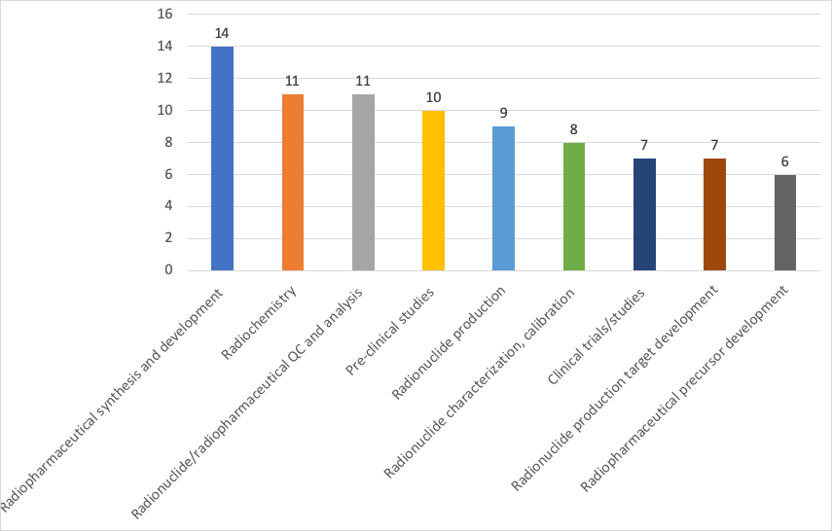
RESEARCH FIELD AND INTERESTS
:
Animal PET/CT or PET/MR (8)
PET, PET/CT or PET/MR (7)
Animal SPECT or SPECT/CT (7)
SPECT, SPECT/CT or SPECT/MR (5)
Experimental long term animal facilities after radiation exposure (5)

Slide 16
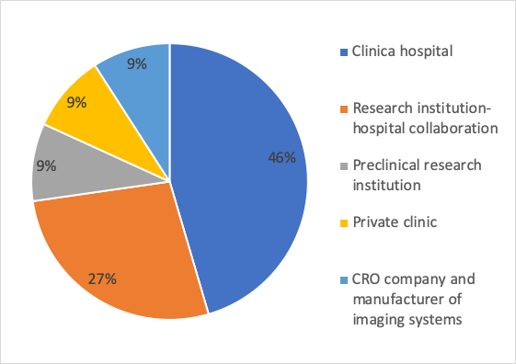
END USER QUESTIONNAIRE
Total 40 respondents
All respondents from the nuclear medicine/user section perform studies in oncology, fewer in cardiology, inflammation, endocrinology, neurology, traumatology/orthopaedics, nephrology and pulmonology.
Necessity to transfer patients to other countries for specified Nuclear Medicine examinations and/or treatment procedures were required in up to 70 % of end user respondents for following reasons - unavailable radiopharmaceutical access, unavailable radionuclide or no reimbursement by the national healthcare system.
End users are interested not only in new radionuclides and pharmaceuticals for research and preclinical/clinical purposes, but also in technology advancements that shows their interest in development but first of all is responsibility of individual centres and not the purpose of this consortium.
oncology
cardiology
infection and inflammation
endocrinology
neurology
animal PET/CT or PET/MR with experimental long term animal facilities for radionuclide therapy studies

Slide 17
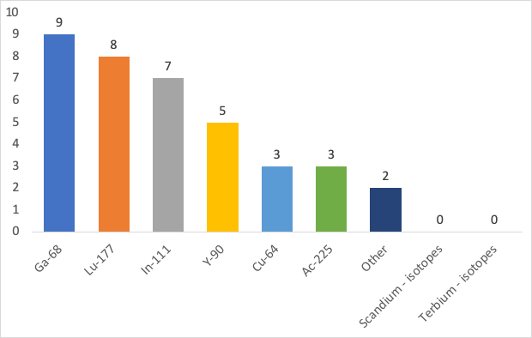
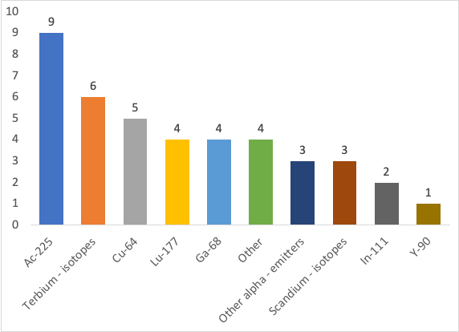
RADIONUCLIDES USED BY END USERS
NOW
2-5 years
None of the current responder institutions are interested in possibilities of “matched pair” theranostics with terbium and scandium radionuclides in the near future, this reflects still insufficient pre-clinical data and/or availability of such radionuclides
Theranostic pairs
[68Ga]Ga- DOTA-peptides - [177Lu]Lu-DOTA-peptides (9 respondents)
[64Cu]Cu-peptides - [177Lu]Lu-peptides (9 respondents)
123I-131I as iodide (5 respondents)
99mTc-223RaCl2 for skeletal metastases (5 respondents)

Slide 18
ISSUES WITH THE ENRICHED MATERIAL SUPPLY/STOCK
Bottleneck for the producers is the availability, which goes hand-in-hand with purity/enrichment grade. Because higher isotopic purity is necessary, the availability decreases drastically
The results show that ½ responders already have national and international distribution routes and methods established. It would be notable to emphasize longer distance distribution routes, such as EU-USA, IT-NL, FR-DK, CH-PK as they require more logistics issue solving and legislation

Slide 19
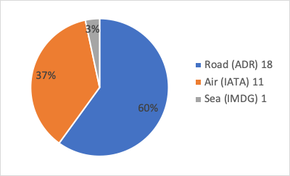
DISTRIBUTION OF RADIONUCLIDES
11/22 institutions plan to increase manufactured volume of radionuclides in following years
Main limitations
Shortage of staff, expertise
Infrastructure
“Beam time” or production capacity
Target material supply
The most often mentioned external suppliers -
ITM in Garching
Curium
Mallinckrodt
Polatom
SCK-CEN
IRCCS Ospedale Sacro Cuore don Calabria di Negrar
GE
Eckert & Ziegler
Arronax
Novartis
IBA
ITG
Oncoinvent
Bayer
The main limitations or transportation issues that respondents faced
regulatory limitations
lack of harmonised import/export legalisation
complex supply chains
licensing
NCBJ (Poland) and CERN-MEDICIS (Switzerland-France) as core PRISMAP consortium members with their expertise and existing distribution routes to a large number of international recipients

Slide 20
LIMITATIONS TO INCREASE MANUFACTURING OF RN
Main limitations that respondents face or foresee -
Shortage of staff, expertise
Infrastructure
“Beam time” or production capacity
Target material supply
Future radionuclides:
149Tb, 152Tb, 155Tb, 149Tb, 161Tb, 225Ac, 89Zr, 67Cu, 64Cu, 165Er/169Er, 47Sc, 44Sc, 177Lu, 211At, 188Re

Slide 21
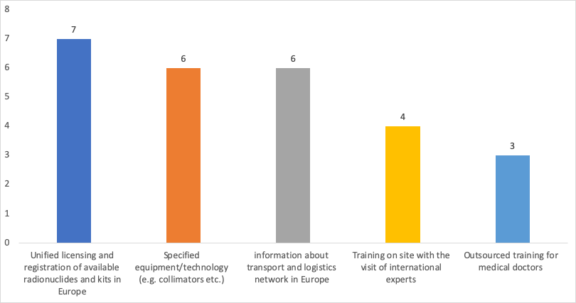
PRECLINICAL/CLINICAL USERS
NEEDS FOR DAILY PRACTICE

Slide 22
RESEARCH AND DEVELOPMENT ACTIVITIES
83% of respondents indicated that their R&D activities would benefit from collaboration/cooperation, offered by efforts of the PRISMAP consortium
Main radionuclides of interest are 175Yb,
Tb radionuclide “family”, 67Cu, 64Cu, 43Sc, 44Sc and 47Sc

Slide 23

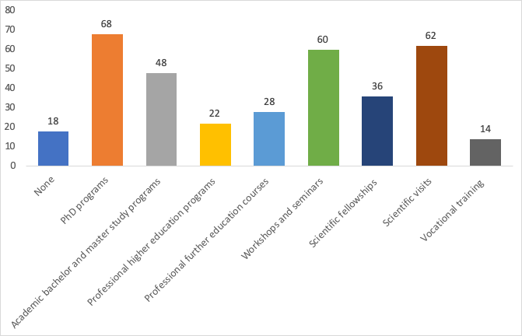
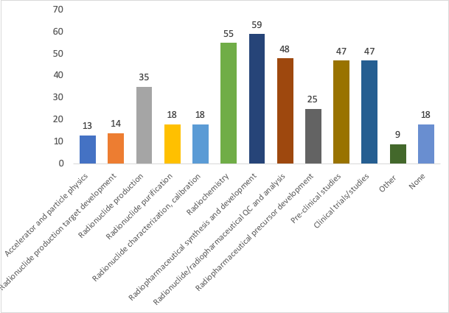
TRAINING
Types
Fields

Slide 24
LIMITATIONS IN THE TRAINING PROCESS
Low funding
Difficulties in recruiting students
The lack of technical staff
Lack of integrating radiopharmaceutical research in faculty courses and student curricula
The number of participants - too low to organise training courses
Insufficient access to radioisotopes
No dedicated program for NM physicians, technologists and radiochemists in university
Lack of trained pre-clinical scientists with a global view from radiochemistry to pharmacology
Lack of fundamental background knowledge on nuclear physics and research reactors when coming from university

Slide 25
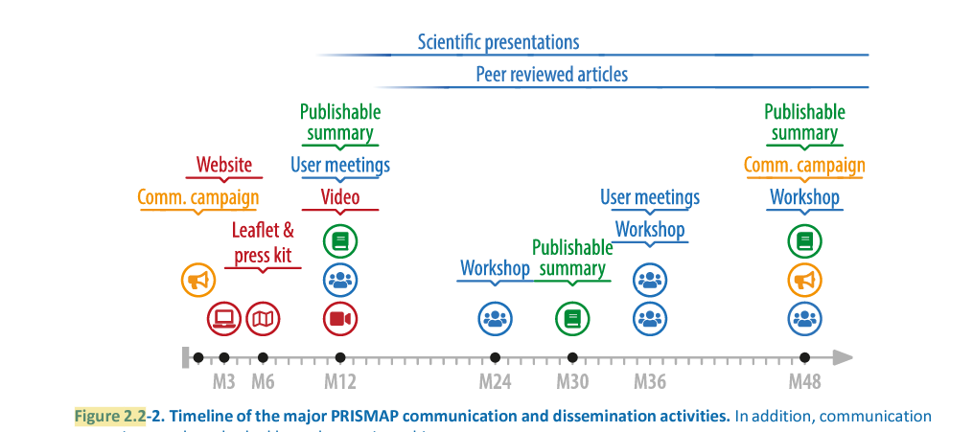
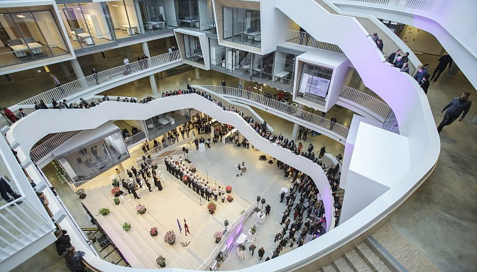
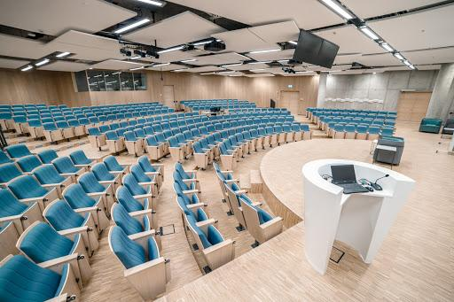
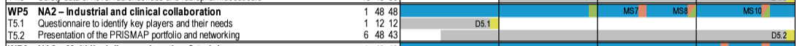
Two Workshops are organised in WP5-NA2 for the industrial and clinical communities
+ in WP6-NA3 for training purposes
Year 1
Year 2
Year 3
Year 4

Slide 26
Networking Activities are expected to fulfil the impact of PRISMAP:
We need strong network to achieve our common goals, participating and sharing the information is the key – website, educational and professional activities, social media, industry and political stakeholder involvement
2. Closer interactions between larger number of researchers active in and around a number of infrastructures facilitate cross-disciplinary fertilisations and wider sharing of information, knowledge and technologies across fields and between academia and non- academic stakeholders, including industry.
Notes:
respective Networking Activities are expected to fulfil the impact of PRISMAP

