Slide 1




Compact Linear Collider: Investigation of electrical breakdown phenomena using multiscale and multiphysics simulations
Veronika Zadin¹, Andreas Kyritsakis¹, Flyura Djurabekova², Tauno Tiirats¹, Sergei Vlassov¹, Sven Oras¹, Ye Wang¹
1. Institute of Technology & Institute of Physics, University of Tartu, Estonia
  ERA Chair MATTER, http://www.matter.ee
  veronika.zadin@ut.ee
2. University of Helsinki, Finland
flyura.djurabekova@helsinki.fi
CBC 2022

Slide 2
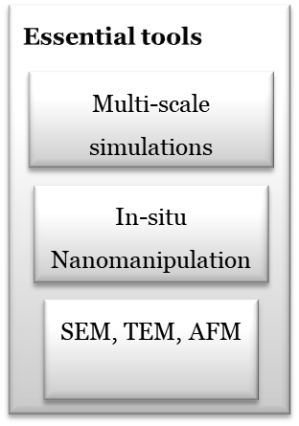
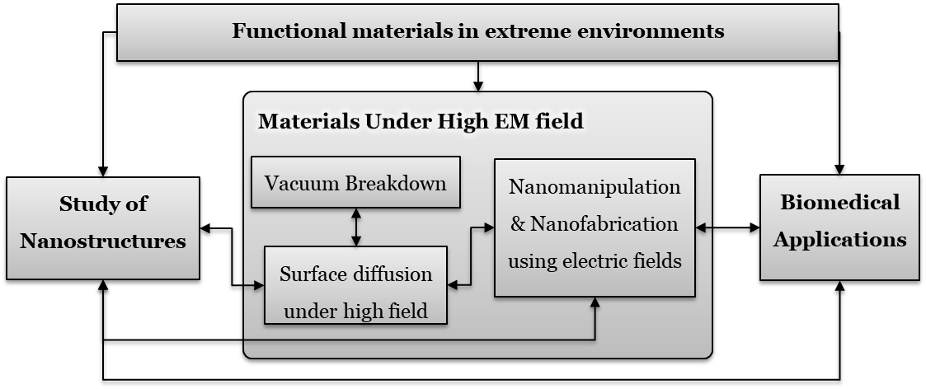
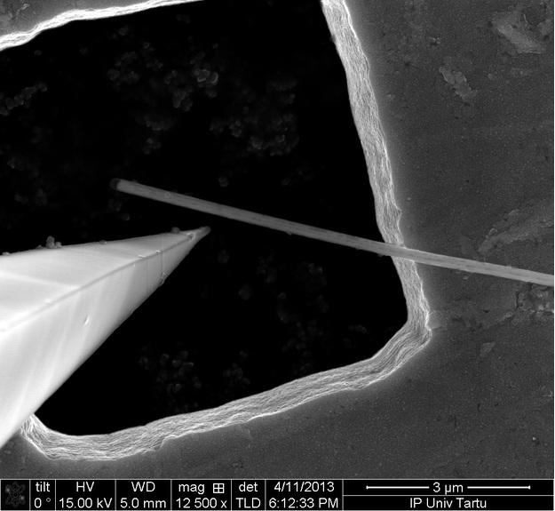
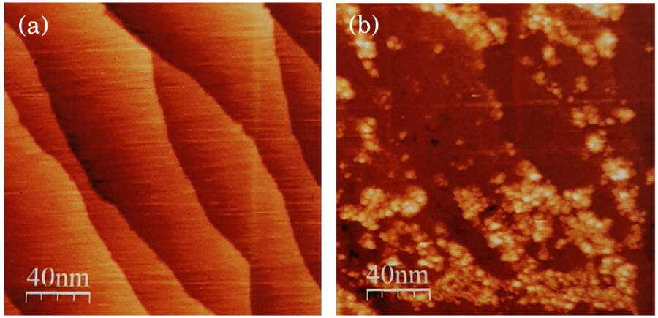
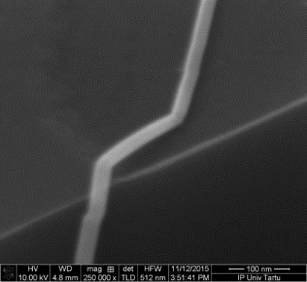
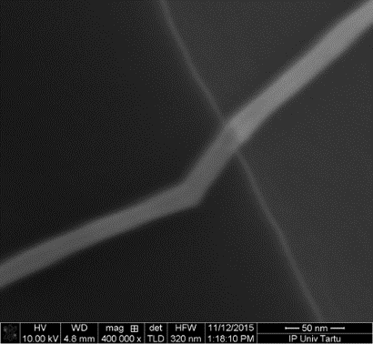
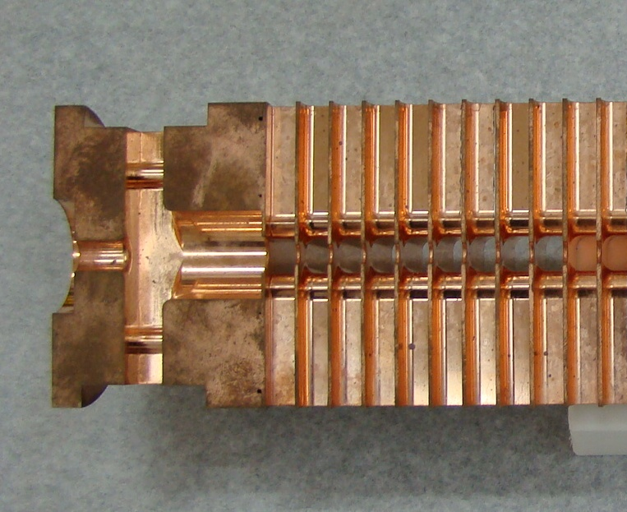
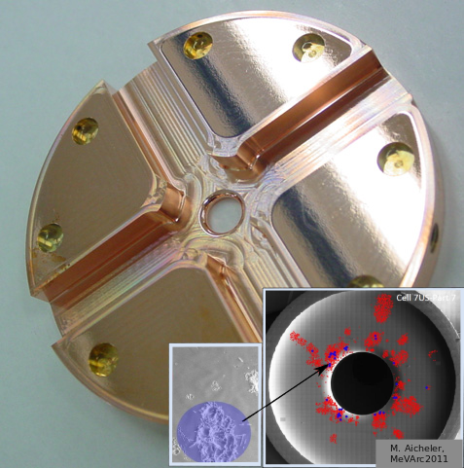
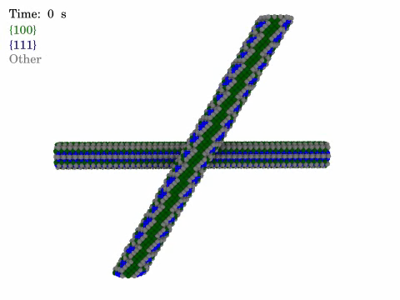
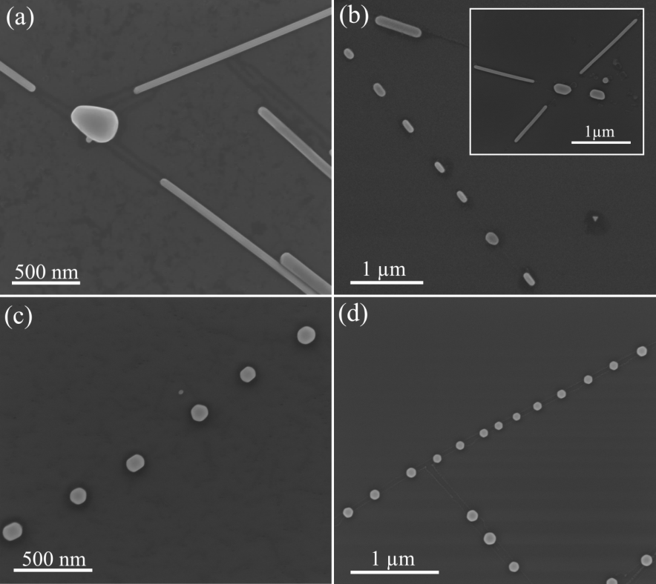
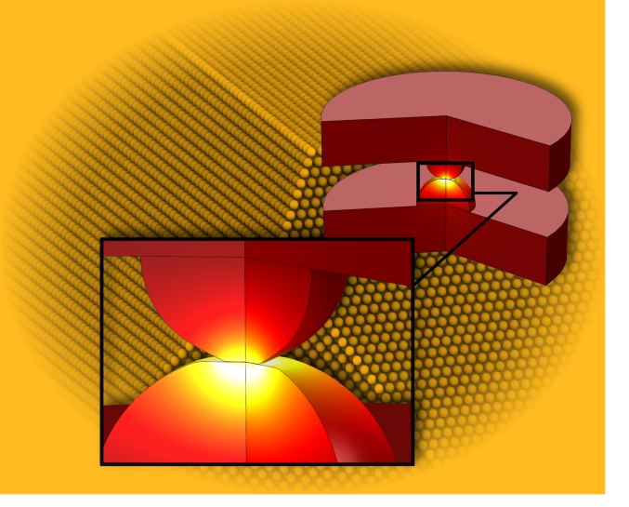
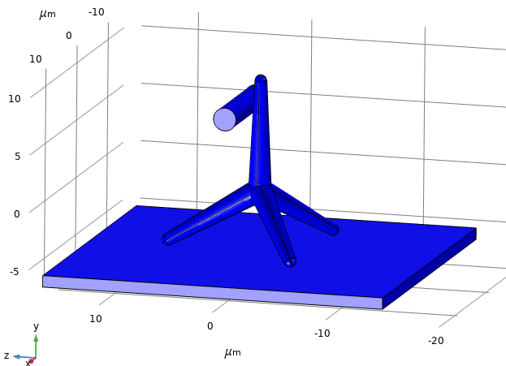
University of Tartu: ERA Chair MATTER
Functional materials in extreme environments
Materials Under High EM field
Vacuum Breakdown
Nanomanipulation & Nanofabrication using electric fields
Study of Nanostructures
Biomedical Applications
Surface diffusion under high field
Essential tools
Multi-scale simulations
In-situ Nanomanipulation
V. Zadin, University of Tartu
SEM, TEM, AFM

Slide 3
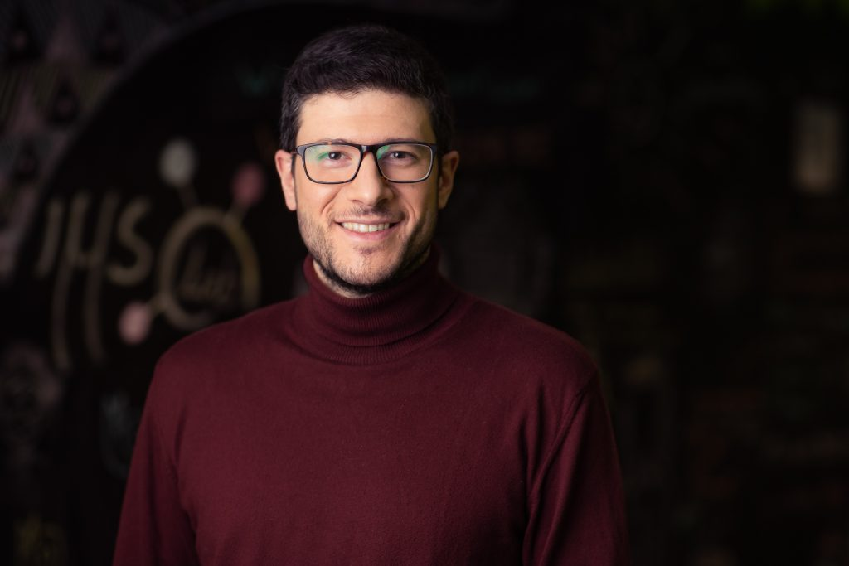
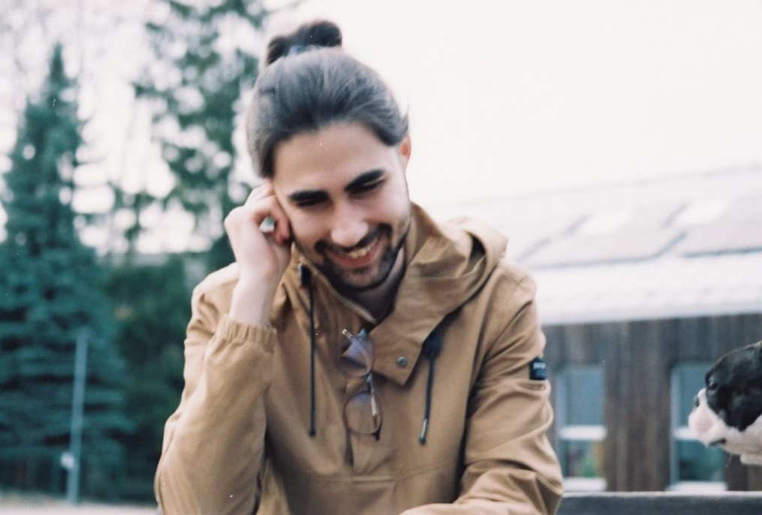
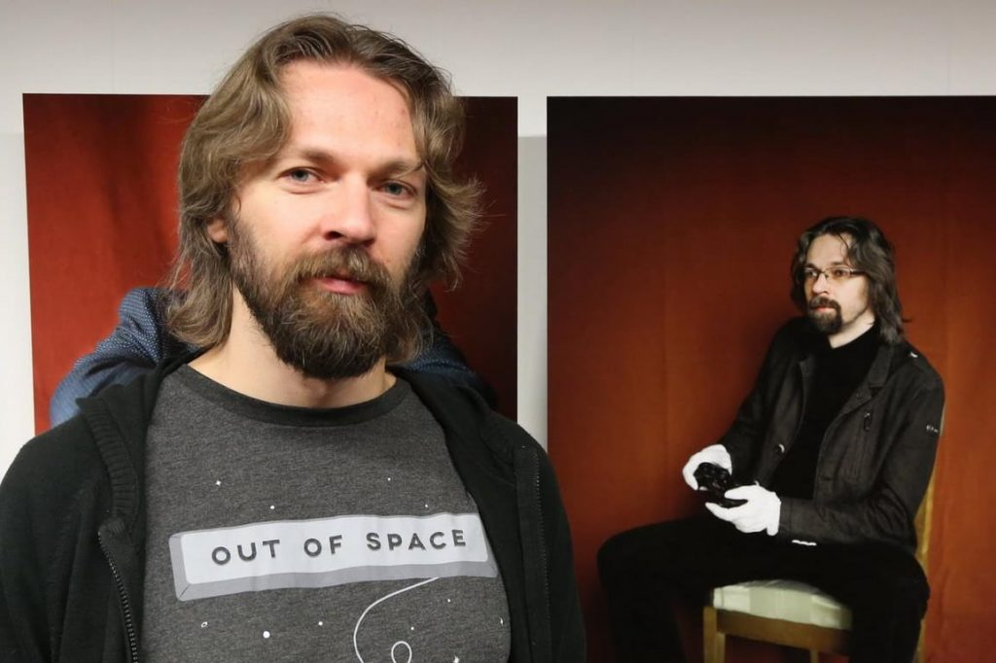
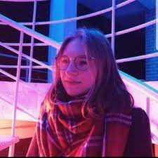
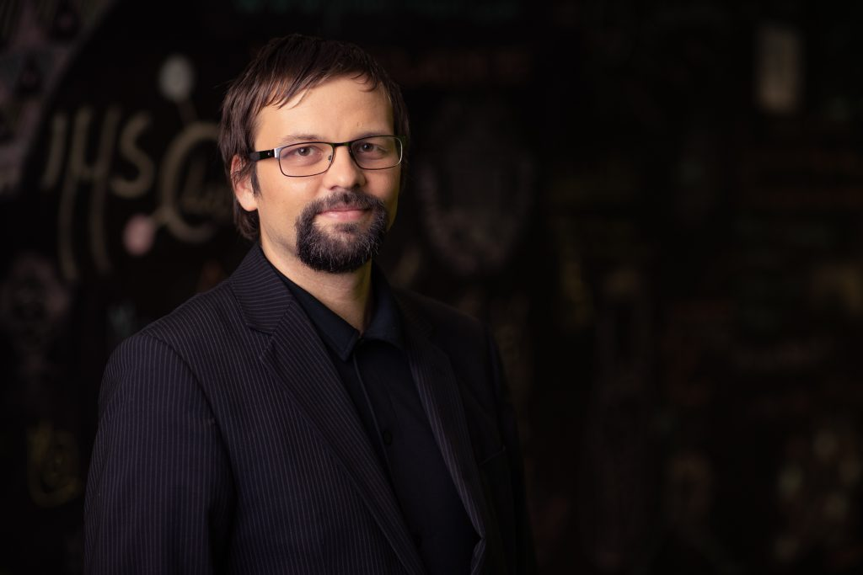
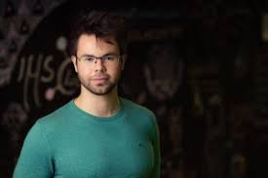
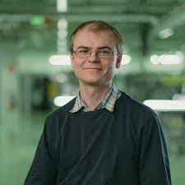
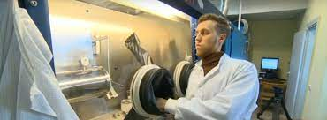
ERA Chair MATTER: Team in action
Veronika Zadin, PhD, prof., coordinator, advanced computer simulations
Andreas Kyritsakis, PhD, ERA Chair holder, associate prof., advanced computer simulations
Sergei Vlassov, PhD, associate prof., Nanomanipulation team lead
Veikko Linkko , PhD, associate prof., Biomedical team lead
Sven Oras, PhD, Postdoc
Edgars Butanovs, PhD, Postdoc
Tauno Tiirats, PhD, Postdoc
Mihkel Veske, PhD, engineer
Mart Ernits, MSc, PhD student
Ye Wang, MSc, PhD student
Elyad Darmechi, MSC, PhD student
Roni Koitermaa, MSC, PhD student
Mikael Rinne, Engineer, BSc student
Theophilus Odubena, BSc student
Ihar Suvorau, BSc student
Kristi Koitla, BSc student
Margit Meiesaar, supporting staff
V. Zadin, University of Tartu

Slide 4
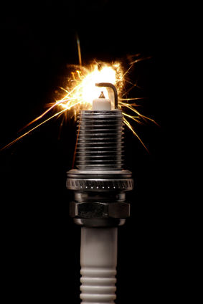
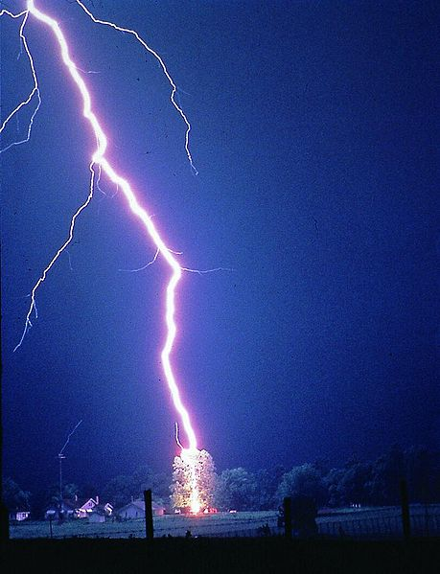
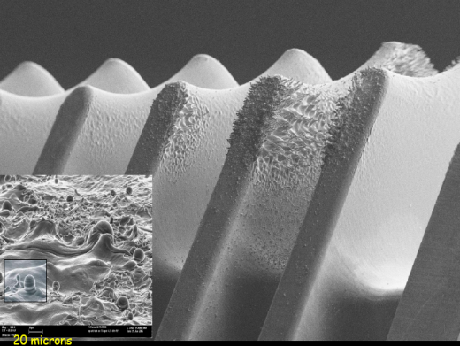
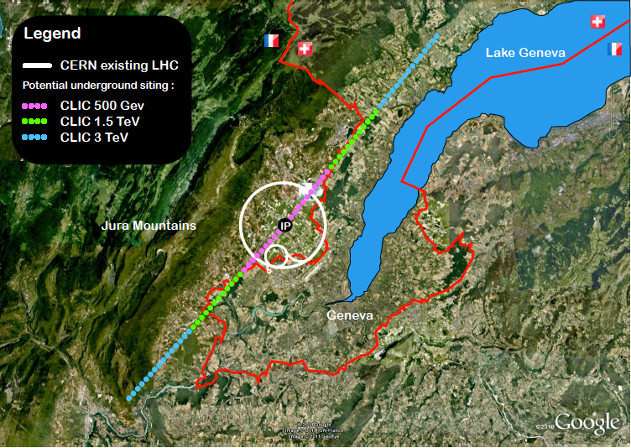
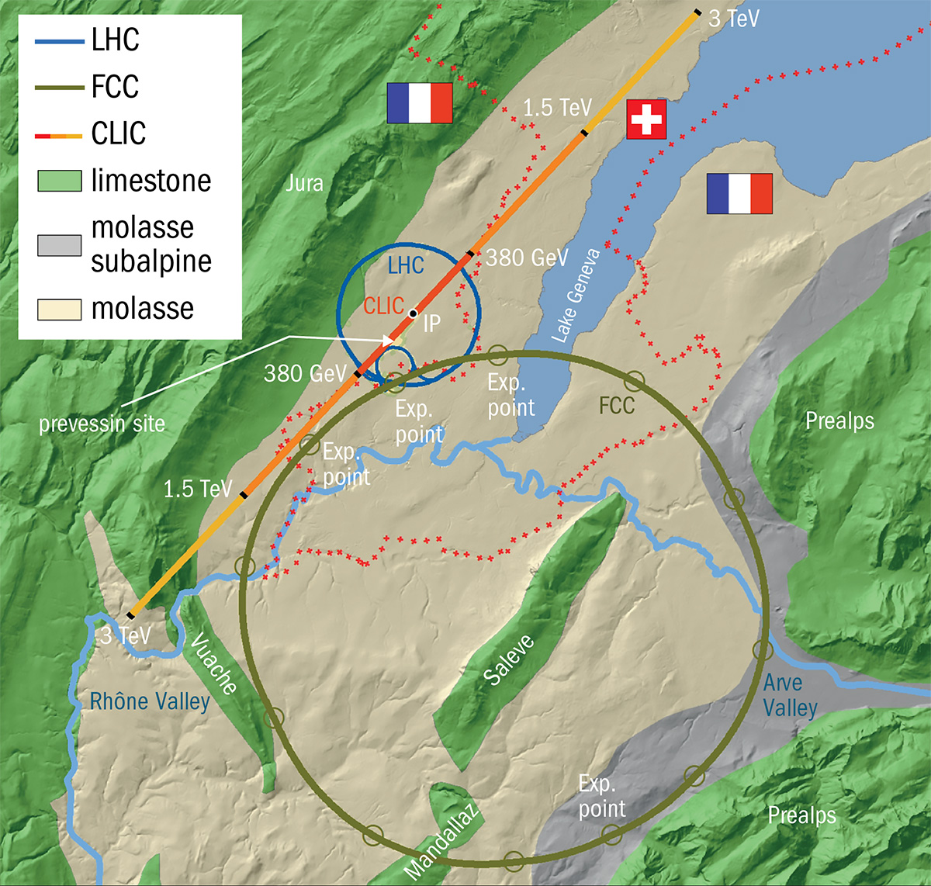
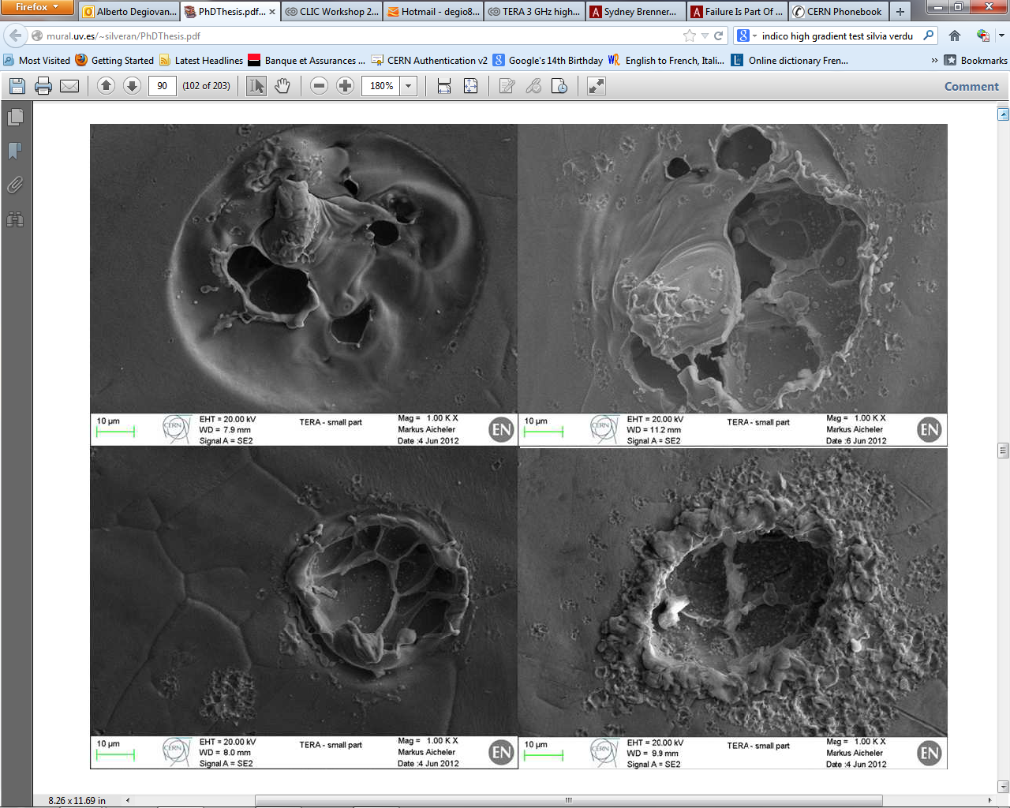

CLIC – Compact Linear Collider in https://clic.cern/
Applications:
CLIC collider in CERN
vacuum switches
novel nanofabrication applications
x-ray sources
medical linear accelerators
RF components for microwave devices
CLIC:
collision energies 0.5-5 TeV
Proposed length 50 km requires E ~ 100 MV/m causing vacuum breakdowns
$p_{required}<{3⋅10}^{−7}\frac{\#}{pulse⋅m}$ → BD mechanisms must be understood
Surface damage in CLIC accelerating structures after the breakdown
V. Zadin, University of Tartu

Slide 5
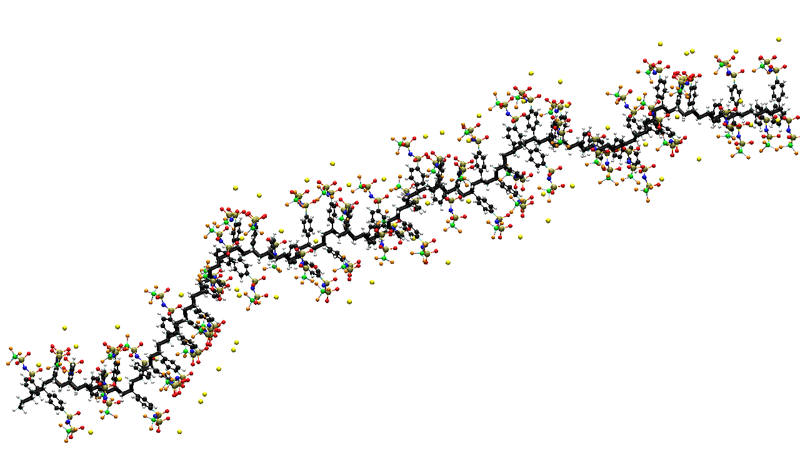
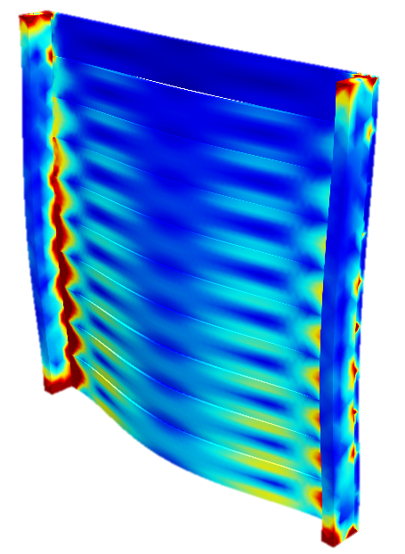
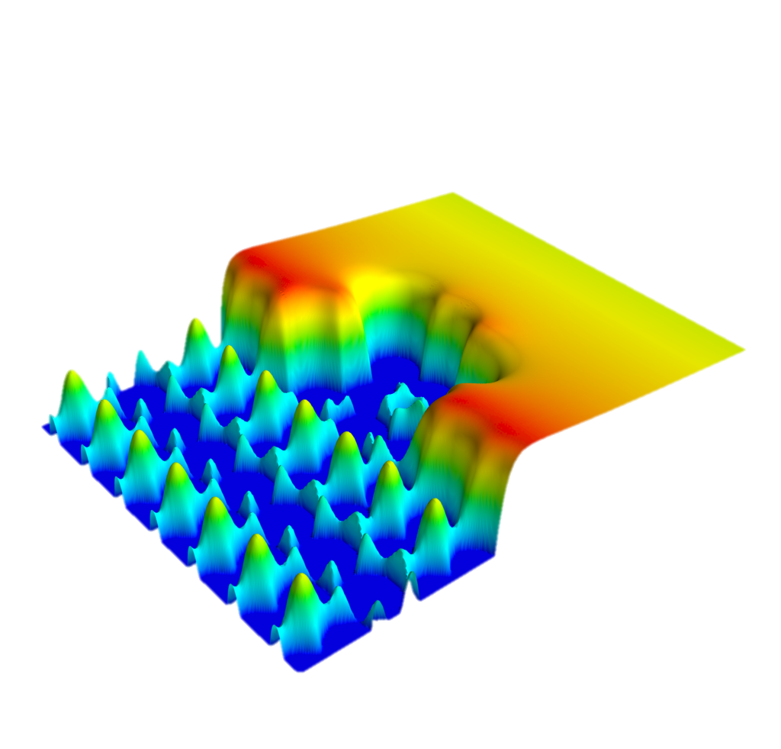
How we decode the nature …
Time
years
Finite Element Analysis
seconds
Mesoscale modeling
microsec
Molecular dynamics
nanosec
picosec
DFT
femtosec
1Å
1nm
10nm
1μm
1mm
Distance
V. Zadin, University of Tartu

Slide 6
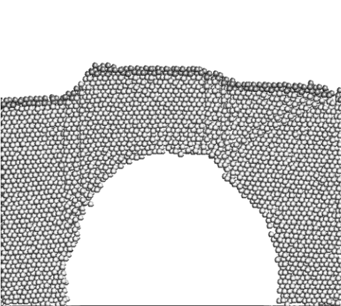
Breakdown initiation mechanisms
e⁻
Fatique damage
Subsurface defects
L. Laurent et al.,
Phys. Rev. ST Accel. Beams. 14 (2011)
A. Pohjonen, F. Djurabekova, et al.
J. Appl. Phys. (2013)
Emission current measurements
Field enhancement factor β
Key problem 1: understanding the mechanism leading to the appearnce of the field emitter
Key problem 2: understanding actual formation of field enhancement factor ~100
A. Descoeudres, et al.,
Phys. Rev. ST Accel. Beams. 12 (2009)
Field emitters with height to radius ratio ~100 (100 nm tall with 1 nm diameter) needed????
V. Zadin, University of Tartu

Slide 7
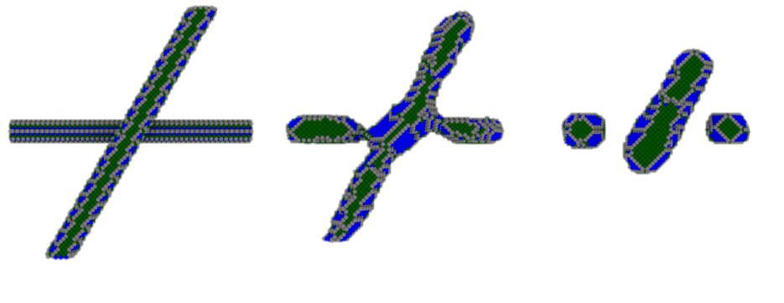
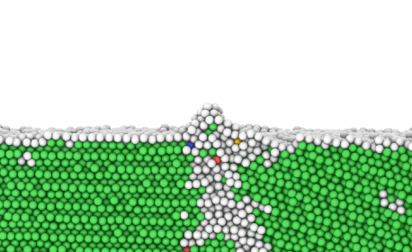
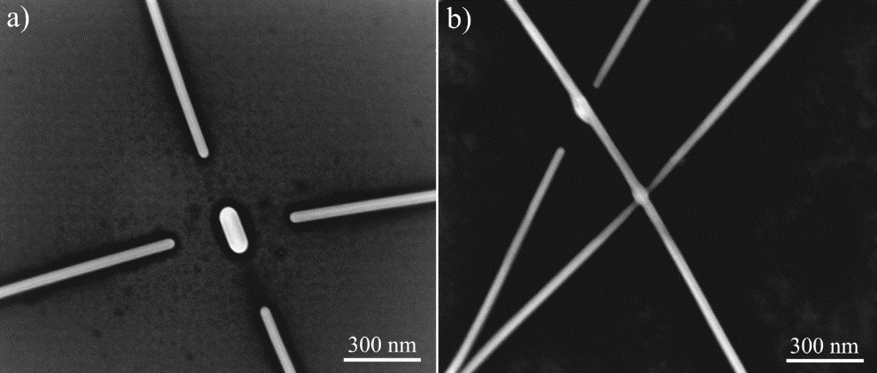
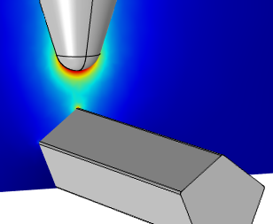
Unlocking BD onset
MD, DFT, FEMOCS, GETELEC
Surface stability, estimation of possible phenomena
KIMOCS
Gold model systems,
Surface behaviour
In situ SEM:
Heating & diffusion
Local El. field
FEM modeling,
Upscaling in X and t
Expectations of experimental conditions
V. Zadin, University of Tartu

Slide 8
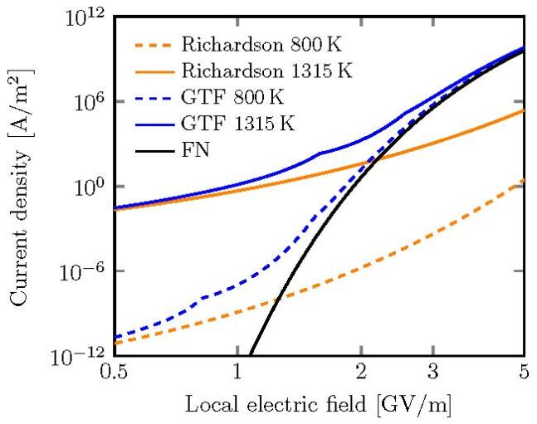
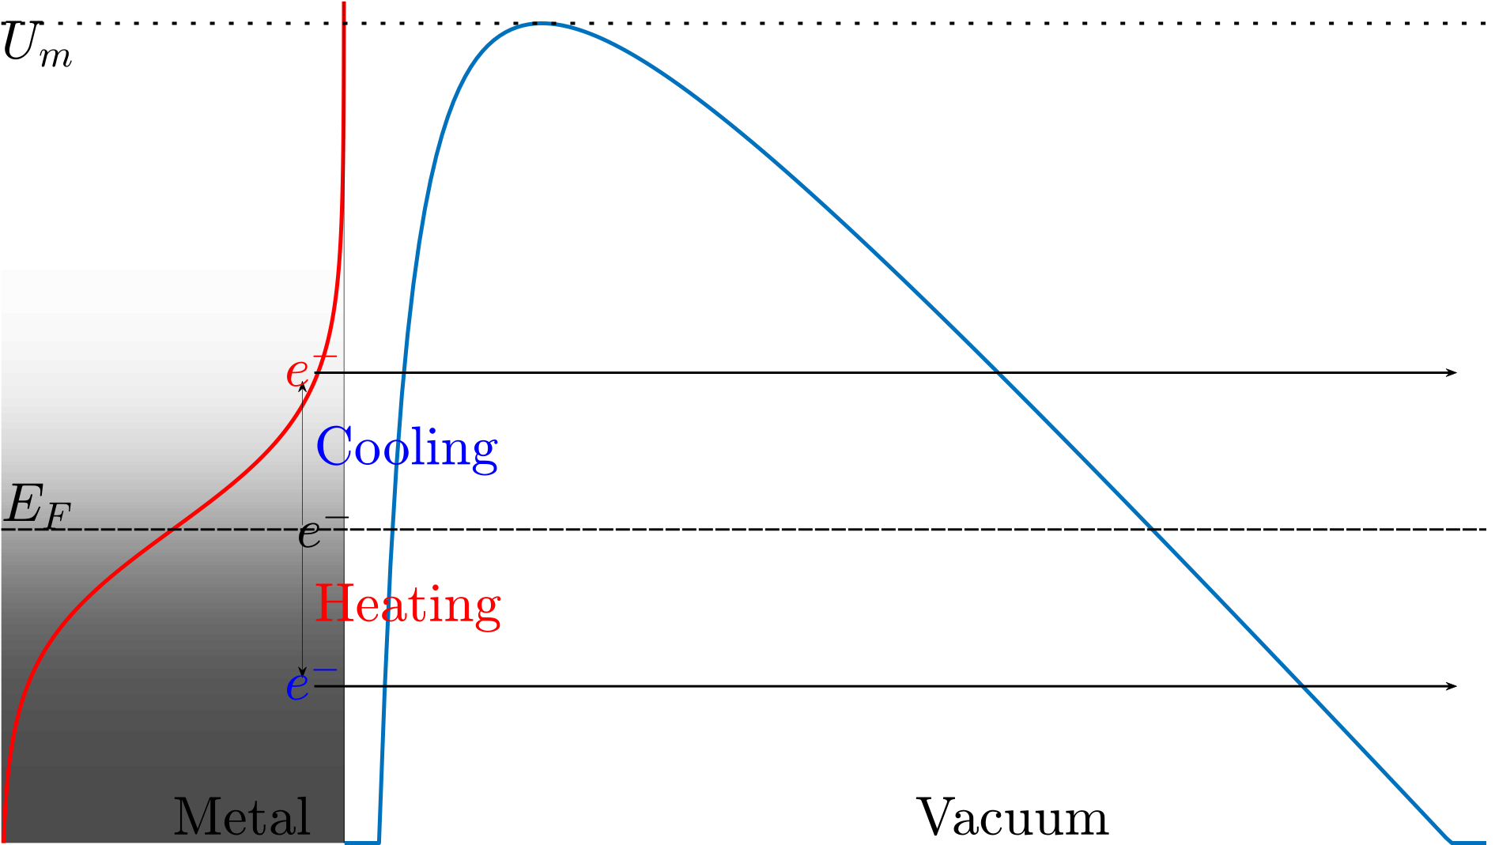
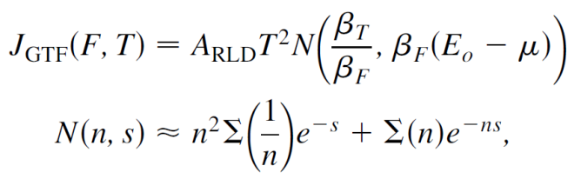
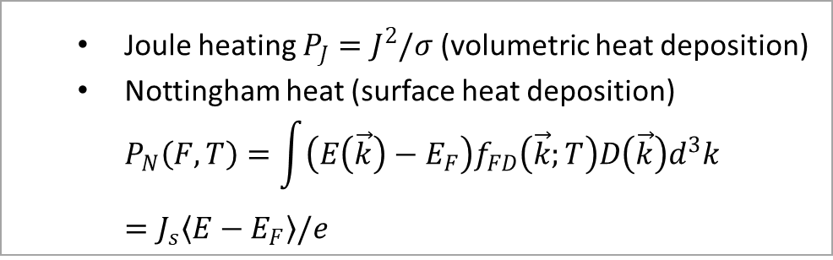
The emission currents & thermal effects of electron emission
Electron Emission by General Thermal Field model
Two heat deposition components
  Joule heating $P_{J}=J^{2}/σ$ (volumetric heat deposition)
  Nottingham heat (surface heat deposition)
  $P_{N}\left(F,T\right)=\int{\left(E\left(\vec{k}\right)−E_{F}\right)f_{FD}\left(\vec{k};T\right)D\left(\vec{k}\right)d^{3}k}=J_{s}\left\langle E−E_{F}\right\rangle /e$
Thermionic emission: high temperature, low field
Field emission: low temperature, high field
Combined effects: general thermal field equation
Electron emission and heating by GETELEC Code:
https://github.com/AndKyr/GETELEC
V. Zadin, University of Tartu
V. Zadin, University of Tartu
A. Kyritsakis, F. Djurabekova, Comput. Mater. Sci 128 15 (2017)
Notes:
Kristjan Eimre will speak more later …

Slide 9
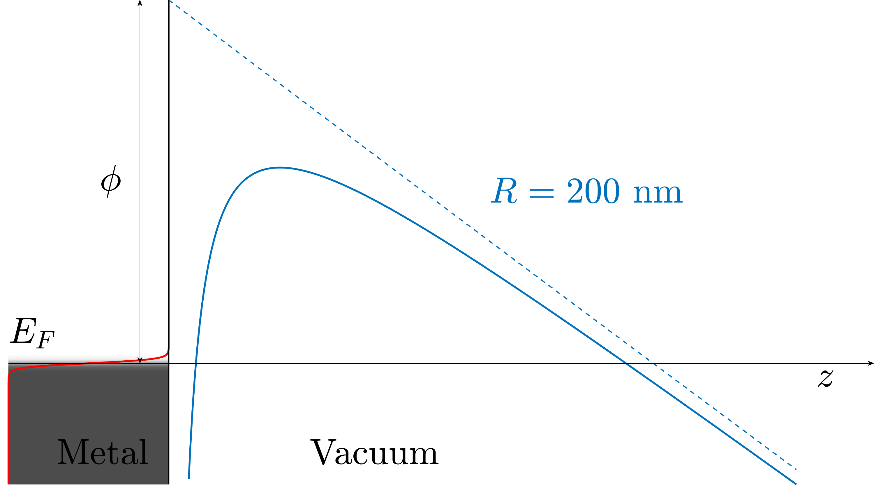
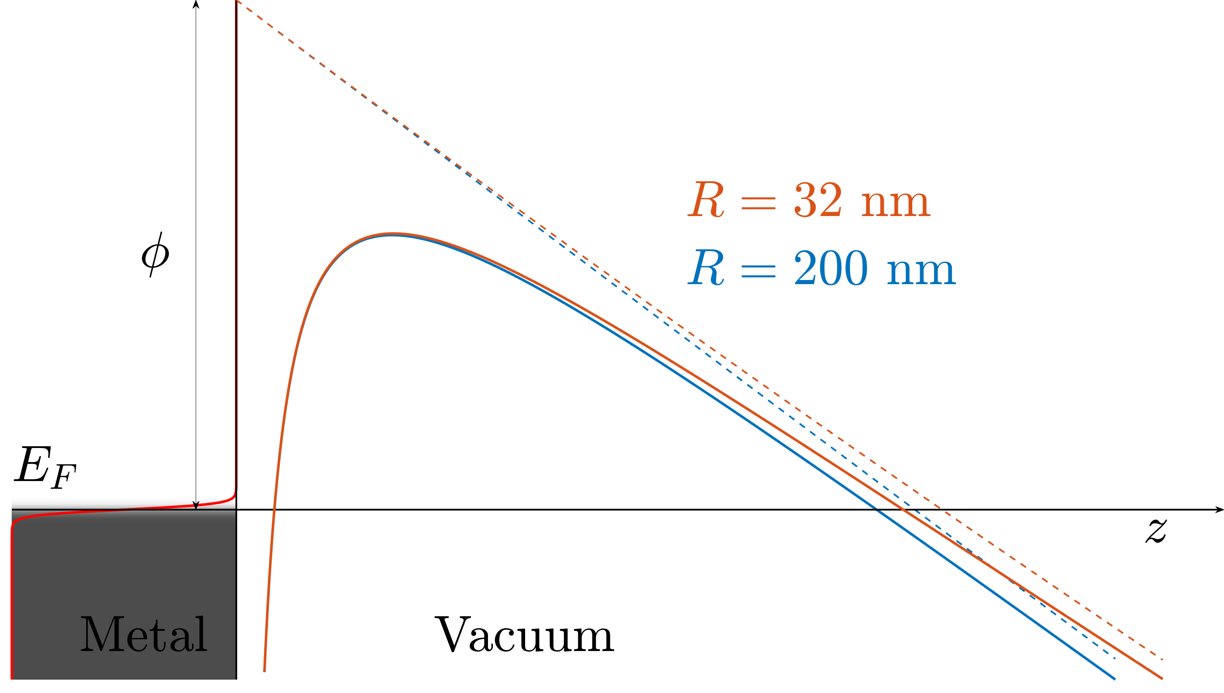
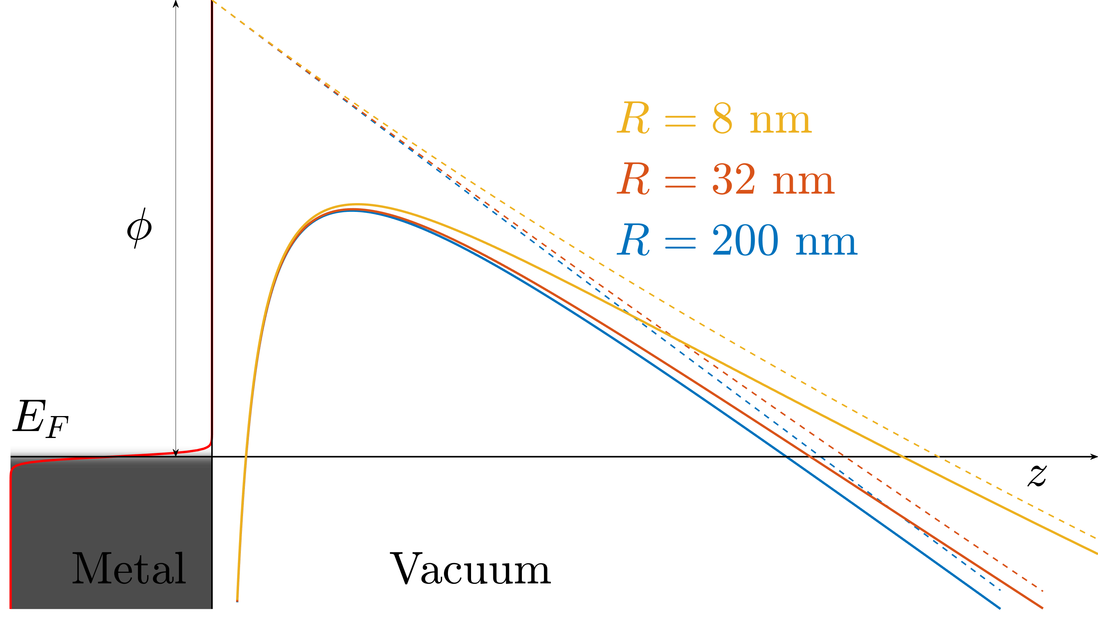
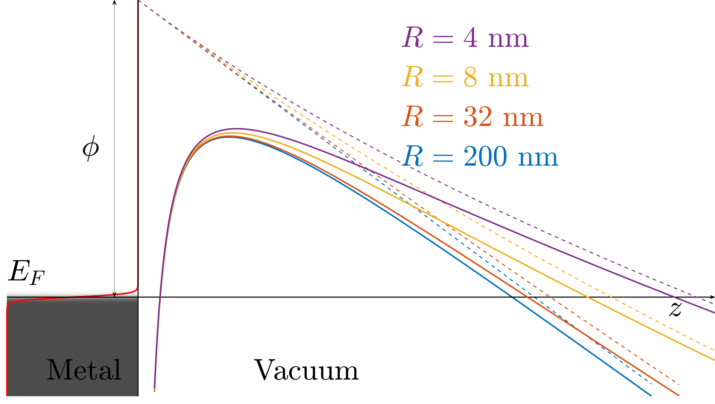
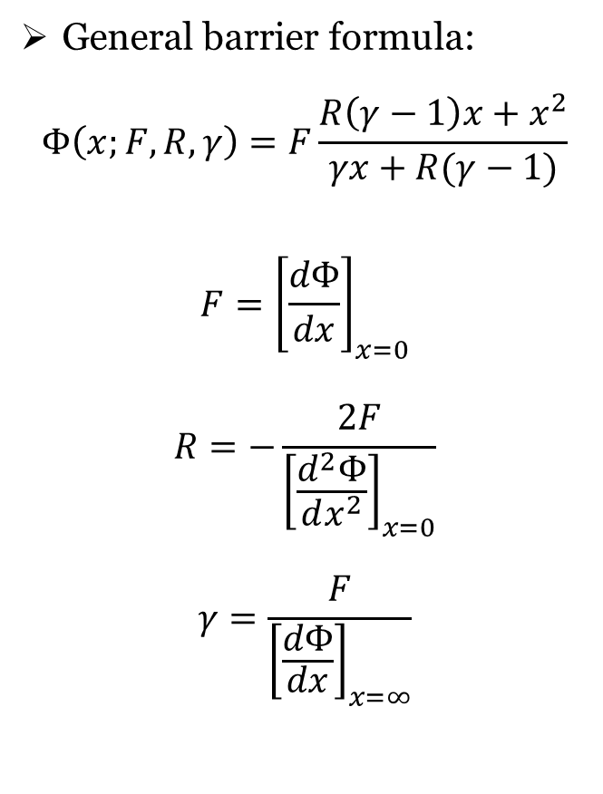
Sharp emitter effects
General barrier formula:
$$Φ\left(x;F,R,γ\right)=F\frac{R\left(γ−1\right)x+x^{2}}{γx+R(γ−1)}$$
$$F={\left[\frac{dΦ}{dx}\right]}_{x=0}$$
$$R=−\frac{2F}{{\left[\frac{d^{2}Φ}{dx^{2}}\right]}_{x=0}}$$
$$γ=\frac{F}{{\left[\frac{dΦ}{dx}\right]}_{x=∞}}$$
V. Zadin, University of Tartu

Slide 10
GETELEC
Input
Local Field
Output
Current density
Radius
GETELEC
Nottingham heat
Temperature
e⁻ Energy spectra
Work function
More details: A. Kyritsakis et. al., Comput. Meter. Sci. 128, 15–21 (2017)
V. Zadin, University of Tartu

Slide 11

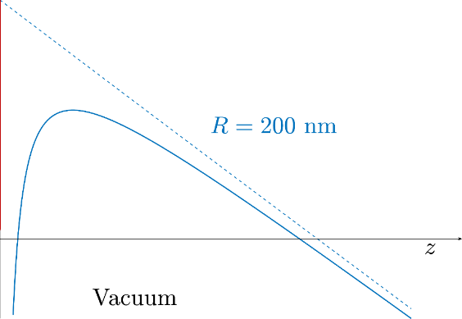

Code implementation
Material + Potential Barrier
Later retrieve by interpolation
Input
Local Field
Output
Pre-calculated
Current density
Radius
GETELEC
Nottingham heat
Temperature
No analytical solutions for our integrals!
e⁻ Energy spectra
Band structure
Nested self-consistent
V. Zadin, University of Tartu

Slide 12
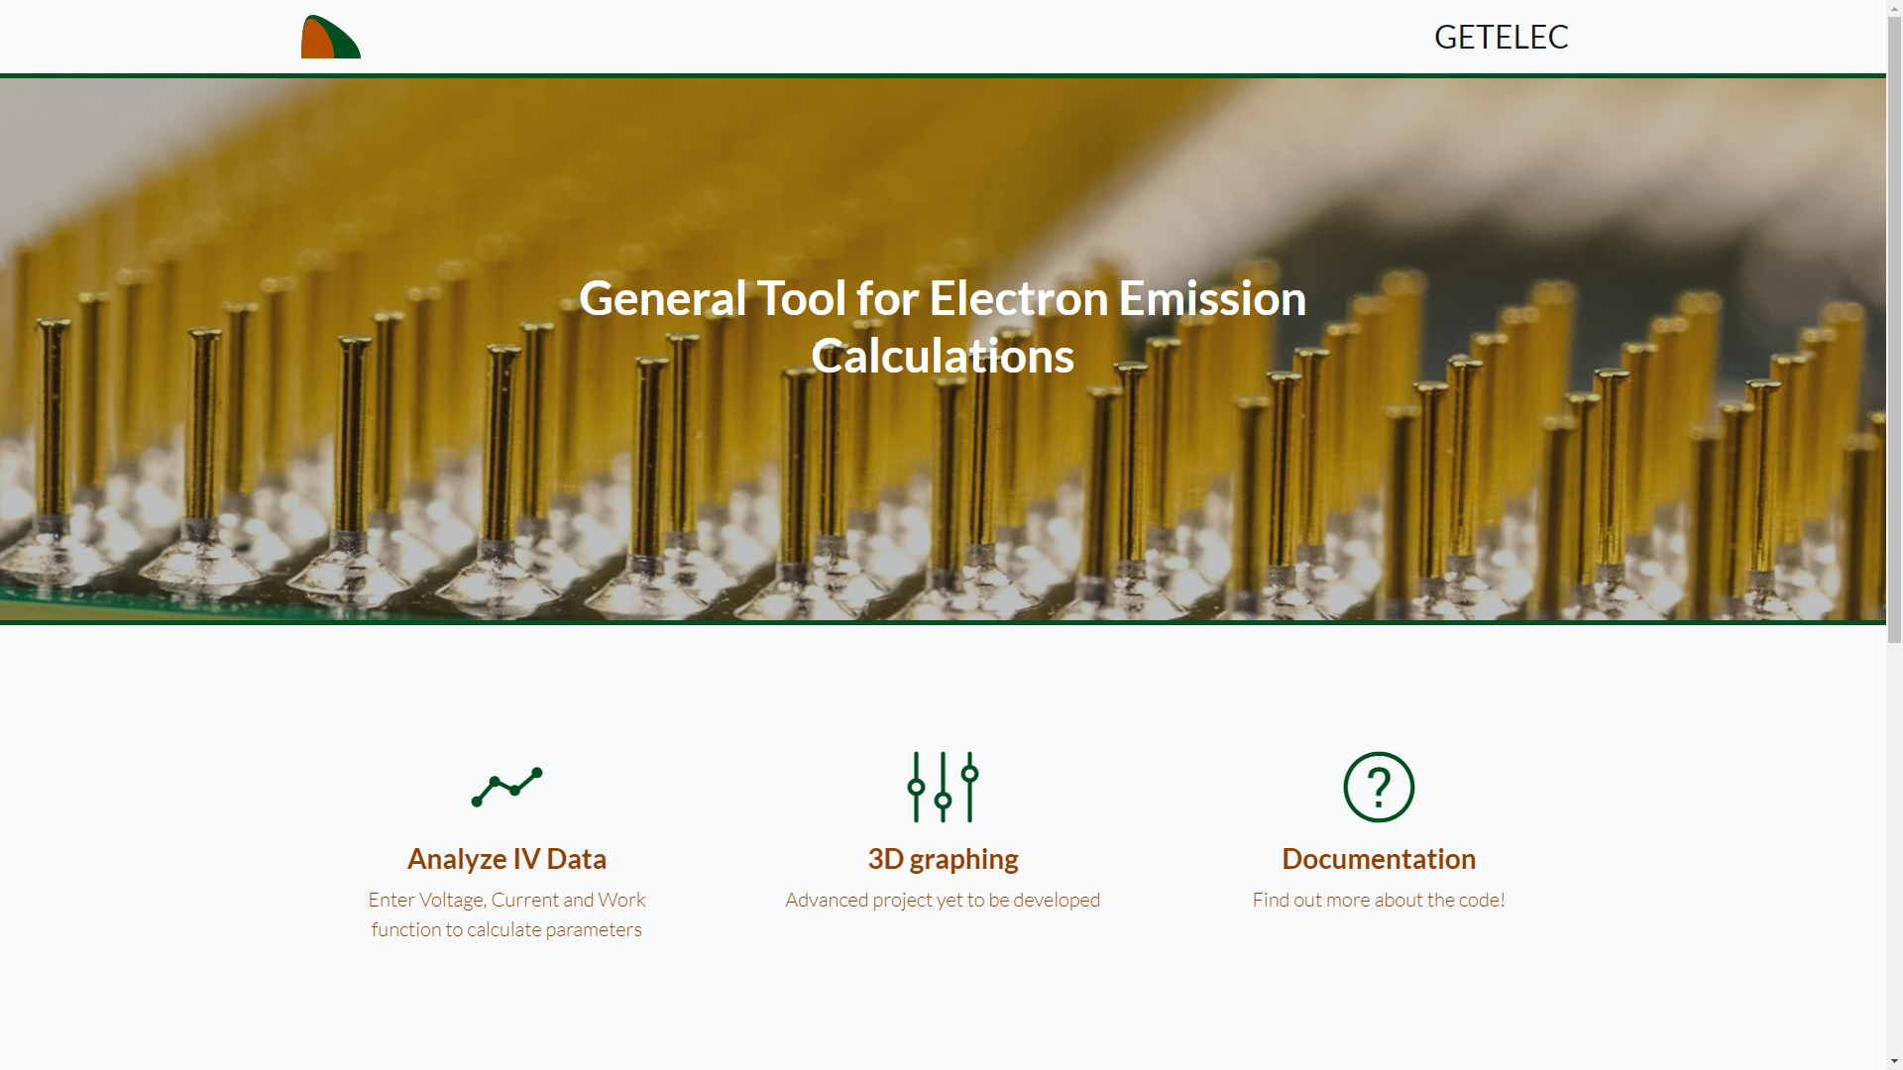
WWW.GETELEC.ORG
V. Zadin, University of Tartu

Slide 13
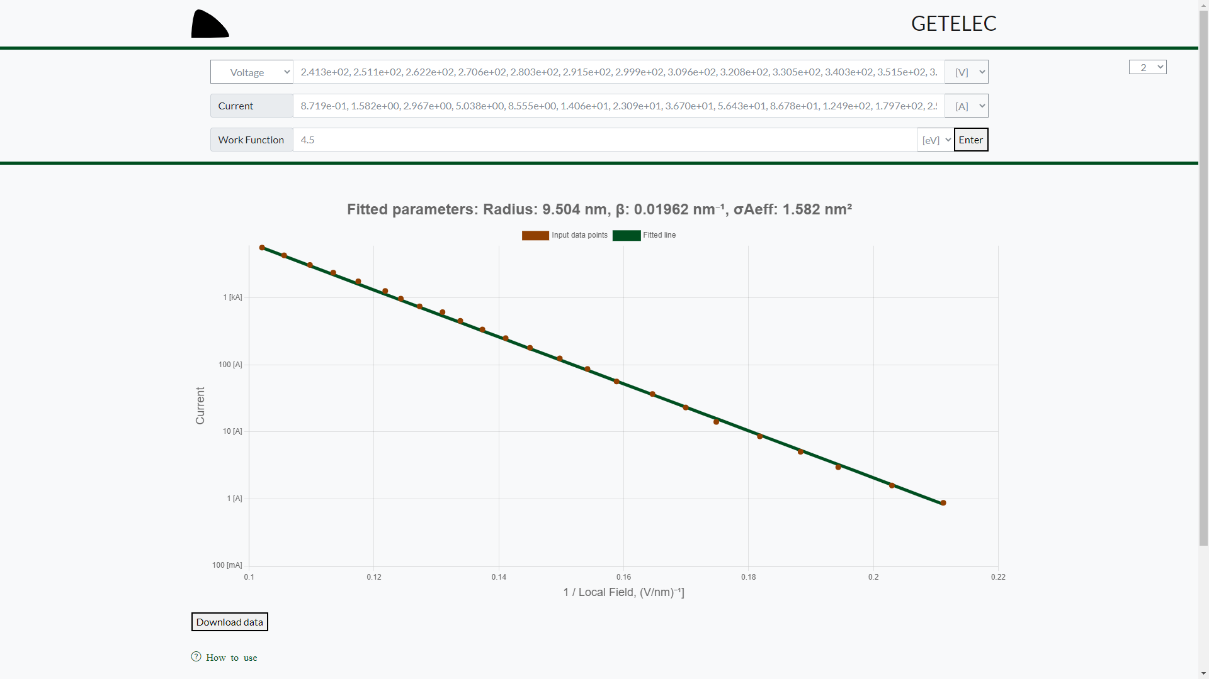
V. Zadin, University of Tartu

Slide 14
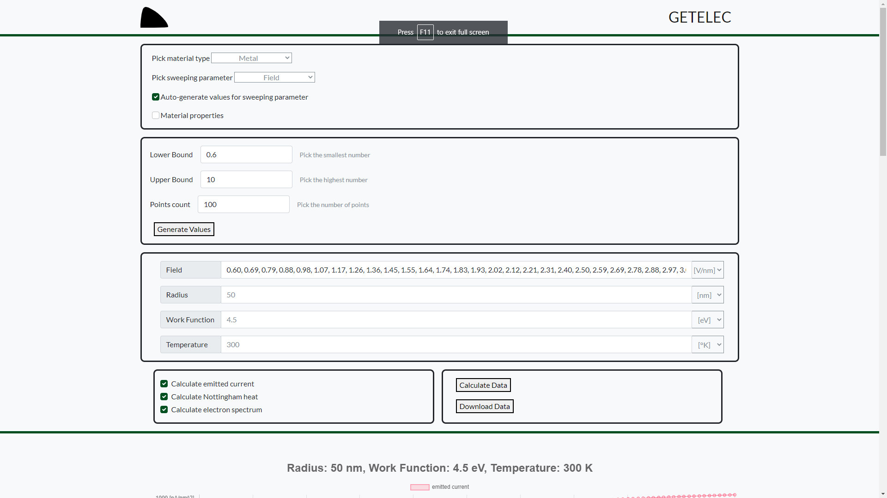
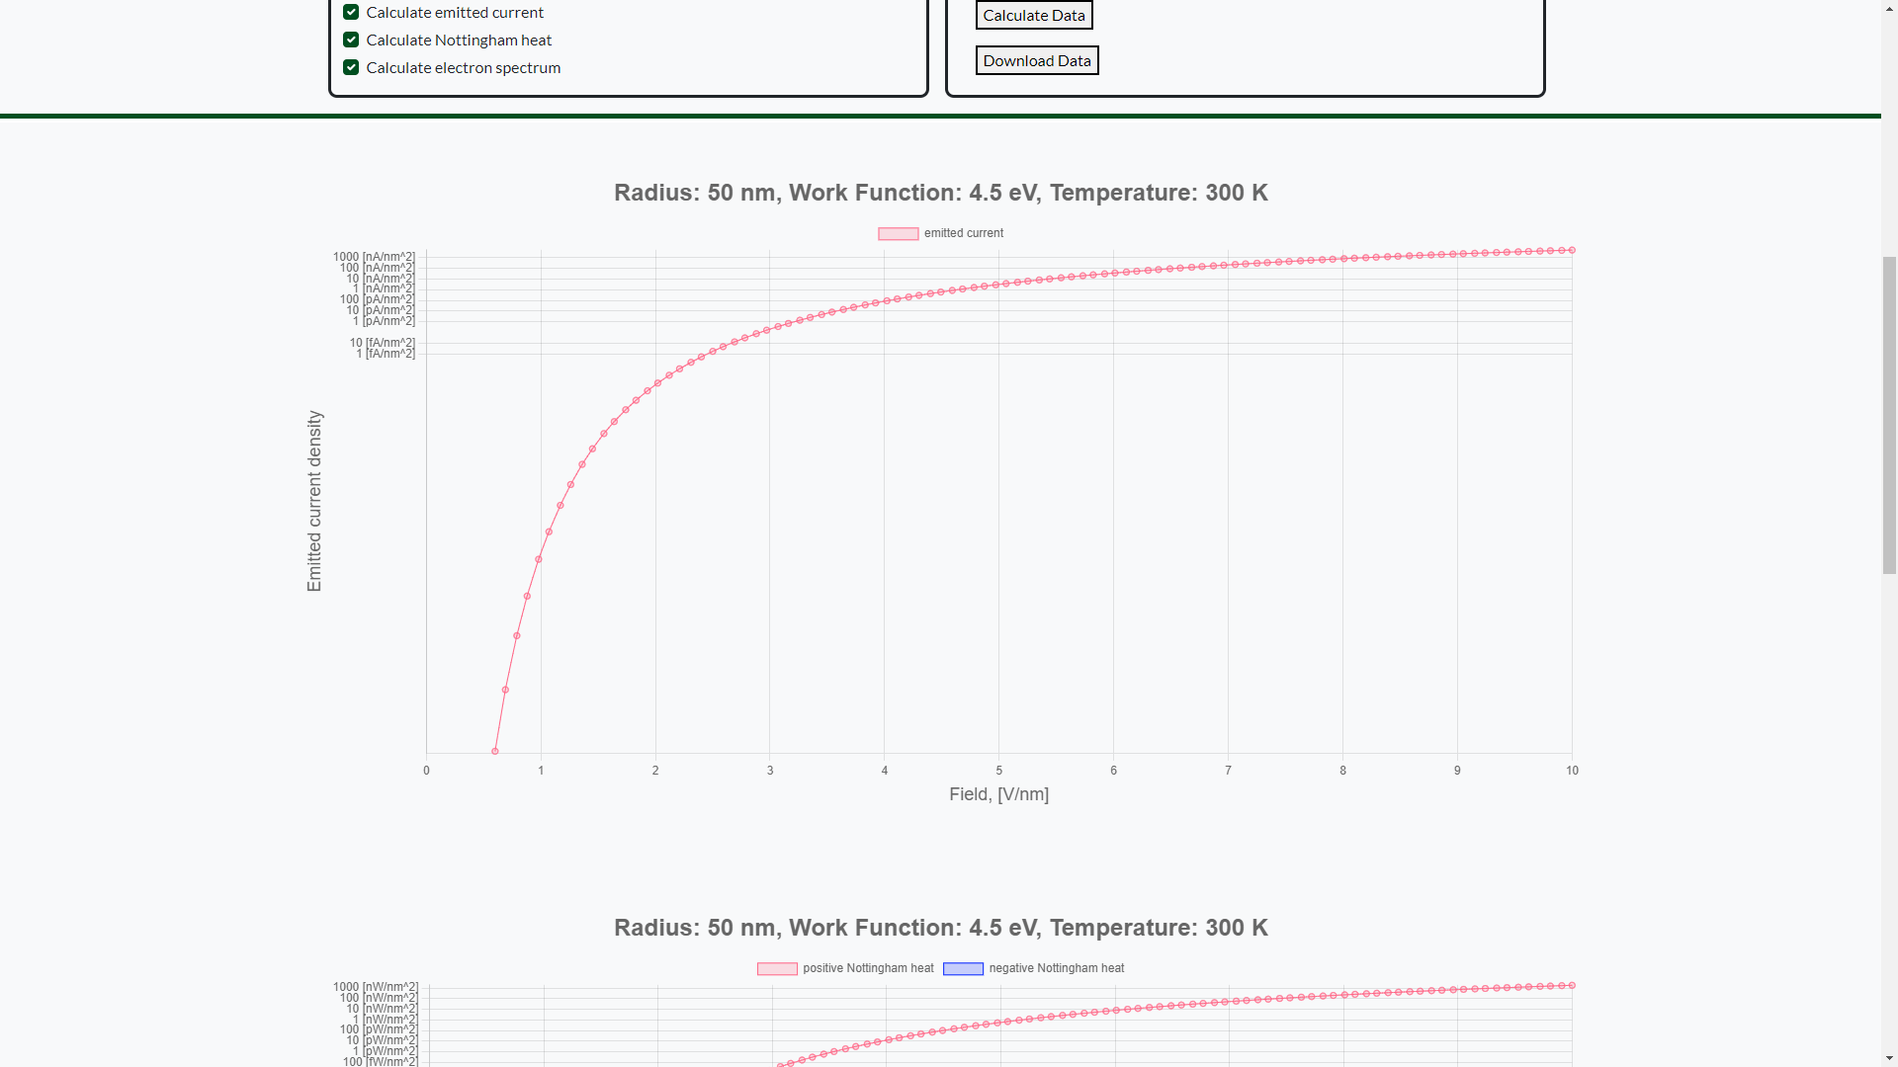
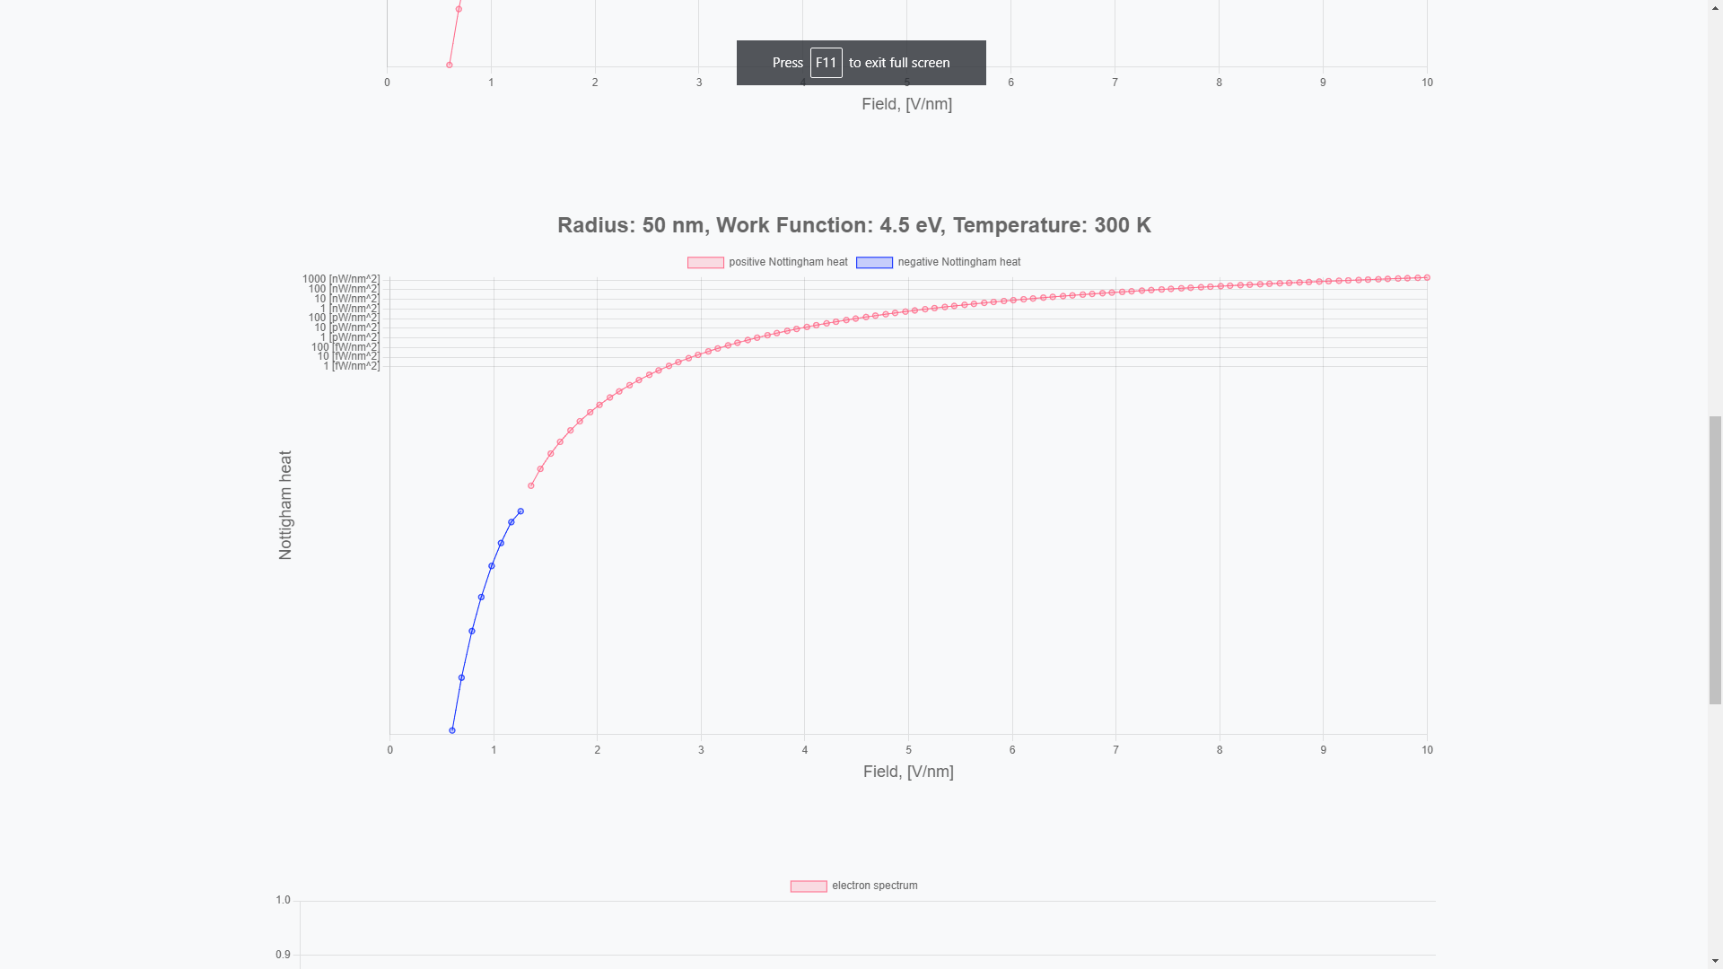


V. Zadin, University of Tartu

Slide 15

Concurrent ED-MD: FEMOCS
Fine elements:
Deal.II library
Molecular Dynamics:
PARCAS MD
LAMMPS
Mesh generation “on the fly” when MD system changes
Solve for E, T, J et al.
Feedback to MD electrostatic forces + heating
https://github.com/veskem/femocs
V. Zadin, University of Tartu

Slide 16
Specifics of FEMOCS algorithm
Atoms (MD)
Velocity
perturbration
Force perturbation
FEM mesh
Temperature distribution
PIC
Electric Field
Current distribution
Sur. charge distribution
Field emission,
Particles (e), Positions, Injections
V. Zadin, University of Tartu
M. Veske et. al, Phys. Rev. E 101, 053307 (2020)

Slide 17








Heating and El. field calculations
Track particles:
  $${\vec{r}}_{i}\left(t+Δt\right)={\vec{r}}_{i}\left(t\right)+{\vec{v}}_{i}\left(t\right)Δt$$
  $${\vec{v}}_{i}\left(t+Δt\right)={\vec{v}}_{i}\left(t\right)+Δt\frac{q_{i}}{m_{i}}∇Φ$$
Interpolate charge density:
  $$ρ\left(\vec{r}\right)=\sum_{i}{w_{i}q_{i}U(\vec{r}−{\vec{r}}_{i})}$$
Collide particles (Monte Carlo method):
  $$e^{−}+Cu→Cu^{+}+2e^{−}$$
  (… and many other collision types)
Solve Poisson equation (FEM)
  $∇^{2}Φ=−\frac{ρ}{ε_{0}}$
Calculate surface currents and inject new particles
Repeat for desired number of time steps
Heating: Joule and Nottingham
The Electric field Calculation: Space Charge Screening effects
GETELEC [1]
Surface Current density J_{s} and
Nottingham heat P_{N} distributions
$$∇⋅J=0$$
$${c_{v}\frac{∂T}{∂t}=κ∇}^{2}T+\frac{J^{2}}{σ}+P_{N}$$
Temperature
distribution T(z)
Conductivities σ,κ(Τ)
MD velocity perturbation (Berendsen thermostat)
  [1] A. Kyritsakis, F. Djurabekova, Comput. Mater. Sci 128 15
V. Zadin, University of Tartu

Slide 18
Static surface under el. field
Field Emission Microscopy experiment
Collaboration with Dr. Hirofumi Yanagisawa(Max-Planck Institute of Quantum Optics)
Surface faceting and protrusion formation
Possible mechanism for emitter formation
H. Yanagisawa, V. Zadin et al. https://arxiv.org/abs/1605.05393
V. Zadin, University of Tartu

Slide 19








Current understanding
Fujita et al., Phys. Rev. 75, 2007
V. Zadin, University of Tartu
V. Jansson, et. al., Nanotechnology 31, 355301 (2020)

Slide 20

Field assisted surface diffusion: the experiment
V. Zadin, University of Tartu

Slide 21
Conclusions
FEMOCS – concentrates our best current understanding of BD onset
  Still has significant limitations – emitter must be pre-created
GETELEC – best currently available tool for field emission calculation & analysis
  Nottingham heat
  Metals & semiconductors
  Web interface to make it usable by wider audience
Whole multiscale range of simulations most probably needed to understand true reasons of BD initiation
Tight integration with in-situ microscopy experiments critical!
V. Zadin, University of Tartu

Slide 22


Thank You for Your attention!
Special thanks to:
Alvo Aabloo
Elyad Darmechi
Tarmo Tamm
Simon Vigonski
Sergei Vlassov
Mihkel Veske
Kristjan Eimre
Kristian Kuppart
Sven Oras
Artur Tamm
Robert Aare
Tarvo Metspalu
Ye Wang
Aile Tamm
Faiza Summer
Helle-Mai Piirsoo
Walter Wuench
Flyura Djurabekova
Ville Jansson
Kai Nordlund
Supproted by:
ERA Chair MATTER with funding from the European Union’s Horizon 2020 research and innovation programme under grant agreement No 856705.
Estonian research council grants:
PUT 57 & PUT 1372

