Slide 1
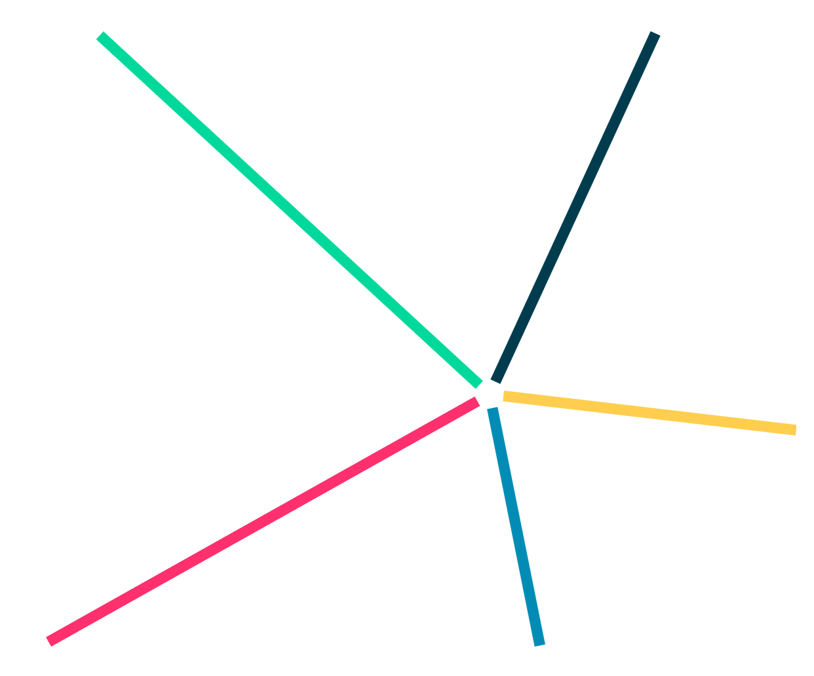

Network of Lithuanian STEAM Education Centres
Paulius L. Tamošiūnas,
Vilnius STEAM Centre,
Vilnius University
2nd CERN Baltic Conference (CBC 2022)
October 10, 2022 | Vilnius

Slide 2






WHY: Strategic vectors of STEAM education centres
Open and motivating community, as a medium for idea realisation
$\vec{A}$creative and proactive future society
Teachers‘ (=catalysers of the change) competence & support
Student (=future creator) skills & motivation
Ministry of Education, Science, and Sports
Republic of Lithuania
4 projects
2017 - 2023

Slide 3



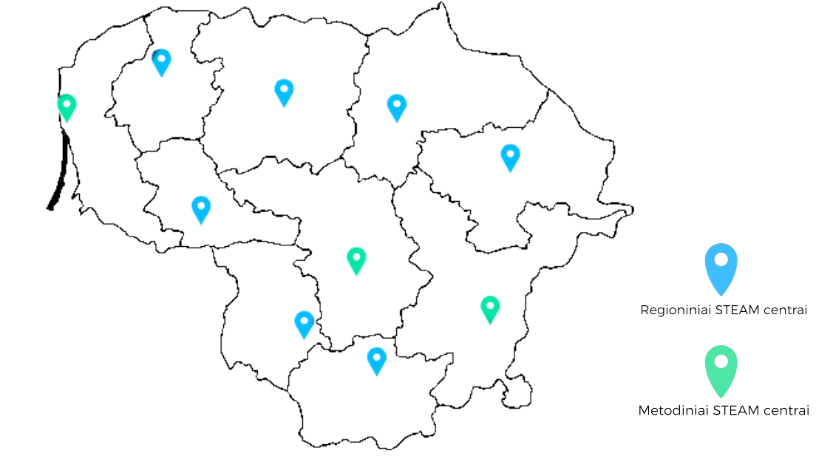
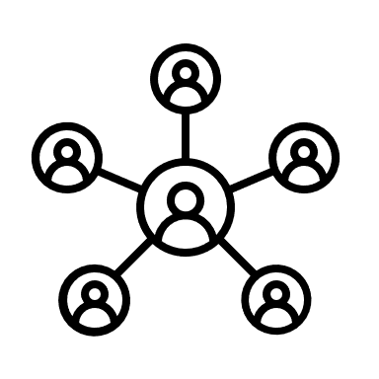










WHAT IT IS: 10 Open access STEAM Education centres
STEAM LT network:
7 regional & 3 methodical centres:
STEAM education
ecosystem
SCHOOL
NGOs
TEACHER
REGIONAL
centres
Regional STEAM centre
Methodical STEAM centre
METHODICAL
centres
UNIVERSITY
Opened: Oct. 27, 2021 (6 /10)
Oct. 7, 2022 (1 /10)
→ 2023 Q3 (3 /10)
PARTNERS
/ INDUSTRY
4 levels of complexity and specialisation
Notes:
Network, Ecosystem
NŠA logo / vu/ ku/ KTU

Slide 4
WHAT‘S INSIDE: Structure of the network
There are 2 or 3 standard laboratories in each centre:
Biology-chemistry
Physics-engineering
Robotics-IT
OR
Science
Mechatronics
AND a specialised laboratory:
Health technologies & quality of life
Artificial intelligence
Marine research
Astrophysics & aerospace
Smart City
Sustainable development, green & alternative energy
Laser technologies;
FABLab
Creativity & media
Food technology, culinary arts, & wellness

Slide 5
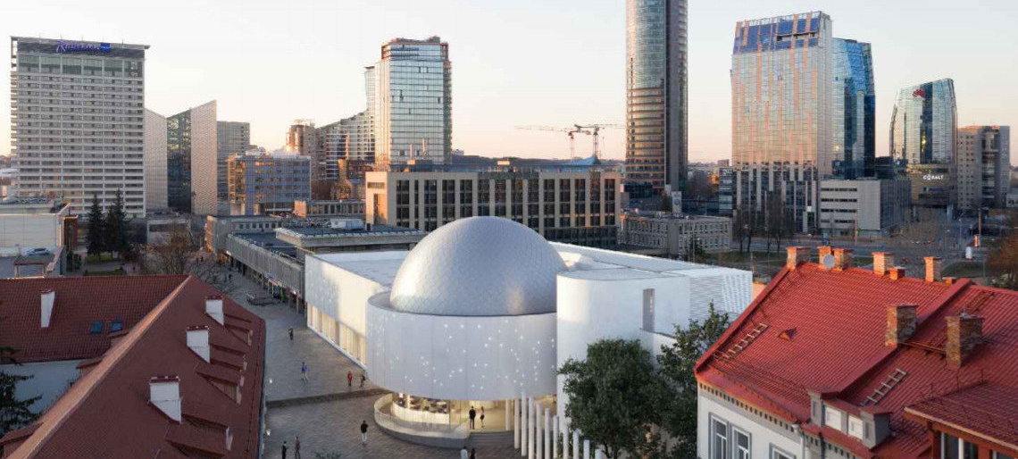
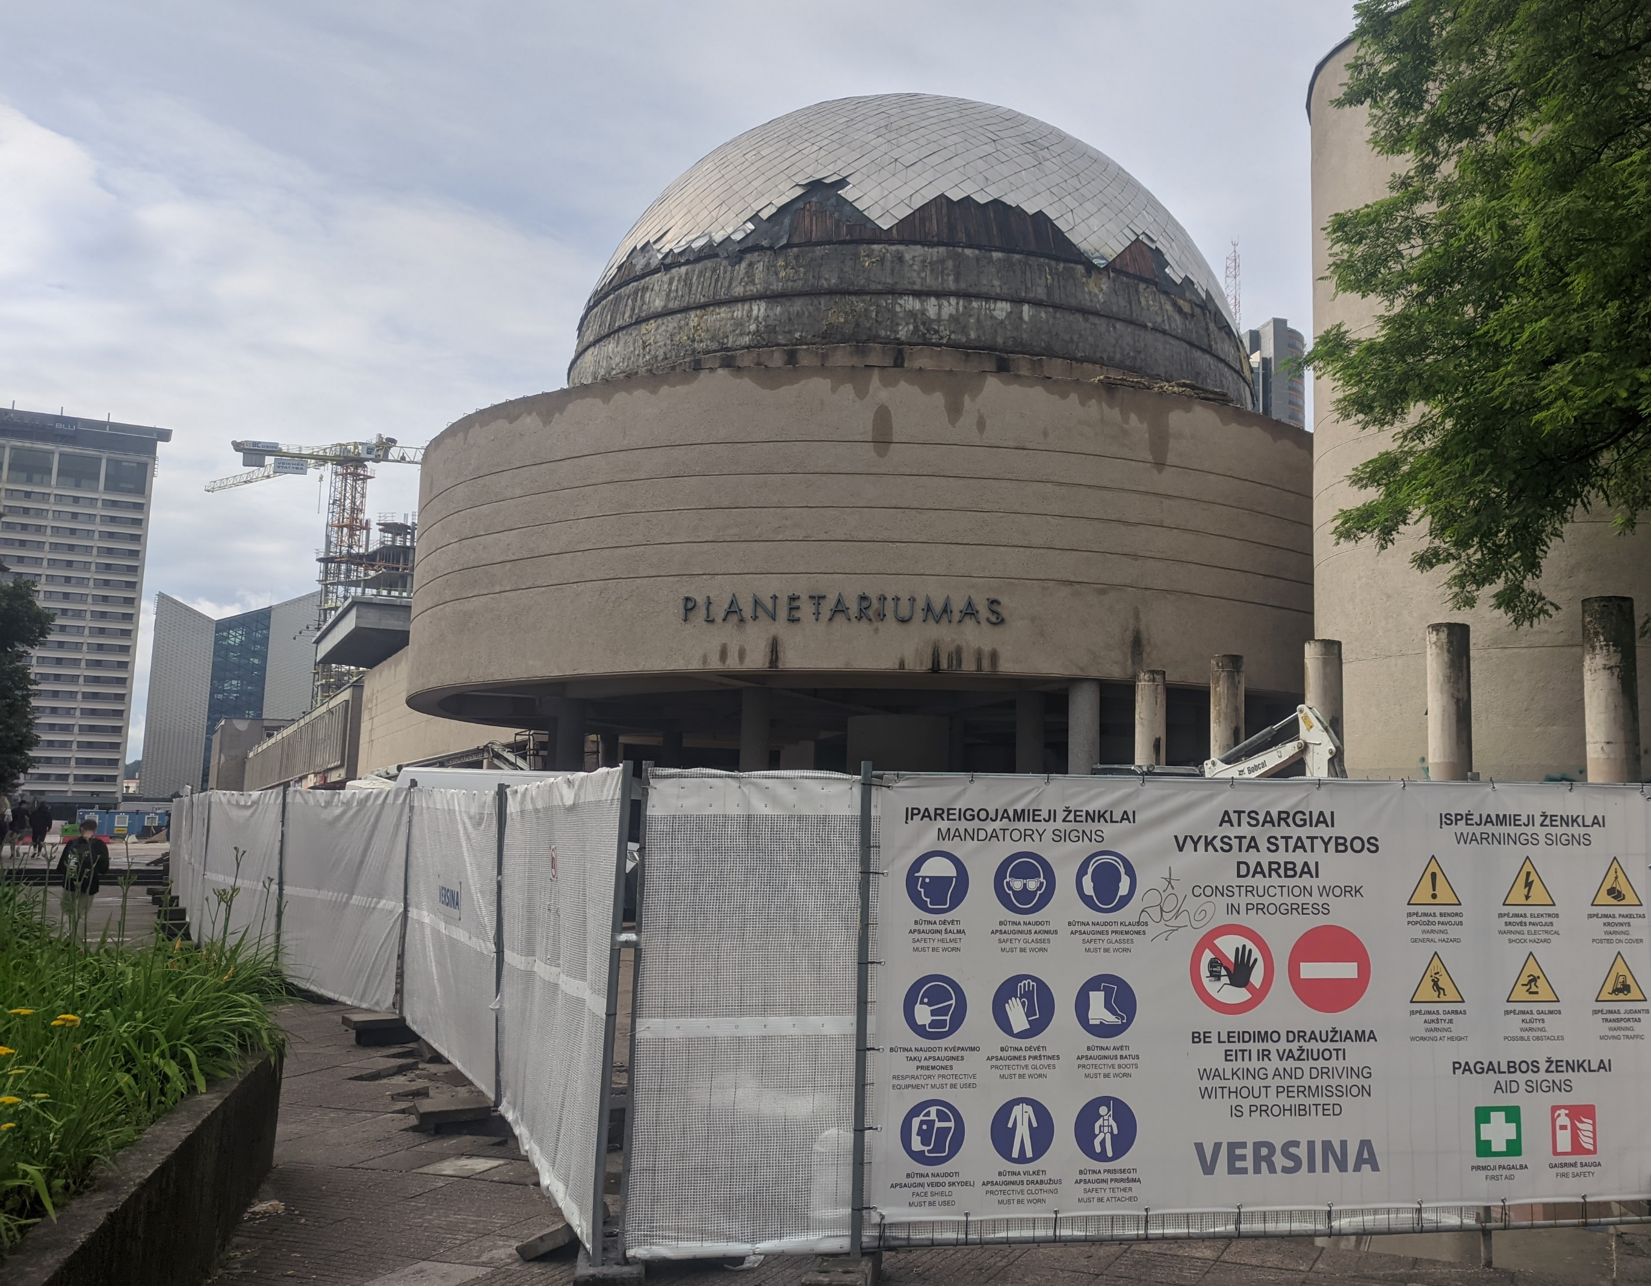



WHAT‘S INSIDE: Vilnius STEAM education centre
Opening:
2023 September
8 laboratories
Life sciences
Chemistry
Physics & astronomy
Engineering
Visual programming
Mobile technologies
Light technologies
FabLAB
+ Star dome (planetarium)
Notes:
Veiklos modelis:

Slide 6
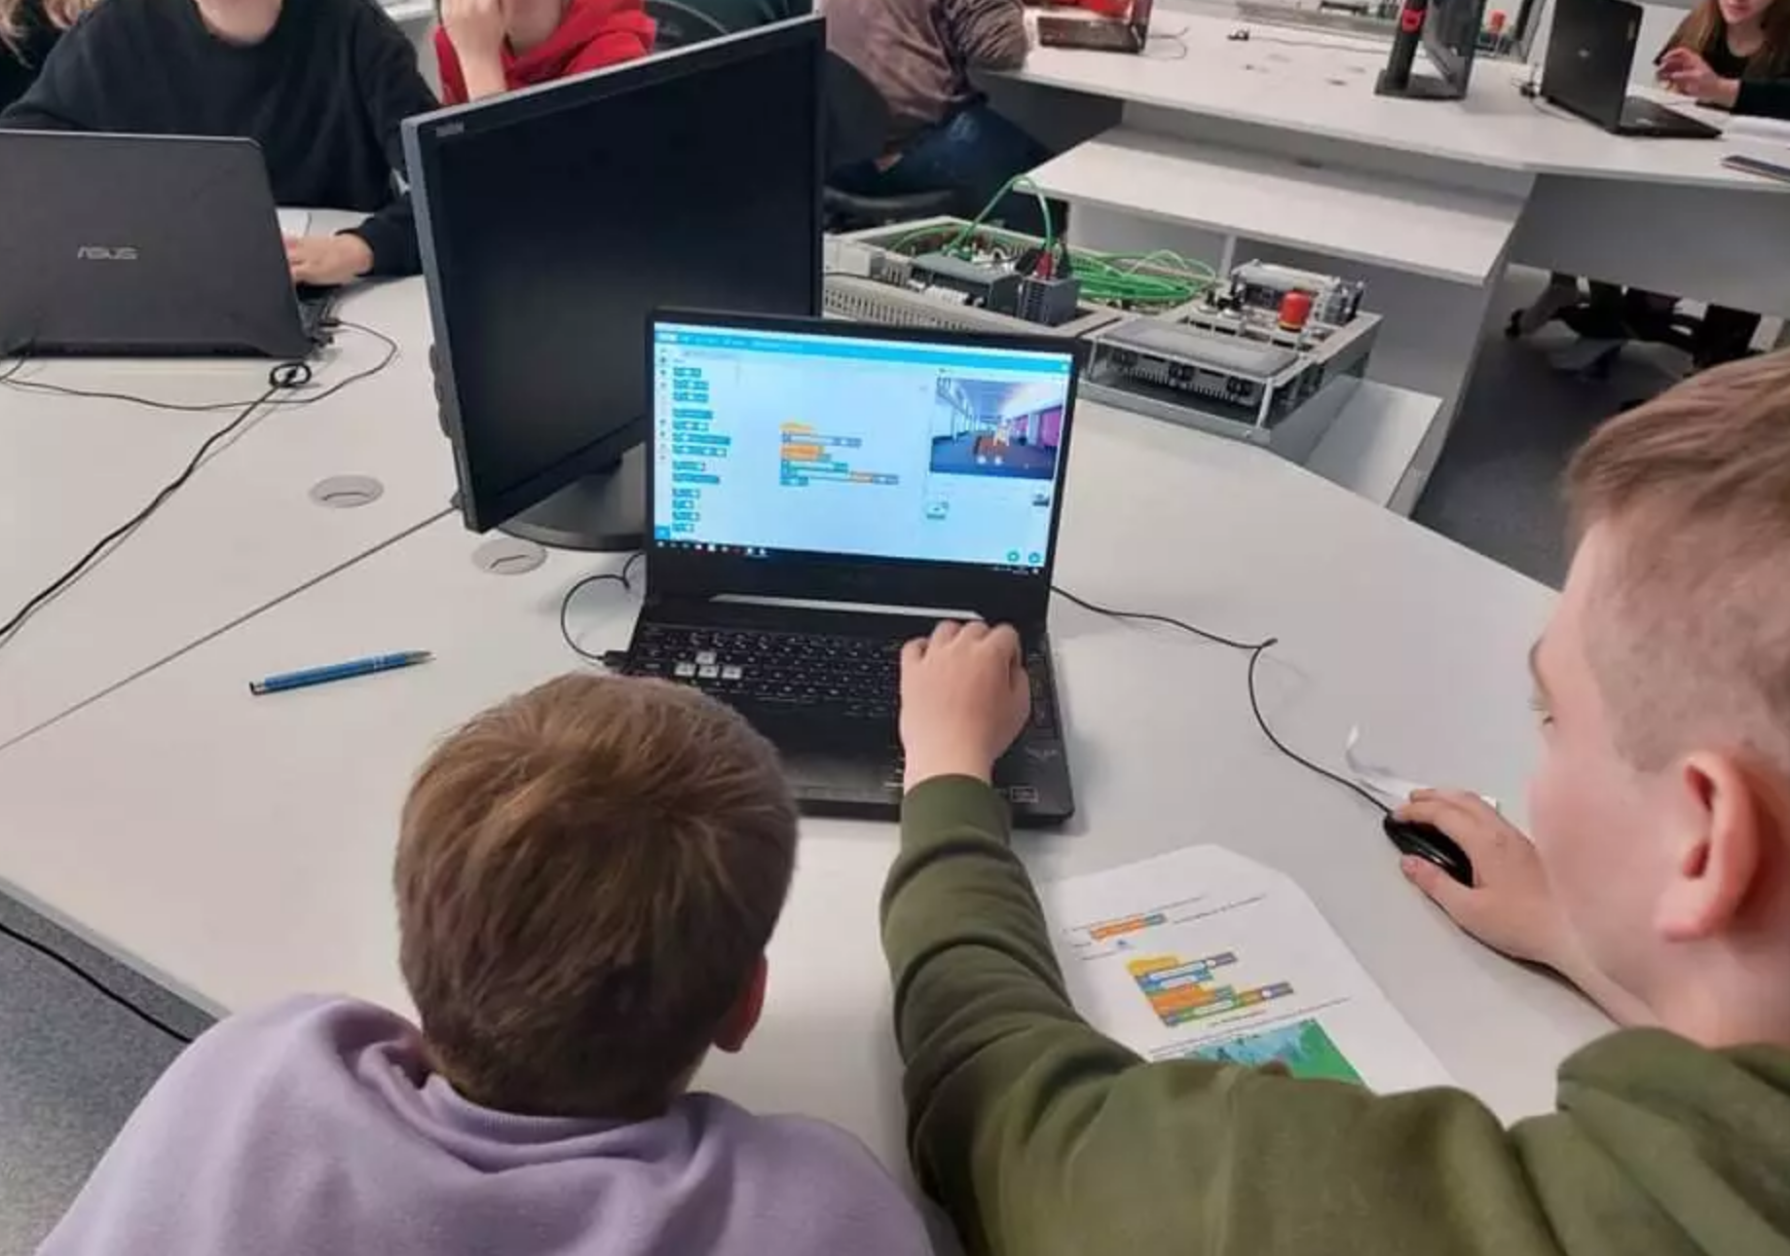
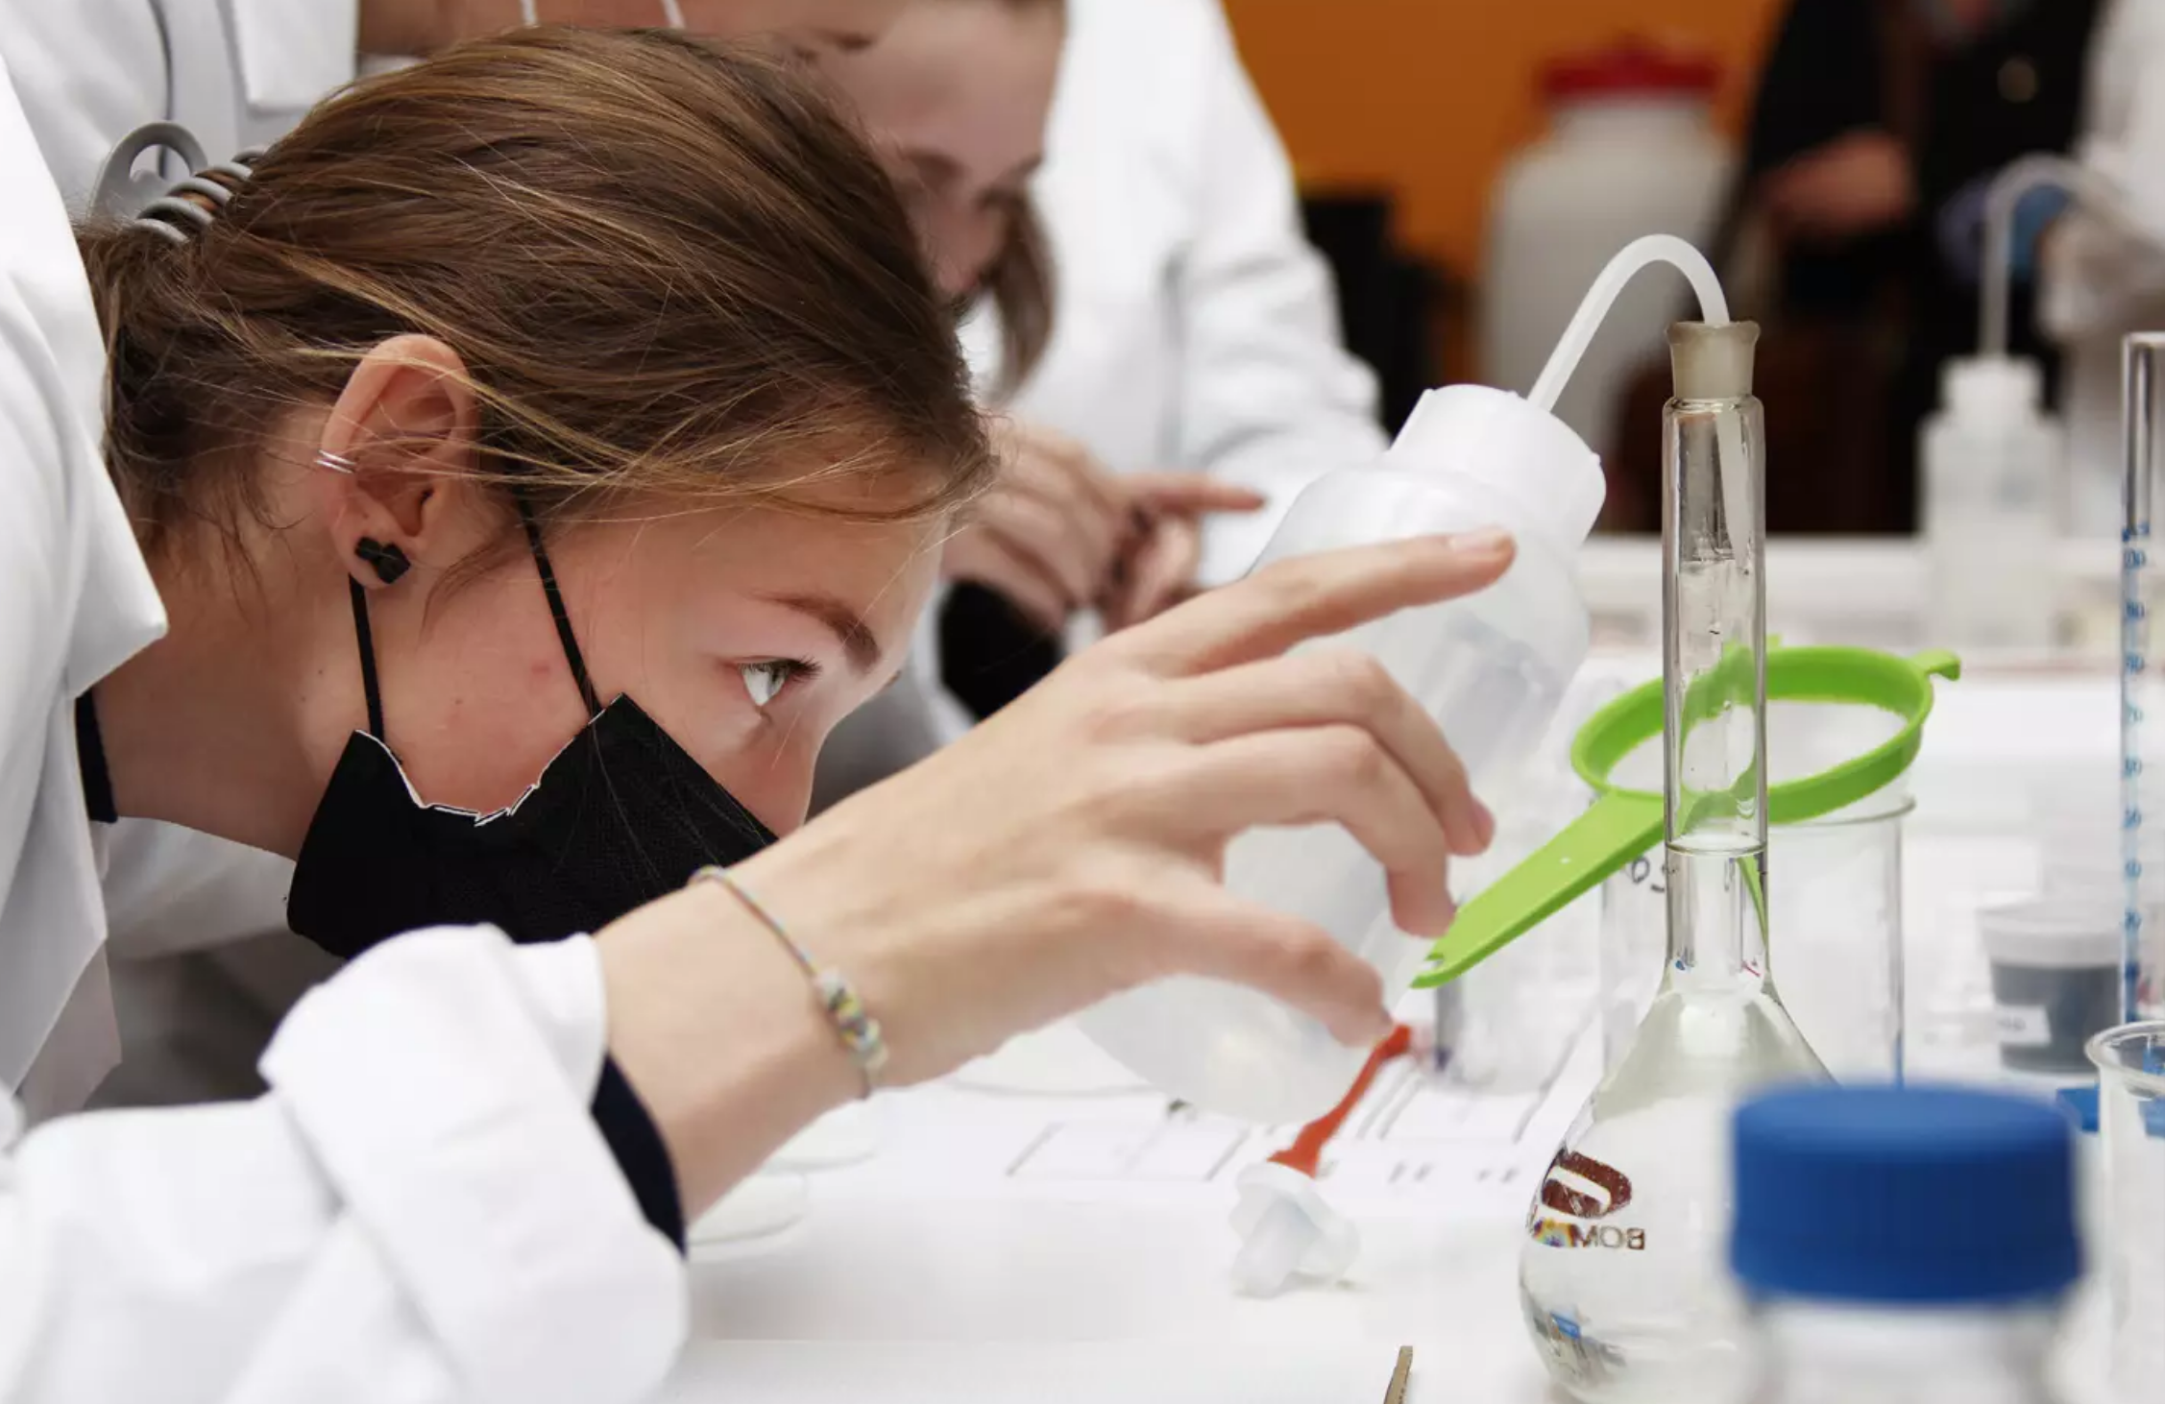
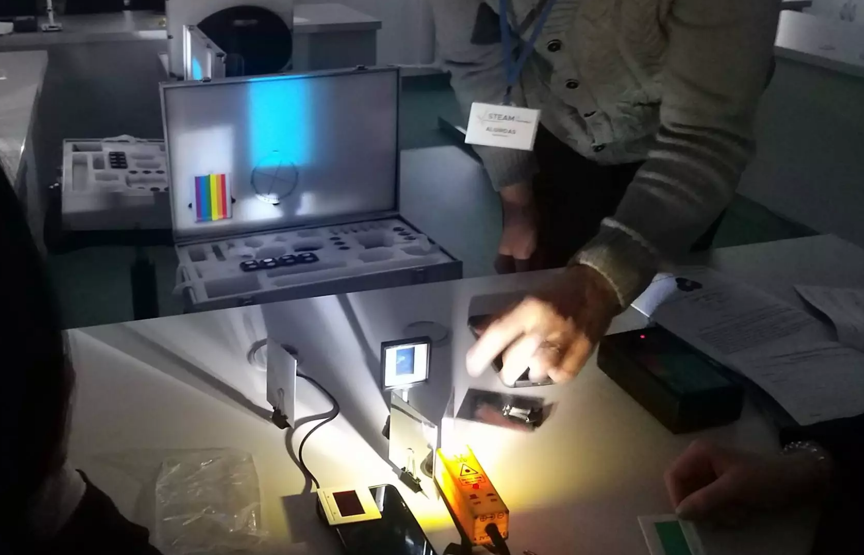
HOW?: Functional model (activities with students)
Laboratory:
15-16 seats
Formal education hands-on activities
7-12 grade (12-18 y.) students,
1-3 hours/activity
conducted by Centre‘s STEAM educator
Class teacher is provided with a set of „before“ and „after“ activity guidelines/scenarios.
Morning & noon
2022 Q1-2 >6000 students
Informal (extracuricular) education (clubs) (K-12)
Afternoon
Individual projects (open access facitily)
[New format] Formal education supplementary programs
9-12 grade (14-18 y.) students, 4 y. program
6 hours/week (888 hrs total)
Specialisation, graduation project

Slide 7
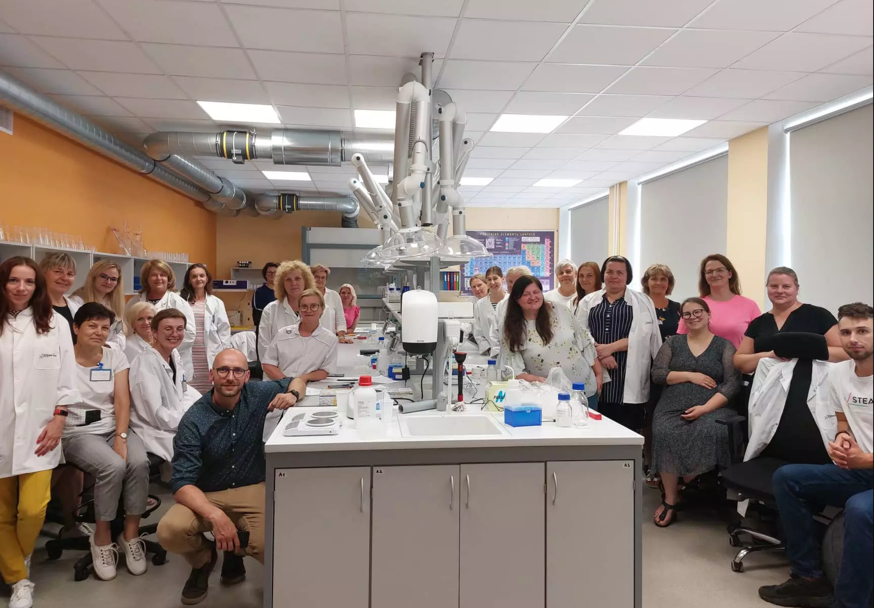
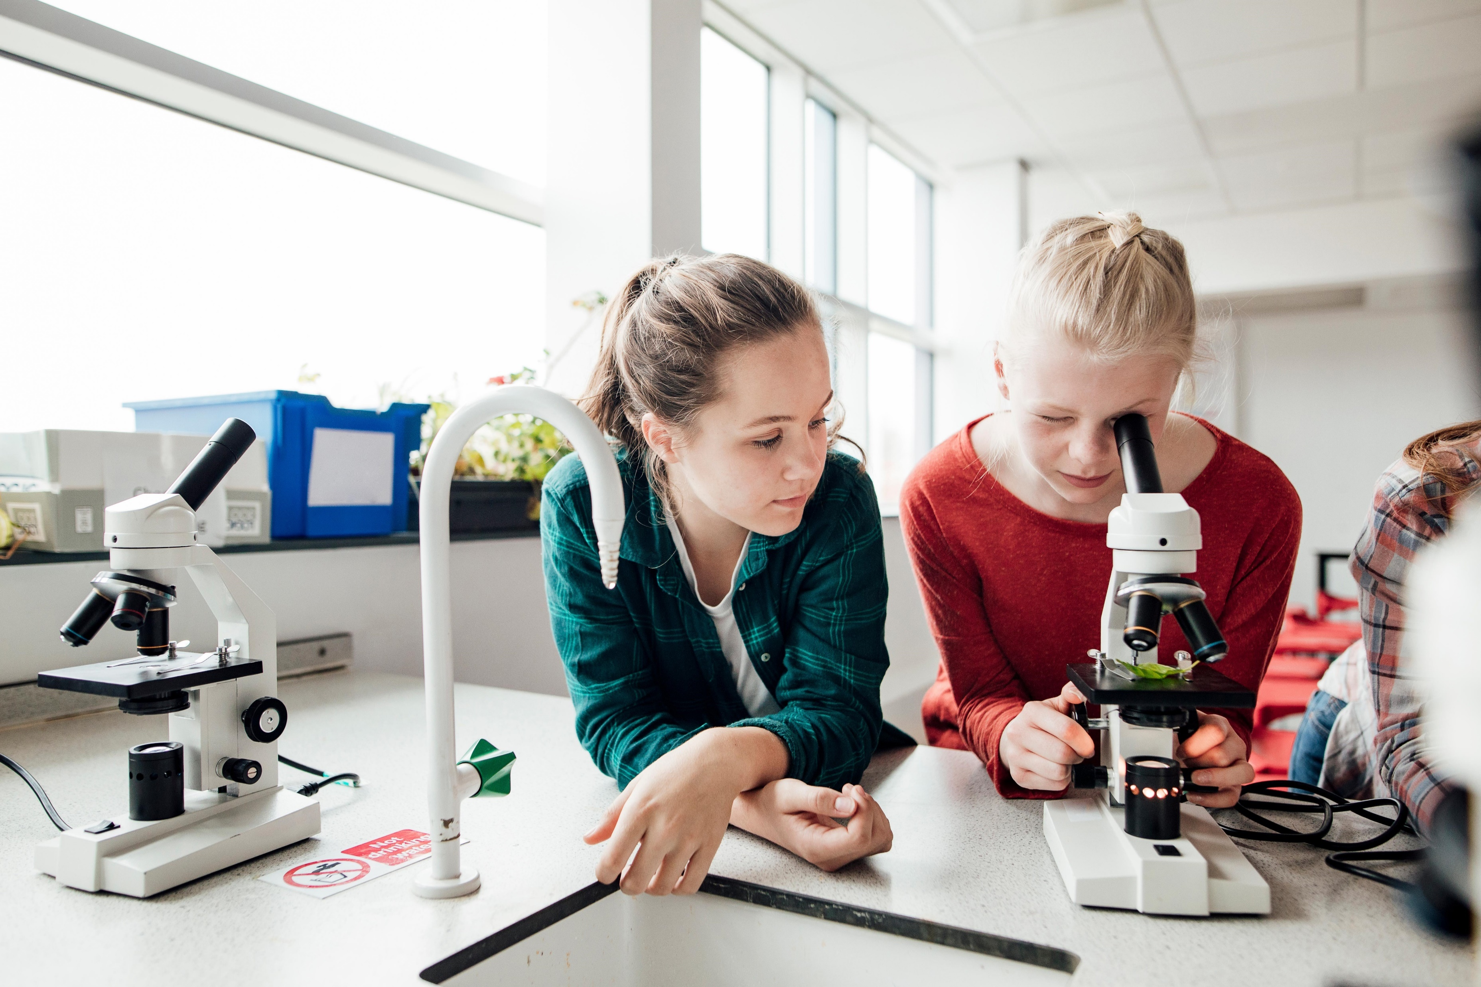
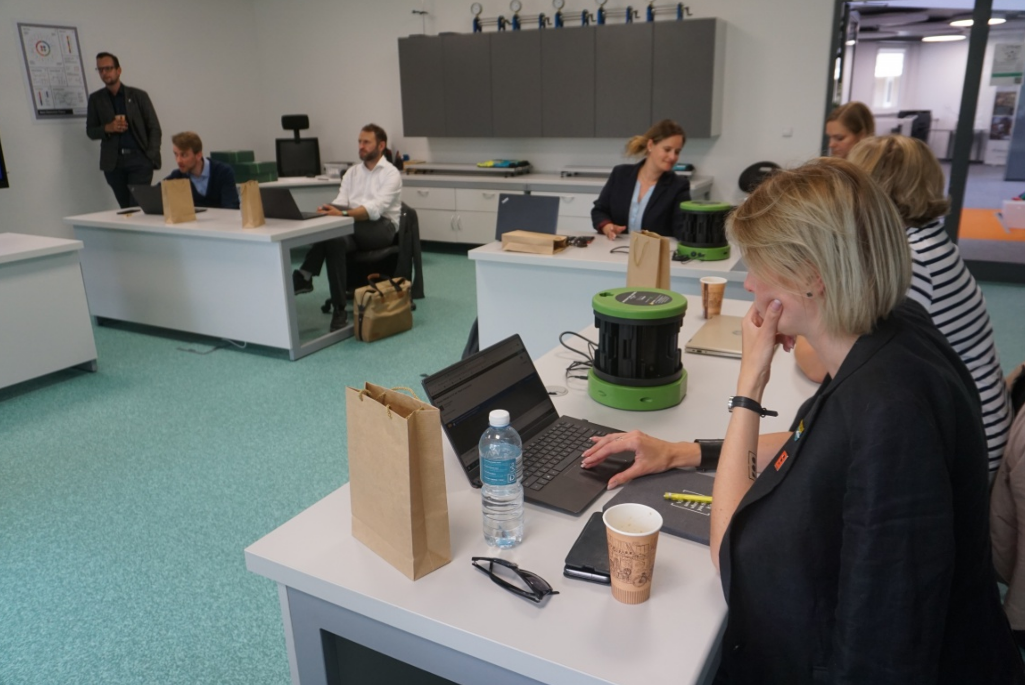
HOW?: Functional model (other activities)
TEACHERS
SCHOOL COMMUNITIES
LOCAL (out of school) COMMUNITIES
Qualification development courses
Consultations for equipment & facilities development
Non-formal education for adults
Online & phone helpline for STEAM-related activities
Conferences, completitions, other outreach activities
Mobile STEAM packs
STEAMbassaror programme to become a change-maker in your community
Partnership facilitation:
FabLAB-Science LAB dialogue, Industry-School connection
Infrastructural and organisational platfom for partners‘ outreach activities

Slide 8
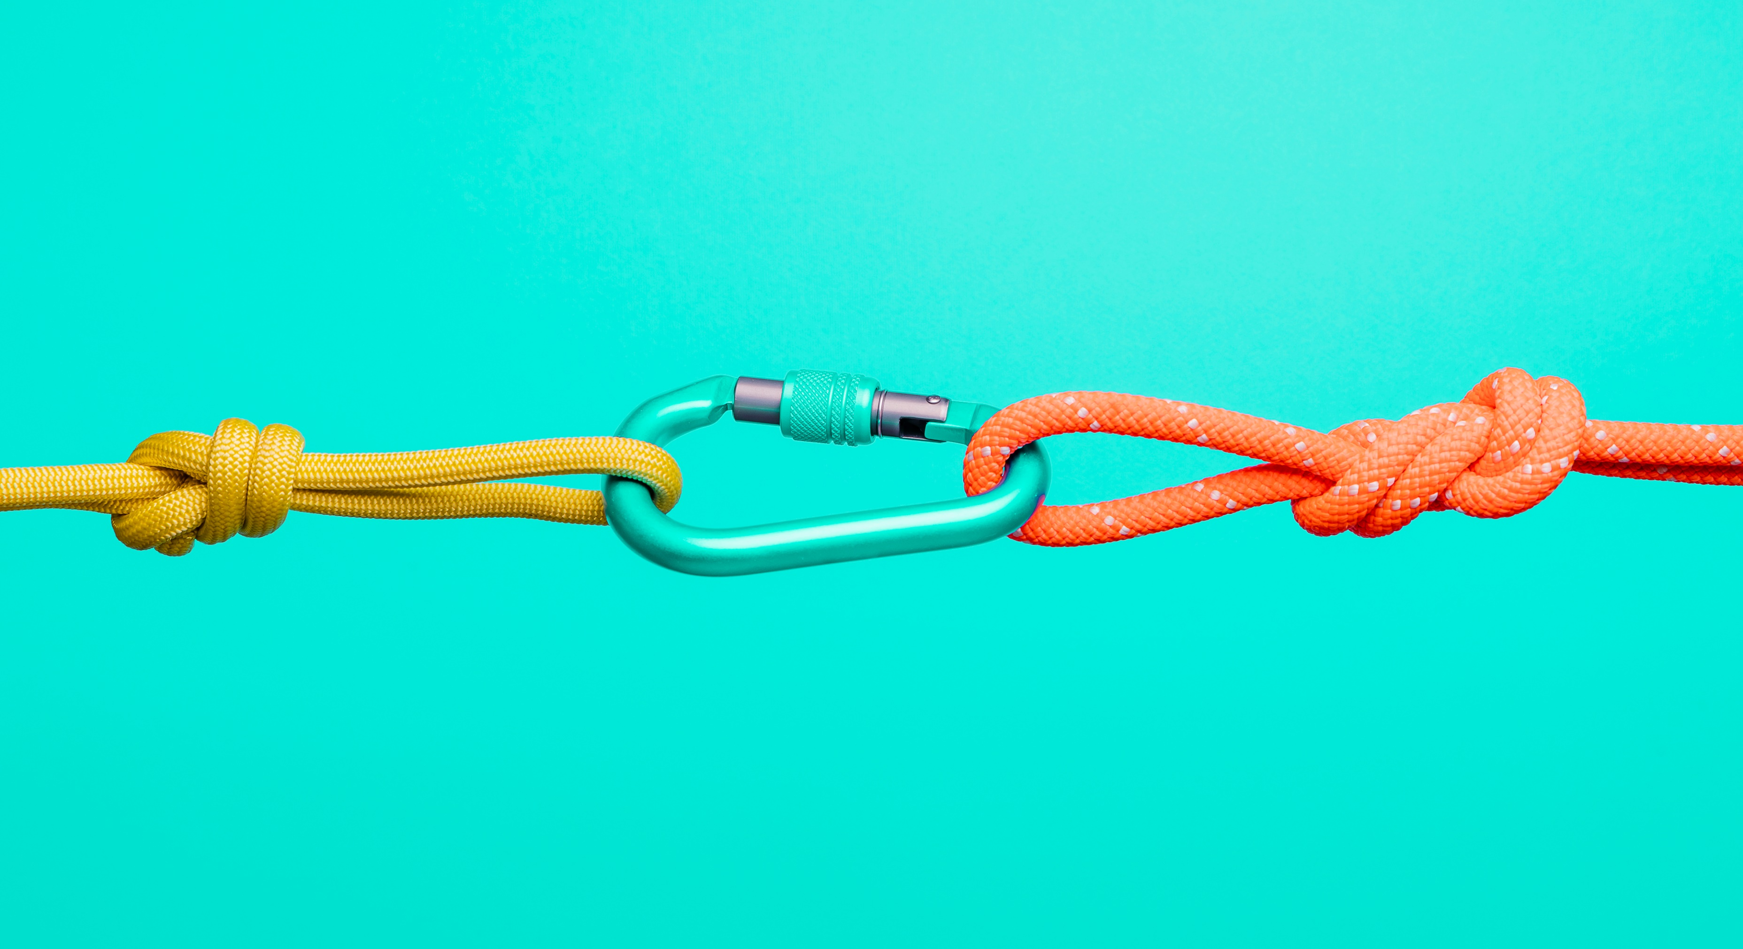

Platform for collaboration
Creative
problem-solving oriented education
Open-access & broad outreach
Inclusive partnership for outreach activities

Slide 9
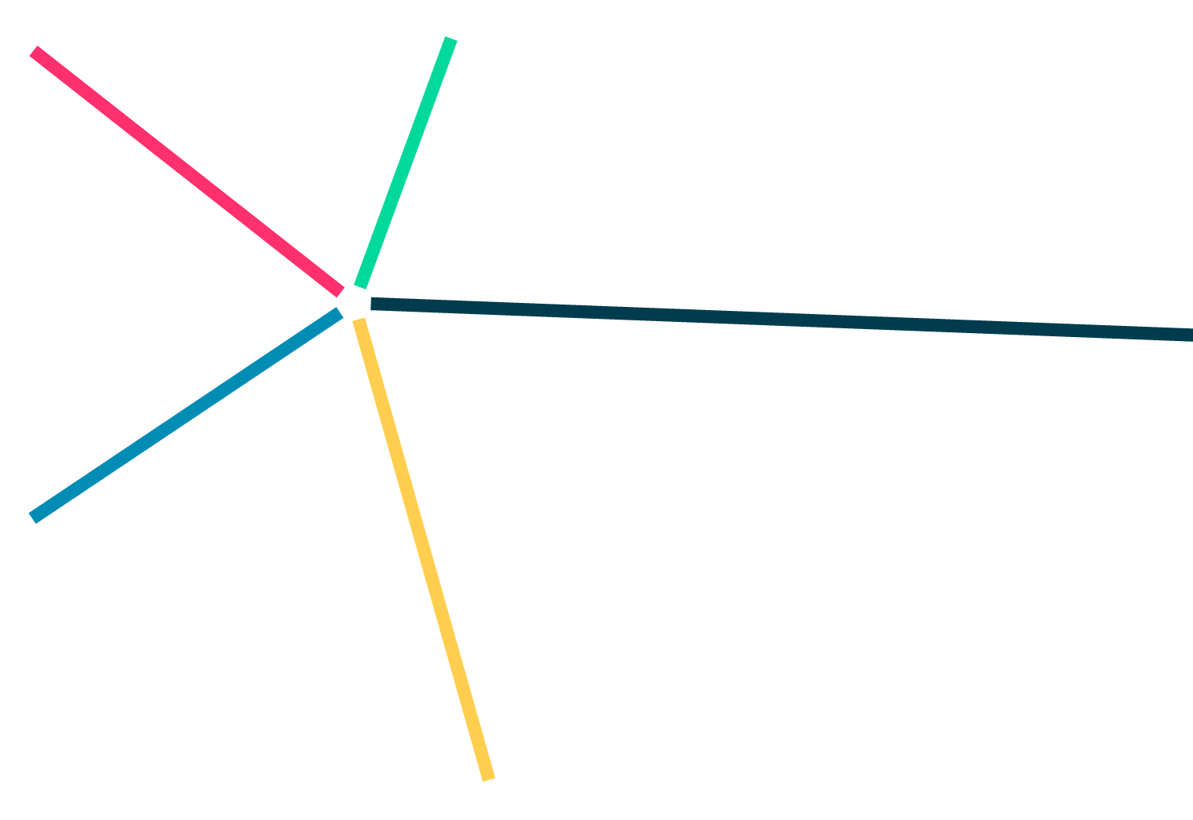
Thank you!
Paulius L. Tamošiūnas, PhD
Vilnius STEAM Centre,
Vilnius University
vilnius@steamlt.lt
https://steamlt.lt

