Slide 1


CERN CMS TIER2 Latvia project
Jānis Irbe janis.irbe@rtu.lv

Slide 2
The goal
Unite high-performance computing resources from multiple academic institutions in a federated HPC resource pool for efficient processing of CERN CMS TIER II workloads.
Jānis Irbe janis.irbe@rtu.lv

Slide 3
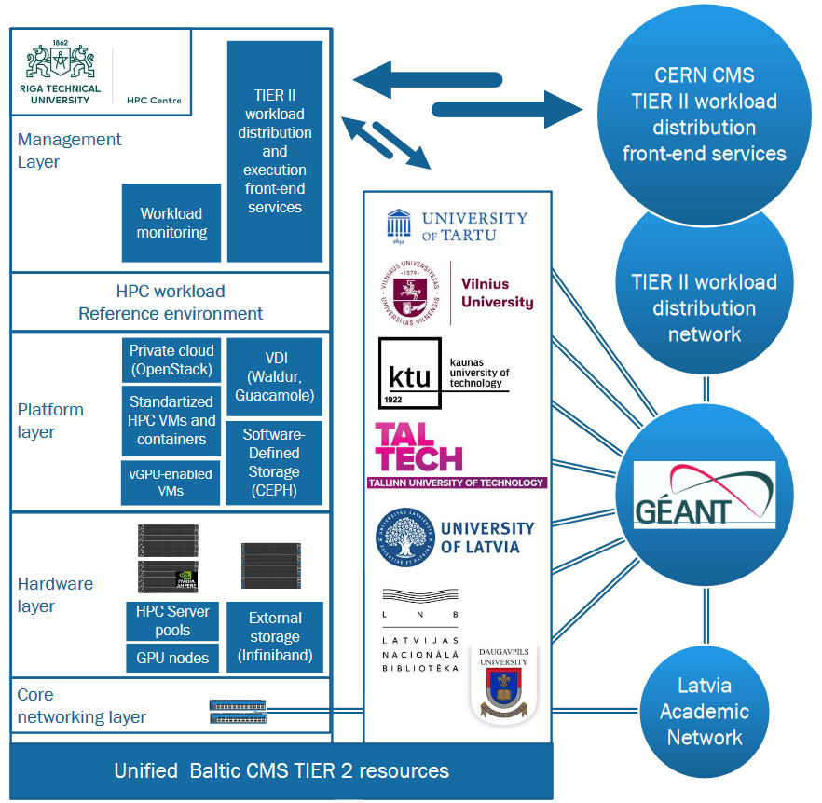



A federated
HPC Cloud architecture

Slide 4
Objectives
Unite HPC resources
Collaboration partners
Identify and unite the High Performance computing (HPC) resources and competencies of academic institutions
Leading partner - RTU High Energy and Accelerator Technology Center.
Expand the Latvian CERN CMS Tier II federated cloud infrastructure created in the pilot project connecting with the CERN CMS infrastructure through the GEANT network.
Latvian partners: University of Latvia, National Library of Latvia, Rēzekne Technology Academy and Ventspils Radio Astronomy Center.
Involving possible Baltic group partners form Estonia and Lithuania: Kaunas Technical University, University of Tartu, Vilnius University, TALTECH.
Industry partners
Jānis Irbe janis.irbe@rtu.lv

Slide 5
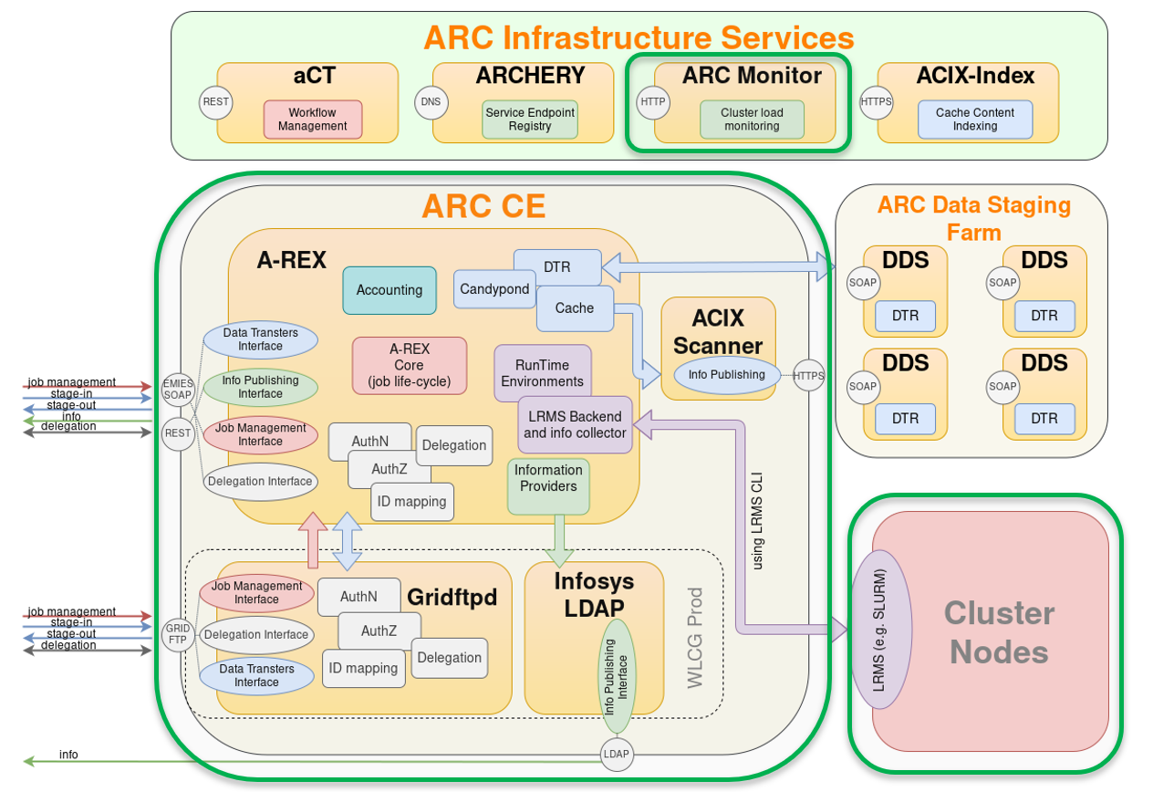
Integration services architecture
Already Tested Modules

Slide 6
Services architecture
ARC-CE and ARC-REX
Monitoring
ARC-CE (v.6) running on separate VM was implemented and tested for job submitting using test user certificates
ARC Information System provides web-based Grid Monitor with user-friendly overview of all cluster(s) resources and current jobs
A-REX (ARC Resource-coupled EXecution service) and gridftpd service now is ready for job submitting and fetching.
Jānis Irbe janis.irbe@rtu.lv

Slide 7
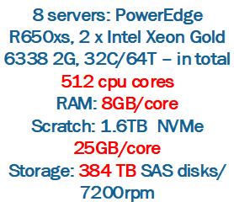
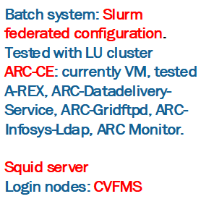
Initial setup to meet TIER II requirements

Slide 8
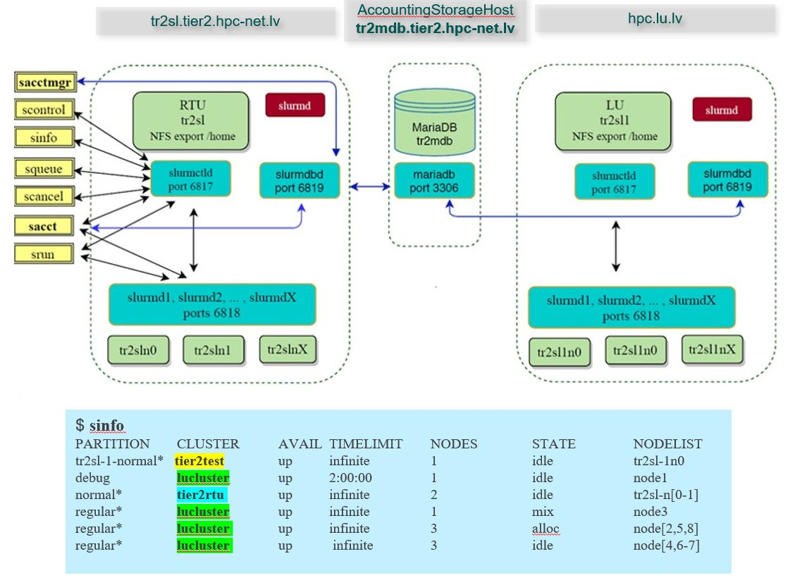
Workload management: clustered model

Slide 9
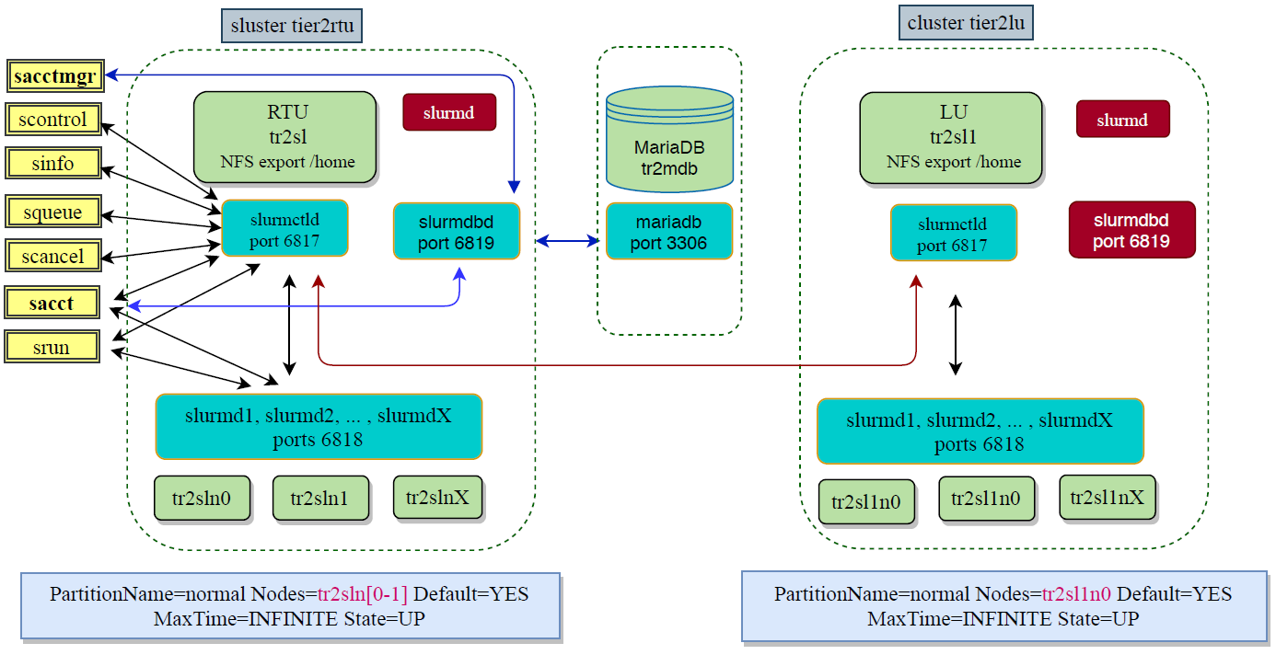
Workload management: federated clusters model

Slide 10


Partner involvement
Joint development of unified cross-border TIER II architecture
Pledging HPC resources for Baltic TIER II to become part of federated cloud
Growing into Baltics HPC GRID with aim to provide HPC services to our govenments and industries
Centralized IT operations to maintain continuous workload execution
Developing tight collaboration with CERN via joint research activities in Computer Science field
Jānis Irbe janis.irbe@rtu.lv

Slide 11
Thank you!
Jānis Irbe janis.irbe@rtu.lv

