Slide 1
The Very-Low Energy Neutrino Factory
physics with a μ storage ring
Alan Bross

Slide 2

VLENF
Experimental Motivation
We have a collection of hints of something…
  LSND:
  MiniBooNE:
  MiniBooNE:
    Low E_{ν} excess
  Reactor flux anomaly
  MINOS: ν_{μ} vs.
Cross-section measurements
  μ storage ring presents only way to measure ν_{μ} & ν_{e} ( ) x-sections in same experiment

Slide 3
SBNW11
Short-Baseline Neutrino Workshop
From Richard Van de Water’s SBNW summary
  There are a smorgasbord of experimental hints that point to possible new physics.
    “Not a single piece of evidence that directly contradicts LSND/MiniBooNE”.
    Much circumstantial experimental evidence that supports LSND/MB from MeV to GeV range. Karmen and ν_{μ} disappearance provides some restriction.
  Need to make smoking gun measurement.
    Need to make a >5 σ measurement at L/E ~1 to convince the community.
    Need to measure neutrino properties to the ~ 1 percent level.
    Need sufficient Rate = Flux x Cross Section x detector response
Can an experiment utilizing ν from a μ storage ring provide this “Smoking Gun?”

Slide 4
Possibilities with μ storage ring
Oscillation Physics @ L/E = 1
  Appearance experiment with low background
    A different approach to explore the LSND/MiniBooNE result
ν disappearance experiment with 1% precision (10⁴ events)
  An experiment that uses a ν_{e} beam from a muon storage ring can go a long way in ruling out sterile νs
  ν_{μ} disappearance (@ short baseline) also
In addition, the beam opens up opportunities for
  Detailed study of ν interactions
    Known ν beam flux and flavor composition
    Only way to get large sample of ν_{e} interactions

Slide 5
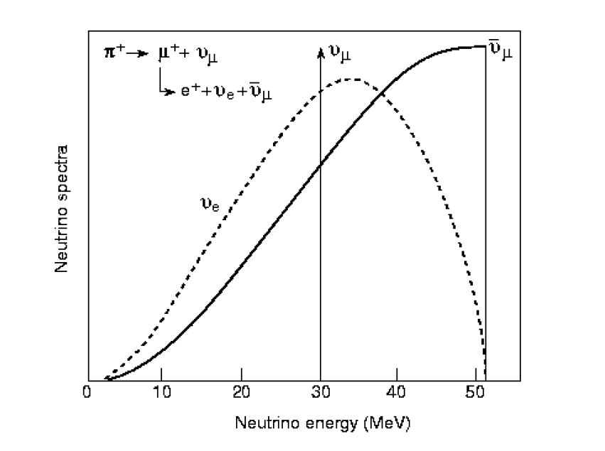
νs from muon decay
Running with μ⁻
Well defined flavor composition & energy

Slide 6
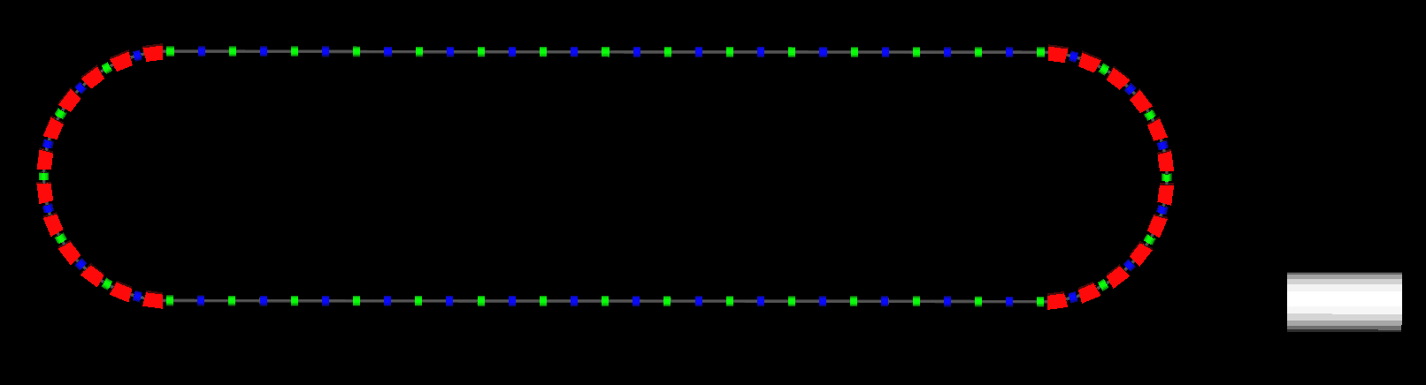
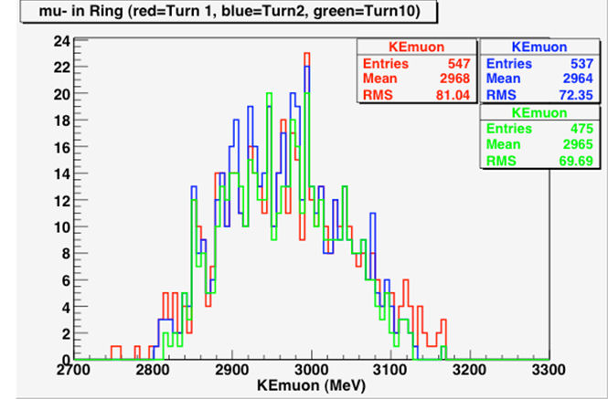
Status of the concept
G4Beamline Simulation
Tom Roberts
Muons Inc.
8 GeV protons on 2 λ_{I} Be target
3 GeV Racetrack ring (M. Popovic)
  For now, injection is perfect
    Not defined
Tuned for μ⁻ with KE = 3.000 GeV
  3 GeV chosen primarily for x-section meas.
  δp/p ≈ 2%
Detectors (scintillator)
  Near: 200T @ 20 m
  Far: 800T @ 600 - 1000 m

Slide 7
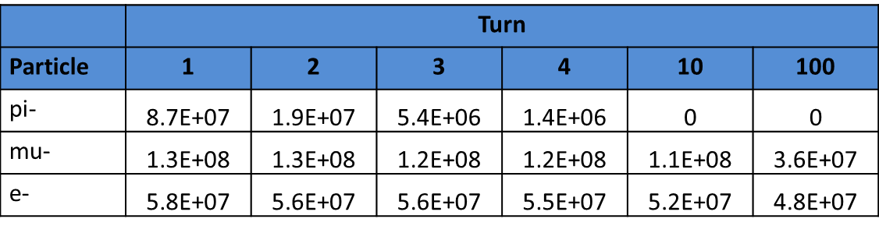
Circulating μ⁻ beam flux
Particle count scaled to 10¹² POT
Figure of Merit: ≈ 1.1 X 10⁻⁴ stored μ/POT
  After all π gone
Note: Based on experience at proton machines, this beam (flux and beam size) can be monitored with 0.1% precision with existing technology BCTs (according to the experts).

Slide 8
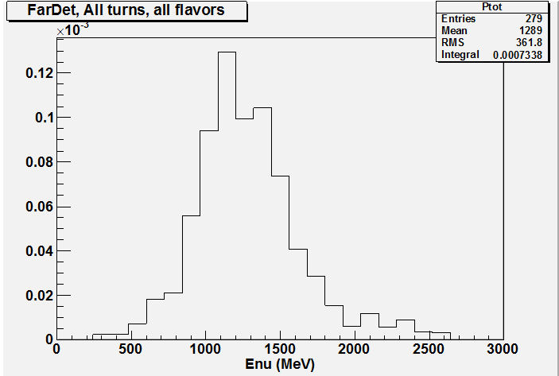
Estimated event rates
Far Detector
ν_{μ} Events per 10²¹ POT (turns 10 & up)
  Near: 1.3 X 10⁵ (200T)
  Far: 0.7 X 10⁴ (800T)
Note: Still having some “issues”
with E_{ν} flux shape

Slide 9
Detector Considerations
Far detector (Large Δm² oscillation physics)
  Magnetized totally active scintillator detector - ideal
  Magnetized Fe (MIND) possible?
    Depends on performance for P_{μ} < 1 GeV/c
  LAr also possible
    But magnetization raises fundamental problem: PMTs used for trigger (Ar scintillation)
    Some R&D on alternate approaches to the scintillation light readout being explored
      WLS bars (might allow for PMTs outside field region?)
      WLS fiber + SiPM readout
  Near detector
    More options, but must be totally active
      TASD (need not be magnetized, but is an advantage)
      LAr (μBooNE, already has made case for X-section meas. in MB line)

Slide 10
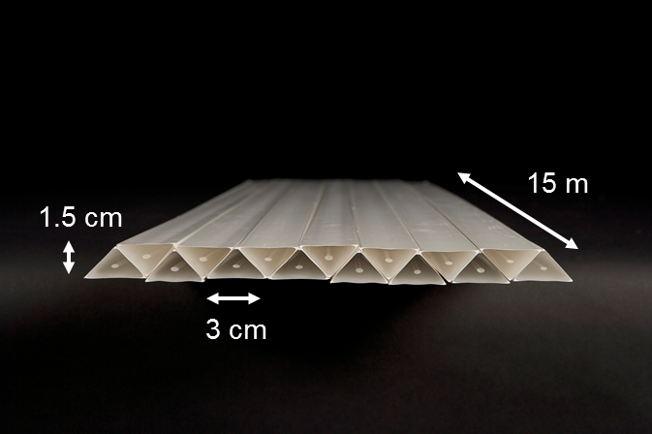
Totally Active Scintillator Detector
Simulation of a Totally Active Scintillating Detector (TASD) using Noνa and Minerνa concepts with Geant4 has been completed
  Momenta between 100 MeV/c to 15 GeV/c
  Magnetic field considered: 0.5 T
  Reconstructed position resolution ~ 4.5 mm

Slide 11
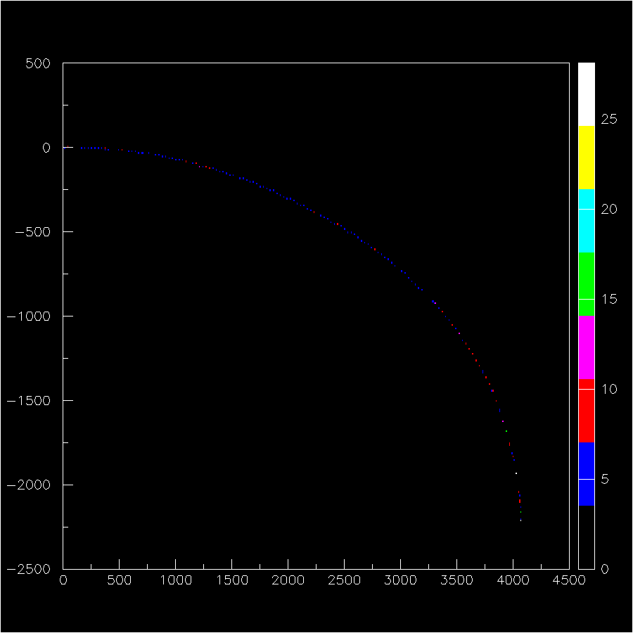
1 GeV μ track in TASD
Y(mm)
Y (bend plane) vs Z
B=0.5T
Z(mm)

Slide 12
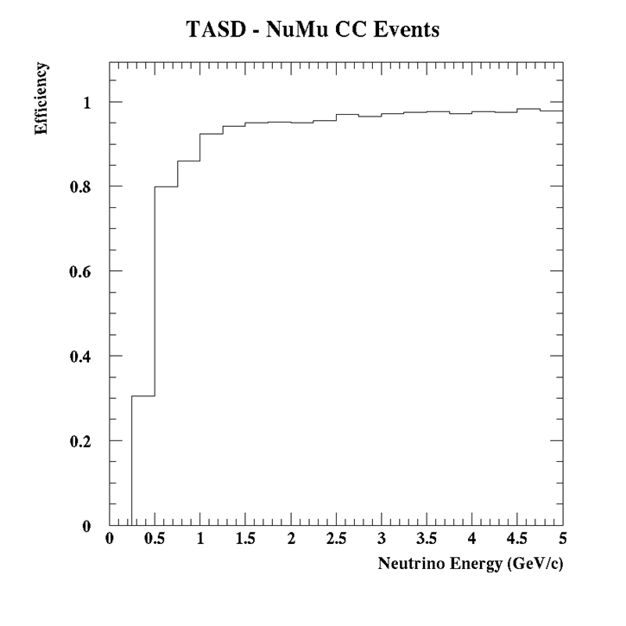
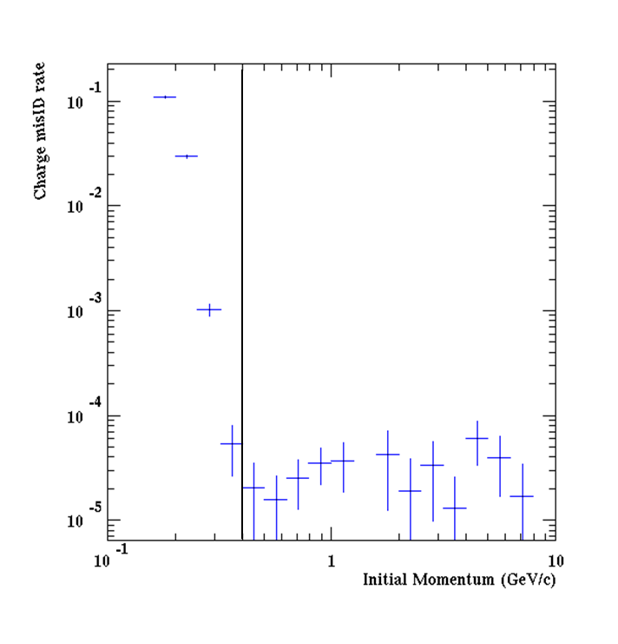
TASD Performance
In region of interest
≈ 5 X 10⁻⁵
ν Event Reconstruction Efficiency
Muon charge mis-ID rate

Slide 13
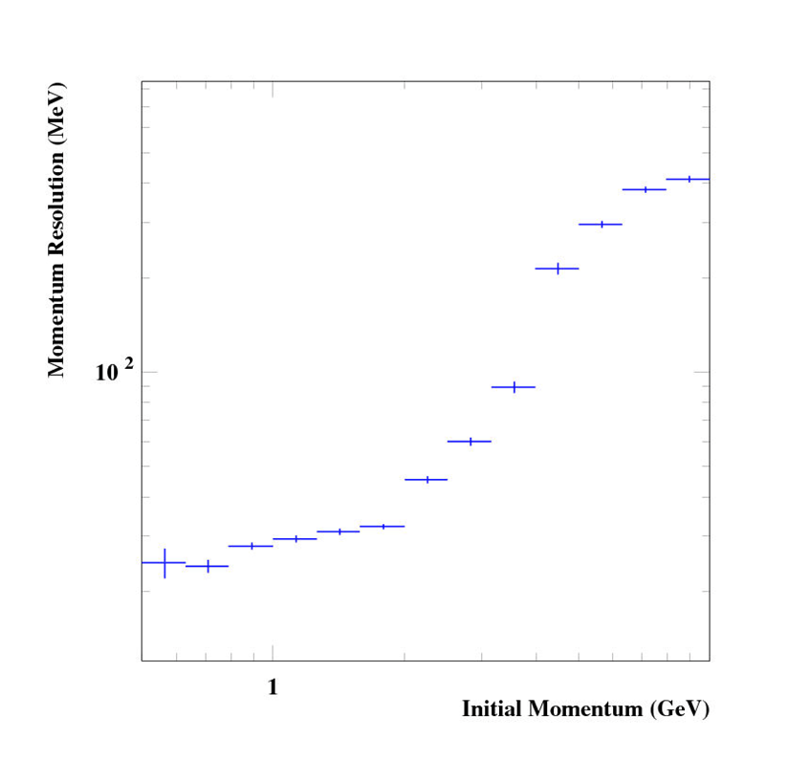
TASD Performance II
Momentum resolution excellent
  Neutrino Event energy reconstruction from tracking
  EM component from hit counting – possibly
  Expect ν event E^{ν}_{res} of ≈ 5%
    From tracking resolution & calorimetry studies

Slide 14
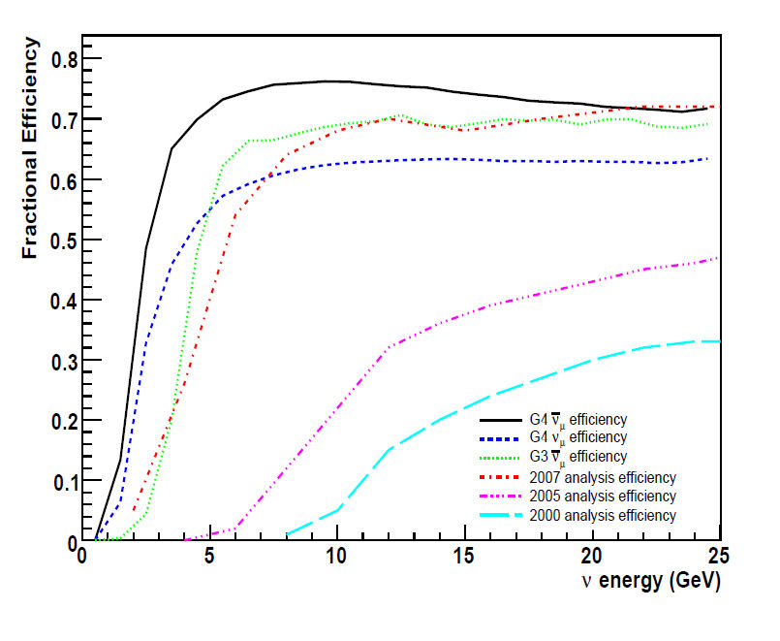
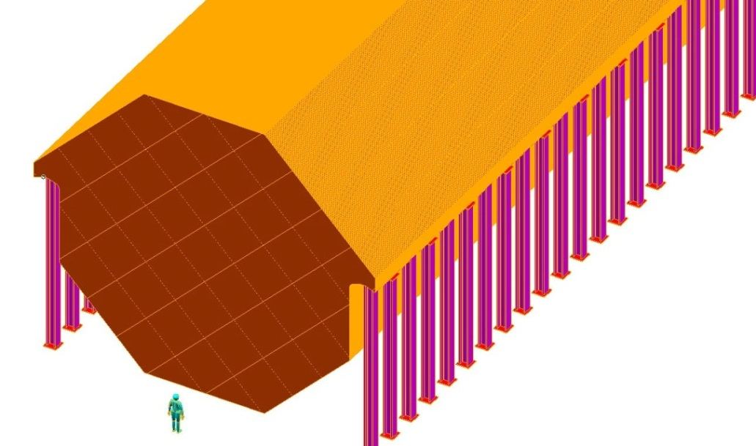
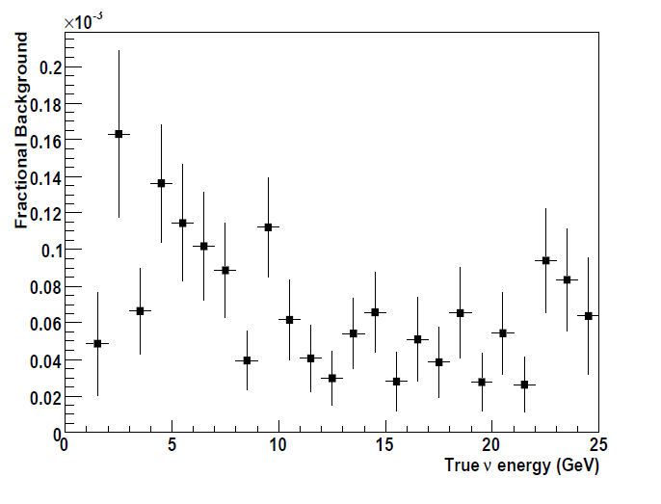
Magnetized Iron Neutrino Detector (MIND)
Re-Optimize for lower energy?
10⁻³
MIND was optimized for the “Golden” channel at the NF (25 GeV μ storage ring)
Optimization for FD for L/E ≈ 1
  Essentially Minos ND with upgrades
    Reduce plate thickness
    100kA-turn excitation (SCTL)
    XY readout between planes

Slide 15
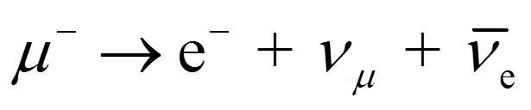
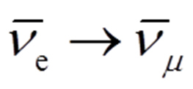
L/E ≈ 1 Oscillation reach
Oscillation signal:
  μ⁺ in detector “NF Golden Channel”
Why is this potentially so Powerful?
  μ charge mis-ID rate 5 X 10⁻⁵ (TASD)
  Res, DIS and NC background very small
  CR bkg eliminated with μ veto
    2nd and 3rd need detailed simulation

Slide 16
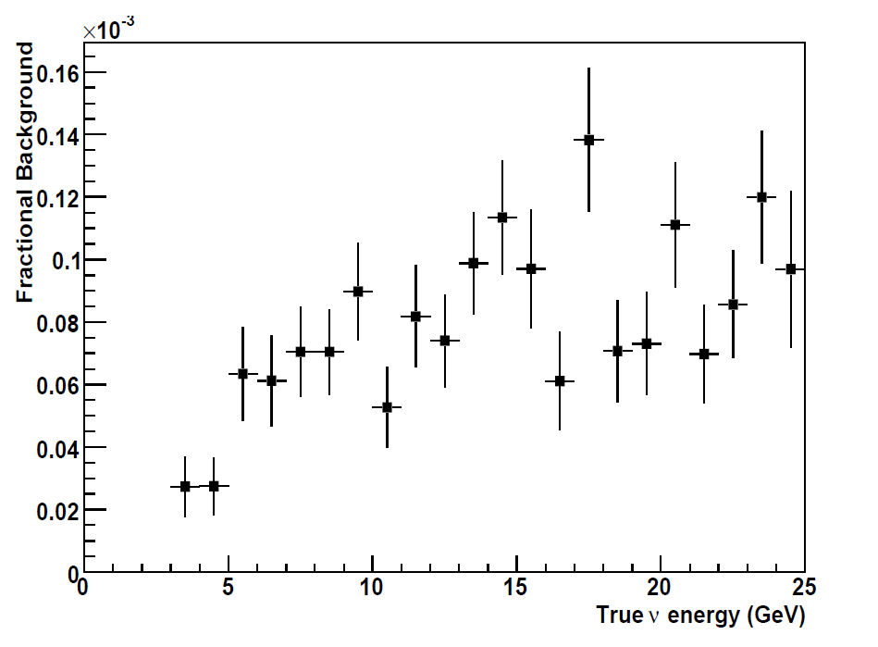
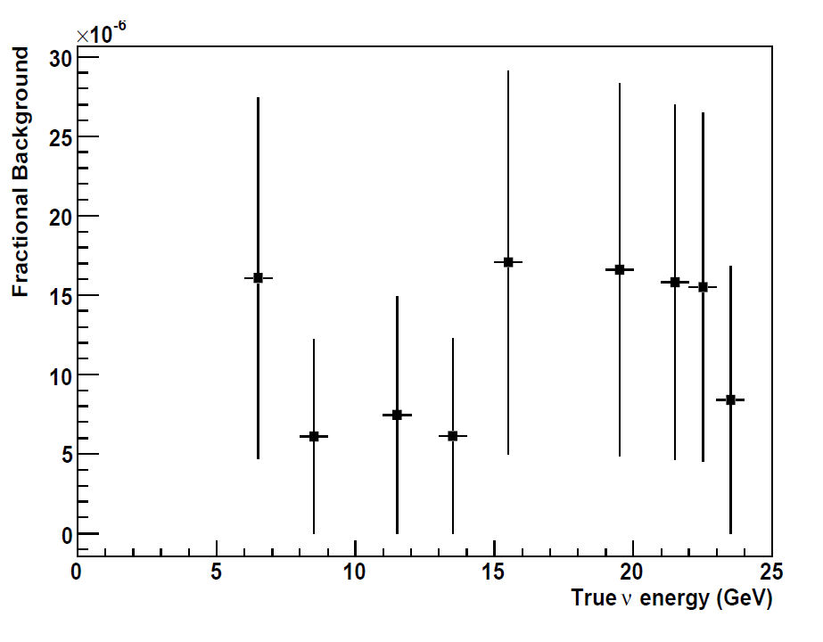
MIND analysis
IDS-NF IDR
Andrew Laing
Glasgow
10⁻³
10⁻⁶
NC background rate
ν_{e} background rate

Slide 17
L/E ≈ 1 Oscillation reach
Numerology
Note: this calc. takes mean values
Signal vs. Background
  N_{sig} (assuming 0.3% oscillation P)=3X10⁻³X4X10³X0.9 = 11
  N_{Bkg} = 7X10³X5X10⁻⁵ = 0.35 (μ charge mis-ID)
  + 0.1 evt (estimate of NC background) = 0.5
E_{μ}^{stored} optimized for oscillation search will improve on these values
Obviously requires full MC simulation, but so far, the indication is that this is a >> 5σ measurement @ the MiniBooNE best-fit value

Slide 18
ν_{e,} ν_{μ} disappearance
Again, 1kT of detector
  200T Near
  800T Far
10²¹ POT exposure (μ⁺)
  Number of ν_{e} events (CC):
    N_{evts-near} ≈ 200,000
    N_{evts-far} ≈ 11,000
  Number of ν_{μ} events (CC):
    Nevts-near ≈ 100,000
    Nevts-far ≈ 5,500
Near benchmark of 10⁴ events in Far detector
Following up on Bob Svoboda’s comment this morning
  “NC disappearance provides very strong case for new physics”
    Also possible with correct detector choices

Slide 19
Cross-section measurements
Gaining a better understanding of x-sections beneficial to future LB expts.
  The energy range of interest is roughly 1-3 GeV
    Some tension here w/r to ideal E_{μ}^{stored} for oscillation experiment
μ storage ring provides only way to get large sample of ν_{e} and ν_{e} interactions
Nuclear effects are important (Short-range correlations, Final-state interactions).
  Important detector implications
Measurements on nuclear targets important
  H₂, C, D₂, Ar, Fe?
LBNE
# of ν_{e} signal evts
Sin²2θ₁₃=0.06, NH, δ=0
200 kTon WC, 5 yrs, 700 kW
(M. Bass and B. Wilson)

Slide 20
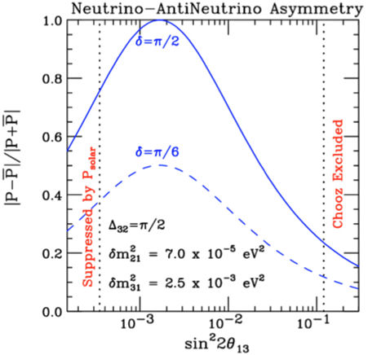
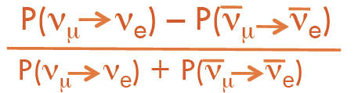
Cross-section measurements II ν_{e} & CP
S. Parke
Better data on ν_{e} and ν_{e}
Important (?) for CP δ_{CP}
measurements

Slide 21
Optimization of E_{μ}
There is some tension between optimizing for the L/E =1 oscillation physics and for the cross-section coverage
  For L/E =1, E_{ν}^{mean} ≈ .7-1.0 GeV is probably optimal
  For the cross-section measurements, we want to cover 0.5 < E_{ν} < 3.

Slide 22
Outlook
Much more work to be done
  Beamline
    Injection
      Need detailed design and simulation for targeting & injection
        Have first iteration on component layout
      Proton removal for + running
    Decay Ring optimization
      Continue study of existing design
      Alex Bogacz has preliminary design for ring with δp/p=5%
      Yoshi Mori considering FFAG racetrack
      ….?
  Detector simulation
    For oscillation studies much more detailed MC study of backgrounds & systematics
    For cross-section measurements need detector baseline design
      And then detailed MC as above

Slide 23
Outlook II
Start of staged program?
  With NF/MC front-end, could get ≈ a X1500 increase in flux
    0.15 μ/POT vs. 1.1 X 10⁻⁴
    Does require acceleration, however: linac + RLA
      Cooling possibly not needed (Factor of 2-3 reduction in μ/POT)
      RLA could be operated in “scanning” mode (dual-purpose: acceleration + decay ring)
        Variable ν energy (scan L/E without moving far detector)
        [First mentioned by Geer & Ankenbrandt in 1997 (Workshop on Physics at the First Muon Collider and at the Front End of the Muon Collider (AIP Conf Proc. 435)]
For 10²¹ POT, # ν_{e} events (low-power, 10-100kW):
    N_{evts-near} ≈ 2 X 10⁹
    N_{evts-far} ≈ 2 X 10⁷
And ProjX would open up the opportunity for much higher power on the target, however

Slide 24
Conclusions
Initial simulation work indicates that a L/E ≈ 1 oscillation experiment using a muon storage ring can “easily” reach a 5σ+ benchmark, it is just the “Golden Channel” after all
ν_{e} and ν_{μ} disappearance experiments delivering at the 1% level look to be doable
Cross section measurements at a 200T near detector offer a unique experimental opportunity
  The detector design is crucial (need not be magnetized)
    TASD
    LAr

Slide 25
Conclusions II
Doing measurements with a ν beam derived from a μ storage ring is both complementary to ongoing experiments and can be supportive to the next (next-to-next) round of experiments
The technology needed to produce this type of ν beam exists and has for some time
  David Neuffer was the first to describe (in detail) this type of experiment at the Telmark Wisconsin Neutrino Physics conference in 1980, and the technology needed to do it (beam) existed even then to a large degree
    First mention – CERN 1970’s? Anyone have the reference?
Finally, the general experimental program utilizing ultra-intense (cLFV, NF, MC) μ beams is compelling
  This is the first, very small step, towards that goal.

Slide 26
Acknowledgements
I want to thank all my colleagues who have been working on these concepts.
Chuck Ankenbrandt, Andrea Palounek, Alex Bogacz, Chris Tunnell, André de Gouvêa, Malcolm Ellis, Joachim Kopp, Ken Long, Kirk McDonald, Nikolai Mokhov, David Neuffer, Patrick Huber, Milorad Popovic, Stephen Brice, Steve Geer, Sergei Striganov, Tom Roberts
Please come join the Fun
https://indico.fnal.gov/categoryDisplay.py?categId=185

Slide 27
Thank You

Slide 28
Back up Slides

Slide 29
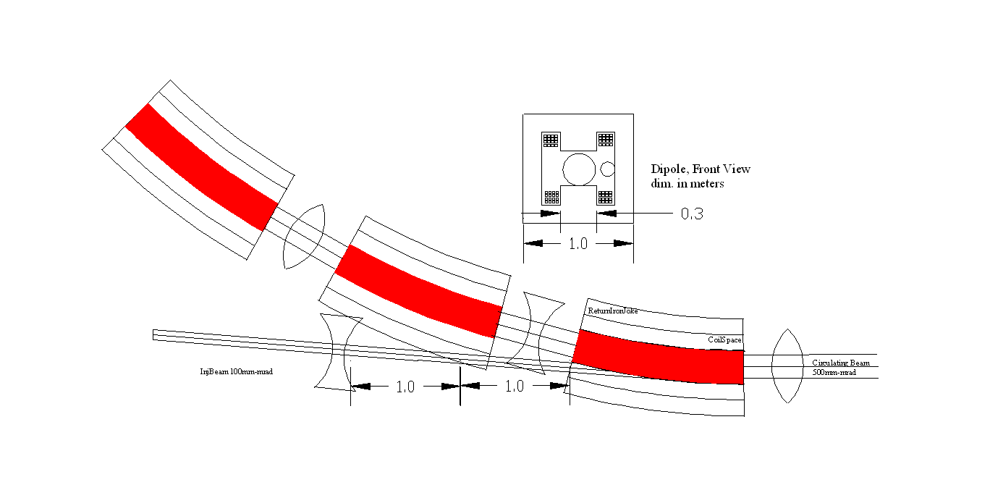
Injection Schematic
M. Popovic

Slide 30
Arc Optics (90⁰ doublets)
12
P = 3 GeV/c
36.25 meter Arc
1.5
BETA_X&Y[m]
DISP_X&Y[m]
0
-1.5
0
BETA_X
BETA_Y
DISP_X
DISP_Y
36.25
b0
qF0 qD0
b0
qF0 qD0
b
qF qD
b
qF qD
b
qF qD
b
qF0 qD0
b0
qF0 qD0
b0
qF0 L[cm]=60 G[kG/cm]=1.100
qD0 L[cm]=60 G[kG/cm]=-1.075
qF L[cm]=60 G[kG/cm]=1.124
qD L[cm]=60 G[kG/cm]=-1.089
drift between quads in a doublet L[cm]=100
drift between a quad and a bend L[cm]=15
b0 L[cm]=125 B[kG]=12.575
b L[cm]=250 B[kG]=12.575
Magnet aperture radius L[cm]=15

Slide 31
Dynamic Aperture – 90 turns
initial
1.000000
$MuDecay=2.2e-6; => 2.2e-06
$C=10150*2; => 20300
$NTurn=$gamma*$MuDecay*$beta*$c/$C; => 92.249966
ε_{Ν} = 30 mm rad
σ_{Δp/p} = 0.05
turn 1
0.720300
turn 30
0.569300
turn 90
0.540900
6/30/08
NuFact08, Valencia

Slide 32
Summary
Decay Ring (3 GeV Racetrack of 203 meter circumference)
  8 m betas, 90 cm hor. dispersion in the Arcs
  15 m betas in the Straight
Acceptance - Dynamic Aperture Study
  transverse: ε_{Ν} = 30 mm rad
  momentum: σ_{Δp/p} = 0.05
  Physical aperture: r = 20 cm (Arc) and r = 25 cm (Straight)
  46% dynamic lost after 90 turns
Compact Ring Optics – Linear lattice
  Dipole bends (2.5 m long, 12.6 kGauss) × 20
  Doublet focusing - Quads (0.6 m long, 1.1 kGaus/cm) × 36
  FODO focusing - Quads (1 m long, 0.2 kGaus/cm) × 38

