Slide 1
BGC regular meeting - Version 3 update
O. Sedlacek, H. Zhang, O. Stringer, S. Mazzoni
08.04.2022

Slide 2
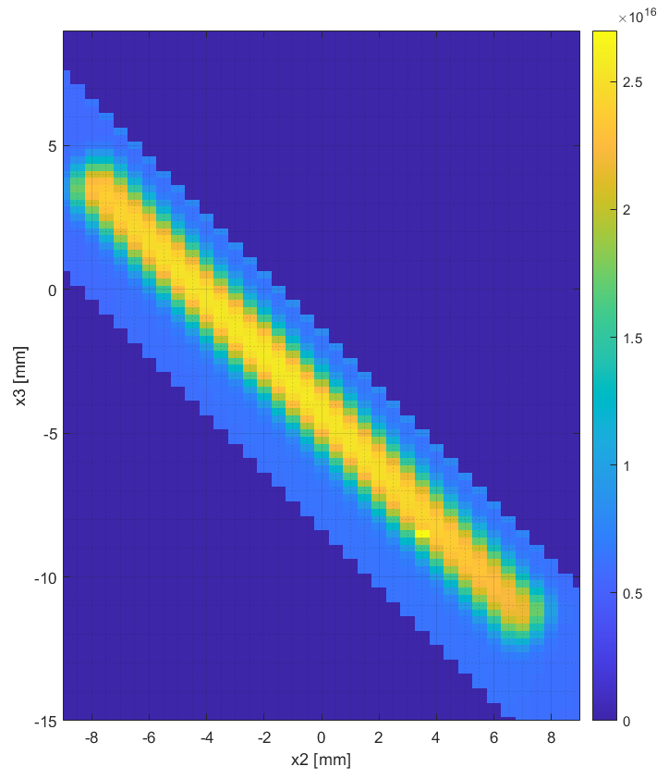
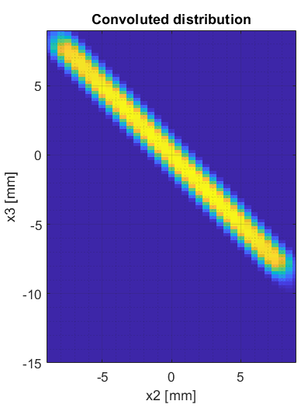

3rd skimmer: 0.7x9mm
Gas Jet profile at CERN
Simulation
Measurements
22 mm
22.5 mm
16 mm

Slide 3
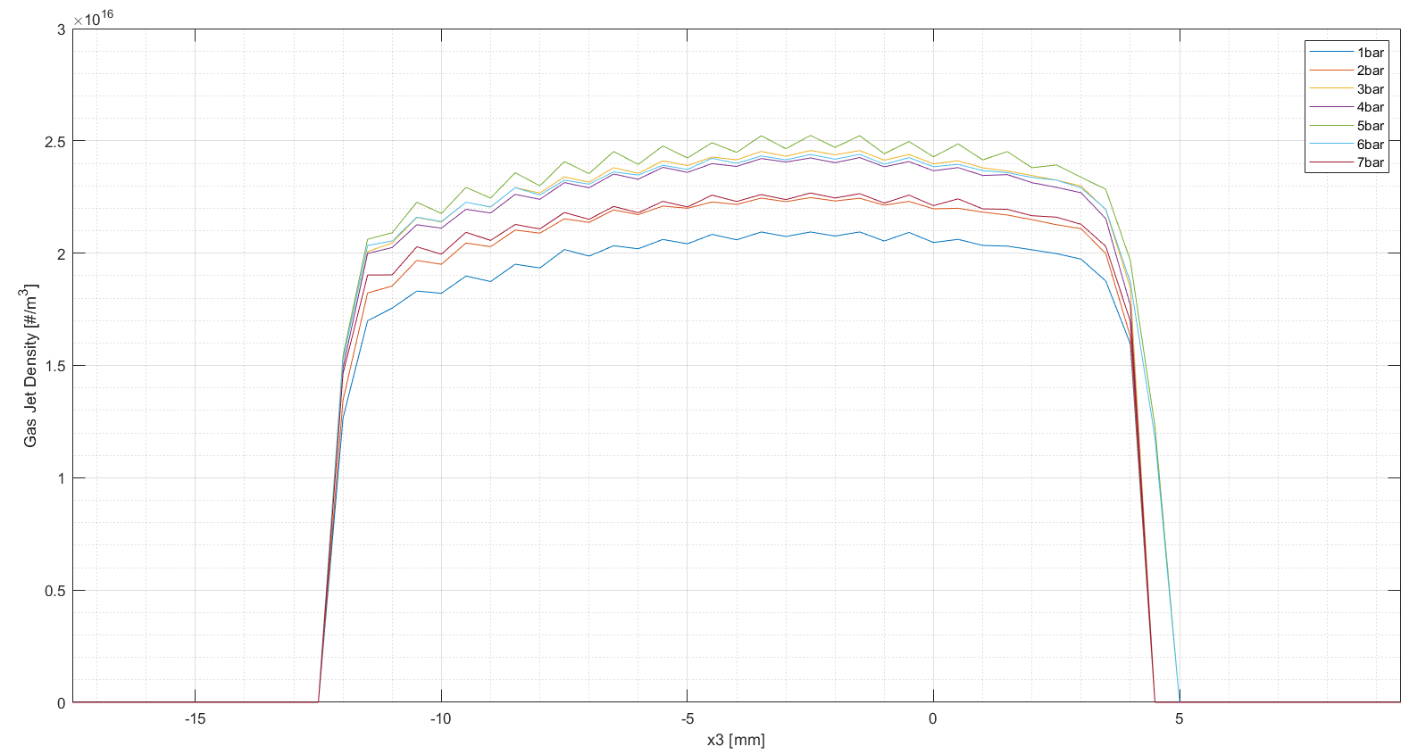
Gas Jet at CERN

Slide 4
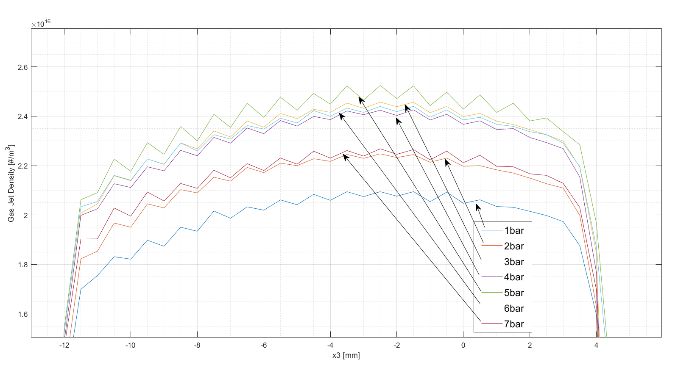
Gas Jet at CERN

Slide 5
Next steps
Further gas jet + e-beam measurements
  Signal still not found
    E-gun
    Camera (noise)
    Higher demagnification -> hard to find
Vacuum tests
Stability gas jet tests for BGV

Slide 6



Thank you for your attention
Any questions?
ondrej.sedlacek@cern.ch
Thank you for your attention
Any questions?
ondrej.sedlacek@cern.ch

Slide 7
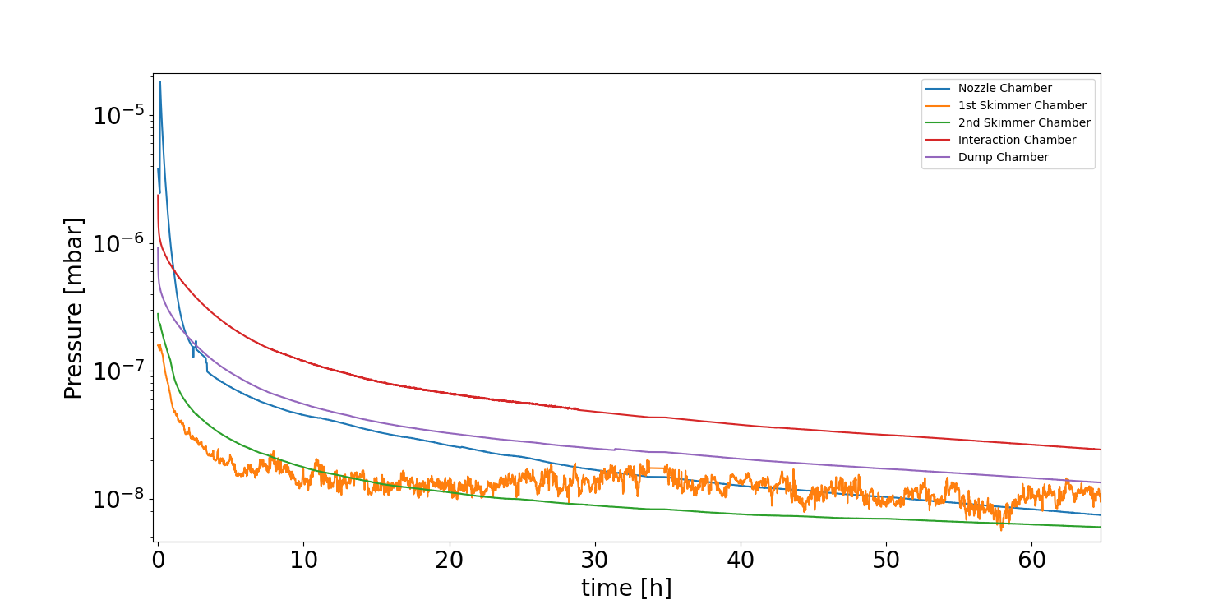
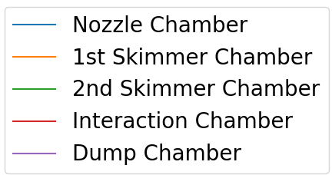
Pressures during pump down

Slide 8
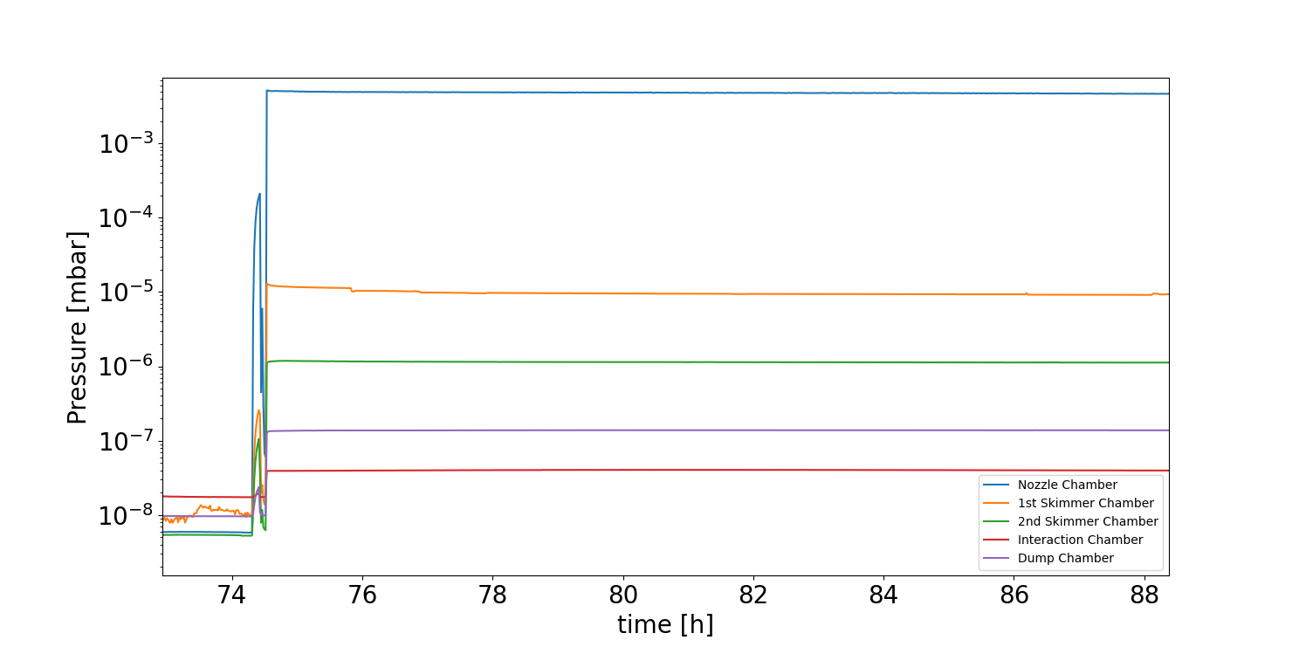
Pressures with Gas jet

