Slide 1
Calibration for Timepix3 HPD’s in the PS-BGI BPMs
Leonard Thiele from SY-BI-XEI

Slide 2
Outline
Instrument overview
Why is calibration necessary?
Equalisation Reference
Equalisation Procedure
Equalisation Results
Next Steps

Slide 3
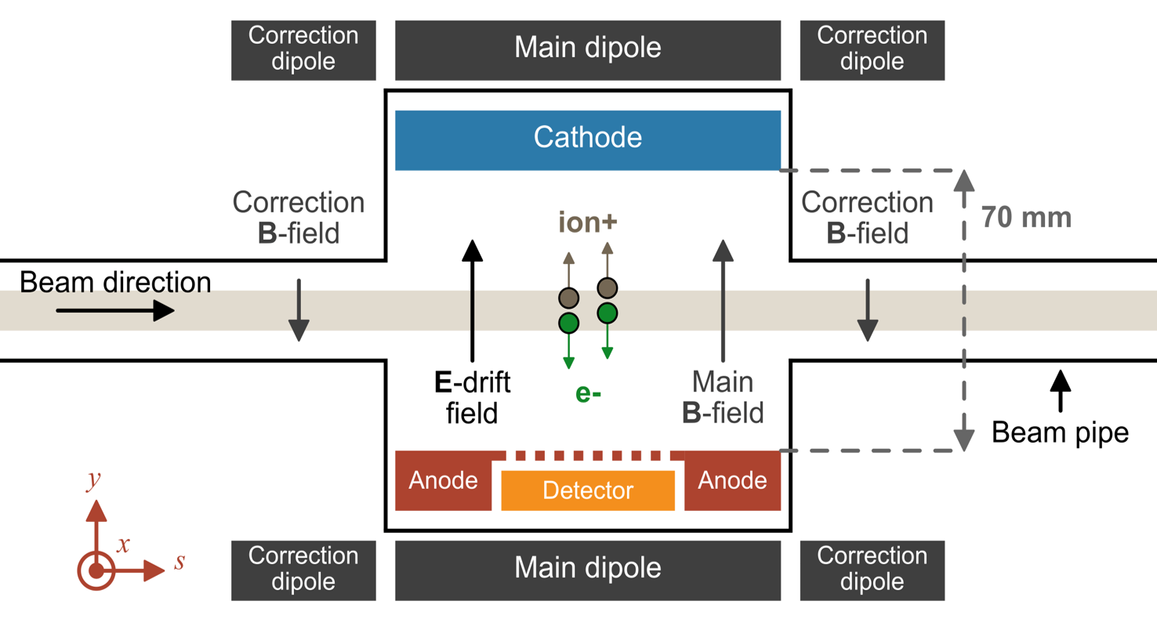
Timepix3 based PS-BGI
(Beam Gas Ionisation)
Non invasive
2 devices currently
installed:
1 horizontal, 1 vertical

Slide 4
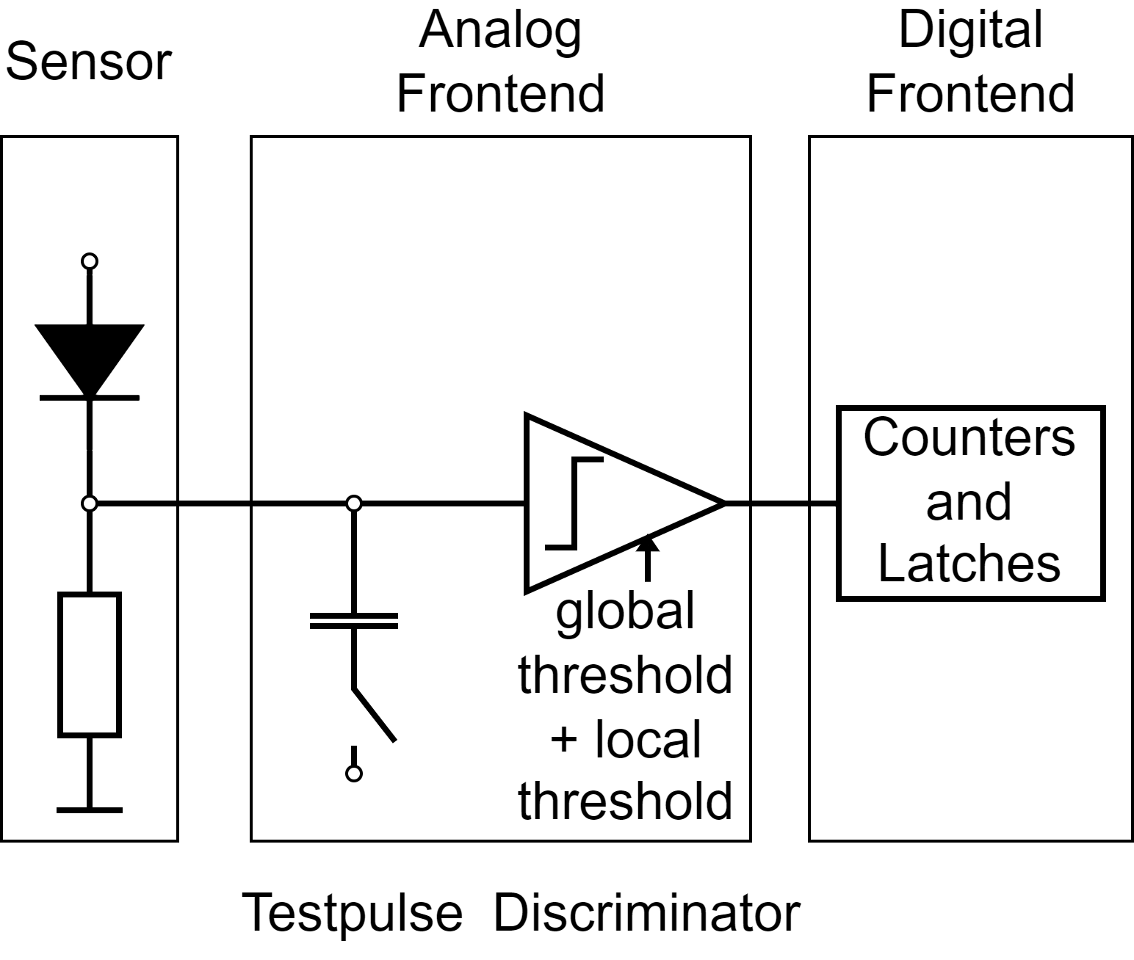
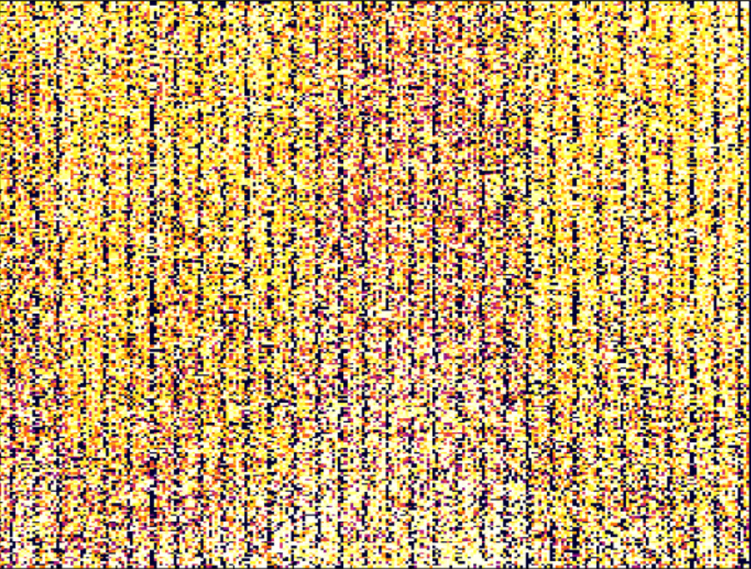

Why is calibration necessary?
ToT values for the Noise Floor
Simlified after: Time and Energy Calibration of Timepix3 Assemblies with Thin Silicon Sensors, F.Pitters, 2019

Slide 5
Why is calibration necessary?
4 Timepix3s
256x256 Pixels per Timepix3
Pixel response should be equal
Fabrication process & degradation
  Differences in analog frontend
Local threshold to compensate for differences
Equalisation == find values for local thresholds

Slide 6
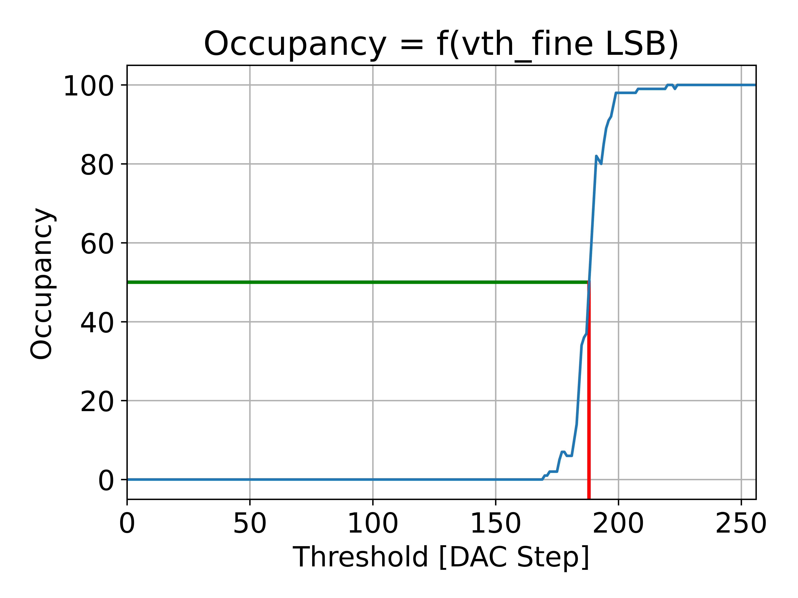

Effects of Pixel differences
Full scan / S-Curves
$$Oc{cupancy}_{pixel}=\frac{iToT_{pixel}}{T_{shutter}}$$

Slide 7
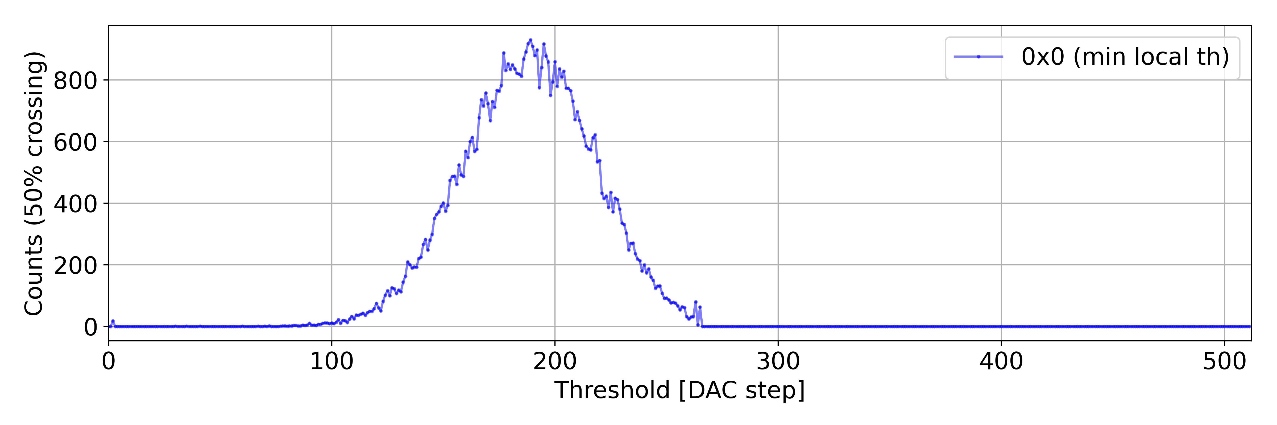
Effects of Pixel differences
50% occupancy histogram
expected signal is small
global threshold need to be near noise floor
narrower distribution allows for lower global threshold

Slide 8
Equalisation reference
Noise Floor:
+ always present
+ assumed to be equal on whole Chip
  dependant on temperature —> might change during equalisation
  readout will cause temperature change
Testpulses:
  + standard feature of the Timepix3
  + amplitude can be changed —> above thermal noise
  actual amplitude will differ
  only a part can be equalised at once

Slide 9
Equalisation procedure
Full scan with minimum local threshold
Full scan with maximum local threshold
Calculate mean of both distributions
  midpoint = target value
Interpolate optimal local threshold values
Fine tuning for each Pixel
Mask bad Pixels
Measure final result

Slide 10
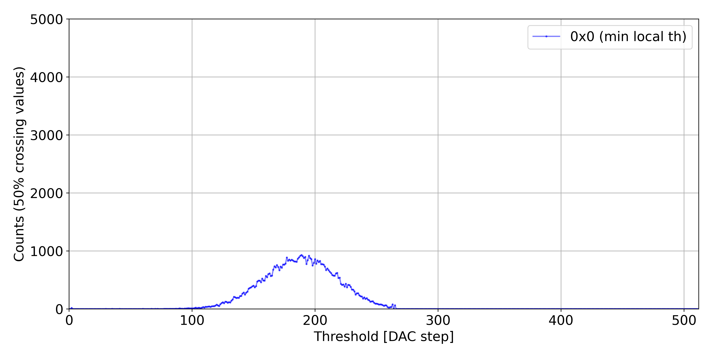
Equalisation Procedure - Step 1:
Full scan with minimum local threshold

Slide 11
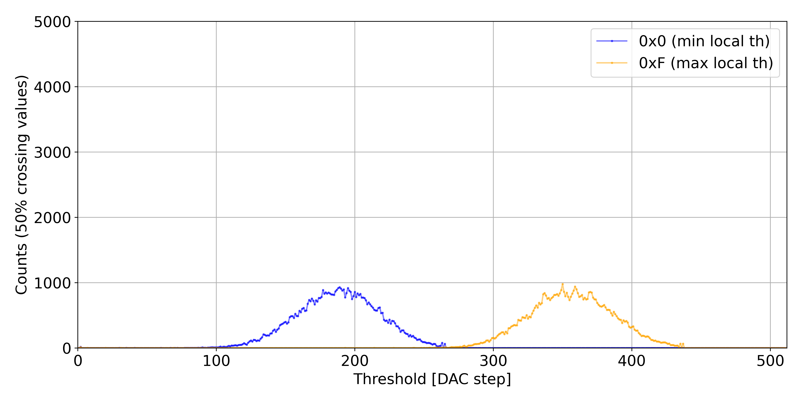
Equalisation Procedure - Step 2:
Full scan with maximum local threshold

Slide 12
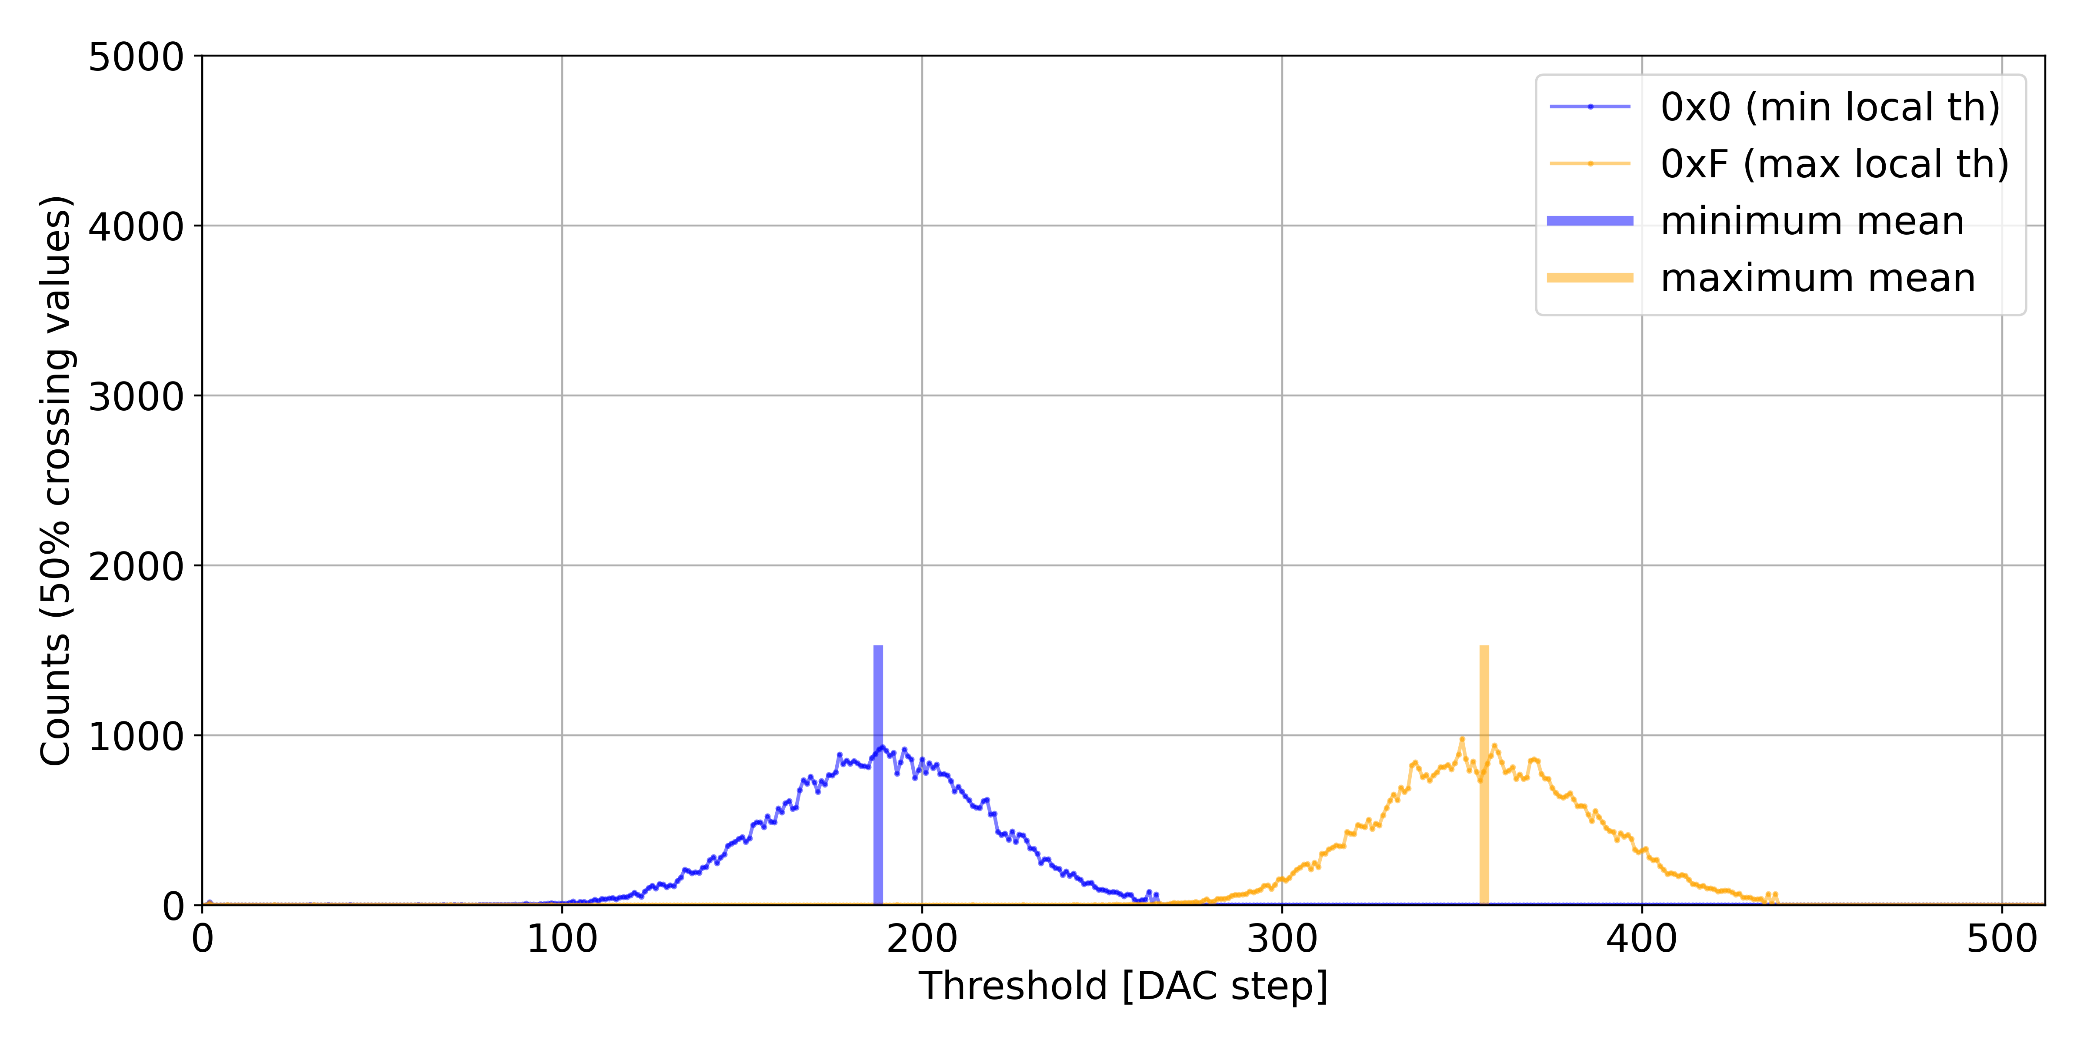
Equalisation Procedure - Step 3:
Calculate mean of minimum and maximum scan

Slide 13
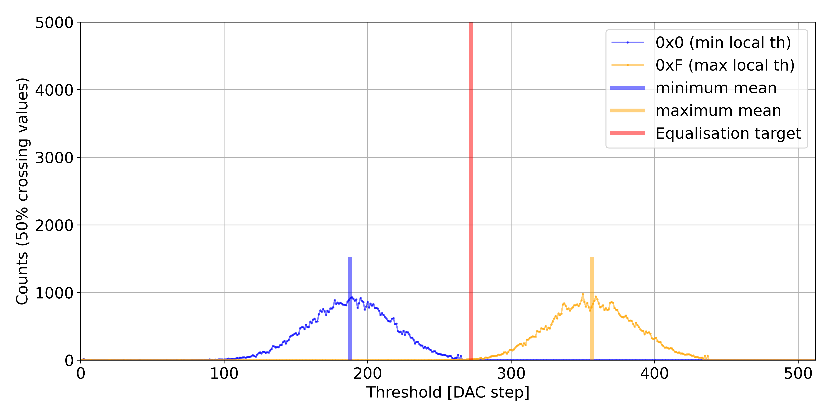
Equalisation Procedure - Step 3:
Define equalisation target as midpoint

Slide 14
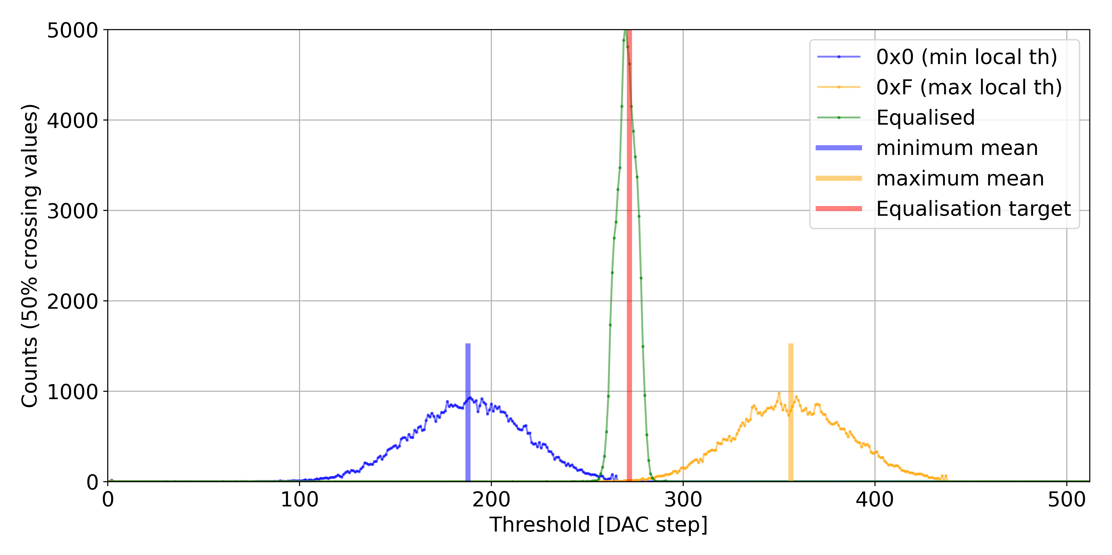
Equalisation Procedure - Step 4:
Interpolate optimal local Thresholds

Slide 15
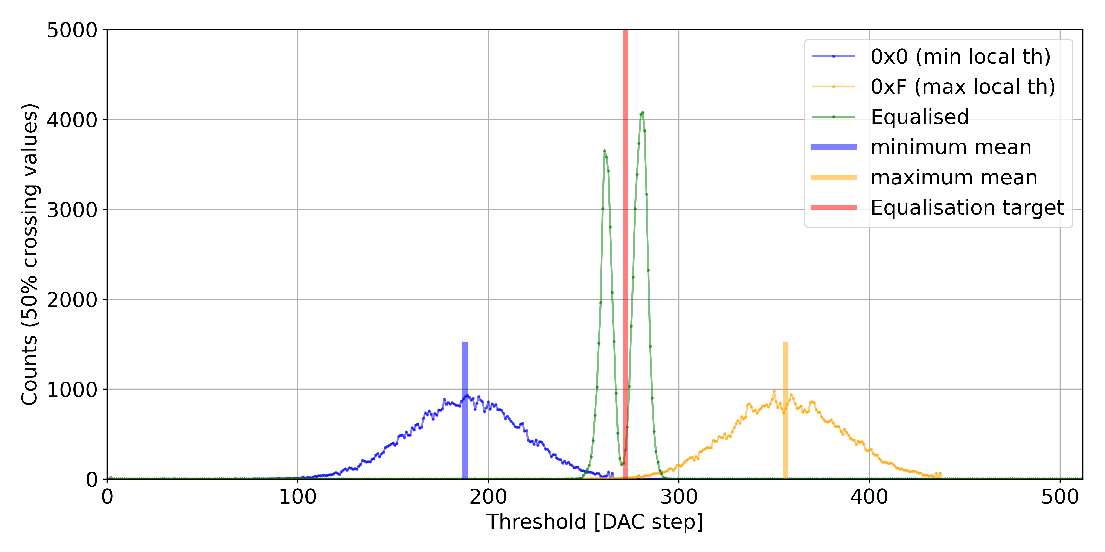
Equalisation Procedure - Step 5:
Fine tuning for each Pixel

Slide 16
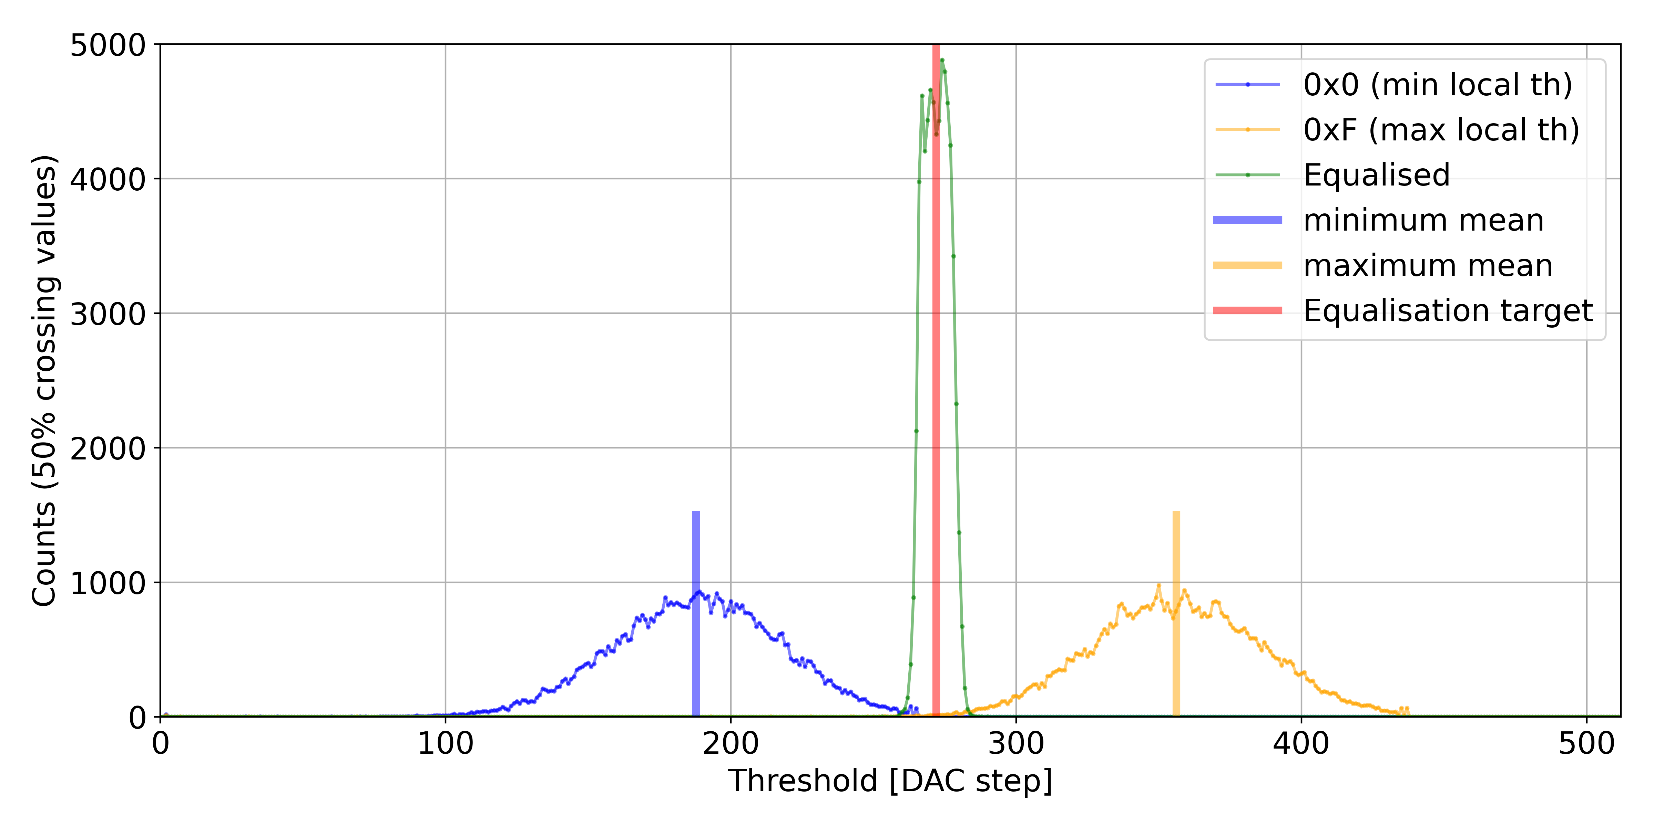
Equalisation Procedure - Step 7:
Measure final equalisation result

Slide 17
Next Steps
Rework of expert GUI
  Current GUI needs direct connection or docker in TN
  Next version should be based on PyQt and not need docker
    Better performance
    Simpler to use and maintain
    Current C++ driver will be kept
  Working together with BI-SW
Semi-automated setup
  Setup communication channels
  Adjust chip voltages
  Automatic masking of dead/noisy pixels

Slide 18
Next Steps
Periodic health checks for instrument
  Is the equalisation still valid?
  All parameters are still ok?
  Is the mask still ok?
  Connection to the instrument ok?
  Power usage normal?
If something fails, try to solve on its own, otherwise contact support

Slide 19
Thank you for your attention.
Questions?
further reading about the BGI: bgi.web.cern.ch

Slide 20
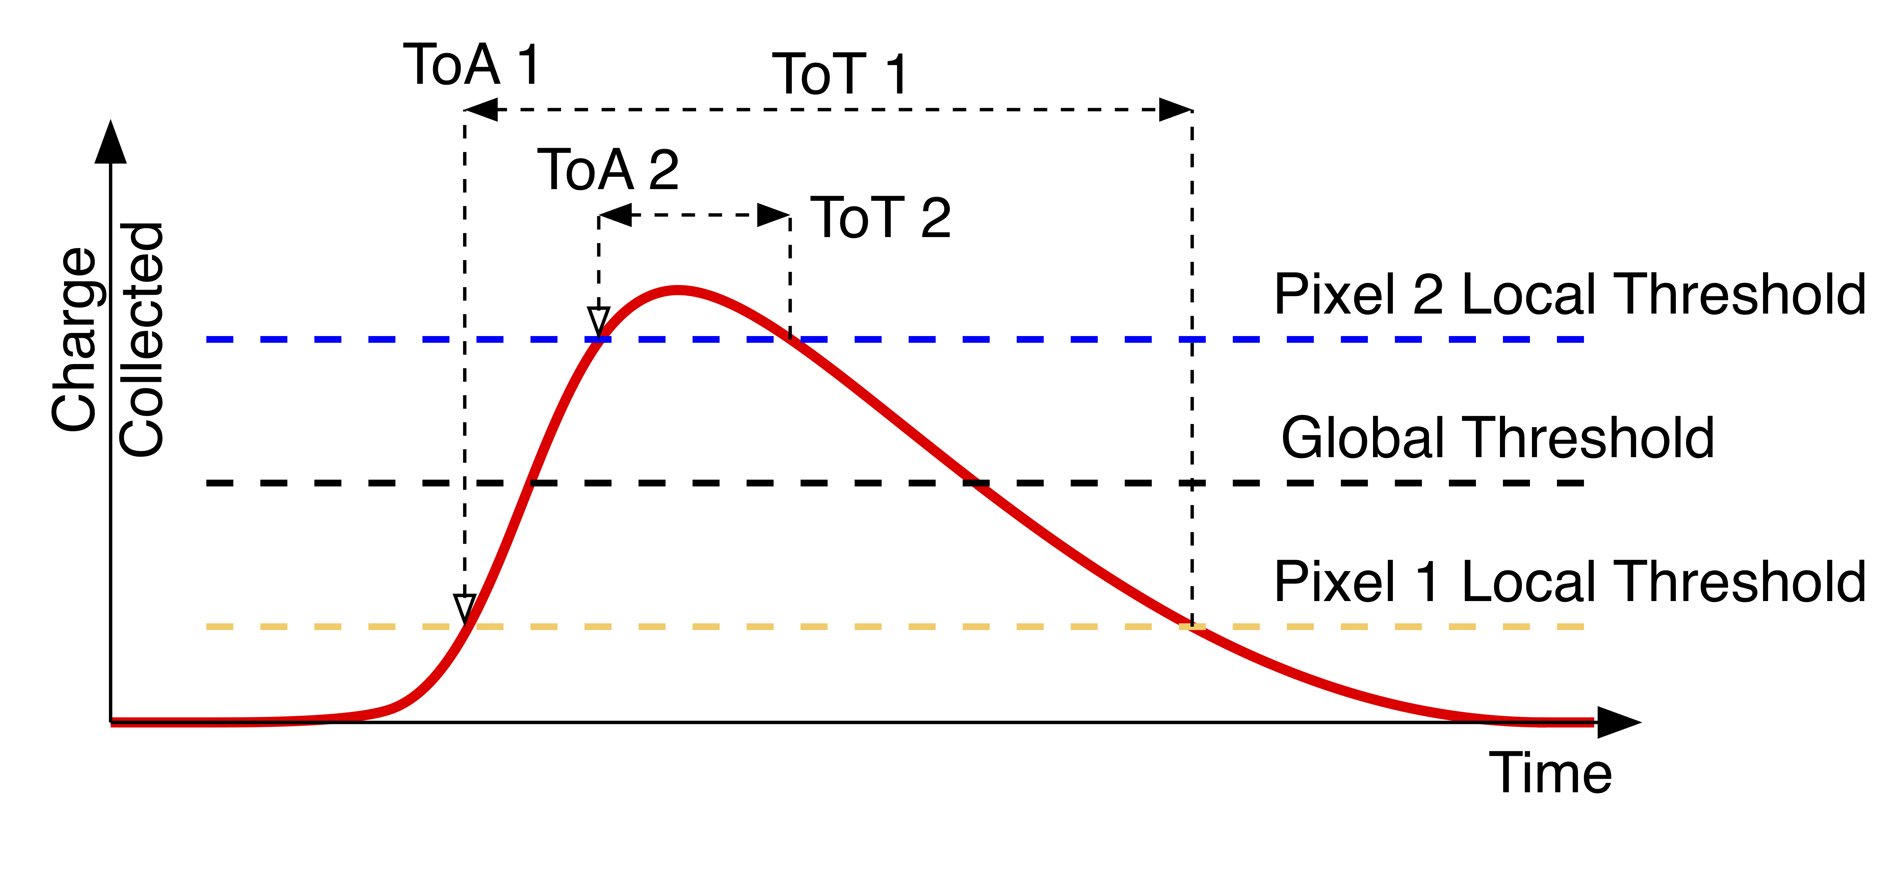
Effects of Pixel differences
—> differences in the Time of Arrival (ToA) and
Time over Threshold (ToT) for the same input

Slide 21
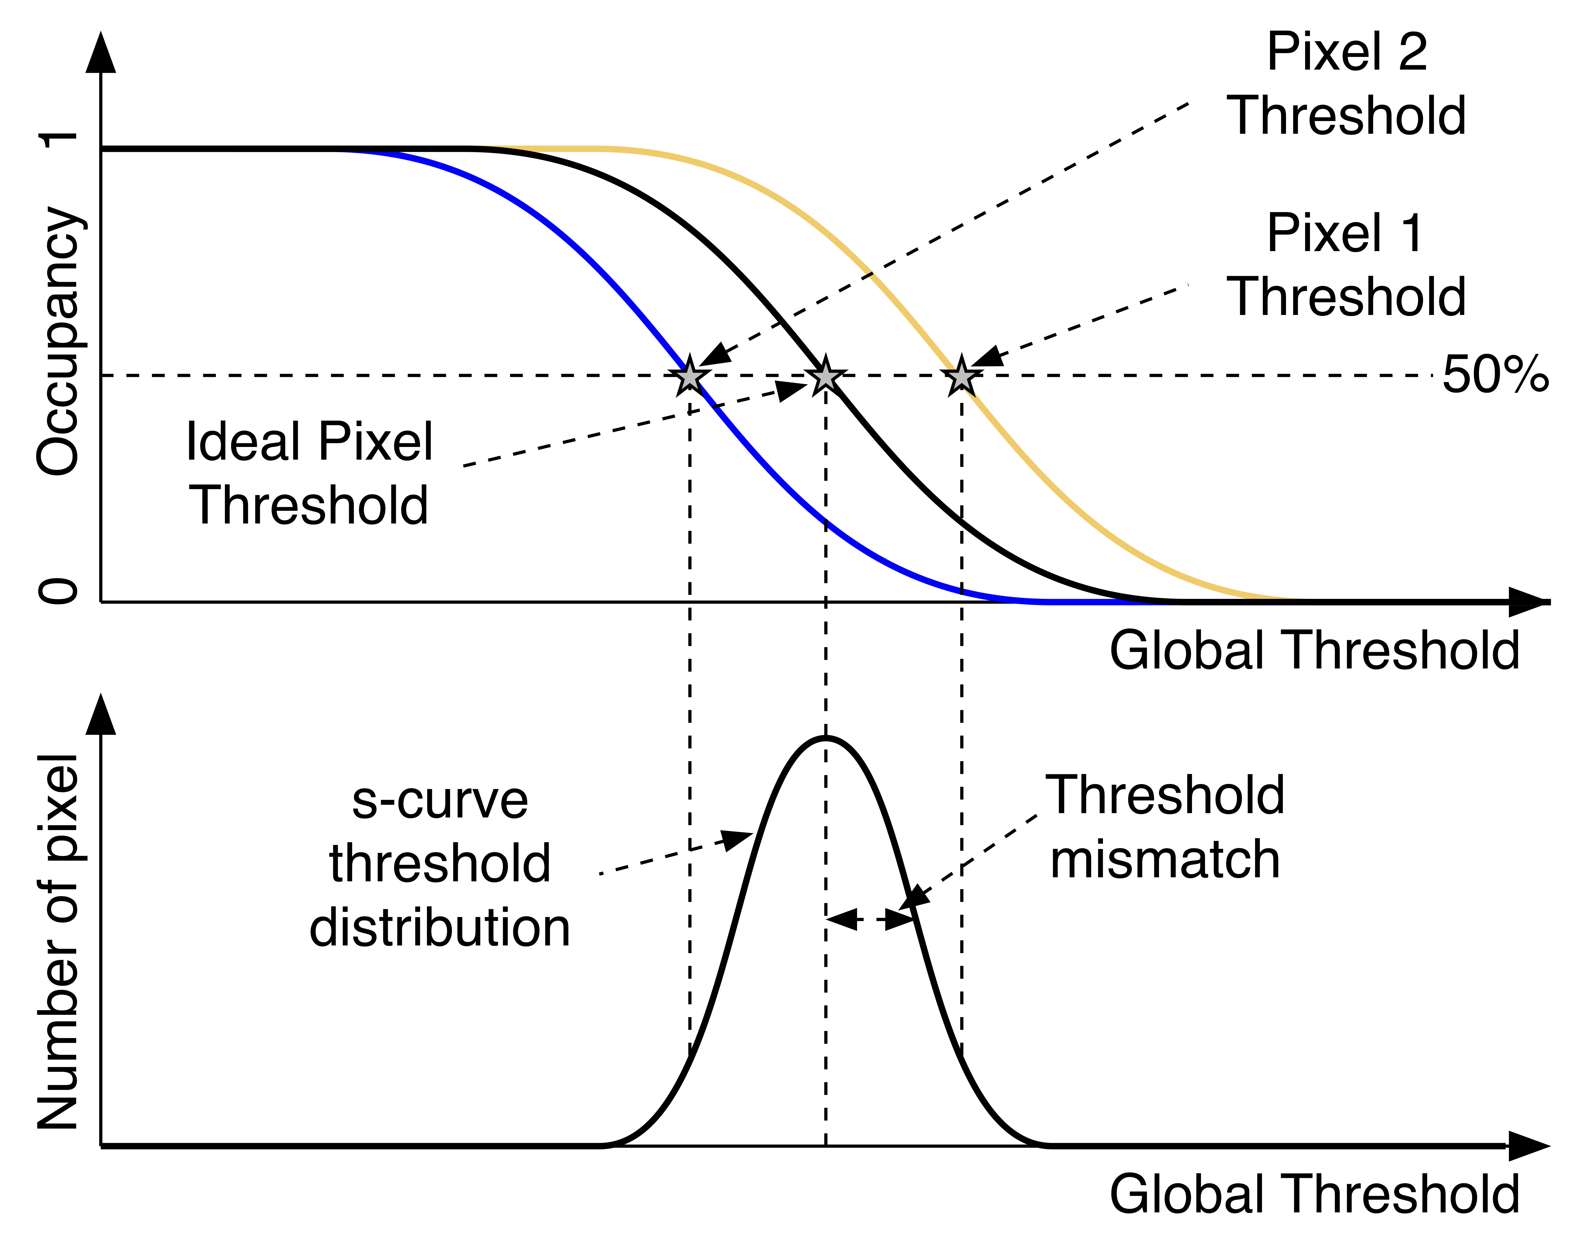

Occupancy
Occupancy:
  Noise Floor
  $Oc{cupancy}_{pixel}=\frac{iToT_{pixel}}{T_{shutter}}$
  Testpulses
  $Oc{cupancy}_{pixel}=\frac{DetectedTP_{pixel}}{GeneratedTP}$

Slide 22
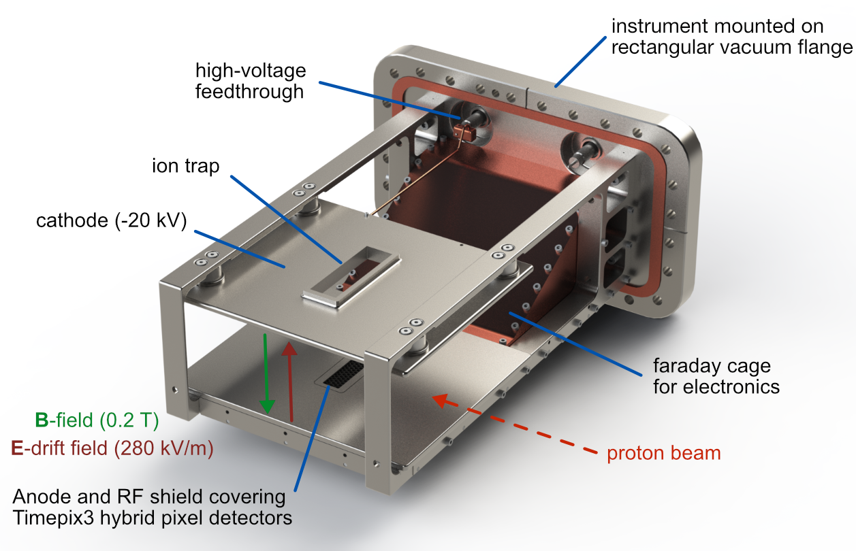
Timepix3 based PS-BGI

Slide 23
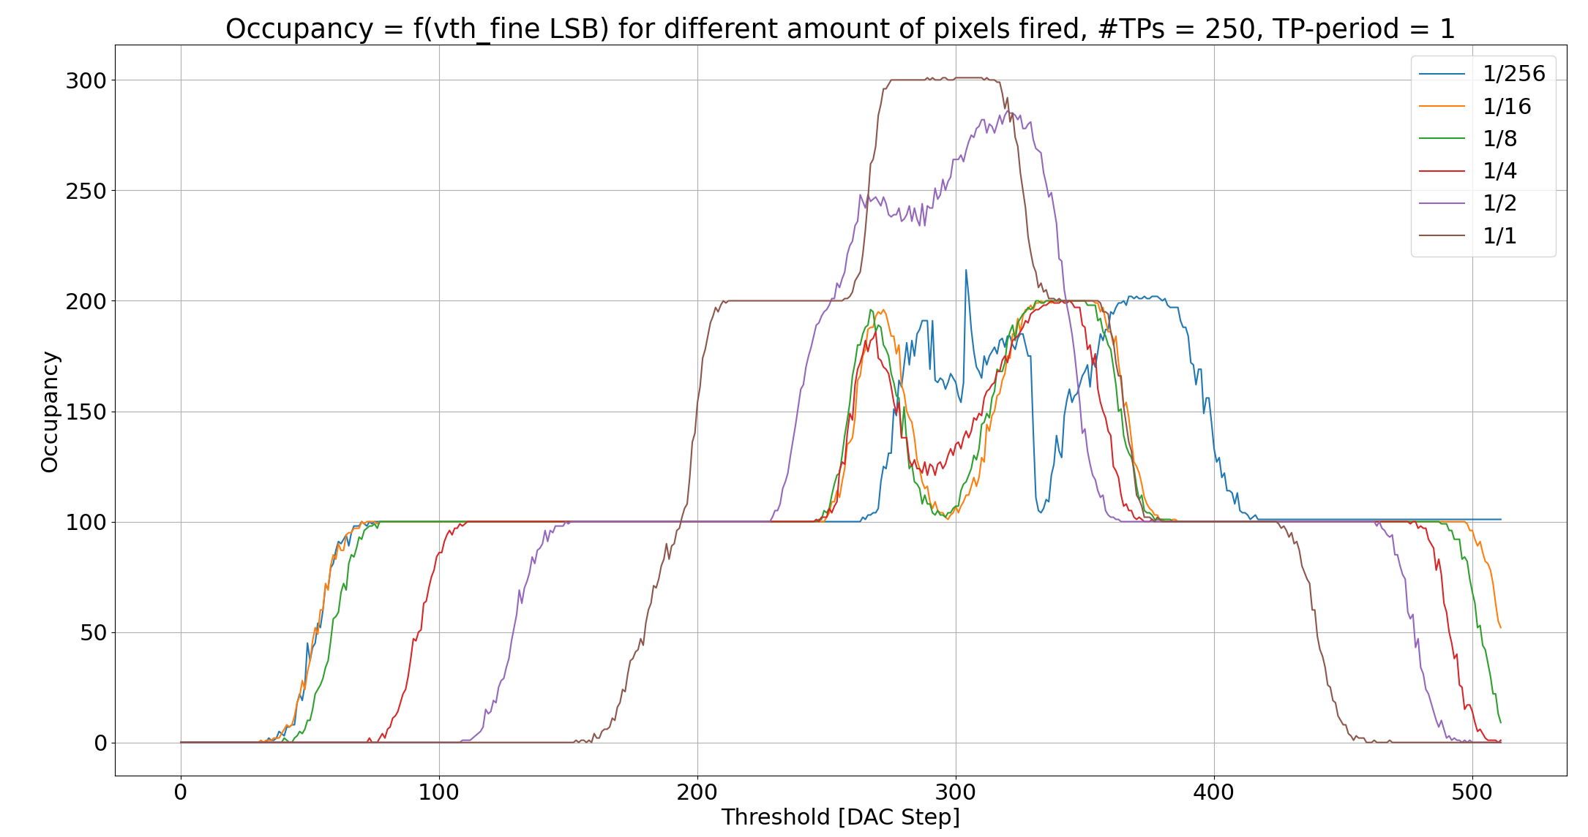
Testpulses - Power considerations

