Slide 1

Thermal Modeling of SEM grids and Wire Scanners
Beam Power Limitations at LINAC4.
Student and R&D Meeting
A. Navarro, F. Roncarolo

Slide 2
Outline
SEM Grids and Wire Scanners. Why are thermal simulations necessary?
Temperature Simulations:
  Thermal Model.
  Examples of Simulations.
  User friendly interface.
Examples of application.
  Linac4 beam power limits.
  Others applications.
Uncertainty calculations.
Emissivity measurements.

Slide 3
SEM Grids and Wire Scanners.
Thin target detectors of intercepting nature.
Purpose: Transverse beam profile measurements.

Slide 4
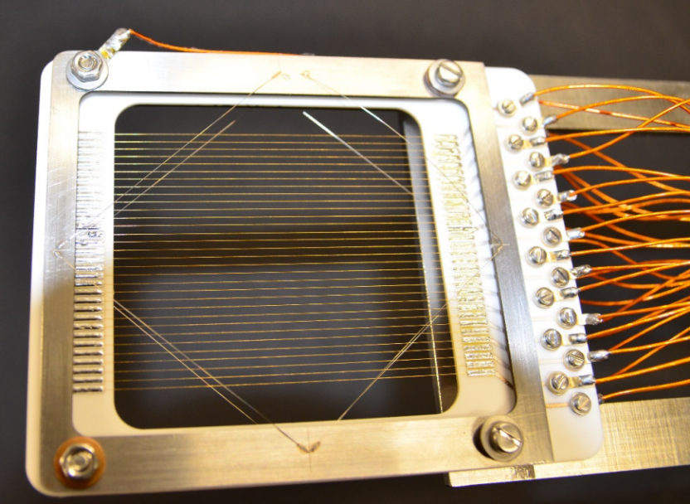
SEM Grids and Wire Scanners.
Secondary Electron Emission Grid
(SEM Grids)
Thin target detectors of intercepting nature.
Purpose: Transverse beam profile measurements.
SEM Grids
  Multiple wires supported on a frame.
  Allow for in pulse measurements.
  Limited resolution and complicated Acquisition system.

Slide 5
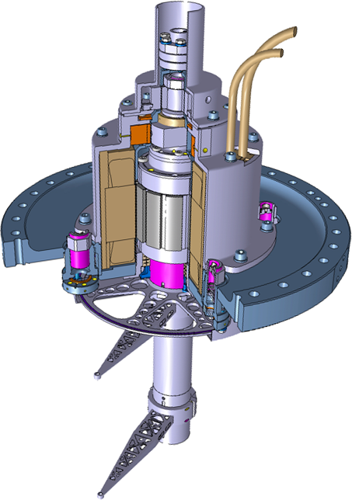
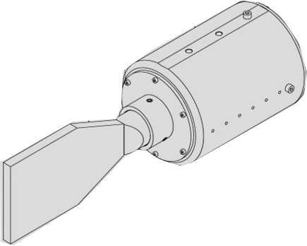
SEM Grids and Wire Scanners.
Secondary Electron Emission Grid
(SEM Grids)
Thin target detectors of intercepting nature.
Purpose: Transverse beam profile measurements.
SEM Grids
  Multiple wires supported on a frame.
  Allow for in pulse measurements.
  Limited resolution and complicated Acquisition system.
Wire Scanners:
  Single wire that can be swept through the beam.
  High resolution can be achieved. Simpler electronics.
    Slow Wire Scanner: Profile reconstructed using SE signal.
    (LINAC4-TLs, SPS BBS)
    Fast Wire Scanners: Profile reconstructed by measuring shower of secondary particles. (Synchrotrons)
(Fast) Wire Scanner
Particle beam
Beam losses
Photomultiplier
Scintillator
From: J. EMERY

Slide 6
Why are thermal Simulations Necessary?
Depending on the beam power density the thermal shocks at the detectors can be quite violent.
This can disturb the measurements and permanently damage the detectors.

Slide 7
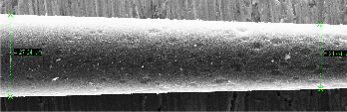
Why are thermal Simulations Necessary?
Depending on the beam power density the thermal shocks at the detectors can be quite violent.
This can disturb the measurements and permanently damage the detectors.
Wire diameter reduction due to beam interaction.

Slide 8
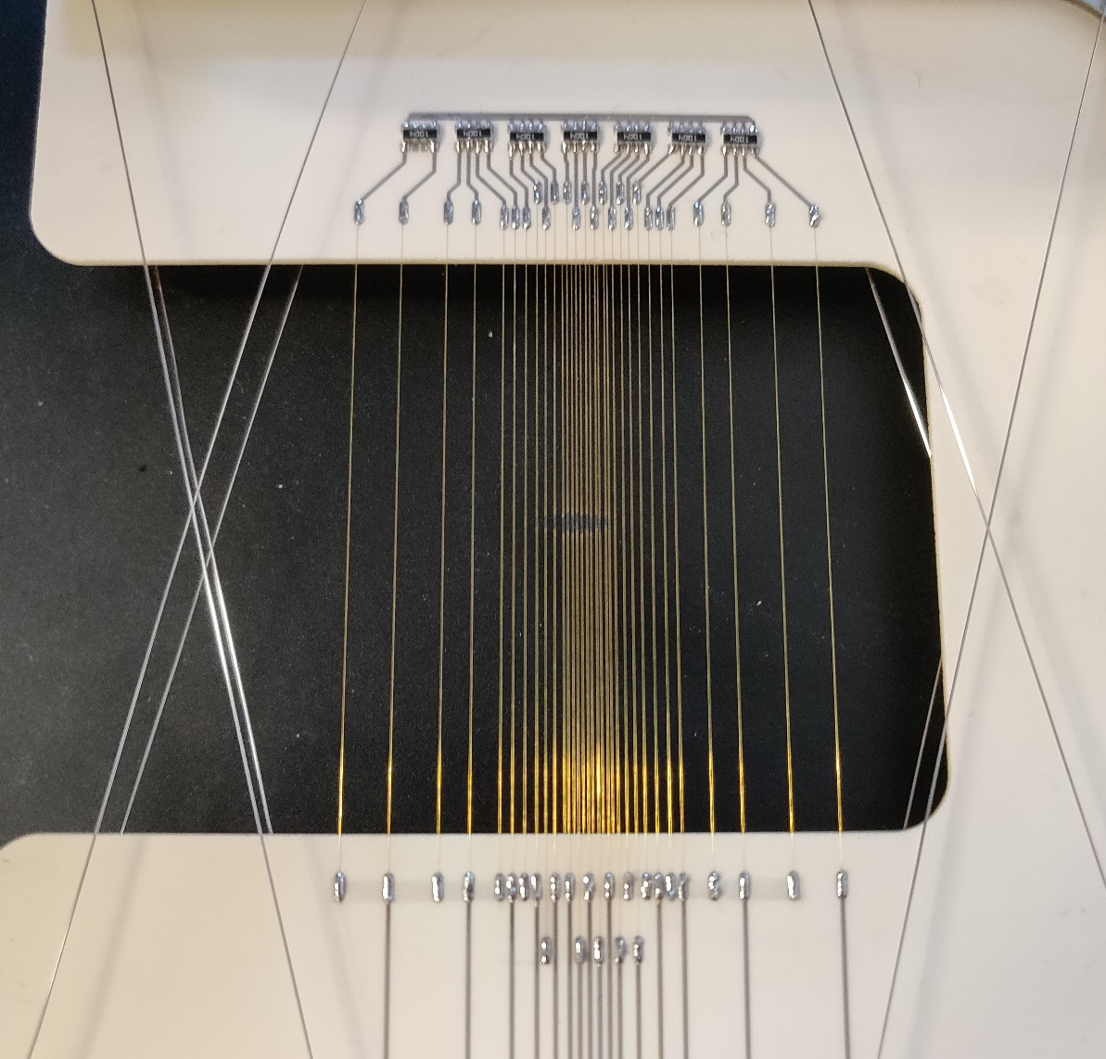
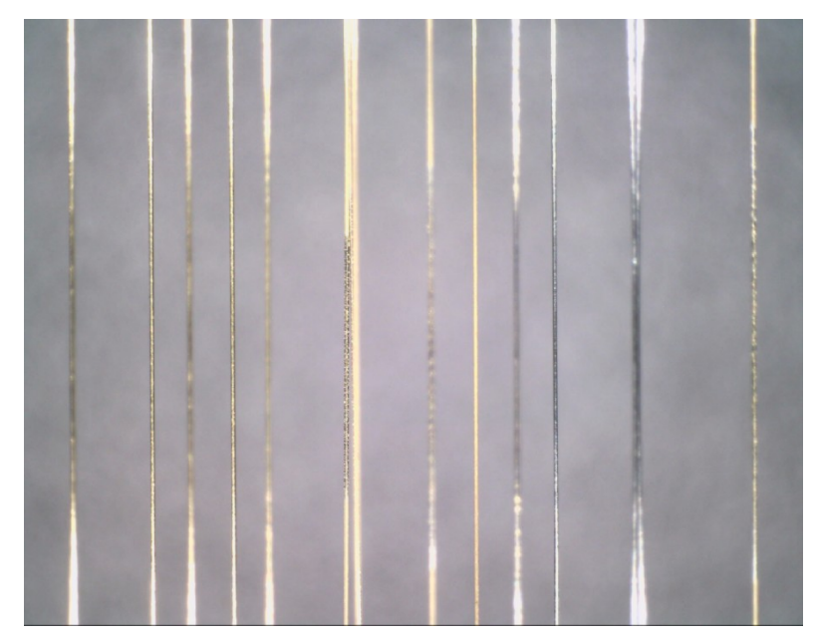
Why are thermal Simulations Necessary?
Depending on the beam power density the thermal shocks at the detectors can be quite violent.
This can disturb the measurements and permanently damage the detectors.
Wire diameter reduction due to beam interaction.
Pictures of Linac4 Wire Grid L4T.BSGV.0223 Featuring the effects of high temperatures in gold coated tungsten wires.

Slide 9
Outline
SEM Grids and Wire Scanners. Why are thermal simulations necessary?
Temperature Simulations:
  Thermal Model.
  Examples of Simulations.
  User friendly interface.
Examples of application.
  Linac4 beam power limits.
  Others applications.
Uncertainty calculations.
Emissivity measurements.

Slide 10
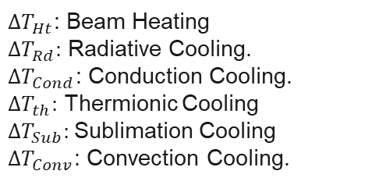
Wire Simulations: Thermal Model
$ΔT_{Ht}$: Beam Heating
$ΔT_{Rd}:$ Radiative Cooling.
$ΔT_{Cond}$: Conduction Cooling.
$ΔT_{th}:$ Thermionic Cooling
$ΔT_{Sub}:$Sublimation Cooling
$ΔT_{Conv}$: Convection Cooling.
Discretized temperature variation during beam pulse.
$$ΔT_{tot}= ΔT_{Ht}−ΔT_{Rd}−ΔT_{Cond}−ΔT_{th}−ΔT_{Sub}−ΔT_{Conv}$$

Slide 11
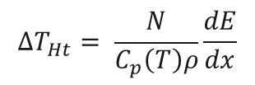
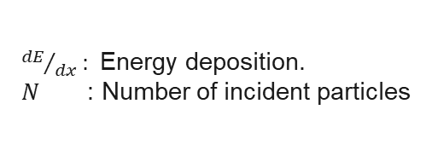
Wire Simulations: Thermal Model
$ΔT_{Ht}$: Beam Heating
$ΔT_{Rd}:$ Radiative Cooling.
$ΔT_{Cond}$: Conduction Cooling.
$ΔT_{th}:$ Thermionic Cooling
$ΔT_{Sub}:$Sublimation Cooling
$ΔT_{Conv}$: Convection Cooling.
Discretized temperature variation during beam pulse.
$$ΔT_{tot}= ΔT_{Ht}−ΔT_{Rd}−ΔT_{Cond}−ΔT_{th}−ΔT_{Sub}−ΔT_{Conv}$$
Beam Heating ($ΔT_{Ht}$): Due to direct interaction with the particle beam.
$$ΔT_{Ht}= \frac{N}{C_{p}\left(T\right)ρ}\frac{dE}{dx}$$
${dE}/{dx}:$Energy deposition.
$N$ : Number of incident particles

Slide 12

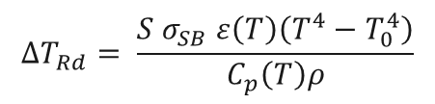
Wire Simulations: Thermal Model
$ΔT_{Ht}$: Beam Heating
$ΔT_{Rd}:$ Radiative Cooling.
$ΔT_{Cond}$: Conduction Cooling.
$ΔT_{th}:$ Thermionic Cooling
$ΔT_{Sub}:$Sublimation Cooling
$ΔT_{Conv}$: Convection Cooling.
Discretized temperature variation during beam pulse.
$$ΔT_{tot}= ΔT_{Ht}−ΔT_{Rd}−ΔT_{Cond}−ΔT_{th}−ΔT_{Sub}−ΔT_{Conv}$$
Beam Heating ($ΔT_{Ht}$): Due to direct interaction with the particle beam.
$$ΔT_{Ht}= \frac{N}{C_{p}\left(T\right)ρ}\frac{dE}{dx}$$
${dE}/{dx}:$Energy deposition.
$N$ : Number of incident particles
Radiative Cooling($ΔT_{Rd}$): black body radiation is the dominant effect and it is described by Stephan Boltzmann’s law.
$$ΔT_{Rd}= \frac{{S σ}_{SB} ε\left(T\right)\left(T^{4}−T_{0}^{4}\right)}{C_{p}\left(T\right)ρ}$$
$ε\left(T\right):$ Emissivity

Slide 13

Wire Simulations: Thermal Model
$ΔT_{Ht}$: Beam Heating
$ΔT_{Rd}:$ Radiative Cooling.
$ΔT_{Cond}$: Conduction Cooling.
$ΔT_{th}:$ Thermionic Cooling
$ΔT_{Sub}:$Sublimation Cooling
$ΔT_{Conv}$: Convection Cooling.
Discretized temperature variation during beam pulse.
$$ΔT_{tot}= ΔT_{Ht}−ΔT_{Rd}−ΔT_{Cond}−ΔT_{th}−ΔT_{Sub}−ΔT_{Conv}$$
Beam Heating ($ΔT_{Ht}$): Due to direct interaction with the particle beam.
$$ΔT_{Ht}= \frac{N}{C_{p}\left(T\right)ρ}\frac{dE}{dx}$$
${dE}/{dx}:$Energy deposition.
$N$ : Number of incident particles
Radiative Cooling($ΔT_{Rd}$): black body radiation is the dominant effect and it is described by Stephan Boltzmann’s law.
$$ΔT_{Rd}= \frac{{S σ}_{SB} ε\left(T\right)\left(T^{4}−T_{0}^{4}\right)}{C_{p}\left(T\right)ρ}$$
$ε\left(T\right):$ Emissivity
Conduction Cooling ($ΔT_{Cond}$): the heat flow is within and through the body itself. Shifts from a warm place to a cold place.
$$\frac{∂T}{dt}= α\frac{∂T}{∂x}$$

Slide 14


Wire Simulations: Thermal Model
$ΔT_{Ht}$: Beam Heating
$ΔT_{Rd}:$ Radiative Cooling.
$ΔT_{Cond}$: Conduction Cooling.
$ΔT_{th}:$ Thermionic Cooling
$ΔT_{Sub}:$Sublimation Cooling
$ΔT_{Conv}$: Convection Cooling.
Discretized temperature variation during beam pulse.
$$ΔT_{tot}= ΔT_{Ht}−ΔT_{Rd}−ΔT_{Cond}−ΔT_{th}−ΔT_{Sub}−ΔT_{Conv}$$
Beam Heating ($ΔT_{Ht}$): Due to direct interaction with the particle beam.
$$ΔT_{Ht}= \frac{N}{C_{p}\left(T\right)ρ}\frac{dE}{dx}$$
${dE}/{dx}:$Energy deposition.
$N$ : Number of incident particles
Radiative Cooling($ΔT_{Rd}$): black body radiation is the dominant effect and it is described by Stephan Boltzmann’s law.
$$ΔT_{Rd}= \frac{{S σ}_{SB} ε\left(T\right)\left(T^{4}−T_{0}^{4}\right)}{C_{p}\left(T\right)ρ}$$
$ε\left(T\right):$ Emissivity
Conduction Cooling ($ΔT_{Cond}$): the heat flow is within and through the body itself. Shifts from a warm place to a cold place.
$$\frac{∂T}{dt}= α\frac{∂T}{∂x}$$
Thermionic Cooling ($ΔT_{th}$): Electrons emitted due to thermal excitation.
$$J_{th}=A_{R}T^{2}\exp\left(\frac{−Φ}{K_{B}T}\right)$$
$$ΔT_{Th}=S\left(φ+σ_{B}T\right)\frac{J_{th}}{Cp ρ}$$

Slide 15

Wire Simulations: Thermal Model
$ΔT_{Ht}$: Beam Heating
$ΔT_{Rd}:$ Radiative Cooling.
$ΔT_{Cond}$: Conduction Cooling.
$ΔT_{th}:$ Thermionic Cooling
$ΔT_{Sub}:$Sublimation Cooling
$ΔT_{Conv}$: Convection Cooling.
Discretized temperature variation during beam pulse.
$$ΔT_{tot}= ΔT_{Ht}−ΔT_{Rd}−ΔT_{Cond}−ΔT_{th}−ΔT_{Sub}−ΔT_{Conv}$$
Beam Heating ($ΔT_{Ht}$): Due to direct interaction with the particle beam.
$$ΔT_{Ht}= \frac{N}{C_{p}\left(T\right)ρ}\frac{dE}{dx}$$
${dE}/{dx}:$Energy deposition.
$N$ : Number of incident particles
Radiative Cooling($ΔT_{Rd}$): black body radiation is the dominant effect and it is described by Stephan Boltzmann’s law.
$$ΔT_{Rd}= \frac{{S σ}_{SB} ε\left(T\right)\left(T^{4}−T_{0}^{4}\right)}{C_{p}\left(T\right)ρ}$$
$ε\left(T\right):$ Emissivity
Conduction Cooling ($ΔT_{Cond}$): the heat flow is within and through the body itself. Shifts from a warm place to a cold place.
$$\frac{∂T}{dt}= α\frac{∂T}{∂x}$$
Thermionic Cooling ($ΔT_{th}$): Electrons emitted due to thermal excitation.
$$J_{th}=A_{R}T^{2}\exp\left(\frac{−Φ}{K_{B}T}\right)$$
$$ΔT_{Th}=S\left(φ+σ_{B}T\right)\frac{J_{th}}{Cp ρ}$$

Slide 16
Wire Simulations: Thermal Model
Example 1D heat equation:
$$\frac{∂T}{∂t}=\frac{N}{C_{p}\left(T\right)ρ}\frac{dE}{dx} − \frac{{S σ}_{SB} ε\left(T\right)\left(T^{4}−T_{0}^{4}\right)}{C_{p}\left(T\right)ρ}−α\frac{∂T}{∂x}−S\left(φ+2σ_{SB}T\right) \frac{J_{Th }(T)}{C_{p}\left(T\right)ρ}$$

Slide 17
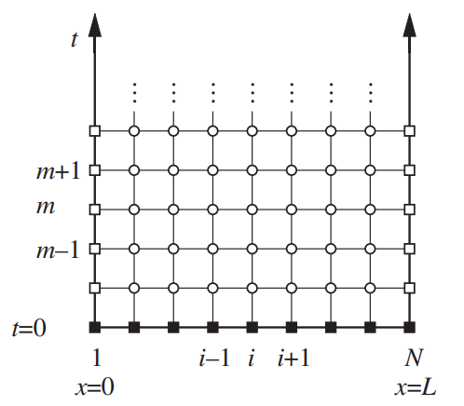
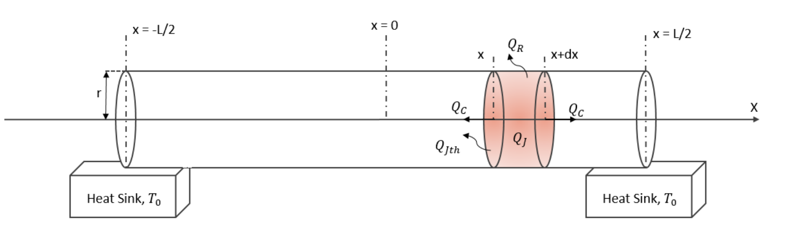
Wire Simulations: Thermal Model
Example 1D heat equation:
$$\frac{∂T}{∂t}=\frac{N}{C_{p}\left(T\right)ρ}\frac{dE}{dx} − \frac{{S σ}_{SB} ε\left(T\right)\left(T^{4}−T_{0}^{4}\right)}{C_{p}\left(T\right)ρ}−α\frac{∂T}{∂x}−S\left(φ+2σ_{SB}T\right) \frac{J_{Th }(T)}{C_{p}\left(T\right)ρ}$$
We must solve a partial differential equation.
One of the simples and oldest methods to solve differential equations: finite diference method. (Program includes ( BTCS, FTCS, Crank-Nicolson)).

Slide 18
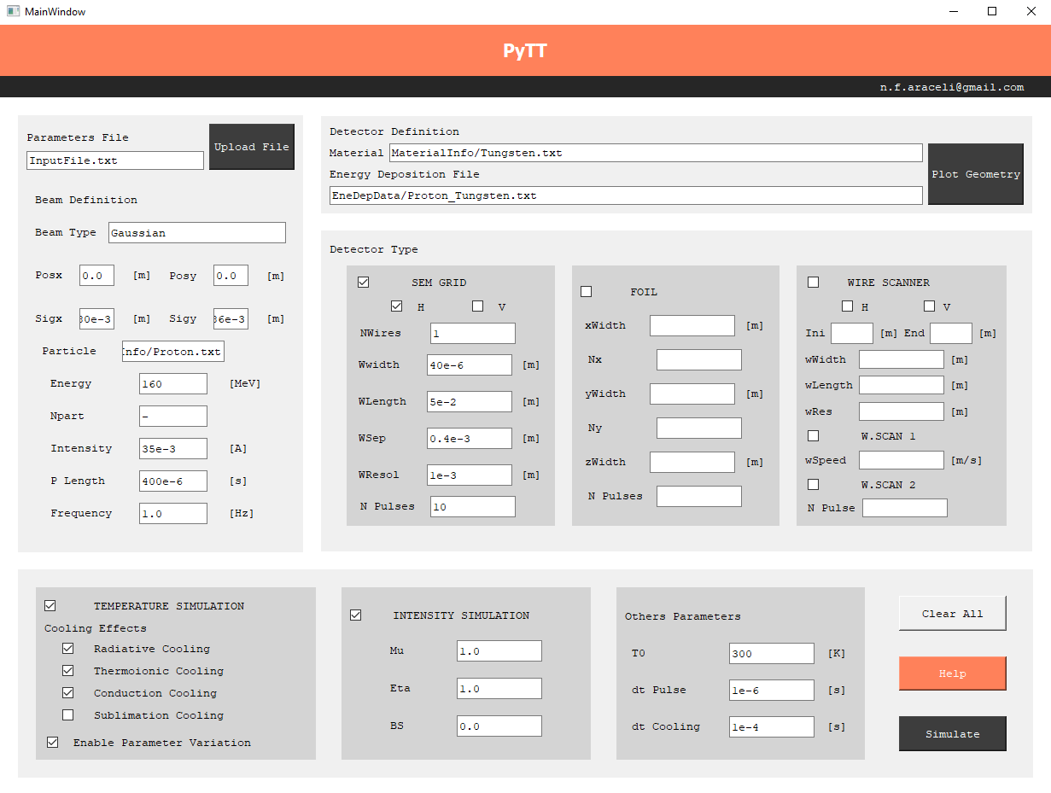

Wire Simulations: Thermal Model
Can be launched via terminal or user-friendly interface.
Easy to implement macro files.
Different beam types and conditions.
Simulations available for Wire Grids, Foils and Wire scanners.
Different cooling mechanisms can be activated or deactivated.
Parameter variation allows parameters to vary with temperature.
Check Me!

Slide 19
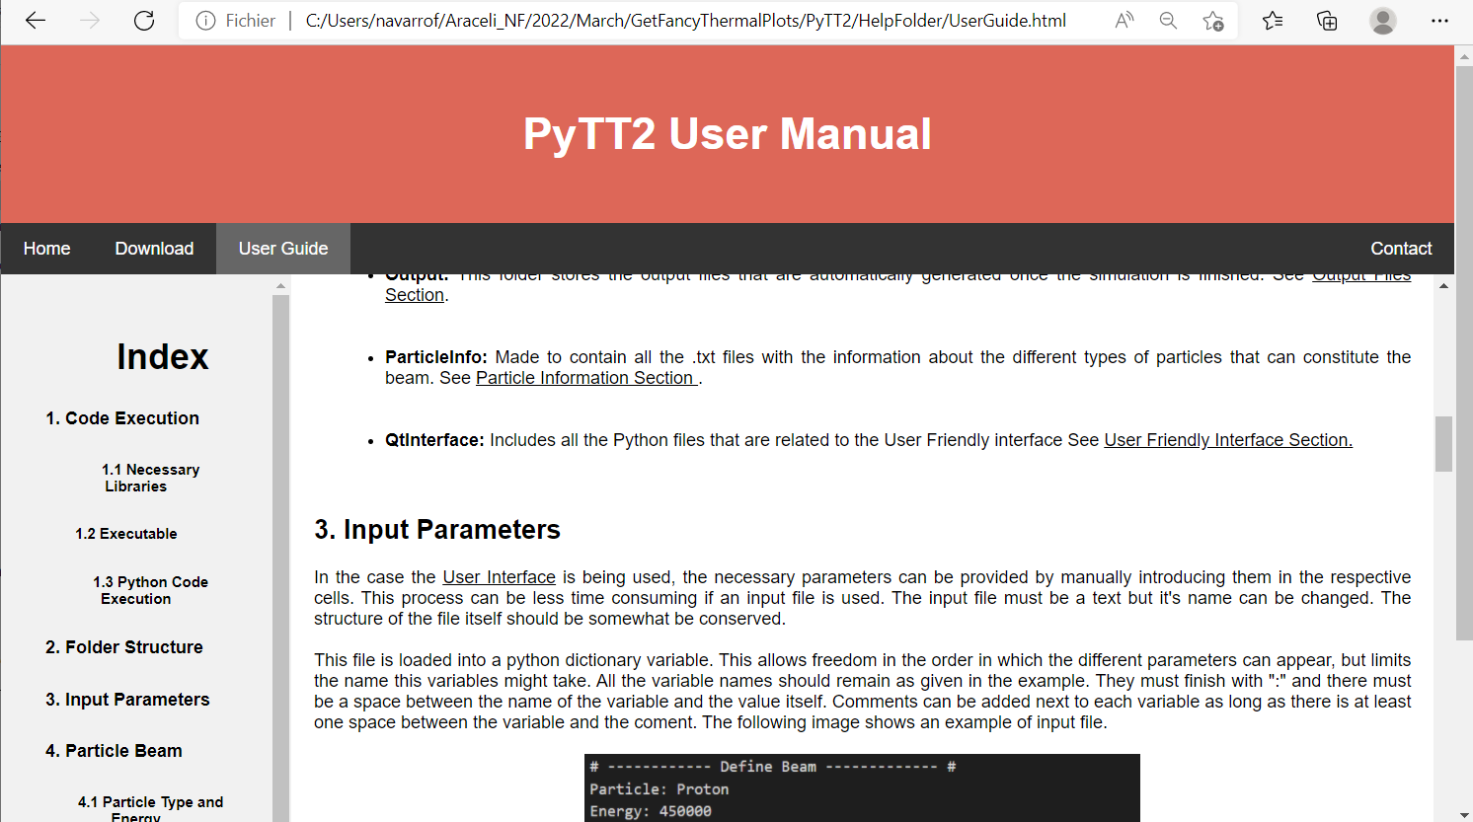
Wire Simulations: Thermal Model
Can be launched via terminal or user-friendly interface.
Easy to implement macro files.
Different beam types and conditions.
Simulations available for Wire Grids, Foils and Wire scanners.
Different cooling mechanisms can be activated or deactivated.
Parameter variation allows parameters to vary with temperature.

Slide 20
Outline
SEM Grids and Wire Scanners. Why are thermal simulations necessary?
Temperature Simulations:
  Thermal Model.
  Examples of Simulations.
  User friendly interface.
Examples of application.
  Linac4 beam power limits.
  Others applications.
Uncertainty calculations.
Emissivity measurements.

Slide 21

Linac4 Beam Power Limits.
Objective: To protect the diagnostic systems along the accelerator.
If beam conditions are above a certain threshold, an interlock is produced before the monitors are damaged.
Beam Parameters:
$$σ_{x}, { σ}_{y} ,Intensity, Pulse Lenght.$$

Slide 22
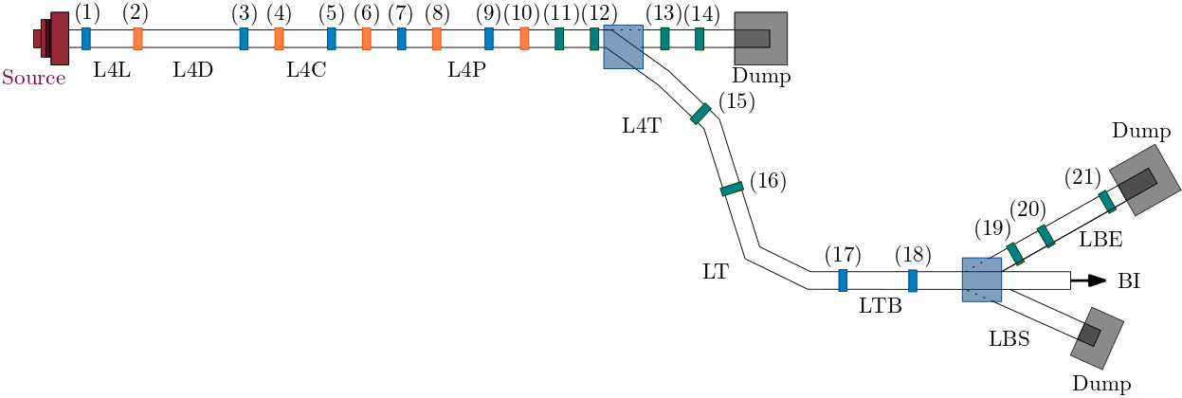
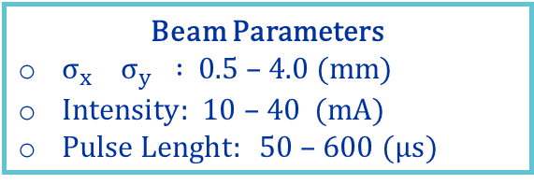
Linac4 Beam Power Limits.
Beam Parameters
$σ_{x} σ_{y} :$0.5 – 4.0 (mm)
$Intensity:$ 10 – 40 (mA)
$Pulse Lenght:$ 50 – 600 ($μs)$
For each device in Linac4, we were able to calculate the beam power limits.
Device Name
(1) L4L.BSGH/V.1173 (2) L4L.BSW.3310 | (11) L4T.BSGH/V.0223 L4T.BWS.0223 (12) L4T. BSGH/V.0243 L4T.BWS.0243 (13) L4T. BSGH/V.0523 L4T.BWS.0523 (14) L4T. BSGH/V.1250 L4T.BWS.1250 | (17) LTB. BSGH/V.30 (18) LTB. BSGH/V.40
(3) L4C.BSGH/V.0121 (4) L4C.BSW.0212 (5) L4C.BSGH/V.0421 (6) L4C.BSW.0622
 |  | (19) LBE. BSGH/V.025 LBE.BWS.025 (20) LBE. BSGH/V.030 LBE.BWS.030 (21) LBE. BSGH/V.040 LBE.BWS.040
(7) L4P.BSGH/V.0121 (8) L4P.BWS.0402 (9) L4P.BSGH/V.0601 (10) L4P.BWS.1002
 | (15) L4Z. BSGH/V.0253 L4Z.BWS.0253 (16) L4Z. BSGH/V.0267 L4Z.BWS.0267

Slide 23
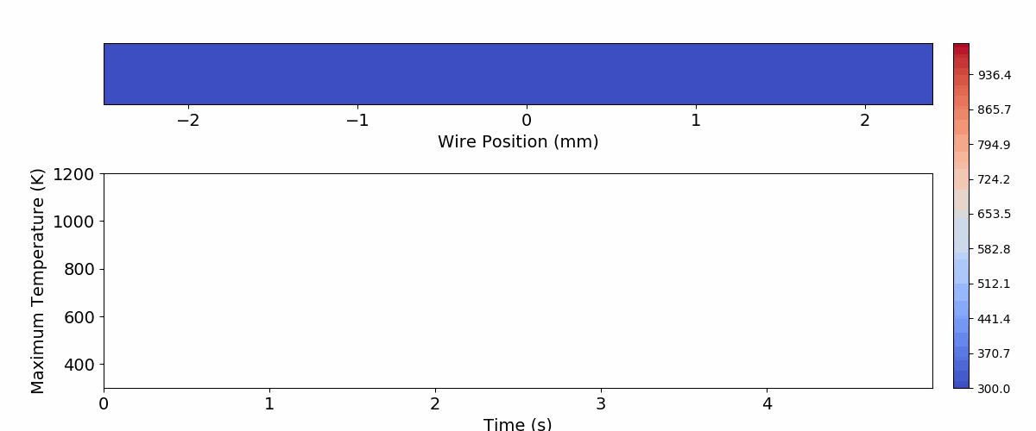
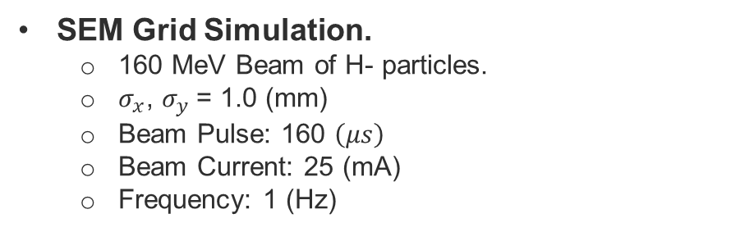
Linac4 Beam Power Limits.
SEM Grid Simulation.
  160 MeV Beam of H- particles.
  $σ_{x}$, $σ_{y}$= 1.0 (mm)
  Beam Pulse: 160 $\left(μs\right)$
  Beam Current: 25 (mA)
  Frequency: 1 (Hz)

Slide 24
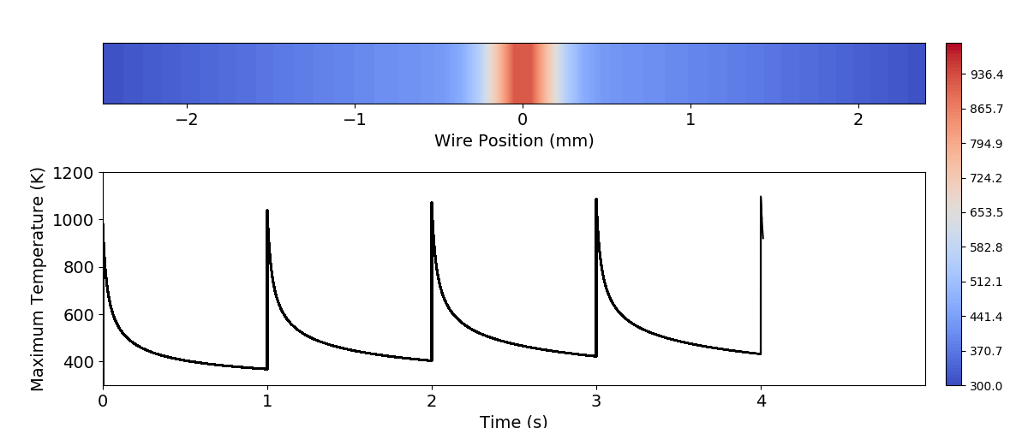
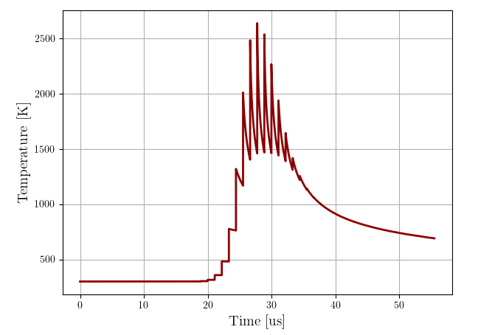
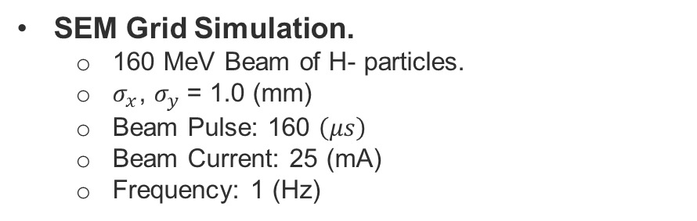
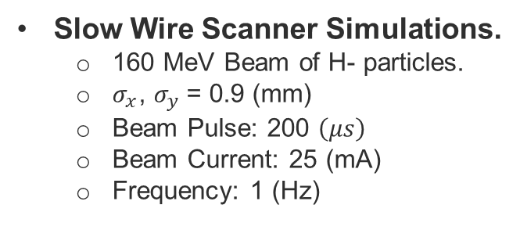
Linac4 Beam Power Limits.
SEM Grid Simulation.
  160 MeV Beam of H- particles.
  $σ_{x}$, $σ_{y}$= 1.0 (mm)
  Beam Pulse: 160 $\left(μs\right)$
  Beam Current: 25 (mA)
  Frequency: 1 (Hz)
Slow Wire Scanner Simulations.
  160 MeV Beam of H- particles.
  $σ_{x}$, $σ_{y}$= 0.9 (mm)
  Beam Pulse: 200 $\left(μs\right)$
  Beam Current: 25 (mA)
  Frequency: 1 (Hz)

Slide 25
Linac4 Beam Power Limits.
$T_{Max}=1400 K$. Has been stablished as the temperature limit at LINAC4 due to gold coated tungsten wires.

Slide 26
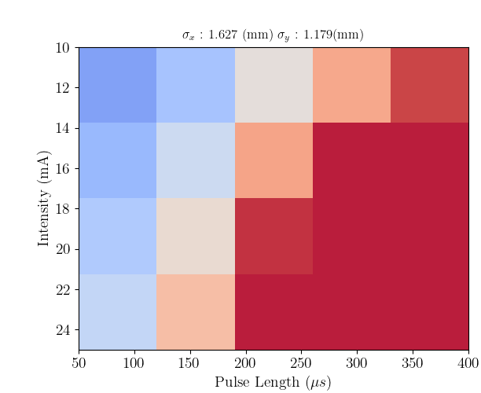
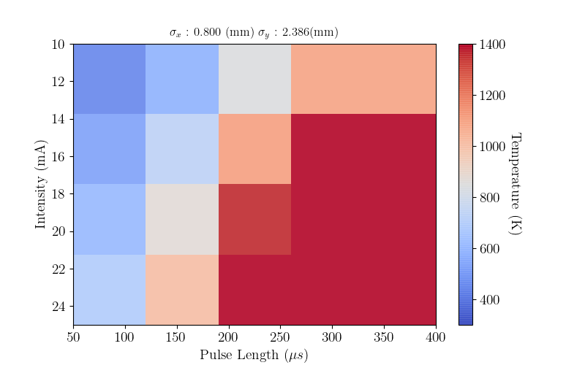

Linac4 Beam Power Limits.
$T_{Max}=1400 K$. Has been stablished as the temperature limit at LINAC4 due to gold coated tungsten wires.
L4C.BSGH/V.0421
$$σ_{x}:1.627 \left(mm\right) σ_{y}:1.179 \left(mm\right)$$

Slide 27
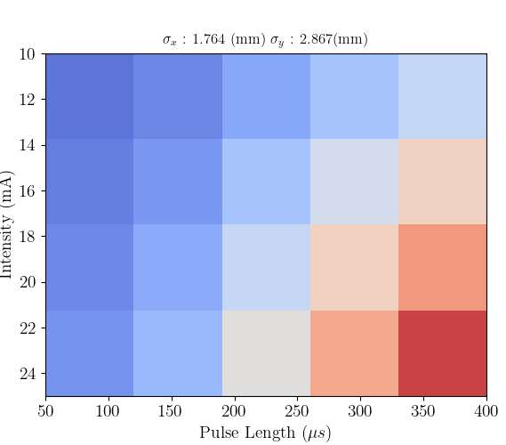

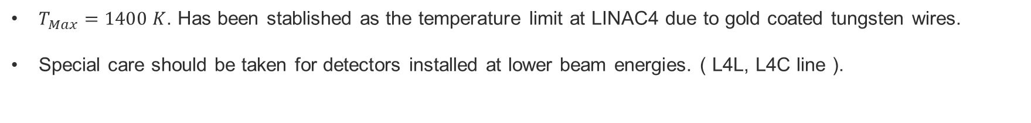
Linac4 Beam Power Limits.
$T_{Max}=1400 K$. Has been stablished as the temperature limit at LINAC4 due to gold coated tungsten wires.
Special care should be taken for detectors installed at lower beam energies. ( L4L, L4C line ).
L4C.BSGH/V.0421
$$σ_{x}:1.627 \left(mm\right) σ_{y}:1.179 \left(mm\right)$$
L4T.BSGH/V.0223
$$σ_{x}:1.764 \left(mm\right) σ_{y}:2.867 \left(mm\right)$$

Slide 28

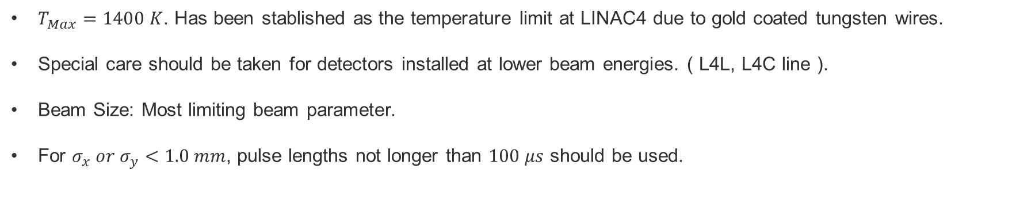
Linac4 Beam Power Limits.
$T_{Max}=1400 K$. Has been stablished as the temperature limit at LINAC4 due to gold coated tungsten wires.
Special care should be taken for detectors installed at lower beam energies. ( L4L, L4C line ).
Beam Size: Most limiting beam parameter.
For $σ_{x} or σ_{y}<1.0 mm$, pulse lengths not longer than $100 μs$ should be used.
L4C.BSGH/V.0421
$$σ_{x}:1.627 \left(mm\right) σ_{y}:1.179 \left(mm\right)$$
L4T.BSGH/V.0223
$$σ_{x}:1.764 \left(mm\right) σ_{y}:2.867 \left(mm\right)$$
L4T.BSGH/V.0223
$$σ_{x}:0.800 \left(mm\right) σ_{y}:2.386 \left(mm\right)$$

Slide 29
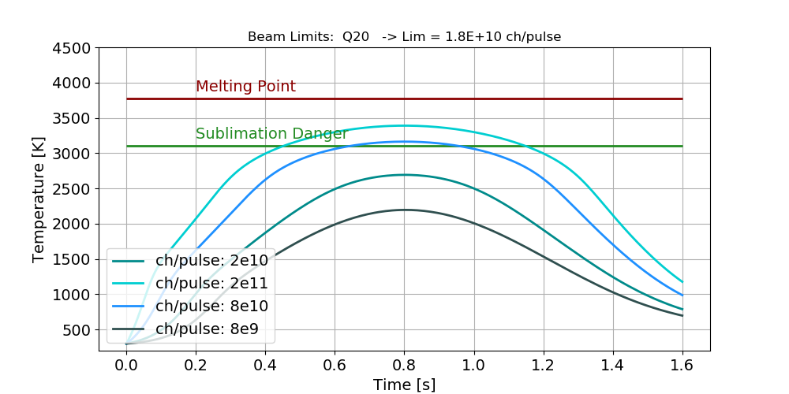
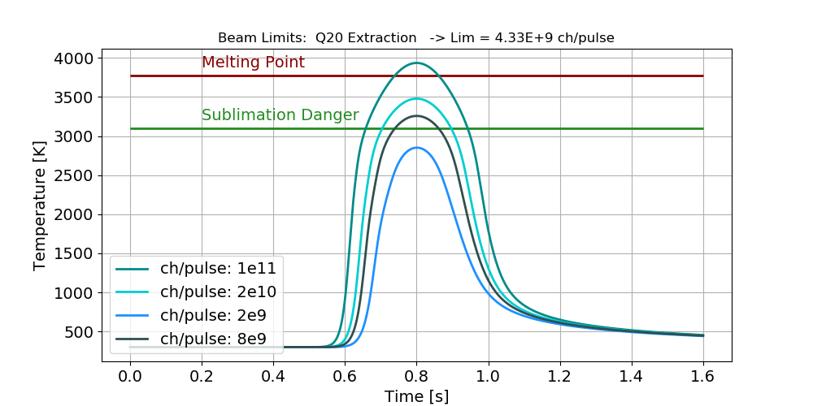
Other Applications
Calculation of Beam Power Limits for wire scanners at CERN SPS.
  Objective: To calculate parameter limits such as, minimum wire speed, maximum number of particles, maximum number of bunches, etc.

Slide 30
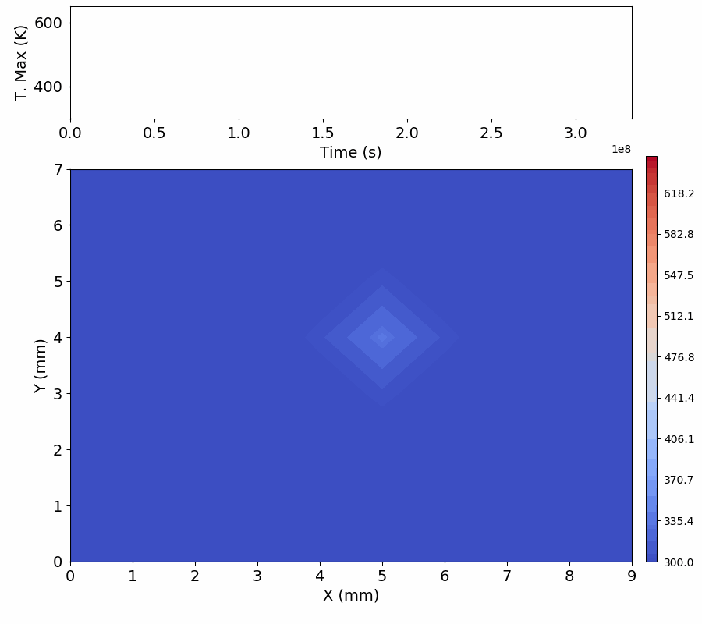
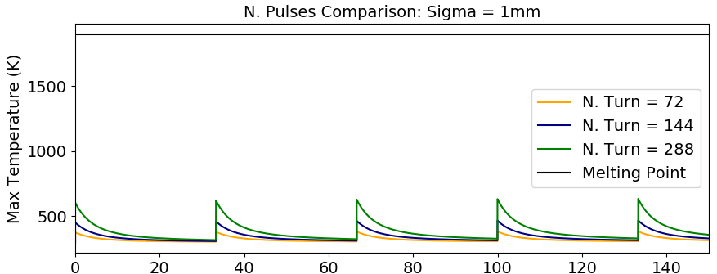
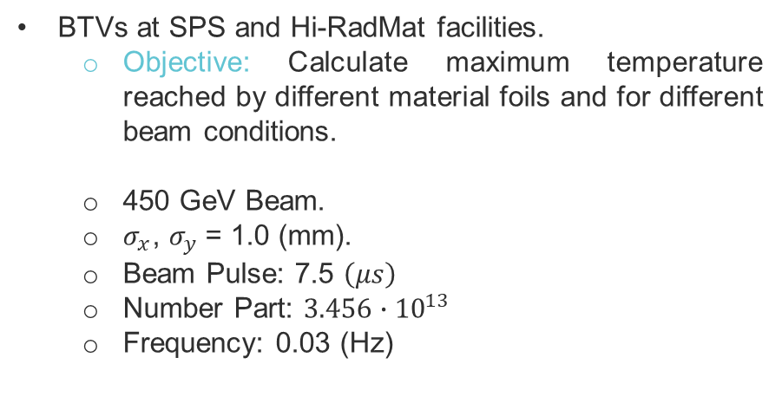
Other Applications
BTVs at SPS and Hi-RadMat facilities.
  Objective: Calculate maximum temperature reached by different material foils and for different beam conditions.
  450 GeV Beam.
  $σ_{x}$, $σ_{y}$= 1.0 (mm).
  Beam Pulse: 7.5 $\left(μs\right)$
  Number Part: $3.456∙{10}^{13}$
  Frequency: 0.03 (Hz)

Slide 31
Outline
SEM Grids and Wire Scanners. Why are thermal simulations necessary?
Temperature Simulations:
  Thermal Model.
  Examples of Simulations.
  User friendly interface.
Examples of application.
  Linac4 beam power limits.
  Others applications.
Uncertainty calculations.
Emissivity measurements.

Slide 32
Uncertainty determination
Several factors can contribute to the final results uncertainty. For example, computational errors, parameters uncertainties.

Slide 33
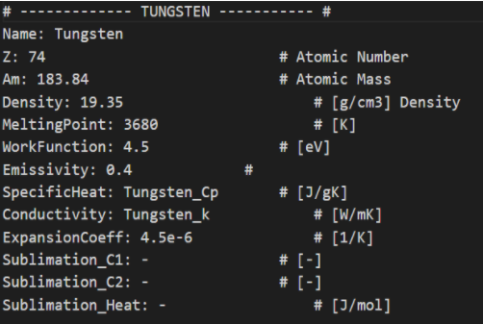
Uncertainty determination
Several factors can contribute to the final results uncertainty. For example, computational errors, parameters uncertainties.
Two types of parameters:
  Beam and Detector Parameters: How well do we know our simulation case.
  Material Parameters: How accurately is our model.

Slide 34
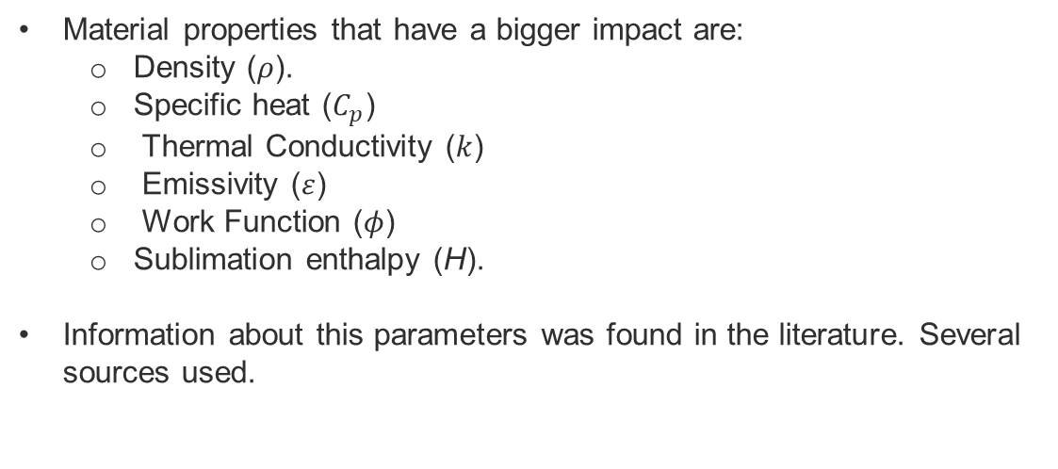
Uncertainty determination
Material properties that have a bigger impact are:
  Density ($ρ$).
  Specific heat ($C_{p}$)
  Thermal Conductivity ($k$)
  Emissivity ($ε$)
  Work Function ($φ$)
  Sublimation enthalpy (H).
Information about this parameters was found in the literature. Several sources used.

Slide 35
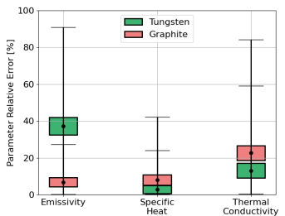
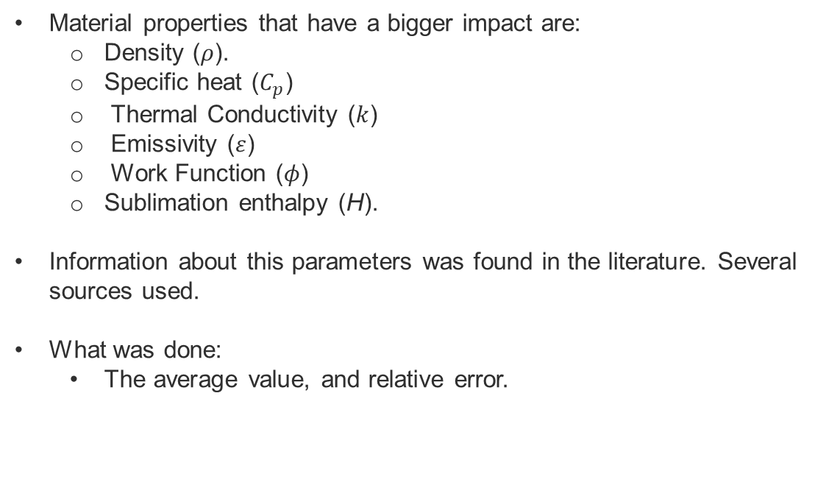
Uncertainty determination
Material properties that have a bigger impact are:
  Density ($ρ$).
  Specific heat ($C_{p}$)
  Thermal Conductivity ($k$)
  Emissivity ($ε$)
  Work Function ($φ$)
  Sublimation enthalpy (H).
Information about this parameters was found in the literature. Several sources used.
What was done:
  The average value, and relative error.

Slide 36
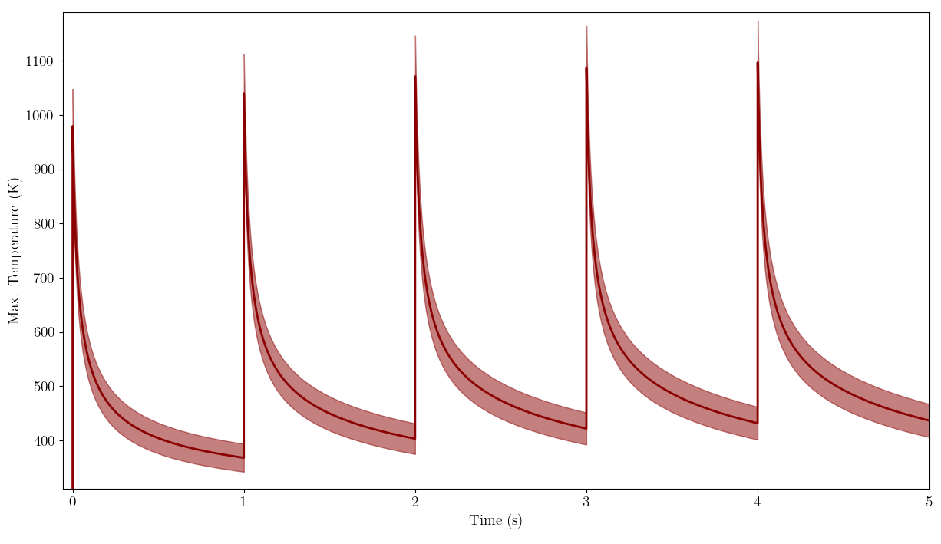
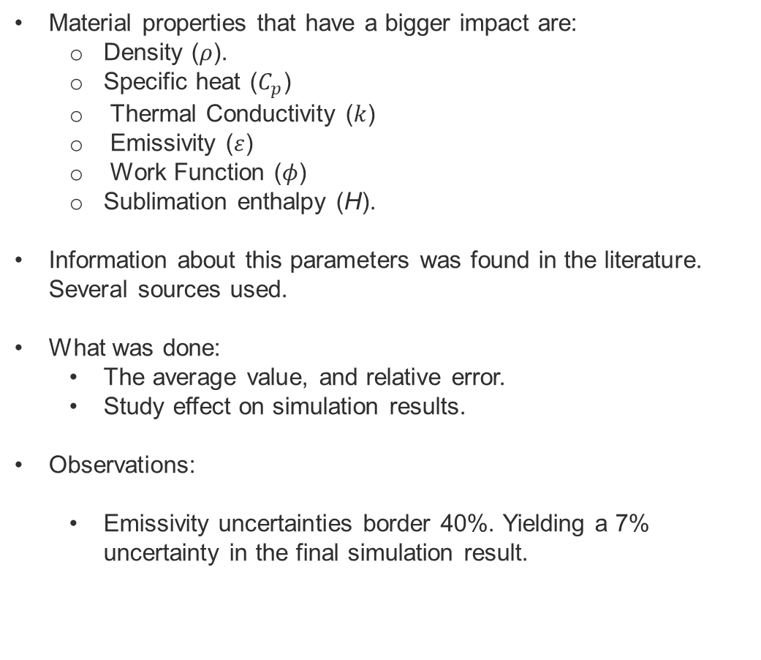
Uncertainty determination
Material properties that have a bigger impact are:
  Density ($ρ$).
  Specific heat ($C_{p}$)
  Thermal Conductivity ($k$)
  Emissivity ($ε$)
  Work Function ($φ$)
  Sublimation enthalpy (H).
Information about this parameters was found in the literature. Several sources used.
What was done:
  The average value, and relative error.
  Study effect on simulation results.
Observations:
  Emissivity uncertainties border 40%. Yielding a 7% uncertainty in the final simulation result.

Slide 37
Outline
SEM Grids and Wire Scanners. Why are thermal simulations necessary?
Wire Simulations:
  Thermal Model.
  Examples of Simulations.
  User friendly interface.
Examples of application.
  Linac4 beam power limits.
  Others applications.
Uncertainty calculations.
Emissivity measurements.

Slide 38
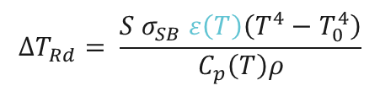
Emissivity measurement
We want to measure the emissivity of Tungsten wires. It tell us how easily materials cool down by emitting electromagnetic radiation.
$$ΔT_{Rd}= \frac{{S σ}_{SB} ε\left(T\right)\left(T^{4}−T_{0}^{4}\right)}{C_{p}\left(T\right)ρ}$$
$$ΔT_{tot}= ΔT_{Ht}−ΔT_{Rd}−ΔT_{Cond}−ΔT_{th}$$

Slide 39
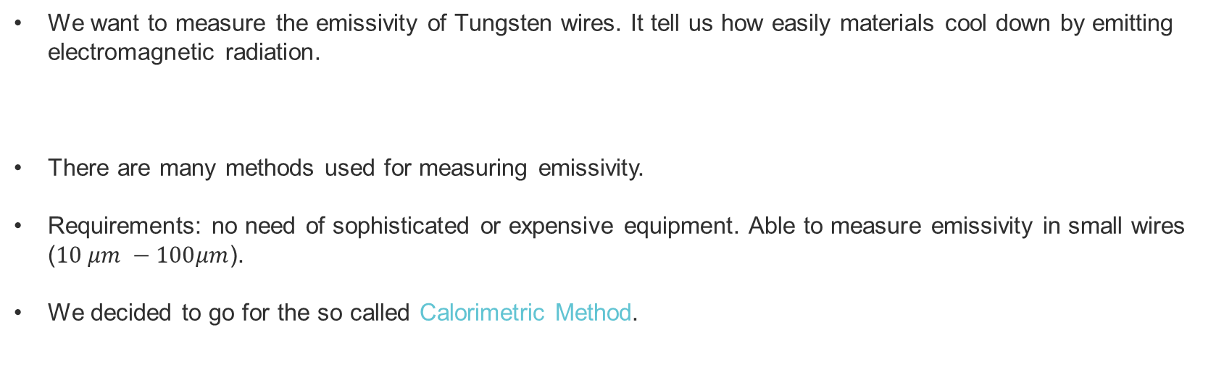
Emissivity measurement
We want to measure the emissivity of Tungsten wires. It tell us how easily materials cool down by emitting electromagnetic radiation.
There are many methods used for measuring emissivity.
Requirements: no need of sophisticated or expensive equipment. Able to measure emissivity in small wires ($10 μm −100μm$).
We decided to go for the so called Calorimetric Method.
$$ΔT_{Rd}= \frac{{S σ}_{SB} ε\left(T\right)\left(T^{4}−T_{0}^{4}\right)}{C_{p}\left(T\right)ρ}$$
$$ΔT_{tot}= ΔT_{Ht}−ΔT_{Rd}−ΔT_{Cond}−ΔT_{th}$$

Slide 40
Emissivity measurement
We want to measure the emissivity of Tungsten wires. It tell us how easily materials cool down by emitting electromagnetic radiation.
There are many methods used for measuring emissivity.
Requirements: no need of sophisticated or expensive equipment. Able to measure emissivity in small wires ($10 μm −100μm$).
We decided to go for the so called Calorimetric Method.
$$ΔT_{Rd}= \frac{{S σ}_{SB} ε\left(T\right)\left(T^{4}−T_{0}^{4}\right)}{C_{p}\left(T\right)ρ}$$
$$ΔT_{tot}= ΔT_{Ht}−ΔT_{Rd}−ΔT_{Cond}−ΔT_{th}$$
[1] C. Izarra, JM. Gitton, “Calibration and temperature profile of a tungsten filament lamp”. European Journal of Physics, 2010
[2] F. Volklein et. al. “The experimental investigation of thermal conductivity and the Wiedemann-Franz law for single metallic nanowires”, Nanotechnology, 2009.
[3] Gerald W. Recktenwald, “Finite-Difference Approximations to the Heat Equation”. Mechanical Engineering, 10, 2004.

Slide 41
Calorimetric Method
It is a direct and absolute method, no reference needed.
Gives us information about the total hemispherical emissivity. No information about wavelength or directionality.
It is based on studying the energy balance of the sample material at a certain temperature.
$$ΔT_{tot}= ΔT_{Ht}−ΔT_{Rd}−ΔT_{Cond}−ΔT_{th}$$

Slide 42

Calorimetric Method
It is a direct and absolute method, no reference needed.
Gives us information about the total hemispherical emissivity. No information about wavelength or directionality.
It is based on studying the energy balance of the sample material at a certain temperature.
$$ΔT_{Ht}= \frac{I^{2}R(T)}{C_{p}\left(T\right)ρ_{v}V_{ol}}Δt$$
$$ΔT_{tot}= ΔT_{Ht}−ΔT_{Rd}−ΔT_{Cond}−ΔT_{th}$$
Joule heating

Slide 43
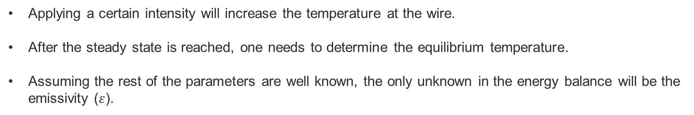
Calorimetric Method
It is a direct and absolute method, no reference needed.
Gives us information about the total hemispherical emissivity. No information about wavelength or directionality.
It is based on studying the energy balance of the sample material at a certain temperature.
$$ΔT_{Ht}= \frac{I^{2}R(T)}{C_{p}\left(T\right)ρ_{v}V_{ol}}Δt$$
$$ΔT_{tot}= ΔT_{Ht}−ΔT_{Rd}−ΔT_{Cond}−ΔT_{th}$$
Joule heating
Applying a certain intensity will increase the temperature at the wire.
After the steady state is reached, one needs to determine the equilibrium temperature.
Assuming the rest of the parameters are well known, the only unknown in the energy balance will be the emissivity ($ε$).
$$\frac{I^{2}R(T)}{C_{p}\left(T\right)ρ_{v}V_{ol}}=\frac{{S σ}_{SB} ε\left(T\right)\left(T^{4}−T_{0}^{4}\right)}{C_{p}\left(T\right)ρ}−α\frac{∂T}{∂x}−S\left(φ+2σ_{SB}T\right) \frac{J_{Th }(T)}{C_{p}\left(T\right)ρ}$$

Slide 44
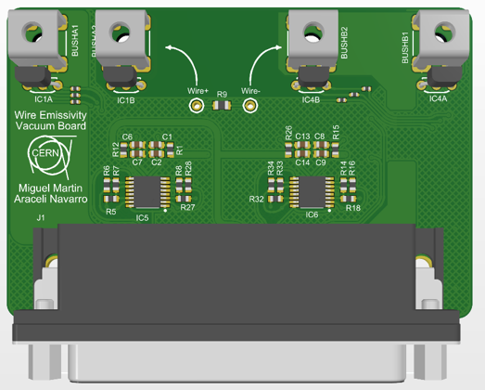
Experimental Set up
Measuring Board
Dedicated electronics design and implementation.
Measuring Board:
  Measures the current and voltage drop on the wire.
  Large range of measured voltages (0 – 6 V), and Intensities (0 – 2 A).
  Three different gains available for Voltage measurements, and Two for intensity measurements.
  Temperature Measured at the extremes of the wire by means of IC temperature sensors.

Slide 45
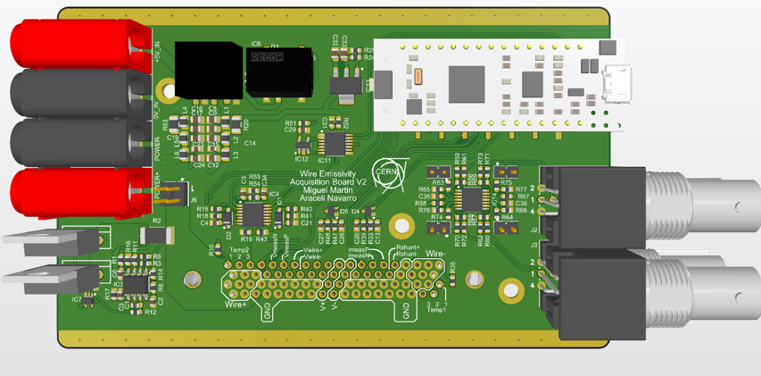
Experimental Set up
Measuring Board
Dedicated electronics design and implementation.
Measuring Board:
  Measures the current and voltage drop on the wire.
  Large range of measured voltages (0 – 6 V), and Intensities (0 – 2 A).
  Three different gains available for Voltage measurements, and Two for intensity measurements.
  Temperature Measured at the extremes of the wire by means of IC temperature sensors.
Acquisition Board:
  Provides the measuring board with the necessary signals.
  Acquires and digitalizes the digitalized intensities and voltages.
Acquisition Board

Slide 46
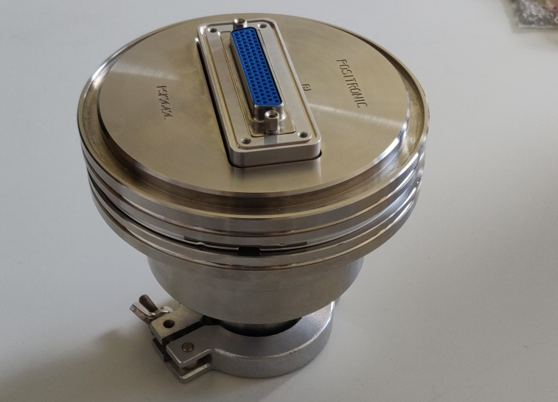
Experimental Set up
In order to avoid convective heat losses and wire oxidation a pressure $≤{10}^{−5} (mbar)$ was needed
Vacuum Chamber. Provided by SY-BI-XEI

Slide 47
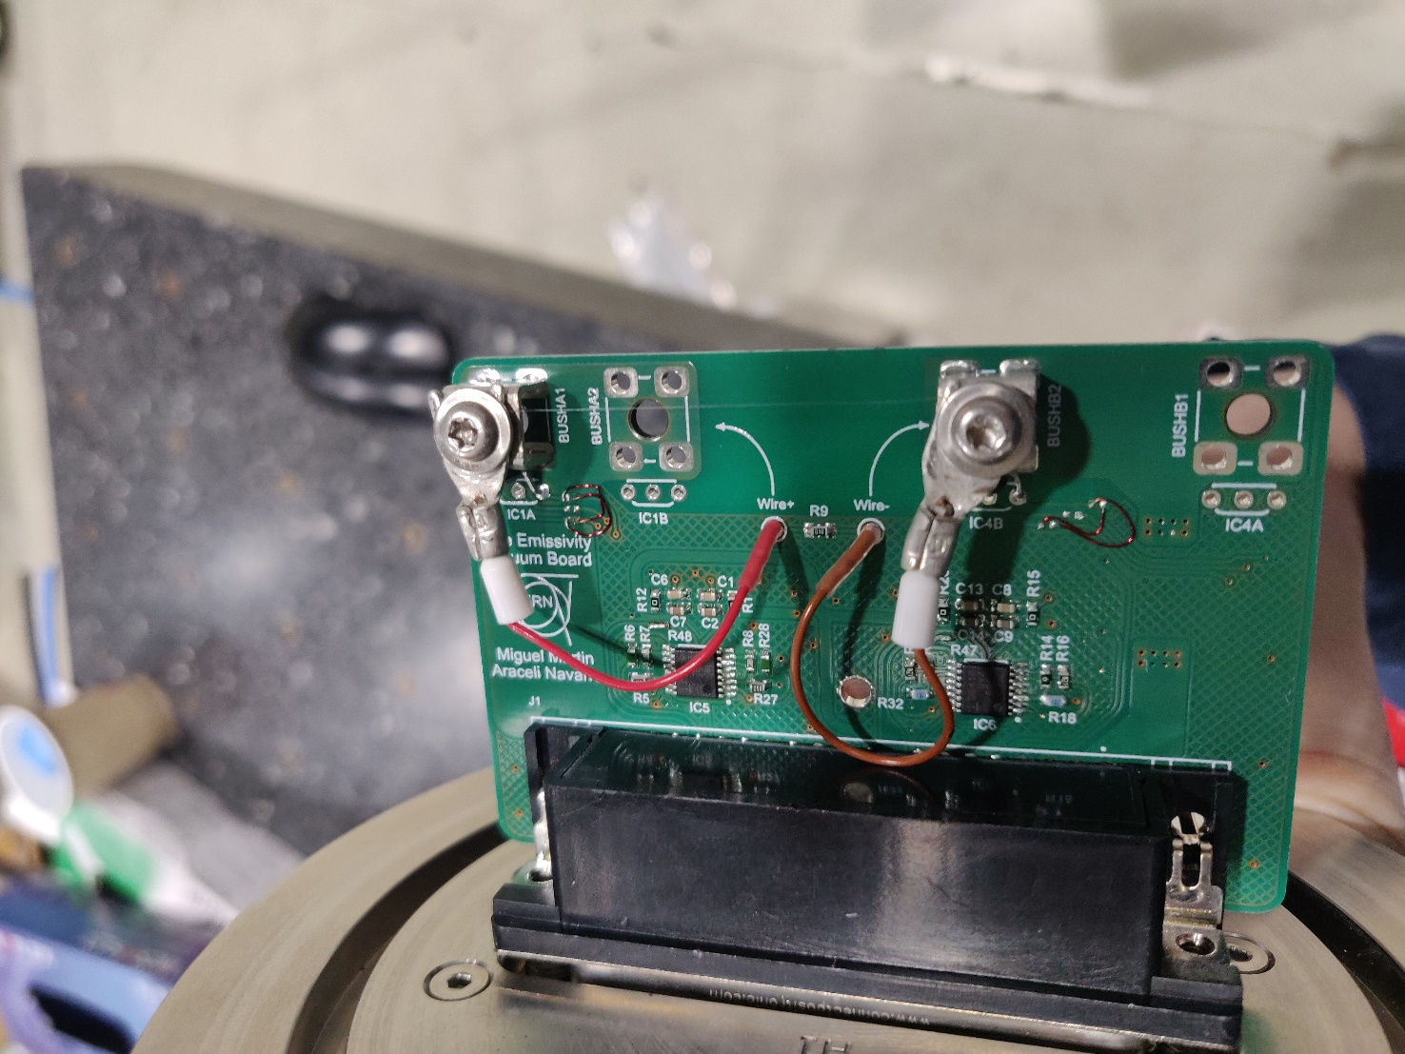
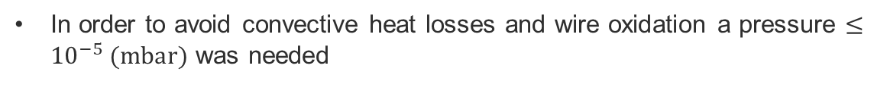

Experimental Set up
In order to avoid convective heat losses and wire oxidation a pressure $≤{10}^{−5} (mbar)$ was needed
Vacuum Chamber. Provided by SY-BI-XEI
Tungsten Wire ($40 μm)$

Slide 48
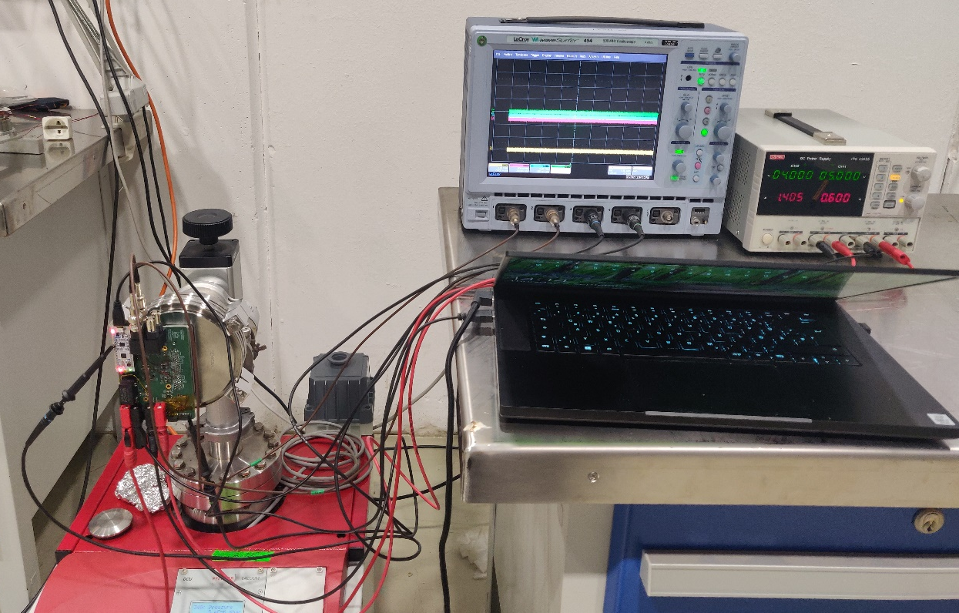
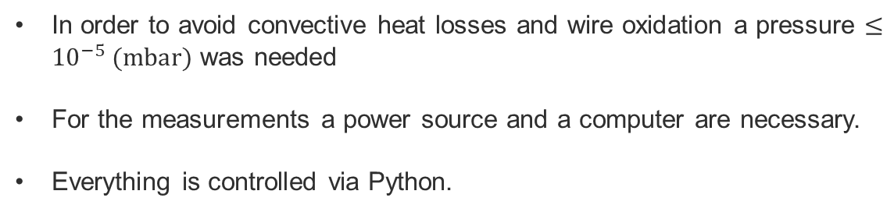
Experimental Set up
In order to avoid convective heat losses and wire oxidation a pressure $≤{10}^{−5} (mbar)$ was needed
For the measurements a power source and a computer are necessary.
Everything is controlled via Python.
Vacuum Chamber. Provided by SY-BI-XEI
Tungsten Wire ($40 μm)$

Slide 49
Current Status

Slide 50
Current Status
First version of the electronics was implemented and tested. It was very useful in order to implement the second version.
Second version of the electronics has been finalized and calibrated.

Slide 51
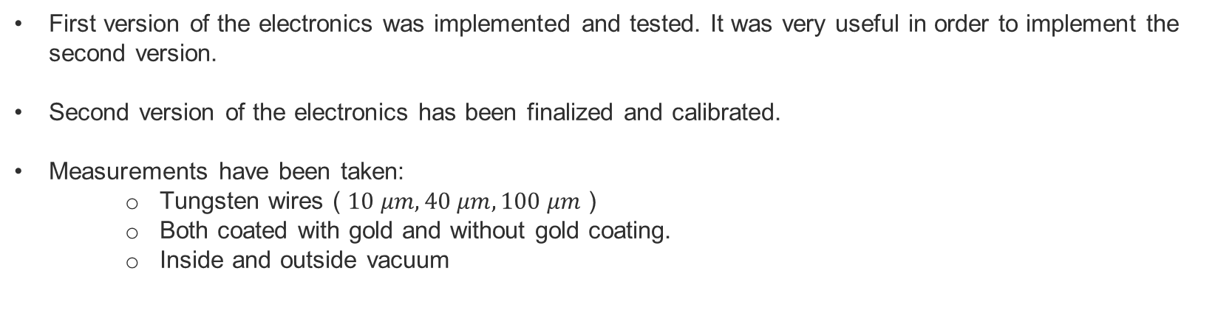
Current Status
First version of the electronics was implemented and tested. It was very useful in order to implement the second version.
Second version of the electronics has been finalized and calibrated.
Measurements have been taken:
    Tungsten wires ( $10 μm, 40 μm, 100 μm$ )
    Both coated with gold and without gold coating.
    Inside and outside vacuum

Slide 52

Current Status
First version of the electronics was implemented and tested. It was very useful in order to implement the second version.
Second version of the electronics has been finalized and calibrated.
Measurements have been taken:
    Tungsten wires ( $10 μm, 40 μm, 100 μm$ )
    Both coated with gold and without gold coating.
    Inside and outside vacuum
To do: Analyze data ……

Slide 53
Summary
Thermal simulations are necessary to understand thermal effects on wire signals and avoid permanent damages.
Finite element code has been implemented in order to simulate this thermal evolution for thin target detectors.
The code is fully operational, it can simulate a variety of beam conditions and detectors.
It has been used for several applications. Ex. Linac4 power limit calculations, SPS wire scanner limits, foil studies, etc.
Parameter uncertainties can induce errors of around 7% in the final simulation results for tungsten wires.
In order to minimize this uncertainties, an experiment to determine the emissivity of tungsten has been is currently taking place.

Slide 55
Bench Marking Method
The best way to cross check the reliability of the simulations is to compare them with experimental measurement of the temperature.
RPOBLEM: Direct measurement of the temperature are not an easy task.

Slide 56


Bench Marking Method
The best way to cross check the reliability of the simulations is to compare them with experimental measurement of the temperature.
RPOBLEM: Direct measurement of the temperature are not an easy task.
Indirect temperature measurement:
$Q\left(\frac{e}{Proj}\right)$ = $Q_{dep}+Q_{SE}+Q_{th}$

Slide 57


Bench Marking Method
The best way to cross check the reliability of the simulations is to compare them with experimental measurement of the temperature.
RPOBLEM: Direct measurement of the temperature are not an easy task.
Indirect temperature measurement:
$Q\left(\frac{e}{Proj}\right)$ = $Q_{dep}+Q_{SE}+Q_{th}$

Slide 58


Bench Marking Method
The best way to cross check the reliability of the simulations is to compare them with experimental measurement of the temperature.
RPOBLEM: Direct measurement of the temperature are not an easy task.
Indirect temperature measurement:
$Q\left(\frac{e}{Proj}\right)$ = $Q_{dep}+Q_{SE}+Q_{th}$

Slide 59



Bench Marking Method
The best way to cross check the reliability of the simulations is to compare them with experimental measurement of the temperature.
RPOBLEM: Direct measurement of the temperature are not an easy task.
Indirect temperature measurement:
$Q\left(\frac{e}{Proj}\right)$ = $Q_{dep}+Q_{SE}+Q_{th}$
$$J_{th}=A_{R}T^{2}\exp\left(\frac{−Φ}{K_{B}T}\right)$$
Thanks to thermionic emission we have a relationship between current and temperature
Idea: If one is able to reach a point were thermionic emission can be measured, by simultaneously measuring the current and the temperature, one should be able to asses the goodness of the thermal simulations.

Slide 60

Bench Marking Method
All the tests were done at Linac4 using L4T.BSGH.0223 Grid. (160 MeV beam)

Slide 61



Bench Marking Method
All the tests were done at Linac4 using L4T.BSGH.0223 Grid. (160 MeV beam)
During Measurements, all beam parameters remained constant except for beam pulse length.
$$N_{i}∝ \frac{I∙∆t}{σ_{x}σ_{y}}$$

Slide 62


Bench Marking Method
Simulation seems to reproduce the experimental results. The agreement in terms of wire signal versus current evolution is well within 10% after averaging for LINAC4 source intensity modulation.
For the moment, the simulations do not include a variable beam intensity during the pulse (e.g. modulation from the source).
The beam parameters taken for the simulation were measured experimentally.
Parameters for wire properties were the best estimate found in literature.
More experiments are necessary, but this first result at LINAC4 gives a high degree of confidence in the accuracy of the simulated temperatures.

