Slide 1
The Changing Landscape of
Alumni Relations
CEADS
20 June 2022
Notes:
Well, we’ve all lived through quite a challenging time….
Everyone has their own war stories.
It feels as though we’re at an inflection point – a time to take stock, to celebrate our agility, to reflect on what the pandemic has taught us and to press the reset button.
Alumni Relations has certainly never been more important….

Slide 2
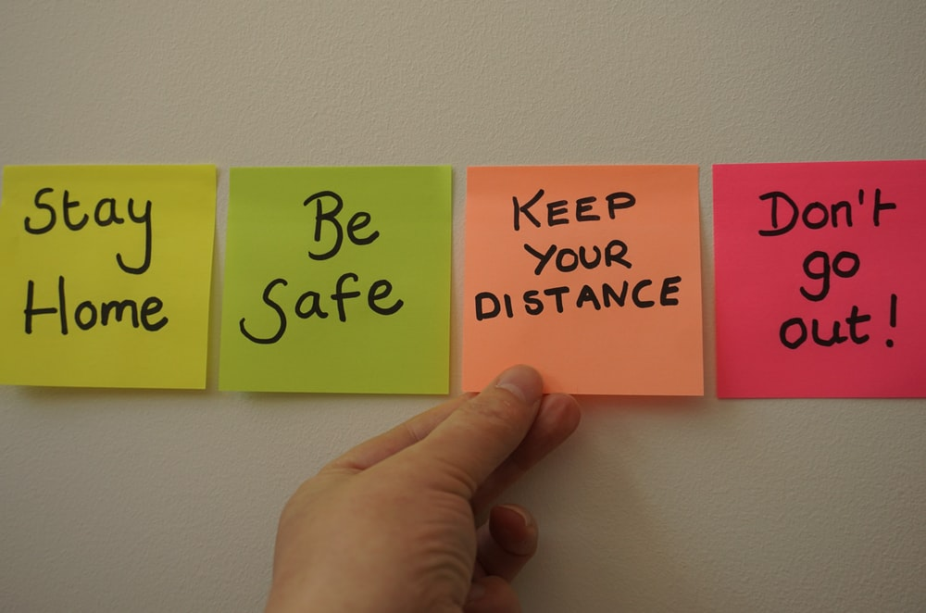
It’s been a strange few years…..
Notes:
No one saw this coming…..one day it was BAU, the next, we were cancelling everything and headed home for the Long Lockdown.
Staff were furloughed, we set up shop in our living rooms/dining rooms/spare rooms and introduced meetings on Teams or Zoom. The world outside got very quiet, the air was cleaner but our focus turned inwards.
Some of us realised that our alumni were vulnerable – especially the older ones – and reached out with a friendly call to say ‘we care about you’. Others embraced digital media and experimented with online programming to replace the face to face events. Our students were sent home and lost the opportunity to have a ‘campus’ experience.
COVID forced us to work differently, learn differently, connect differently….and to assess what was important.

Slide 3




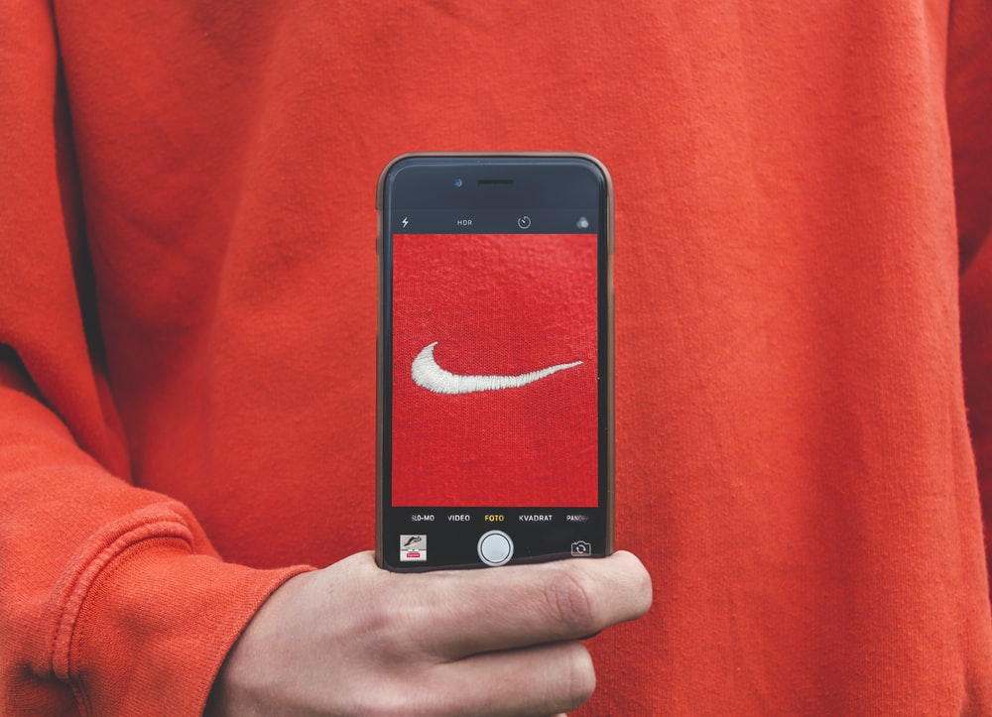
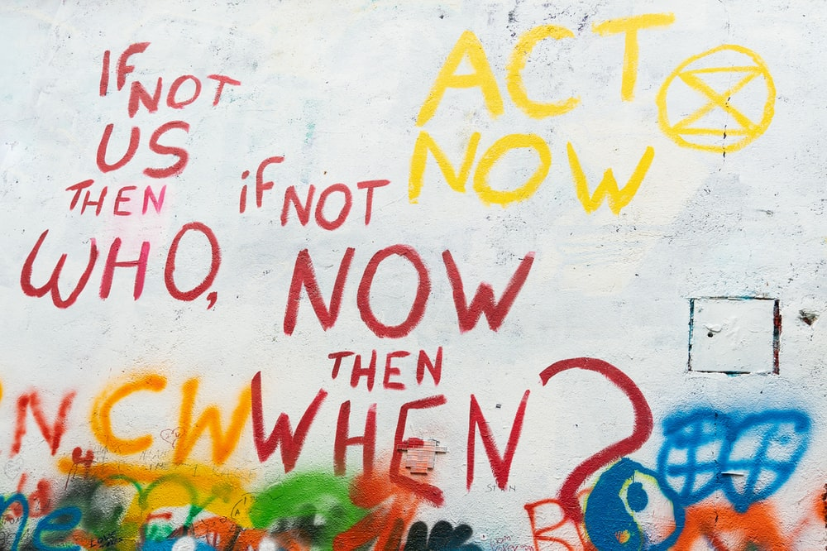

COVID hasn’t been the only disruptor……
Notes:
But COVID hasn’t been the only disruptor. We’re at an inflection point because of a number of other mitigating factors:
The explosion of technology as a delivery mechanism for alumni engagement
The arrival of Gen Z and their very specific characteristics which set new expectations (cynicism about institutions, nomad like existence,
The rise of alumni as customer – I paid my money/what are you going to give me?
Universities need to diversify their funding sources (government funding is reduced/alumni are seen to be a new source of funds
Competition across universities for applicants, research funding, philanthropy
The rise of the University as a Brand – how can alumni help to shape that?
Rise of activism amongst younger alumni – can their university provide the platform for that activism
Alumni are no longer simply graduates of their university – they are seen to be partners, enablers, image shapers, brand advocates, sources of internships and jobs for students…..and, of course, funders.

Slide 4
Mission of the Oxford Alumni Office
To inform, engage and empower alumni
Our values
Agile, creative, risky, collaborative, responsive, bold
Vision of the alumni community
An engaged alumni community of Oxford Alumni who find relevance in the University and are inspired to participate throughout their lifetime.
Notes:
Through it all, though – our mission, vision and values haven’t changed.

Slide 5
Pro-Vice Chancellor for Development & External Affairs
David Gann OBE
Key
Blue – employed by UOAO
Green = Not employed by UOAO
Yellow = Only certain times of year
Executive Assistant to the Pro-Vice Chancellor
Lynn Boswell
Director of Alumni Relations
Christine Fairchild
Deputy Director of Alumni Relations
Clare Monaghan p/t
Administrative Assistant
Delia Skinner p/t
Personnel & Administration Officer
Claire Larkin
Assistant Accountant
Lisa Young p/t
Alumni Relations Manager (Medical Sciences)
Bella Pratt
Senior Manager for Strategic Marketing, Communications & Data
Steve Buchanan
Alumni Networks Manager
Charlotte Richards
Data & Insights Manager
Elina Cotterill
Alumni Networks Assistant
Christina White
Data Entry Assistant
Christopher Cuthbert p/t
Alumni Events & Lifelong Learning Manager
Jenny Wood
Communications Officer
Joanna Whiting p/t
MMG Intern
June – Sept post
Alumni Content Assistant
Zoe Burns p/t
Young Alumni Engagement Manager
Kathryn Suares p/t
Communications Officer
Harriet Packer
Digital Systems Officer
Vacant
Notes:
And our staff numbers have remained relatively stable. Except….
More staff are working from home
There are more PT staff
Skill sets have changed dramatically……
And staff are rethinking their job satisfaction and realigning their priorities…..
We’re certainly finding it really hard to recruit for our open positions.
We’re perhaps more closely aligned with the Development Office and Public Affairs

Slide 6




Janet, BA
View of own career trajectory:
Accomplished
Transitioning
Unaccomplished
Seeking the next step after university
AGE
21
STATUS
Recently graduated, seeking full-time work
COUNTRY OF RESIDENCE
UK
Philanthropic Inclination
Emotional connection to Oxford
Preferred alumnus/a engagement type
Converting my academic network into a professional one is key. Helping me to build connections in industry and carving out the beginning of my career.
AVOID communicating formally. I prefer authenticity and approachability.
CURRENT: Having just graduated, I don’t have enough funds to donate.
FUTURE: If I retain an engaging and thoughtful relationship with the University I would consider donating, depending on my financial position.
OXFORD UNIVERSITY VS COLLEGE: At the moment I’m closest to my college. It’s where most of my time-spent with the University has been. I can imagine this developing over time to be more inclusive of both.
Heartfelt
OXFORD EDUCATION
BA
LIFE AFTER OXFORD
Having just finished my BA and moved back home, I’m proactively trying to find my way into an industry where I can use my transferrable skills and do meaningful work.
The pivot to remote working and collaboration due to the pandemic has made it difficult to network and find job prospects.
I’m very close to my college and course friends, and hope that I can use the University’s career and alumni resources to find permanent work.
Instrumental
Current degree of involvement with and attachment to the Oxford community
Poorly connected
Highly connected
Attached to University
Attached to College
DO:
DON’T:
Connect me with alumni from my college or course in the workforce to help me scope out what next steps I can take. I’d value the mentorship.
Over-communicate about surface-level Oxford narratives such as the buildings and history, it’s cliché. I want to hear about more diverse perspectives. I also seek a more pragmatic relationship with the University. How can it help me kick-start my career?
Invite me only to generic events – I’d prefer a more targeted set of options with course, college, career-specific events.
Keep me regularly updated with the University’s work in current affairs and research advancements. I want to know about the University’s commitments to corporate/social good.
Notes:
Key snippets from Six Generational research
Generation Z is on track to be the best educated generation to date & more likely to have a university-educated parent. This has contributed to high levels of awareness of socio-cultural issues shaping society.
As a result, Gen Z are the the most ethically and racially diverse generation in history. Diversity matters to them through many dimensions, not just isolated to race and gender, but also related to identity, orientation, ideas, creativity and community.
Gen Z’s have had crucial formative years completely disrupted by the COVID-19 crisis. For the older ones, they were entering into the workforce of a booming global economy and now are entering a recession. And for the younger ones, their educational experience has been significantly altered.
Further to recent events, Gen Z are experiencing increasing frustration with older generations around the Climate Crisis, Black Lives Matter, Globalisation and polarizing politics.
58% of Gen Z designated ‘Belonging to a community’ as very or quite important..
Gen Z chose communications to be targeted in a friendly way (60:40). This is in alignment with Gen Z’s desire to be ‘authentic’ and ‘independent’, thus favouring communication which echoes in- person conversation, rather than a formally constructed ema

Slide 7
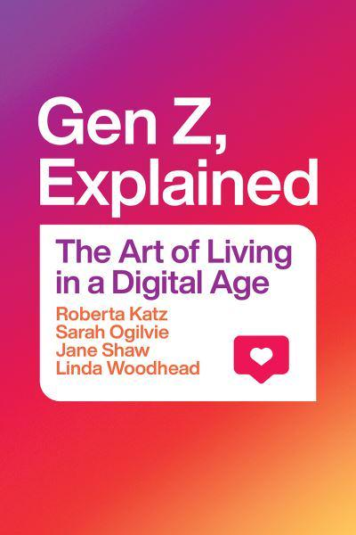
Food for thought…..
Deloitte’s 2022 Gen Z and Millennial Survey: https://www2.deloitte.com/content/dam/Deloitte/global/Documents/deloitte-2022-genz-millennial-survey.pdf

Slide 8
Top Level KPIs
% for whom we have consent to contact
% of Leavers who have set up a My Oxford Account
% of alumni with a My Oxford Account
% of alumni groups working as ‘Partners’
% of alumni from prioritised cohorts who participate
Submit engagement metrics to CASE for comparison with sister institutions

Slide 9

More food for thought….

Slide 10
How do we respond?
Stay agile – the landscape will continue to change
Stay close to alumni; use your data to inform strategy and decisions
Ensure staff are well supported and prepared to take on the new challenges (skill building)
Stay purposeful and intentional with everything you do – what do you expect to get out of your activities? What do you want alumni to get out of them? How will you know if you’re successful?
Keep an eye on the future; what’s next?

Slide 11
Questions? Thoughts? How are you responding to these changes?

