Slide 1
CASE Update for the
Central Europe Advancement Directors Summit (CEADS)
June 2022

Slide 2



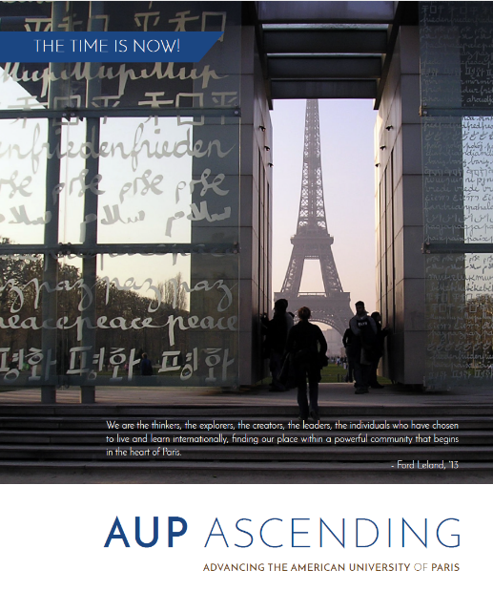



A little bit about me

Slide 3
Today’s Session
Developments
CASE’s new Strategy for 2022-2027
Research &
Data Update
What has happened since our last meeting in June-2020.
Europe and CASE
What next?

Slide 4
Championing Advancement
2022-2027
1

Slide 5
The world has changed immeasurably in the 21st Century and educational institutions across the globe recognise the ever-vital role of Advancement in building reputation, relationships, and revenue.
CASE is championing the next level of professionalism in advancement, driving our institutions to success…
Council for Advancement and Support of Education © 2022

Slide 6
CASE is GLOBAL
Europe
North America
Emerging in Middle East and Africa
Asia Pacific
Latin America
Find more maps at slidescarnival.com/extra-free-resources-icons-and-maps

Slide 7
97,000
3,100
80
Advancement practitioners
Member institutions
Countries

Slide 8
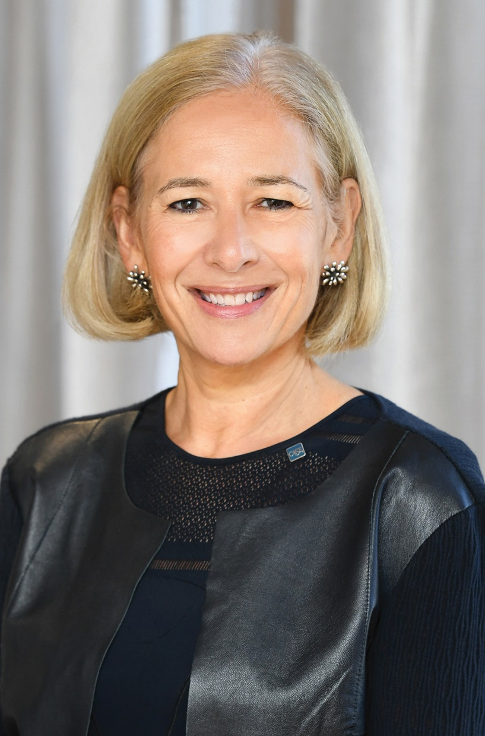

Sue Cunningham
President and CEO of CASE
“No matter how we might reimagine ourselves, our capacity to connect all those who care about advancing education & research will be at the core of what we do.”

Slide 9
CASE’s Vision and Mission
As a catalyst for advancing education worldwide, we inspire, challenge, and equip communities of professionals to act effectively and with integrity to champion the success of their institutions.
Advancing education to transform lives and society.

Slide 10

Find your connection.
Notes:
What does that mean in practice

Slide 11
Welcome to a global community
When your institution is a member of CASE, it is integrated into a community of more than 97,000 advancement professionals worldwide with access for your entire team to a suite of benefits and opportunities for global exchange
CASE Communities (regional & global)
e-Mentoring or volunteering opportunities
Find your community, get to know your district cabinet and regional council.

Slide 12
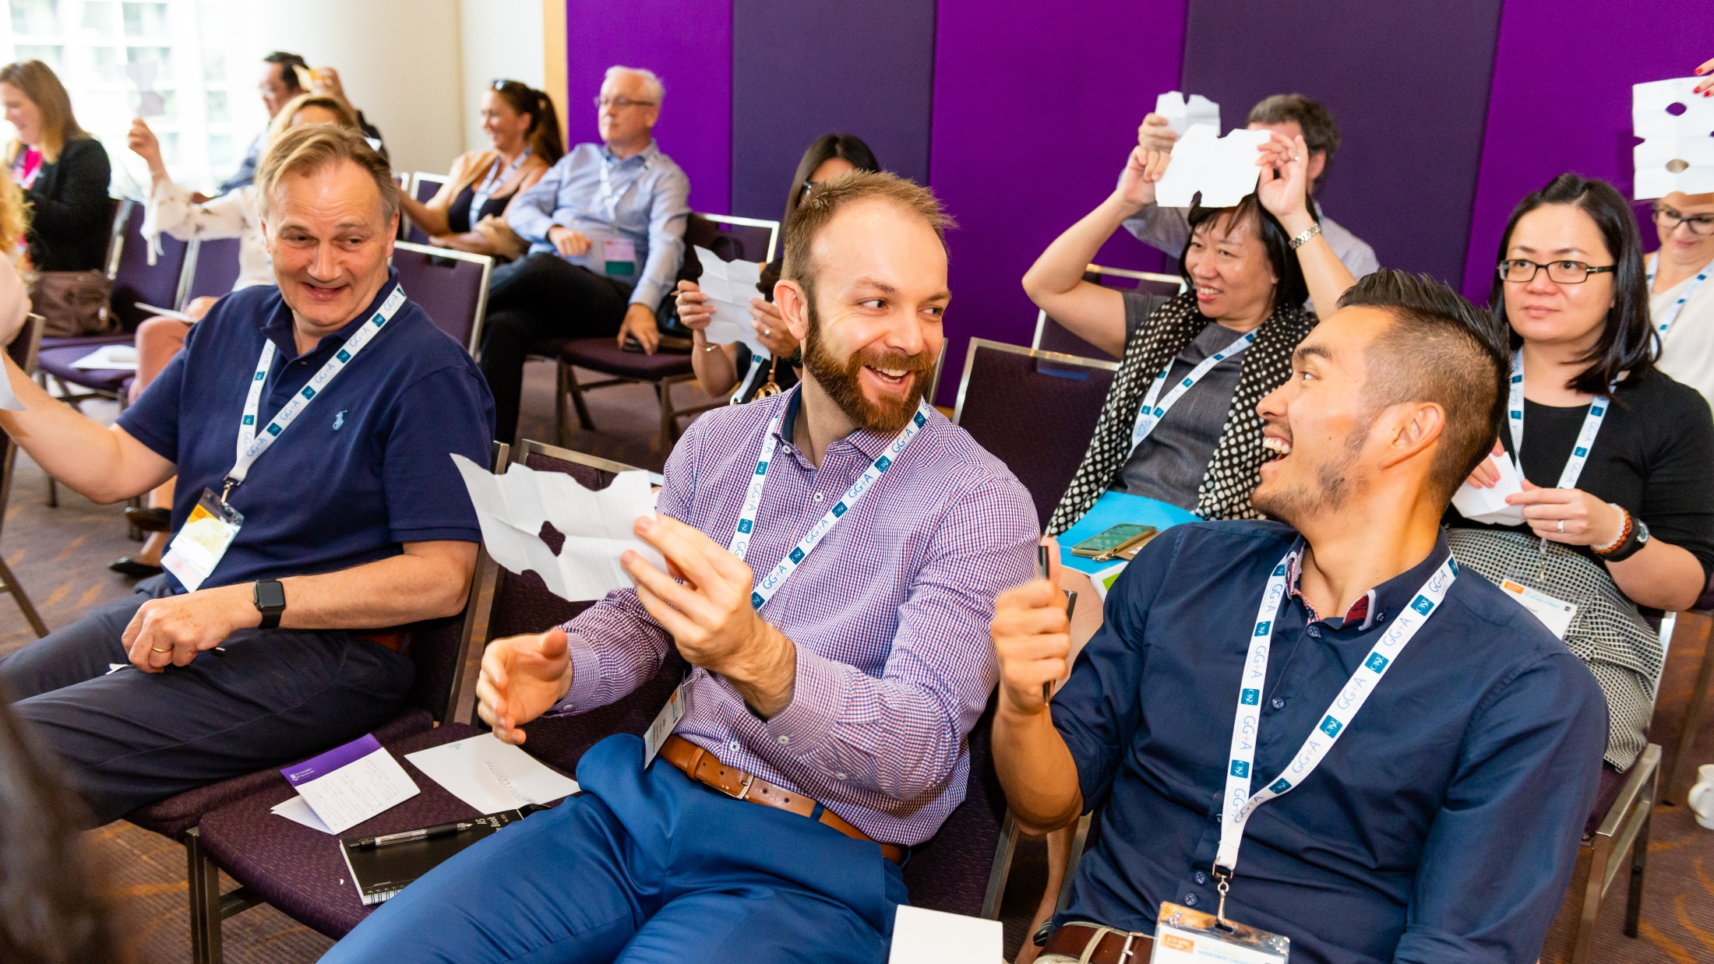
Find your inner leader.

Slide 13
Professional Development
Keep your skills competitive through a curriculum of content presented by the most innovative and inspiring leaders in the industry – at special member rates of up to 40% delegate discount
Conferences and events for all levels
Career journey mapping
Career Central jobs community
Talent management and scholarships

Slide 14

Find data that drives decisions.

Slide 15
Data and research
Get the tools & insights you need to respond to challenges and make data-driven decisions.
Renowned benchmarking surveys and reports
CASE’s Global Reporting Standards for fundraising
Data Miner and other tools

Slide 16
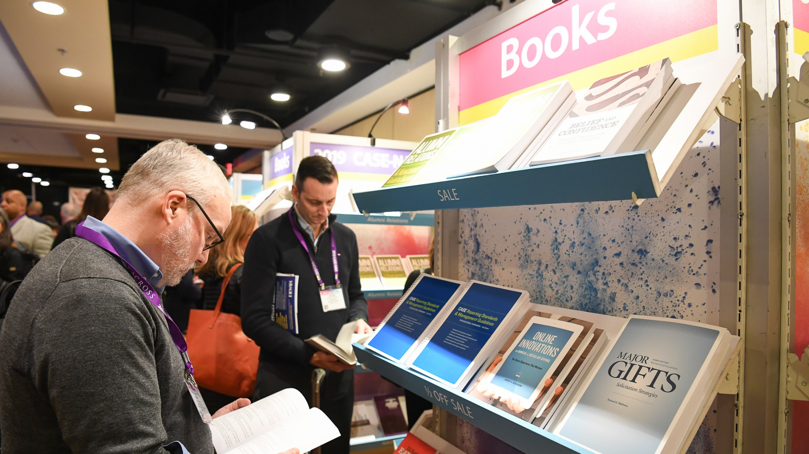
Find your next great idea.

Slide 17
Publications and Learning
Discover the latest in advancement-related news and articles from newsletters, blogs, and Currents magazine.
Bookstore and catalog of titles
CASE Academy
Online subject guides and news
Sample collections, templates

Slide 18
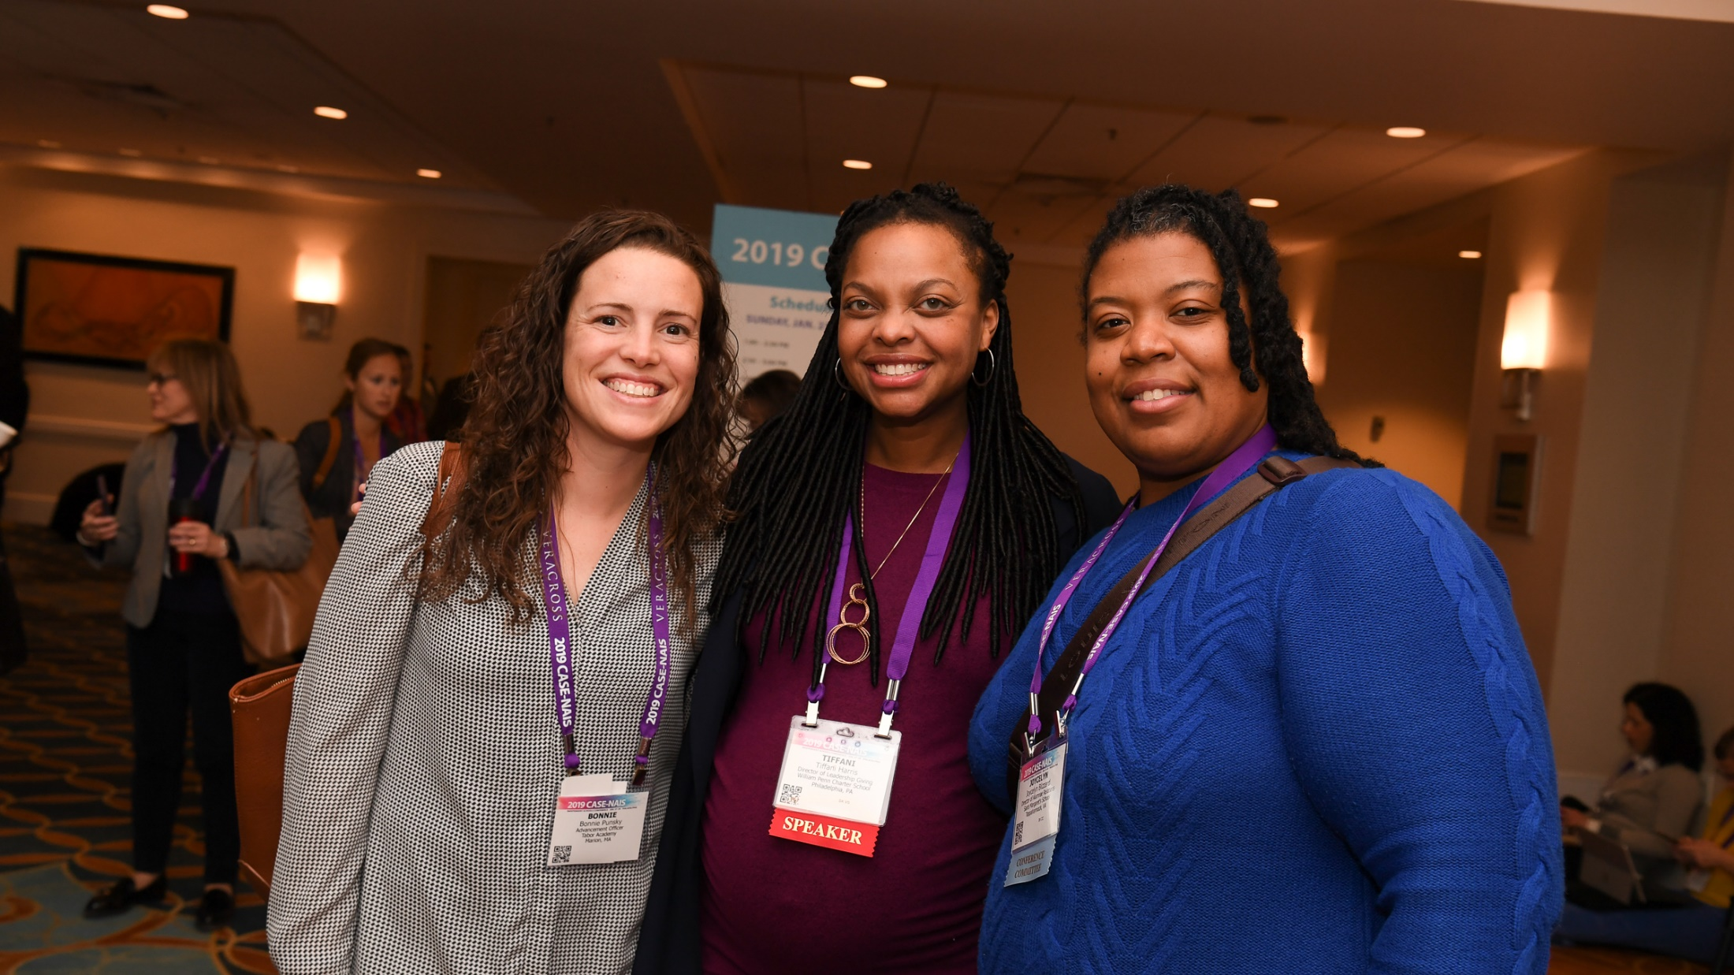
Find your diverse team.

Slide 19
Diversity, Equity, Inclusion, Belonging
Increasing support and intensifying focus on diversity, equity, inclusion and belonging (DEIB) in advancement.
DEIB Training
Resources for Minority Serving Institutions
CASE Inclusion Toolkit

Slide 20

Find your voice.

Slide 21
Advocacy and Public Policy
Amplify the issues related to advancement through support and expertise that helps advance growing government support for philanthropy.
Thought leadership and policy engagement
U.S. Advocacy Action Center
Europe Policy Resources

Slide 22

Research at CASE
2

Slide 23
Research at CASE
AMAtlas is CASE’s global resource for educational advancement-related metrics, benchmarks and analytics. (https://www.case.org/resources/amatlas)
We help you navigate data-driven decision making.
Participation in CASE surveys and access to data from those surveys is a membership benefit.
Its success depends on your participation
Collect data via surveys
Help you understand data
Assist your decision making
Notes:
AMAtlas = Advancement Metrics Atlas

Slide 24
CASE Global Reporting Standards
Alumni Engagement Metrics
Campaign Metrics
Emerging and Specialised Data
Philanthropy Metrics
Alumni engagement across four modes: Philanthropy, Volunteer, Experiential, and Communication. Testing engagement lifecycle and engagement by graduation cohort.
Key Philanthropic Indicators on Funds Received and overall Fundraising Activity (New Funds Committed)
Benchmark Completed Capital and Comprehensive Campaigns. Take part if you are in an Active campaign or if your institution’s campaign recently closed.
CASE Membership includes Global Benchmarks via AMAtlas surveys
Specialized and sponsored research to understand emerging trends.
Notes:
Notes:
AMAtlas’s work is underpinned by the CASE Global Reporting Standards; this includes all of our associated benchmarking surveys on fundraising, alumni relations, and marketing and communications.
Out regional fundraising surveys include:
CASE-Ross Group Support of Education Survey for United Kingdom and Ireland
Voluntary Support of Education for North America
CASE-CCAE Support of Education Survey for Canada
CASE Support of Education Survey, Australia and New Zealand
We also have global surveys:
CASE Global Core Metrics pilot which has key metrics for fundraising and alumni relations
CASE Global Alumni Engagement Metrics Survey which looks at alumni engagement across 4 modes – philanthropy, volunteerism, experiential and communication
CASE Marts&Lundy Global Campaign Metrics for active and completed campaigns
Additionally, we also undertake research on specialised topics like Diversity, Equity, Inclusion and Belonging (e.g., our UK DEI&B survey last year) and sponsored research like we have done on the University of Queensland project in 2020-2021, the largest gifts study which is just releasing now.

Slide 25
Updates since June-2020
CASE Global Reporting Standards
  Book launched Mar-2021 – both hard copy and digital version. 1st July 2022 onwards, CASE membership renewal comes with a Standards 1-year digital subscription.
Standards Training Sessions
  General training sessions for various regions were held in 2021 – to provide an introduction to the changes in the Standards.
CASE Global Reporting Standards Course
  Course launched in 2022.
  Comprehensive training course for professionals in Advancement Services, Advancement Operations, Data Insights and Strategy, Database Managers, and Gifts and Records.
  Course come with a 2-year digital subscription of the Standards.
Notes:
Points to note:
The CASE Global Reporting Standards
are updated from time-to-time (including corrections etc.), anyone with an active digital version will get access to such updates immediately (unlike those with a hard copy book). However, the digital version is linked to a person’s (at an institution) CASE login – so 1 digital version of the Standards per person needs to be taken.
Book – hard copy or 2-year digital subscription: £72 members/£90 non-members or $95 members /$120 non-members
Standards course:
Participants will receive a Certificate with ability to upload to LinkedInBadge on completion upon completion of modules and accompanying quizzes among other things.
Course: $750 members/$950 non-members

Slide 26
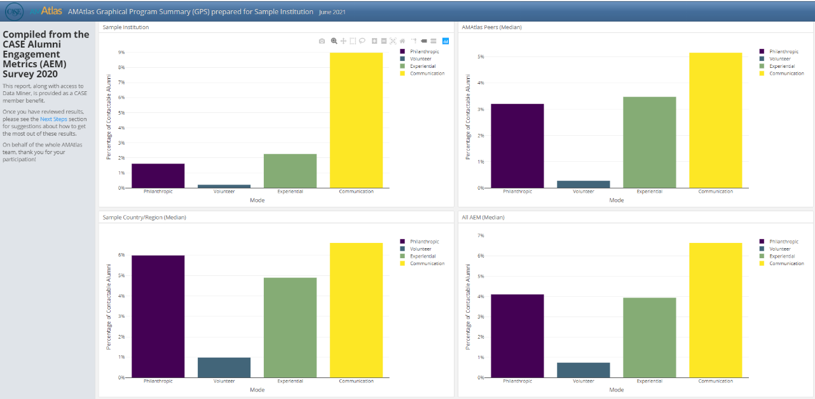
Sample Complimentary GPS Reports (members)

Slide 27
European Participation in CASE Research
CASE Global Reporting Standards
Institutions from the following countries have purchased copies:
    Finland
    France
    Italy
CASE Global Reporting Standards Course
187 registrants to the course.
None from Europe (outside of UK).
AEM/ CASE Global Alumni Engagement Metrics Survey
Participating institutions are from:
  Finland
  France
  Hungary
  Italy
  Netherlands
  Switzerland (2)
CASE Global Core Metrics Pilot Program
Participating institutions are from:
  Finland
  France
  Germany
  Hungary
  Italy
  Netherlands
  Sweden (2)
  Switzerland
More participation from Europe is needed!
Notes:
CASE Global Reporting Standards Course
187 registrants for course
11 Australia
14 Canada
4 UK
158 US
No one from Europe (outside of UK)
CASE Global Reporting Standards book
Finland 3 copies
France 4 copies
Italy 2 copies
CASE Global Core Metrics Pilot Program (Core Metrics)
University of Helsinki, Finland
American School of Paris, France
Central European University, Hungary
Bocconi University, Italy
University of Groningen, Netherlands
Ecole Polytechnique Federale de Lausanne, Switzerland
International School of Zug and Luzern, Switzerland

Slide 28
What’s next?
3

Slide 29

What’s next for CASE?
Looking back
Two tough years
Staff reductions
Loss of membership
Looking ahead
An ambiotious plan for growth
CEAC 2022 - Reimagine
Back in person in Glasgow
40% contributions from Europe

Slide 30
Reality check…
Has that changed your perception of
  What CASE can do for you?
  What you can do for CASE?
If there is one thing I can do…?

Slide 31
Thank you!
Maarten Vervaat
mvervaat#@case.org
For any research related questions contact:
Divya Krishnaswamy
Senior Research Analyst (London)
dkrishnaswamy@case.org or
research@case.org

