Slide 1
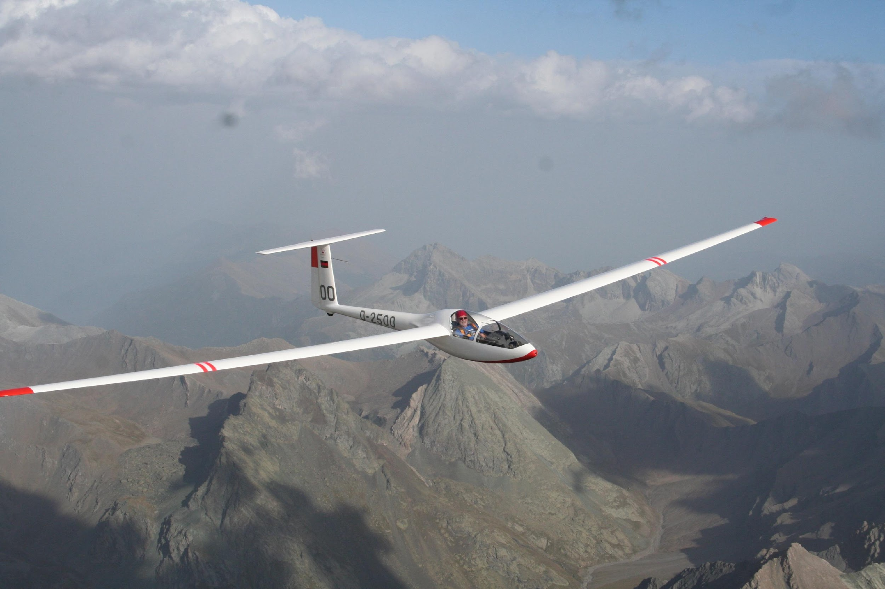
Alumni as an integral resource
Mehrnoosh Rayner
Head of Alumni Relations
CEADS
20-21 June 2022
Notes:
How and to whom do you communicate what you can do for your University / institute / organisation?
Do you use your institute‘s own language and priorities?
How do you set your goals? And are you measuring your alumni engagement metrics?

Slide 2
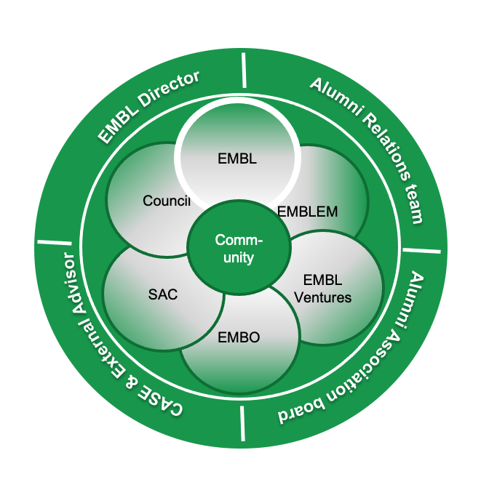
EMBL Alumni Relations: Operational Set Up
Active for +20 years
Community of 10,000 alumni
Shaped by
  EMBL Director
  Alumni Relations team
  Alumni Association board
  CASE & External Advisor
In regular consultation with internal stakeholders
Notes:
This is how we describe our operational set up.
The visual is taken from the new EMBL scientific programme.
It shows the focus of our work which is managing a portfolio of 10,000 alumni: data and relationship.
It also shows the 4 pillars that shape EMBL Alumni Relations.

Slide 3
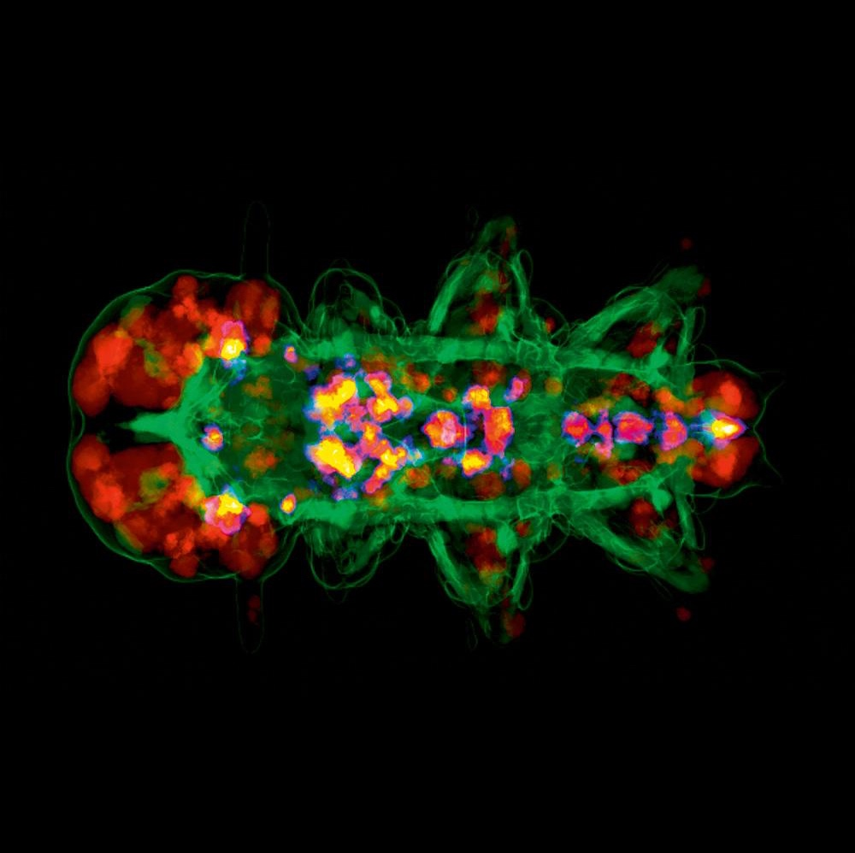
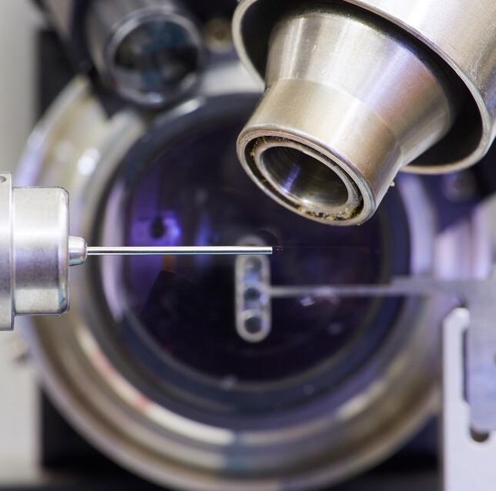
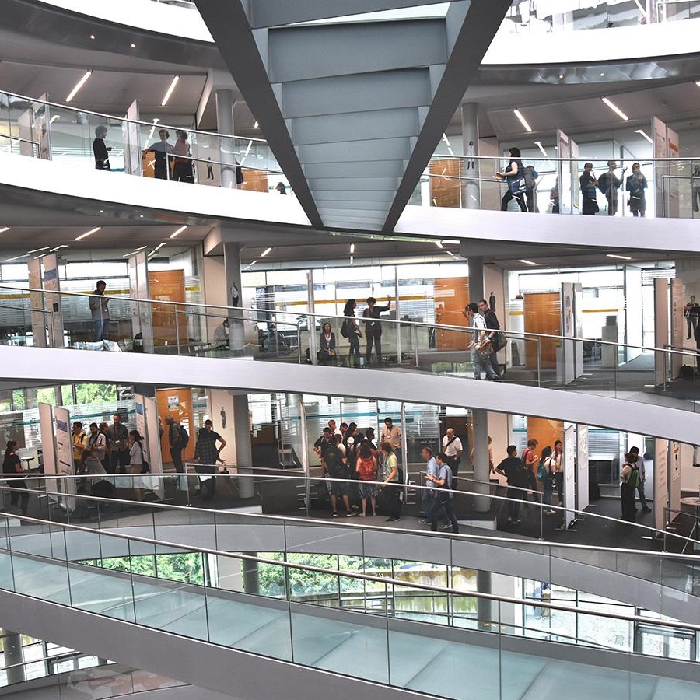
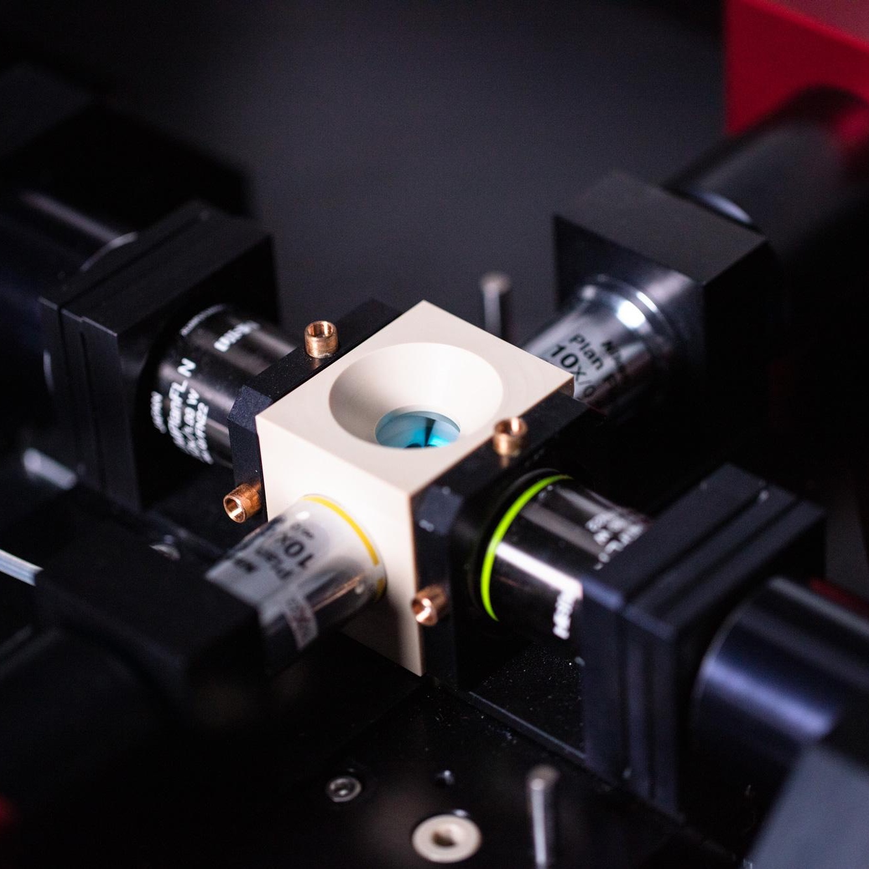

EMBL’s missions
Excellent research
Scientific services
Advanced
training
Innovation and translation
Integrating
life sciences
To Support Life Sciences in Europe and Beyond
Notes:
When management talks about EMBL‘s mission, they focus on the 5 missions.
In AR, we take the broad mission as our focus.

Slide 4
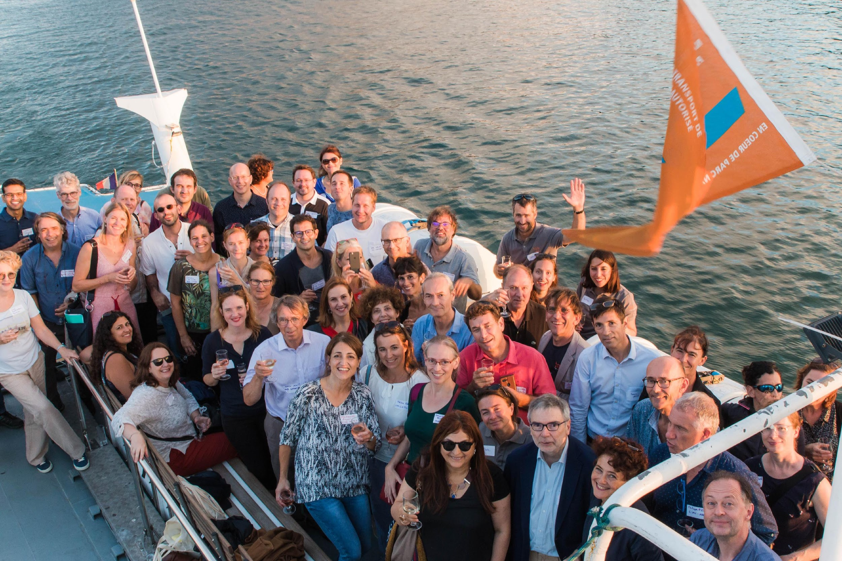
Mission
  The EMBL Alumni Relations programme
  is built to advance EMBL and the
  relevance of life sciences research
  in the scientific community and society at large, by fostering connections between the laboratory, its member states, current EMBL staff, EMBL alumni and the public through EMBL’s engaged, global alumni community.
Formulated by the EMBL Alumni Association Board in 2013
EMBL in France, 2019
Notes:
Our mission acknowledges that our global community are well-placed to support EMBL themselves and through their networks.

Slide 5
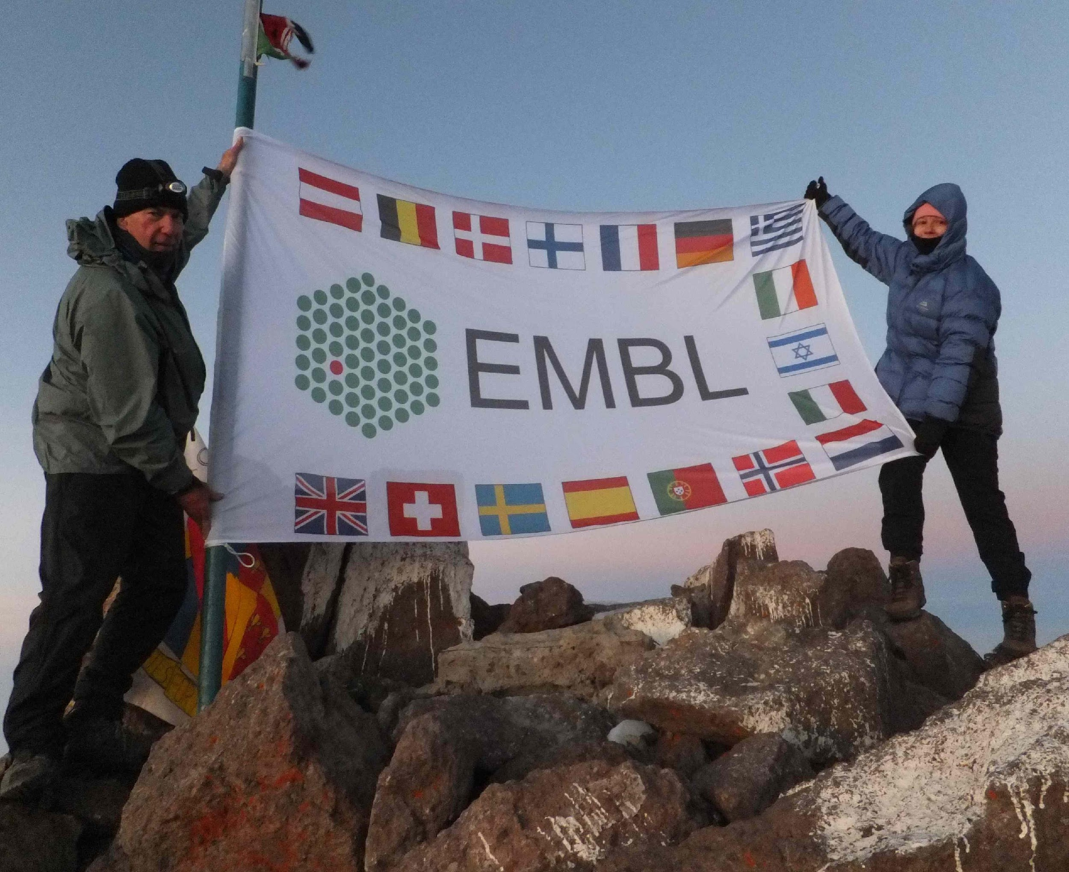
Goals - overview
Increase EMBL resources and opportunities
Aid EMBL growth and reputation
Support recruitment & career development
Facilitate life sciences globally
Harness EMBL’s history and culture
Evidence EMBL’s global impact
Former board members on Mount Kenya, 2012
Notes:
Here’s an overview of our 6 goals which haven‘t changed over the years, while the projects and initiatives that support them are always evolving.
This – to me – makes EMBL Alumni Relations very integral to the institute. I could go into detail for all of these, but would rathe stop here, and do a little exercise.

Slide 6
Ask yourself
What’s your internal elevator pitch?
  “We help to create meaningful and impactful ways for alumni to engage with the University which supports the University’s brand and reputation; provides access to influential networks and is a means of philanthropic and gift-in-kind support.”
  Anita Ender, Liverpool University
If they did away with AR: Who would miss you internally?
  “Careers Service”
  Ross Munnelly, Dublin City University
  EMBL: Strategy, Communications and International Relations
What does AR offer at your work place that’s integral?
  “A cadre of volunteer foot soldiers that represent the brand around the world. Regular programming that keeps alumni informed and inspired about the work of the University. Practical support and resources for alumni that leaves them feeling grateful and hopefully loyal.”
  Christine Fairchild, Oxford University
Notes:
2. Strategy, International Relations, Equality, Diversity and Inclusion, Careers: EMBL
3. EMBL: Volunteer programme, Ambassadors, Institutional memory & impac

Slide 7

Metrics – EMBL Engagement Metrics
Volunteer
2019 2020 2021
81 125 229
Communication
2019 2020 2021
882 543 174
Experiential
2019 2020 2021
279+ 1100 1700
Philanthropic
2019 2020 2021
n/a n/a 5
Unit is individuals
Notes:
Whole of EMBL and six sites across EMBL, to capture data

Slide 8
Metrics – Engagement Metrics
Volunteer
“Formally defined and rewarding volunteer roles that are endorsed by and valued by the institution”
Communication
“Interactive, meaningful and informative communication that supports the institution’s mission, strategic goals and reputation”
Experiential
“Meaningful experiences that inspire alumni, are valued by the institution, promote its mission, celebrate its achievements and strengthen its reputation”
Philanthropic
“Financial support that is meaningful to the donor and supports the institution’s mission and strategic goals”
Notes:
Whole of EMBL and six sites across EMBL, to capture data

Slide 9
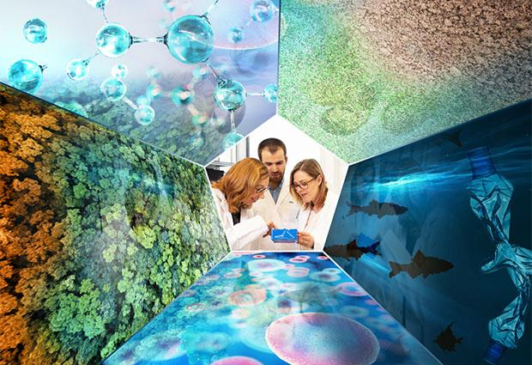
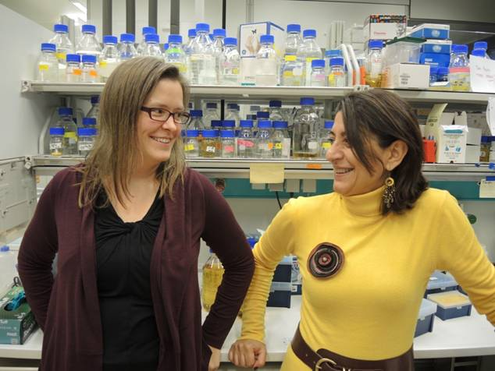
Goals and Example Activities
Increase EMBL Resources & Opportunities
Aid EMBL Growth & Reputation
Support Recruitment &
Career Development
Ongoing …
Grow Alumni Volunteer Programme (2017)
Alumni metrics
Support:
Friends of EMBL (2021)
Environmental Research Initiative (2022)
Communications
EMBL in ... Events (2016)
Coffee with EMBL (2020)
Kafatos Lecture (2022)
YouTube channel (2022)
John Kendrew Award (2007)
Careers data, eg Fellows study
Careers speakers, blogs, mentors (LEAP)
Alumni Mentorship Programme (2022)
New …
Notes:
Volunteer programme: dedicated staff just to run this: recruitment, stewardship and metrics for whole organisation
Friends of EMBL: aiming for 10 members per year – to grow and internatinalise the programme; internal support.
ERI: aiming to fund one catalyst project worth €20,000 (a quarter has been raised so far); internal support
EMBL in events: strategy behind them, what we need to plan next with input from EMBL - see separate slide
Coffee with EMBL: creating ambassadors; a close global community
Kafatos Lecture: reaching the public
YouTube channel: to house existing and new content
Mentorship Programe: see separate slide – open to staff?
Careers:
EDI: LEAP Mentors (64 alumni – 100%), EDI Reflections (2 – 50%), Events (5 – 75%) , LEAP 2 Mentors (90+ - 100%)
EMBL Fellows’ Career Services: Careers Blog, Career Day, Webinars

Slide 10
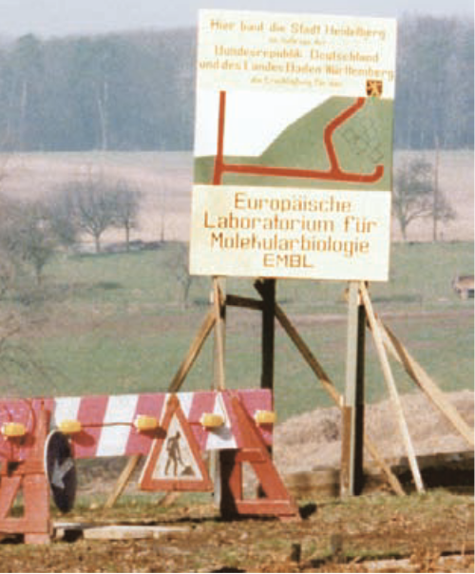
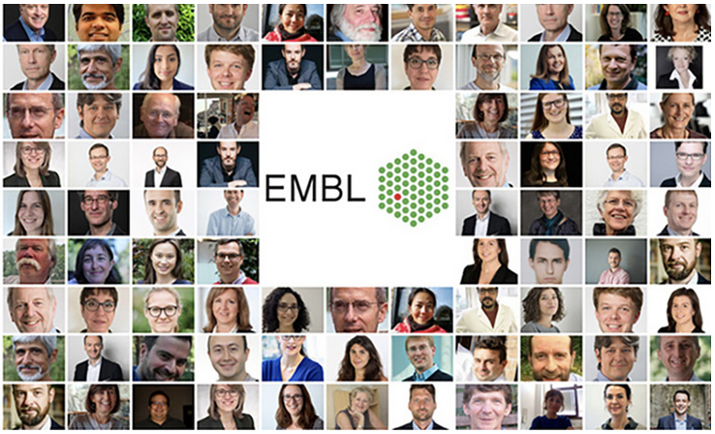
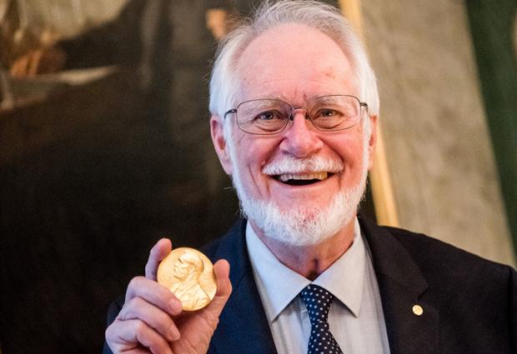
Goals and Example Activities
EMBL HD 1973
Facilitate life sciences globally
Harness EMBL’s history and culture
Evidence EMBL’s Global Impact
Ongoing …
Supporting alumni
Supporting Life Science institutes
EMBL Anniversaries (2004)
EMBL Archive (2015)
EMBL’s 50th Anniversary (2024)
Alumni surveys
Alumni testimonials
Lennart Philipson Award
New …

Slide 11

Thank you!

