Slide 1
1st AIDAInnova Software Hackathon
Frank Gaede (DESY) and Graeme Stewart (CERN)
2022-06-21

Slide 2
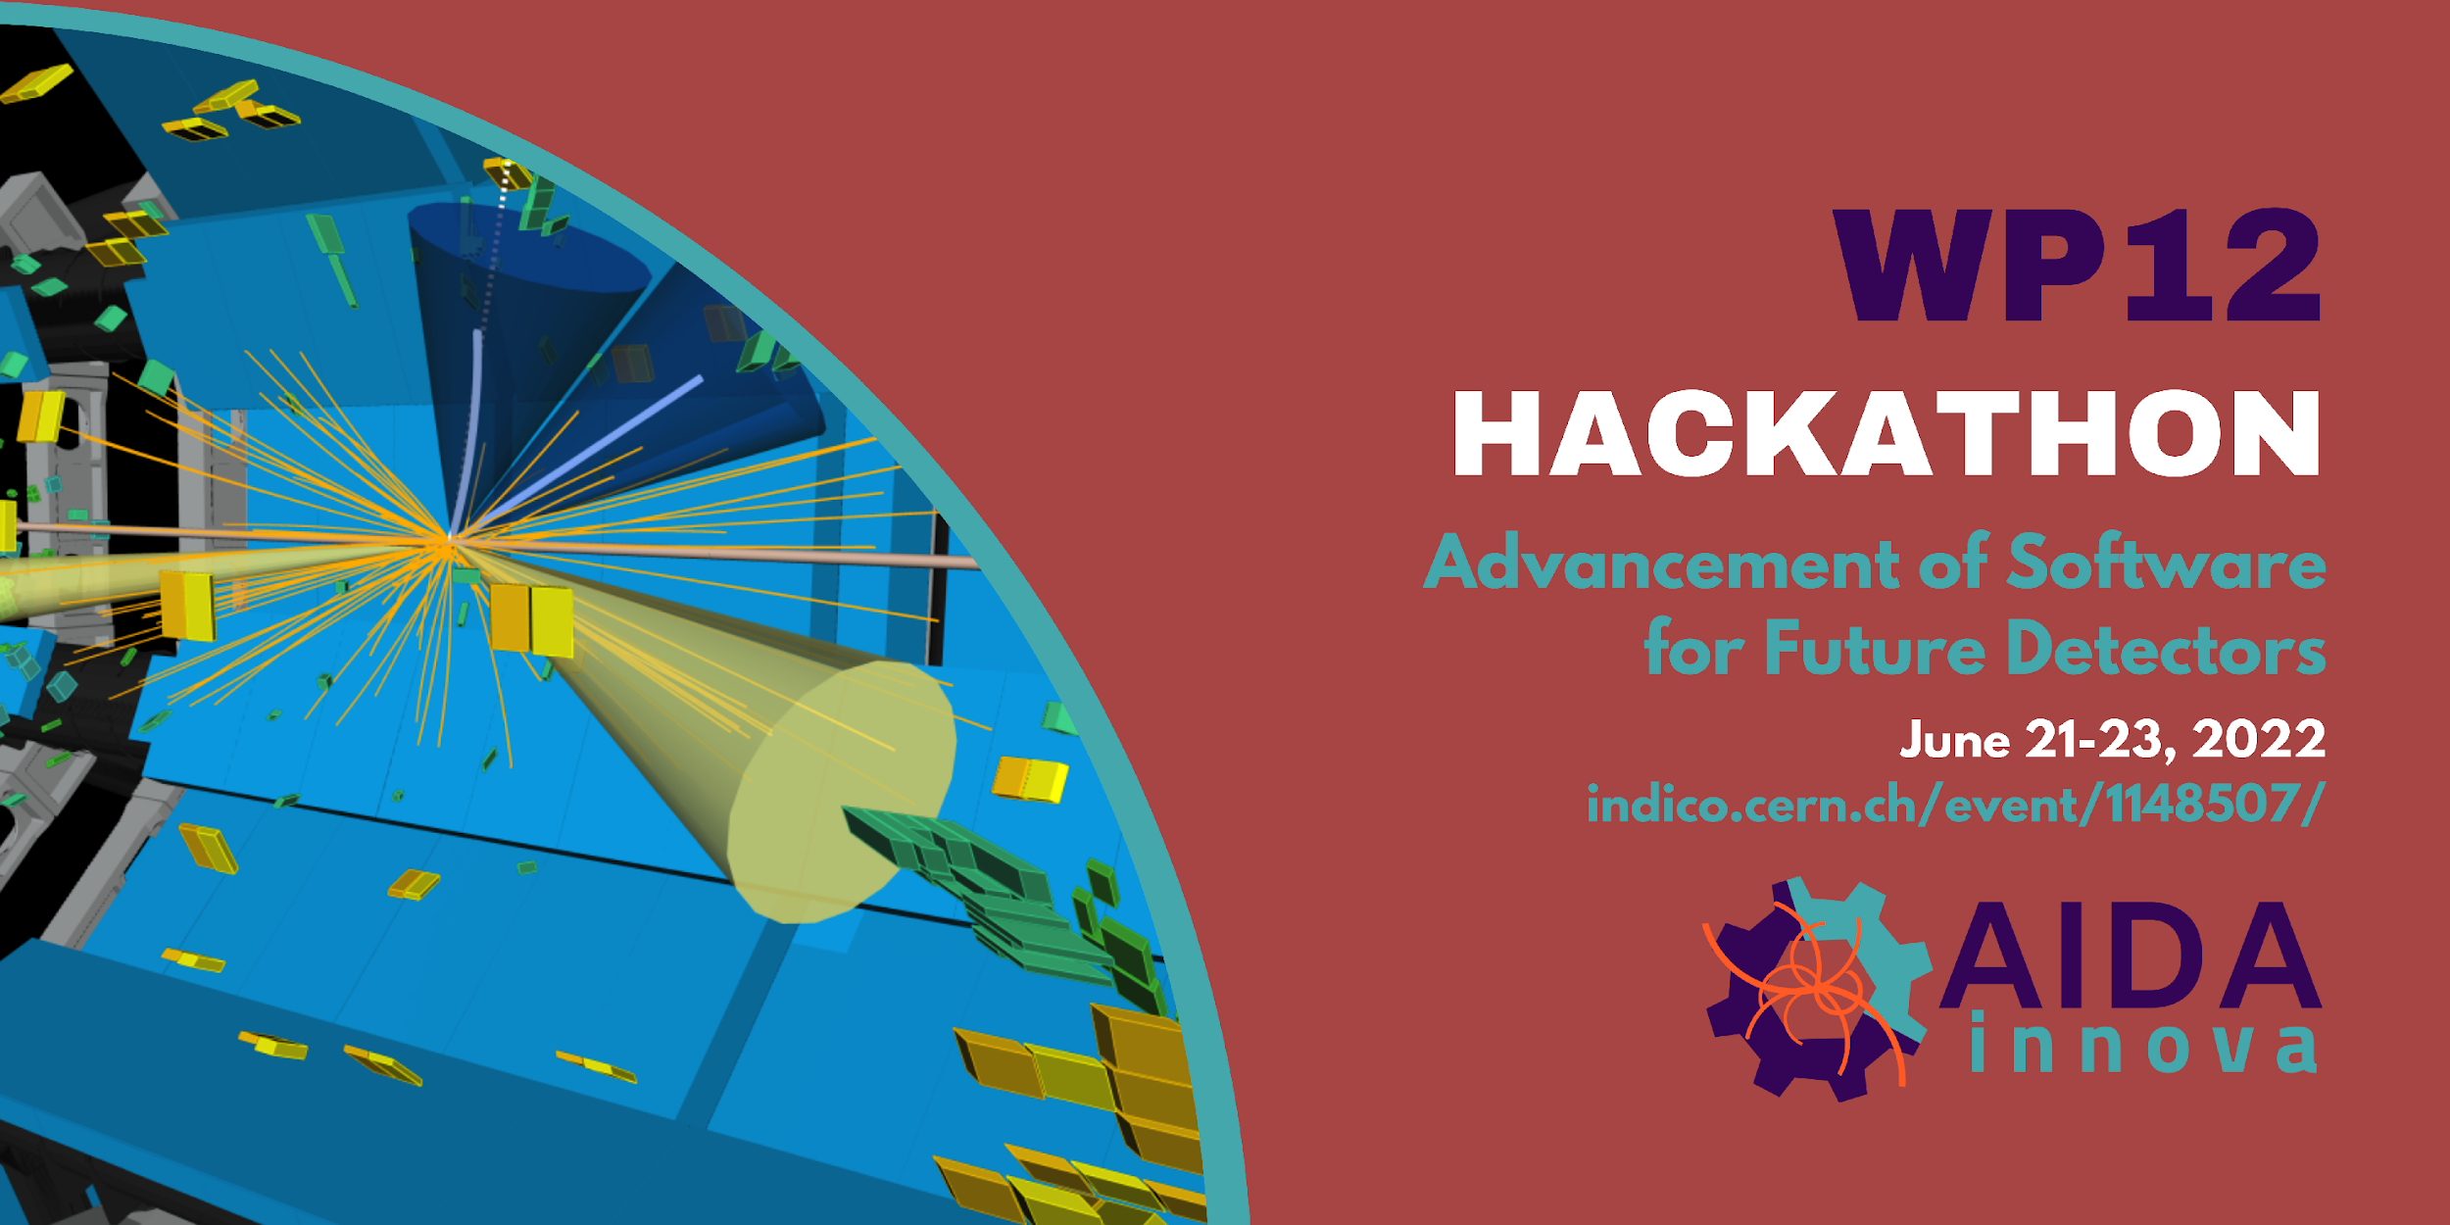
Antoine was kind enough to make us a poster!

Slide 3
Welcome
Welcome to the first AIDAInnova Software Hackathon
After a difficult start to AIDAInnova, due to the pandemic, we thought that it would be a great idea to work together in person
We are happy that so many of you managed to make it
  Especially people who travelled to be here

Slide 4
Topics and Timetable
We will hear from each of the task leaders about topics that we shall be tackling in the next three days
  Rough planning is in this Google Sheet
  We will try and keep Indico up to date with who is meeting where
    Task leaders, it’s most efficient if you edit Indico directly
However, the time is ours, so we consider this to be a starting point and we maintain the agility to use the time as usefully as possible
  Feel free to use the rooms we have, jump into offices, go for coffee, ice cream, …
  Simply address interesting topics as they come up …

Slide 5
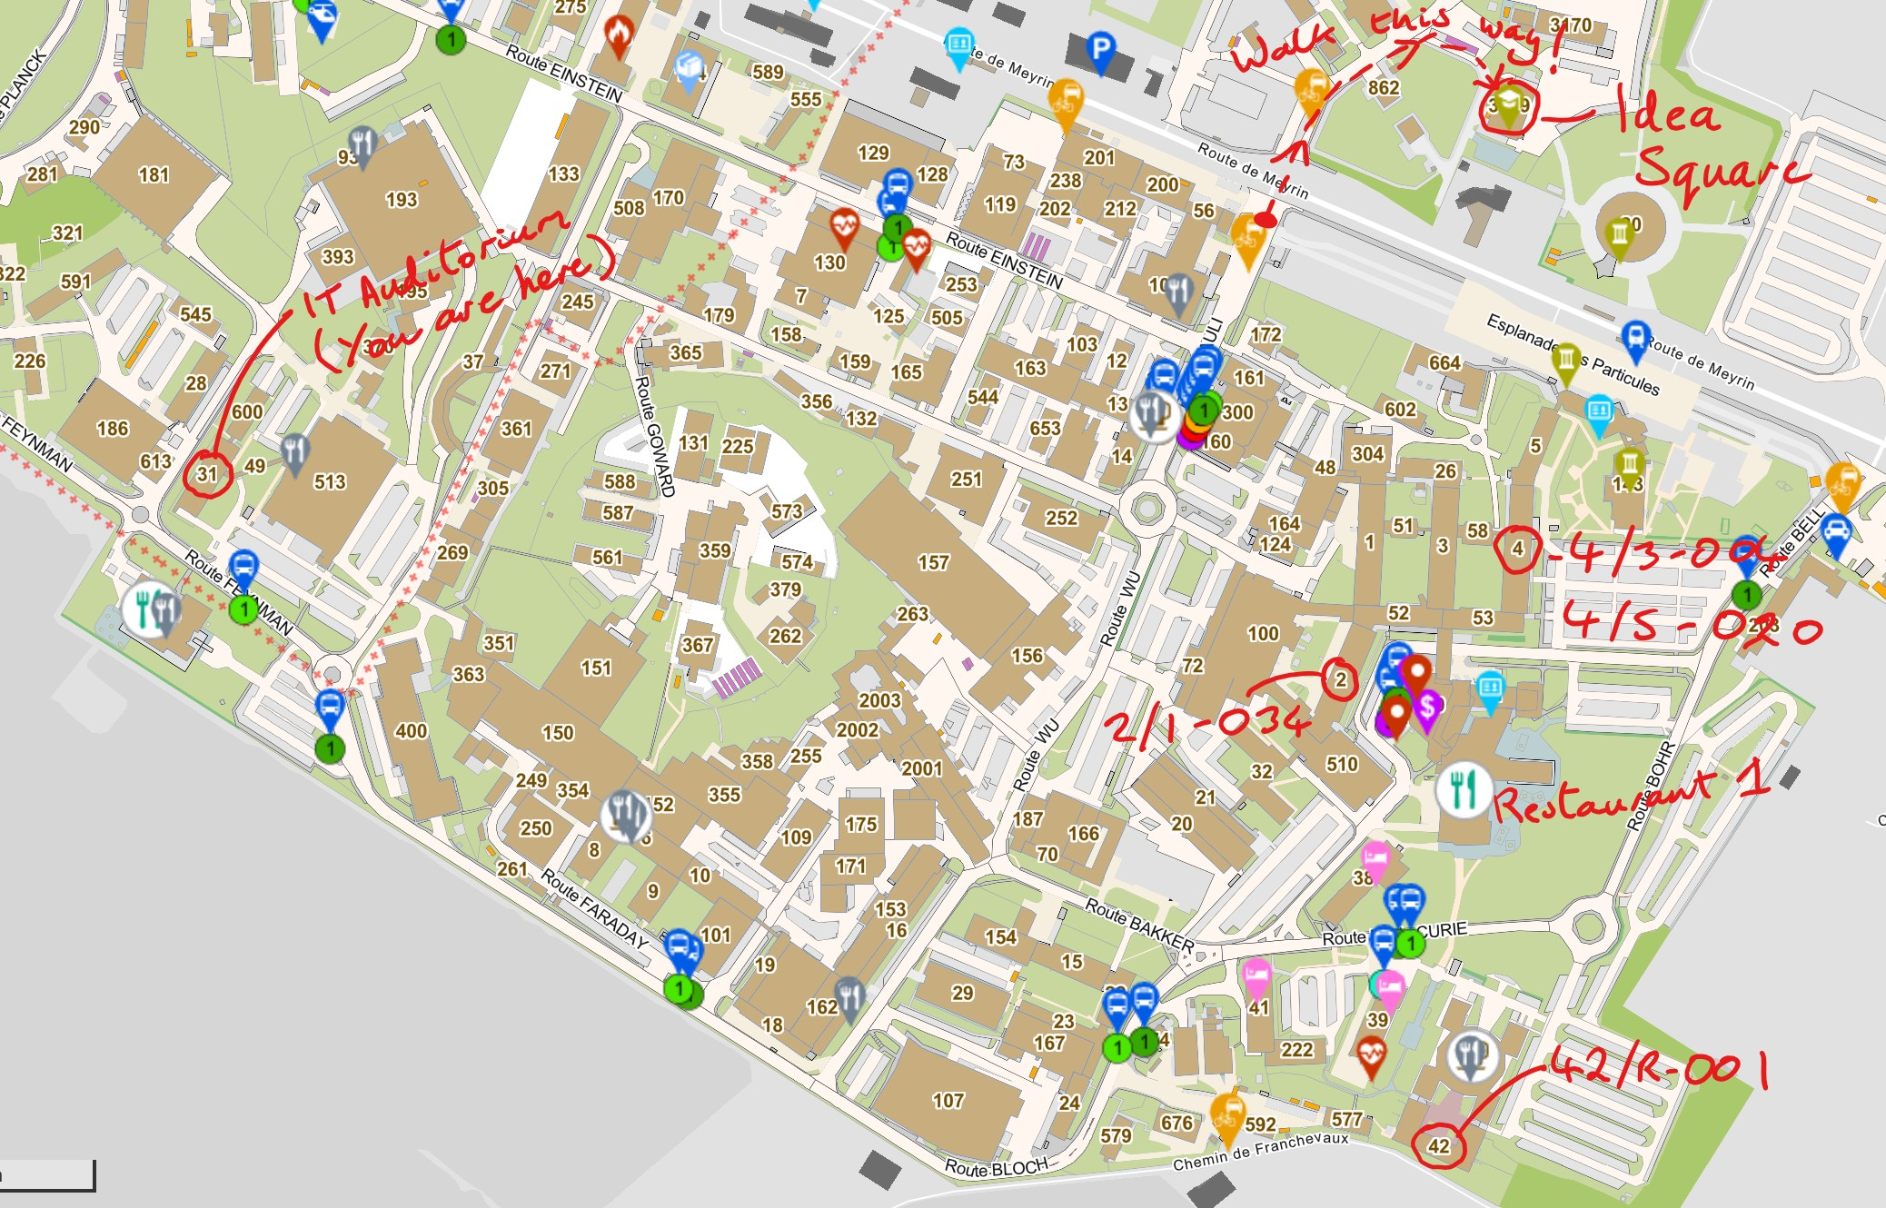
Practicalities - Rooms
Rooms for today and tomorrow are here on the main campus
On Thursday we have use of the IdeaSquare space
  Across the road from main Gate B entrance

Slide 6
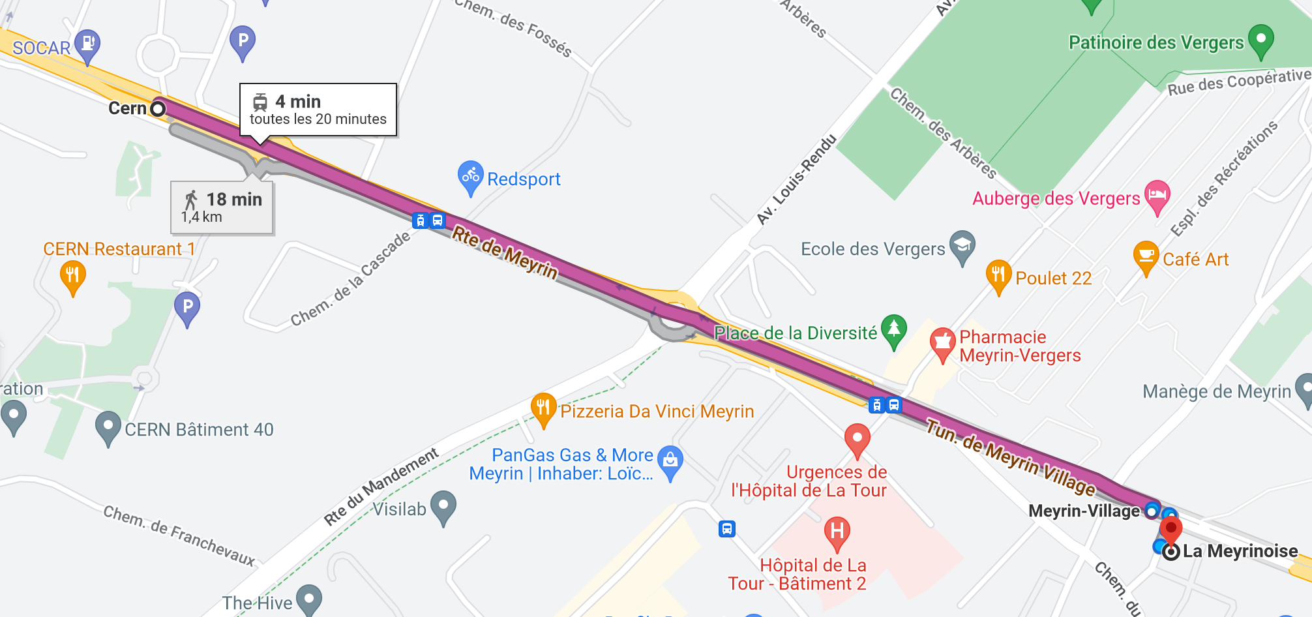
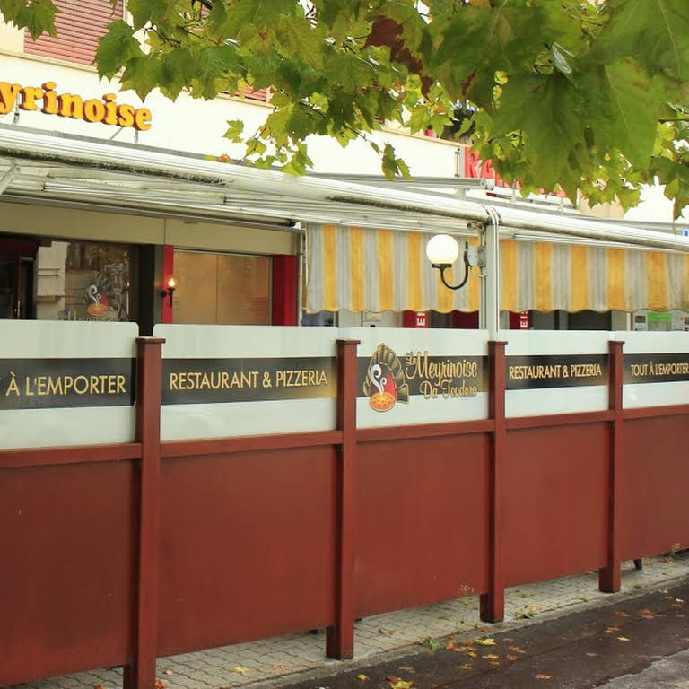
Practicalities Dinner
The hackathon dinner is at La Meyrinoise Pizzeria, Wednesday at 7.30pm
Getting there takes a few minutes by tram, a few more by bicycle or 15-20 minutes walking

Slide 7
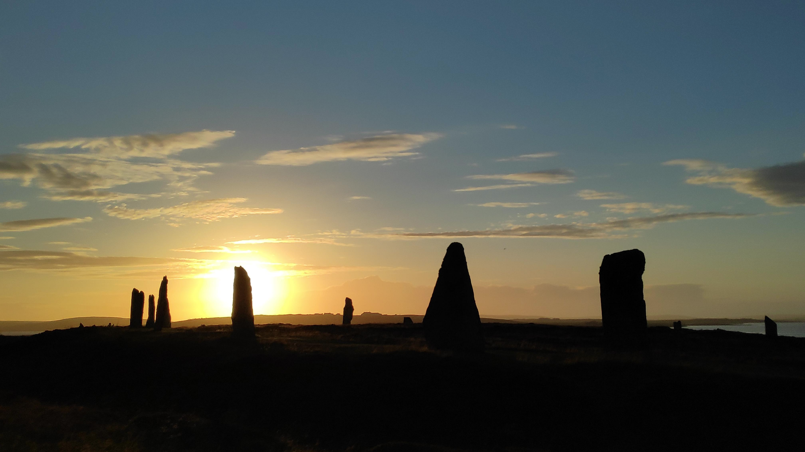
Happy Summer Solstice!
@11h13 CEST

