Slide 1
IdeaSquare
Open Doors
15 and 16 February 2023

Slide 2
GRADE Programme (Generic pre-R&D at IdeaSquare)
Markus Nordberg (CERN)
IdeaSquare Open Doors
February 14-15, 2023

Slide 3
IdeaSquare
The Innovation Space at CERN
IdeaSquare is the innovation space at CERN, that uses collaborative methodologies, access to CERN expertise and cross-connectivity to ideate solutions for the future of humankind. A place where people have the licence to dream.

Slide 4
Stimulating instrumentation in research

Slide 5

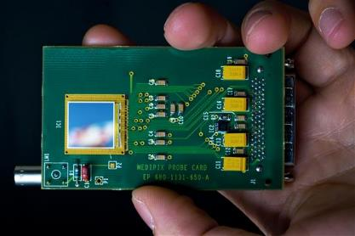
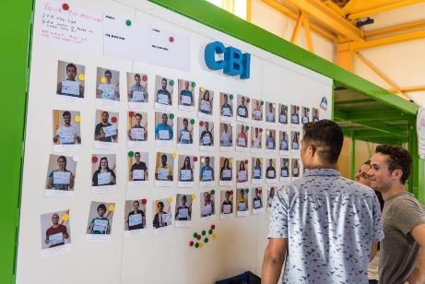
GRADE MoU: Short Intro
Approved by the CERN Research Board in December 2015 for (very) early-stage R&D efforts on new promising detector concepts and technologies for possible use in future experiments (hi-lumi LHC, ILC, FCC...).
Includes strong educational involvement to explore potential future use also outside HEP, e.g. in society, including industry and cross-disciplinary students.
Participating institutes (also from outside HEP) contribute as in-kind. It requires institutes to spend time at IdeaSquare to design, build prototypes, test, integrate, prepare TDRs, EU-grants like ATTRACT etc.).
Recognized status in Gray Book.

Slide 6
GRADE: Developments in 2022 (informal)
  Collaborations:
  Neutrino platform (Dune) for the development of a smart and fast readout system for large tracking systems
  Members are part of the ATLAS collaboration and lead the LHC Phase-2 upgrade project of the muon barrel trigger.
  Recent activities:
  Development of a new generations of detectors and related electronics for the LHC-phase 2 upgrade, the dark matter particle searches and for the next generation colliders
  Detector prototype design and test
  Chip design and bench-test
  Development of a new type of low power neuromorphic analog electronics, capable to support ns-level inference and correlation on large and sparse data sets, for a new approach to green computing.

Slide 7
EXAMPLES OF PAST GRADEs:
TT-PET
To develop a demonstrator for a ToF PET Scanner with a chip of matrix of 3x10 pixels with efficiency larger than 99.9% and a time resolution down to 110ps;
Involving testing and student presence at IdeaSquare;
Main partners: Geneva, HUG, Bern
Has received 1.9 MCHF from SNSF, funding period ended
Has achieved the set goals and is currently seeking for additional funding. Geneva continues one thread with a received ATTRACT grant. Examples of related publications:
G. Iacobucci,, R. Cardarelli,, S. Débieux, F.A. Di Bello, Y. Favre, D. Hayakawa, M. Kaynak, M. Nessi, L. Paolozzi, H. Rücker, DMS Sultan,and P. Valerio. A 50 ps resolution monolithic active pixel sensor without internal gain in SiGe BiCMOS technology. Prepared for submission to JINST
HEALTH
To develop a radon dose monitor, and a GEMPix-based integrated system for measurement of the 3D energy deposition in water by proton and C-ion beams for medical applications;
    Involving two PhD students at IdeaSquare working on the two prototypes;
    Has received two related ATTRACT grants for further developing GEMPix
    Requested extension to EoY2020
    Main partners: CIRA, ISS
    Examples of related publications:
        S. Romano, M. Caresana, A. Curioni and M. Silari, RaDoM2: an improved radon dosimeter, submitted for publication in JINST
        J. Leidner, M. Ciocca, A. Mairani, F. Murtas and M. Silari, A GEMPix-based Integrated System for Measurements of the 3D Energy Distribution in a Water Phantom for Carbon Ion Beam Therapy, to be submitted for publication in Medical Physics

Slide 8
FROM GRADE TO ATTRACT (P1):
Selected Projects involving CERN

Slide 9
GRADE: Examples of new eligible projects
  Recycable materials for calorimeters (scintillators)?
  Use of TIP avalanche diodes (red wavelength) in physics??
  “Green Village” initiatives that could potentially evolve into future EU-funded projects (see P. Tello’s presentation)
  Next round of ATTRACT projects (e.g. environmental, wearable Detection & Imaging techs)?

Slide 10
Thank You

