Slide 1












Why ATTRACT?
Pablo Garcia Tello and Markus Nordberg,
ATTRACT Project Administrative Office
IdeaSquare Open Days 2023

Slide 2

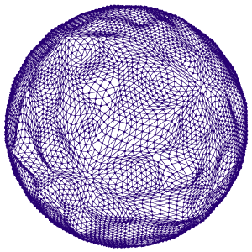
Why ATTRACT? A CERN Perspective
Supporting CERN R&D programs with additional resources.
Supporting CERN R&D developments embedding potential breakthroughs.
Putting CERN at the forefront in EU R&D&I strategies, as an organization not only excellent in science but also in innovation and training of young entrepreneurs.

Slide 3
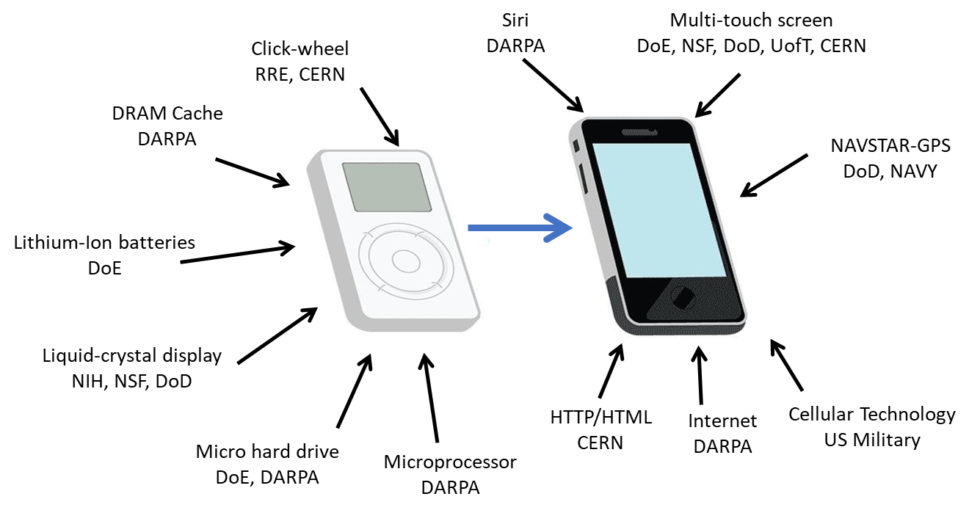
ATTRACT: Key pillars (1)
“Where does breakthrough Innovation come from?”
Public Funding: Key for helping nascent breakthrough technologies, many of them even at the conceptual level, mature for raising the interest of private capital .
DARPA: Defense Advance Research Project Agency
RRE: Royal Radar Establishment
CERN: European Organization for Nuclear Research
DoE: Department of Energy
NIH: National Institute of Health
NSF: National Science Foundation
DoD: Department of Defence
UofT: University of Toronto

Slide 4
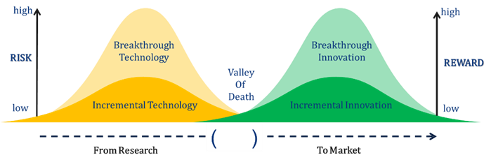
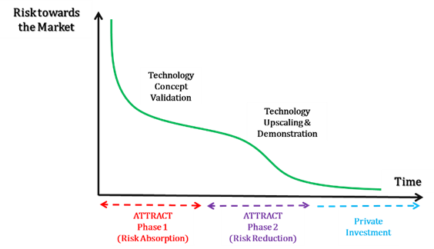
ATTRACT: Key pillars (2)
“Not two Valleys of Death look the same”
Phase approach to funding: Breakthrough Technologies (coming from Fundamental Research) are very risky to invest upon for private capital.
De-risking them needs public funding:
  First, a risk-absorption stage, where ideas and concepts could reach a prototype level and technology concept validation.
  Second, a risk-mitigation stage, where the most promising concepts are further helped raising towards a pre-market product.

Slide 5

ATTRACT: Key pillars (3)
“Trust and shared know-how is not built in one day”
Co-Innovation:
Bridge between two communities (research and industry) that in principle have different motivations and goals for undertaking R&D&I (capital and/or resource intensive) efforts .
Entails the identification and collaboratively pursuing of win-win outcomes, starting already at the conceptual stages of a technology development and enduring them until the later stages of the innovation value chain (e.g. commercialization).
Departs from research-industry relationships established as simply customer-supplier ones.
If I would have known…
I solved it years ago!
I have a solution!
But I don’t have a problem.
Finally I solved the problem!
Research
Industry
Research
Industry
Your problem is my problem!
Let’s find a solution!!
Industry
Research
Co-Innovation

Slide 6

ATTRACT: Key pillars (4)
“Young people want to change the world”
Young Innovators Projects:
ATTRACT is facilitating the integration of interdisciplinary MSc level students teams working side by side with professional researchers from academia and industry developing the R&D&I funded projects.
These Young Innovators’ goal is prototyping technology solutions specifically addressing the United Nations Sustainable Development Goals,
They use a Design Thinking approach inspired by the technology developed by the projects.

Slide 7
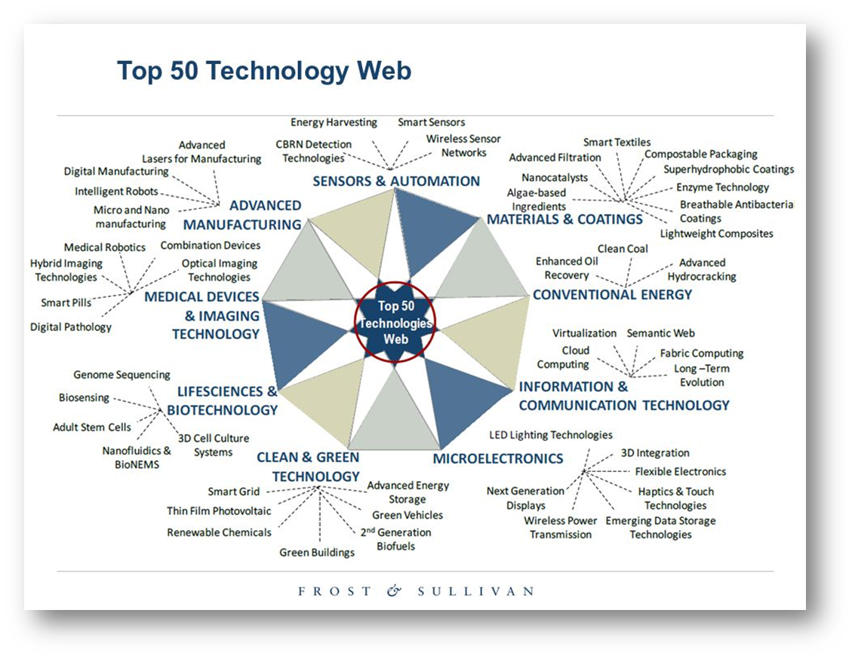
ATTRACT: Why Detection and Imaging?
Are you able to point a field in the picture with nothing to do with Detection and Imaging?
The scientific mission of European RIs as well as their R&D associated communities is strongly coupled with detection and imaging technology instrumentation (including computing).
Detection and Imaging technologies are and will be at the core of future industrial developments applications and business (e.g. IoT, Smart Cities, Autonomous Transport, Sustainable Agriculture, etc).

Slide 8
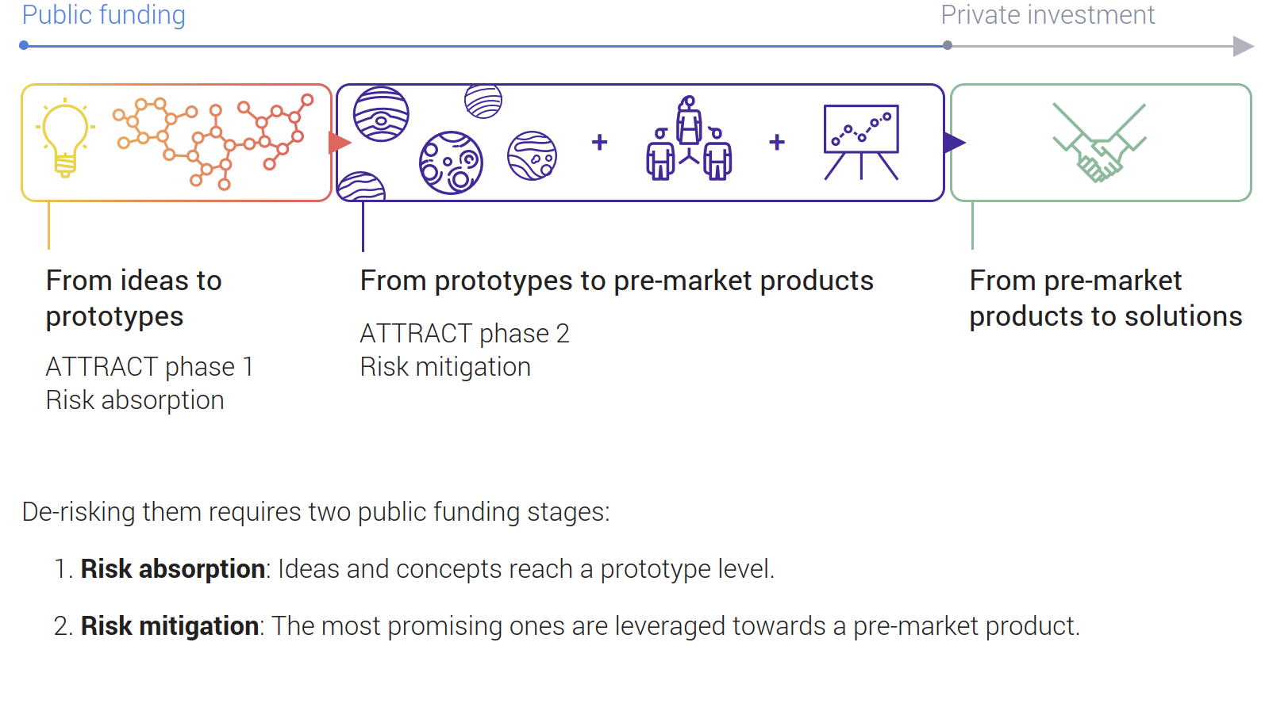
ATTRACT: Some key milestones
ATTRACT Phase 1:
  170 projects funded with 100 k each for achieving a proof of concept and prototype (19 with CERN participation).
  100 young innovators from organizations of CERN MS trained.
ATTRACT Phase 2:
  8 R&D&I projects funded coming from Phase 1 for achieving pre-industrial scale (1 of CERN of 2M Euros for smart pipes).
  500 young innovators in the training process.

Slide 9
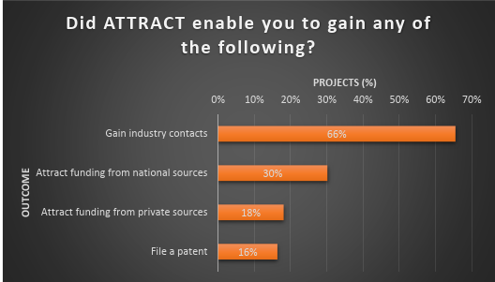
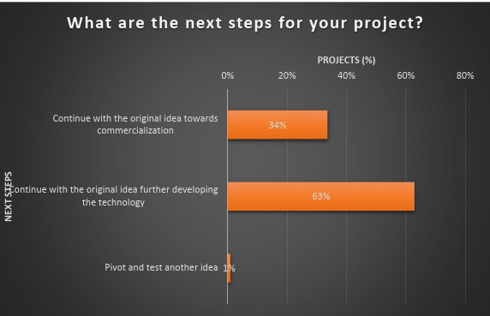
ATTRACT: Some figures of merit (1)
“How are we doing even just after Phase 1?”
Even at low TRL, 18% of the funded projects got private investment.
30% of the projects got additional National Funding.
34% of the projects are going towards commercialization.

Slide 10
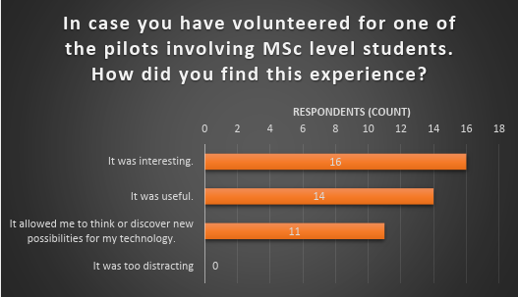
ATTRACT: Some figures of merit (2)
“How are we doing even just after Phase 1?”
11 projects discovered new potential applications of their technology proposed by the interdisciplinary MSc student teams.

Slide 11

NEW Opportunities: Foreseen open call
The existing paradigm for Earth monitoring is still largely based on networks of sparse measurement stations and/or in situ human-operated measurements systems.
This technology paradigm is highly unsuitable for providing data and information matching the continuous spatiotemporal and heterogeneous dynamics of the Earth as a global system and understanding its causes and related phenomena.

Slide 12
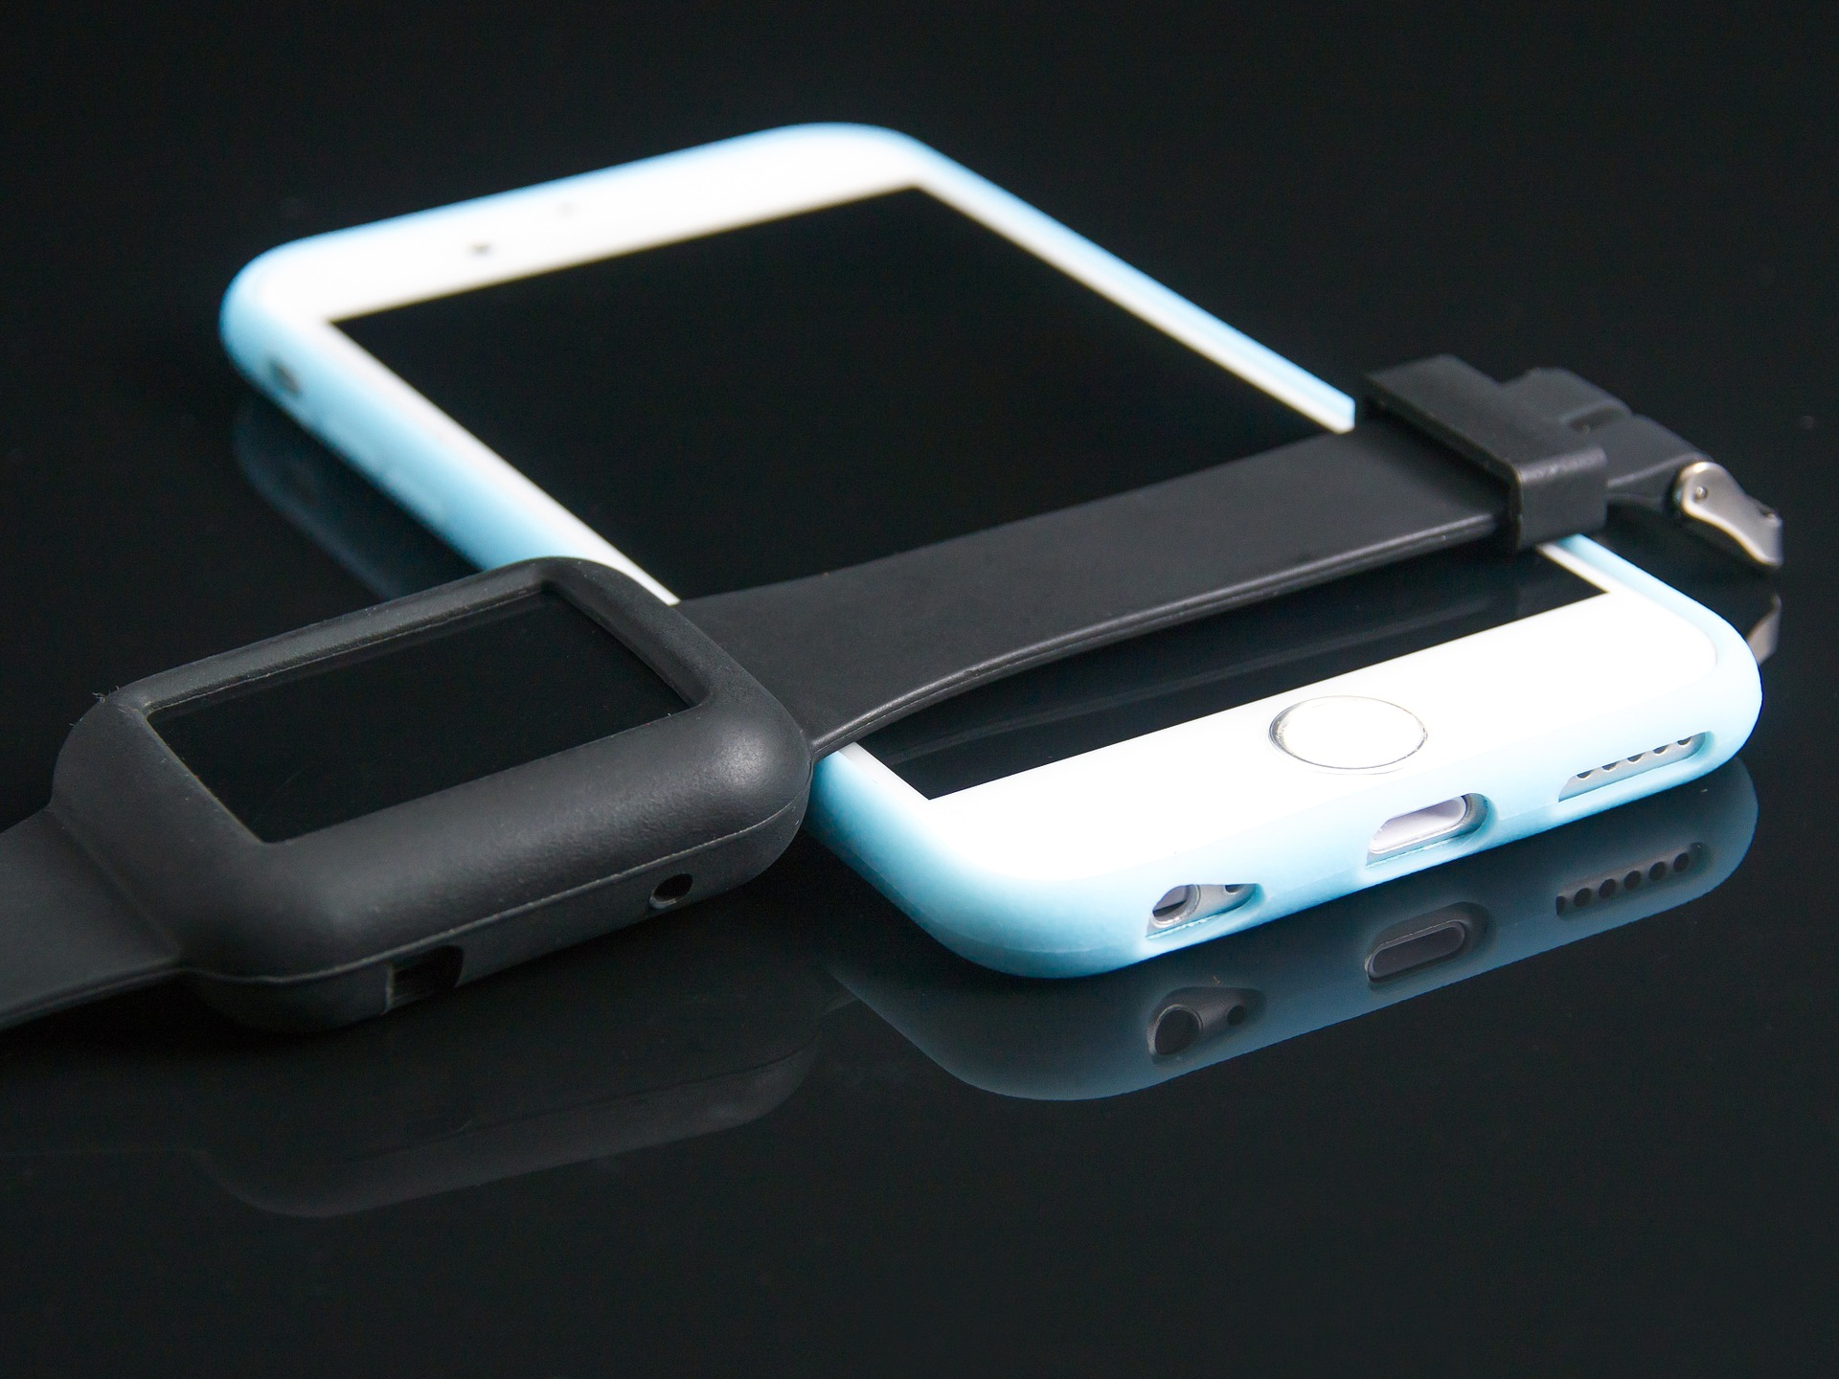
ATTRACT Phase 3 foreseen open call
To be launched by the end of March and closing the end of June. 100 kEuros/project. Funding for a total of 30 projects.
Novel and breakthrough detection and imaging technologies are sought, capable of collecting data (physical, chemical, biological, etc, characteristics) with high specificity and extreme sensitivity (orders of magnitude beyond those being the state of the art) while offering high spatial and temporal resolution and massive parallelism.
Proposed technologies should be suitable for seamless integration into pervasive, low-cost and low-power ICT systems (e.g. portable, wearable, IoT, etc).
By the end of the project, the technology should achieve an integrated prototype.

Slide 13

ATTRACT Phase 3 foreseen open call
Examples of Challenges
Availability and sustainable management of food and water resources.
Sustainable consumption and production patterns.
Combatting climate change and its associated impacts.
Sustainable use of the oceans, seas, rivers and other natural water resources and preservation of their (bio)-diversity.
Sustainable use and preservation of terrestrial ecosystems and their (bio)-diversity.

Slide 14

ATTRACT Phase 3 foreseen open call
Could we turn every citizen into a data gathering agent for contributing to the sustainability of Planet Earth?

Slide 15
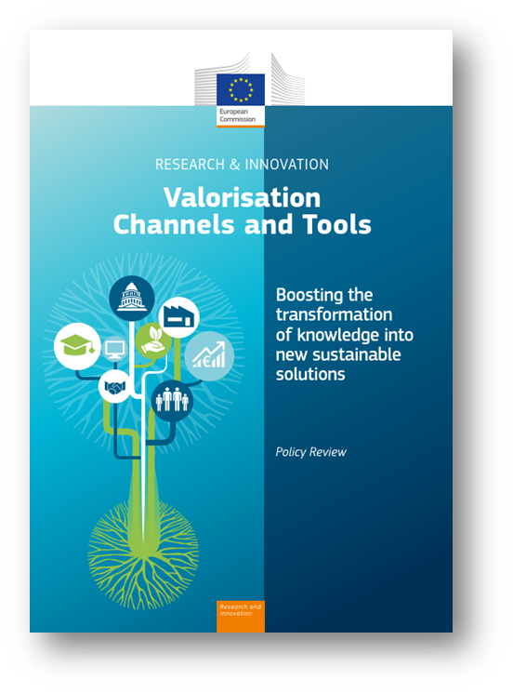
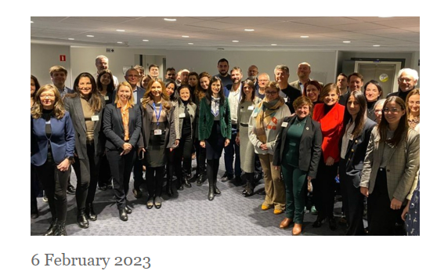
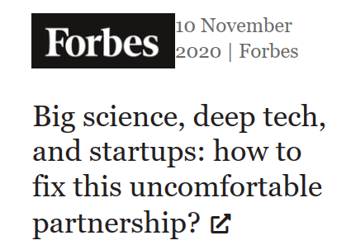
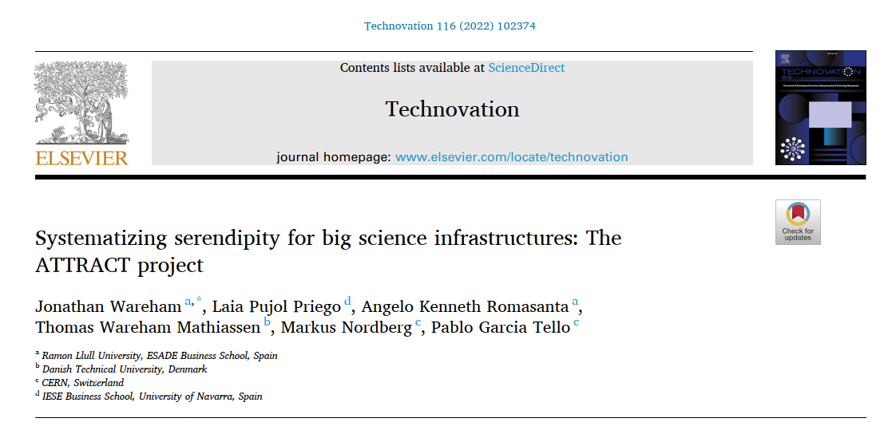
And our “impact in Brussels” and beyond?
Example
CERN IdeaSquare highlighted on a pier basis with other innovations hubs outside Europe such as the Hitachi and the University of Tokyo Joint Research Laboratory.
ATTRACT was chosen as one of the most relevant projects supporting the New European Innovation Agenda
https://doi.org/10.1016/j.technovation.2021.102374

Slide 16
Find and follow ATTRACT at:
https://attract-eu.com/
https://twitter.com/AttractEu
https://www.youtube.com/attract-eu
https://www.facebook.com/ATTRACTEU/
https://www.instagram.com/attractacademy/
https://www.linkedin.com/company/attract-eu/

Slide 17


Thanks!
This project has received funding from the European Union’s Horizon 2020 research and innovation programme under grant agreement No. 101004462

