Slide 1

Claudia Marcelloni, CERN
10 February 2022
This project has received funding from the European Union’s Horizon 2020 research and innovation programme under grant agreement No 872944

Slide 2
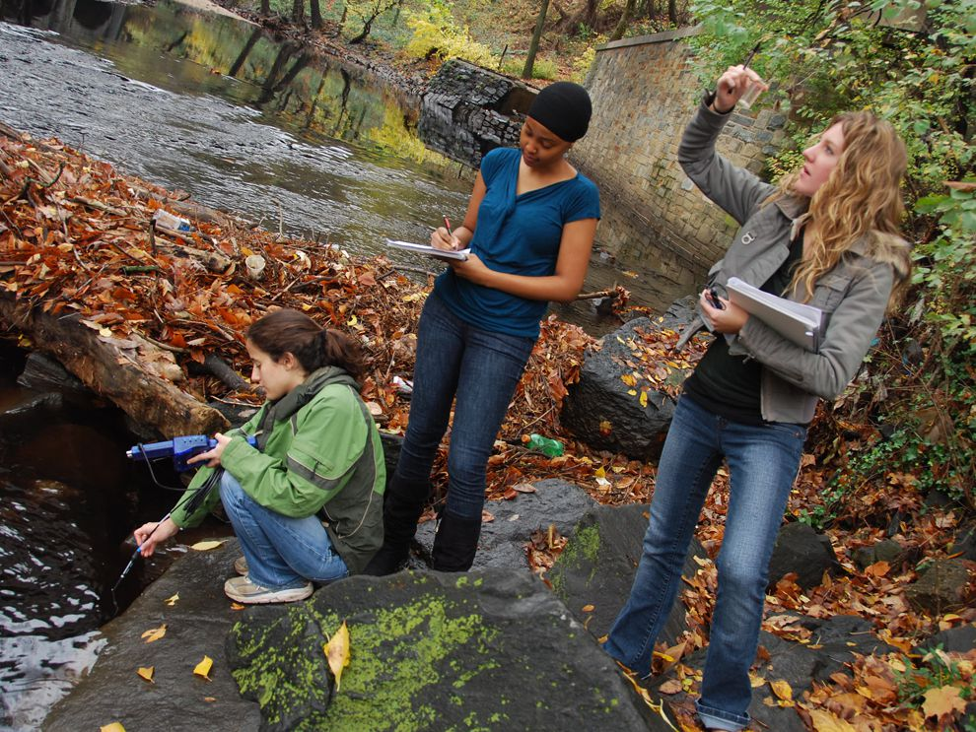
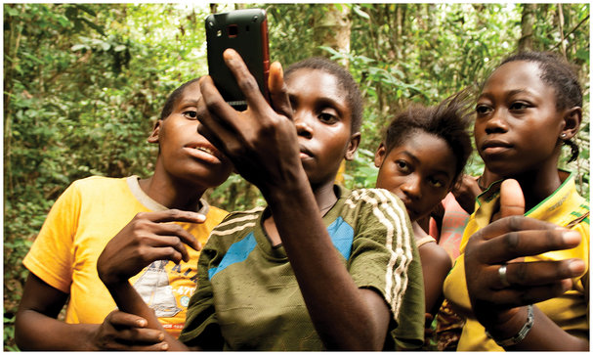
Citizen Science (CS)
Measuring Water Quality in United States
Mapping forests in Republic of Congo

Slide 3
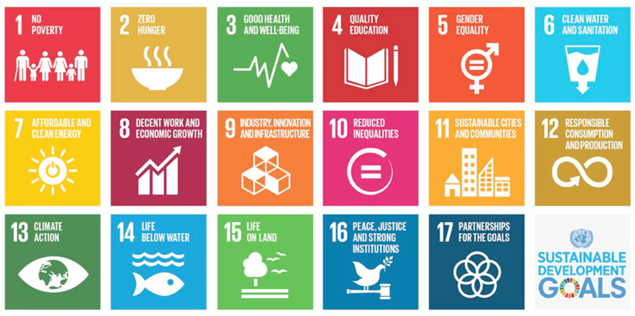
SDGs

Slide 4
Crowd4SDG Mission
The Crowd4SDG project aims to explore and assess how crowdsourcing can contribute to the tasks of:
tracking progress towards the SDGs
generating grassroots innovation that enable such progress

Slide 5
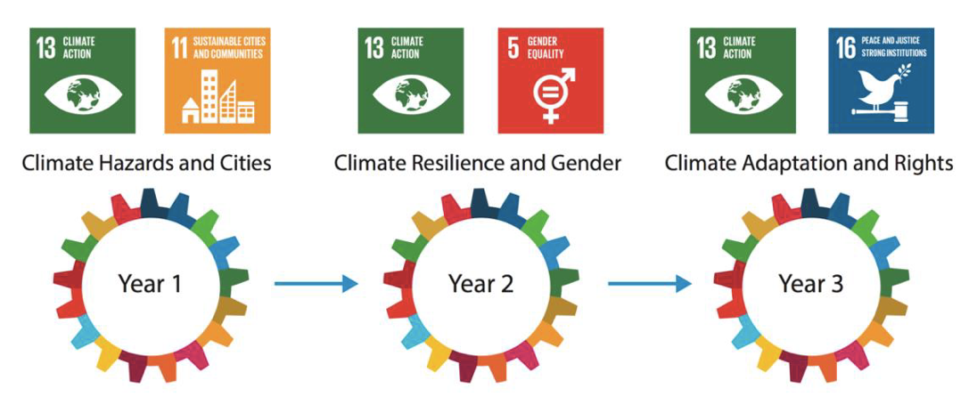
Timeline : 3 GEAR Cycles (2020-23)

Slide 6
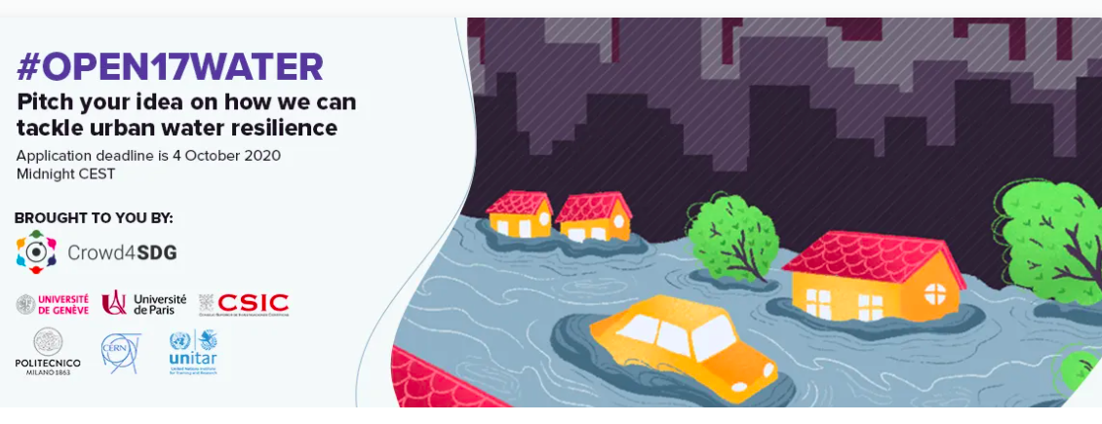
Year 01 - #open17water (2020)

Slide 7
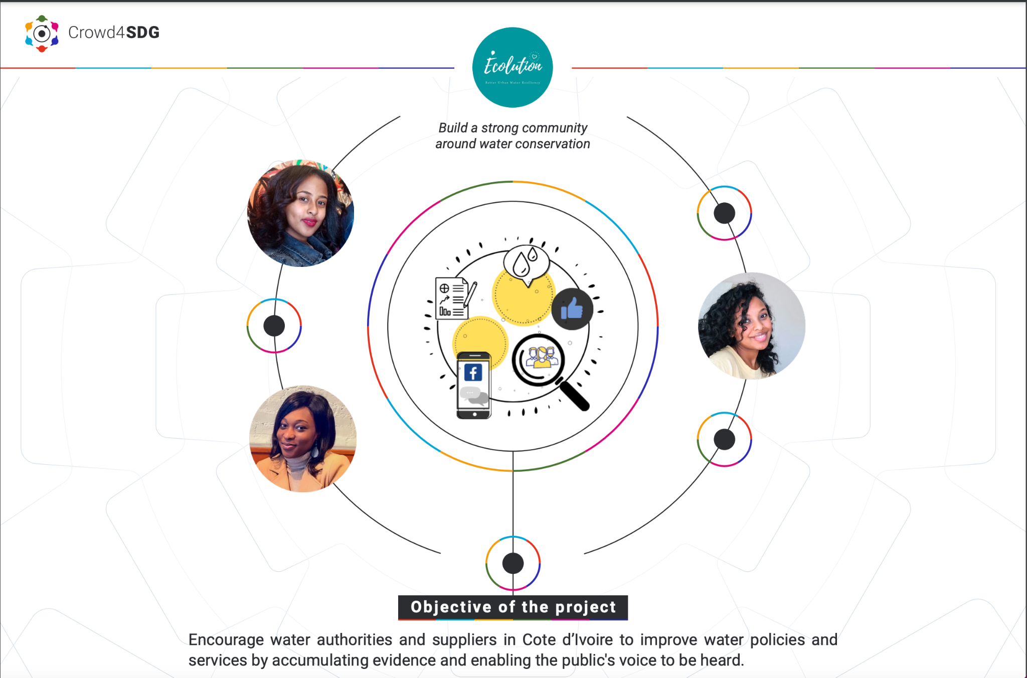
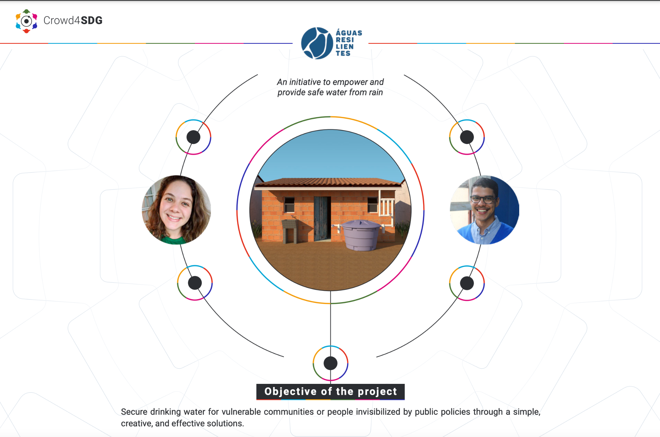
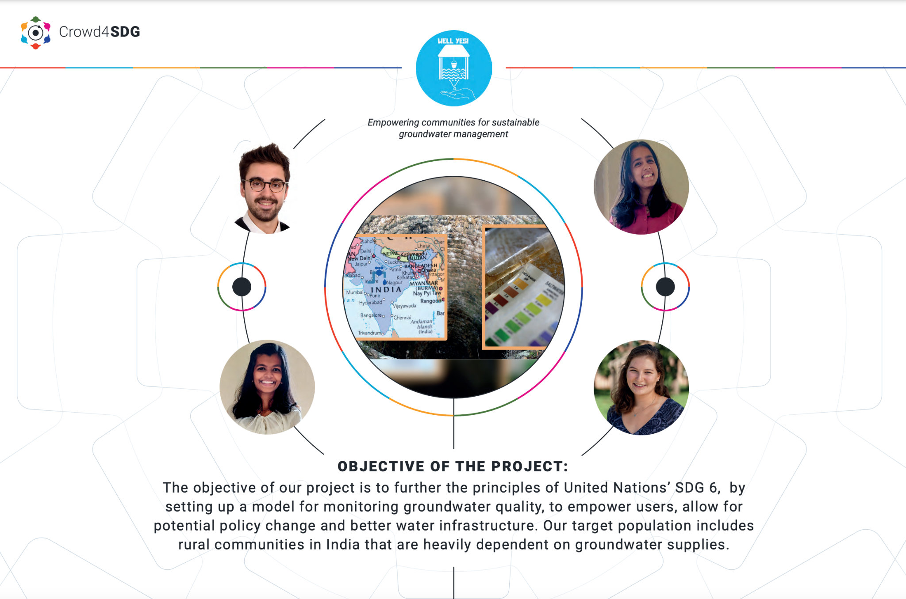
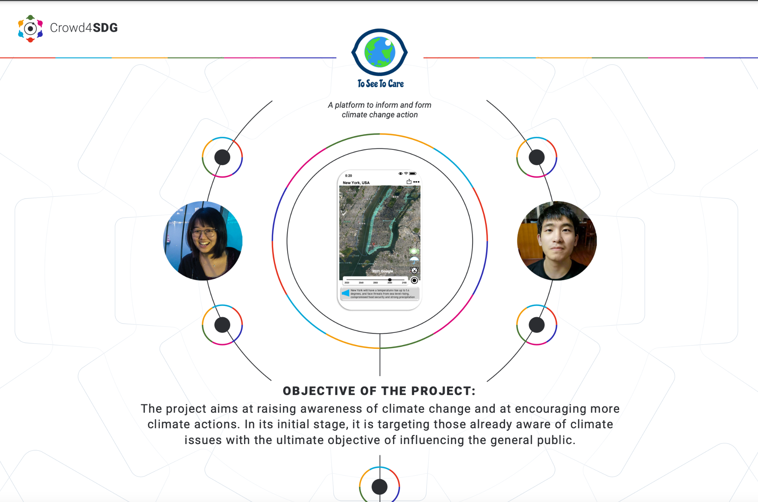
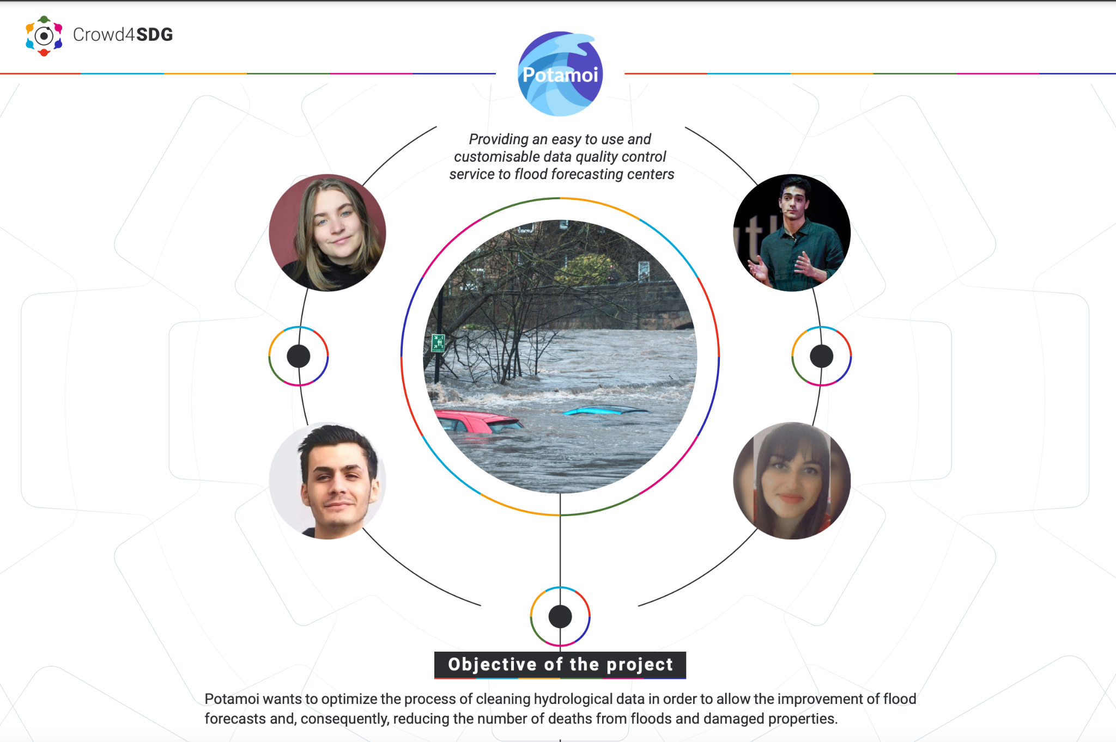
Year 01 - #open17water (2020)
community building awareness of climate change resilience and water conservation
flood forecasting through clean Hidrological data
monitoring groundwater quality

Slide 8
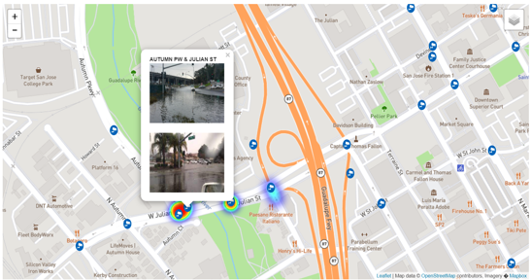
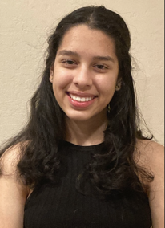
Ex: Flood Finder
Project Flood Finder
Student project from Crowd4SDG
Based on crowdsourcing and AI
Deeya Viradia
16 year-old highschool student
Led the Flood Finder team
Deeya is first author on a poster about her project accepted at ISCRAM 2021
Flood Finder won competition to join social incubator run by Code for America

Slide 9
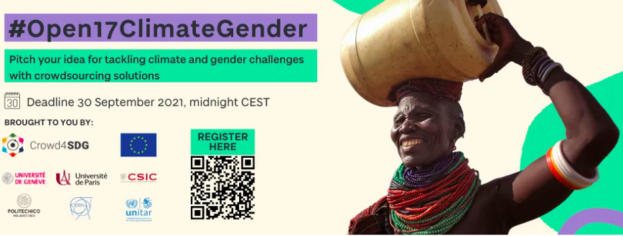
Year 02 - #Open17ClimateGender (2021)

Slide 10
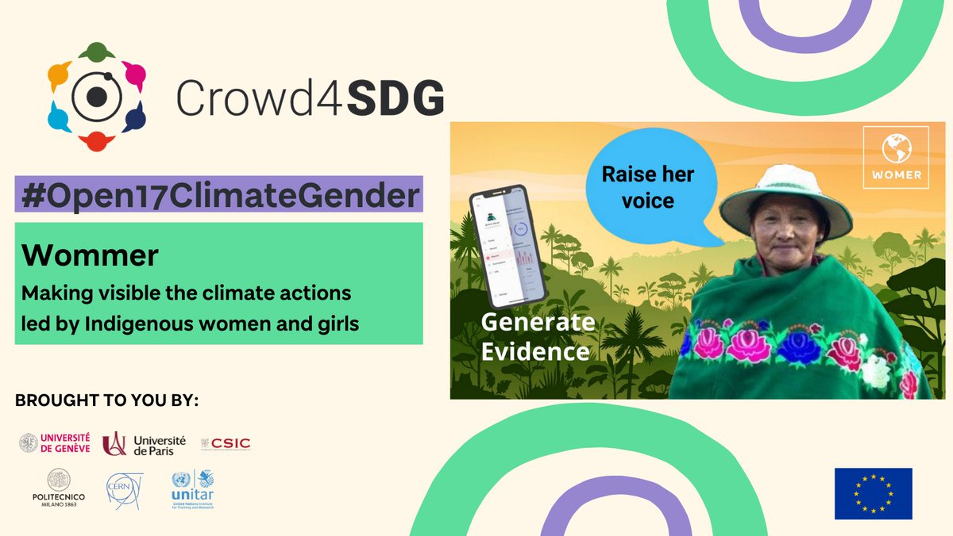
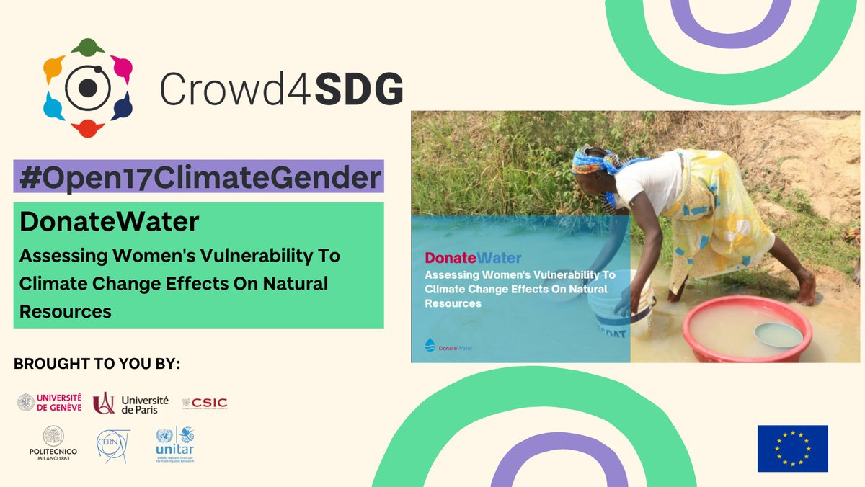
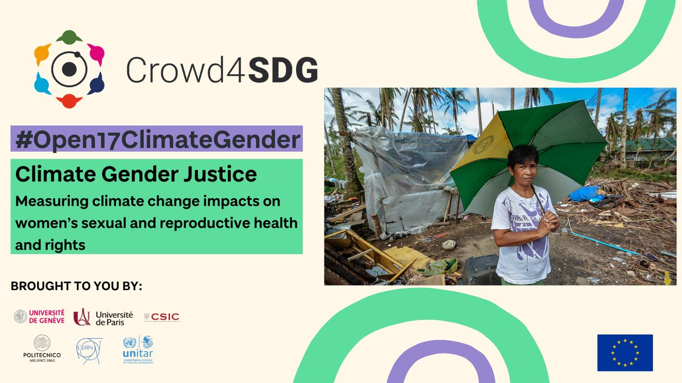
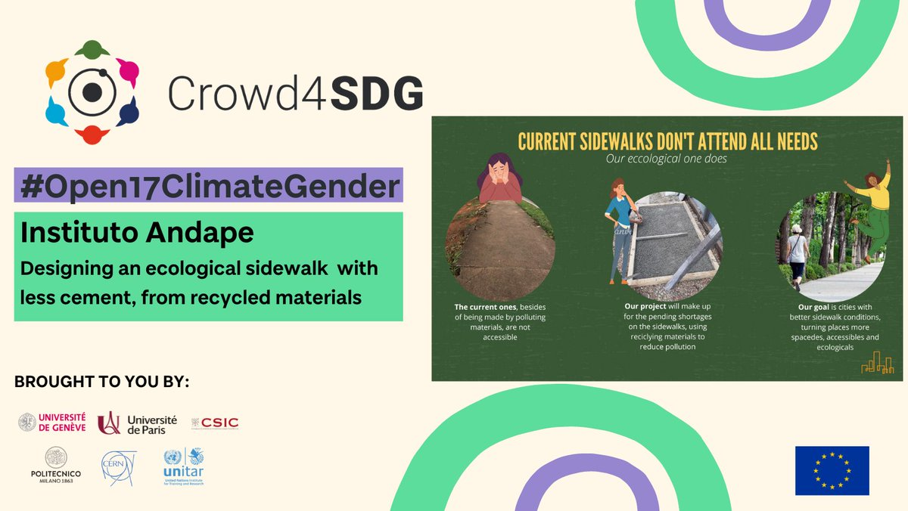
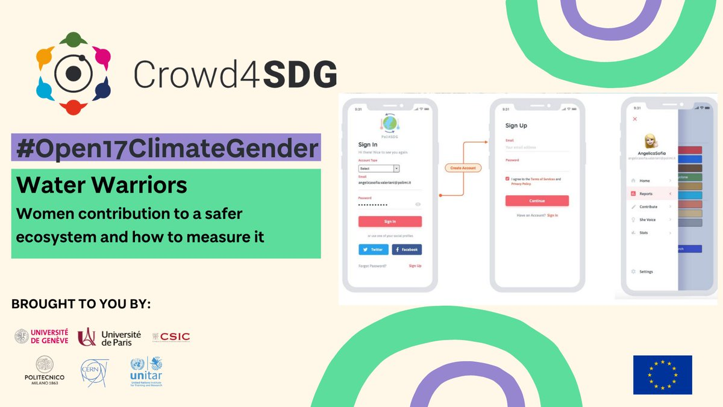
Year 02 - #Open17ClimateGender (2021)
Climate actions led by indigenous women
Measuring climate change impact on women reproductive health and rights
Assessing women vulnerability to climate

Slide 11
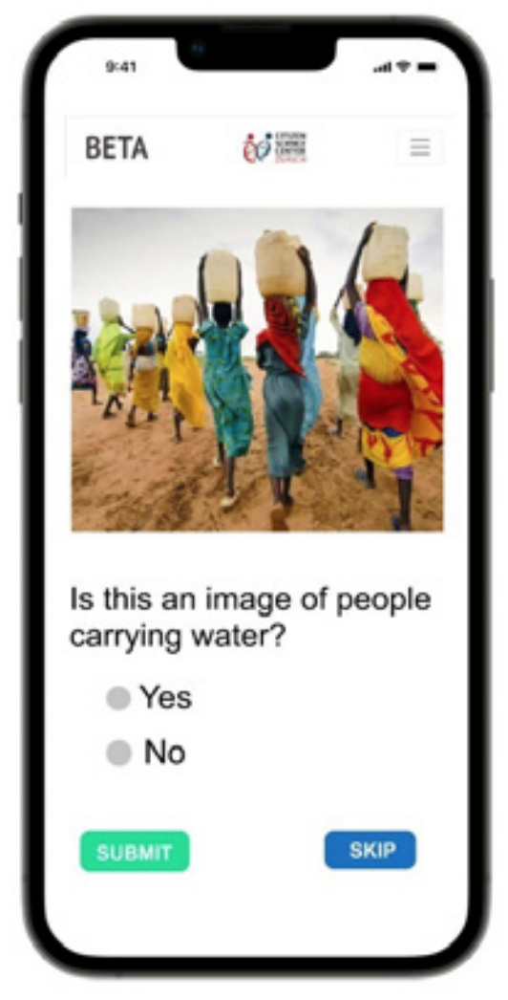
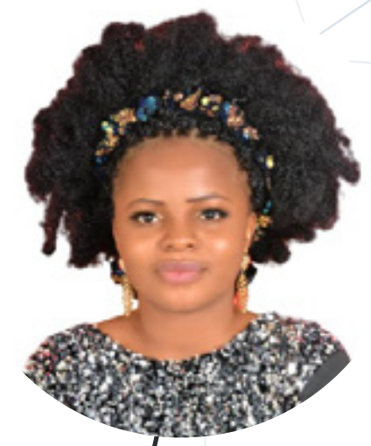
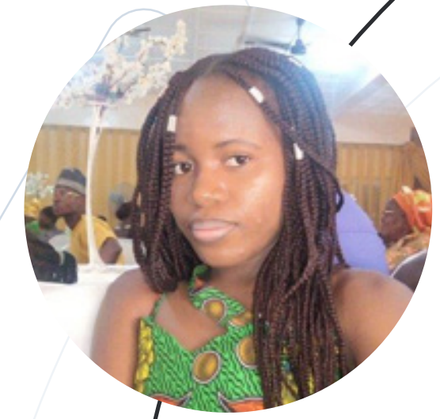
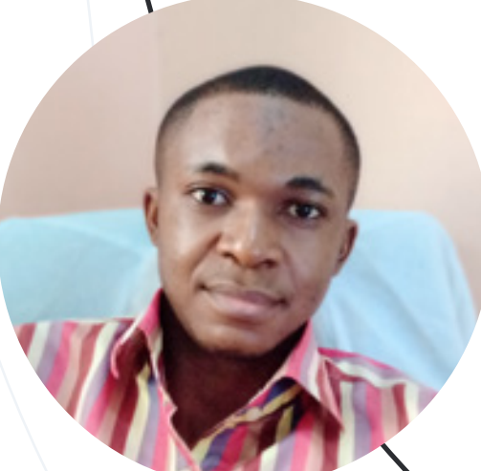
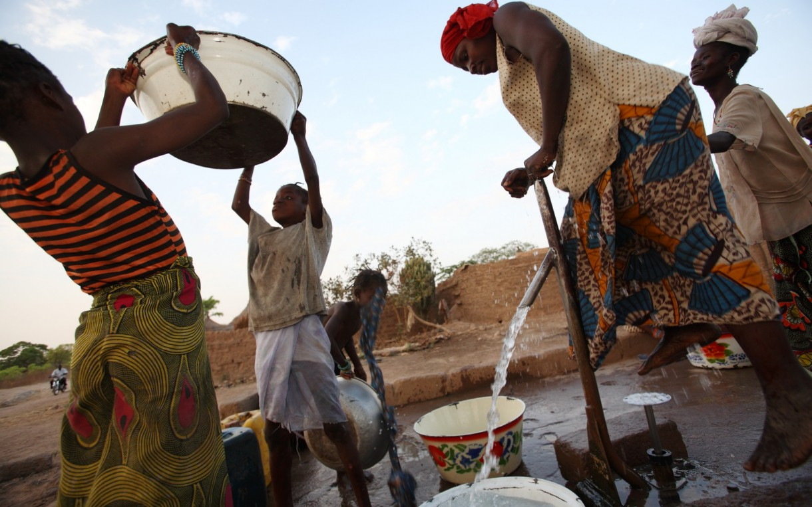

Donate Water
Is this pump broken?
Original Plan: install solar-powered water pumps in Nigeria.
Final Result: gather data about broken mechanical pumps
Theory of Change: convince local authorities and NGOs to invest in solar-powered pumps
Notes:
Improve the talk with some background about CBI.

Slide 12

Year 3 - #Open17ClimateJustice

Slide 13
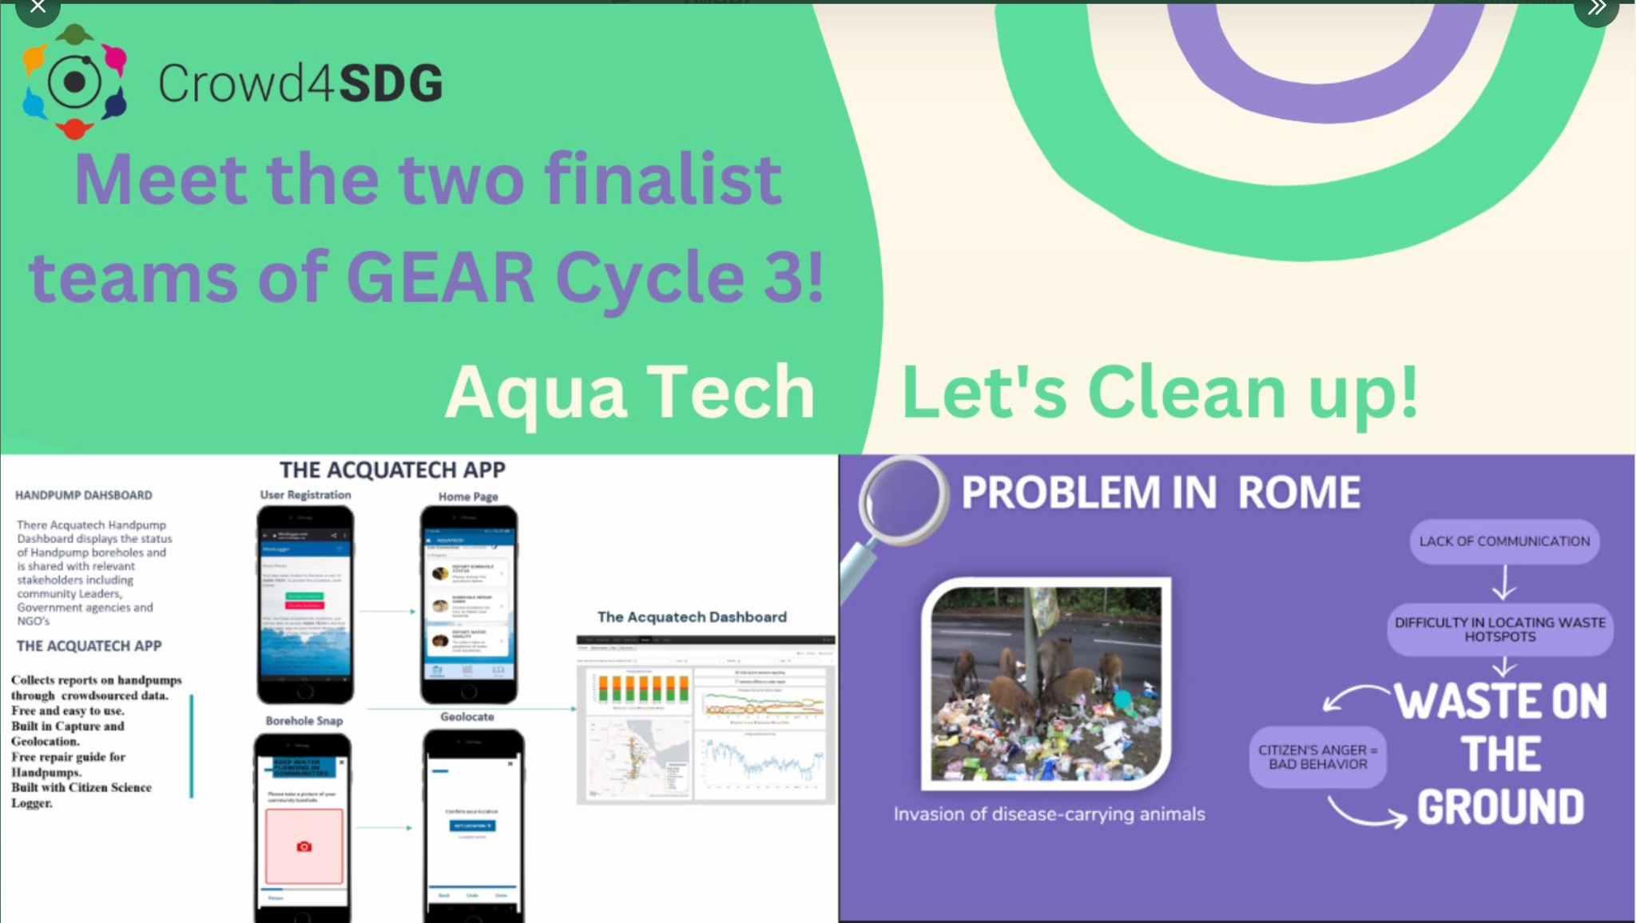
Year 3 - #Open17ClimateJustice
hardware hand pump borehole monitoring solution
Software to help with efficient waste management

Slide 14

Crowd4SDG Methodology: GEAR cycle
GATHER
Selecting with Goodwall
100 applicants, August-September
M1
REFINE
Sharing at Geneva Trialogue
2 teams, 4 days
March
EVALUATE
Coaching with Open 17
12-15 teams, 5 x 2hrs
October-November
M9
M3
M6
ACCELERATE
Prototyping with CBI Workshop
4-5 teams, 10x4hrs, December-February

Slide 15
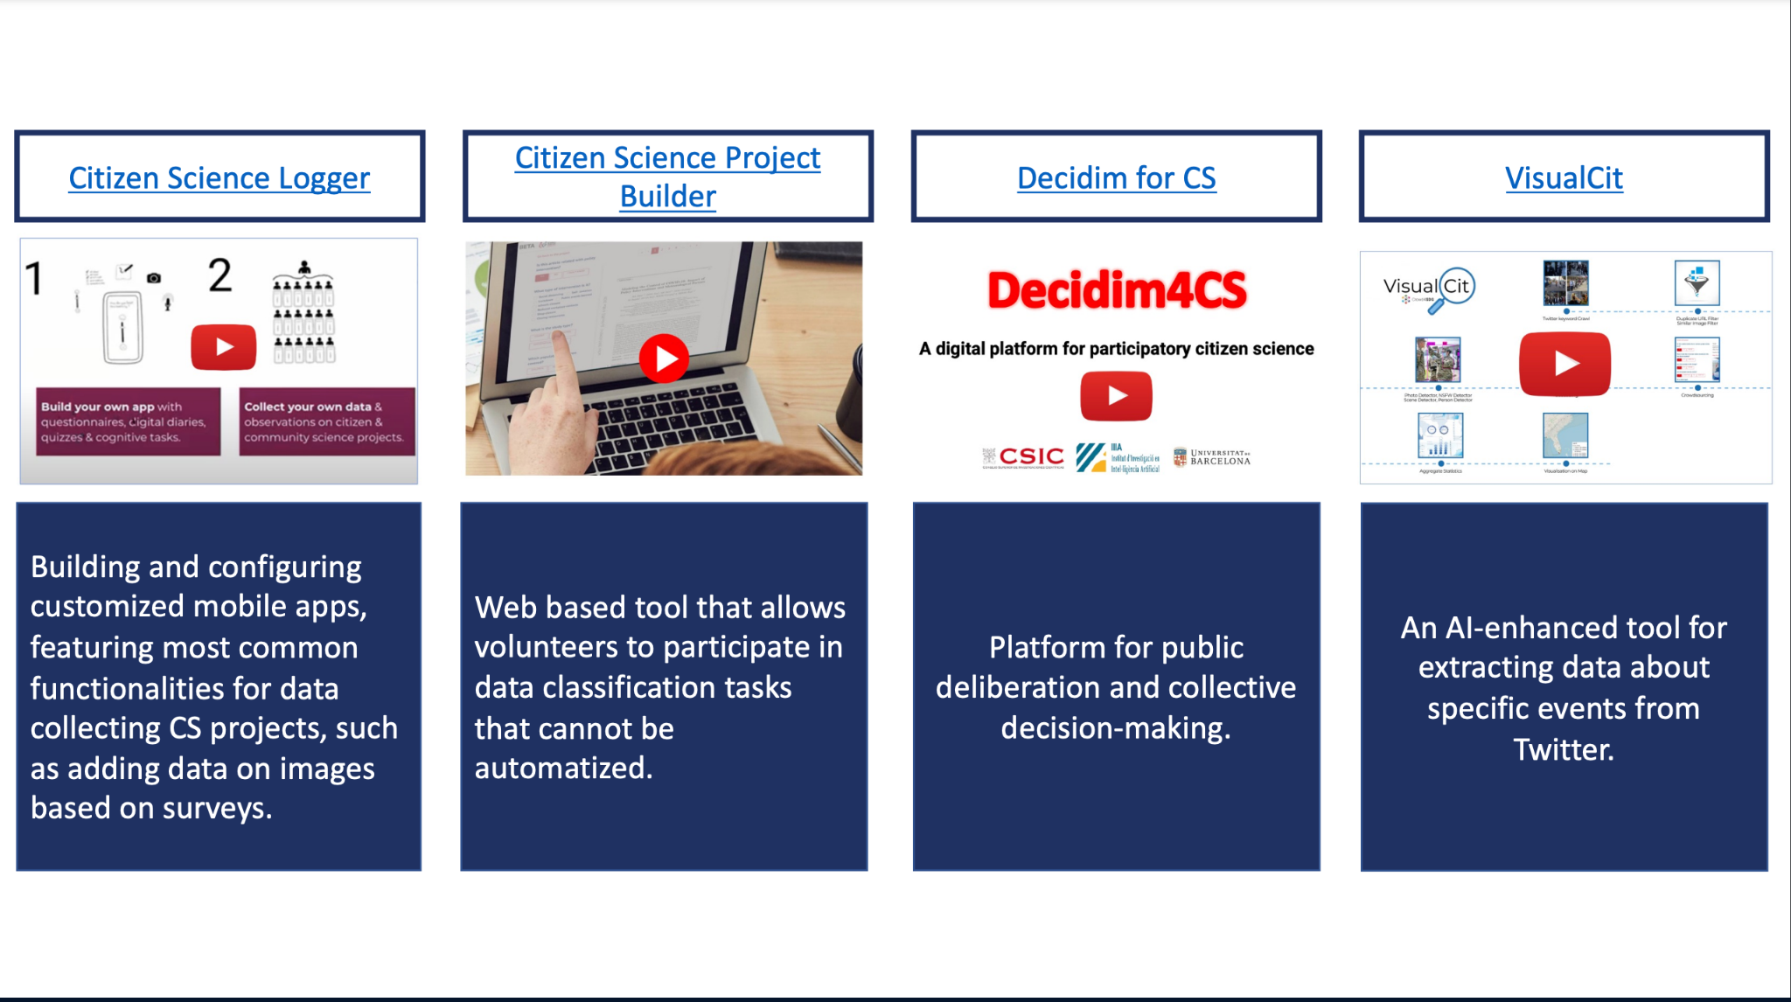

Crowdsourcing and Collaboration Tools
Crowdsourcing
Tool 1: CS Project Builder - crowdsourced data classification
Tool 2: CS Logger - crowdsourced data gathering
Tool 3: Decidim4CS - crowdsourced deliberation
Tool 4: Visual Cit - filtering data crowdsourced from social media
Collaboration
Tool 1: Slack
Tool 2: InnProgress

Slide 16

Learning objectives Evaluate Phase
Objective 1: Problem definition
Objective 2: Theory of Change
Objective 3: Value proposition and Persona
Objective 4: How to Pitch
Final Session: Teams pitch to jury

Slide 17
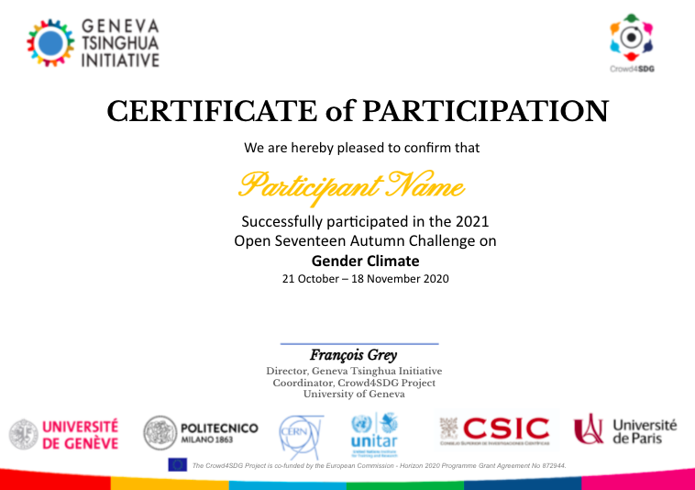
Rewards
Certificate from United Nations (UNITAR)
Opportunity to progress to CBI workshop (4-5 teams)
Opportunity to earn and learn with Yoma (everyone)
Other project support opportunities (SDG Accelerator)

Slide 18

Learning objectives Accelerate Phase
Objective 01: Create a prototype
Objective 02: Engage with stakeholders:
Objective 03: Practice pitching
Objective 04: Create a path forward

Slide 19
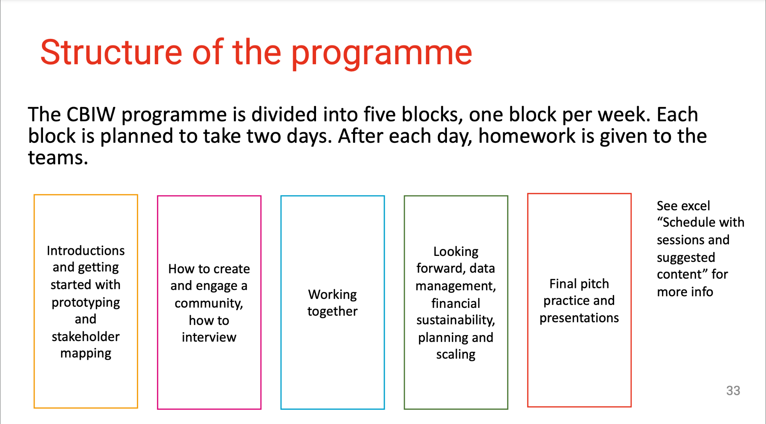
Learning objectives Accelerate Phase
Objective 01: Create a prototype
Objective 02: Engage with stakeholders:
Objective 03: Practice pitching
Objective 04: Create a path forward
https://crowd4sdg.eu/training-materials/

Slide 20
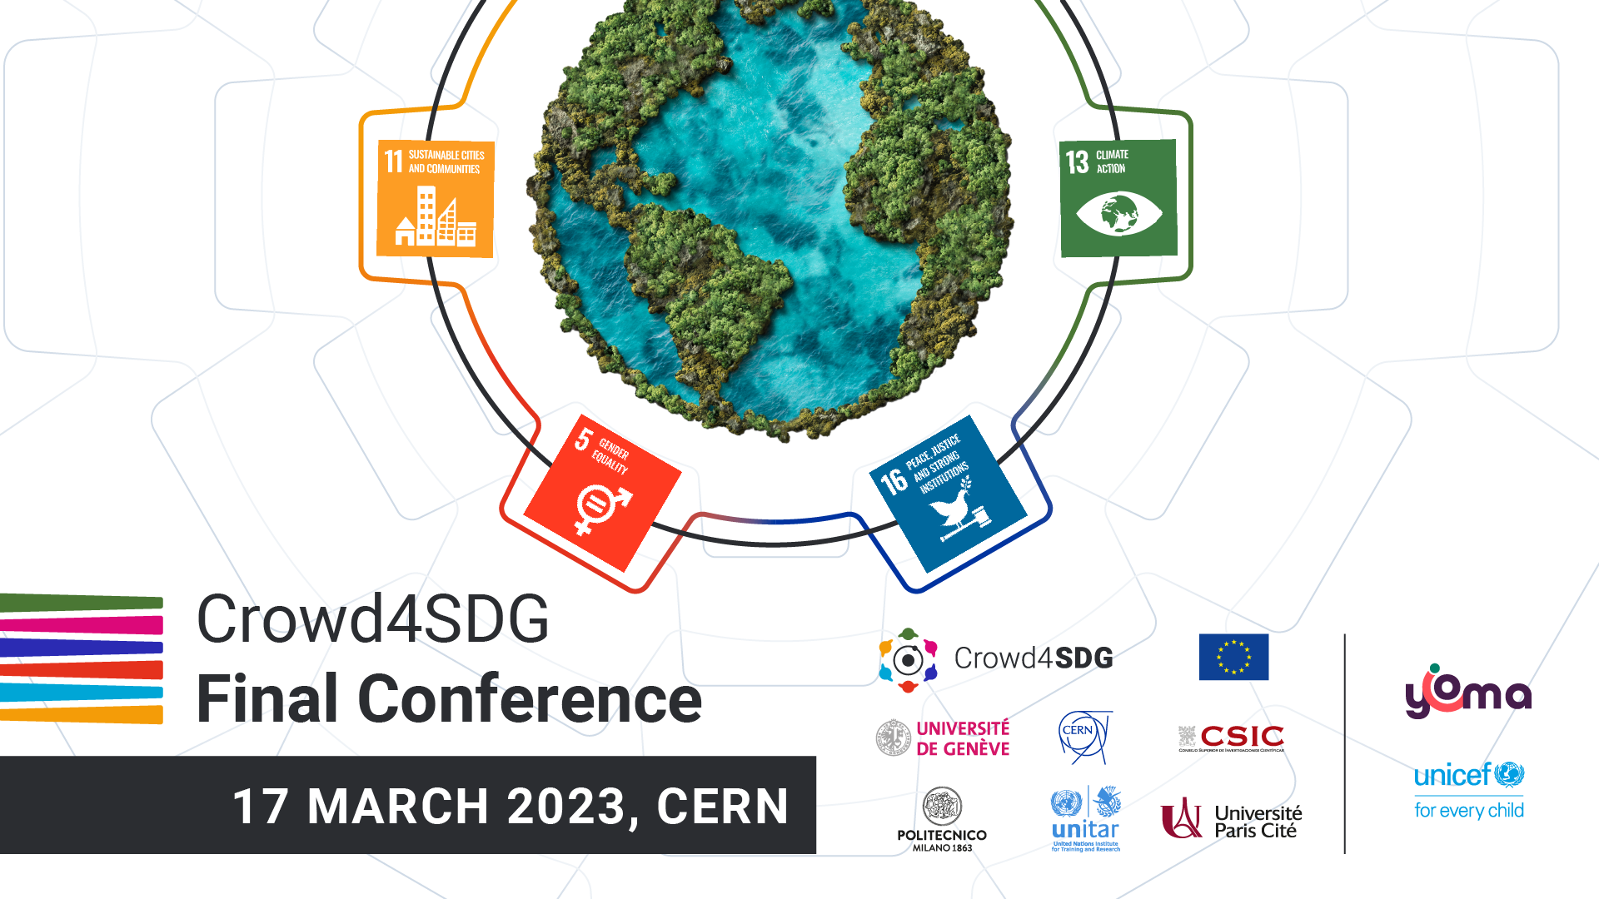
Final Conference - Join us!

Slide 21
crowd4sdg.eu

