Slide 1
IdeaSquare
Open Doors
15 and 16 February

Slide 2
Piching Prototype Challenges from the CERN Community
F. Pedrosa and R. Morton
15/Feb/2023

Slide 3

The trigger and the idea
The trigger:
  Scarcity of masks availability in the market and the COVID crisis
The idea:
  Develop a 3D printed washable mask with replaceable filters that could offer a better protection than a surgical type mask
  Find filters that could be easily available in a period of scarcity like the Covid-19
  Make all the Information publicly available once we have the test results and the OK from the CERN management

Slide 4
The team

Slide 5
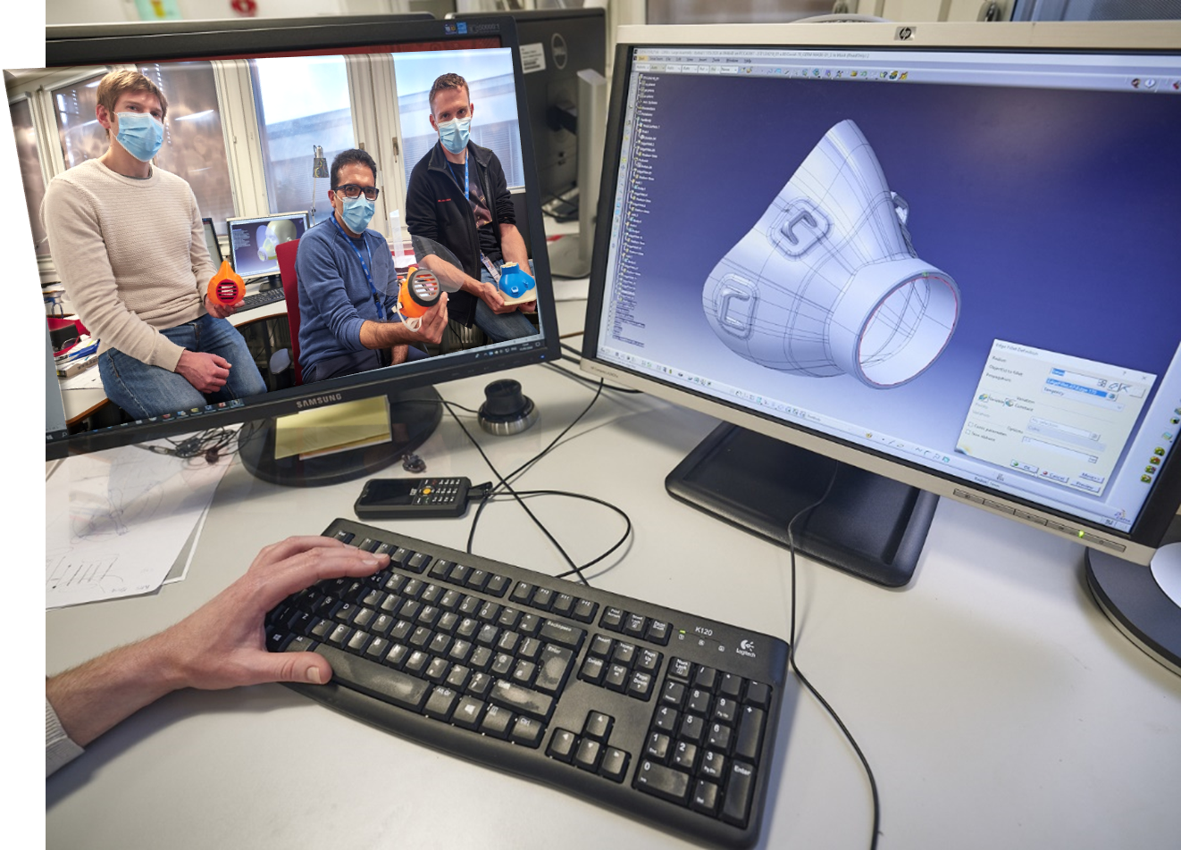
The mask design

Slide 6
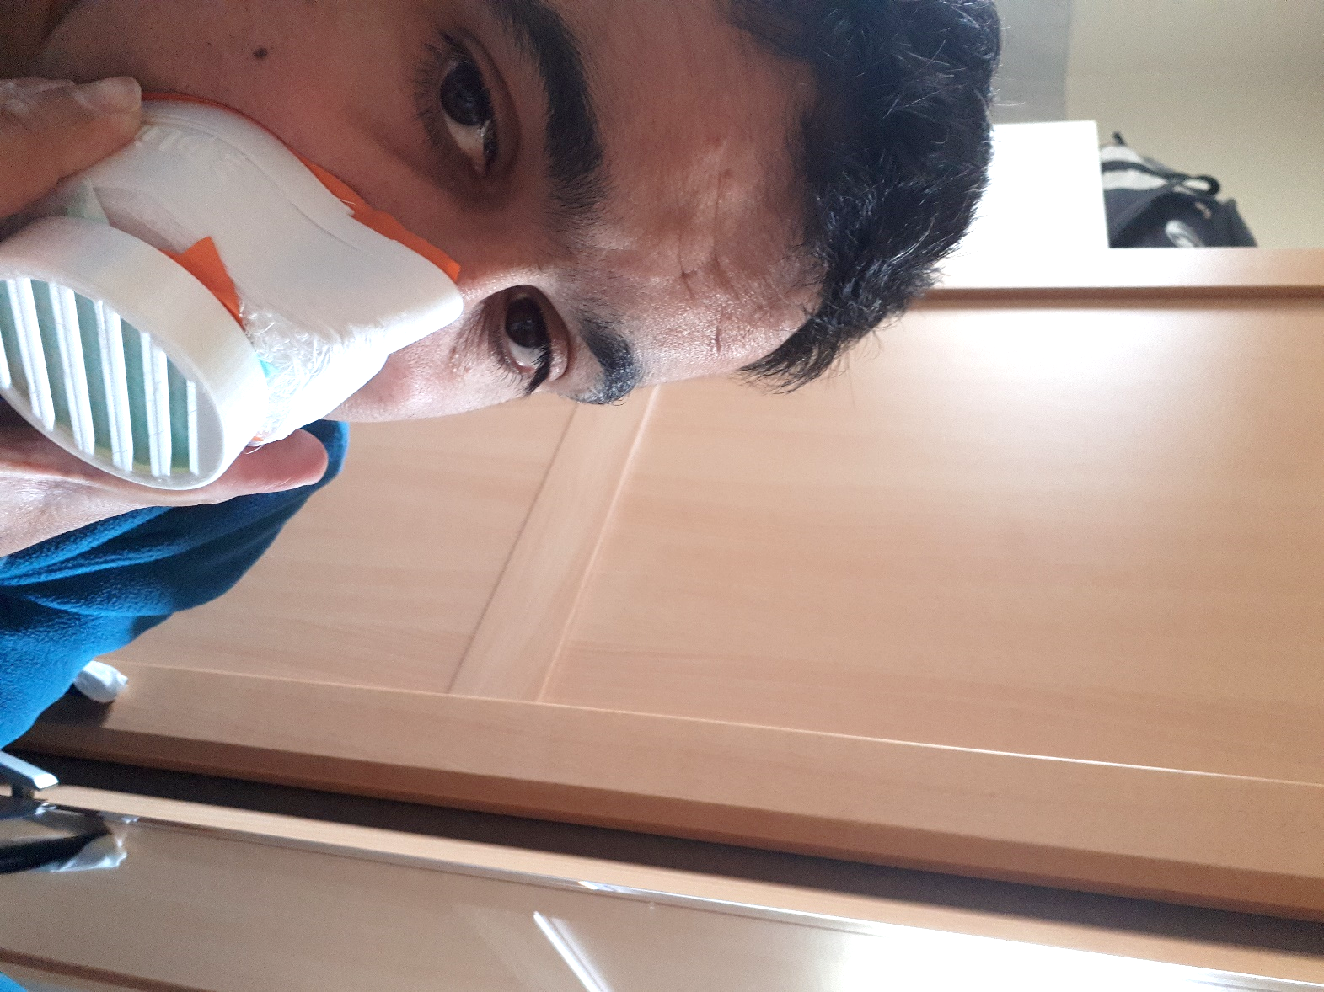
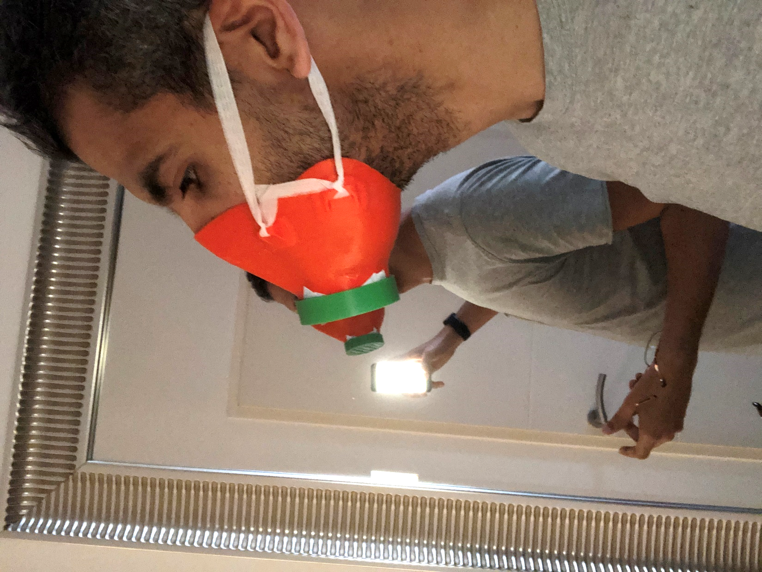
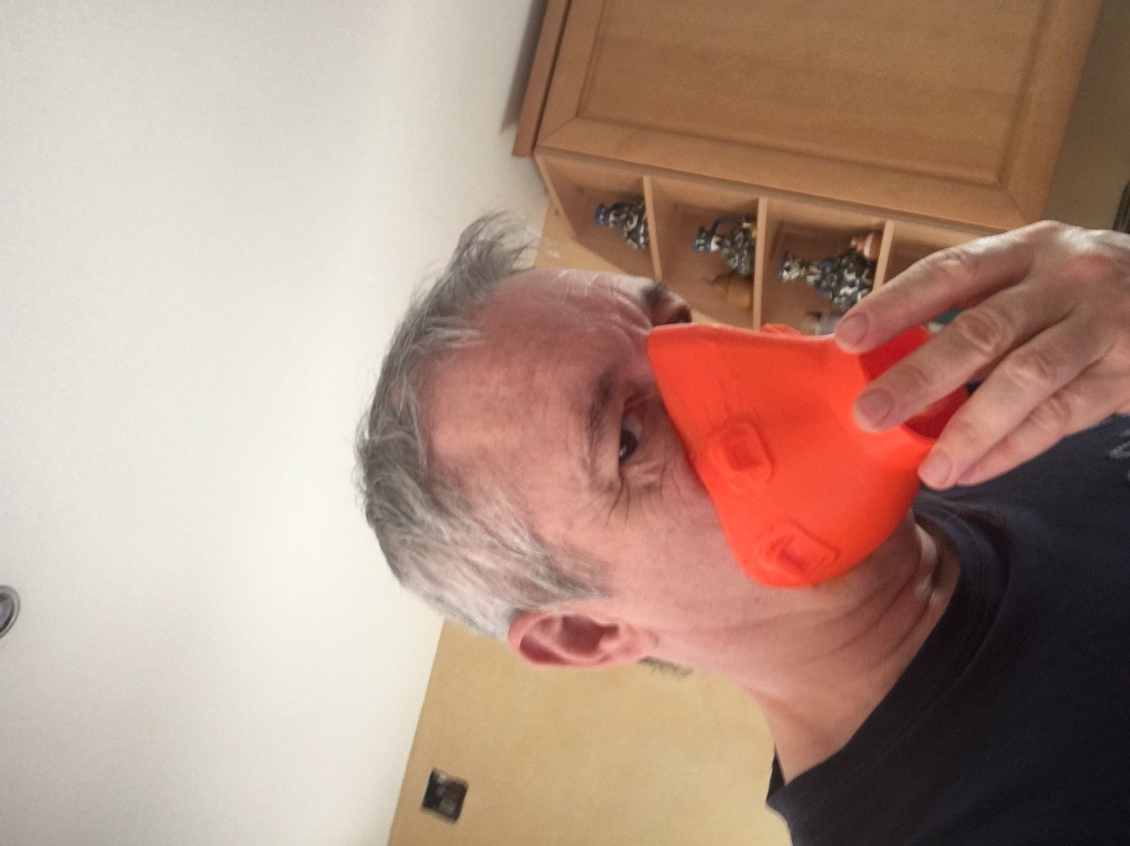
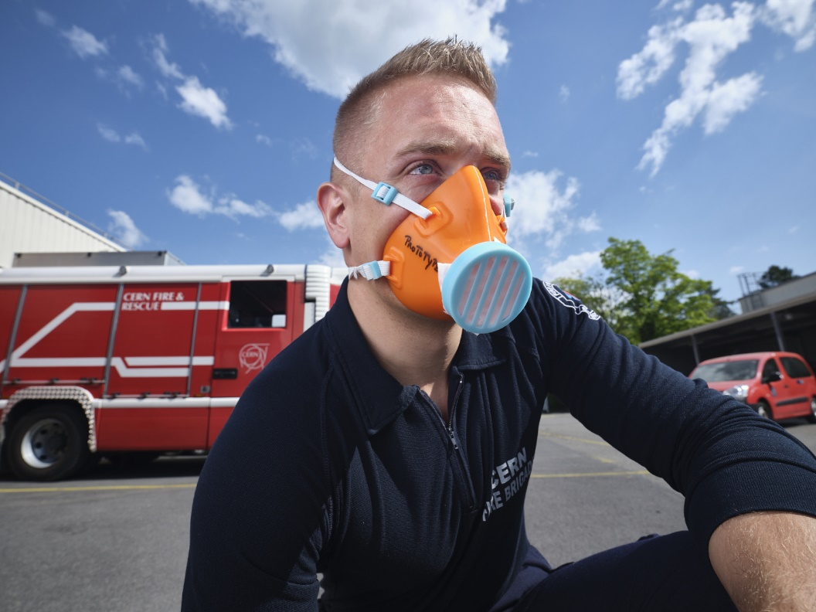
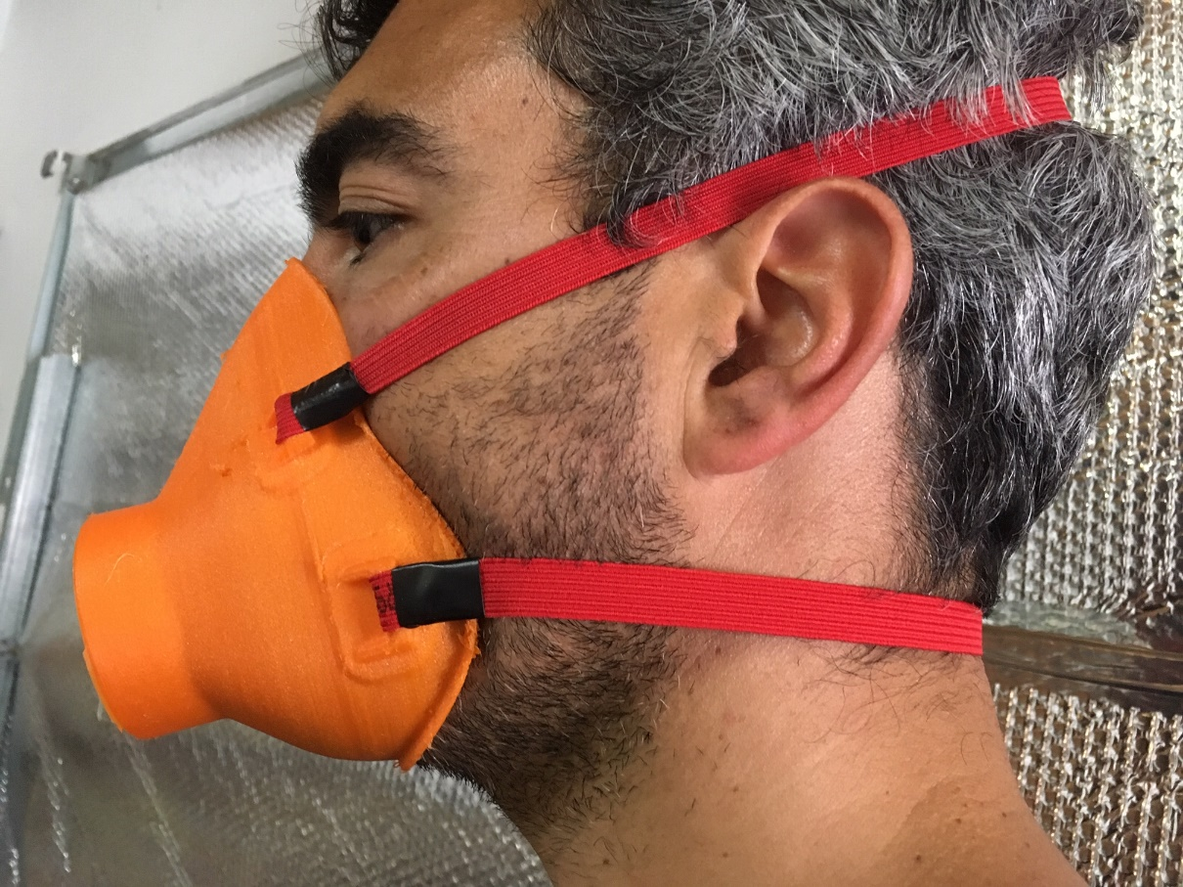
Design for “Human Interface”
Too loose
Too small
… no space for the nose
Great !
Too tight

Slide 7
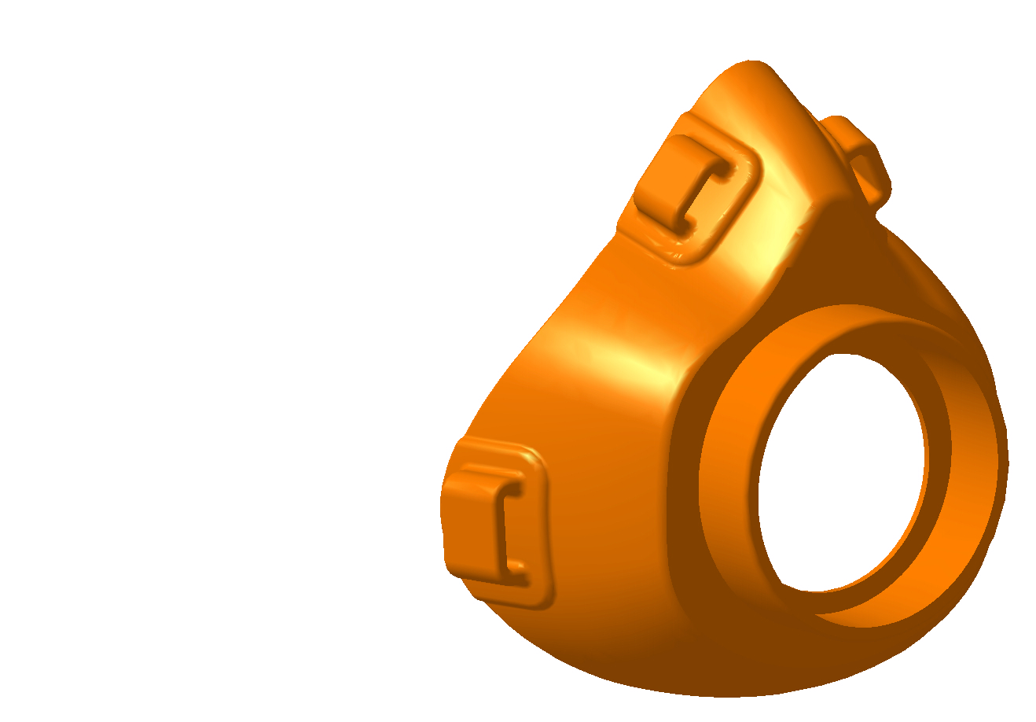
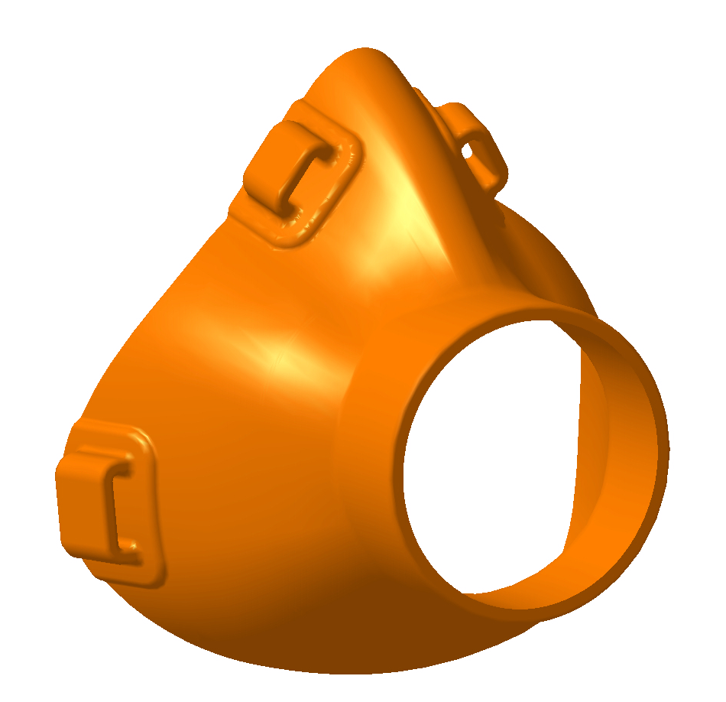
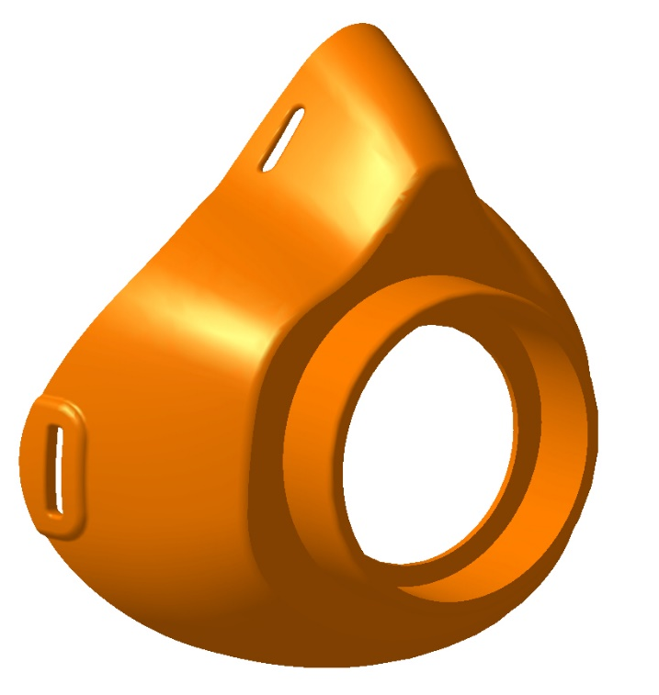
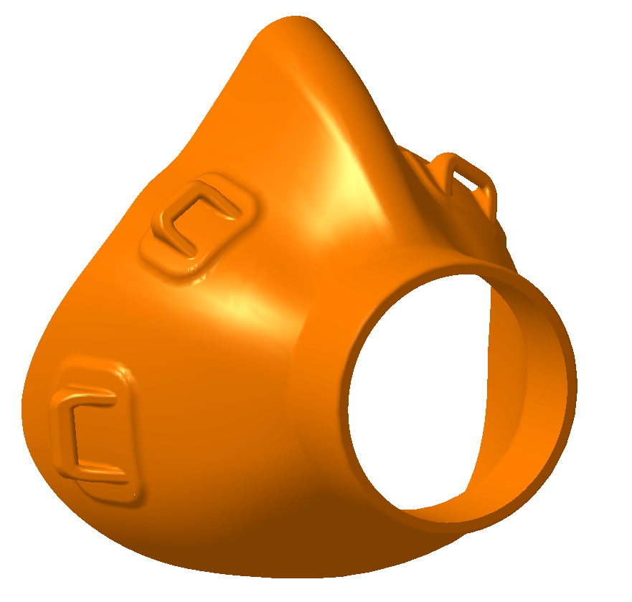
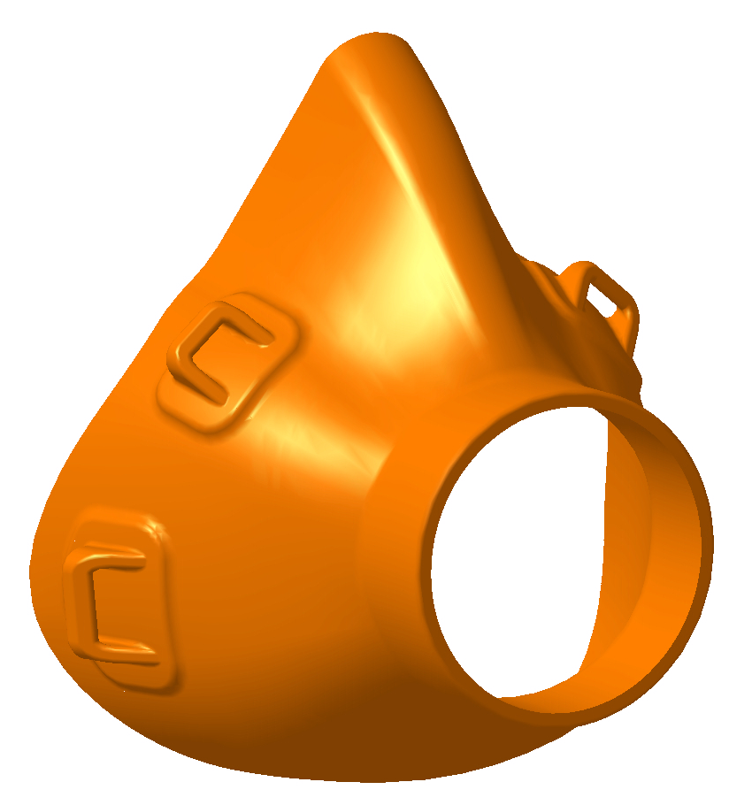
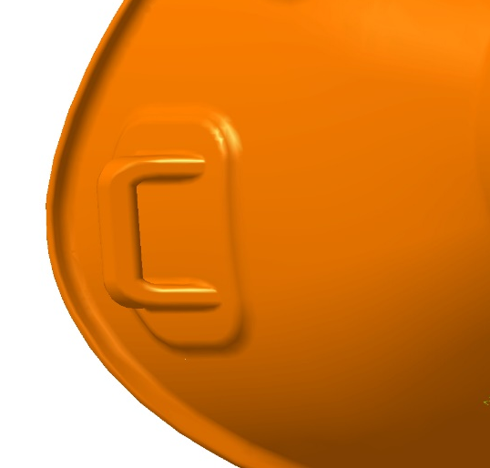

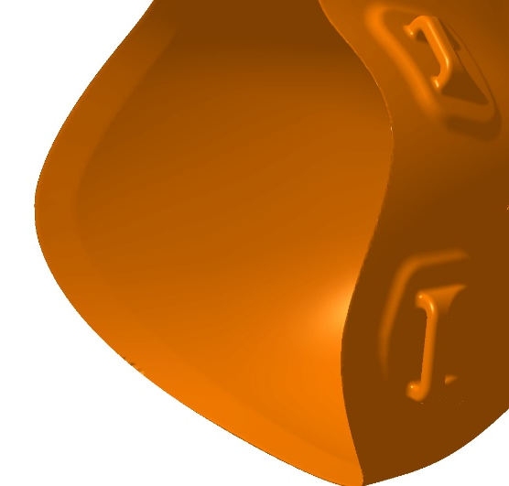
Design Steps
Starting model
SMALL
LARGE
  Change anchor point
  Avoid flat plane for easier printing
  Shape anchor points for EASIER printing
flap
chamfer

Slide 8
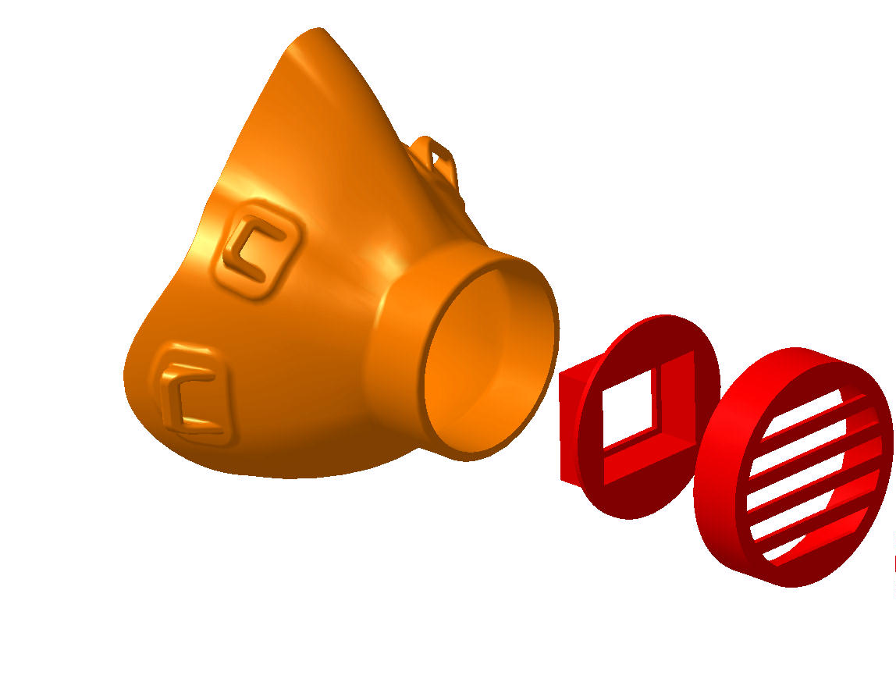
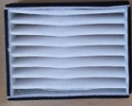
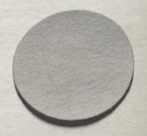
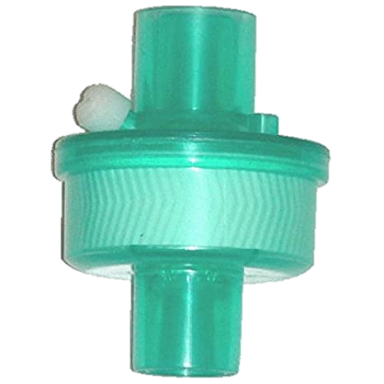
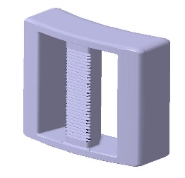
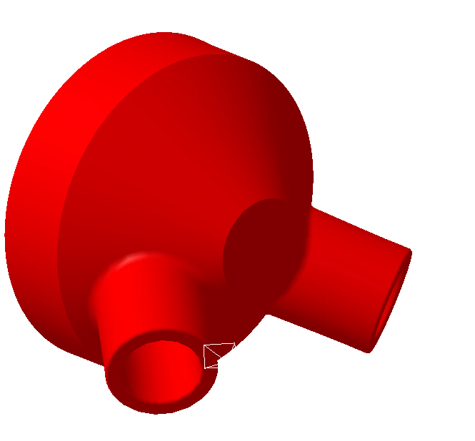
Design for filters
  WE DESIGNed SEVERAL INTERCHANGEABLE SUPPORTS So as TO HAVE THE FLEXIBILITY TO USE DIFFERENT FILTERS

Slide 9
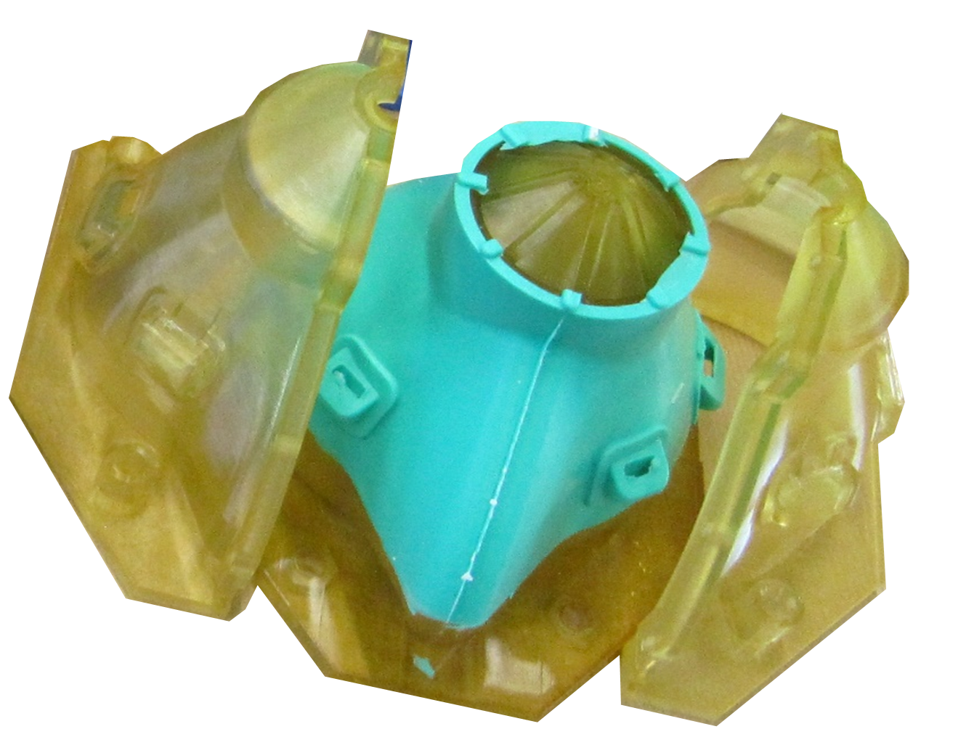
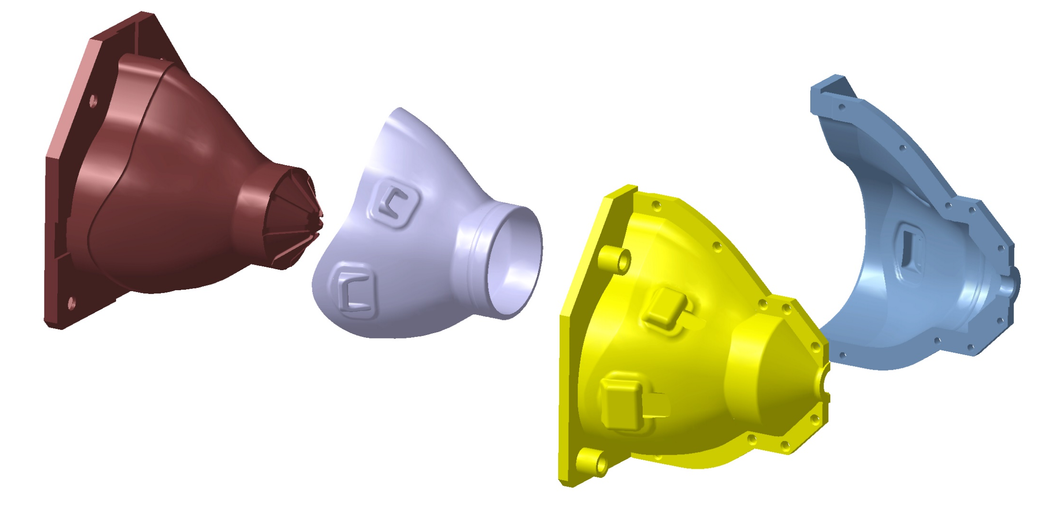
Design a mould
  WE DECIDED TO DESIGN A MOULD in order TO PRINT THE MOULD INSTeaD OF THE MASK, AND produce SEVERAL MASKs BY manual INJECTING SILICON

Slide 10
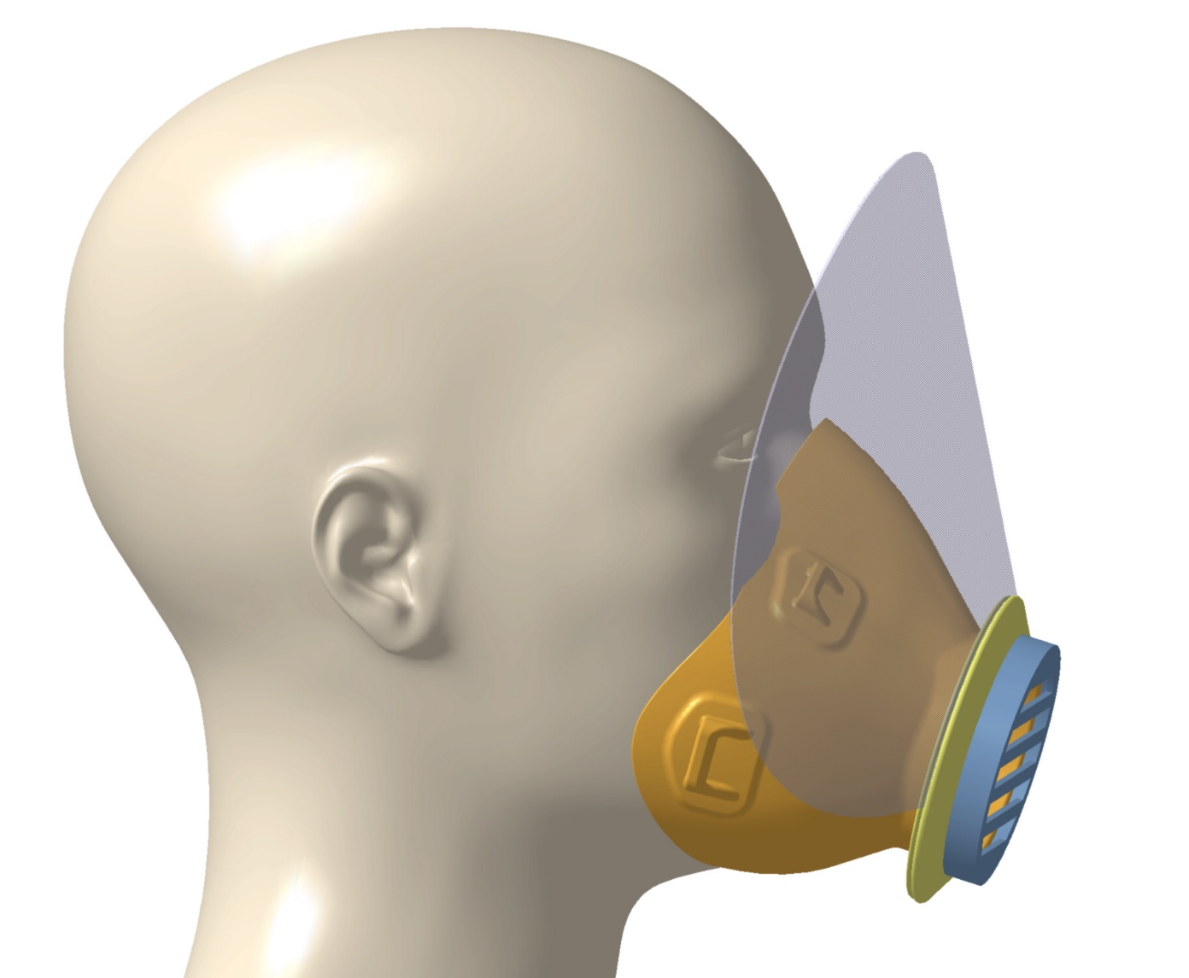
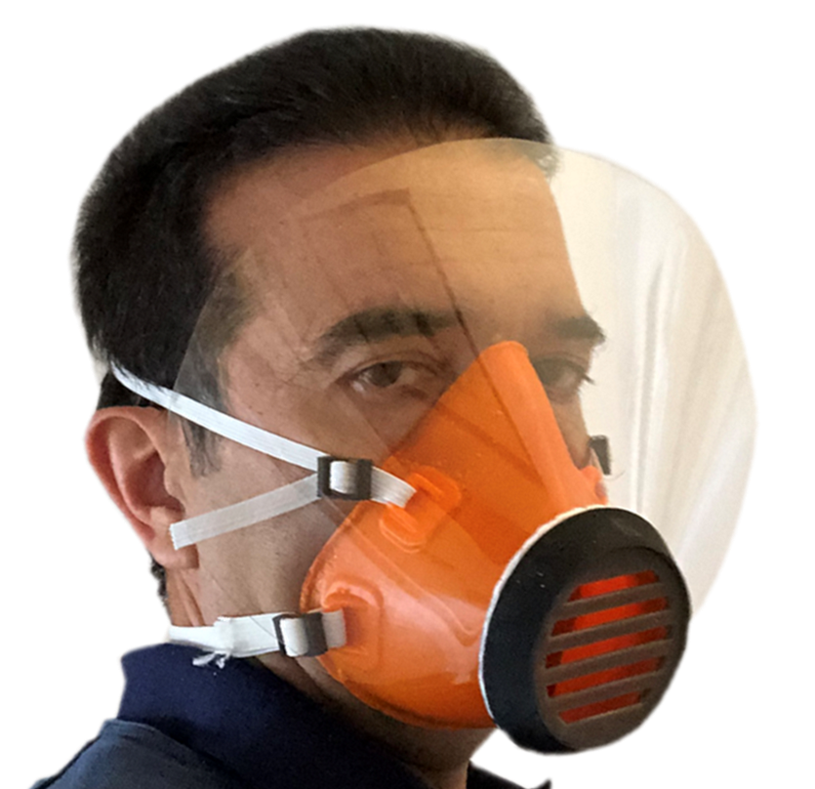


Light shield integrated in the mask
  FINALLY WE DESIGNED A LIGHT SHIELD DIRECTLY SUPPORTED BY THE MASK

Slide 11
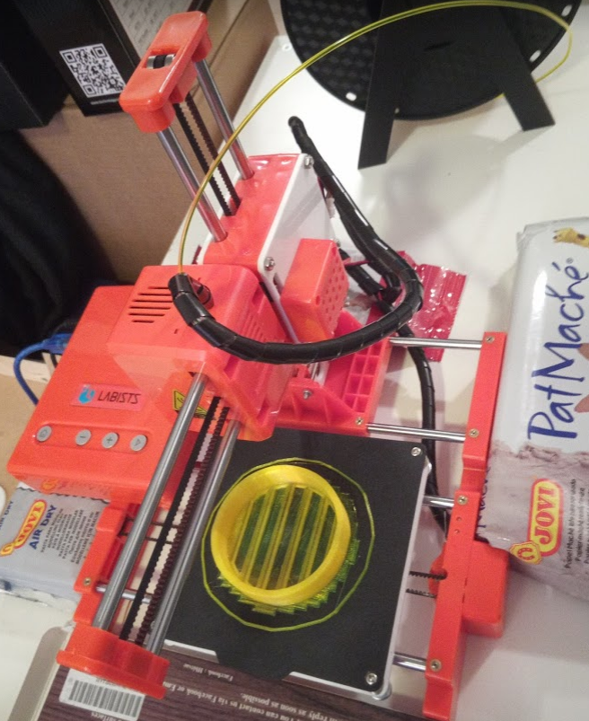
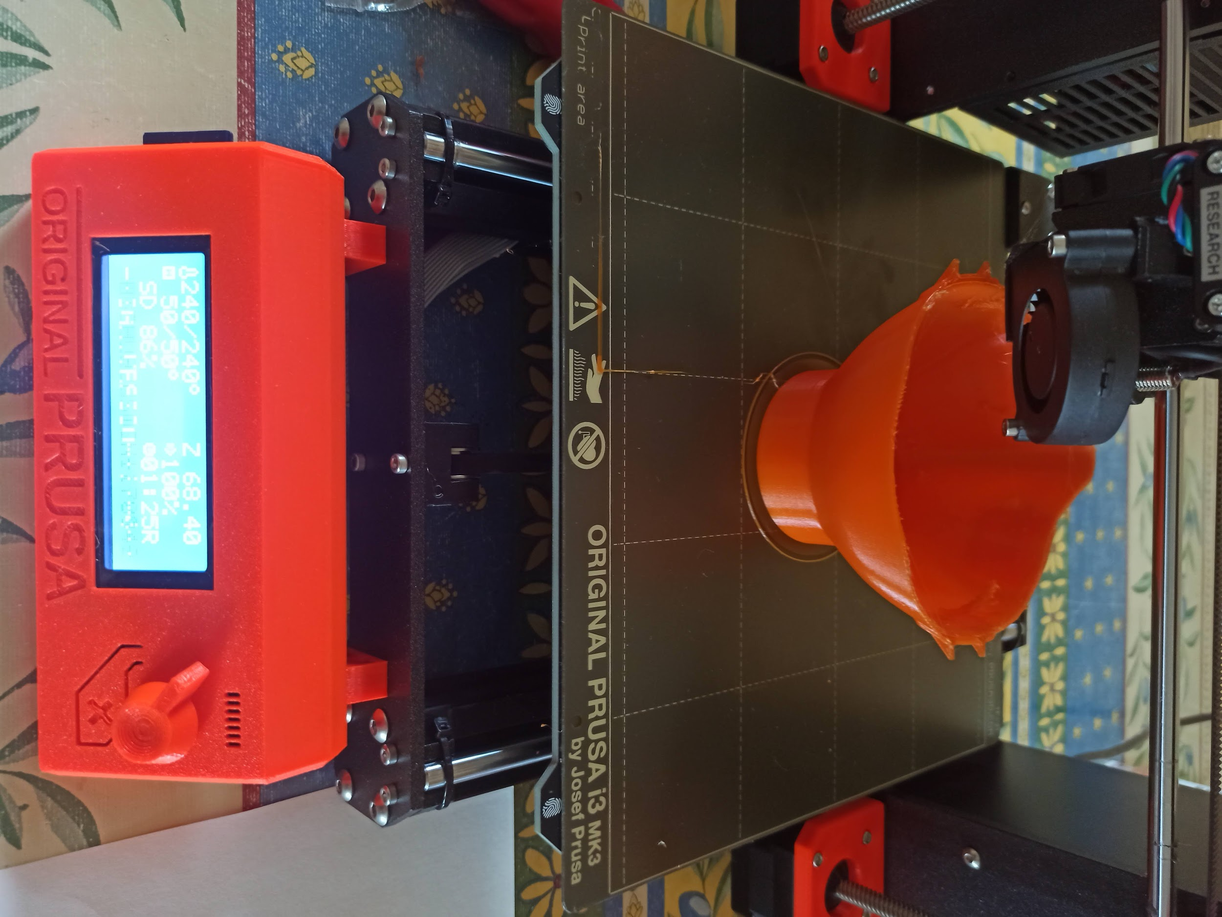
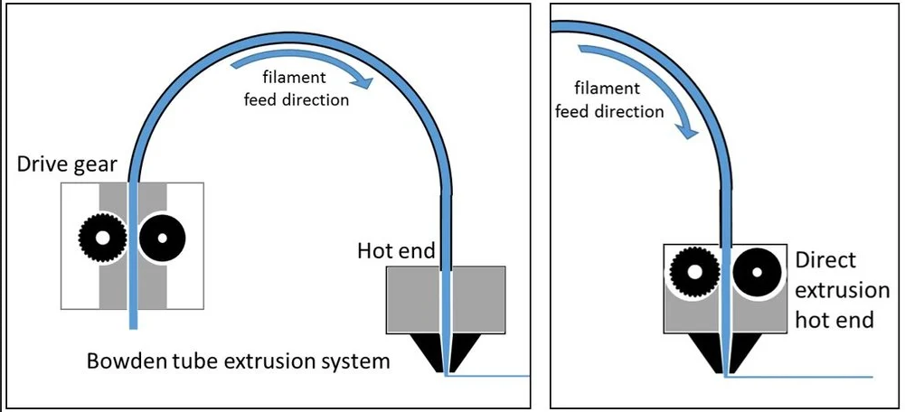
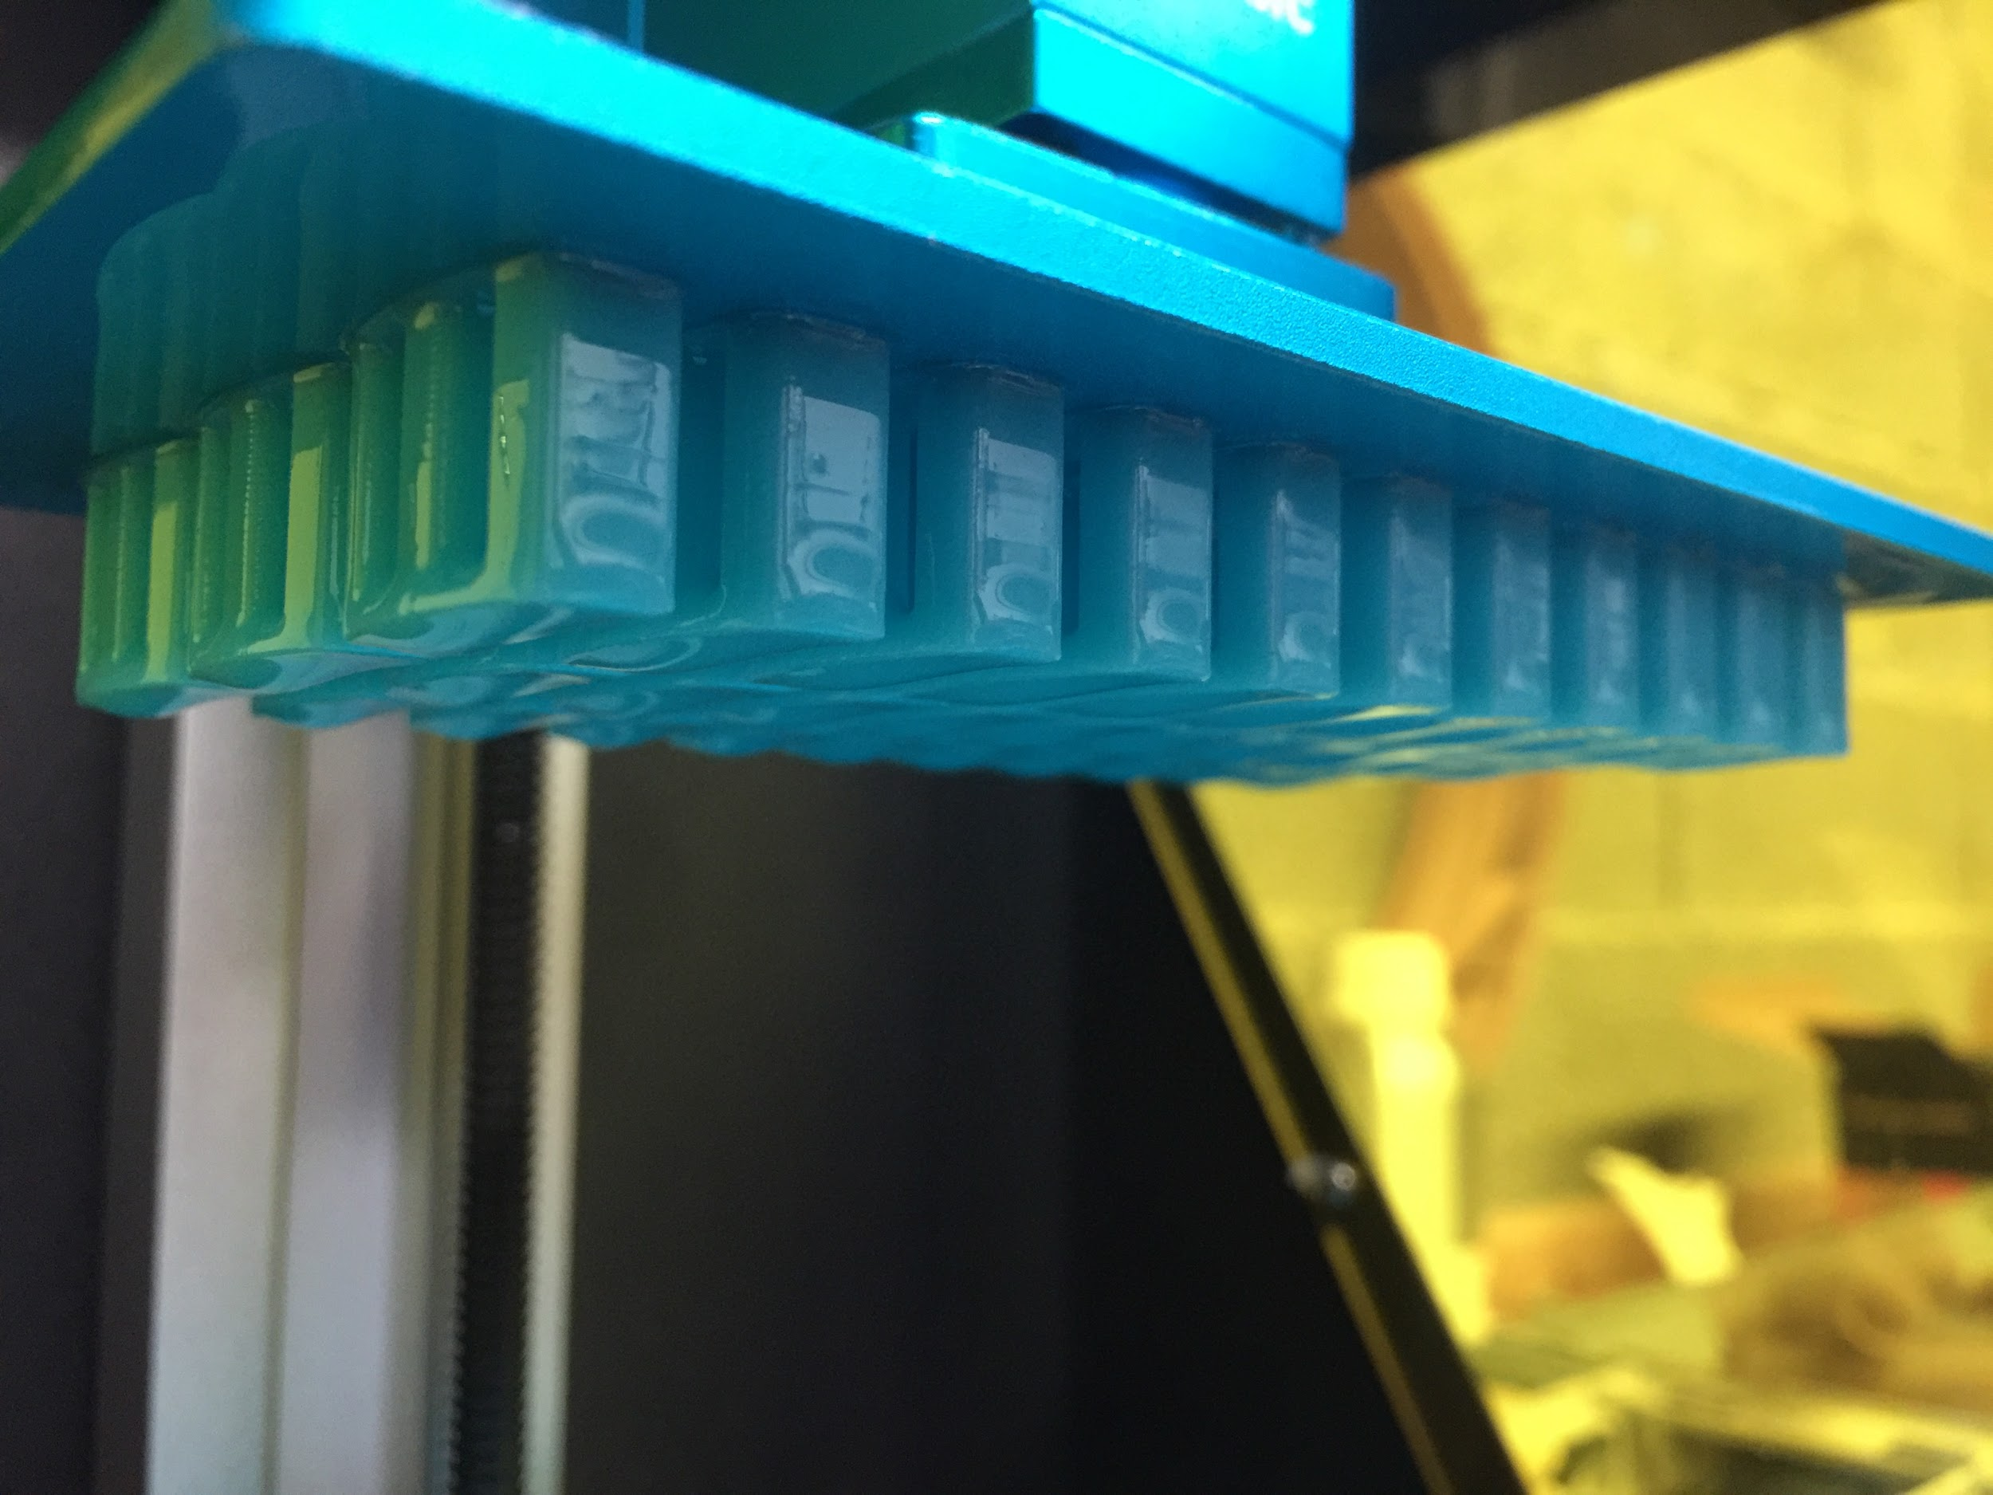
3D printing
Image: forefrontfilament.co.uk
STEREOLIThOGRAPHY (SLA): ANYCUBIC PHOTON ZERO
FUSED DEPOSITION MODELlING (FDM) PRUSA i3 MK3, ERYONE THINKER S, LABISTS X1, ULTIMAKER

Slide 12
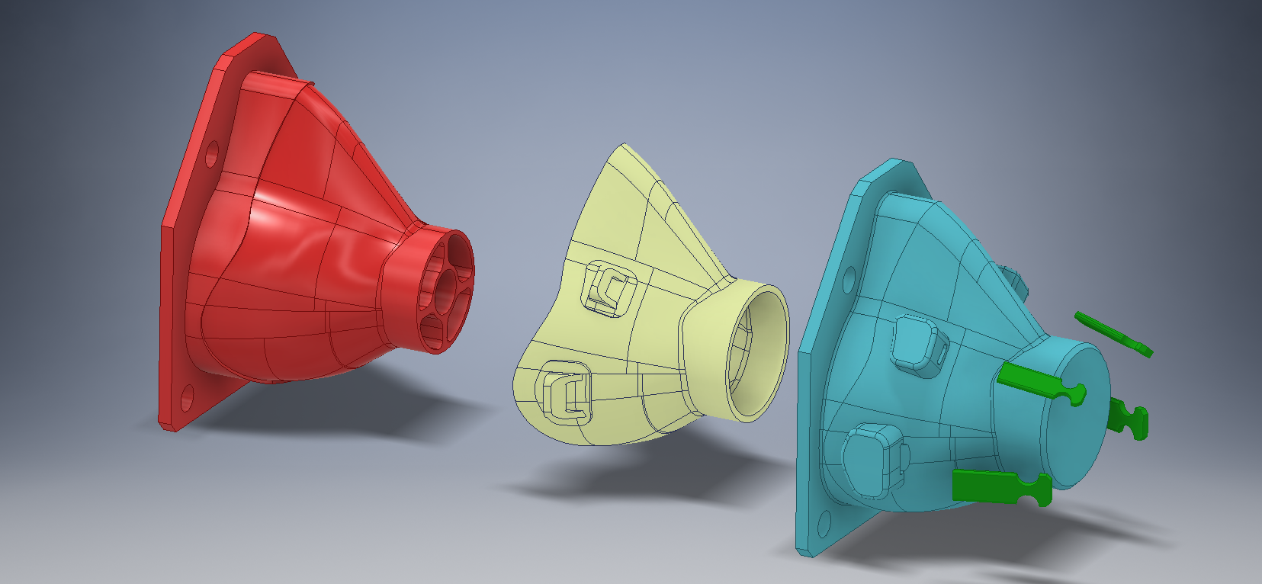
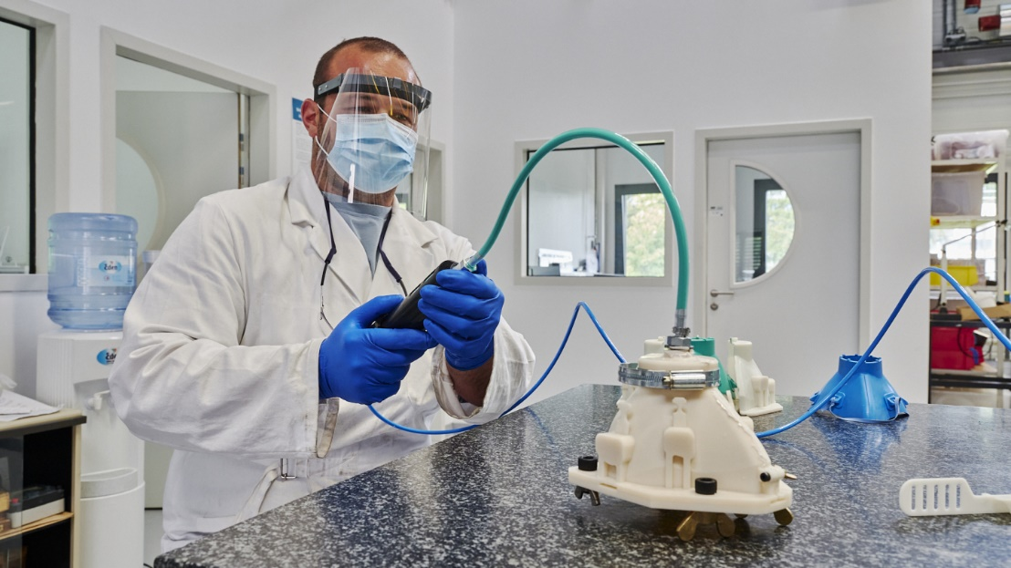
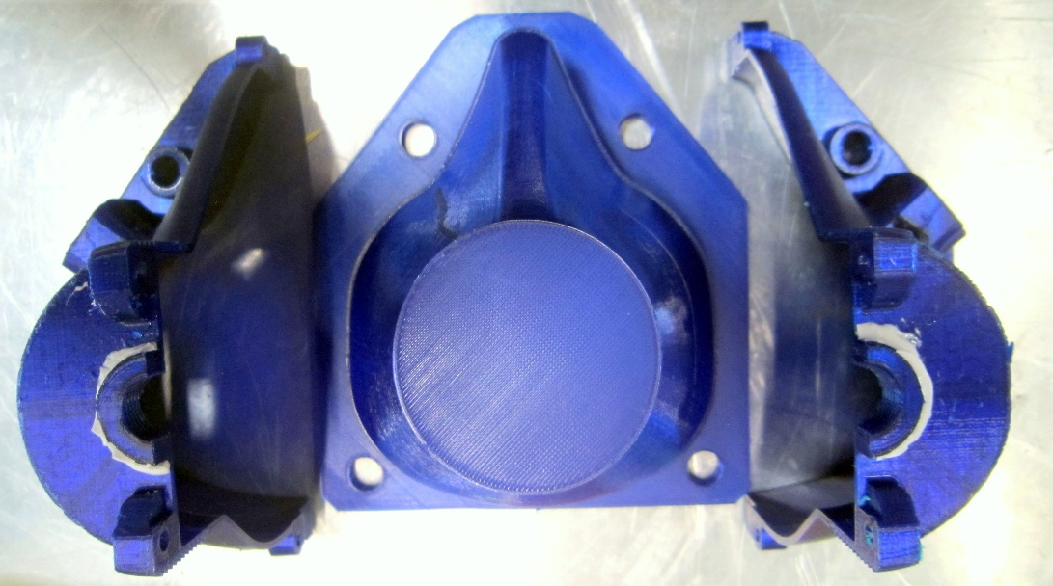
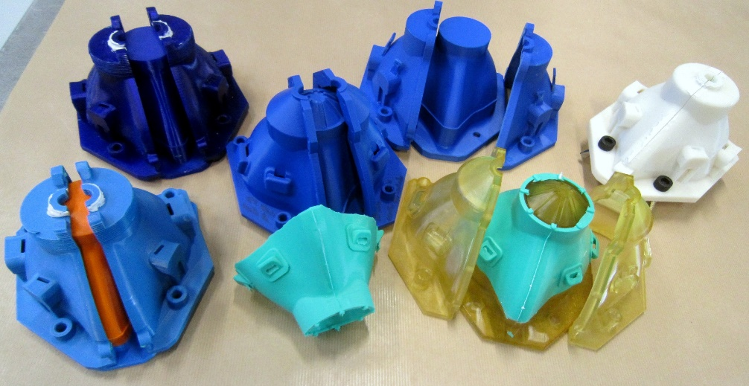
Injection using 3D printed moulds
WE TESTED THE MOULD WITH DIFFERENT SILICONES TYPES AVAILABLE IN THE POLIMER LAB, BUT WE ALSO RECEIVED SOME SILICONE DONATIONS FROM COMPANIES THAT WE CONTACTED

Slide 13
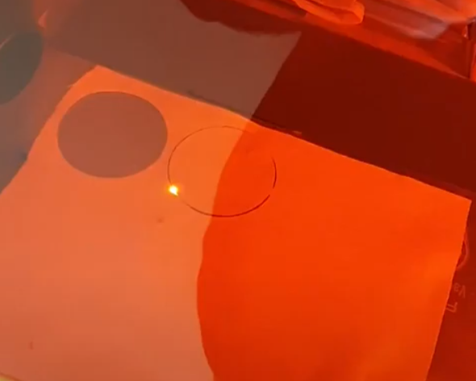
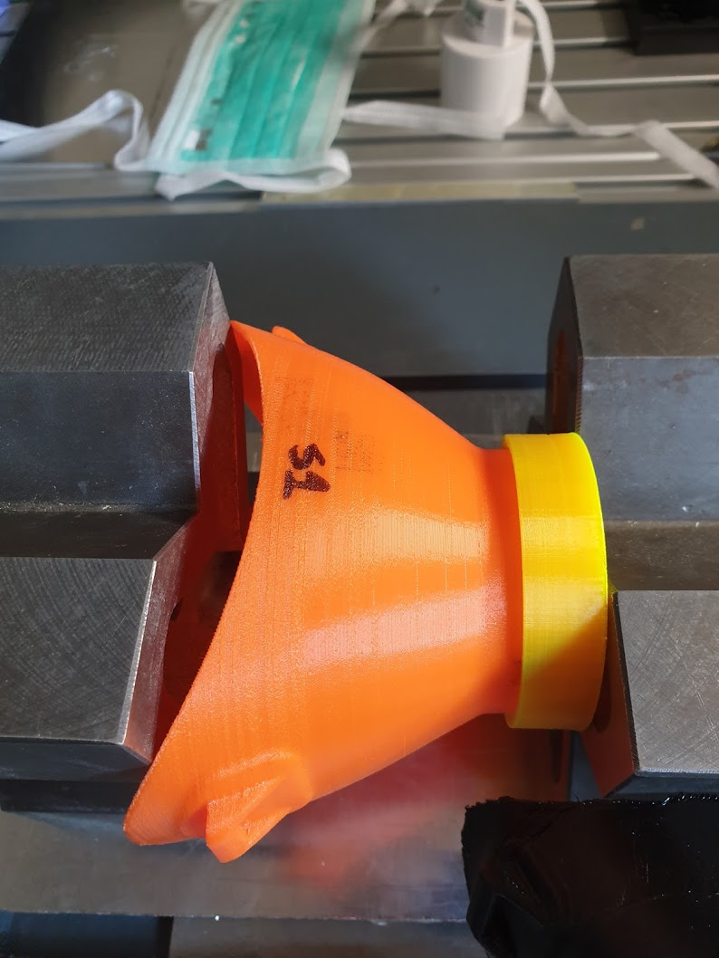
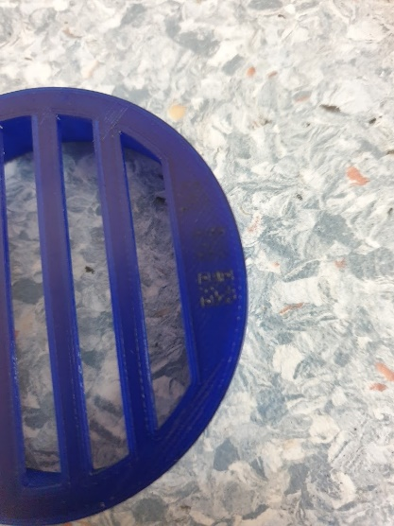
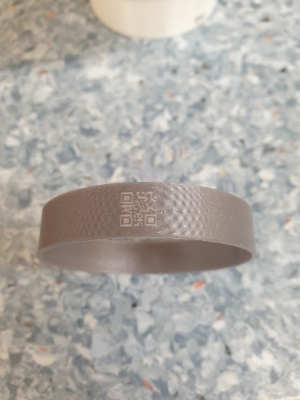
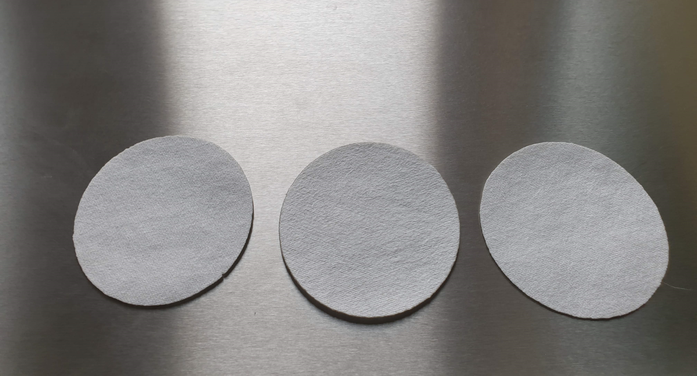
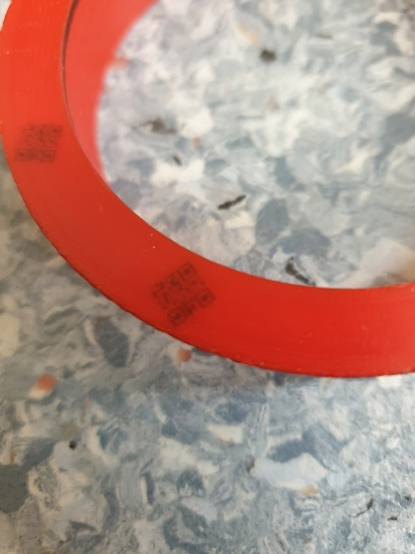
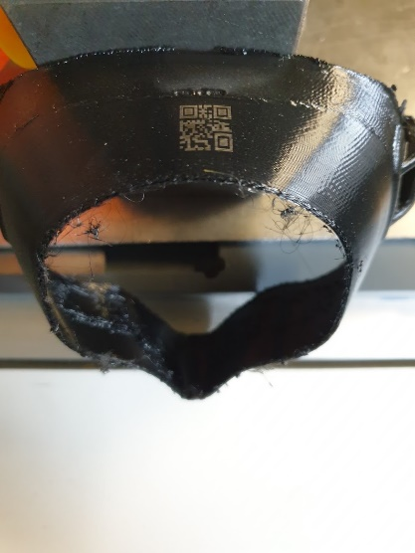
Filters and traceability
WE RECEIVED A DONATION FROM AN ITALIAN COMPANY THAT WAS IN THE PROCESS OF VALIDATION THEIR MATERIAL FOR AN FFP3 TYPE
fig.1
fig.3
fig.5
WE CREATED A QR CODE THAT WOULD ALLOW TO HAVE ALL THE INFORMATION NEEDED IN A CENTRAL PLACE
fig.2
fig.4

Slide 14
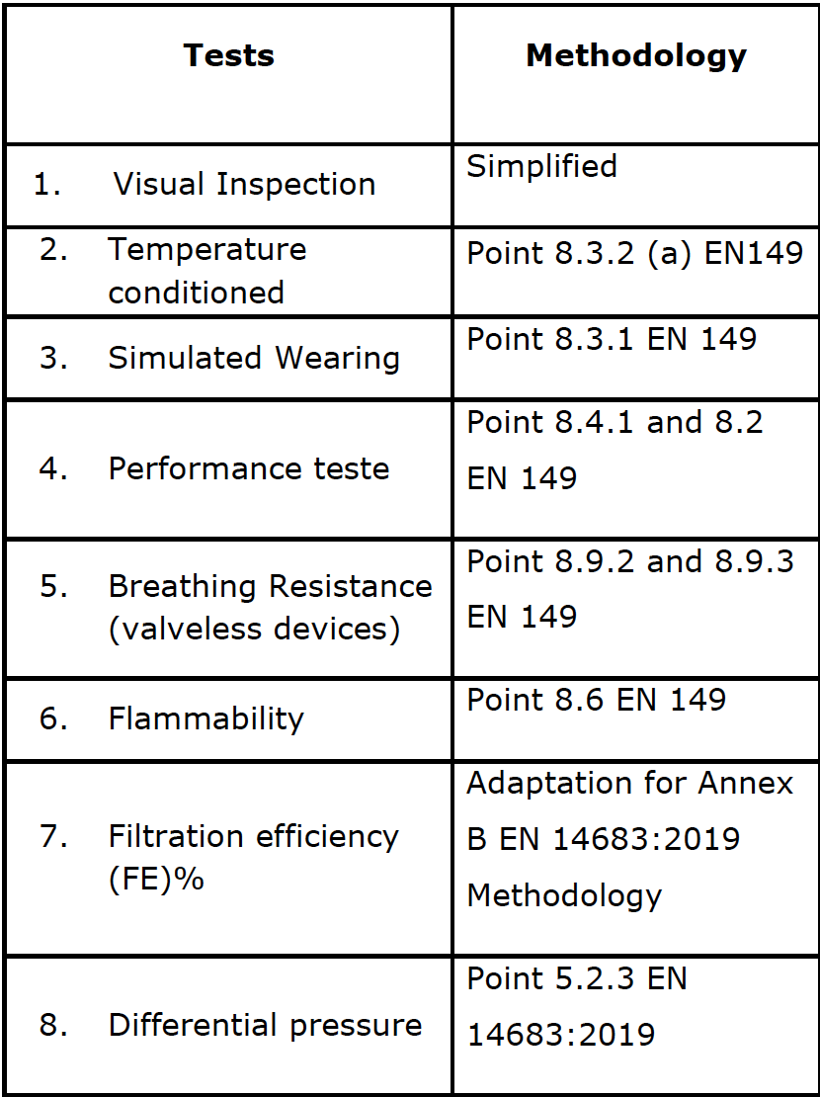
Safety tests
Difficult to find a certified lab available during the COVID19 period to perform the tests
List of tests suggested by the certified LAB and approved by HSE
One additional test requested by HSE
  CO2 concentration
These tests don’t certify the mask, but before making the mask information public we wanted to be sure the product was safe

Slide 15
Few conclusions
3D design for comfort and easy 3D printing was a complex process
3D printing flexible materials adds quite some challenges to the 3D printing process where some of us had no experience or limited experience
Finding easily available filters that offer a good filtration level and that let you breathe proved to be more difficult than initially expected
Manual injection moulding was a great experience and added some additional challenges for the team (mould development, silicone selection, …)
Material usually easily available (3D printing filament) can become complicated to obtain with confinement, and the same reference for different manufacturers doesn’t mean the same product
We were all out of our comfortable zone, but together and with a mixture of competencies we managed a great end result
Essential support from the CERN Against COVID19 task force, CERN Fire Brigade, CERN Legal service and CERN knowledge transfer group
If you believe never give up (CERN OHL Page - https://ohwr.org/project/3dmask/wikis/home)

Slide 17
The trigger and the ideas
The trigger:
  Old electrical switchboard handles breaking and unavailability of spare parts
The idea:
  3D print a handle that could do the job
The team:
  Richard Morton (HSE-OHS)
  Oscar Lilleloekken (IPT-DI)
  Patrick Gallay (EN-EL)
  Christophe Mutin (SY-EPC)

Slide 18
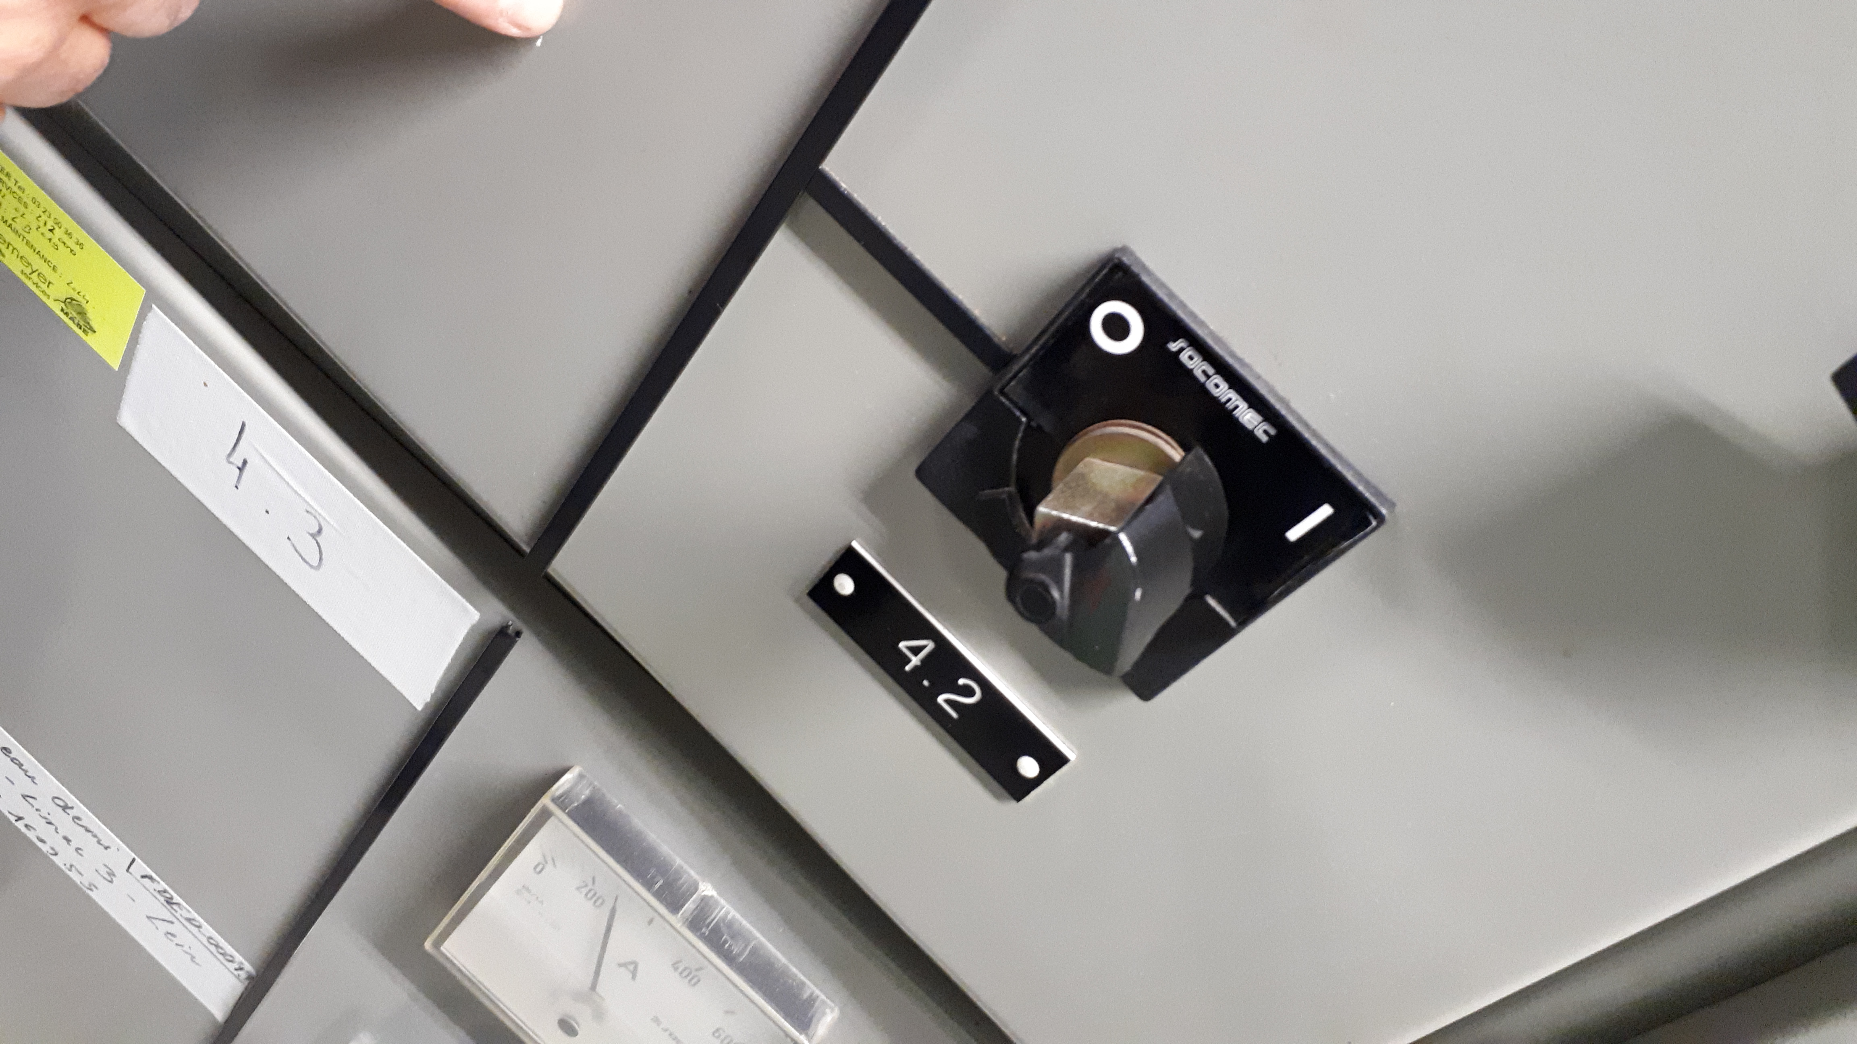
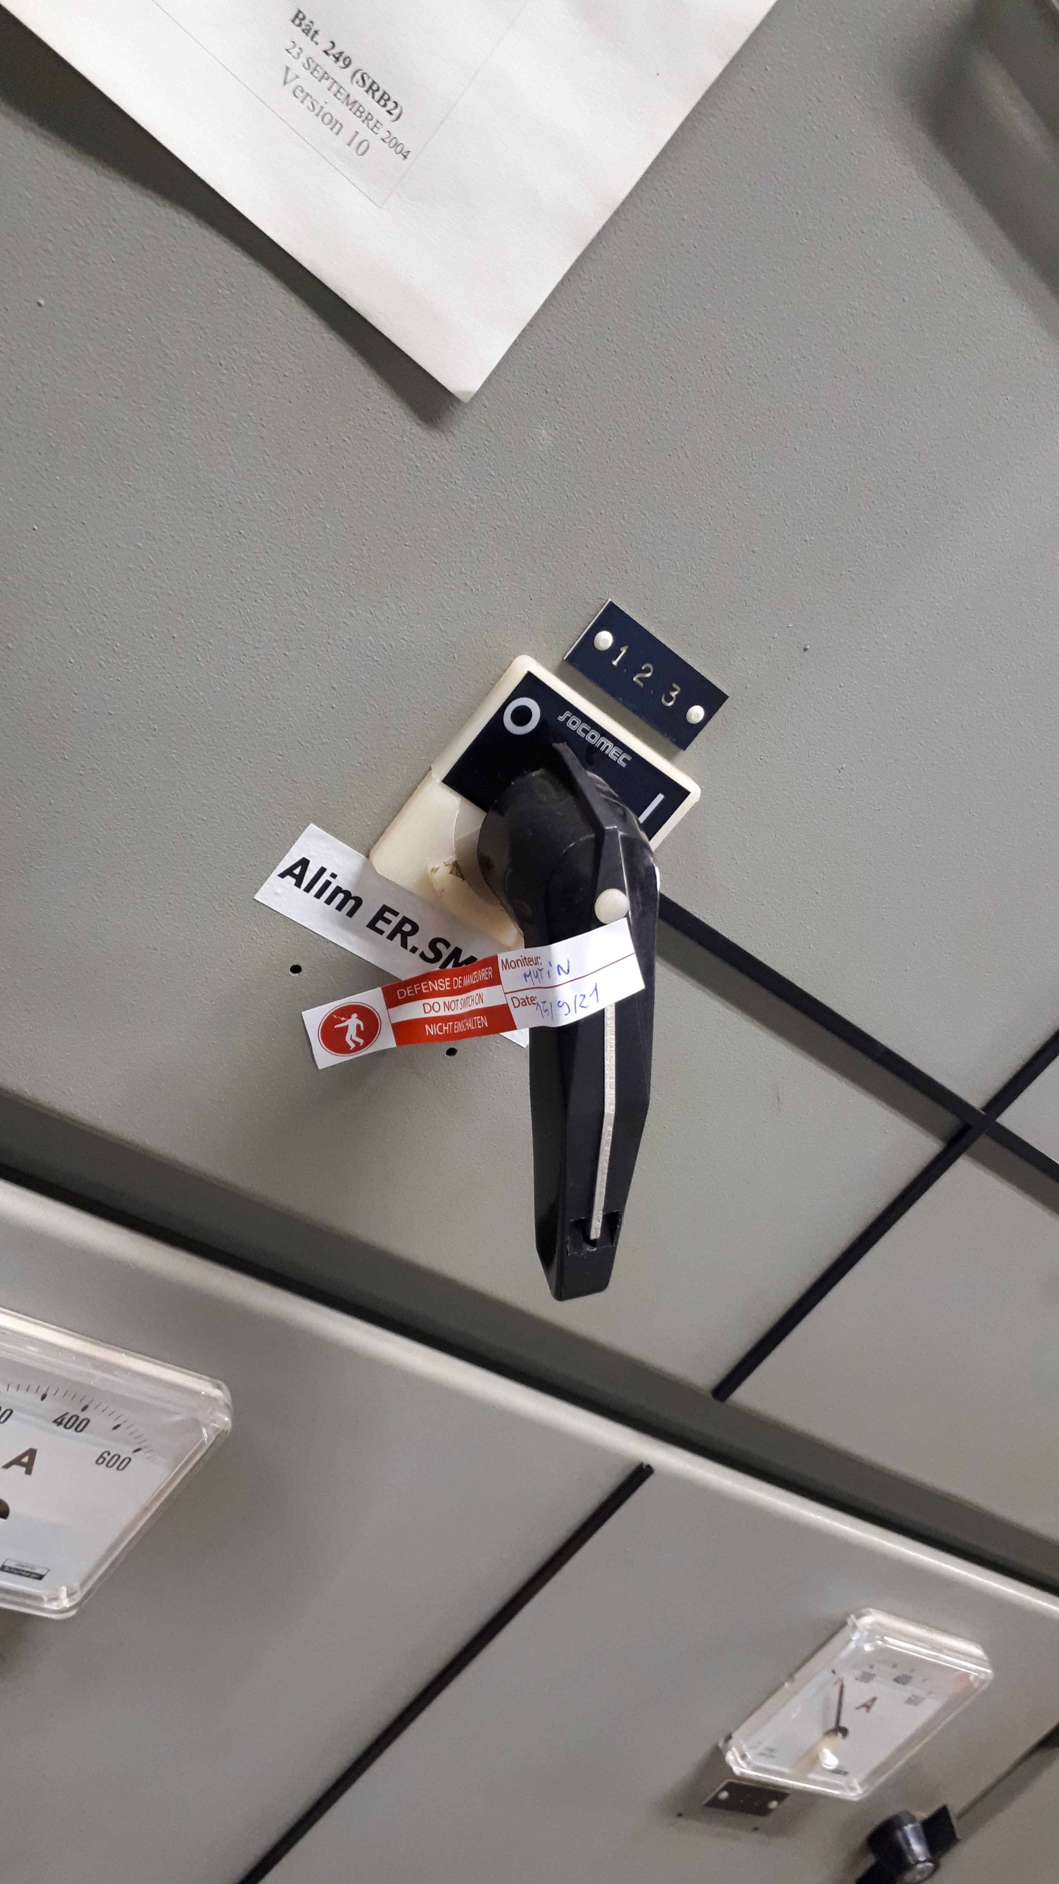
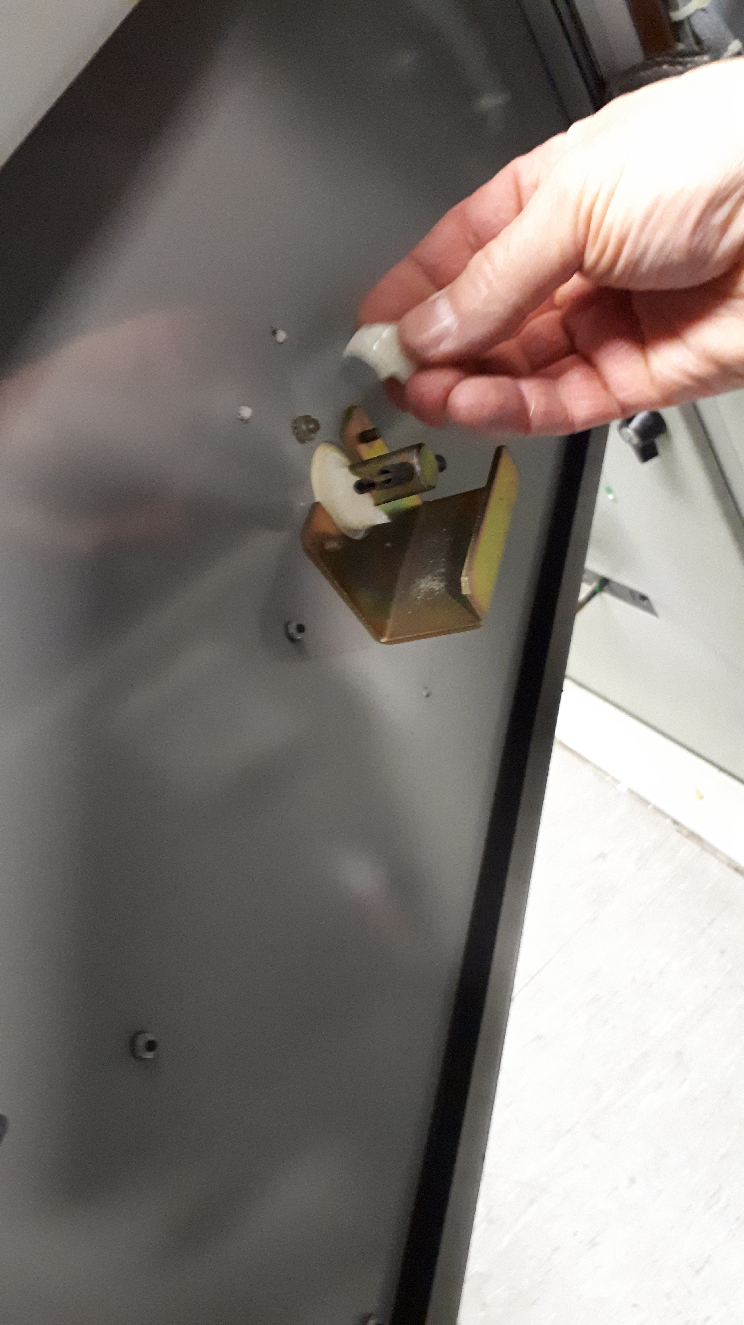
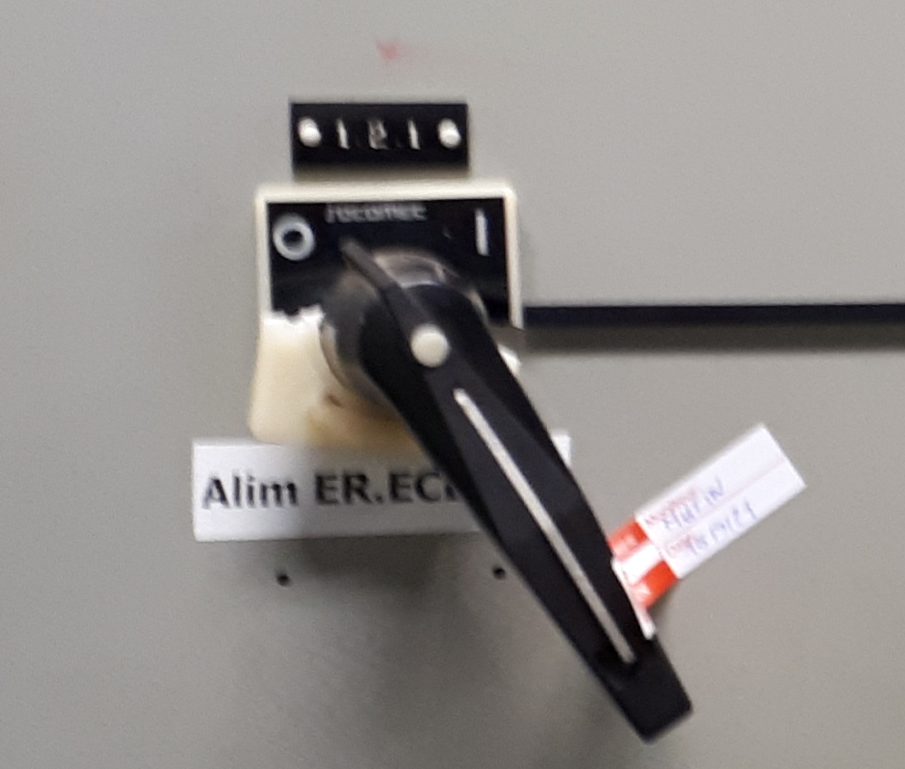
The existing handles
WE WENT ON-SITE TO SEE THE HANDLES BUT WE FOUND ALSO OTHER PIECES

Slide 19
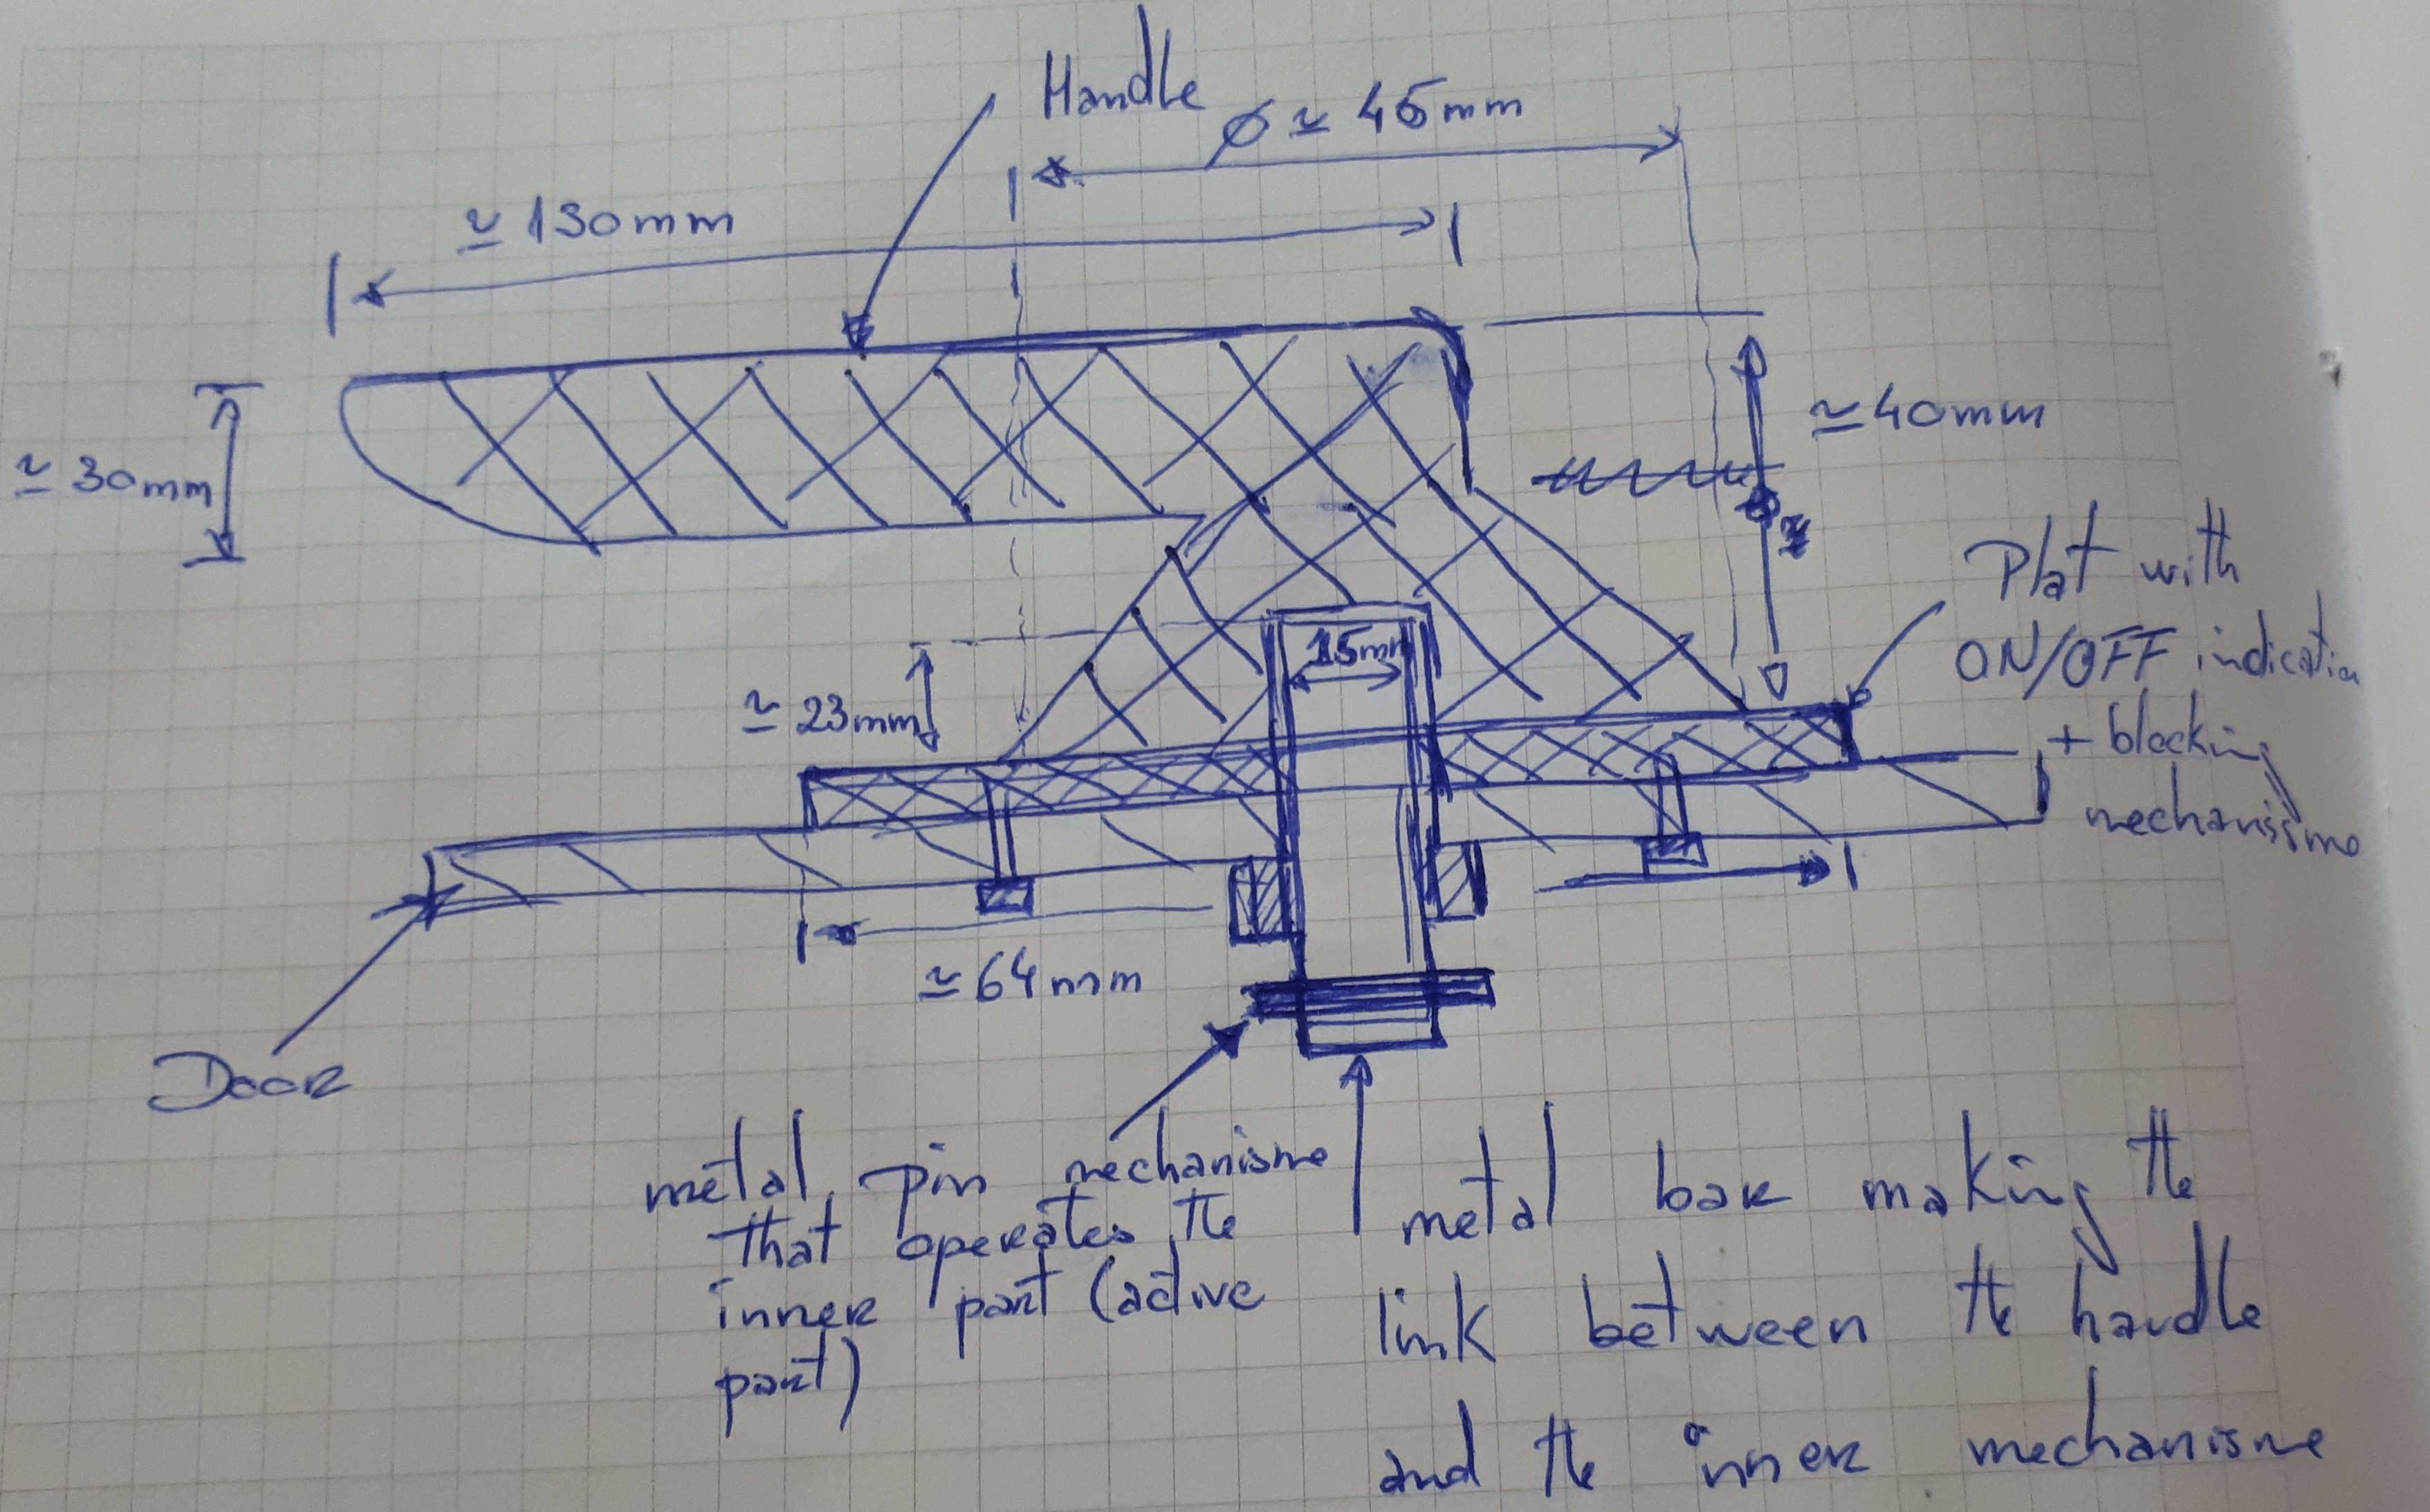
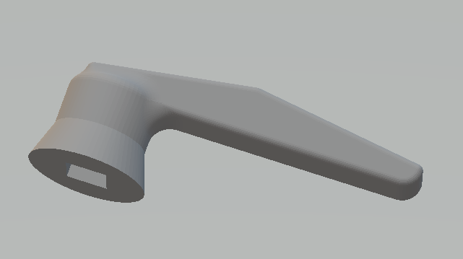
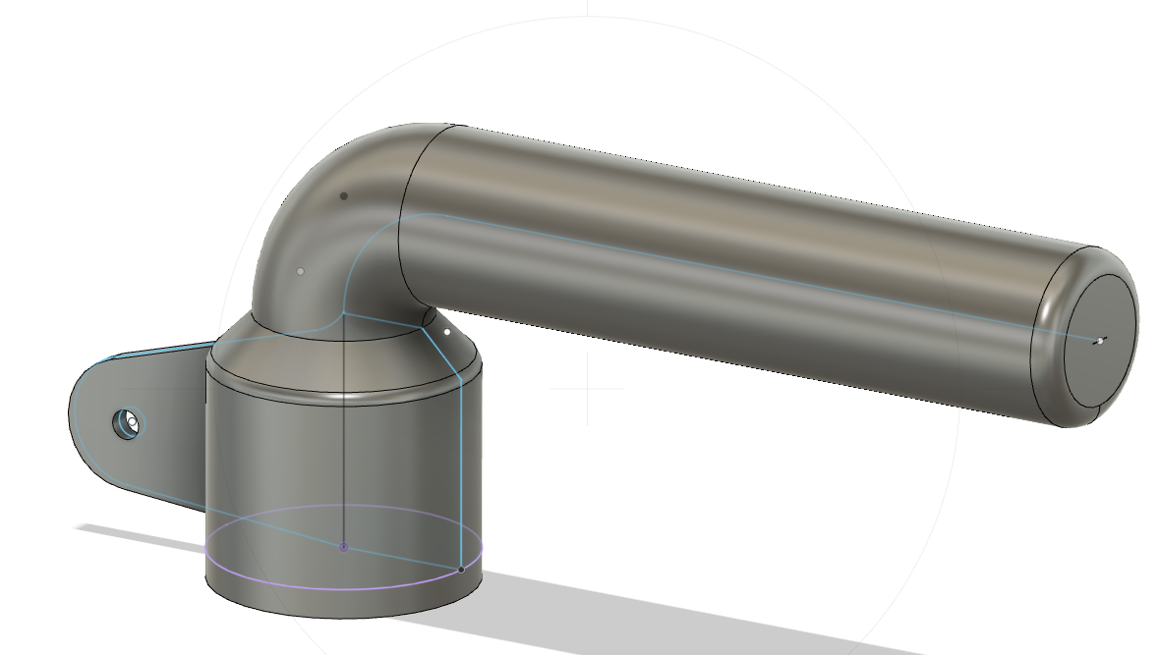
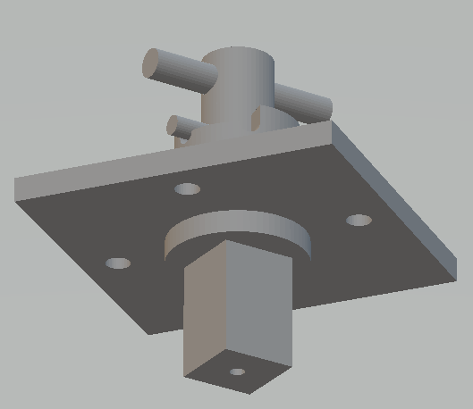
The schematics from the on-site visit
WHILE DOING IT AND DISCUSSING WITH THE PEOPLE WE ALSO UNDERSTOOD BETTER THE PROBLEM

Slide 20
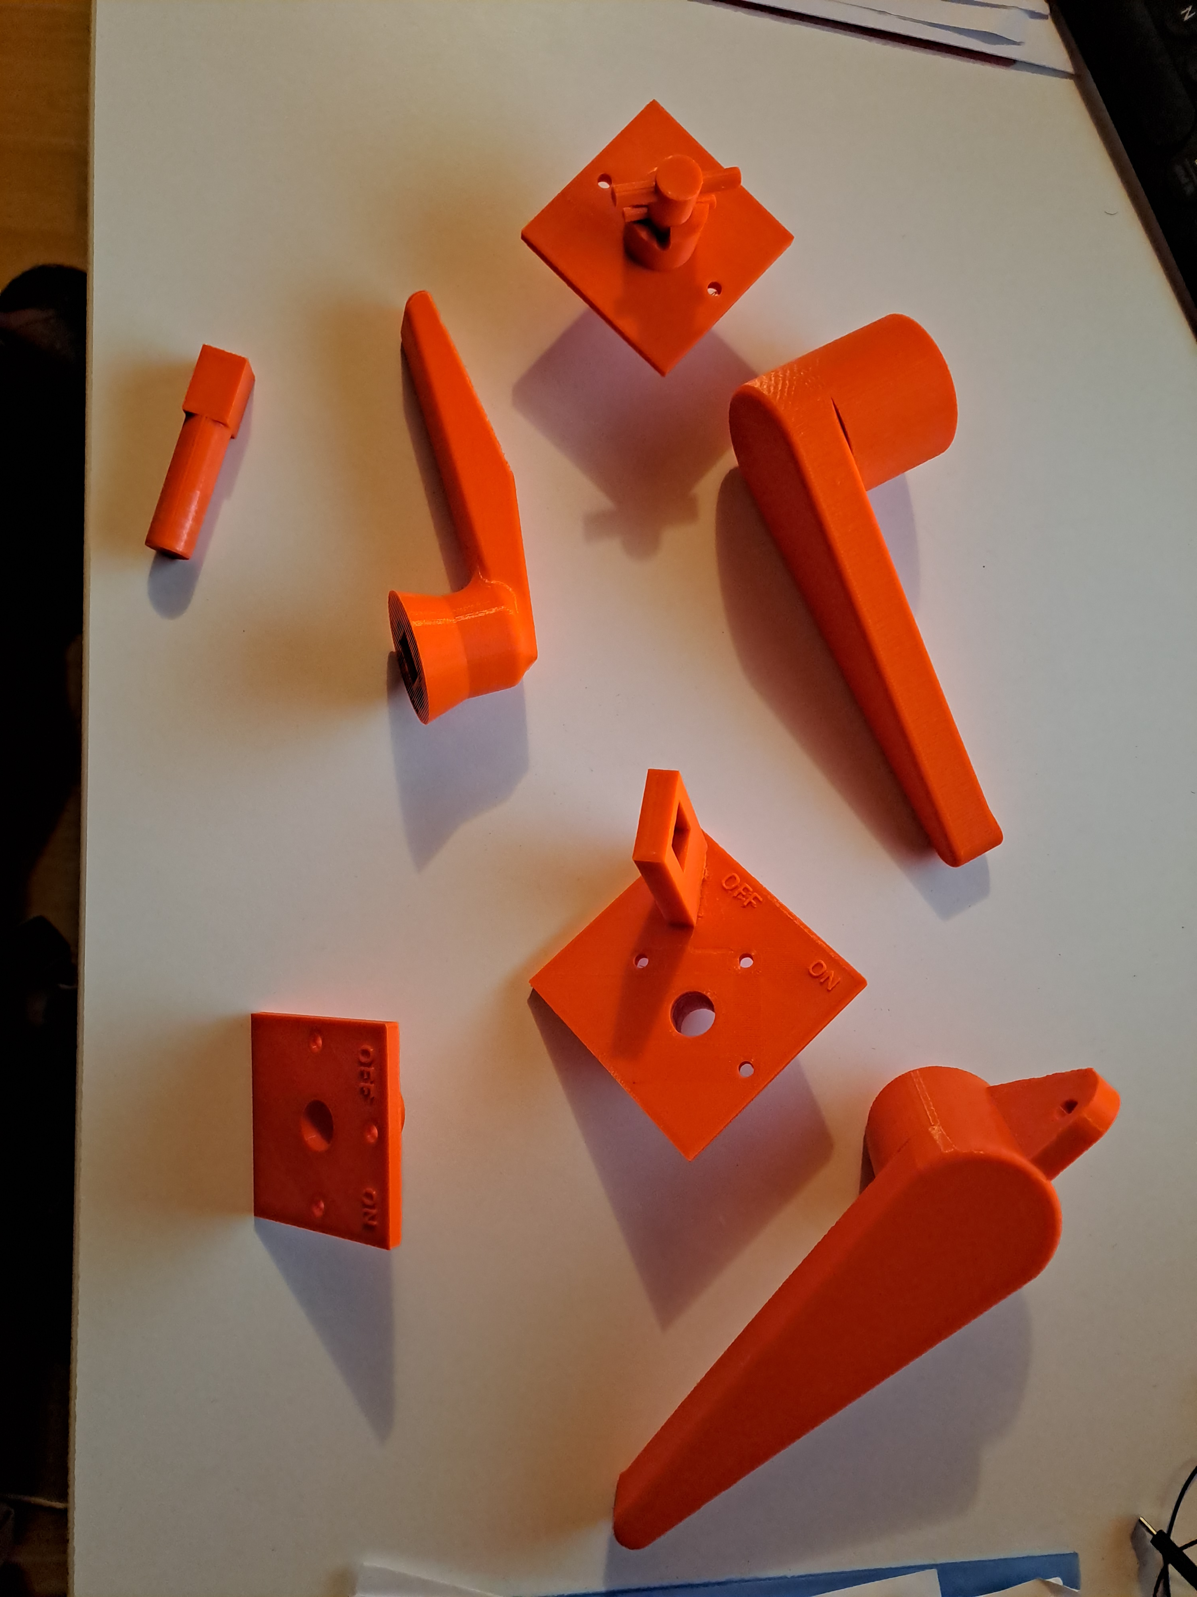
The result of different iteractions
WE HAD SOME DIFICULTIES OF TIME AVAILABILITY AMONG THE DIFFERENT MEMBERS, AND SOME CONSTRAINTS TO TEST THE SOLUTIONS ON AN OPERATIONAL INSTALLATION

Slide 21
Few conclusions
Good example how easy solutions could help
Good example of collaboration between those that needed something and those that were willing to help with the tools they had available
Time availability of team members and the installation to test is a key
The decision to replace the full switchboard was taken before all prototypes could be tested, so none of the handles was used

Slide 23
If you
like to collaborate and you are willing to collaborate in an informal way
are willing to come out of your comfort zone
need help prototyping something
want to take part in a discussion forum to find practical solutions
have equipment that could be useful for the CERN community
…
Then don’t hesitate to subscribe to the following e-group:
Engineers-at-IdeaSquare@cern.ch

