Slide 1
Prototyping workshops at IdeaSquare
Open Doors Event 15.02.23
Dina Zimmermann and Ole Anton Werner

Slide 2
Agenda
09.00-09.15
Brief Introduction to IdeaSquare prototyping workshops
09.15-09.45
Prototyping Challenges from CERN Community by Fernando Baltasar
09.45-10.30
Hands-on Prototyping Session
10.30-10.55
Coffee Break
10.55-11.15
Next steps in prototyping at IdeaSquare

Slide 3

What it IdeaSquare?
The innovation space at CERN
Notes:
R&D&I projects –
Our phycisists Umut and Karsten working with scintillator detecting neutrinos. Superkamoikande.
We have the Italians on the second floor here working on discovering muons for ATLAS. The ATLAS experiment employs a trigger system consisting of a first-level hardware trigger (L1). The L1 muon trigger system uses resistive-plate chambers (RPCs) to generate the muon-induced trigger signals in the central (barrel) region of the ATLAS detector. Pattern recognition for particle identification. Developing a chip. RPC.
Europaen projects –
ATTRACT: is a funding instrument for early-stage R&D&I projects. Initiative to bring together Europe’s fundamental research and industrial communities to create the next generation of detection and imaging technologies.
Crowd4SDG
Prototype workshop –
I will show you.
Educational programmes –
IdeaSquare co-designs and runs more than 22 project-based student courses in collaboration with international universities from Europe, Australia and the US.
Tackling challenges – SDGs and exploring how to use the technologies developed in ATTRACT in new ways.
Events –
CMS Patatrack Hackaton, Arduino, FPGA workshops.
Innovation knowledge –
CIJ

Slide 4
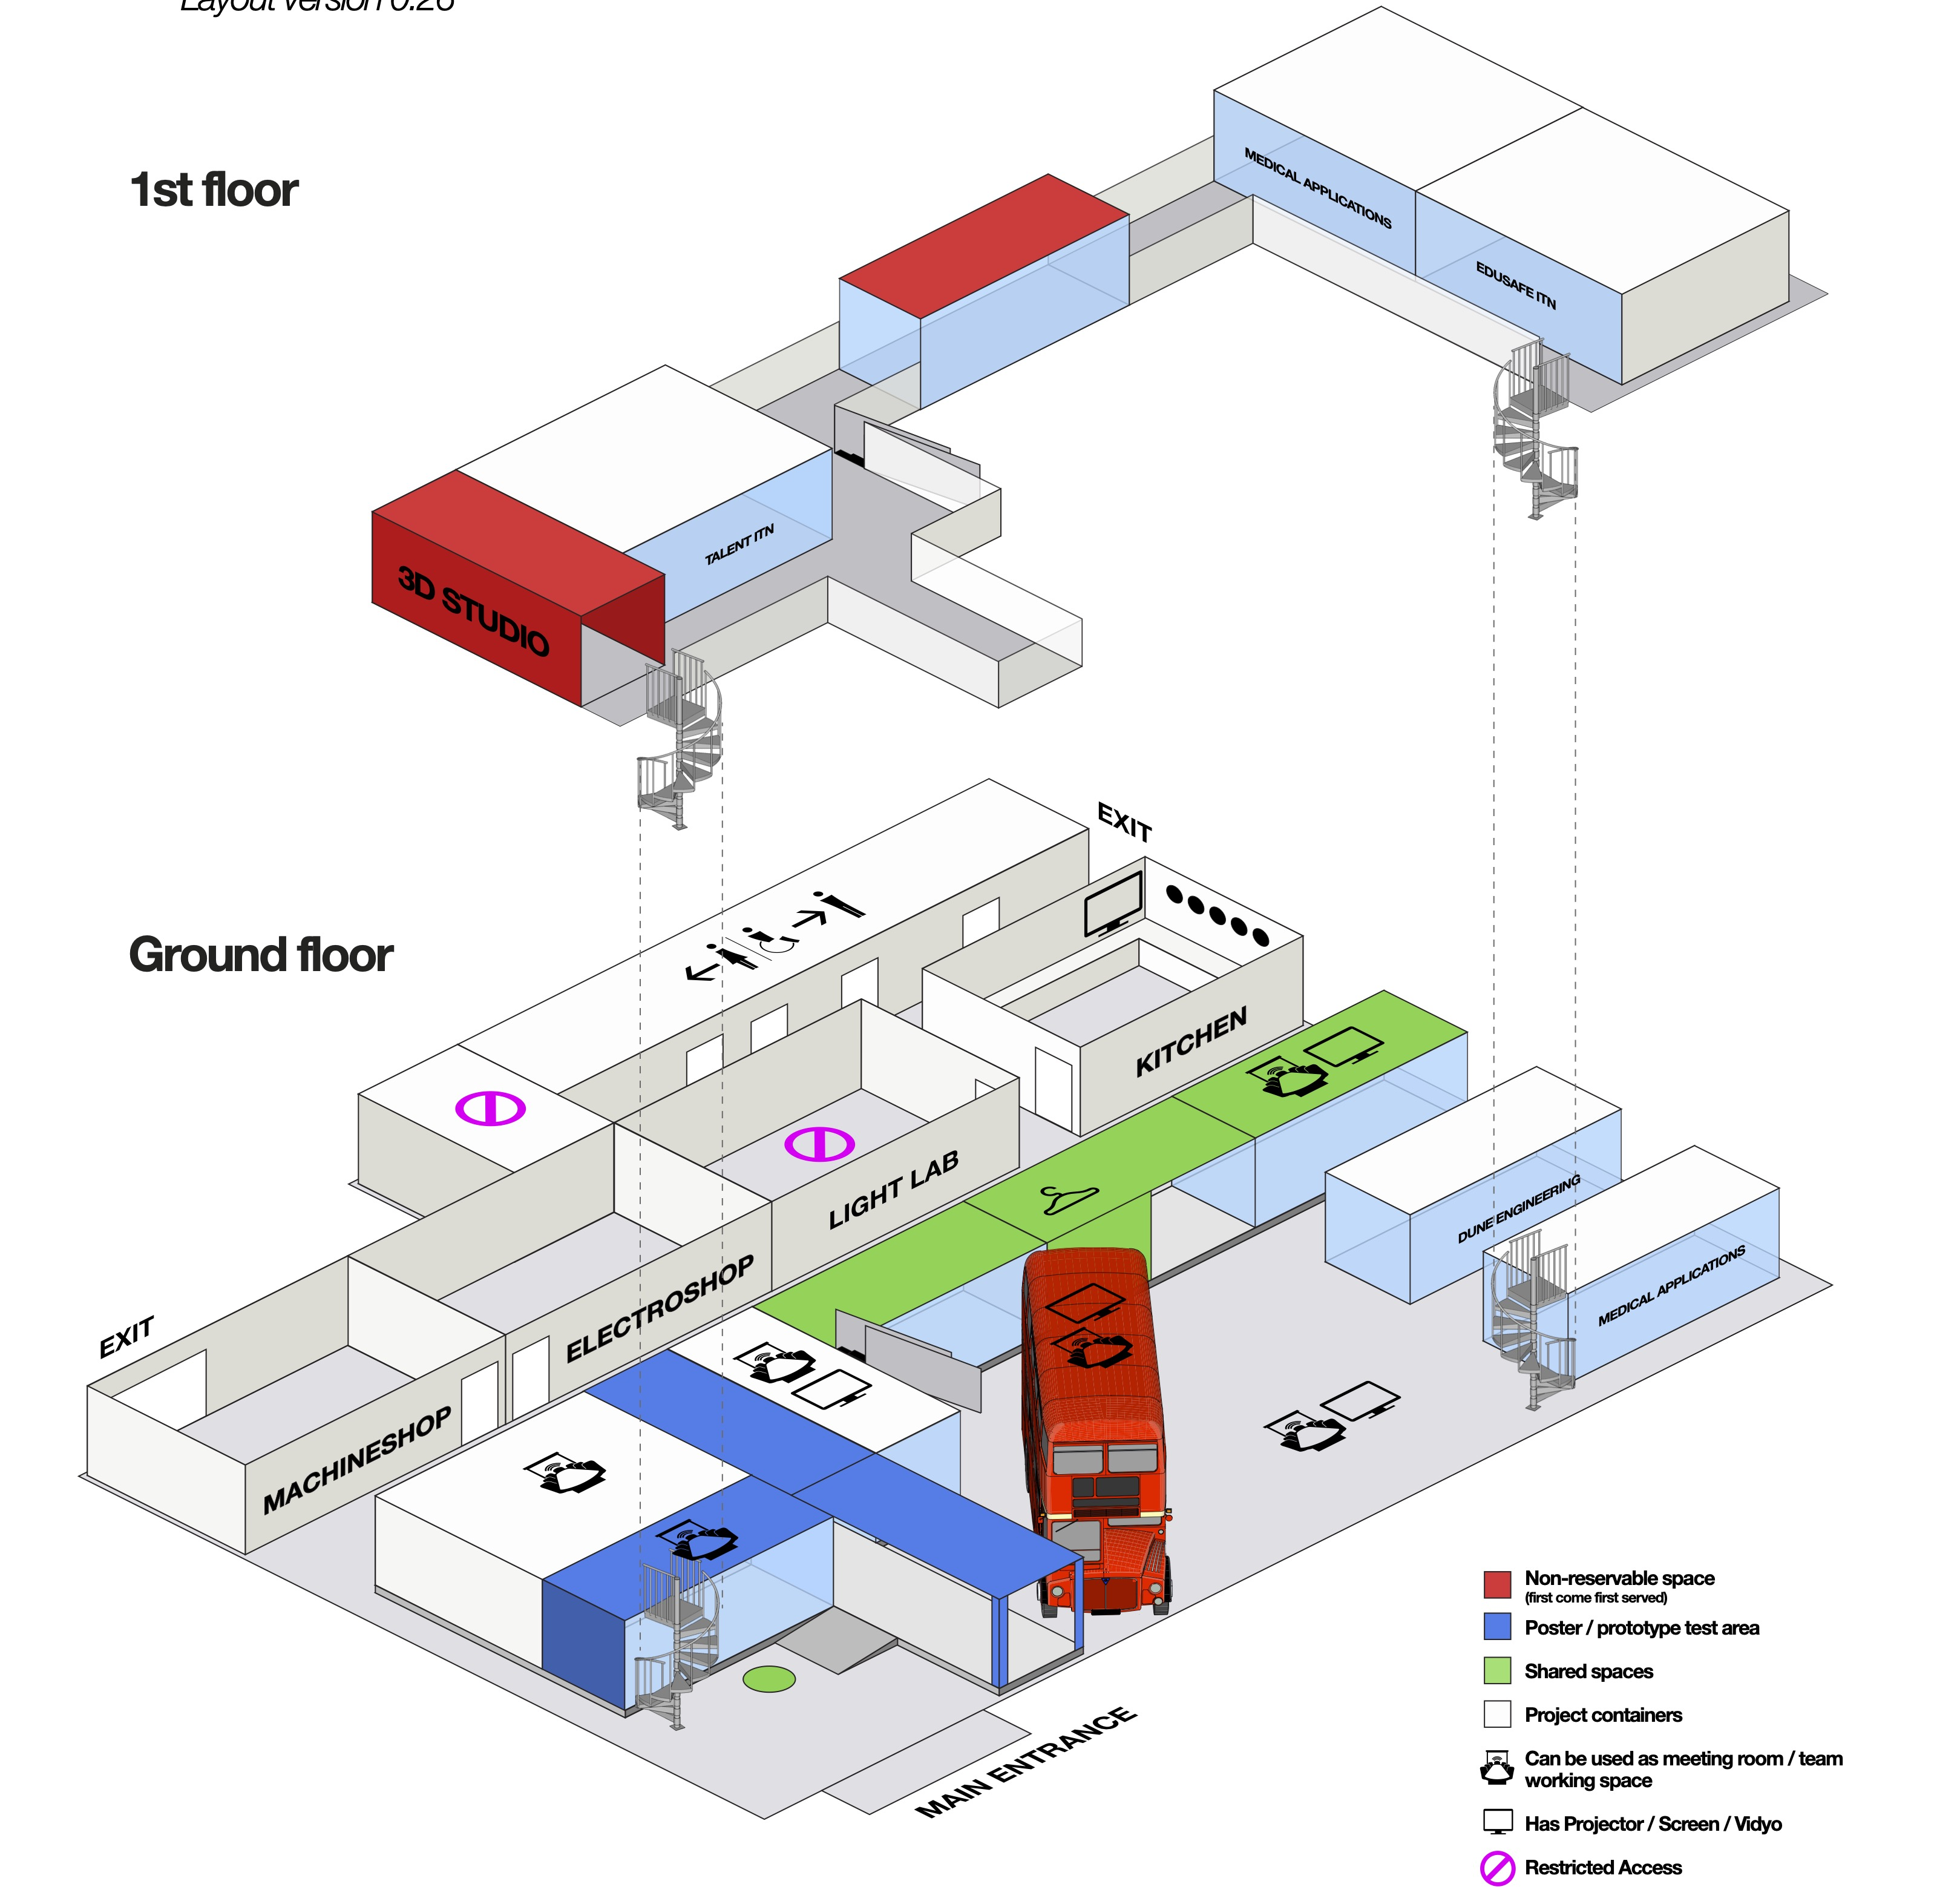


Slide 5
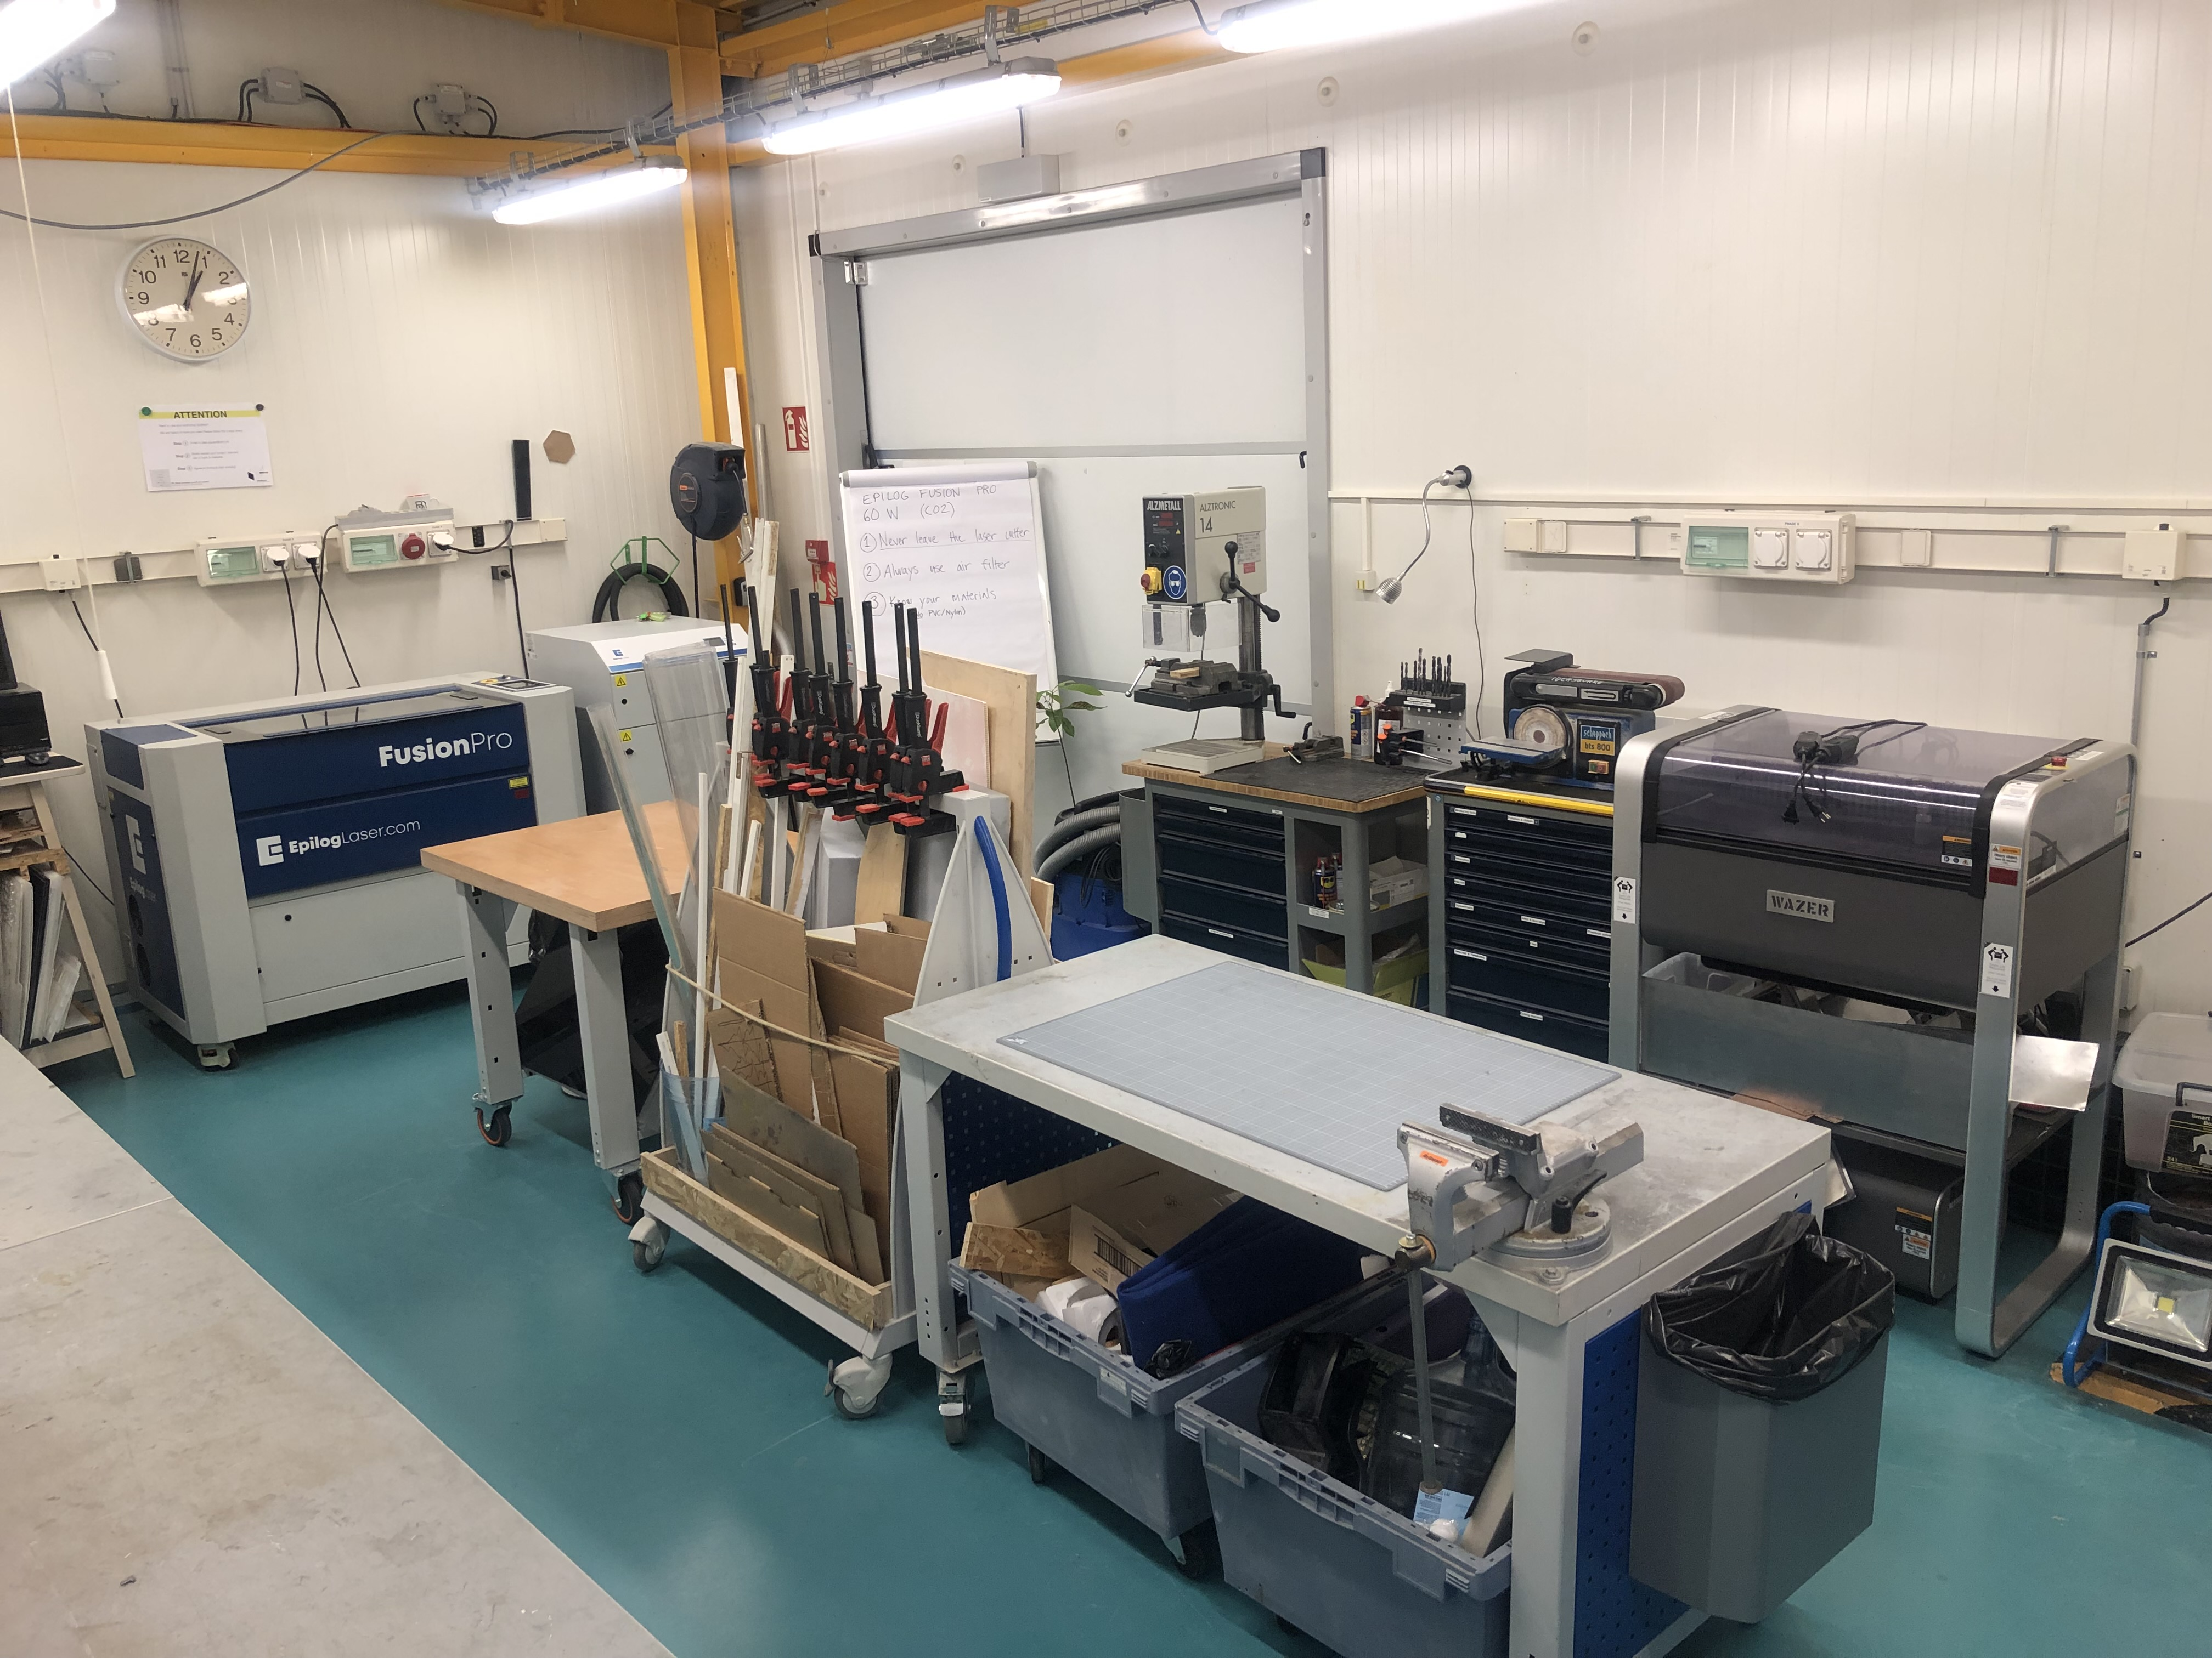
The Machine Shop

Slide 7
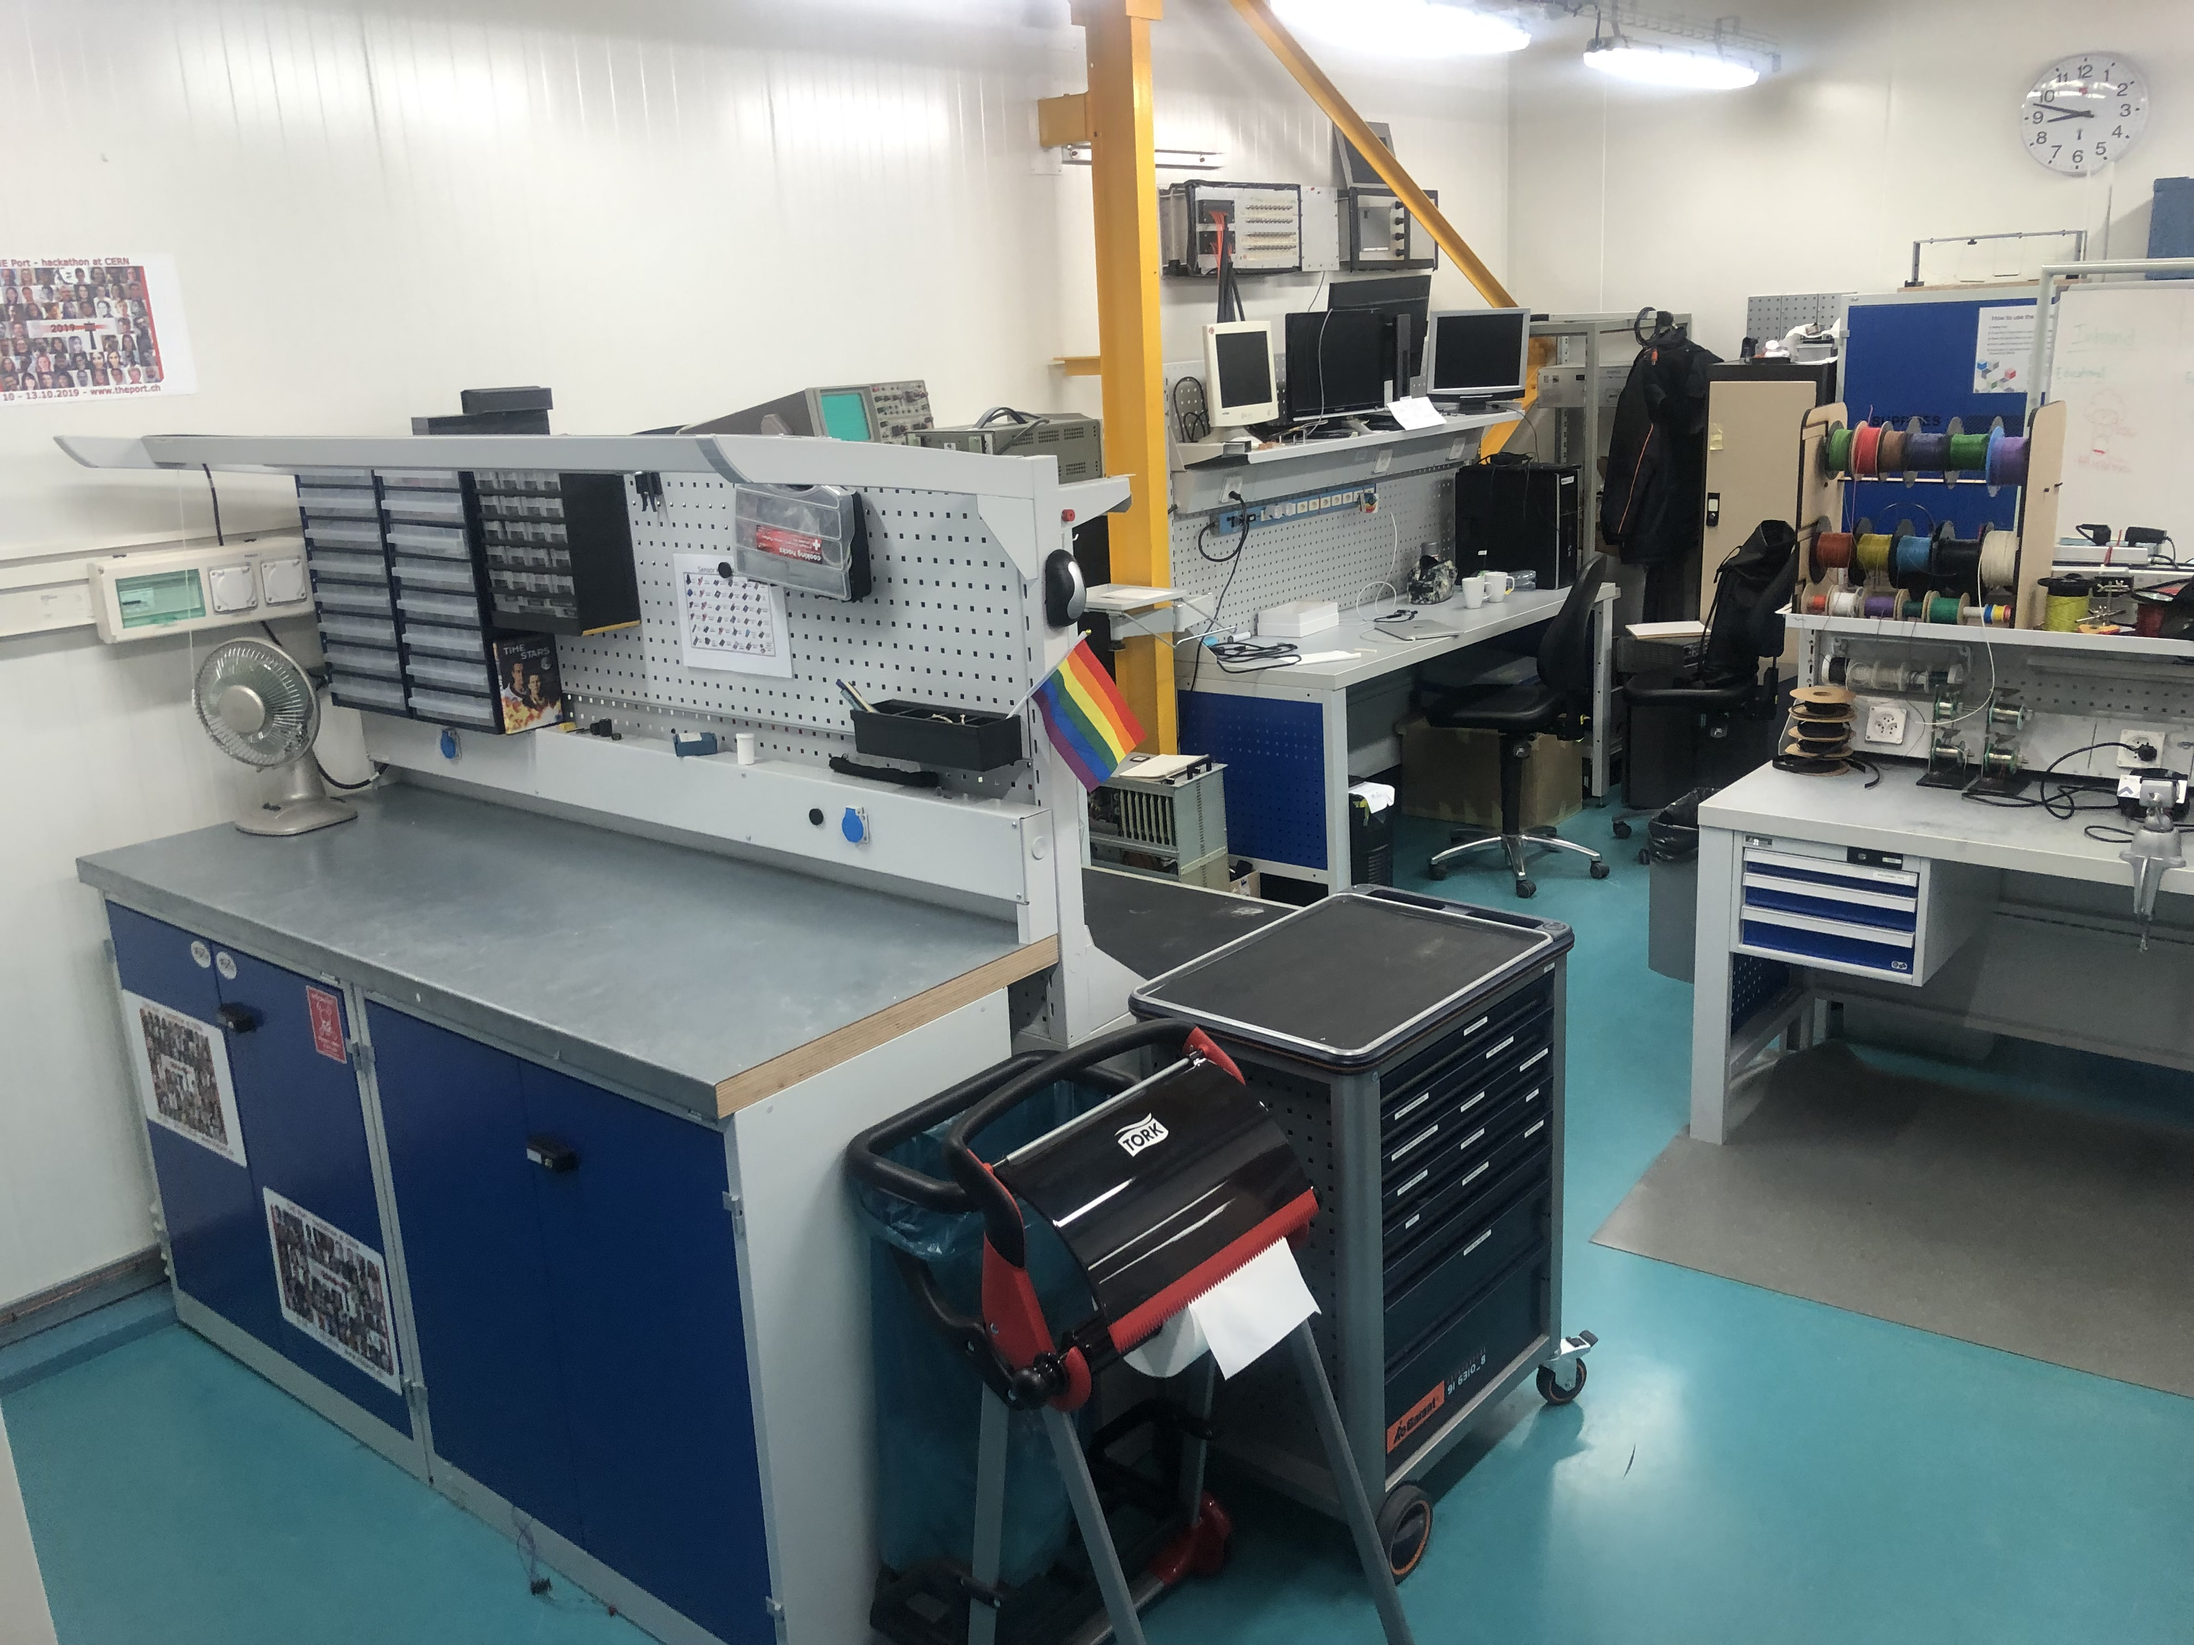
The Electro Shop

Slide 9
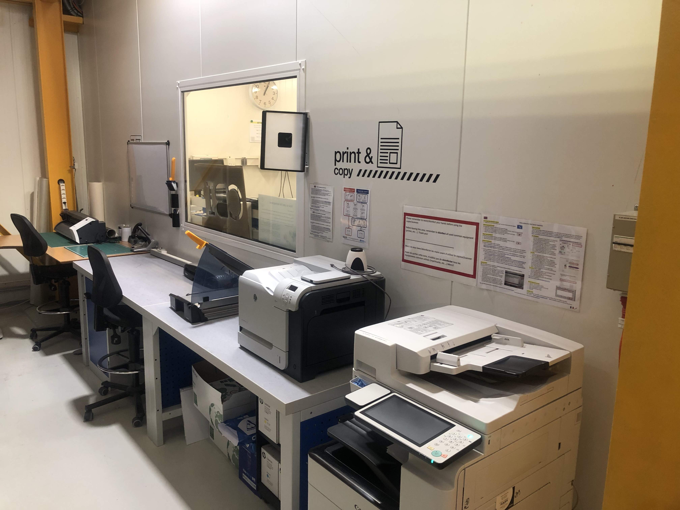
Print & copy

Slide 11
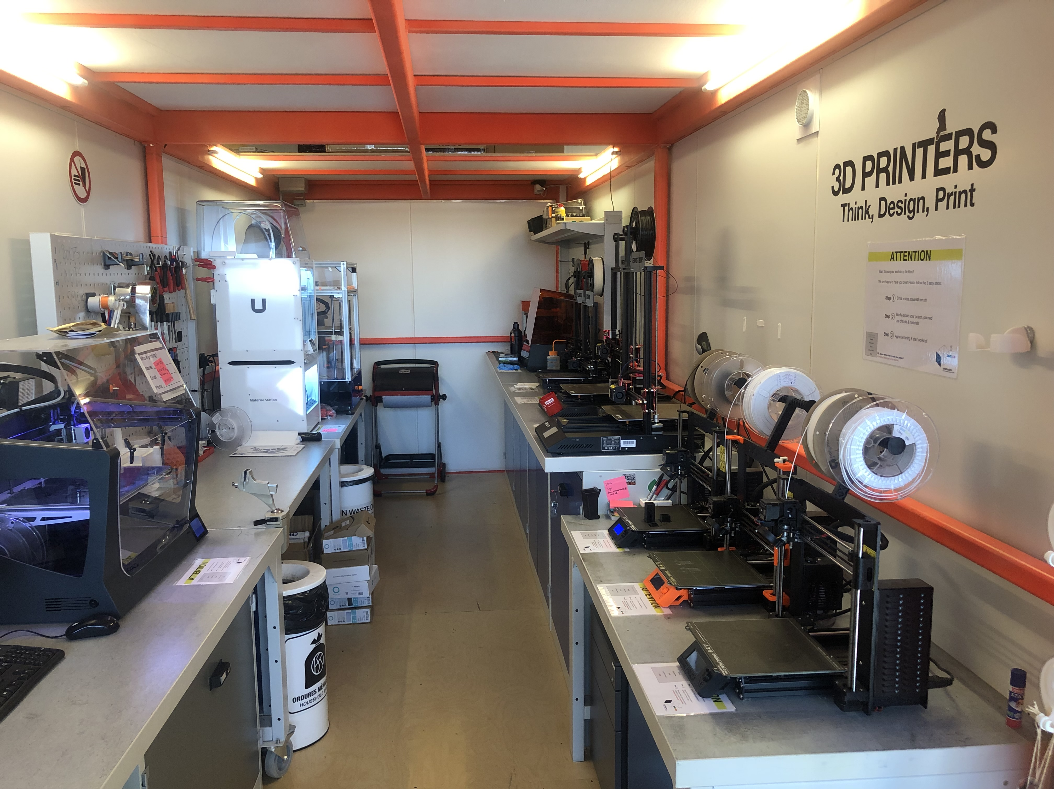
The 3D Studio

Slide 12
Let’s check it out!

