Slide 1
Innovation for solving wicked problems
Open Doors Event, 15th Feb 2023
Catarina Batista & Laura Wirtavuori

Slide 2
Agenda
Welcome and settling in, making groups | 15 min - Laura
SDG warm-up | 15 min - Laura
Innovation for solving wicked problems | 5 min for intro - Catarina 15 min imagining future - Laura 30 min defining roadmap - Laura 10 min sharing
Intro to student programmes | 5 min - Catarina
Listening from CERNies | 15 min - Catarina

Slide 3
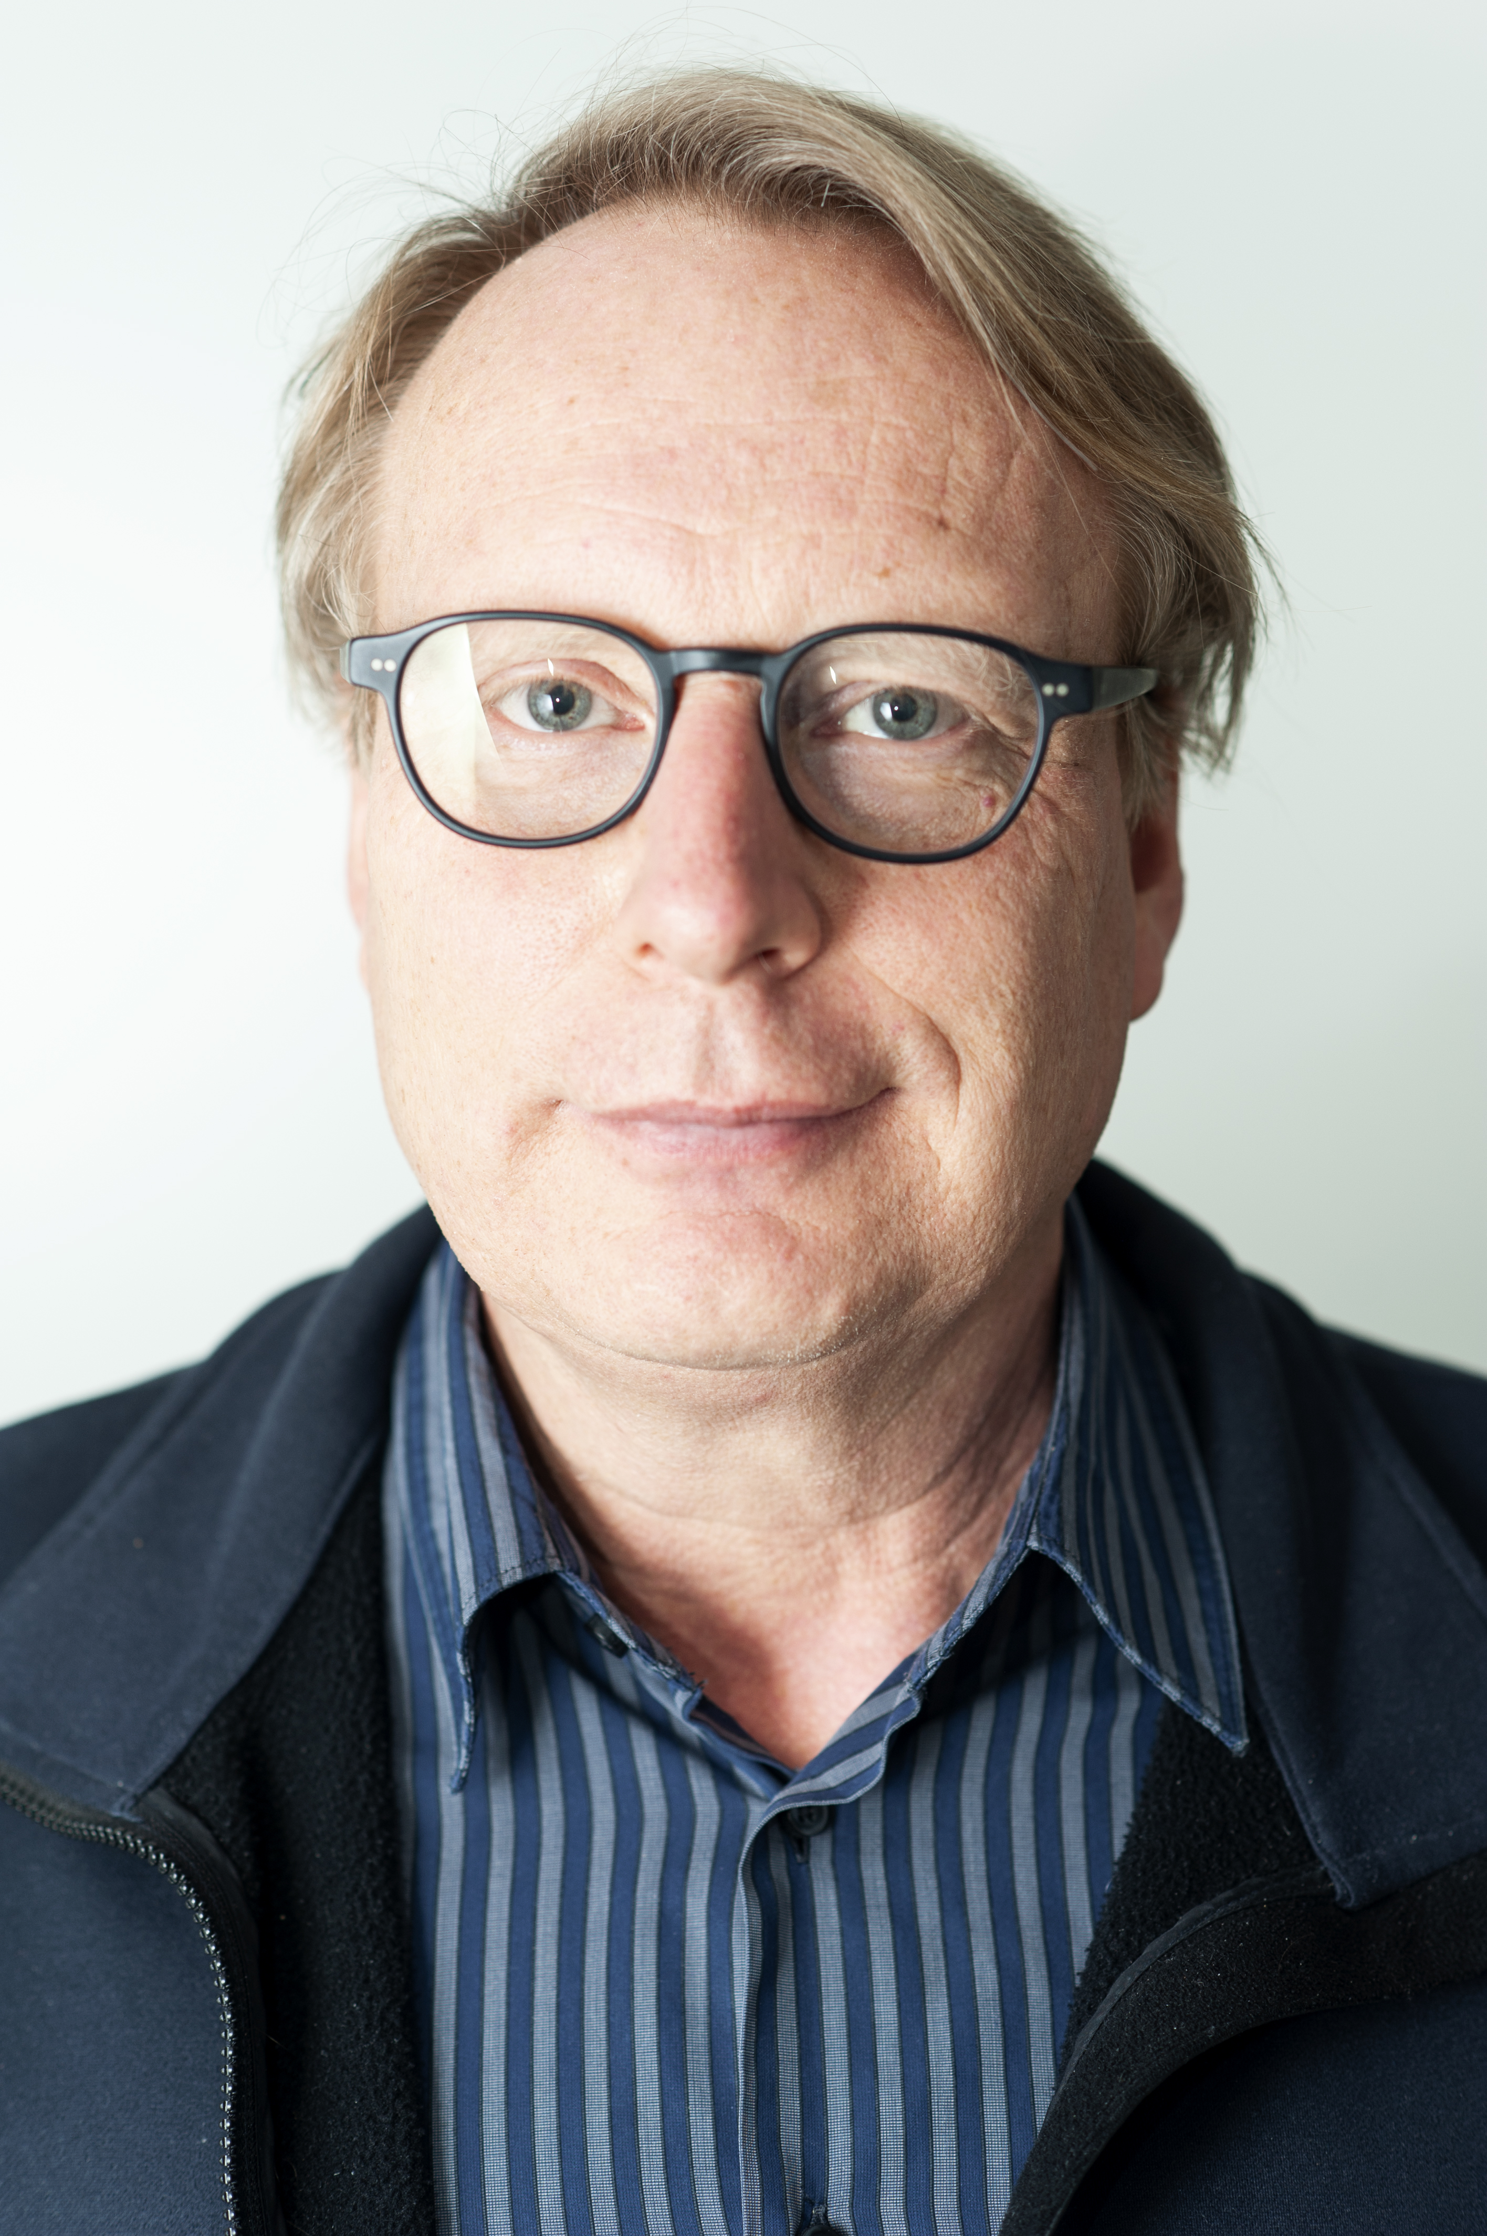
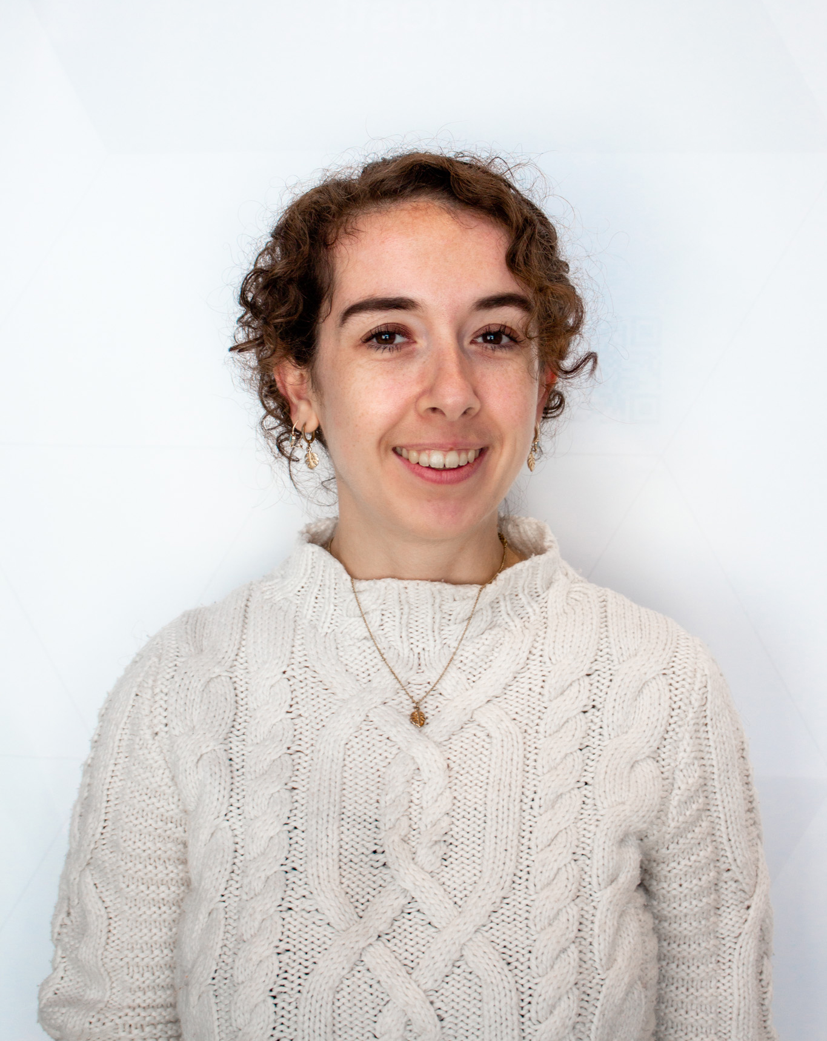

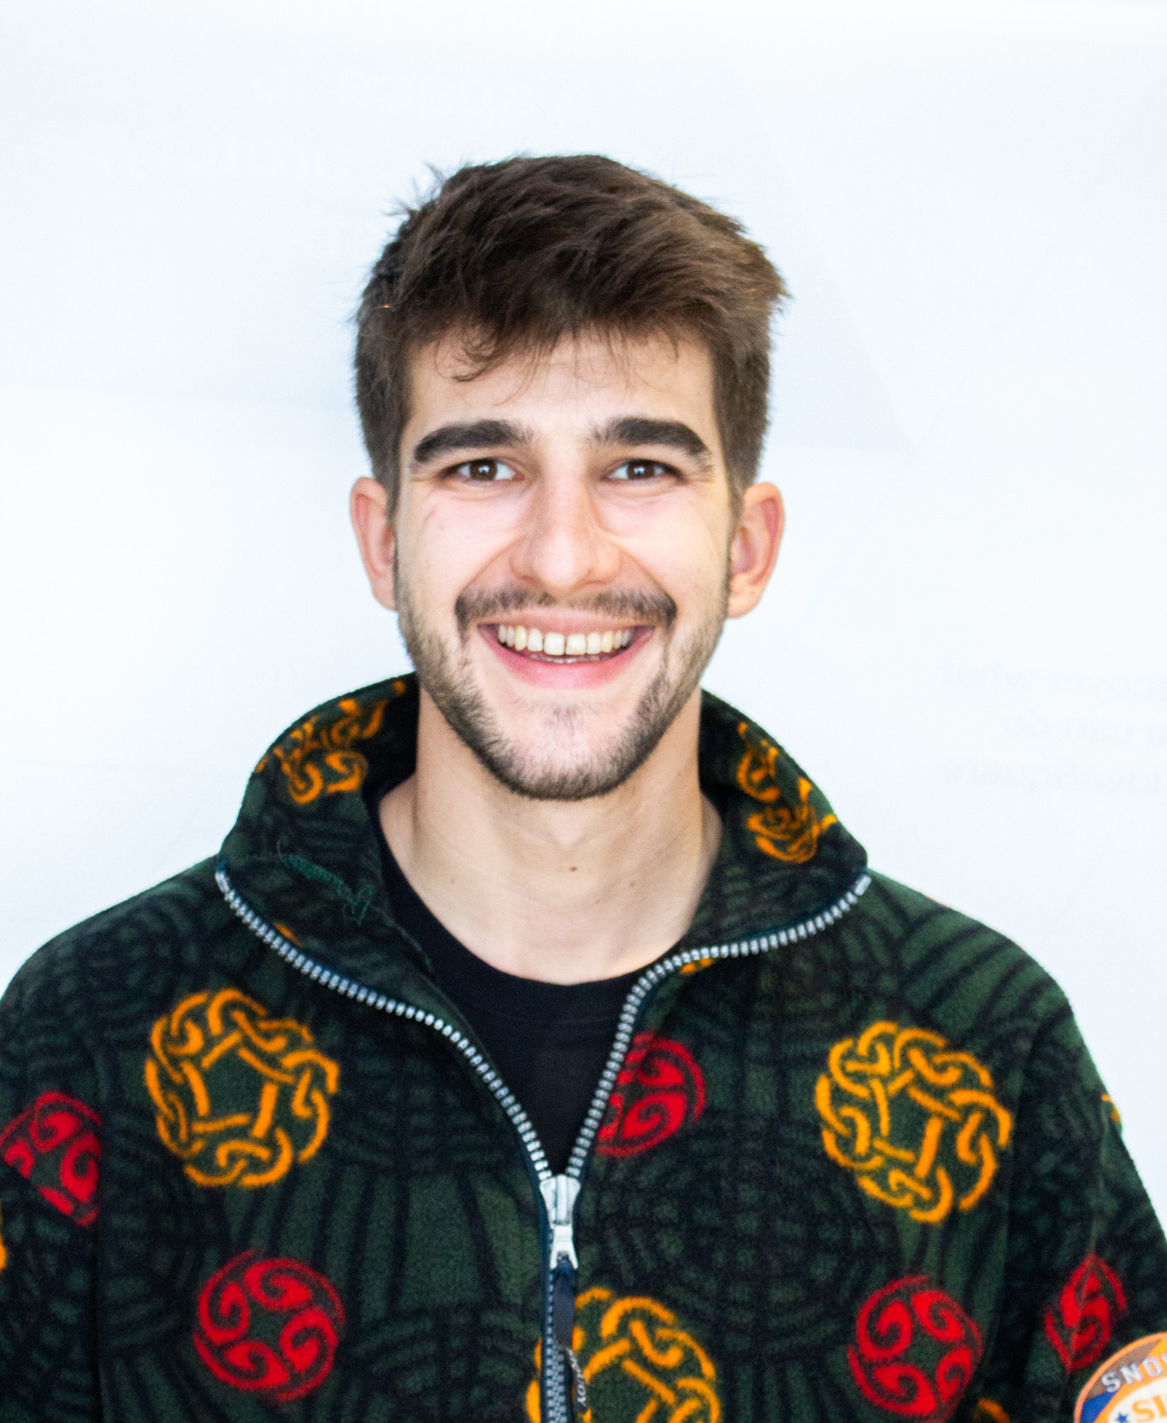
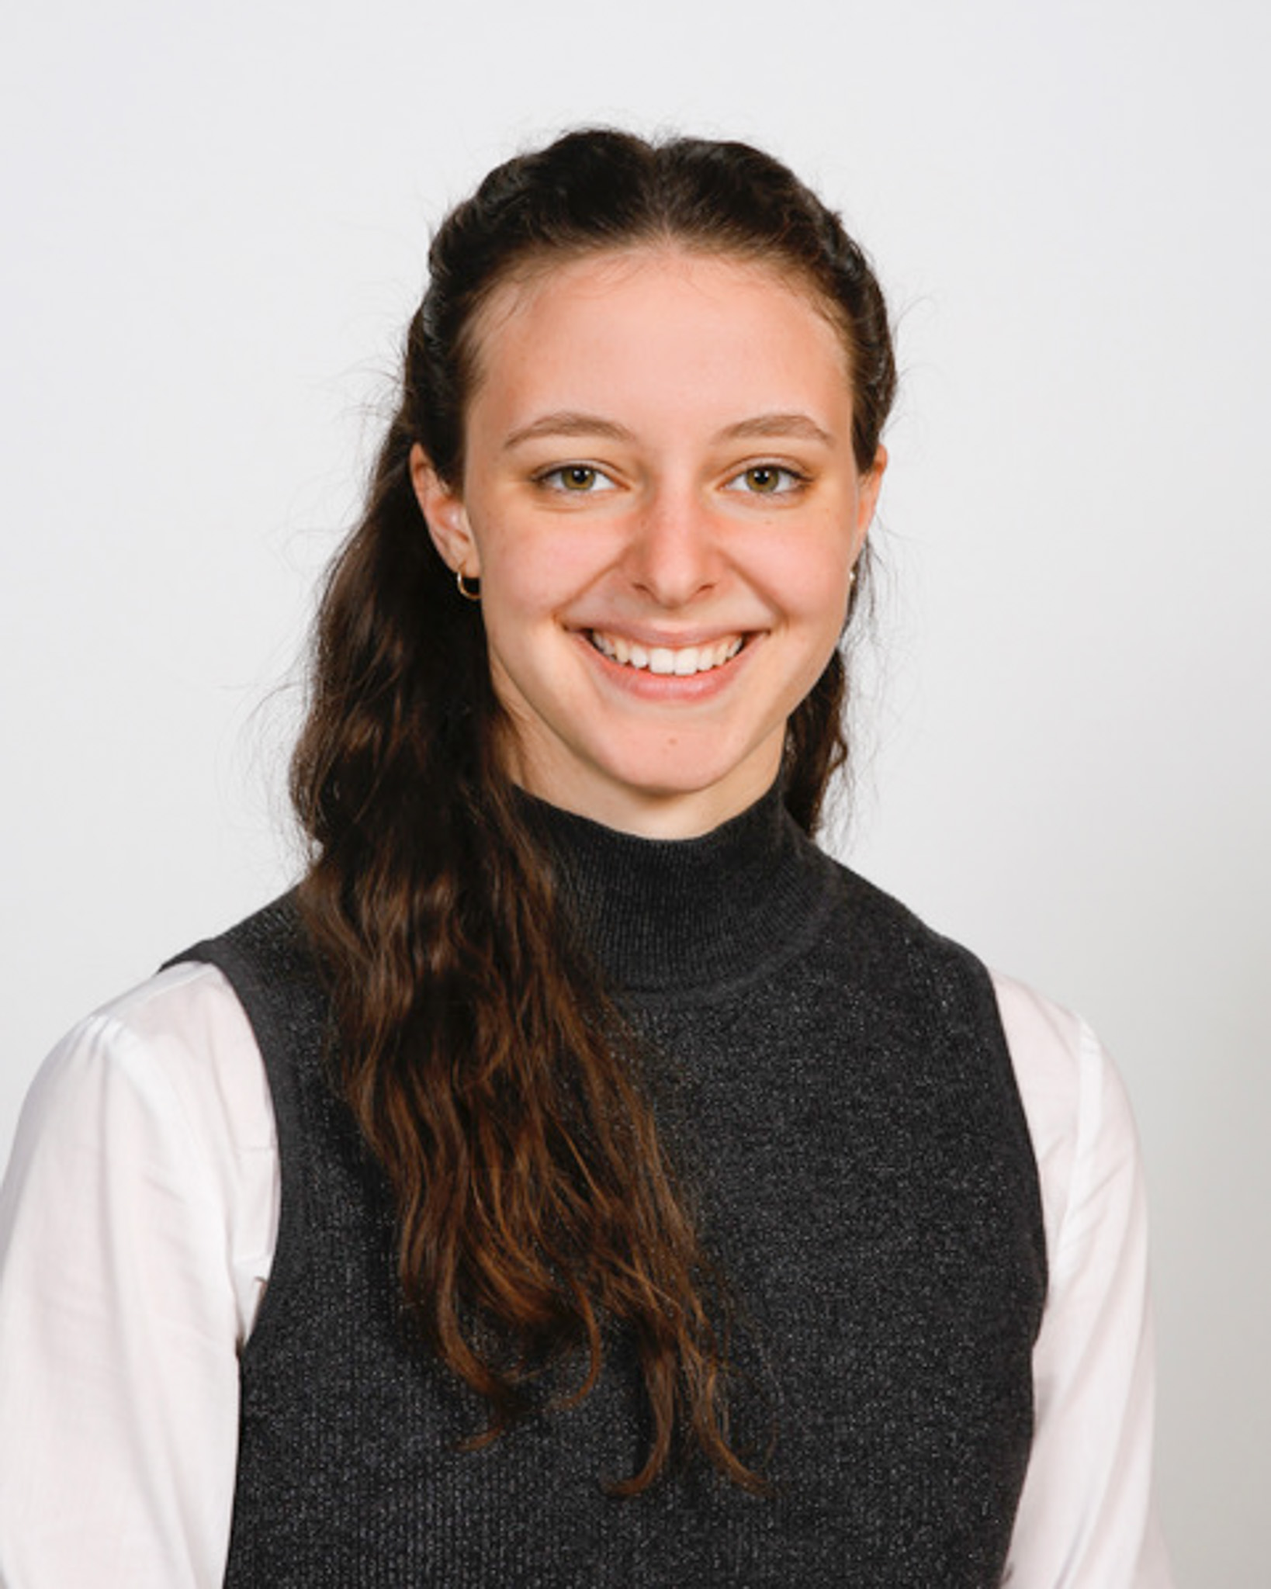
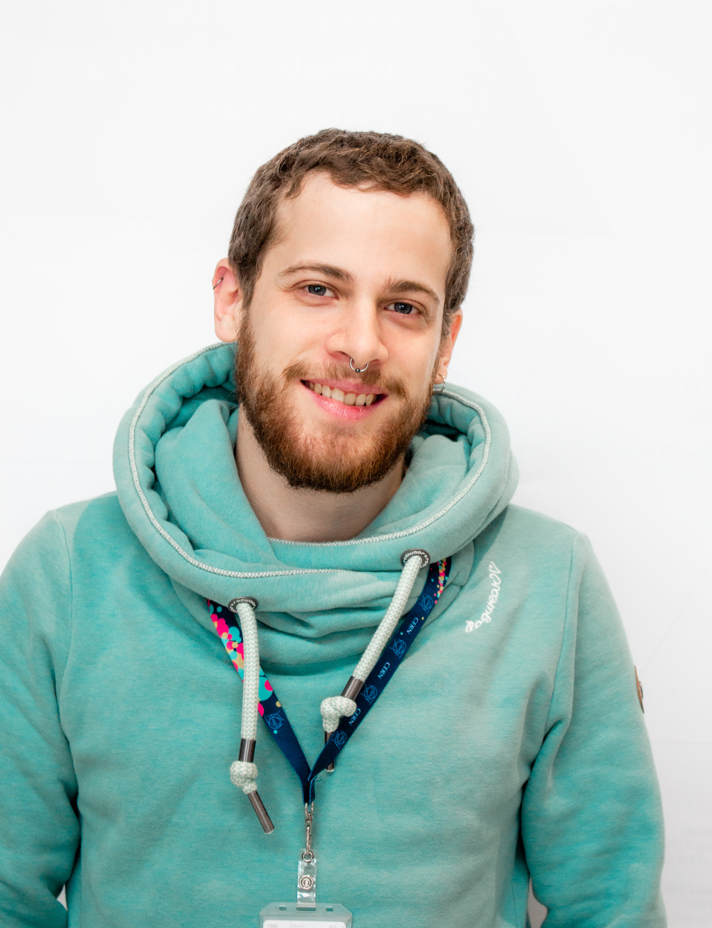

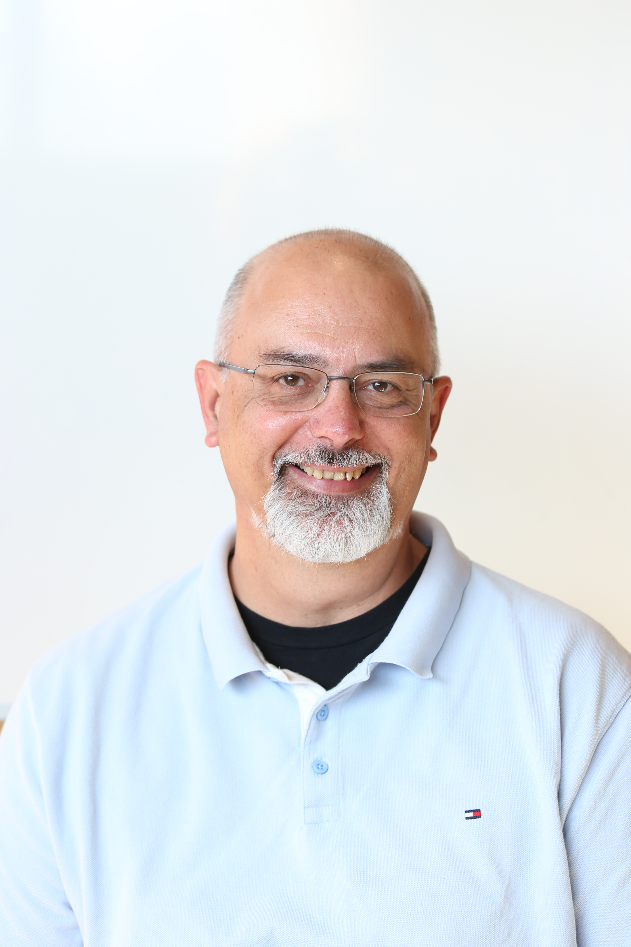
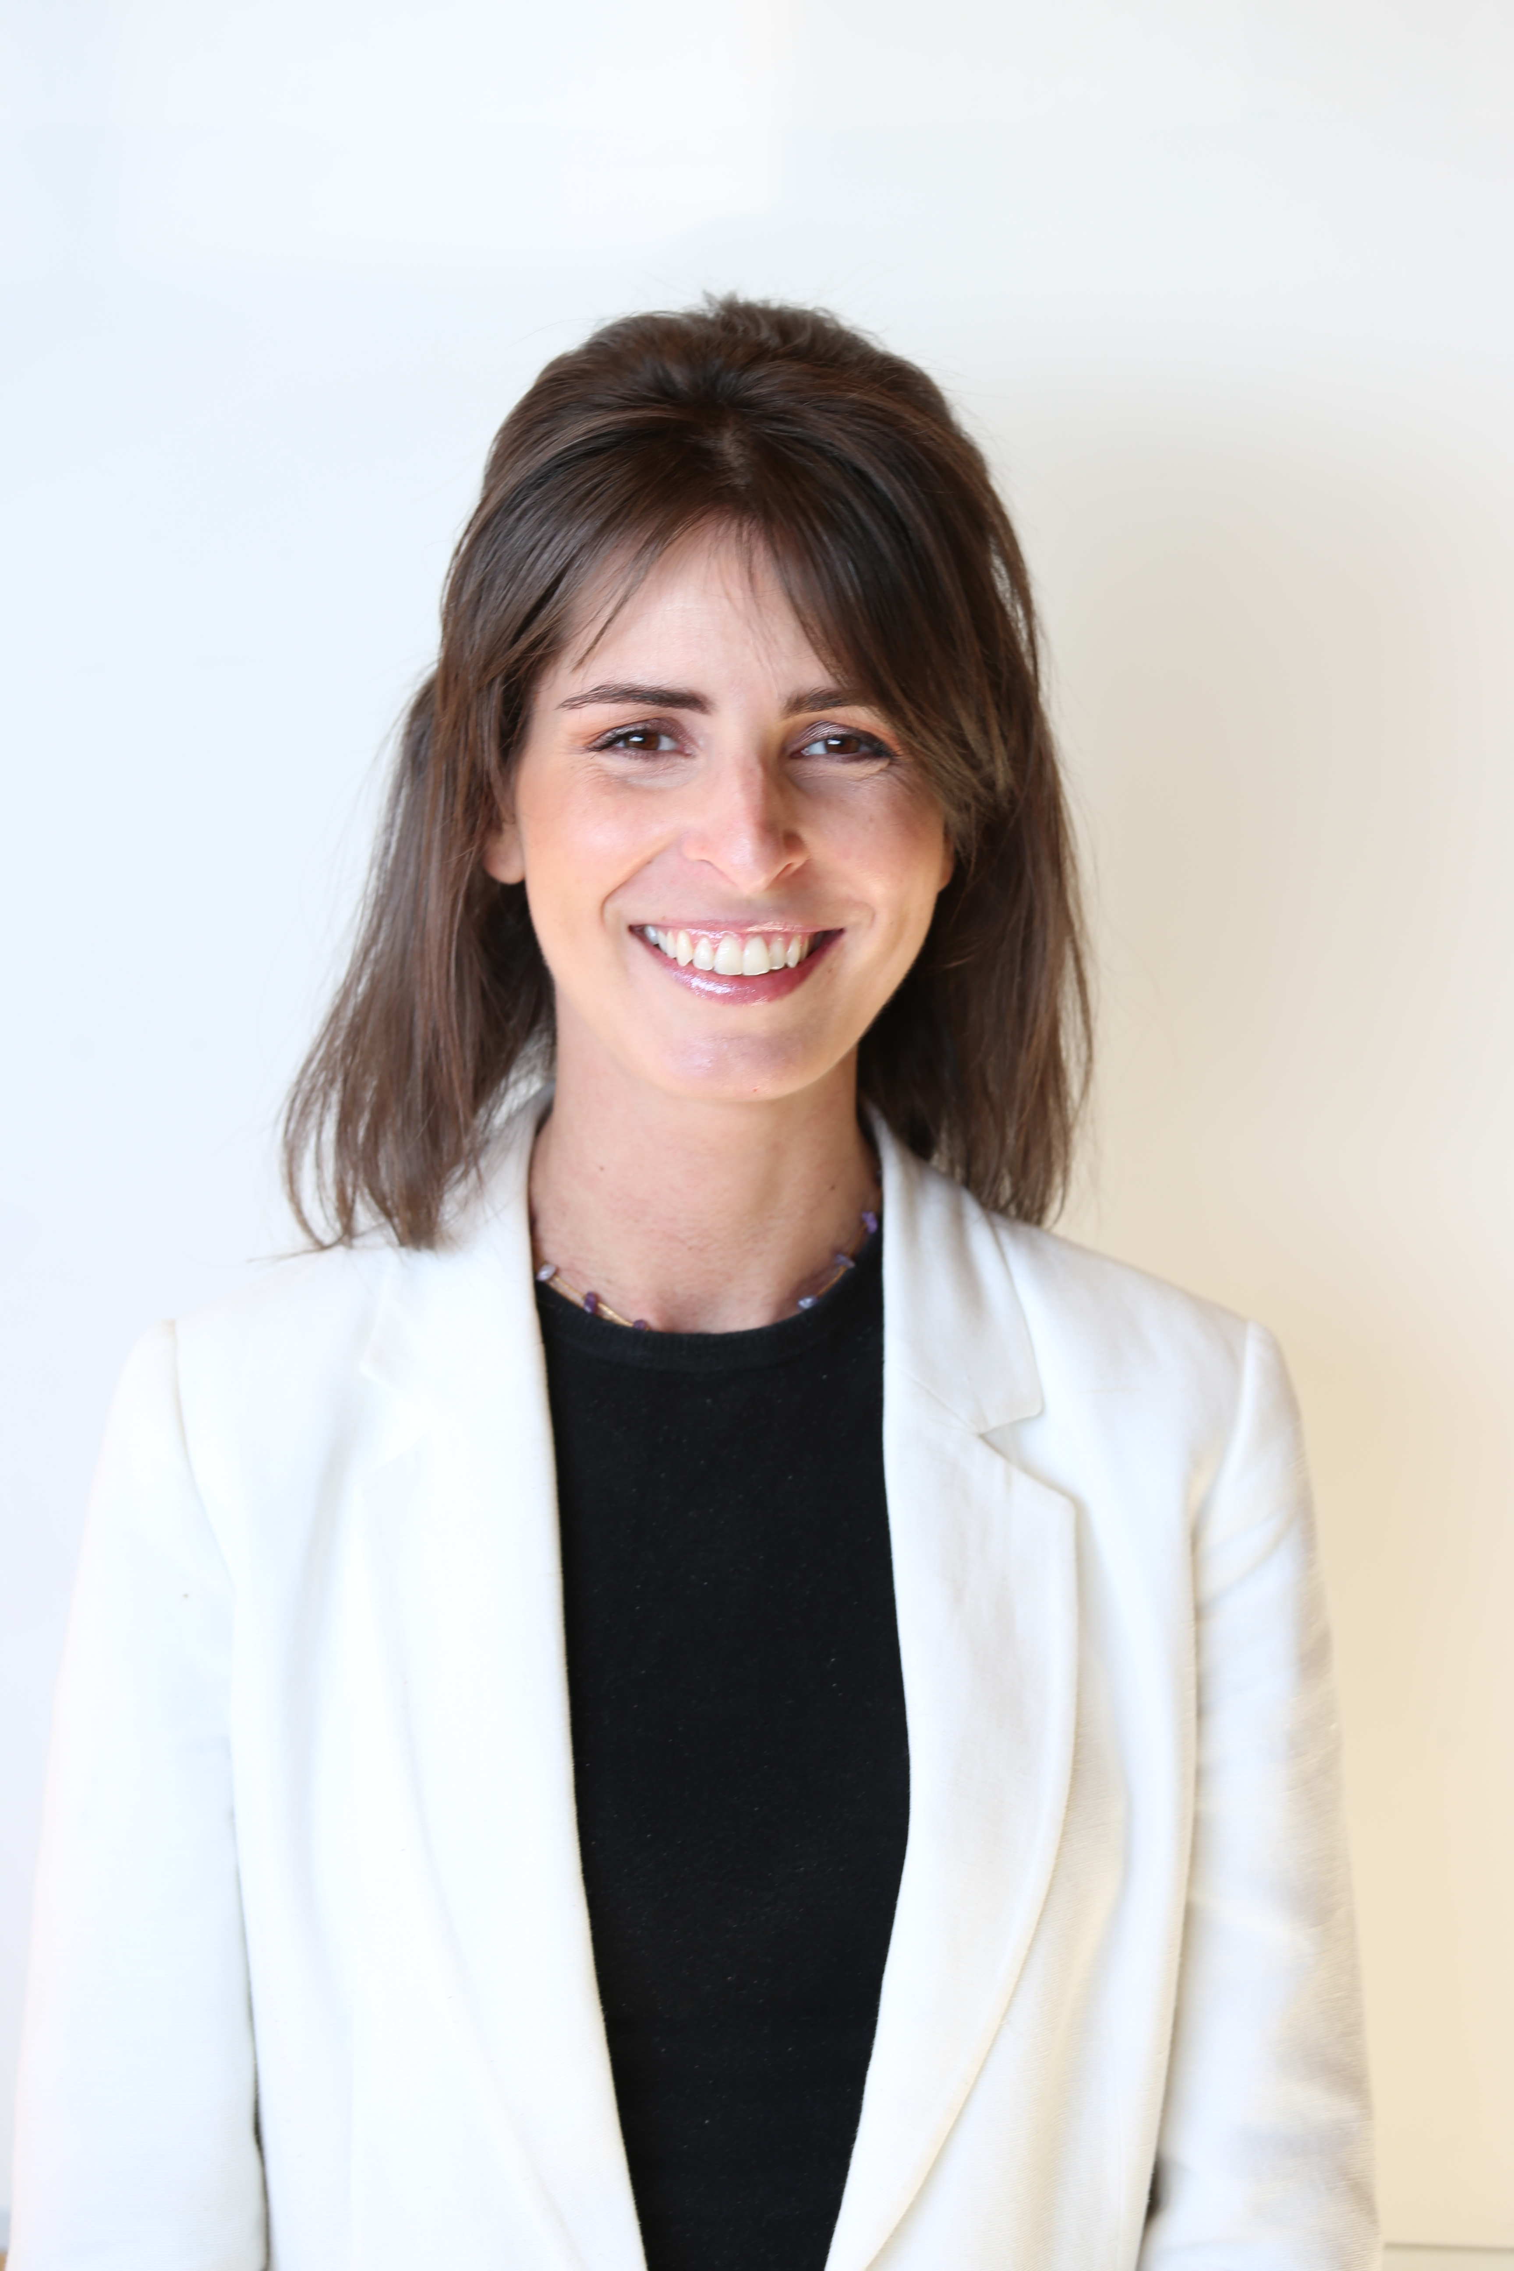
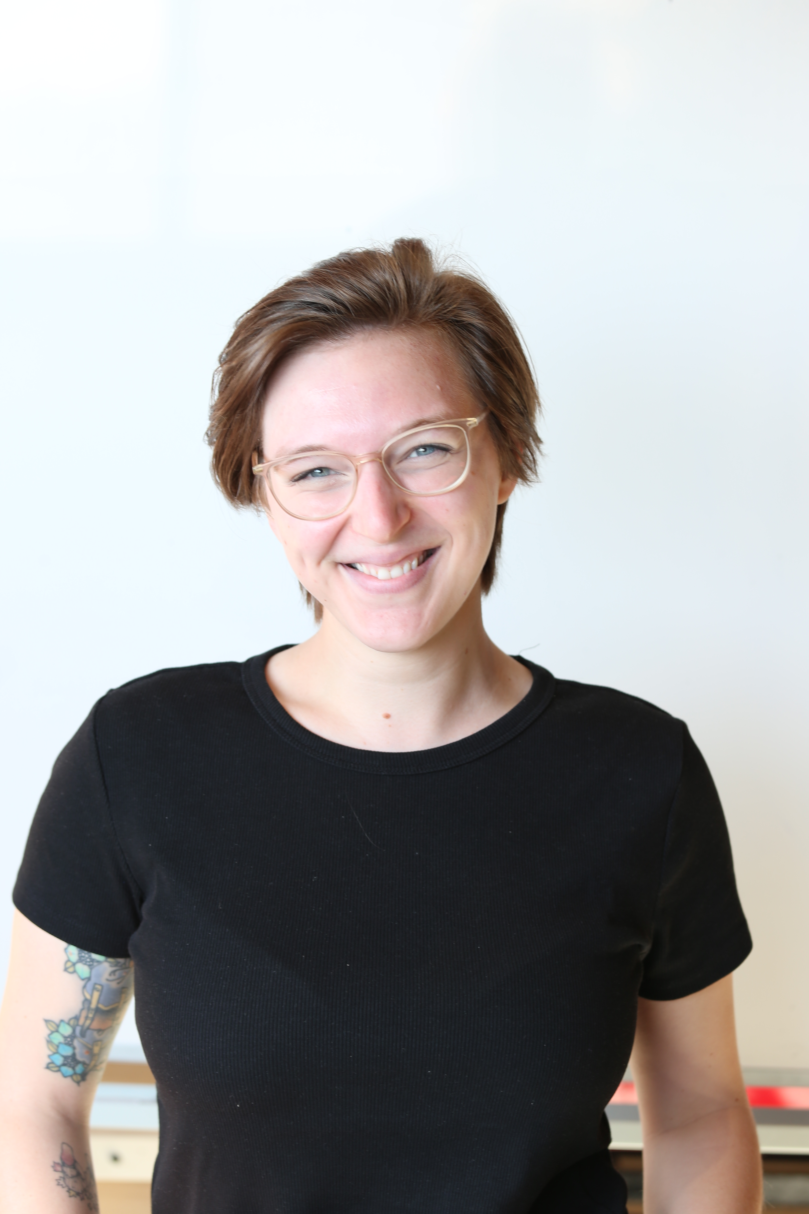
The CREW at IdeaSquare
Alexia Yiannouli
Communications
Laura Wirtavuori
Edu programmes
Ole Werner
Edu Programmes
Dina Zimmermann
Prototyping
Markus Nordberg
Fixing things
Pablo Garcia Tello
The bear from Mowgli
Laëtitia Pedroso
Events
Catarina Batista
Edu programmes
Jimmy Poulaillon
Communications
Tuuli Utriainen
Cosmic collaborator

Slide 4
IdeaSquare
The Innovation Space at CERN
collaborative methodologies;
access to CERN expertise;
cross-connectivity
to ideate solutions for the future of humankind.
Notes:
Fast forward through prototyping
Stimulating instrumentation in research
Connecting curious minds
Linking science innovation and the SDGs

Slide 5
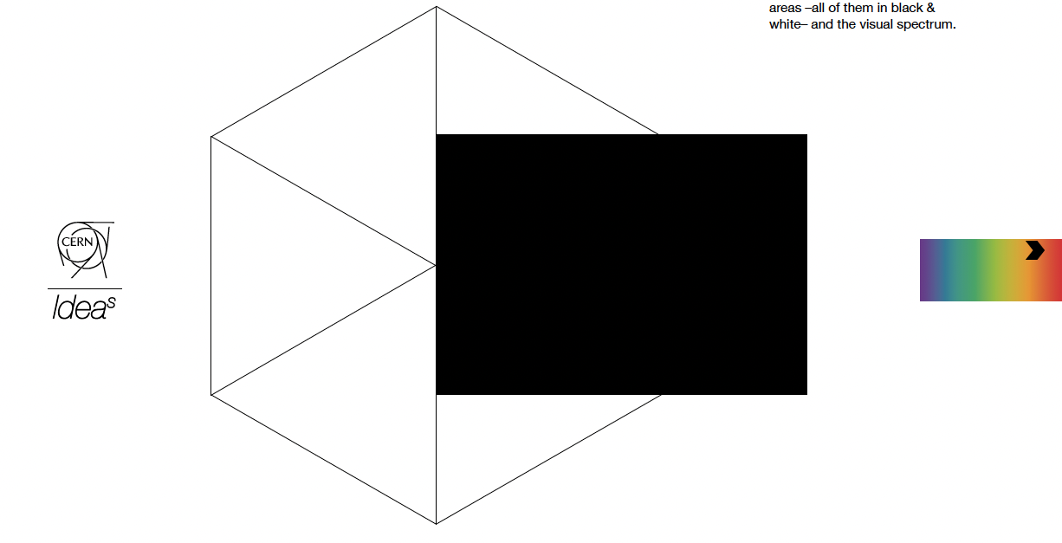
A place where people have the licence to dream!
Notes:
Visual: License to dream card!

Slide 6
Solving wicked problems in times of change

Slide 7

Some examples of complex problems
Climate change
Homelessness
Integrated healthcare
Smart cities
Poverty
Gender equality
…
Notes:
https://www.eur.nl/en/master/governance-and-management-public-sector/examples

Slide 8
SDG Game!

Slide 31
A system is an ever living organism…
So how might we predict possible changes?

Slide 32
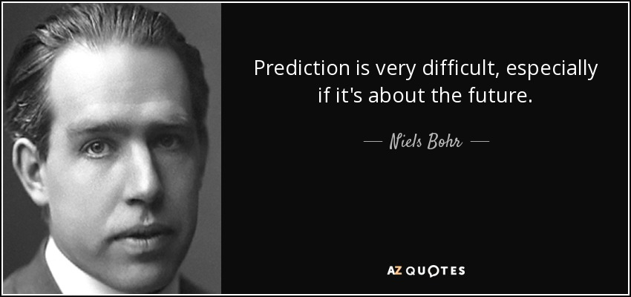

Slide 33
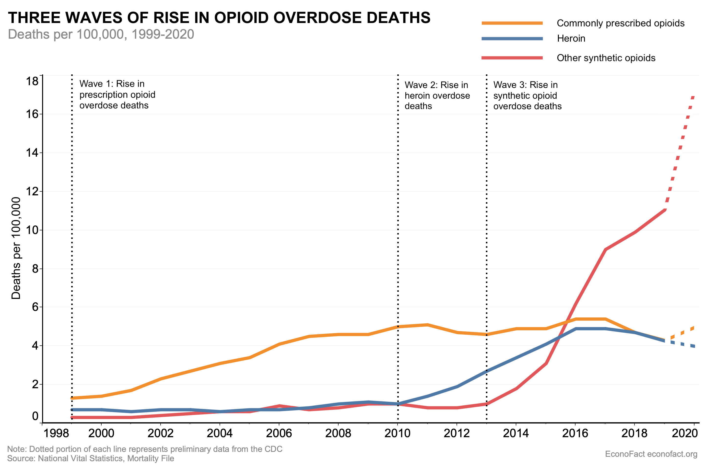

Slide 34
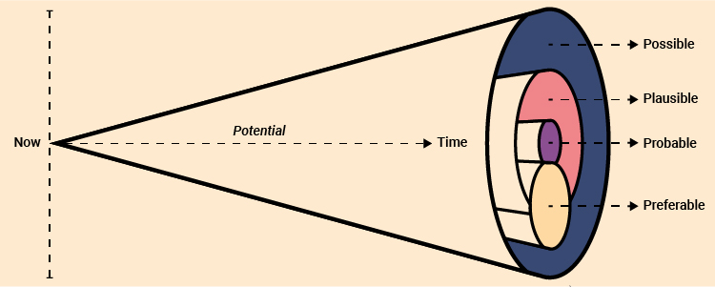
There are many possible futures…
https://www.jisc.ac.uk/guides/vision-and-strategy-toolkit/futures-cone

Slide 35

Imagine the future
Choose one challenge related to the SDGs to work on, e,g:
  access to clean water / free access to clean drinking water for all
  no poverty / no homelessness
  access to quality education / everybody gets basic education in their own language
Imagine what the world will look like in 2050, when that challenge has been solved. Consider technological, social, economical, legal, ethical, political and environmental aspects.
No Harry Potter, but reasonable assumption about tech advancement, for e.g., are ok.
Note that you can modify the challenge as you go along.
(15 min)
Notes:
Where did we say the 3 challenges would come from? Or are we just randomly choosing? I put 3 examples with a more overall and more specific versio

Slide 36

Challenge we focus on
2050 - our grand vision
Notes:
print on A3 for each group of 5

Slide 37
Let’s reflect…
How does your preferable future look like?
Where you would need to be in 2040, in order to achieve your vision for 2050? How about in 2030?
What can you change today to make your 2050 vision more probable?
How does that impact your journey as an individual and professional?

Slide 38
Challenge we focus on
2040 – almost there
2030 – on our way
Now: What we can start with tomorrow
2050 - our grand vision
Notes:
print on A3 for each group of 5

Slide 39
How to fill the canvas
Write your challenge as clearly as you can – it has to match the vision you came up with and does not need to be exactly what you started with.
Write your key insights for your vision: include technological, social, economical, legal, ethical, political, and environmental aspects.
Think about where we would need to be in 2040, in order to achieve your vision for 2050.
Think backwards and outline what that would mean for the year 2030.
What should we start implementing now in order to get to your 2050 vision?
(30 min)

Slide 40
Time to share!

Slide 42
Why IdeaSquare?
We believe that for fundamental change to be made, we need more than traditional innovation methods and mindsets.

Slide 43
Why IdeaSquare?
We believe that for fundamental change to be made, we need more than traditional innovation methods and mindsets.
We enable students and innovators to imagine a future worth fighting for, and we give them the tools and confidence to start building that future.

Slide 44
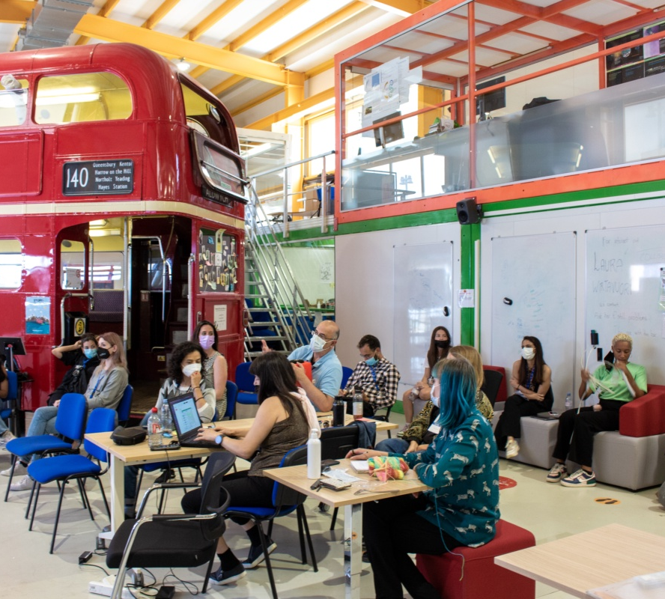
Challenge Based Innovation (CBI)
+22 active program collaborations;
Universities from 8 different countries;
Design Thinking methods to solve global challenges, intersected with deep tech;
UN Sustainable Development Goals as a lens in the process;
Multidisciplinary teams of students: business, design, engineering, social sciences…
CERN researchers who act as technological coaches.
Notes:
Over 1200 students have participated with more than 200 conceptual prototypes produced at IdeaSquare, contributing to the UN Sustainable Development Goals

Slide 45

Intersecting societal challenges with deep tech
Societal needs (UN SDGs)
i2
Futures thinking
Exponential thinking
Speculative design
Deep tech
(detection & imaging, criogenics…)

Slide 46
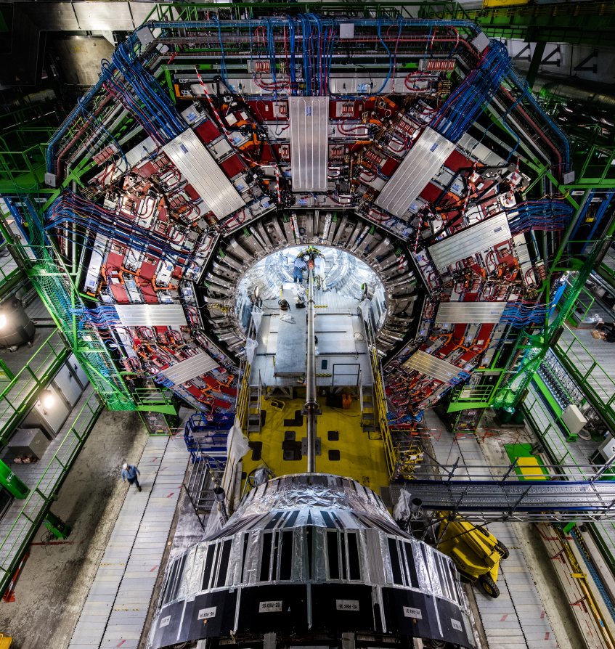
Business as usual is not in our DNA, but we also don’t want any “magic”…
Ideas should be disruptive, without:
Breaking the laws of physics;
Causing more harm than good.

Slide 47
Our specialties
Order of magnitude thinking (+ estimations!)
    - Ideas should be disruptive enough to generate excitement
    - While also having a substantial basis behind - “Do the math”
Systemic and Exponential thinking
    Going for exponential ideas
    Thinking in planetary levels
    Nothing is so great that there is nothing bad: what are the implications of your solution?

Slide 48
How can you get involved… and why?
Listening to the stories of Shalini Epari and Gunn Khatri.

Slide 49
How can you get involved?
Send us an email to idea.s@cern.ch (it will come to one of us).
Let us know what you are interested in:
  interacting with the students;
  attending their presentations;
  providing your expertise (software engineering, CERN tech…)
  tours of CERN experiments
We will keep you informed about future opportunities!

Slide 50
catarina.batista@cern.ch
laura.wirtavuori@cern.ch

Slide 51
Further reading and sources
Epstein. D (2019). ‘The cult of the head start‘ in Epstein. D. Range: Why generalists thriumph in a specialized world. New York: Riverhead books, pp.30-34.
Epstein. D (2019). ‘Thinking outside experience‘ in Epstein. D. Range: Why generalists thriumph in a specialized world. New York: Riverhead books, pp.99-119.
Mlodinow, L. (2018). Your elastic mind. Psychology Today.
Meadows D. and Wright D. (2008), Thinking in Systems. Chelsea Green Publishing.
Got a wicked problem? First, tell me how you make toast, Tom Wujec.
Hirsh, J. B., Mar, R. A., & Peterson, J. B. (2012). Psychological entropy: a framework for understanding uncertainty-related anxiety. Psychological review, 119(2), 304–320. https://doi.org/10.1037/a0026767
Protopia Futures Framework, https://medium.com/protopia-futures/protopia-futures-framework-f3c2a5d09a1e
Juncker, J.-C., & European Commission. (2017). White paper on the future of europe : reflections and scenarios for the eu27 by 2025. European Commission. https://doi.org/10.2775/550306
The workforce of the future, pwc, https://www.pwc.com/gx/en/services/people-organisation/publications/workforce-of-the-future.html
Vision and Strategy Toolkit, Jisc, https://www.jisc.ac.uk/guides/vision-and-strategy-toolkit

