Slide 1
CERN IdeaSquare Journal of Experimental Innovation
IdeaSquare Open Doors
Catarina Batista & Tuuli Utriainen

Slide 2

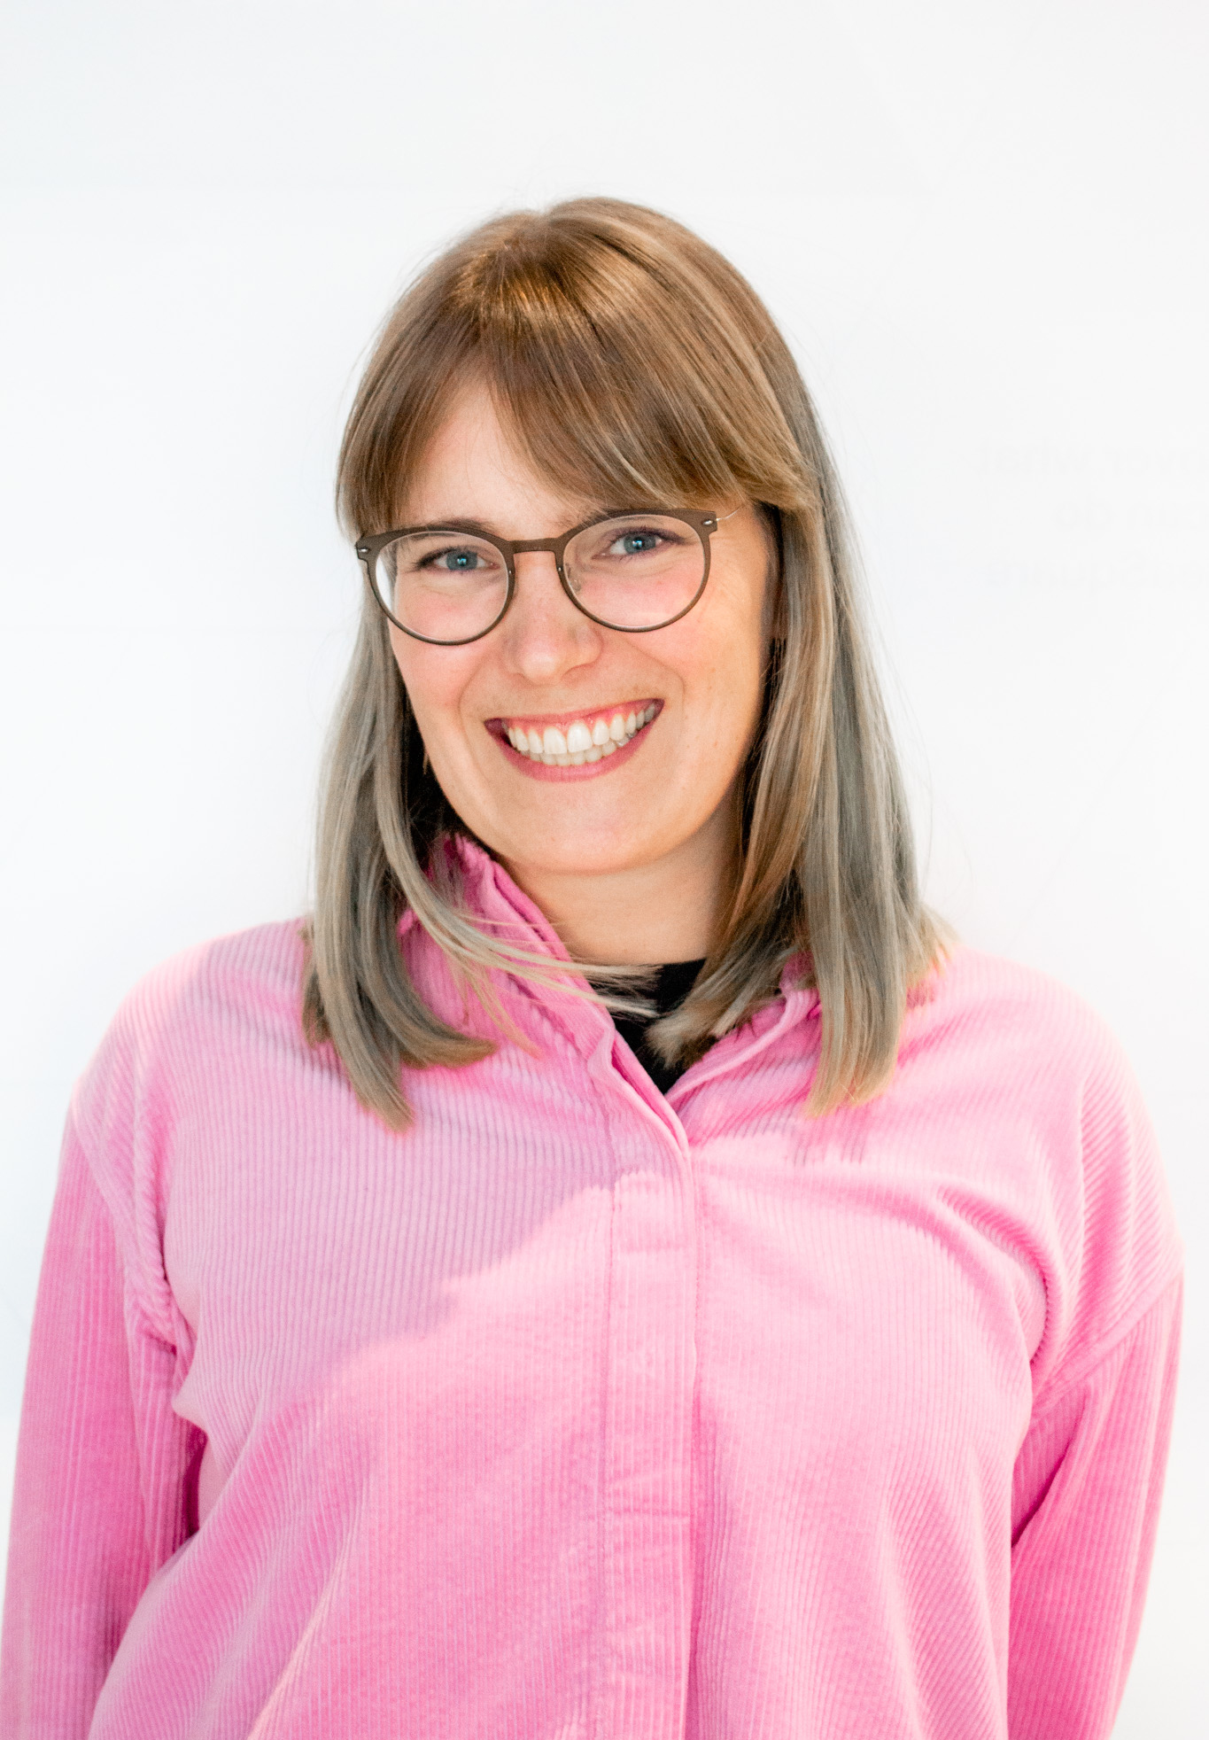
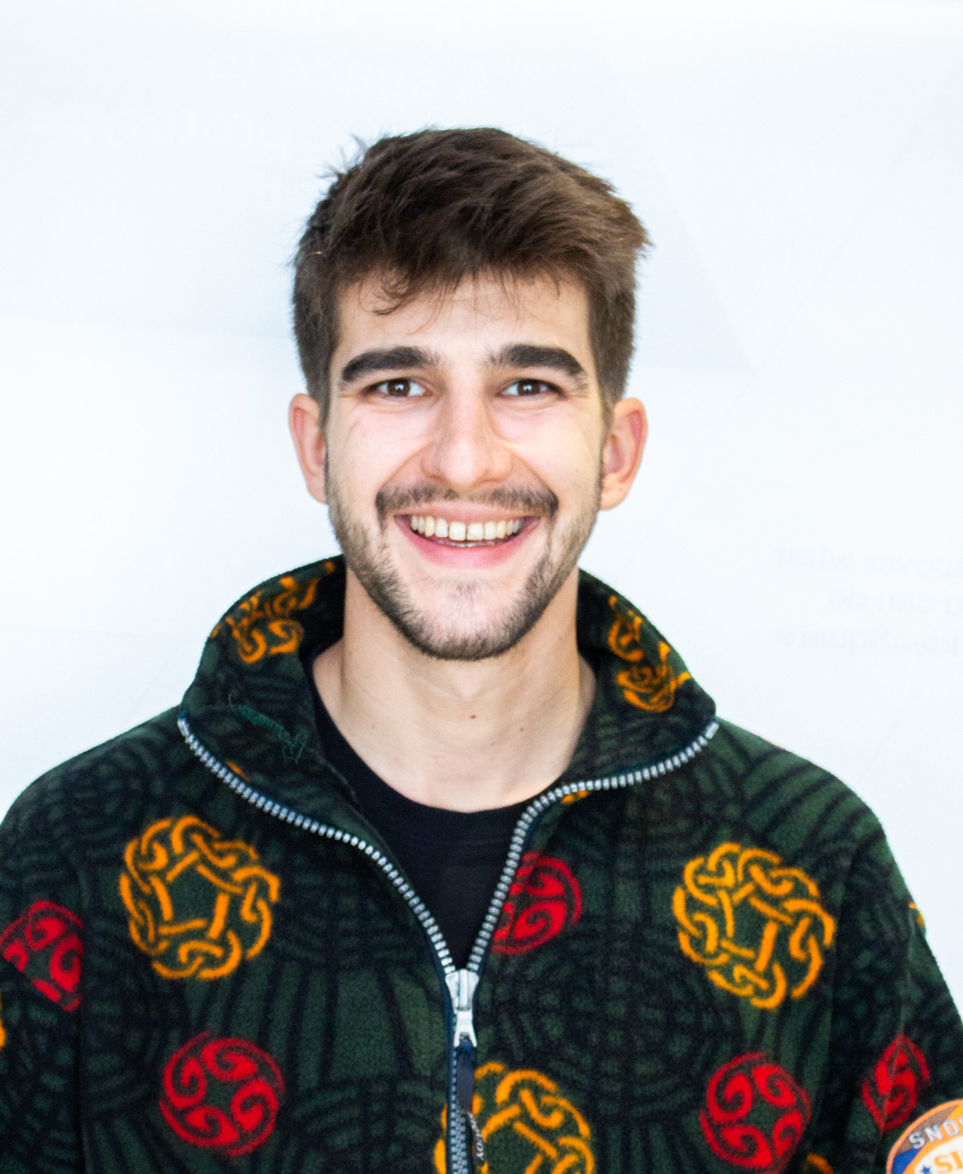
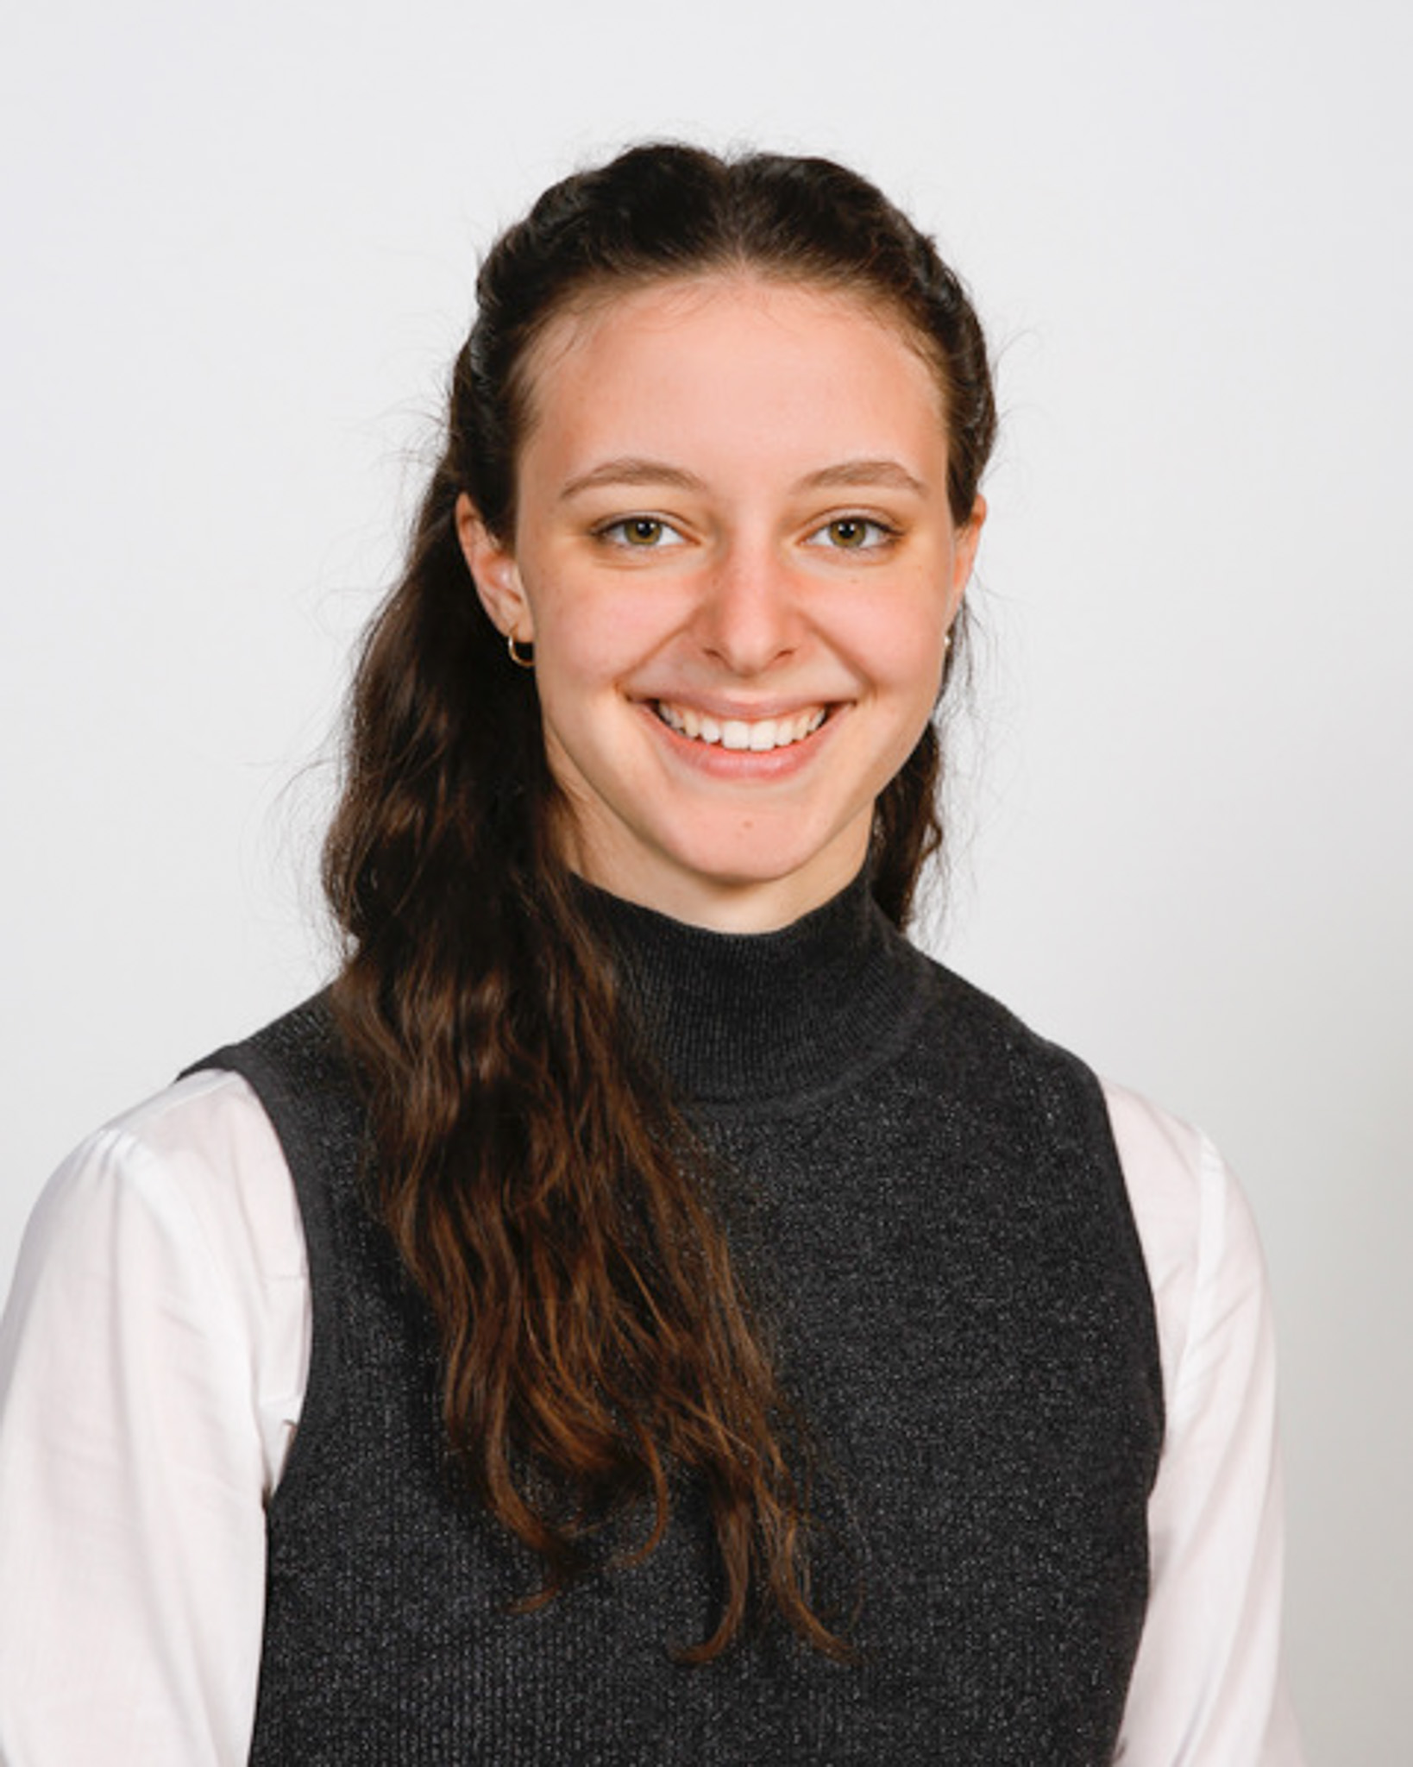

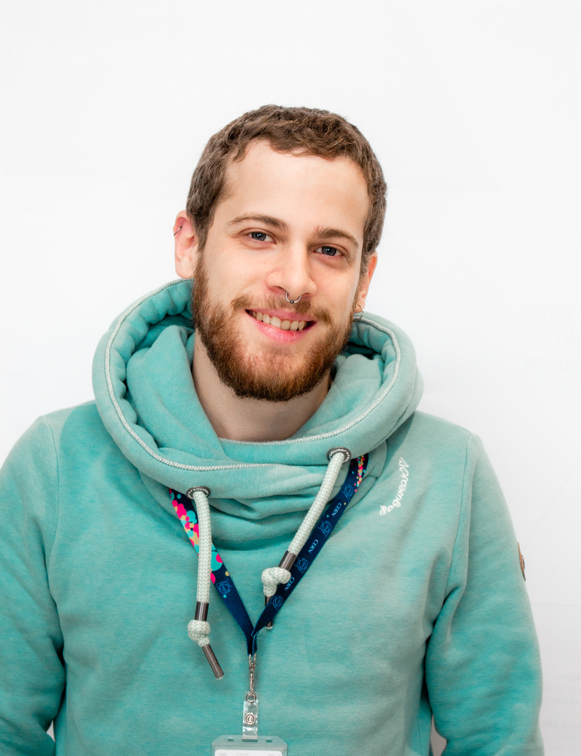


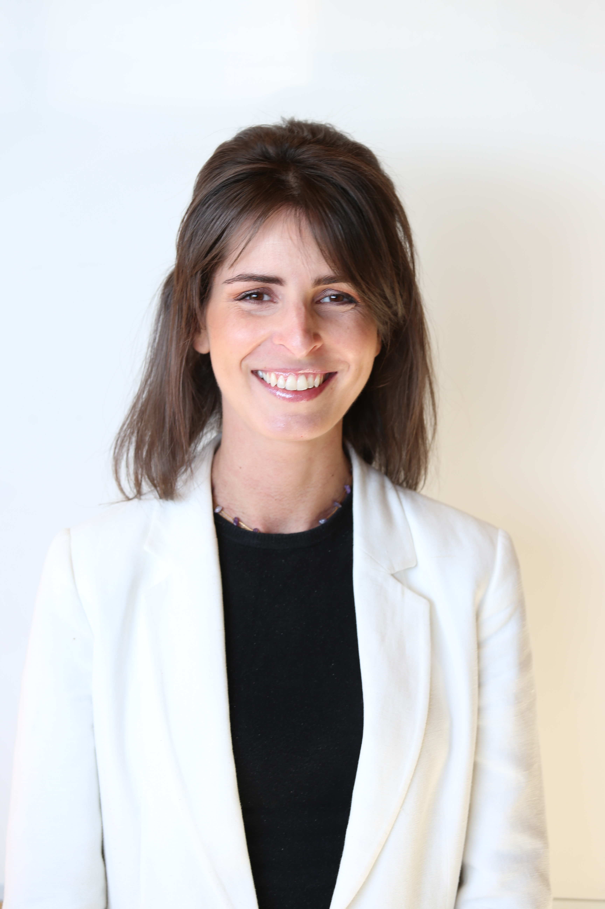
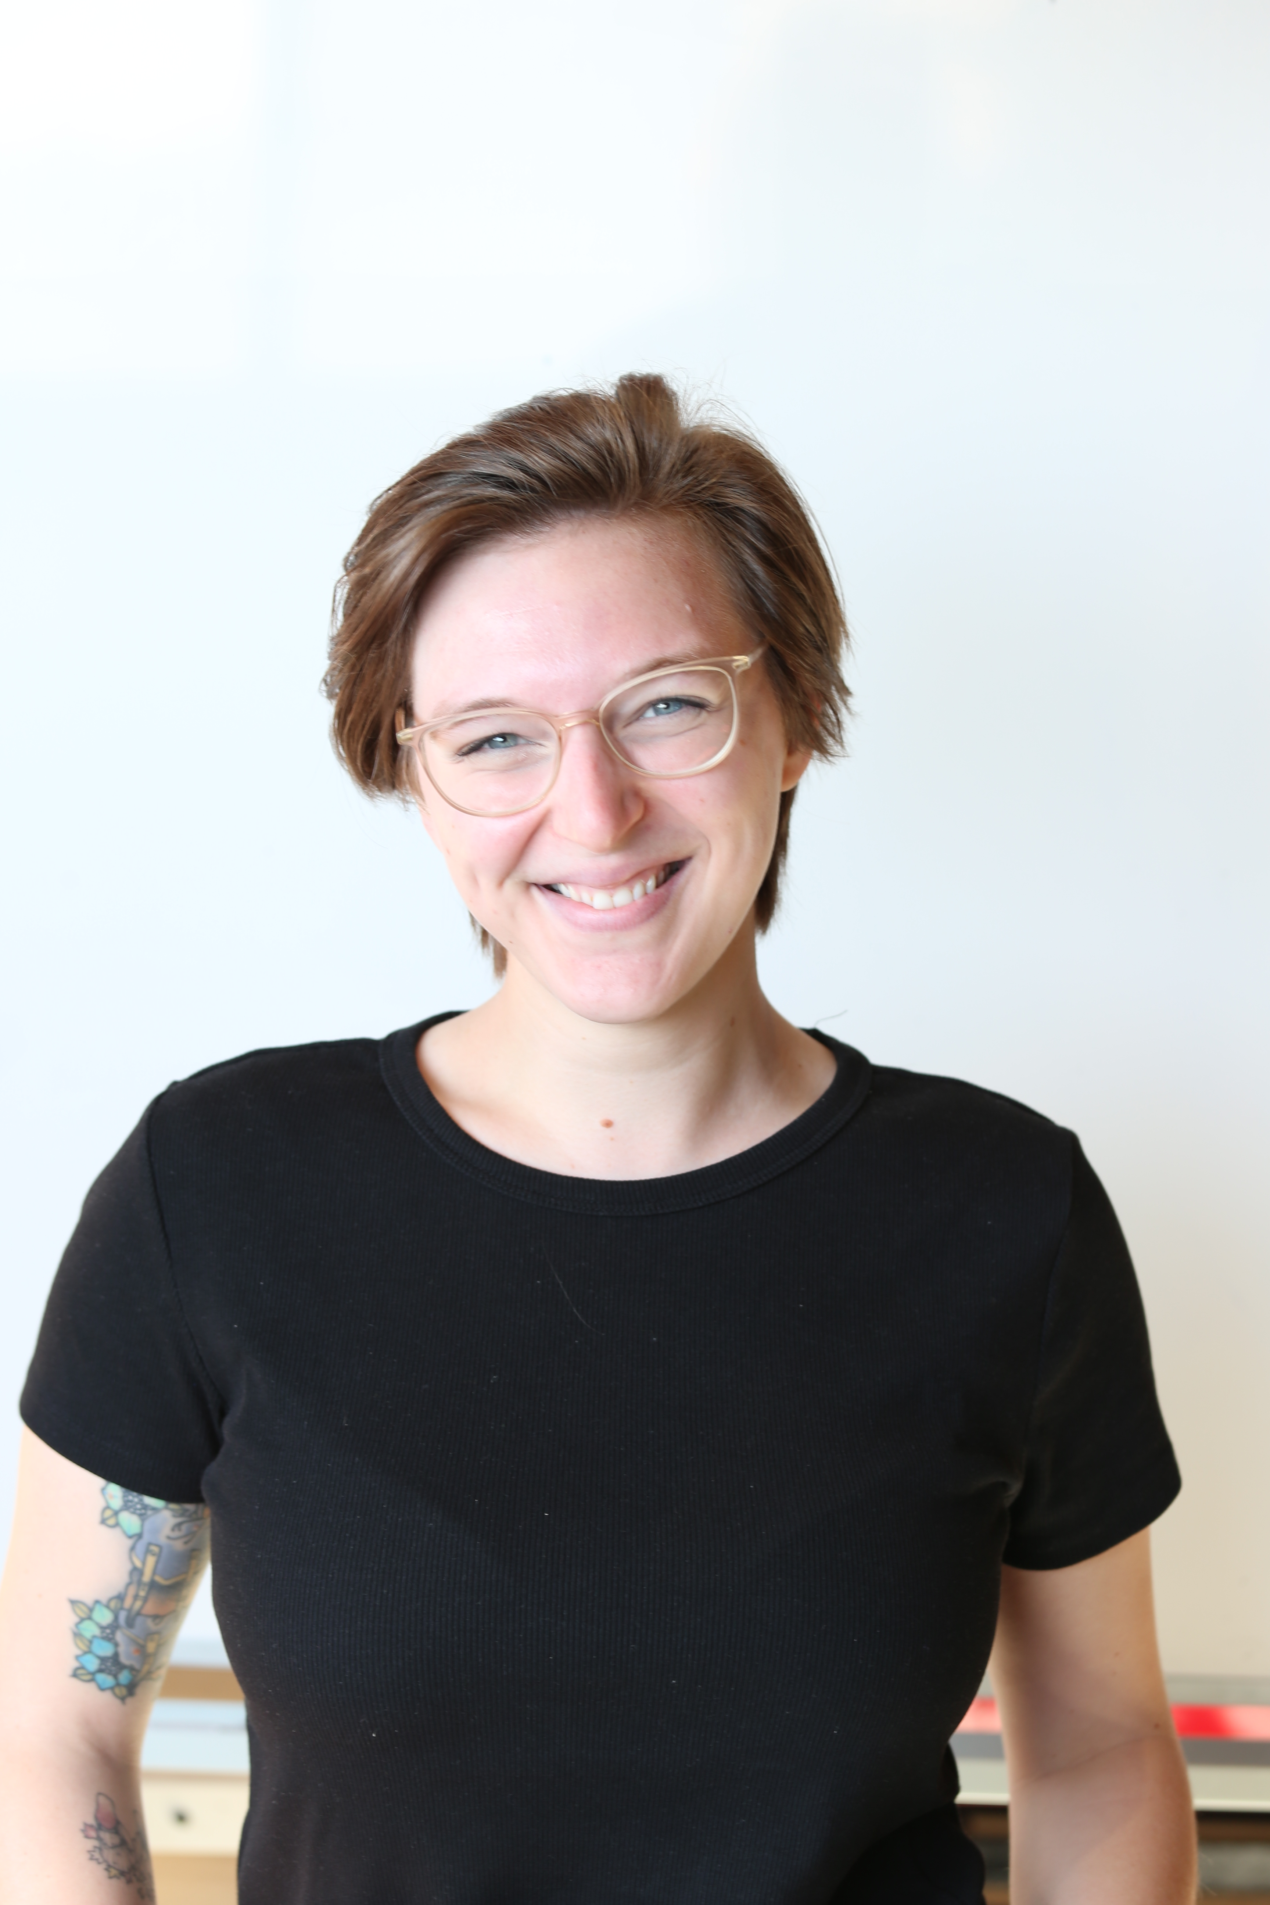
The CREW at IdeaSquare
Alexia Yiannouli
Communications
Laura Wirtavuori
Edu programmes
Ole Werner
Edu Programmes
Dina Zimmermann
Prototyping
Markus Nordberg
Fixing things
Pablo Garcia Tello
EU projects
Laëtitia Pedroso
Events
Catarina Batista
Edu programmes
Jimmy Poulaillon
Communications
Tuuli Utriainen
Cosmic collaborator

Slide 3
IdeaSquare
The Innovation Space at CERN
Collaborative methodologies;
Access to CERN expertise;
Cross-connectivity to ideate solutions for the future of humankind.
A place where people have the licence to dream.

Slide 4
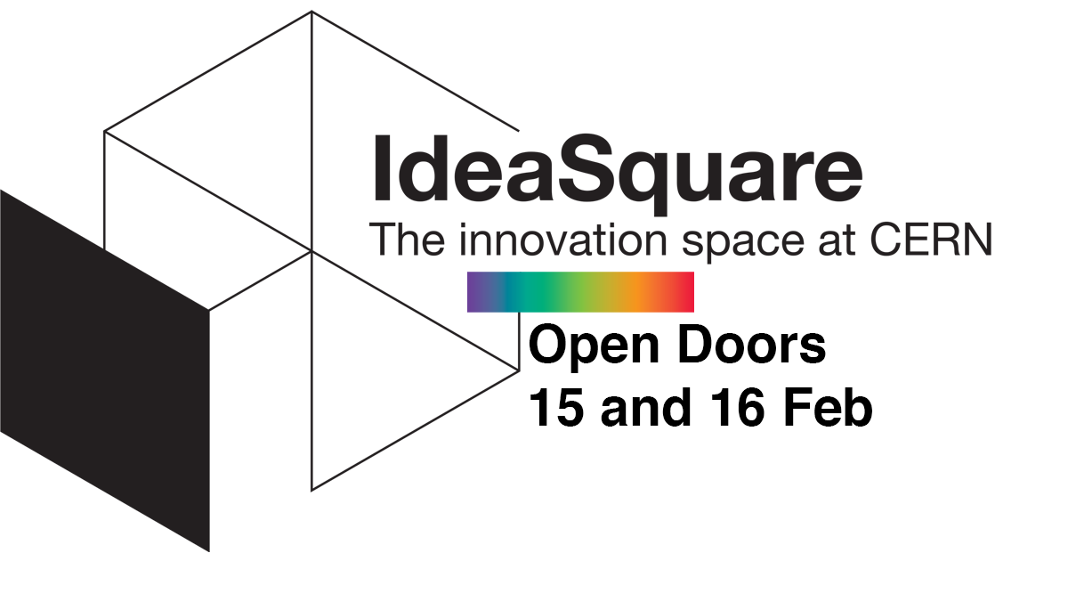
Why CIJ?
CERN IdeaSquare Journal (CIJ) of Experimental Innovation
Created to support the work of our networks;
Open for provocative and daring research;
Indexed in SCOPUS;
Two issues a year (walking to three);
Very fast publication cycle (less than 3 months);
Constructive reviewers feedback;
Personal relation with editors;
Issues publicised through CERN IdeaSquare communication and social media;

Slide 5

Our Manifesto
[BOLD]
[INTEGRATIVE]
[OPEN]
[CONNECTING]
[EXPERIMENTAL]
[USEFUL]
Photo by Hunter Harritt on Unsplash

Slide 6

Our Manifesto
[MISFIT]
CIJ is a place where high-risk high-gain research is welcome and encouraged. Research that doesn't fit in any existing discipline either because they are between—or simply beyond—disciplines. Everything that challenges the status quo and could inspire future generations in the true spirit of scientific curiosity.
Photo by 愚木混株 cdd20 on Unsplash

Slide 7
What are we looking for?
Taking in the scientific spirit of CERN, CIJ is focused on experimental approaches to innovation and education.
Beyond commonly used methods such as surveys, questionnaires and case studies.
Applicable and relevant studies that are able to take into consideration complex and interactive networks.
“Experiment” as an overarching technique that allows the researcher or innovator to challenge or validate a certain hypothesis.
Range from laboratory to field to natural experiments and the studies might employ quantitative and/or qualitative methods.

Slide 8
Published articles

Slide 9
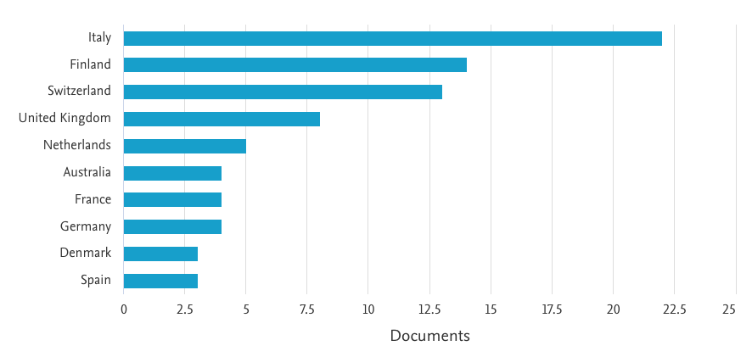
Manuscripts by country

Slide 10

Our scope
original research articles including conceptual/theoretical, empirical and experimental articles;
preliminary results of innovation experiments;
case-study of innovation experiments;
coffee papers;
replication studies;
data sources.
Photo by Daniel Christie on Unsplash

Slide 11
Design innovation integrating deep technology, societal needs, radical innovation, and future thinking
A case study of the CBI A3 program
Christine Thong, Andreea Cotoranu, Aaron Down, Kirstin Kohler, Catarina Batista.
IdeaSquare Open Doors
16th Feb 2023

Slide 12
How does the CBI A3 program foster different design skills?
Thong, C. et al. (2021)
Need for innovators with design capability to translate deep technology into applications that consider desirable futures and positive societal impact.
Measurement of skills related to deep technology, societal needs, radical innovation, and futures thinking.
Initial findings indicate CBI A3 program achieves its learning objectives, although learning is not equal in the different target areas, but that the topics are interrelated.
Further investigation on the influence of their experience at IdeaSquare is needed.

Slide 13
Design-driven entrepreneurship: a cooking exercise to integrate effectuation and design thinking
Luca Iandoli, Kevin James
IdeaSquare Open Doors
16th Feb 2023

Slide 14
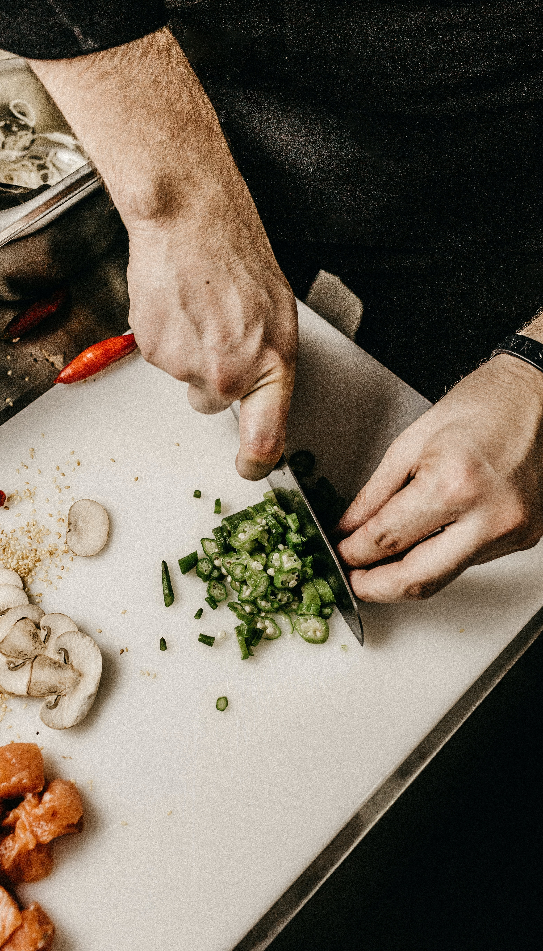
Using cooking as a metaphor for design-driven innovation.
Iandoli, L., James, K. (2022)
Role of making in entrepreneurial problem-solving;
Effective analogy between the design process and the cooking experience – having different ingredients and steps to achieve an end goal, while making decisions along the way.
Hands-on activity to make the students to experience making at home, moving from ideation to making during COVID times.
Importance of aesthetic criteria, emotional validation, and empathy in entrepreneurial endeavours.
Photo by Jonathan Borba on Unsplash

Slide 15
CIJ Coffee Papers
IdeaSquare Open Doors
16th Feb 2023

Slide 16

Coffee Papers
Lighter, inspirational, food-for-thought articles.
Collaborative efforts prepared by researchers from various walks of life visiting or staying at CERN IdeaSquare.
Identity of the authors is kept anonymous (although known), helpful hints can be found in the literature references.
Photo by Markus Spiske on Unsplash

Slide 17
Soap bubbles and flying to the moon
Exploration of the science (and excitement) behind soap bubbles seeking for keys to achieve “order of magnitude jumps” in projects.
IdeaSquare Open Doors
16th Feb 2023

Slide 18
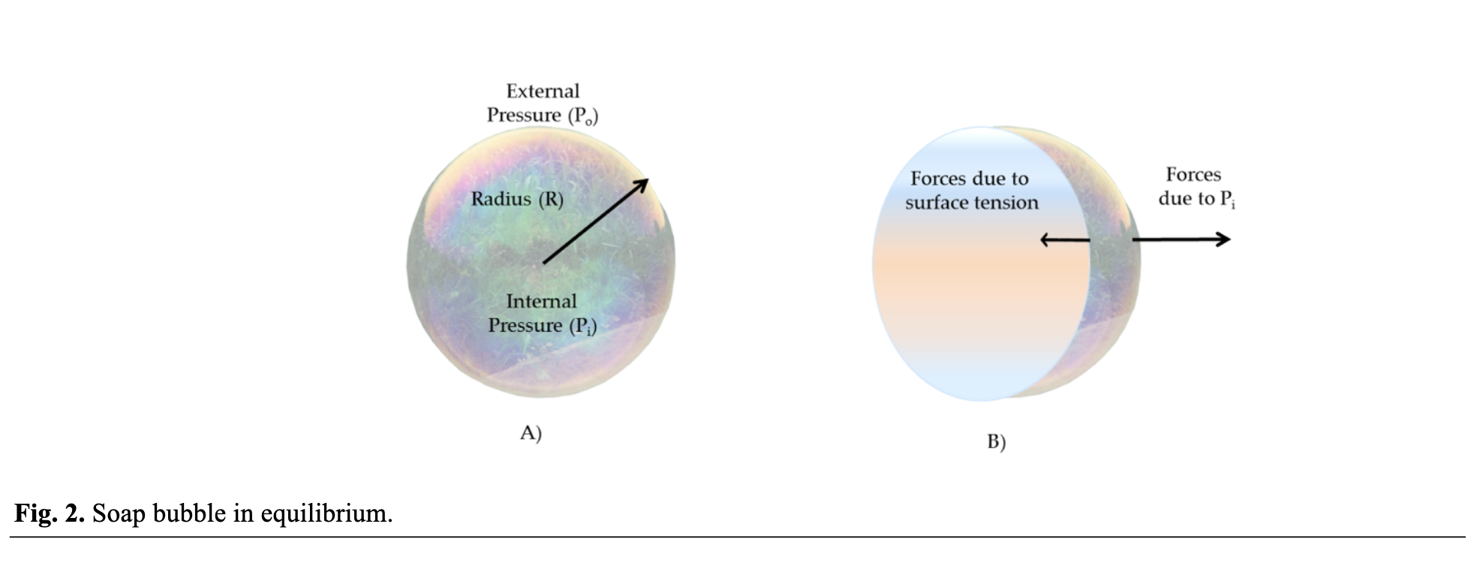
Moon-shot projects as soap bubbles in equilibrium

Slide 19
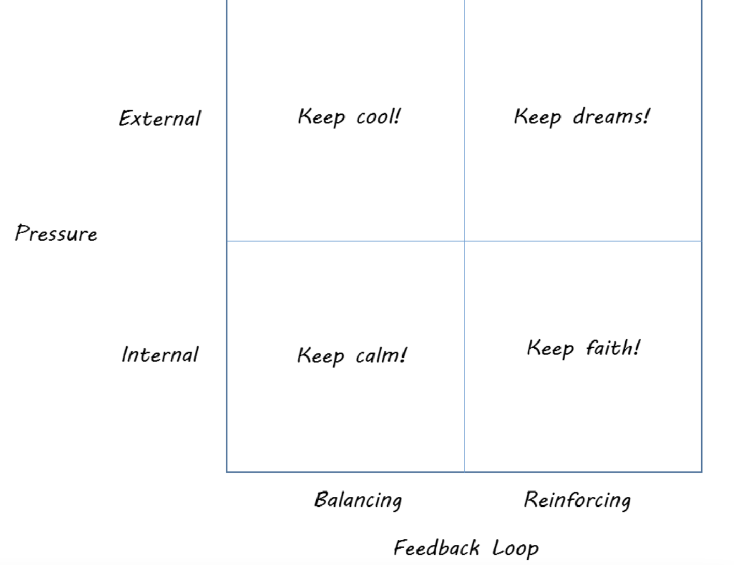
“Quick and dirty” strategic management matrix for “order of magnitude jumps” projects.

Slide 20
Reflection
Passion is the “secret weapon” of the courageous who breathe at the intersection of a far-reaching goal and the requirement of radical solution to produce “order of magnitude jumps”.
Universal recipe for “order of magnitude jumps”:
  1. Dough your “unreachable goal”.
  2. Spice it with the largest possible network of committed and passionate individuals.
  3. Bake it carefully allowing it to grow but not to pop by reinforcing feedback

Slide 21
Harnessing butterflies for creating innovation tornadoes
“Gedankenexperiment” related to the question of amplification of innovation.
Inspired by chaos and non-linear dynamical system theories and the famous “butterfly effect”.
An arm-chair recipe on how to amplify innovation is casually offered and some concrete examples are outlined.

Slide 22
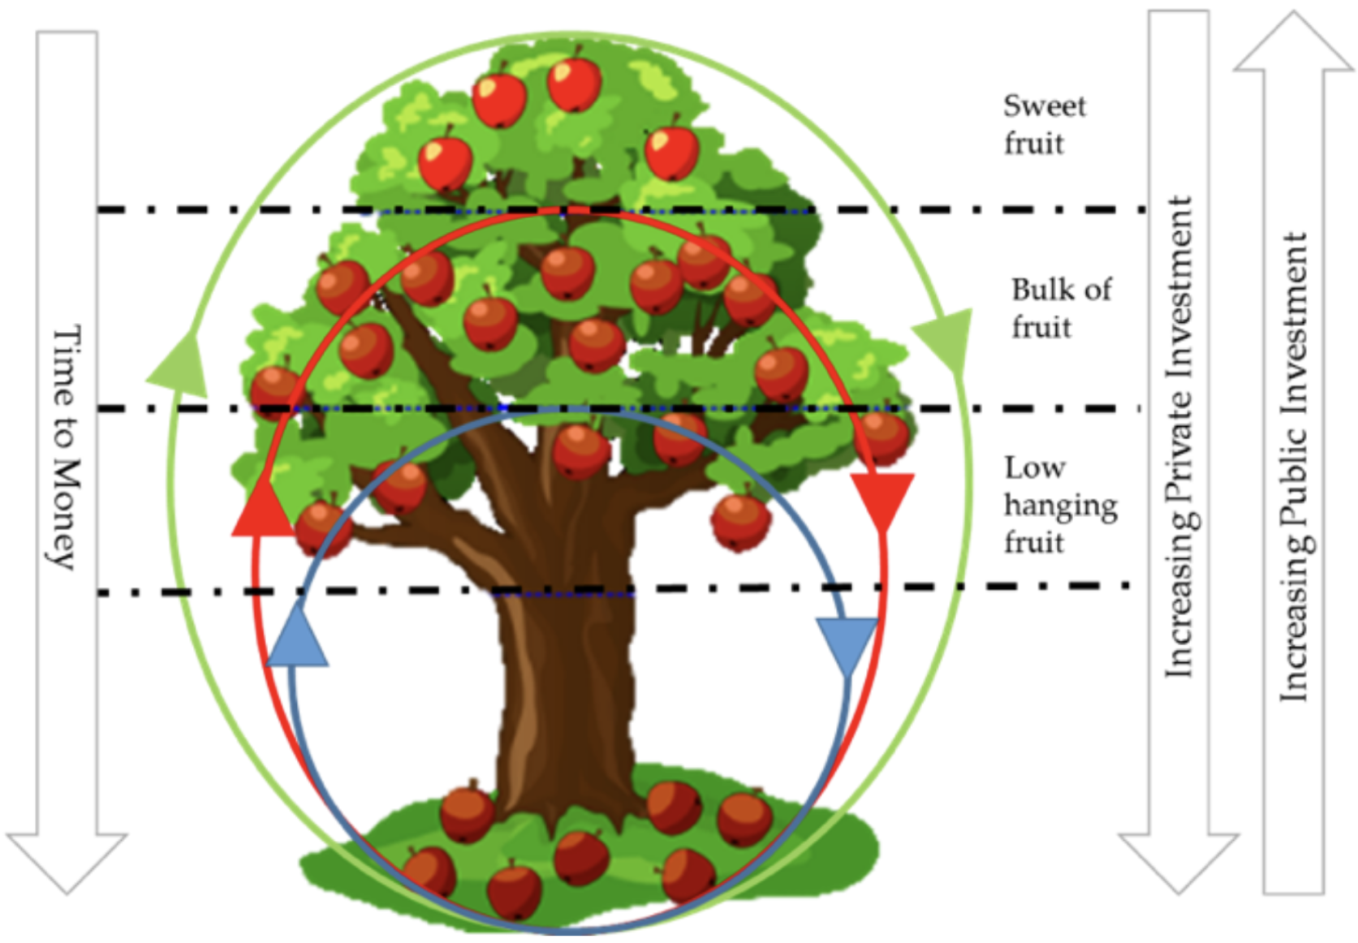
IdeaSquare set-up ecosystem illustrating its innovation dynamics cycles
(short = low hanging fruits, mid = bulk of fruit, long = sweet fruit)
Notes:
deaSquare set-up ecosystem illustrating its innovation dynamics cycles (short = low hanging fruits, mid = bulk of fruit, long = sweet fruit)

Slide 23
Can innovation amplification be created by design?
Man-made breakthrough innovations such as the printing press or accelerometers bring unexpected benefits that are also themselves game changers.
Mother Nature gives us clues in the shape of the long-term memory of atmospheric cycles.
We have given examples showing that this appears to be possible and have offered our recipe for innovation amplification and related simulation results.
Notes:
deaSquare set-up ecosystem illustrating its innovation dynamics cycles (short = low hanging fruits, mid = bulk of fruit, long = sweet fruit)

Slide 24
Framing the future of physics collaborations together

Slide 25
Name +
Role at CERN +
If you could have dinner with any person (living or dead) who would that be?
Introduce yourself:
Notes:
deaSquare set-up ecosystem illustrating its innovation dynamics cycles (short = low hanging fruits, mid = bulk of fruit, long = sweet fruit)

Slide 26
“What might disrupt physics collaborations and evolve them to the next level in the future (next 100 years)?”
In your groups, explore the following question:
Notes:
deaSquare set-up ecosystem illustrating its innovation dynamics cycles (short = low hanging fruits, mid = bulk of fruit, long = sweet fruit)

Slide 27
“What might disrupt physics collaborations and evolve them to the next level in the future (next 100 years)?”
In your groups, explore the following question:
VR/AR technologies
Quantum computing
Selforganized teams
Economic crisis
ChatGPT
Notes:
deaSquare set-up ecosystem illustrating its innovation dynamics cycles (short = low hanging fruits, mid = bulk of fruit, long = sweet fruit)

Slide 28

Coffee papers
Thought experiment to frame potential areas of interest and find surprising and delightful ideas.

Slide 29
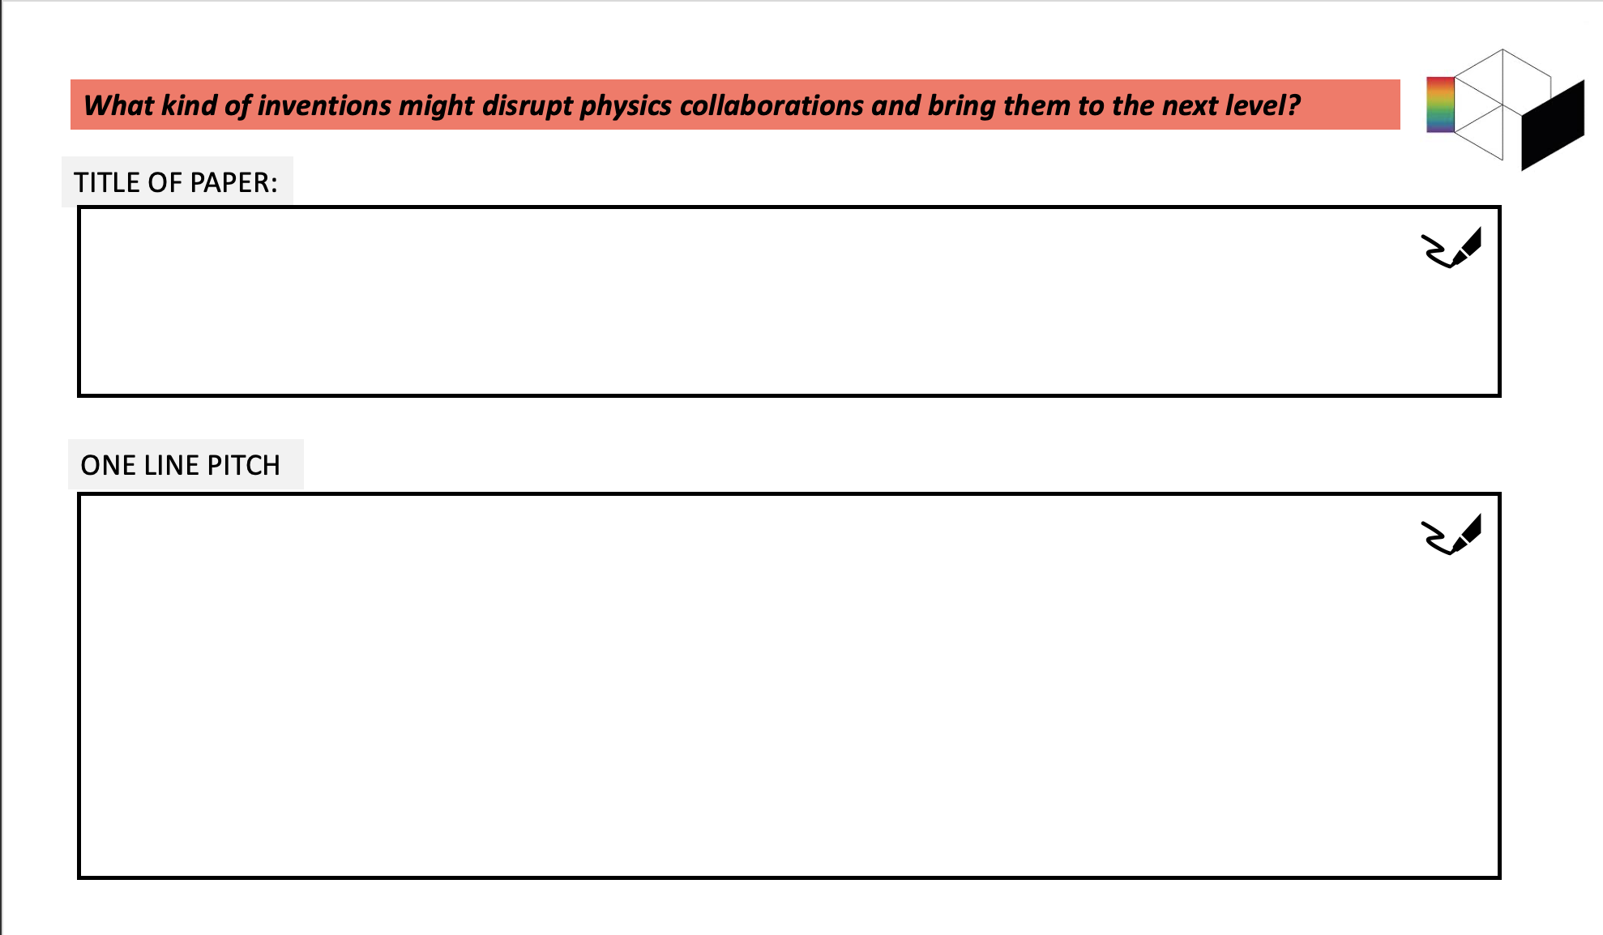

Slide 30
Coffee papers
Elevator pitches -Best pitch wins!

Slide 31
Pitch!

