Slide 1


Slide 2
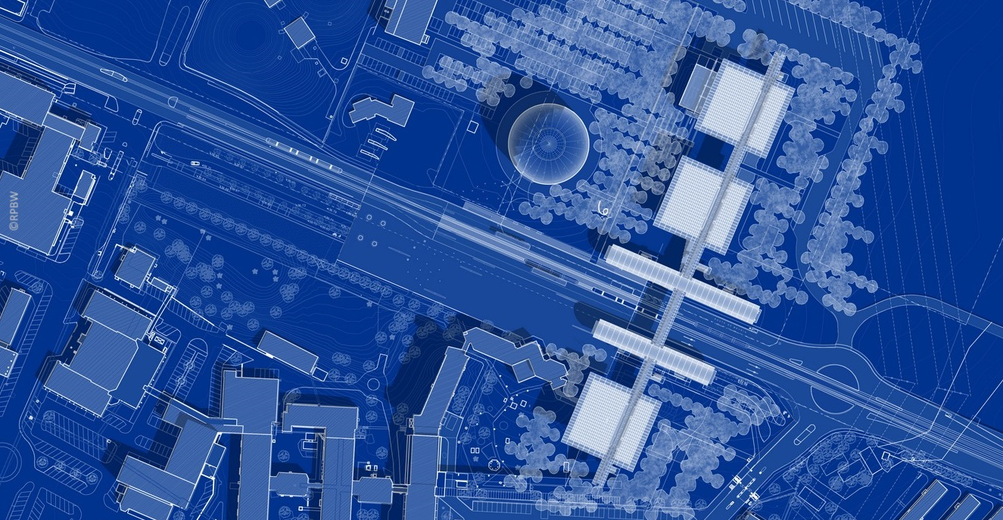
Science
Gateway
Campus
IdeaSquare
Auditorium
Globe
Reception
Shop
Restaurant
Labs
Exhibitions

Slide 3
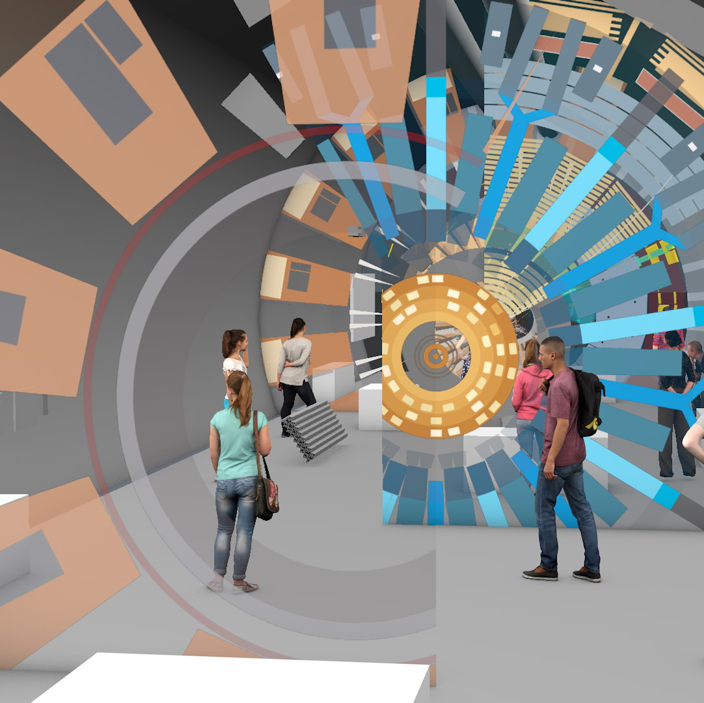
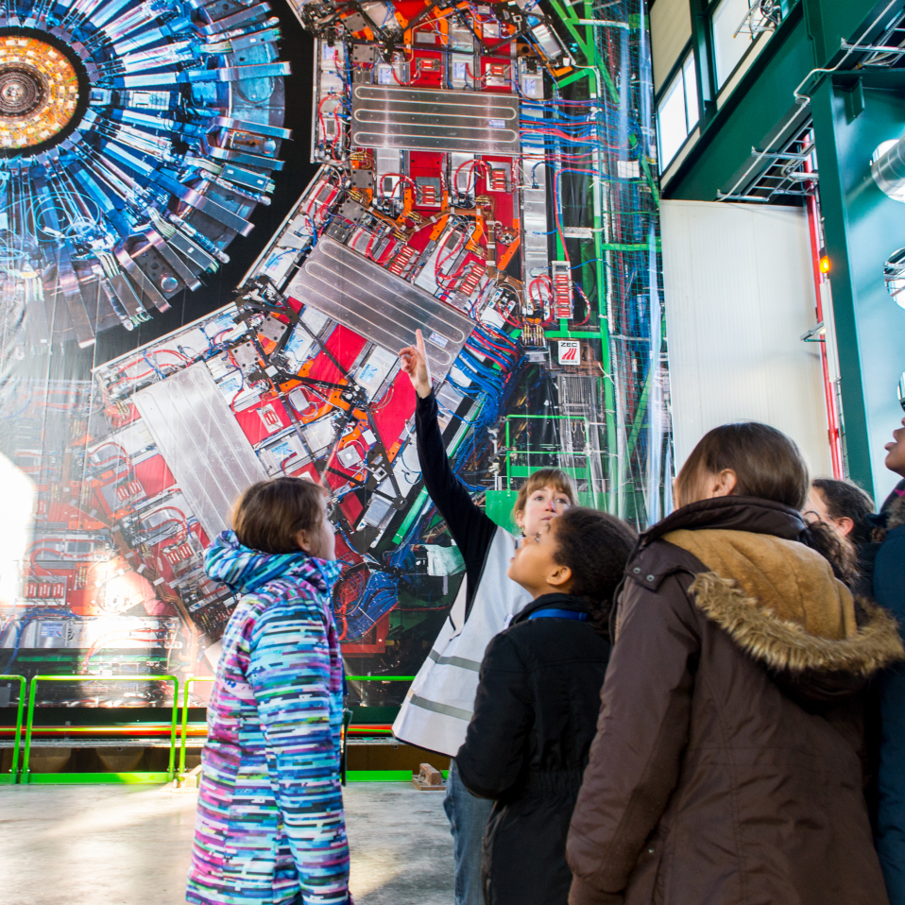
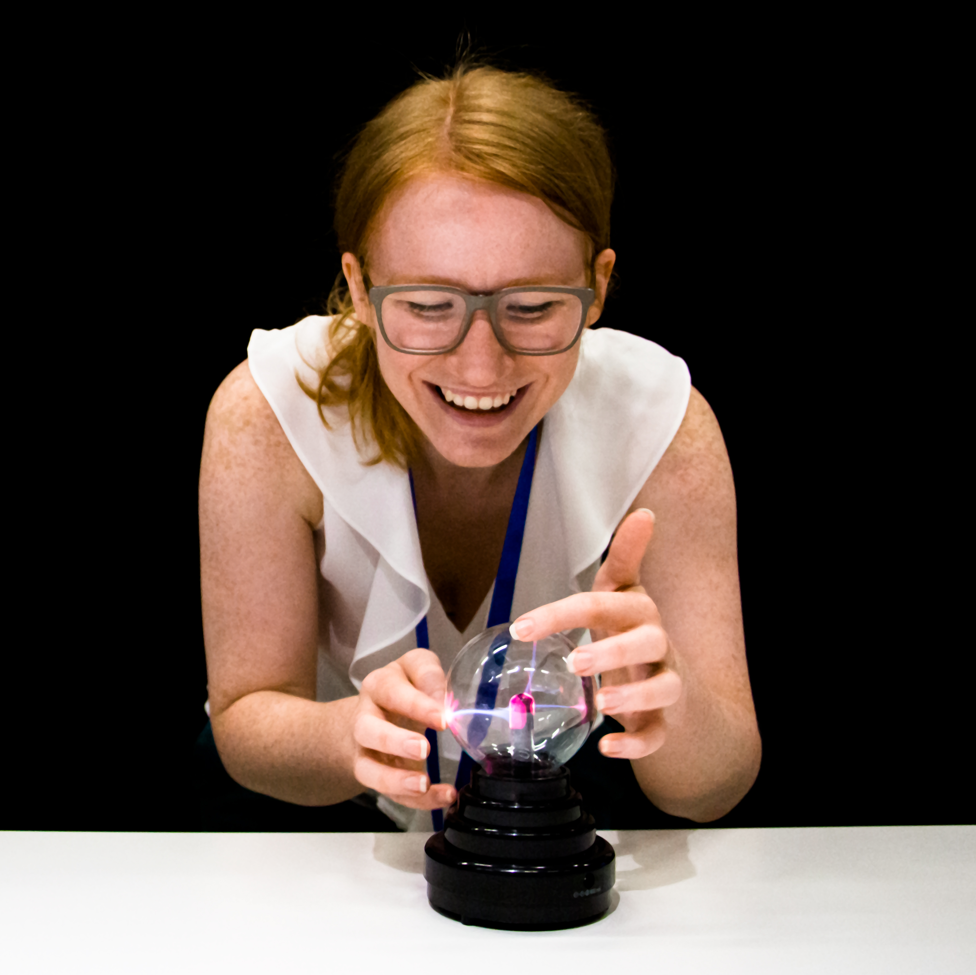
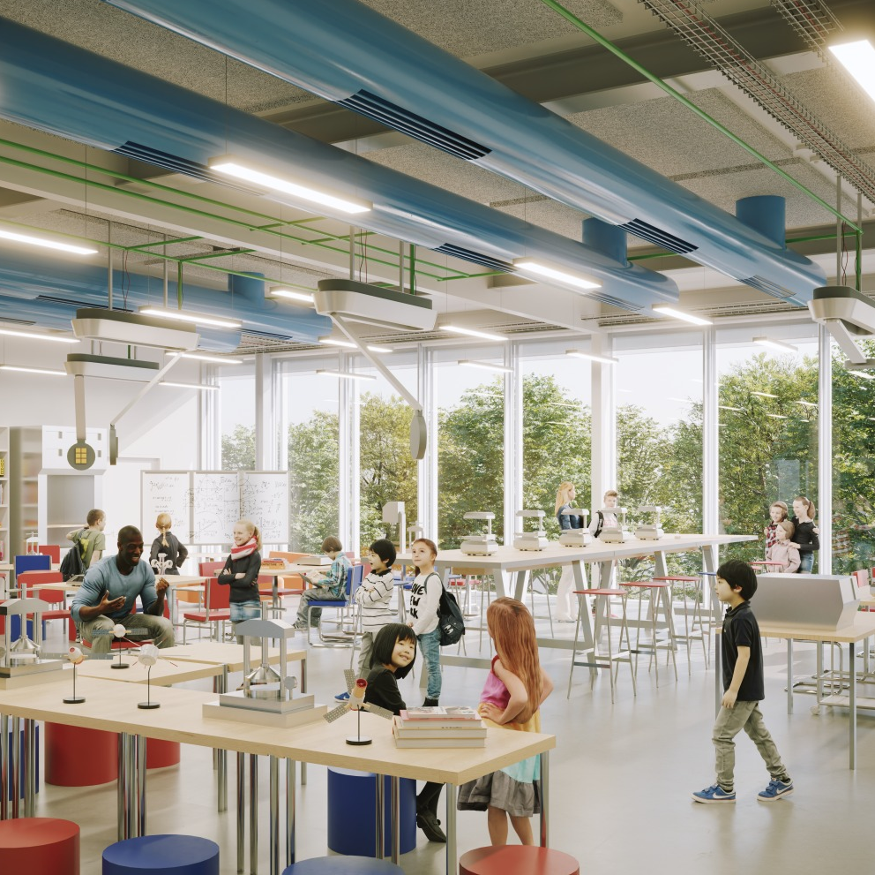
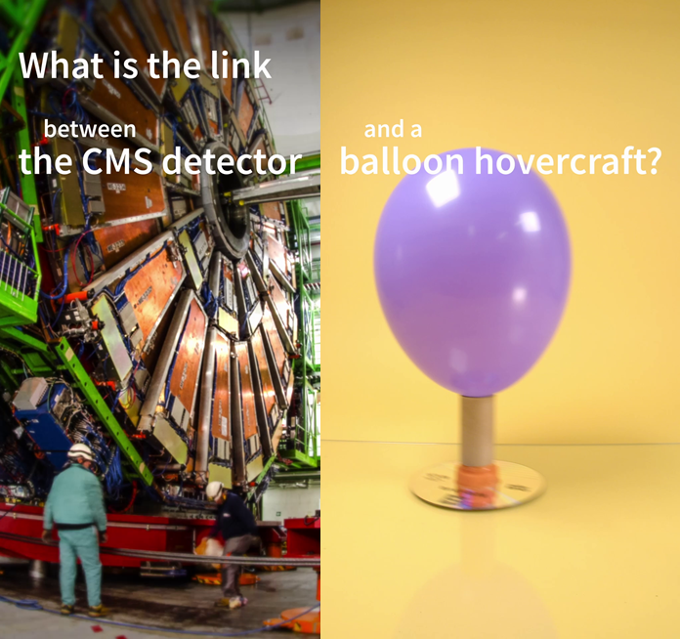
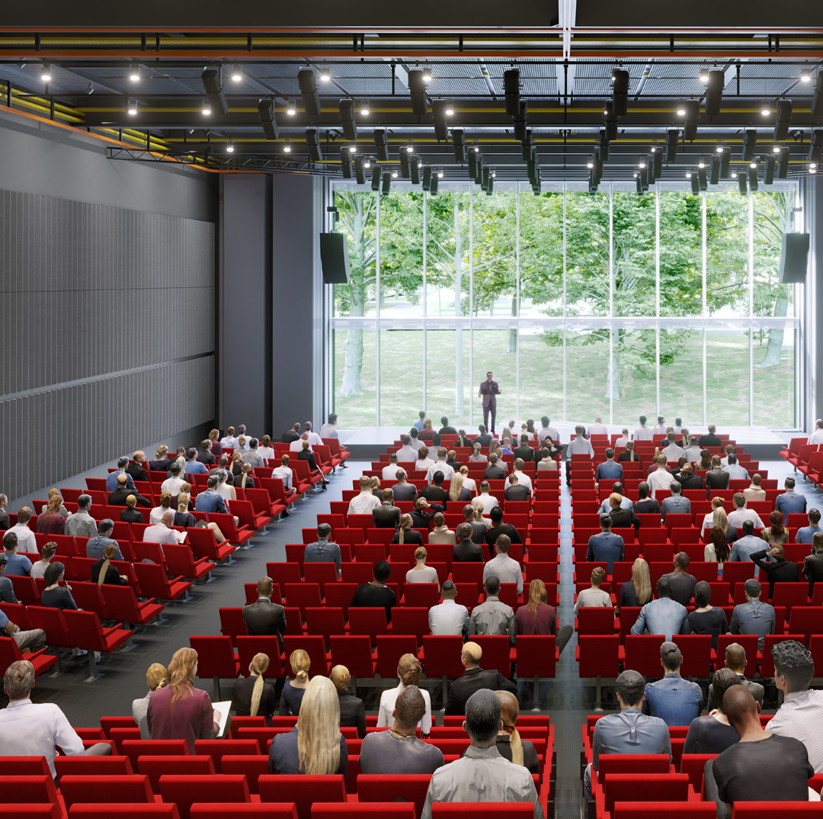
Science Gateway programme
Guided tours
Science Shows
Lab Workshops
Exhibitions
Learn Online
Events

Slide 4
Science Gateway Exhibitions

Slide 5
Tube 1: Discover CERN
Discover CERN

Slide 6
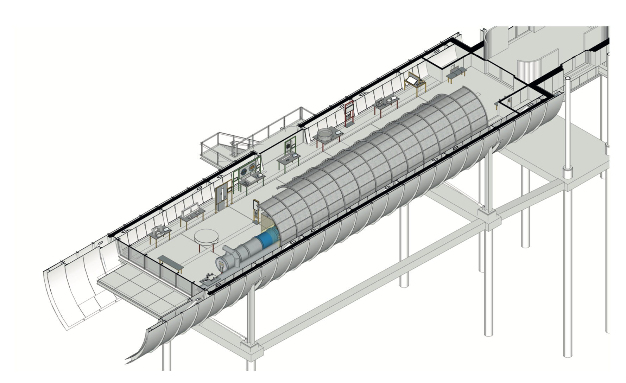
Accelerate
Proton
football
Demo area
with proton accelerator
Realistic tunnel environment
Tables are placeholders for exhibits

Slide 7
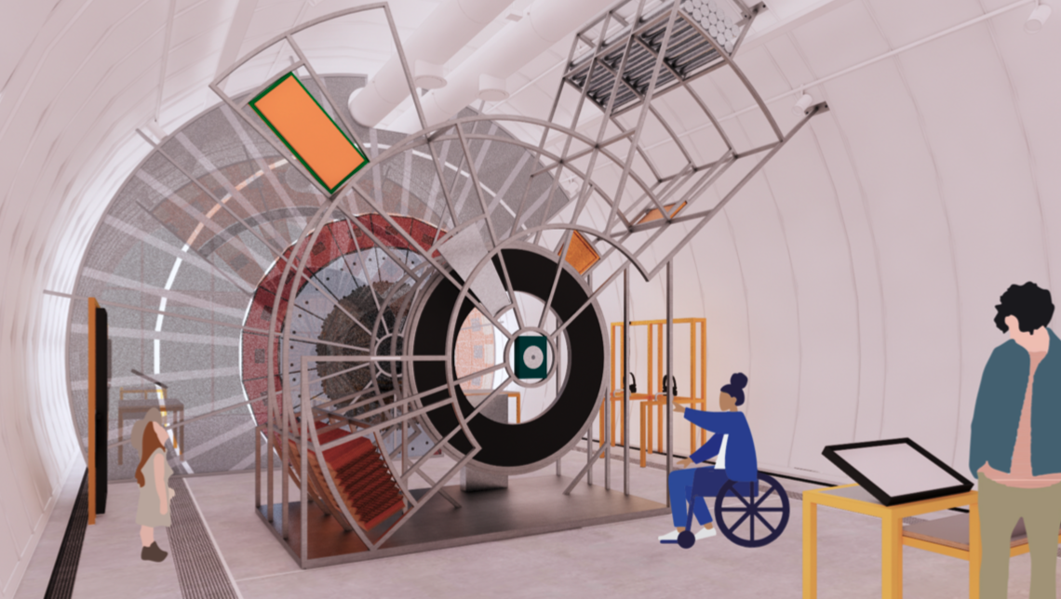
Collide

Slide 8
Tube 2: Our Universe
Our Universe

Slide 9
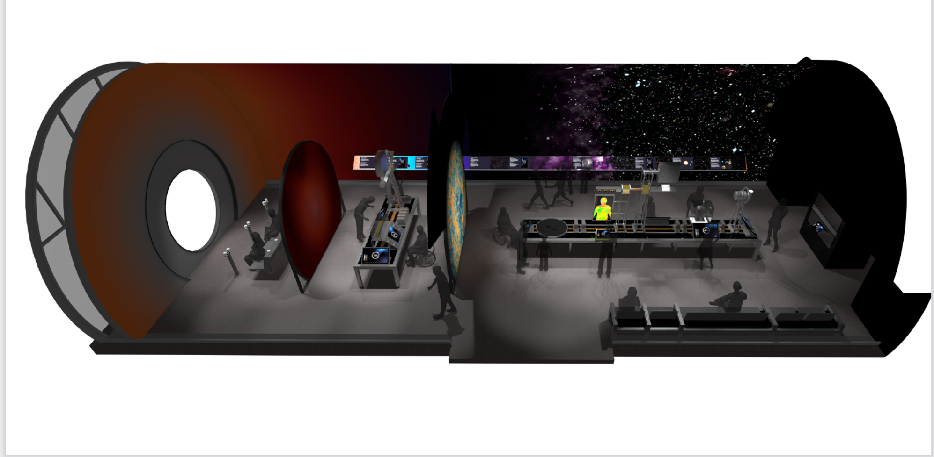
History of the Universe
White circle on the left is a film screen

Slide 10
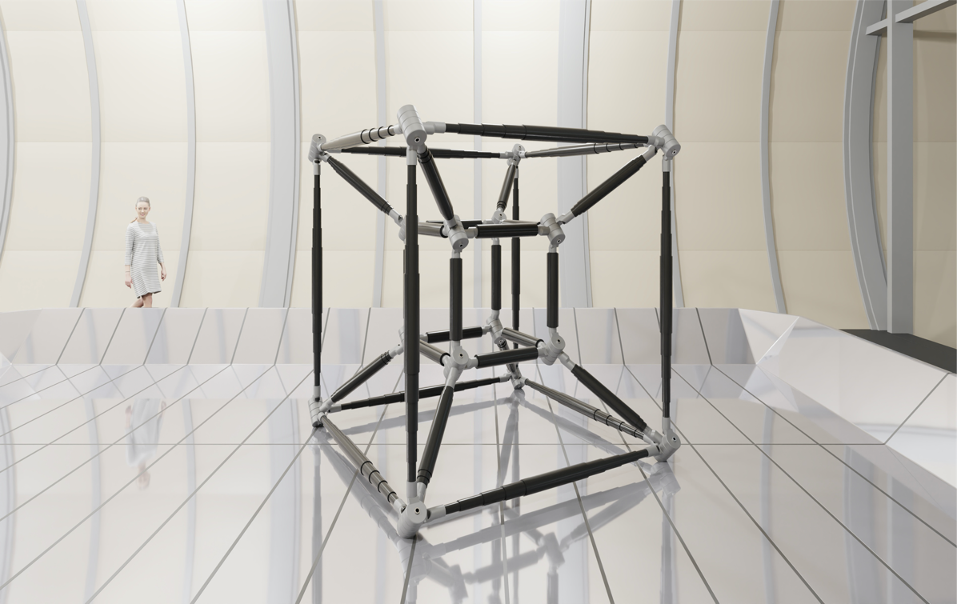
Exploring the Unknown
Artworks as an entry point to the big open mysteries in physics
Exhibition Themes: Space & Time, the Void and the Invisible.
New commissions from Rosa Barba, Julius von Bismarck, Chloé Delarue & Ryoji Ikeda, in collaboration with Arts at CERN.
Residencies in 2021 for artists to exchange on the scientific topics of the exhibition with theorists.
Main Art Commission: Round About 4 Dimensions / Julius von Bismarck

Slide 11
Pavillion 3: Quantum World
Quantum World

Slide 12
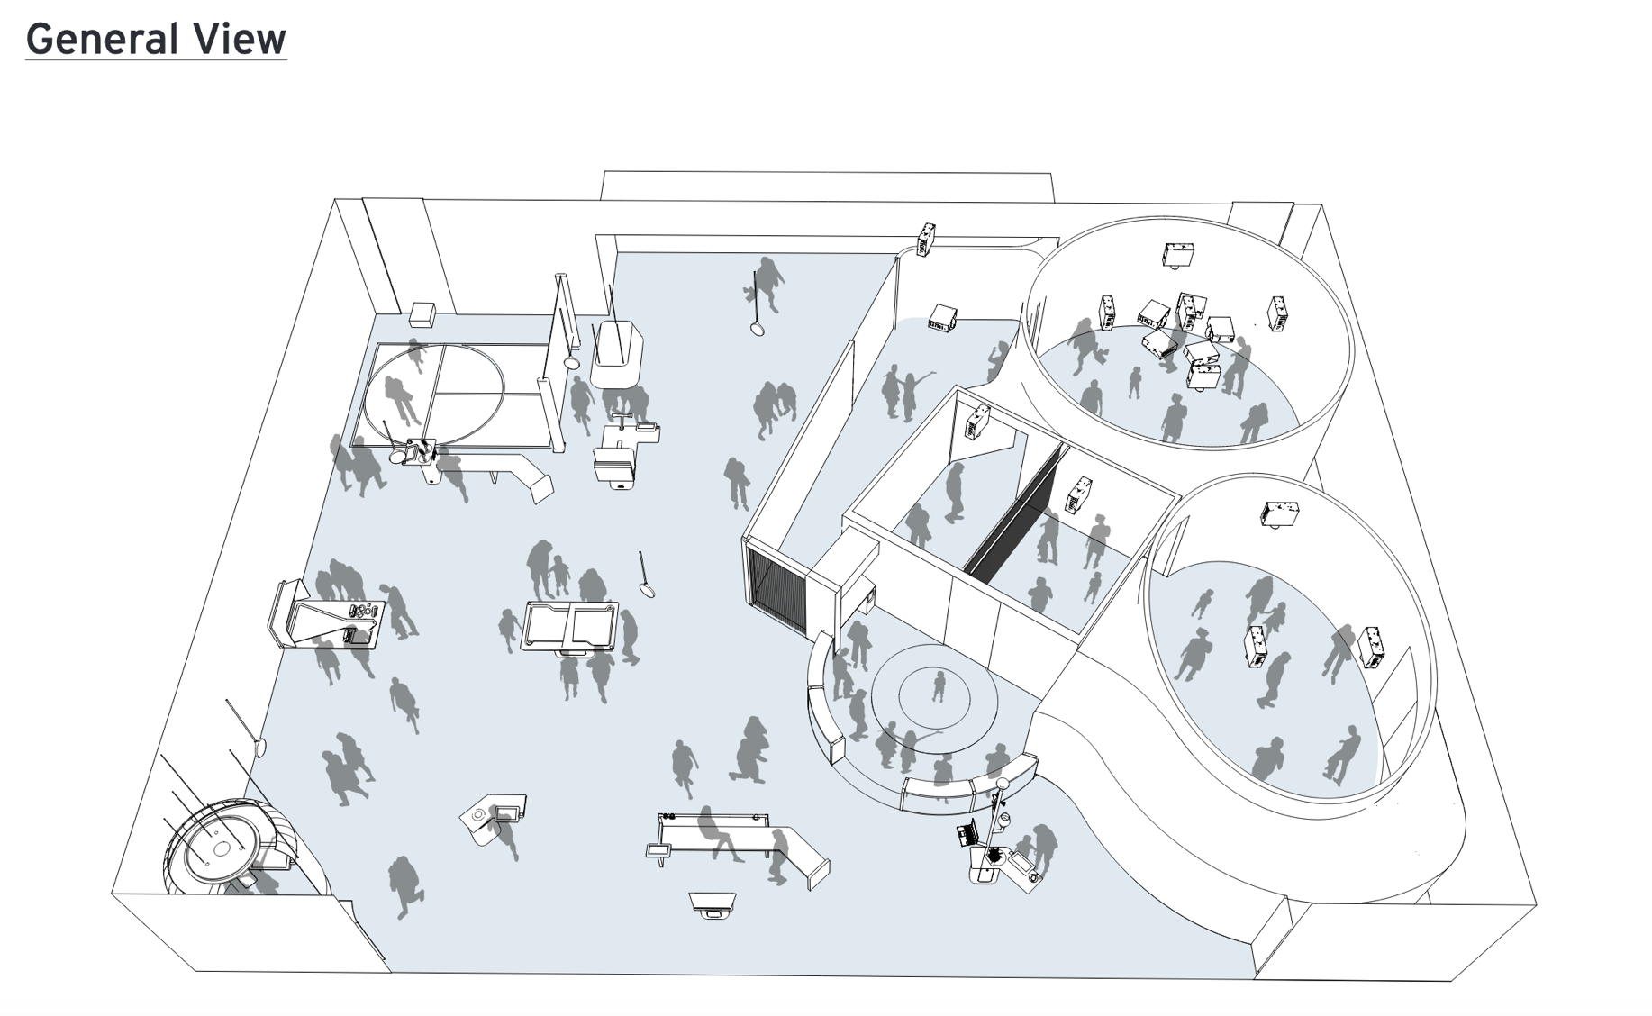
Arrival from
bridge
window

Slide 13
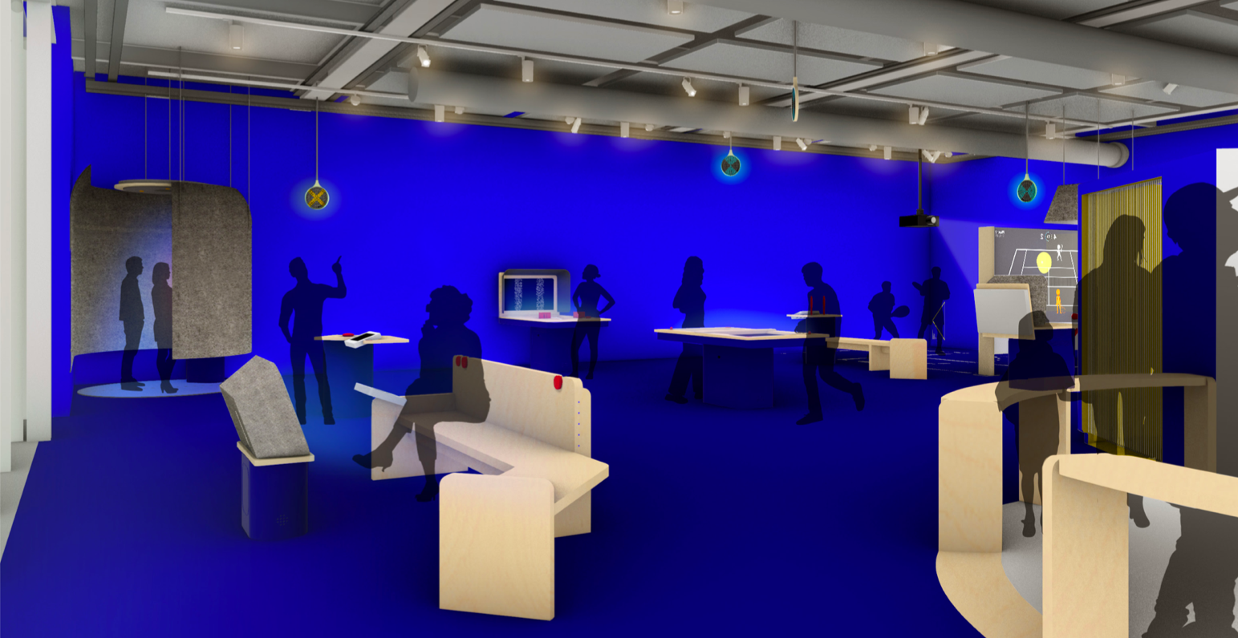

Slide 14
Science Gateway Education

Slide 15
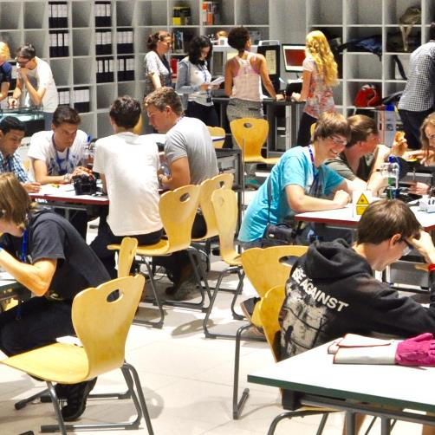
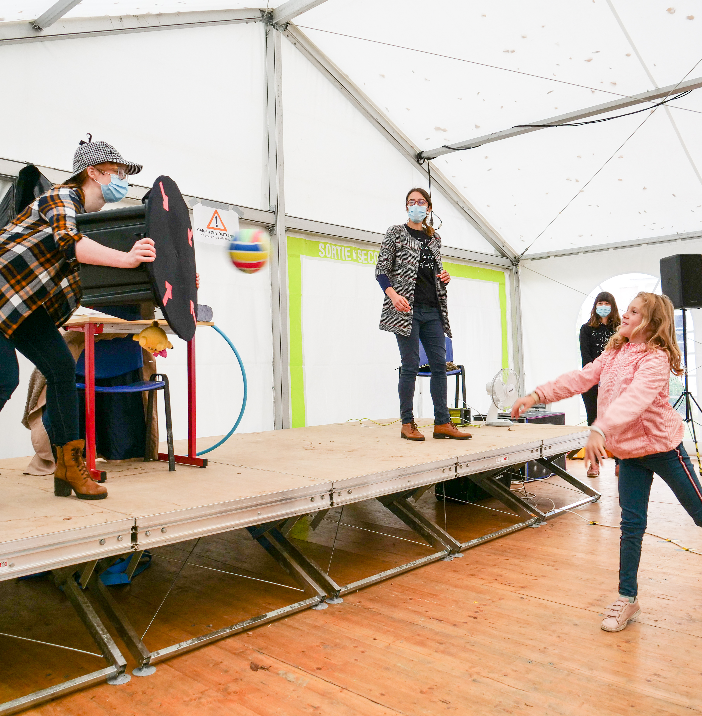
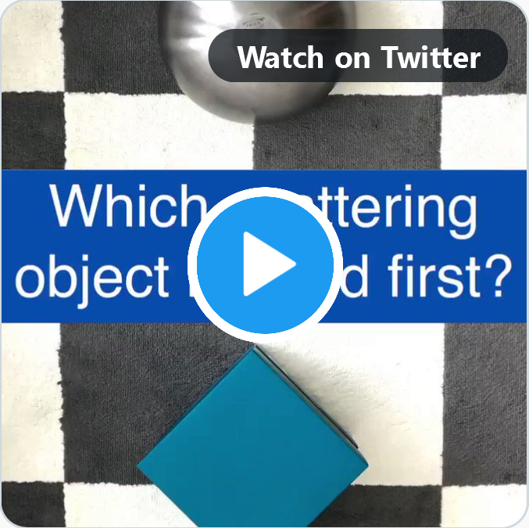
Science Gateway Education Activities
Labs
Discover your inner scientist
Science Shows
Explore the stories of discoveries
Online Learning
Engage online to find out more
sciencegateway.education@cern.ch
Notes:
Science Gateway will offer different education activities – each with a unique education potential:

Slide 16
Science Gateway Education
Labs
Discover your inner scientist
Science Shows
Explore the stories of discoveries
Online Learning
Engage online to find out more
45-90 min workshops in different languages & tailored to age groups
Focus on independent hands-on experimentation and teamwork
Two lab spaces for each
24 participants
sciencegateway.education@cern.ch
Notes:
Labs
Discover your inner scientist
The hands-on labs at Science Gateway will allow participants to explore their scientific curiosity and learn how to conduct scientific investigations. Through enquiry-based learning activities, they will be able to engage with members of CERN's scientific community and explore the science, the discoveries and the technologies at CERN.

Slide 17
Science Gateway Education
Labs
Discover your inner scientist
Science Shows
Explore the stories of discoveries
Online Learning
Engage online to find out more
45-90 min workshops in different languages & tailored to age groups
Focus on independent hands-on experimentation and teamwork
Two lab spaces for each
24 participants
30-45 min shows tailored to an international audience and different age groups
Focus on surprising demonstrations and interactive storytelling
Auditorium for 200+ people
sciencegateway.education@cern.ch
Notes:
Science shows
Explore the stories behind CERN’s discoveries
Science shows at Science Gateway will let visitors participate in the investigation of awe-inspiring experiments in a theatre-style setting. Together with members of CERN’s scientific community, they will explore the exciting stories and scientific methods behind major advances in science and technology.

Slide 18
Science Gateway Education
Labs
Discover your inner scientist
Science Shows
Explore the stories of discoveries
Online Learning
Engage online to find out more
45-90 min workshops in different languages & tailored to age groups
Focus on independent hands-on experimentation and teamwork
Two lab spaces for each
24 participants
30-45 min shows tailored to an international audience and different age groups
Focus on surprising demonstrations and interactive storytelling
Auditorium for 200+ people
Videos with quiz questions, DIY experiments, material for educators
Focus on independent learning
Material in English and French
sciencegateway.education@cern.ch
Notes:
Online Learning
Engage online to find out more
Dedicated online education activities will allow learners from around the world to actively engage with Science Gateway. The material will include easy do-it-yourself experiments and explainer videos inspired by the exhibits, experiments and demonstrations at Science Gateway.

Slide 19
Topics
Detectors & sensors: making the invisible visible
Accelerators & magnets: manipulating particles
Information Technology: creating a unique computing infrastructure
Engineering: making the impossible possible
Theory: rationalising, predicting and explaining phenomena
Data reconstruction & analysis: making sense of observations
Technology: manipulating robots, vacuum and cryogenics
Applications: bringing CERN’s technologies into our everyday life
Scientific methods, models and nature of science: doing science
STEM careers: exploring STEM occupations and workplaces

Slide 20
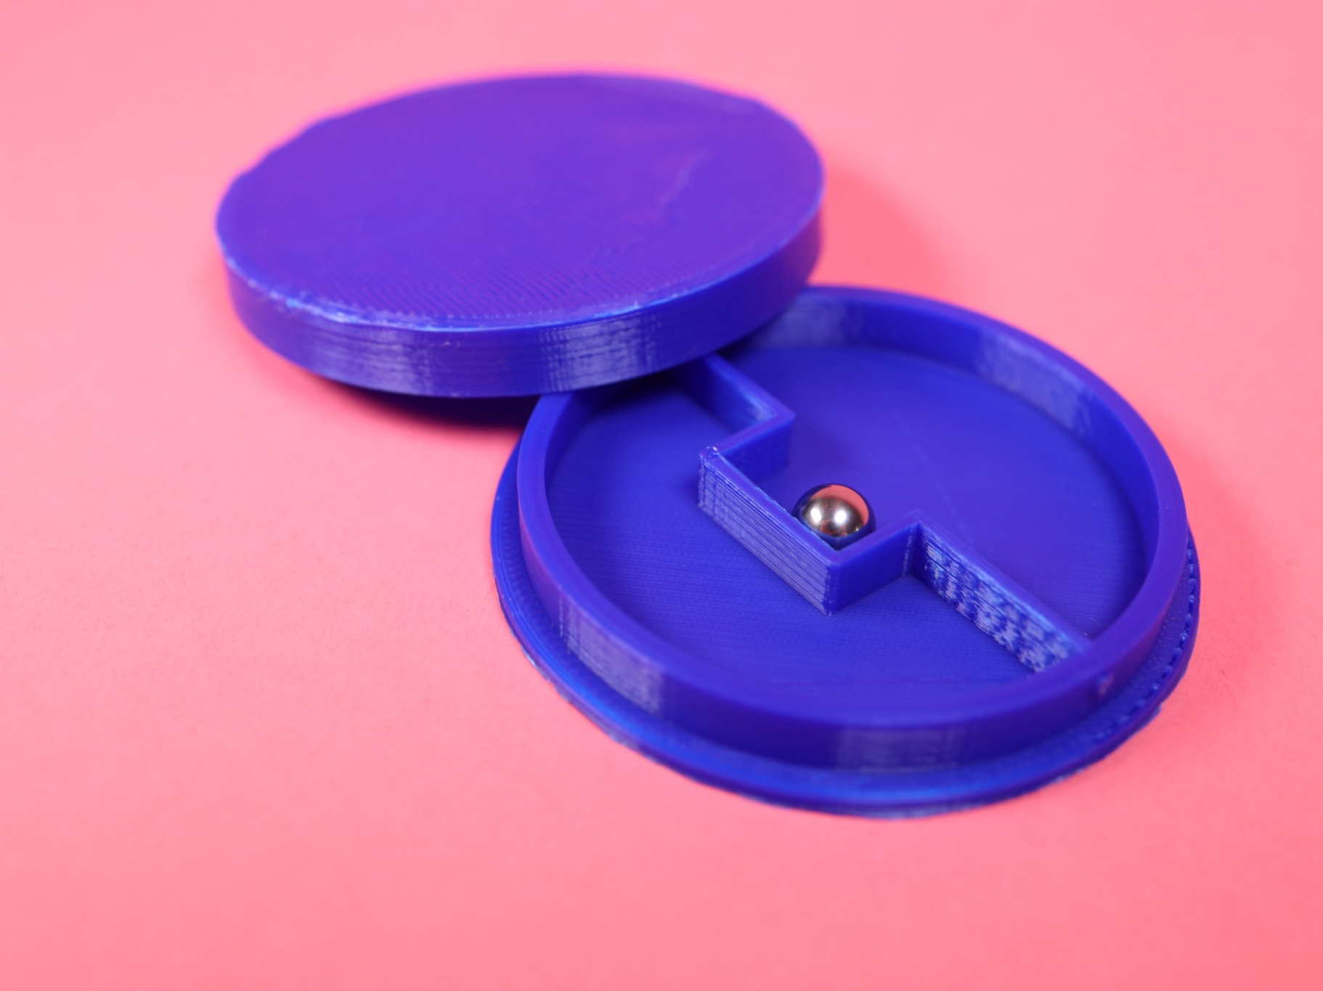
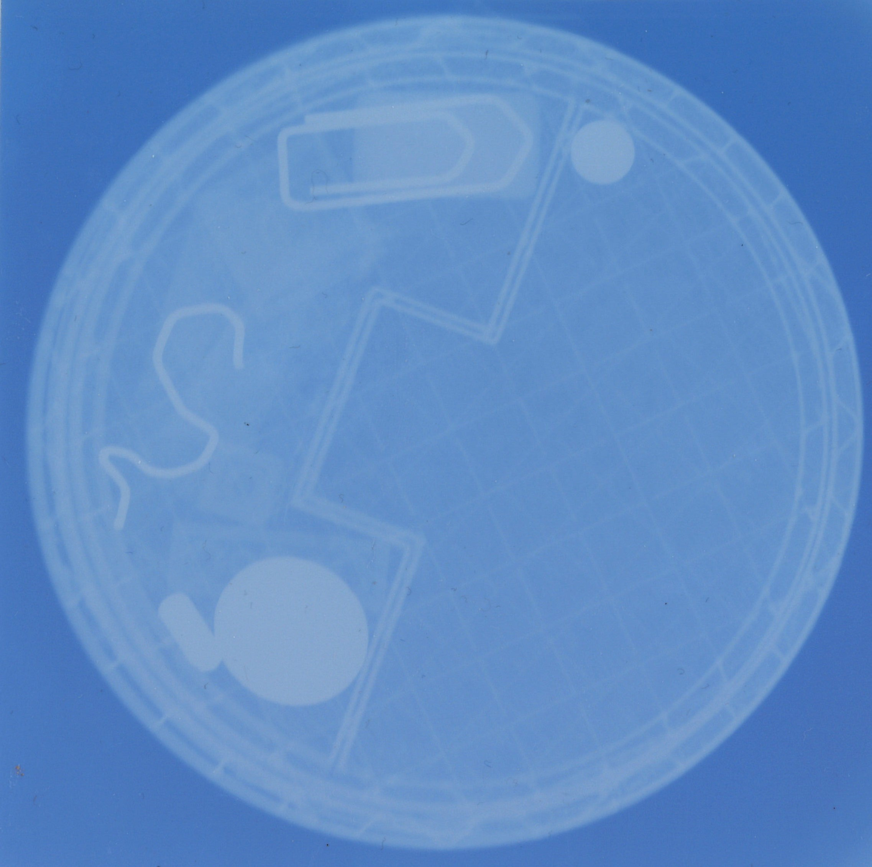
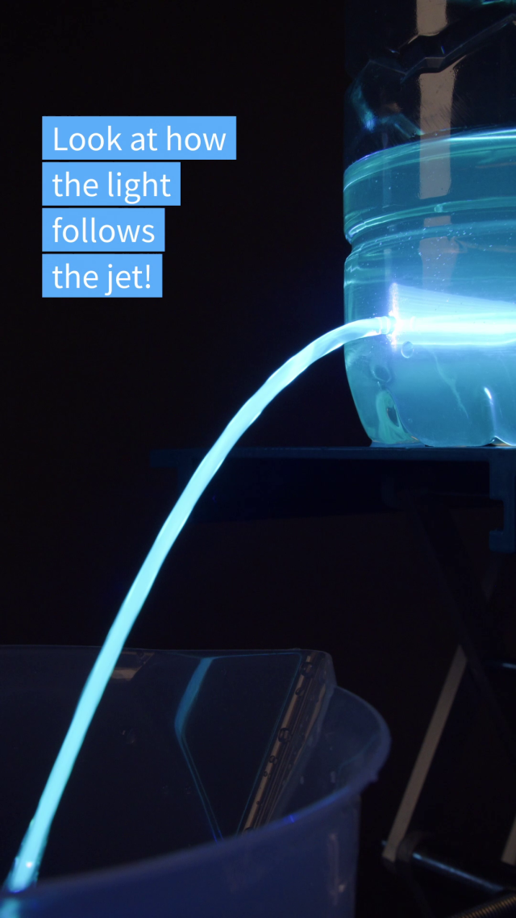
Examples of content development
?
A new workshop about „seeing the invisible“ teaching Nature of Science aspects using new types of mystery boxes, IR cameras, X-ray images
A new science show about data & data analysis including concepts such as big data, triggering, statistics
Short videos for social media linking DIY experiments with CERN technologies in the framework of CERN‘s Solvay Education Programme
Notes:
Hands-on workshop about seeing the inisible will explore new types of mystery boxes, X-ray machines, and IR cameras
Science will include e.g. a LEGO vaccum to demonstrate principles of filtering data / triggering
Ballon hovercraft shows similar principle than CMS detector gliding on air cushions
Liquid light guide (= jet of water leaving a bottle, highlighter dye makes blue laser beam visible, similarilty to scintillators e.g. at ATLAS tile calorimeter
Idea to use these experiments together with online education content to prepare or follow up on visits to Science gateway

Slide 21
Science Gateway Events

Slide 22
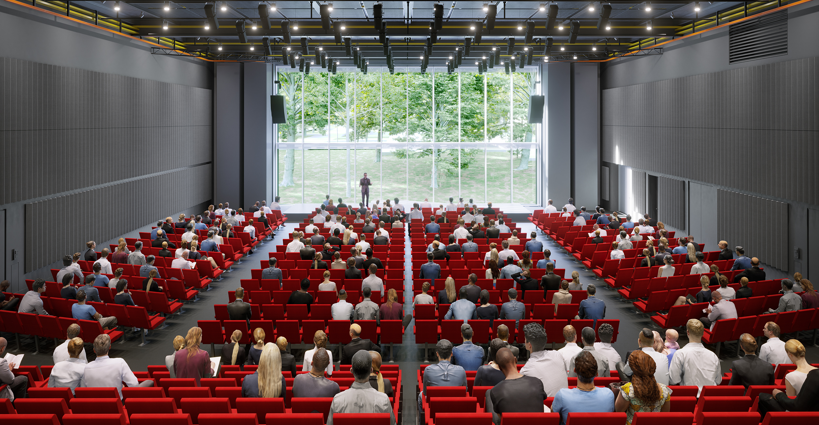
Auditorium
your.event@cern.ch

Slide 23
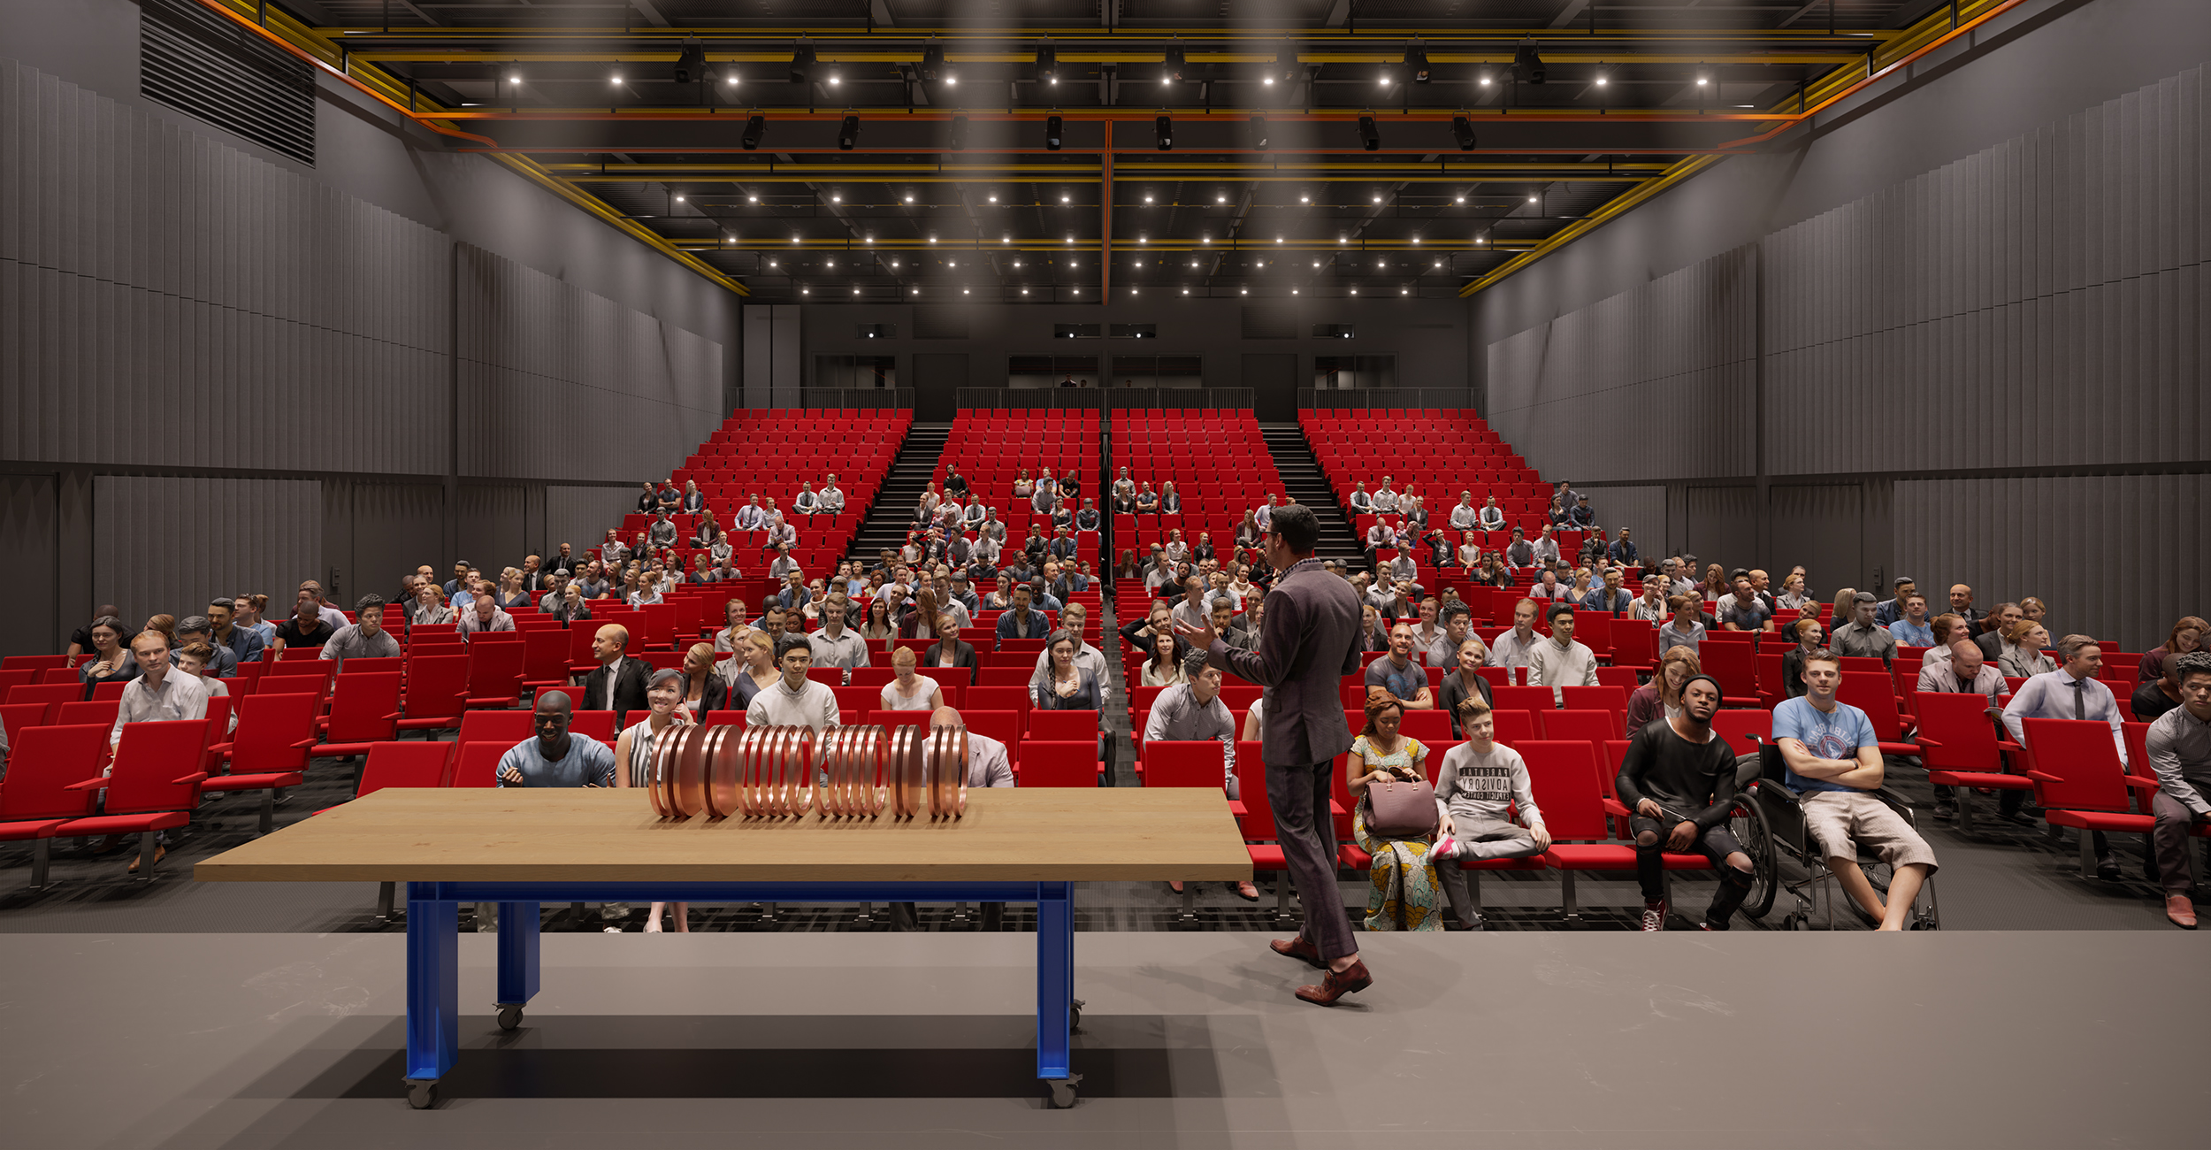
Auditorium
your.event@cern.ch

Slide 24
Auditorium
your.event@cern.ch

Slide 25
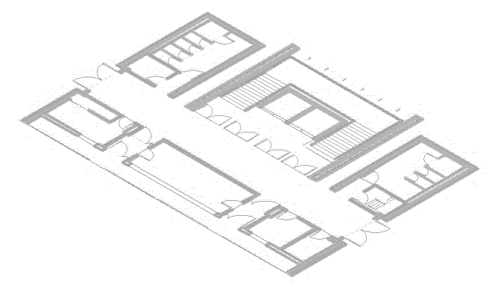
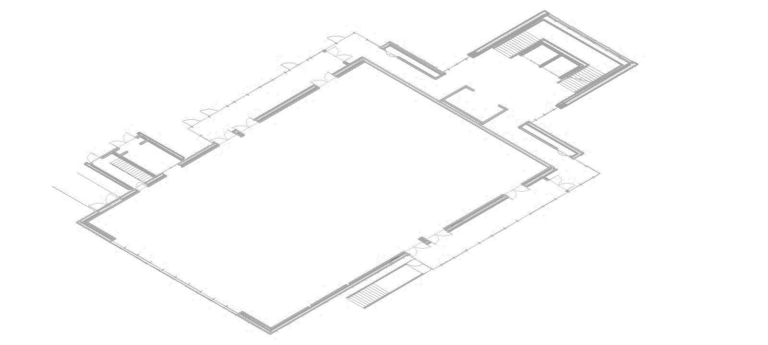
As one auditorium (900 seats)
bridge to other pavilions
your.event@cern.ch

Slide 26
As two auditoriums (450 + 364 seats)
movable panels
bridge to other pavilions
your.event@cern.ch

Slide 27
As three auditoriums (450 + 198 + 198 seats)
movable panels
bridge to other pavilions
your.event@cern.ch

Slide 28
As one 717 m² flat space
stored seating
bridge to other pavilions
your.event@cern.ch

Slide 29
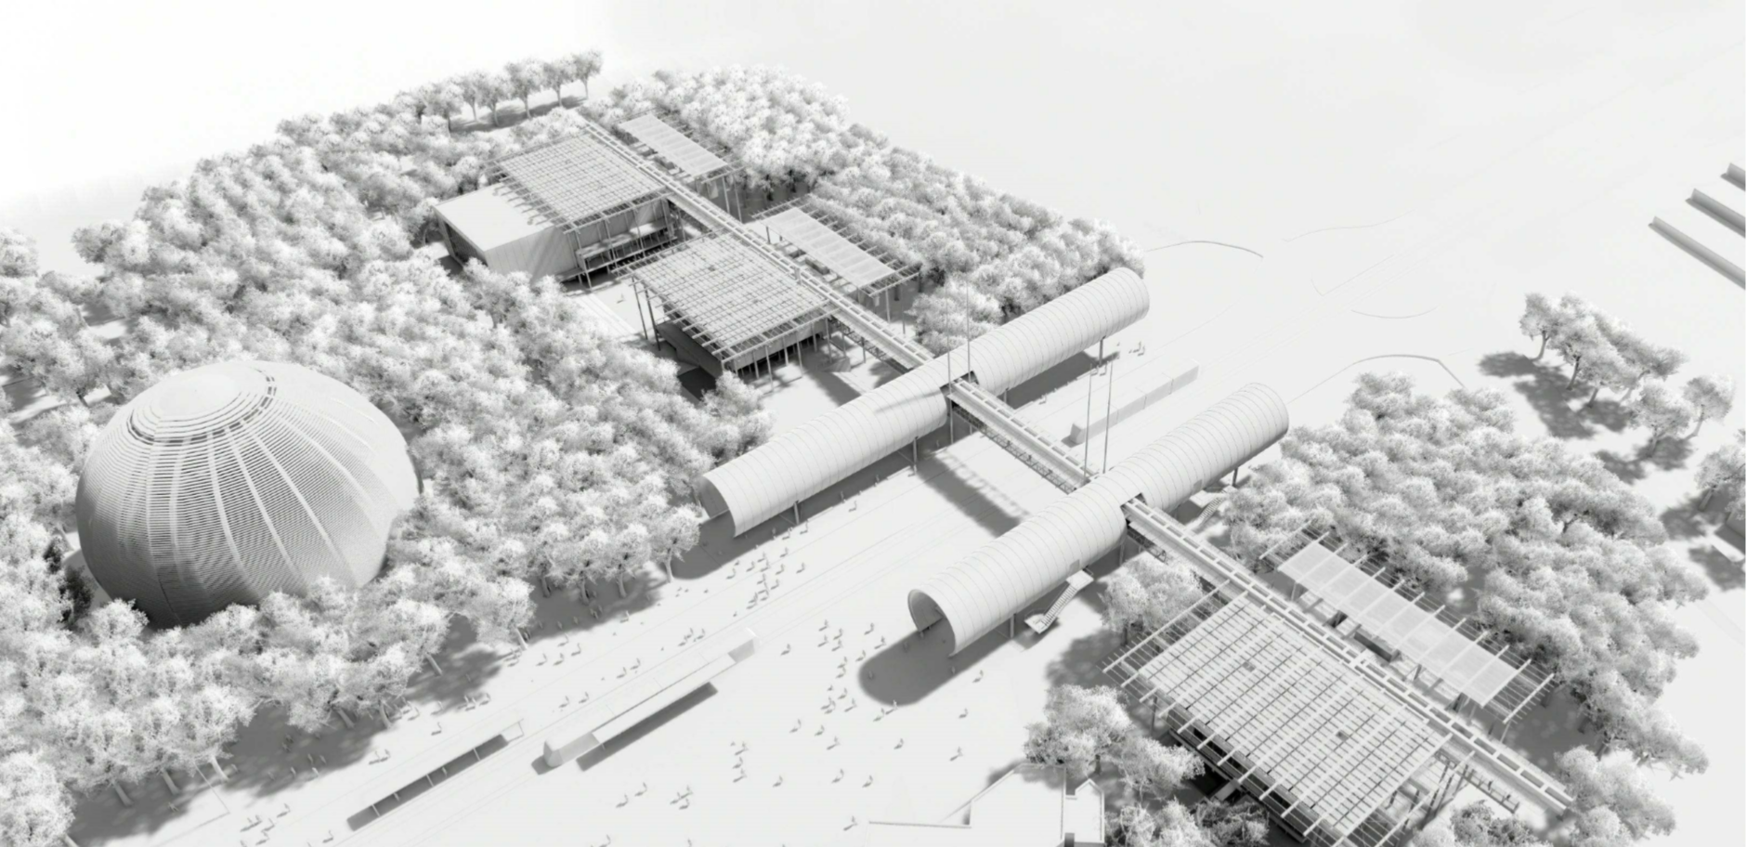
Globe of Science and Innovation
The Globe of Science and Innovation will continue to host events at first floor but will also offer a multifunction space at ground floor (currently used by Universe of Particles exhibition that will be dismantled after Science Gateway opening).
your.event@cern.ch

Slide 30
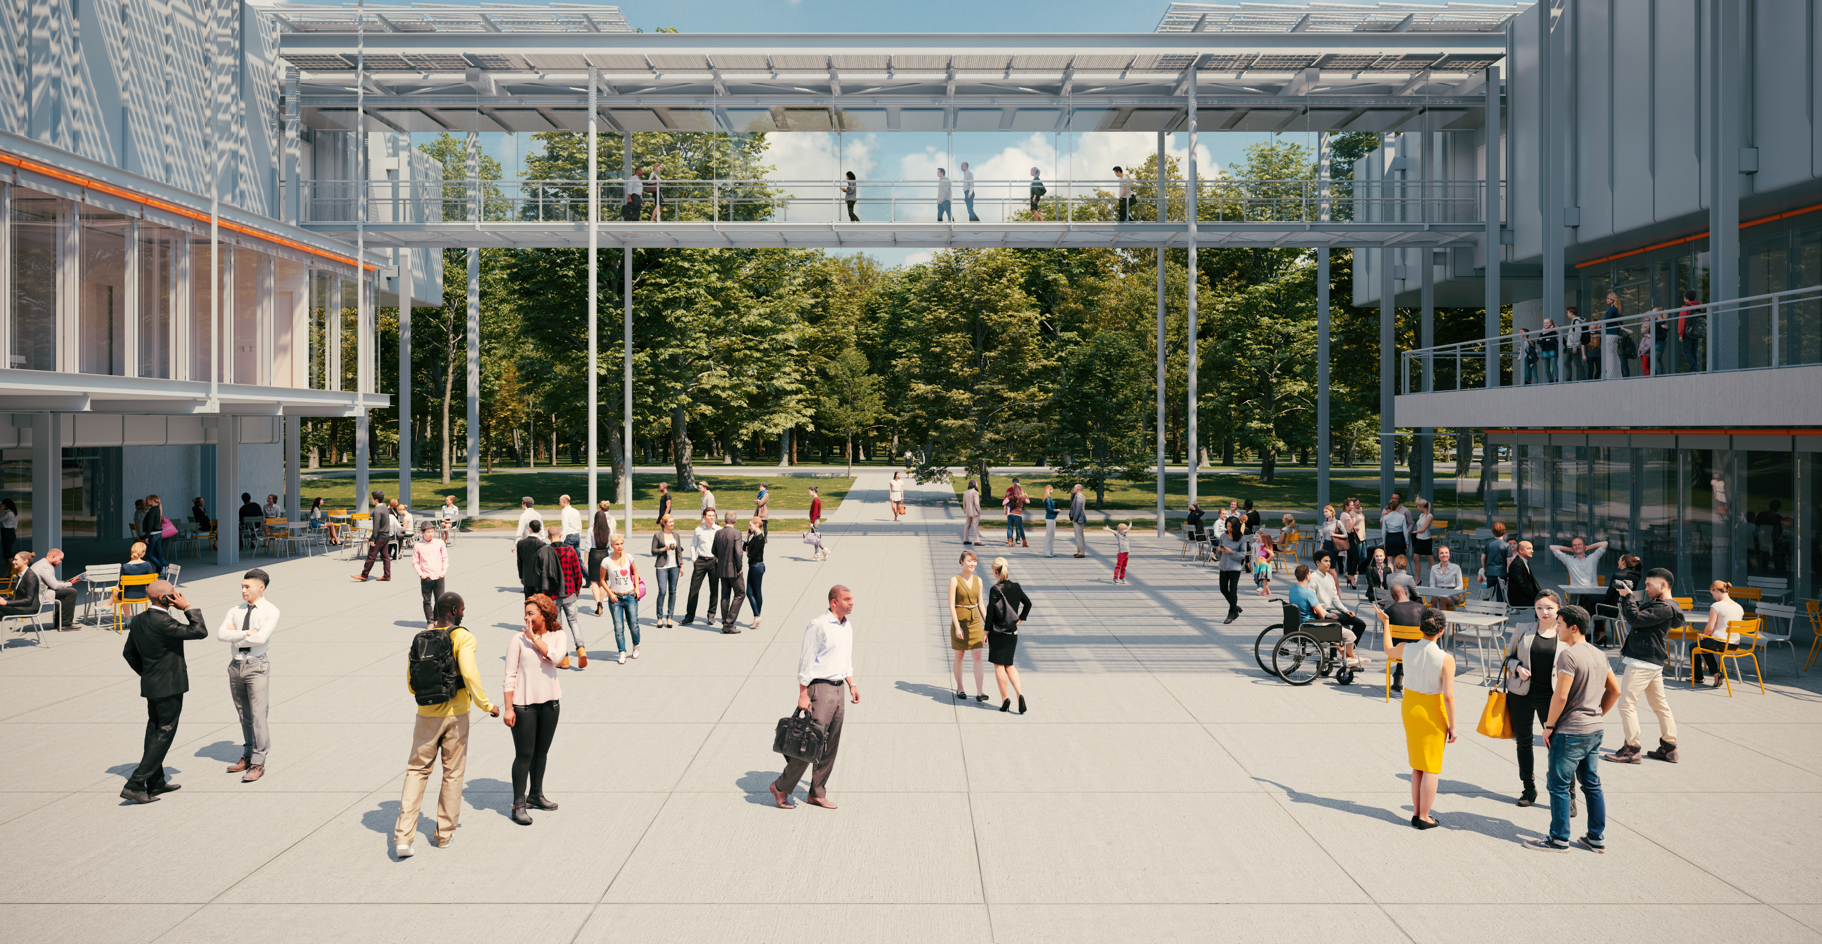
The piazza
The piazza is an outdoor space with natural seating (from Globe car park) that can host public events depending on the weather
your.event@cern.ch

Slide 31
Ideasquare in the Science Gateway Campus

Slide 32
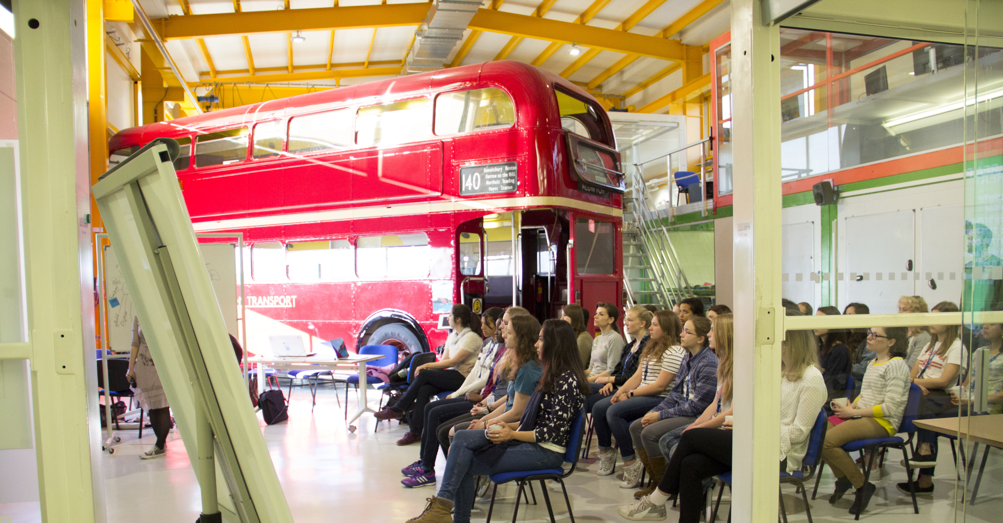
Spaces
Cross use of various spaces of Science Gateway, Globe and Ideasquare for events organised from Science Gateway and Ideasquare

Slide 33
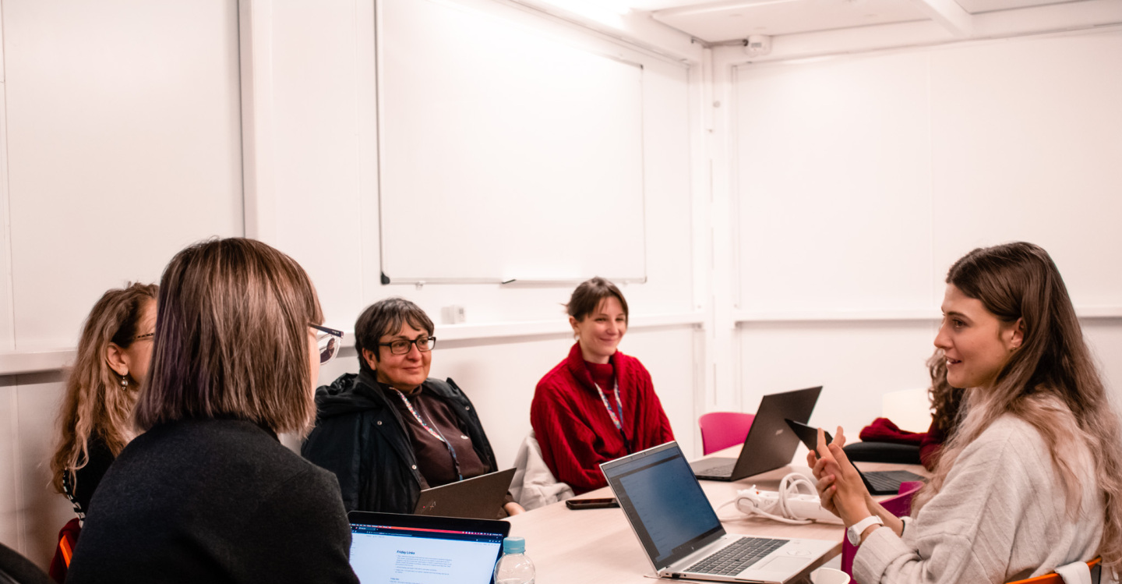
Workshops

Slide 34
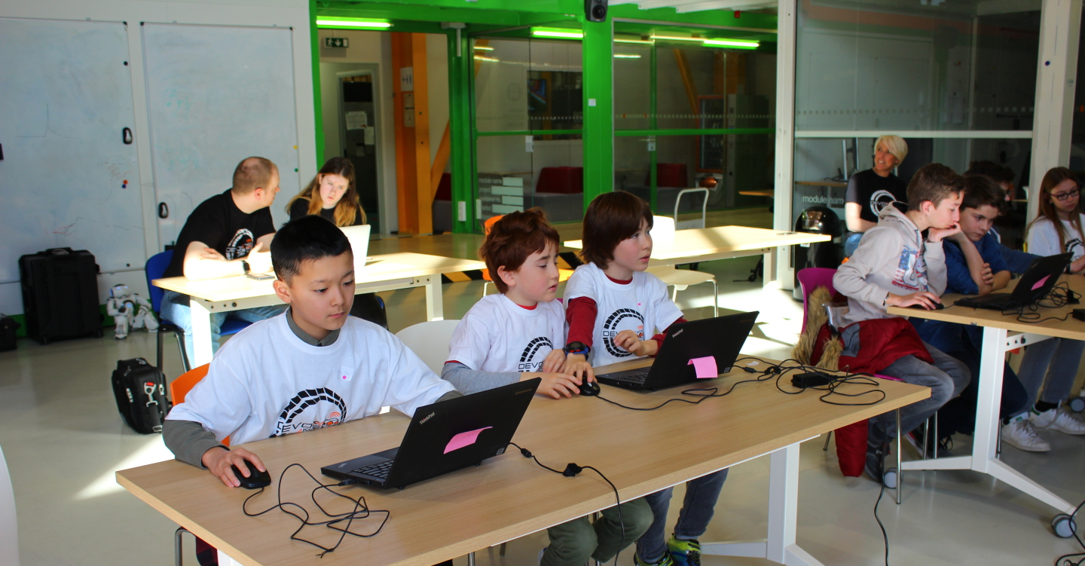
Events
Continue to use Ideasquare for specific events such as workshops, trainings, etc.

Slide 35
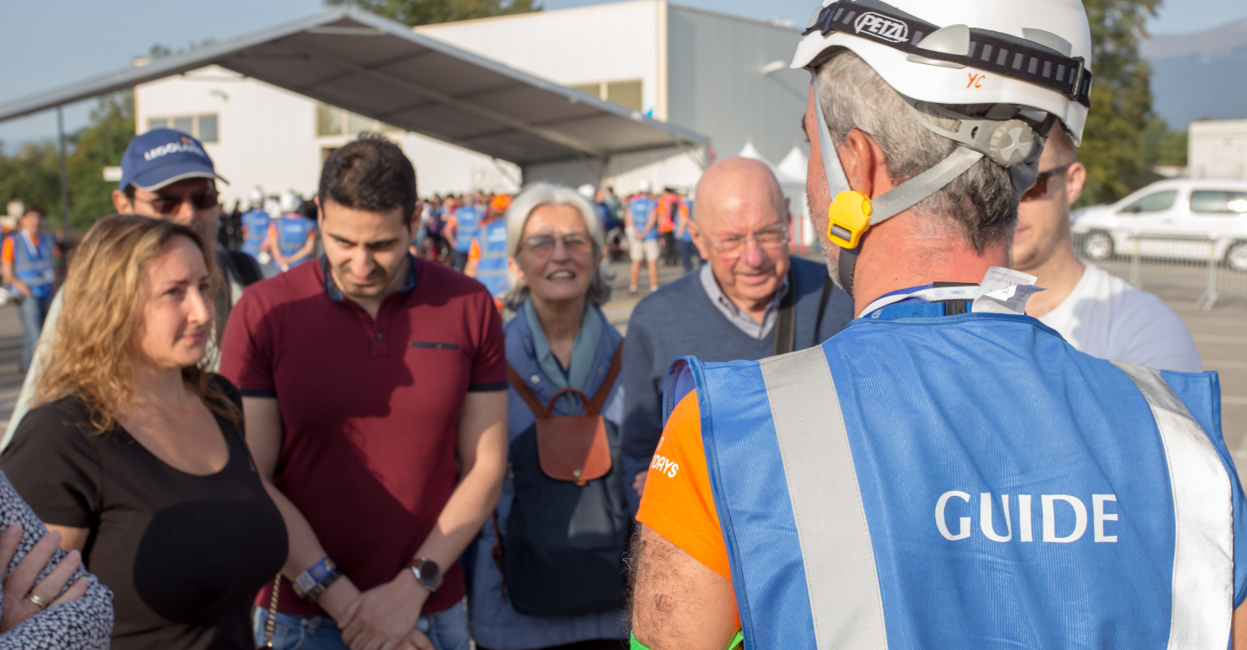
Guided tours
Developement of a Science Gateway Campus guided tour with a focus on buildings and Ideasquare offer

