Slide 1
IdeaSquare
Open Doors
15 and 16 February

Slide 2
SDGInnProgress
Capture Your Innovation Process
Oday Darwich
Innovator in Residence
Oday.Darwich@cern.ch
Feb. 16, 2023

Slide 3
SDGInnnProgress
Capture Your Innovation Process
Why InnnProgress
How it works
Impact of AI on documentation
Future perspectives

Slide 4



Slide 5


Slide 6




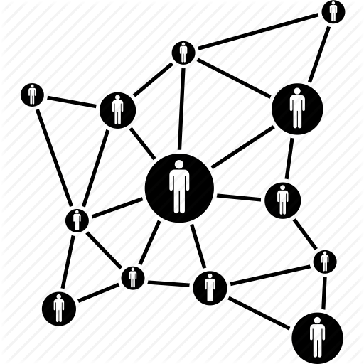

Slide 7

Notes:
In a open place, you give and you take and you have a gift at the end!

Slide 8


Slide 9

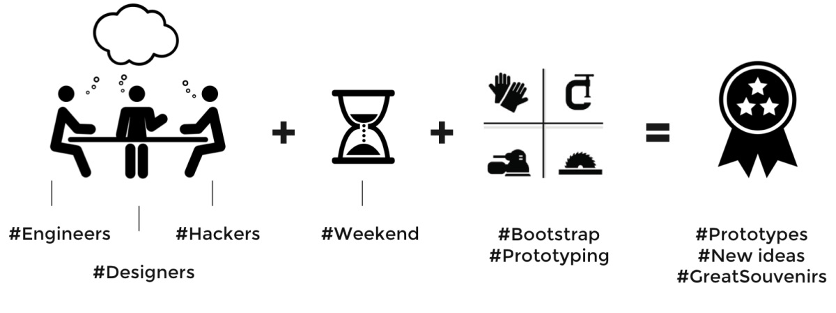

Slide 10



Slide 13
#GreatMemories

Slide 14
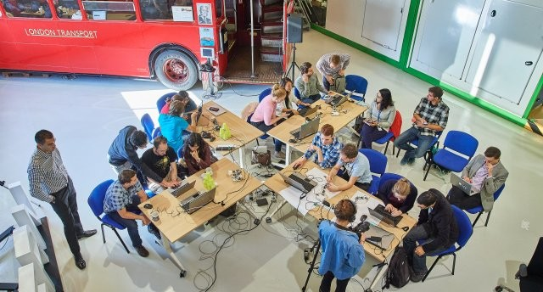








Slide 15


Slide 16
#GreatMemories

Slide 20
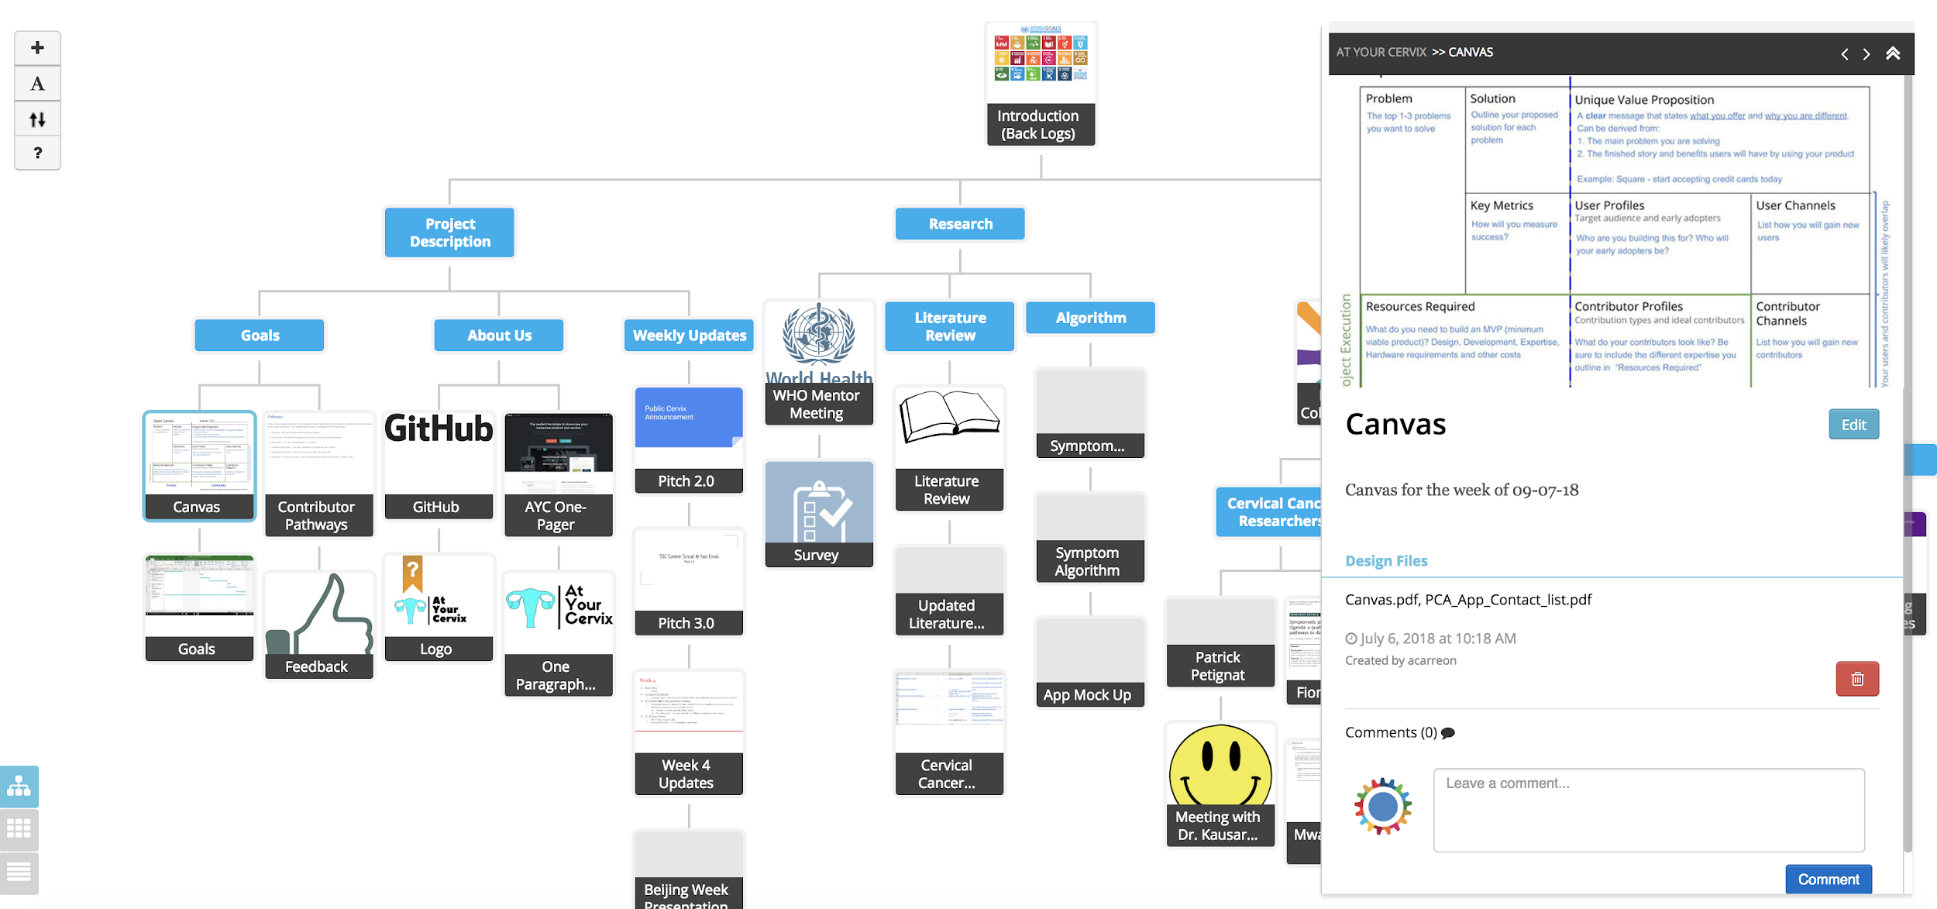
Topical documentation

Slide 21
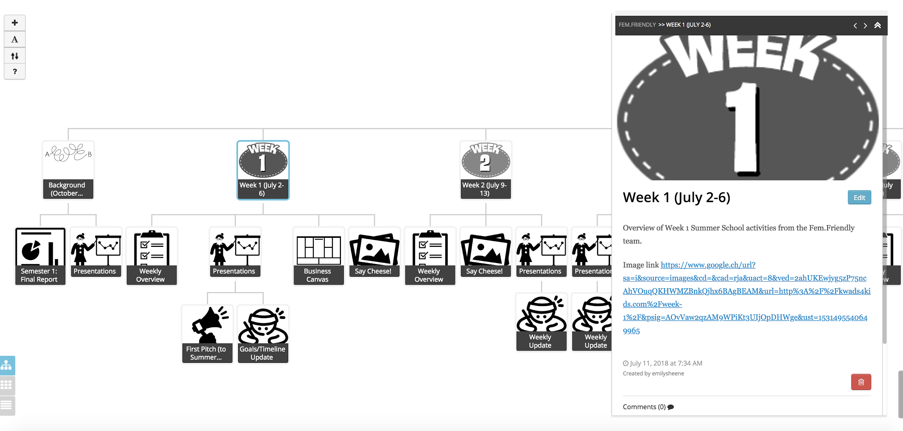
Chronological documentation

Slide 22
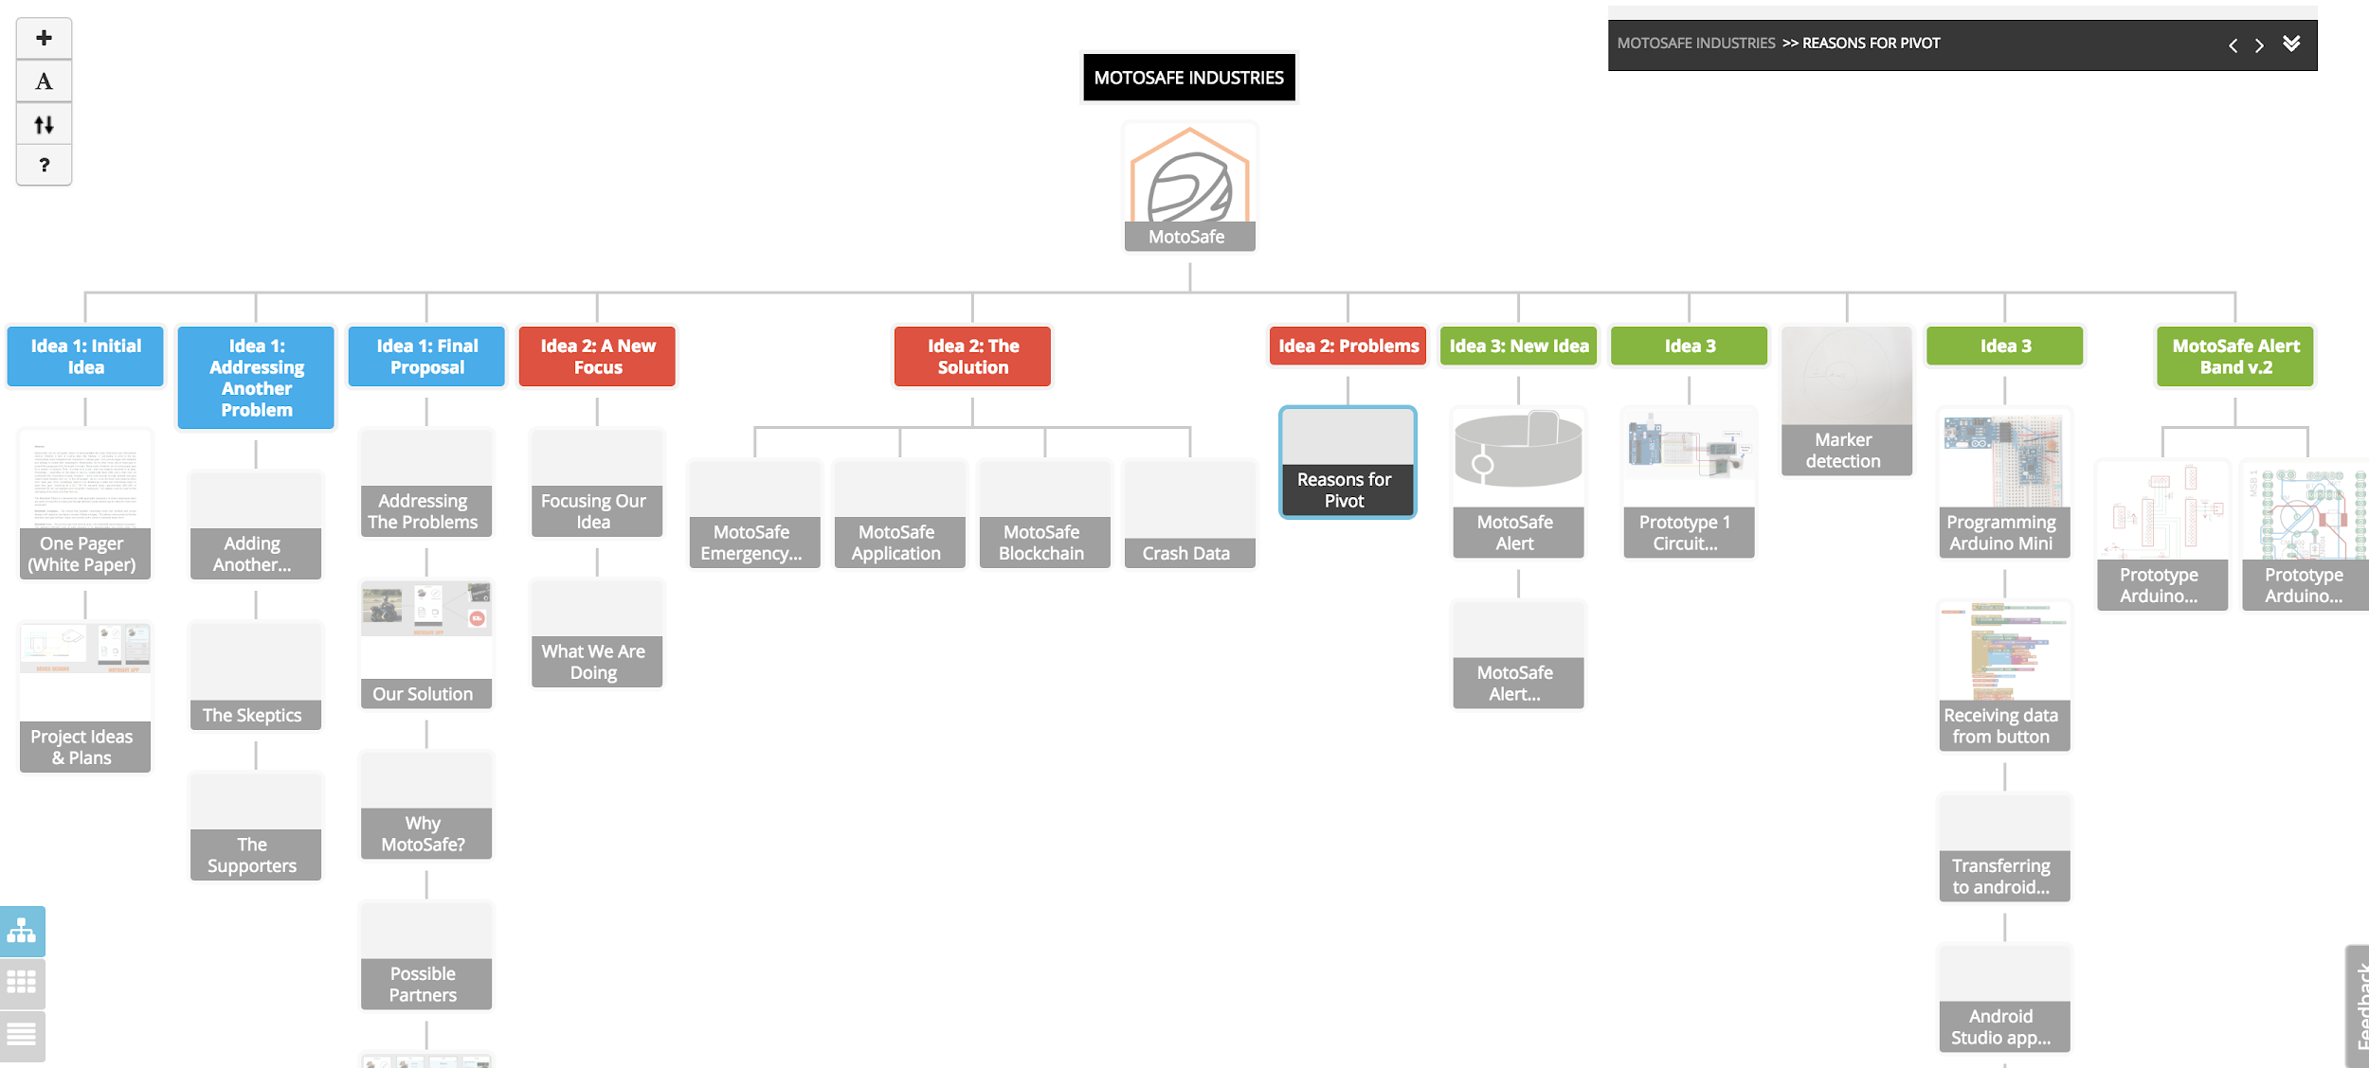
Hybrid

Slide 23
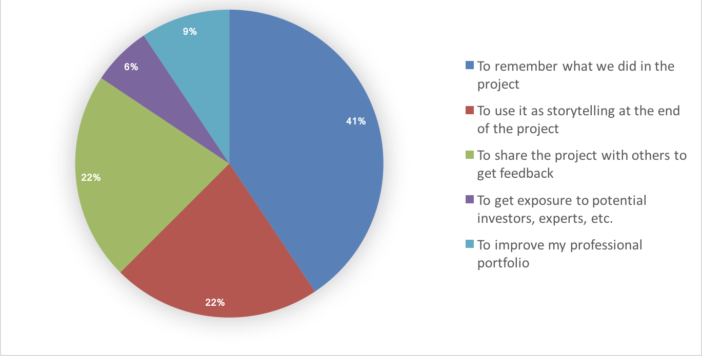
Why participants use the platform?

Slide 24
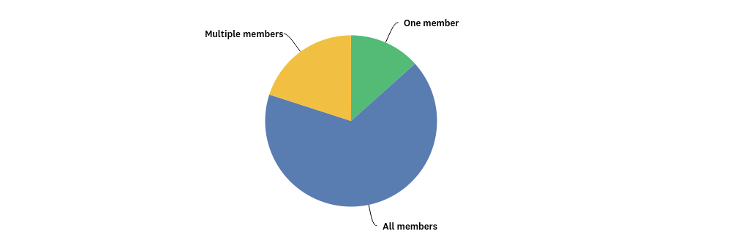

Slide 25




Who use the platform?
Students
Professors
Coordinators
Creative people

Slide 26
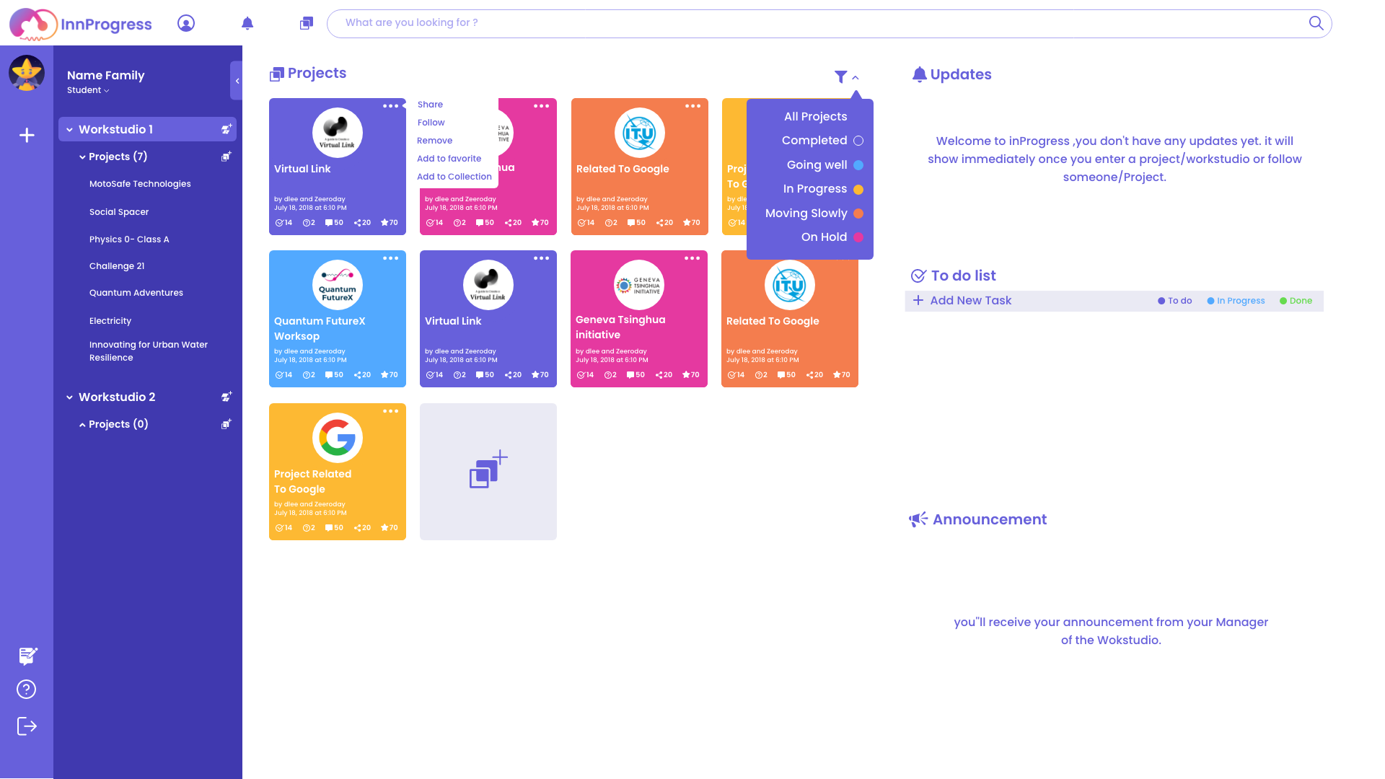

Slide 27
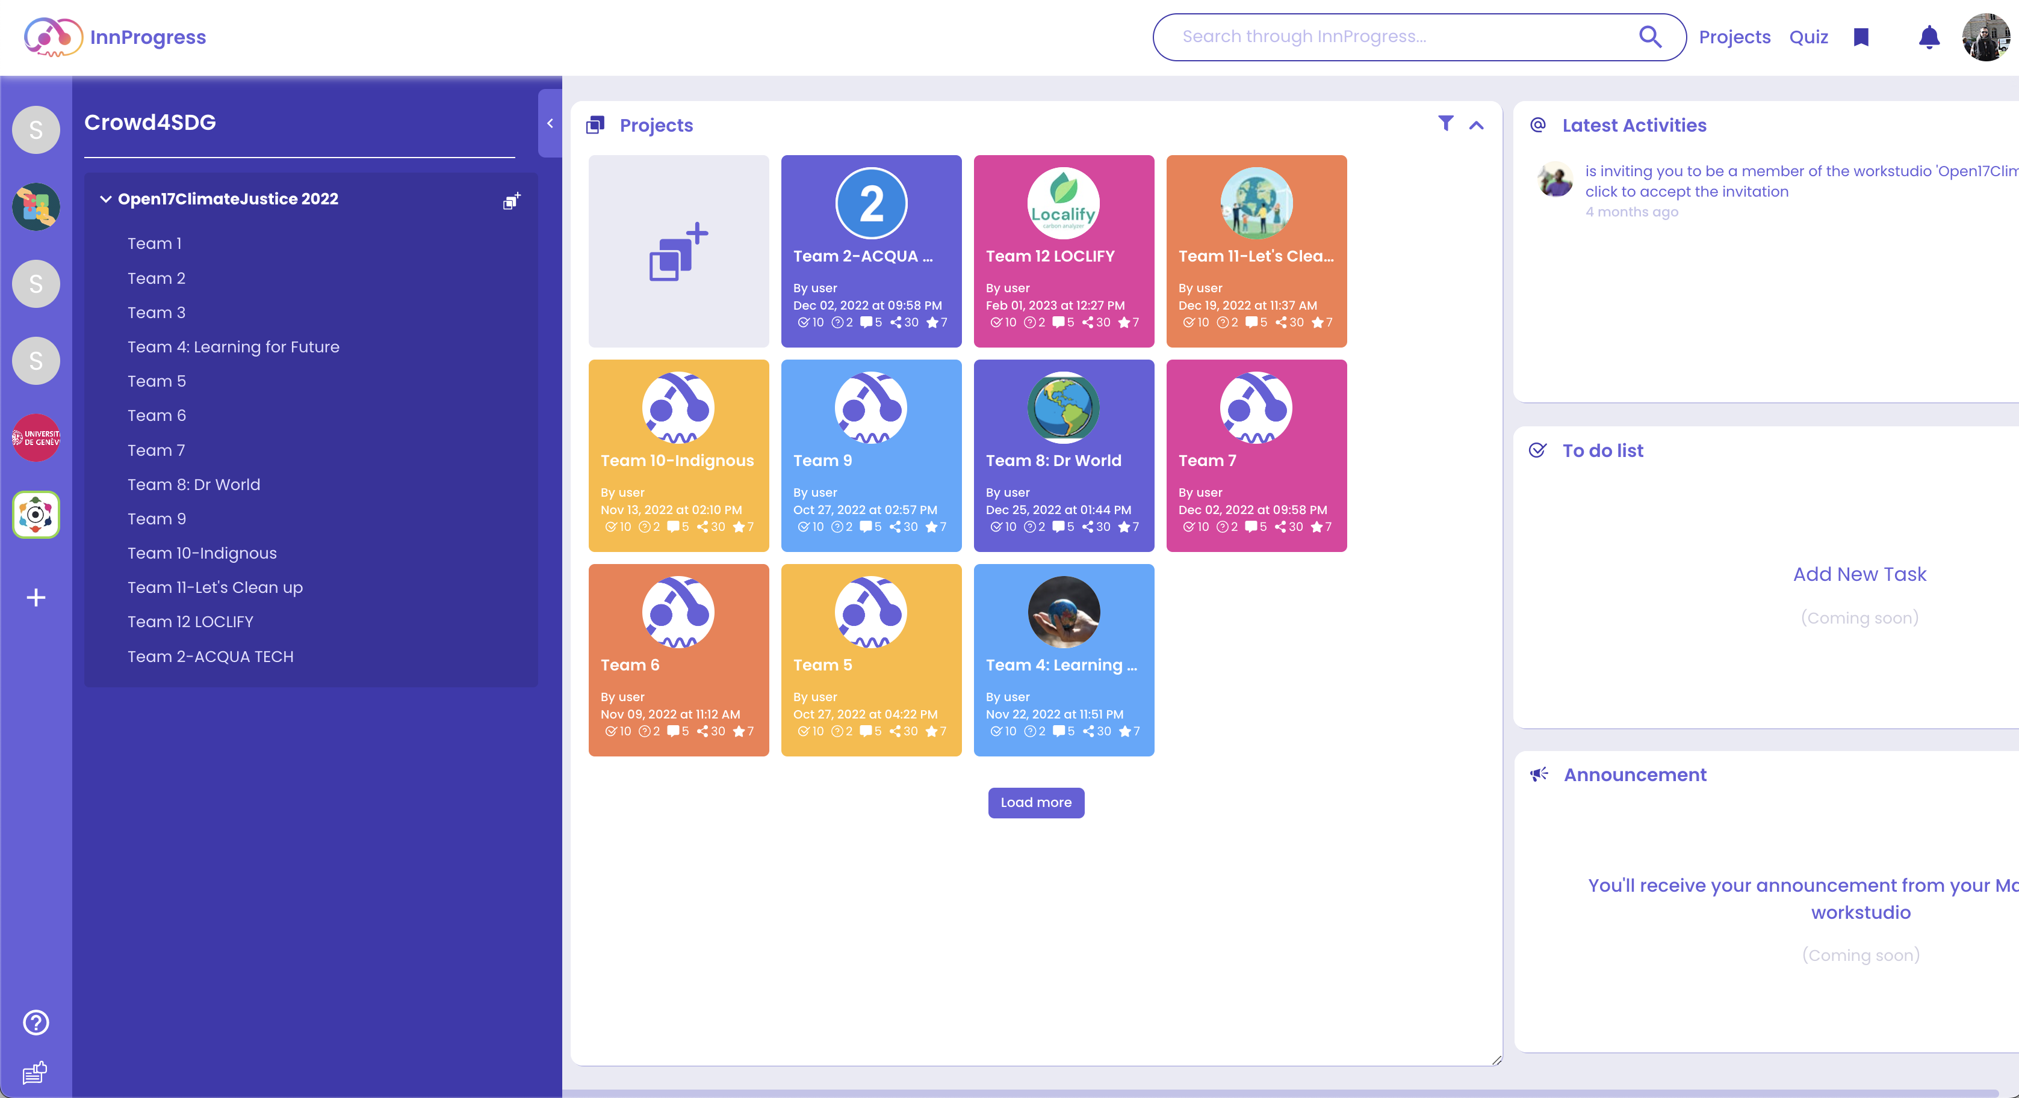
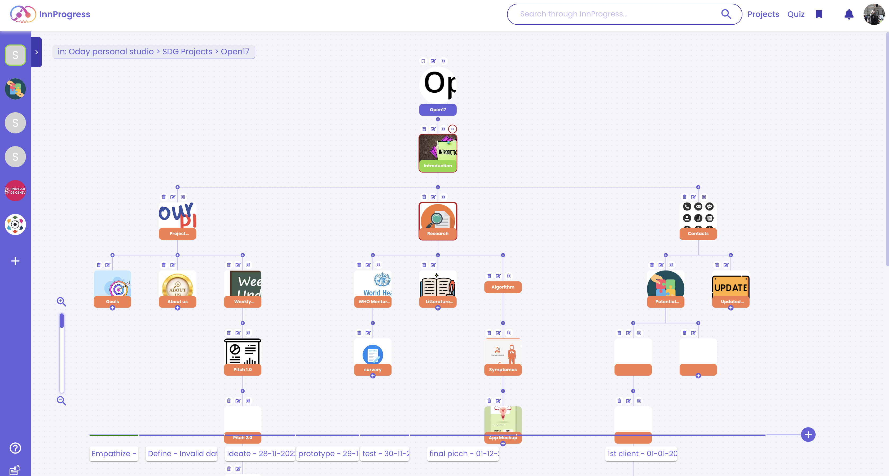

Slide 28
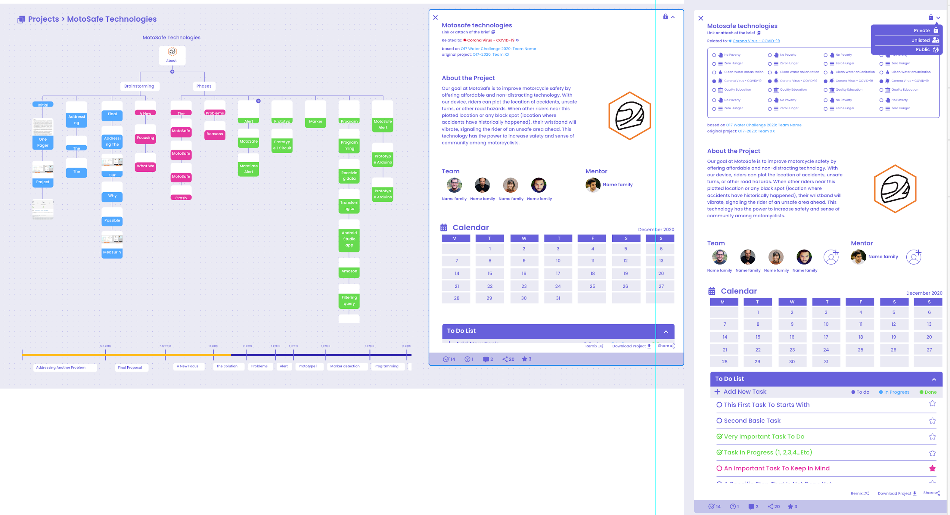
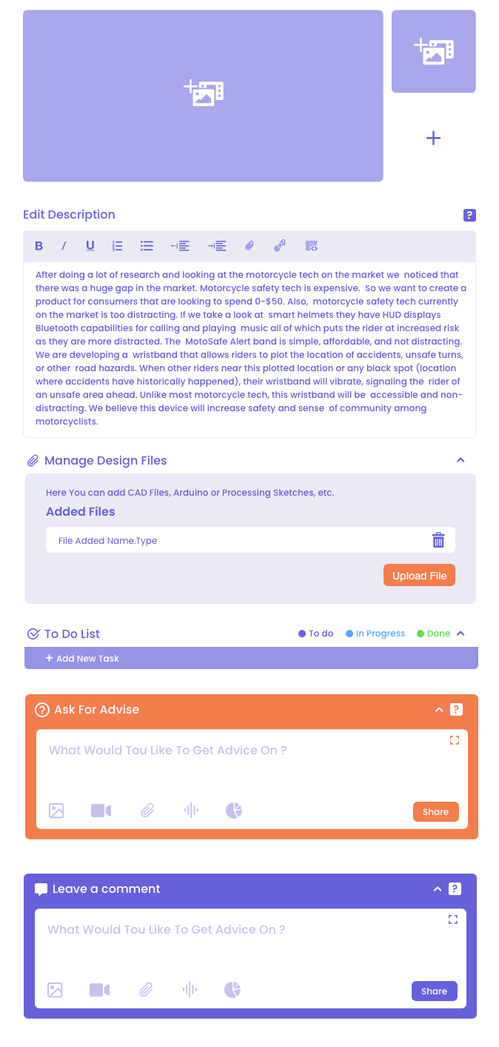


Slide 29
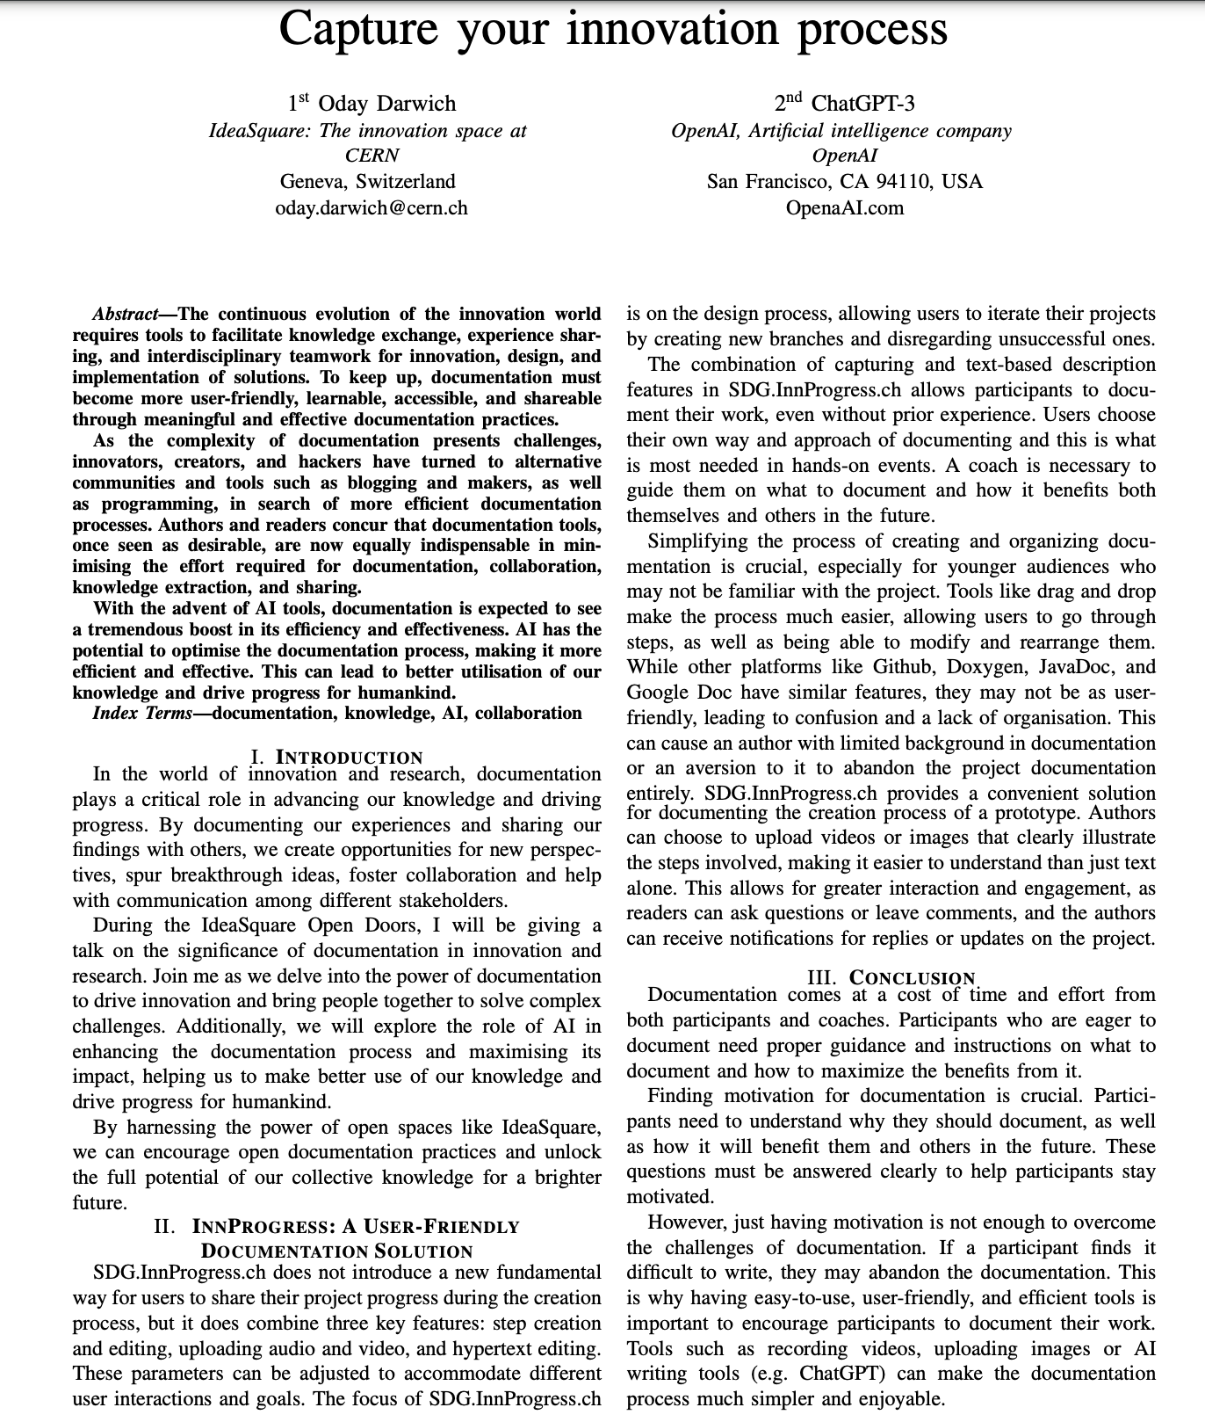

Slide 30
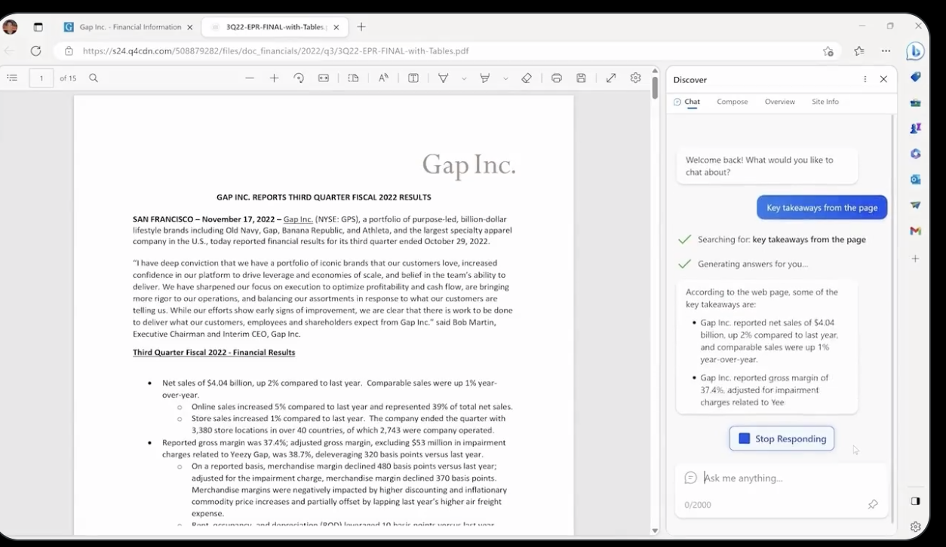
https://twitter.com/i/status/1624077152302862339
https://twitter.com/i/status/1623707730367086595

Slide 31
https://twitter.com/i/status/1624077152302862339
https://twitter.com/i/status/1623707730367086595

Slide 32
