Slide 1
European Roadmaps for Accelerator - R&D
Mike Lamont
UPHUK -8 5th September 2022
Acknowledgements: Dave Newbold, Lucio Rossi, Bernhard Auchmann

Slide 2
European Strategy for Particle Physics update 2020
… an electron-positron Higgs factory is the highest-priority next collider for the field, followed by a hadron collider at the energy frontier in the longer term
should investigate the technical and financial feasibility of a future hadron collider at CERN with a centre-of-mass energy of at least 100 TeV and with an electron-positron Higgs and electroweak factory as a possible first stage.
The timely realisation of the electron-positron International Linear Collider (ILC) in Japan would be compatible with this strategy
Two possible energy-frontier colliders have been studied for implementation at CERN, namely CLIC and FCC...
In addition to the high field magnets the accelerator R&D roadmap could contain: an international design study for a muon collider, as it represents a unique opportunity to achieve a multi-TeV energy domain beyond the reach of e+e- colliders, and potentially within a more compact circular tunnel than for a hadron collider.

Slide 3
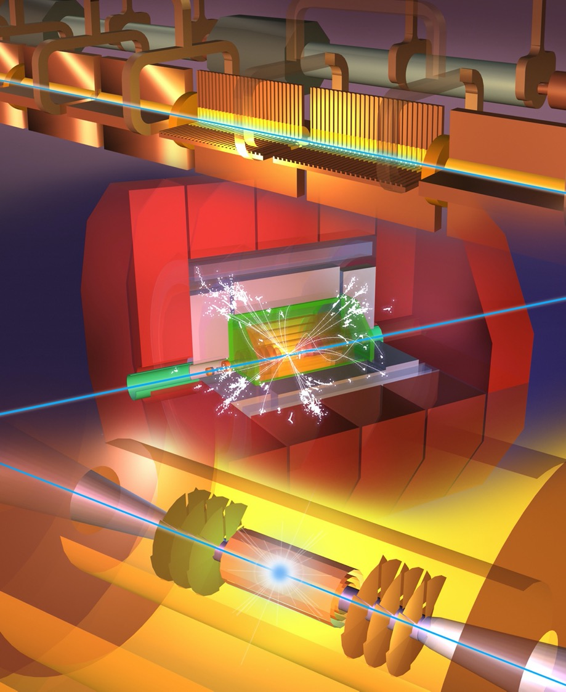
Future Collider options
Higgs factory
  Plan A1: FCC-ee
  Plan A2: ILC
  Plan B: CLIC
  Plan C: CepC, C³
Multi-TeV
  e+e- : CLIC, C³
  muons: Muon Collider
  protons: FCC-hh, SppC

Slide 4




LEGEND
CERN ExistingLHC
LHC
FCC
Muon Collider
CLIC
FCC
CLIC
Muon Collider ring
Muon Acceleration ring

Slide 5

2020 Update of the European Strategy for Particle Physics
  “The technologies under consideration include high-field magnets, high-temperature superconductors, plasma wakefield acceleration and other high-gradient accelerating structures, bright muon beams, energy recovery linacs.
  The European particle physics community must intensify accelerator R&D and sustain it with adequate resources.
  A roadmap should prioritise the technology, taking into account synergies with international partners and other communities such as photon and neutron sources, fusion energy and industry. Deliverables for this decade should be defined in a timely fashion and coordinated among CERN and national laboratories and institutes.“
http://cds.cern.ch/record/2721370

Slide 6
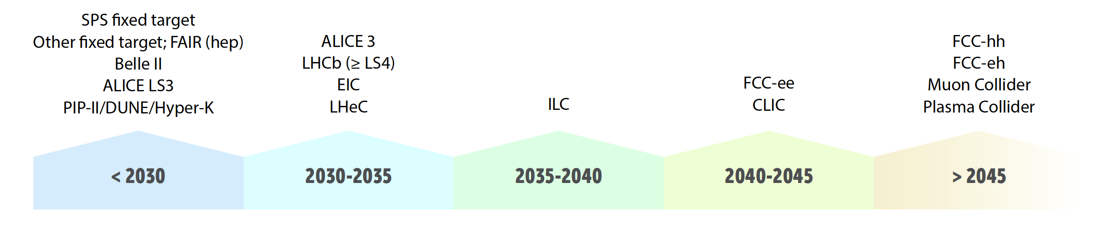
Future Facilities Timeline
‘Chicken-and-egg’ problem
  ‣ Need the approximate dates of future facilities to define an R&D timeline
  ‣ Cannot predict dates of future facilities without knowing R&D needs
‣ Detector / accelerator roadmaps have used a common timeline
‣ Highly approximate, and not to be used out of context
‣ Dates represent the ‘earliest feasible date’, driven by both technical considerations and approval processes
‣ The goal on both sides is that R&D shall not be the rate-limiting step

Slide 7
CERN’s scientific priorities
Following the ESPP update
successful completion of the high-luminosity upgrade of the LHC machine and experiments, with a view to the full exploitation of the LHC physics potential;
increased R&D efforts on advanced accelerator technologies, including high-field superconducting magnets, high-gradient accelerating structures, plasma wakefield acceleration, muon colliders, etc.;
investigation of the technical and financial feasibility of a future hadron collider at CERN, with a centre-of-mass energy of at least 100 TeV, and with an electron-positron Higgs and electroweak factory as a possible first stage;
support to long-baseline neutrino experiments in Japan and the United States; and support to a diverse, high-impact scientific programme complementary to high-energy colliders.

Slide 8
HFM R&D Goals
Demonstrate Nb₃Sn magnet technology for large scale deployment, pushing it to its limits in terms of maximum field and production scale.
  The effort to quantify and demonstrate Nb₃Sn ultimate field comprises the development of conductor and magnet technology towards the ultimate Nb₃Sn performance.
  Develop Nb₃Sn magnet technology for collider-scale production, through robust design, industrial manufacturing and cost reduction.
Demonstrate the suitability of HTS for accelerator magnets, providing a proof-of-principle of HTS magnet technology beyond the reach of Nb₃Sn.
Performance
Robustness
Cost

Slide 9
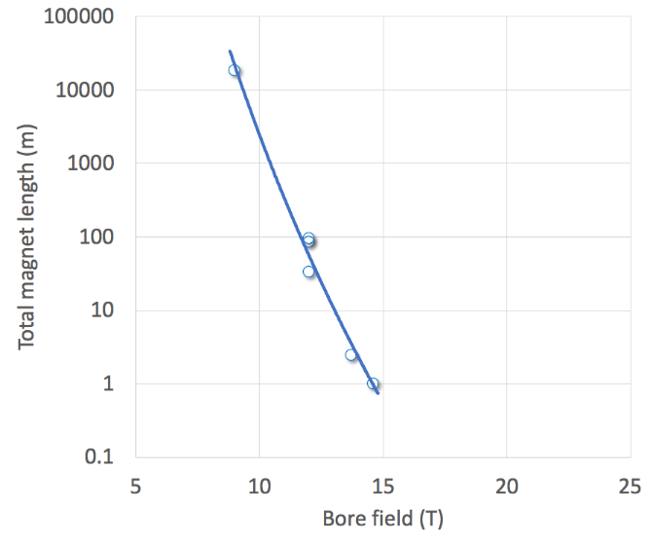
HFM strategy
Development of robust and cost-efficient processes
LHC
Robust Nb₃Sn
Other key parameters:
• Cost of Magnets & R&D
• Timeline of a realistic development
• Potential for wider societal applications
• Training and education
HL-LHC QXF
Logical step for a next phase (2027-2034)
HL-LHC 11T
D20
Fresca2
MDPCT1
Ultimate Nb₃Sn
Exploration of new concepts and technologies
HTS
Notes:
This figure translates the three axes in graphical form, reporting the field generated by a dipole magnet on the horizontal axis, and the total length of magnets produced on the vertical axis.
The horizontal axis is the line of exploration of field limits, new concepts and technology
The vertical axis is the direction of series production, where a robust and efficient process is required.
The blue line represents magnets that have been produced to date. At one extreme is the LHC, with an ultimate field of 9 T and nearly 20 km of magnets installed in the accelerator tunnel. At the other extreme are single realizations such as FRESCA2 or MDPCTI, with field in excess of 14.5 T but single magnetic length of the order of 1 m. In the middle is HL-LHC, with a few magnets built that have reached field levels of 11 T (operation) to 12 T (ultimate).
The search for high fields will push the boundary along the horizontal axis, looking at Nb3Sn (red) and HTS (purple), over the scale of length typical of demonstrators and models (1 m or less)
At the same time, we wish to review results and develop the technology relevant for the production on large scale, i.e. from a few tens of m to (potentially) km of accelerator magnets (blue).
A key of the approach is that both lines proceed simultaneously, the shaded area, to achieve the objective set for the next 5 to 7 years, i.e. demonstrate that Nb3Sn can be used in a large scale accelerator and probe the potential of HTS. There is an obvious interaction among the lines, as many of the technologies are shared, and the results in each line can influence the progress along the other lines.
Finally, and logically, the next step of this R&D should be to take stock of both the push in maximum field and in production scale, to demonstrate on medium scale the maximum field that can be reached with Nb3Sn (green). But this is for the moment only a conjecture.

Slide 10
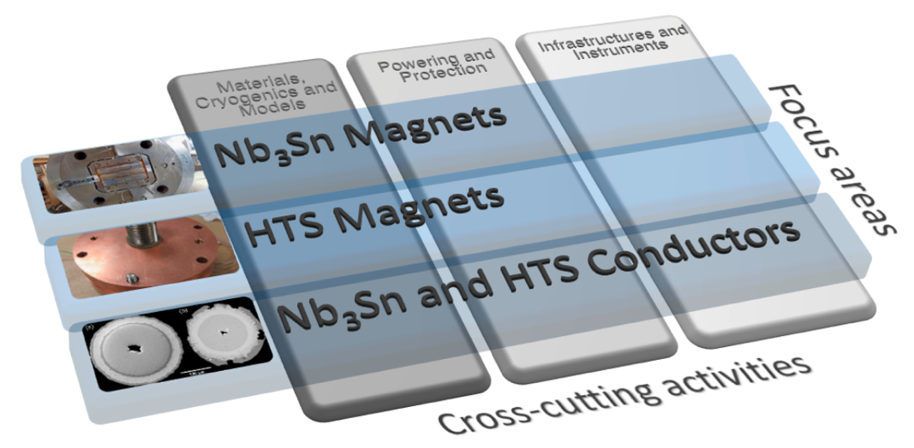
R&D Focus Areas and Cross-Cutting Activities
“The R&D programme must be holistic in nature: a compatible selection of electromagnetic, mechanical and thermal design approaches, conductors, materials, and manufacturing processes and methods needs to be integrated seamlessly with instrumentation and protection into a specific magnet solution responding to the required specification.“
Conversely, work across R&D areas must be closely coordinated.

Slide 11
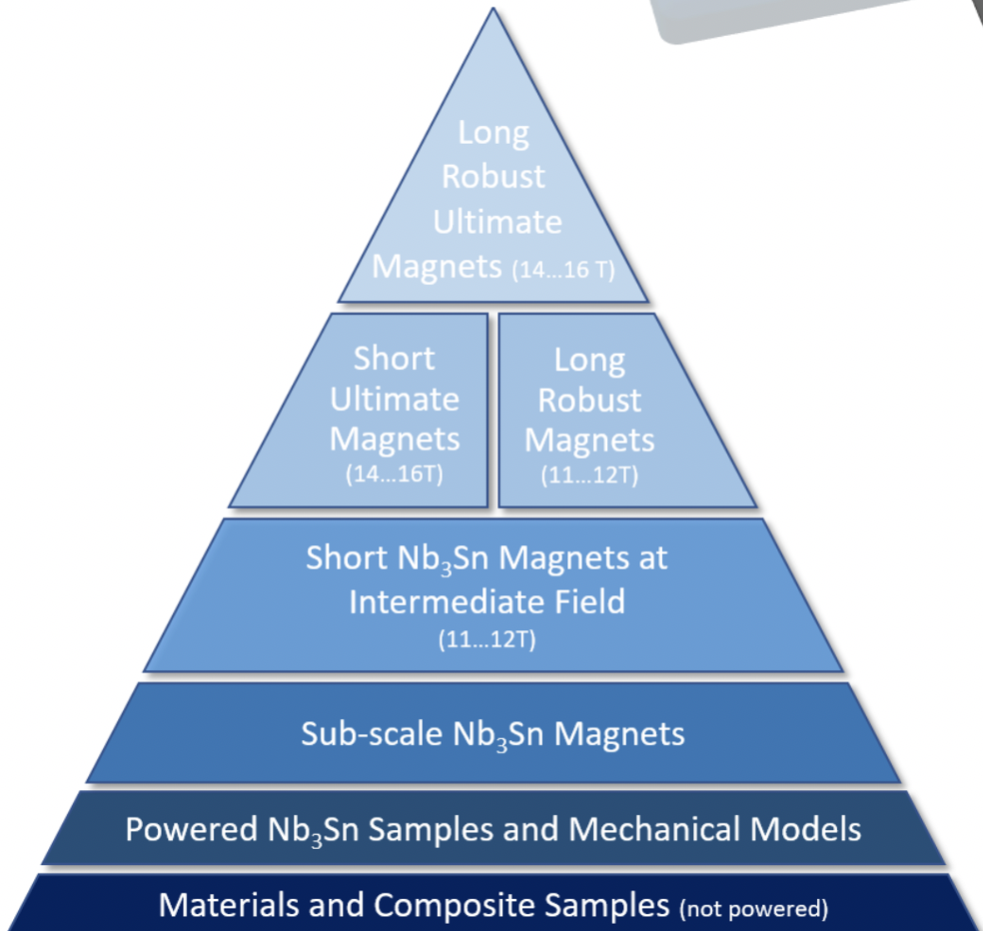
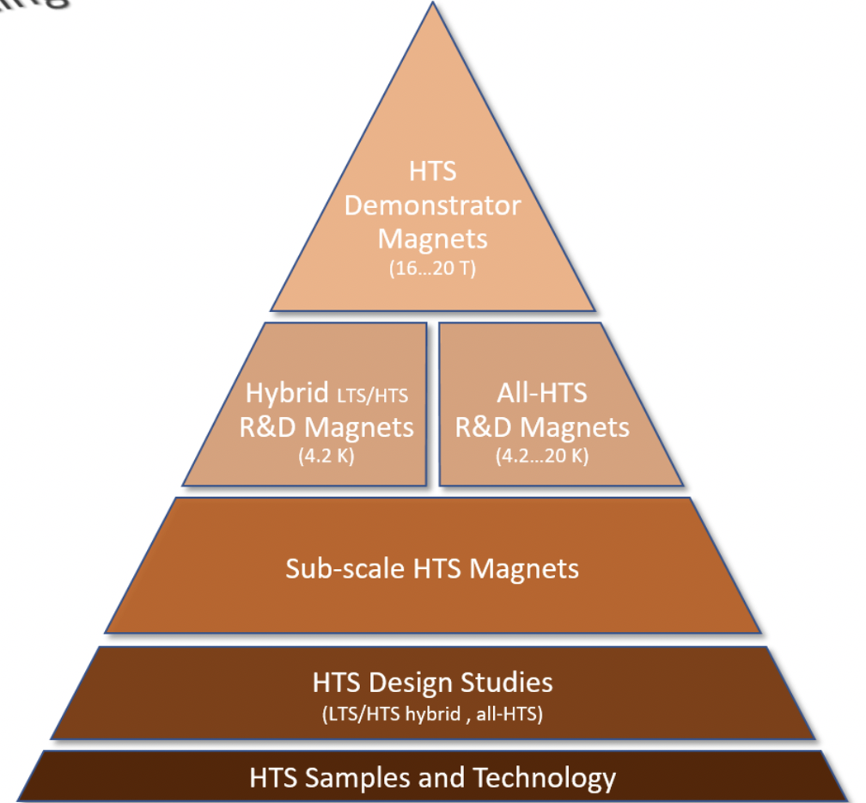
HFM - Overall vision
Nb₃Sn conductor R&D
Nb₃Sn magnet technology R&D
Nb₃Sn accelerator magnet development
HTS material and conductor R&D
HTS coil technology and accelerator magnet R&D
Insulating materials, polymers and composites
Infrastructure for development, manufacture, test and measurement

Slide 12
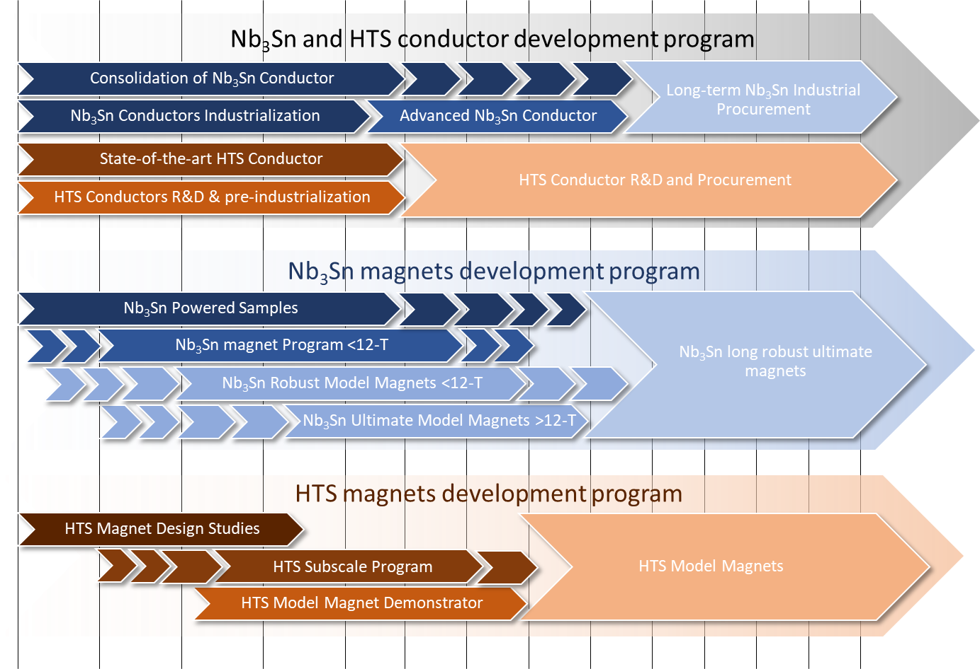
HFM

Slide 13
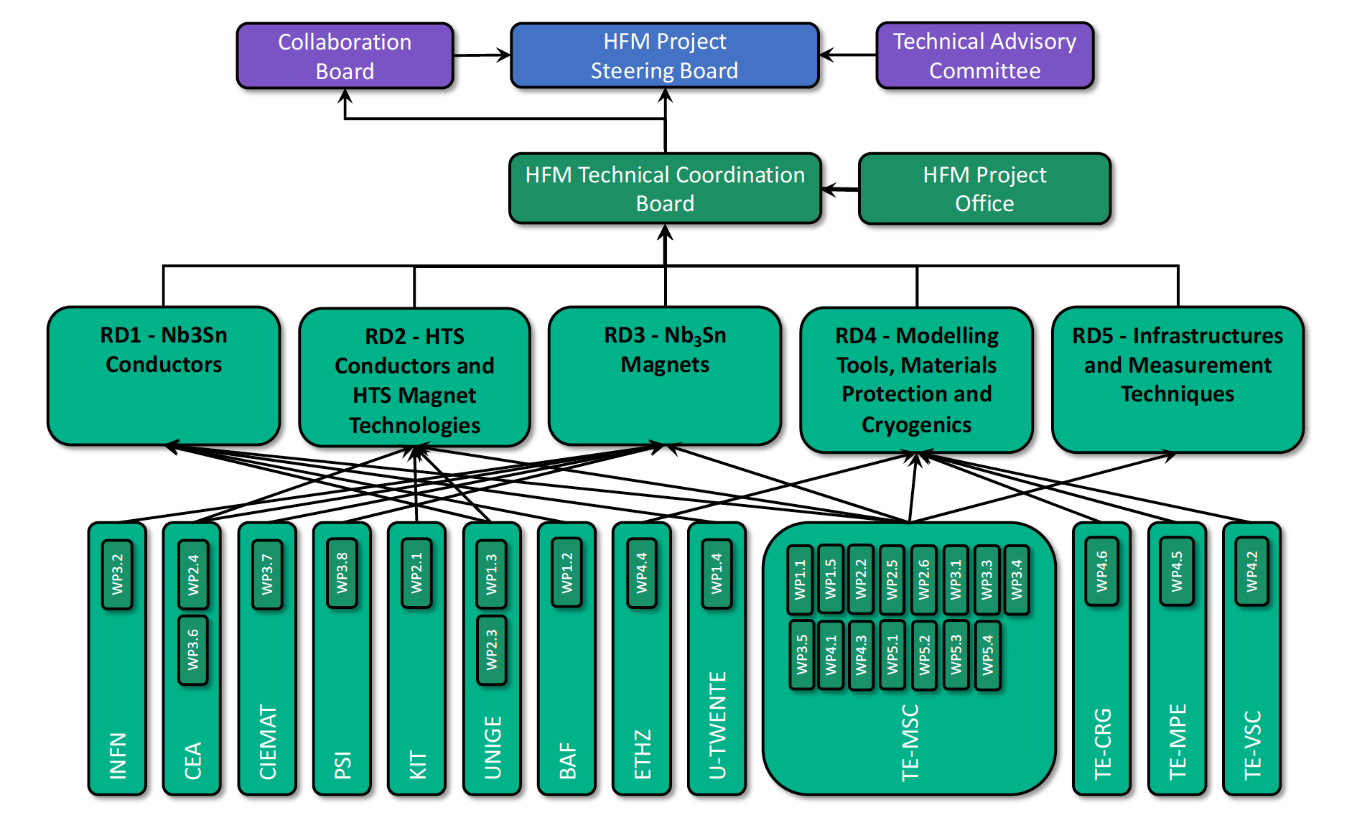
In practice… implementation of HFM Roadmap

Slide 14





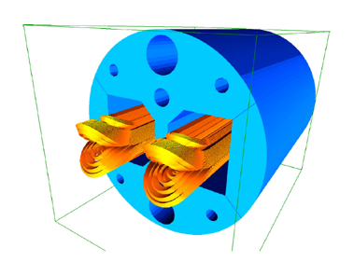
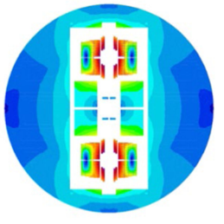
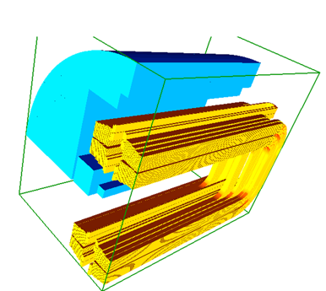
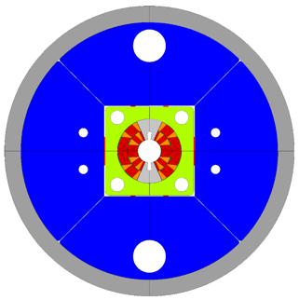

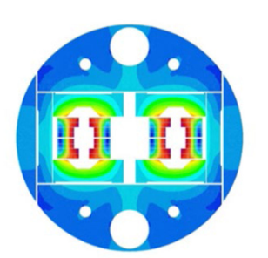
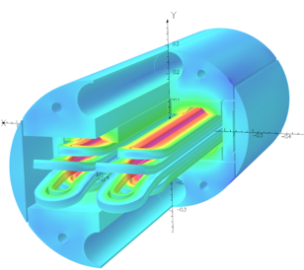


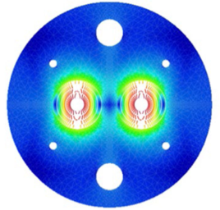
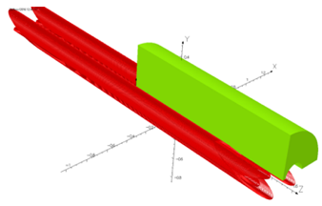



FCC-hh high field dipole R&D: world effort
50 mm aperture B = 12 T
Robust design & procedures
CERN, CEA,
INFN-GE-MI,
...
OD = 600 mm, L = 2 m, 50 mm aperture, B = 16 T

Slide 15
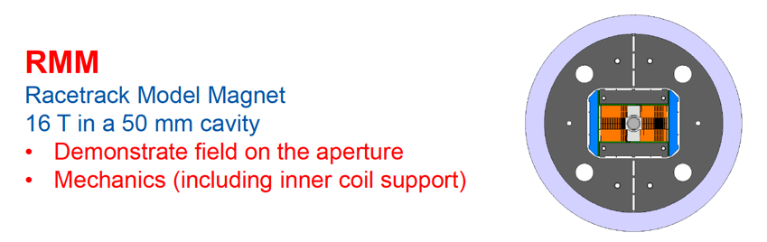
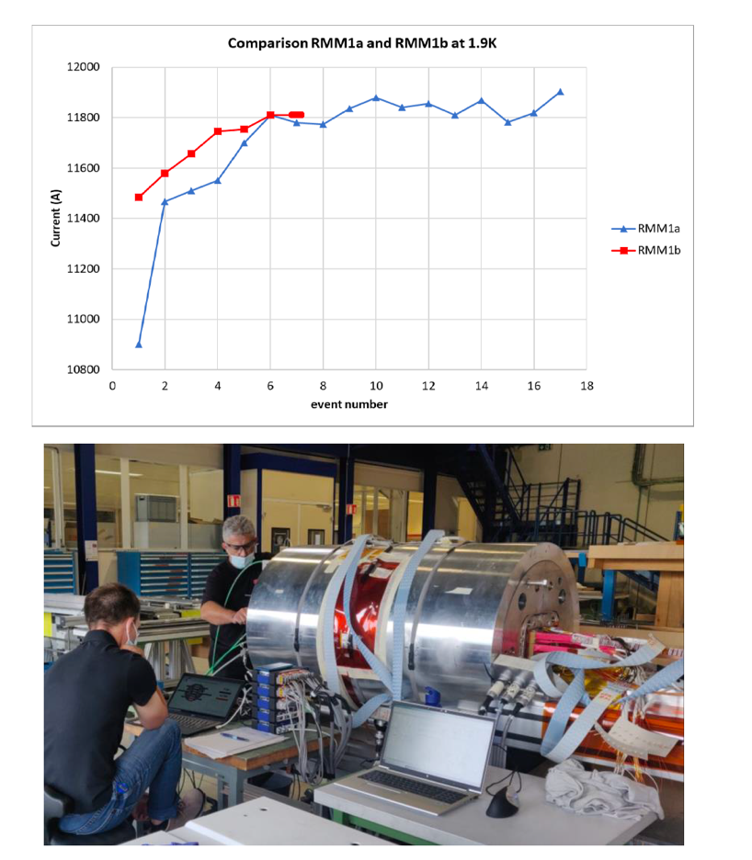
2 weeks ago at CERN
The RMM1b quench training at a higher value than for RMM1a, but after 5 quenches reached about the same level.
3 powering ramps were done, all reaching the present target of 11.81 kA (16.5 T conductor peak field)
Part 1 of the test program is now completed
The quench signatures seem rather similar to that of RMM1a except that the mechanical vibrations on the rods disappeared.

Slide 16
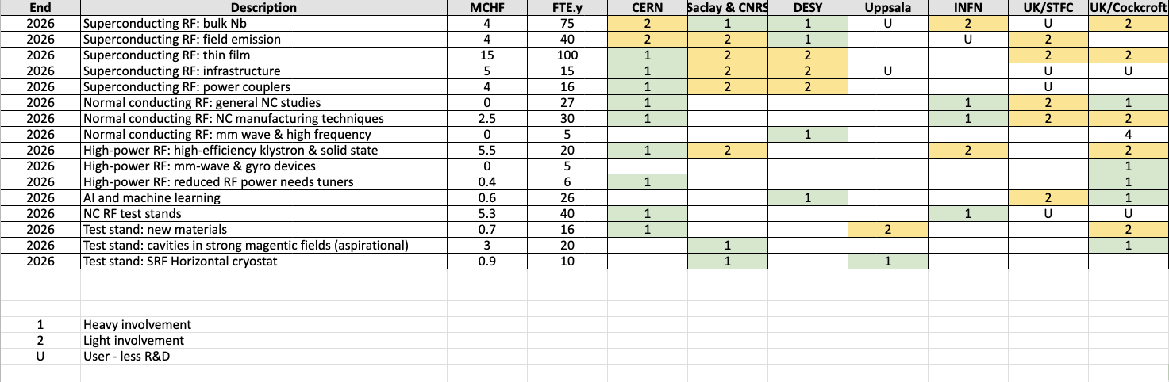
RF
Huge amount going on out there both SRF and RT
Strongly application driven (ILC, CLIC, FCC-ee, LCLS-II, PIP2, ESS, ERL…)
Aim is to help exploit synergies, focus attention etc. and report up…

Slide 17



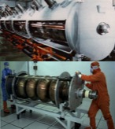


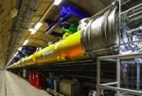

SRF Technology: vast experience, diffuse know-how
Progress (1988~)
TRISTAN
LEP-II
HERA
CEBAF
CESR
KEKB
BES
cERL
In Operation: → # cavities
SNS: 1 GeV
CEBAF 12 GeV → 80
ISAC-II, ARIEL
Super-KEKB
Eu-XFEL → 800
FRIB → 340
Under Construction:
LCLS=II → 300
PIP-II → 115
ESS→ 150
Shine → 600
To be realized:
HL-LHC-Crab → 20
EIC
ILC-250 → 8,000
FCC
CEPC/SPPS
1980
2000
2020
The success of the EU- XFEL at Desy is instrumental for all future projects based on SRF
Courtesy A. Yamamoto
> 2,000 SRF cavities realized, in last 10 years !

Slide 18
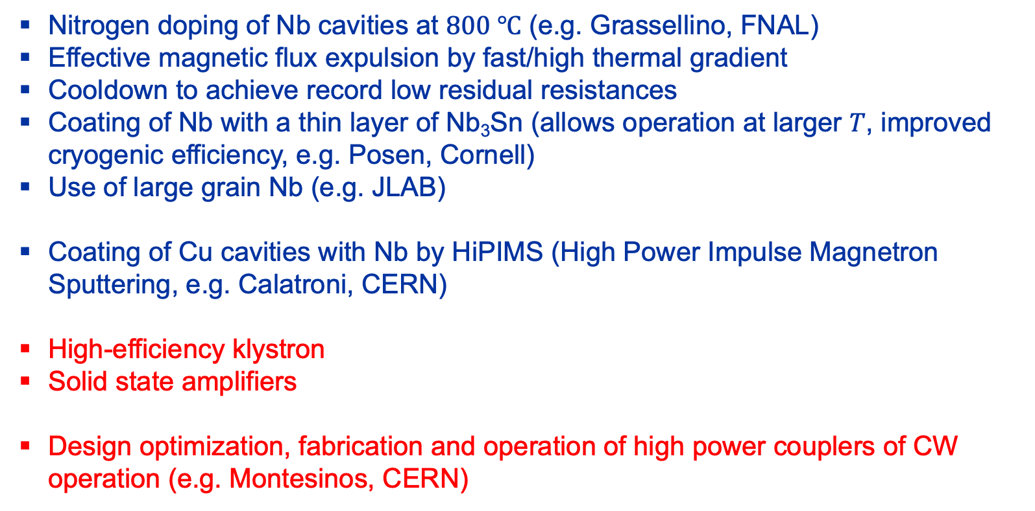
Recent trends
Nitrogen doping of Nb cavities at $800 ℃$ (e.g. Grassellino, FNAL)
Effective magnetic flux expulsion by fast/high thermal gradient
Cooldown to achieve record low residual resistances
Coating of Nb with a thin layer of Nb₃Sn (allows operation at larger $T$, improved cryogenic efficiency, e.g. Posen, Cornell)
Use of large grain Nb (e.g. JLAB)
Coating of Cu cavities with Nb by HiPIMS (High Power Impulse Magnetron Sputtering, e.g. Calatroni, CERN)
High-efficiency klystron
Solid state amplifiers
Design optimization, fabrication and operation of high power couplers of CW operation (e.g. Montesinos, CERN)
Bulk Nb
Thin film coating
on copper

Slide 19
E.g. SRF at CERN

Slide 20
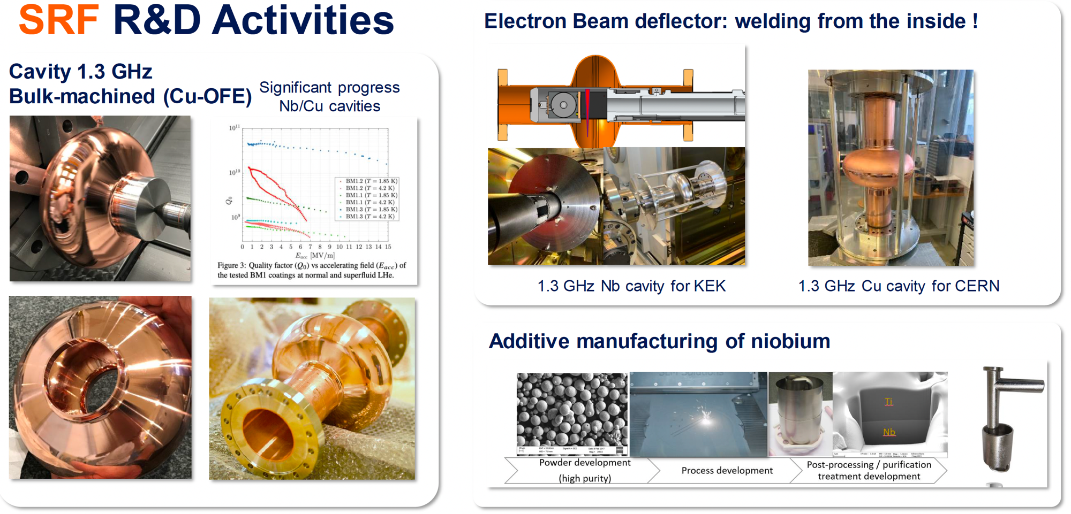

Slide 22
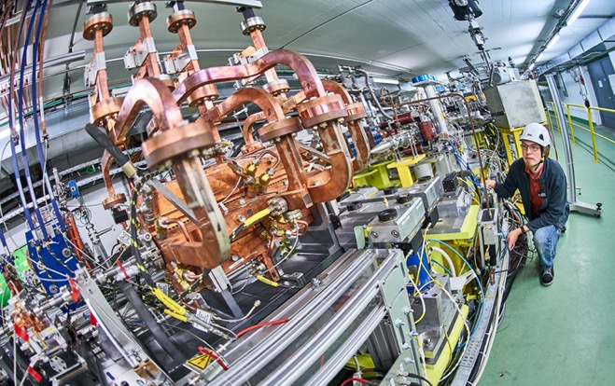
CLIC – X-band
Optimise and develop the X-band core-technology by exploiting the existing experimental facilities, the High Gradient test stands, for testing and verifications of prototypes made within the collaboration;
Maintain linear collider and linac design capabilities;
Continue High Efficiency klystron optimisation in a coordinated effort with other studies and projects at CERN with similar needs;
Continue high gradient studies, using the CLEAR facility, including among others wakefields, instrumentation for nano-beams, medical accelerators based on the technology;
Follow up with collaborators the many smaller projects outside CERN where X-band technology is used – for medical, industrial and research linacs, providing very relevant effort/studies for CLIC, including industrial capability build up;

Slide 23
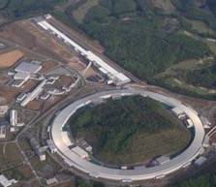
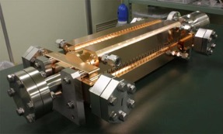
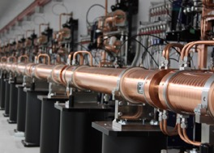

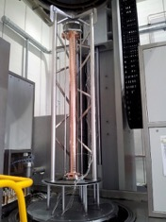
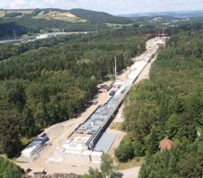
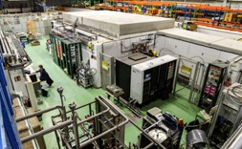
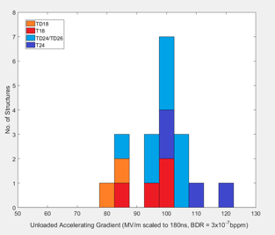
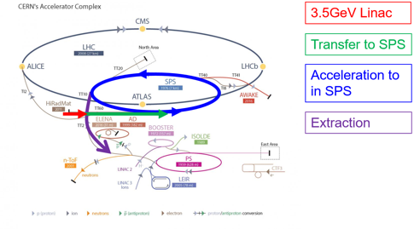
NC Linac Technology status
Courtesy: W. Wuensch, S. Stapnes, A. Yamamoto
Components:
Laboratory with commercial
Accelerating structures
pulse compressors
alignment
Stabilization, etc.
Full commercial supply
X-band klystrons
solid state modulator,
C-band (6 GHz),
low-emittance
GeV-range facilities
Operational:
SACLA
SwissXFEL (8 GeV)
Systems Facilities:
(100 MeV-range)
XBoxes at CERN
(NEXTEF KEK)
Frascati
NLCTA SLAC
Linearizers at Electra, PSI, Shanghai and Daresbury
Test stand at Tsinghua
Deflectors at SLAC, Shanghai, PSI and Trieste
NLCTA
SmartLight
FLASH
X-band (12 GHz)
GeV-range facilities
Planning:
Eu-Praxia
e-SPS
CompactLight
(EU DS for X-band FEL→ EuPraxia
→ Flash Therapy)
CLIC
~ 100 (+/-20) MV/m

Slide 24
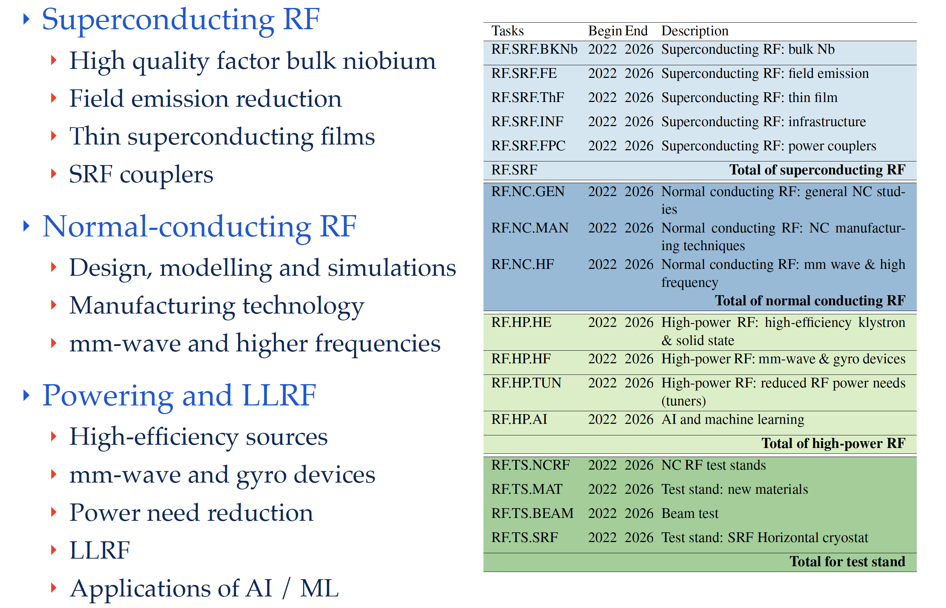
Roadmap Plan - Overview

Slide 25
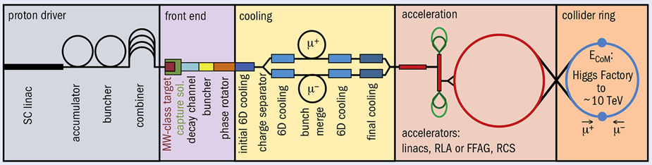
See Christian Carli – up next
Muon Collider
International Design Study
Main foreseen R&D lines:
High field superconducting magnets
  Collider ring, interaction region, muon cooling, target area, …
Fast-ramping magnets and efficient energy recovery
  RT or HTS magnets in accelerator, recovery of magnetic energy
Superconducting RF
  Efficient acceleration with high gradients
Normal conducting RF
  Very high fields in muon cooling system to minimize muon loss
Target area with high proton beam power
  Stress in target, radiation in magnets and RF components
Re-optimization of muon cooling system
It is, and will be, intensely collaborative!

Slide 26
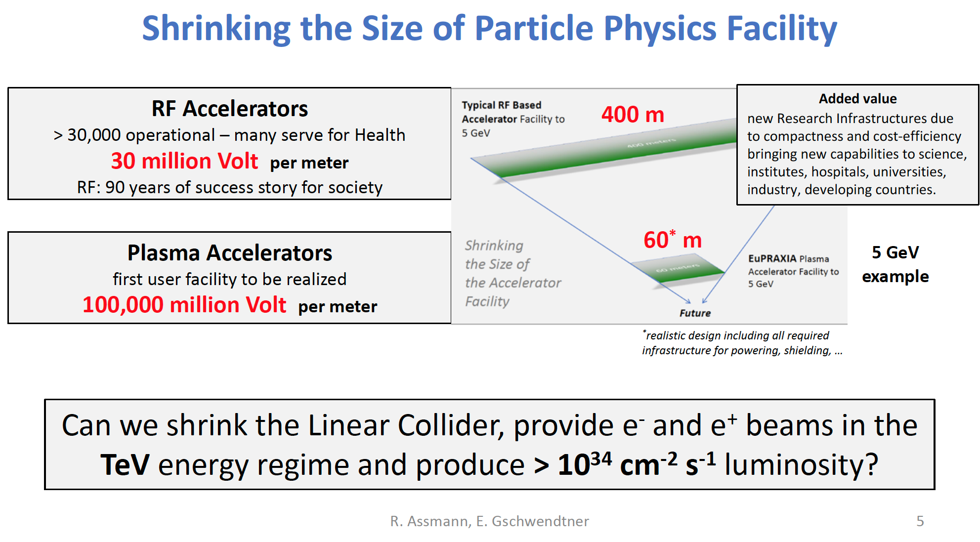

Slide 27
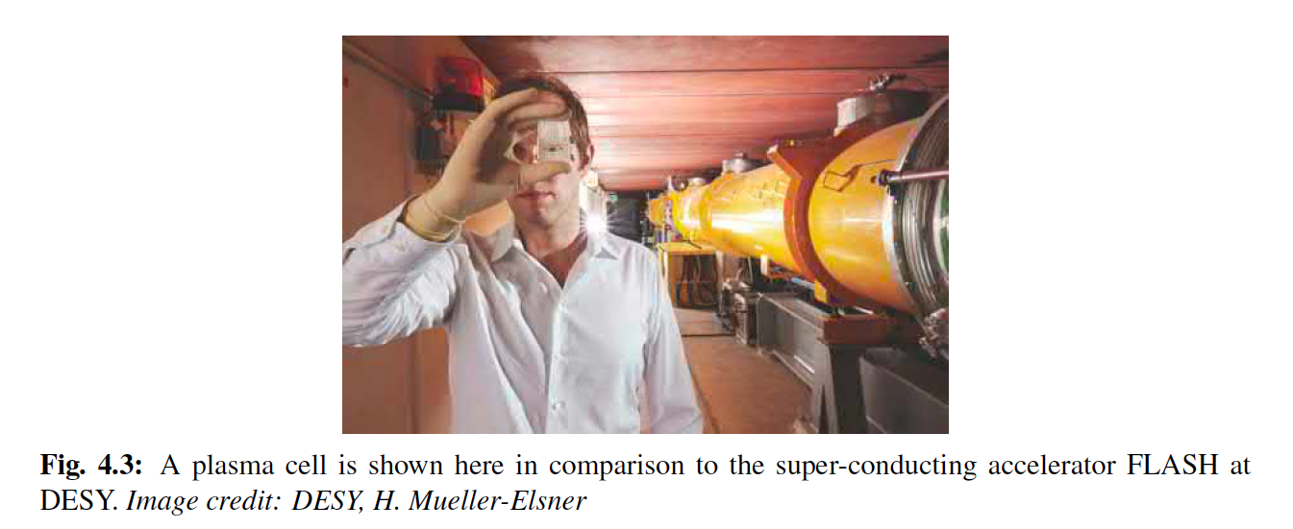

Slide 28
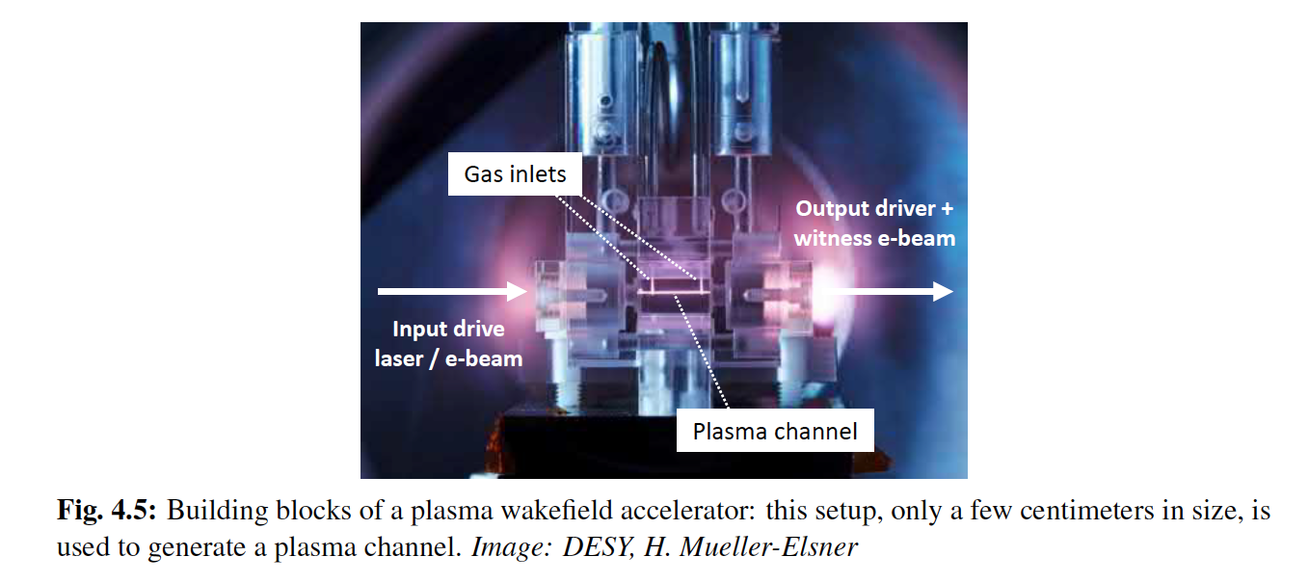

Slide 29
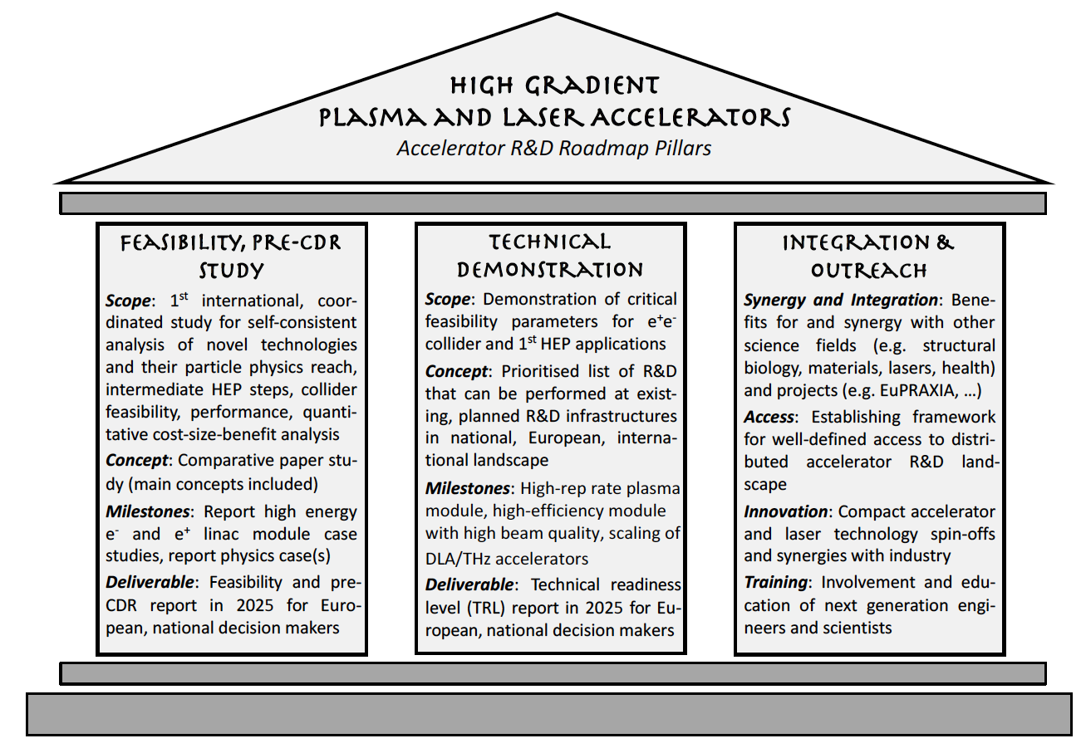
High Gradient Plasma and laser Accelerators
Goal is to complement large ‘external’ investment in plasmas
Ensure that the HEP-specific aspects are fully covered
Drive for plausible case for large-scale project at next ESPPU

Slide 30
Long term plans
2025 - Feasibility and pre-CDR Report on Advanced Accelerators for Particle Physics. This includes an assessment of Technical Readiness Levels (TRL), taking into account results from technical milestones until 2025.
2027 – Definition of physics case and selection of technology base for a Conceptual Design Report (CDR), in accordance with guidance from the European Strategy. An update on the timeline will be provided appropriate to particle physics requirements and realistically achievable goals.
2031 – Publication of a CDR for a Plasma-Based Particle Physics collider.
2032 – Start of Technical Design Report (TDR), prototyping and preparation phase. Eventual start of a dedicated test facility (to be defined in the pre-CDR report).
2039 – Decision on construction, taking into account the results of the advanced accelerator R&D and the international landscape of colliders.
2040 – Start of advanced collider construction.
Beyond 2050 – It is expected that a plasma-based collider can only become available for particle physics experiments beyond 2050, given the required feasibility and R&D work described in this report

Slide 31
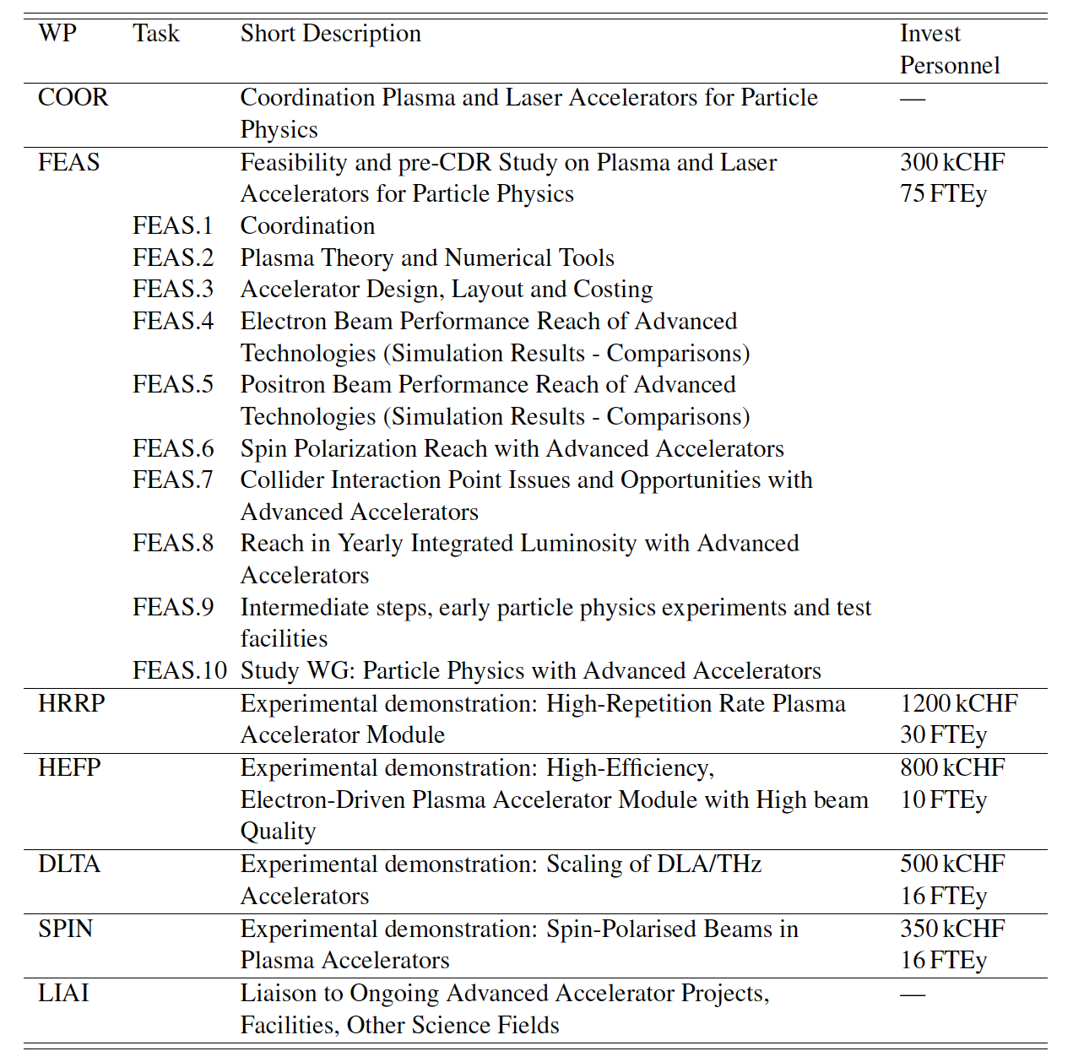
Task breakdown
Minimal scheme

Slide 32
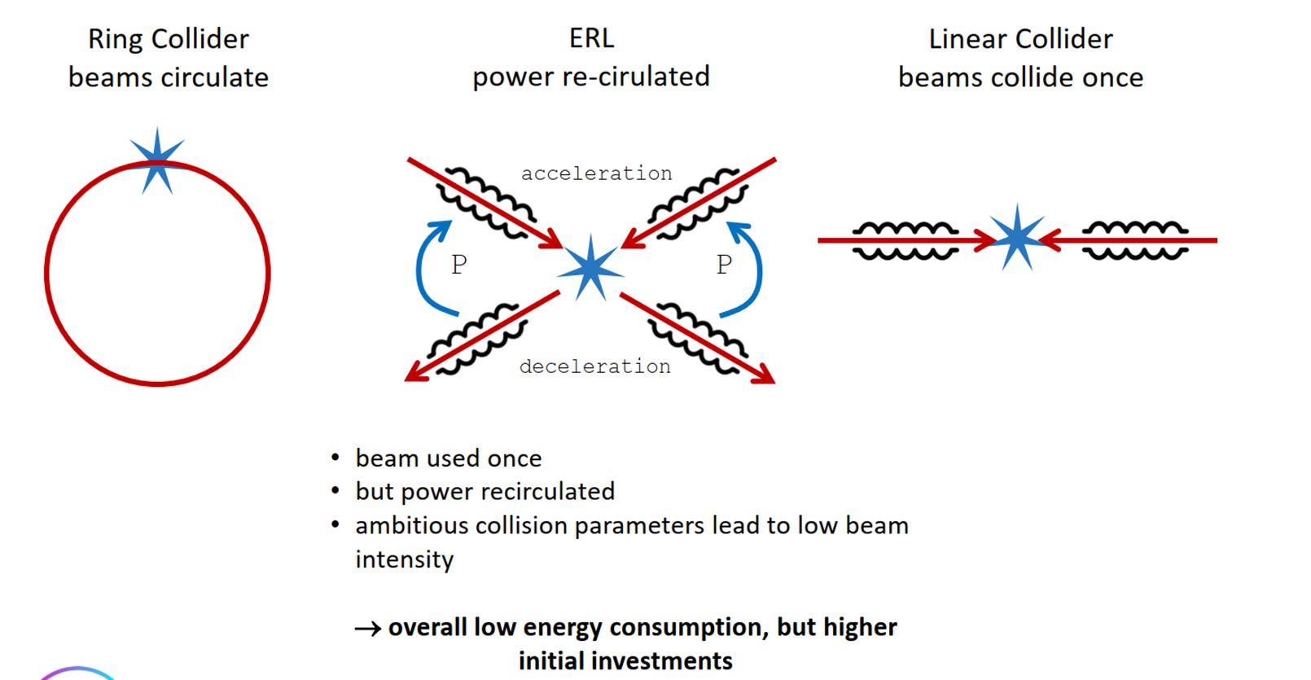
Energy Recovery Linacs (ERL)
Mike Seidel

Slide 33
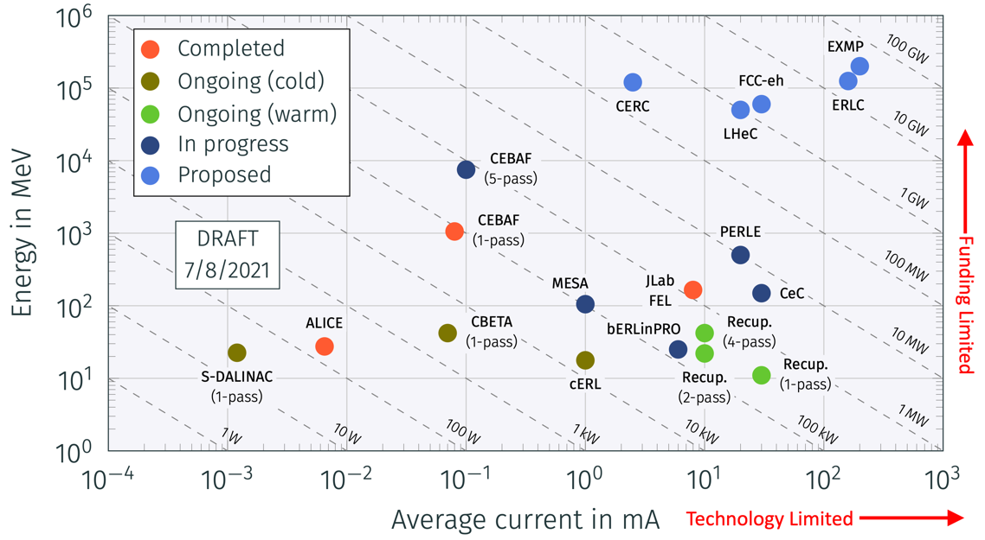
ERL Objectives
3 part programme
Support and exploit ongoing facility programmes (worldwide)
Focussed technical R&D into key technologies
Development or upgrade European facilities for mid-2020s
Relevant to both absolute performance and sustainability of future machines

Slide 34
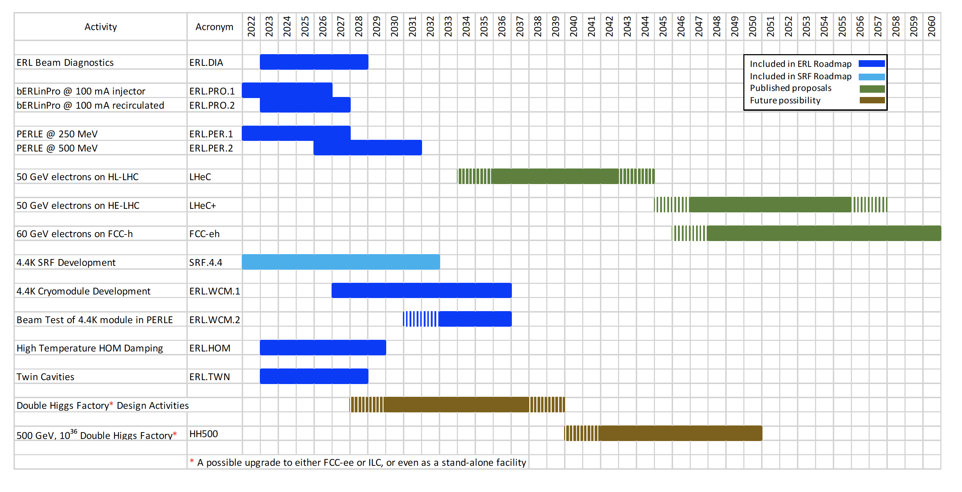
ERL Plan

Slide 35
Technology R&D
Two main areas: electron guns and SRF
Electron Guns – options include thermionic, CW DC, NCRF and SRF
  Examples exist of all of these gun types, mostly at lower performance
  Need to down-select two and build prototypes at full specifications
  Example: PERLE electron gun must deliver 20 mA (same as LHeC)
    Easy for unpolarized electrons, harder for polarized electrons
SRF – ERLs have some specific features that require additional R&D to that of SRF accelerators
  Higher Order Modes are extremely important, requires careful mode analysis and heavy damping
  Fast Reactive Tuner (FRT) technology can drastically reduce RF power requirements
  Example: PERLE cryomodules must support 120 mA (3-pass accelerating, 3-pass decelerating)
Other technology areas: arcs, beam dynamics, beam loss, separate recovery transport . . . .

Slide 36
ERLs - Sustainability
Any future particle accelerator facility is expected to be sustainable!
The accelerator community often conceives very large and energy-hungry machines, but we have an obligation to significantly improve energy efficiency to receive support from society
Methods to improve energy efficiency are already a part of any strategy towards future accelerator facilities
ERLs are an innovative, high luminosity, green accelerator concept, for HEP, NP and industrial applications with far reaching impacts for science and society
Dumping the beam at injection energy is environmentally friendly
ERLs are one of the key technologies for a sustainable HEP future
This message courtesy the ERL community

Slide 37
Sustainability, societal impact – in general
  Environmental sustainability should be/has become a primary consideration
    Objective metrics should allow judgment of the cost and impact of future facilities over their entire life cycle.
  Emphasis should be placed on prompt scientific exploitation of R&D outputs
  Practical considerations of manufacturing, assembly, testing, and commissioning should factor into the design and parameters of future machines with the close engagement of industry
  Close cooperation between European and international laboratories is required
  Training and professional development of accelerator physicists is a key factor in sustaining a vibrant and productive field

Slide 38
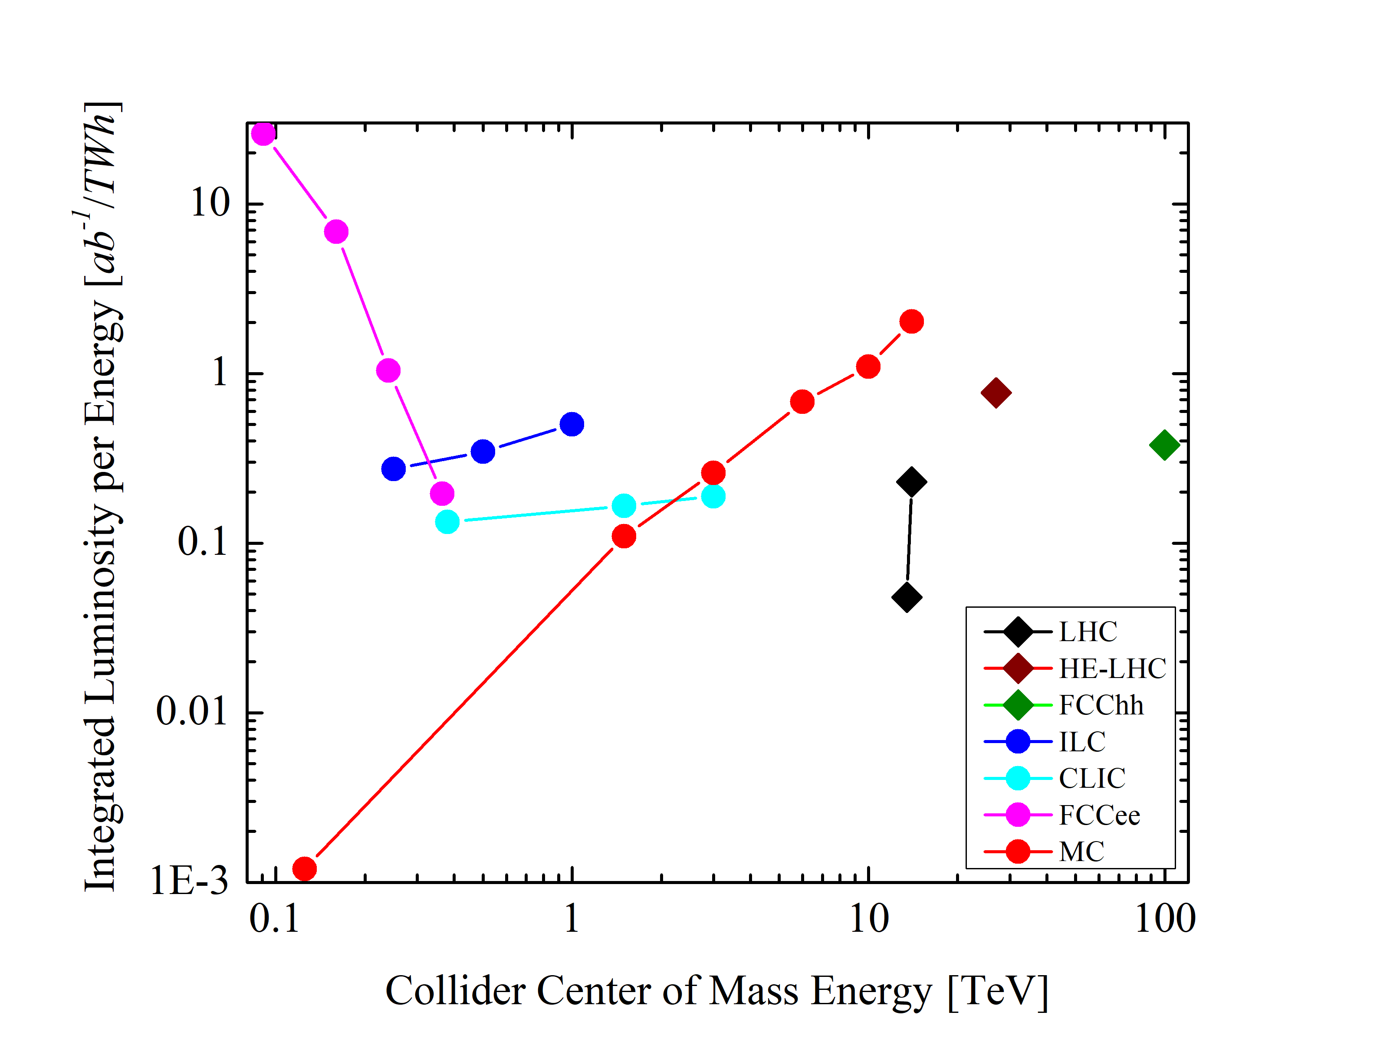

Energy Efficiency of Future Colliders
FCCee
Muon Collider
ILC
FCChh
CLIC
HL-LHC

Slide 39
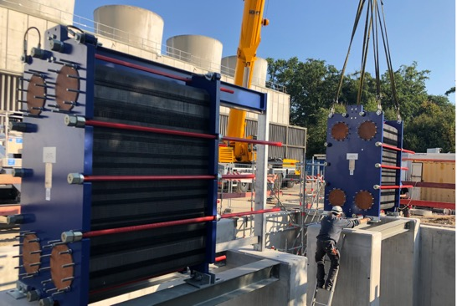
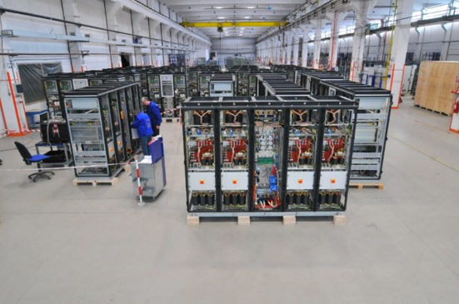
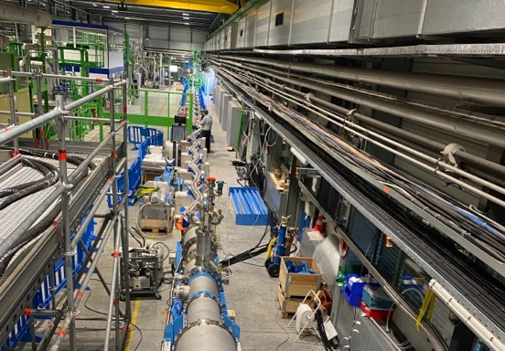
Accelerators and Sustainability
Future machines – full lifecycle
    Construction to dismantling
    Technology: SRF, klystrons, magnets (SC, HTS, permanent)
    Design: optics, FFA, ERLs
    Technical infrastructure: efficiency, heat recovery
Innovative technology
    Power/energy distribution (HTS, smart grids, hydrogen…)
    Energy storage (SC magnets, hydrogen…)
Support to alternatives
    Fusion – ITER
    ADS, thorium – MYRHHA
Exploitation/energy use
    Energy Management Panel (heat recovery, targeted consolidation (magnets, RF, power converters), greenhouse gases, HVAC efficiency)
    CERN to adopt ISO 50001 - efficient energy management standards
Climate research
    CLOUD
Procurement
  Energy use considered in system design, specifications, arbitration

Slide 40
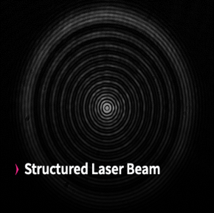
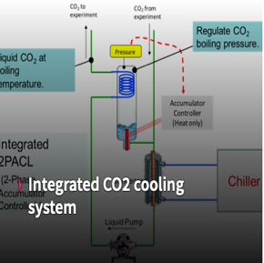
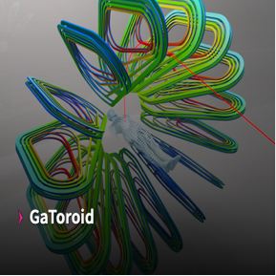

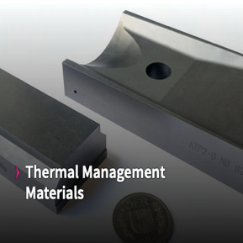

















Knowledge Transfer

Slide 41
Conclusions
ESPP has bequeathed a challenging charge with the aim of providing a technological base for possible future developments in the field
Development of the Roadmap – has been an interesting, not obvious process
Implementation, funding, working together is going to required the strengthening of existing collaborative links… ongoing
But the initiative does provide an opportunity, visible and important focus for funding agencies, a formal reporting line to CERN Council and member state representatives.
We must recognize the increasing importance of sustainability and societal impact and look for these to become a core component of future developments

