Slide 1



Longitudinal and Transverse Impedance Measurements and Simulations for ThomX
Ezgi Ergenlik (HZB-2022)
BIMP-IJCLab(2020-2022)
DEPACC-LAL(2018-2020)

Slide 2

Outline
1.Introduction to Accelerators and Collective Effects
2.Wakefield and Impedances
3.Studying The Wakefield and Impedance
3.Two examples
4.Conclusion

Slide 3
Outline
1.Introduction to Accelerators and Collective Effects
2.Wakefield and Impedances
3.Studying The Wakefield and Impedance
3.Two example
4.Conclusion
{
  How we achieved expected performance in accelerator?
  Why are the Collective effects are important?
  What is ThomX and what are the effects of collective effects on ThomX?
1

Slide 4
Outline
1.Introduction to Accelerators and Collective Effects
2.Wakefield and Impedances
3.Studying The Wakefield and Impedance
3.Two examples
4.Conclusion
{
  How we achieved expected performance in accelerator?
  Why are the Collective effects are important?
  What is ThomX and what are the effects of collective effects on ThomX?
  Different Kind of Impedances and Formalism
  The effect of the impedances
  The Goal of Impedance Study
  The methods of Defining the impedance on accelerators
1
{
2

Slide 5
Outline
1.Introduction to Accelerators and Collective Effects
2.Wakefield and Impedances
3.Studying The Wakefield and Impedance
3.Two examples
4.Conclusion
{
  How we achieved expected performance in accelerator?
  Why are the Collective effects are important?
  What is ThomX and what are the effects of collective effects on ThomX?
  Different Kind of Impedances and Formalism
  The effect of the impedances
  The Goal of Impedance Study
  The methods of Defining the impedance on accelerators
  Impedance Simulations with CST and Parameters
  The Coaxial Wire Technique and Experimental Setup
  Different Kind of Impedances and Measurements
1
{
2
{
3

Slide 6
Outline
1.Introduction to Accelerators and Collective Effects
2.Wakefield and Impedances
3.Studying The Wakefield and Impedance
3.Two examples
4.Conclusion
{
  How we achieved expected performance in accelerator?
  Why are the Collective effects are important?
  What is ThomX and what are the effects of collective effects on ThomX?
  Different Kind of Impedances and Formalism
  The effect of the impedances
  The Goal of Impedance Study
  The methods of Defining the impedance on accelerators
  Impedance Simulations with CST and Parameters
  The Coaxial Wire Technique and Experimental Setup
  Different Kind of Impedances and Measurements
  Bellow for two wire
  FBT for moving wire
1
{
2
{
3
{
4

Slide 7
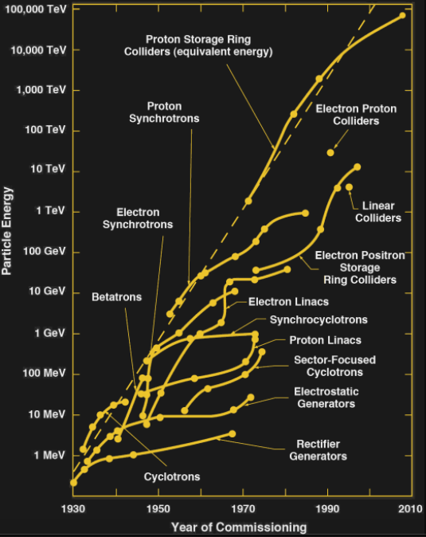
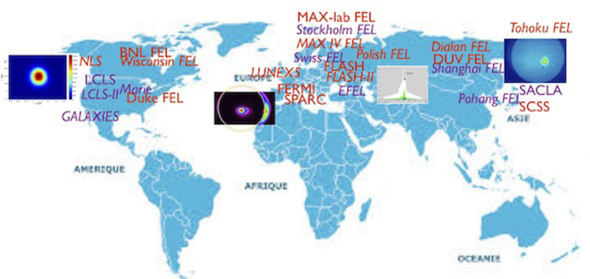
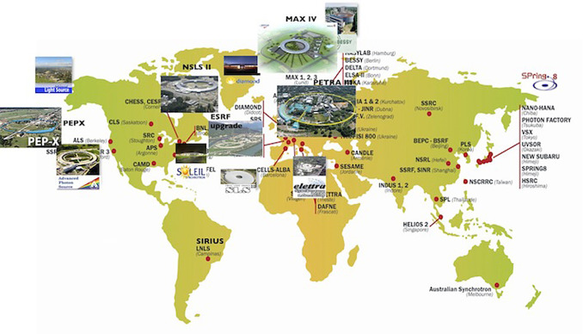
Introduction
Nowadays the accelerators especially the light sources are used widely(e.g. physics research, medical applications, historical research etc.).
Different usage needs different parameters(e.g energy, flux etc). For well-performed experiment the parameters should be achieved precisely.

Slide 8
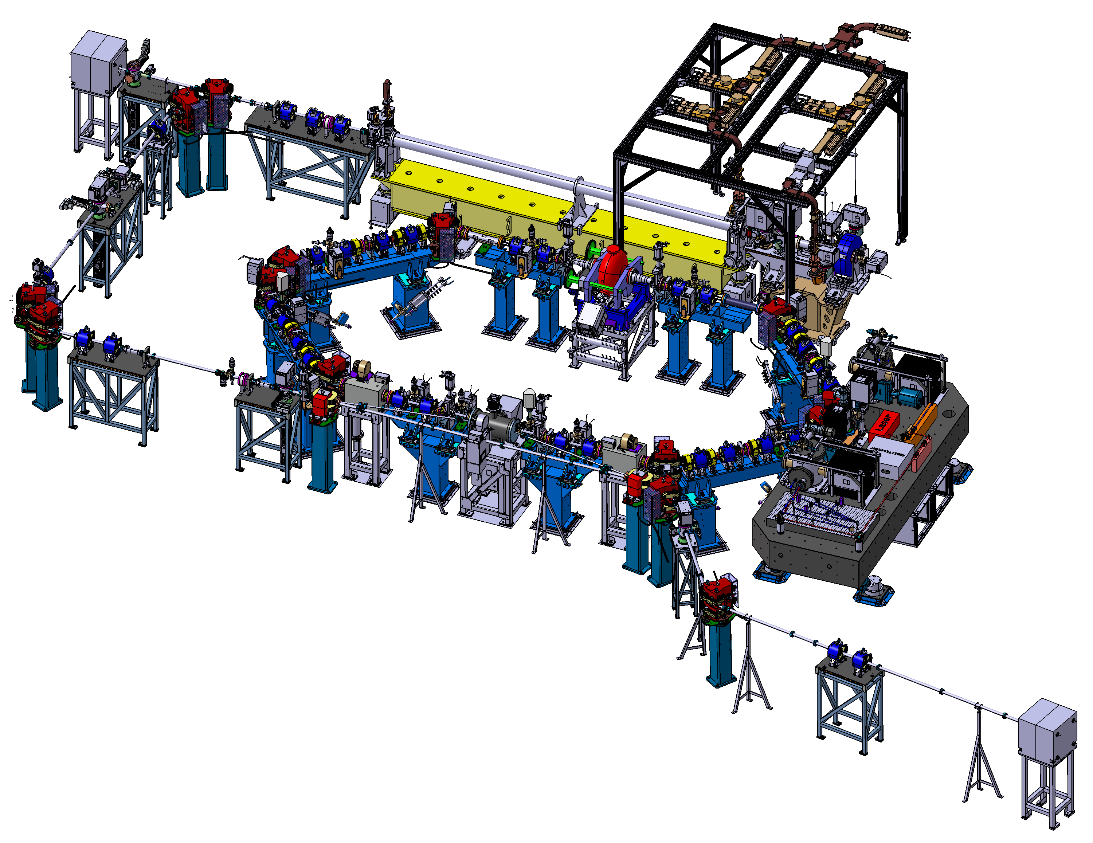
How we achieved expected performance in accelerator?
Designing the accelerator for having the precise parameters in the exact places.
The beam diagnostic (measuring the beam parameters in different place of accelerators) and feedback systems
Studying the collective effects.

Slide 9
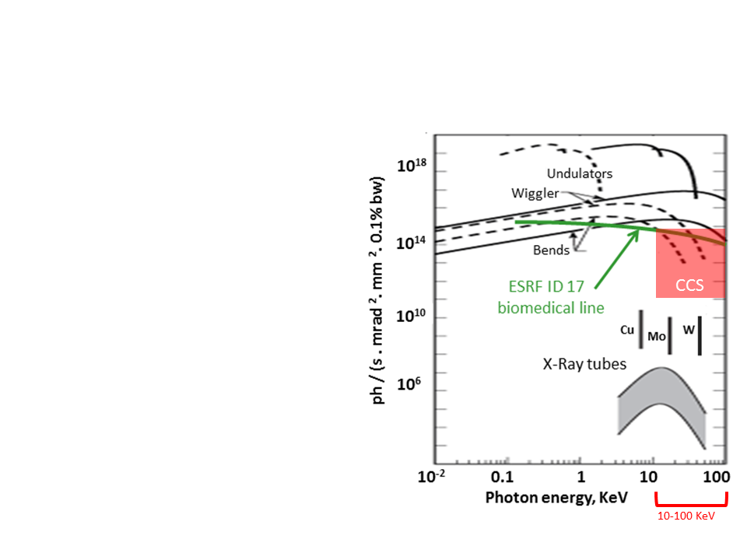


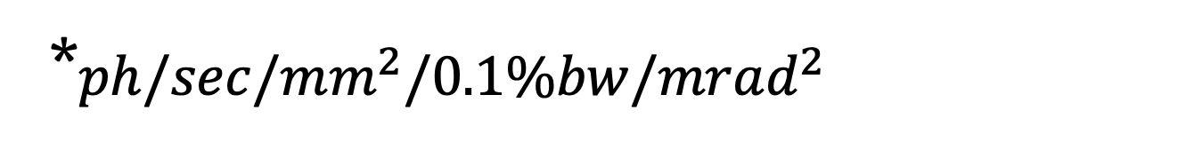
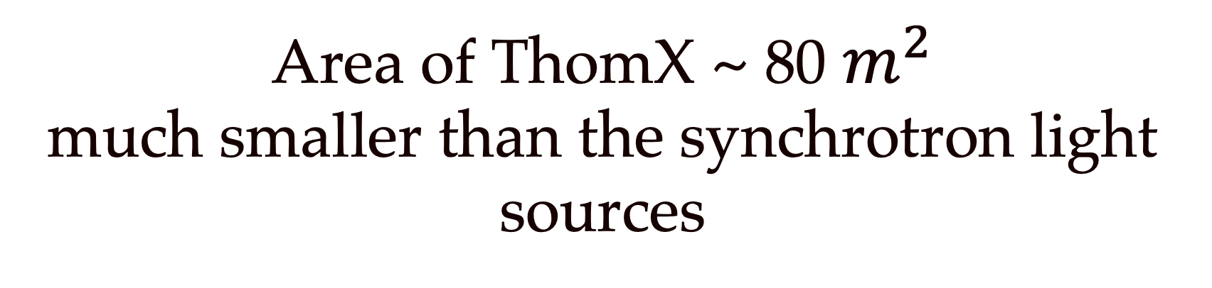
ThomX
ThomX X-Ray
Usage
Flux
10¹³ ph/sec
Art History
Brigthness
10^{11*}
Radiotherapy
Transv. beam
size
70 μm
Imaging
E_{X-ray}
30-90 KeV
Area of ThomX ~ 80 $m^{2}$
much smaller than the synchrotron light sources
*$ph/sec/mm^{2}/0.1\%bw/mrad^{2}$

Slide 10


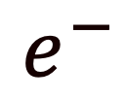
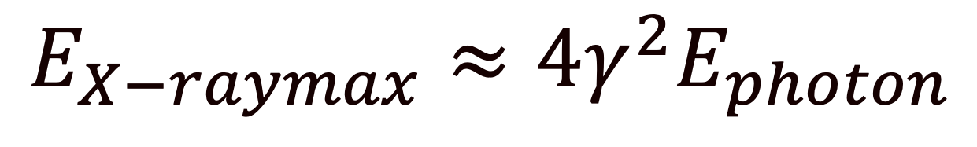
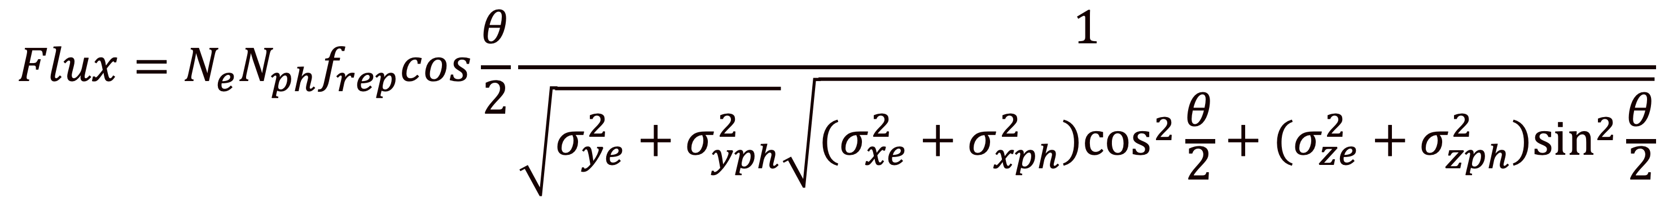
Compton Backscattering
To maximizing the flux of the light sources we need:
  High repetition rate
  Small interaction angle
  High charge
$$E_{X−raymax}≈4γ^{2}E_{photon}$$
Photon
ThomX
40 k times of the laser energy
50 MeV electrons
$$e^{−}$$
X-Ray
$$Flux=N_{e}N_{ph}f_{rep}cos\frac{θ}{2}\frac{1}{\sqrt{σ_{ye}^{2}+σ_{yph}^{2}}\sqrt{(σ_{xe}^{2}+σ_{xph}^{2})\cos^{2}\frac{θ}{2}+(σ_{ze}^{2}+σ_{zph}^{2})\sin^{2}\frac{θ}{2}}}$$

Slide 11
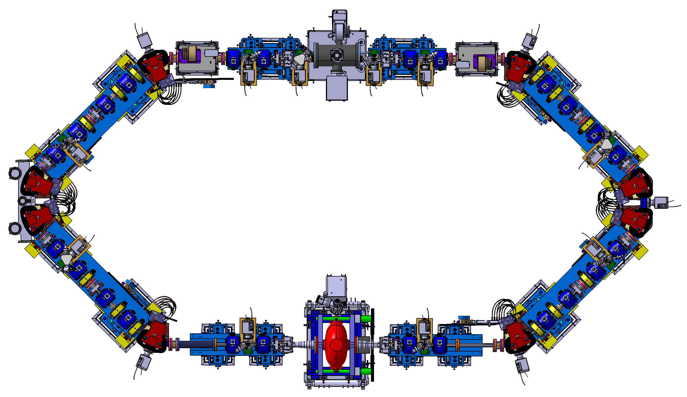

Compton Backscattering-Repetition Rate
To maximizing the flux of the light sources we need:
  High repetition rate
Repetition Frequency
17 MHz
Photon
$$e^{−}$$
X-Ray
$$Flux=N_{e}N_{ph}f_{rep}cos\frac{θ}{2}\frac{1}{\sqrt{σ_{ye}^{2}+σ_{yph}^{2}}\sqrt{(σ_{xe}^{2}+σ_{xph}^{2})\cos^{2}\frac{θ}{2}+(σ_{ze}^{2}+σ_{zph}^{2})\sin^{2}\frac{θ}{2}}}$$

Slide 12
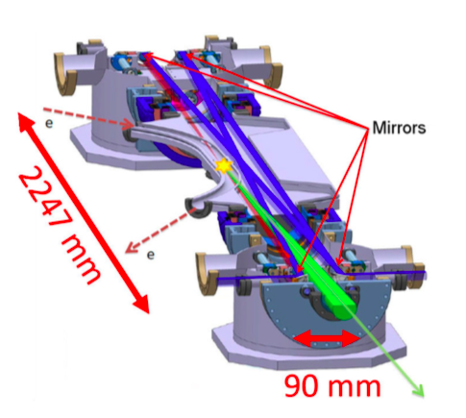
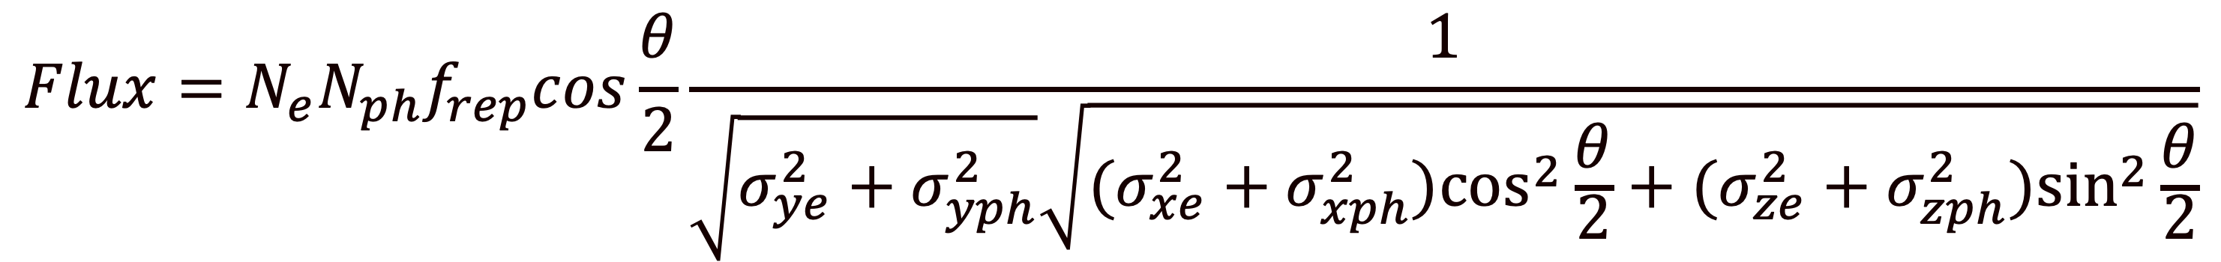
Compton Backscattering-Interaction
To maximizing the flux of the light sources we need:
  Small interaction angle
  High laser intensity
The electrons beam, the broken red line, interacts with the laser beam, in blue, to produce X-rays, the green cone, via Compton backscattering
Photon
$$e^{−}$$
X-Ray
$$Flux=N_{e}N_{ph}f_{rep}cos\frac{θ}{2}\frac{1}{\sqrt{σ_{ye}^{2}+σ_{yph}^{2}}\sqrt{(σ_{xe}^{2}+σ_{xph}^{2})\cos^{2}\frac{θ}{2}+(σ_{ze}^{2}+σ_{zph}^{2})\sin^{2}\frac{θ}{2}}}$$

Slide 13
Compton Backscattering-High charge and Energy
To maximizing the flux of the light sources we need:
  High beam charge
$$E_{X−raymax}≈4γ^{2}E_{photon}$$
Photon
ThomX
40 k times of the laser energy
50 MeV electrons
$$e^{−}$$
X-Ray
$$Flux=N_{e}N_{ph}f_{rep}cos\frac{θ}{2}\frac{1}{\sqrt{σ_{ye}^{2}+σ_{yph}^{2}}\sqrt{(σ_{xe}^{2}+σ_{xph}^{2})\cos^{2}\frac{θ}{2}+(σ_{ze}^{2}+σ_{zph}^{2})\sin^{2}\frac{θ}{2}}}$$

Slide 14
What is the collective effects?
The Collective Effect term is used for defining the interaction of the particles with each other and surroundings.
The Wakefield and Impedance formalism are generally used the collective effects.
There are different type of collective effects which are act on accelerators.

Slide 15
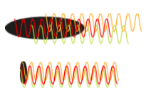


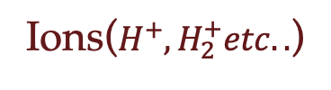

Collective Effects
Space Charge
Beam Coupling Impedance
Coulomb repulsion with the particles inside the beam
Impedance
Distortions
Emittance growth
Bunch oscillations
Instabilities
Beam losses
$$F_{E}$$
I->
$$F_{B}$$
Beam pipe
Coherent Synchrotron
Radiation
Intra beam Scattering
Beam-Ion Interaction
$$F_{E}$$
Collisions of the particles inside the beam change the colliding particles momentum by addition of multiple random small-angle scattering events.
Ions($H^{+},H_{2}^{+}etc..$)
Coulomb attraction of the particles with the ions of residual gases

Slide 16
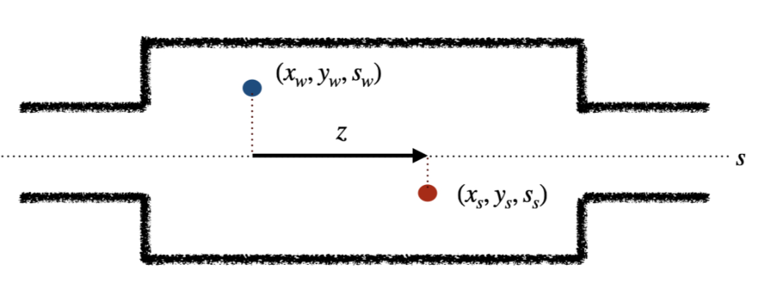
Impedance
When a particle beam passing through inside the beam pipe it can create electromagnetic fields behind it. These fields,which are called the wake fields, can have big effect on the beam dynamics for causing the energy lost. These fields can be define by wake potential or Impedance.

Slide 17
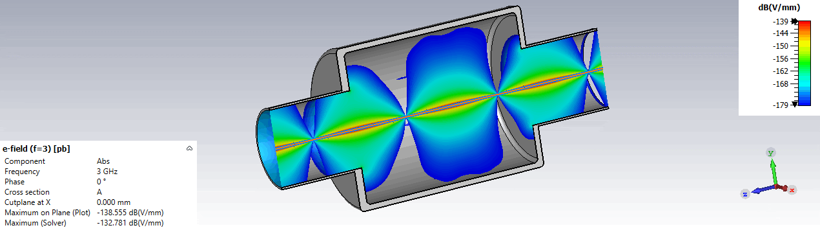
Impedance
When a particle beam passing through inside the beam pipe it can create electromagnetic fields behind it. These fields,which are called the wake fields, can have big effect on the beam dynamics for causing the energy lost. These fields can be define by wake potential or Impedance.

Slide 18
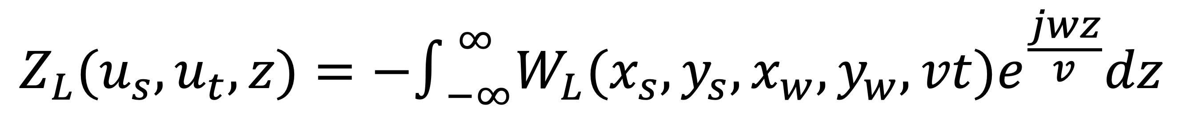
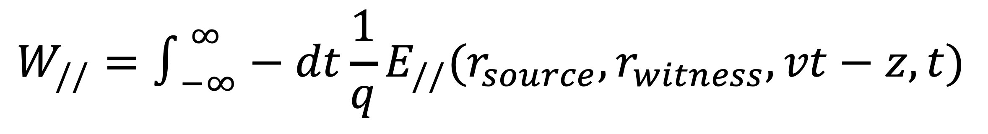
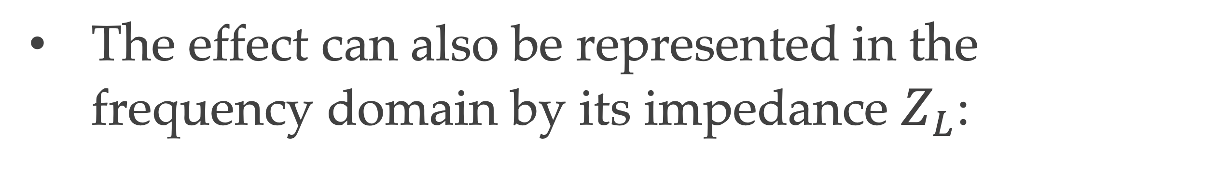
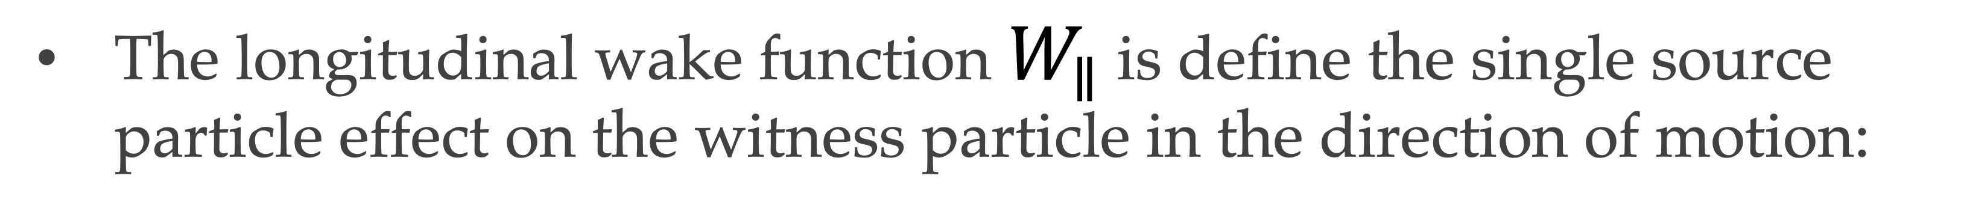
Longitudinal impedance
The longitudinal wake function $W_{∥}$ is define the single source particle effect on the witness particle in the direction of motion:
$$W_{//}=∫_{−∞}^{∞}−dt\frac{1}{q}E_{//}(r_{source},r_{witness},vt−z,t)$$
The effect can also be represented in the frequency domain by its impedance $Z_{L}$:
$$Z_{L}(u_{s},u_{t},z)=−∫_{−∞}^{∞}W_{L}(x_{s},y_{s},x_{w},y_{w},vt)e^{\frac{jwz}{v}}dz$$

Slide 19
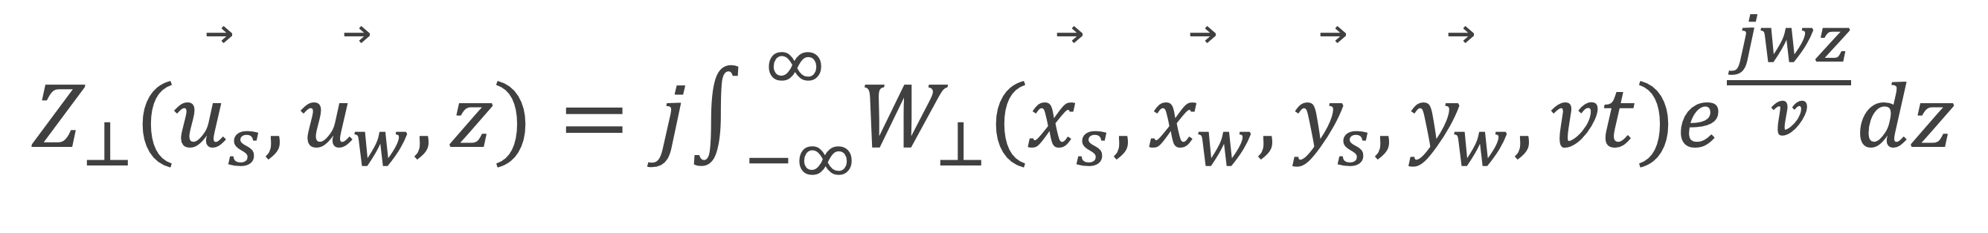
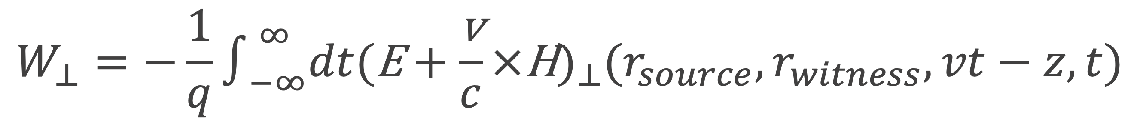
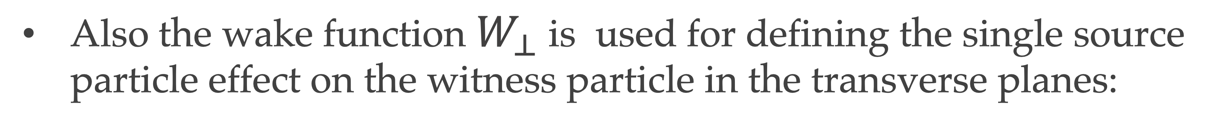
Transverse impedance
Also the wake function $W_{⊥}$ is used for defining the single source particle effect on the witness particle in the transverse planes:
$$W_{⊥}=−\frac{1}{q}∫_{−∞}^{∞}dt(\text{E}+\frac{\text{v}}{c}×\text{H})_{⊥}(r_{source},r_{witness},vt−z,t)$$
The impedance becomes:
$$Z_{⊥}(\overset{⃗}{u_{s}},\overset{⃗}{u_{w}},z)=j∫_{−∞}^{∞}W_{⊥}(\overset{⃗}{x_{s}},\overset{⃗}{x_{w}},\overset{⃗}{y_{s}},\overset{⃗}{y_{w}},vt)e^{\frac{jwz}{v}}dz$$

Slide 20
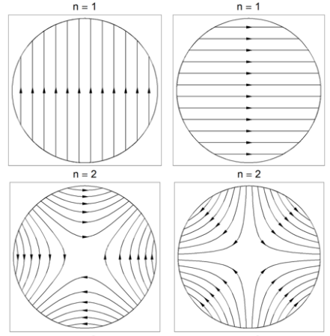
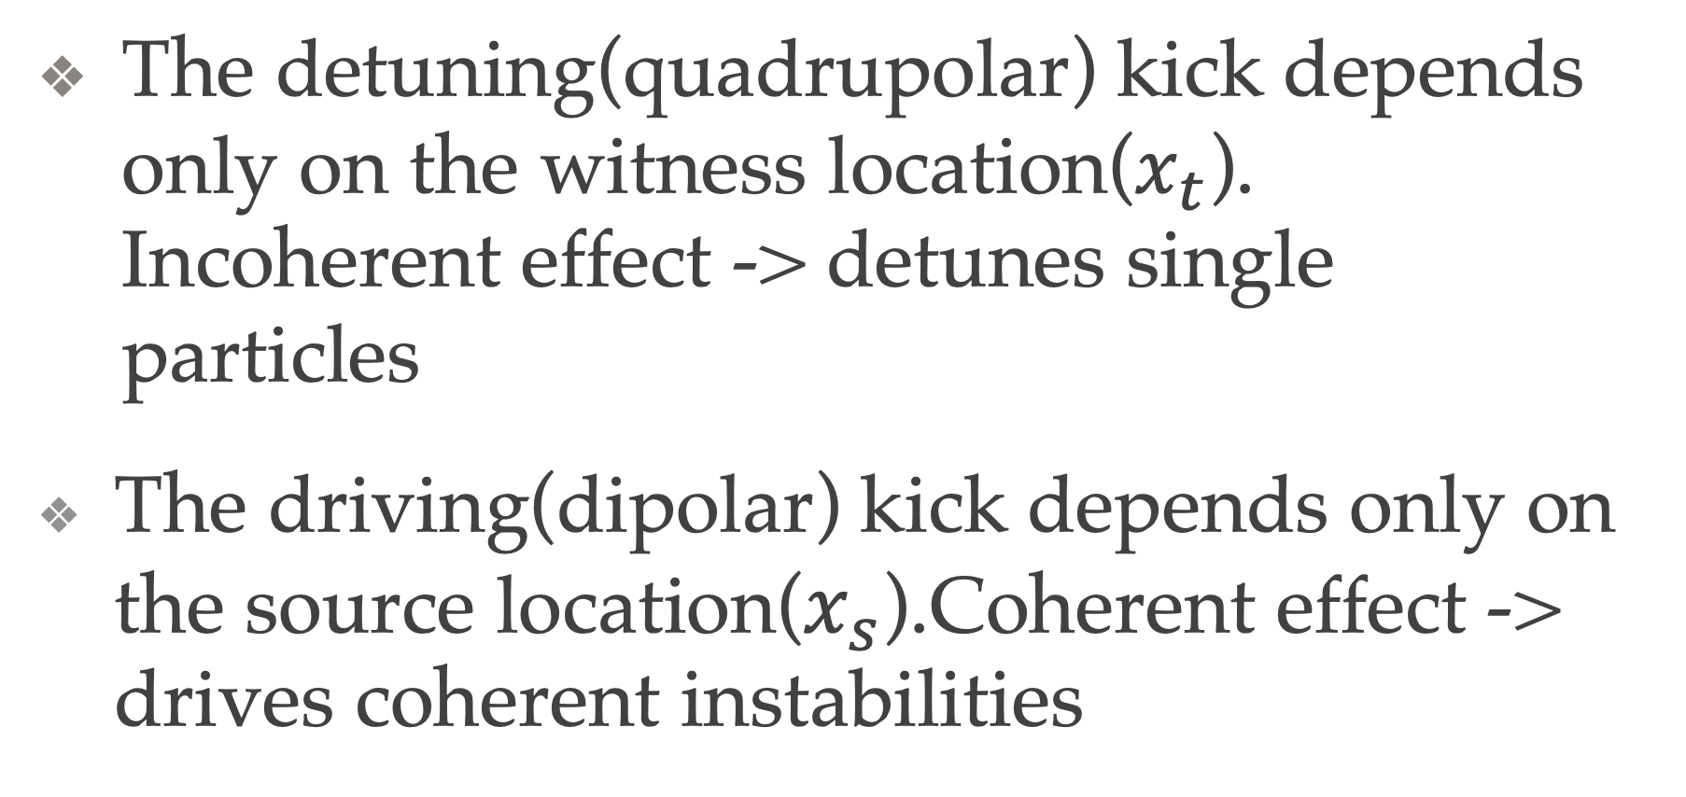
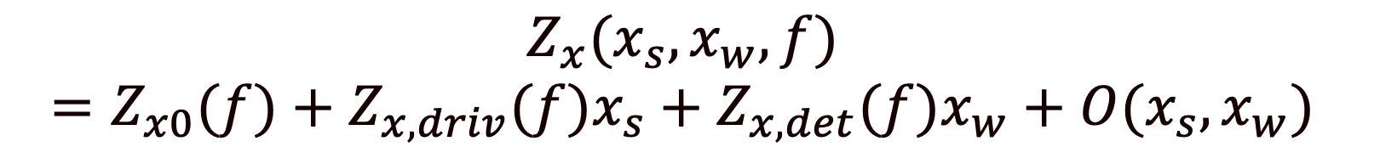
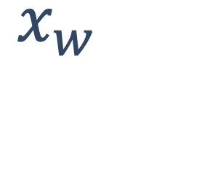
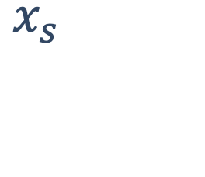
Dipolar-Quadrupolar Impedance
$$Z_{x}(x_{s},x_{w},f)=Z_{x0}(f)+Z_{x,driv}(f)x_{s}+Z_{x,det}(f)x_{w}+O(x_{s},x_{w})$$
$$x_{w}$$
$$x_{s}$$
The detuning(quadrupolar) kick depends only on the witness location($x_{t}$). Incoherent effect -> detunes single particles
The driving(dipolar) kick depends only on the source location($x_{s}$).Coherent effect -> drives coherent instabilities

Slide 21
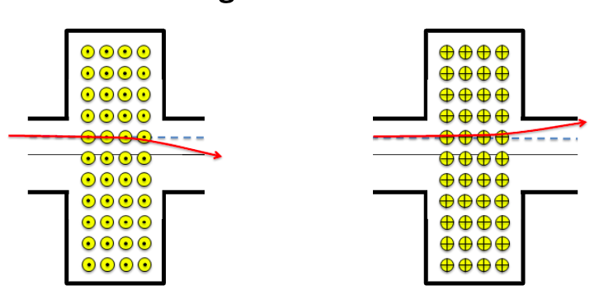
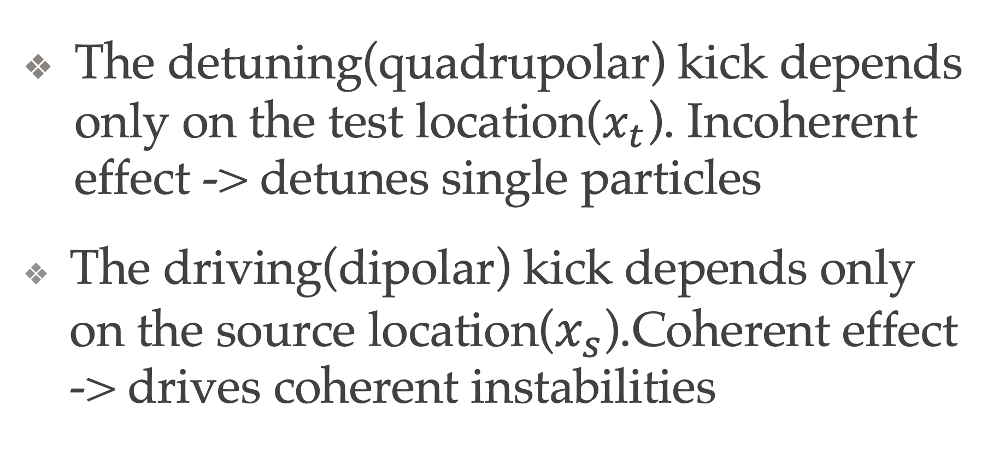
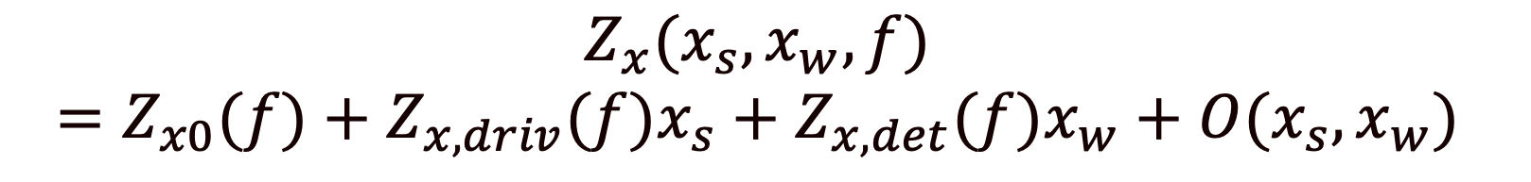


Dipolar-Quadrupolar Impedance
$$Z_{x}(x_{s},x_{w},f)=Z_{x0}(f)+Z_{x,driv}(f)x_{s}+Z_{x,det}(f)x_{w}+O(x_{s},x_{w})$$
$$x_{t}$$
$$x_{s}$$
The detuning(quadrupolar) kick depends only on the test location($x_{t}$). Incoherent effect -> detunes single particles
The driving(dipolar) kick depends only on the source location($x_{s}$).Coherent effect -> drives coherent instabilities

Slide 22
The effect of the impedances
Impedances | Measurable effects
Longitudinal broad band | Bunch lengthening Synchronous phase shift Orbit distortion Energy spread growth
Transverse broad band | Coherent betatron tune shift Chromatic head-tail Orbit distortion
Transverse narrow band | Transverse coupled bunch instability

Slide 23

The Goal of Impedance Study
Impedance Simulations
Impedance
Measurements
Wake Function
Calculations
Design
Manufacturing
Comparison Results with
Machine Measurements
Beam Dynamics
Program
Study of Beam
Dynamics

Slide 24
The Methods for Defining the Impedance
Beam Measurements(after comissioning)
Simulations(CST particle studio-Wakefield Solver)
Wire Measurements
  Longitudinal One Wire
  Moving wire
  Two wires
  Wire Resonance Measurements

Slide 25
Simulations
The main method used to design this model is 3D electromagnetic time domain simulations using the wakefield solver of CST Particle Studio
It allows to study complex structures which are close to the geometry of the real objects.
The standard output is the wake potential and the impedance is computed by Fourier Transform
expected problems

Slide 26
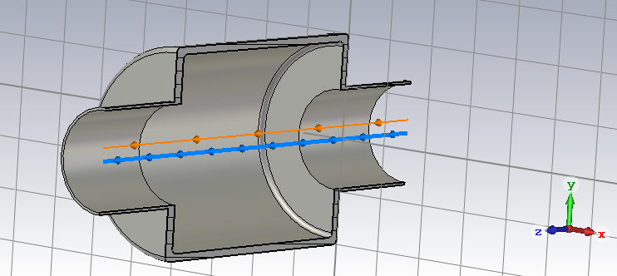
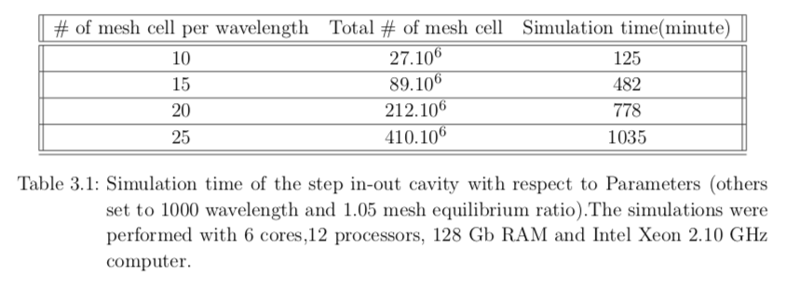
CST Simulation example
All simulations were performed with CST Particle Studio
There are many parameters should be checked:
  Number of Mesh cell
  Mesh cell equilibrium ratio
  Mesh cell per wavelength
  Integration methods
Many simulations were performed with step in out and rectangular cavity to optimizing the computational time , power and the accuracy.

Slide 27
CST Simulation example
All simulations were performed with CST Particle Studio
There are many parameters should be checked:
  Number of Mesh cell
  Mesh cell equilibrium ratio
  Mesh cell per wavelength
  Integration methods
Many simulations were performed with step in out and rectangular cavity to optimizing the computational time , power and the accuracy.

Slide 28
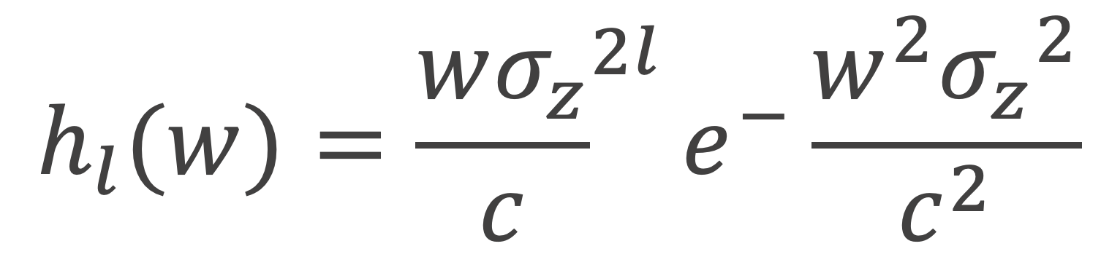
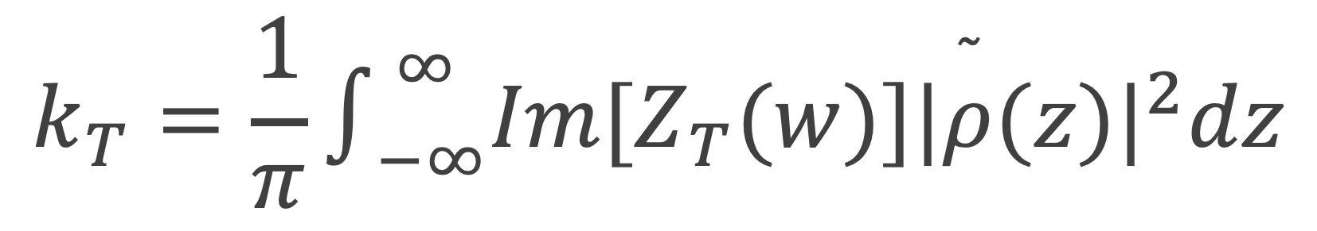
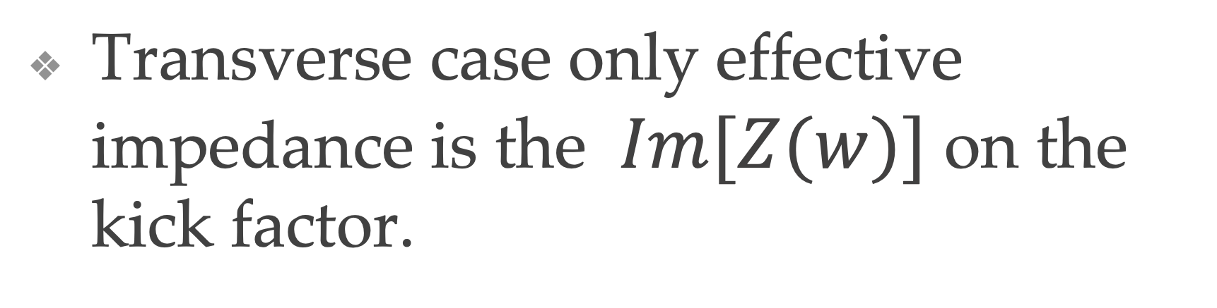
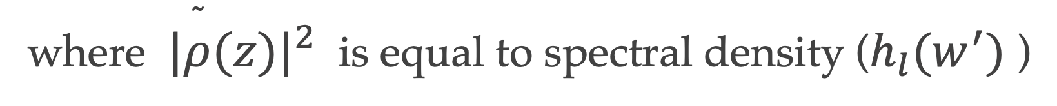
Kick Factors
$$k_{T}=\frac{1}{π}∫_{−∞}^{∞}Im[Z_{T}(w)]{|\overset{˜}{ρ}(z)|}^{2}dz$$
The kick factors describes the transverse kick that a particle feel due to the impedance.
where ${|\overset{˜}{ρ}(z)|}^{2}$ is equal to spectral density ($h_{l}(w^{′})$ )
Transverse case only effective impedance is the $Im[Z(w)]$ on the kick factor.
$$h_{l}(w)={\frac{wσ_{z}}{c}}^{2l}e^{−}\frac{w^{2}{σ_{z}}^{2}}{c^{2}}$$
where $σ_{z}$ is equal to standart deviation of the gaussian bunch.

Slide 29
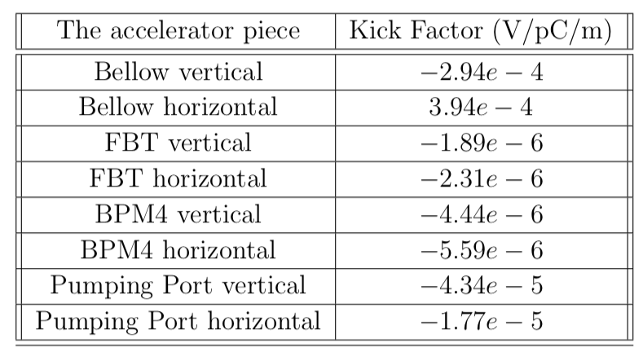
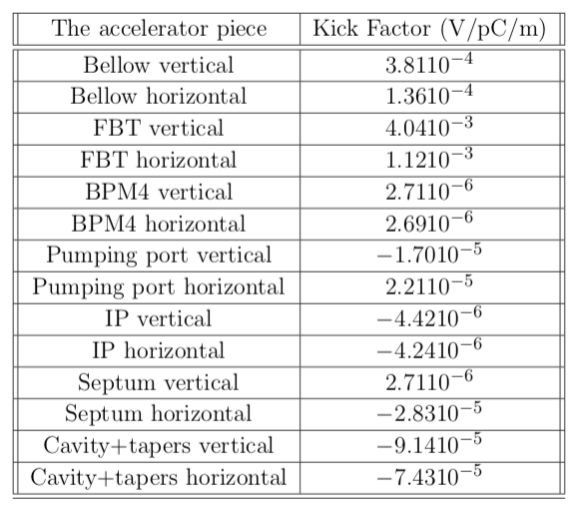
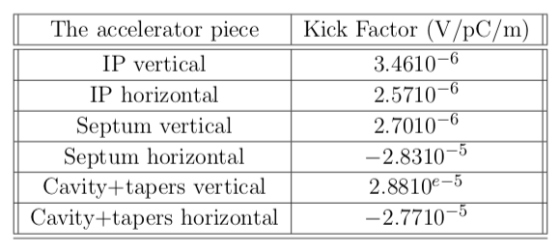
Kick Factors
Dipolar
Quadrupolar

Slide 30
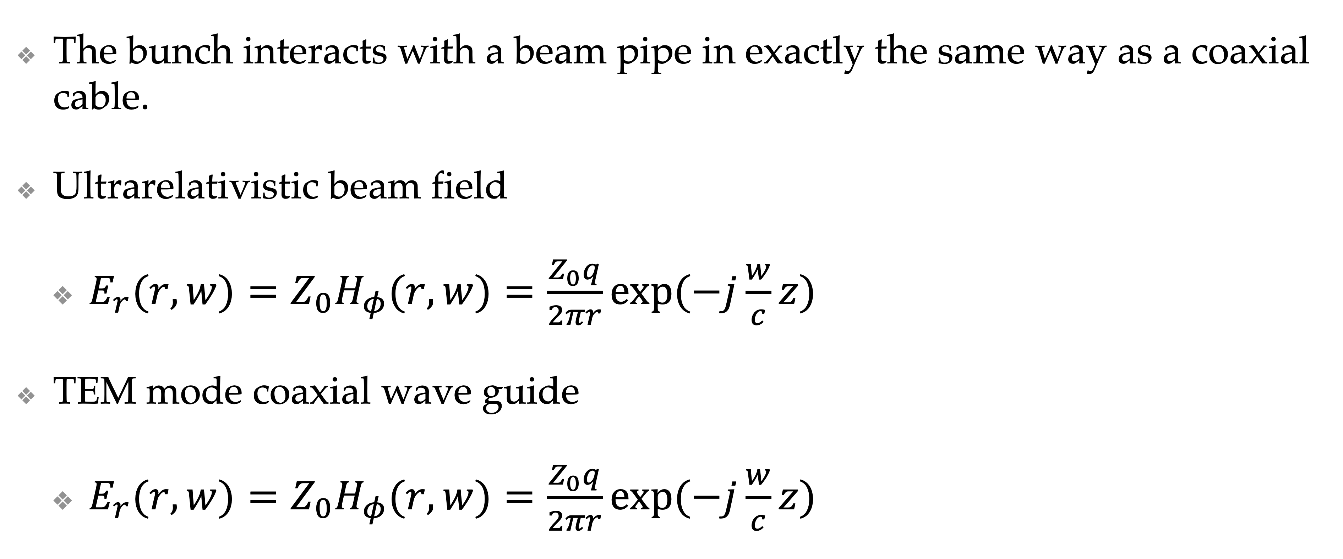
Beam vs. Coaxial Cable
The bunch interacts with a beam pipe in exactly the same way as a coaxial cable.
Ultrarelativistic beam field
  $E_{r}(r,w)=Z_{0}H_{φ}(r,w)=\frac{Z_{0}q}{2πr}exp(−j\frac{w}{c}z)$
TEM mode coaxial wave guide
  $E_{r}(r,w)=Z_{0}H_{φ}(r,w)=\frac{Z_{0}q}{2πr}exp(−j\frac{w}{c}z)$

Slide 31
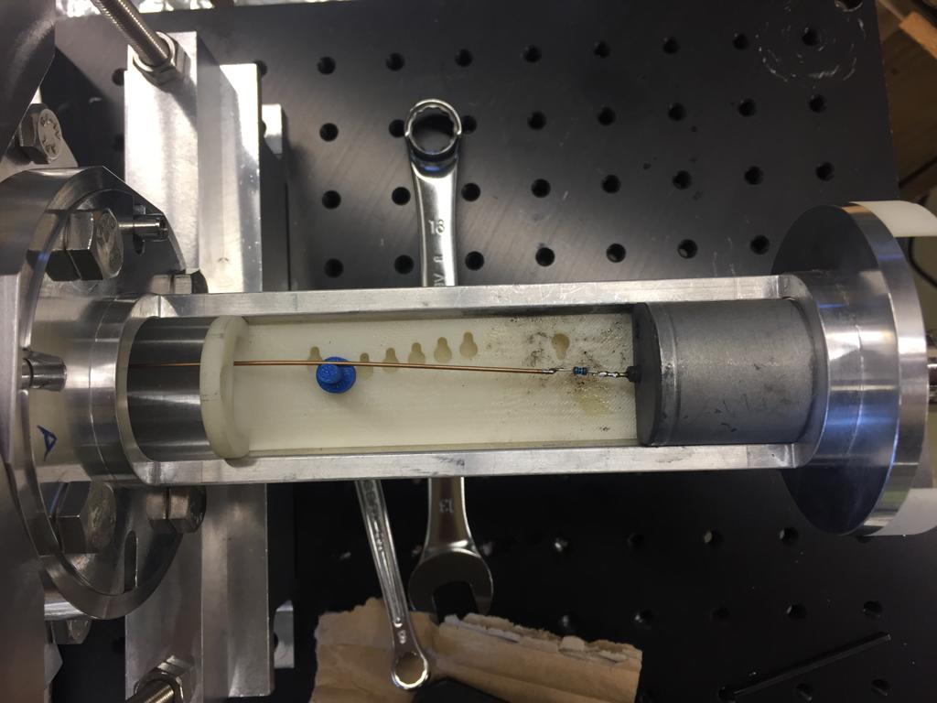

Experimental Procedure
DUT
(Device Under test)
The electromagnetic wave propagate through wire to VNA.
VNA port 1
VNA port 2
VNA port 1
VNA port 2
Reflected
incident
Transmitted

Slide 32
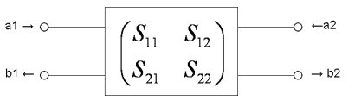

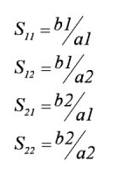



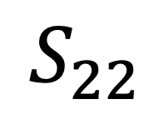
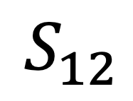
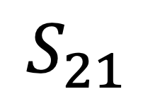
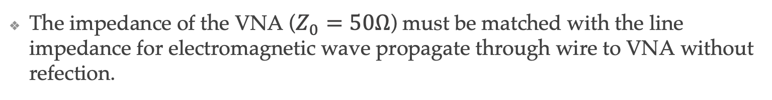
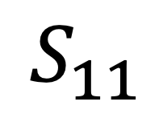
S parameters
      The scattering matrix is a mathematical construct that quantifies how RF energy propagates through a multi-port network
$$S_{11}$$
$$S_{21}$$
$$S_{22}$$
$$S_{11}$$
$$S_{12}$$
The impedance of the VNA ($Z_{0}=50Ω$) must be matched with the line impedance for electromagnetic wave propagate through wire to VNA without refection.

Slide 33





Reference Piece
reference pieces photo
$$Z=−2Z_{L}ln(\frac{S{21}_{DUT}}{S{21}_{REF}})$$
28 mm
$$Z_{L}=\frac{Z_{v}}{2π}ln(\frac{D}{d})$$
40 mm
where $Z_{L}$ is the line impedance $S{21}_{DUT}$ is the measured S parameter of the device under test and $S{21}_{REF}$ is the measured S parameter of the referance section,D is the diameter of the pipe($D_{eq}=30.9mm$ was used) and d is the diameter of the wire.

Slide 34


Design and Reliability of the Bench

Slide 35





Two wire Measurements
180° hybrid coupler
180° hybrid coupler
$$Δ$$
VNA
Two wire method contains two wires driven with opposite phases which only gives the dipolar contribution of the impedance
$Z_{T}=\frac{cZ}{2πfΔ^{2}}$ where $Δ$ is wire spacing.
where w is the frequency and $Δ$ is the distance between two wire

Slide 36


Tests for Measurements
Minimizing the parasitic and human error the measurements were performed 5 times.
Different wire diameters were checked to find compromised between attenuation on the signal and high line impedance.
Step in-out cavity

Slide 37

An Example for Two Wire: Bellow
The Bellow aims to compansate termal expansions and contractions.
They are also give sufficient tolerance for misalignments. Due to their geometry, bellows are tend to create high impedances and trigger higher order modes. These behavior can create beam instabilities and heats. The rf fingers can be used to shield rf fields to reduce impedances.
The measurements can be performed without rf finger to check the reliability of the rf fingers but also reliability of the measurement bench.

Slide 38

S Parameter Measurements of Reference
The mean of 5 different $S_{21}$ measurements with standard deviation

Slide 39



Dipolar Impedance Calculation and CST Simulation Comparison of Bellow
$$Z_{T}=\frac{cZ}{2πfΔ^{2}}$$
Bellow Transverse Impedance(Dipolar) Comparison with CST Simulations
(1 cm distance)
$$Z=−2Z_{L}ln(\frac{S{21}_{DUT}}{S{21}_{REF}})$$

Slide 40











One Wire Measurements
On axis
Moving wire
$$x=x$$
$$y=y$$
$$y=0$$
$$x=0$$
$$y$$
$$x=0$$
$$x$$
$$y=0$$
$$Z_{T}=Z_{L}+Z_{1x}x^{2}+Z_{1y}y^{2}$$
where $Z_{L}$ is the longitudinal impedance which was measured at the center, $Z_{1x}$ and $Z_{1y}$ are the measured impedance coefficents with and wire offset with x and y respectively.
The general transverse impedances are:
$Z_{x}=Z_{dipx}−Z_{quadx}=\frac{c}{2πf}Z_{1x}$
$Z_{y}=Z_{dipy}+Z_{quady}=\frac{c}{2πf}Z_{1y}$
The coefficient $Z_{1x}$ and $Z_{1y}$ are extracted by fitting a parabola.
when it was measured at the center the only term you measured will be the $Z_{L}$ which is the longitudinal impedance.
The moving wire measurements in both planes can be crosschecked with the two wire measurements.

Slide 41

An Example for Longitudinal and Moving Wire: FBT
The transverse feedback kicker is a part of the system which is aim to suppress beam instabilities with a fast response. The system is capable of detecting a coherent transverse motion(with BPM) and applying a counter kick to damp it (FBT), bunch by bunch and turn by turn.

Slide 42

An Example for Longitudinal and Moving Wire: FBT
Scheme for capacitive gaps
The transverse feedback kicker has four electrodes which are supported by the ceramic holders. It is connected to the feed-through with the copper foils . The electrodes are connected to stripline which creates electric field for a counter kick.
It was designed to minimize the impedance with the capacitive gaps and capacitive height which should be checked after manufacturing with the wire measurements.

Slide 43

Moving wire Measurements of FBT

Slide 44
Moving wire Measurements of FBT

Slide 45

Moving wire Measurements of FBT
The contribution of the transverse impedance
The fair blue one is on axis measurements which is longitudinal impedance of FBT.

Slide 46
Moving wire Measurements of FBT
The contribution of the transverse impedance
The fair blue one is on axis measurements which is longitudinal impedance of FBT.

Slide 47
Moving wire Measurements of FBT
0.252 GHz
The contribution of the transverse impedance

Slide 48


Parabolic fit Example
$$Z_{T}=Z_{L}+Z_{1x}x^{2}+Z_{1y}y^{2}$$

Slide 49


Longitudinal Impedance Results
$Z_{T}=Z_{L}+Z_{1x}x^{2}+Z_{1y}y^{2}$

Slide 50

Longitudinal Impedance Results

Slide 51


Total Transverse of FBT
Do the double axis
$$Z_{T}=Z_{L}+Z_{1x}x^{2}$$

Slide 52






Total Dipolar Impedance
$$Z_{y}=Z_{dipy}+Z_{quady}=\frac{c}{2πf}Z_{1y}$$
In our case the structure is not symmetric so the total dipolar impedance also contains some of the qudrupolar component of y axis. But the normalization will be done with the help of simulations.
$$Z_{x}=Z_{dipx}−Z_{quadx}=\frac{c}{2πf}Z_{1x}$$
$$Z_{y}+Z_{x}=Z_{dipy}+Z_{quady}+Z_{dipx}−Z_{quadx}=Z_{totdip}$$
for symmetric structures

Slide 53

Quadrupolar Impedance
The quadrupolar impedance which was taken as dipolar impedance extracted from total transverse impedance

Slide 54
Quadrupolar Impedance
The quadrupolar impedance which was taken as dipolar impedance extracted from total transverse impedance

Slide 55


Quadrupolar Impedance
The quadrupolar impedance which was taken as dipolar impedance extracted from total transverse impedance
$$Z_{x}=Z_{dipx}−Z_{quadx}=\frac{c}{2πf}Z_{1x}$$
$$Z_{y}=Z_{dipy}+Z_{quady}=\frac{c}{2πf}Z_{1y}$$

Slide 56

All impedances FBT

Slide 57


Conclusion
The quadrupolar impedance can be extracted from moving wire even from 8 $Ω/mm$
Maximum error is ~%5 in the frequency scale for all measurements from 0 to 6 GHz.
The total horizontal and vertical dipolar kick factors are −0.00088V/pC/m and −0.0011V/pC/m.
Total horizontal and vertical quadrupolar kick factors are 0.003976V/pC/m and 0.0033986V/pC/m respectively.
The longitudinal impedance can be measured from 9 $Ω$

Slide 58
Thank you for your Attention!

Slide 59
Back-ups

Slide 60


Relation Between Logaritmic and Linear
$$S(dB)=20∗Log(\sqrt{{reS}^{2}+{imS}^{2}})$$
$$Z_{log}(Ω)=20∗Log(\sqrt{{reZ}^{2}+{imZ}^{2}})$$

Slide 61

ThomX-Injection and Linac
Beam energy E at exit and charge | 5 MeV 1 nC
RF Frequency | 3 GHz
Number of bunches per RF pulse | 1
Number of cells | 2.5
Accelerating gradient | 80 MV/m
Repetition Frequency | 50 Hz
Beam energy E at exit | 50 (70) MeV
Length | 4.5 m
RF Frequency | 3 GHz
Accelerating gradient | 12.5 (18) MV/m
Electron bunch length _{s} at the exit (@ 1 nC) | 3-6 ps
Repetition Frequency | 50 Hz
Emittance at exit (@ 1 nC) | 5 pi.mm.mrad

Slide 62

ThomX Storage Ring
Beam energy E at exit | 50 (70) MeV
Length | 4.5 m
RF Frequency | 3 GHz
Accelerating gradient | 12.5 (18) MV/m
Electron bunch length _{s} at the exit (@ 1 nC) | 3-6 ps
Repetition Frequency | 50 Hz
Emittance at exit (@ 1 nC) | 5 pi.mm.mrad
$$T_{store}=20ms$$

Slide 63




Step in out Theory

Slide 64



Error Estimation

Slide 65







Theory of Moving wire
The impedance can be defined with current density:
$$Z_{m,n}=\frac{−1}{I^{2}}∫dV \overset{→}{E_{m}}.\overset{→}{J_{n}}$$
$m,n=0,±1,±2$,…
where Zm,n (m,n=0,±1,±2,...) are the impedances due to the n-th order current density, a is the displacement of the wire from the centre axis and θ is the azimuthal angle of displacement of the wire.
$$\overset{→}{J_{n}}=\frac{I}{2πa^{\left|m\right|+1} }δ\left(r−a\right)e^{jnθ}e^{j\left(wt−kz\right)}\overset{ }{e_{z}}$$
In that case, the longitudinal impedance created by a single wire displaced from the center by $a$ and with an azimuthal angle $θ$ is :
$$Z$$
$$=Z_{0,0}+ae^{−jθ}\left(Z_{1,0}+Z_{0,−1}\right)+ae^{jθ}\left(Z_{0,1}+Z_{−1,0}\right)+a^{2}e^{−2jθ}\left(Z_{2,0}+Z_{1,−1}+Z_{0,−2}\right)+a^{2}\left(Z_{1,1}+Z_{−1,−1}\right)+a^{2}e^{2jθ}\left(Z_{0,2}+Z_{−1,1}+Z_{−2,0}\right)+O\left(a^{3}\right)$$
Subsequently, by using the Panowsky-Wenzel Theorem and using a cartesian coordinate system x = acosθ, y = asinθ and ignoring constant, coupling and higher order terms, we can define a general transverse impedance in the horizontal and vertical planes.
It should be noted that Z0,0 is what is commonly referred to as the longitudinal impedance, referred to as Zlong, measured at a displacement a = 0. If we scan for different $x_{0}=a$ ($θ=0$) then we get :
$$Z=Z_{0,0}+x_{0}^{2}\left(Z_{1,1}+Z_{−1,−1}+Z_{1,−1}+Z_{−1,1}+Z_{2,0}+Z_{0,−2}+Z_{0,2}+Z_{−2,0}\right)$$
$$=Z_{0,0}+x_{0}^{2}\left({Z_{dip}}_{x}−Z_{quad}\right)$$
$y_{0}=a$ and $θ=\frac{π}{2}$:
$$Z=Z_{0,0}+y_{0}^{2}\left({Z_{dip}}_{y}+Z_{quad}\right)$$

Slide 66

Theory of Two Wire
$$Z={\left(2a\right)}^{2}\left(Z_{1,1}+Z_{−1,−1}+Z_{1,−1}+Z_{−1,1}\right)+O\left(a^{4}\right)$$
$${Z_{dip}}_{x}=\frac{Z_{1,1}+Z_{−1,−1}+Z_{1,−1}+Z_{−1,1}}{k}=\frac{c}{2πf}\frac{Z}{Δ^{2}}$$

Slide 67


Slide 68


Thank you for your Attention!

