Slide 1


8th Internationally Participated Congress
On Particle Accelerators And Applications (UPHUK VIII)
RF powering for accelerators
eric.montesinos@cern.ch
September 05 - 07 2022, The Turkish Physical Society, Bodrum, Turkey

Slide 2
RF Powering
W → kW → MW
€ → k€ → M€
(Very important for all projects)

Slide 3
Outlook
RF power amplifiers for accelerators
  Grid Tubes
  Klystrons
  Inductive Output Tubes (IOT)
  Transistors (LDMOS)
  Combiners
RF power lines
  Wave Guides
  Coaxial lines
  Circulators
FPC
Efficiency

Slide 4

RF Power Amplifier
DUT
(Device Under Test)

Slide 5
RF power source classification
Vacuum Tubes
Transistors
Bipolar Junction Transistor (BJT)
Field Effect Transistor (FET)
Junction Gate FET (JFET)
Metal Oxide Semiconductor FET (MOSFET)
power MOSFET
Vertically Diffused Metal Oxide Semiconductor (VDMOS)
Laterally Diffused Metal Oxide Semiconductor (LDMOS)
Gallium Nitride (GaN)
Silicon Carbide MOSFET (SiC)
Grid Tubes
Triodes
Tetrodes
Pentodes
Diacrodes
Linear Beam Tubes
Klystrons
Travelling Wave Tubes (TWT)
Gyrotrons
Inductive Output Tube (IOT)
Crossed-field Tubes
Magnetrons

Slide 6
RF power source classification
Vacuum Tubes
Transistors
Bipolar Junction Transistor (BJT)
Field Effect Transistor (FET)
Junction Gate FET (JFET)
Metal Oxide Semiconductor FET (MOSFET)
power MOSFET
Vertically Diffused Metal Oxide Semiconductor (VDMOS)
Laterally Diffused Metal Oxide Semiconductor (LDMOS)
Gallium Nitride (GaN)
Silicon Carbide MOSFET (SiC)
Grid Tubes
Triodes
Tetrodes
Pentodes
Diacrodes
Linear Beam Tubes
Klystrons
Travelling Wave Tubes (TWT)
Gyrotrons
Inductive Output Tube (IOT)
Crossed-field Tubes
Magnetrons

Slide 7
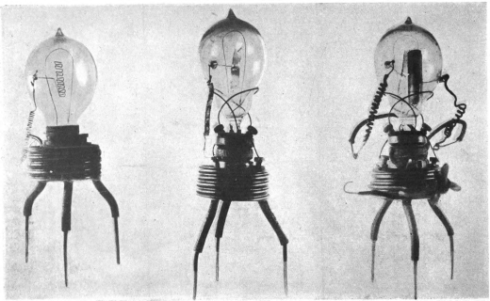
Grid tubes
Diode, John Ambrose Fleming
Audion (first triode), Lee de Forest
Triode as amplifier, Fritz Lowenstein
Triode ‘higher vacuum’, Harold Arnold
first transcontinental telephone line, Bell
1916 Tetrode, Walter Schottky
Pentode, Bernardus Tellegen
1994 Diacrode, Thales Electron Devices
The first diode prototype Fleming Diode, 1904
Thales TH 628 diacrode, 1998

Slide 8
Essentials of grid tube
Vacuum tube
Heater + Cathode
  Heated cathode
    Coated metal, carbides, borides,…
  thermionic emission
  Electron cloud
Anode
Diode
Ua
Anode
e-
e-
e-
e-
I_{current}
e-
e-
e-
e-
e-
e-
e-
Cathode & Filament

Slide 9
Essentials of grid tube
Vacuum tube
Heater + Cathode
  Heated cathode
    Coated metal, carbides, borides,…
  thermionic emission
  Electron cloud
Anode
Diode
Ua
Anode
I_{current}
e-
e-
e-
Cathode & Filament

Slide 10
Essentials of grid tube
Triode
  Modulating the grid voltage proportionally modulates the anode current
  Transconductance
    Voltage at the grid
    Current at the anode
  Limitations
    Parasitic capacitor Anode/g1
    Tendency to oscillate
Ua
Anode
e-
e-
e-
e-
Ug1
Control Grid
e-
e-
e-
e-
e-
Cathode & Filament

Slide 11
Essentials of grid tube
Tetrode
  Screen grid
    Positive (lower anode)
    Decouple anode and g1
    Higher gain
  Limitations
    Secondary electron
    Anode treated to reduce secondary emission
Ua
Anode
e-
e-
e-
e-
Ug2
Screen Grid
Ug1
Control Grid
e-
e-
e-
e-
e-
Cathode & Filament

Slide 12
Tetrode
RS 2004 CERN SPS example
Grounded Screen Grid
RF out
Ua
Anode
RF in
Ug2
Screen Grid
Ug1
Control Grid
Cathode & Filament
CERN SPS, RS 2004 Tetrode (very) simplified bloc diagram

Slide 13
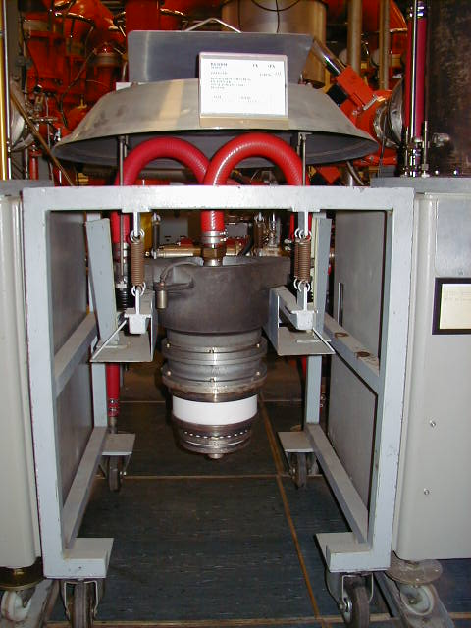
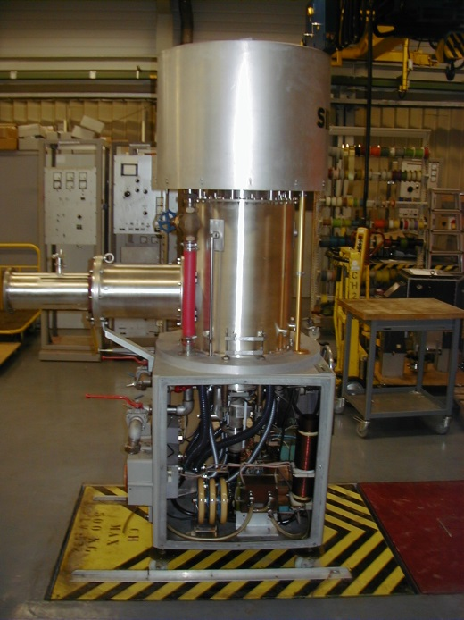
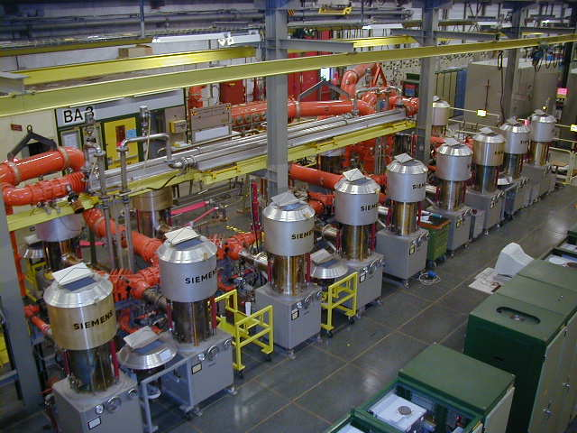
Tetrode
RS 2004 CERN SPS amplifier @ 200 MHz
CERN SPS, RS 2004 Tetrode, Trolley (single amplifier), and transmitter (combination of amplifiers)
Two transmitters of eight tubes delivering 2 x 1 MW @ 200 MHz, into operation since 1976

Slide 14
Tetrodes & Diacrodes available from industry

Slide 15
RF power source classification
Vacuum Tubes
Transistors
Bipolar Junction Transistor (BJT)
Field Effect Transistor (FET)
Junction Gate FET (JFET)
Metal Oxide Semiconductor FET (MOSFET)
power MOSFET
Vertically Diffused Metal Oxide Semiconductor (VDMOS)
Laterally Diffused Metal Oxide Semiconductor (LDMOS)
Gallium Nitride (GaN)
Silicon Carbide MOSFET (SiC)
Grid Tubes
Triodes
Tetrodes
Pentodes
Diacrodes
Linear Beam Tubes
Klystrons
Travelling Wave Tubes (TWT)
Gyrotrons
Inductive Output Tube (IOT)
Crossed-field Tubes
Magnetrons

Slide 16
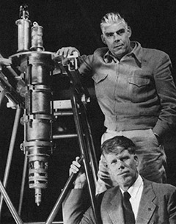
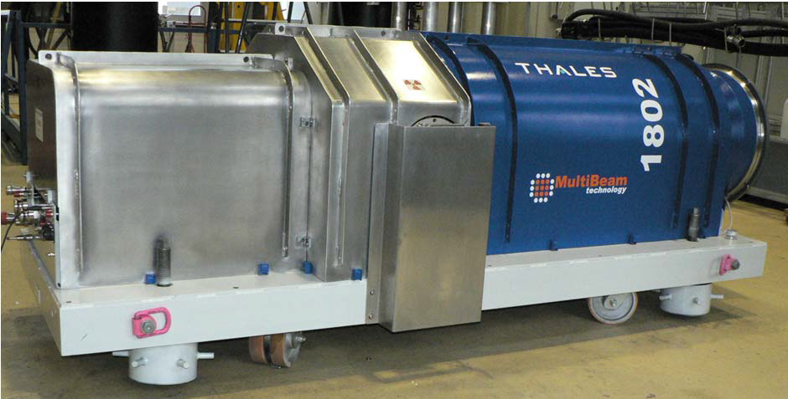
Linear beam tubes
1937 Klystron, Russell & Sigurd Variant
1938 IOT, Andrew V. Haeff
1939 Reflex klystron, Robert Sutton
1940 Few commercial IOT
1941 Magnetron, Randall & Boot
1945 Helix Travelling Wave Tube (TWT), Kompfner
1948 Multi MW klystron
1959 Gyrotron, Twiss & Schneider
1963 Multi Beam Klystron, Zusmanovsky and Korolyov
1980 High efficiency IOT
Russell & Sigurd Varian klystron, 1937
Thales TH 1802, 2002

Slide 17
Essentials of klystron
U_{beam}
Klystrons velocity modulation
  converts the kinetic energy into radio frequency power
Vacuum tube
Electron gun
  Thermionic cathode
  Anode
Electron beam
Drift space
Collector
e- constant speed until the collector
Collector
Drift Space
Electron Gun
U_{anode}
Cathode & Filament

Slide 18
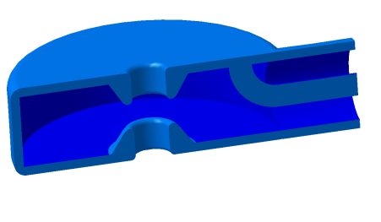
Essentials of klystron
U_{beam}
Cavity resonators
RF input cavity (Buncher)
  modulates e- velocity
  Some are accelerated
  Some are neutral
  Some are decelerated
  Bunching the e-
RF output cavity (Catcher)
  Resonating at the same frequency as the input cavity
  At the place with the numerous number of e-
  Kinetic energy converted into voltage and extracted
Cavity
Coupling
loop
U_{anode}
Cathode & Filament
Beam
line
Accelerating
gap

Slide 19
Essentials of klystron
Cavity resonators
RF input cavity (Buncher)
  modulates e- velocity
  Some are accelerated
  Some are neutral
  Some are decelerated
  Bunching the e-
RF output cavity (Catcher)
  Resonating at the same frequency as the input cavity
  At the place with the numerous number of e-
  Kinetic energy converted into voltage and extracted
-
+
→
-
→
+

Slide 20
Essentials of klystron
Cavity resonators
RF input cavity (Buncher)
  modulates e- velocity
  Some are accelerated
  Some are neutral
  Some are decelerated
  Bunching the e-
RF output cavity (Catcher)
  Resonating at the same frequency as the input cavity
  At the place with the numerous number of e-
  Kinetic energy converted into voltage and extracted
+
-
→
+
→
-

Slide 21
Essentials of klystron
Cavity resonators
RF input cavity (Buncher)
  modulates e- velocity
  Some are accelerated
  Some are neutral
  Some are decelerated
  Bunching the e-
RF output cavity (Catcher)
  Resonating at the same frequency as the input cavity
  At the place with the numerous number of e-
  Kinetic energy converted into voltage and extracted

Slide 22
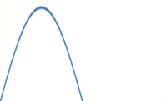
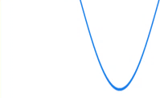
Essentials of klystron
Voltage in cavities
vs time
Cavity resonators
RF input cavity (Buncher)
  modulates e- velocity
  Some are accelerated
  Some are neutral
  Some are decelerated
  Bunching the e-
RF output cavity (Catcher)
  Resonating at the same frequency as the input cavity
  At the place with the numerous number of e-
  Kinetic energy converted into voltage and extracted
e- density at input cavity
e- density at output cavity
time
accelerated
+
neutral
decelerated
-
Distance (drift space)
Bunching of e- beam in a klystron

Slide 23
Essentials of klystron
Collector
Additional bunching cavities
  Resonate with the pre-bunched electrons beam
  Generate an additional accelerating/decelerating field
  Better bunching
  Gain 10 dB per cavity
Focusing magnets
  To maintain the e- beam as expected and where expected
Anode
Cathode & Filament

Slide 24
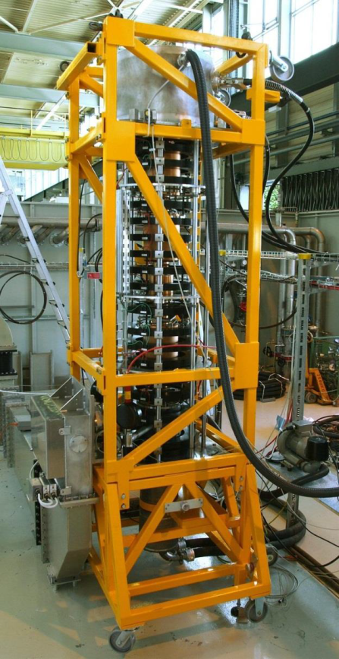
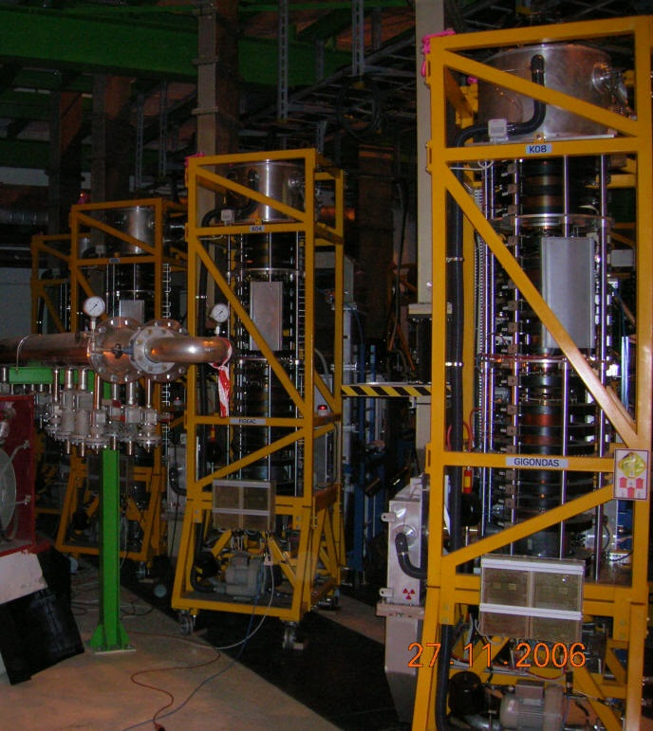

Klystron
TH 2167 CERN LHC @ 400 MHz
CERN LHC, TH 2167 klystron in lab and in UX45 cavern
16 klystrons delivering 330 kW @ 400 MHz, into operation since 2008

Slide 25
Klystrons available from industry

Slide 26
RF power source classification
Vacuum Tubes
Transistors
Bipolar Junction Transistor (BJT)
Field Effect Transistor (FET)
Junction Gate FET (JFET)
Metal Oxide Semiconductor FET (MOSFET)
power MOSFET
Vertically Diffused Metal Oxide Semiconductor (VDMOS)
Laterally Diffused Metal Oxide Semiconductor (LDMOS)
Gallium Nitride (GaN)
Silicon Carbide MOSFET (SiC)
Grid Tubes
Triodes
Tetrodes
Pentodes
Diacrodes
Linear Beam Tubes
Klystrons
Travelling Wave Tubes (TWT)
Gyrotrons
Inductive Output Tube (IOT)
Crossed-field Tubes
Magnetrons

Slide 27
Essentials of IOT
U_{anode}
IOT density modulation
  converts the kinetic energy into radio frequency power
Vacuum tube
Triode input
  Thermionic cathode
  Grid modulates e- emission
Klystron output
  Anode accelerates e- buckets
  Short drift tube & magnets
  Catcher cavity
  Collector
e-
e-
U_{grid}
e-
e-
e-
Cathode & Filament

Slide 28
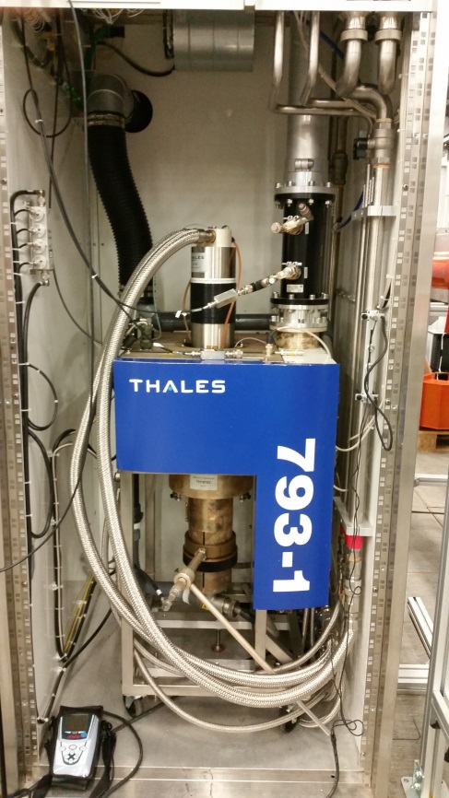
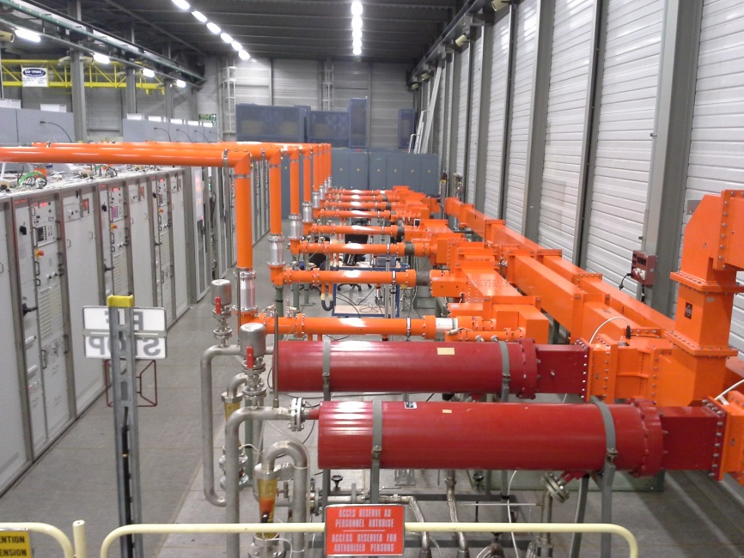
IOT
TH 795 CERN SPS @ 800 MHz
CERN SPS, TH 795 IOT, Trolley (single amplifier), and transmitter (combination of amplifiers)
Two transmitters of four tubes delivering 2 x 240 kW @ 801 MHz, into operation since 2014

Slide 29
IOT available from industry
Possible even if
never requested yet

Slide 30
RF power source classification
Vacuum Tubes
Transistors
Bipolar Junction Transistor (BJT)
Field Effect Transistor (FET)
Junction Gate FET (JFET)
Metal Oxide Semiconductor FET (MOSFET)
power MOSFET
Vertically Diffused Metal Oxide Semiconductor (VDMOS)
Laterally Diffused Metal Oxide Semiconductor (LDMOS)
Gallium Nitride (GaN)
Silicon Carbide MOSFET (SiC)
Grid Tubes
Triodes
Tetrodes
Pentodes
Diacrodes
Linear Beam Tubes
Klystrons
Travelling Wave Tubes (TWT)
Gyrotrons
Inductive Output Tube (IOT)
Crossed-field Tubes
Magnetrons

Slide 31
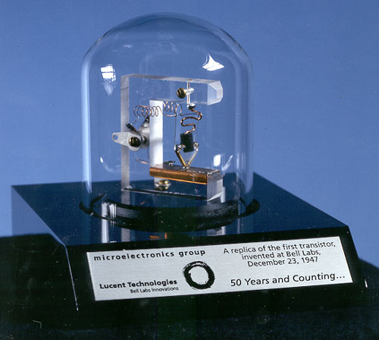
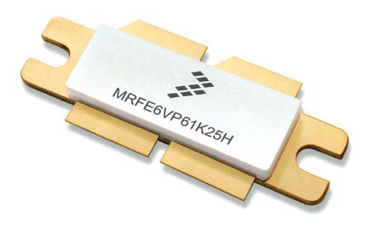
Transistor for RF power
1925 theory, Julius Edgar Lilienfeld
1947 Germanium US first transistor, John Bardeen, Walter Brattain, William Shockley
1948 Germanium European first transistor, Herbert Mataré and Heinrich Welker
1953 first high-frequency transistor, Philco
1954 Silicon transistor, Morris Tanenbaum
1960 MOS, Kahng and Atalla
1966 Gallium arsenide (GaAs)
1980 VDMOS
Silicon-Germanium (SiGe)
Gallium Nitrade (GaN)
1997 Silicon carbide (SiC)
Graphene (GFET)
20xx …
First transistor invented at BELL labs in 1947
XXI century LDMOS

Slide 32
Essentials of RF transistor
In a push-pull circuit the RF signal is applied to two devices
  One of the devices is active on the positive voltage swing and off during the negative voltage swing
  The other device works in the opposite manner so that the two devices conduct half the time
  The full RF signal is then amplified
Two different type of devices
Vdc
NPN BJT
Vin
Vout
PNP BJT

Slide 33
Essentials of RF transistor
Another push-pull configuration is to use a balun (balanced-unbalanced)
  it acts as a power splitter, equally dividing the input power between the two transistors
  the balun keeps one port in phase and inverts the second port in phase
Since the signals are out of phase only one device is on at a time
This configuration is easier to manufacture since only one type of device is required
Vdc
0 ⁰
NPN BJT
0 ⁰
Input balun
(Unbalanced-Balanced)
Output balun
(Balanced-Unbalanced)
Vin
Vout
180 ⁰
180 ⁰
NPN BJT

Slide 34
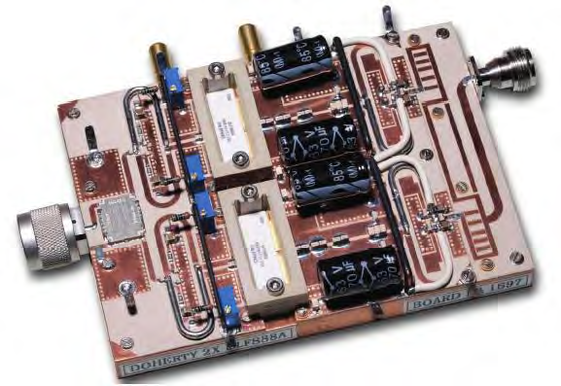
Essentials of RF transistor
NXP Semiconductors AN11325
2-way Doherty amplifier with BLF888A

Slide 35
Transistors available from industry

Slide 36
Combiners & Splitters
RF power combiners and RF power splitters are the same items
Resistive power splitters & Combiners
  Cheap and easy to build
  Use of resistor to maintain the impedance
  Power limitation and losses induces by the resistors (→ not used in high power)
Hybrid power splitters & Combiners
  Use RF lines
  Low levels of loss
  Limitation by the size of the lines
P
2P
P
P/2
P
P/2

Slide 37
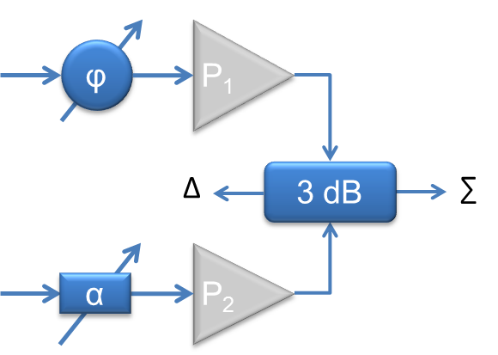



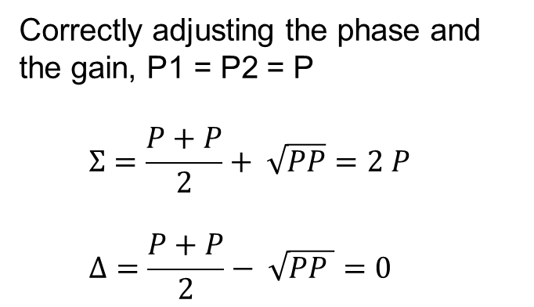

Combiners & Splitters
3 dB phase combiner
With correct input phases
$$Σ=\frac{P1+P2}{2}+ \sqrt{P1P2 }$$
$$Δ=\frac{P1+P2}{2}− \sqrt{P1P2 }$$
P₁
$$Σ$$
$$λ/4$$
$$3 dB$$
Δ
P₂
Correctly adjusting the phase and the gain, P1 = P2 = P
$$Σ=\frac{P+P}{2}+ \sqrt{PP}=2 P$$
$$Δ=\frac{P+P}{2}− \sqrt{PP }=0$$

Slide 38
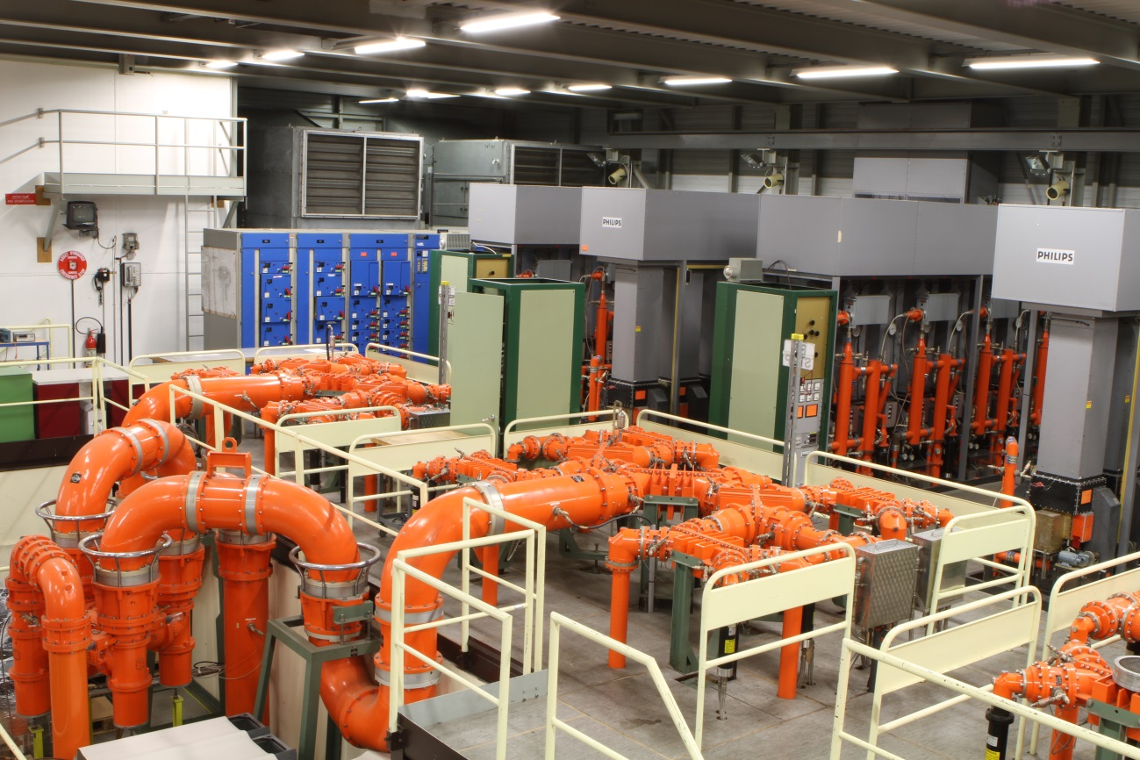
Combiners & Splitters
CERN SPS 64 to 1 combiner @ 200 MHz

Slide 39
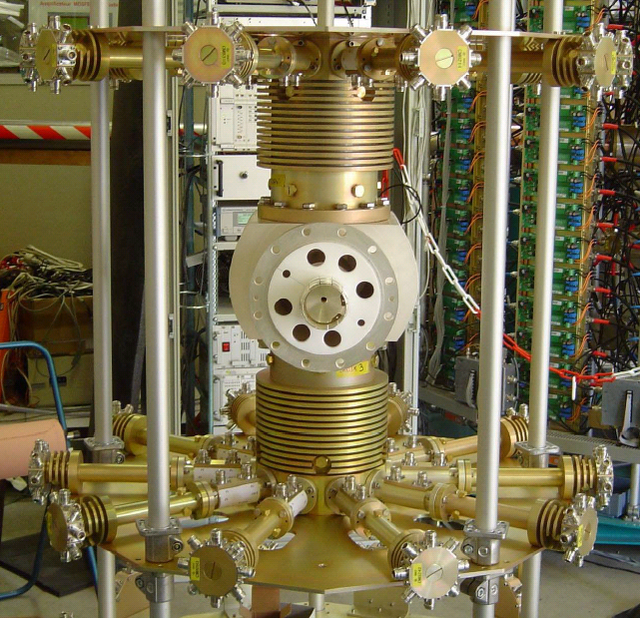






Combiners & Splitters
Low loss T-Junction
With $Zλ/4 =Zc \sqrt{N}$
We have a N-ways splitter
Z_{c} $\sqrt{N}$
$$λ/4$$
Z_{c}
Z_{c}
Z_{c}
$$λ/4$$
Z_{c} $\sqrt{N}$
160 to 1 @ 352 MHz
T-junction combiner

Slide 40
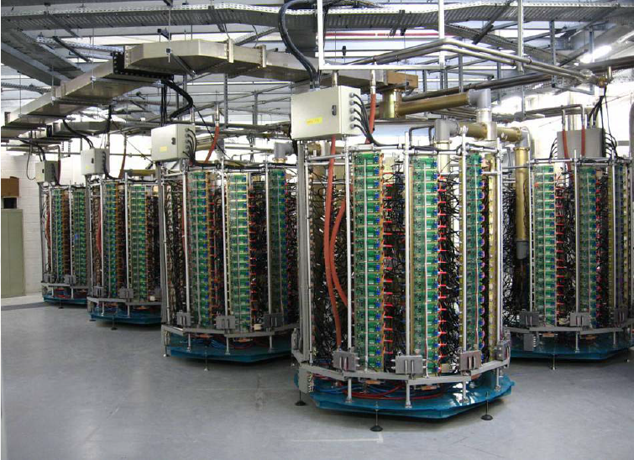
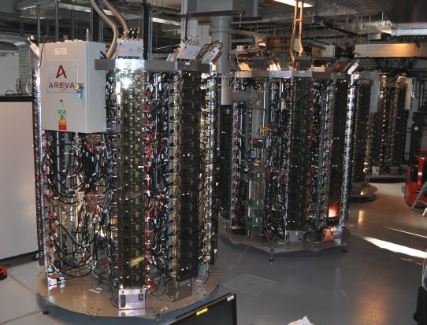
Transistors
SOLEIL @ 352 MHz and ESRF @ 352 MHz
SOLEIL 45 kW @ 352 MHz
solid state amplifier towers (2004 & 2007)
ESRF four 150 kW @ 352 MHz
solid state amplifiers (2012)

Slide 41
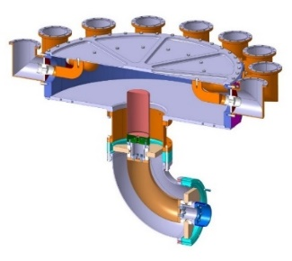
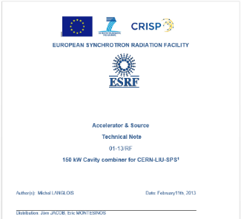
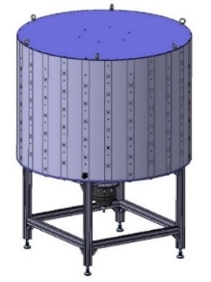

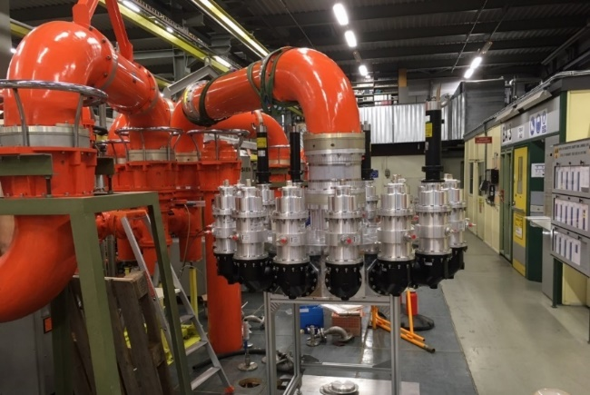
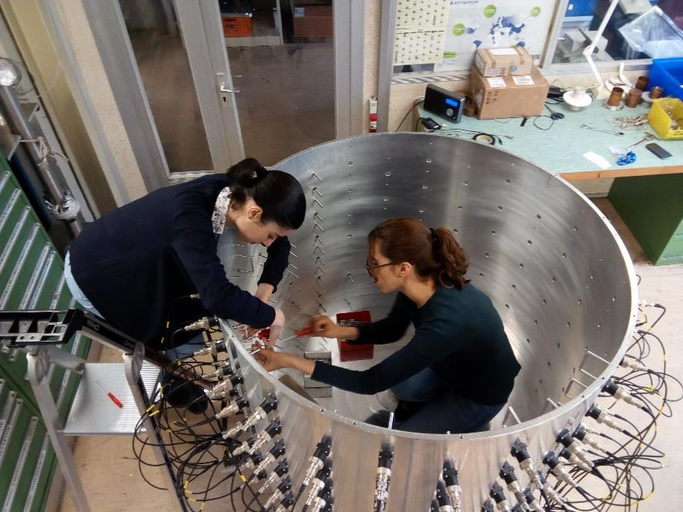
Combining system
3 dB combiner
32 x 35 kW to 1 x 1 MW
(~ 50 m²)
VHPCC (Very High Power Cavity Combiner)
16 x 70 kW to 1 x 1 MW
(~ 3 m²)
CC (Cavity Combiner)
144 x 1 kW to 1 x 144 kW

Slide 42


Combining system
In order to ensure 100 % availability, your combining system will define the number ‘Base units’
Nominal Output = 16
Wish to have full performance with 2 ‘Off Line’
Degraded Output = 12.25
So, in order to be 100 % available, this system composed of 16 x Base Units, is in fact a 12 x Base Unit
In order to perform the same 12 x Base Unit, with the same 2 Base unit tolerance, with a cavity combiner, you need only 14 x Base Unit instead of 16
Base unit = 1
$$Pout=\frac{A1+A2}{2}+\sqrt{A1 . A2}$$
$$Pout=n A1$$

Slide 43
Combining system granularity
In order to ensure 100 % availability, your Granularity will define the number ‘Module units’ and ‘Base units’
Nominal Output = 16
If because of your ‘pre-grouping’, several transistors are not available, granularity is then not enough
Degraded Output = 9
So, in order to be 100 % available, this system composed of 16 x Base Units, is in fact a 9 x Base Unit
In order to perform the same 9 x Base Unit, with the same 1 Module unit tolerance, with a cavity combiner and keeping the Base unit granularity, you need only 10 x Base Unit instead of 16
1 Module =
4 x Base unit
$$Pout=\frac{A1+A2}{2}+\sqrt{A1 . A2}$$
$$Pout=n A1$$

Slide 44
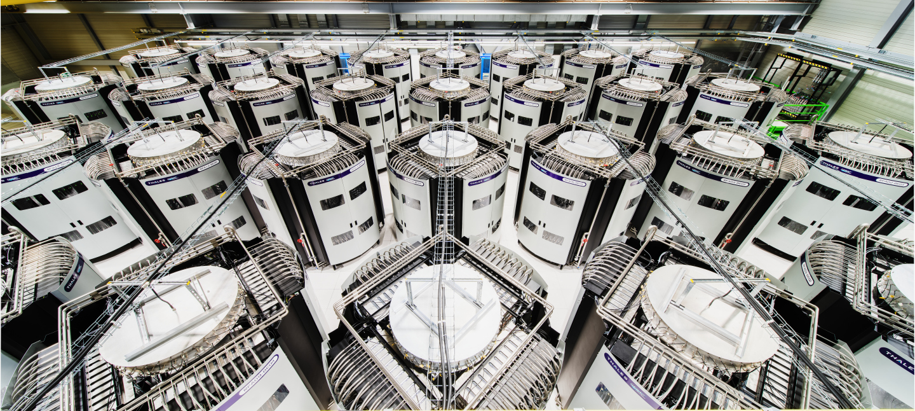
‘Young’ technology for HPRF in 100 kW to MW range
CERN SPS Thales Solid State Power Amplifiers,
32 towers x 144 kW @ 200 MHz, combined into 2 x 2 MW amplifiers,
into operation since 2021

Slide 45
Transistors available from industry

Slide 46
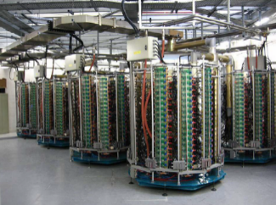

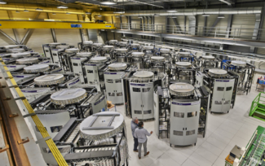
Power density
$$Power density \left(f\right)=Power density200 MHz \sqrt{200/f}$$
Approximation, given the fact that transistors deliver less with respect to frequency, and taking into account a smaller combining system size
SOLEIL 45 kW @ 352 MHz
2004
Power density
3.5 kW m⁻³
ESRF 150 kW @ 352 MHz
2012
Power density
6.5 kW m⁻³
FCC 1 MW @ 400 MHz
Power density
43 kW m⁻³
CERN 160 kW @ 200 MHz
2021
Power density
15 kW m⁻³
FCC 200 kW @ 800 MHz
Power density
10 kW m⁻³

Slide 47
Overhead comparison

Slide 48
High Power options
Final stage | DC Voltage | Driver | Gain | Power per unit | Combiner (for 1 MW)
Tetrode | 15 kV | 6.2 kW | 13 dB | 135 kW | 8:1
Klystron | 100 kV | 10 W | 50 dB | 1 MW | -
IOT | 40 kV | 320 W | 23 dB | 65 kW | 16:1
SSPA | 50 V | 5 W | 23 dB | 1100 W | 1024:1
Combiner
(0.05 dB losses per flange level)
mW
Driver
MW
Final

Slide 49
RF Power Lines
DUT
(Device Under Test)

Slide 50
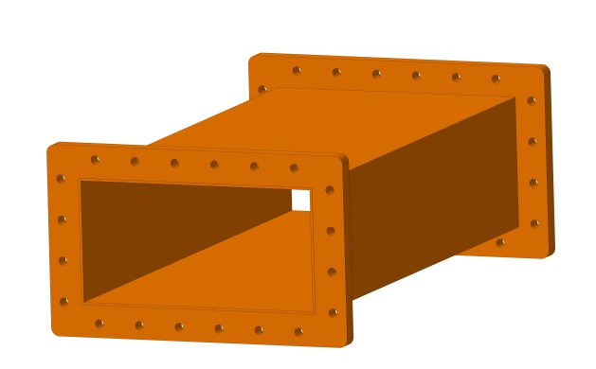
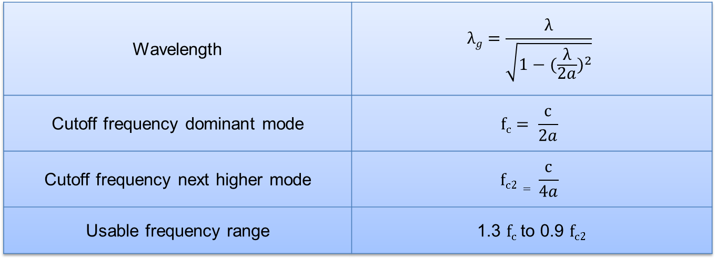
Rectangular waveguides
The main advantage of waveguides is that waveguides support propagation with low loss
b
a
Wavelength | $$λg=\frac{λ}{\sqrt{1−{(\frac{λ}{2a})}^{2}}}$$
Cutoff frequency dominant mode | $$fc= \frac{c}{2a}$$
Cutoff frequency next higher mode | $$fc2= \frac{c}{4a}$$
Usable frequency range | 1.3 $fc$to 0.9 $fc2$

Slide 51
Rectangular waveguides
Waveguides are usable over certain frequency ranges
  For very lower frequencies the waveguide dimensions become impractically large
  For very high frequencies the dimensions become impractically small & the manufacturing tolerance becomes a significant portion of the waveguide size
b
a
Waveguide name |  |  | Recommended frequency band of operation (GHz) | Cutoff frequency of lowest order mode (GHz) | Cutoff frequency of next mode (GHz) | Inner dimensions of waveguide opening (inch)
EIA | RCSC | IEC
WR2300 | WG0.0 | R3 | 0.32 — 0.45 | 0.257 | 0.513 | 23.000 × 11.500
WR1150 | WG3 | R8 | 0.63 — 0.97 | 0.513 | 1.026 | 11.500 × 5.750
WR340 | WG9A | R26 | 2.20 — 3.30 | 1.736 | 3.471 | 3.400 × 1.700
WR75 | WG17 | R120 | 10.00 — 15.00 | 7.869 | 15.737 | 0.750 × 0.375
WR10 | WG27 | R900 | 75.00 — 110.00 | 59.015 | 118.03 | 0.100 × 0.050
WR3 | WG32 | R2600 | 220.00 — 330.00 | 173.571 | 347.143 | 0.0340 × 0.0170

Slide 52
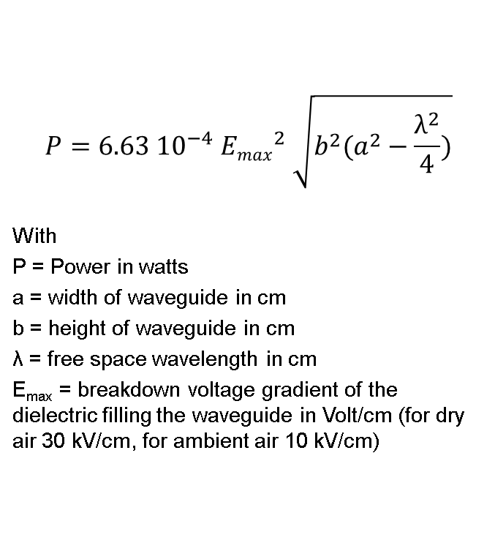
Rectangular waveguides
Maximum Power handling
$$P=6.63 {10}^{−4} {Emax}^{2} \sqrt{b^{2}(a^{2}−\frac{λ^{2}}{4})}$$
With
P = Power in watts
a = width of waveguide in cm
b = height of waveguide in cm
λ = free space wavelength in cm
E_{max} = breakdown voltage gradient of the dielectric filling the waveguide in Volt/cm (for dry air 30 kV/cm, for ambient air 10 kV/cm)
WR2300
WR2100
WR1800
WR1500
WR1150
WR975

Slide 53
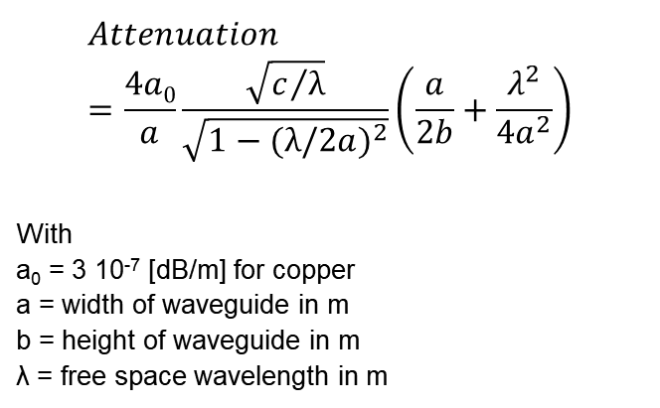
Rectangular waveguides Attenuation
$$Attenuation=\frac{4a0}{a}\frac{\sqrt{c/λ}}{\sqrt{1−{(λ/2a)}^{2}}}\left(\frac{a}{2b}+\frac{λ^{2}}{{4a}^{2}}\right)$$
With
a₀ = 3 10⁻⁷ [dB/m] for copper
a = width of waveguide in m
b = height of waveguide in m
λ = free space wavelength in m
WR975
WR1150
Attenuation factors of waveguides made from different material normalized to a waveguide of same size made of copper
Copper | 1.00
Silver | 0.98
Aluminium | 1.30
Brass | 2.05
WR1500
WR2100
WR2300

Slide 54
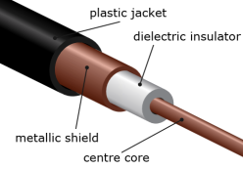

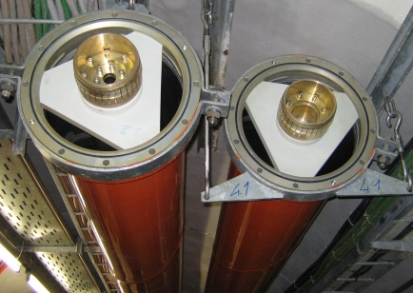
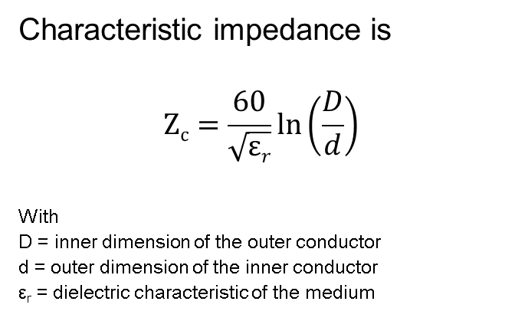
Coaxial Lines
Characteristic impedance is
$$Zc=\frac{60}{\sqrt{εr}}\ln\left(\frac{D}{d}\right)$$
With
D = inner dimension of the outer conductor
d = outer dimension of the inner conductor
ε_{r} = dielectric characteristic of the medium
Coaxial cables are often with PTFE foam to keep concentricity
Flexible lines have spacer helicoidally placed all along the line
Size | Outer conductor |  | Inner conductor
 | Outer diameter | Inner diameter | Outer diameter | Inner diameter
7/8" | 22.2 mm | 20 mm | 8.7 mm | 7.4 mm
1 5/8" | 41.3 mm | 38.8 mm | 16.9 mm | 15.0 mm
3 1/8" | 79.4 mm | 76.9 mm | 33.4 mm | 31.3 mm
4 1/2" | 106 mm | 103 mm | 44.8 mm | 42.8 mm
6 1/8" | 155.6 mm | 151.9 mm | 66.0 mm | 64.0 mm
Rigid lines are made of two rigid tubes maintained concentric with supports

Slide 55
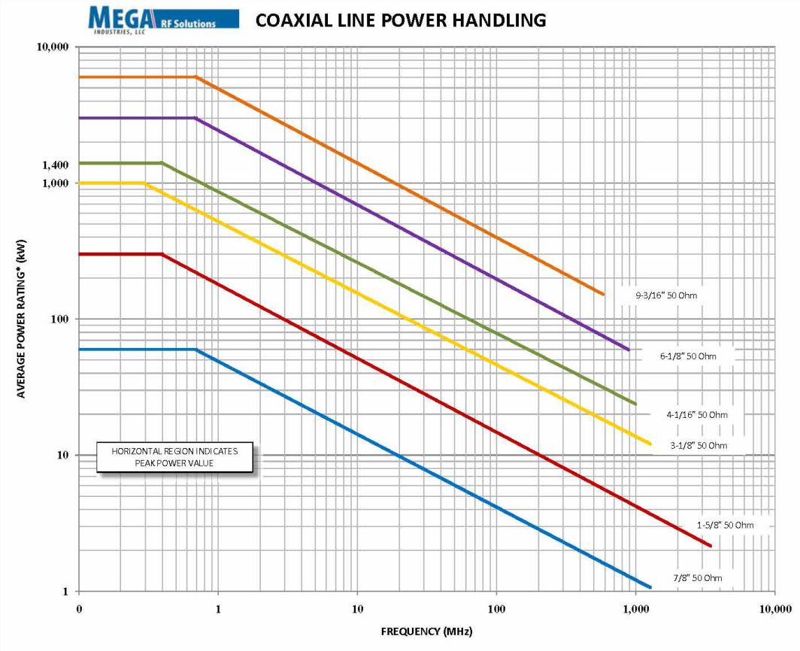
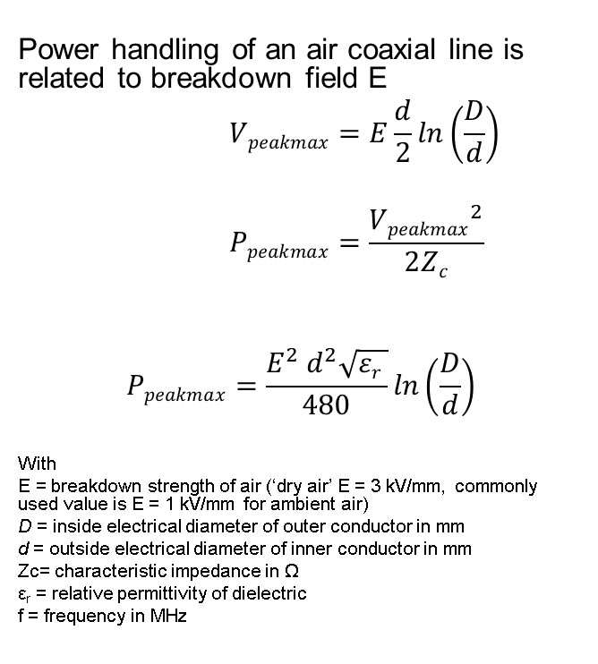
Coaxial lines Maximum Power handling
Power handling of an air coaxial line is related to breakdown field E
$$Vpeakmax=E\frac{d}{2}\ln\left(\frac{D}{d}\right)$$
$$Ppeakmax=\frac{{Vpeakmax}^{2}}{2Zc}$$
$$Ppeakmax=\frac{{E^{2} d}^{2}\sqrt{εr }}{480}\ln\left(\frac{D}{d}\right)$$
With
E = breakdown strength of air (‘dry air’ E = 3 kV/mm, commonly used value is E = 1 kV/mm for ambient air)
D = inside electrical diameter of outer conductor in mm
d = outside electrical diameter of inner conductor in mm
Zc= characteristic impedance in Ω
ε_{r} = relative permittivity of dielectric
f = frequency in MHz
D
d

Slide 56
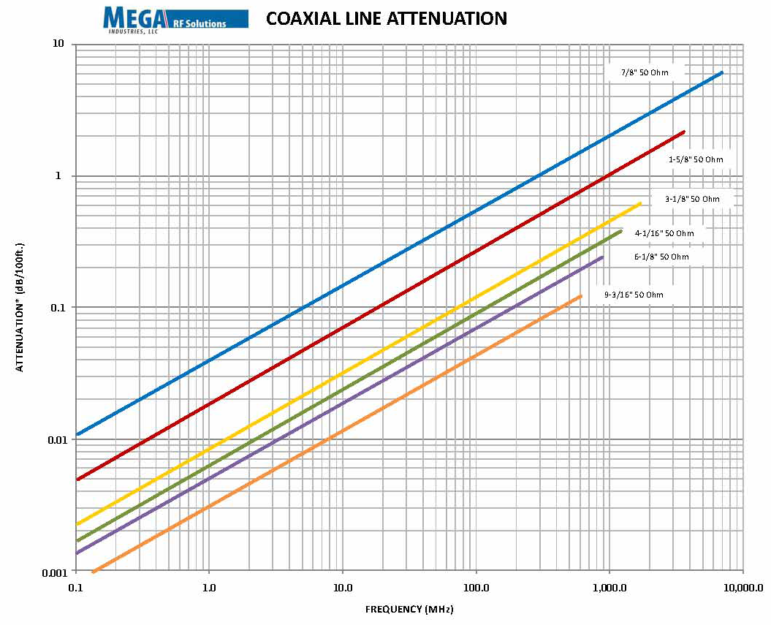
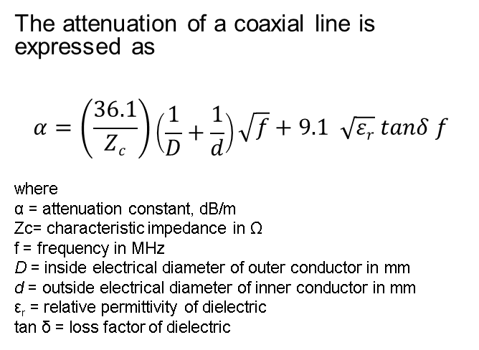
Coaxial lines Attenuation
The attenuation of a coaxial line is expressed as
$$α=\left(\frac{36.1}{Zc}\right)\left(\frac{1}{D}+\frac{1}{d}\right)\sqrt{f}+9.1 \sqrt{εr} tanδ f$$
where
α = attenuation constant, dB/m
Zc= characteristic impedance in Ω
f = frequency in MHz
D = inside electrical diameter of outer conductor in mm
d = outside electrical diameter of inner conductor in mm
ε_{r} = relative permittivity of dielectric
tan δ = loss factor of dielectric
Material | ε_{r} | tan δ | Breakdown MV/m
Air | 1.00006 | 0 | 3
Alumina 99.5% | 9.5 | 0.00033 | 12
PTFE | 2.1 | 0.00028 | 100

Slide 57
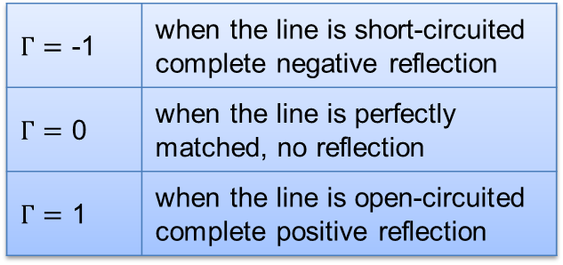
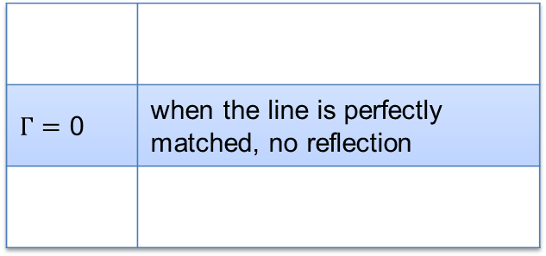
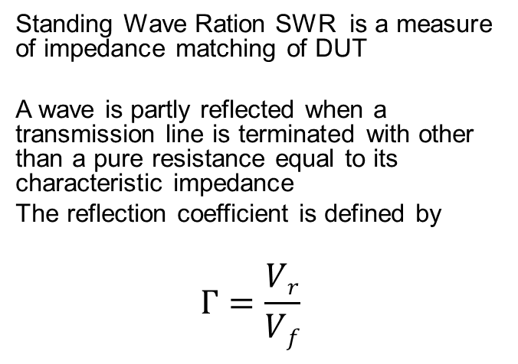
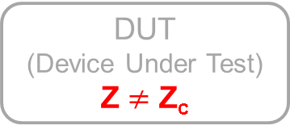
Reflection from Load
Standing Wave Ration SWR is a measure of impedance matching of DUT
A wave is partly reflected when a transmission line is terminated with other than a pure resistance equal to its characteristic impedance
The reflection coefficient is defined by
$$Г=\frac{Vr}{Vf}$$
Z_{c}
Line = Z_{c}
V_{r}
V_{f}
$Г=$ 0 | when the line is perfectly matched, no reflection
$Г=$ -1 | when the line is short-circuited complete negative reflection
$Г=$ 0 | when the line is perfectly matched, no reflection
$Г=$ 1 | when the line is open-circuited complete positive reflection
DUT
(Device Under Test)
Z_{c}
DUT
(Device Under Test)
Z $≠$ Z_{c}

Slide 58
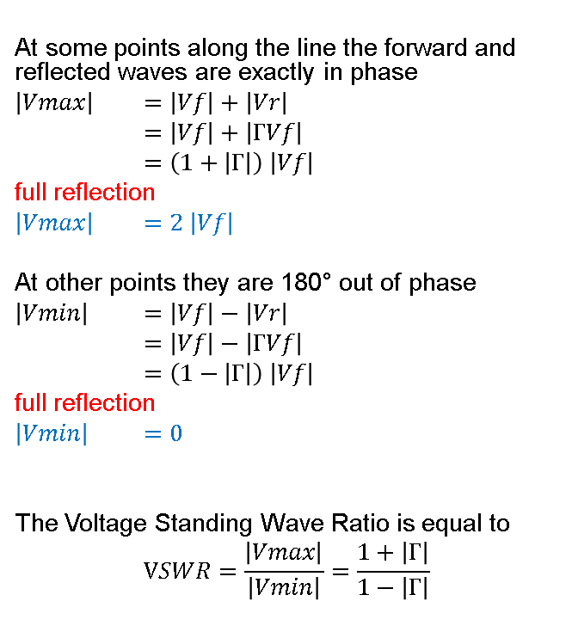
Reflection from Load
At some points along the line the forward and reflected waves are exactly in phase
$\left|Vmax\right|$ $=\left|Vf\right|+\left|Vr\right|$
$=\left|Vf\right|+\left|ГVf\right|$
$=\left(1+\left|Г\right|\right) \left|Vf\right|$
full reflection
$\left|Vmax\right|$ $=2 \left|Vf\right|$
At other points they are 180° out of phase
$\left|Vmin\right|$ $=\left|Vf\right|−\left|Vr\right|$
$=\left|Vf\right|−\left|ГVf\right|$
$=\left(1−\left|Г\right|\right) \left|Vf\right|$
full reflection
$\left|Vmin\right|$ $=0$
The Voltage Standing Wave Ratio is equal to
$$VSWR=\frac{\left|Vmax\right|}{\left|Vmin\right|}=\frac{1+\left|Г\right|}{1−\left|Г\right|}$$
Z_{c}
Line = Z_{c}
V_{r}
V_{f}
DUT
(Device Under Test)
Full reflection

Slide 59
Reflection from Load
In case of full reflection V_{max} = 2 V_{f} (P_{max} equivalent to 4 P_{f})
RF power amplifiers will not like this reflected wave
  Klystron output cavity disturbed
  Grid tube, IOT and Transistor voltage capability
Swift protection if P_{r} > P_{rmax}
  system NOT operational (not always possible)
P_{f}
DUT
P_{r}
Swift protection if P_{r}

Slide 60
Circulator
In order to protect our lines and our amplifiers from this reflected power: Circulator
  passive non-reciprocal three-port device
  signal entering any port is transmitted only to the next port in rotation
The best place to insert it is close to the reflection source
  Lines between circulator and DUT shall sustain 4 P_{f} if full reflection
  A load of P_{f} is needed on port 3 to absorb P_{r}
1
2
V_{f} →
V_{f} →
← V_{r}
3
Full reflection
2 V_{f}
(4 P_{f})
V_{r}
↓
Load

Slide 61
Circulator
Even in case of full reflection V_{max} = 2 V_{f} (P_{max} equivalent to 4 P_{f})
  RF power amplifiers will not see reflected power and will not be affected
  Lines between circulator and DUT MUST at least be designed for 4 P_{f}
  Loads must be designed for P_{f}
System remains always operational at any time
4 P_{f}
DUT
P_{f}
P_{f}

Slide 62
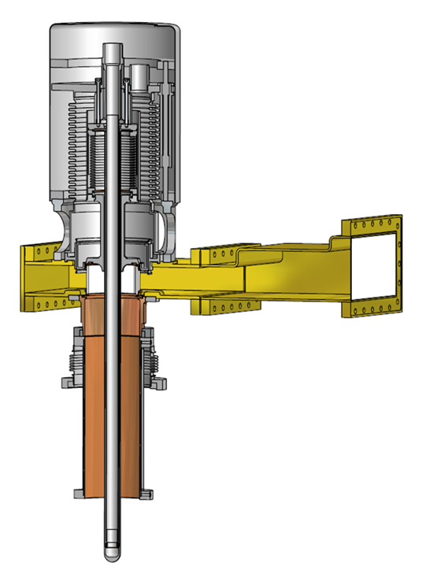
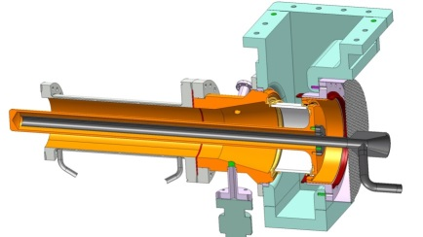


Fundamental Power Coupler FPC
SPL FPC
The Fundamental Power Coupler is the connecting part between the RF transmission line and the RF cavity
It is a specific piece of transmission line that also has to provide the vacuum barrier for the beam vacuum
FPC are one of the most critical parts of the RF cavity system in an accelerator
A good RF design, a good mechanical design and a high quality fabrication are essential for an efficient and reliable operation
LHC FPC
L4 FPC window
HL-LHC FPC
Various FPC at CERN

Slide 63

Overall Efficiency = Electrical bill
Building HVAC (Heating, Ventilation, Air Conditioning)
Building Cooler
Amplifier Cooler
Heat out
RF power in
RF power out
DUT
(Device Under Test)
DC power in
AC power in
$$Overall efficiency$$
$≃\frac{PRFout}{PACin+PRFin +Pcoolers }$ $≃$ 45 %
AC/DC

Slide 64

Efficiency
Thales design report: ‘Le rendement des blocs RF avec les MRFE6VP61K25N est de l’ordre de 66 % (valeur conservative)’
This was before linearity and bandwidth adjustments, I reduced it to 60 % for this exercise
Cavity = 1 MW
150 m coaxial line = + 0.2 dB = + 5 % = 1.050 MW
Circulator = + 0.2 dB = + 5 % = 1.103 MW
Hybrid combiner 16:1 = + 0.3 dB = + 7 % = 1.175 MW
DC to RF (efficiency ~ 60 %) = 1.960 MW
AC to DC (efficiency ~ 90 %) = 2.175 MW (1’000 kW to be dissipated)
Air cooling station (10 % of 1’000 kW = 100 kW) ~ + 50 kW = 2.225 MW
Water cooling station (90 % of 1’000 kW = 900 kW) ~ + 45 kW = 2,270 MW
Electrical distribution (5 % of 2.270 MW) ~ + 50 kW = 2,4 MW taken from the grid
Overall efficiency 41,9 %

Slide 65


Efficiency
HL-LHC
LIU-SPS
150 m
Cavity = 1 MW
20 m coaxial line = + 5 % + 1 % = 1.010 MW
Circulator = + 0.2 dB = + 5 % = 1.060 MW
20 m
Hybrid combiner 16:1 = + 0.3 dB = + 7 % = 1.130 MW
Having the amplifiers very close to the cavity, will reduce all other losses
A gallery is very expensive, as an acquisition cost, but can help to reduce acquisition cost of transmission lines and to reduce cost of operation
DC to RF (efficiency ~ 60 %) = 1.890 MW
AC to DC (efficiency ~ 90 %) = 2,100 MW (970 kW to be dissipated)
Air cooling station (10 % of 970 kW = 97 kW) ~ + 49 kW = 2,149 MW
Water cooling station (90 % of 970 kW = 873 kW) ~ + 44 kW = 2,190 MW
Electrical distribution (5 % of 2,190 MW) ~ + 99 kW = 2,3 MW taken from the grid
41,9 %
Overall efficiency 43,5 %

Slide 66

Efficiency
Cavity = 1 MW
20 m coaxial line = + 1 % = 1.010 MW
NO Circulator = + 5 % + 0 % = 1.010 MW
Hybrid combiner 16:1 = + 0.3 dB = + 7 % = 1.080 MW
As said, we are now able to build Power Amplifiers without circulator (Tetrodes and IOT can also do it)
The ‘cost’ is a (very) good protection system on the LLRF side
DC to RF (efficiency ~ 60 %) = 1.800 MW
AC to DC (efficiency ~ 90 %) = 2,000 MW (920 kW to be dissipated)
Air cooling station (10 % of 920 kW = 92 kW) ~ + 46 kW = 2,046 MW
Water cooling station (90 % of 920 kW = 828 kW) ~ + 42 kW = 2,088 MW
Electrical distribution (5 % of 2,088 MW) ~ + 104 kW = 2,2 MW taken from the grid
Overall efficiency 45,5 %
41,9 %
41,9 %

Slide 67

Efficiency
Cavity = 1 MW
20 m coaxial line = + 1 % = 1.010 MW
NO Circulator = 1.010 MW
VHPCC 16:1 = + 0.1 dB = + 7 % + 2,5 % = 1.035 MW
DC to RF (efficiency ~ 60 %) = 1.725 MW
Using cavity combiners instead of 3 dB combiners will also reduce maintenance cost as no more power loads to maintain
AC to DC (efficiency ~ 90 %) = 1,920 MW (882 kW to be dissipated)
Air cooling station (10 % of 882 kW ~ 88 kW) ~ + 44 kW = 1,964 MW
Water cooling station (90 % of 882 kW ~ 794 kW) ~ + 39 kW = 2,003 MW
Electrical distribution (5 % of 2,003 MW) ~ + 100 kW = 2,1 MW taken from the grid
41,9 %
Overall efficiency 47,6 %

Slide 68


Efficiency
Cavity = 1 MW
20 m coaxial line = + 1 % = 1.010 MW
NO Circulator = 1.010 MW
Granularity of the SSPA solution also allows
to switch ON the exact correct number of modules such that we operate as close as possible to the nominal point
VHPCC 16:1 = + 0.1 dB = + 2,5 % = 1.035 MW
DC to RF (efficiency ~ 60 % ~ 66 %) = 1.570 MW
AC to DC (efficiency ~ 90 % ~ 95 %) = 1,650 MW (615 kW to be dissipated)
Air cooling station (10 % of 615 kW ~ 62 kW) ~ + 31 kW = 1,681 MW
Water cooling station (90 % of 615 kW ~ 553 kW) ~ + 28 kW = 1,709 MW
El. distribution (5 % of 1,709 MW) ~ + 86 kW = 1,8 MW taken from the grid
Overall efficiency 55,5 %
41,9 %

Slide 69


Efficiency
Cavity = 1 MW
20 m coaxial line = + 1 % = 1.010 MW
NO Circulator = 1.010 MW
VHPCC 16:1 = + 0.1 dB = + 2,5 % = 1.035 MW
5 m from HV to LV
DC to RF (efficiency ~ 66 %) = 1.590 MW
AC to DC (efficiency ~ 95 %) = 1,625 MW (590 kW to be dissipated)
Taking advantage of the natural chimney effect of the tower, having a well defined water station (variable speed), and shortening the LV cables will help reducing the remaining losses
Air cooling station (10 % of 615 kW 590 kW ~ 60 kW) ~ + 27 kW = 1,652 MW
Water cooling station (90 % of 615 kW 590 kW ~ 530 kW) ~ + 24 kW = 1,676 MW
El. distribution (5 % of 1,709 MW 3 % 1,676 MW) ~ + 50 kW =
1,7 MW taken from the grid
Overall efficiency 58,8 %
41,9 %

Slide 70
Acquisition & operation costs
Technology * Including SSPA driver | Very rough estimates for a 100 kW CW 352 MHz RF system including RF power + Power Supplies + circulators + cooling + controls (lines not included) | Lifetime ** x 1000 hours | 20 years Maintenance Tubes, HVPS, workshop | 20 years Electrical bill 3000 hours / year 10 hours/day 6/7 days 50 weeks/year 0.15 € / kWh η = 45 % | Total 20 years
Tetrode | 500 k€ | 20 | 350 k€ | 200 k€ | 1050 k€
IOT | 600 k€ | 50 | 200 k€ | 200 k€ | 1000 k€
Klystron | 750 k€ | 100 | 100 k€ | 200 k€ | 1050 k€
SSPA | 850 k€ | 200 | 50 k€ | 200 k€ | 1100 k€
Circulator | 75 k€ | - | - |  | 75 k€
Lines | 1 k€/m | - | - |  | 1 k€/m
* Construction of the infrastructure not included
SSPA option requires more volume
** Tubes need highly qualified HV specialists for maintenance

Slide 71
Conclusion
We plan to launch (or we even already launched) R&D on
  Combining systems, this will reduce foot print and increase power density; plenty of ideas, cavity combiners, waveguide progressive combiners, RF transmission combiners, Gysel combiners, multi layers waveguides combiners)
  Availability, including granularity, hot swappable modules, embedded spares
  Efficiency, next key parameter, must be grid AC to RF for fair comparison
  Low cost circulators, at small power level ~kW and high power level ~MW
  Cost optimization, asking the correct architecture
  Mass production optimization, asking for the correct parameters
  Close follow-up of new technologies available in large series production (SiC, GaN, 2D transistors…).

Slide 72
RF powering
DUT
(Device Under Test)
This was a quick overview of the RF powering, for detailed explanations, please refer to specialized CAS on RF
  2010 (468 pages) https://cas.web.cern.ch/schools/ebeltoft-2010
  2000 (486 pages) CERN-2005-003
  1992 (596 pages) http://cds.cern.ch/record/211448/files/CERN-92-03-V-2.pdf

Slide 73
References
Reference Data for Radio Engineers (ISBN 0-672-22753-3)
HÜTTE des ingenieurs taschenbuch (Berlin 1955 edition)
Taschenbuch der Hochfrequenz-technik (Berlin-Heidelberg-New York 1968 edition)
Online
Thales, e2v, CPI, L-3 communications, Toshiba
NXP, Freescale

Slide 74
They did not know it was impossible, so they did it !
Mark Twain

