Slide 1
HF Cable Selection
T. Shaw
29-NOV-2010

Slide 2
Cabling Selection
4 cable schemes are under review
  VPLSP cables; 24-pair, low skew, 100 ohm differential impedence
  Samtec 50 ohm High Isolation Cable; 50 ohm coax
  Tyco Z-Pack HM-ZD cables; using 26 AWG coax
  Doubling of current cables

Slide 3
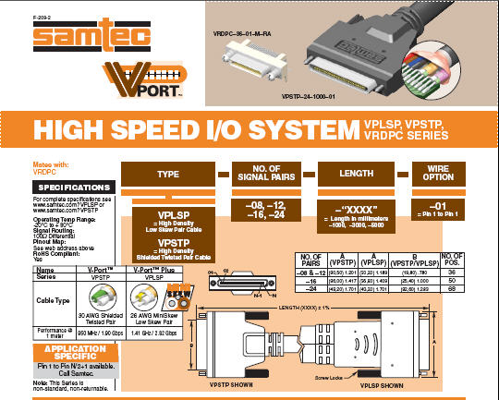
Samtec VPLSP Cables
Have ordered (3) 5-meter cables and connectors; these are now in-hand
Low Skew Pair Cable –
100 ohms differential

Slide 4
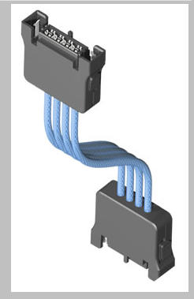
Samtec 50ohm High Isolation Cable
Have ordered (3) 5-meter cables with 8 coax/cable and connectors; ~4 week delivery time (end of December)

Slide 5
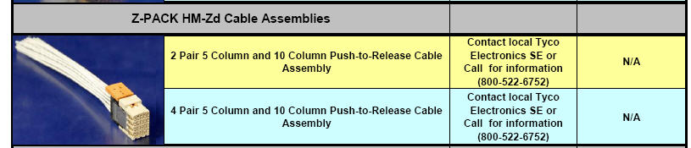
Tyco Z-Pack HM-Zd Cables
Sergey and I had a tele-conference with an applications engineer. Proposal made for a 5-meter cable using 26AWG 50 ohm coax with overall shield. Initially spec’d 24 coax pairs per cable. Sample has been received of the coax.

Slide 6
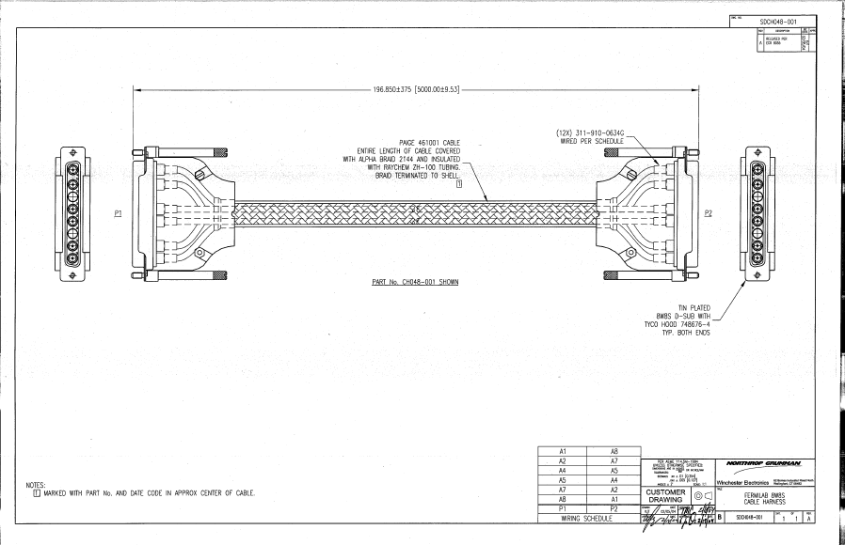
Double Current Cables

Slide 7
Conclusions
Cable studies will begin soon.
A working HF readout at FNAL will help us make a decision.

