Slide 1

HF Sleeve Raddam Test Plans
Ugur Akgun

Slide 2
Outline
We’ll start sleeve raddam in Iowa, ASAP.
So Please ship any material you wanted to be tested.
Tyvek D series samples from DuPond is on the way.
We also ordered 0.5mm GORE diffusive reflective material.
They’ll be tested for neutron and gamma radiation.

Slide 3
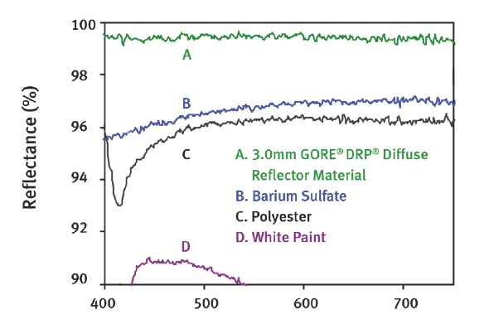
GORE DRP Diffuse Reflective Material

Slide 4
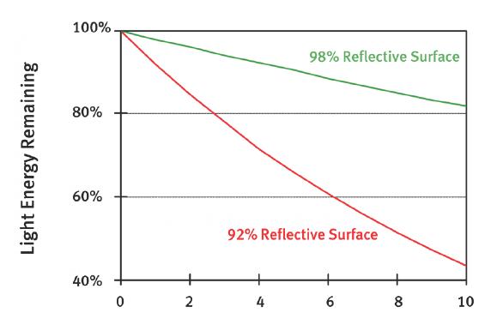
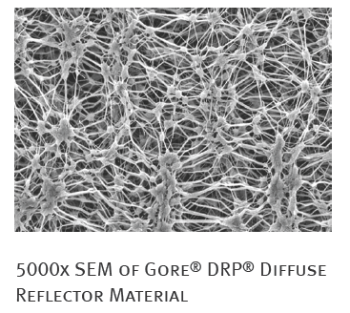
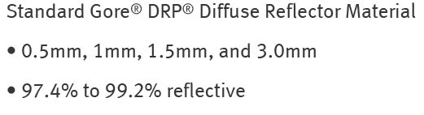
GORE
$250, $500, $750

Slide 5
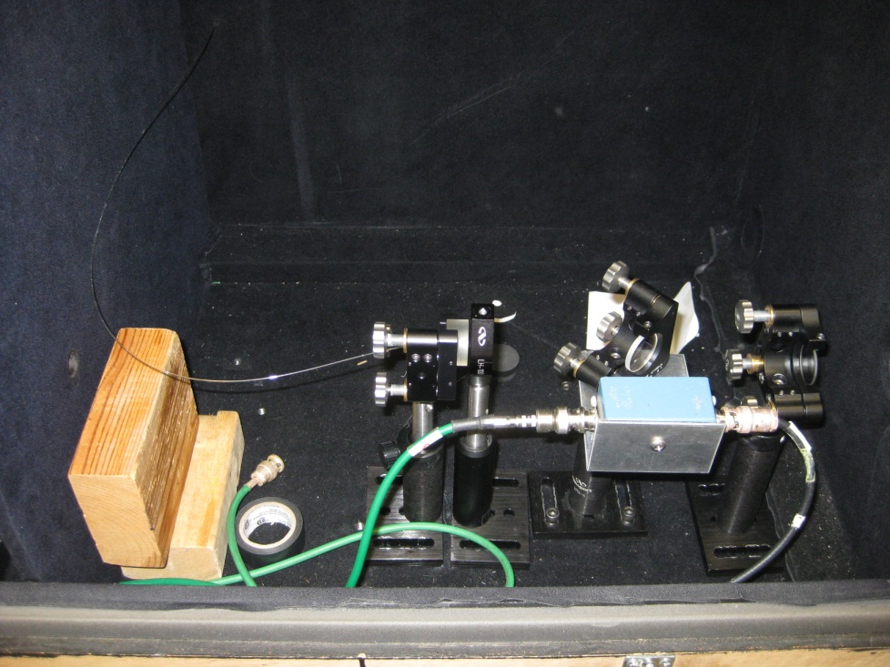
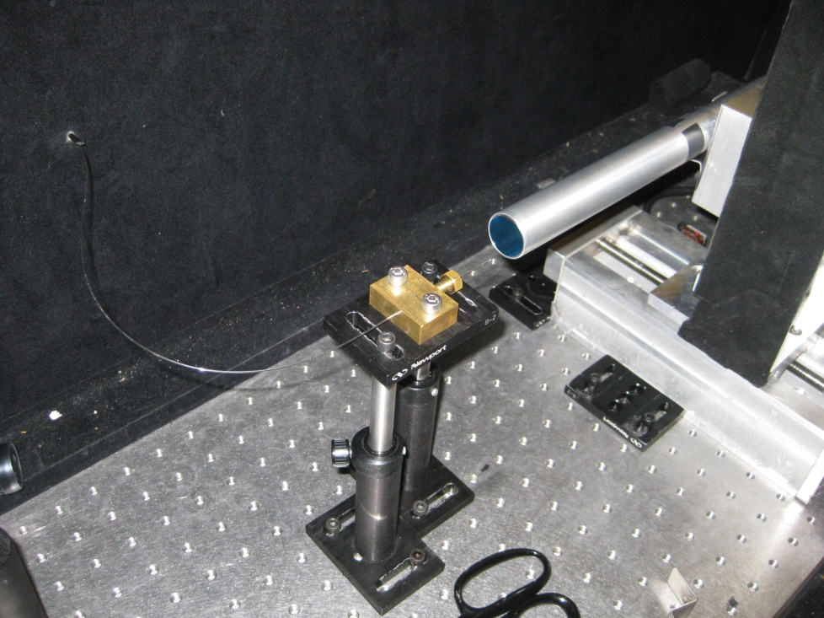
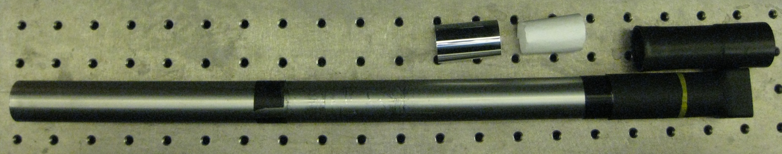
Light Guide Tests - Setup

Slide 6
Test Procedure
Prepare three samples from each material.
One control, one neutron and one for gamma irradiation.
Run light guide tests X-Y scan (1 mm steps)
Light generated using 337 nitrogen laser, then via scintillator light is shifted to 450nm peak, broad blue distribution.
Carried to next dark box via quarz fiber (600 micron core diameter)
Fiber is fixed, light guide is attached to XY scanner.
The sleeves will be tested before and after irradiation, control will be used to make sure the setup is reproducible.

Slide 7
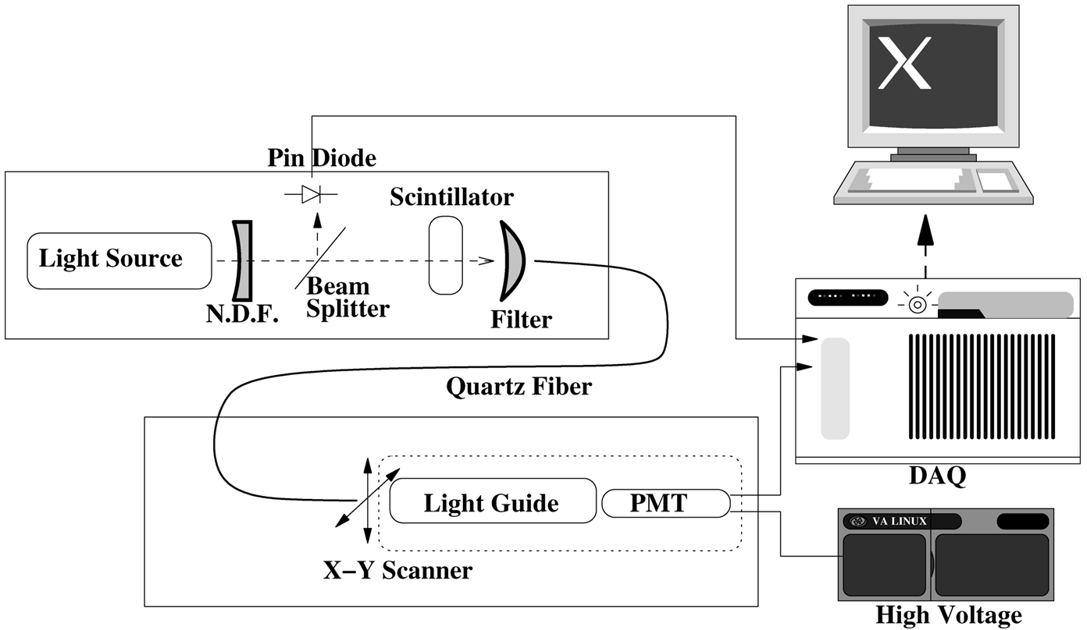
Light Guide Setup

Slide 8
Neutron Irradiation Setup
Iowa PET, heavy water target gives 14 MeV neutrons.
¹⁸O₈ + p → ¹⁸F₉ + n (14 MeV)
10¹⁰ neutrons/cm²s in 4π direction
We are 1 m away, so ~10⁷ fast neutron/cm².s
Thermalizer: polyethelene, paraffin
Gamma shielding with lead and bismuth.

Slide 9
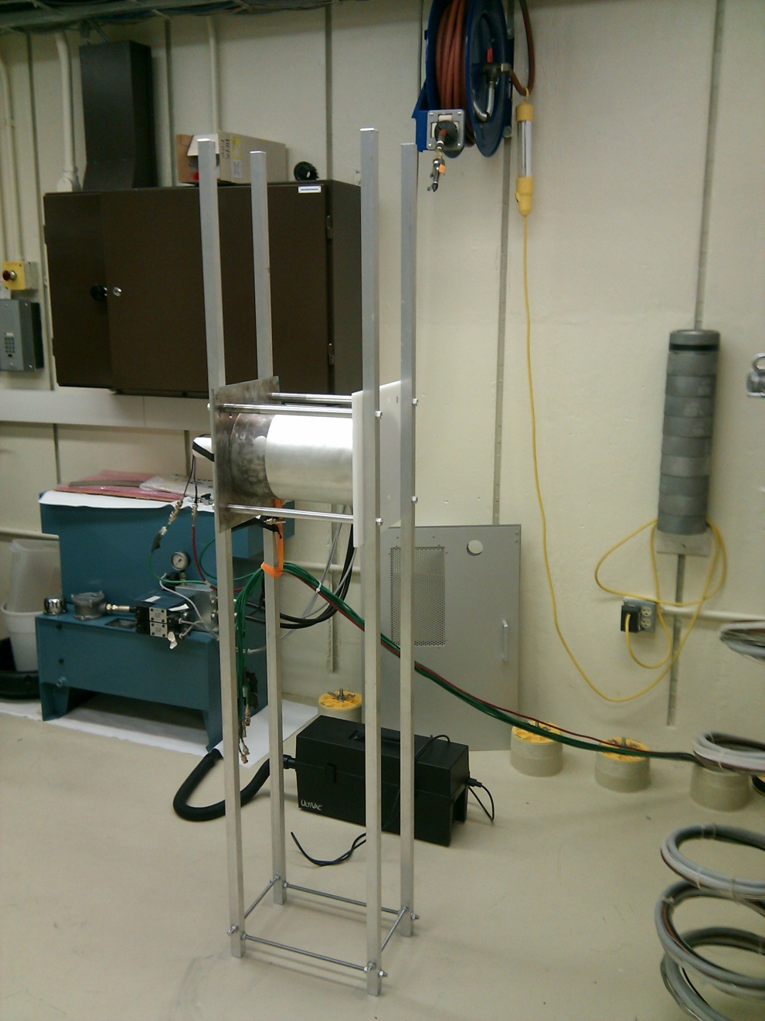
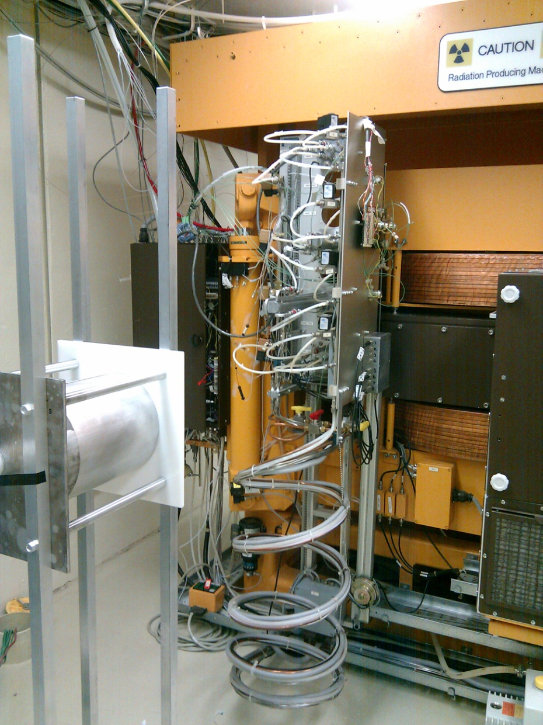

Slide 10
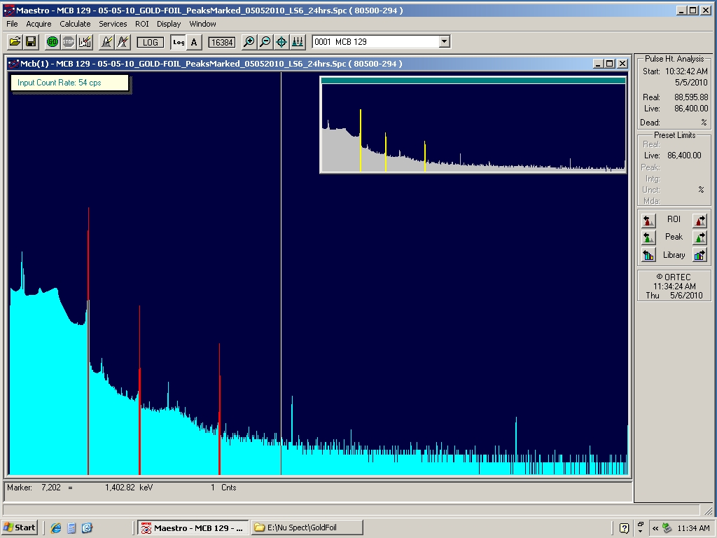
Counting Thermal Neutrons
We used Iowa PET, high performance Germanium detector to count neutrons.
Gold foil was used for counting, 411 keV photons were counted.
After all the corrections
We counted thermal
Neutrons inside the setup
as:
0.4 x 10⁵ neutron/cm²s

Slide 11
Gamma Irradiation Setup
9500 Currie Gamma source in University of Iowa Hospitals and Clinics.
We have to pay for the irradiation, we’ll try to get a deal.
20cmX10cm opening, we can get as close as 30cm to sourse.

Slide 12
Conclusion
The sleeve raddam is about the start, everything is ready in Iowa.
We’ll start with Tyvek D series and GORE reflective materials.
Please send your samples.
Neutron irradiation is tricky, but the setup is ready. Gamma is trivial but not free ☹

