Slide 1
SLEEVE Update - DRW
- Candidate Materials
- Optics Tests
- Background Tests
- HV Tests
- Radiation Resistance/Aging
- Test Beam Rig
30 Oct 2010
D.R. Winn

Slide 2
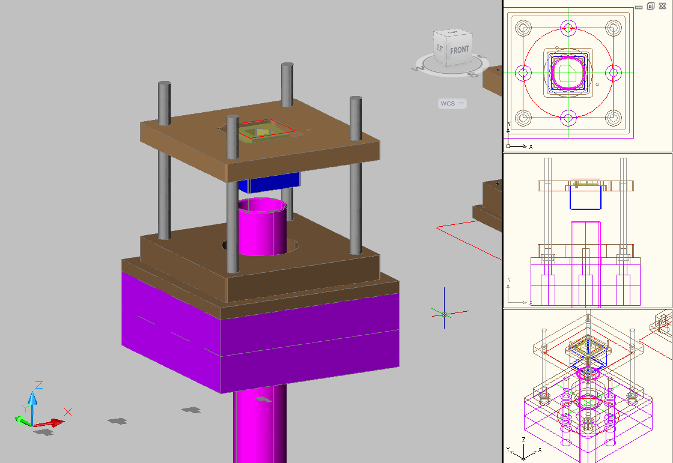
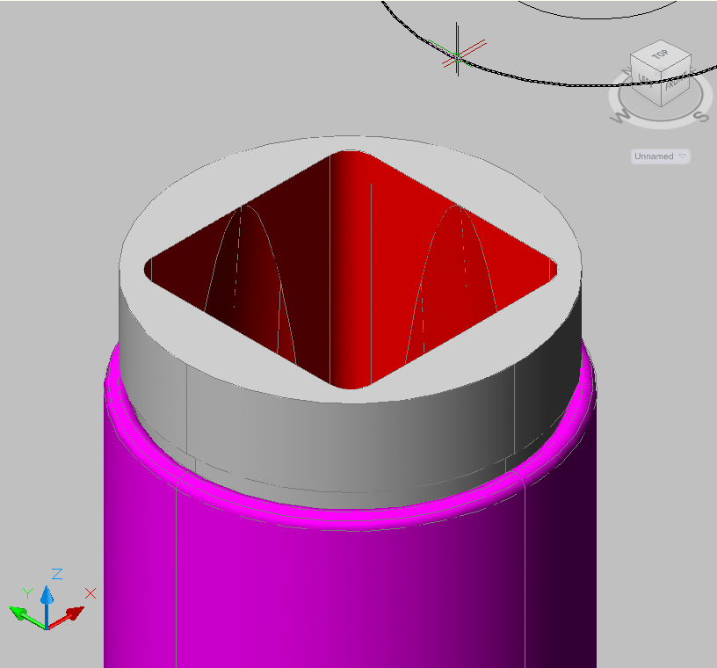
Square PMT Mockup
Ianos Schmidt
For study of PMT insulation, support, shielding, and optical coupling.
Sleeve Provides:
Tolerance Adjust.
Insulation from HV
Adapt round-sqauare
Ianos Schmidt. Oct. 11,2010

Slide 3
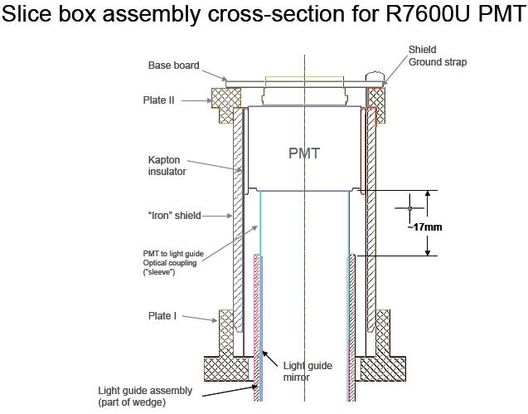
Sleeve Drawing – I.Schmidt

Slide 4
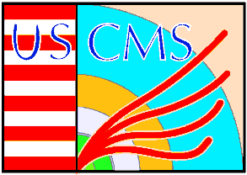

Sleeve Material Properties/Goals
Reflectivity > 95% 350-650 nm - Specular desired.
    Preserve >95% of existing Light
- Photons from MIP (0-90º) to Photocathode < 10 (?)
- High Dielectric Strength, >10V/µm
High Resistance/Resistivity, >10¹² Ohm-cm
Low Corona
- Adiabatic circle to square – deformable, or machineable.
- Raddam: 100 KRad (?) gamma, n; > 95% orig. reflectivity.
- Aging Reflectivity degrades <2% 10 years, N2enriched.

Slide 5
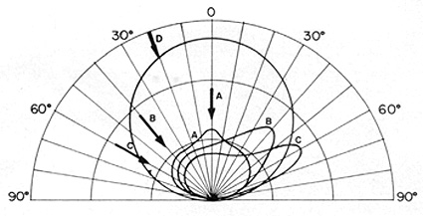
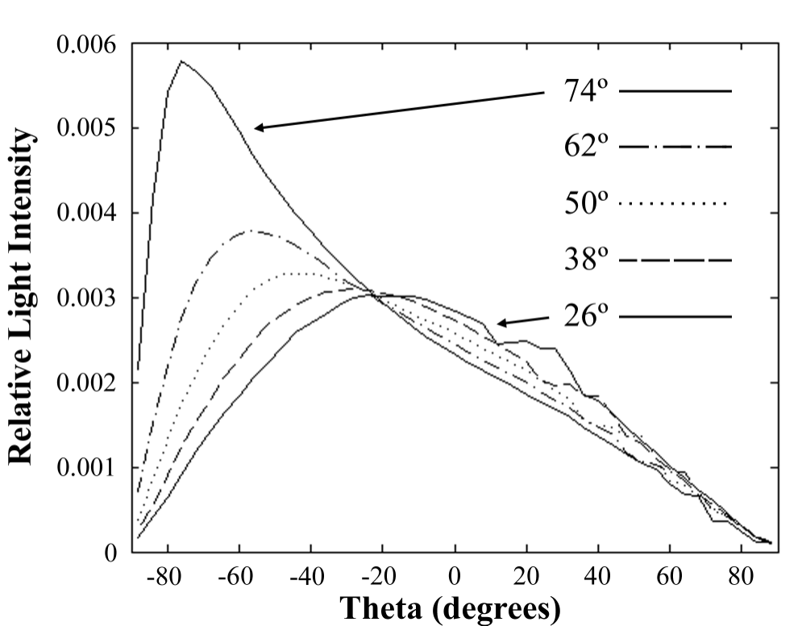
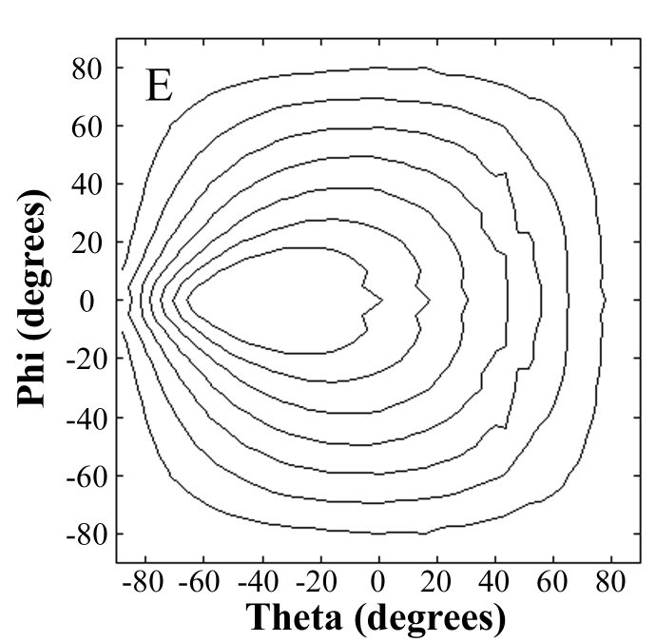
Semi-Lambertian/Semi-Specular
ExampleTyvek

Slide 6
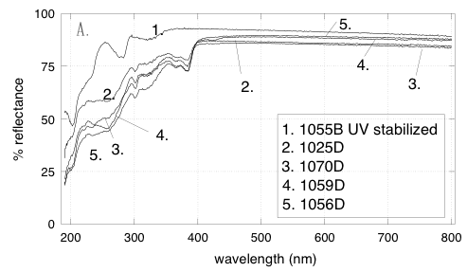
Baseline: Tyvek 1025D
Note: Reflectivity rel to spectralon
This is worst measurement found.
Tyvek is a spun-bonded cyclic polyolefin (alkenes –100% high density polyethylene – HDPE; n=1.5. Sheet formed by spinning continuous plexifilaments (0.5-5 µm), bonding heat, press. Preferred: 1025D. 1055D is corona-processed.
Raddam: 25% elongation reduction @ 50 MRad; BESIII reflect: >1KRad ok.
-> A new form is called Tyvek Brillion, 50% smoother [sic] “whiter and brighter”.
Types: 4173D 75 g/m2; 4182D 105 g/m2
ACHTUNG! CORONA MAY BE A PROBLEM! Cerenkov IS possible!
30 Oct 2010
DRW

Slide 7
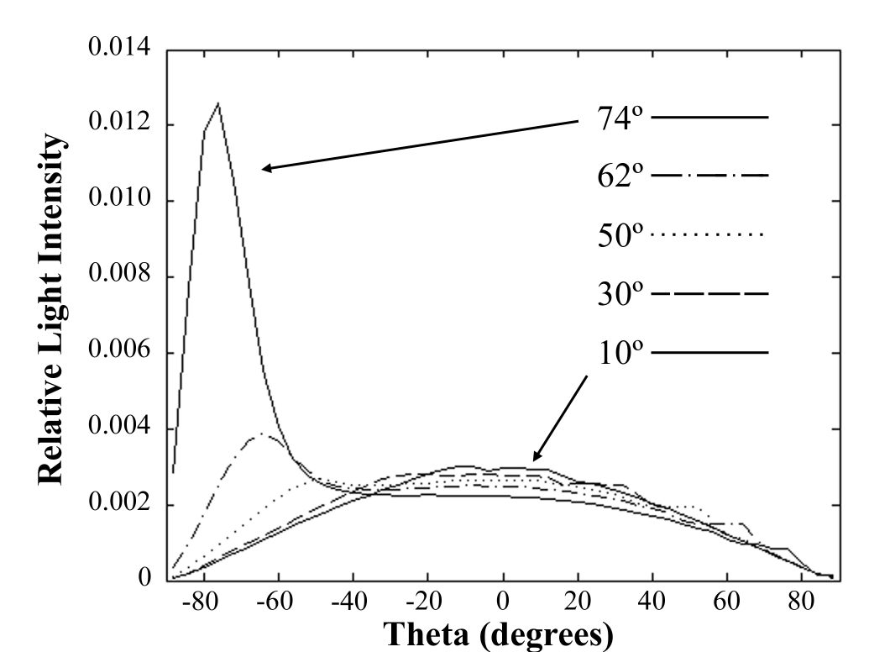
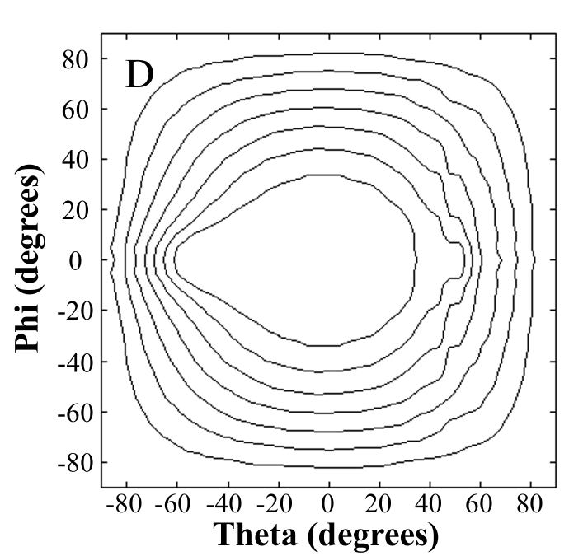
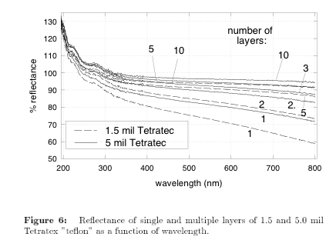
Teflon
Inert PTFE(Polytetrafluoroethylene)
Semi-crystalline –n=1.34-1.35
The only material a Gekko cannot stick to.
.

Slide 8
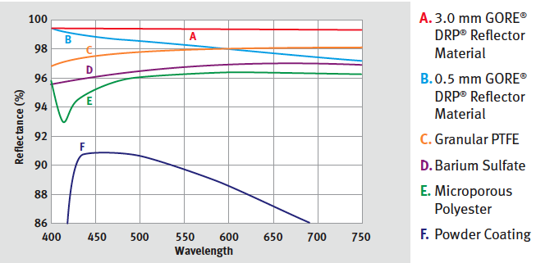
TEFLON-Like:
GORE DRP Diffuse Reflector Material - Teflons: expanded or foamed (ePTFE) The foaming process gives good reflective properties. Very flexible.

Slide 9
Teflon Rad-Soft – Is it ok for HF PMT region?
PTFE Raddam is essentially a function of the amount of energy absorbed: beta, gamma, X-ray, neutron etc. have about equivalent effect. Doses in Rads:
In Air In Vacuum
Threshold 2-7x10⁴ 2-7x10⁵ or more
50% tensile 10⁶ 10⁷
40% tensile 10⁷ 8X10⁸
100% elong 2-5x10⁵ 2-5x10⁶
Goretex (expanded PTFE) surface reflectivity was measured by Belle collaboration up to 8.6 MRad. No radiation damage is observed within measurement errors.
MIT: fast n 8x10⁷ Rad embrittles but <1% dimension change

Slide 10
Teflon vs Tyvek:
Comments Teflon:
- more UV, less radhard, fluorine evolutes?, F(n, γ/α/T) and F(γ, n/2) reactions?, corona islands (10¹⁸ Ω-cm).. Less Cherenkov??
Comments Tyvek:
possible Cerenkov; less specular in base type than Teflon, fine filments: corona?, precipitates?
WE TEST BOTH

Slide 11
Tasks: Background
Investigate Cerenkov, Scint background Tyvek, Teflon, and other : ACHTUNG! The cyclic polyolefin of Tyvek has an index of refraction of ~1.5!
Beta, cosmics, or test beam, using the material shaped as a sleeve; radiation into it at several angles 0-90. This is a High Priority.
Secondarily, an alpha source for scintillation.
BEAM DATA! - See Taylan Yetkin’s Talk

Slide 12
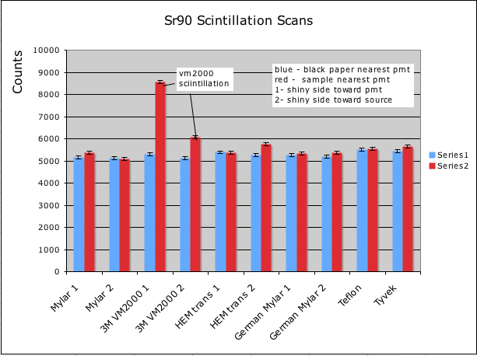
HF Sleeve Studies - Scintillation Scans
Several samples arrived from Iowa Friday Oct 15, 2010.
Sr90 source (Y90 -> 2.2 MeV)
Coincidence of Trigger Counter + 911WB PMT made.
Threshold set on 911WB PMT to reject random coindidences.
Samples measured 4 times (shielded/unshielded) x (side1/side2).
Teflon and Tyvek show low scintillation properties wrt low energy betas.\
Only VM2000 shows excess scintillation.
Shielded Open
pmt
Vdisc
AND
Vdisc
Counter
pmt
red/blue
1.04
0.99
1.62
1.19
1.00
1.10
1.02
1.03
1.01
1.04
L. Cremaldi, P. Sonnek, U Mississippi Oct 24, 2010

Slide 13
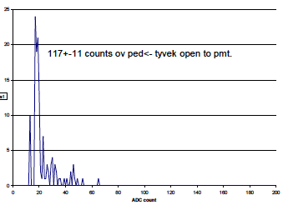
Tyvek/Teflon Beta exposure
peak ~ 9-12 p.e.
PMT Gain ~0.5-0.7 x 10⁶
Ratio (Tyvek+PMT)/PMT = 1.04
Ratio (Teflon+PMT)/PMT = 1.01
Consistent w/ Beta PMT window+1-2 pe TeflonTyvek

Slide 14
Scintillation/Cerenkov Study
No scintillation observed in Teflon or Tyvek with Am²⁴¹ (No difference from black anodized Al within 1%)
Extra light observed from Tyvek/Teflon tickets: < 2 p.e. signal. Consistent w/ <0.3 mm thick (n=1.5) Cerenkov. (2.3 MeV endpoint beta source, flat samples normal to track, 1” PMT)
Tyvek has slight additional signal compared with teflon.
Very Little Angular Effects – But need real test beam

Slide 15
Sleeve Background Tasks
Stronger alpha source
Ru¹⁰⁶ source – more energetic
Re-Measure tickets as function of angle 90º-5⁰
  SEE NEW DATA FROM MISSISSIPPI -
Use real sleeves with round HFPMT, square R7600, both teflon and tyvek – and brillion and Gore materials.
Neutron response F(n,x), C(n,x)
Test Beam: Feb 16-22 FNAL M
  Need preliminary time x task and team members

Slide 16
Tasks: HV Safe
Measure the response of a powered R7600 (~1500V), HFPMT (<900V) w/ varied lengths of tyvek, teflon (or other), formed into deformable sleeve, interposed between PMT and a grounded aluminum tube simulating the existing light guides: - Vary sleeve length between 5 mm - 15 mm.
Measure spikes on the HV (HV capacitive coupling to ‘scope)
Measure PMT Dark Noise HV on/off
Detect Glow Discharges: View PMT/SLEEVE w/ another PMT, camera both DC and at 100 pe x 40 MHz.
Relative Gain Shift: one+ month between PMT without sleeve and with the grounded sleeve.
Goal: Safest minimal Length: This is a priority, and would benefit light collection if we could reduce the length of the sleeve to ~5mm rather than 17mm

Slide 17
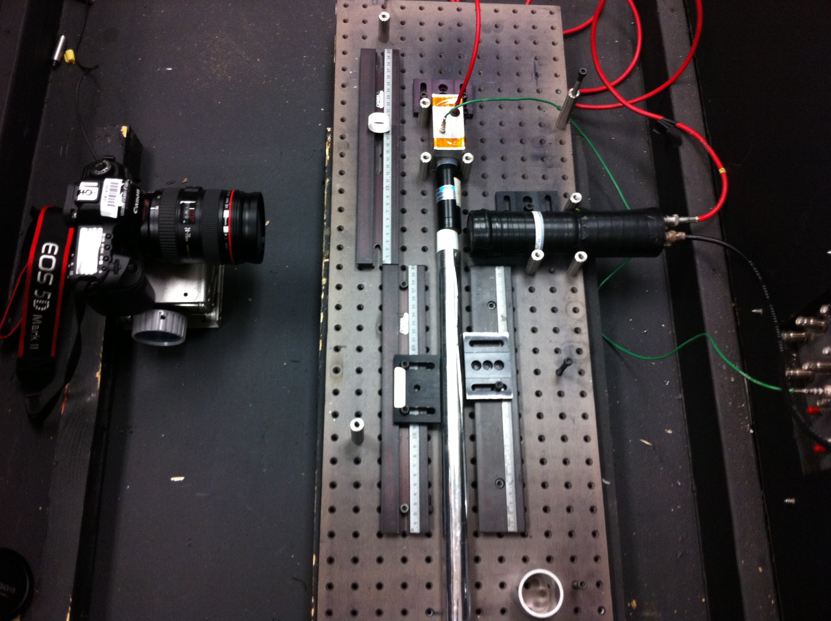
HV/Corona testing
Tyvek Sleeve
HF PMT
Canon
5D camera
USB Cntrl
2” Spy PMT
Preliminary:
No Corona
Over 4 hours
1” Tyvek
(Cosmic Bkgrnd)
Al Mylar
Light Guide

Slide 18
Corona Tests
Sleeve tyvek mockups: 10 mm, 5 mm to HF-PMT
Recording DVM: 50 µF from HV over 12 hours – no excursions sleeve/no-sleeve larger than 0.5 V.
Digital Scope: 50 µF from HV – ripple appears identical sleeve/no-sleeve – integrals same within 2% over 8 hours.
2” PMT viewing HF-PMT/Sleeve: Sleeve/no-sleeve can see no difference on ‘scope from cosmics/light leaks. Integrals same within 3%.
Digital camera: consistent speckle,sleeve/no sleeve. (no temperature info) over two one hour exposures.

Slide 19
Tasks: Light Source
Bench Test Stand: "HFcal-ferrule-lightguide equivalent" light, using sources or cosmics.
LED blue/green: Collimate to Fiber NA = 0.22/13º cone – or scan pitch/yaw at 0-NA - across a diameter.
Scintillator-Fiber light: ok, but spectrum, NA…
This is an important – We must parametrize tranmission vs length of sleeve 0.5-1.5cm.
CMS HF Tests promising – see previous talks.

Slide 20
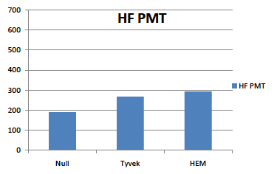
Preliminary Compare Tests
Test A: Light Guide driven by x-y scan HF fiber, 337 nm laser exciting Scintillator; 450 nm peak
John Neuhaus/Iowa
See 11 Oct.
Test B: Fairfield Blue (405nm) LED,
collimated 15º
off-shelf (not German) Al Mylar LG
- No HEM sleeve –
1” Tyvek sleeve/Al Mylar = 91% +/- 3%

Slide 21
Tasks: Light Transport
Measure the angular, radial and spectral intensity (the spectral brilliance) of the light emerging from a standard light guide driven by fiber-bundle equivalent light. This would be used to identify needed reflectivity (angle).
Same, but out of Sleeve, driven by light guide.
Use Mockup light source or Test Beam
(Use above measurements to model circle->square, after length and reflectivity known)
This TASK largely superceded by HF in-situ Data.

Slide 22
Plans T> 01/01/12
Raddam Exposures–Co60, n When? (see previous meetings – Iowa cyclotron, Co source).
Aging probably ok? Electrostatic precip? More Corona under Radiation?
Forming into sleeves: exact procedure
Planning for Test Beams: Fermi: 16 Feb; CERN??
Cost/Time Estimates Sleeve Fabrication pre-install.
Install: Procedure + Manpower/Cost/Time needs

Slide 23
Plans T> 01/01/11
Raddam Exposures–Co60, n
  Date Complete:________________
Sleeve Production:
  First Square-Round Adapter:____________
  First Sleeve Prototype:______________
  Manufacture Procedure: __________
Cost/Time Estimates Sleeve Fabrication/pre-install.

Slide 24
2011
Planning for Test Beams:
  Fermi: 16 Feb: R7600, Square Adaptor, Sleeves
    Angle 90->0; compare old-new: signal & background.
  CERN??
Install: Procedure + Manpower/Cost/Time needs
Sleeve: Aging probably ok? Electrostatic precip? More Corona under Radiation?

