Slide 1

HF Sleeve Raddam Test Plans
Ugur Akgun

Slide 2
Outline
We started sleeve raddam in Iowa, ASAP.
11 different types of Tyvek from DuPond, two different thickness of GORE DRP, polyethelene, and teflon are planned to be tested.
They’ll be tested for neutron and gamma radiation, as well as activation.

Slide 3
Detailed List of the Candidates
TYVEK 1025 D | TYVEK inkjet sheet
TYVEK 1073 D | TYVEK inkjet banner
TYVEK 1085 D | TYVEK TY31
TYVEK 1056 D | TYVEK cc sleeve
TYVEK 1443 R | GORE DRP -- 3 mm
TYVEK 1079 | GORE DRP -- 0.5 mm
TYVEK Vivia | % Cotton paper
Polyethelene (HDPE) (*) | Teflon (*)
All of the candidate sleeve materials are ready in Iowa.
(*) being prepared in machine shop

Slide 4
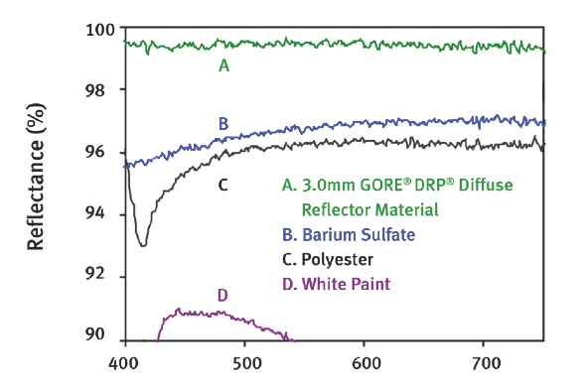
GORE DRP Diffuse Reflective Material

Slide 5
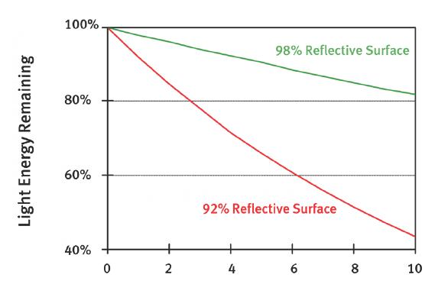
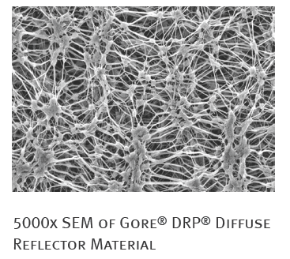
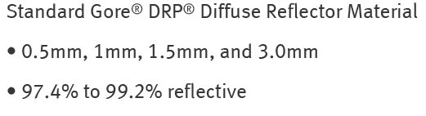
GORE
$250, $500, $750

Slide 6
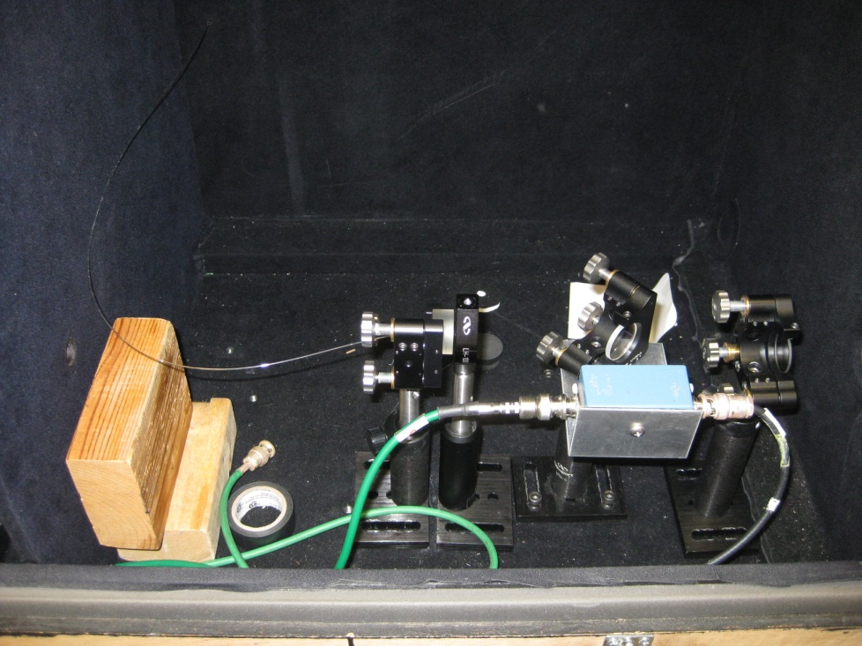
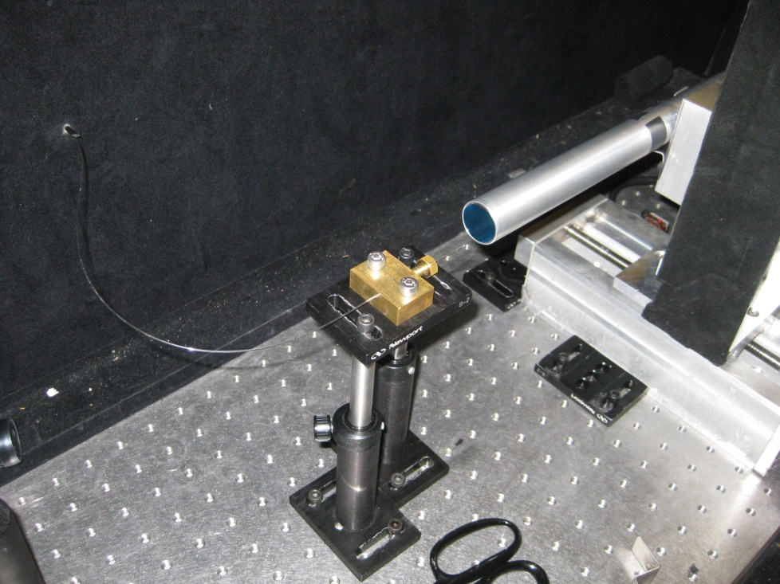
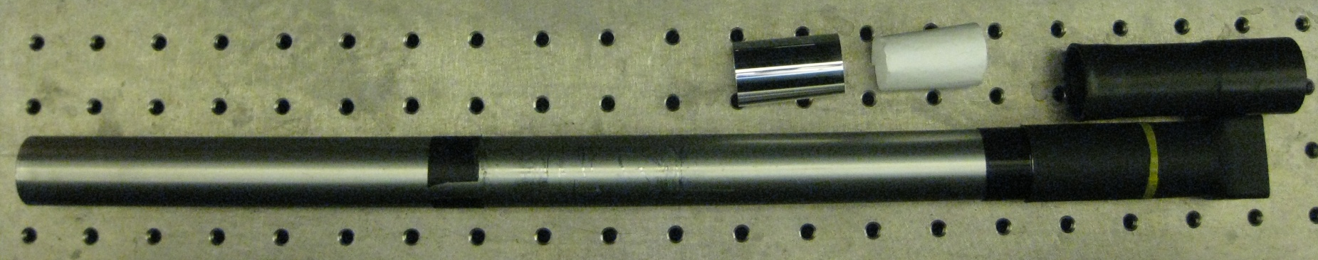
Light Guide Tests - Setup

Slide 7
Test Procedure
Prepare three samples from each material.
One control, one neutron and one for gamma irradiation.
Run light guide tests X-Y scan (1 mm steps)
Light generated using 337 nitrogen laser, then via scintillator light is shifted to 450nm peak, broad blue distribution.
Carried to next dark box via quarz fiber (600 micron core diameter)
Fiber is fixed, light guide is attached to XY scanner.
The sleeves will be tested before and after irradiation, control will be used to make sure the setup is reproducible.

Slide 8
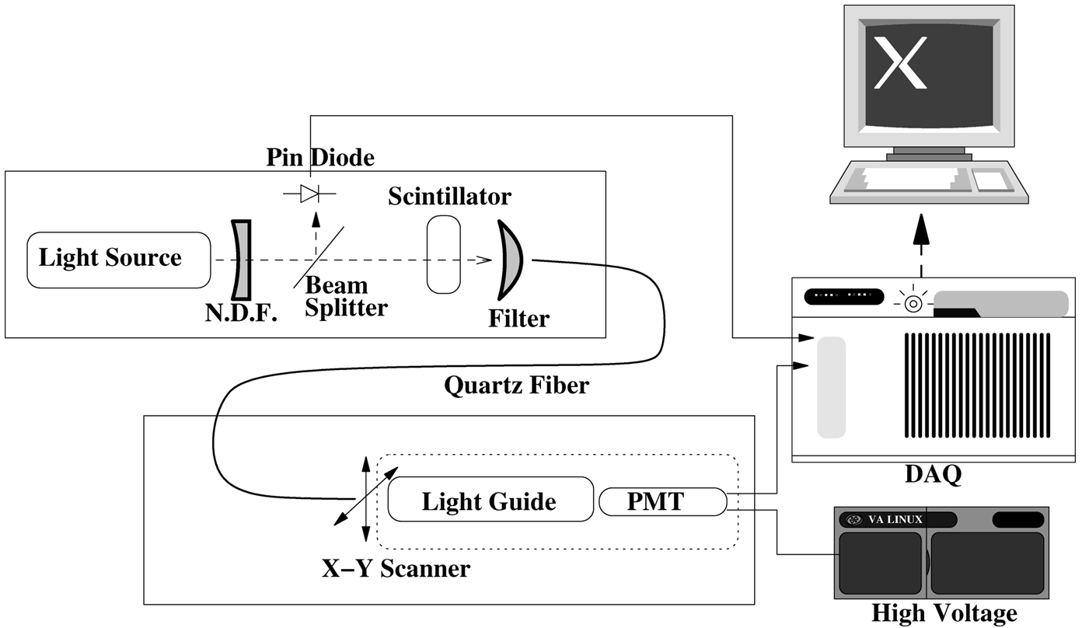
Light Guide Setup

Slide 9
Neutron Irradiation Setup
Iowa PET, heavy water target gives 14 MeV neutrons.
¹⁸O₈ + p → ¹⁸F₉ + n (14 MeV)
10¹⁰ neutrons/cm²s in 4π direction
We are 1 m away, so ~10⁷ fast neutron/cm².s
Thermalizer: polyethelene, paraffin
Gamma shielding with lead and bismuth.

Slide 10
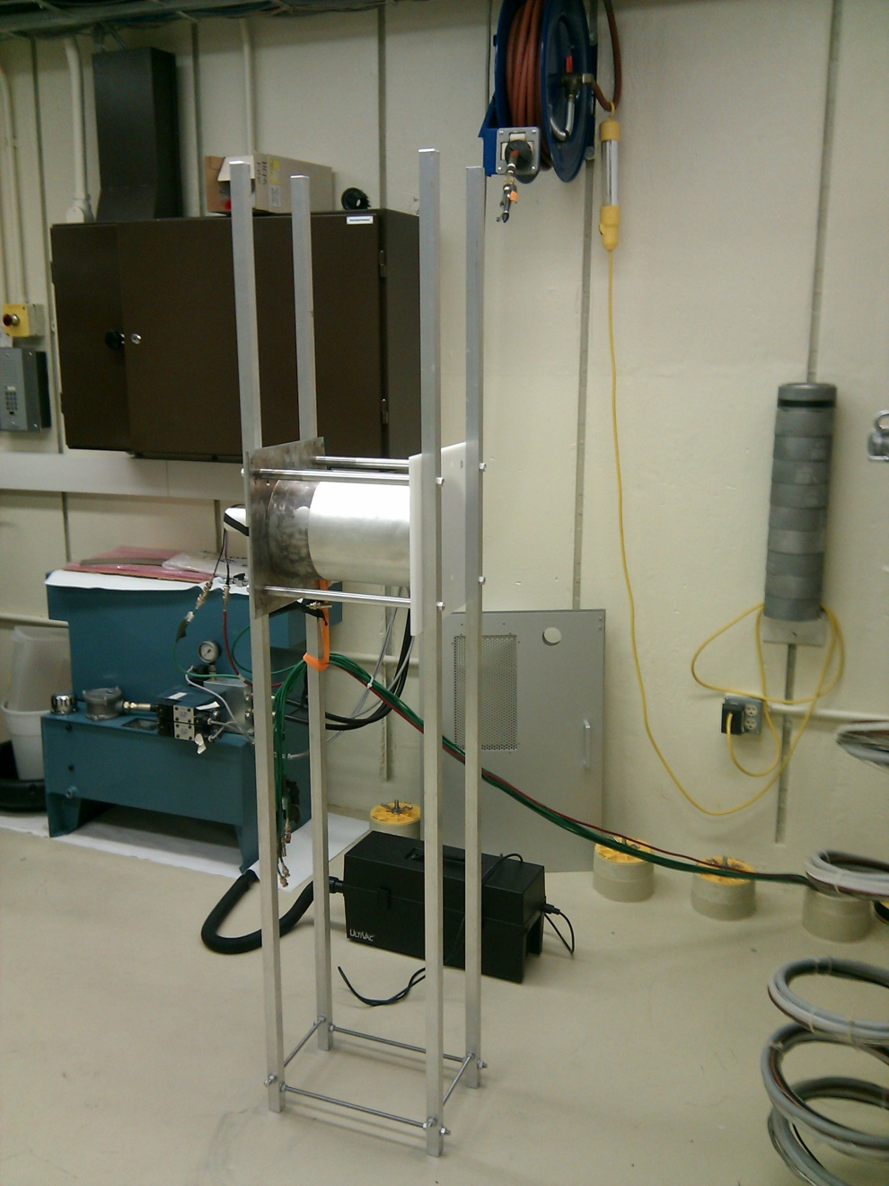
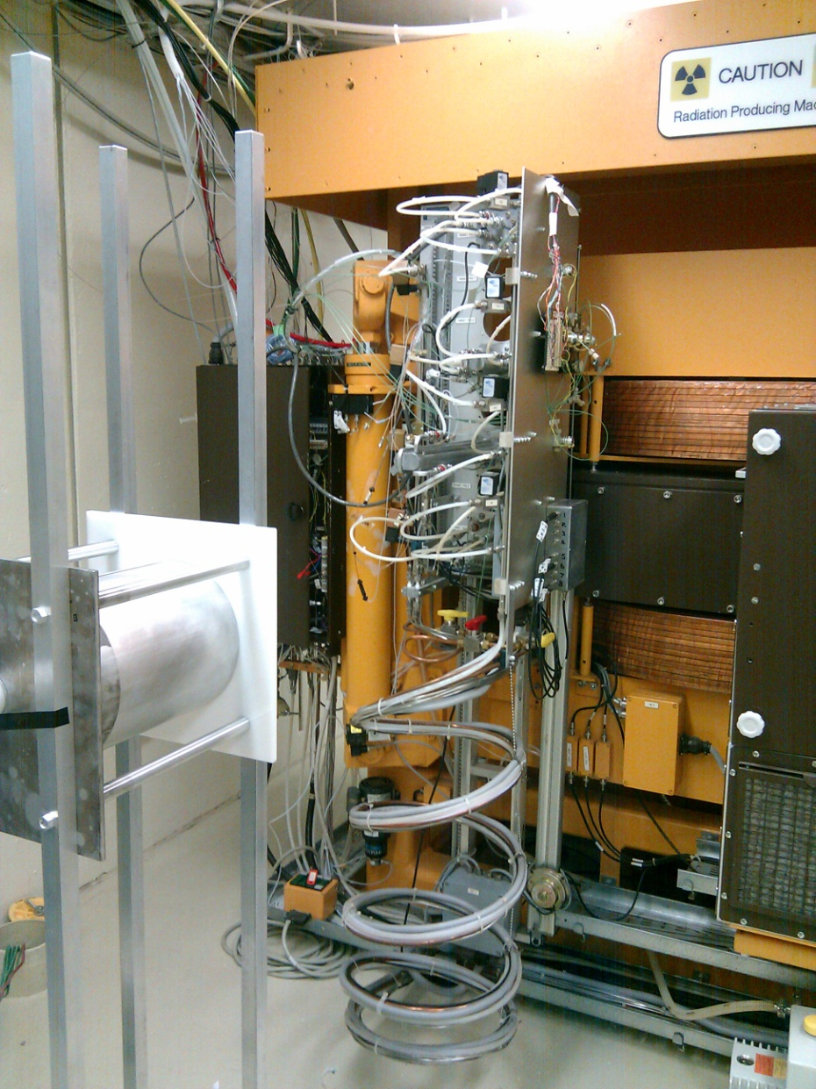

Slide 11
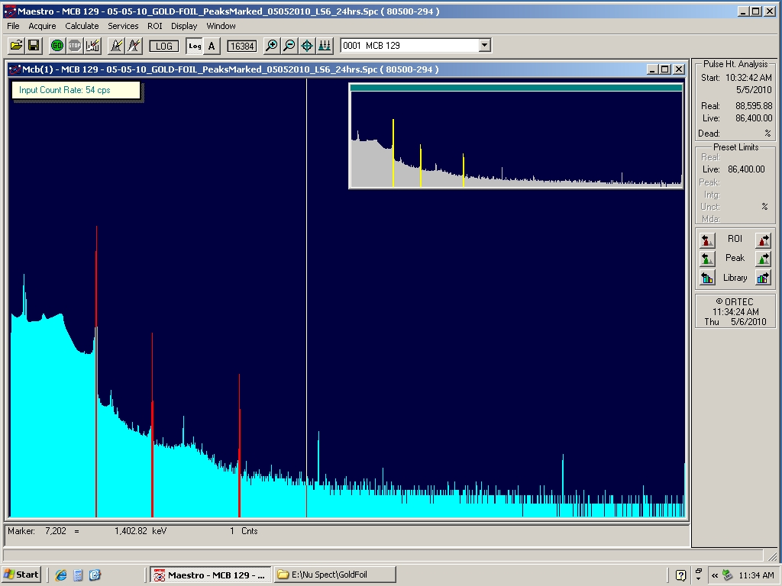
Counting Thermal Neutrons
We used Iowa PET, high performance Germanium detector to count neutrons.
Gold foil was used for counting, 411 keV photons were counted.
After all the corrections
We counted thermal
Neutrons inside the setup
as:
0.4 x 10⁵ neutron/cm²s

Slide 12
Gamma Irradiation Setup
9500 Currie Gamma source in University of Iowa Hospitals and Clinics.
We have to pay for the irradiation.
20cm X 10cm opening, we can get as close as 30cm to source.

Slide 13
Conclusion
The sleeve raddam is about the start, everything is ready in Iowa.
We’ll start with various Tyvek and GORE reflective materials.
We aim to reach:
  10¹⁰ neutron/cm²
  10⁵ Gy gamma irradiation

