Slide 1

Iowa PMT Test Station
Ugur Akgun

Slide 2
HF PMT Proposed Tests
On Every PMT:
  Rise Time
  Negative Pulse Width
  Transit Time
  Transit Time spread
  Single Pulse Linearity
  Anode Dark Current
  Cathode Dark Current
  Gain vs HV
  Cathode Luminous Sensitivity
  Anode Luminous Sensitivity
  Cathode Blue Sensitivity
One PMT on every Batch:
  Cathode surface non-uniformity
  Double Pulse Linearity
  Single photoelectron resolution
  Anode Cross-talks
  Afterpulse measurements
One time tests:
  PMT Lifetime
We have been performing these test in our laboratory for the last 10 years.
All HF PMTs, ZDC PMTs were tested here.
We have “almost all” equipment and personnel ready.
We need to build some mounting pieces for new PMTs.
We can test 200 PMTs a month.

Slide 3
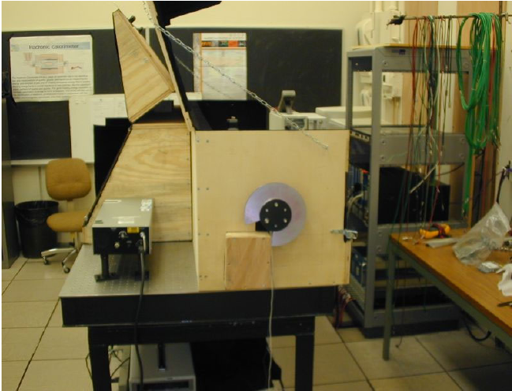
PMT Test Laboratory
3 dark boxes
VME and CAMAC DAQ systems
Computer controlled XY scanner and n.d.f. wheels
3 picoammeters
3 digital scopes
UV and visible power meters
UV and Blue LED light source
2 nitrogen lasers
Nitrogen Dye Laser
2 dark boxes has DC light source (tungsten light bulbs)
Optical table with all mounts and stands
Pico second LED pulsers and 1 double pulse generator

Slide 4
References
We have selected Hamamatsu R7525 as HF PMT and tested 2000 of them in University of Iowa. Along with PMTs we have constructed and tested the
light guide system and parallel dynode bases of the HF PMTs. We also extensively studied the PMT candidates and their responses to muon and neutron
beams. All studies are published as journal articles and/or CMS internal / detector notes.
Journal Publications:
U. Akgun et al. "Boron and Thermal Neutron Interactions on Borosilica Window Photomultiplier Tubes", Journal of Instrumentation, JINST 5 P08005, 2010
S. Chatrchyan et al. "Study of Various Photomultiplier Tubes with Muon Beams And Cerenkov Light Produced in Electron Showers", CMS NOTE 2010-003, JINST 5:P06002
U. Akgun et al. "Afterpulse Timing and Rate investigation of Three Different Hamamatsu Photomultipler Tubes", JINST, 3 T01001, 2008.
U. Akgun et al. "Radiation damage and light transmission studies on air core light guides", IEEE TNS, Vol 53, No. 3, 1547, 2006
U. Akgun et al. “Complete tests of 2000 Hamamatsu R7525HA Phototubes for the CMS-HF Forward Calorimeter", CMS-NOTE 2004/019, NIM A550:145-156, 2005
U. Akgun et al. "Comparison of PMTs from three different manufacturers for the CMS-HF Forward Calorimeter", CMS-NOTE 2003/029, IEEE TNS 51: 1909, 2004
Other Publications:
U. Akgun et al., "A Novel Method to Eliminate Muon Events on HF PMT Windows”, CMS DN-2009/014, 2009.
U. Akgun et al., "Study of CMS HF Candidate PMTs with Cerenkov Light in Electron Showers", CMS Detector Note, CMS DN-2009/012, 2009.
U. Akgun et al., "Tests of CMS HF Candidate PMTs with Muons", CMS Detector Note, CMS DN-2009/011, 2009.
U. Akgun et al., "Beam Test Results for the Anomalous Large Energy Events Removal in Hadronic Forward Calorimeter", CMS Detector Note, CMS DN-2009/005, 2009.
J. Olson et al. "Comparison of resistive and parallel dynode bases", CMS-IN 2006/019, 2006
J. Olson et al. "Parallel Dynode Base for HF", CMS-IN 2005/042, 2005
U. Akgun et al. "Afterpulse Studies for HF Calorimeter PMTs", CMS-IN 2004/034, 2004
U. Akgun et al. "CMS HF Calorimeter Light Guide System Radiation Damage Studies", CMS-IN 2003/029, 2003
U. Akgun et al. "Timing, Gain and Dark current Measurements of PMTs from Three Different Manufacturers for HF Calorimeter", CMS-IN 2002/032, 2002
P. Bruecken et al. "Radiation Effect Studies on High Efficiency Mirror (HEM) and Aluminized Mylar for the HF Optical Design", CMS-IN 2002/031, 2002
U. Akgun et al. "Single and Double Pulse Linearity Studies Performed on Candidate PMTs for HF Calorimeter", CMS-IN 2002/030, 2002
U. Akgun et al. "Tests of the CMS-HF Light Guide System at the University of Iowa PMT Test Station", CMS-IN 2002/029, 2002
U. Akgun et al. "Single Photoelectron Spectrum Measurements of HF Calorimetry Candidate PMTs in The University of Iowa Test Station", CMS-IN 2002/026, 2002

Slide 5
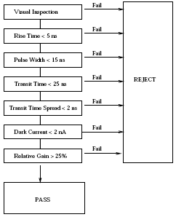
PMT Traveler Sheet Inspection List
As they arrive every PMT is attached to a traveler sheet and all related info is edited on this sheet as our internal document.
Simple algorithm is followed to reject of accept a PMT after each test.

Slide 6
Tests and Special Needs
Linearity needs neutral density filter wheels.
Gain requires homemade base to read cathode current.
Double pulse linearity requires double pulse generator
Lifetime tests requires light stability monitored by power meter.
Single photoelectron tests are very sensitive, in last 10 years we build 4 different versions of it. As long as PMT has a single p.e. sensitivity, we can detect it.

Slide 7
Cukurova University Capacity and Proposed Tests
We are organizing the tests to be performed in Cukuroav as well.
Cukurova has a optical laboratory to perform some of these tests. I confirmed that they have
Nitrogen Laser, Picoammeter, Keithley 6485,
Oscilloscope, LeCroy WaveRunner 6051, DAQ.
We’ll build the socket for them to read cathode current for gain measurements. Iowa team will help them to start, and train the manpower.
After Iowa tests Cukurova is going to confirm
  Gain, Dark Current, Afterpulse, and Timing tests.

Slide 8
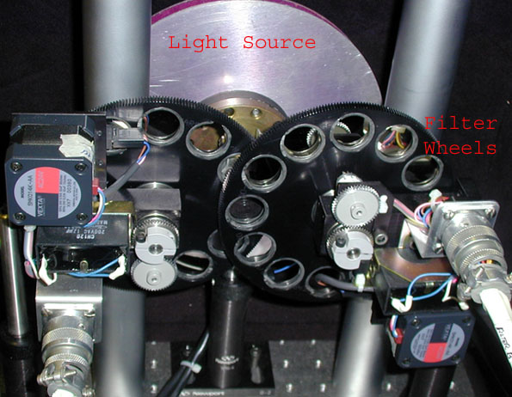
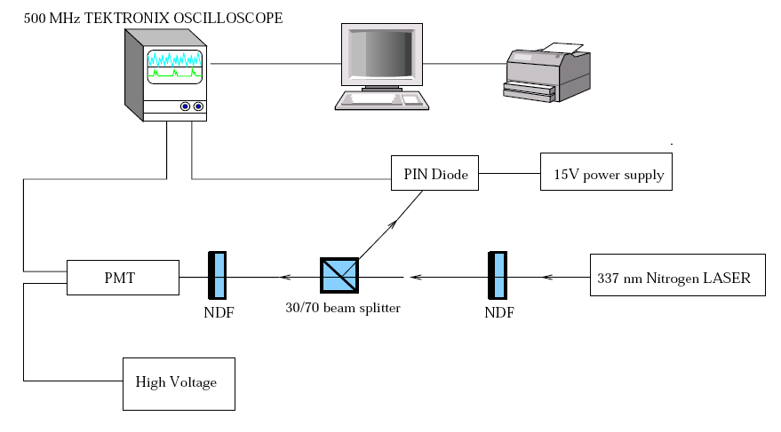
Timing @ Linearity Setup
Testing PMT Linearity between 1-3000 p.e. is done by
automated ndf filter wheel system.
Timing tests include rise time, pulse width, transit time,
transit time spread. They are all done via visual basic code
run by digital scope

Slide 9
Iowa Timing Measurements
 | Anode 1 | Anode 2 | Anode 3 | Anode 4
Pulse Width | 4.01 | 4.19 | 4.42 | 4.16
Rise Time | 1.91 | 2.1 | 2.14 | 2.39
Transit Time | 7.25 | 7.15 | 7.26 | 7.44
Transit Time Spread | 0.12 | 0.07 | 0.09 | 0.09

Slide 10
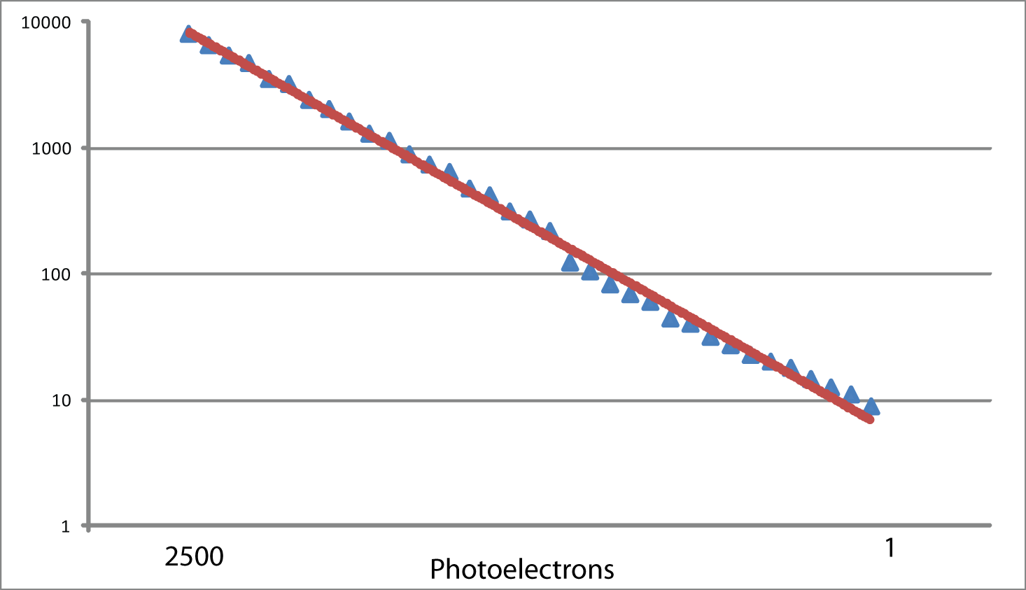
Iowa Linearity Measurement

Slide 11
Iowa Anode Gain Measurements
Each Dynode Measured Separately – Gains show little variation

Slide 12
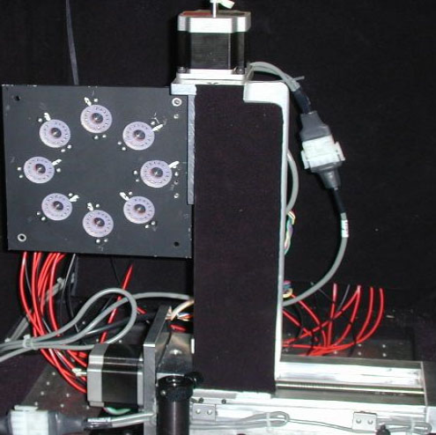
Automated X-Y Scanner
Computer controlled XY scanner has 1/4000 inch step size. It is used for cathode surface nonuniformity tests.
It is also being used for light guide
tests for sleeve studies. During sleeve raddam studies this unit is
handy.

Slide 13
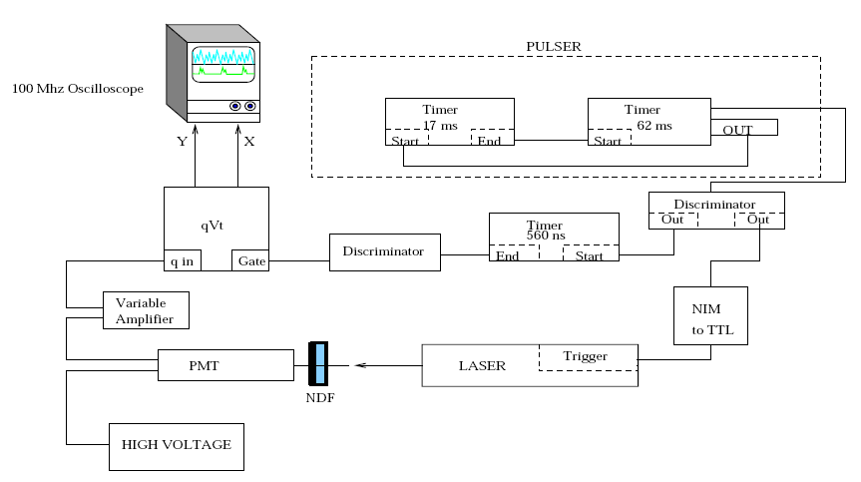
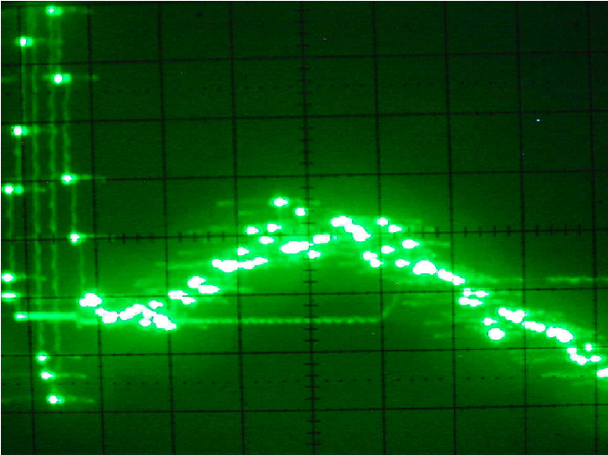
1st Generation Single p.e. Setup

Slide 14
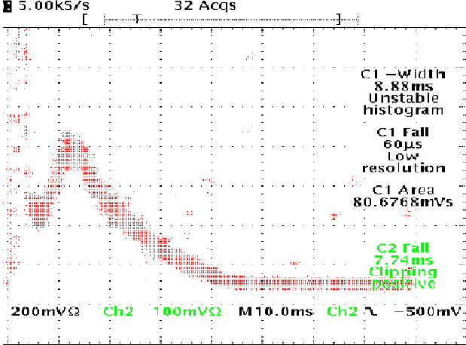
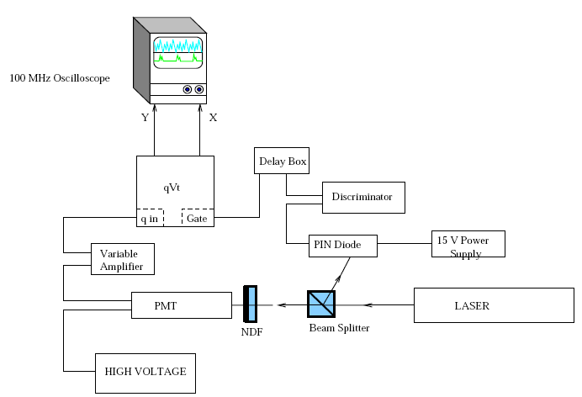
2nd Generation Single p.e. Setup

Slide 15
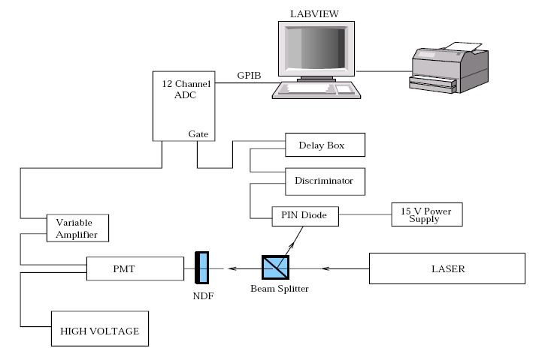
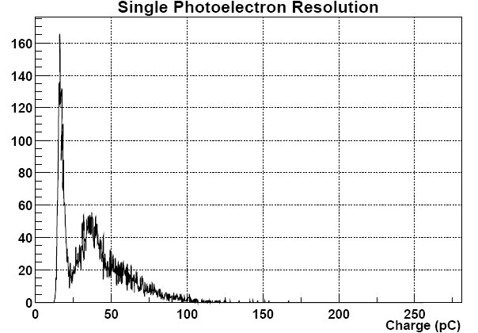
3rd Generation Single p.e. Setup

Slide 16
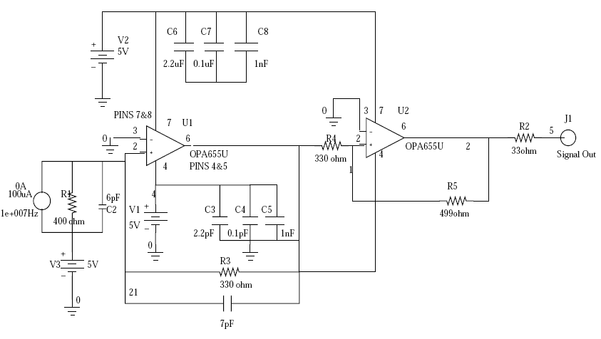
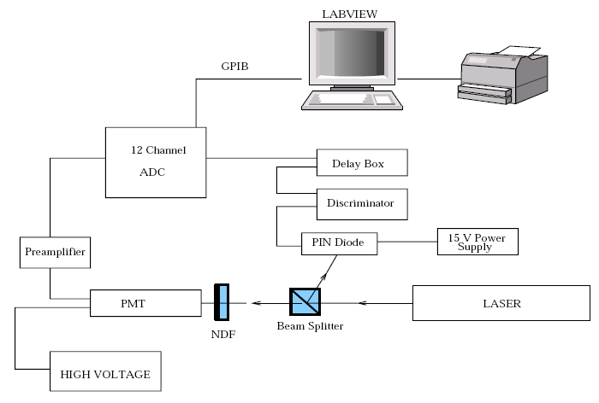
4th Generation Single p.e. Setup

Slide 17
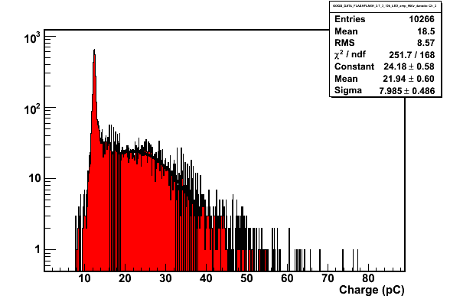
Iowa Single p.e. Measurement

Slide 18
R7600 & Magnetic Field
We tested R7600 under magnetic field up to 200 Gauss.
The PMTs lost only 3% of the light under 200 Gauss, with NO SHIELDING !!
The Ianos’ design square mu shields reduce the outside 100 Gauss to to 5 Gauss.

Slide 19
Barcode Strategy
14 digit “interleaved 2 of 5” format barcode
Digit:
1
2
3
4
5
6
7
8
9
10
11
12
13
14
3
4
3
9
8
0
x
x
x
x
x
x
x
x
Part Number
Location
0-Not specified
1-Plus
2-Minus
3-Wheel 2Plus
4-Wheel 1Plus
5-Wheel 0
6-Wheel 1Minus
7-Wheel 2Minus
8-Electronics
Regional center no.
99-FNAL
98-U of I
0-LHC accelerator
1-ALICE
2-ATLAS
3-CMS
4-LHCB
1x-Magnet
2x-Tracker
3x-ECAL
4x-HCAL
40-Not specified
41-HB
42-HE
43-HF
44-HO

Slide 20
HF PMT barcode scheme
The PMT serial number will be encoded in the barcode.
Digit:
1
2
3
4
5
6
7
8
9
10
11
12
13
14
3
4
3
9
8
0
0
1
0
1
x
x
x
x
HF sub-group
Numeric portion
of serial no.
01-PMT’s
PMT serial no. letter prefix
Reference number.
01-”CA” *
*All Hamamatsu HF PMT serial numbers will have a letter prefix of “CA”

Slide 21
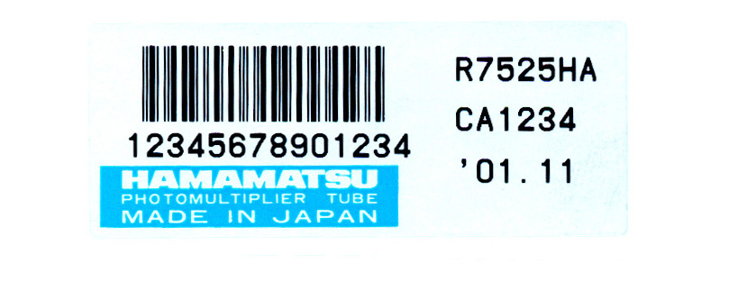
HF PMT label
PMT’s will be labeled by Hamamatsu during production.
Barcode
Sample PMT label
Part number
(size: 50mm x 20mm)
Serial number
Manufacturer
Delivery date : year / month

Slide 22
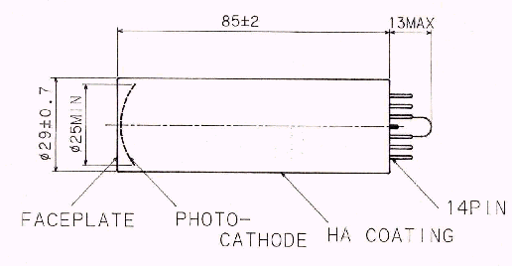
PMT label placement
R7525HA
10 – 15 mm
Short cut pin
BAR CODE LABEL
The short cut pin will approximately be the center of the BAR CODE LABEL.

Slide 23
Conclusion
Iowa is ready for PMT tests.
Every test procedure is well documented on published papers.
This time we have few additional tests: Gain vs HV for each PMT, and crosstalk.
Cukurova will perform some PMT tests, but they need a little help from Iowa team. We are working on their test setup details.

