Slide 1
Searching for Educational Resources in a Study Assistant: An Open Search Use Case
Leon Martin, M.Sc.
Felix Engl, M.Sc.
Tobias Hirmer, M.Sc.
Michaela Ochs, M.Sc.
Prof. Dr. Andreas Henrich
Media Informatics, University of Bamberg
https://www.uni-bamberg.de/minf/

Slide 2
Outline
Motivation
Study (Planning) Assistant
Search for Educational Resources
Planned Research
Conclusion

Slide 3
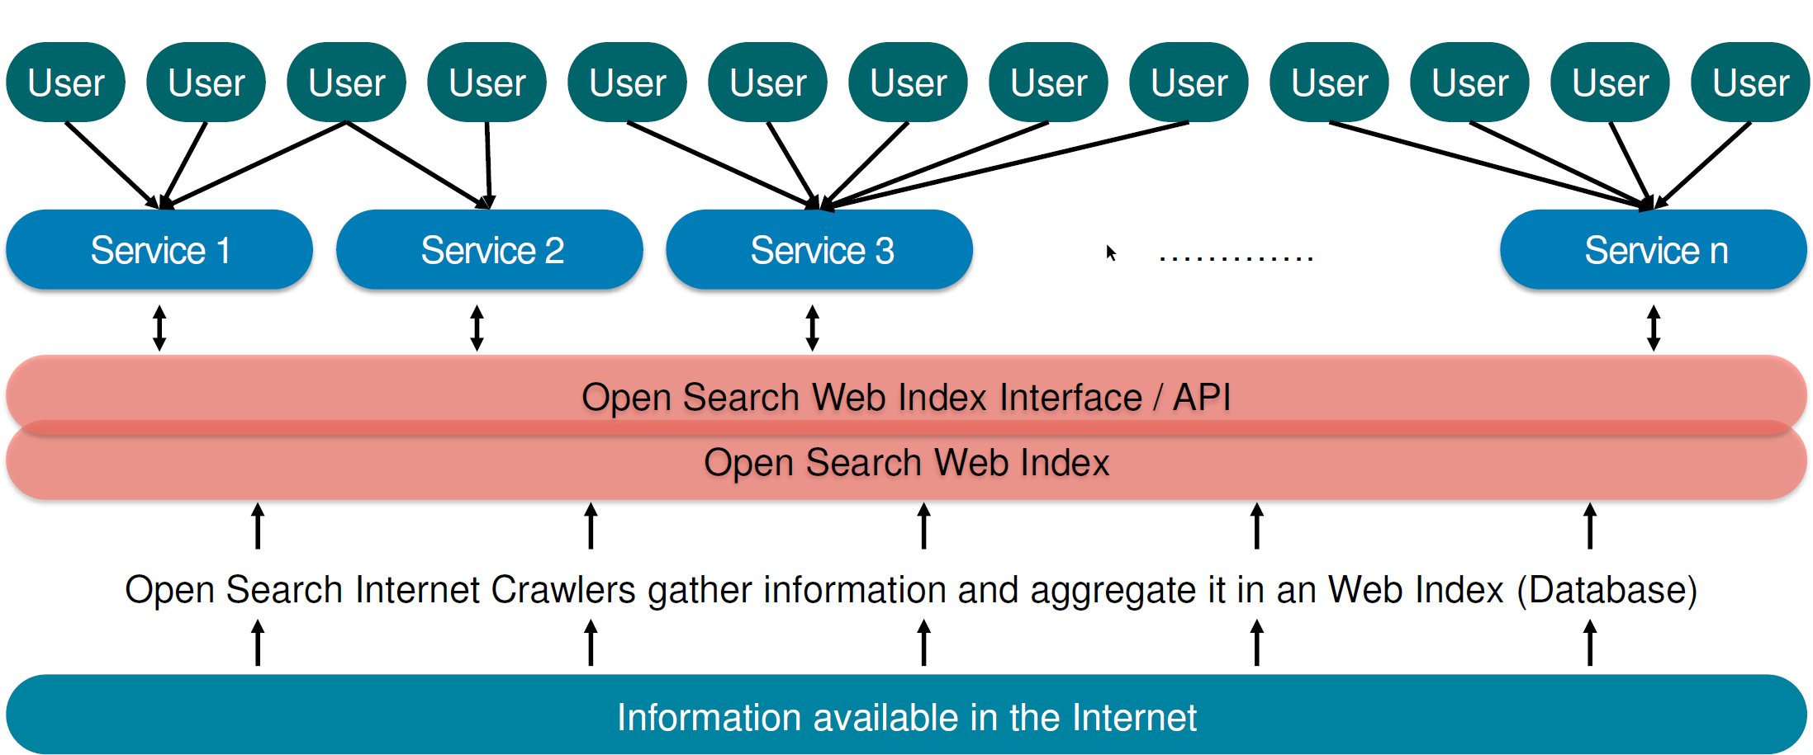
Motivation: Additional Use Case
IT Atlas [3]
Study Assistant
Searching for Educational Resources in a Study Assistant
https://opensearchfoundation.org/
Notes:
Different verticals have (very) different requirements.

Slide 4
Outline
Motivation
Study (Planning) Assistant
Search for Educational Resources
Planned Research
Conclusion
Notes:
20 minutes presentation + discussion
→ 15 minutes presentation

Slide 5
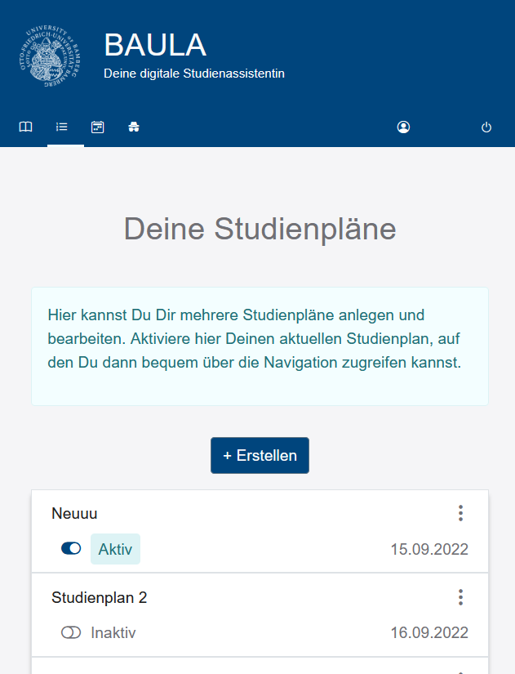
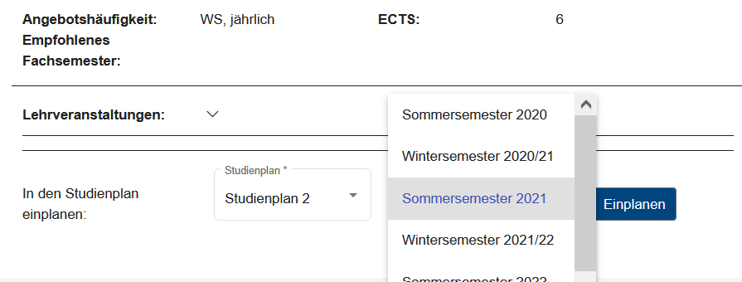
Study (Planning) Assistant
Core functionality:
  Selecting modules (courses) for short-term and long-term planning (study course)
  View individual study progress
Extended functionality
  Module recommendations
  Search for learning resources
Manage (several) long-term study plans
Select modules for long-term study plan

Slide 6

Additional Use Case for an OSI
Study planning assistant for university students shall be extended towards a more general study assistant
Extension shall include the possibilities of
  searching for (open) educational resources
  Receiving (personalised) resource recommendations based on one‘s user profile
Aim: a more thorough understanding of a vertical provider‘s requirements for an OSI (like the IT Atlas)

Slide 7
Outline
Motivation
Study (Planning) Assistant
Search for Educational Resources
Planned Research
Conclusion
Notes:
20 minutes presentation + discussion
→ 15 minutes presentation

Slide 8
Search for Educational Resources
Educational Resources (ER) „are learning, teaching and research materials in any format and medium” [1]
  Educational Videos,
  Software Documentations,
  Tutorials, …
Open in the context of open educational resources (OER) refers to a publication „in the public domain or […] under an open license, that permit no-cost access, re-use, re-purpose, adaptation and redistribution by others.” [1]
For usage in the study (planning) assistant:
  Meeting the demand for (missing) information of the individual learner
  Focus on open access for personal usage, not on reuse of ER

Slide 9
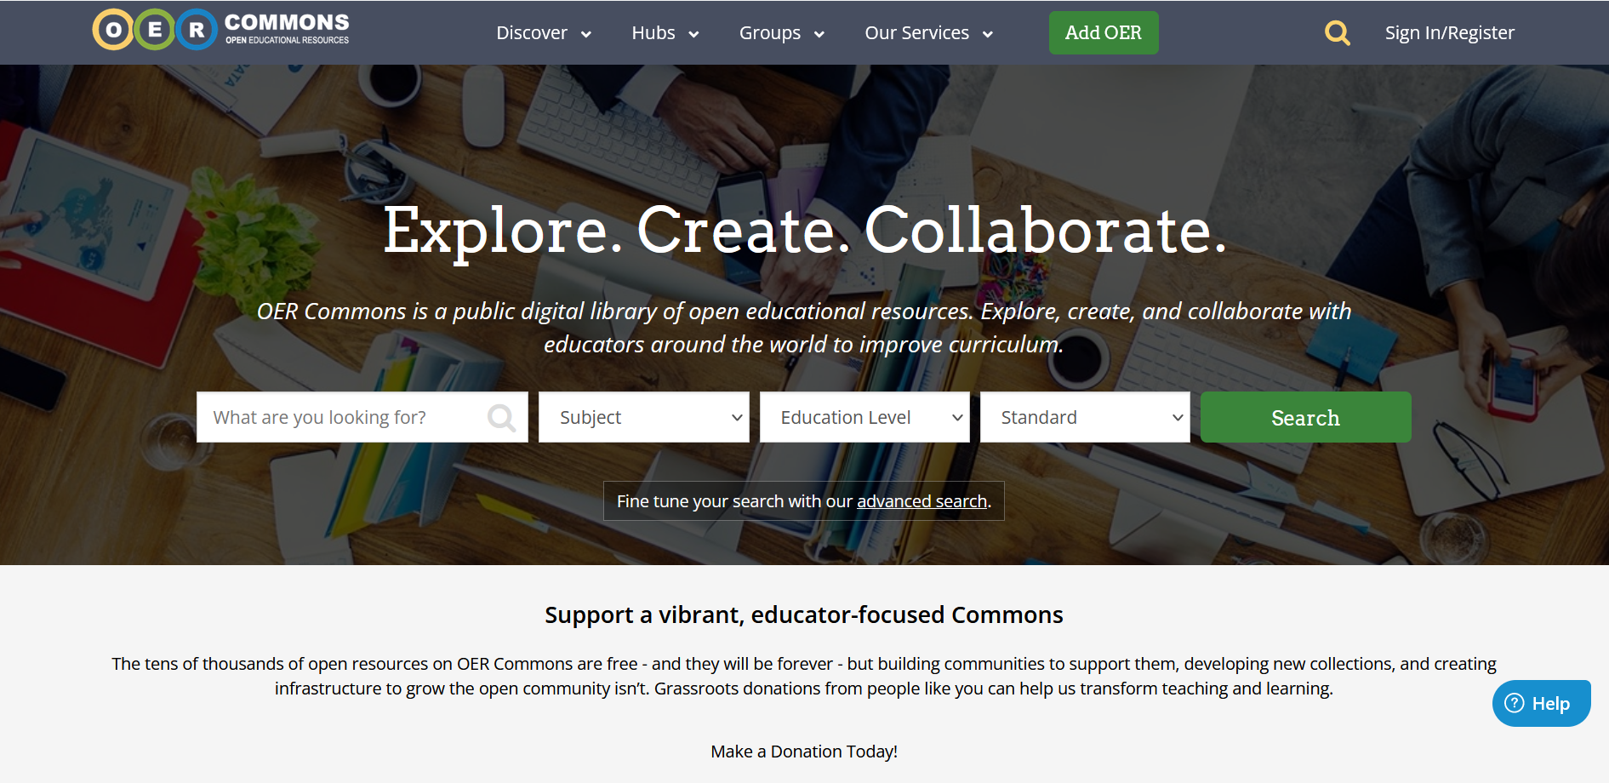
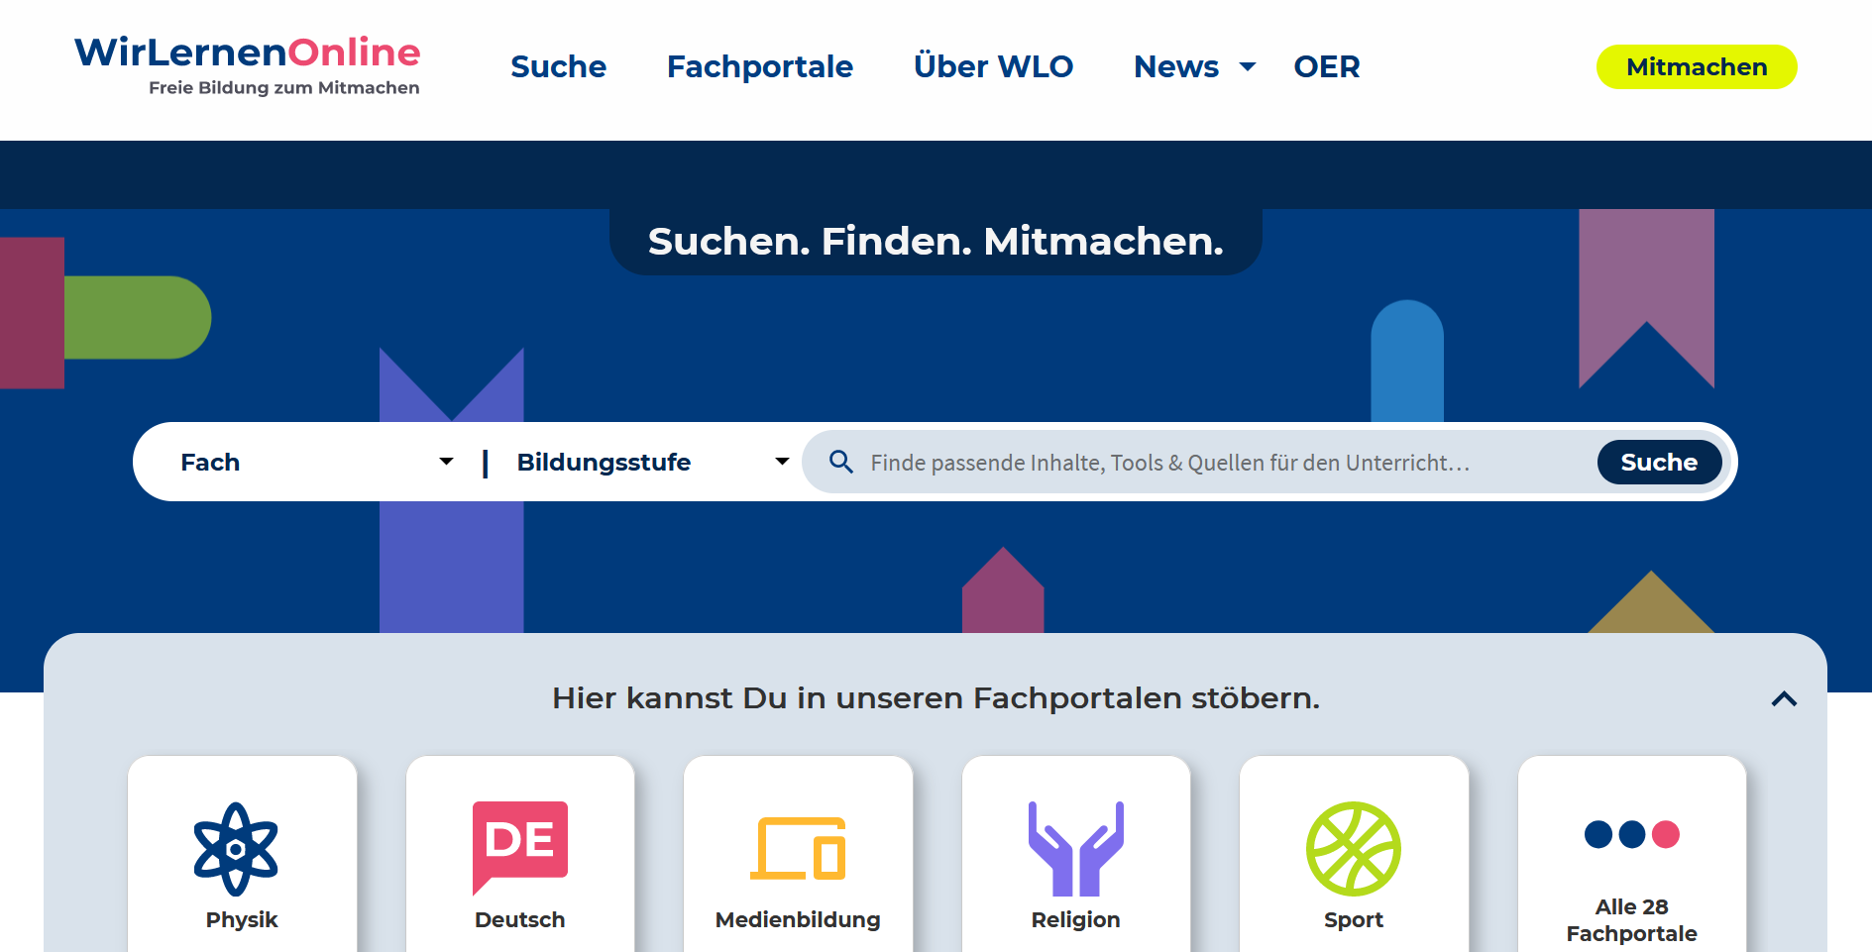


Search for Educational Resources
oercommons.org
wirlernenonline.de
oersi.org
Focus on…
  different educational level
  re-use for educators (e.g. school teachers)
  simple queries (e.g. term search)
Study (planning) assistant extends context for query and demands a broader learner-centered search for material
oerhoernchen.de
Notes:
Oercommons → different educational levels
Werlernenonline → re-use for educators

Slide 10
Outline
Motivation
Study (Planning) Assistant
Search for Educational Resources
Planned Research
Conclusion
Notes:
20 minutes presentation + discussion
→ 15 minutes presentation

Slide 11
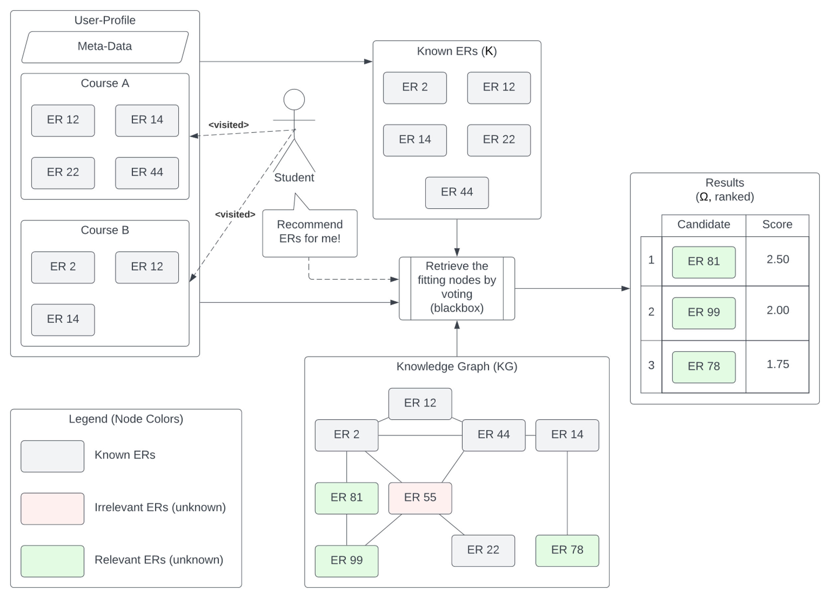

Planned Research

Slide 12
Server-side Representation of ERs
ERs possess various properties
  A URL
  A type
  Target audience(s)
  Author(s)
  Focused topic(s)
  …
Different types of relationships
  One-to-one: One ER has exactly one URL
  One-to-many: One ER has one or more content parts
  Many-to-many: One or more ERs have one or more authors
→ Graph-based representations are suitable
→ Knowledge Graphs

Slide 13
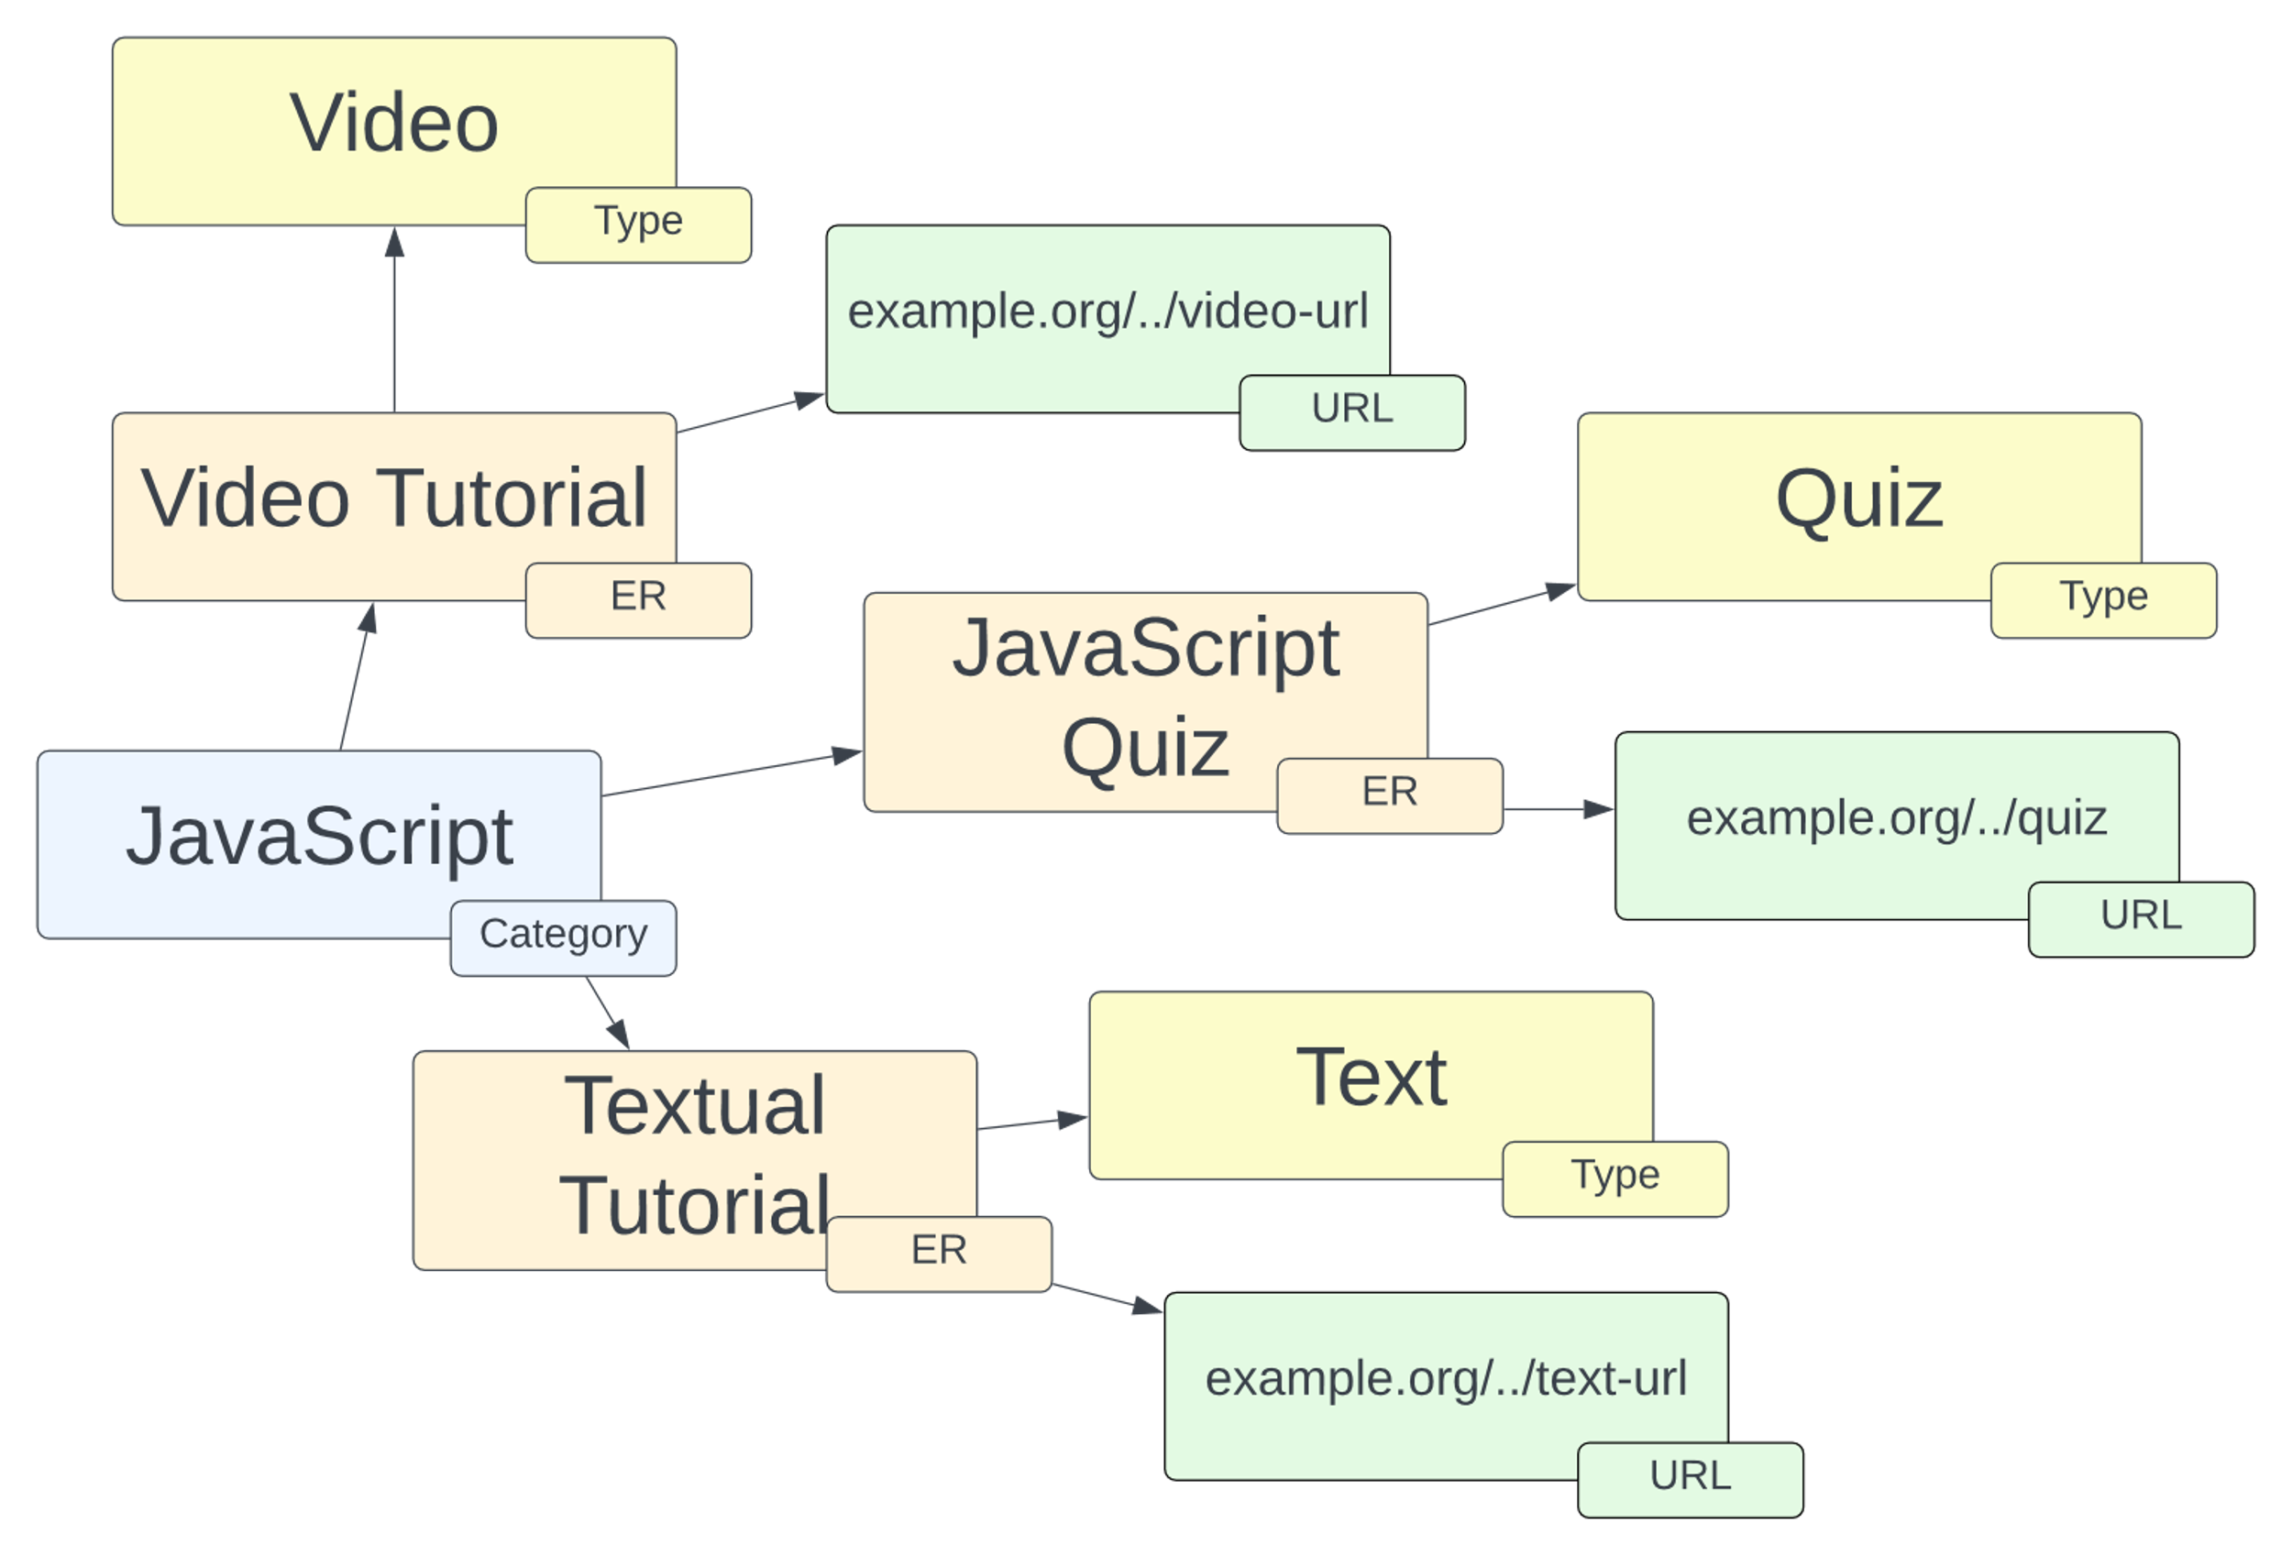
Server-side Representation of ERs
Simple exemplary KG
IRIs omitted for readability
Only URLs and type information of ERs are included
Notes:
International Resource Identifier

Slide 14
Voting – Model with voting
Notes:
Explain with example of javascript → user prefer video over text and wants to be challenged in quizzes
With regards to voting, the KG is viewed in a more leveraged way, by only considering the connections between the Ers with regard to the recommendation-query.

Slide 15
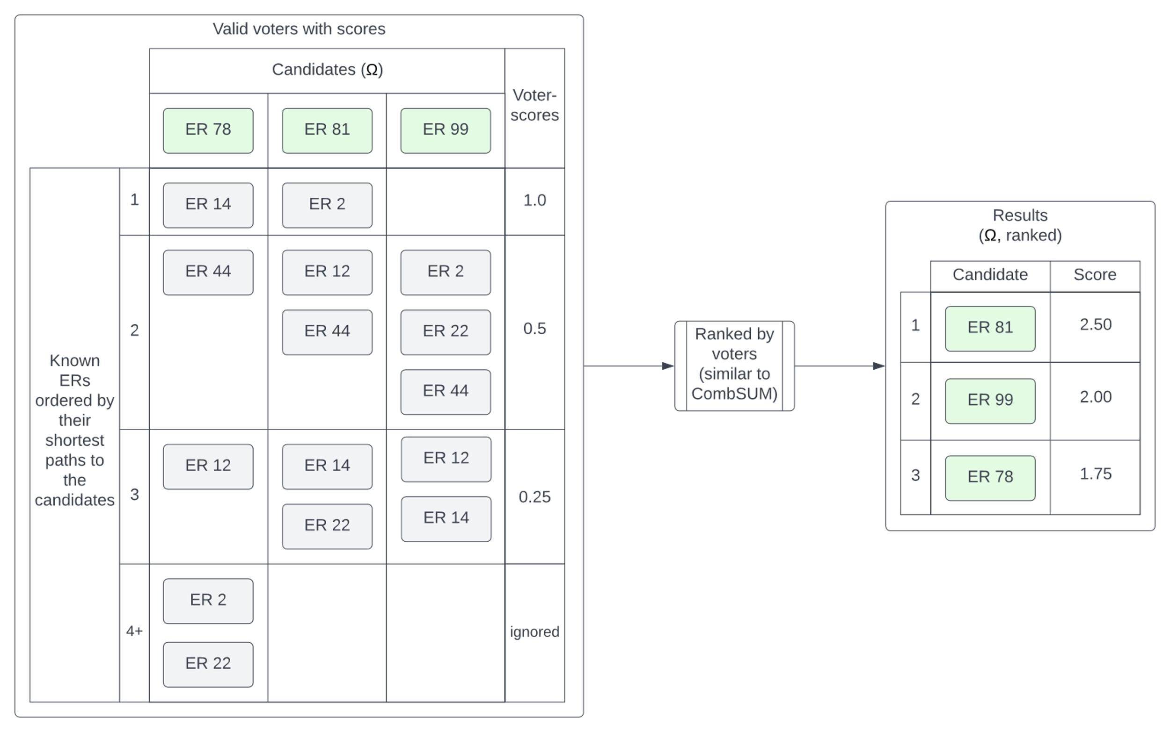
Voting – Explained
[2]

Slide 16
Outline
Motivation
Study (Planning) Assistant
Search for Educational Resources
Planned Research
Conclusion
Notes:
20 minutes presentation + discussion
→ 15 minutes presentation

Slide 17
Conclusion
Proposal for use case of a vertical provider
Requirements for an OSI resulting from this proposal:
  Providing an interface for the integration of KGs or a KG-Service
  Developing a strategy for integrating external indices (e.g., OER search engines like oersi.org)
  Handling personal data – especially enabling the configuration of the geolocation of hosted personal data
Thereby the requirements from the first use case (IT Atlas) are complemented

Slide 18
Thank you!

Slide 19
References
UNESCO. “Recommendation on open educational resources (oer).” (2019), http://portal.
unesco.org/en/ev.php-URL_ID=49556&URL_DO=DO_TOPIC&URL_SECTION=201.html
A. Henrich and M. Wegmann, “Search and evaluation methods for class level information retrieval: Extended use and evaluation of methods applied in expertise retrieval,” in SAC ’21: The 36th ACM/SIGAPP Symposium on Applied Computing, Virtual Event, Republic of Korea, March 22-26, 2021, ACM, 2021, pp. 681–684.doi:10.1145/3412841.3442092.
L. Martin, F. Engl, and A. Henrich, “Requirements for an Open Search Infrastructure from the Perspective of a Vertical Provider,” Zenodo, Oct. 2021. https://doi.org/10.5281/zenodo.6139647

Slide 20
Representation of User Profiles
Goal: Provide user profiles as part of the queries
  Improve quality of recommendations and search results
  But: Risk of compromising privacy
Video
example.org/.../quiz
example.org/.../video-url
Video Tutorial
JavaScript Quiz
Quiz
…
JavaScript
Example User:
Prefers videos over text
Likes to be challenged in quizzes
Textual Tutorial
Text
example.org/.../text-url
Notes:
Search result for example user – Subset of KG

Slide 21
Representation of User Profiles
Two parts:
Default Personas
Study program specific
  Derived from user studies
Prevent cold-start problem
Privacy preserving option for concerned users
User Profiles
Personalized
  via initial questionnaire
  via search log analysis
Improved quality of recommendations and search results

Slide 22
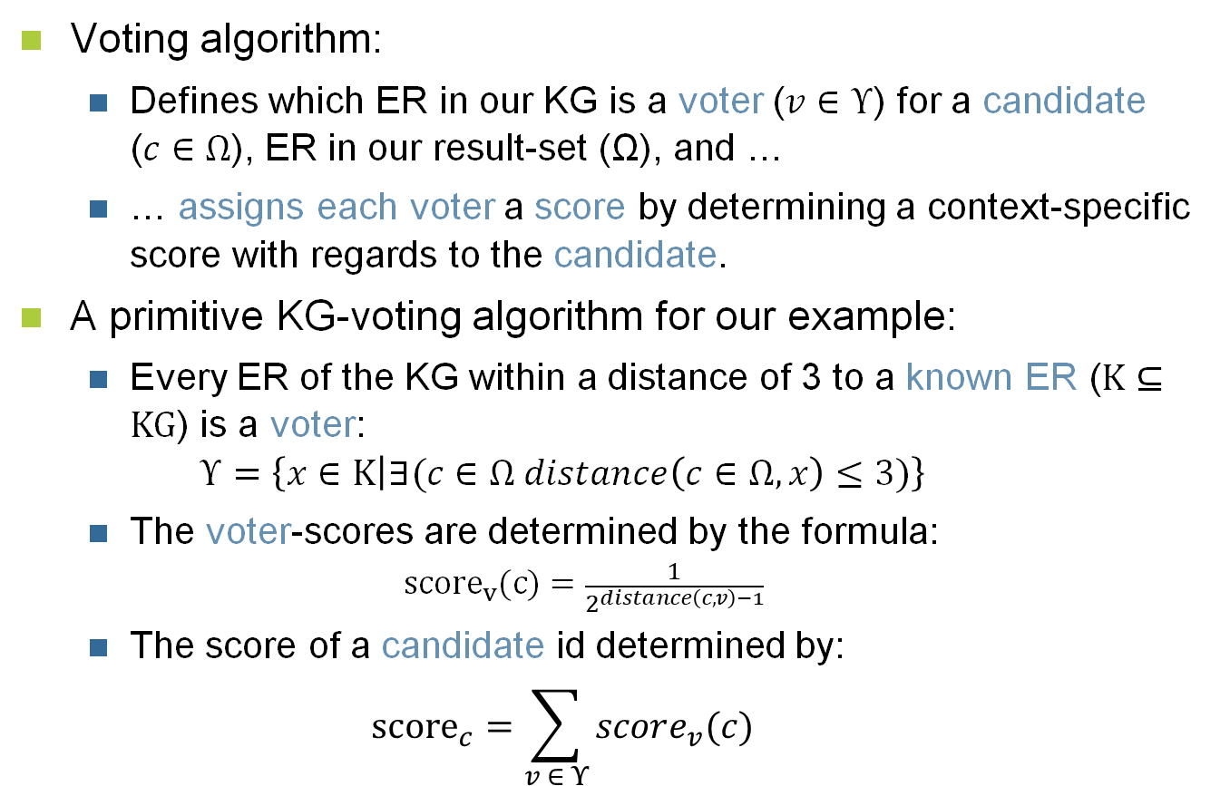
Voting – Definition
Voting algorithm:
  Defines which ER in our KG is a voter ($v∈Υ$) for a candidate ($c∈Ω$), ER in our result-set (Ω), and …
  … assigns each voter a score by determining a context-specific score with regards to the candidate.
A primitive KG-voting algorithm for our example:
  Every ER of the KG within a distance of 3 to a known ER ($Κ⊆\text{KG}$) is a voter:
  $Υ=\left\{x∈Κ | ∃(c∈Ω distance\left(c∈Ω,x\right)≤3)\right\}$
  The voter-scores are determined by the formula:
  ${score}_{v}(c)=\frac{1}{2^{distance\left(c, v\right)−1}}$
  The score of a candidate id determined by:
  ${score}_{c}=\sum_{v ∈ Υ}{score_{v}(c)}$
Notes:
Distance = number of ERs between two ERs

Slide 23
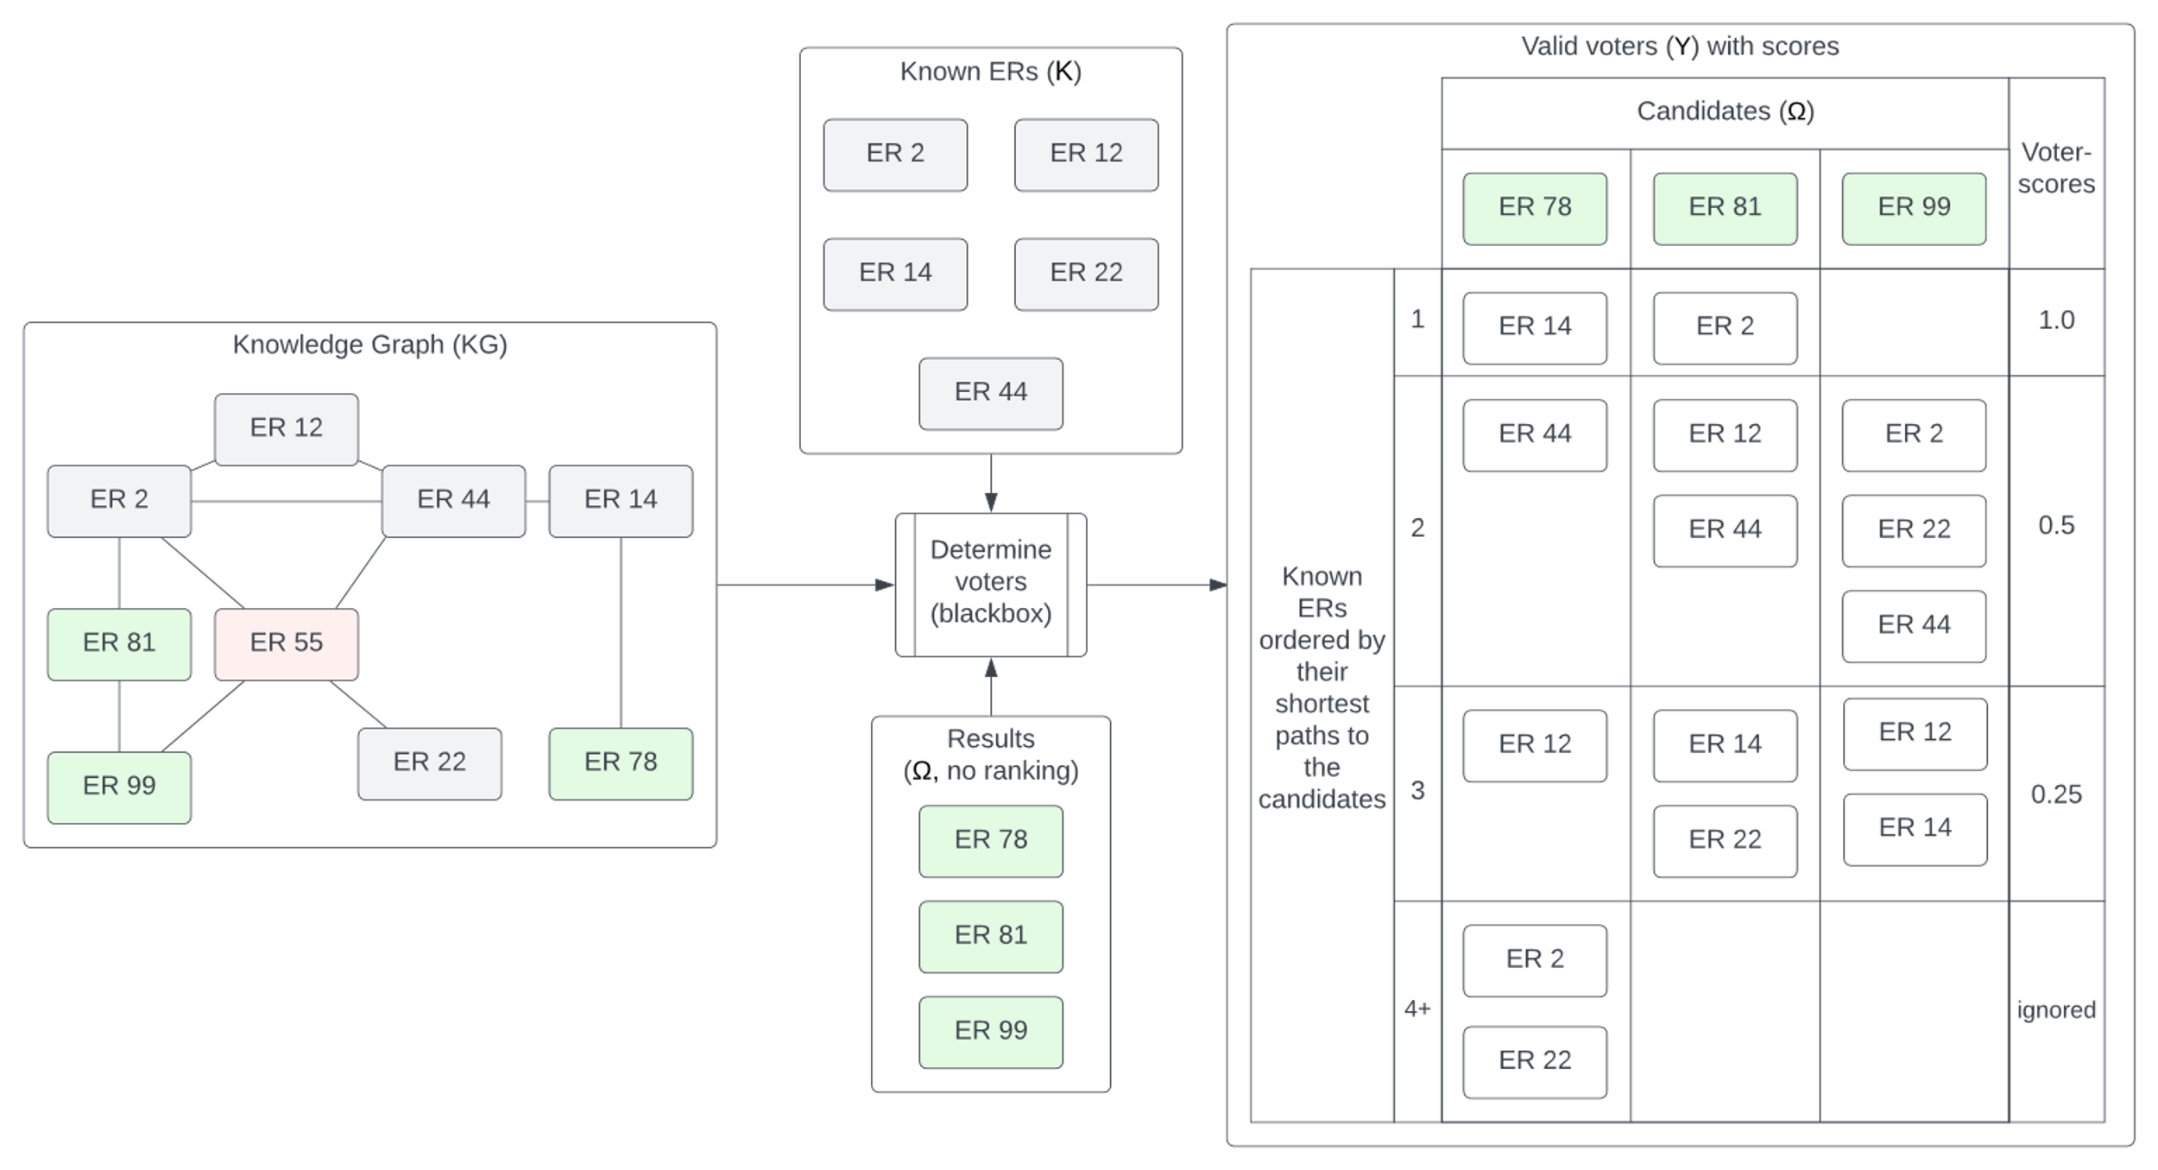
Voting – Example cont.
Determining the valid voters and their voter-scores for our example:

Slide 24
Voting – Example cont.
Rank the recommendations by their relative candidate-scores:

