Slide 1
Education + Literacy
Prof. Dr. Melanie Platz

Slide 2
Explaining

Slide 3
Explaining
Everyday means of mediation in teaching and learning processes.
Takes a central place in school
Knowledge should be transferred, developed or negotiated in such a way that students understand it and are able to act accordingly.
Kiel (1999)

Slide 4
Explaining
3 categories of explaining:
Transferring knowledge: Transferring knowledge from one person to another
Developing knowledge: students find their own explanation for an issue
Negotiating knowledge: Knowledge mediators and learners as equal communication partners; attempt to reach an explanation of the subject matter through communicative exchange.
Kiel (1999)

Slide 5
Explaining
4 dimensions of explaining in order to be able to formulate an understandable explanation:
Structural dimension: the teacher must define the content of the explanation and determine a suitable situational example to illustrate the facts.
Comprehension dimension: The teacher must clarify in advance the goal of the explanation and the audience to be reached.
Content dimension: It must be clarified whether the content of the explanation is generally applicable and whether there is a potential for linking it to other facts or whether it can be connected to other content.
Linguistic dimension: Correct use of technical terms; addressee orientation: do the terms need a more detailed explanation or should technical language be used?
Kiel, Meyer & Müller-Hill (2015)

Slide 6
Explaining
3 types of explanations
Explain-WHAT: The focus is on concepts and the associated concept formation process. This declarative knowledge is mostly built on the basis of already known concepts in order to construct the product that is in focus.
Explain-HOW: The explanations are related to actions. The procedural knowledge of these explanations must be apparent to others, so that different step sequences of an action can be understood.
Explain-WHY: Here, connections and relationships are explained. The transfer of knowledge is ensured by argumentations, justifications and proofs and can already take place among the learners.
Klein (2009); Schmidt-Thieme (2009)

Slide 7
Children`s Questions

Slide 8



Material Overview
Dear Experts at the Open Search Symposium,
Letter from a child
Envelope and letter paper

Slide 9
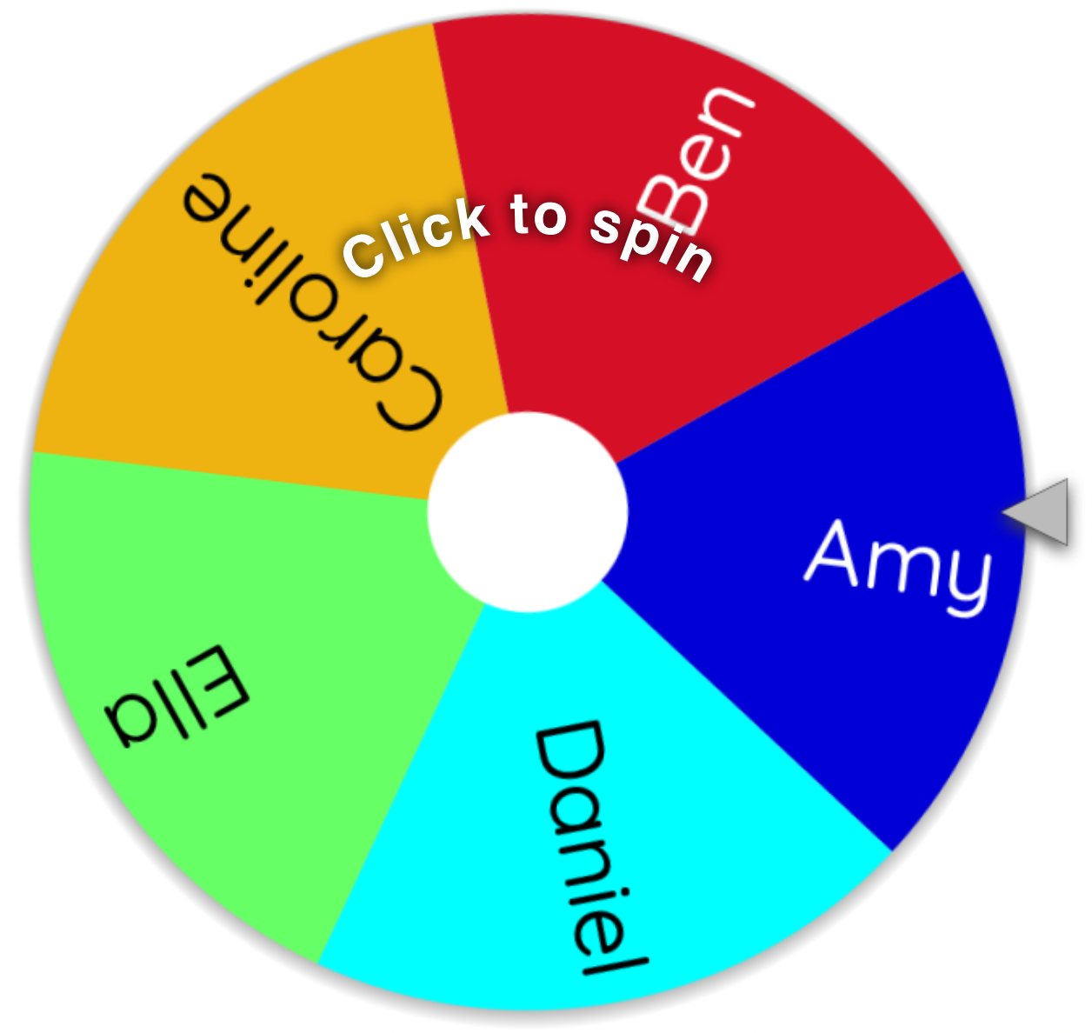
Challenge
https://wheelofnames.com/jbu-hqd

Slide 10
Your turn
Reply to the letter.

Slide 11
Children‘s Questions
Dear Experts at the Open Search Symposium,
My name is Amy and my dad can ask each question to Google,
like “how to draw an elephant” or “recipe for chocolate cake”.
Why does Google know everything?
Do you at the Open Search Foundation also know everything?
Best regards,
Amy

Slide 12
Children‘s Questions
Dear Experts at the Open Search Symposium,
My name is Ben and I have a question: What is Google?
I already asked my dad, and he said Google is the place where daddies ask questions and that it is on his phone.
But what is it? And what is the Open Search Foundation?
Best regards,
Ben

Slide 13
Children‘s Questions
Dear Experts at the Open Search Symposium,
My Name is Caroline and I have a question:
Are there real people behind Google? I never saw one.
What do they do?
And what do you do at the Open Search Foundation?
Best regards,
Caroline

Slide 14
Children‘s Questions
Dear Experts at the Open Search Symposium,
My name is Daniel and my parents do not allow me to go to the internet alone or to use Google, because they say it is not safe and that there are websites that are not safe.
What can I do?
Do you at the Open Search Foundation know which website is safe and which is not?
Best regards,
Daniel

Slide 15
Children‘s Questions
Dear Experts at the Open Search Symposium,
My name is Ella and I have a question.
You say on your homepage, that the internet was meant to be free.
Why is it not free?
And how do you plan to free it?
Can I help?
Best regards,
Ella

Slide 16
Refrences
Kiel, E. (1999). Erklären als didaktisches Handeln. Würzburg: Ergon Verlag.
Kiel, E., Meyer, M. & Müller-Hill, E. (2015). Erklären – Was? Wie? Warum? Praxis in der Mathematik in der Schule. Sekundarstufe I und II, 57 (64), 2–9.
Klein. J. (2009). Erklären-Was, Erklären-Wie, Erklären-Warum – Typlogie und Komplexität zentraler Aspekte der Welterschließung. In J. Vogt (Hrsg.), Erklären: Gesprächsanalytische und fachdidaktische Perspektiven (S. 25–36). Tübingen: Stauffenburg.

Slide 17

Thank you
for your attention and
for your active participation!
melanie.platz@uni-saarland.de
https://opensearchfoundation.org/en/working-group-educationliteracy/

