Slide 1

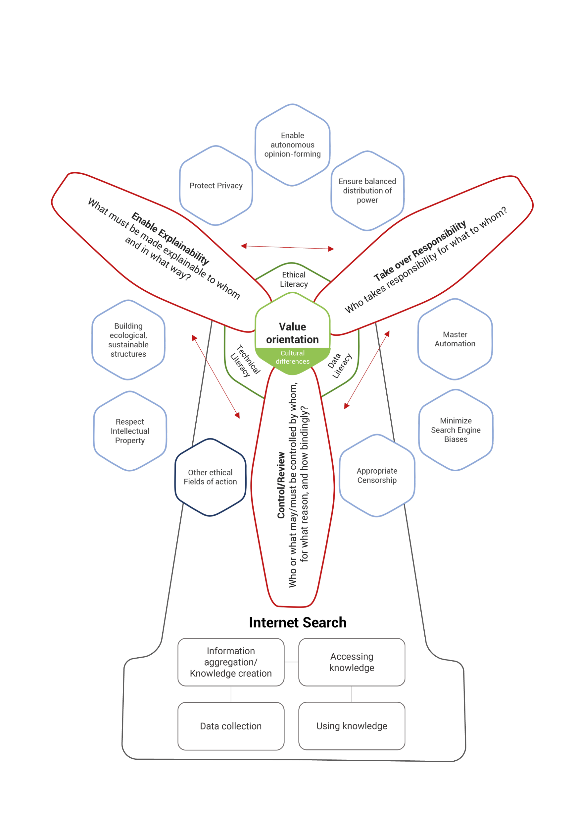

Ethics in Search Engines
OSSYM 2022 – 4th International Open Search Symposium
The Development of
the Ethics Mill of Internet Search
Benedikt Hoffmann, Inlinity Technologies GmbH
Alexander Decker, Technische Hochschule Ingolstadt
Christine Plote, Open Search Foundation e.V.

Slide 2
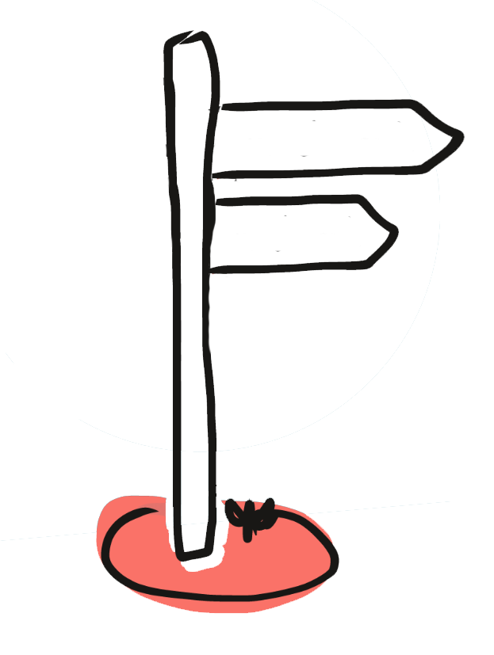
Ethical
Internet Search
Problem: on ethics
specifically in the internet search
there are hardly any scientific publications
Extensive ethical consideration & reflection
Where do we start?
3
Benedikt Hoffmann, Alexander Decker, Christine Plote | OSSYM 2022

Slide 3

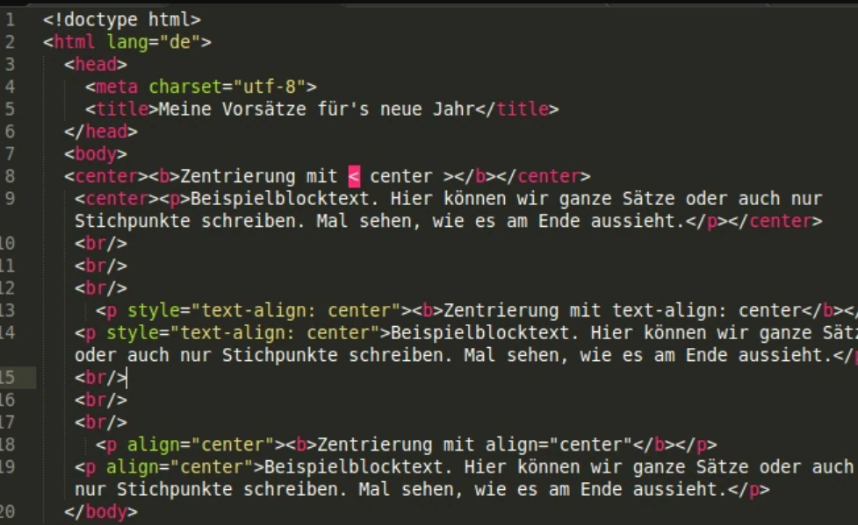

Scientific Basis
MEDIA ETHICS
ALGORITHM ETHICS
SOCIAL-MEDIA ETHICS
ROBOT ETHICS
DATA ETHICS
AI ETHICS
4
Benedikt Hoffmann, Alexander Decker, Christine Plote | OSSYM 2022

Slide 4
Scientific Method
Systematic
Literature analysis
Concept Matrix
with ethical topics & fields of action from different publications
Transfer process
with prioritization and thesis development for internet search
Value Matrix
The ethics mill of
Internet search
5
Benedikt Hoffmann, Alexander Decker, Christine Plote | OSSYM 2022

Slide 5
Scientific method
Systematic
Literature analysis
Topic Matrix
with ethical topics & fields of action from different publications
Transfer process
with prioritization and thesis development for internet search
1. Universal reasoning
General validity
2. Direct reference
Direct reference to the internetsearch
3. Indirect reference
Indirect connection with the Internet search
4. Comparison
Similar contexts
(quantity and quality of the fields of action were also taken into account)
Transfer process
with prioritization and thesis development for internet search
Value Matrix
The ethics mill of
Internet search
5
Benedikt Hoffmann, Alexander Decker, Christine Plote | OSSYM 2022

Slide 6

Scientific method
Systematic
Literature analysis
Topic Matrix
with ethical topics & fields of action from different publications
Transfer process
with prioritization and thesis development for internet search
Value Matrix
Value Matrix
The ethics mill of
Internet search
5
Benedikt Hoffmann, Alexander Decker, Christine Plote | OSSYM 2022

Slide 7
Scientific method
Systematic
Literature analysis
Concept Matrix
with ethical topics & fields of action from different publications
Transfer process
with prioritization and thesis development for internet search
Value Matrix
The ethics mill of
Internet search
5
Benedikt Hoffmann, Alexander Decker, Christine Plote | OSSYM 2022

Slide 8

The Ethics Mill of
Internet Search
Worry about
People
Value
orientation
Enable international
dialoque
Cultural differences
Provide
competencies
Comprehension
6
Benedikt Hoffmann, Alexander Decker, Christine Plote | OSSYM 2022
Notes:
components

Slide 9

The Ethics Mill
of Internet Search
Concern about people
The Core
Sicherung der
Ethical
Literacy
Not every person/organization cares about other people or acts ethically....
Value
orientation
Comprehension
Cultural
differences
What level of detail is required for different actors to receive further training in the three areas of competence so that they are able to make ethical decisions independently?
Technical
Literacy
Data
Literacy
There is not only one value system
Enabling international dialogue on values
7
Benedikt Hoffmann, Alexander Decker, Christine Plote | OSSYM 2022

Slide 10
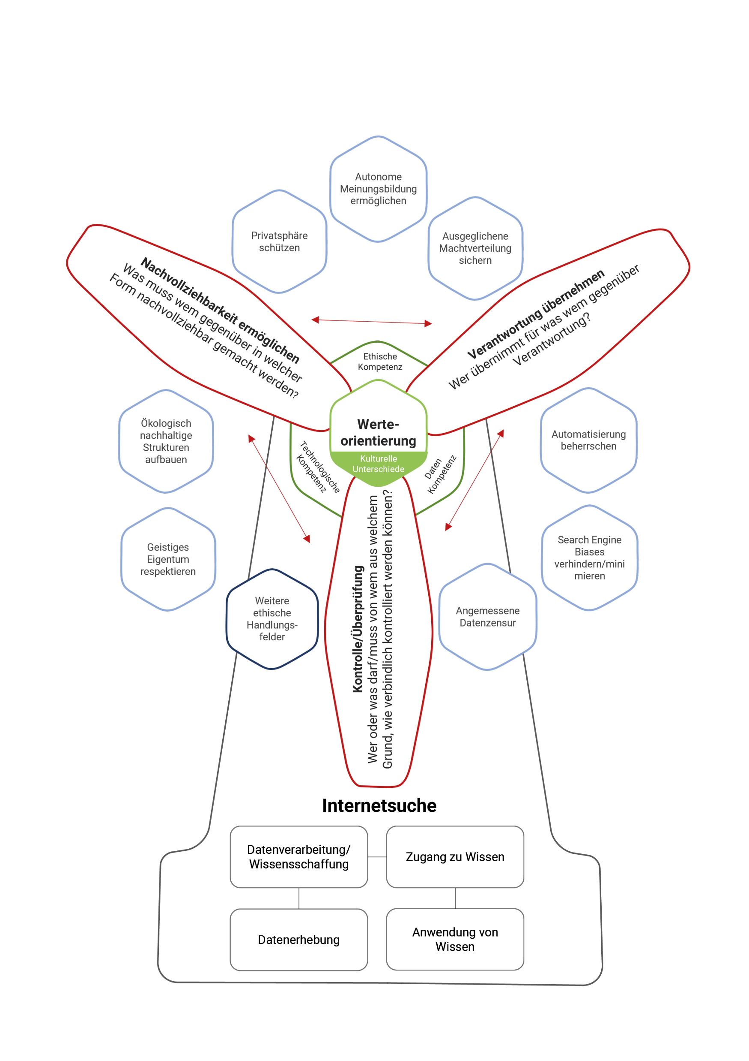
The Ethics Mill
of Internet Search
Acting ethically means taking responsibility
The Rotor Blades
Enable Explainability
What must be made explainable to whom
and in what way?
Take over Responsibility
Who takes responsibility for what to whom?
Value
orientation
Transparency is not enough
Control/Review
Who or what may/must be controlled by whom,
for what reason, and how bindingly?
Non-binding ethical review
or
binding control?
8
Benedikt Hoffmann, Alexander Decker, Christine Plote | OSSYM 2022
Notes:
Continuous process = FORTLAUFEND

Slide 11
The Ethics Mill
of Internet Search
The Basis
9
Benedikt Hoffmann, Alexander Decker, Christine Plote | OSSYM 2022

Slide 12
The Ethics Mill
of Internet Search
Guiding Principles
Worry about people
Value
orientation
Enable international dialogue on values
Cultural
differences
Provide competencies
Comprehension
10
Benedikt Hoffmann, Alexander Decker, Christine Plote | OSSYM 2022

Slide 13
Scientific method
Systematic
Literature analysis
Topic Matrix
with ethical topics & fields of action from different publications
Transfer process
with prioritization and thesis development for internet search
Value Matrix
Question Catalogue
5
Benedikt Hoffmann, Alexander Decker, Christine Plote | OSSYM 2022

Slide 14
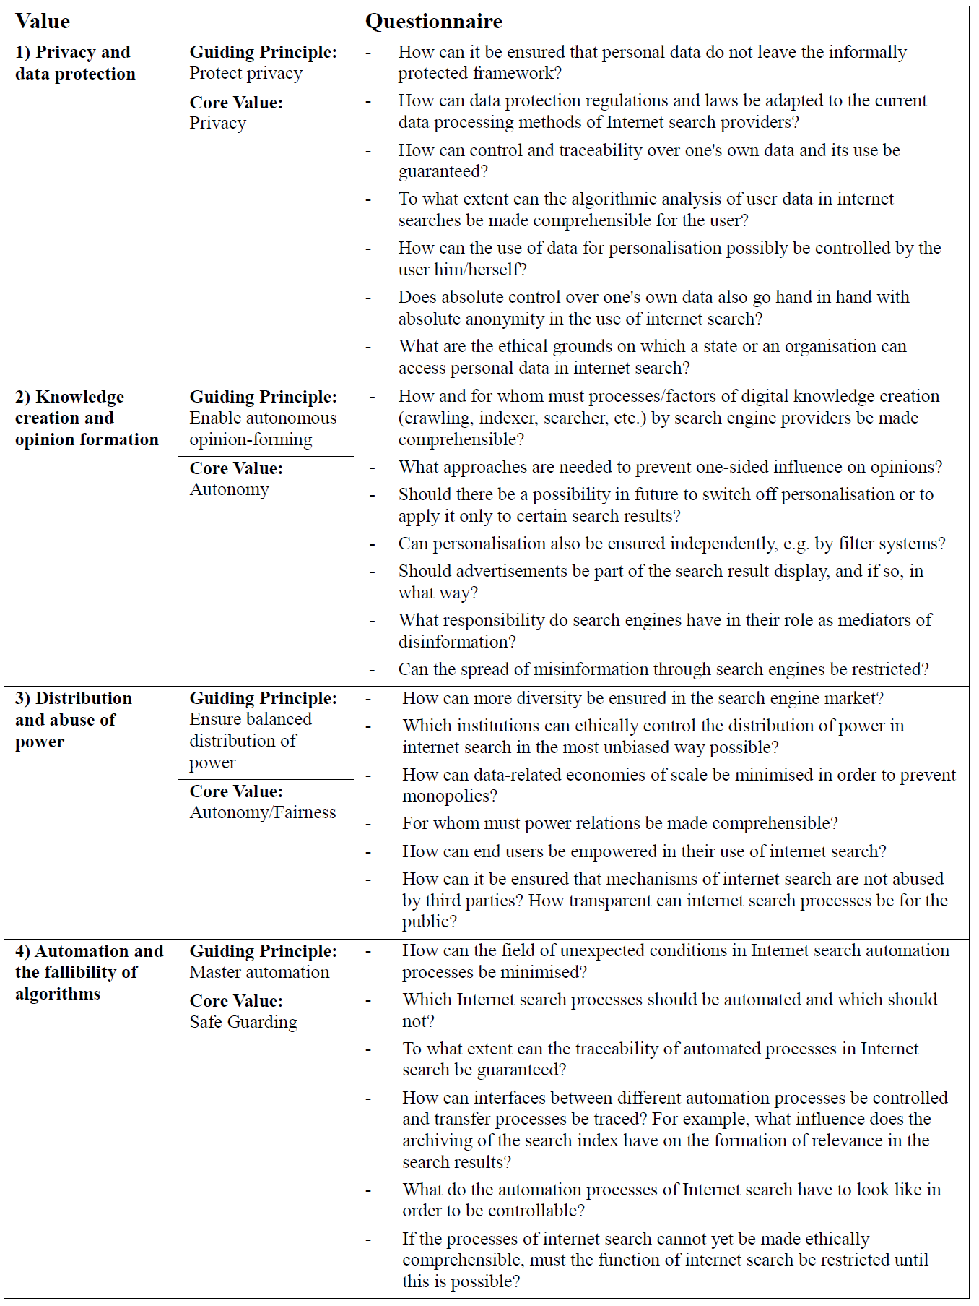
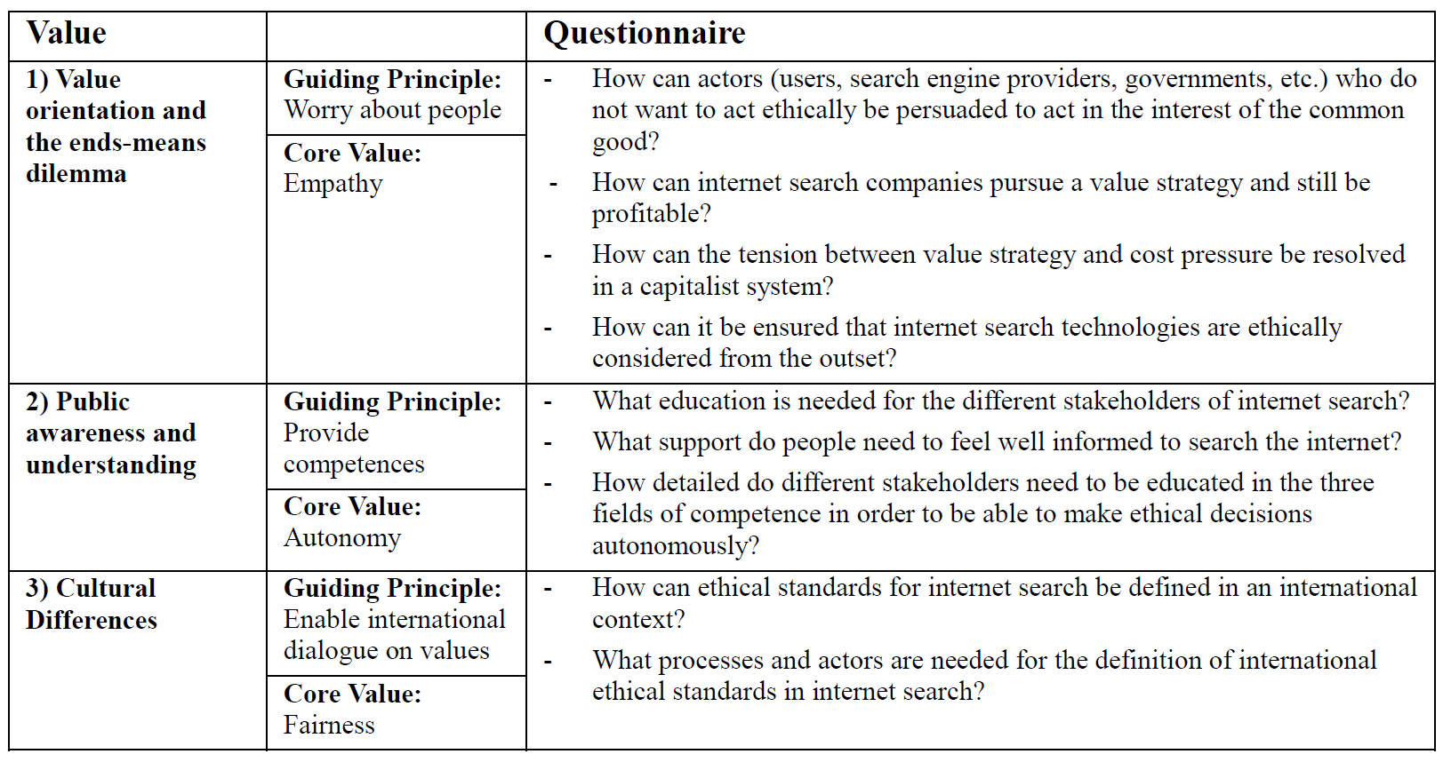
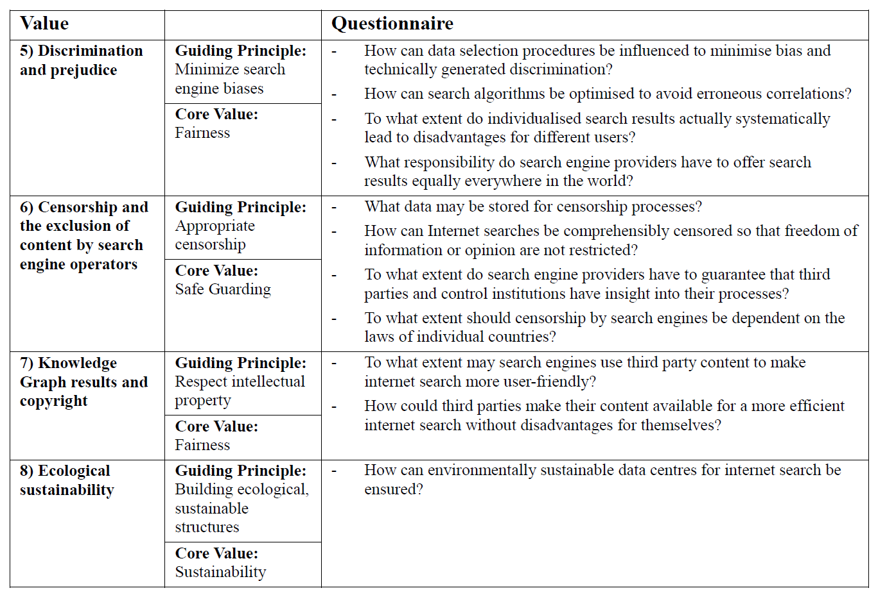
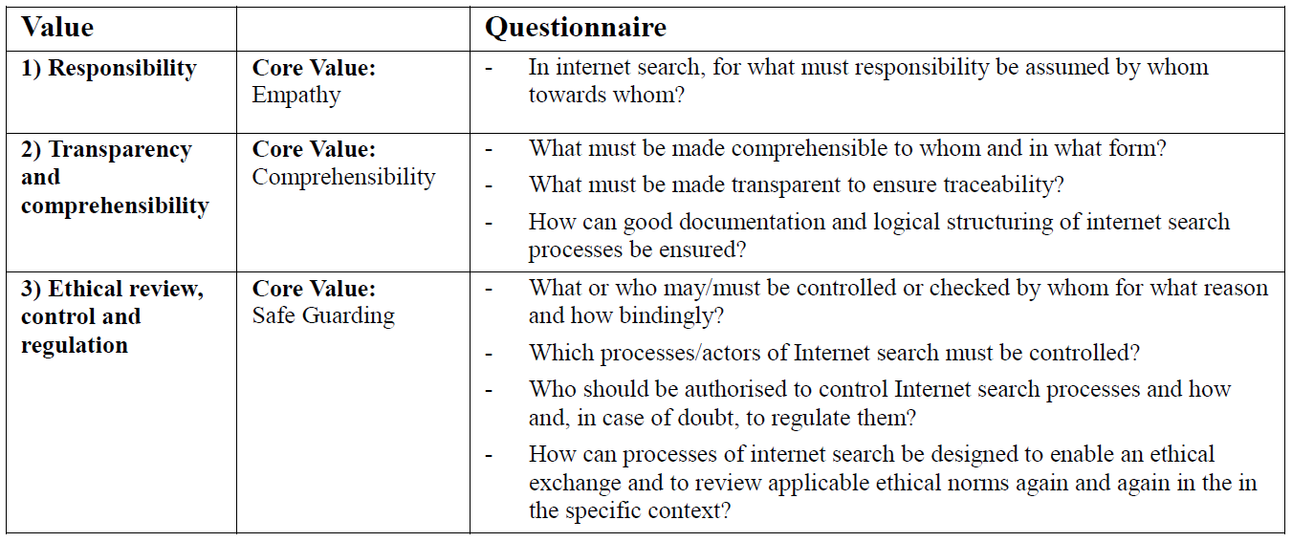
Structured Question Catalogue
12
Benedikt Hoffmann, Alexander Decker, Christine Plote | OSSYM 2022

Slide 15
Application
The Model
Value Matrix
Structured Question
Catalog
...provides structure for ethical discourse in Internet search
...enables logical chains of reasoning.
The Model…
..links the ethical values with the specific practical relevance in internet search
...is flexibly
expandable
Why do we act,
how we act?
13
Benedikt Hoffmann, Alexander Decker, Christine Plote | OSSYM 2022

Slide 16
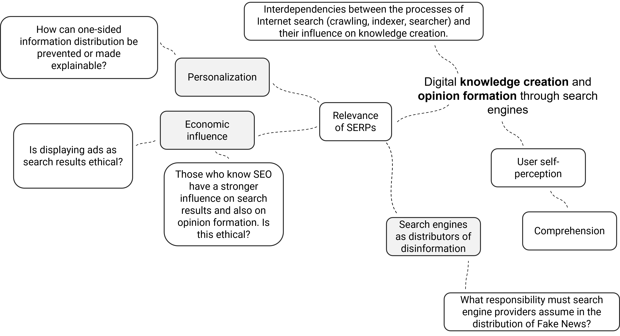
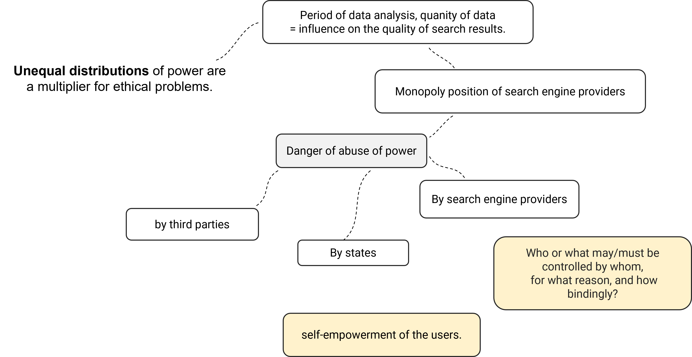
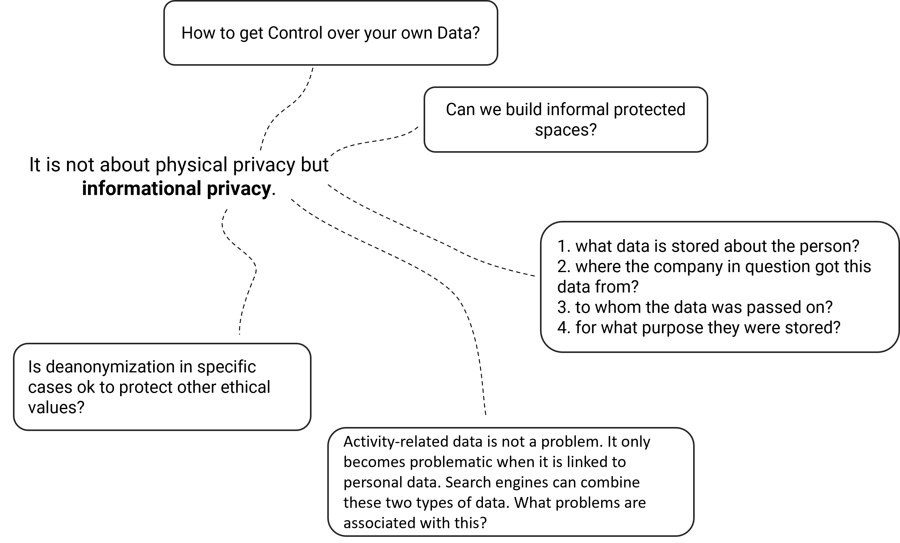
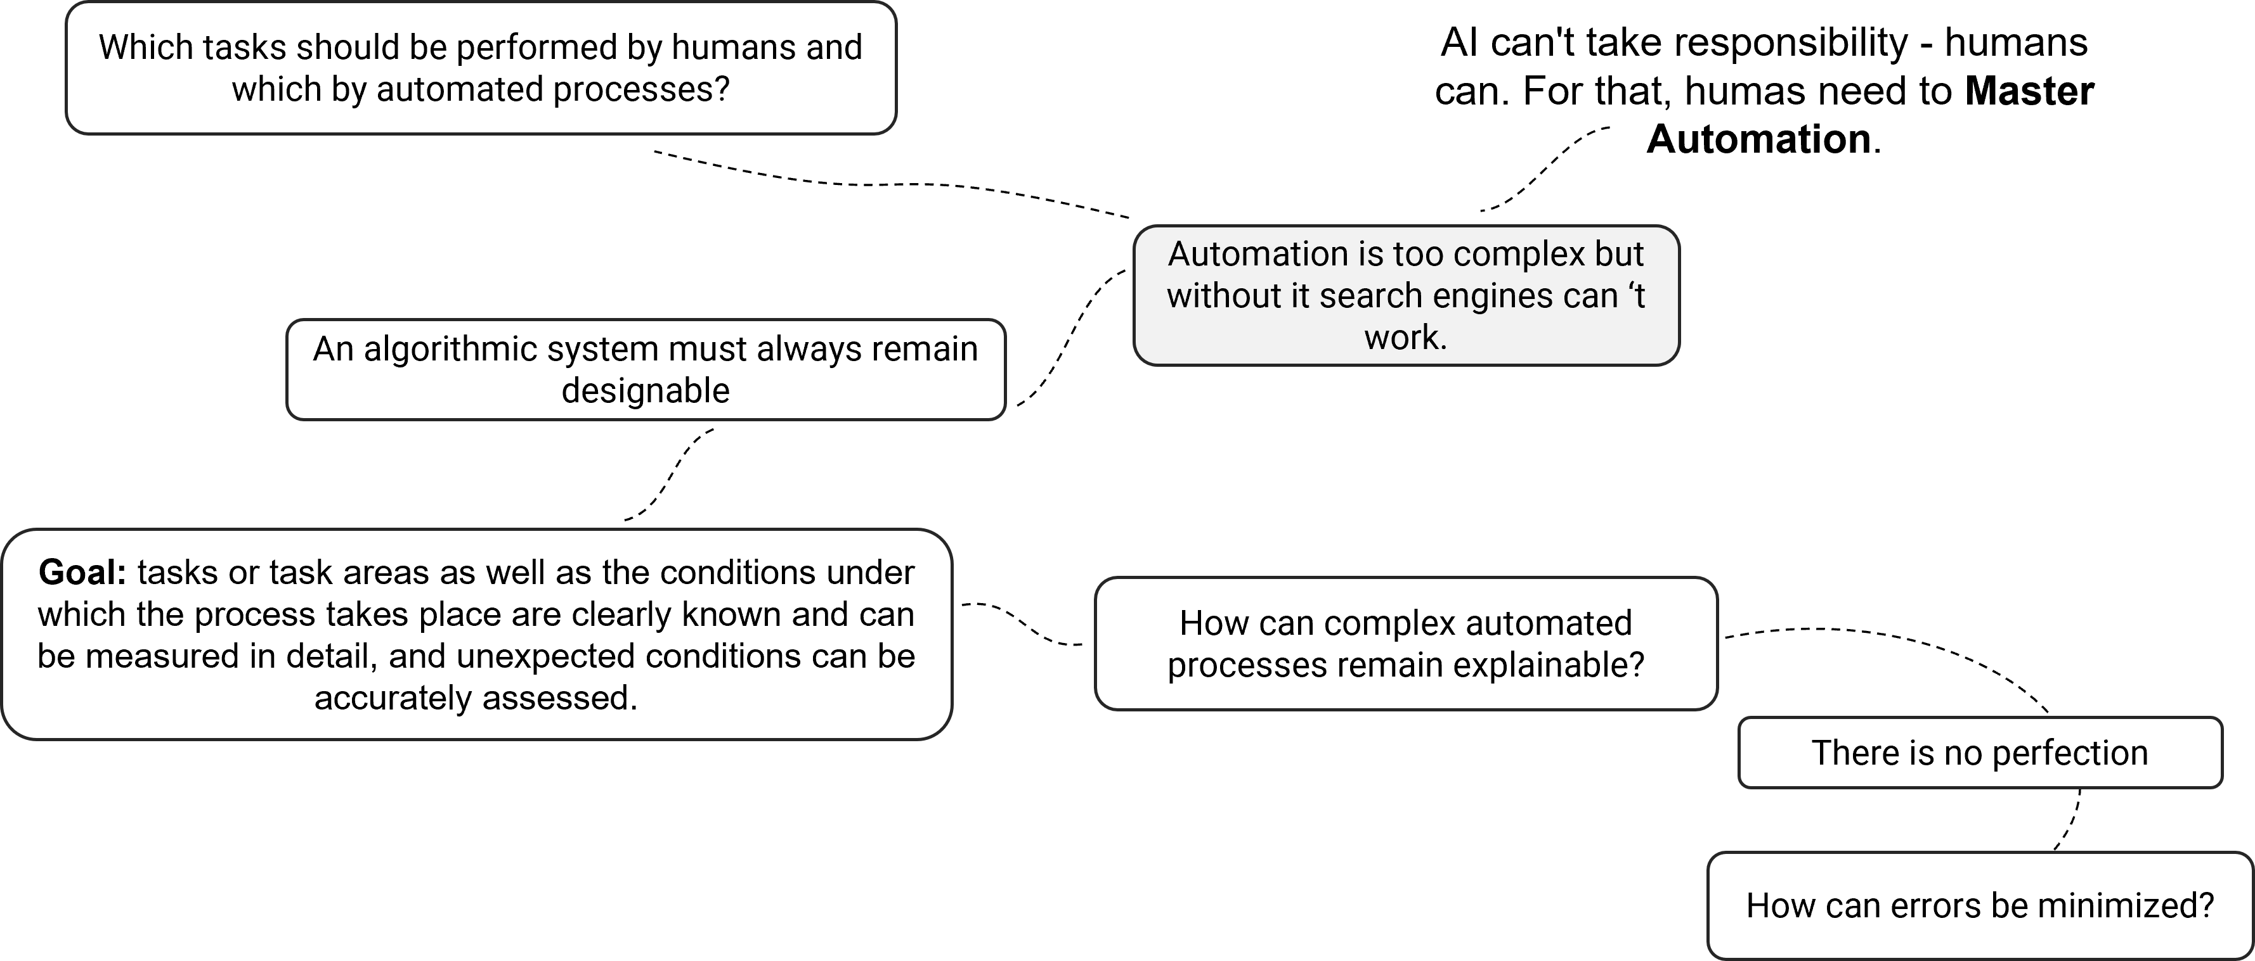
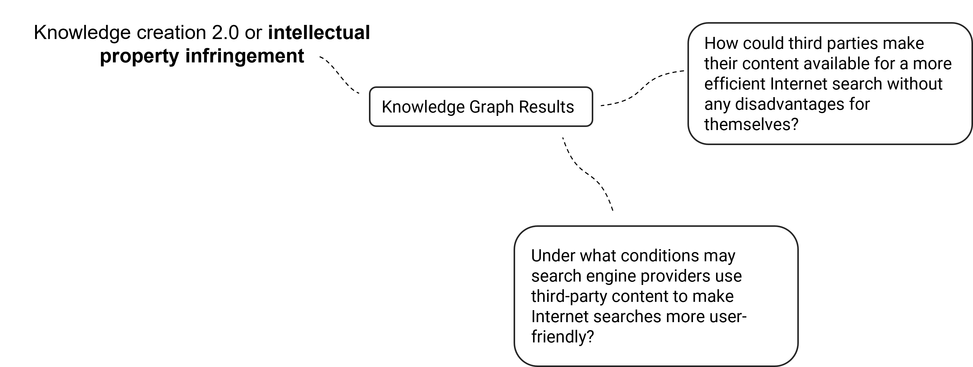
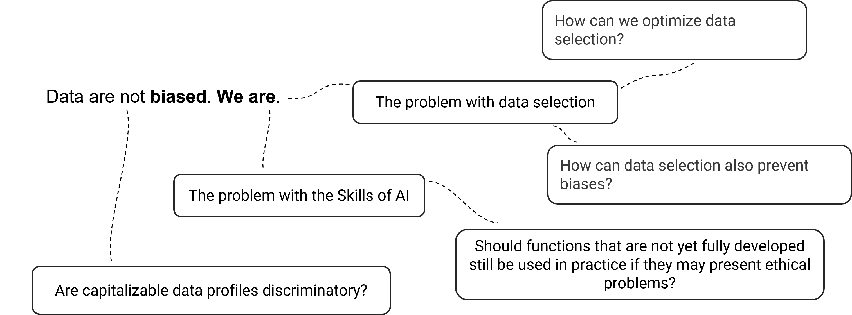
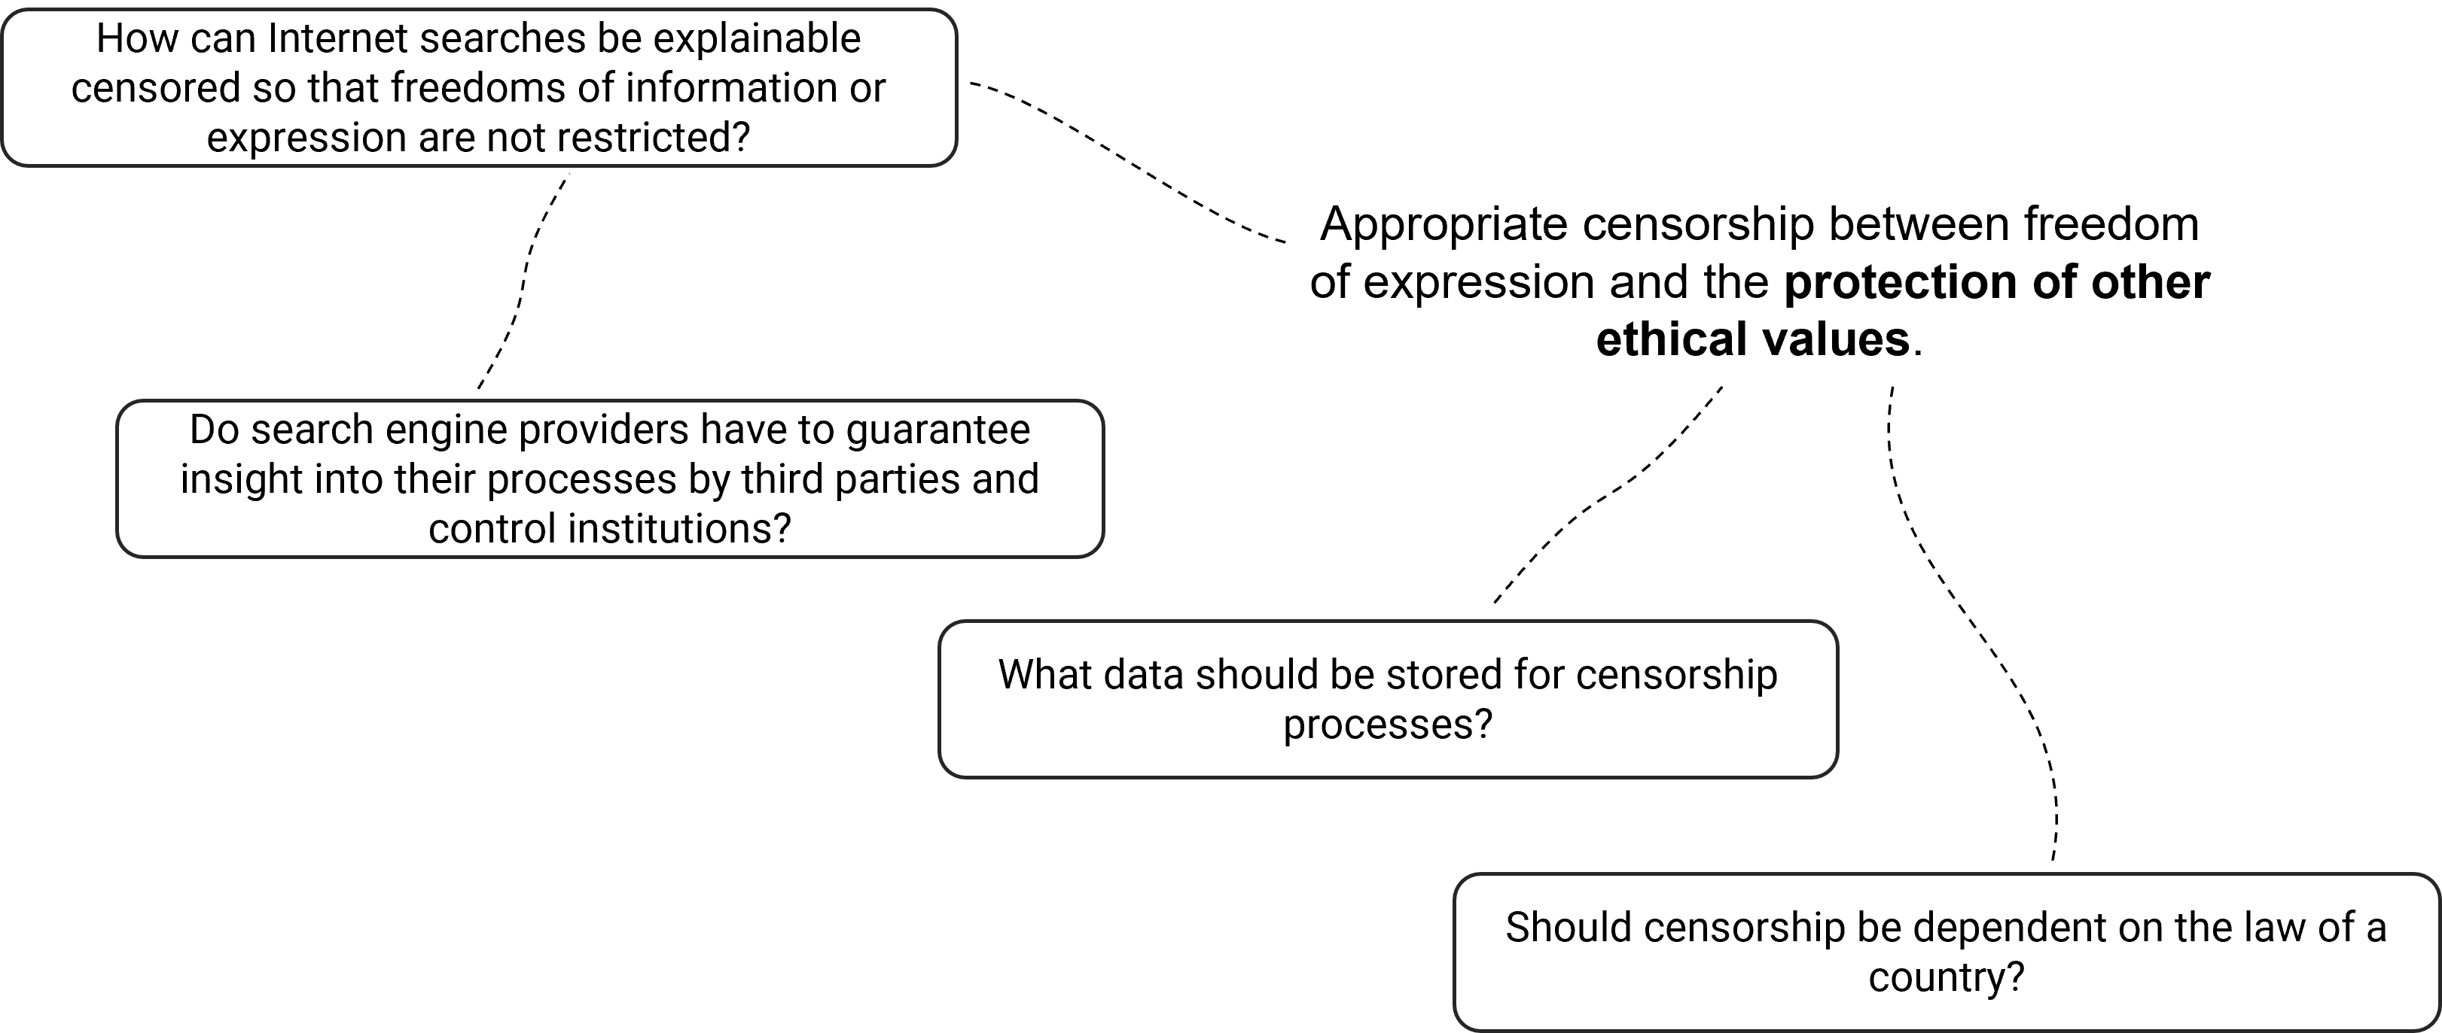
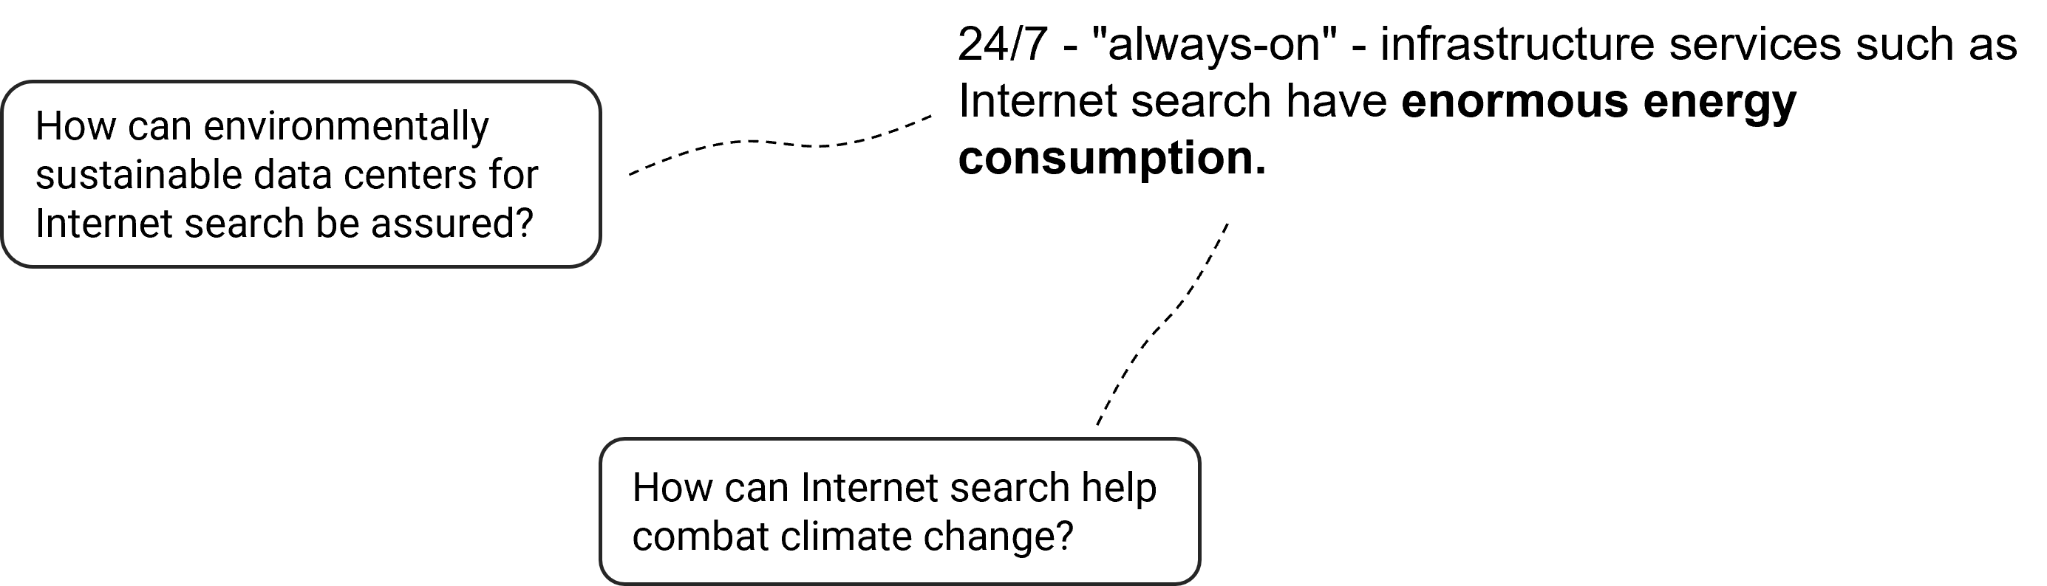
Application
Use Cases
Find answers and put them into practice
Check completeness: Must
certain guiding principles be
supplemented or be changed?
Expand question catalog: Which questions arise in your own context within the individual fields of action/guiding principles?
15
Benedikt Hoffmann, Alexander Decker, Christine Plote | OSSYM 2022

Slide 17

Thank you for your attention!
17
Benedikt Hoffmann, Alexander Decker, Christine Plote | OSSYM 2022

Slide 18
Contact :
Benedikt Hoffmann
Mail:
benedikt.hoffmann@inlinity.ai
LinkedIn:
https://www.linkedin.com/in/
benedikt-hoffmann/
Alexander Decker
Mail:
Alexander.Decker@thi.de
LinkedIn:
https://www.linkedin.com/in/
alexander-decker-94624813/
Christine Plote
Mail:
cp@opensearchfoundation.org
LinkedIn:
https://www.linkedin.com/in/
christineplote/

