Slide 1


Developing and promoting search engine literacy in primary education
Prof. Dr. Melanie Platz,
Dr. Friederike Klan &
Prof. Dr. Alexander Decker

Slide 2
Contents
What is Search Engine Literacy (SEL)?
Why SEL in Primary School?
How to teach SEL?
Where are we now and what happens next?

Slide 3
What is Search Engine Literacy?

Slide 4
Search Engine Literacy
Information Literacy
Information literacy is the ability to understand when information is needed, to seek information efficiently, and evaluate and use information appropriately. It also includes integrating new information with prior knowledge and using it legally, economically, socially, and ethically correct to achieve goals.
Search Literacy
Search literacy is a specific aspect of information literacy. It relates directly to the process of obtaining information and refers to the ability to find and access the desired information to satisfy information needs efficiently and effectively.
Search Engine Literacy
Achieving accurate search results requires search engine literacy, which is the knowledge of how search engines work and the following: findability, linguistic functions, query language, and ranking.
Project „PrimaSearch“ (Uni Saarland, TH Ingolstadt, DLR_School_Labs);
cf. Fuhr (2014)

Slide 5
Why Search Engine Literacy in Primary School?

Slide 6
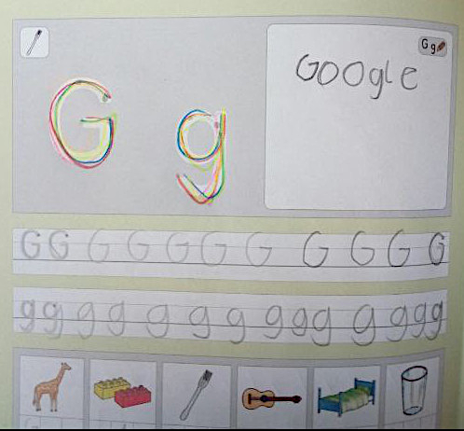
Search Engine Literacy in Primary School
Primary school children mostly use search engines like Google (KIM, 2020; Feil, Gieger & Grobbing, 2013) without knowing or questioning how they work (Le Deuff, 2017).
Lisa, grade 1, words with „G“

Slide 7

Current Policies
Developing and acquiring the skills needed to live in a digital world goes far beyond the necessary basic knowledge of information technology and affects all subjects. Therefore, they cannot be assigned to an isolated learning area.
KMK, 2016, p. 12
direct link with "traditional" mathematical
teaching topics

Slide 8

Current Policies
In concrete terms, this means that teachers must be able to use digital media in their respective subject lessons in a professional and didactically meaningful way and to reflect on their content in accordance with the educational mandate.
KMK, 2016, p. 24
Behind the simplicity and the clear interface of currently popular search engines hides a complexity that is not understood by many users.

Slide 9
How to teach Search Engine Literacy

Slide 10

Teaching Concept
Identification of Fundamental Ideas of Search Engine Literacy in direct relation with the traditional curriculum.
Fundamental Idea
Platz, Müller, Niehaus & Müller (2021)

Slide 11
Teaching Concept
Representation level
How is information represented on the Internet and how do I therefore need to communicate with the search engine?
Search index as basis,
searching
Algorithm level
How does a search engine work?
Filter & sorting algorithms,
Crawling & Index
Evaluation level
Are my results trustworthy and usable? What information about me do third parties receive from my search entries?
Filter bubbles,
critical handling
Risks & Opportunities
Project „PrimaSearch“ (Uni Saarland, TH Ingolstadt, DLR_School_Labs)

Slide 12
Teaching Strategy
Goal: to understand a concept in a theoretically sound way (topic "algorithms" (Etzold et al., 2019) transferred to "search engines" and extended by a reflection)
Initial
example
﻿First, an initial example is discussed intensively. This must be characteristic for the concept to be formed, i.e. the essence of the concept must be particularly well recognizable and tangible in it. It should not be a special case, but also not contain too many additional components that distract from the actual concept.
Initial abstraction
﻿After the initial example has been discussed, the essence of the term is worked out and formulated as an initial abstraction. This can be, for example, a definition suitable for children. It is important that it is actually a general formulation. This means that references to the initial example can and should be made, but they do not play a role in the formulation of the abstraction itself.
Concreti-zations
Now the initial abstraction is applied to further examples, the concretizations. In doing so, the initial abstraction is worked with, reasons are given why it is applicable or why the examples contain certain properties, etc. Through this occupation, the essence of the concept is once again penetrated and better internalized.
Reflection
Consequences for dealing with search engines are drawn and "guidelines" for optimized search are formulated.

Slide 13
Example: Ranking
Text statistics are used to compare search queries and documents.

Slide 14
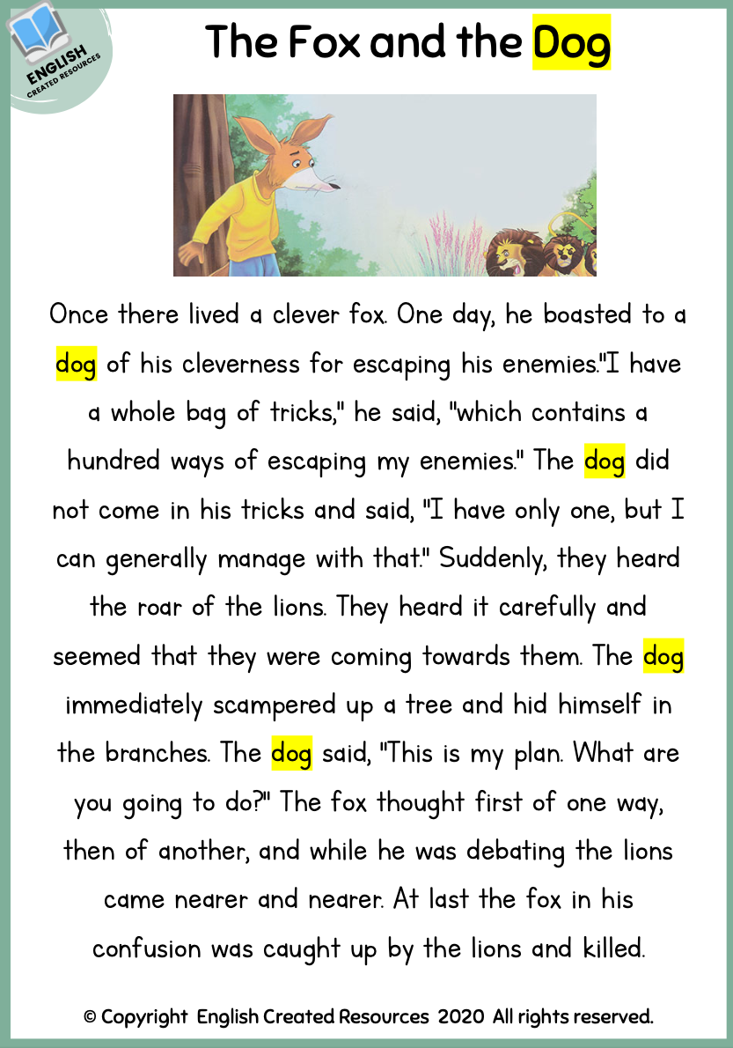
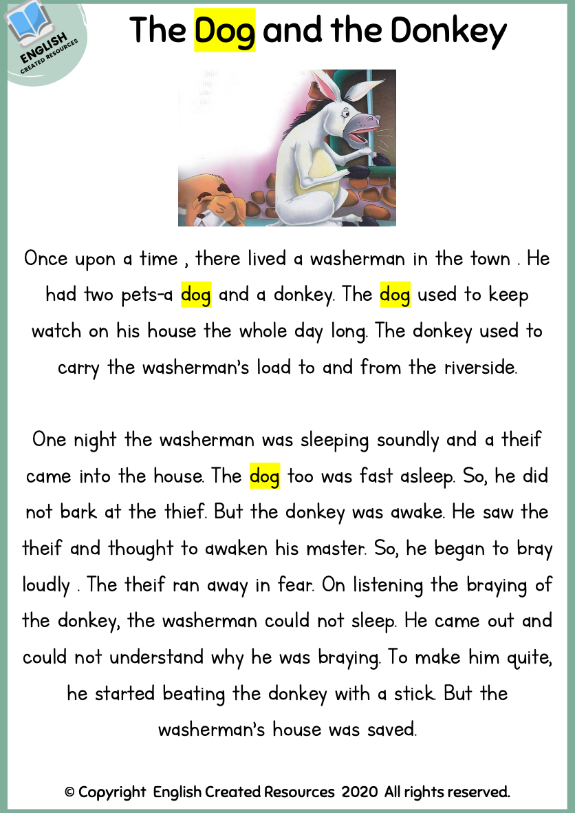
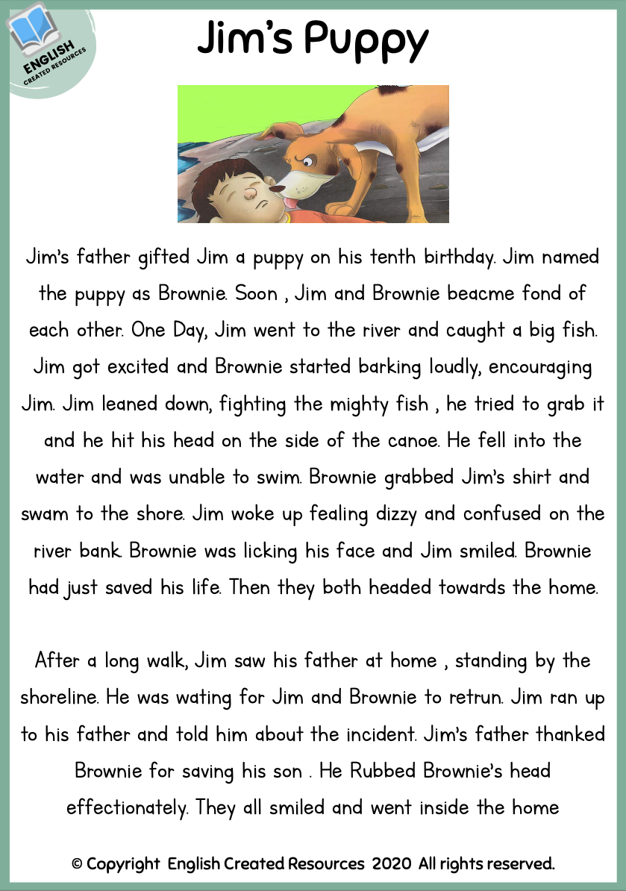
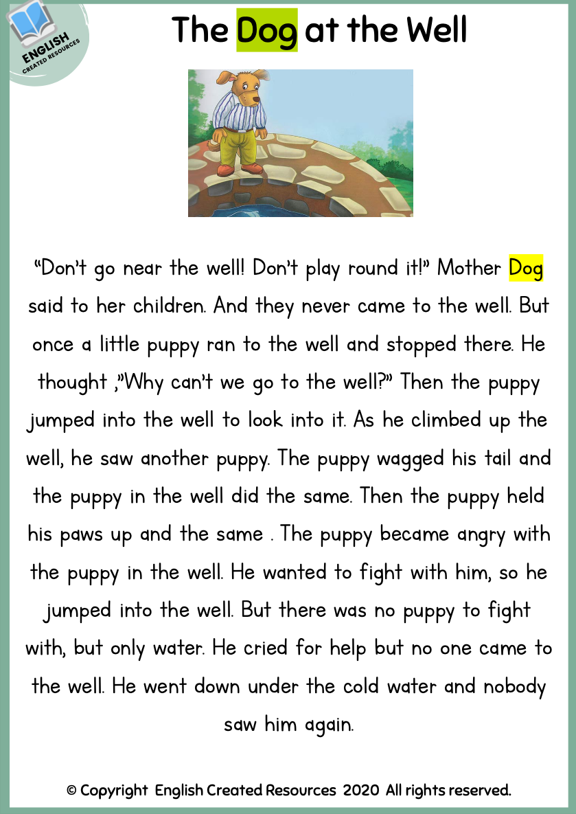
Initial
example
﻿First, an initial example is discussed intensively. This must be characteristic for the concept to be formed, i.e. the essence of the concept must be particularly well recognizable and tangible in it. It should not be a special case, but also not contain too many additional components that distract from the actual concept.
Initial Example
frequency determination
search of text sections of the same length for a specific search term
e.g., „dog“

Slide 15
Initial
example
﻿First, an initial example is discussed intensively. This must be characteristic for the concept to be formed, i.e. the essence of the concept must be particularly well recognizable and tangible in it. It should not be a special case, but also not contain too many additional components that distract from the actual concept.
Initial Example
frequency determination
search of text sections of the same length for a specific search term
e.g., „dog“
4
5
2
0

Slide 16
Initial
example
﻿First, an initial example is discussed intensively. This must be characteristic for the concept to be formed, i.e. the essence of the concept must be particularly well recognizable and tangible in it. It should not be a special case, but also not contain too many additional components that distract from the actual concept.
Initial Example
frequency determination
search of text sections of the same length for a specific search term
e.g., „dog“
4
5
2

Slide 17
Initial
example
﻿First, an initial example is discussed intensively. This must be characteristic for the concept to be formed, i.e. the essence of the concept must be particularly well recognizable and tangible in it. It should not be a special case, but also not contain too many additional components that distract from the actual concept.
Initial Example
frequency determination
search of text sections of the same length for a specific search term
e.g., „dog“
5
4
2
1.
2.
3.

Slide 18
Initial abstraction
After the initial example has been discussed, the essence of the term is worked out and formulated as an initial abstraction. This can be, for example, a definition suitable for children. It is important that it is actually a general formulation. This means that references to the initial example can and should be made, but they do not play a role in the formulation of the abstraction itself.
Initial Abstraction
A ranking of search results for a search term can be created by first excluding the texts, mathematical objects, etc., that do not contain the search term. Afterward, the order in which the texts, mathematical objects, etc., are to be displayed can be determined using frequency determination. The text, mathematical object, etc., in which the search term is found most often, comes first, the text, mathematical object, etc., in which the search term occurs second most often, comes second, and so on.

Slide 19
Concreti-zations
Now the initial abstraction is applied to further examples, the concretizations. In doing so, the initial abstraction is worked with, reasons are given why it is applicable or why the examples contain certain properties, etc. Through this occupation, the essence of the concept is once again penetrated and better internalized.
Concretizations
On the set of numbers up to 20, "large, even" is searched for.
On the set of geometric solids {cube, sphere, cone, triangular-based pyramid, cylinder} "face" is searched.

Slide 20
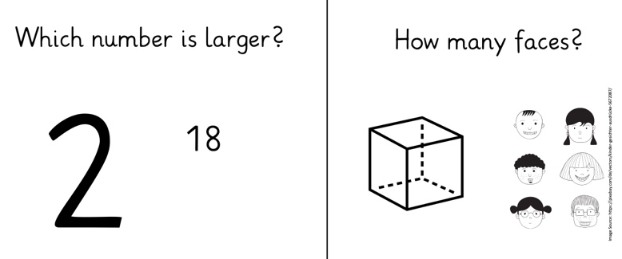
Reflection
Consequences for dealing with search engines are drawn and "guidelines" for optimized search are formulated.
Reflection
Consideration of structural information in documents:
What are "meaningful" search results that help the searcher?
  the idea of quality control can be stimulated
the formulation of the search query is essential
not only the first hits should be considered but also subsequent ones since the ranking "is always only one of many possible algorithmic views of the contents of the World Wide Web" (Lewandowski, 2021, p. 93)

Slide 21
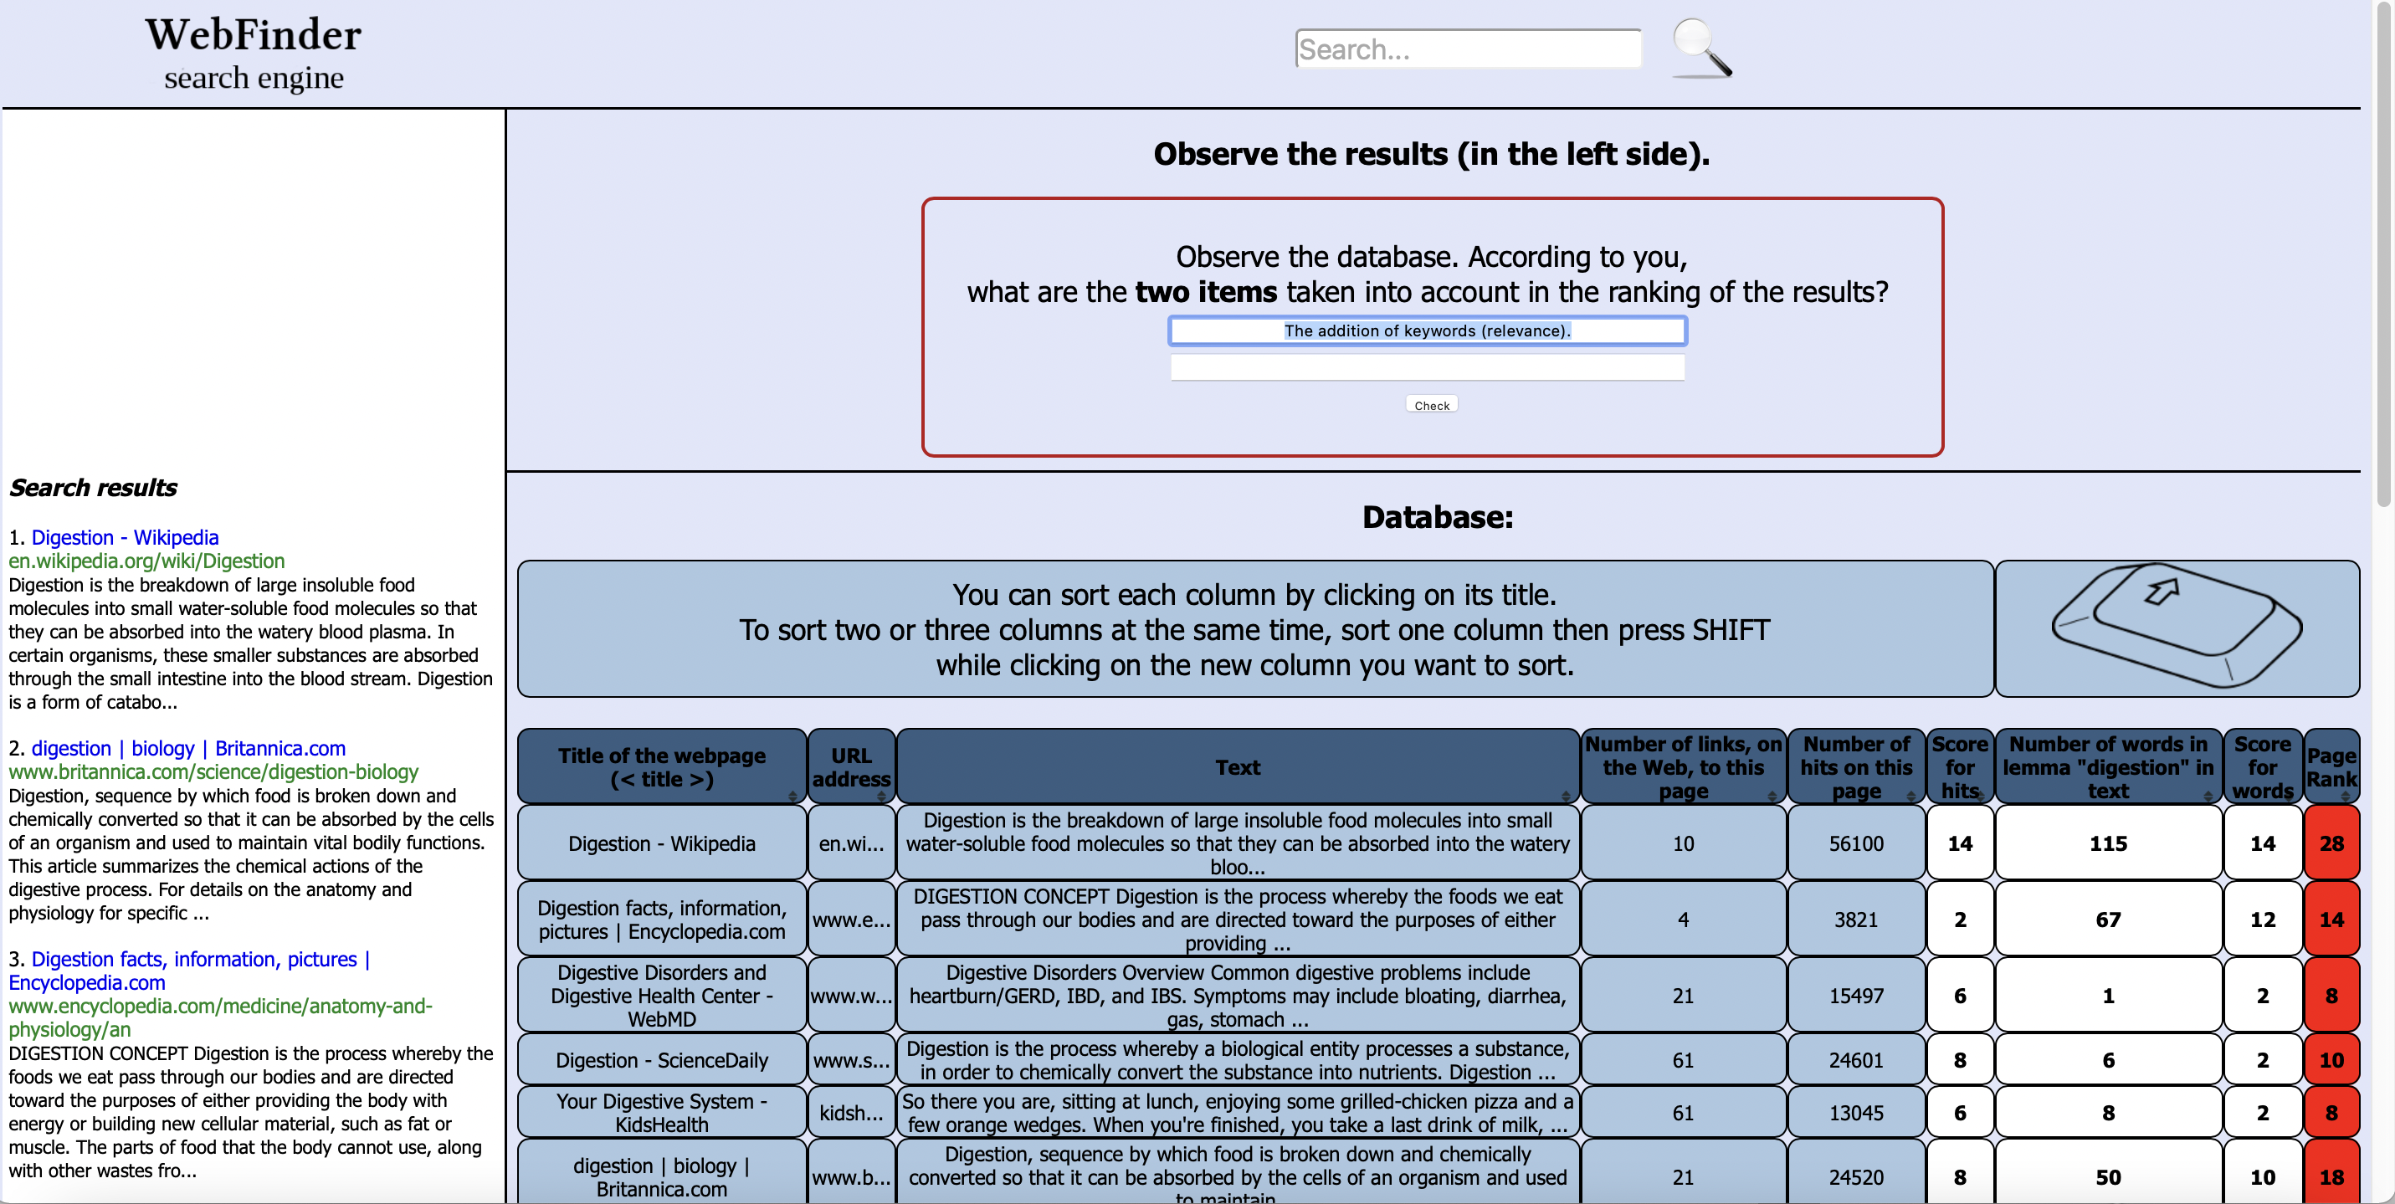
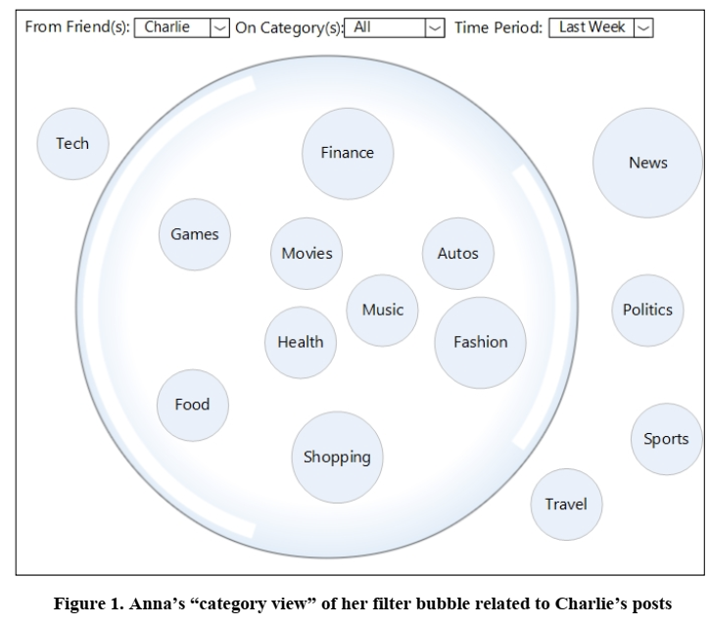
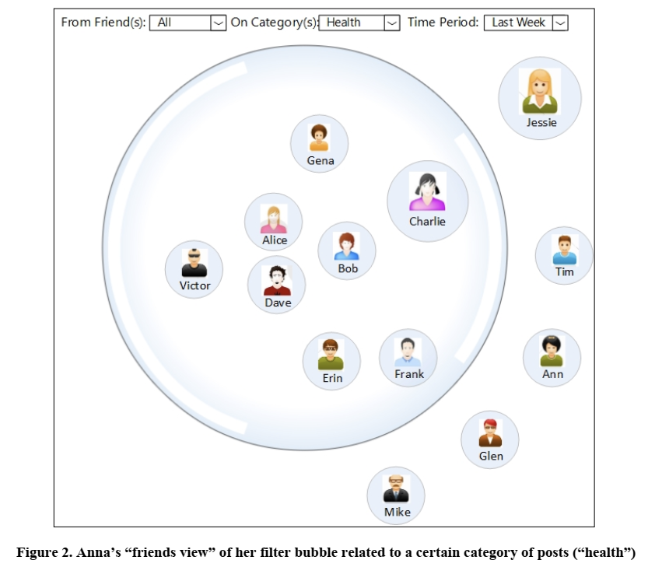
Not reinventing the wheel
Based on this idea, existing concepts of SEL can be transferred to the primary school level.
Le Deuff (2017); https://iddocs.fr/webfinder/index.php
Nagulendra & Vassileva (2014)

Slide 22
Teaching Concept
Developing search strategies (2nd Big6 stage) through problem solving.
"How do I get the best search results?" "Which strategy fits when?"
2. Block
Problem Solving
& arguing
Derivation of "guidelines" for optimized search
"What do I need to consider when using search engines?" "Why is it important?"
Relate and reflect, arguing
1. Block
Topic: Functionality of search engines
"How does a search engine work?"
KMK Competencies in the digital world
Traditional Curricula (e.g. Mathematics & Science; KMK Bildungsstandards & GDSU Perspektivrahmen)
Project „PrimaSearch“ (Uni Saarland, TH Ingolstadt, DLR_School_Labs)

Slide 23
Where are we now and what happens next?

Slide 24
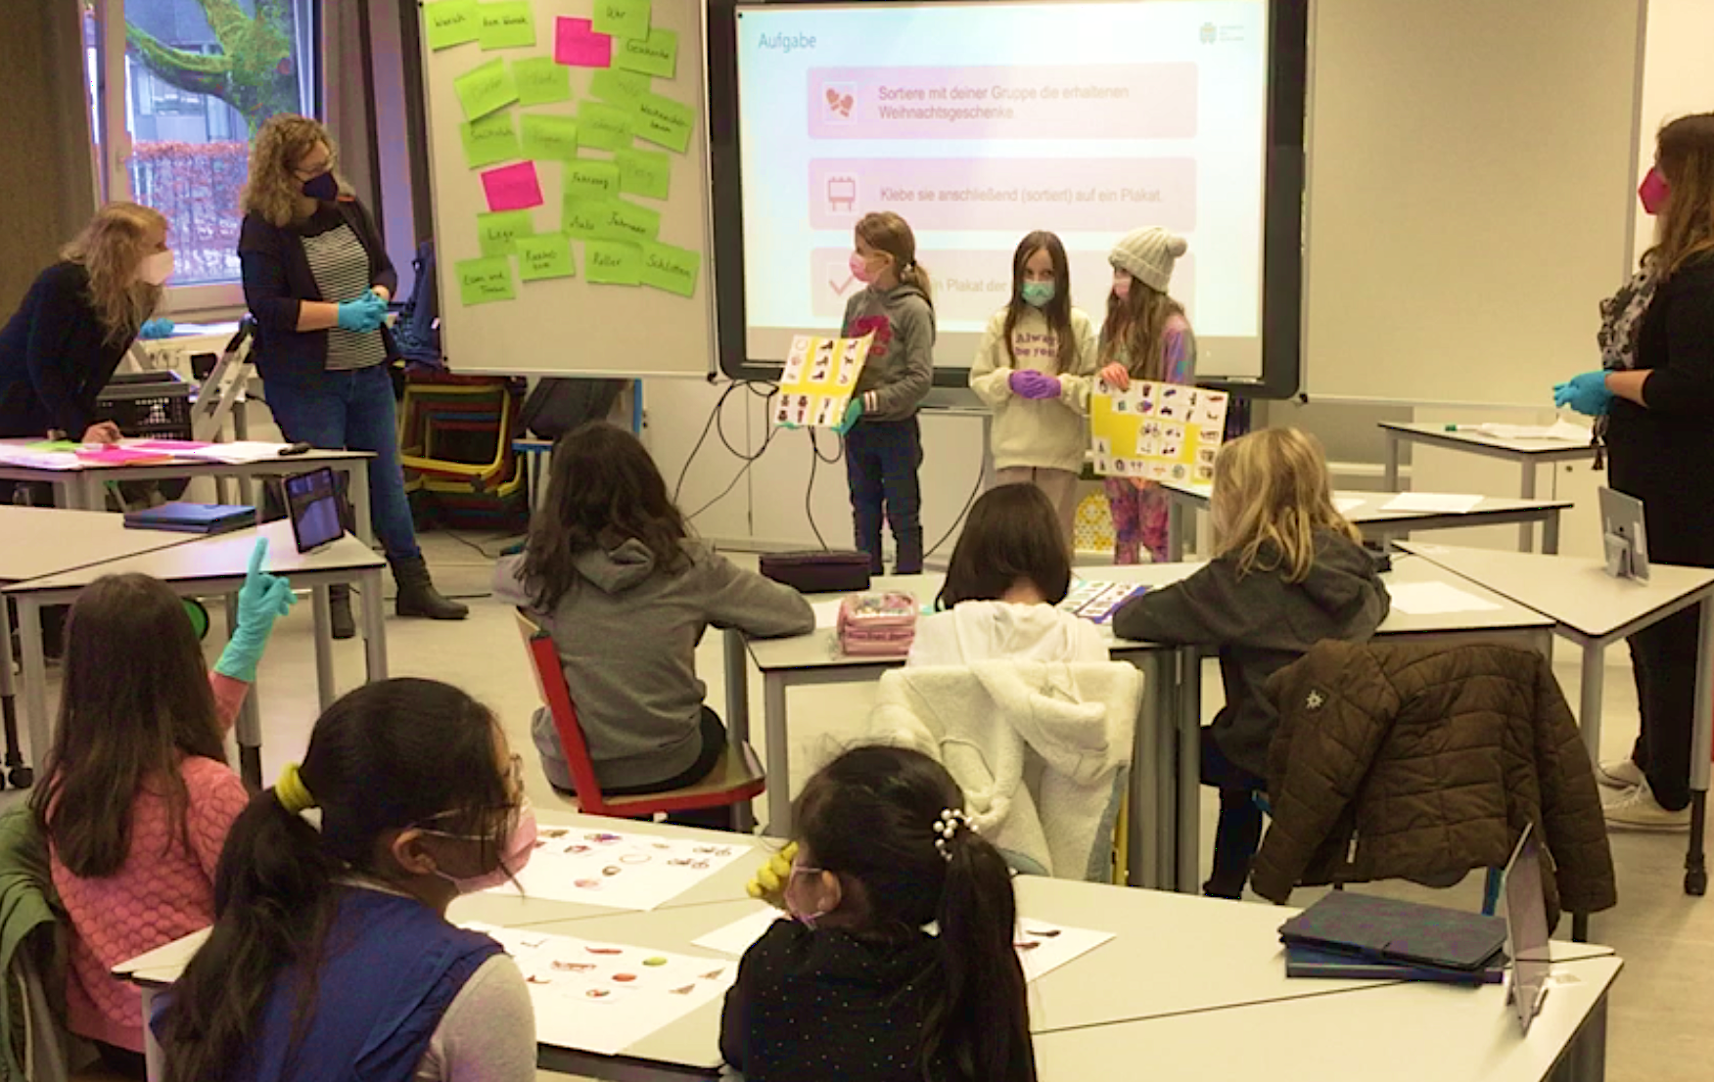
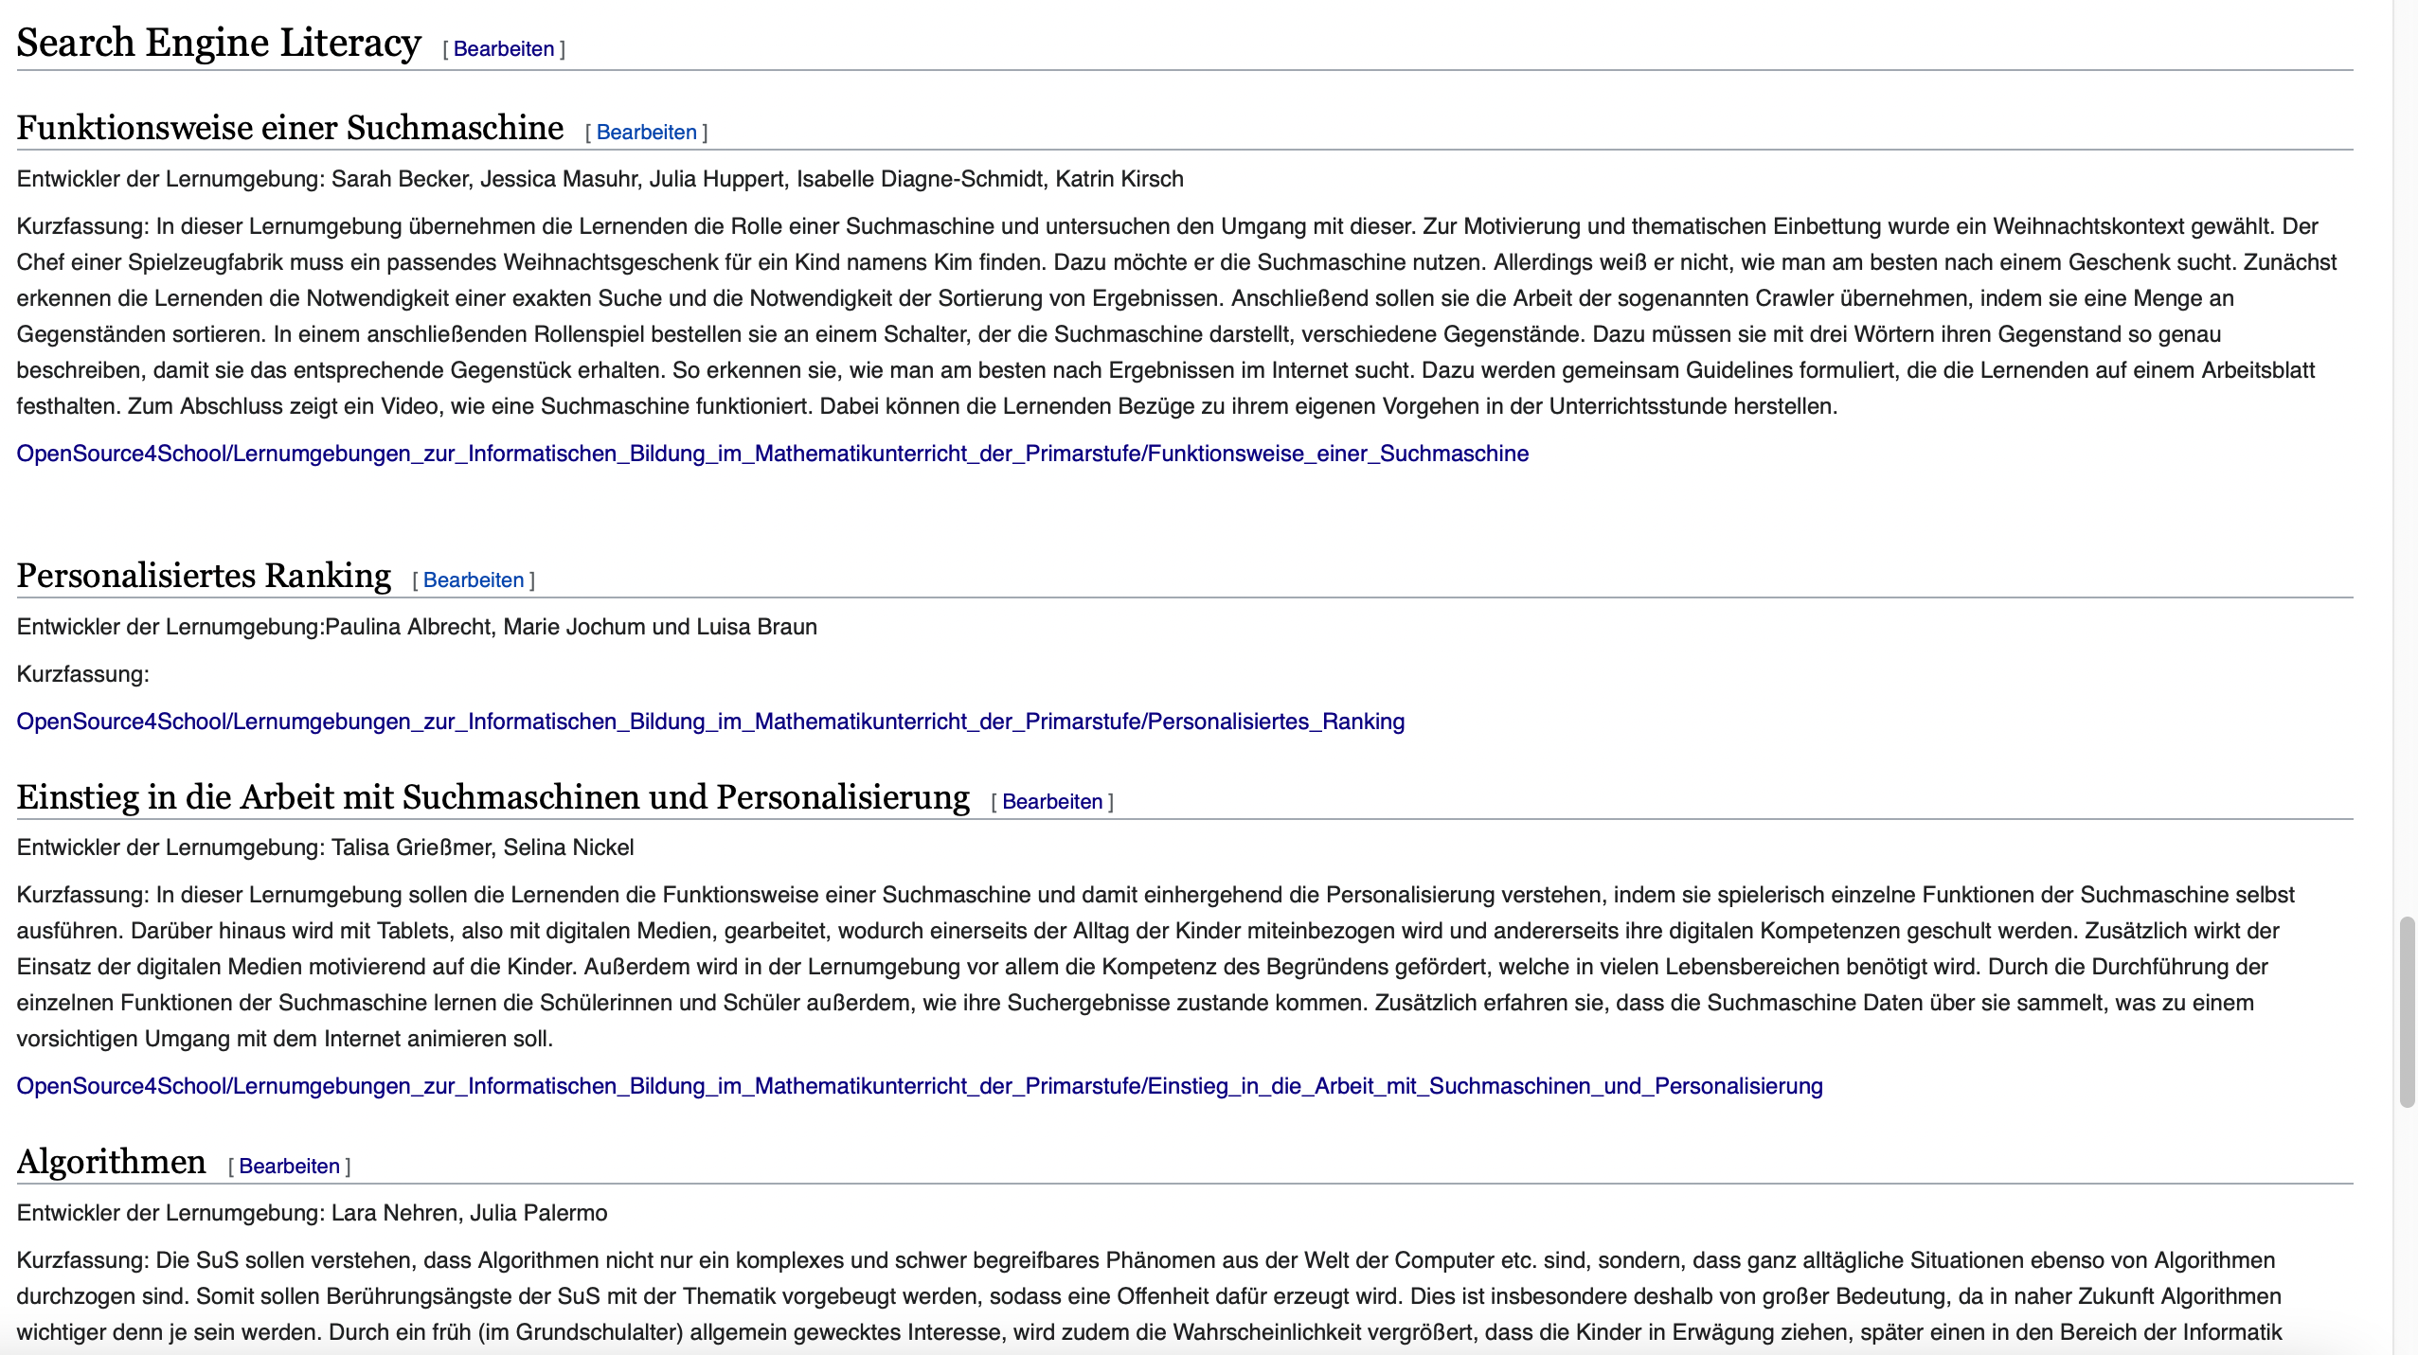
Current developments
https://de.wikiversity.org/wiki/OpenSource4School/Lernumgebungen_zur_Informatischen_Bildung_im_Mathematikunterricht_der_Primarstufe#Search_Engine_Literacy
Cf. Purao (2002); Vaishnavi et al. (2019)
OER
Platz (2020)

Slide 25
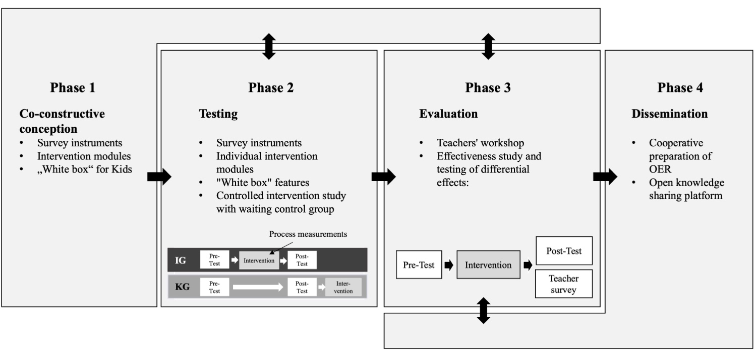
Project phases
Project „PrimaSearch“ (Uni Saarland, TH Ingolstadt, DLR_School_Labs)

Slide 26

Thank you
for your attention!
melanie.platz@uni-saarland.de
Friederike.Klan@dlr.de
Alexander.Decker@thi.de

Slide 27
References (1)
Etzold, H., Noack, S. & Jurk, A. (2019). Algorithmen im Alltag. Leitfaden für Lehrerinnen und Lehrer. Teil 1: Hintergrund und Theorie. Digitales Lernen Grundschule, Universität Potsdam. Abgerufen von https://dlgs.uni-potsdam.de/sites/default/files/u3/Leitfaden_Algorithmen_Teil_1.pdf
﻿Feil, Ch., Gieger, Ch., Grobbing, A. (2013). Projekt: Informationsverhalten von Kindern im Internet – eine empirische Studie zur Nutzung von Suchmaschinen. München: Deutsches Jugendinstitut. https://www.dji.de/fileadmin/user_upload/wwwkinderseiten/898/1-BMBF-Fkz%2001PF08017.pdf
Fuhr, N. (2014). Internet search engines – Lecture script for the course in SS 2014, 2014. Available online at http://www.is.inf.uni-due.de/courses/ir_ss14/ISMs_1-7.pdf
KIM (2020). Kim-Studie 2020. Kindheit, Internet, Medien. Medienpädagogischer For-schungsverband Südwest. https://www.mpfs.de/fileadmin/files/Studien/KIM/2020/KIM-Studie2020_WEB_final.pdf.
Kultusministerkonferenz (KMK) (2016). Strategie der Kultusministerkonferenz „Bildung in der digitalen Welt“ (Beschluss der Kultusministerkonferenz vom 08.12.2016) [Electronic version]. https://www.kmk.org/fileadmin/Dateien/pdf/PresseUndAktuelles/2016/Bildung_digitale_Welt_Webversion.pdf
Le Deuff, O. (2017). Search engine literacy. In European Conference on Information Literacy (pp. 359–365). Springer, Cham.
Lewandowski, D. (2021). Suchmaschinen verstehen. Berlin/Heidelberg: Springer Vieweg.
Nagulendra S, Vassileva J. (2014) Understanding and controlling the filter bubble through interactive visualization: a user study. Proceedings of the 25th ACM conference on Hypertext and social media;; Santiago, Chile. New York: Association for Computing Machinery.

Slide 28
References (2)
Platz, M. (2020). Ein Schema zur kriteriengeleiteten Erstellung und Dokumentation von Lernumgebungen mit Einsatz digitaler Medien. In F. Dilling & F. Pielsticker (Hrsg.), Mathematische Lehr-Lernprozesse im Kontext digitaler Medien (S. 29–56). Wiesbaden: Springer Spektrum.
Platz M., Müller L., Niehaus E., Müller S. (2021). Modules for Open Search in Mathematics Teaching. In Proceedings of the 3rd International Symposium on Open Search Technology, CERN. Abrufbar unter: https://doi.org/10.5281/zenodo.5772576.
Purao, S. (2002). Design Research in the Technology of Information Systems: Truth or Dare (Working Paper). GSU Department of CIS. Atlanta, GA.
Vaishnavi, V., Kuechler, W. & Petter, S. (2019). Design Science Research in Information Systems. January 20, 2004 (created in 2004 and updated until 2019 by Vaishnavi, V. and Kuechler, W.). Abgerufen von http://www.desrist.org/design-research-in-information-systems/

