Slide 1

ALICE general results and upgrades
Massimo Masera on behalf of the ALICE Collaboration
University of Torino and I.N.F.N. - Italy
masera@to.infn.it
LISHEP 2011 - Workshop on LHC – Present and Future
4,10 July 2011

Slide 2

Outline
The ALICE experiment
Present detector performance
Results from 2010 Pb-Pb run:
  Global event features
  Two particle correlation and flow
  Hard processes: heavy flavours and J/ψ
The future: plans for an upgrade of the ALICE detectors
Conclusions
I had to make choices:
Pb-Pb results: pp only as a baseline
Justa a (personal) selection of the available results

Slide 3
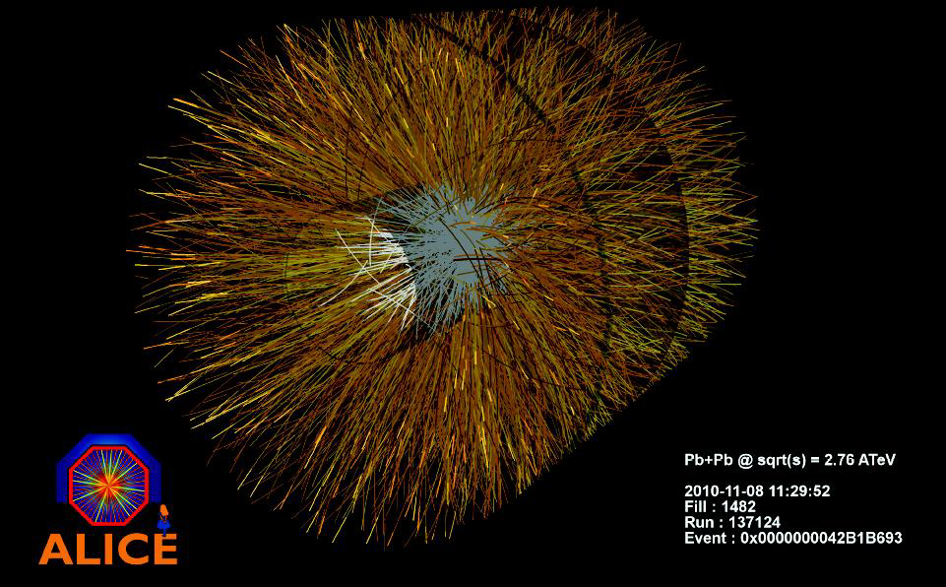
Heavy Ions at the LHC
ALICE: A Large Ion Collider Experiment
  Indeed ALICE has been designed to be the general purpose Heavy Ion experiment at the LHC
  ALICE has also a physics programme for pp collisions, that are used as a reference for Pb-Pb
PbPb run: from Nov, 7 2010 → 30 days
Collected statistics: 3.75 μb⁻¹ (30 M hadronic m.b. interactions)
 |  | 2010 | Target
√s / nucleon pair | TeV | 2.76 | 5.5
Initial luminosity | cm⁻² s⁻¹ | 3×10²⁵ | 10²⁷
Number of colliding bunches |  | 137 | 592
Bunch spacing | ns | 500 | 99.8
β* | m | 3.5 | 0.5
Transverse normalized emittance | μm | 3 | 1.5
Ions per bunch |  | 1.2×10⁸ | 7×10⁷

Slide 4
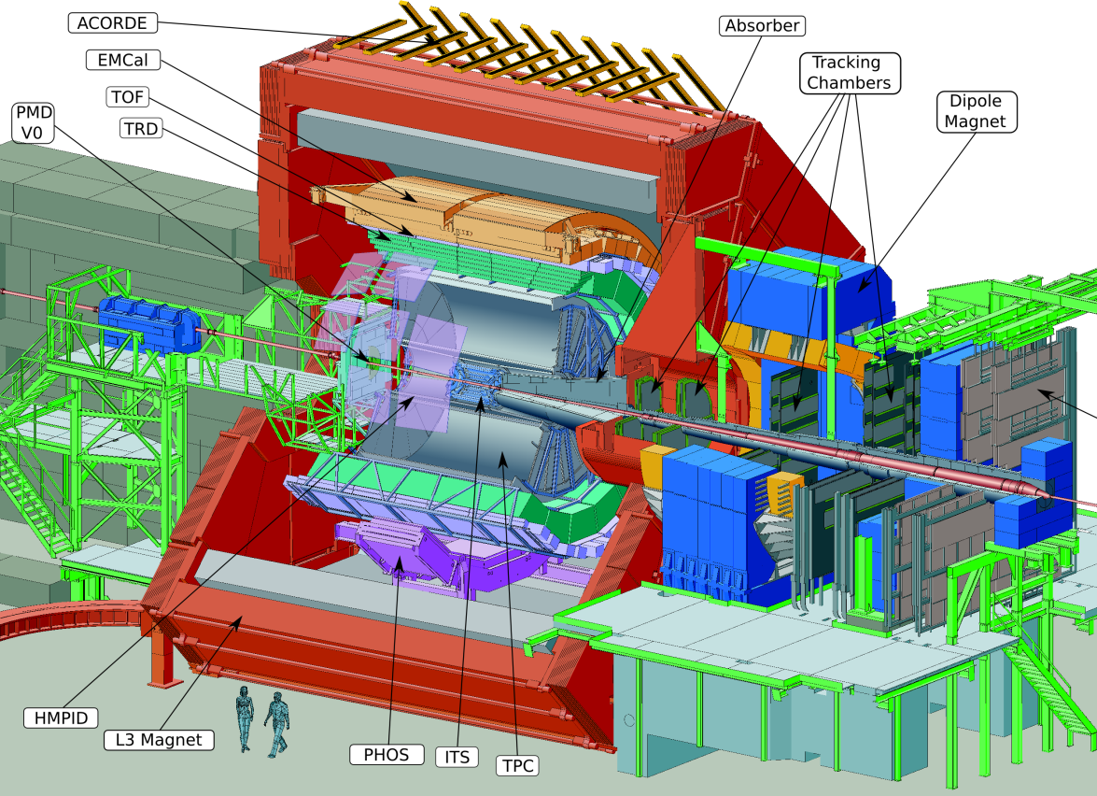
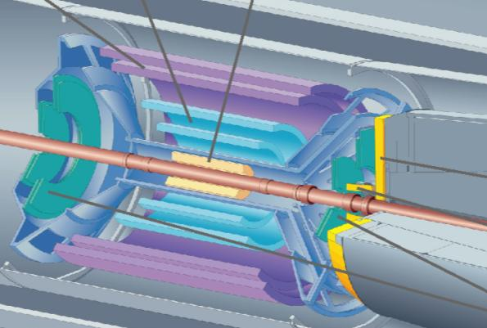
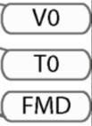
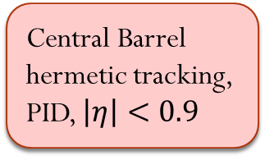
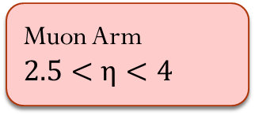
Central Barrelhermetictracking, PID, $\left|η\right|<0.9$
Muon Arm $2.5<η<4$
ALICE numbets:
1200 members
100 institues
30 Countries

Slide 5
Detector status
EMCAL
Complete since 2008:
ITS, TPC, TOF, HMPID,
FMD, T0, V0, ZDC,
Muon arm, Acorde
PMD , DAQ
Partial installation (2010):
4/10 EMCAL* (approved 2009)
7/18 TRD* (approved 2002)
3/5 PHOS
~ 60% HLT (High Level Trigger)
2011
10/10 EMCAL
10/18 TRD
HMPID
TOF
TRD
TPC
ITS
L3 Magnet
*upgrade to the original setup
PHOS
PLC 20J. Schukraft

Slide 6
Detector Performance
Tracking
Vertexing
PID

Slide 7
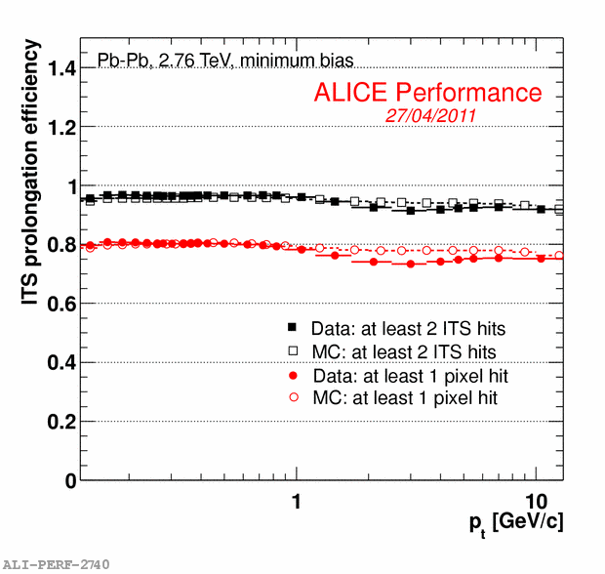
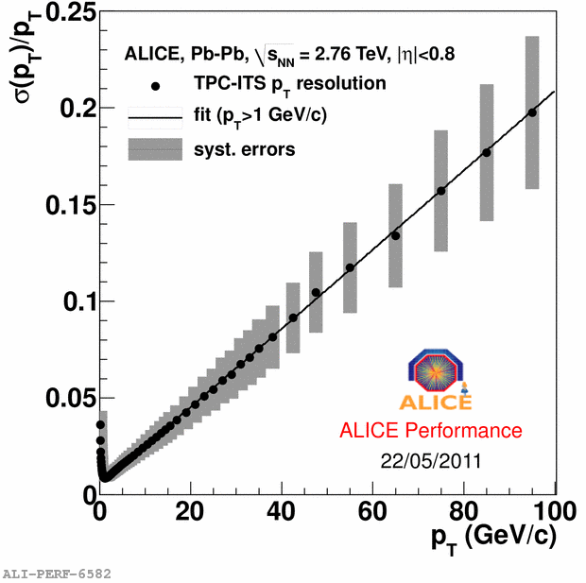
Tracking
Tracking capabilities in the central barrel are crucial for most of the physics topics addressed in Pb-Pb collisions
Tracking detectors: Inner Tracking System (ITS), Time Projection Chamber (TPC) and Transition Radiation Detector (TRD)
Algorithm based on Kalman filter, with seeding in the TPC. ITS is used as a standalone tracker with leftover points
Hermetic detectors: very high efficiency for |η|<0.8
Contamination from fake tracks is ~5% at p_{T}=1 GeV/c for central PbPb
Notes:
resolution from track residuals, verified cosmic tracks and with of K_0_S

Slide 8
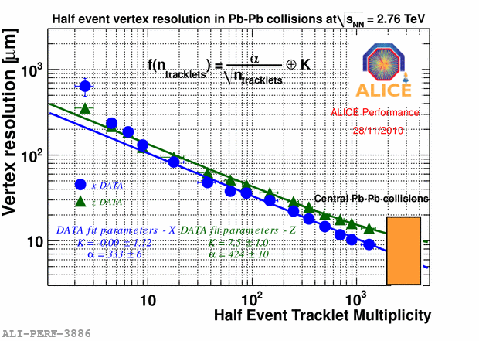
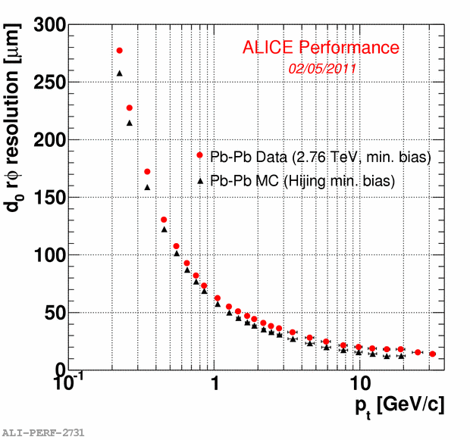
Vertexing
ALICE vertexing capabilities were designed to reconstruct weak decays of D mesons (cτ=124 μm for D⁰)
Vertexing is done with the ITS
  Primary vertex resolution is essentially limited by the residual misalignment → ~10 μm for central Pb-Pb events
  Transverse impact parameter d₀ (=distance of closest approach of a particle to the primary vertex in the transverse plane): ~60 μm resolution at p_{T}=1 GeV/c
  Enough for charmed mesons

Slide 9
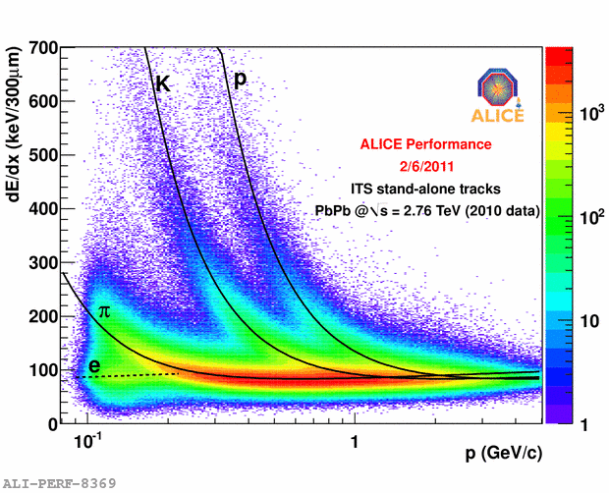
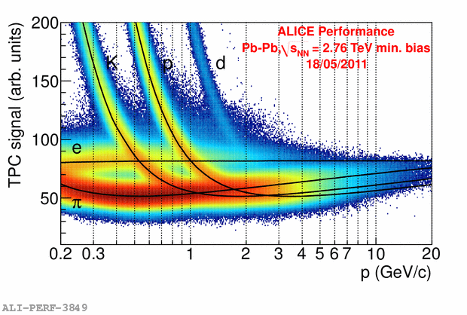
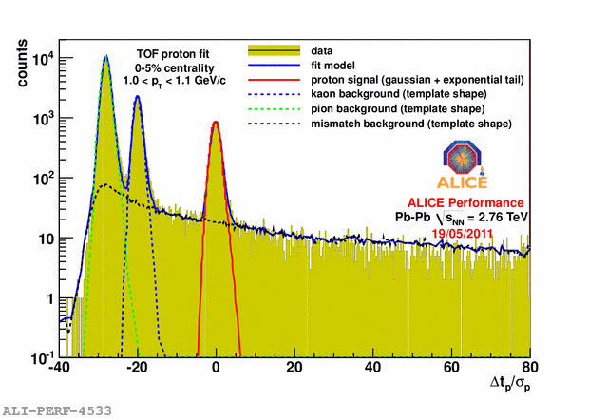
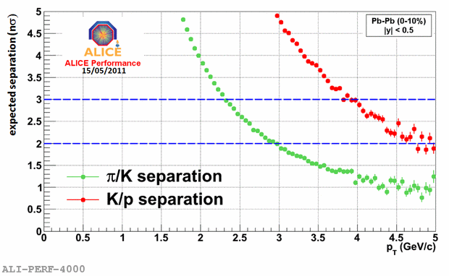
PID with TPC, ITS & TOF
PID in the barrel is mainly done via dE/dx in TPC and ITS and via Time of Flight Measurements. A RICH detector provide PID at higher momenta in a limited acceptance
TOF

Slide 10
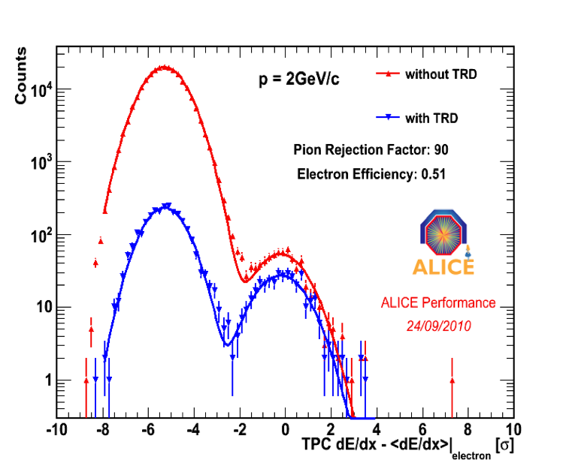
Transition Radiation Detector
(dE/dx measured in the TPC) – (dE/dx expected for electrons from Bethe-Bloch)
without likelihood information and with likelihood information from TRD
little change in the number of identified electrons; large suppression of pions

Slide 11
π⁰ and γ reconstruction
Centrality class 40-60% of the total cross section
Detection done via:
PHOS (Photon Spectrometer)
EMCAL (E.M. Calorimeter)
Through photon conversions in the barrel tracking detectors (V0 finder)
Electrons from γ conversions are used to estimate the material budget of the detector and to validate the Monte Carlo geometry description

Slide 12
Global event features
Multiplicity
Energy density
Size of the fireball

Slide 13
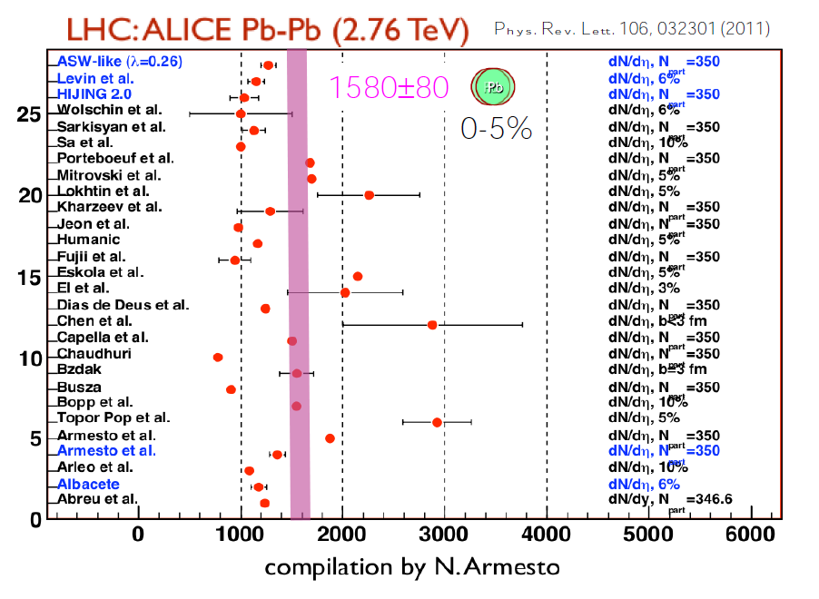
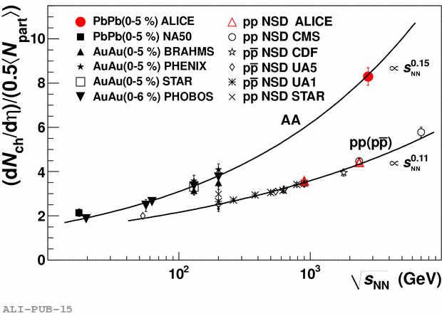
Charged particle multiplicity
PRL 105, 252301 (2010)
For Heavy Ion collisions a significantly stronger rise with centre of mass energy is observed w.r.t. pp
Charged particle multiplicity was determined with the first machine fills in Nov. 2010.
Multiplicity is difficult to predict: the available theoretical estimates were mostly on the low side

Slide 14
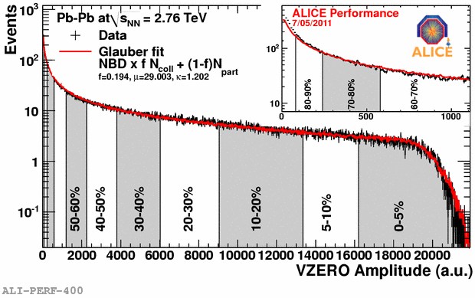
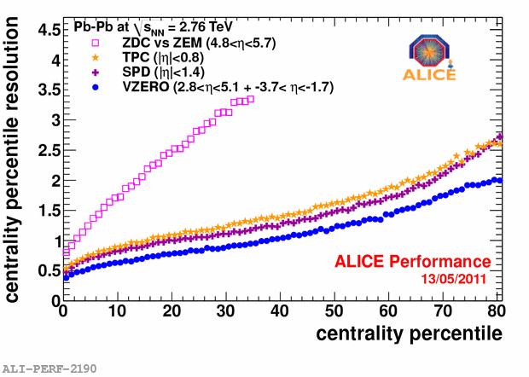
Centrality
The number of nucleons that participate in the collision N_{part} is determined by the initial geometry (i.e. by the degree of overlap of the 2 colliding nuclei)
Observables related to N_{part}:
  Particle multiplicity
  Transverse energy
  “Zero Degree” energy (a measure of the number of spectator nucleons)
Several ALICE subsystems can be used to measure centrality
Ingredients to determine centrality classes:
  Glauber model to describe the nuclear collision
  Number of particle-producing sources (N_{coll} = N. of binary collisions):
  The number of particles produced by each source is distributed according to a negative binomial distribution
  The parameters of the NBD and the fraction f are determined with a fit to an observable related to the multiplicity
Centrality resolution depends on the rapidity coverage of the detector
Glauber fit
NBD×fN_{part}+(1-f)N_{coll}
f=0.806, μ=29.003,κ=1.202

Slide 15
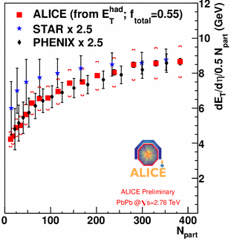
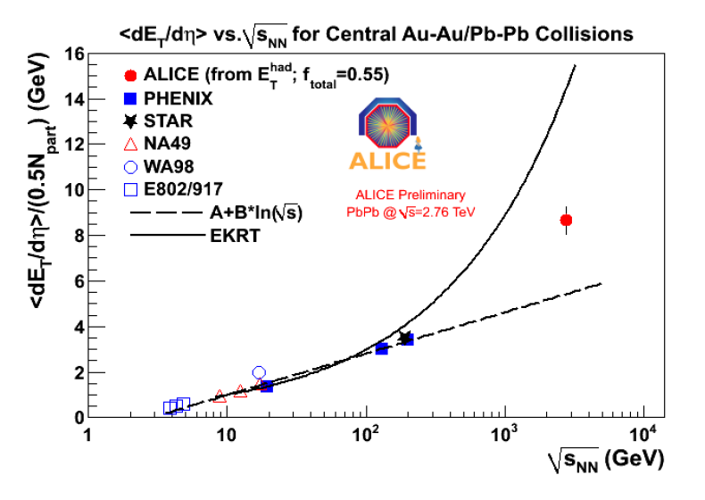
Energy density
From RHIC to LHC: increase of dE_{T}/dη by a factor 2.5
Similar centrality dependence
Energy density: 3×RHIC
It grows with power of centre of mass energy faster than simple logarithmic scaling extrapolated from lower energy (trend similar to multiplicity density)

Slide 16
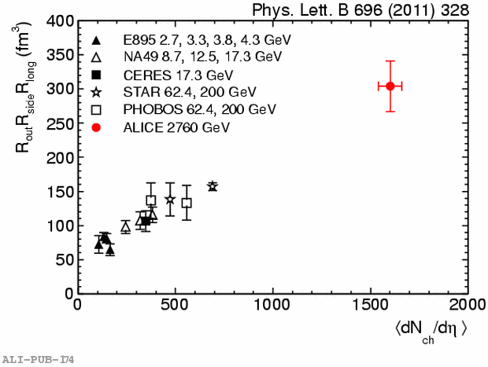
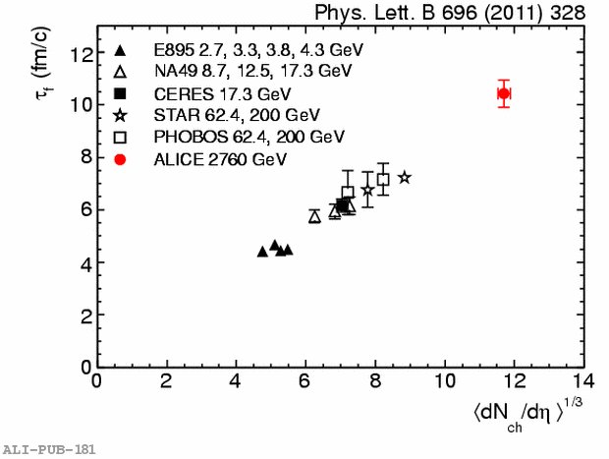
HBT correlations
HBT interferometry of identical bosons
measure the size of the homogeneity region formed after the collision
Size: twice w.r.t. RHIC
Lifetime: 40% higher w.r.t. RHIC (decoupling time extracted from R_{long} )
Notes:
the size and shape of the phase space cloud of outgoing particles whose velocities have a specific magnitude and direction. If the collective expansion of the produced matter is strong, as is the case in central collisions, then the region of homogeneity is significantly smaller than the entire source volume. OUT // pair transv. momentum, SIDE |_ OUT in the transverse plane, LONG // beam axis. q=momentum difference, calculaed in the longitudinal Comoving system (p1z+p2z=0)

Slide 17
Assessing the nature of the medium: 2 particle correlations and transverse flow
Space-time evolution of the fireball
Collective phenomena
Effects of fluctuactions in the initial nucleon distributions

Slide 18
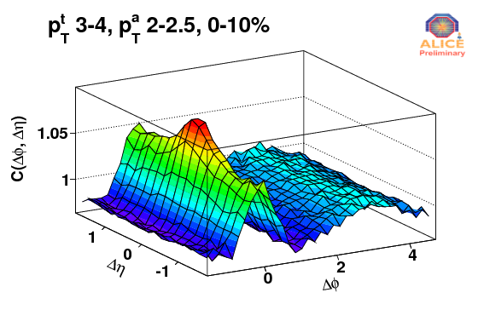
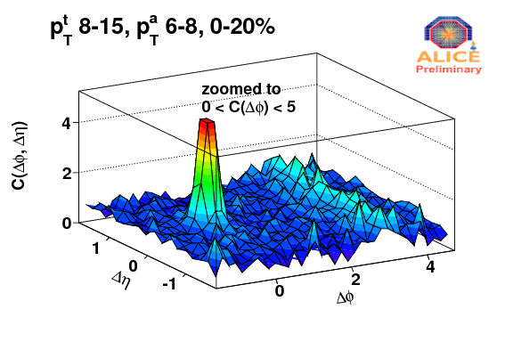
Triggered correlations / 1
Triggered correlations: a particle belonging to a p_{T} region (= trigger particle) is associated to particles belonging to another p_{T} region (= associated particles) → 2D histos in ΔηΔφ are then built in bins of p_{T,trigger} and p_{T,assoc.} (p_{T,assoc}<p_{T,trigger})
Low p_{T} region:
Soft processes
Collective phenomena: flow
Near side ridge
Away side broad structure
High p_{T} region:
Hard processes
Dominated by jets
Suppression of the away side jet: parton interactions in the medium

Slide 19
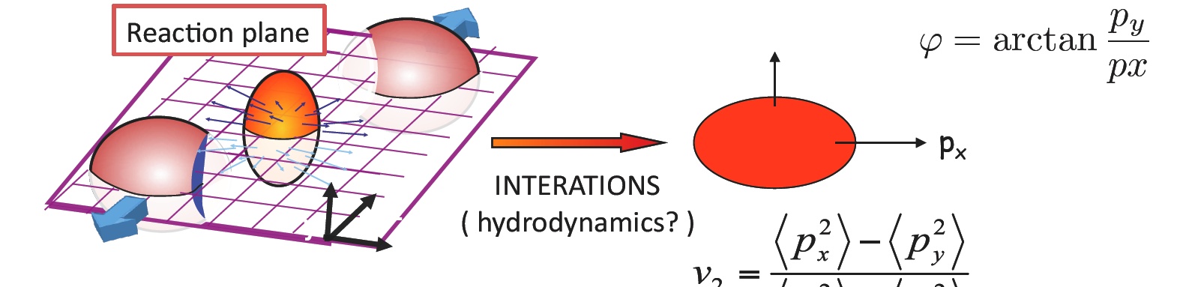
Anisotropic transverse flow
p_{y}
elliptic flow
p_{y}
INTERACTIONS
Initial spatial asymmetry
Final momentum asymmetry
Azimuthal distribution
Fourier decomposition of azimuthal distributions w.r.t. the reaction plane (RP)
IF smooth matter distribution in the colliding nuclei
  Ψ_{n}=Ψ_{RP}
  v_{2n+1} = 0 by symmetry

Slide 20
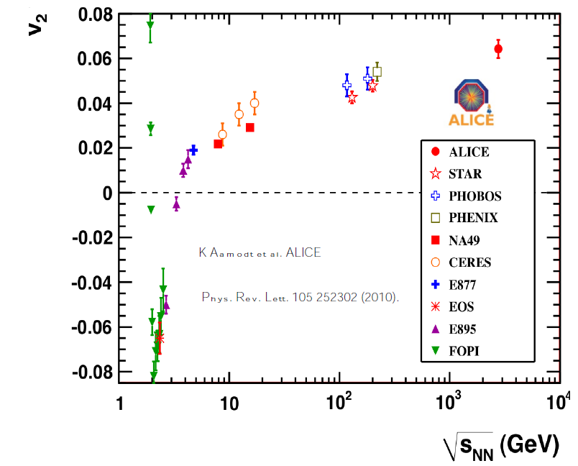
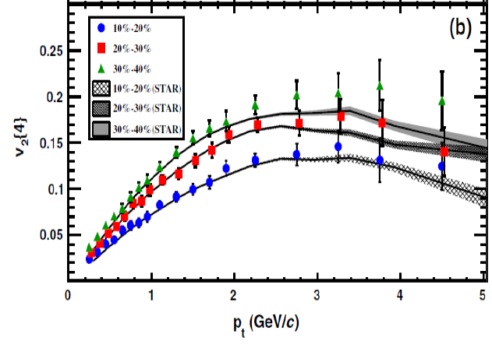
Elliptic flow
30% increase of p_{T} integrated flow from RHIC to LHC
Elliptic flow p_{T} differential distribution do not change from RHIC to LHC
The overall increase is due to a higher mean p_{T}
This is suggestive of an increased radial expansion

Slide 21
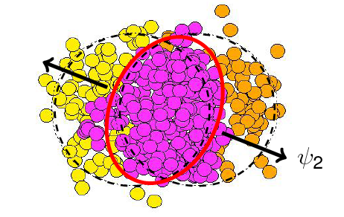
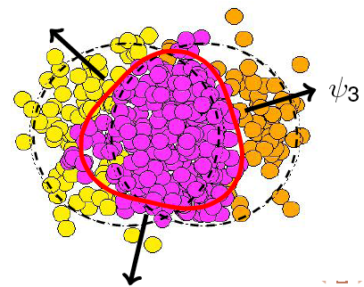
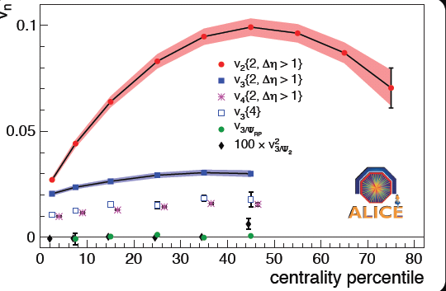
Higher harmonics: v₃, v₄,…
ψ₃
Fluctuations in the initial nucleon distribution
Event-by-event fluctuations of the symmetry plane w.r.t. Ψ_{RP}
Odd harmonics are not null, with magnitude related to the ratio (viscosity/entropy density)
ψ_{RP}
ψ₂
arXiv:1105.3865v1
Accepted by PRL
Non flow
Initial state fluctuactions
“Triangular flow” v₃:
Small dependence on centrality
v₃{4} is positive → flow
v₃{4}< v₃{2} → initial geometry fluctuactions
v₃{Ψ_{RP}}∼0 → Ψ₃ not correlated with Ψ_{RP}

Slide 22
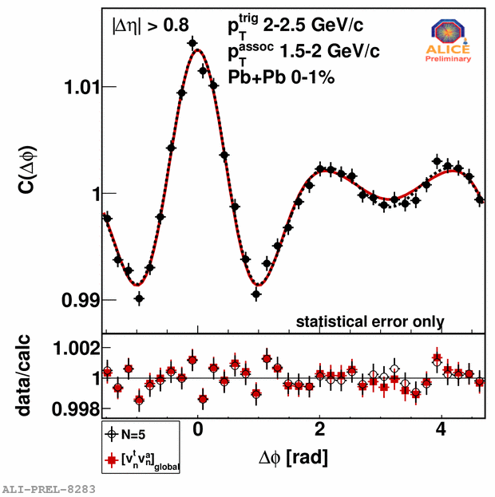
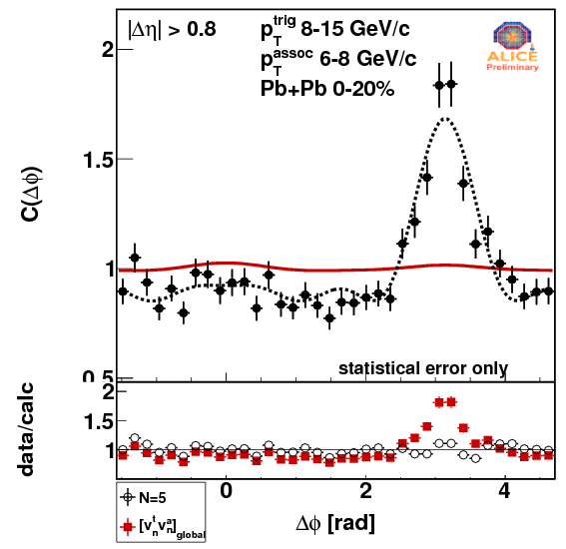
Triggered Correlations / 2
Red line: flow analysis (factorization)
Dashed line: C(Δφ) Fourier components: <cos nΔφ> (n=1-5)
Low p_{T}: if Fourier components of the correlation function are taken as v_{n}(p_{T}^{trigg})v_{n}(p_{T}^{assoc}) → good description of the correlation (Mach cone & ridge) in terms of collective flow
High p_{T}: correlations cannot be described in terms of flow → away side jet dominates

Slide 23
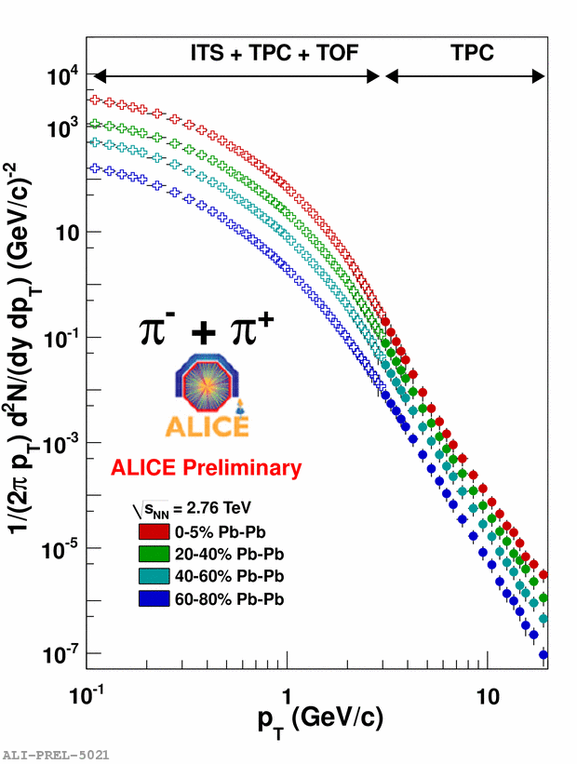
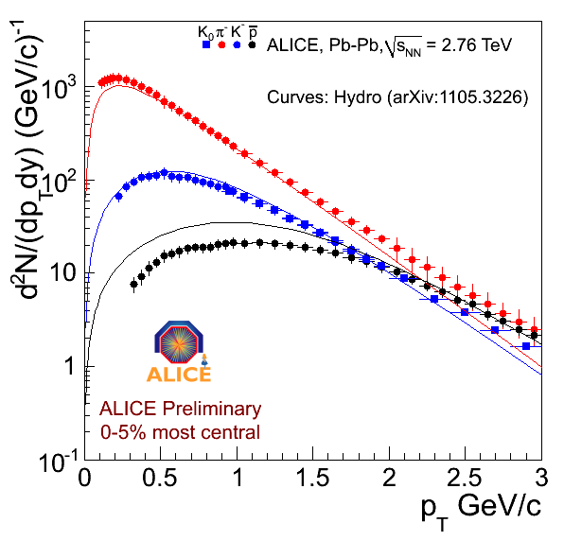
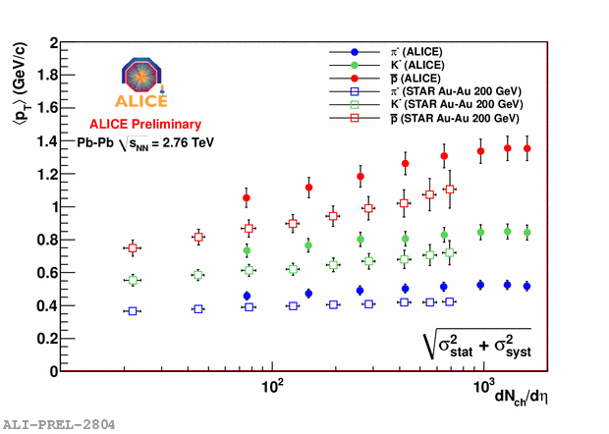
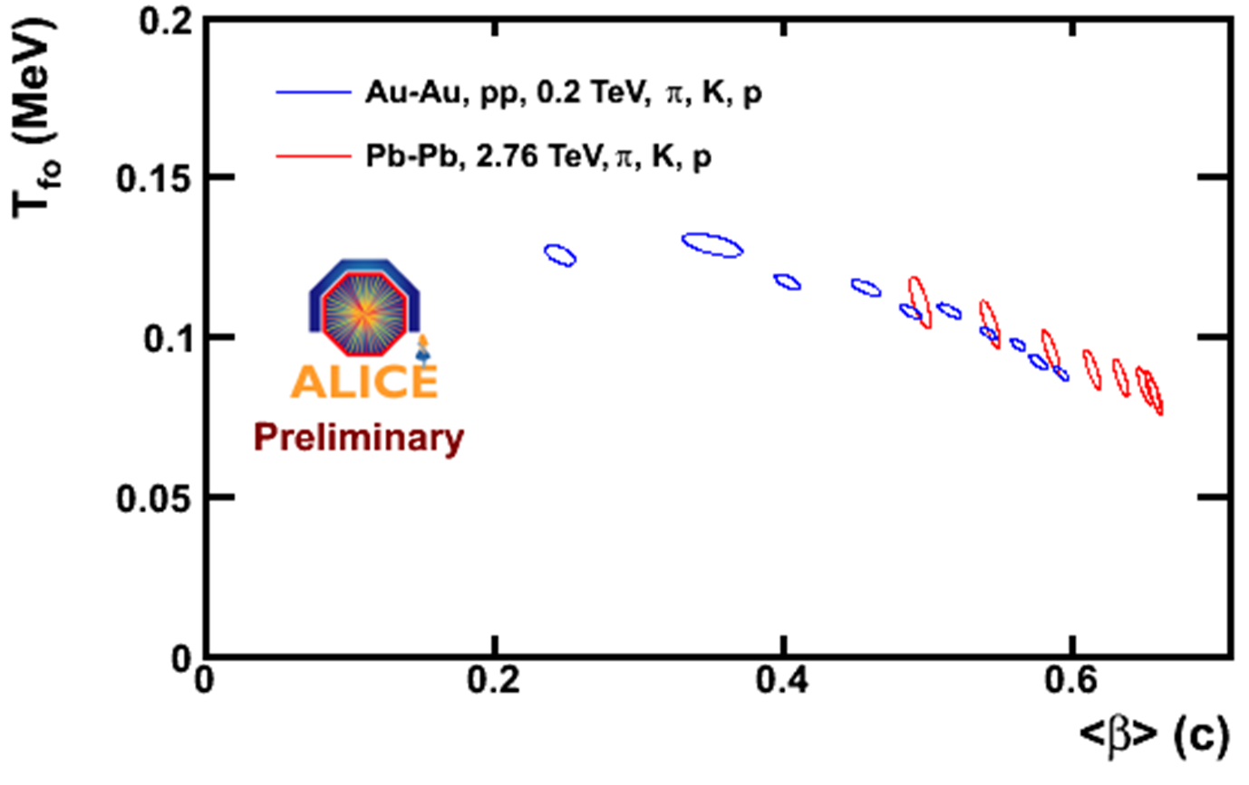
p_{T} spectra
Significant change in mean p_{T} from RHIC to LHC
In particular for protons
Common Blast Wave fit to p, K and π is consistent with RHIC data → F.O. temperature and mean velocity
Strong radial flow: β∼0.66 for central Pb-Pb
  Larger w.r.t. hydro predictions
RHIC
centrality
Hydro parameters from Blast Wave Fit

Slide 24
Probing the medium with hard processes
Nuclear modification Factor vs. p_{T}
Heavy Flavours
Quarkonia

Slide 25
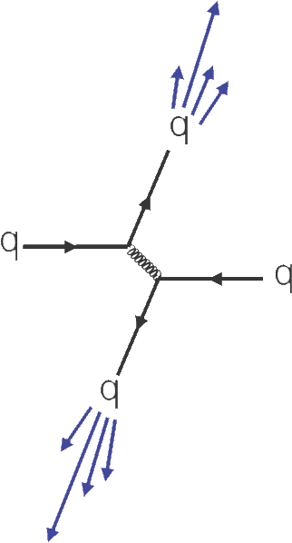
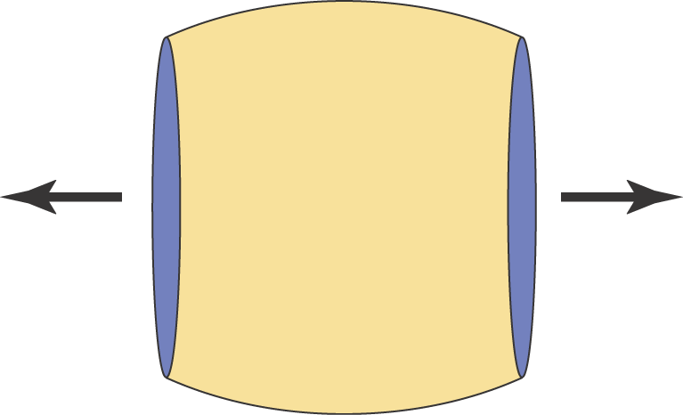
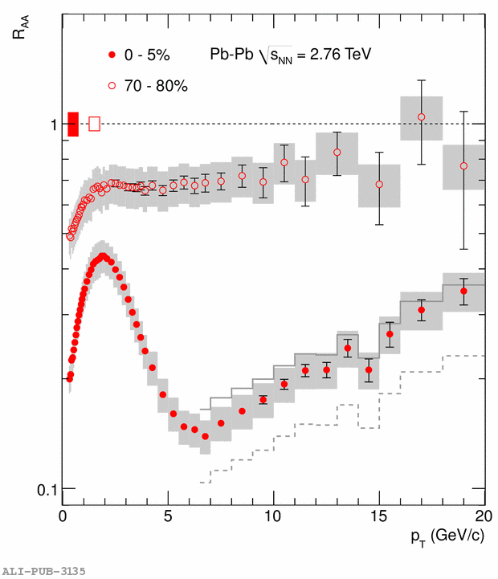
Hard probes
Parton-parton scatterings with high momentum transfers:
  pQCD can be used to calculate initial cross sections
  scattered partons originate jets
In nucleus-nucleus collisions:
  Partons produced in hard processes are a probe of the medium
  Final state will depend on the properties of the medium
    Jet tomography
The effect of the medium is expressed through the Nuclear Modification Factor R_{AA}:
Phys. Lett. B 696 (2011)

Slide 26
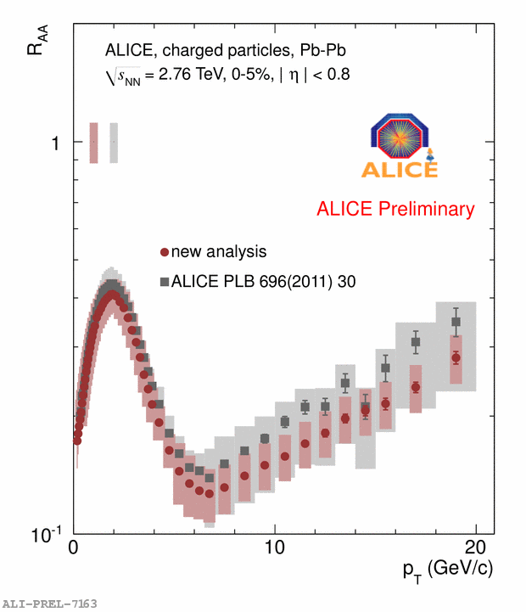
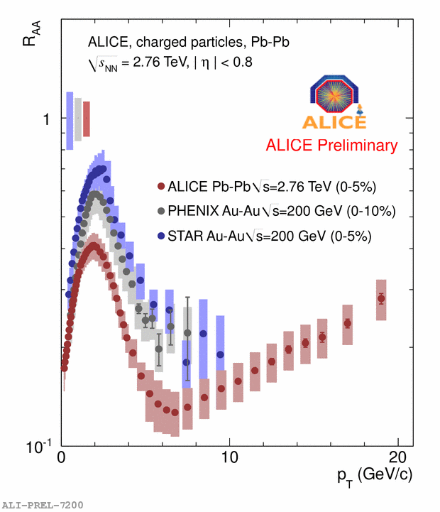
R_{AA} for charged particles
New pp reference data @ 2.76 GeV collected in 2011
  Smaller systematic errors
  Smaller increase of R_{AA} with p_{T}
Factor 7 suppression at ~7 GeV/c
Suppression stronger at LHC w.r.t. RHIC collisions

Slide 27
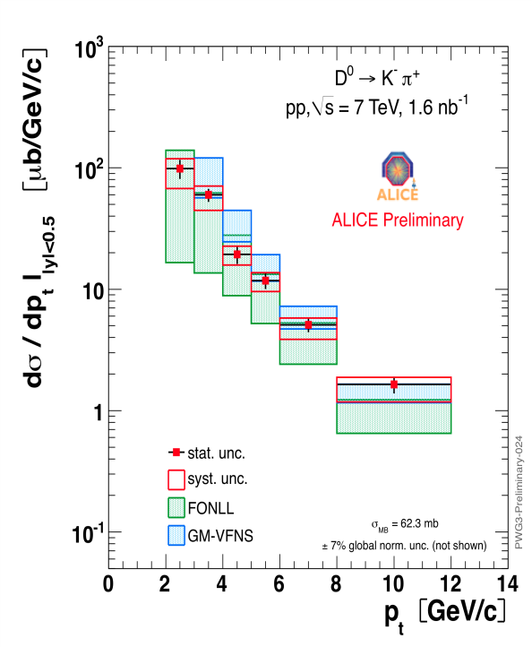
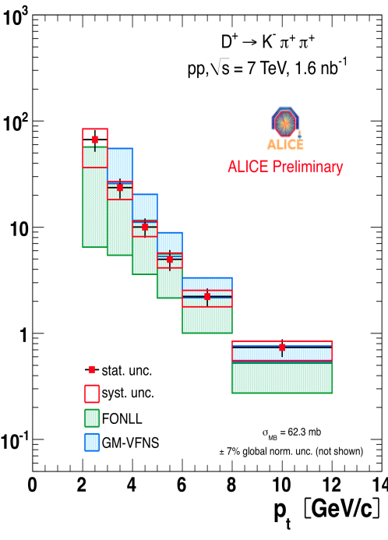
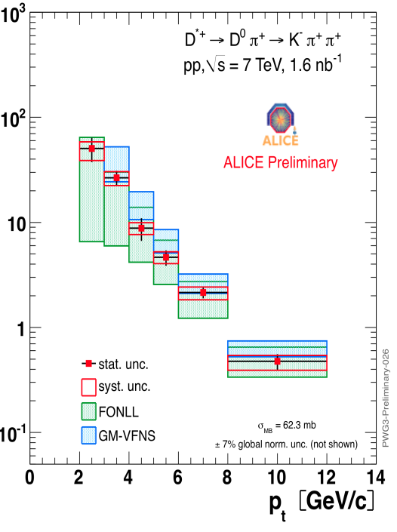
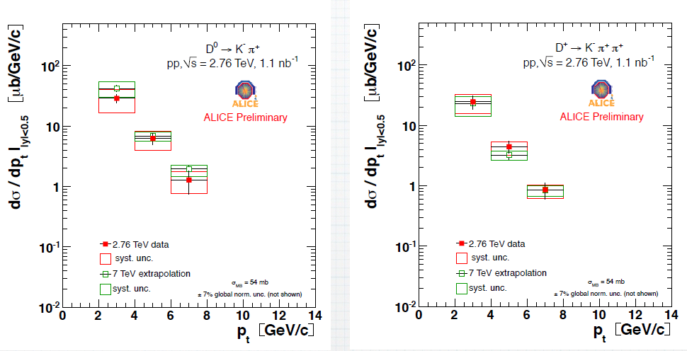
Open Charm: pp baseline
D⁰→ Κ⁻π⁺
D⁺→ Κ⁻π⁺π⁺
D*⁺→ D⁰π⁺
Data: pp @ 7 TeV
Hadronic dacays of different mesons
Differential cross sections, after B feed down subtraction
Scaled down to 2.76 TeV using FONLL
Checked with pp data @ 2.76 TeV
Total cross sections compared to results of other experiments
pp 2.76 TeV

Slide 28
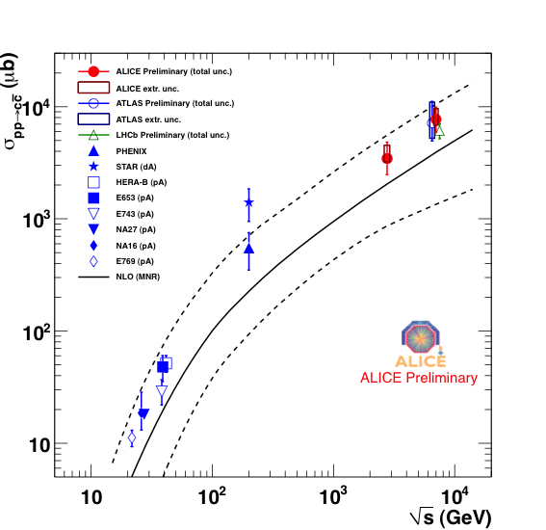
Open Charm : pp baseline
Data: pp @ 7 TeV
Hadronic dacays of different mesons
Differential cross sections, after B feed down subtraction
Scaled down to 2.76 TeV using FONLL
Checked with pp data @ 2.76 TeV
Total cross sections compared to results of other experiments
Total Charm cross section
ALICE
ATLAS
LHCb

Slide 29
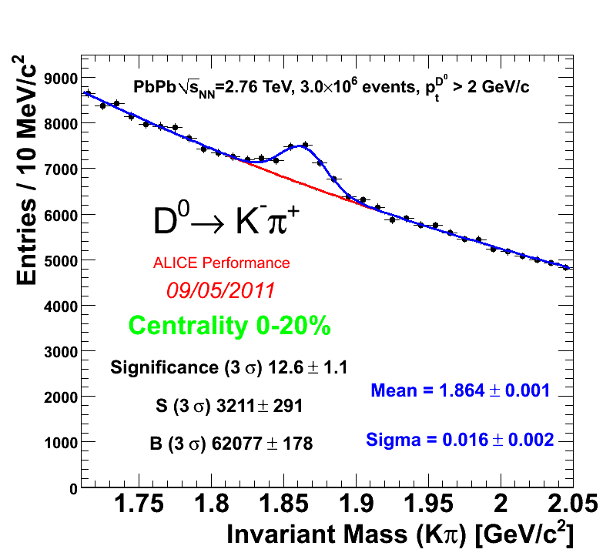
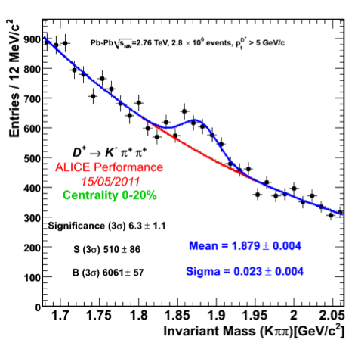
Open Charm: Pb-Pb results
Central collisions (0-20%):
  D⁰: 5 p_{T} bins in 2-12 GeV/c
  D⁺: 3 p_{T} bins in 5-12 GeV/c
Reconstruction efficiency ~1-10 %
  From MC simulation
    Detector conditions described in MC at the level of few %
    No centrality dependence
Feed down from B: 10-15 % after cuts

Slide 30
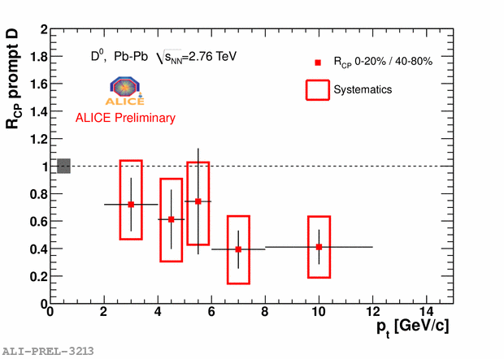
Charm R_{AA} & R_{CP}: results
Suppression for charm is a factor 4-5 for p_{T}>5 GeV/c
Suppression is also visible in the PbPb central / peripheral ratio (R_{CP}): factor 2-3 for p_{T}>5 GeV/c

Slide 31


Charm R_{AA}: comparison with π
Suppression for charm not too different w.r.t. that for pions
  D mesons seem to be less suppressed for p_{T}<5 GeV/c
Qualitative expectations: R_{AA} charm > R_{AA} pions:
  Energy loss for gluon > energy loss for quarks (Casimir factor)
  Energy loss of massless partons > energy loss of heavy quarks (“dead cone effect”)

Slide 32

Heavy Flavours from μ and e
Semileptonic decays of HF contribute to the electron and muon yields
(Inclusive electron spectra) – (“cocktail” of known sources) is dominated by HF for p_{T}>3-4 GeV/c
Muon yield is suppressed by a factor of ~3 for p_{T}>6 GeV/c, where is dominated by Beauty
R_{AA} for muons and electrons are compatible within the large electron signal systematic uncertainties

Slide 33



Comparison with models
Little shadowing at medium-high p_{T} (as predicted by EPS09 for cold nuclear matter) → suppression is a hot matter effect
Low p_{T} rise: pPb data needed to understand it
Radiative Eloss (BDMPS-ASW)
  D & muon lie on the same curve
Radiative+collisional (WHDG @ 2.76 TeV)
  Fair description
Light-cone wave function approach with dissociation (Vitev)
  OK for muons (beauty)

Slide 34



J/Ψ R_{AA}: pp reference
3 days of data taking @ 2.76 TeV
Sample: 20.2 nb⁻¹ (13.3 nb⁻¹ used for the present analysis @ 7 TeV )
J/ψ yield extracted from a fit to the invariant mass spectrum (crystal ball shape for the signal + double exponential for the background)
Good agreement of differential cross sections with pQCD

Slide 35

J/Ψ R_{AA}: results
Inclusive J/ψ R_{AA}^{0-80%} = 0.49 ± 0.03 (stat.) ± 0.11 (sys.)
Bars: statistical errors
Open rectangles: systematic errors dependent on centrality
Filled rectangle: common systematics
Suppression of ~0.5
Cold Nuclear Matter Effects not measured → pPb data needed for this
Contribution from B feed-down:
  ~ 10% from p-p measurement (LHCb Coll., arXiv:1103.0423)
  Rough estimation assuming simple scaling with N_{coll}: ~ 11% reduction of R_{AA}^{0-80%}

Slide 36
J/Ψ R_{AA}: comparison with RHIC
ALICE data plotted as a function of <N_{part}>
J/ψ less suppressed at LHC (2.5<y<4) than at RHIC (1.2<|y|<2.2)
R_{AA} for ALICE and Phenix are similar if Phenix data are restricted to |y|<0.35

Slide 37
J/Ψ R_{AA}: comparison with RHIC
ALICE data plotted as a function of <N_{part}>
J/ψ less suppressed at LHC (2.5<y<4) than at RHIC (1.2<|y|<2.2)
R_{AA} for ALICE and Phenix are similar if Phenix data are restricted to |y|<0.35

Slide 38

J/Ψ R_{CP}: comparison with ATLAS
Peripheral reference: 40-80% centrality bin
Less suppression in ALICE than in ATLAS
ALICE data: 2.5<y<4.0 – p_{T}>0 GeV/c
ATLAS data: |y|<2.5 – 80% of J/ψ with p_{T}>6.5 GeV/c – error in the 40-80% bin not propagated

Slide 39
ALICE upgrades

Slide 40


Motivations
Small x – large y physics
  gluon saturation is expected at low x
Particle correlations
  need to access large y ranges
  Observed features need a thorough investigation
Heavy Flavours
  First measurements of R_{AA} and R_{CP} available
  Need to study production and interactions mechanisms
  Collective phenomena for heavy quarks
  thermalization/recombination?
Particle production
  Observed species dependencies need to be understood
  e.g. “Baryon anomaly” Λ/K⁰
  Hadronization mechanisms: fragmentation and coalescence

Slide 41
Motivations → proposed upgrades
Small x – large y physics
Particle correlations
Heavy Flavours
Particle production
Forward EM calorimeter (FoCal)
  Coverage at large rapidity (y>3)
  Photon/pion discrimination
  Possible extension (phase II): η>4.5 with charged tracking and hadronic calo (baryon ID)
Vertex upgrades: ITS and a new Muon Forward Tracker (MFT)
  HF baryons
  Charm at low p_{T}
  B-tagging in the muon arm
  exclusive B decays
Particle ID upgrade: Very High Momentum PID (VHMPID)
  Track-by-track identification up to O(20) GeV/c

Slide 42
Schedule
Upgrade plans defined by Pb-Pb results from first HI runs. However, long LHC shutdowns determine access to the experiment.
Timeline:
  Expression of Interest (spring 2011) for various proposals (see following slides)
  Workshop on the physics of upgrades in ALICE, July 12+13, 2011 – close interaction with theorists
  Letters of Intent → autumn 2011
  Preliminary decision on approval of upgrade projects by end 2011
  Most upgrades scheduled for LHC shutdown 2017/18

Slide 43

FOrward CALorimeter (FOCAL)
Large rapidity coverage: 2.5<η<4.5
EM calorimeter: γ, neutral mesons (π⁰,η), possibly electrons
Requirements
  π⁰/γ discrimination at p~200 GeV/c
  High granularity (<1cm²)
  3.5 m from the interaction point
Favoured solution: SiW
  Approx. 21 layers along z
  W thickness: 3.5 cm
  Options for Silicon
    Si-pads (1cm × 1 cm)
    Monolithic pixels
First segment
Second segment
Third segment
2γ distance from π⁰ decays at 4.5 m from IP
Si pixel
Tungsten
Si pad

Slide 44


Very High Momentum PID (VHMPID)
Focusing RICH with spherical (or parabolical) mirrors
C4F10 radiator (~1 m), alternative aerogel
Photon detector: MWPC operated with CH4, with CsI photocathode
Readout: current HMPID FEE (GASSIPLEX)
Expected performance: embedding single particles in Hijing
Separation for different angular resolutions

Slide 45



Muon Forward Tracker (MFT)
Muon track matching before/after the absorber
Secondary vertices detection
  J/ψ from B decays
Better mass resolution
Better background rejection
Needs modifications of the beam pipe and integration with ITS
Technology: under discussion. Possibly monolithic silicon pixel detectors (as for ITS upgrade)
Present spectrometer
Expected invariant mass spectrum

Slide 46


Inner Tracking System (ITS)
Requirements:
  Improve impact parameter resolution by a factor of ~3
  High standalone tracking efficiency → possibility of L2 trigger based on decay topology
  Low material budget (existing ITS is ~7% X₀)
Technical goals:
  Smaller beam pipe (R=2 cm, ΔR=800 μm)
  First Silicon layer at r=2.2 cm
  New pixel solution:
    Material budget reduced to 0.3-0.5 X₀
    Pixel size: 20-30 μm in r-φ
    Trigger capabilities:
      L0/L1; fast-OR and fast-SUM (1.2/7.7 μs)
      L2 topological trigger (100 μs)

Slide 47

Inner Tracking System (ITS)
Possible layout:
  3 layers of Si-pixels followed by 3-4 layers of Si-strips
Possible pixel technologies:
  Hybrid pixels:
    Thickness: 100 mm sensor + 50 μm ASIC
    Pixel size: 30×100 μm²
  Monolithic pixels:
    Thickness: 50 μm ASIC
    Pixel size: 20×20 μm²
New strip detector
  Smaller size (half length)
  New Front End chip:
    CMOS 0.13 μm
    On-chip ADC
Readout time < 50 μs
Radiation tolerance: 2Mrad, 2×10¹³ n_{eq}/cm²
Low power design: 250 mW/cm²

Slide 48
Conclusions
First pp and Pb-Pb runs were a success for ALICE
  Detector performance at design level
  Good measurement of pp reference at 7 TeV and, with smaller statistics, at 2.76 TeV
New frontier for heavy ion collisions:
  Energy density: 3×RHIC - Size: 2×RHIC - Lifetime: 40%>RHIC
Soft probes:
  Smooth connection with RHIC data
  QGP is a low viscosity fluid also at the LHC
  Importance of triangular flow and higher harmonics to describe the observed pattern of particle correlation
Hard probes:
  Strong leading hadron suppression (factor of ~7 at p_{T}≈7 GeV/c)
  Full measurement of hadronic decays of charmed mesons: R_{AA} similar to that of light mesons
  Strong J/ψ suppression at high p_{T}
    At low p_{T} less suppressed than at RHIC
Future:
  Future (>2020) physics programme is emerging now
  Upgrade proposals under way: LOI are prepared for autumn 2011
  Current ideas: rate capabilities, heavy flavours with topological trigger, high p_{T} PID, low x physics…

