Slide 1


Safety – EP experiments
Set-ups in n_TOF experimental areas
Authors: J. Devine, L. Di Giulio, N. Patronis

Slide 2
EP Safety Team
Each department at CERN has a reference Department Safety Office
EP Safety Office:
  Departmental Safety Officer (EP DSO): O. Beltramello
  Deputy Departmental Safety Officer (EP DDSO): L. Di Giulio
  Website: https://ep-th-safety.web.cern.ch
  Contact: ep-safety-office@cern.ch
Each experiment/experimental area has an Experimental Safety Officer (EXSO):
  n_TOF EXSO: N. Patronis
  Contact: Nikolaos.Patronis@cern.ch
You can always contact us for any question in matter of safety!

Slide 3

Safety Appendix for n_TOF proposals
For the future n_TOF experiments’ proposals submissions (starting from the ones with deadline 27/09/2022), the templates will have a Safety Appendix
This annex will help us identify if any additional hazard is brought to CERN with the equipment/activities associated with a specific experiment
When an hazard is identified, an assessment will follow to make sure any necessary control measures are/have to be in place

Slide 4
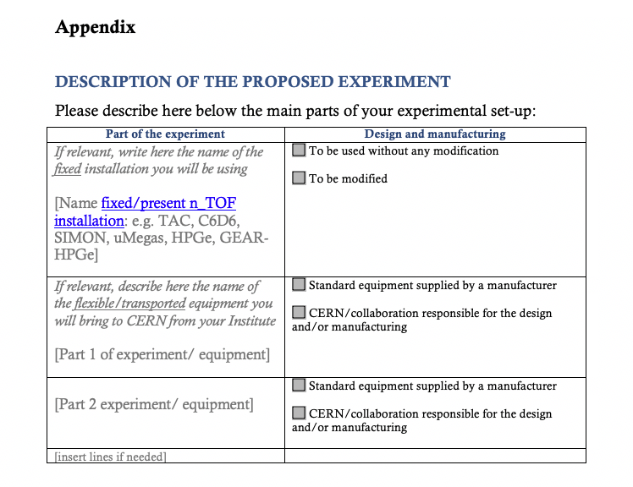
Safety Appendix for experiments’ proposals
In this first part of the Appendix, you should write if, for your experiment, you will use only the existing n_TOF detectors (specify which one) OR if you will bring new equipment/detectors on site

Slide 5
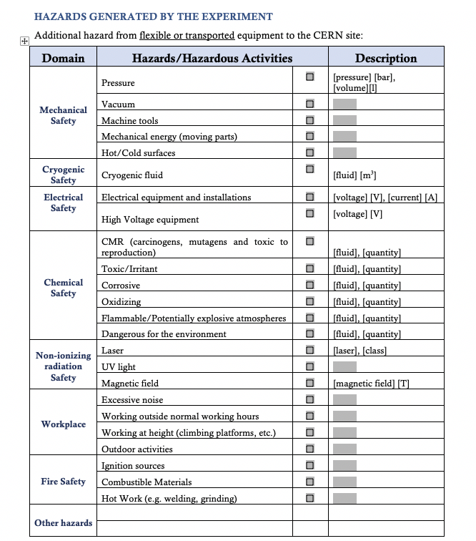
Safety Appendix for experiments’ proposals
Only if you are bringing NEW equipment, you fill this table with the specific hazards generated by the equipment/activities

Slide 6
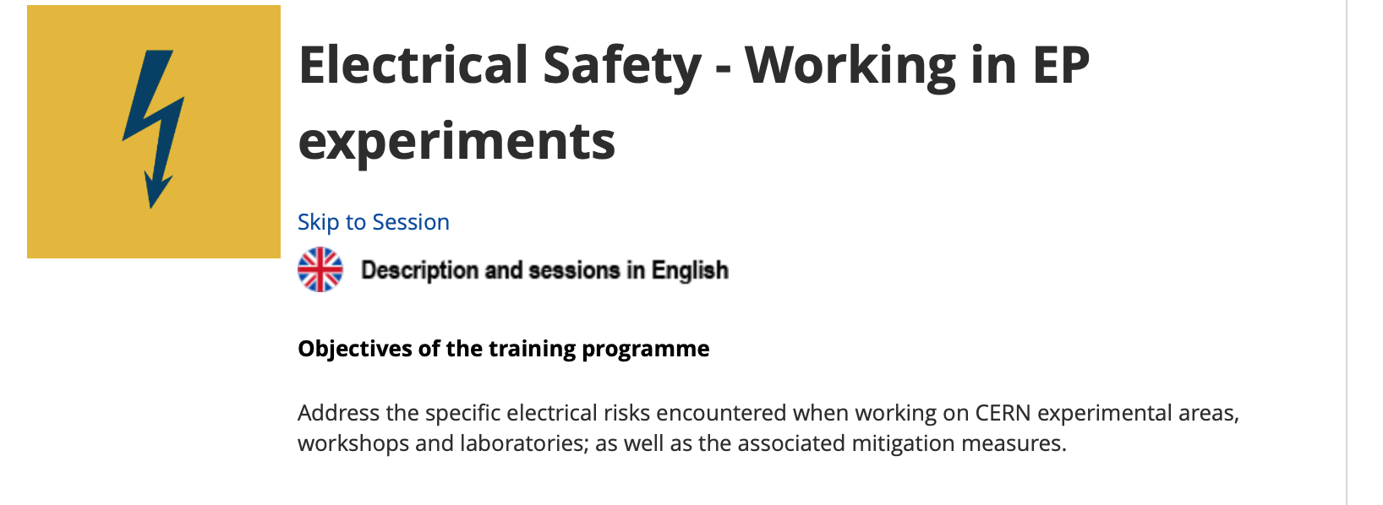
Electrical Safety – New training
A new electrical safety course have been developed specifically for working in experiments.

Slide 7
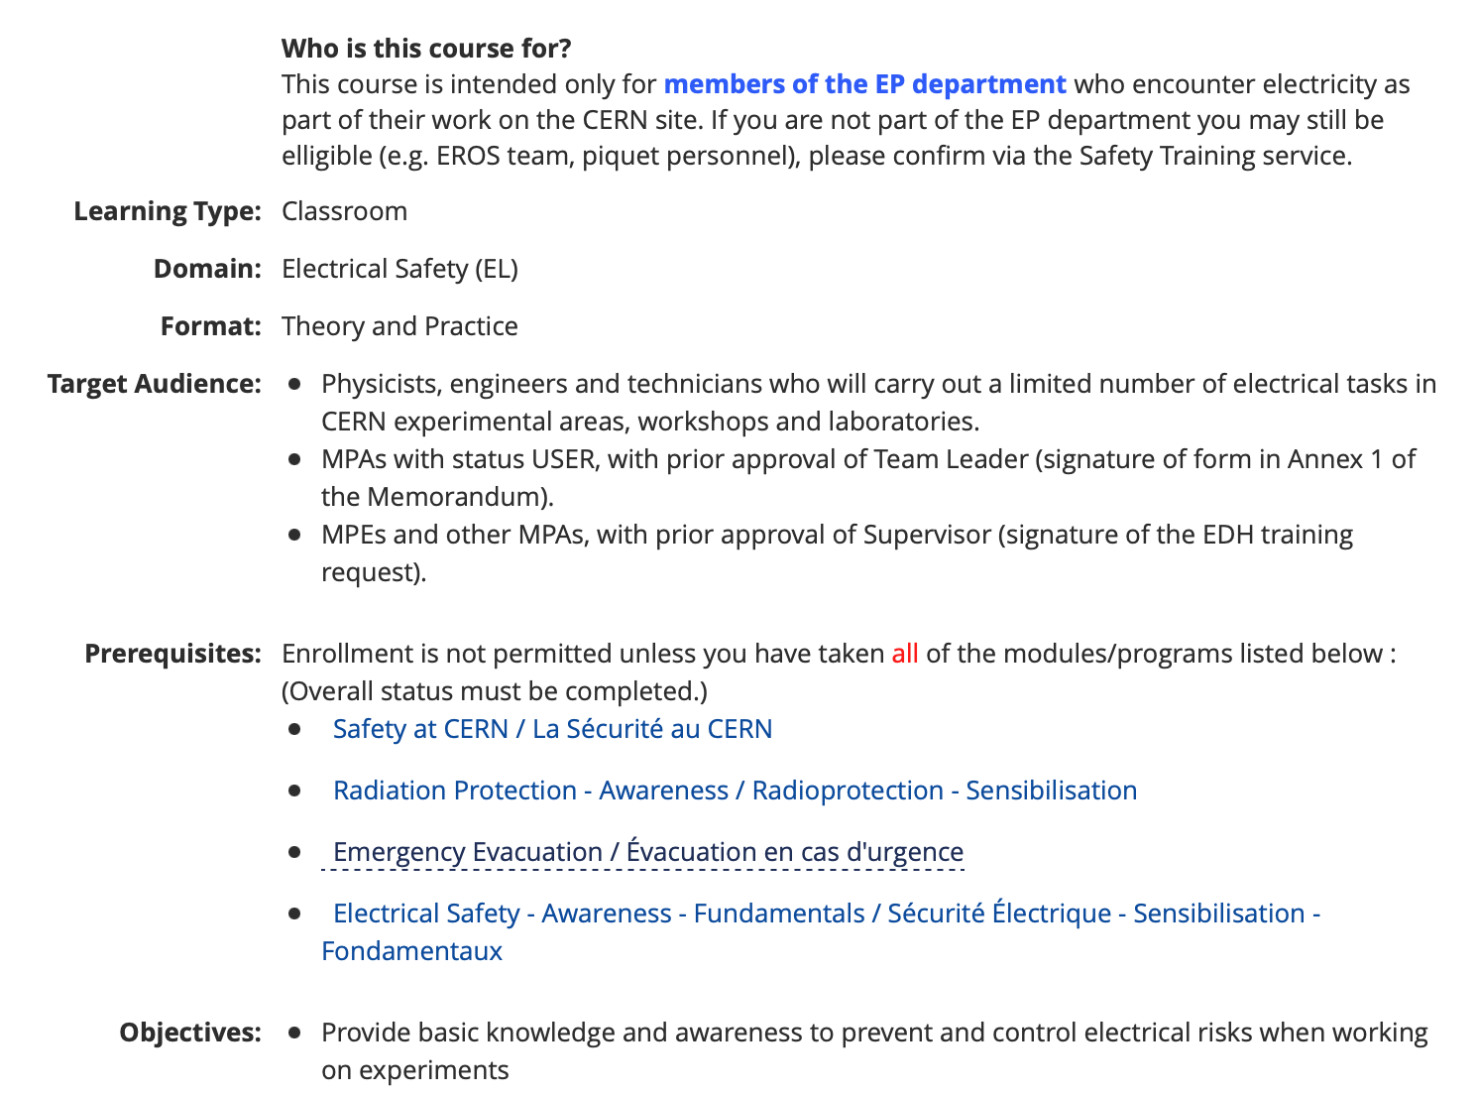
Electrical Safety – New training
4 hours training
To sign up you can click on this link (CERN LMS page)
It is held (almost) every Tuesday at CERN Prevessin
Custom sessions can be organised with the Safety Training, if needed
Online trainings

Slide 8
Electrical Safety – New training
List of activities allowed can be found in the training description
As a prerequisite to the course, CERN Supervisors will have to confirm that the persons concerned are competent and adequately trained to carry the electrical tasks assigned to them
For MPEs and MPAs who are not USERS, the signature of the EDH training request will be deemed to constitute confirmation by the Supervisor that this is the case and that, subject to successful completion of the course, the person is authorized to carry out the tasks in question
For MPAs with USER status, a specific Memorandum has to be filled and signed by the Team Leader or another representative of the Institute (Safety Training will send you the Memorandum - here)
In the future, this course will become mandatory for access in EAR’s and Electrical Lab
At the moment the Local Team and users are strongly encouraged to take this course ASAP

Slide 9
Thank you! Any questions?

