Slide 1
The n_TOF EAR1 beam line
S. Amaducci, M. Bacak, A. Casanovas, F. Garcia-Infantes, J. Lerendegui-Marco, A. Manna, E. Musacchio, N. Patronis, J. Pavon-Rodriguez, M. Sabate-Gilarte, E. M. Stamati, R. Zarrella
30.05.2022 – n_TOF Collaboration Meeting

Slide 2
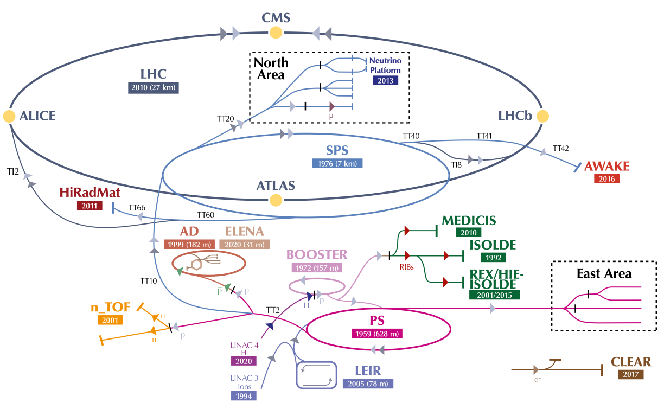
n_TOF @ CERN
CERN: European Organization
for Nuclear Research
(Geneva, Switzerland)
Neutron Time Of Flight facility: n_TOF
Operation since 2001
2022:
37 institutes
131 researchers

Slide 3
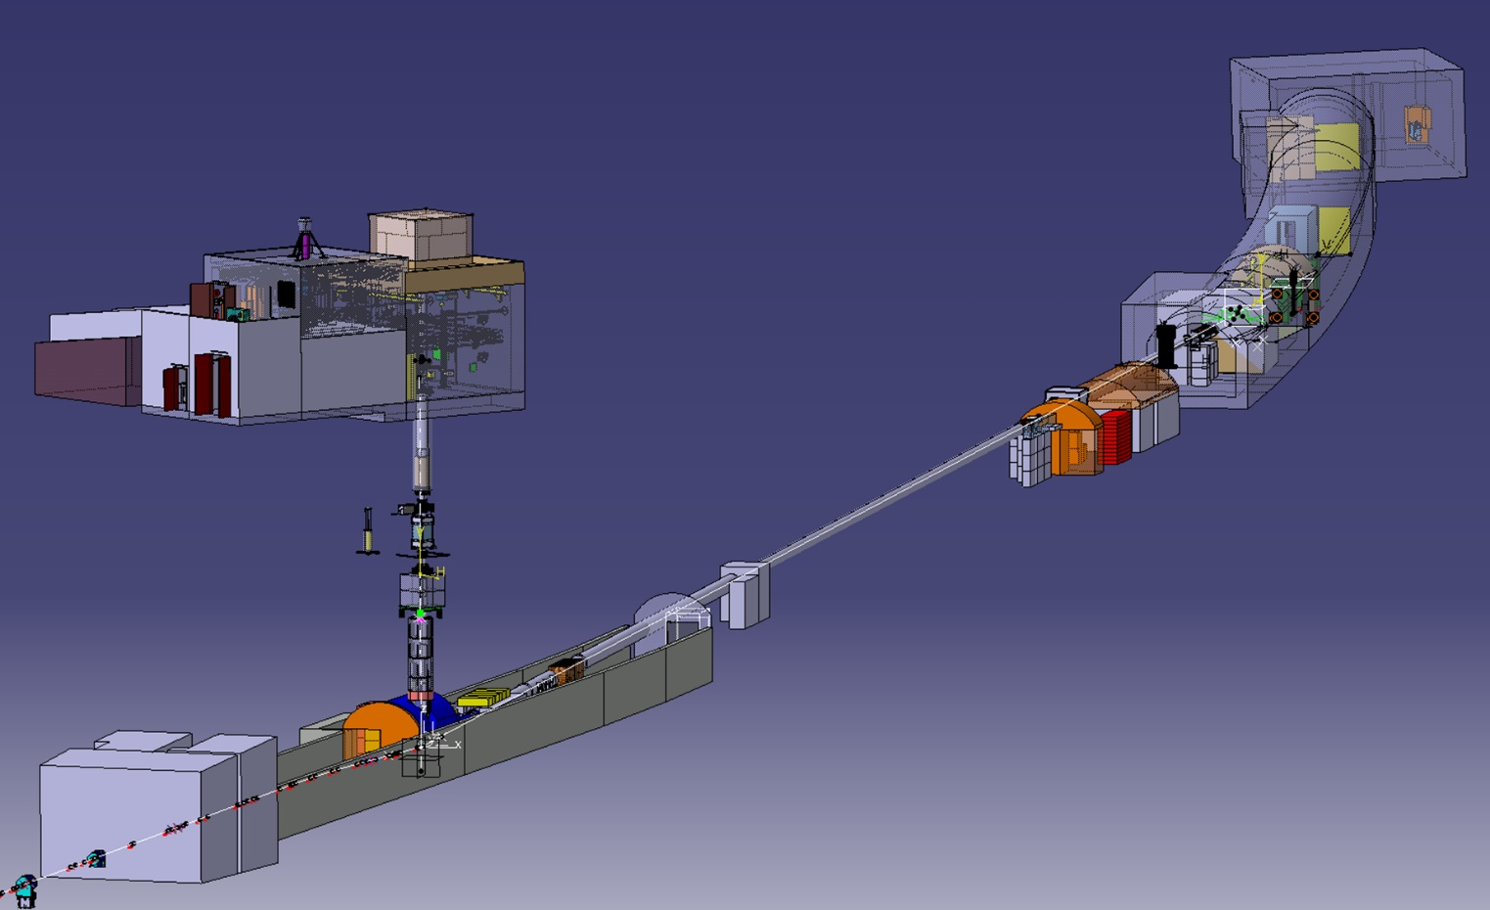
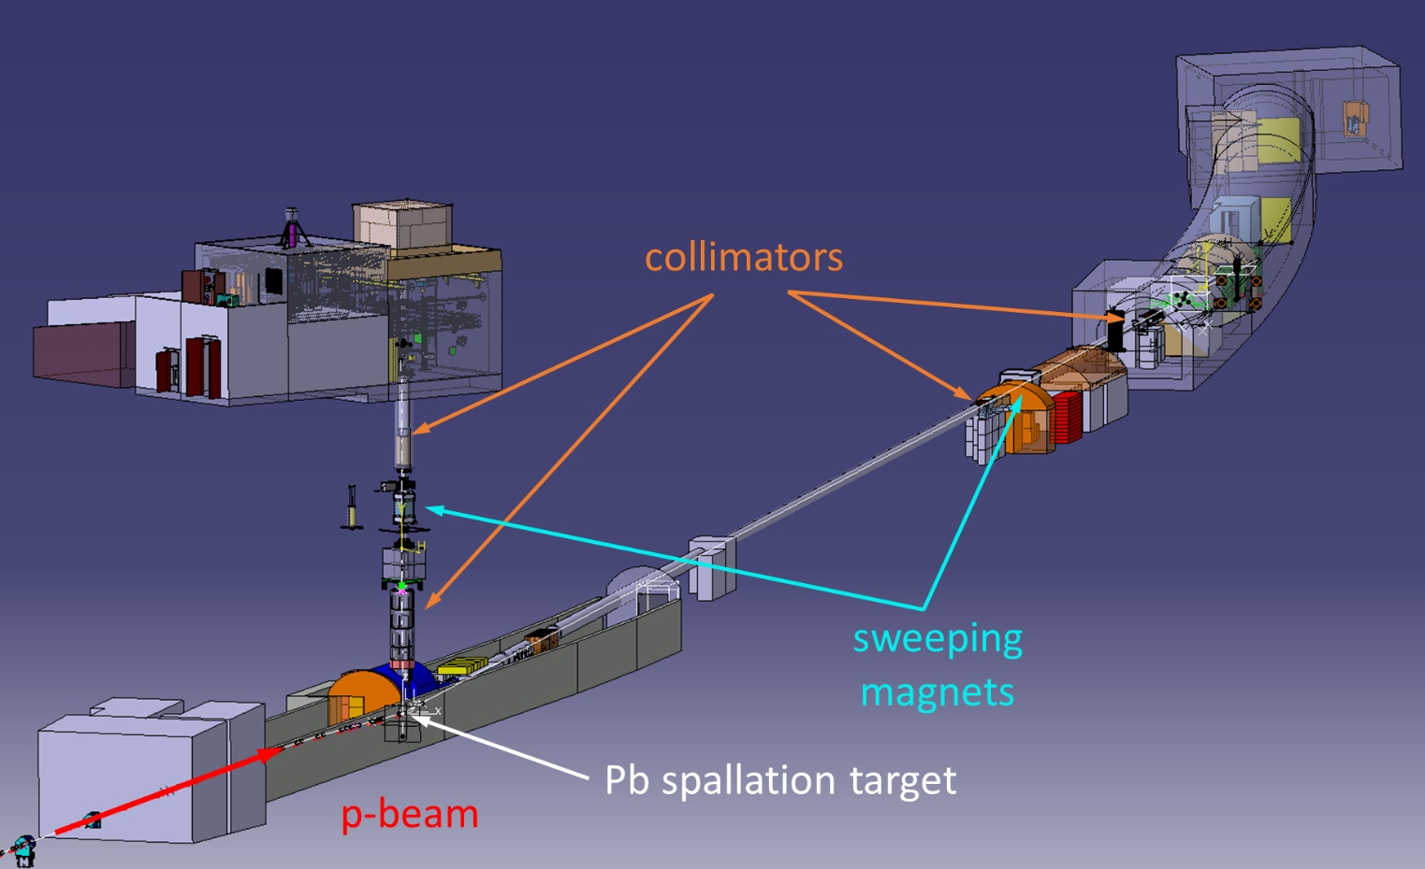
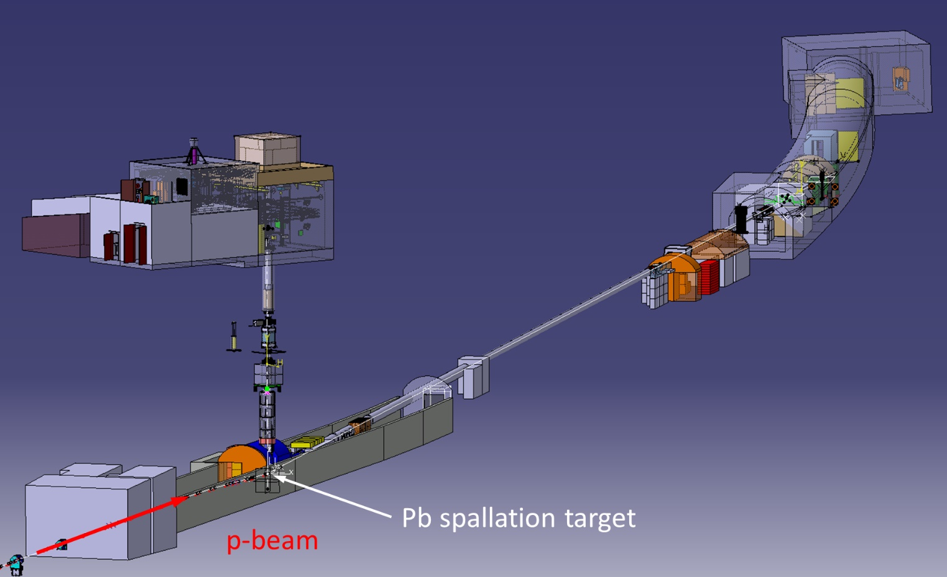
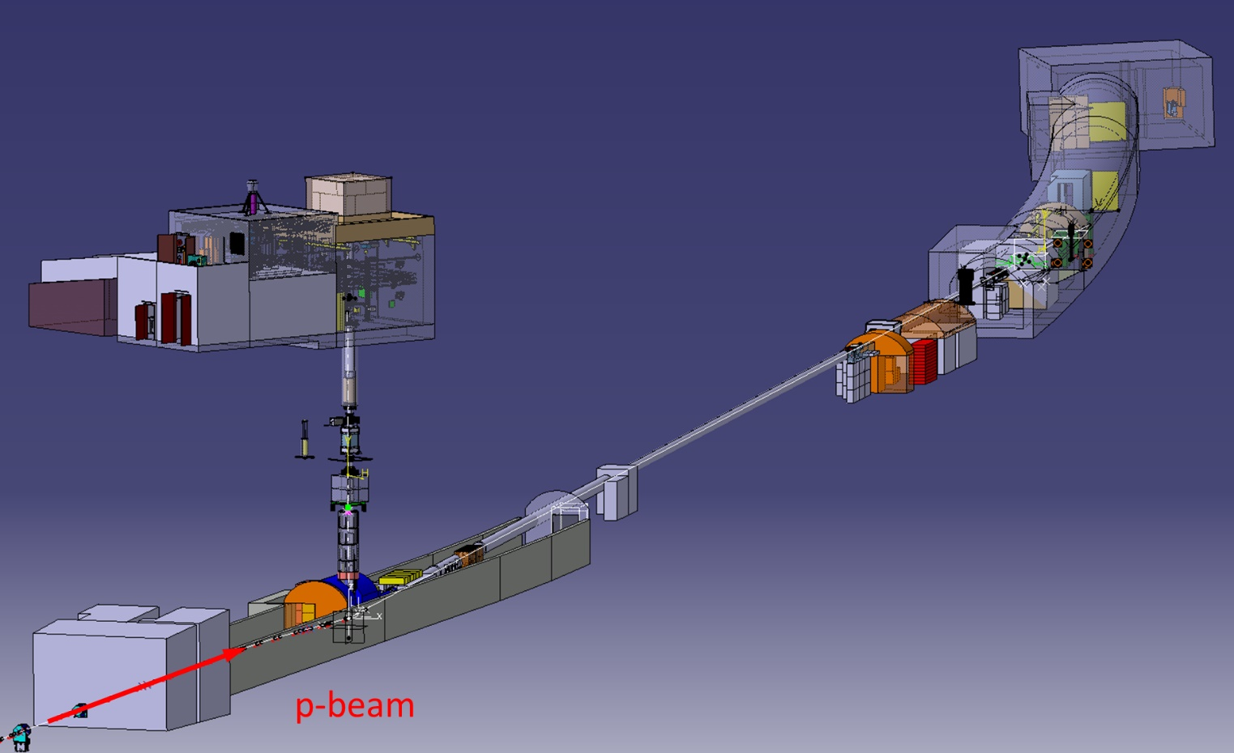
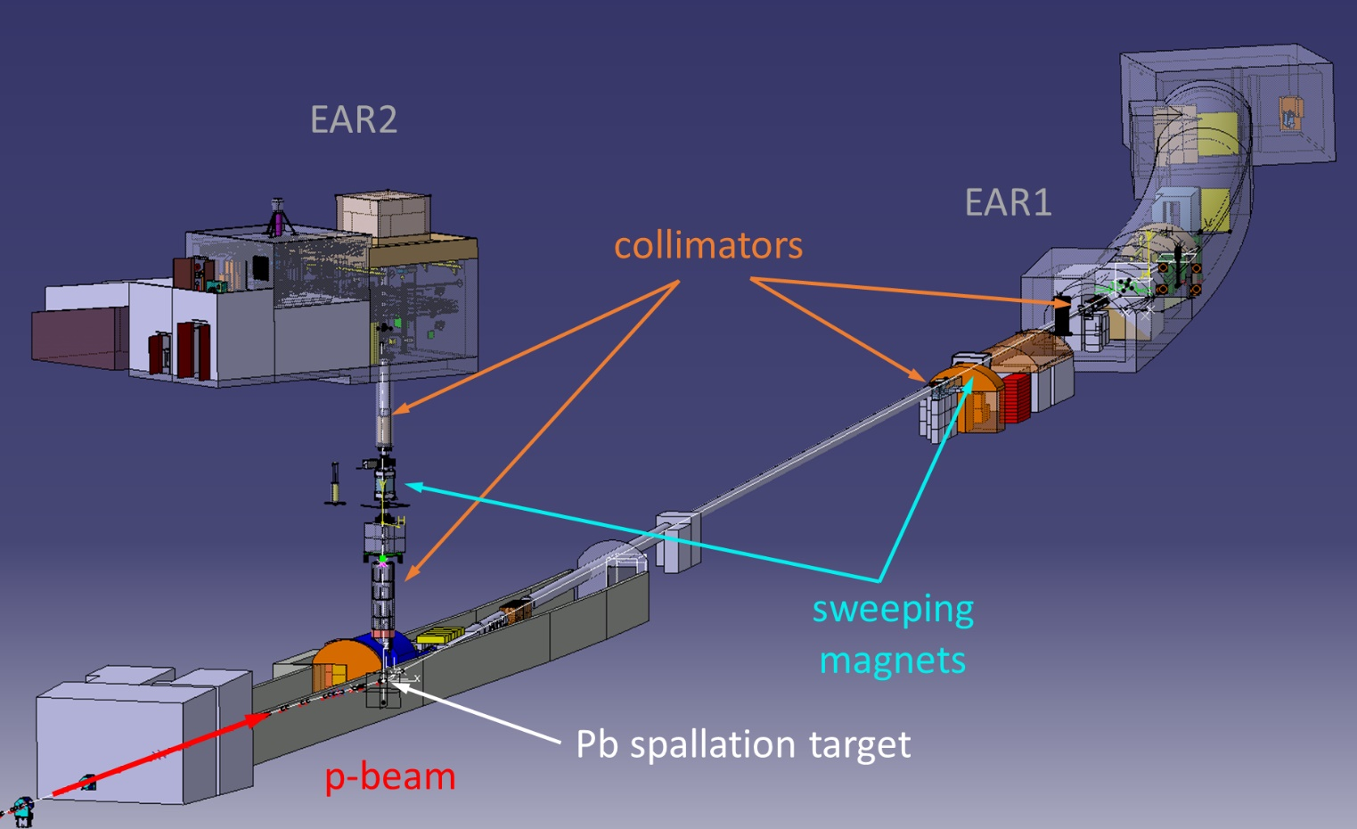
n_TOF overview
Experimental ARea 2
@ 18.5 m
~10⁶ cm⁻²pulse⁻¹
ΔE/E ~ 4·10⁻³ @ 1 eV
Experimental ARea 1
@ 185 m
~10⁴ cm⁻²pulse⁻¹
ΔE/E ~ 5·10⁻⁴ @ 1 eV
pulsed
0.8 Hz
20 GeV/c
11 ns RMS
850·10¹⁰ ppp
~ 300 n/p
clean charged particles
< 2020: water cooled uncladded lead block
>2020: Nitrogen-gas cooled uncladded lead slabs

Slide 4
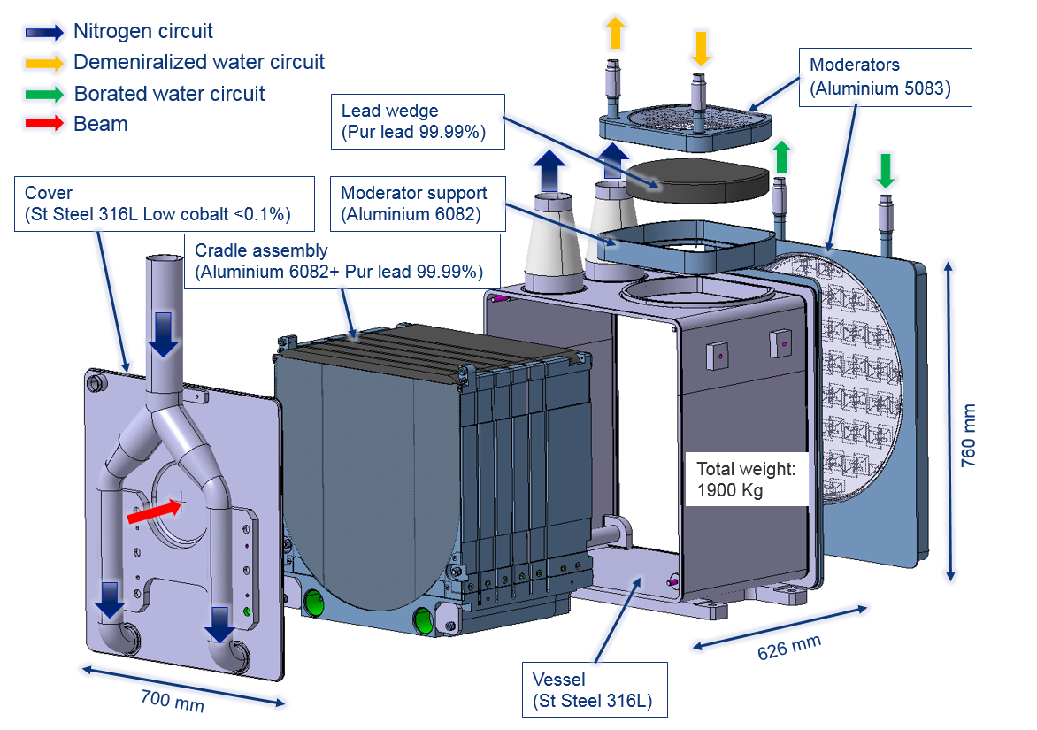
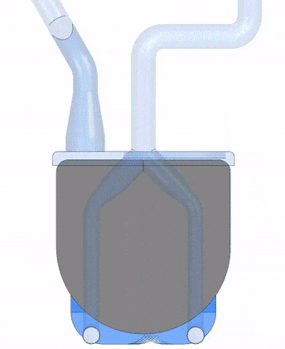
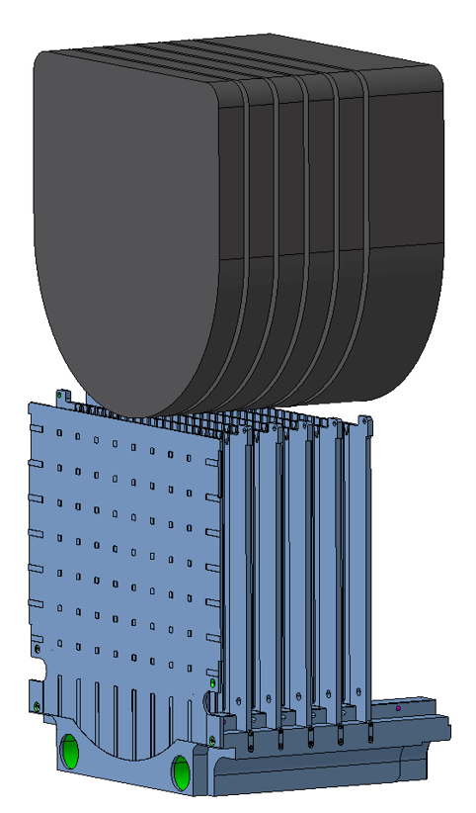
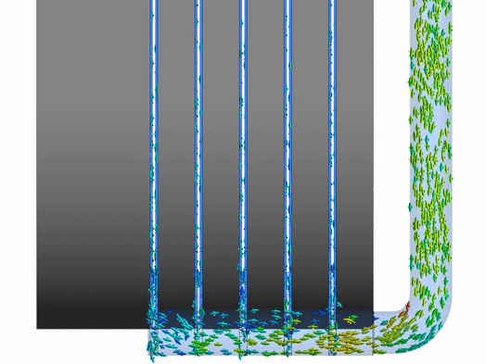
Facility upgrades – spallation target
50 mm
150 mm
N₂ gas cooling to avoid Pb corrosion and contamination of the cooling circuit
Al-6082-T6 supporting structure
(anti-creep and N₂ cooling channels)
See O. Aberle’s talk
Phys. Rev. Accel. Beams 24, 093001 (2021)

Slide 5
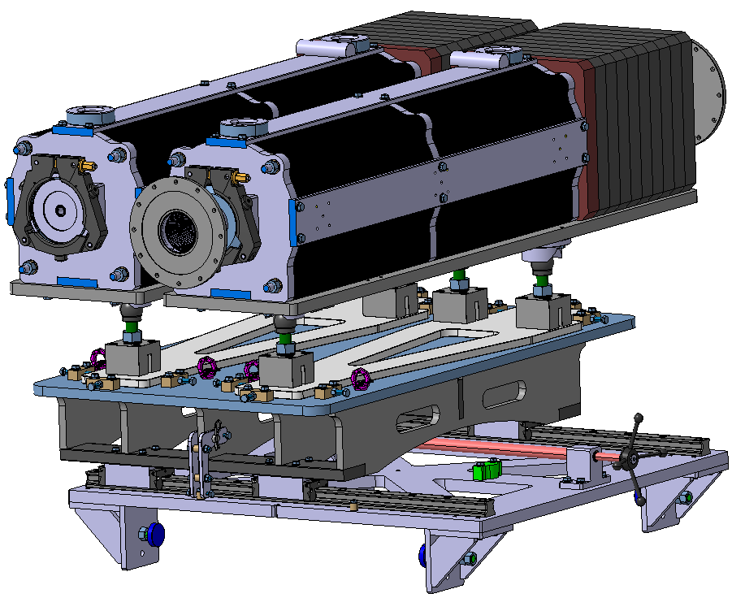
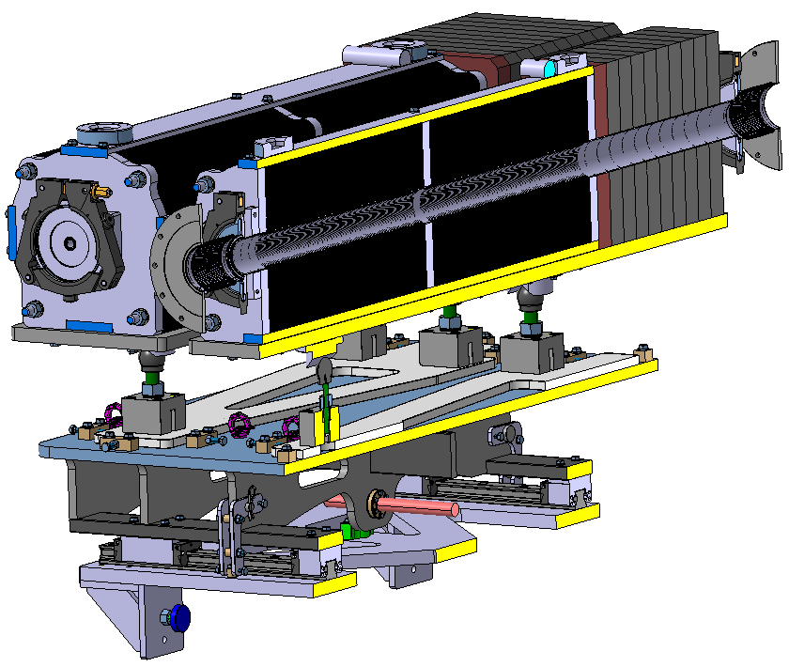
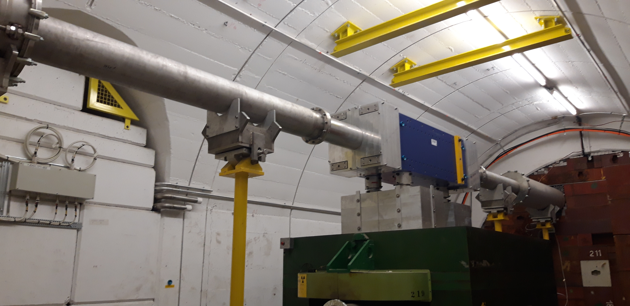
Facility upgrades – neutron line
2nd collimator
(reproducibility & faster)
Sweeping magnet from electro magnet to
Cobalt-Samarium permanent magnet
Borated PE
Carbon steel sheets, laser cut
Ø 20 mm
Vacuum chambers
Ø 80 mm
See O. Aberle‘s talk
Movement

Slide 6
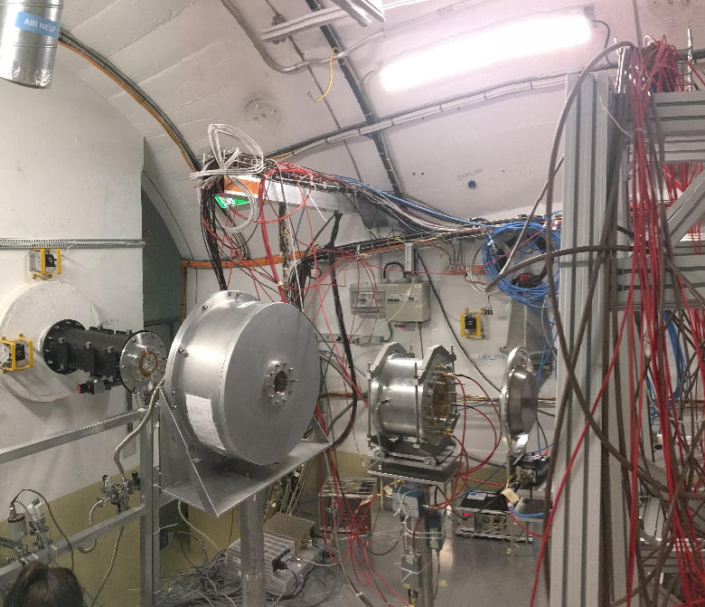
Flux setup
 | Reaction(s) | Mass (μg/cm²) | Energy RoI (eV)
SiMon | ⁶Li(n,α)³H | 600 (95% ⁶LiF) (± 20%) | 25⋅10⁻³ – 10⁶
PPACMon1 | 2x ²³⁵U(n,f) | 278.5 (± 1%) 298.4 (± 1%) | 25⋅10⁻³ 0.15⋅10⁶ – 10⁹
μMeGas | ¹⁰B(n,α)⁷Li ²³⁵U(n,f) | 24.5 (80% ¹⁰B₄C) (± 20%) 281.4 (± 1.1 μg/cm²) | 25⋅10⁻³ – 10⁶ 25⋅10⁻³ 0.15⋅10⁶ – 10⁹
PTB | 10x ²³⁵U(n,f) | 10x 444.3 (± 2%) | 25⋅10⁻³ 0.15⋅10⁶ – 10⁹
Gold | 2x ¹⁹⁷Au(n,γ) | 50 μm (upstream) 100 μm (downstream) | 4.9
PPACMon1 ²³⁵U
Neutrons
SiMon
⁶Li
μMeGas
²³⁵U & ¹⁰B
PTB
²³⁵U
+ Gold foil activation

Slide 7
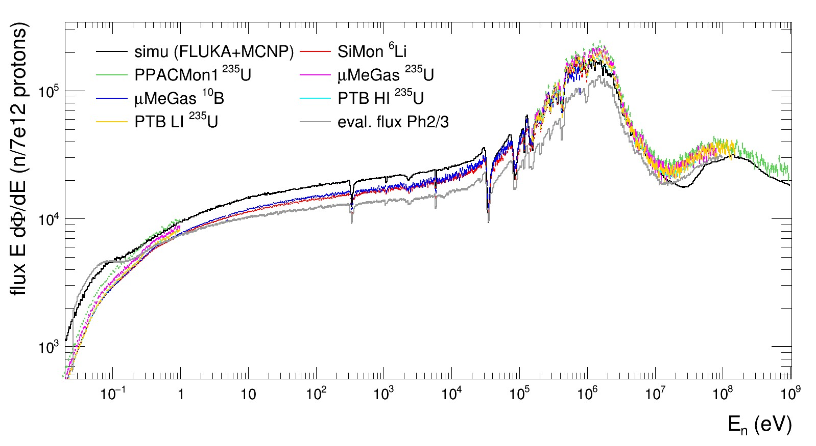


Extracted preliminary flux
Good detector agreement
Simulations under investigation
Gold foil activation analysis pending
 | SiMon | PPACMon1 | μMeGas | PTB | Gold
PSA |  |  |  |  | n/a
Gain drifts |  | n/a |  |  | n/a
Pile-Up |  |  |  |  | n/a
Efficiency
High Energy | n/a |  |  |  | n/a
Transmission | n/a
∼
∼
∼
∼
∼
Data: transmission correction pending
simulation vs. data:
collimator alignment
Geometry / B content

Slide 8
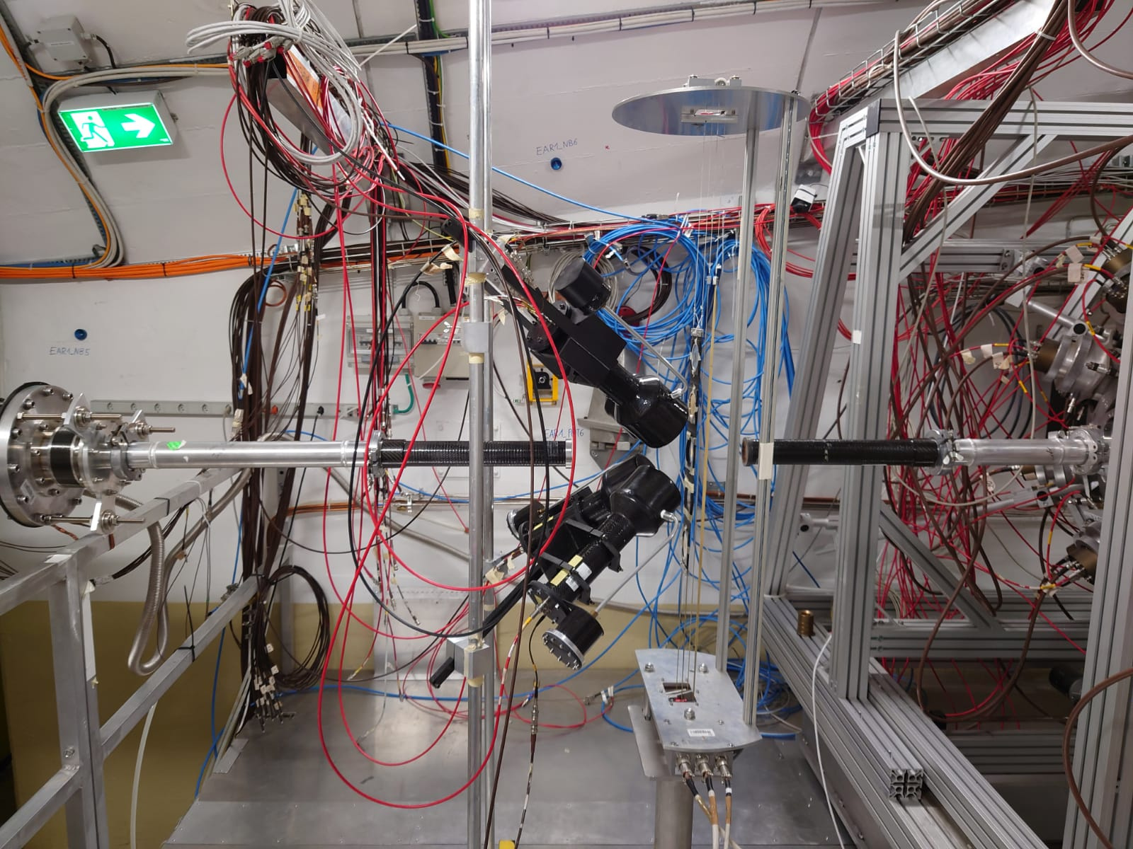
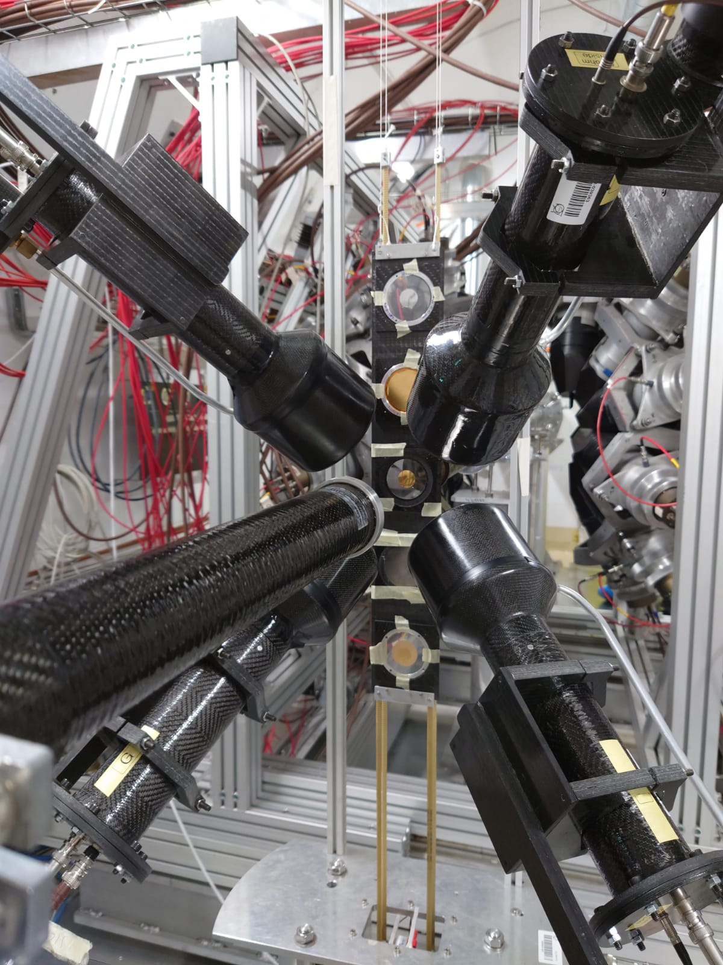
Resolution function – setup
4x C6D6 detectors

Slide 9
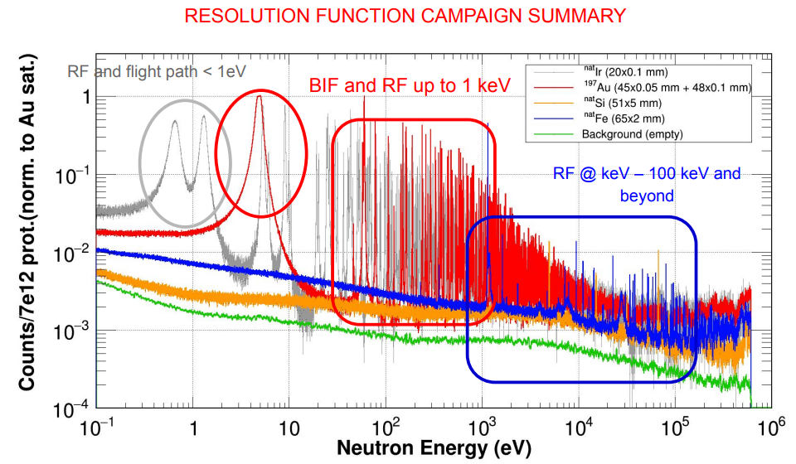
Resolution function – measurements

Slide 10
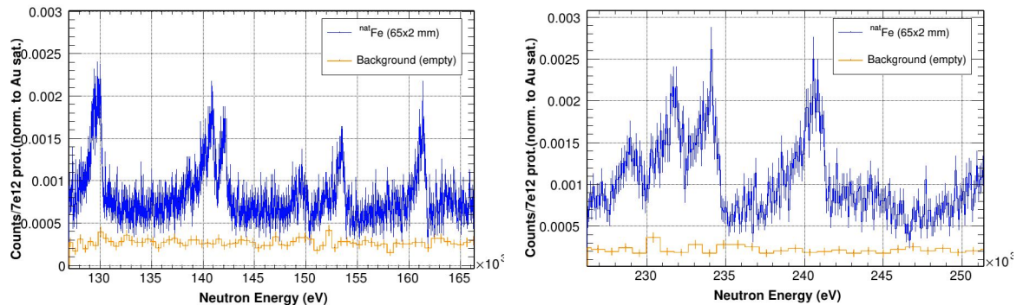
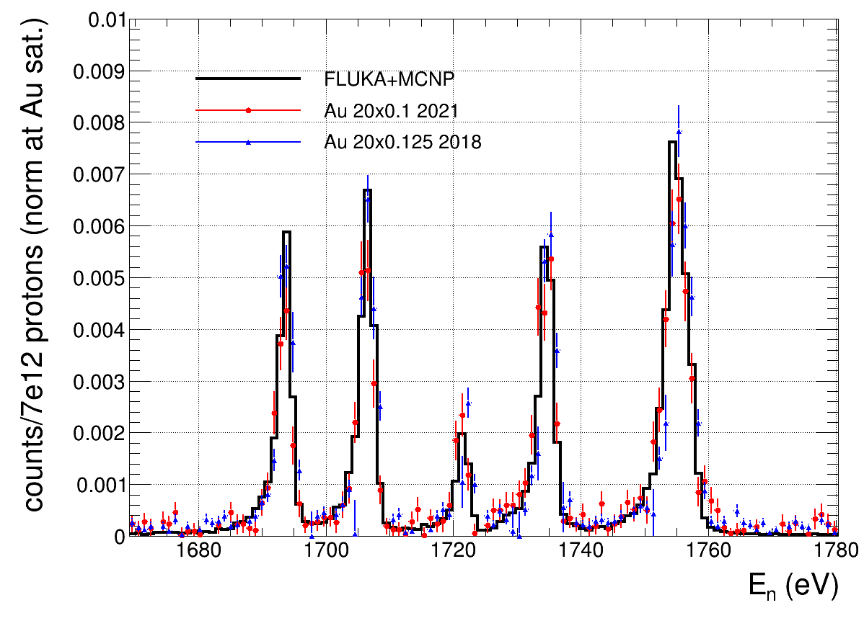
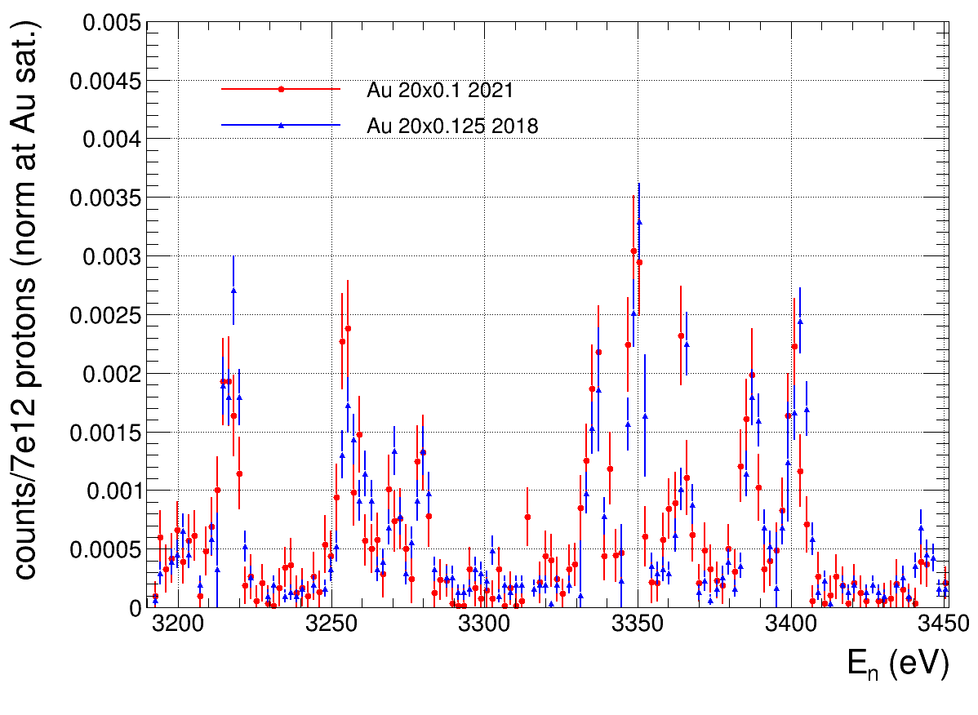
Resolution function – results
Analysis ongoing
  Gain calibrations done
  Flight path calibration ongoing
  Careful subtraction ongoing
  Preparation for SAMMY
  potentially before ND2022
First impression:
comparable with
previous target

Slide 11
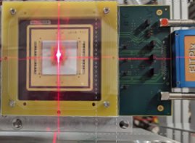
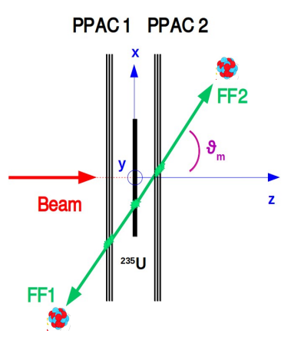
Profile – setup
X
Timepix Quad
  ~ 30x30 mm² active area → not covering full beam
  Sensitive to neutrons (> 1 MeV) and gammas
  TOF integrated (time delay/gating possible)
  Excellent for alignment
PPACMon1:
  Covering full beam
  Sensitive to neutrons only
  TOF/E_{n} selective
  Detector rotated with respect to world-axes

Slide 12
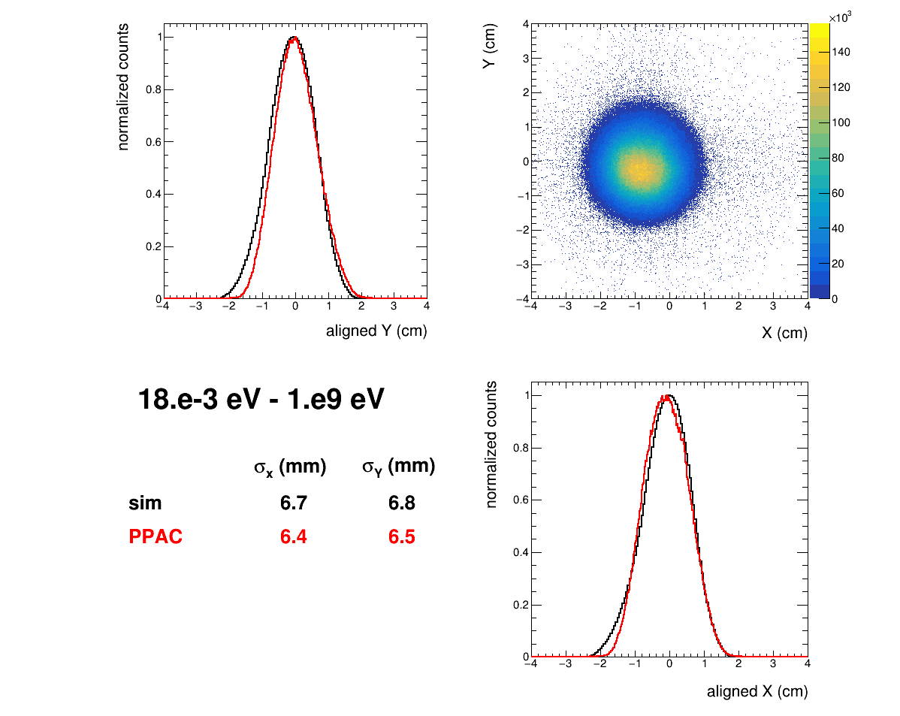
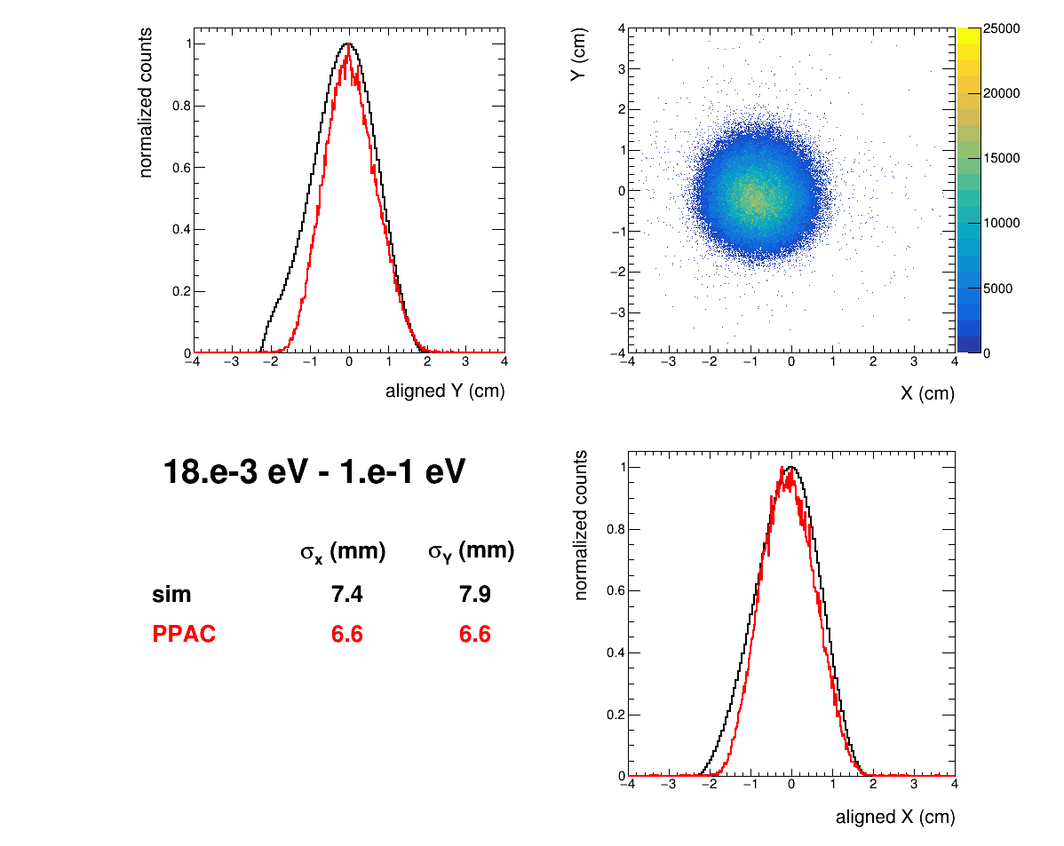
Profile – PPACMon1 ²³⁵U (target2)
*I am a GIF

Slide 13
Summary & outlook
Successful restart after long shutdown at CERN with
  New N₂ gas-cooled spallation target
  New permanent sweeping magnet and 2nd collimator for the neutron beam line
(A lot of) Commissioning data under analysis by several groups:
  Neutron flux: 4 detectors & 6 samples (Q4/2022*) + evaluation
  Resolution function: 4 detectors & 5 samples + SAMMY (Q4/2022*)
  Profile: 1 detector (2 samples) (Q4/2022*)
  + simulations (Q4/2022*)
Final results in dedicated publication ~Q2/2023*
*estimated

Slide 16
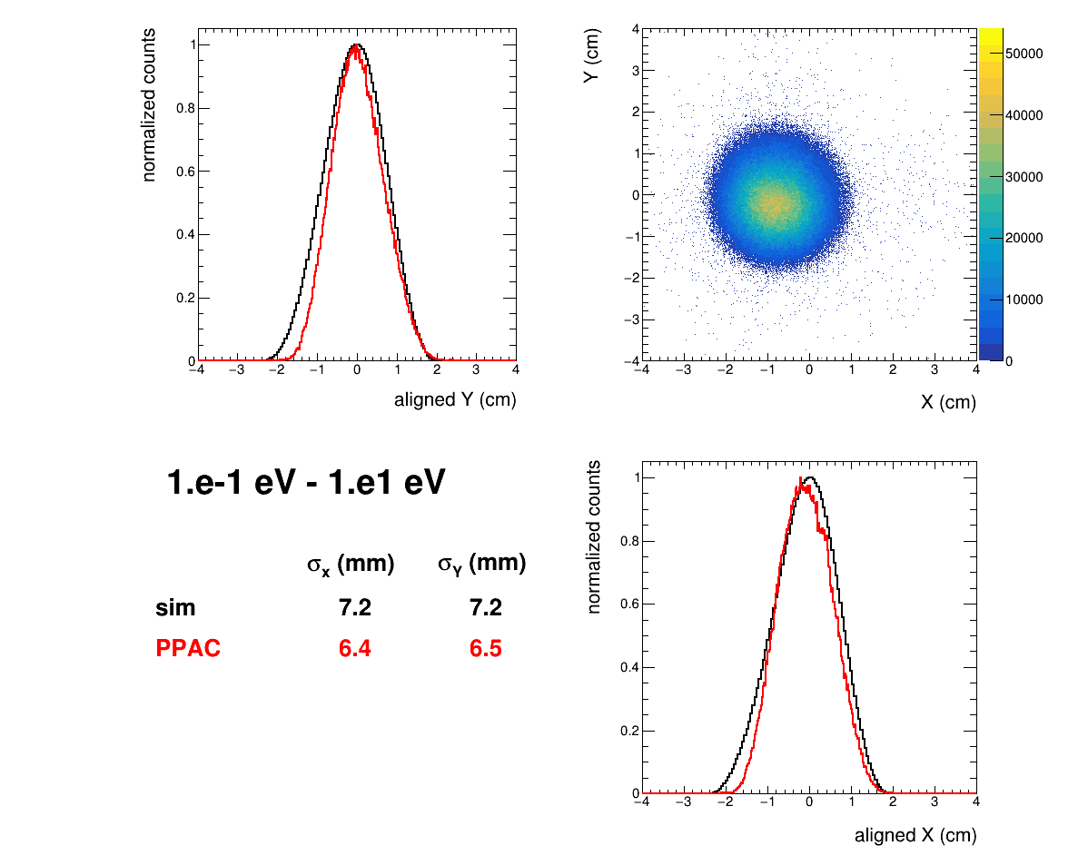
Profile – PPACMon1 ²³⁵U (target2)

Slide 17
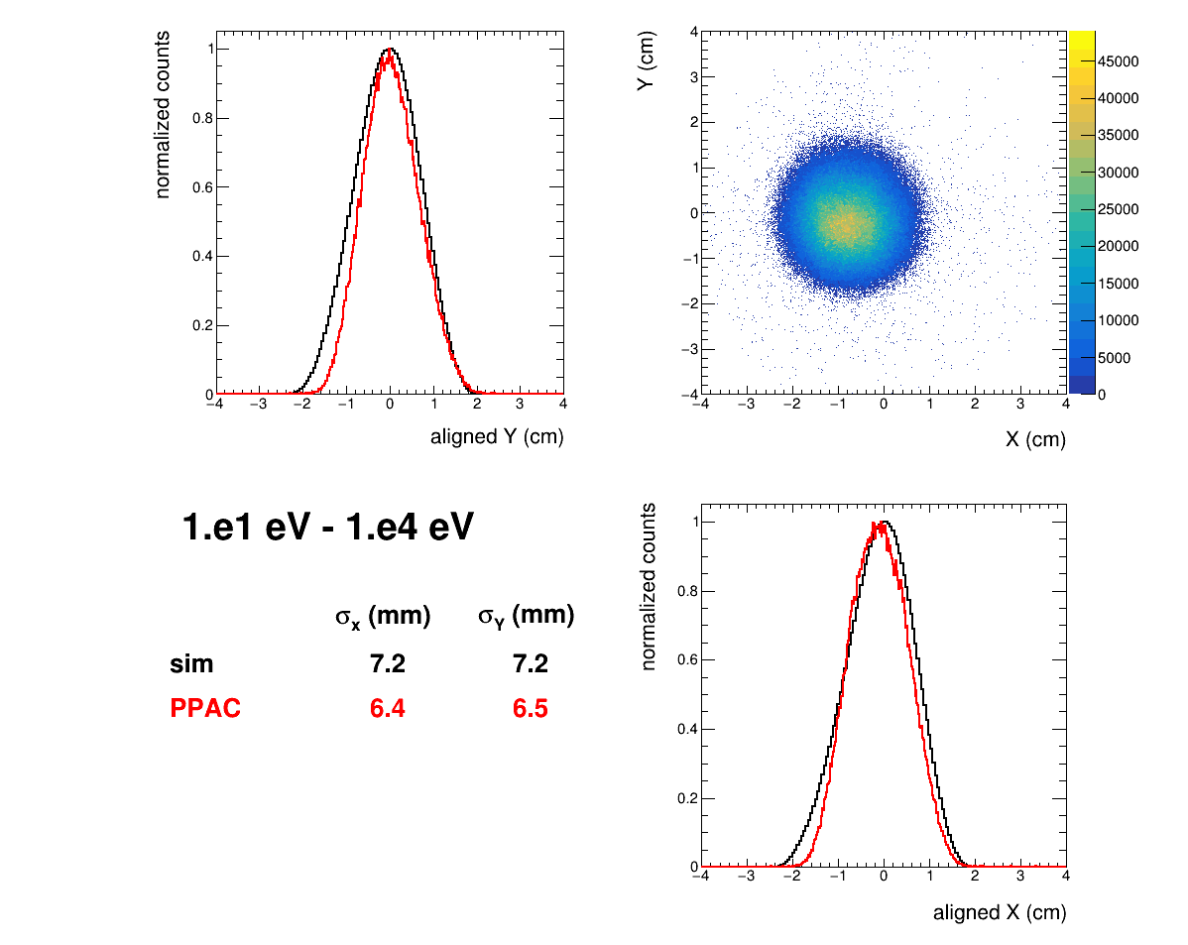
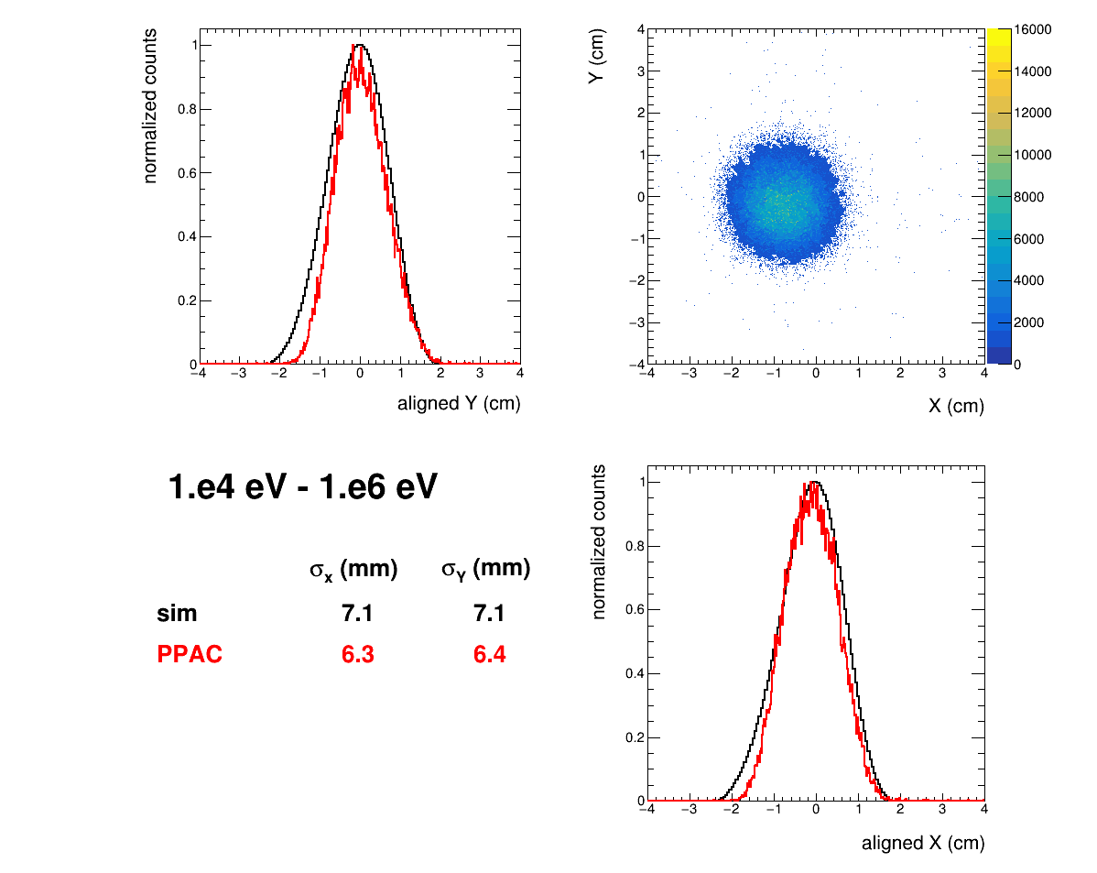
Profile – PPACMon1 ²³⁵U (target2)

Slide 18
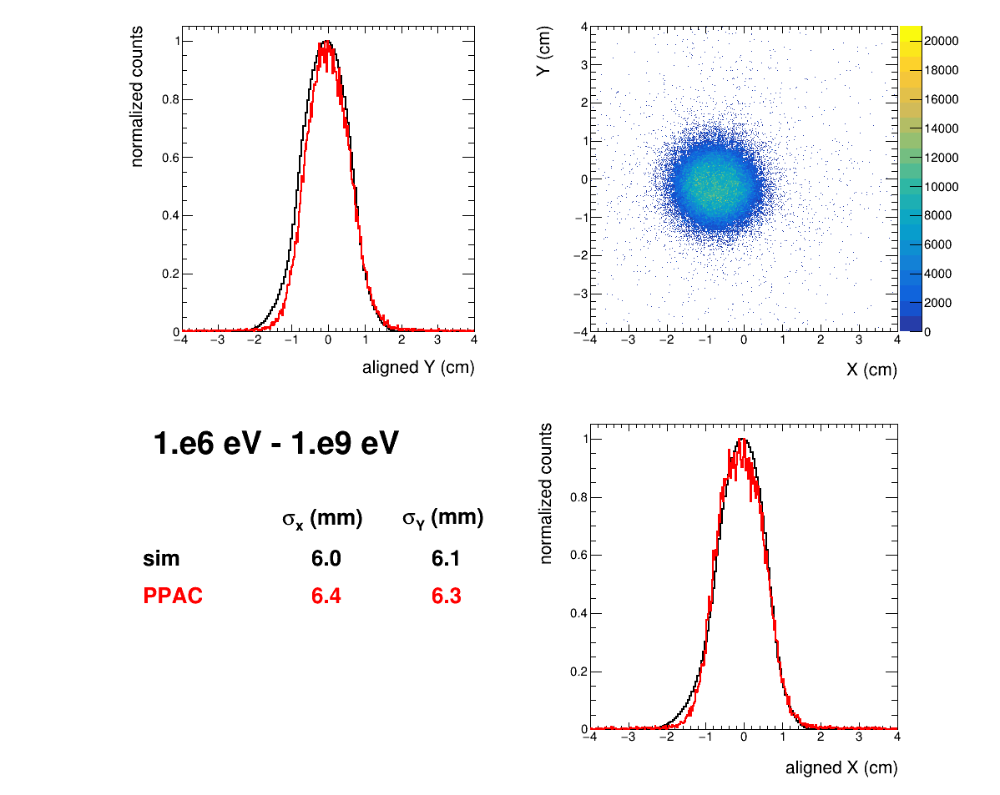
Profile – PPACMon1 ²³⁵U (target2)

Slide 19
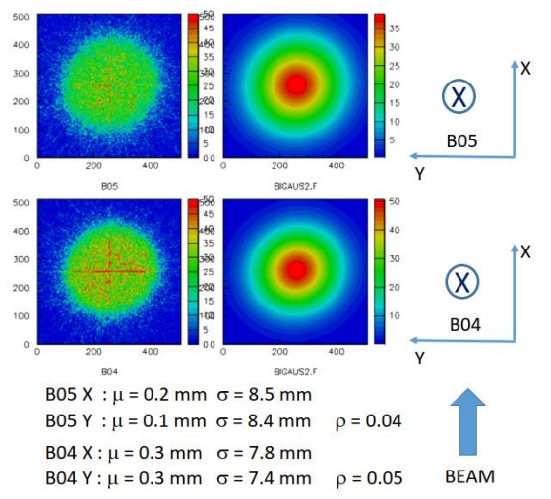
Profile – Timepix results
Sensitive to neutrons and gammas
TOF integrated
~188 m
~184 m

Slide 21
Flux analysis - corrections
 | SiMon | PPACMon1 | μMeGas | PTB | Gold
PSA |  |  |  |  | n/a
Gain drifts |  | n/a |  |  | n/a
Pile-Up |  |  |  |  | n/a
Efficiency
High Energy | n/a |  |  |  | n/a
Transmission | n/a
∼
∼
∼
∼
∼

