Slide 1



Update on the NEAR neutron flux measurement with ANTILoPE
A NeuTron multi-foIL sPEctometer
Pablo Pérez-Maroto, Carlos Guerrero and José M. Quesada
on behalf of Universidad de Sevilla, CIEMAT and the n_TOF Local Team.
The n_TOF Collaboration meeting. 30/05/2022

Slide 2
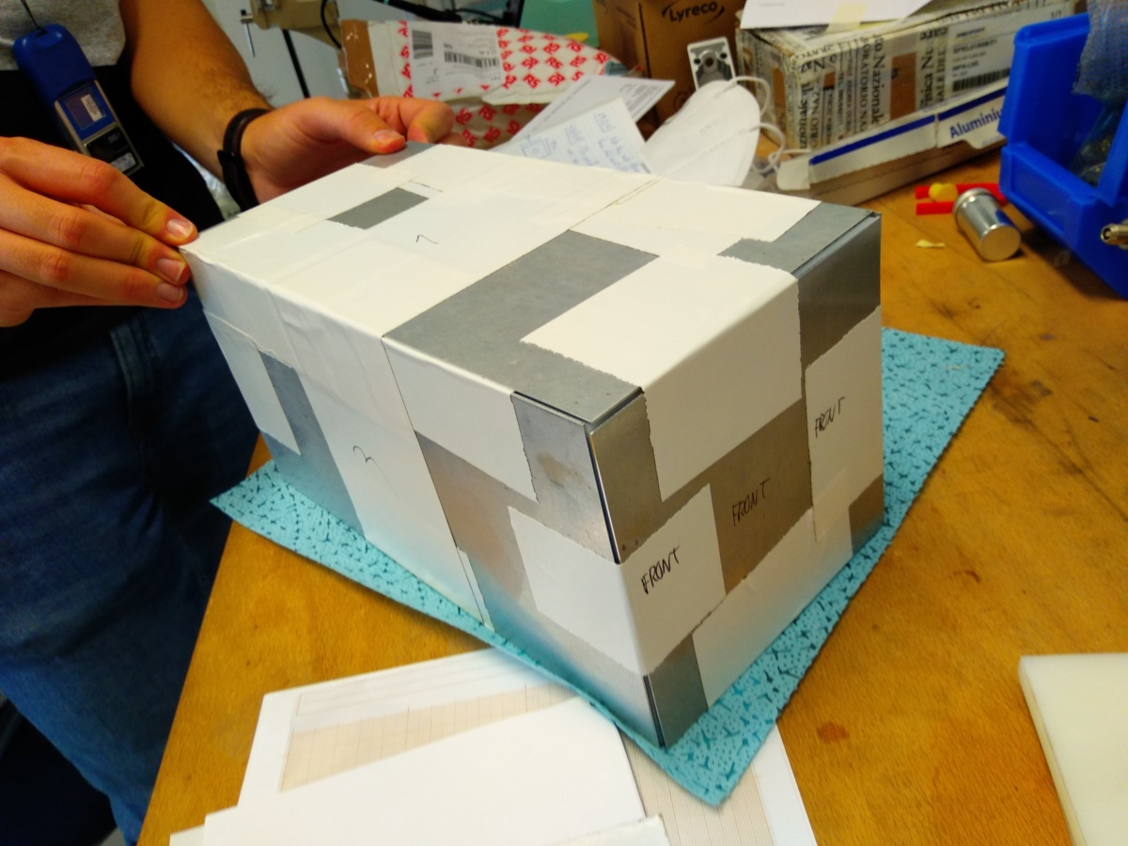
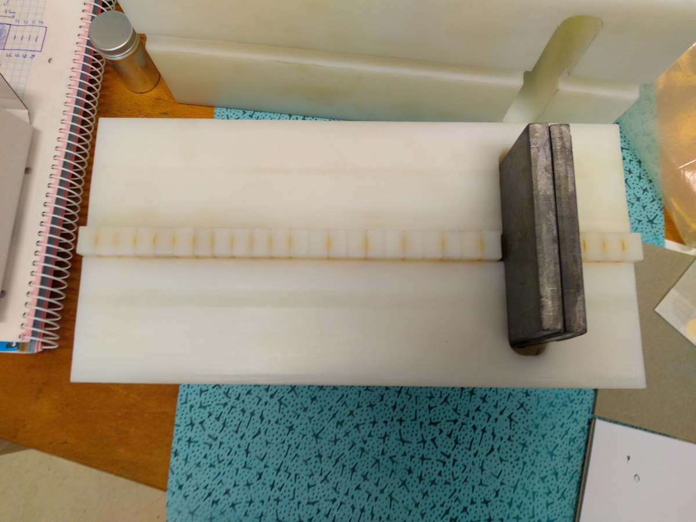
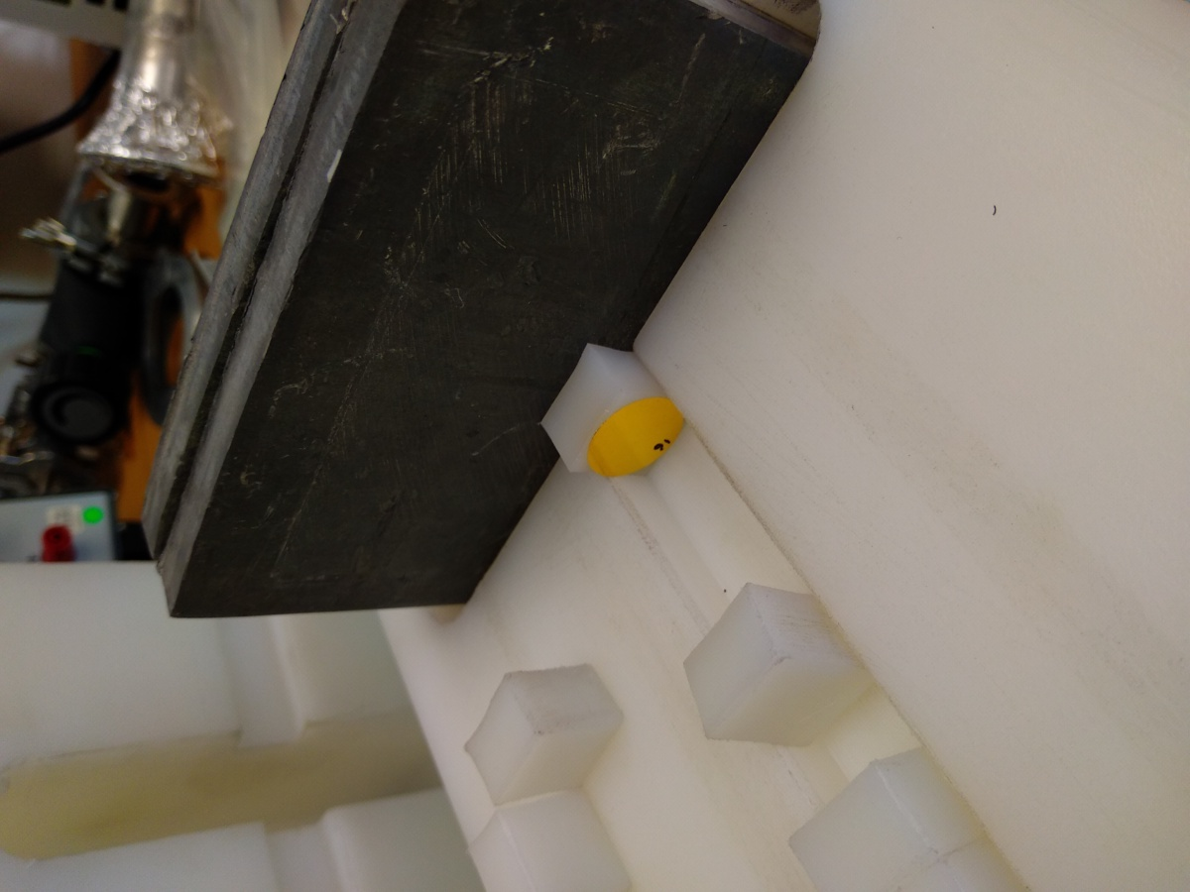
A neutron multi-foil spectrometer for NEAR
Neutrons
Fast-neutron Pb converter
Neutrons
Gold foils
Pablo Pérez Maroto || nTOF Collaboration Meeting || 30/05/2022

Slide 3
ANTILoPE response matrix with Geant4
ANTILoPE irradiated at n_TOF-NEAR in October 2021
Gold sample’s activities measured with USevilla’s LaBr3 + CAEN digitizer
Analyis ongoing with CERN’s RooUnfold
Pablo Pérez Maroto || nTOF Collaboration Meeting || 30/05/2022

Slide 4
We have investigated the effect on the results of several issues/inputs/choices
How critical is the dependence with
Neutron scattering background
New FLUKA simulations
Number of iterations
Number of foils
Initial guess
Binning
Deconvolution code
Pablo Pérez Maroto || nTOF Collaboration Meeting || 30/05/2022

Slide 5
We have investigated the effect on the results of several issues/inputs/choices
How critical is the dependence with
Neutron scattering background
New FLUKA simulations
Number of iterations
Number of foils
Initial guess
Binning
Deconvolution code
FLUKA simulations by J.A. Pavón & M. Sabaté
Pablo Pérez Maroto || nTOF Collaboration Meeting || 30/05/2022

Slide 6
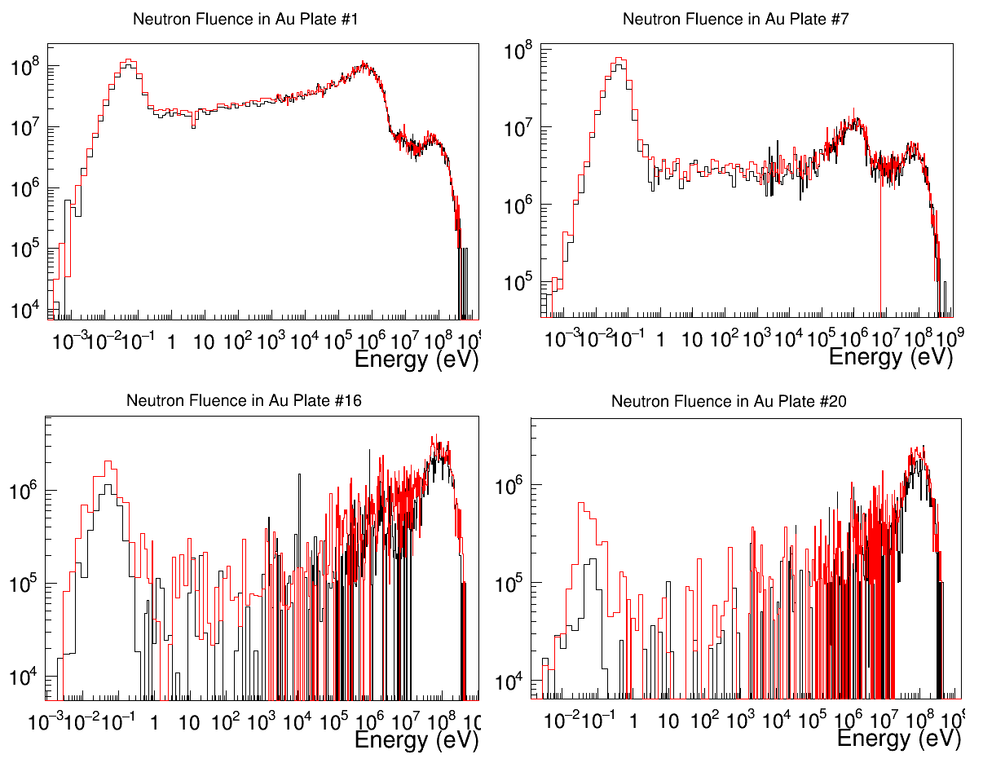
FLUKA simulations: J.A. Pavón & M. Sabaté
NEAR real geom.
Vacuum
NEAR real geom.
Vacuum
NEAR real geom.
Vacuum
NEAR real geom.
Vacuum
Pablo Pérez Maroto || nTOF Collaboration Meeting || 30/05/2022

Slide 7
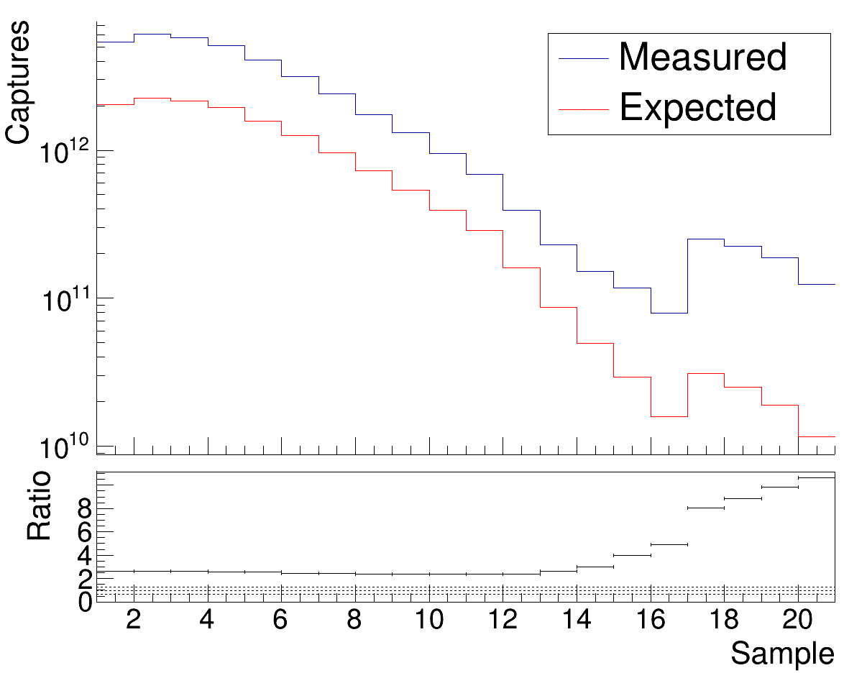
Difference in Au activation by scattered neutrons
Ratio between 2.5 & 9
Pablo Pérez Maroto || nTOF Collaboration Meeting || 30/05/2022

Slide 8
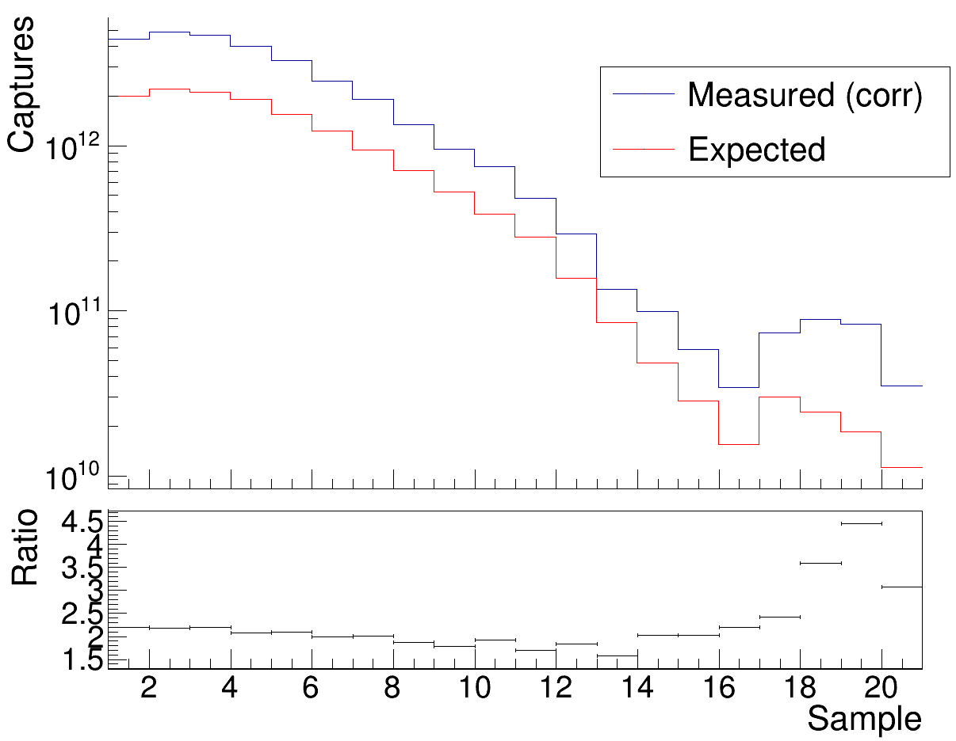
Difference in Au activation by scattered neutrons
Correction by the contribution of scattered neutrons
Ratio between 2.5 & 9
Ratio between 2 & 4.5
Pablo Pérez Maroto || nTOF Collaboration Meeting || 30/05/2022

Slide 9

We have investigated the effect on the results of several issues/inputs/choices
How critical is the dependence with
Neutron scattering background
New FLUKA simulations
Number of iterations
Number of foils
Initial guess
Binning
Deconvolution code
Succesfully corrected
Nº of captures higher than expected
Pablo Pérez Maroto || nTOF Collaboration Meeting || 30/05/2022

Slide 10
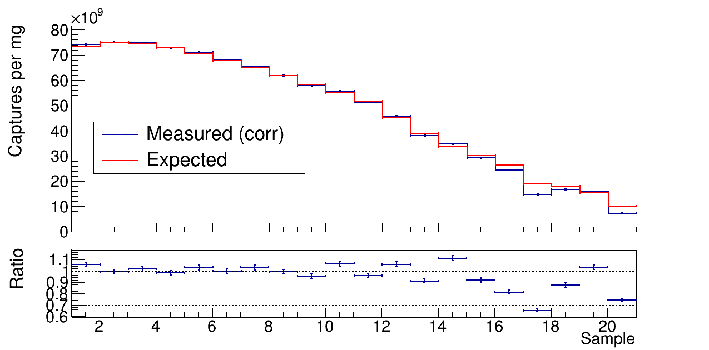
Then: updated FLUKA simulations by M. Cecchetto
New FLUKA simulations by M. Cecchetto available
With the updated expected flux together with the background correction the measured values match with the expected ones: better than 5% in the first 14 samples!
±5%
Pablo Pérez Maroto || nTOF Collaboration Meeting || 30/05/2022

Slide 11
We have investigated the effect on the results of several issues/inputs/choices
How critical is the dependence with
Neutron scattering background
New FLUKA simulations
Number of iterations
Number of foils
Initial guess
Binning
Deconvolution code
Succesfully corrected
Succesfully corrected
Effects in the unfolding
Pablo Pérez Maroto || nTOF Collaboration Meeting || 30/05/2022

Slide 12
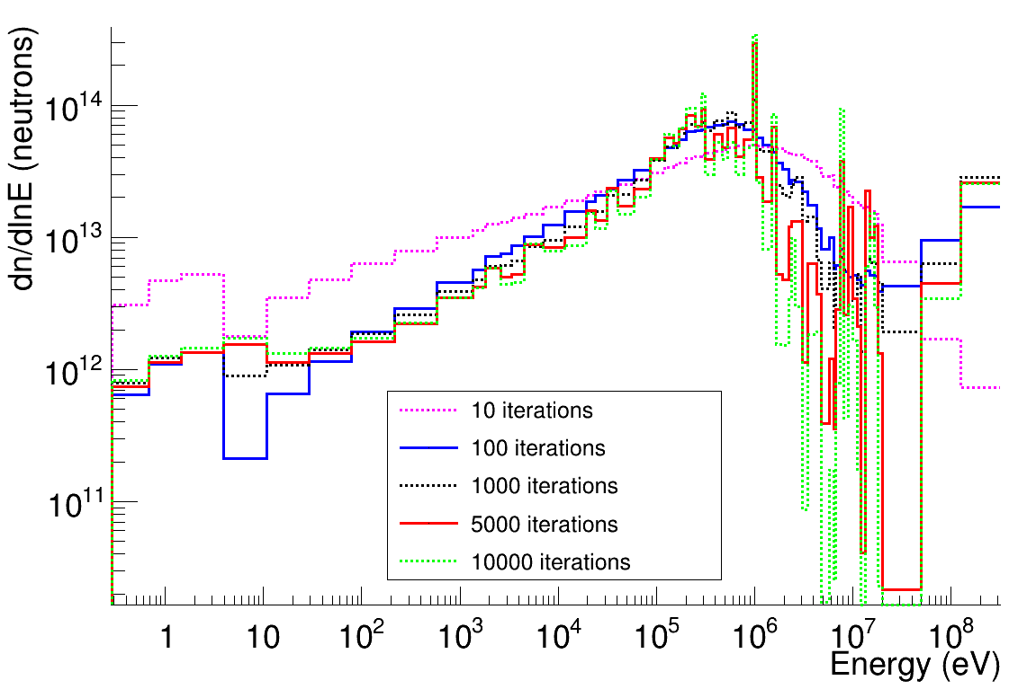
Effect of # iterations
Stabilization of the eV-MeV range after 100 iterations
Large fluctuations in the above 1 MeV, optimum choice?
Pablo Pérez Maroto || nTOF Collaboration Meeting || 30/05/2022

Slide 13
We have investigated the effect on the results of several issues/inputs/choices
How critical is the dependence with
Neutron scattering background
New FLUKA simulations
Number of iterations
Number of foils
Initial guess
Binning
Deconvolution code
Succesfully corrected
Succesfully corrected
Studied, not clear conclusions
Effects in the unfolding
Pablo Pérez Maroto || nTOF Collaboration Meeting || 30/05/2022

Slide 14
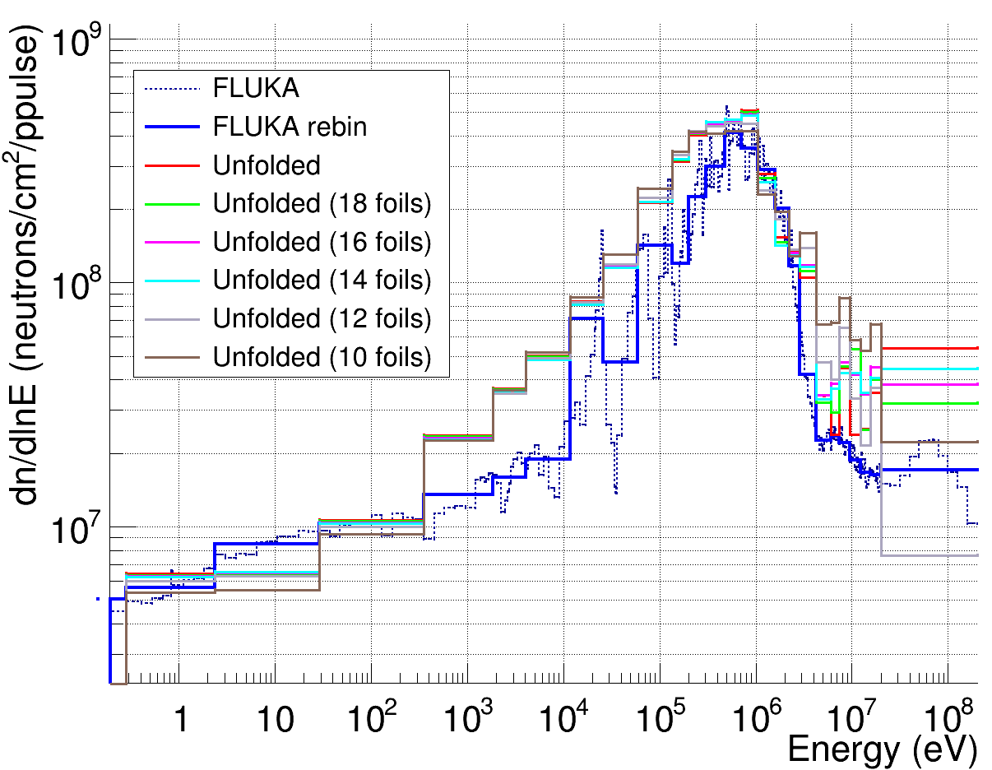
Effect of # foils
Removal of up to 10 downtream foils affects only above 5 MeV, and very significantly above 20 MeV
Pablo Pérez Maroto || nTOF Collaboration Meeting || 30/05/2022

Slide 15
We have investigated the effect on the results of several issues/inputs/choices
How critical is the dependence with
Neutron scattering background
New FLUKA simulations
Number of iterations
Number of foils
Initial guess
Binning
Deconvolution code
Succesfully corrected
Succesfully corrected
Studied, not clear conclusions
Stable results below ~5-10 MeV
No effects in the unfolding
Pablo Pérez Maroto || nTOF Collaboration Meeting || 30/05/2022

Slide 16
We have investigated the effect on the results of several issues/inputs/choices
How critical is the dependence with
Neutron scattering background
New FLUKA simulations
Number of iterations
Number of foils
Initial guess
Binning
Deconvolution code
Succesfully corrected
Succesfully corrected
Studied, not clear conclusions
Stable results below ~5-10 MeV
Does not affect the results
Ongoing
Pablo Pérez Maroto || nTOF Collaboration Meeting || 30/05/2022

Slide 17
We have investigated the effect on the results of several issues/inputs/choices
How critical is the dependence with
Neutron scattering background
New FLUKA simulations
Number of iterations
Number of foils
Initial guess
Binning
Deconvolution code
Succesfully corrected
Succesfully corrected
Studied, not clear conclusions
Stable results below ~5-10 MeV
Does not affect the results
Ongoing
Others to be tested
Pablo Pérez Maroto || nTOF Collaboration Meeting || 30/05/2022

Slide 18
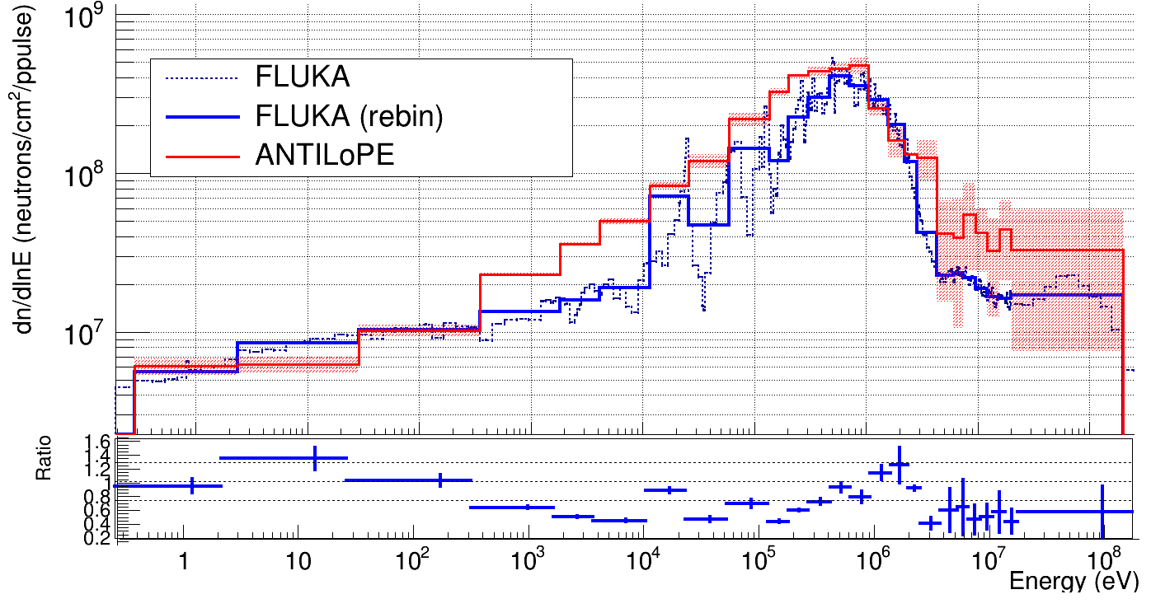
NEAR flux with ANTILoPE
Pablo Pérez Maroto || nTOF Collaboration Meeting || 30/05/2022

Slide 19

CEIDEN Grupo de Usuarios Neutrónicos meeting @CNA, 8-9 June 2022
The meeting will connect basic nuclear physics groups with others working on neutron dosimetry, medical physics, engineering and other applications.
Several groups use deconvolution codes for dosimetry and use Bonner Spheres, we hope to share our experience and doubts to get some defintive answer to (some of) the open questions just discussed.
Pablo Pérez Maroto || nTOF Collaboration Meeting || 30/05/2022

Slide 20
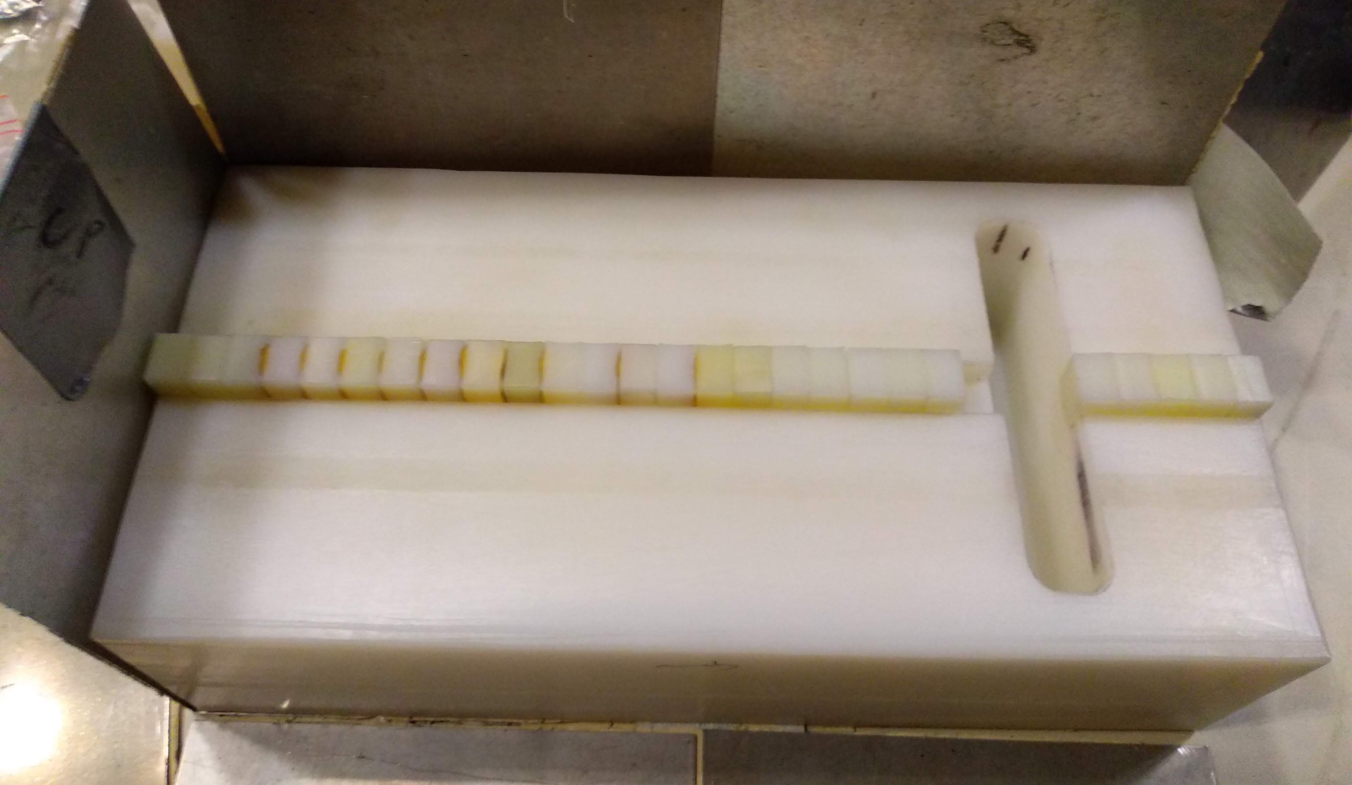
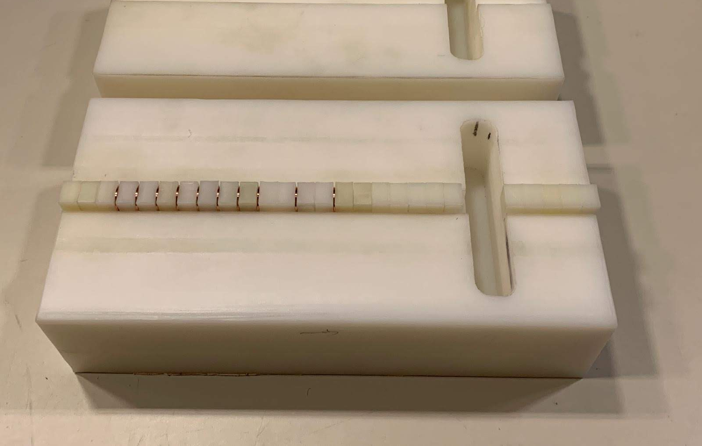
Simplified design test at HiSPANoS@CNA
Changes in the set-up
No need for the Pb converter
Removal of the first 2 foils and the last 8
Test of target material: the strong 5 eV ¹⁹⁷Au resonance may make gold a not optimal choice => test of Cu for producing ⁶⁴Cu(β⁺; 12,7h)
Goals:
Irradiate with epithermal (1-100 keV) and mono-energetic fast (4,6 MeV) fluxes to test the sensibility of ANTILoPE.
Irradiation at HiSPANoS last week: results soon!
20 um Au foils
1 mm Cu foils
Pablo Pérez Maroto || nTOF Collaboration Meeting || 30/05/2022

Slide 21
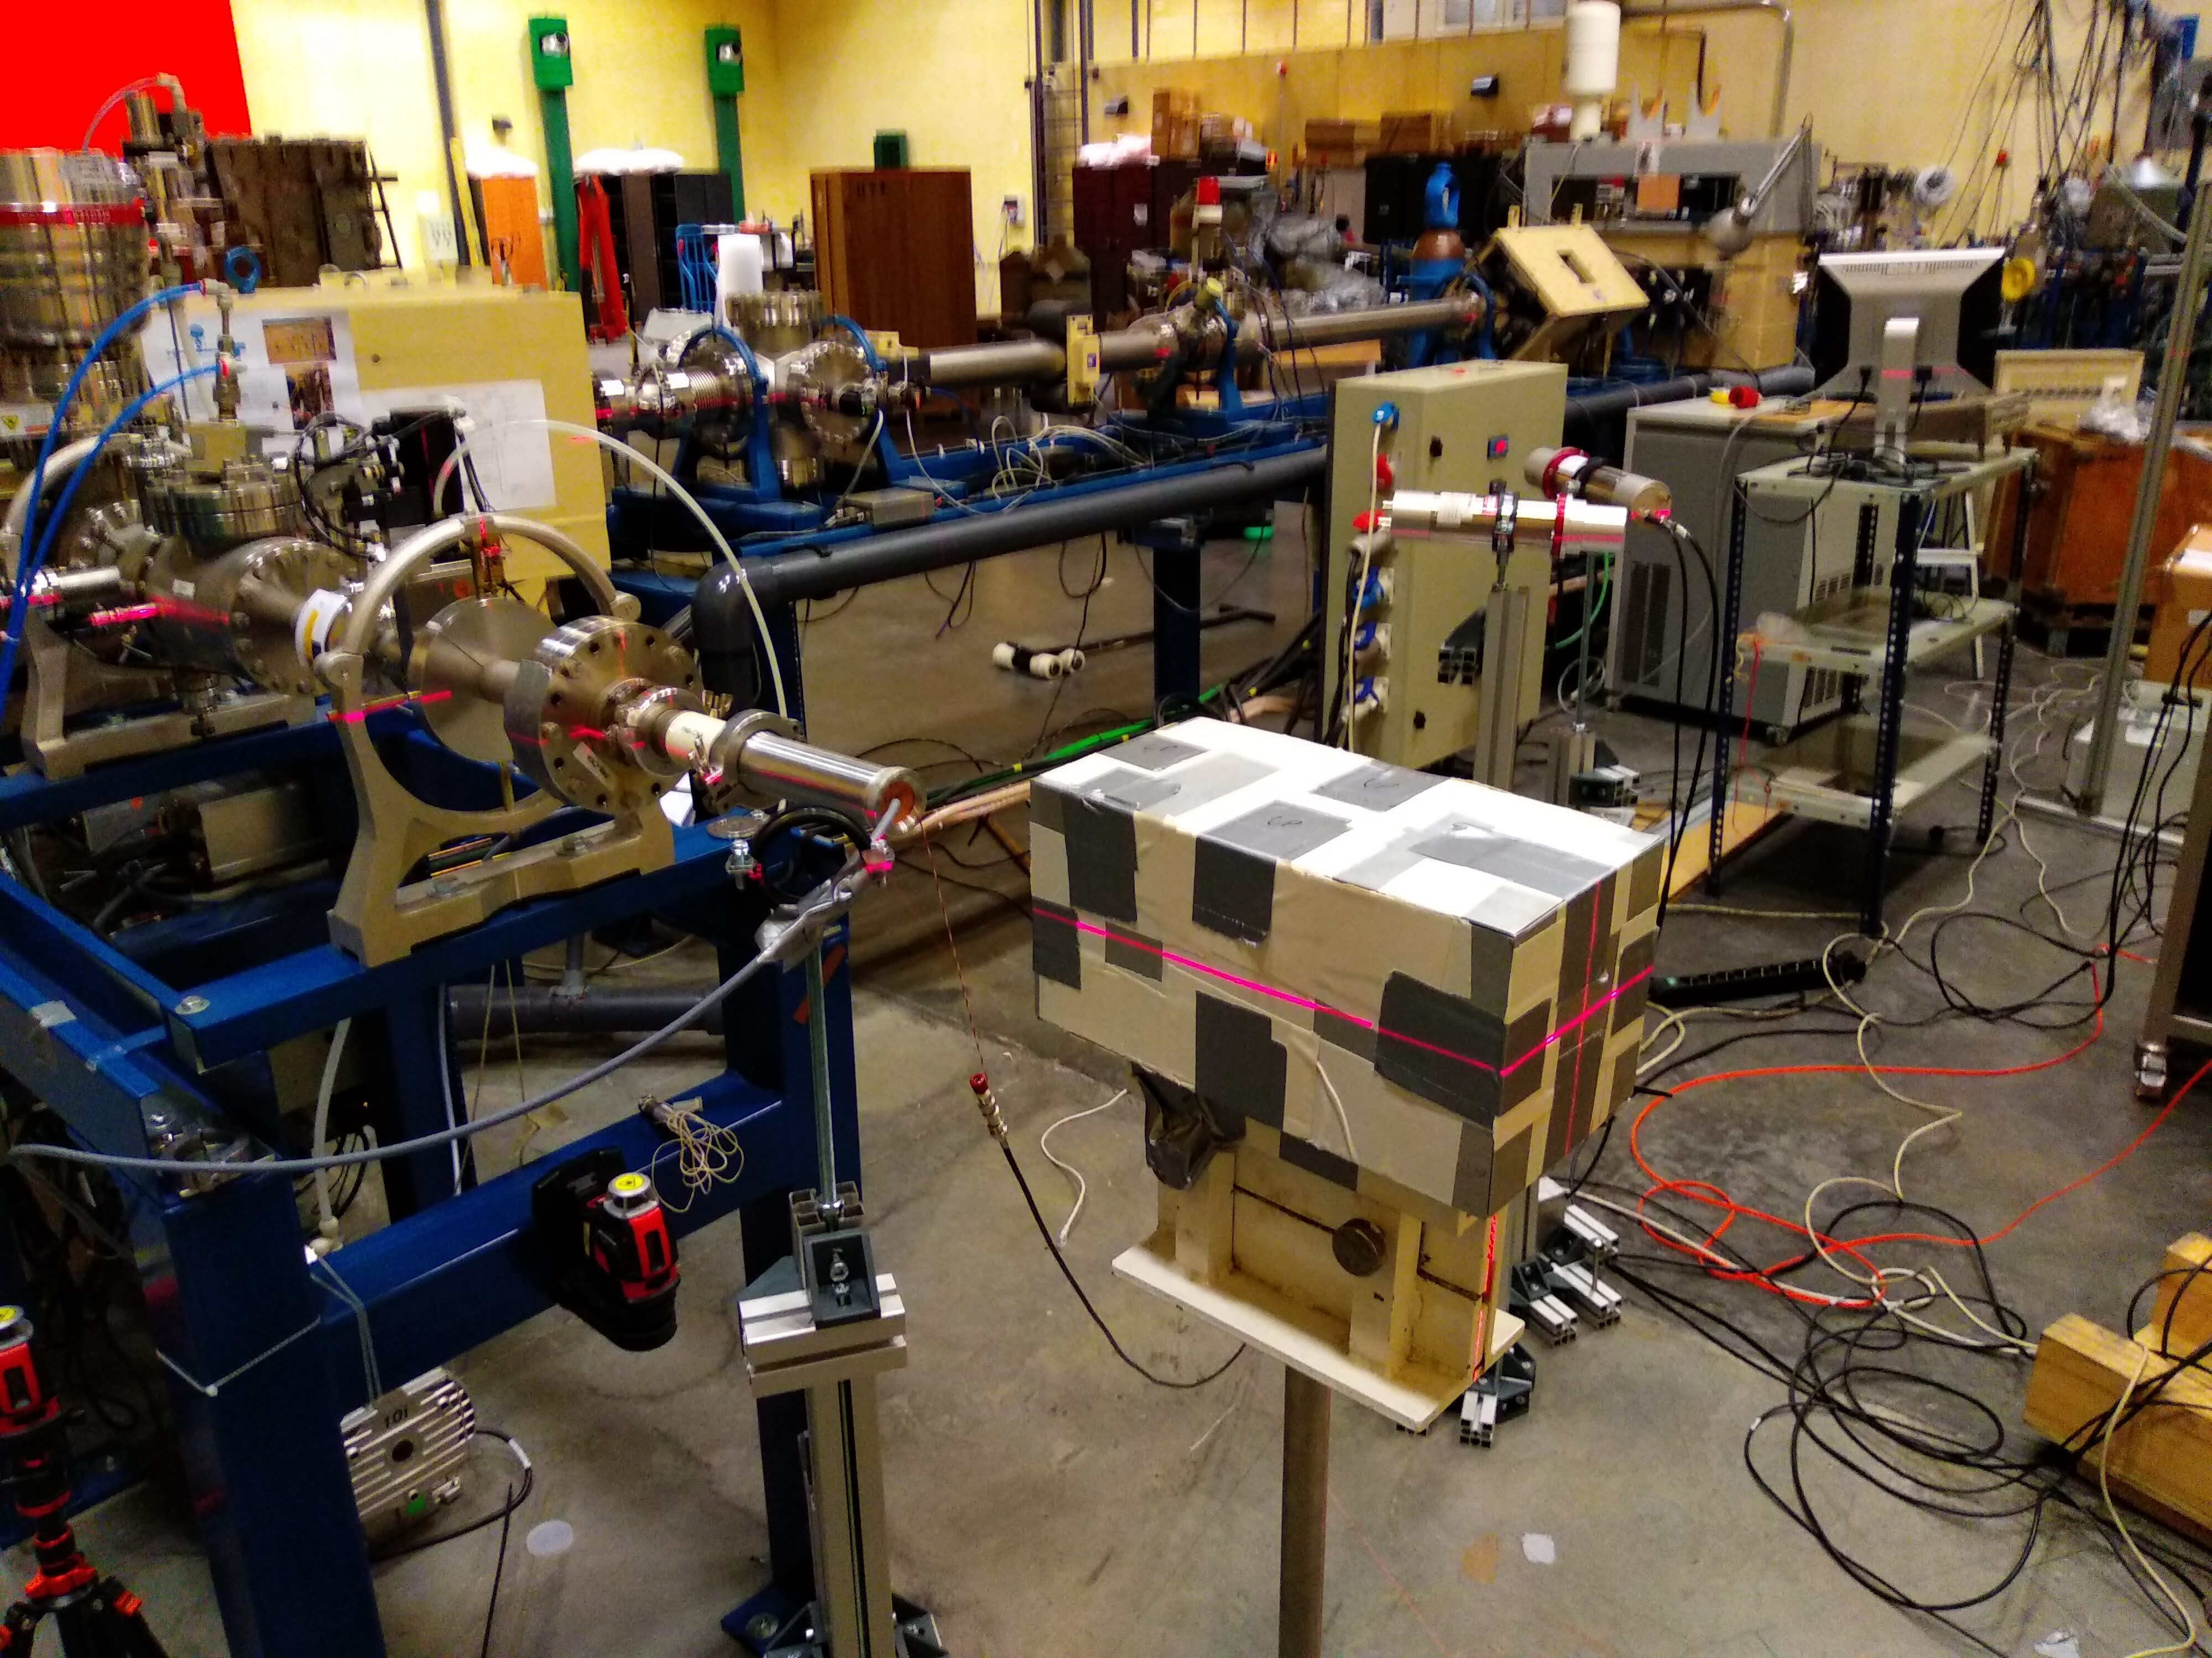
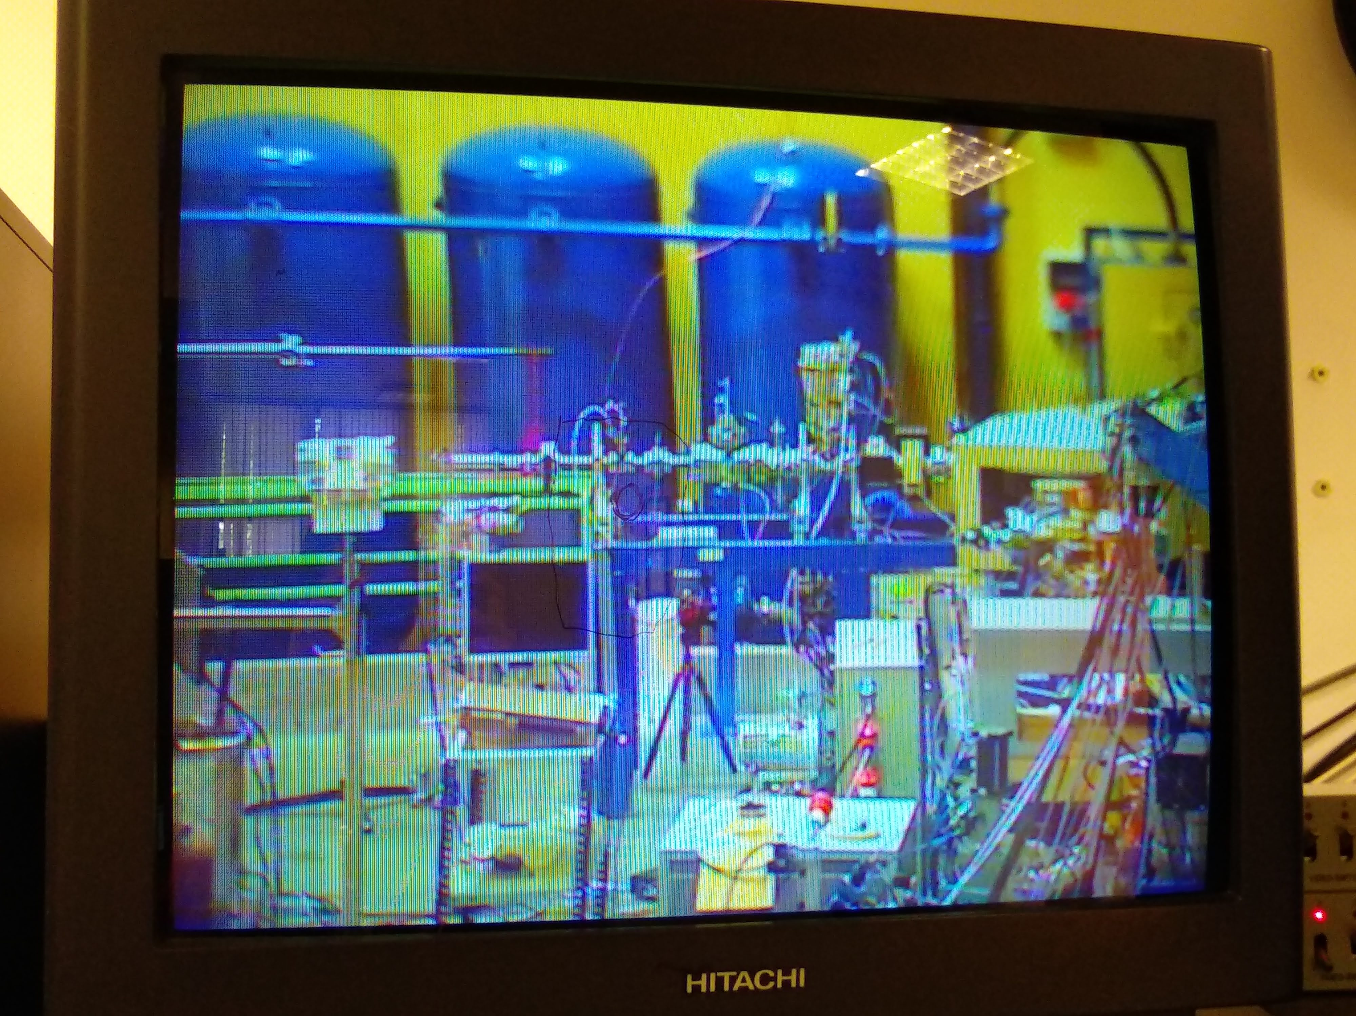
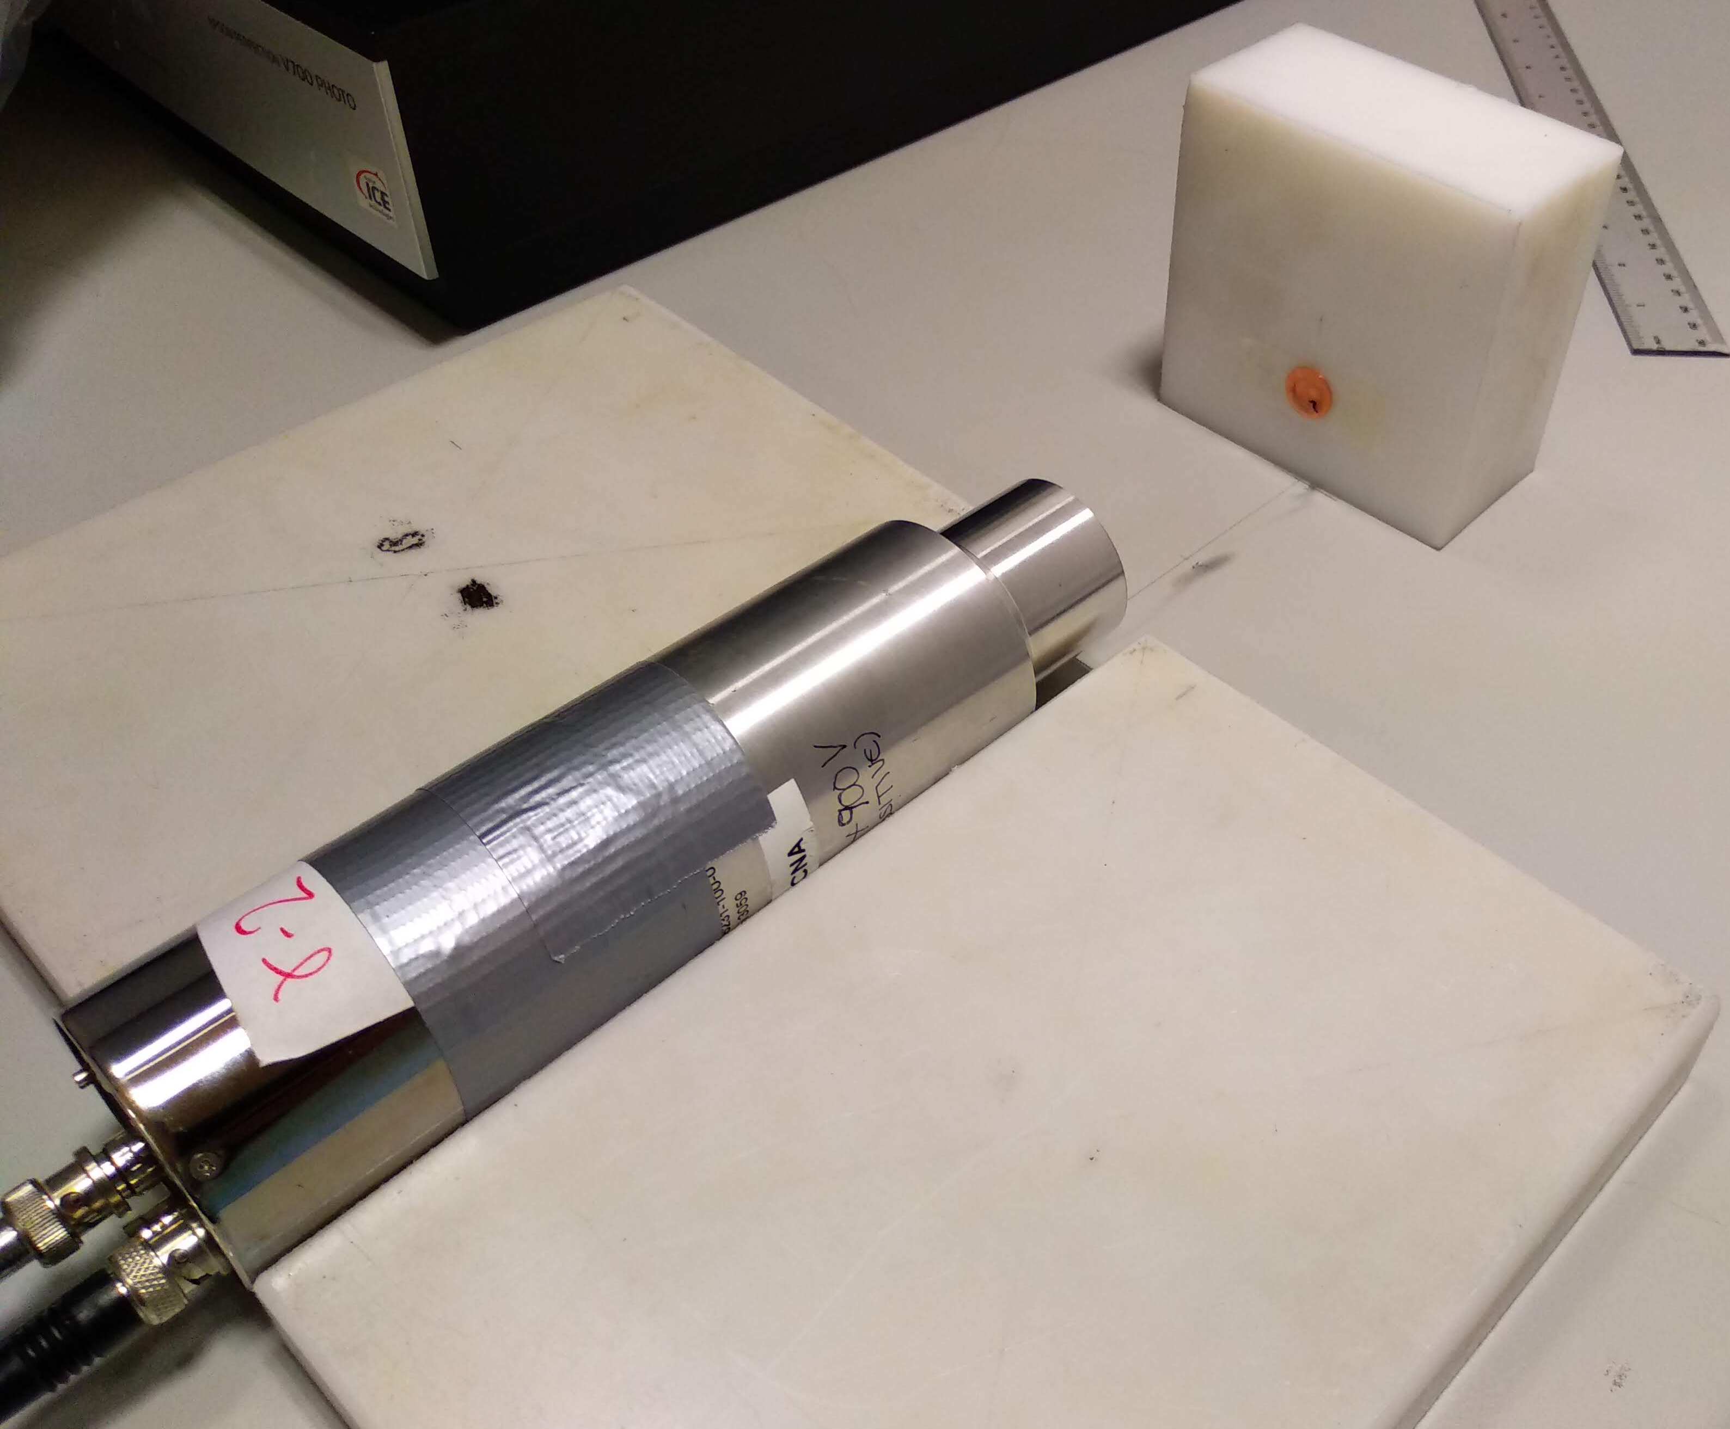
Simplified design test at HiSPANoS@CNA
Changes in the set-up
No need for the Pb converter
Removal of the first 2 foils and the last 8
Test of target material: the strong 5 eV ¹⁹⁷Au resonance may make gold a not optimal choice => test of Cu for producing ⁶⁴Cu(β⁺; 12,7h)
Goals:
Irradiate with epithermal (1-100 keV) and mono-energetic fast (4,6 MeV) fluxes to test the sensibility of ANTILoPE.
Irradiation at HiSPANoS last week: results soon!
Pablo Pérez Maroto || nTOF Collaboration Meeting || 30/05/2022

Slide 22
Summary & Conclusions
ANTILoPE: designed in 2021 for measuring the neutron flux at NEAR
Measurements were succesfully perfomed at both NEAR and EAR-2 in 2021
New FLUKA simulations of NEAR flux => estim./meas. # captures agree within ±5%
Effect of the scattered neutrons with FLUKA => affects the E_{n}>10 MeV mainly
Effect of the choice of # iterations and # foils: reasonable results
Study of binning dependence: ongoing
Test others unfolding codes pending: coming soon
Meanwhile, simplified design and irradiation at HiSPANoS@CNA
Epithermal neutrons (1912 keV proton on LiF target): quasimaxwellian of ~ 30 keV
Mono-energetic fast neutrons (d-D producing 4,6 MeV neutrons)
Analysis ongoing
RooUnfold is a “black box” for us. Looking forward to CEIDEN-GUN meeting in June to improve our understanding
Pablo Pérez Maroto || nTOF Collaboration Meeting || 30/05/2022

Slide 23
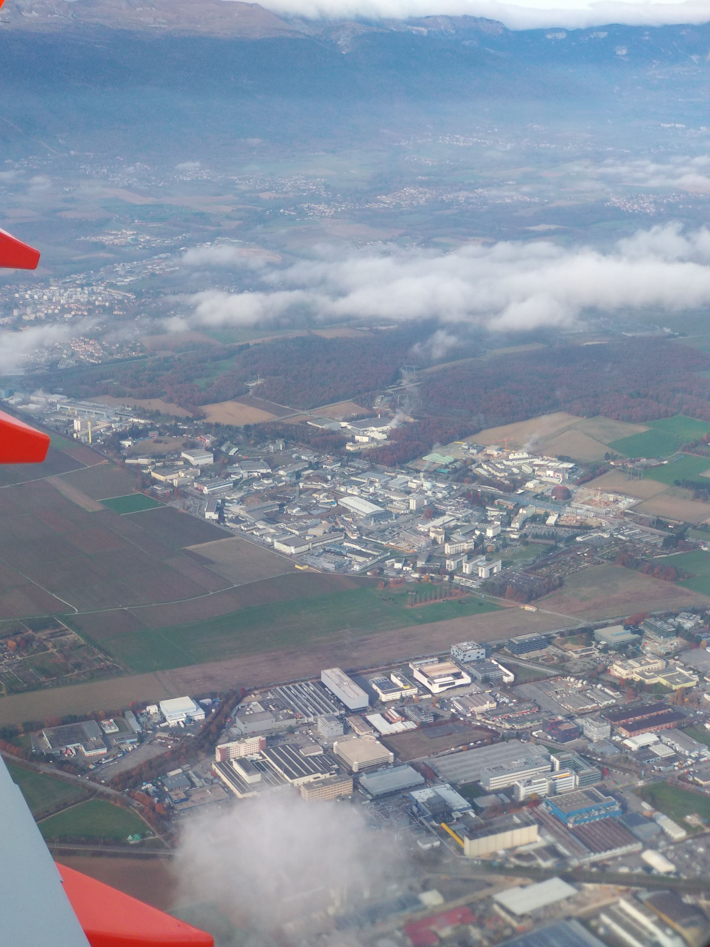
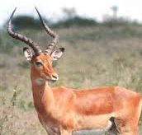
Thank you!
Pablo Pérez Maroto || nTOF Collaboration Meeting || 30/05/2022

Slide 24
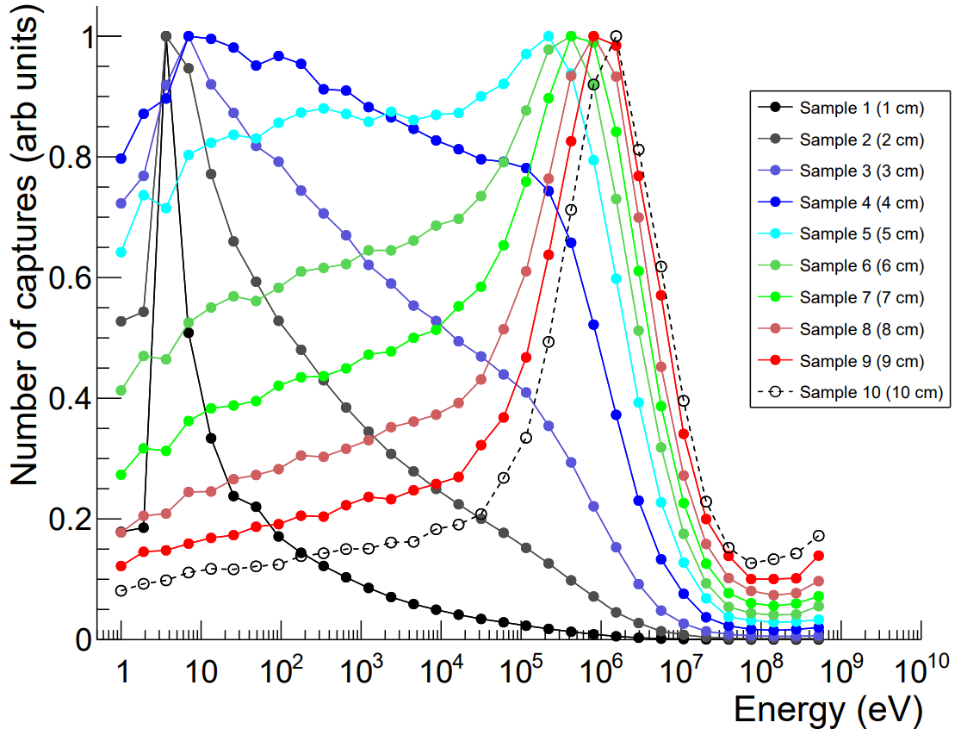
Sensitivity according to the position inside the block
Simulated with Geant4 & G4NeutronHPThermal physics
The first two samples respond mainly to the 5 eV resonance
No peaks in the keV region, but the response is different enough for unfolding
Well defined response peaks around the MeV region
Pablo Pérez Maroto || nTOF Collaboration Meeting || 30/05/2022
Notes:
We simulate the activation with the equation seen earlier, and we can see very well the different response of the foils
What we see in the keV region is the same that happens with Bonner Sphere
Simulations benchmarked with MCNP

Slide 25
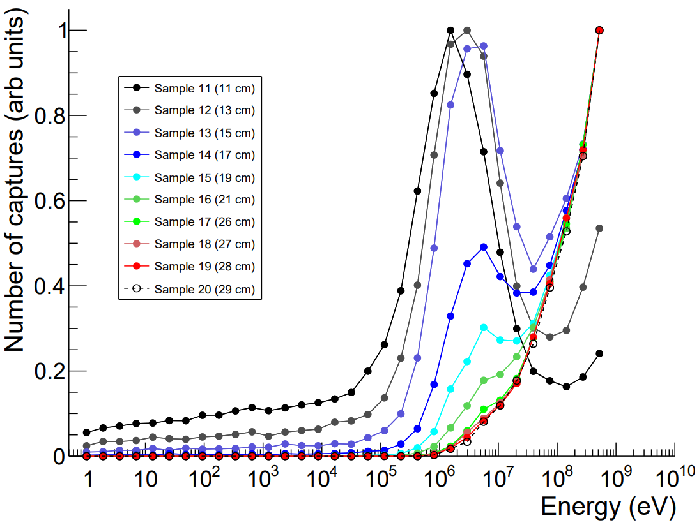
Sensitivity according to the position inside the block
Some limitations around the 100 MeV region
Thanks to the Pb we improve a lot the last bins
Pablo Pérez Maroto || nTOF Collaboration Meeting || 30/05/2022

Slide 26
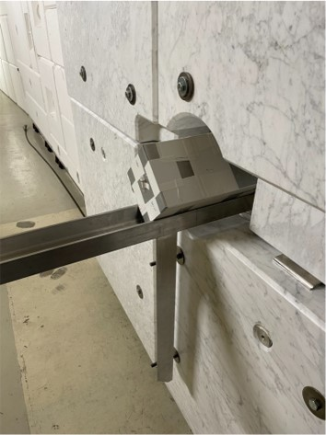
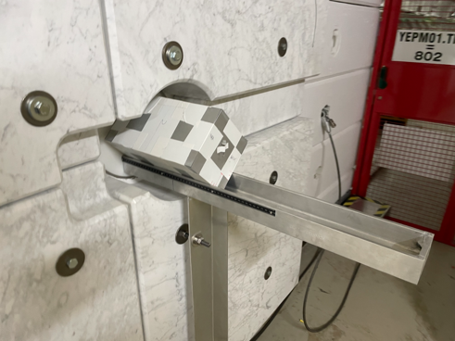
Irradiation at NEAR during 12 days (20/10 -> 01/11)
Pablo Pérez Maroto || nTOF Collaboration Meeting || 30/05/2022

Slide 27
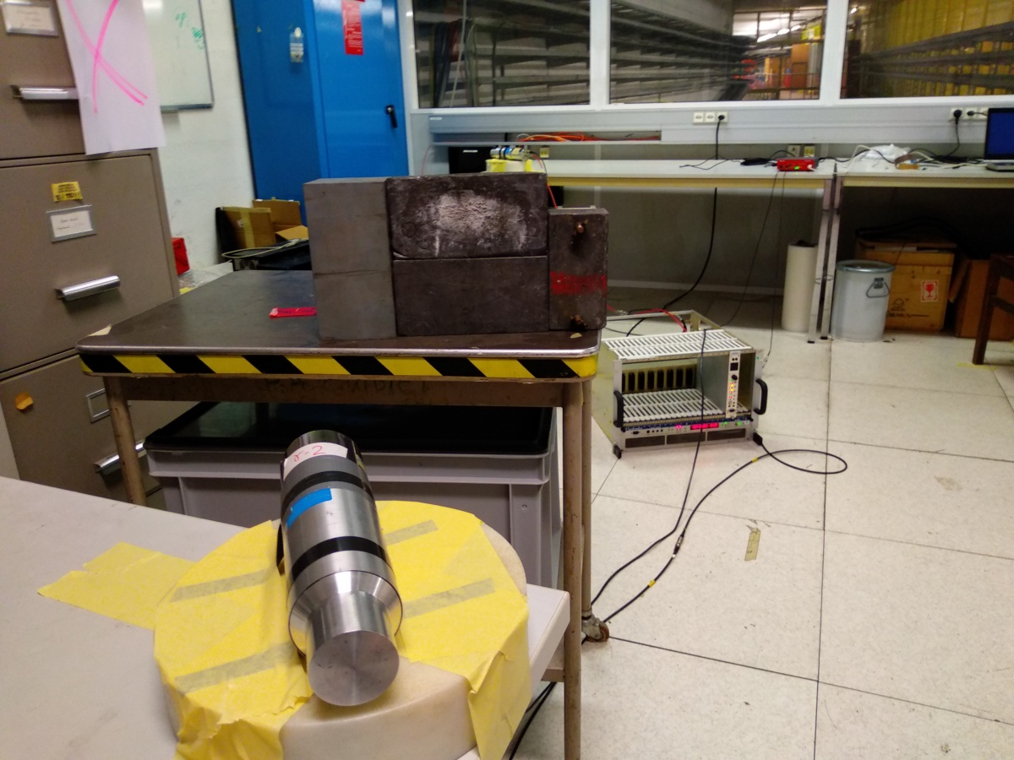
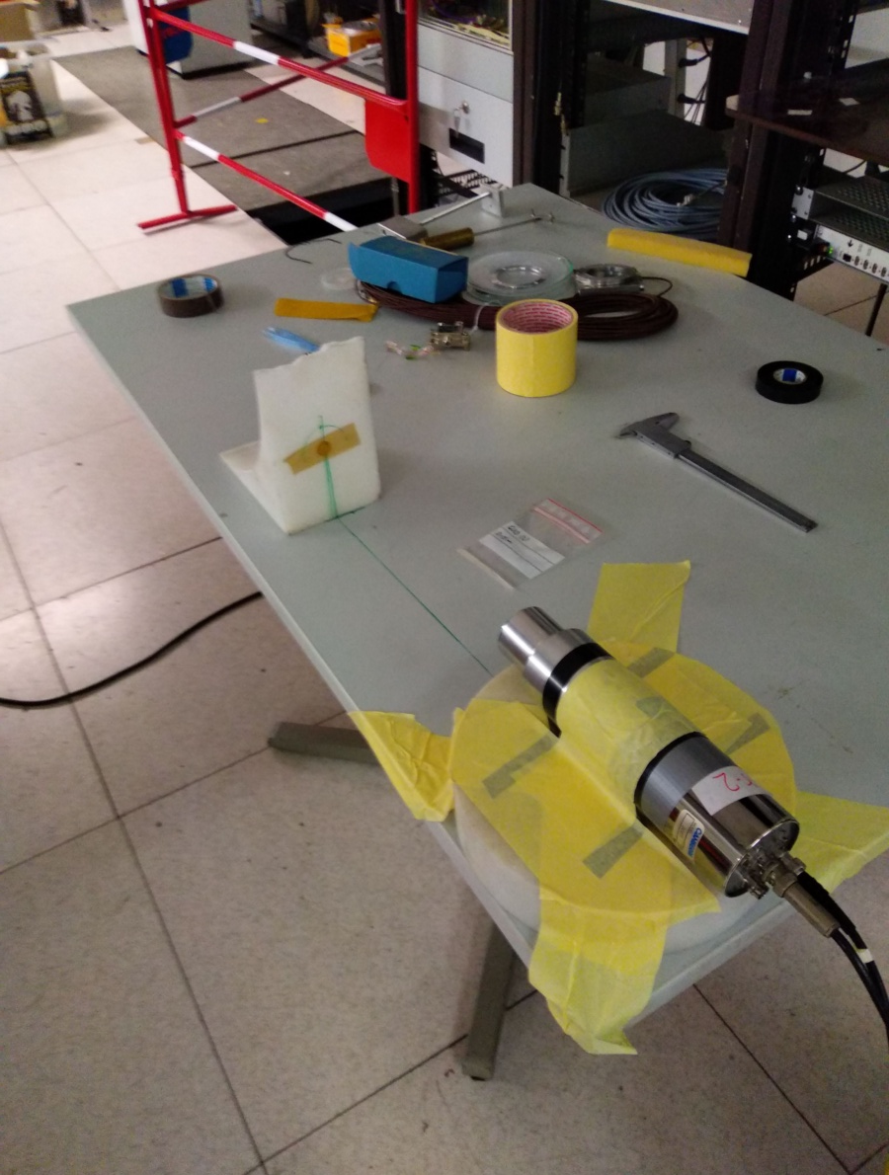
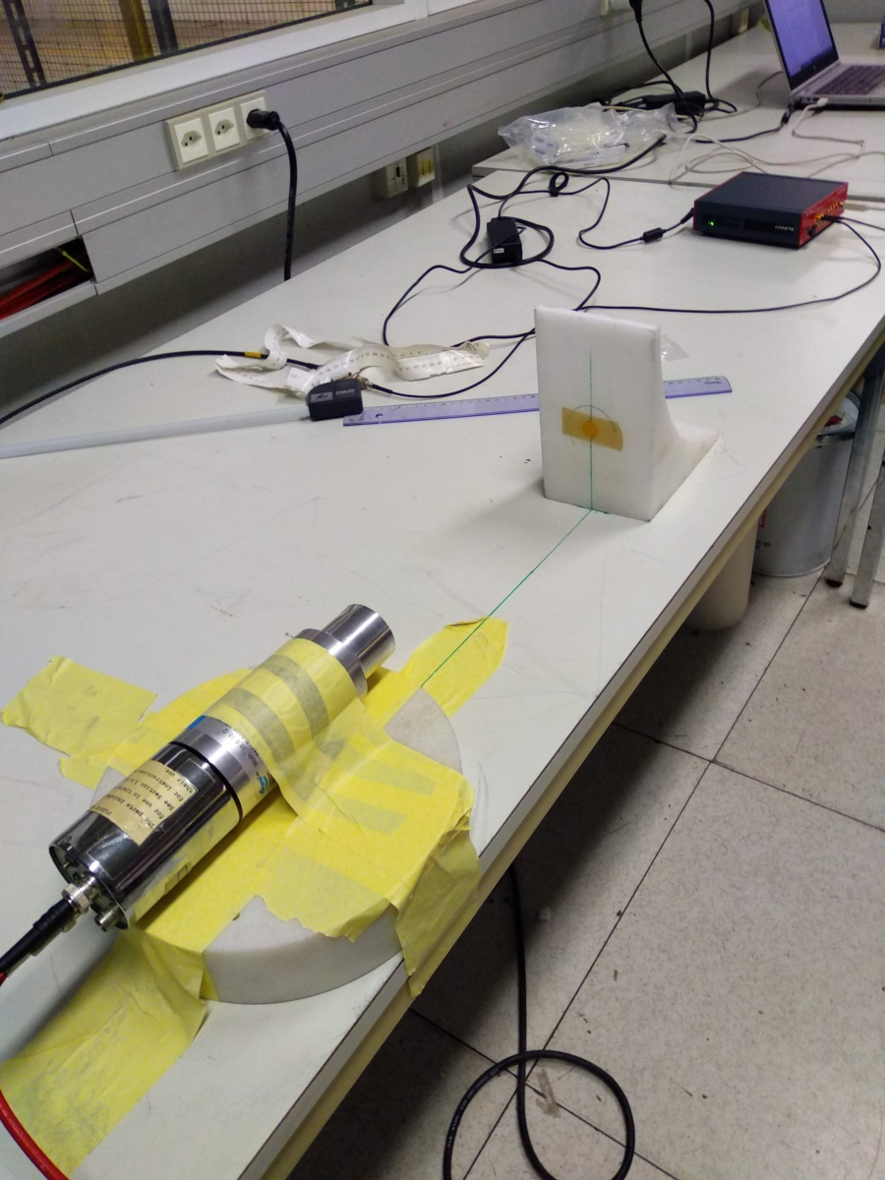
Measurement of the decay of the samples
During 9 days, in the “old Control Room”
Almost one sample per day, every day
Two LaBr₃ detectors and one CAEN-720 digitizer (from Universidad de Sevilla)
Pablo Pérez Maroto || nTOF Collaboration Meeting || 30/05/2022

Slide 28
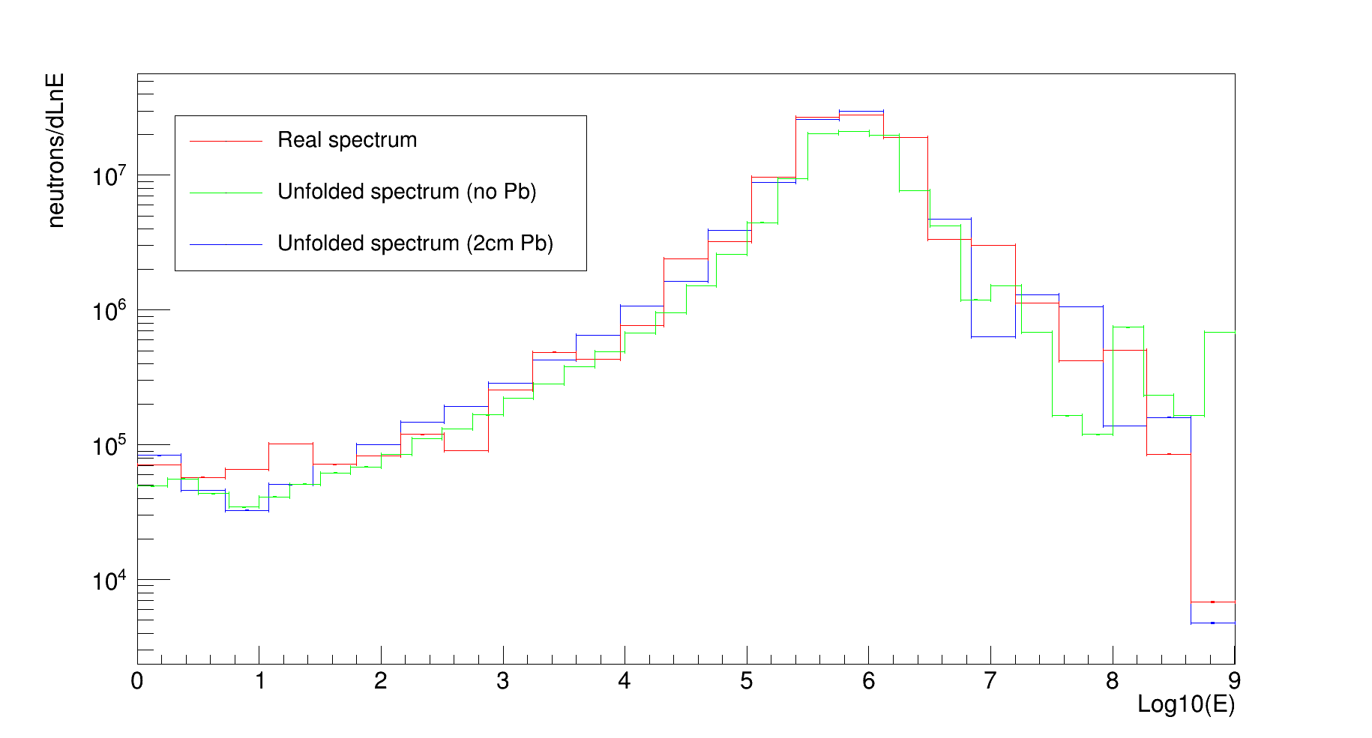
Unfolding with and without Pb
Pablo Pérez Maroto || nTOF Collaboration Meeting || 30/05/2022

