Slide 1

Are TOF measurements possible at the NEAR Station
(or in its neighborhood)?
Alberto Mengoni
30 May 2022

Slide 2
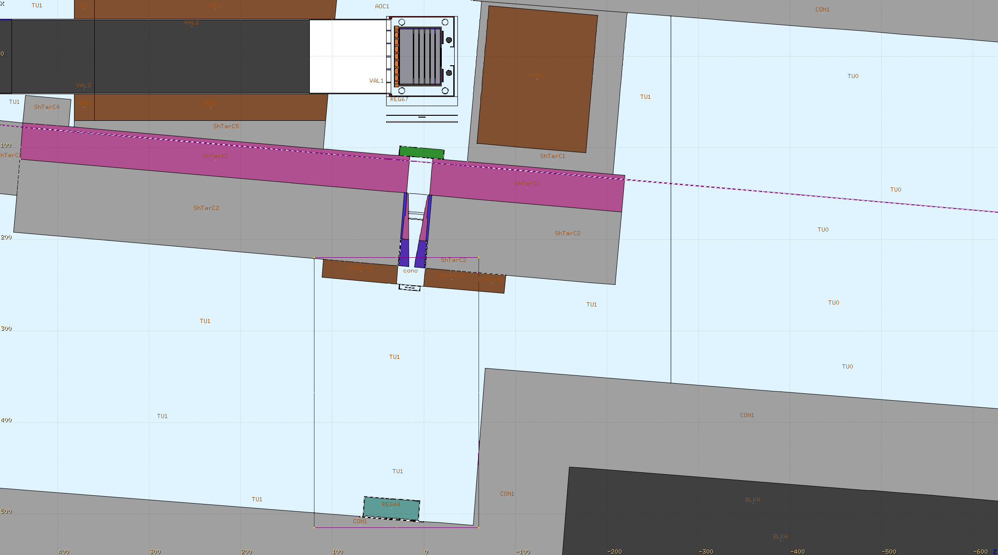
NEAR
z
n_TOF Collaboration Meeting, 30 May 2022

Slide 3
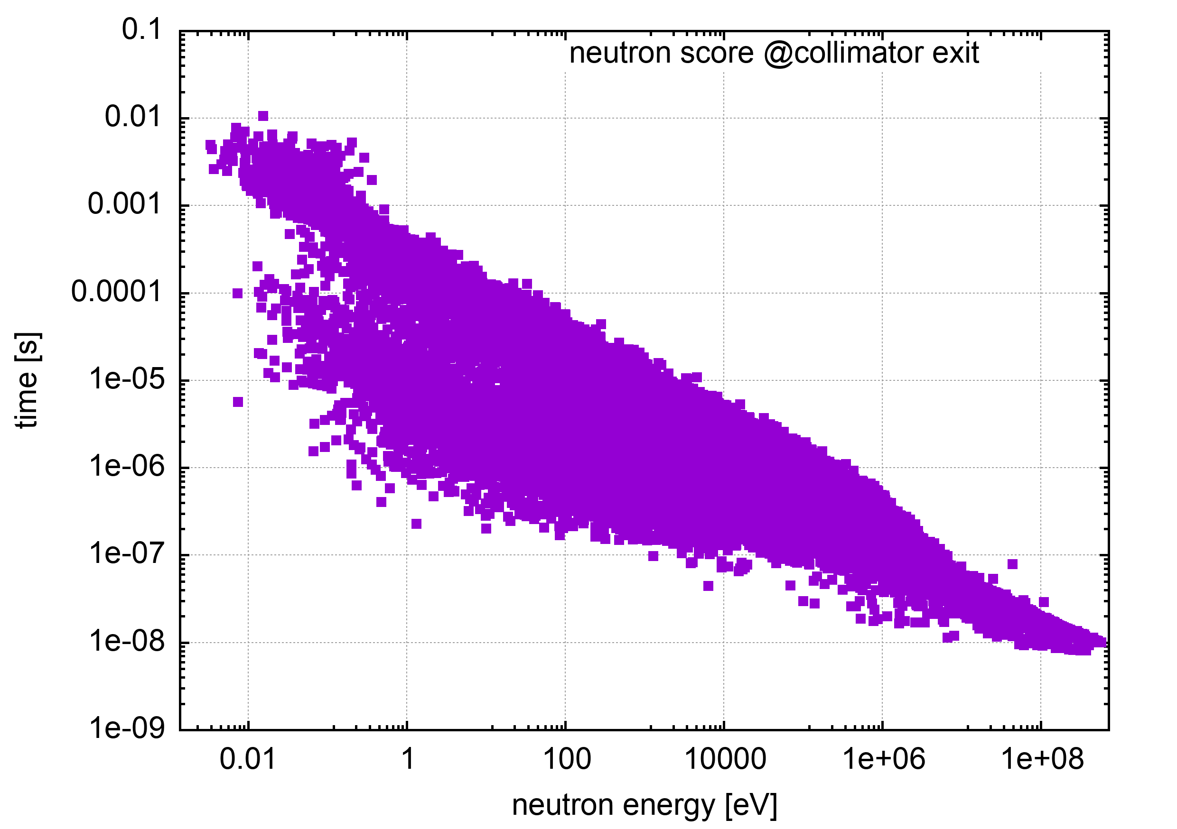
NEAR
n_TOF Collaboration Meeting, 30 May 2022

Slide 4
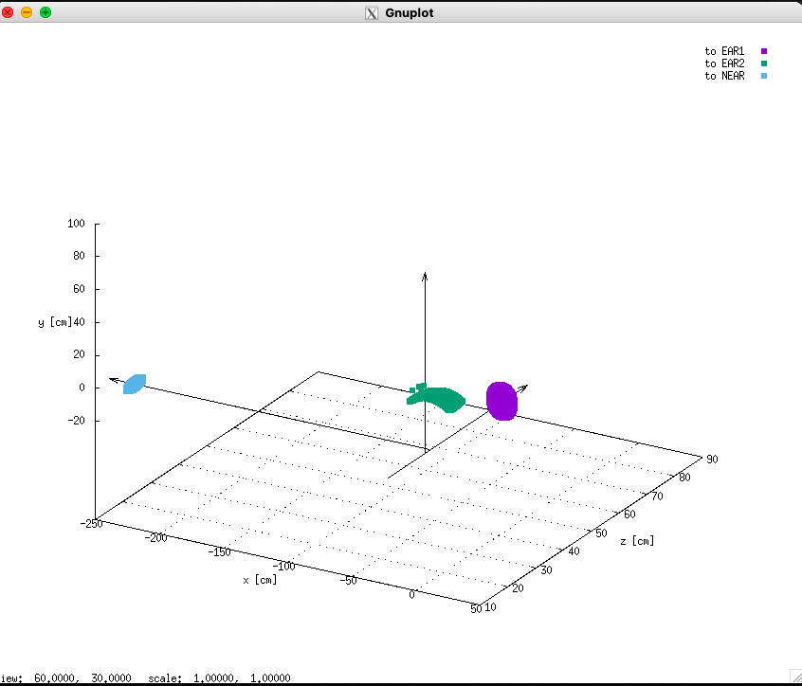
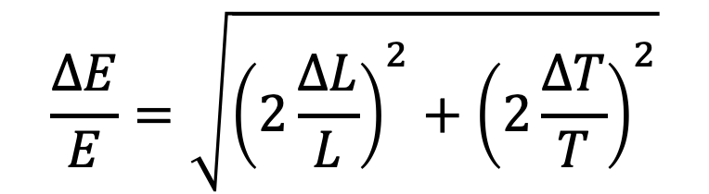
To the EARS
FLUKA simulations from the FLUKA team:
Matteo Cecchetto, Jose’ Anotnio Pavon,
Marta Sabate, Giuseppe Lerner,
Vasilis Vlachoudis et al.
$$\frac{∆E}{E}=\sqrt{{\left(2\frac{∆L}{L}\right)}^{2}+{\left(2\frac{∆T}{T}\right)}^{2}}$$
n_TOF Collaboration Meeting, 30 May 2022

Slide 5
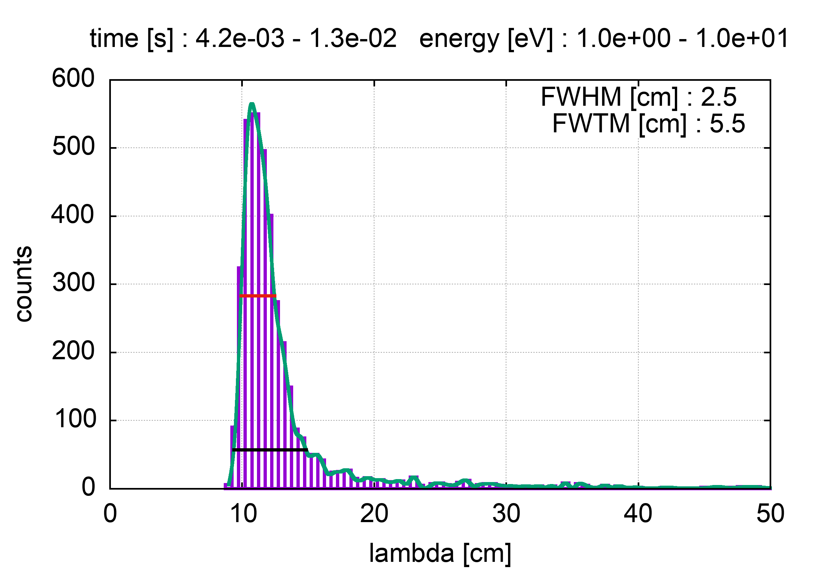
EAR1
n_TOF Collaboration Meeting, 30 May 2022

Slide 6
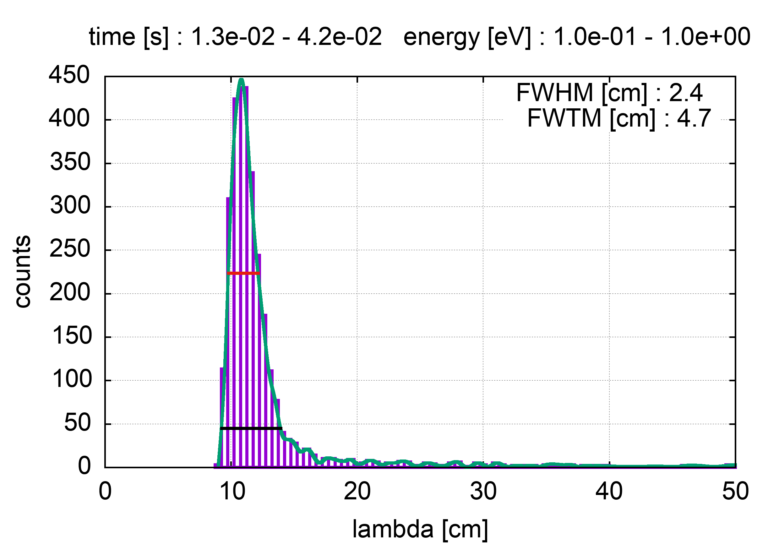

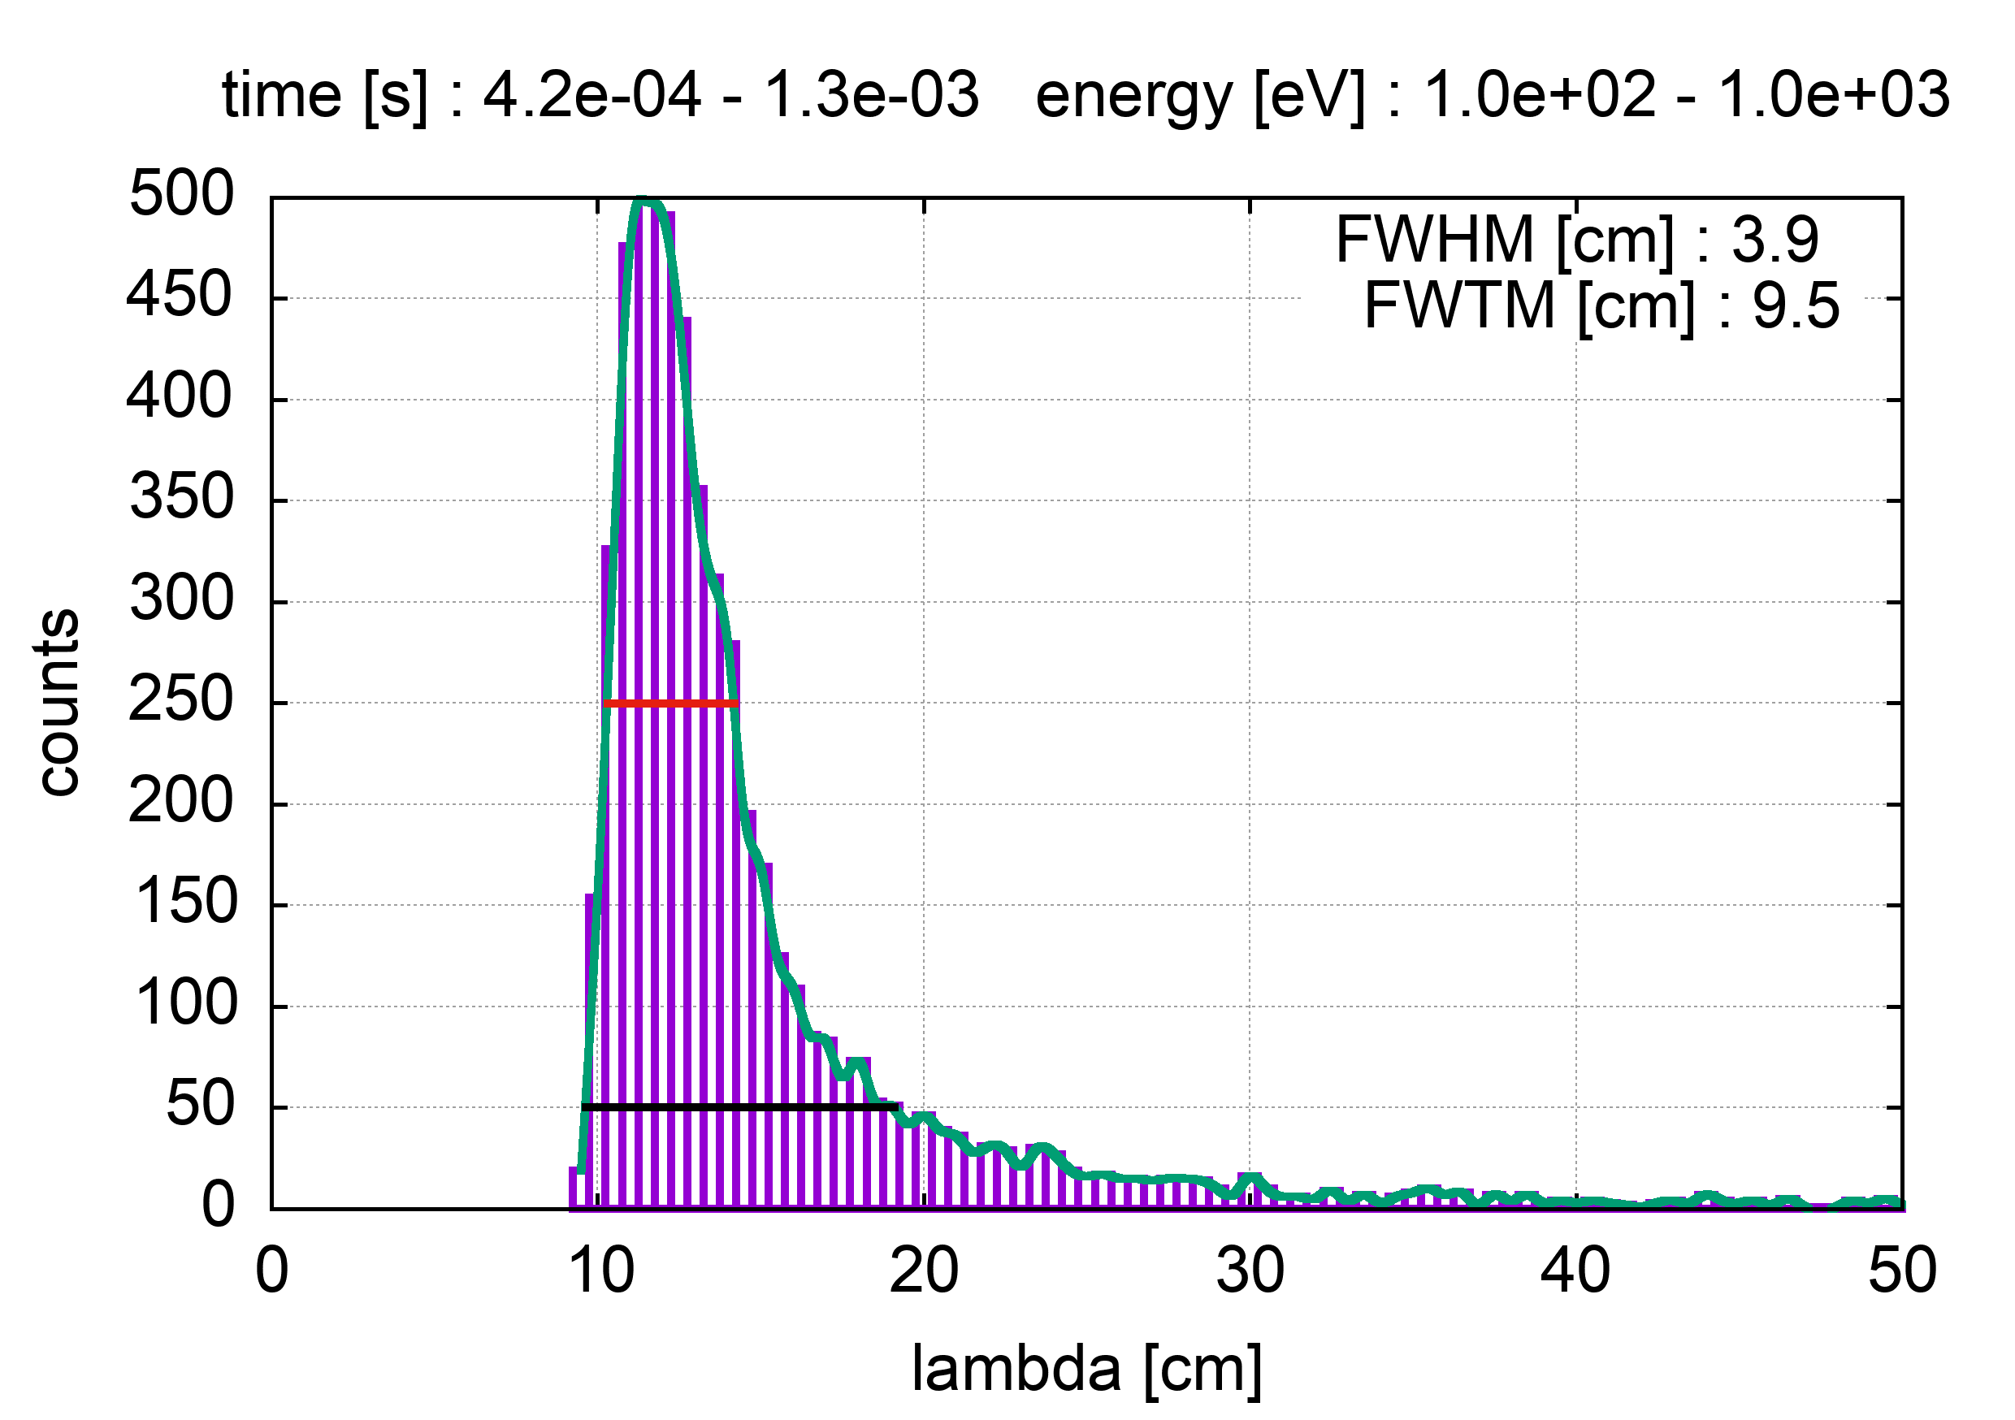
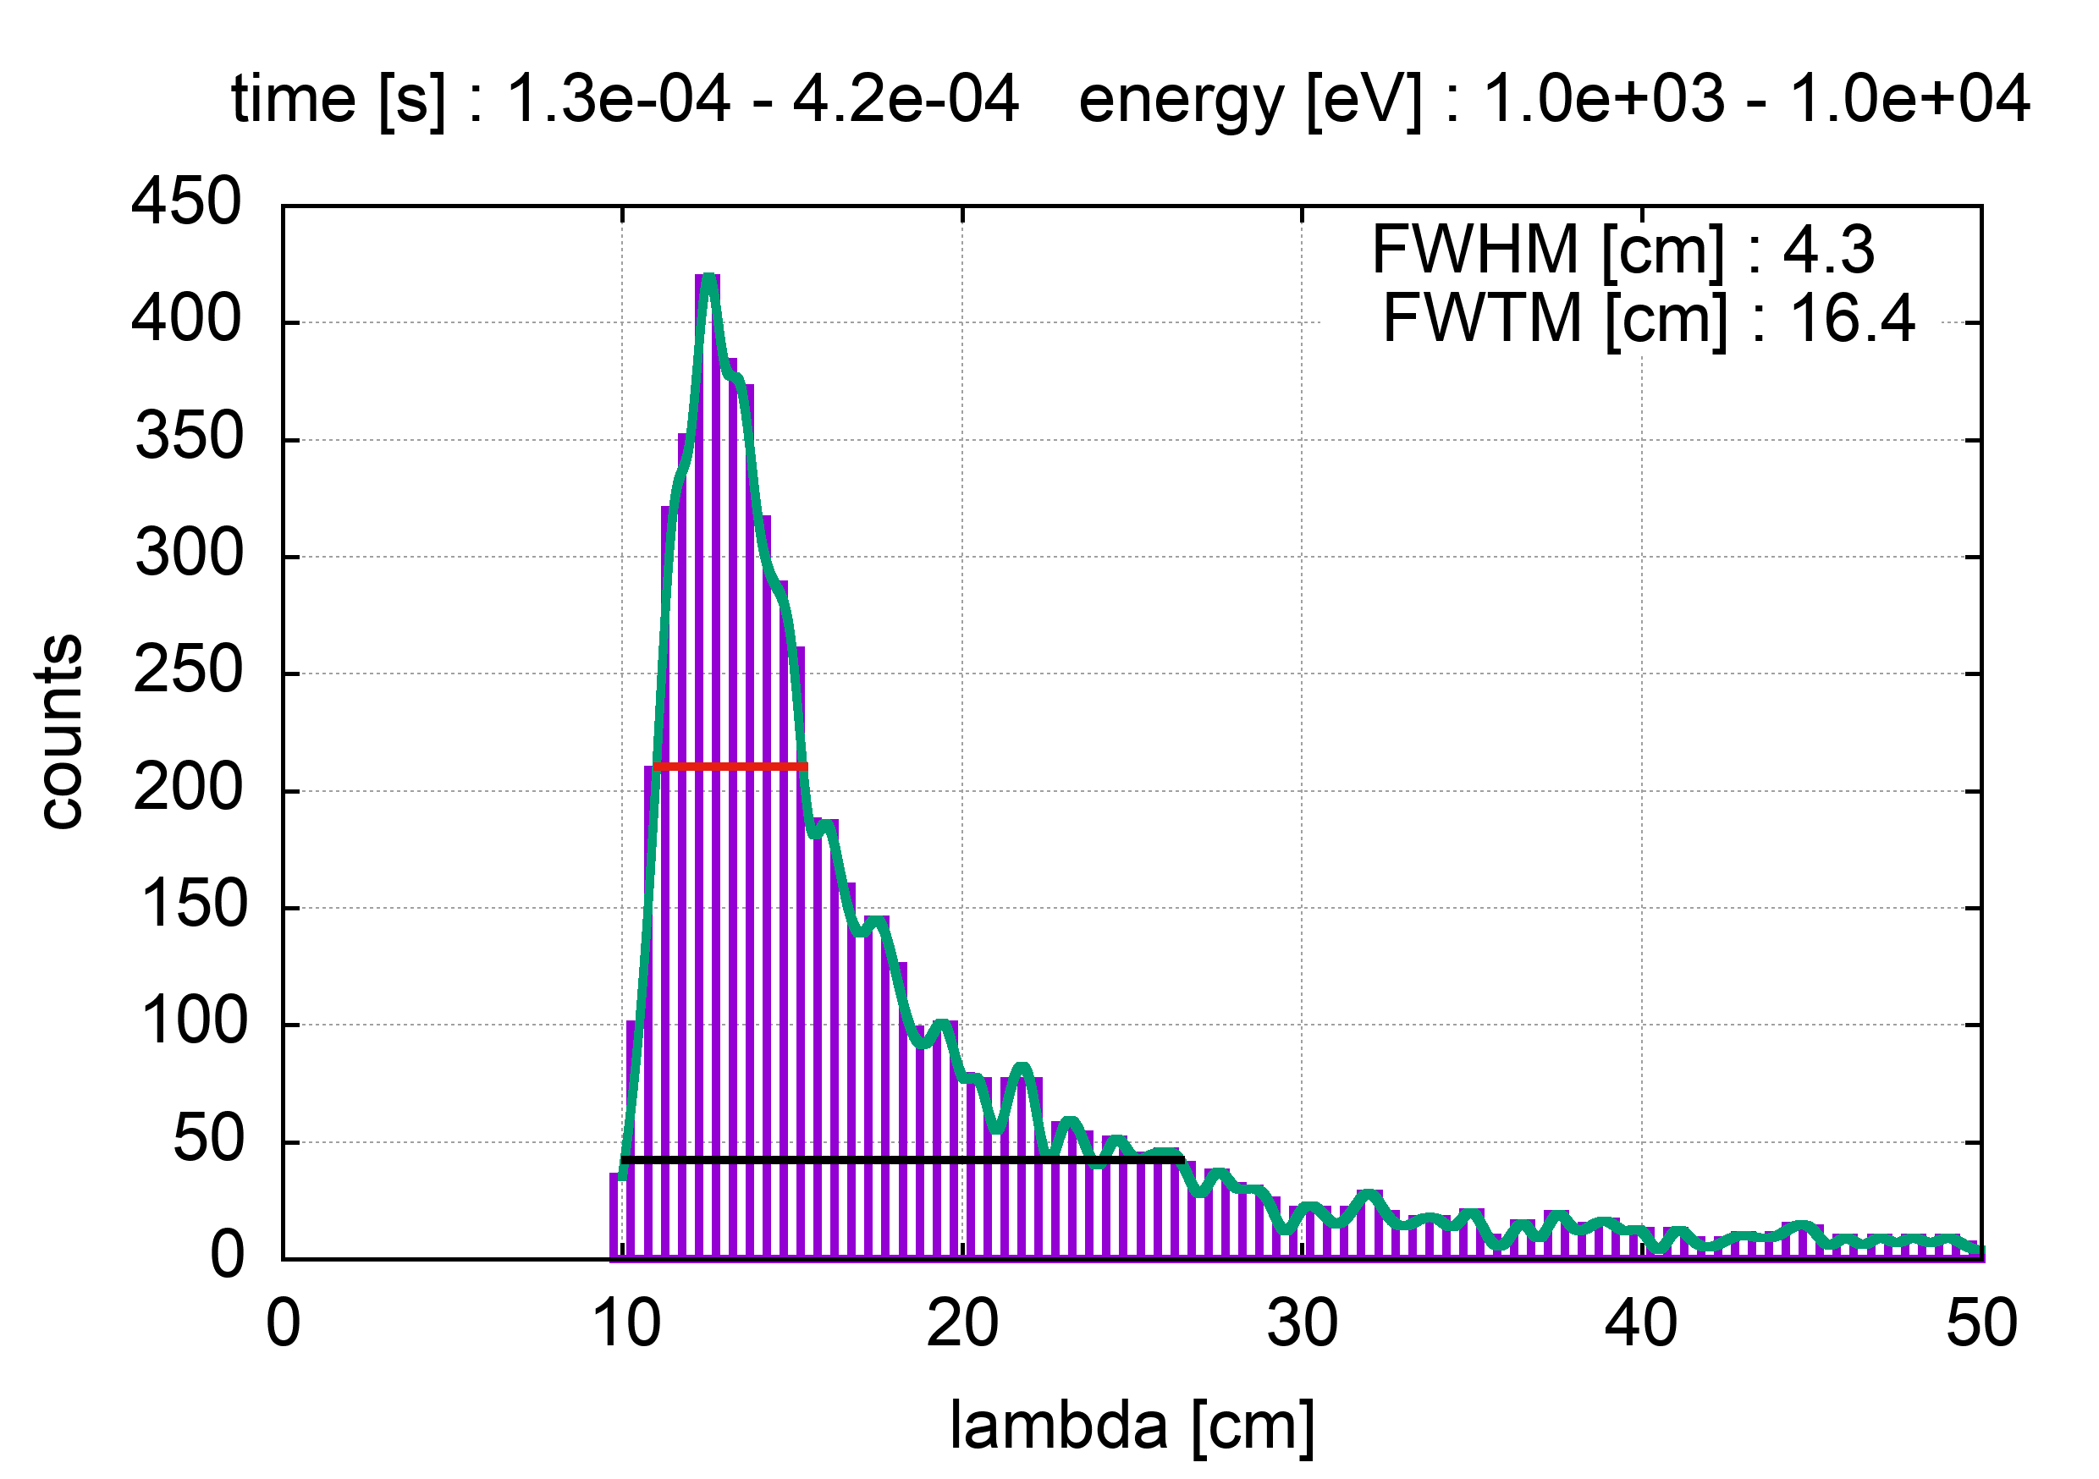
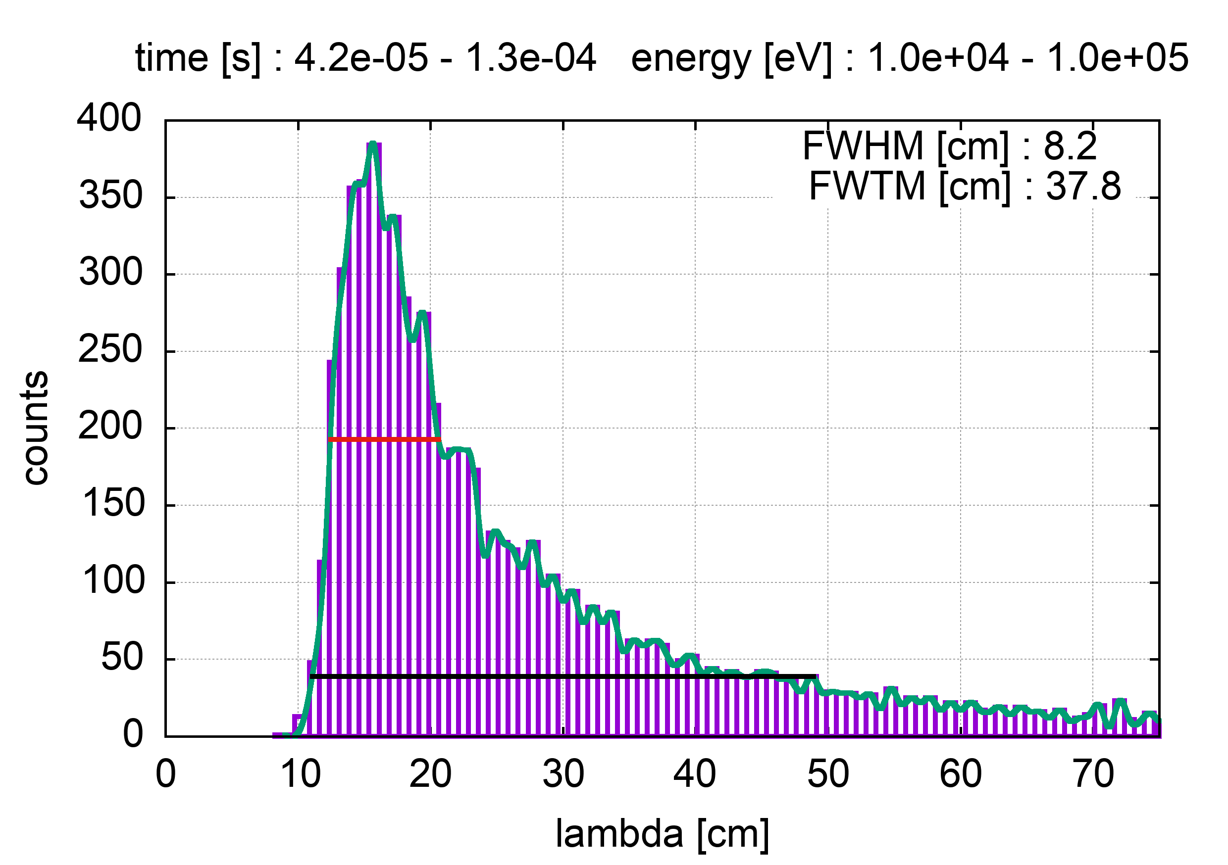
EAR1
n_TOF Collaboration Meeting, 30 May 2022

Slide 7
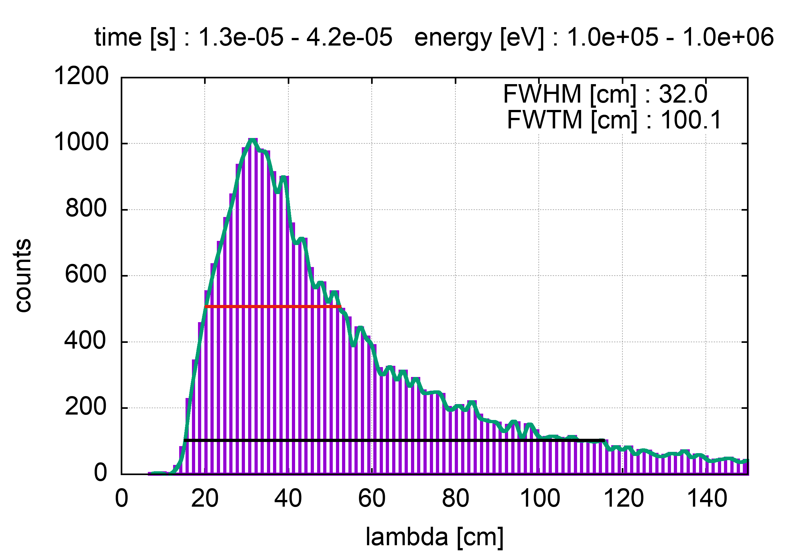
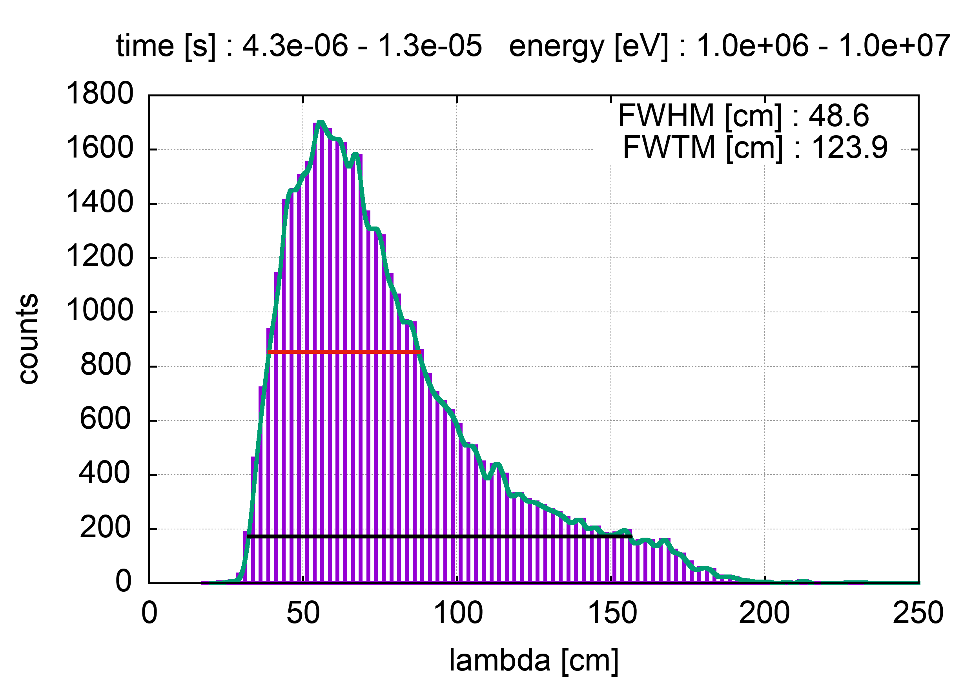
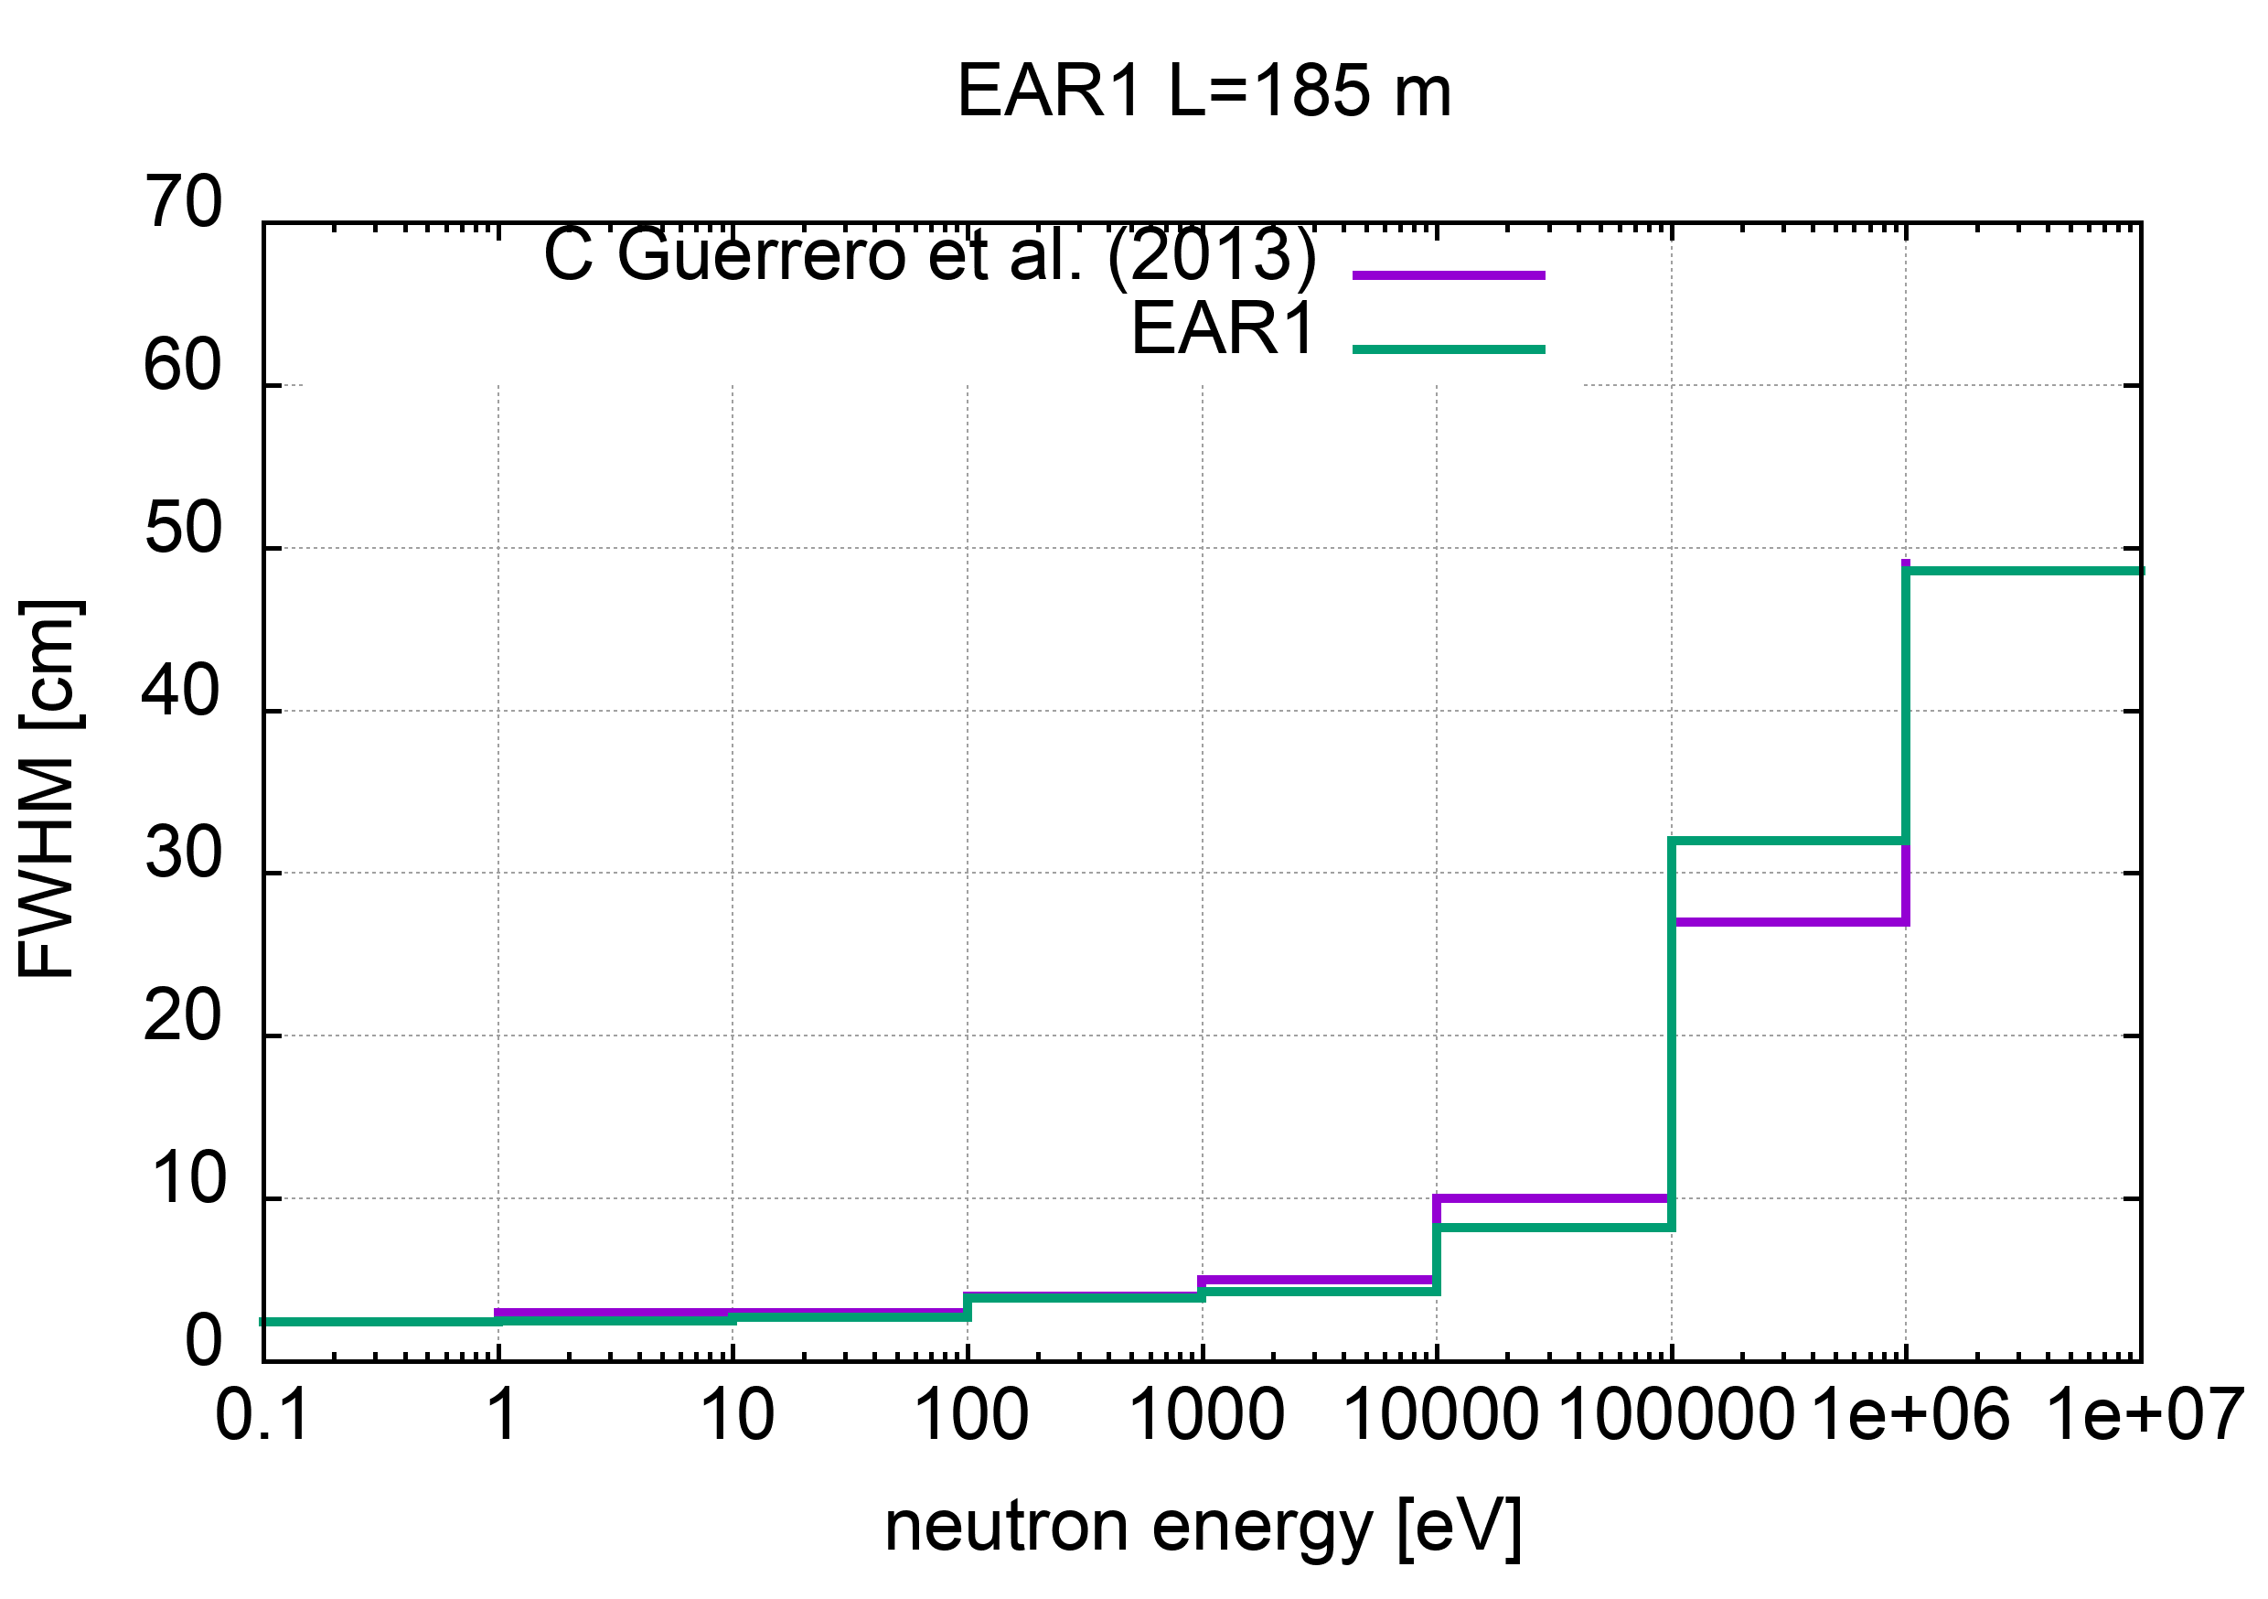
EAR1
#area : EAR1
#data file : data/EAR1_win
#flight-path [cm] : 18500.0
#relativistic : yes
#pbeam rms [ns] : 11.0
# energy range [eV] FWHM [cm] FWTM [cm] dE/E
0.1 1.0 2.4 4.7 2.6e-04
1.0 10.0 2.5 5.5 2.7e-04
10.0 100.0 2.7 6.6 2.9e-04
100.0 1000.0 3.9 9.5 4.3e-04
1000.0 10000.0 4.3 16.4 5.1e-04
10000.0 100000.0 8.2 37.8 1.1e-03
100000.0 1000000.0 32.0 100.1 4.2e-03
1000000.0 10000000.0 48.6 123.9 7.8e-03
(table updated 1 June 2022)

Slide 8
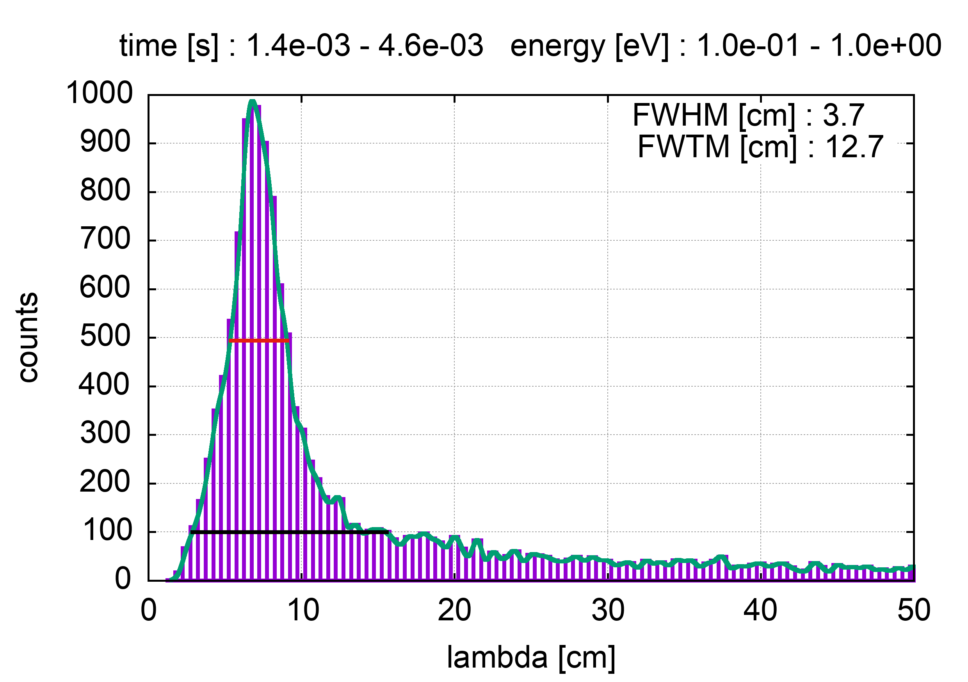
EAR2
n_TOF Collaboration Meeting, 30 May 2022

Slide 9
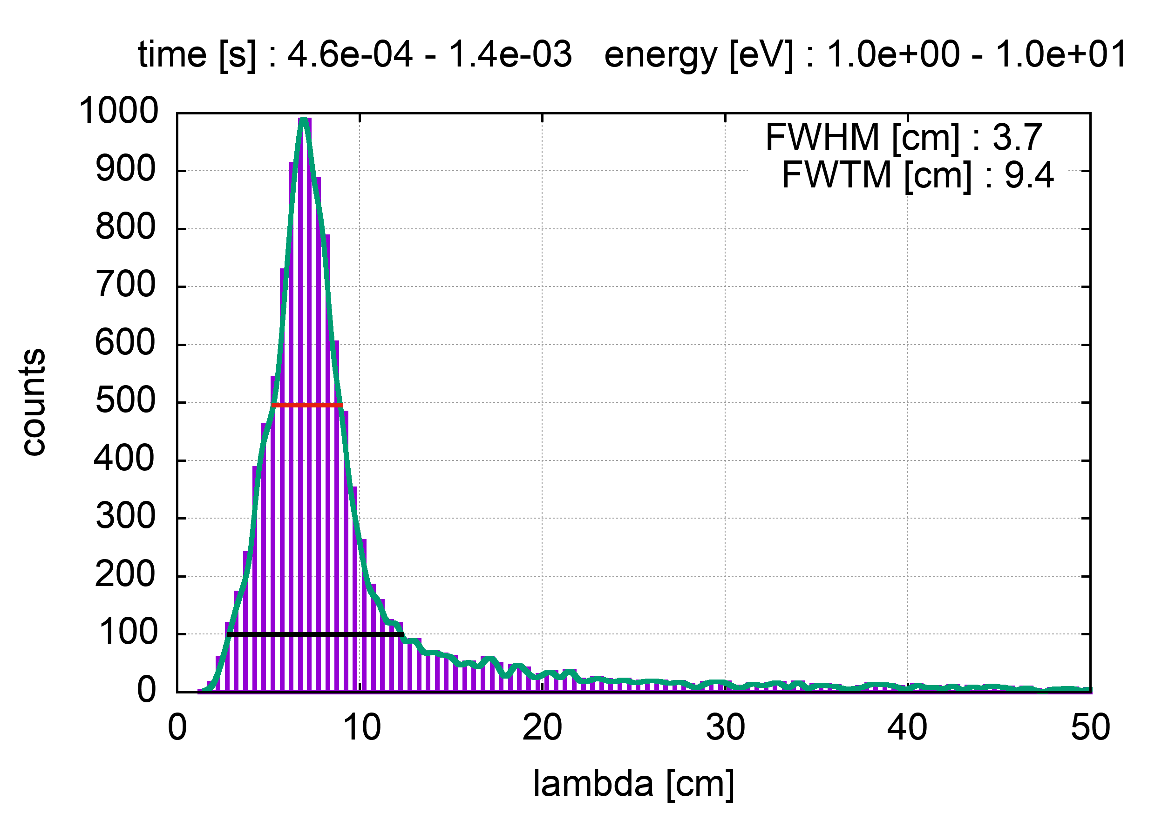
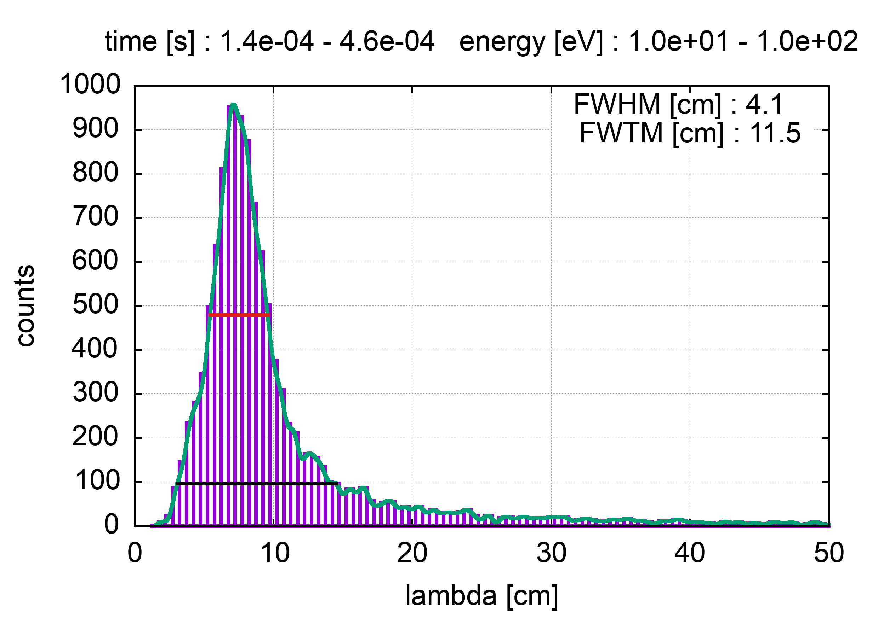
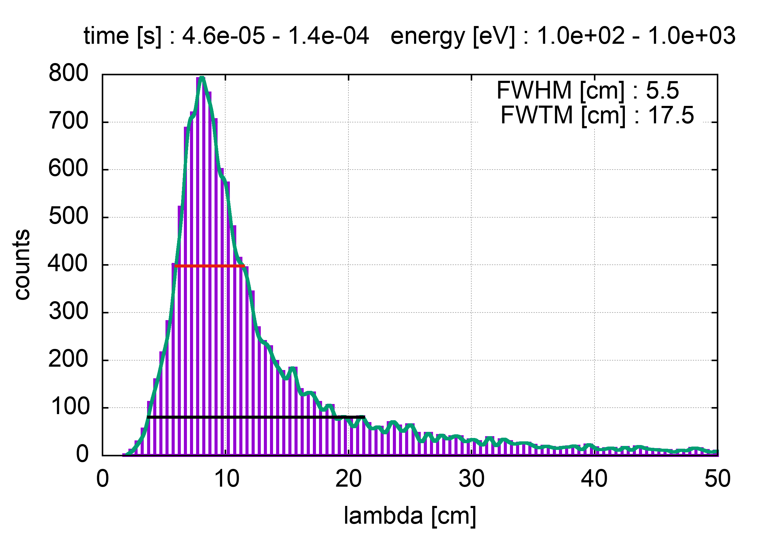
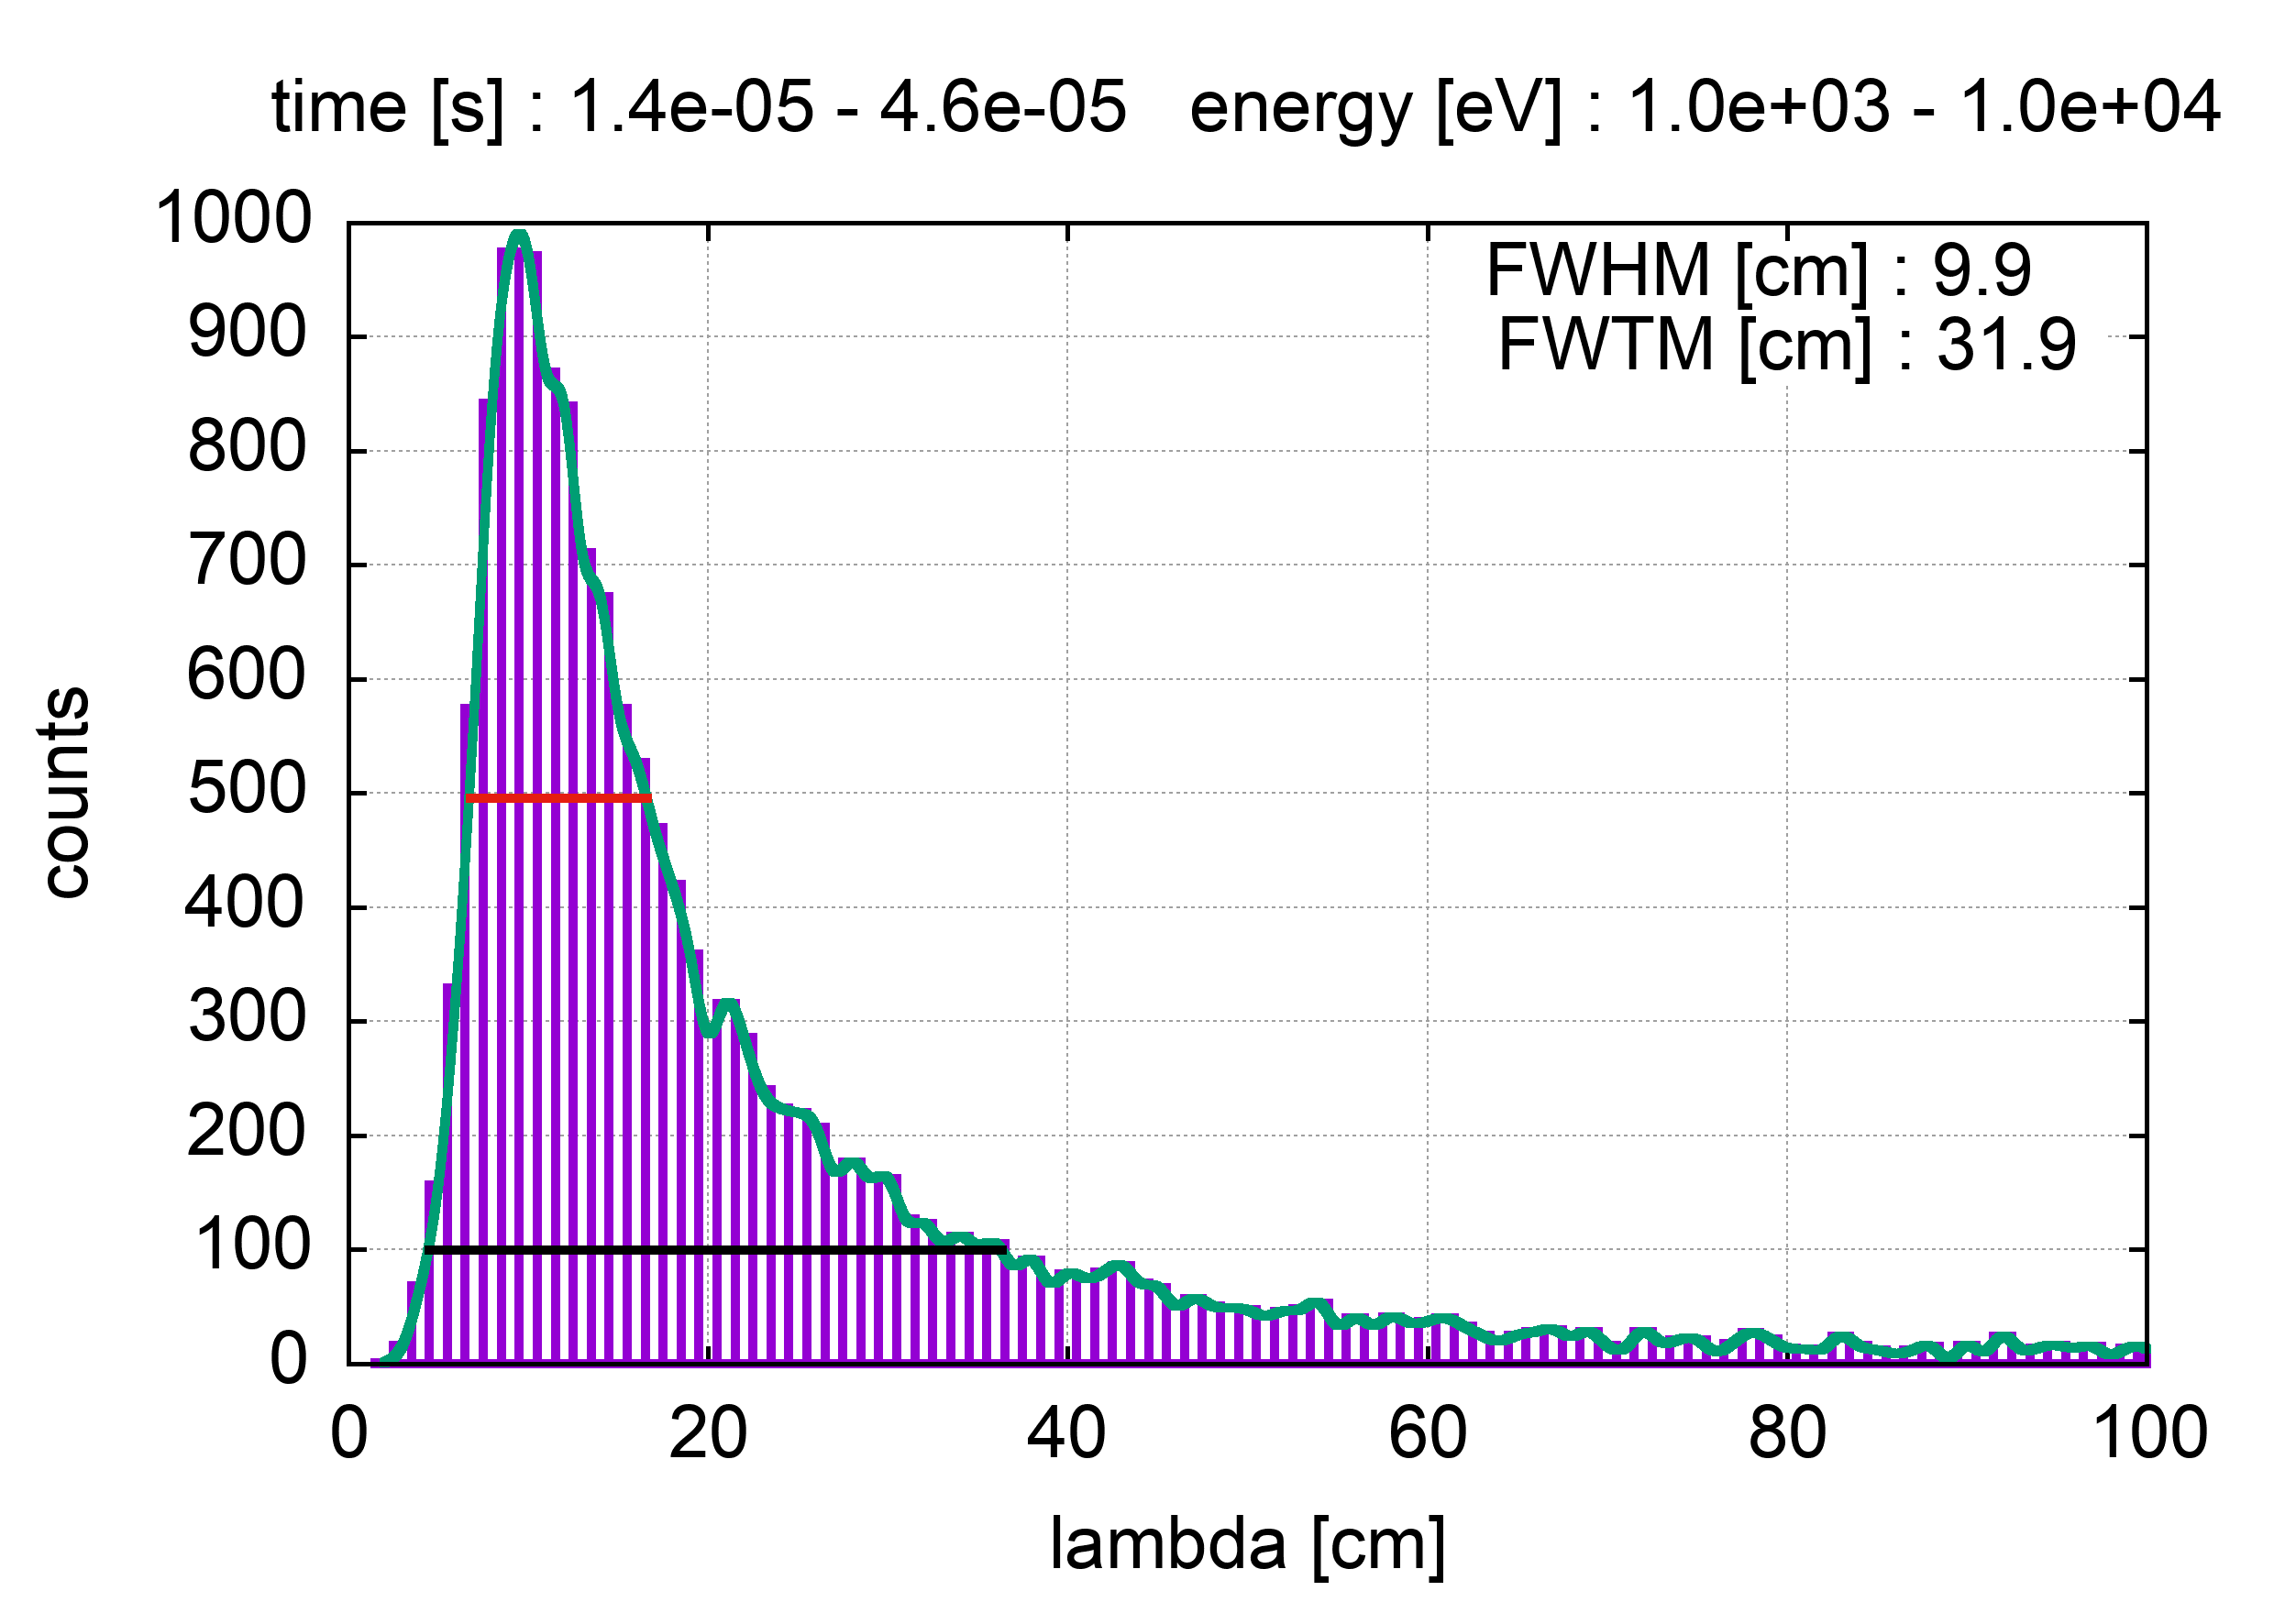
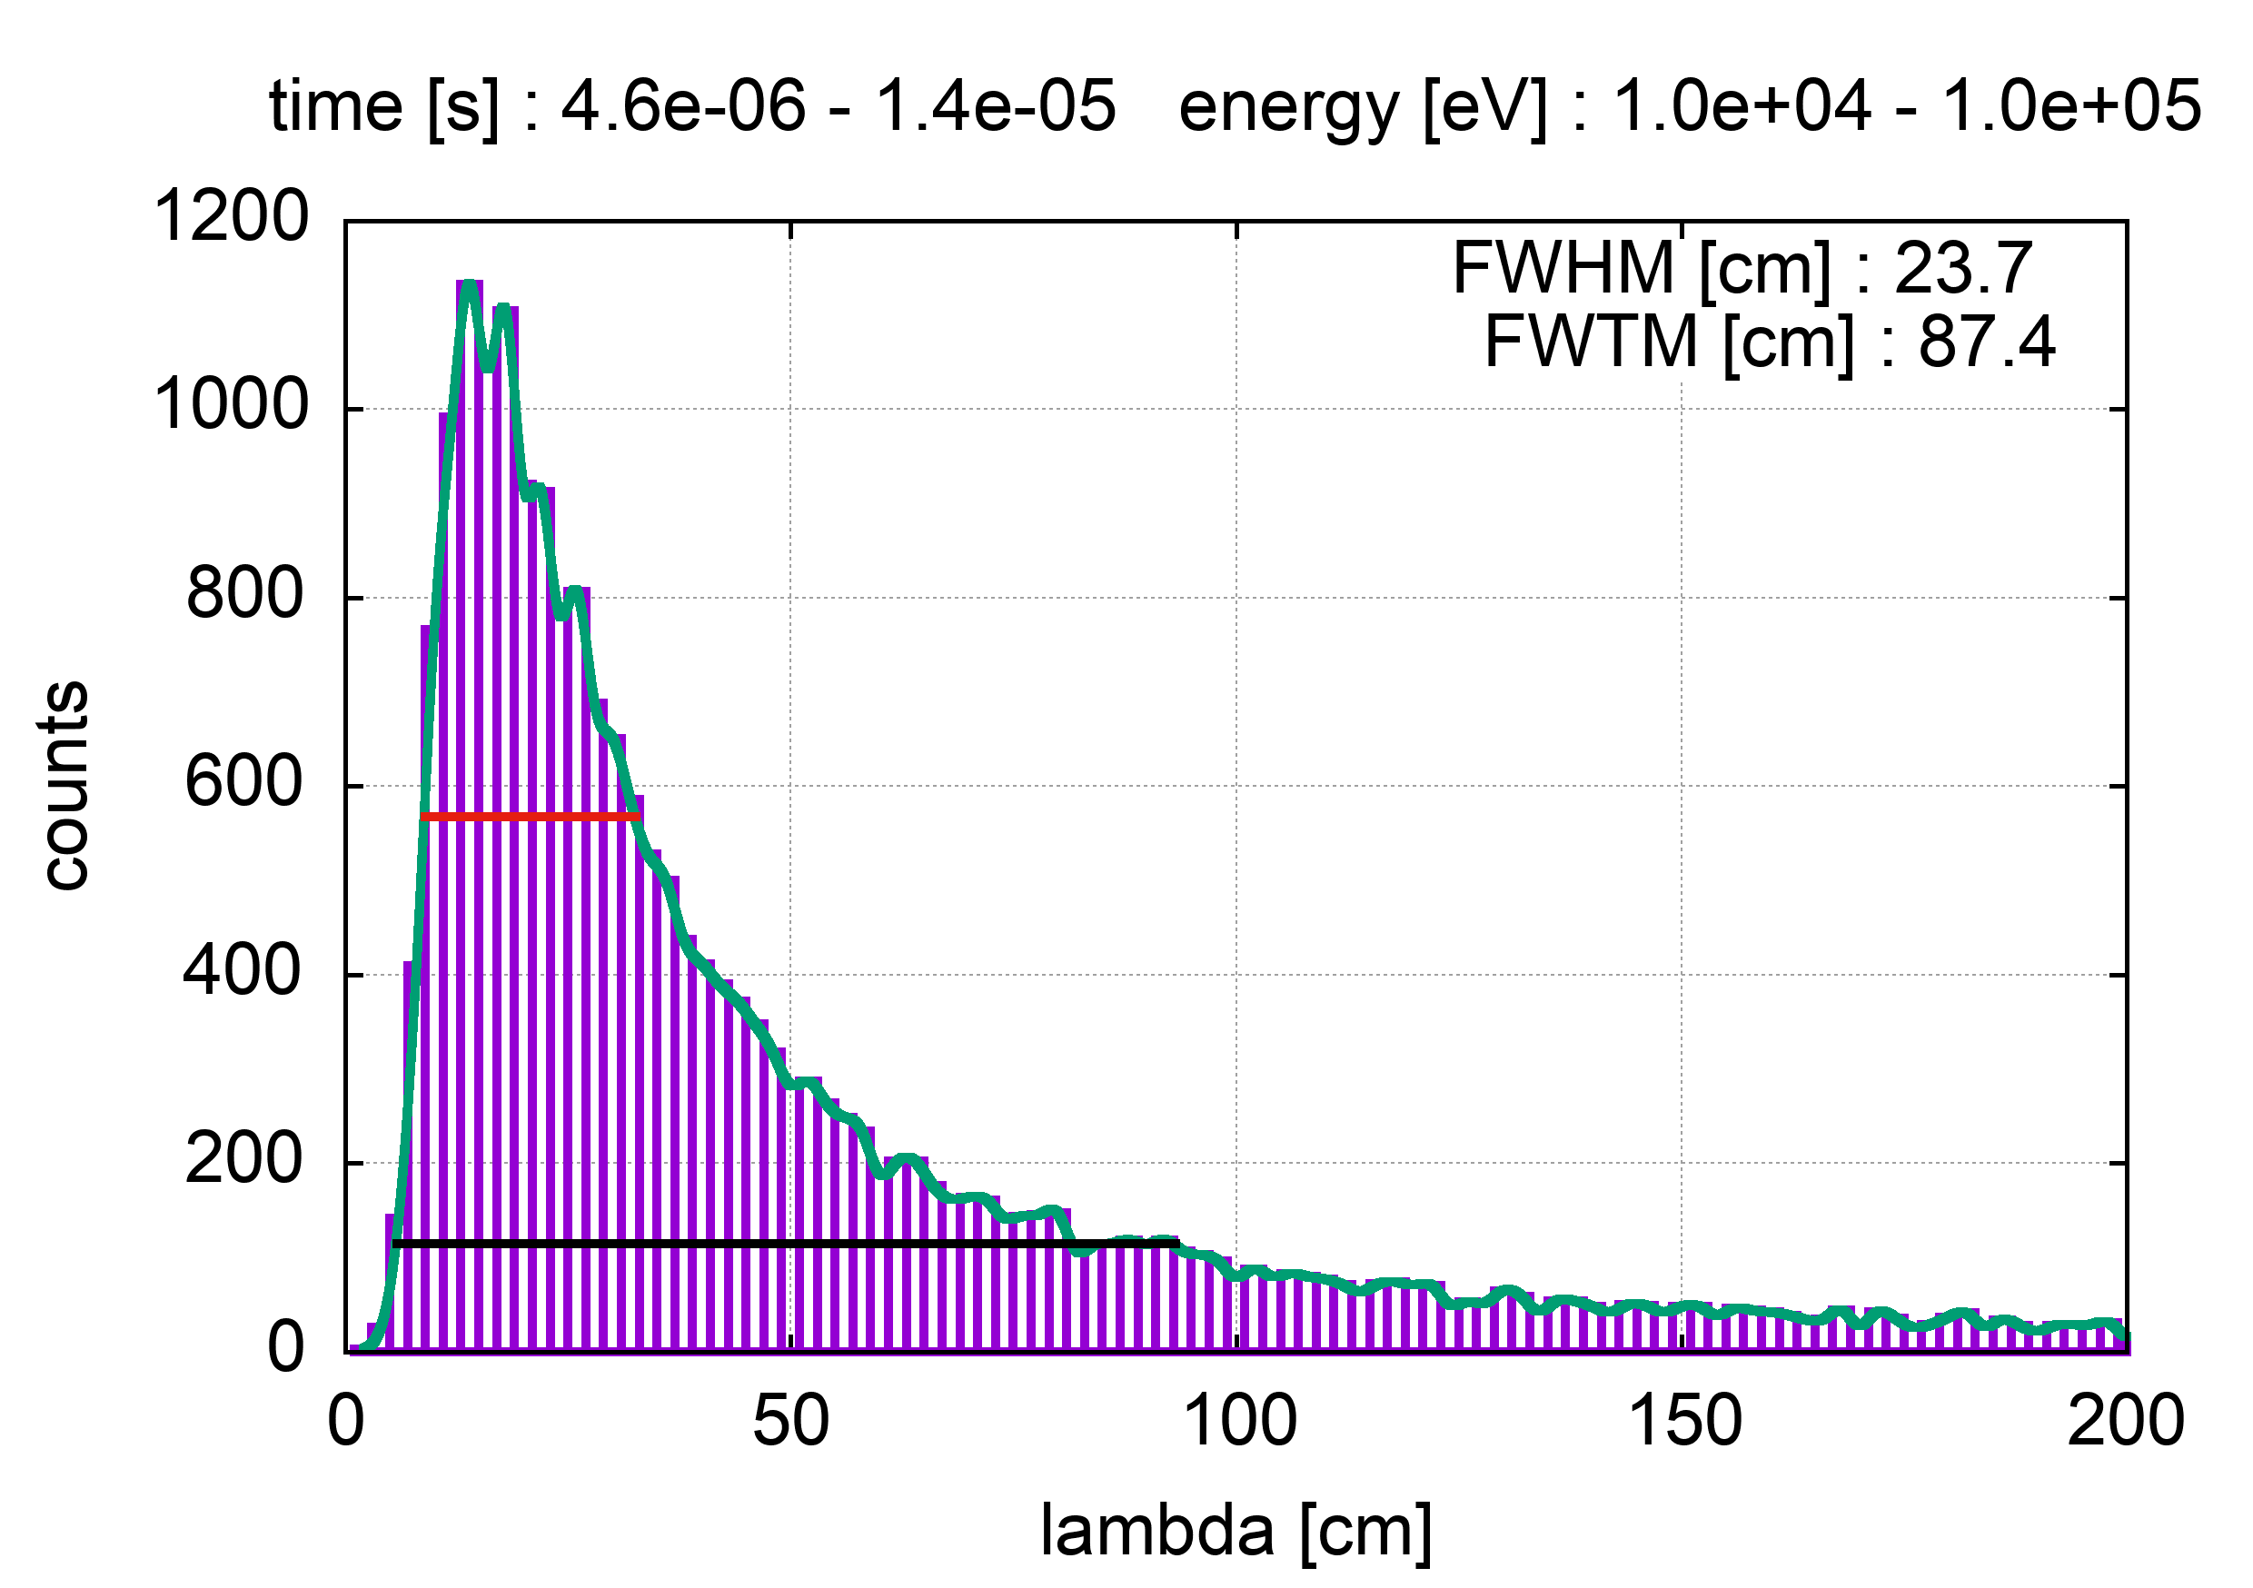
EAR2
n_TOF Collaboration Meeting, 30 May 2022

Slide 10
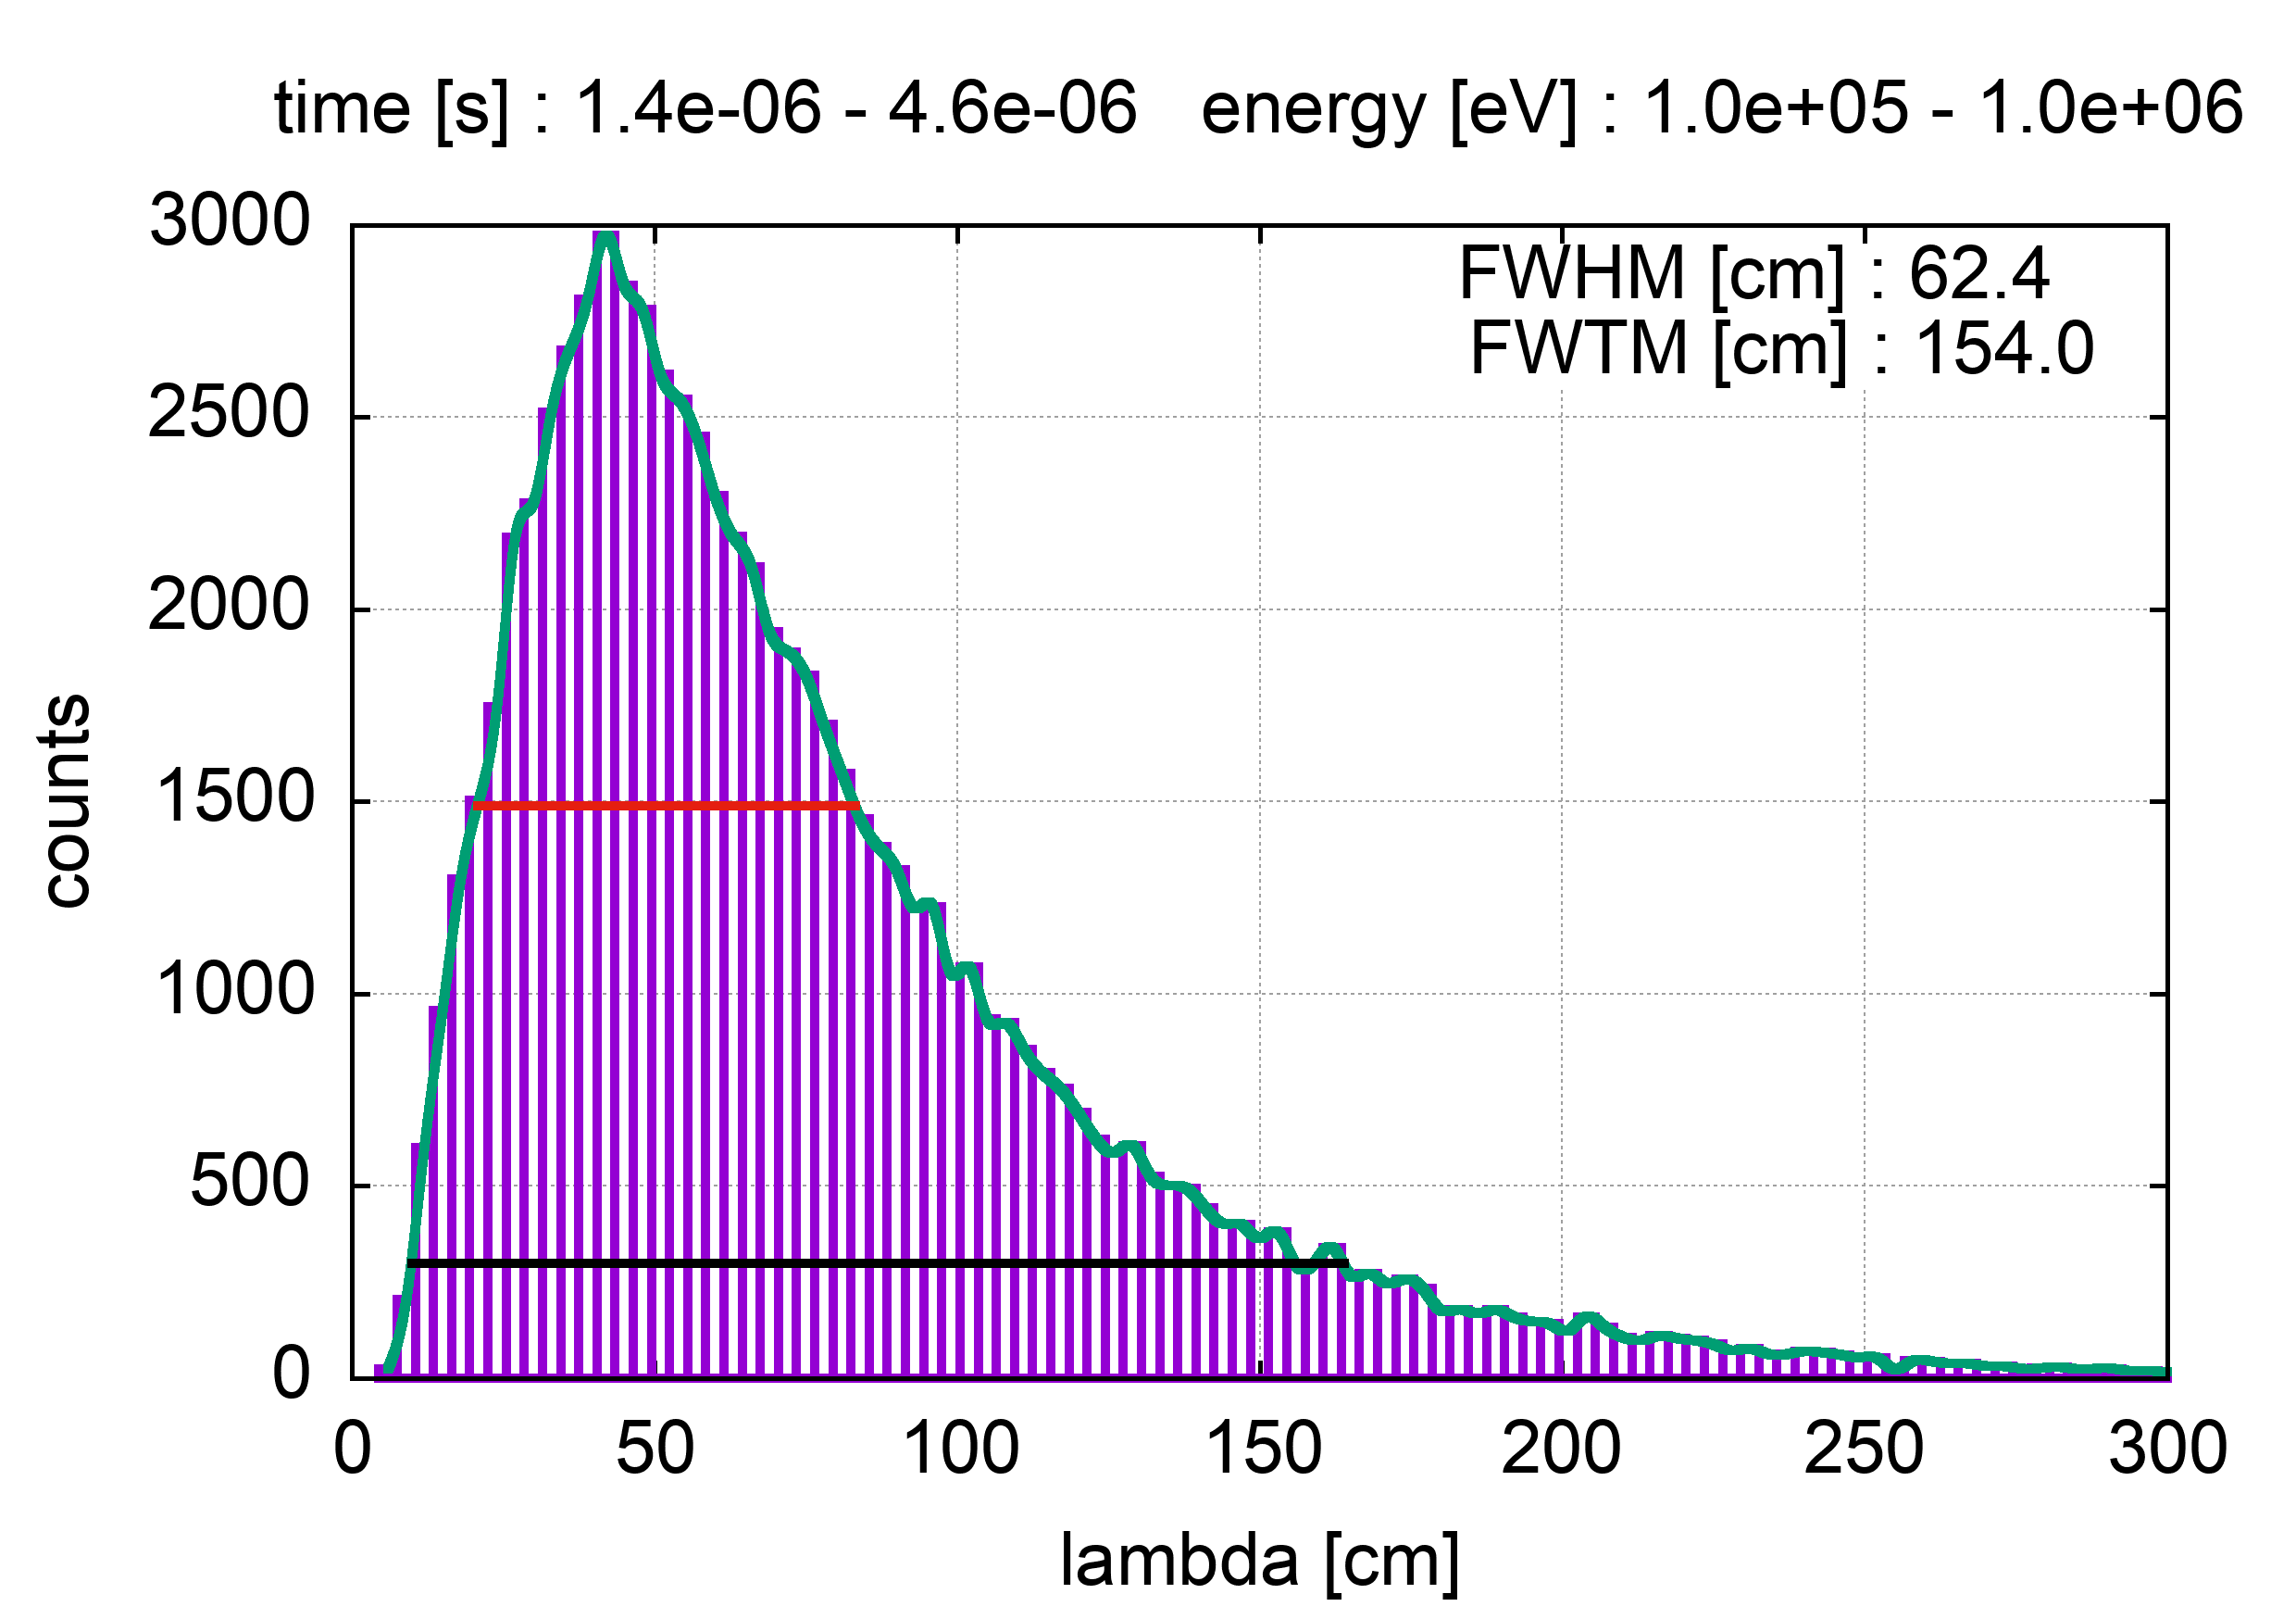
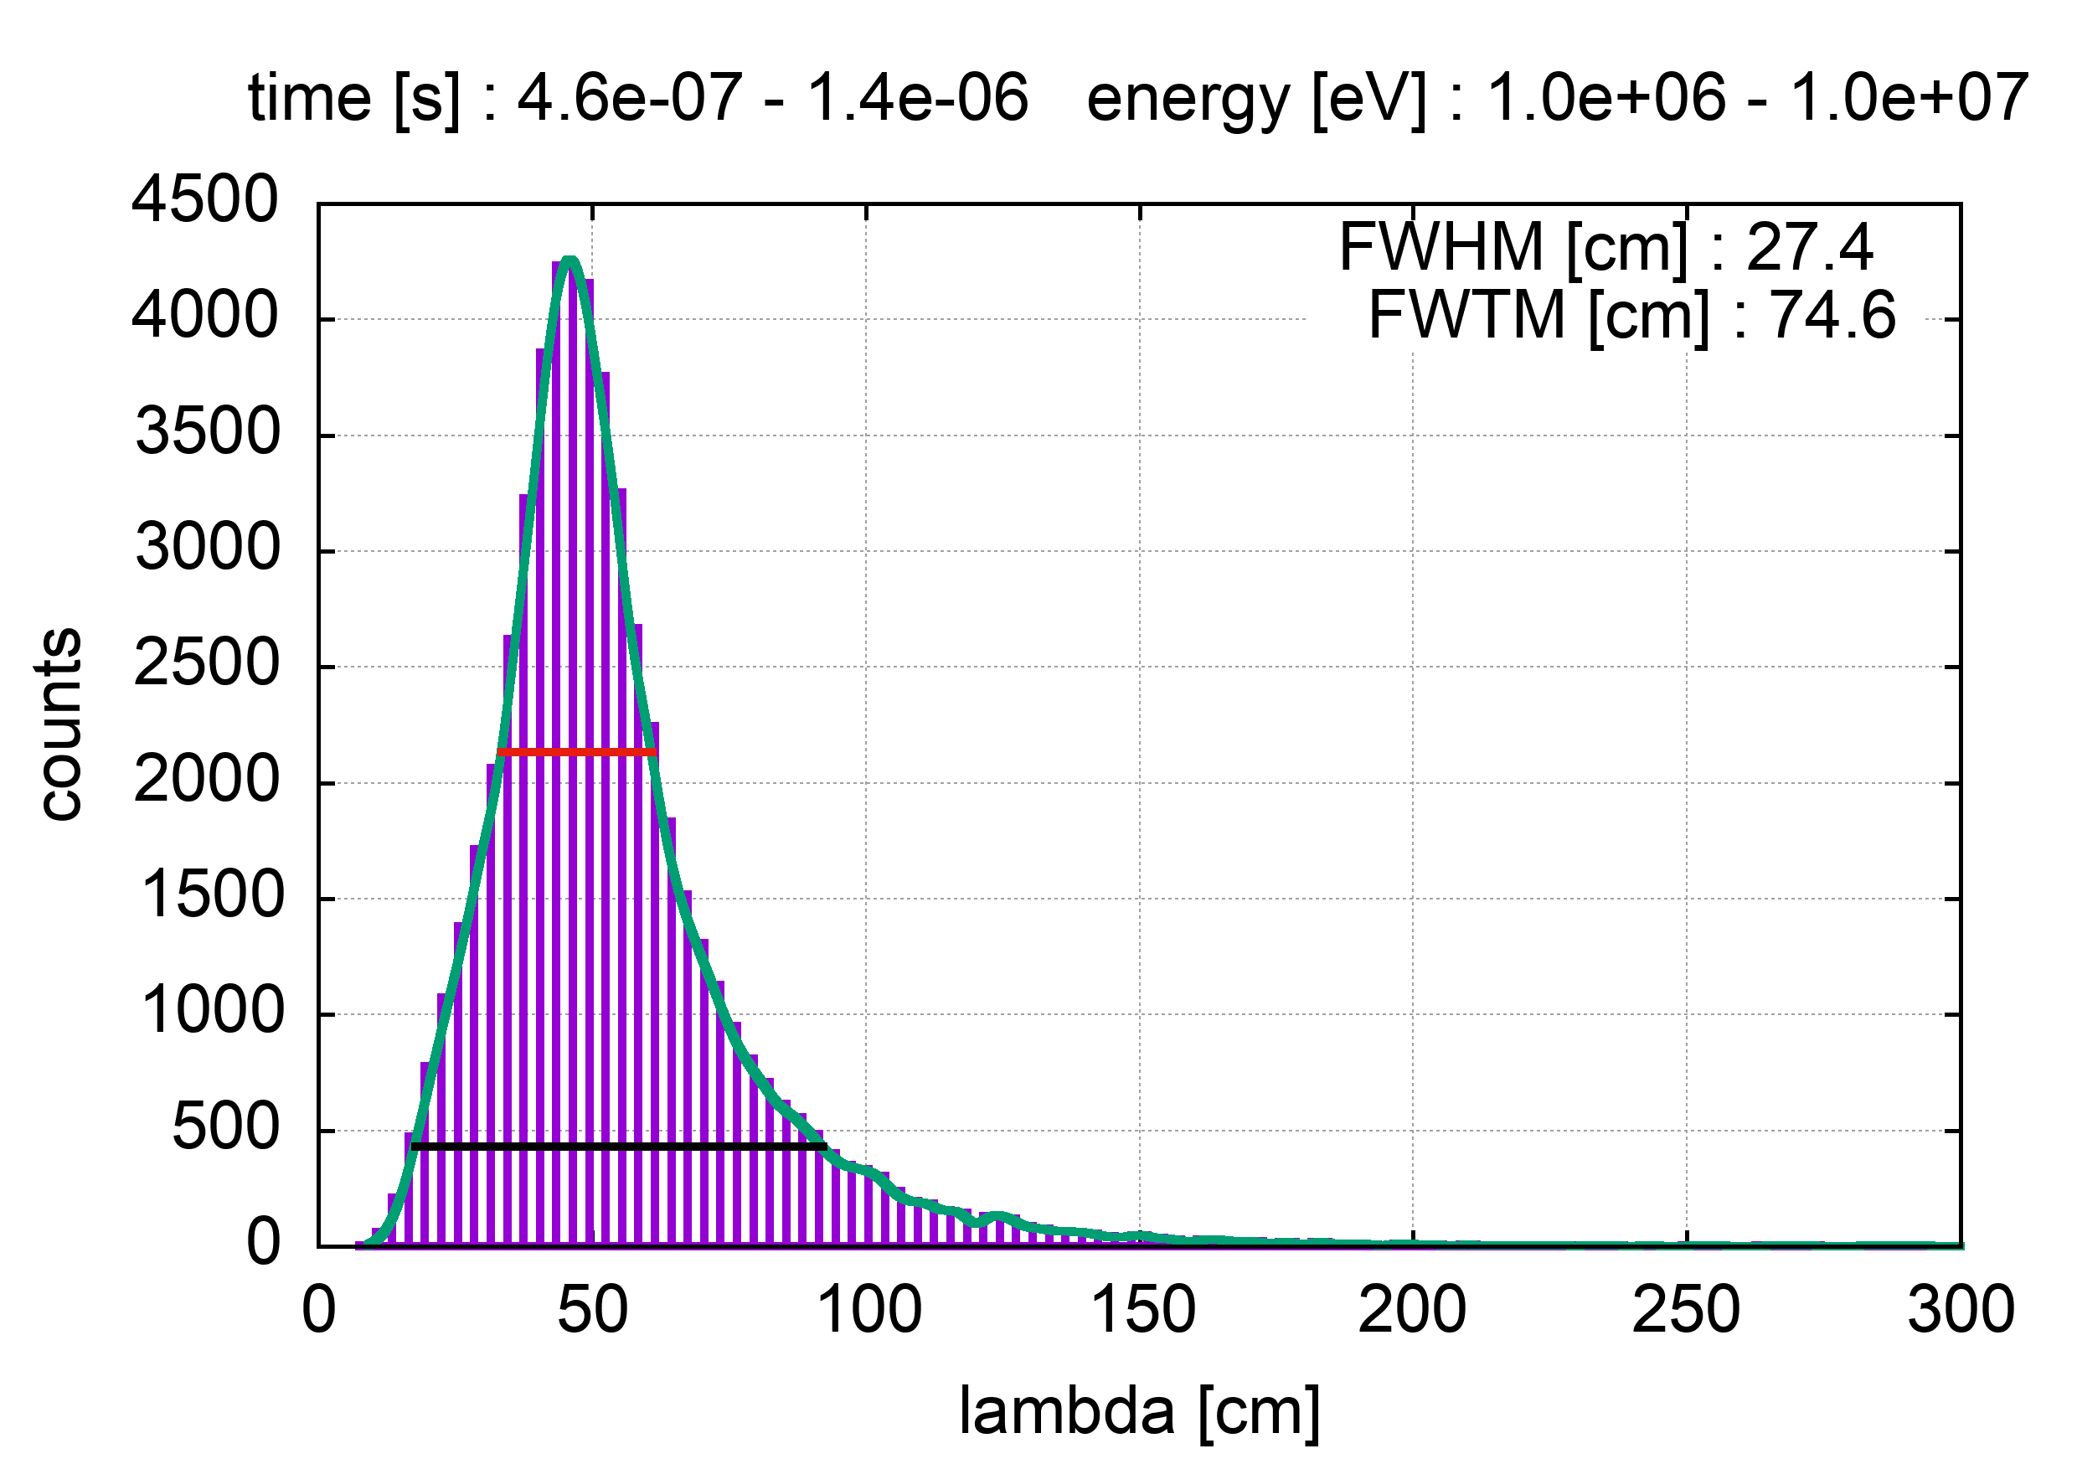
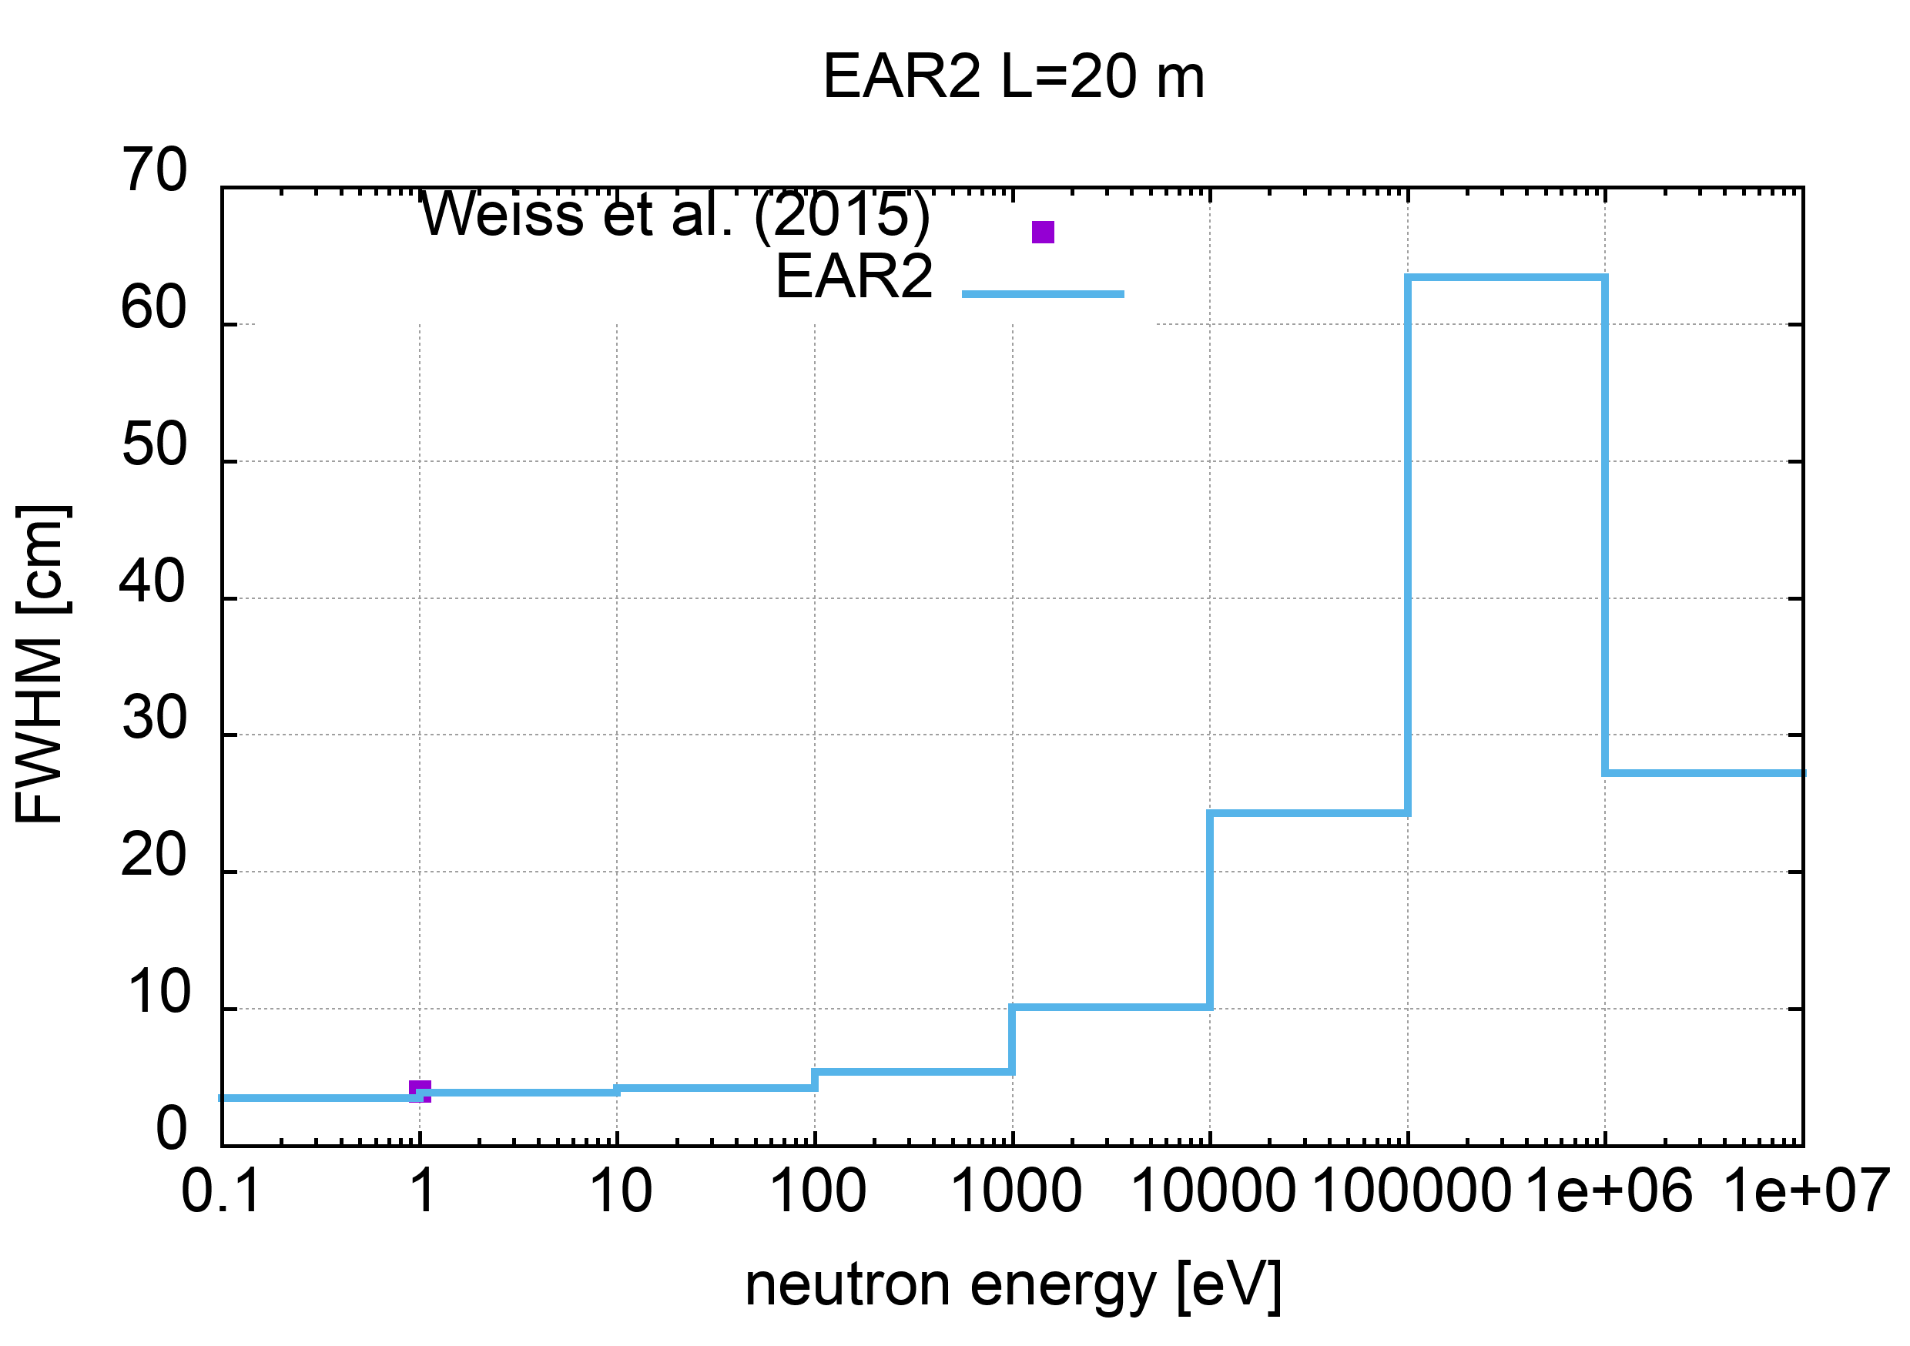
EAR2
#area : EAR2
#data file : data/EAR2_scorewin
#flight-path [cm] : 2000.0
#relativistic : yes
#pbeam rms [ns] : 11.0
# energy range [eV] FWHM [cm] FWTM [cm] dE/E
0.1 1.0 3.7 12.7 3.7e-03
1.0 10.0 3.7 9.4 3.7e-03
10.0 100.0 4.1 11.5 4.1e-03
100.0 1000.0 5.5 17.5 5.5e-03
1000.0 10000.0 9.9 31.9 1.0e-02
10000.0 100000.0 23.7 87.4 2.5e-02
100000.0 1000000.0 62.4 154.0 6.6e-02
1000000.0 10000000.0 27.4 74.6 5.6e-02
(table updated 1 June 2022)

Slide 11
NEAR
z
a flight path of 4 m assumed
n_TOF Collaboration Meeting, 30 May 2022

Slide 12
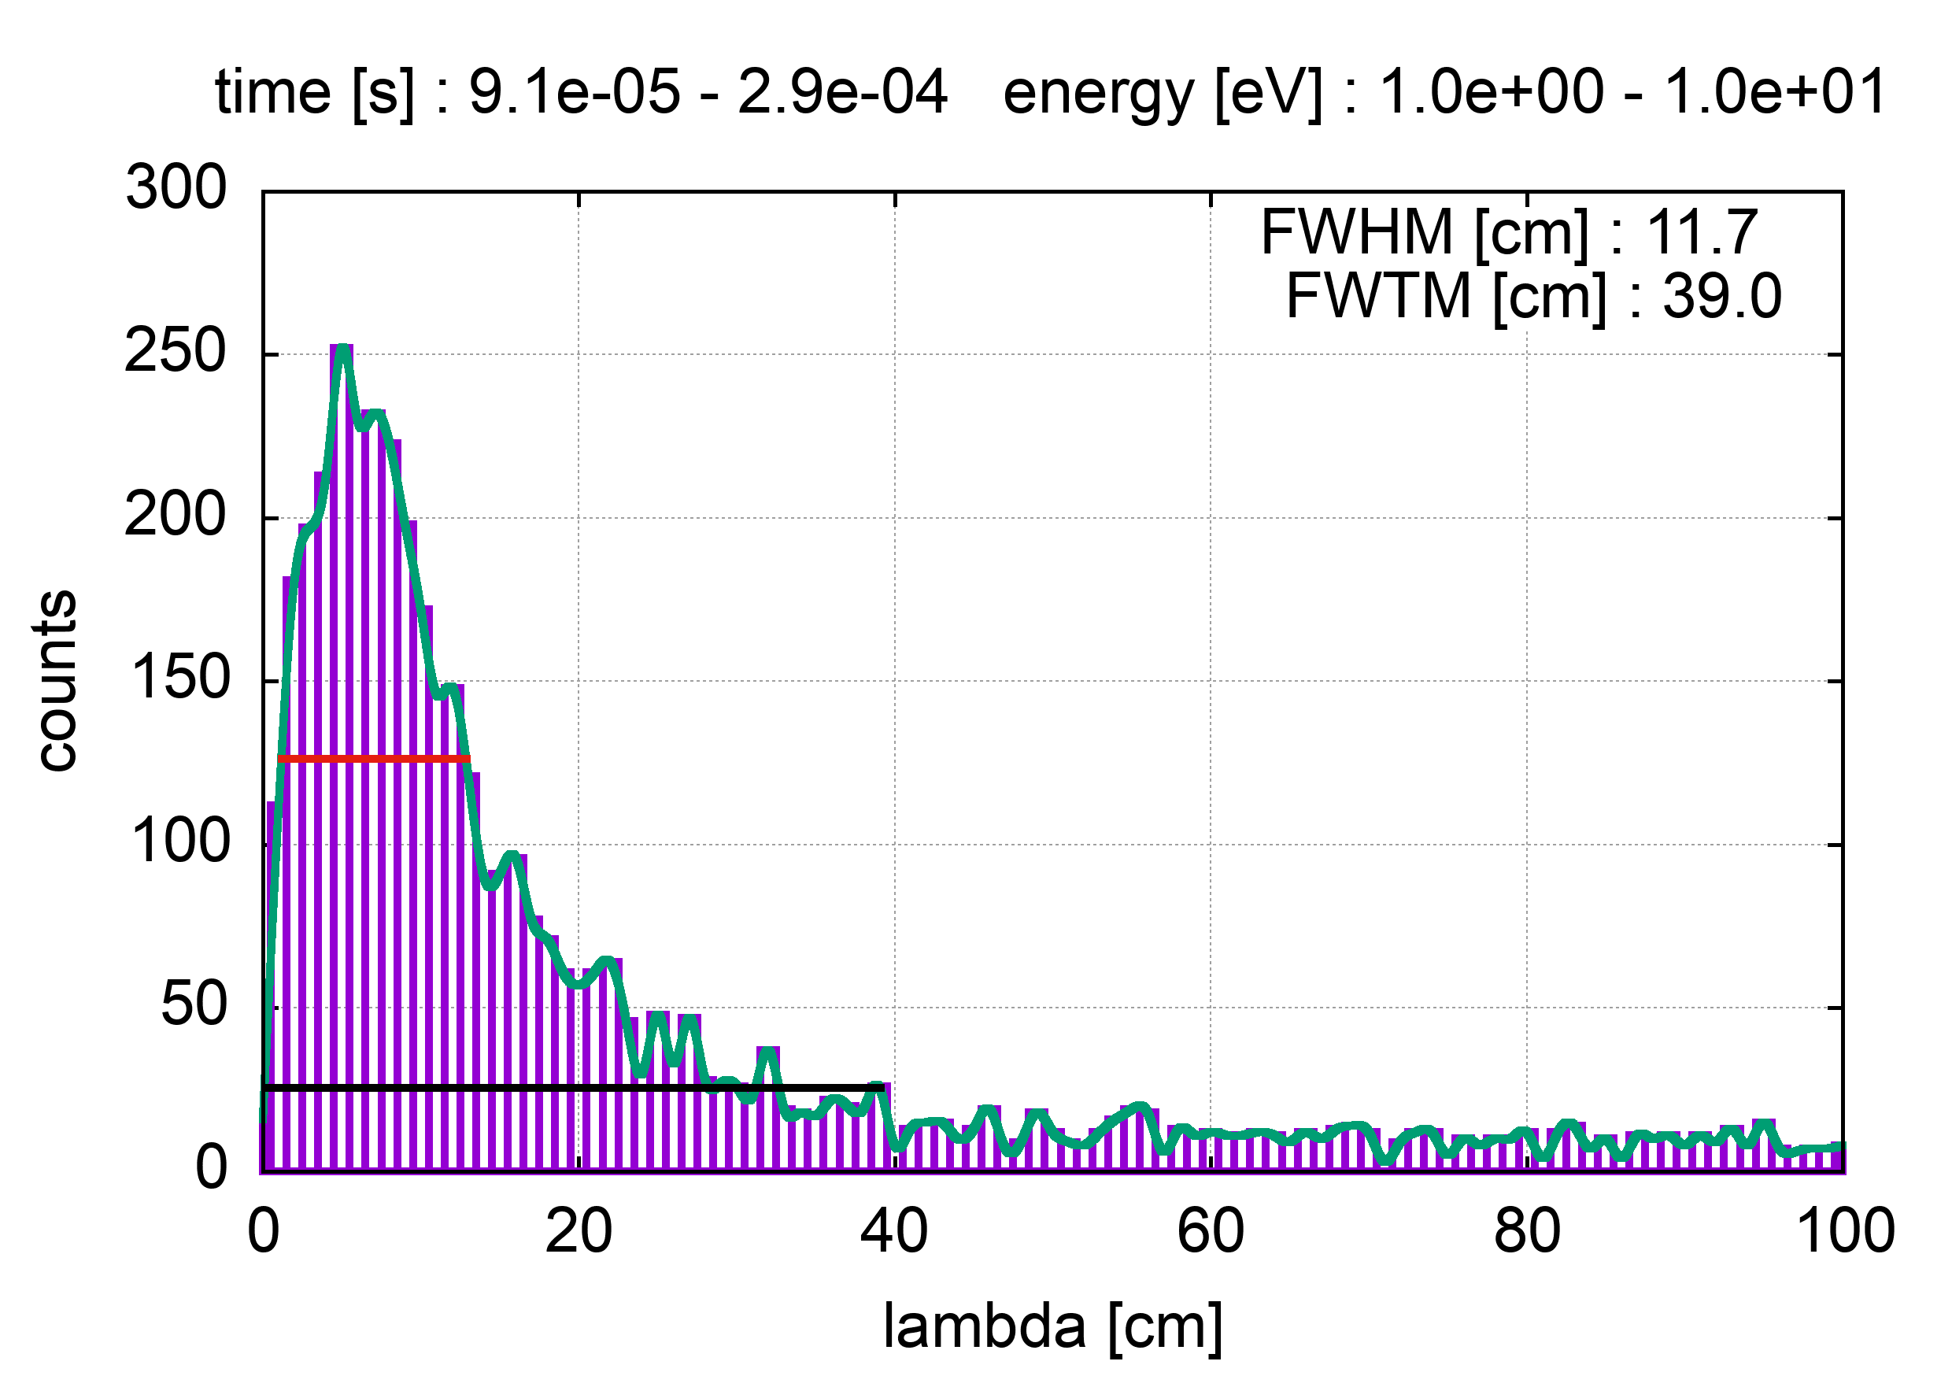
NEAR
Flight_path assumed: 4m
n_TOF Collaboration Meeting, 30 May 2022

Slide 13
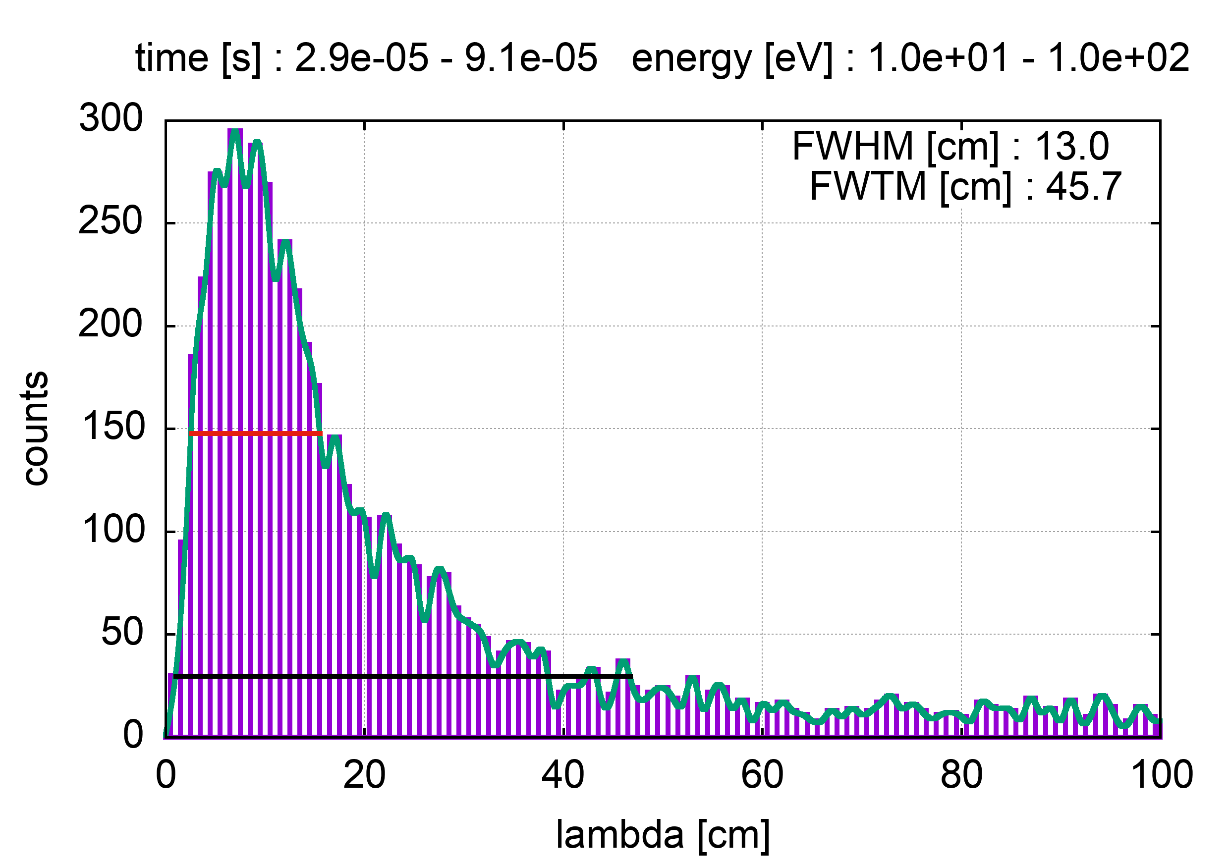
NEAR
Flight_path assumed: 4m
n_TOF Collaboration Meeting, 30 May 2022

Slide 14
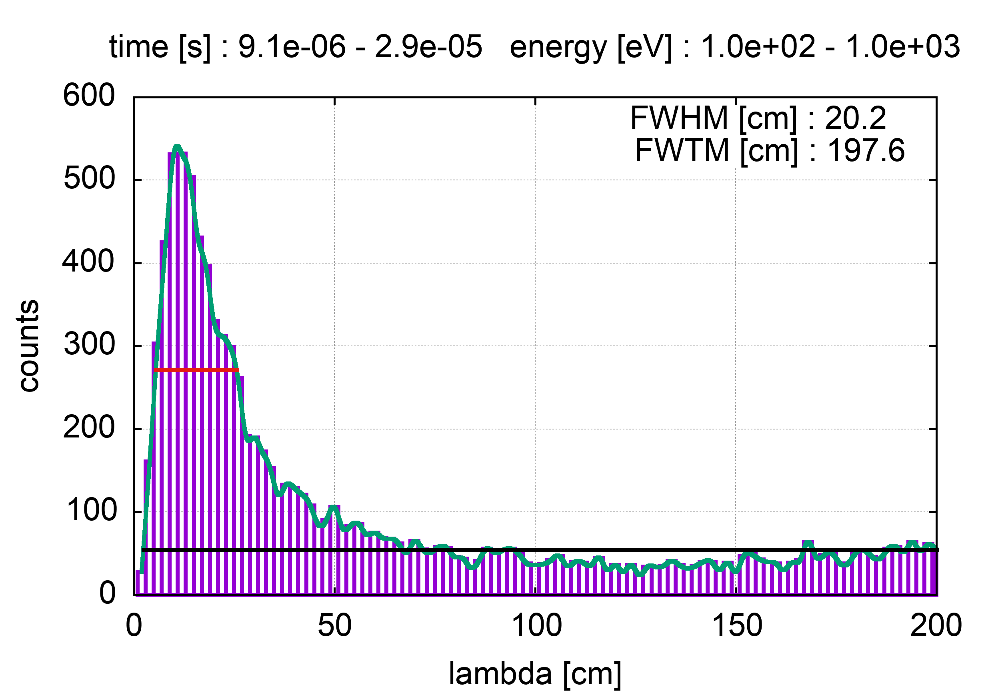
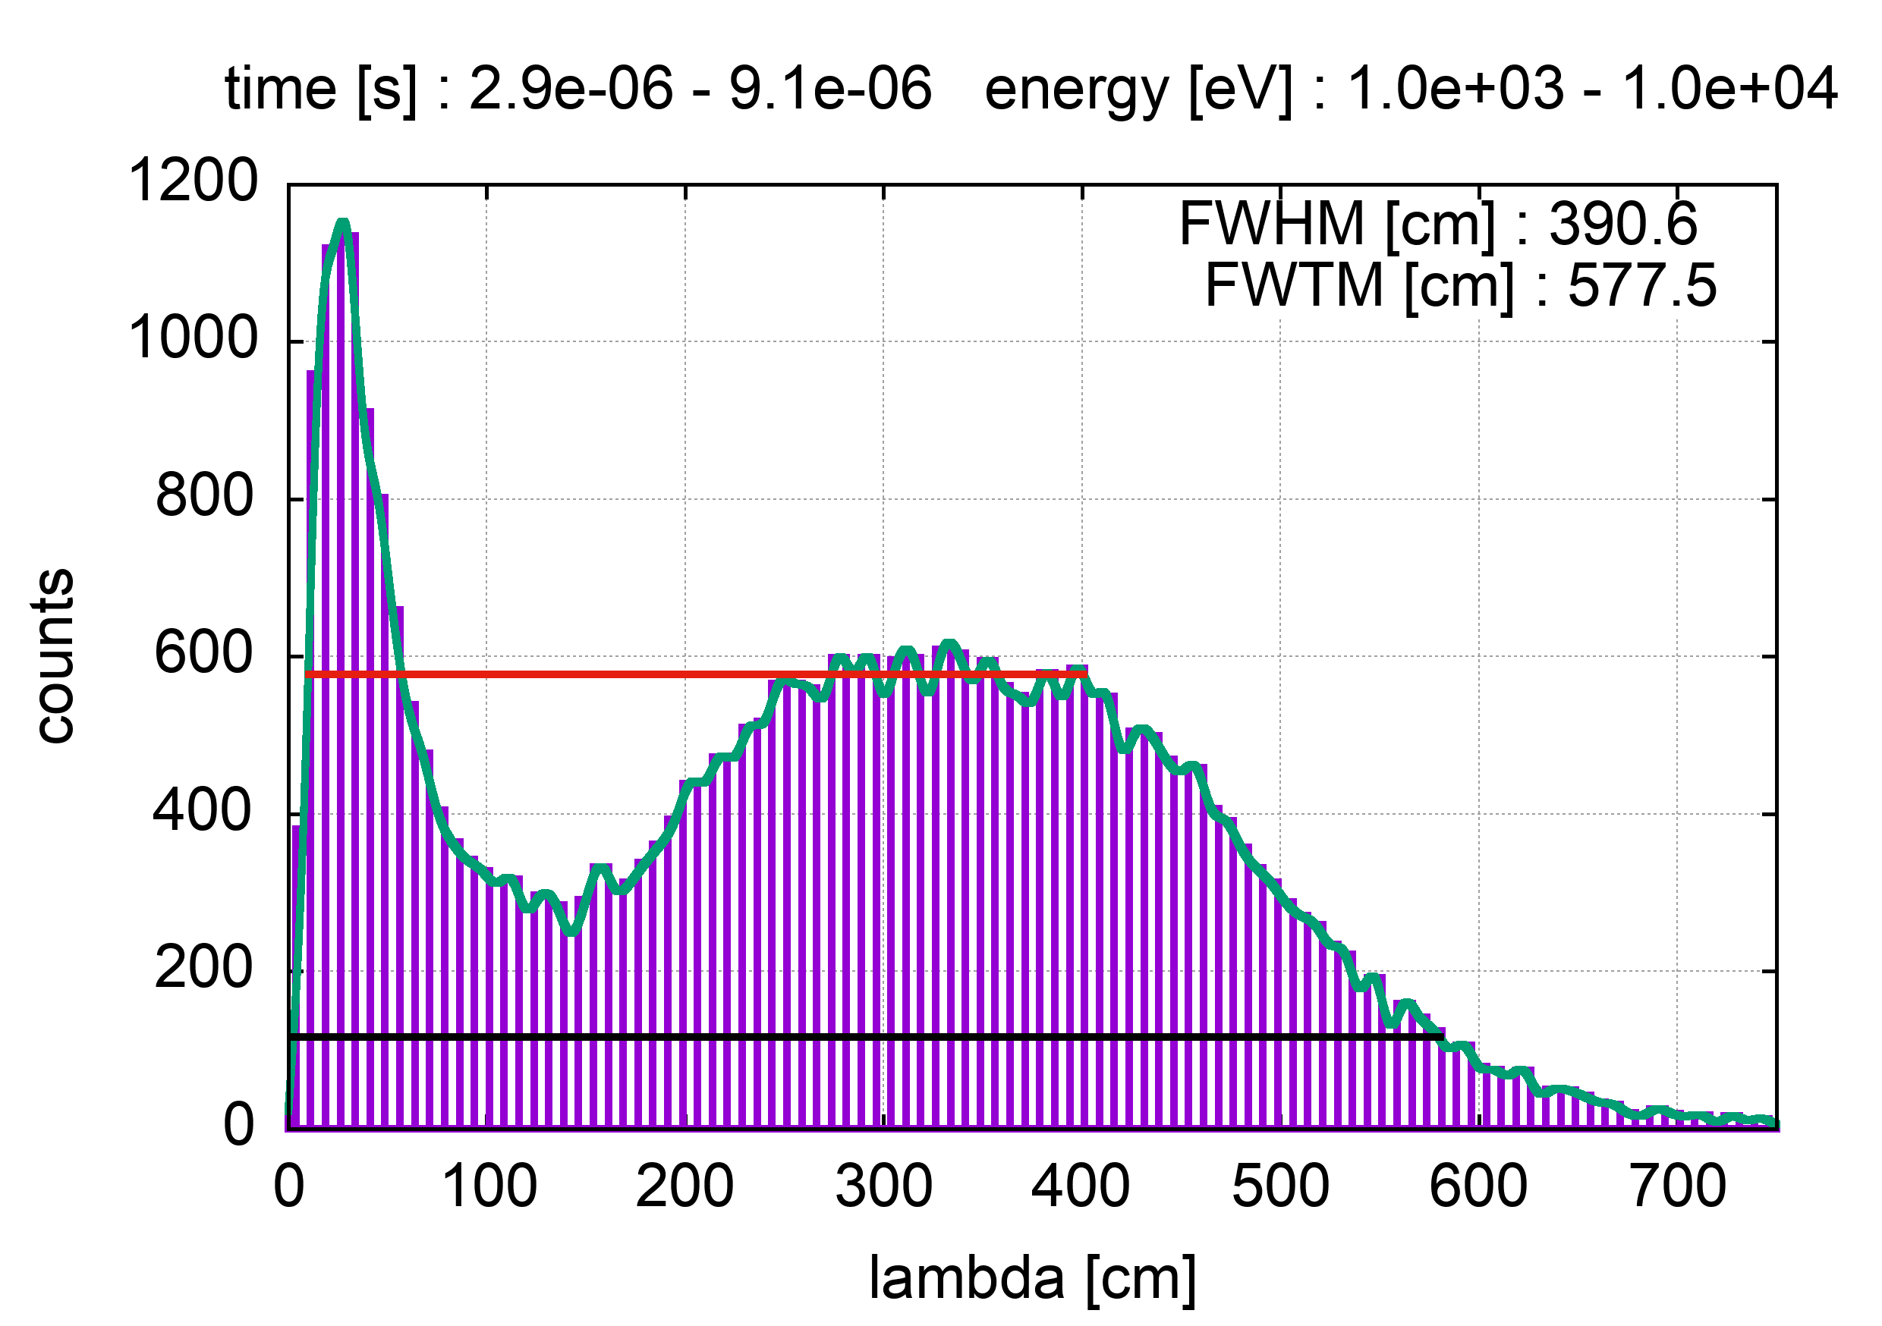
NEAR
Flight_path assumed: 4m
n_TOF Collaboration Meeting, 30 May 2022

Slide 15
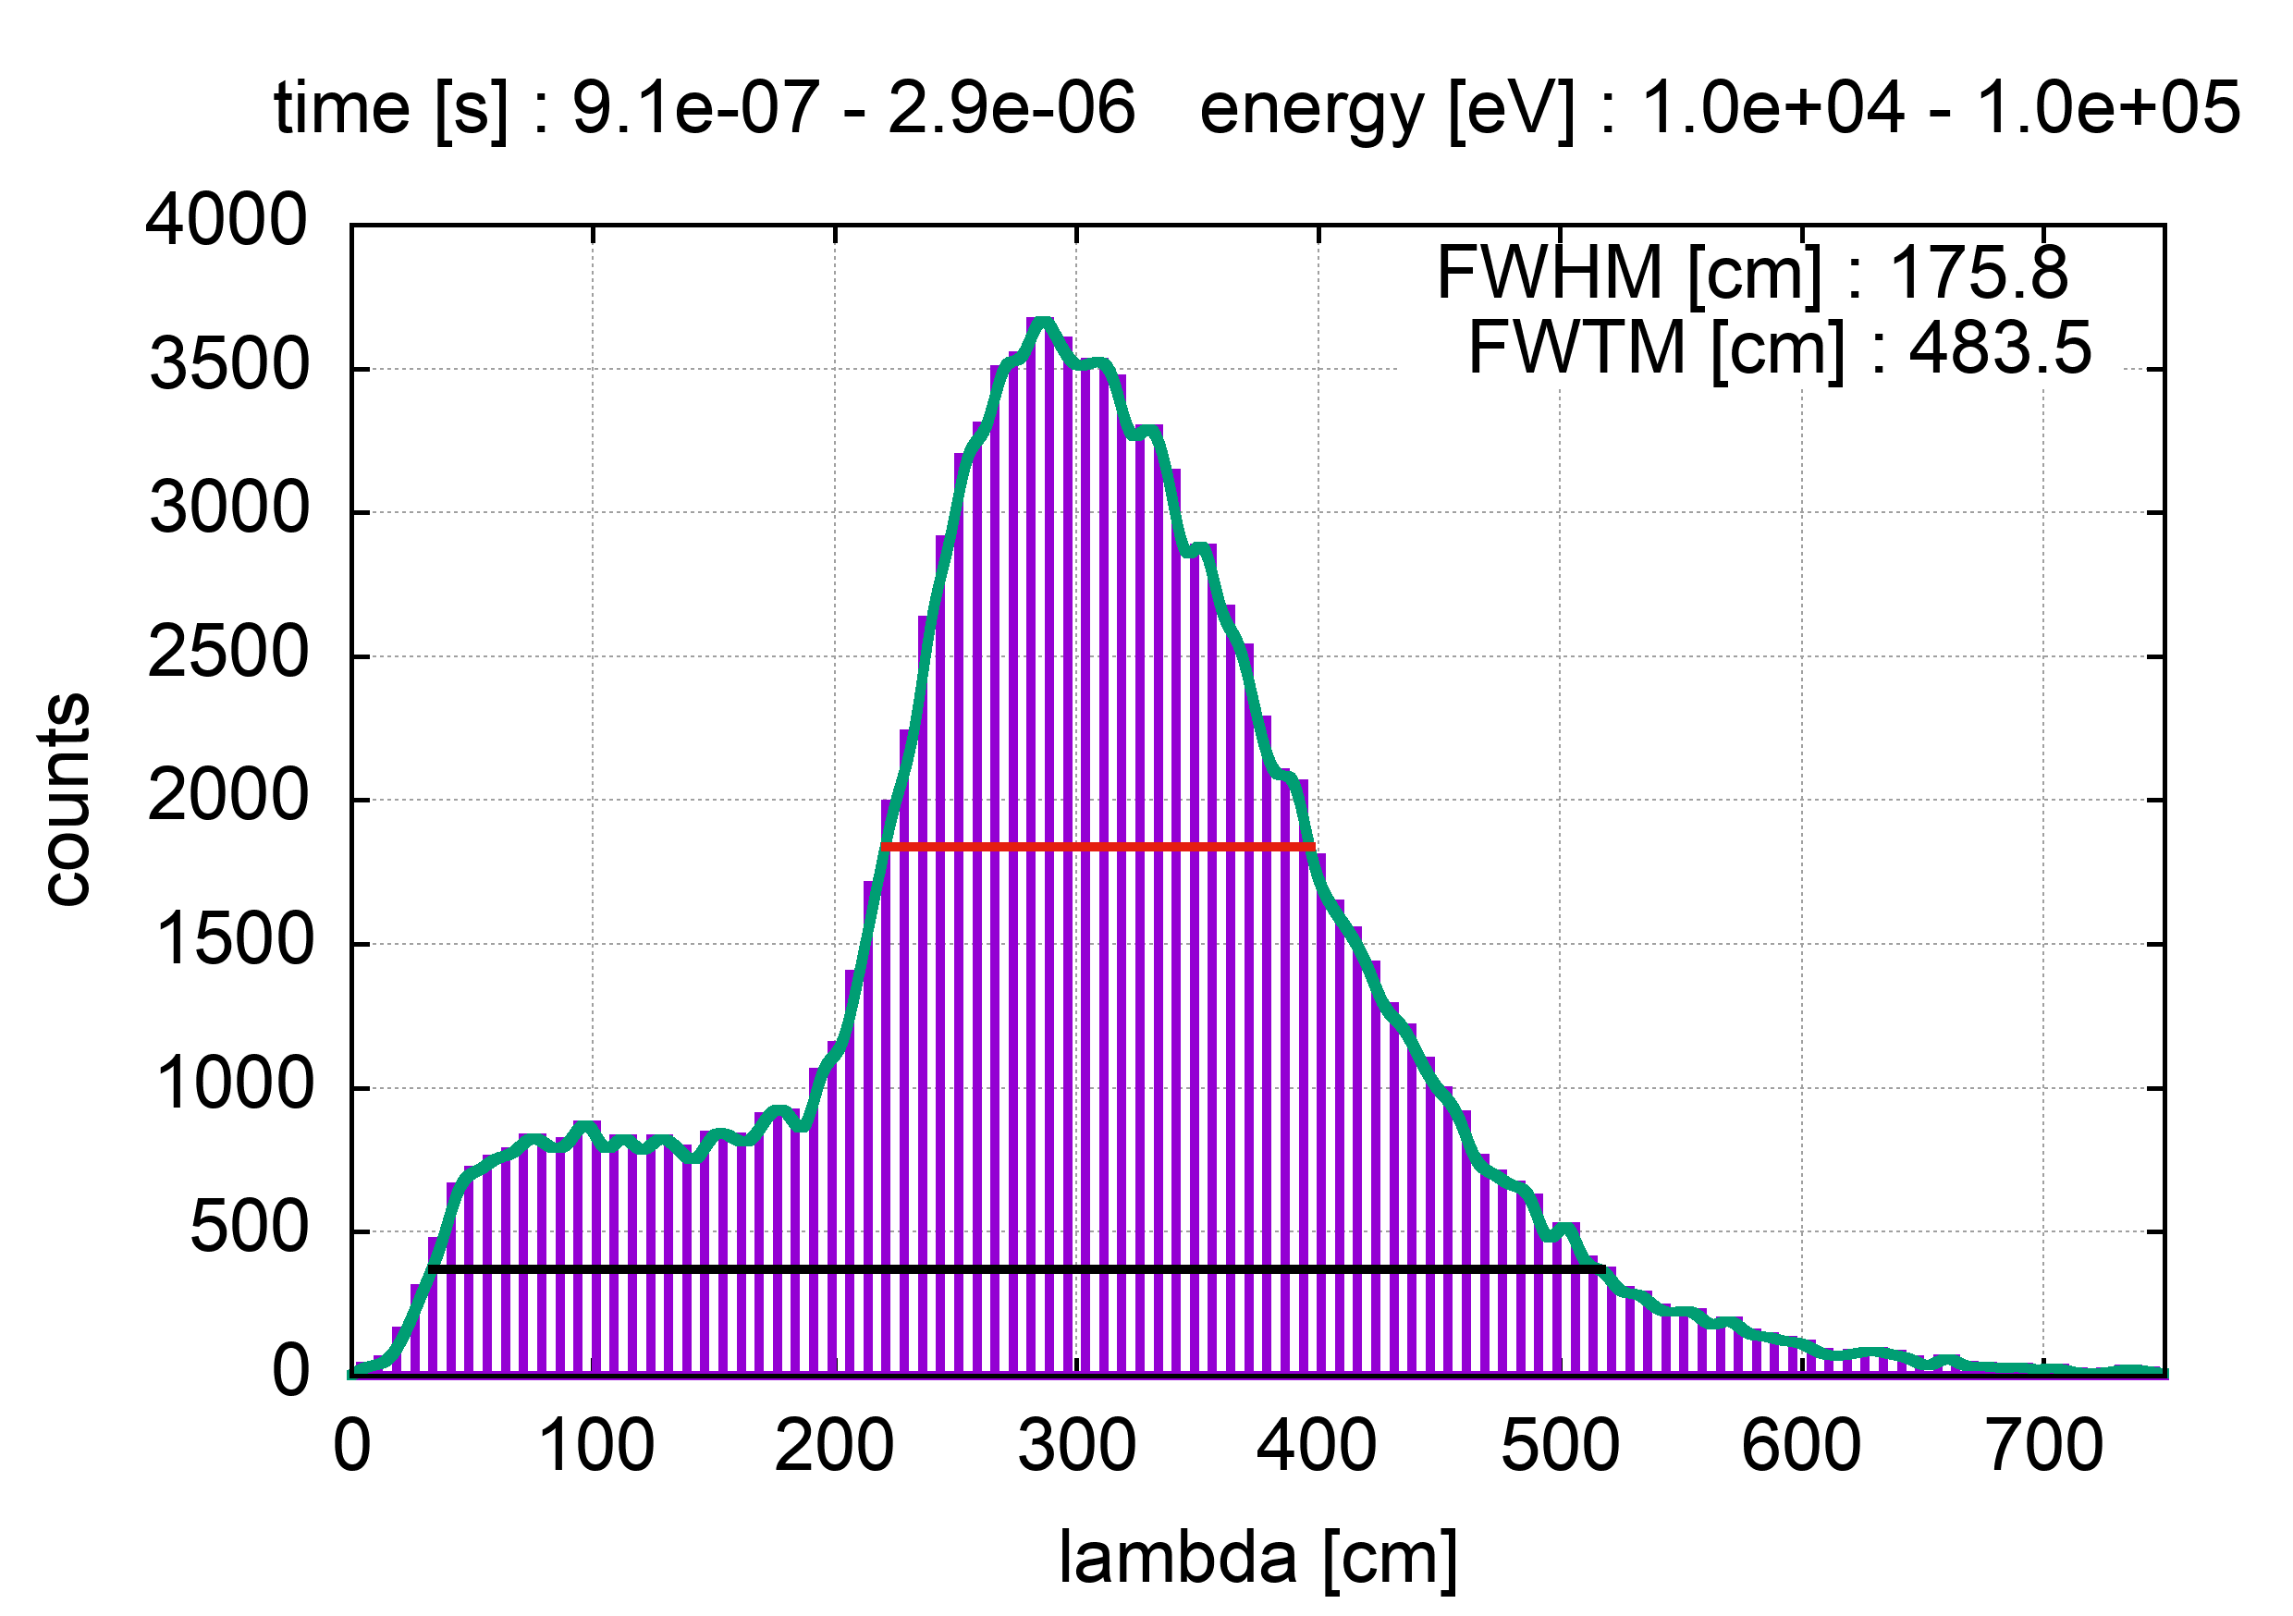
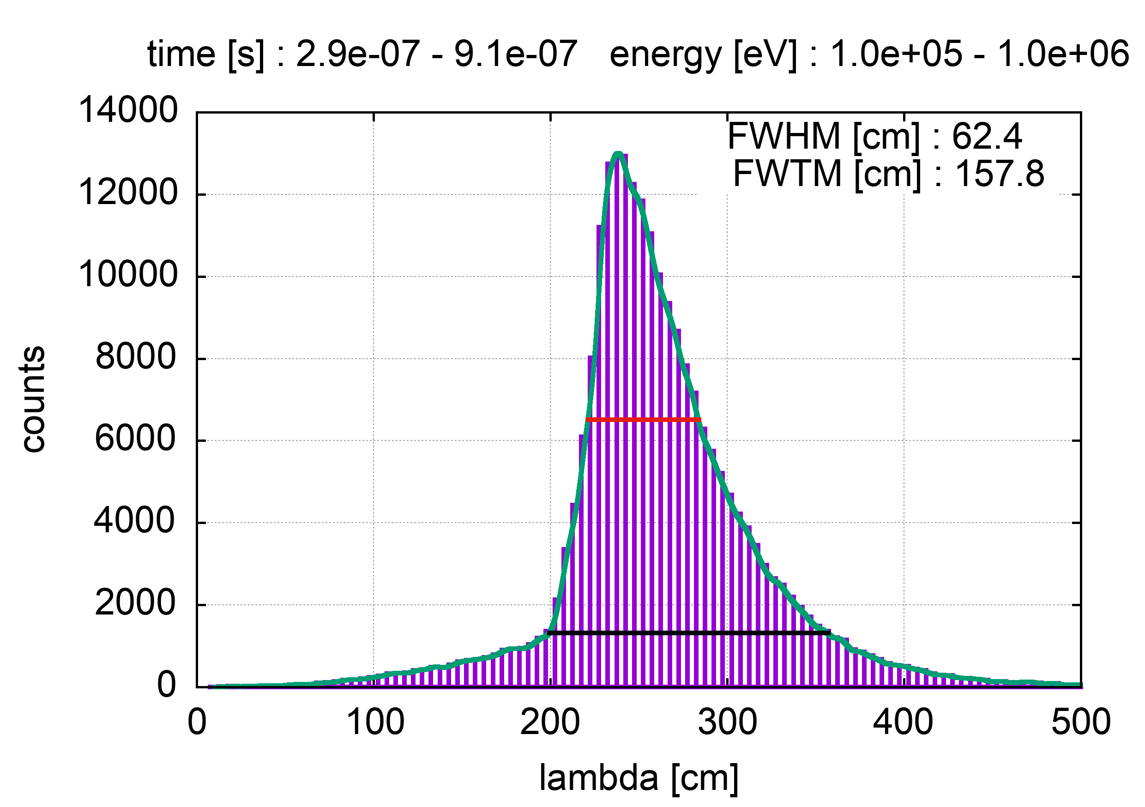
NEAR
Flight_path assumed: 4m
n_TOF Collaboration Meeting, 30 May 2022

Slide 16
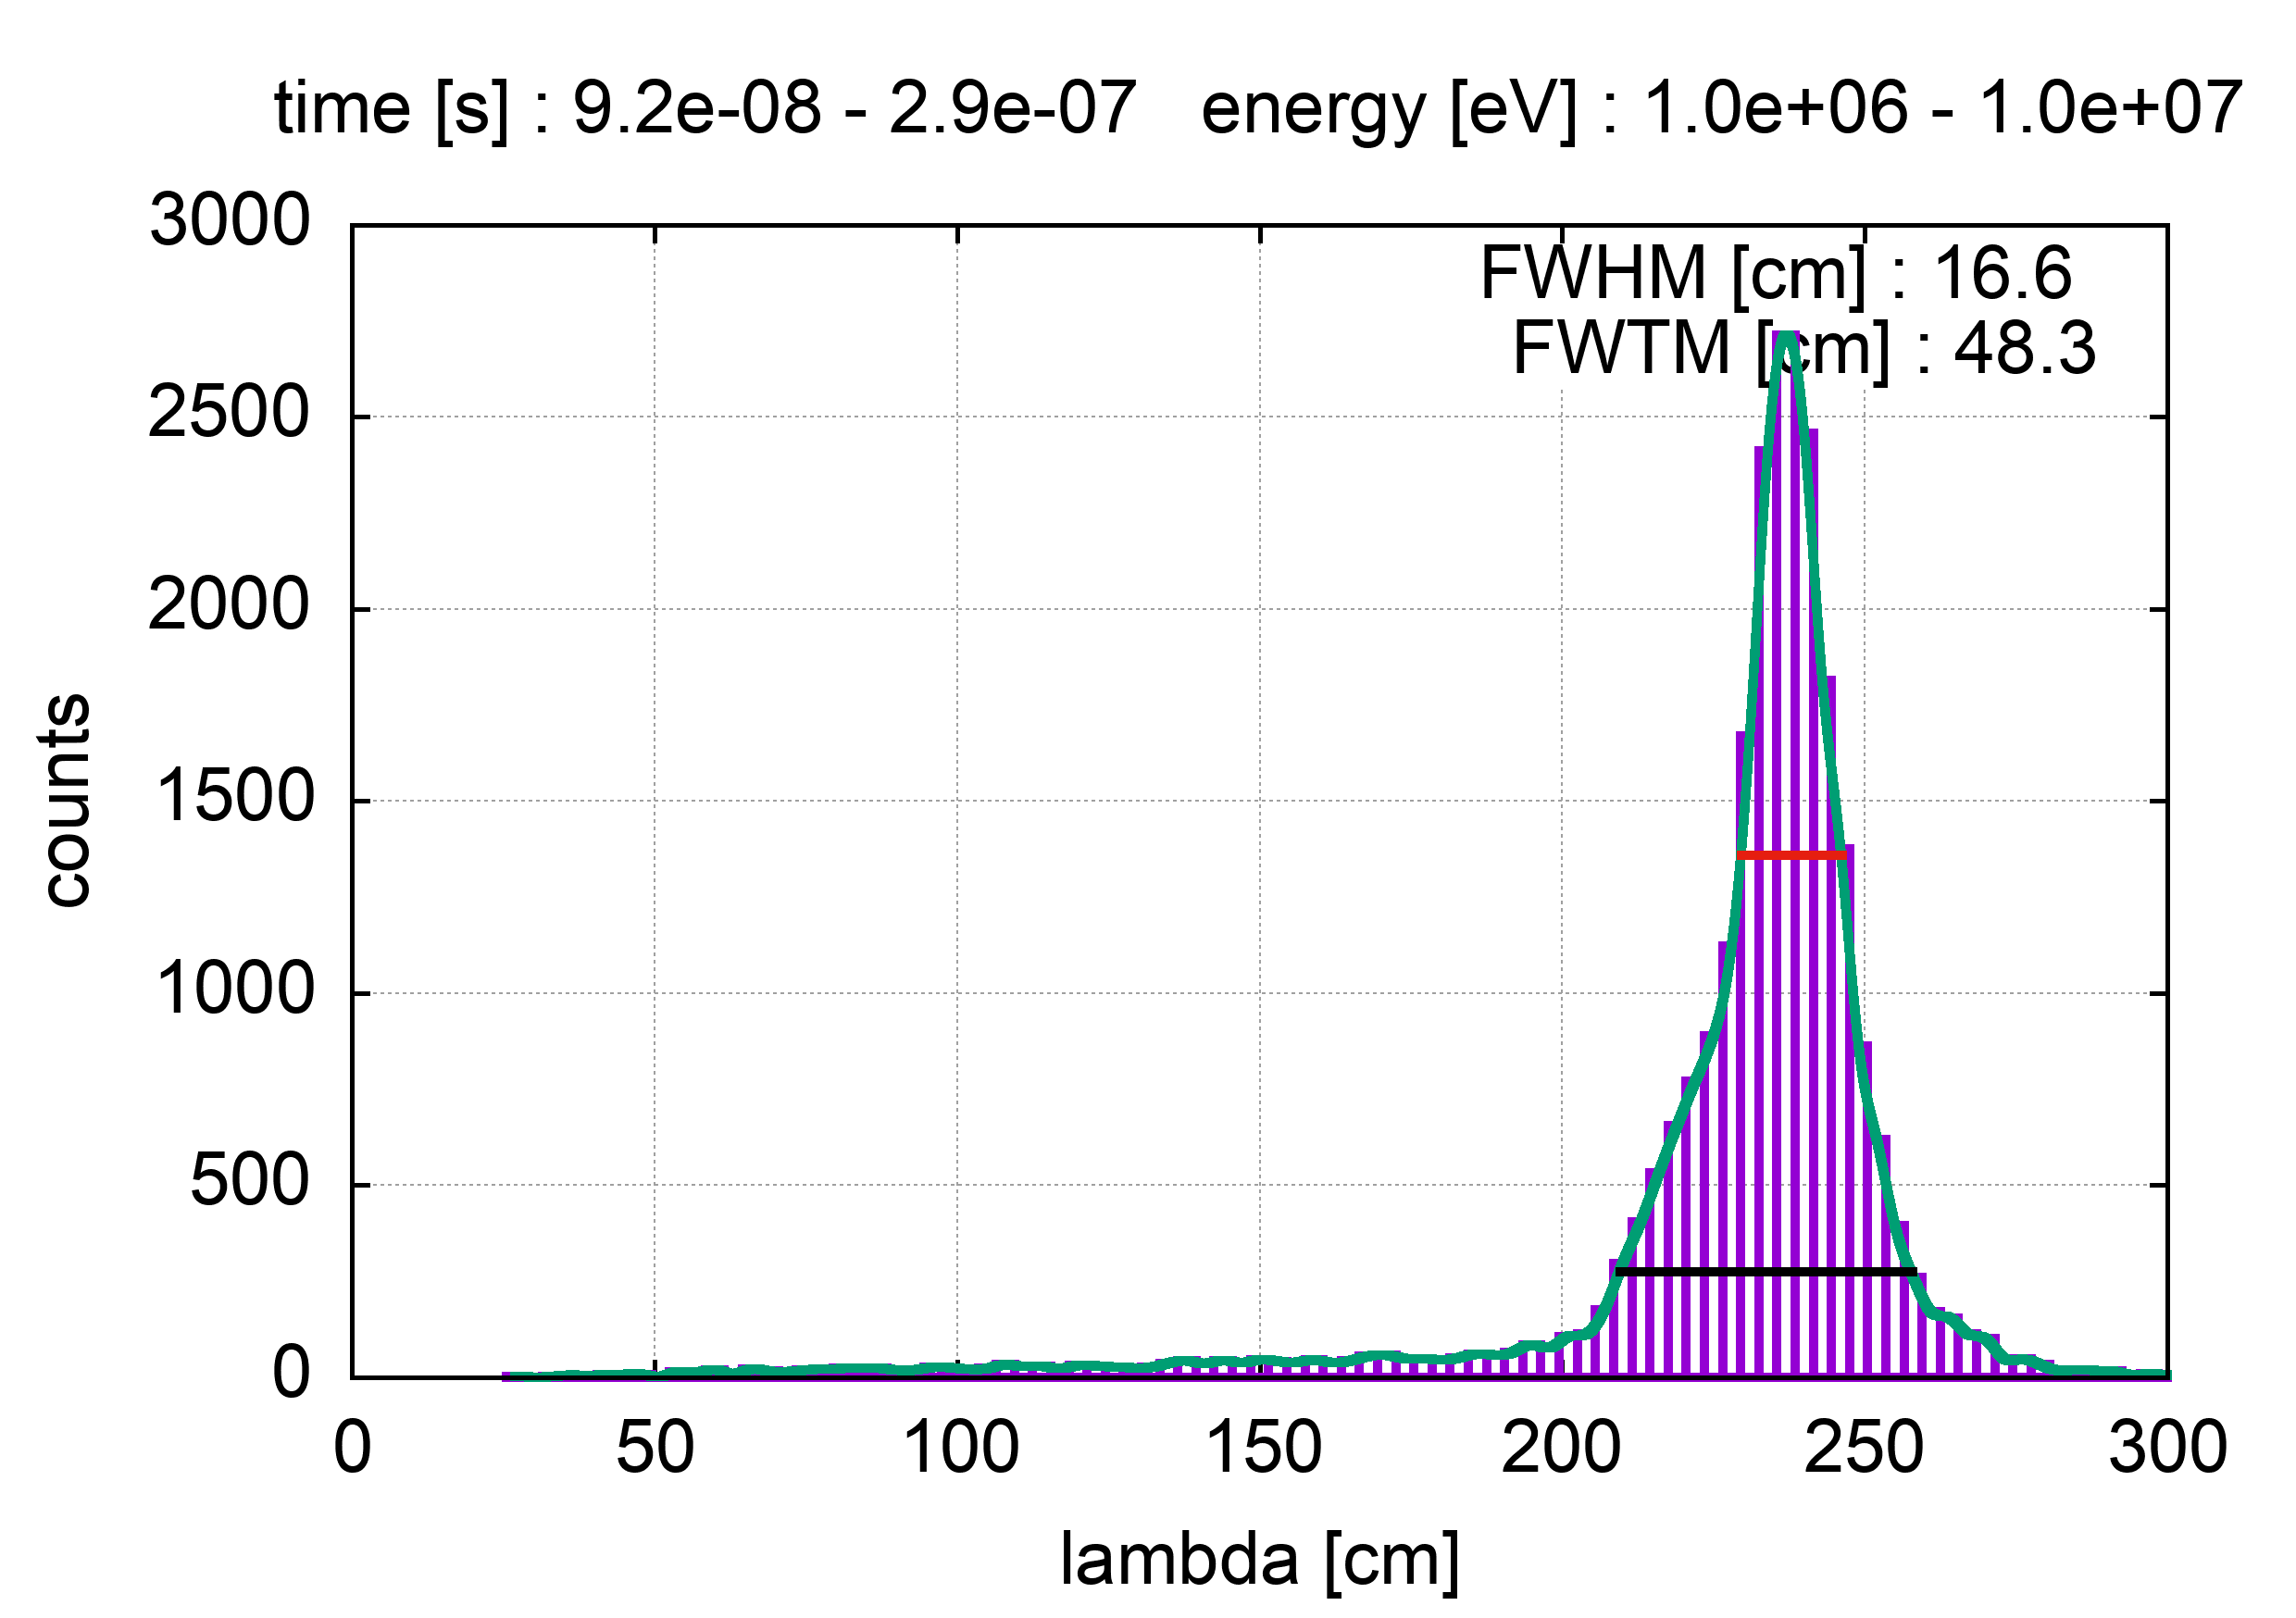
NEAR
Flight_path assumed: 4m
n_TOF Collaboration Meeting, 30 May 2022

Slide 17
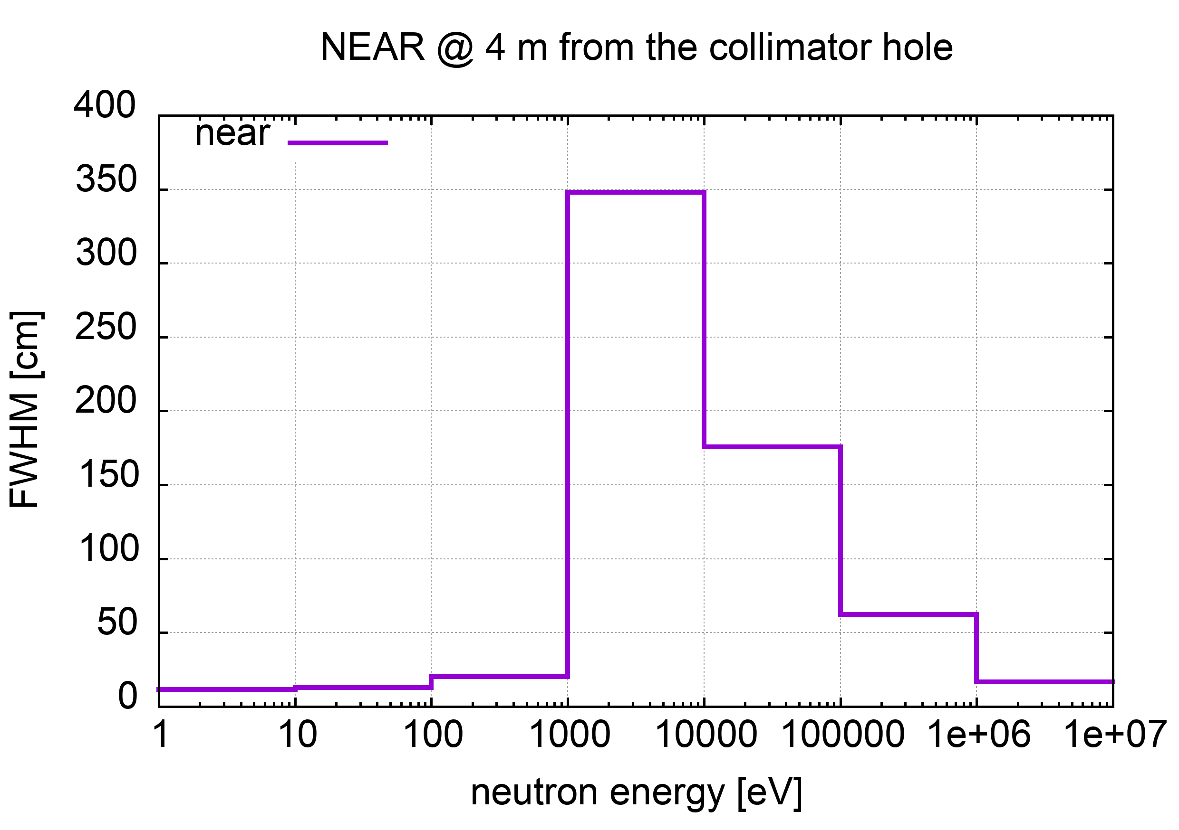
NEAR
Flight_path assumed: 4m
#area : NEAR
#data file : data/NEAR_score
#flight-path [cm] : 400.0
#relativistic : yes
#pbeam rms [ns] : 11.0
# energy range [eV] FWHM [cm] FWTM [cm] dE/E
1.0 10.0 11.7 39.0 5.8e-02
10.0 100.0 13.0 45.7 6.5e-02
100.0 1000.0 20.2 197.6 1.0e-01
1000.0 10000.0 390.6 577.5 2.0e+00
10000.0 100000.0 175.8 483.5 8.8e-01
100000.0 1000000.0 62.4 157.8 3.2e-01
1000000.0 10000000.0 16.6 48.3 2.8e-01
(table updated 1 June 2022)

Slide 18
Are TOF measurements possible at the NEAR Station
(or in its neighborhood)?
Perhaps…
n_TOF Collaboration Meeting, 30 May 2022

Slide 19
The End
n_TOF Collaboration Meeting, 30 May 2022

