Slide 1
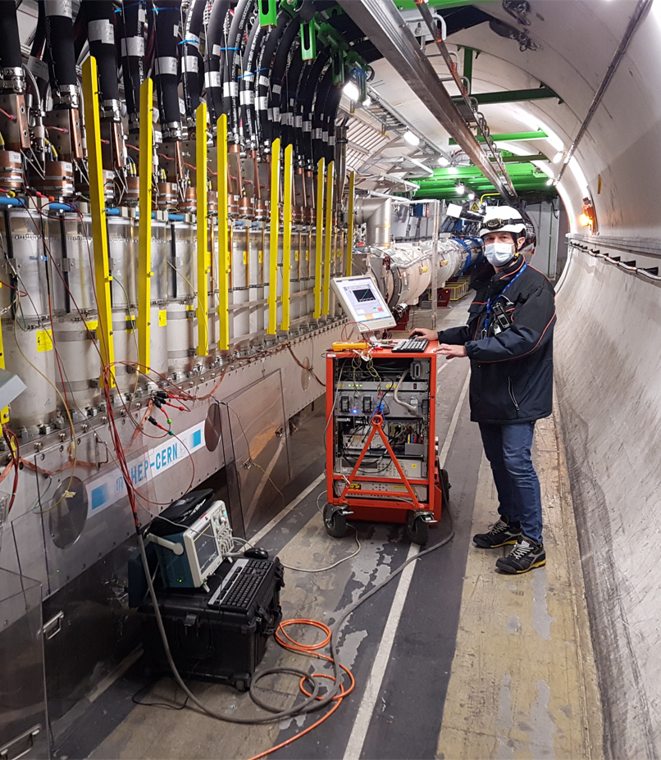
The ELQA program for the Inner-Triplet String test in SM-18
Mateusz Bednarek on behalf of the ELQA team
2022-04-13 TE-MPE-PE

Slide 2
Outline
ELQA – Introduction
ELQA plan post-LS2
ELQA program on the IT String

Slide 3
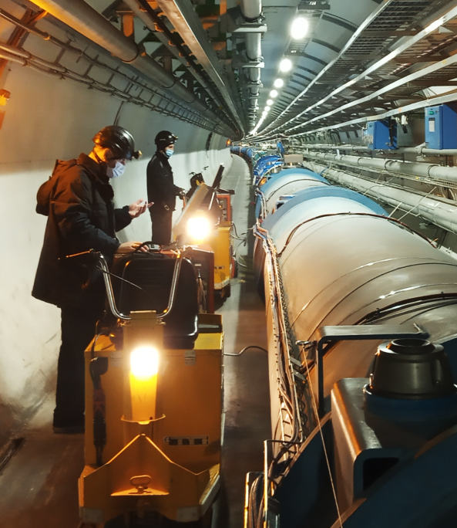
ELQA - introduction
Test superconducting circuits and magnets
(at warm, cold and during thermal transitions)
Ensure readiness for powering
Detect signs of faults, ageing, degradation
The test results are assessed according to defined acceptance thresholds and also they are traced over time to find possible trends and signatures of faults that may develop
The objective is to validate circuits for operation at high currents in a safe way
Regularly performed starting from the LHC assembly phase (~2005) until today

Slide 4
ELQA „building blocks”
HVQ – High Voltage Qualification
TFM – Transfer Function Measurement
IRC – Instrumentation Resistance Check
ICC – Instrumentation Configuration Check
TDR – Time Domain Reflectometry
COC – Continuity of Conductor check
QHR – Quench Heater Resistance measurement
DVC – Diode opening Voltage Check
TSQ – Temperature Sensor Qualification

Slide 5
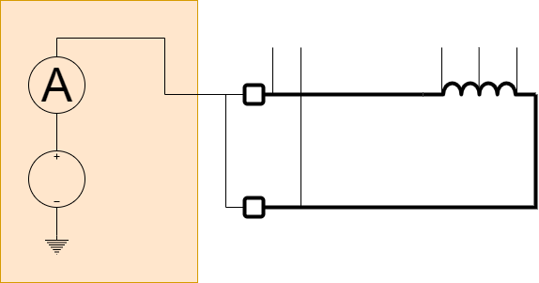
HVQ – High Voltage Qualification
Each circuit (part of a circuit, bus-bar, instrumentation wire or quench heater) is energized individually with respect to ground using a DC voltage source limited to a current of 2 mA
During the test of a given circuit, all other circuits of the same electrical safety sub-sector are grounded
Applied test voltages are defined for each component at each configuration and for warm and cold tests

Slide 6
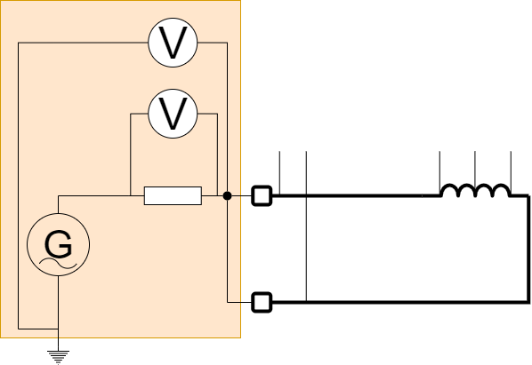
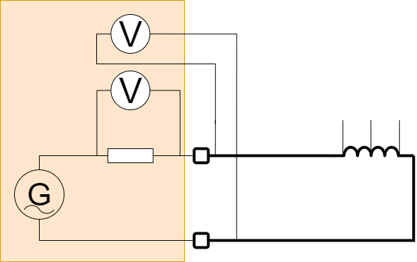
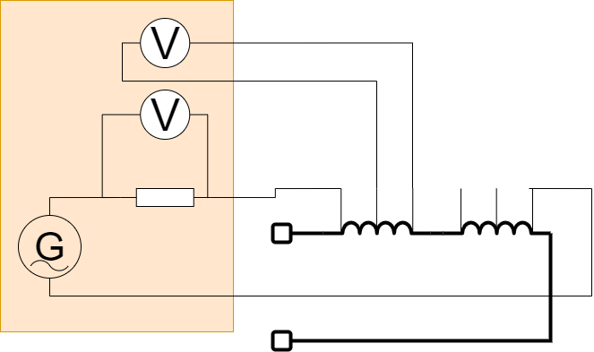
TFM – Transfer Function Measurement
This measurement determines the impedance as a function of frequency
The results of these measurements are used to spot possible inter-turn shorts and detect other possible circuit anomalies
The impedance is measured by applying a sinusoidal signal with maximum amplitude of 10 V and maximum current of 1 A
Frequency range of 0.1 Hz - 100 kHz
Principle of TFM vs. GND measurement
Principle of TFM measurement
Principle of Local TFM measurement on the magnet (applied during MIC test)

Slide 7
Detailed description of other tests is available in the test procedures:
Regular ELQA in the LHC: EDMS 788197
IT string procedures being finalised at the moment

Slide 8
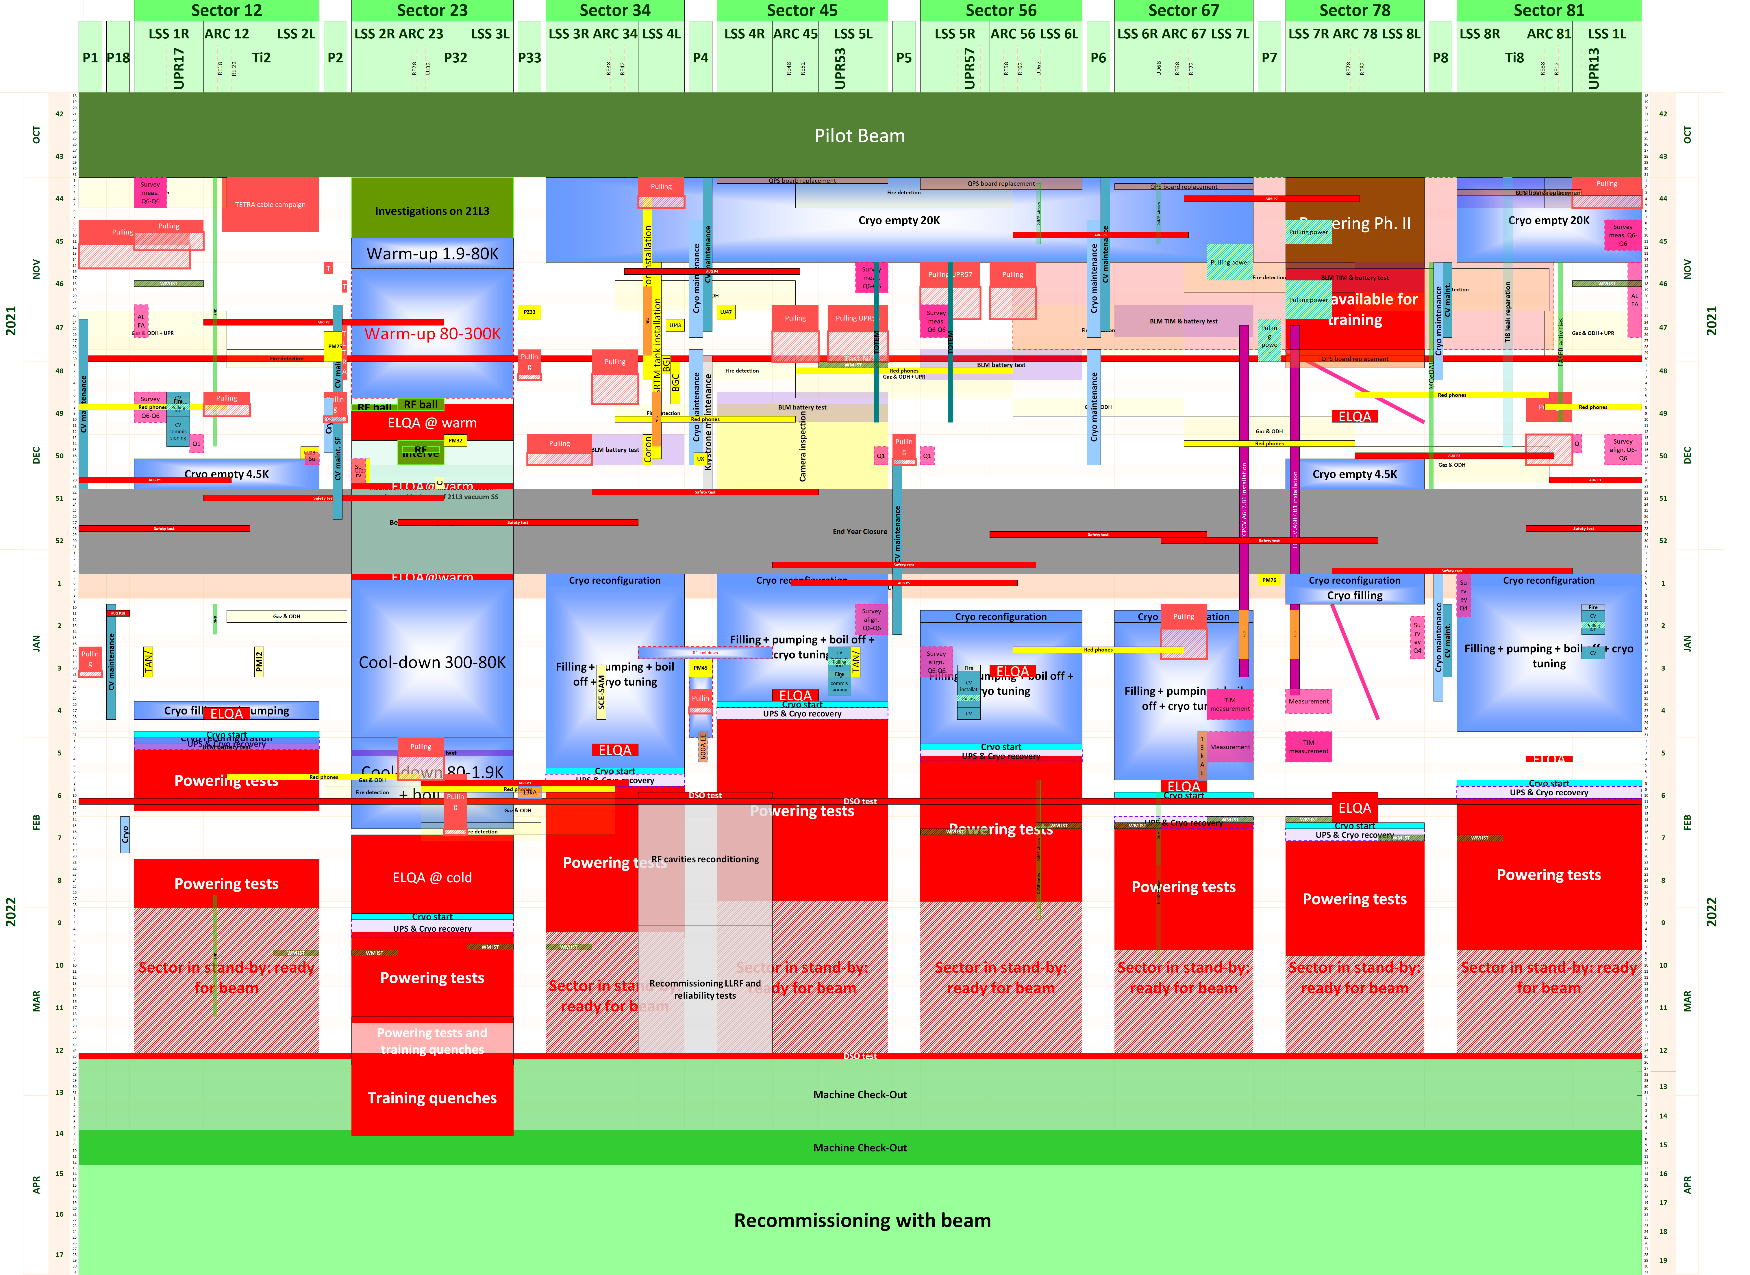
Example: program of activities YETS 21/22

Slide 9
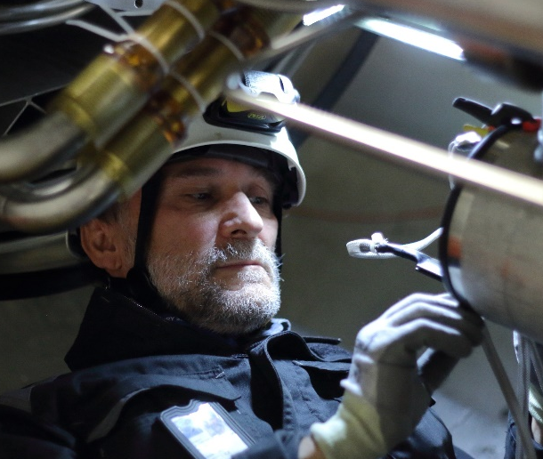
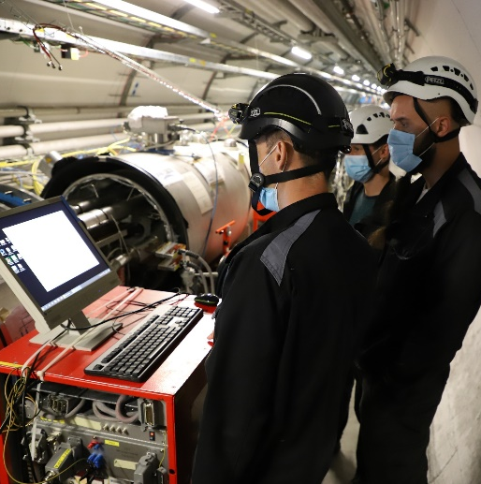
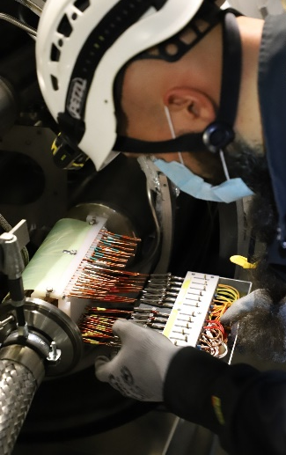
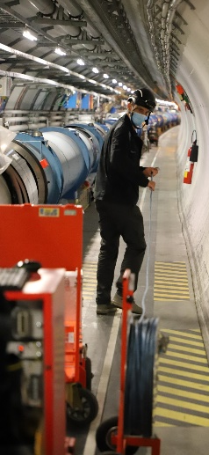
Number of ELQA tests – LS2
Each test consists of several measurements. Results are stored and analysed.
Notes:
As you can imagine,
ELQA tests generate a huge amount of data that needs to be stored and analyzed: Automated tools and experts knowledge is required.

Slide 10

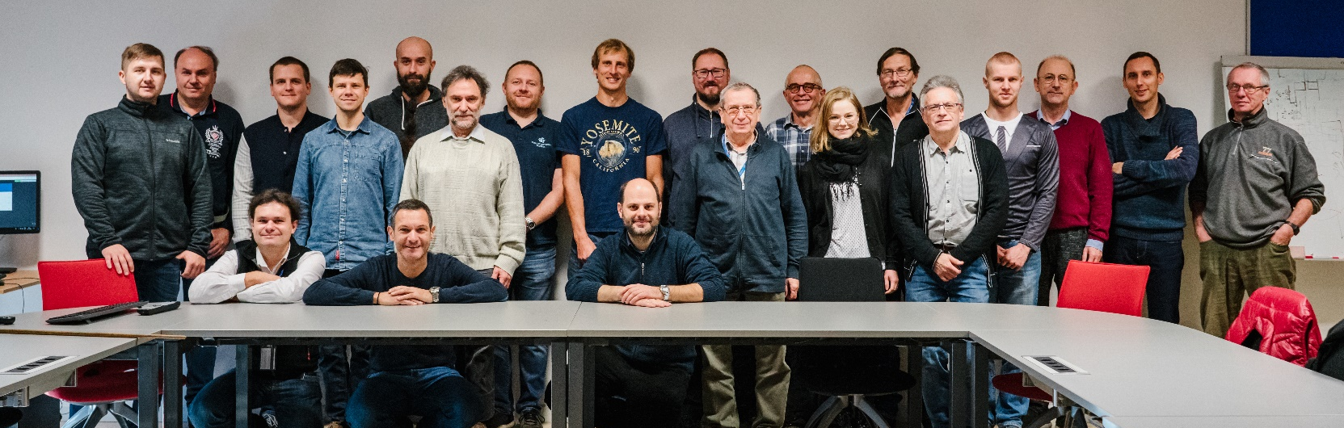
The ELQA team – LS2
Collaboration with Henryk Niewodniczanski Institute of Nuclear Physics Polish Academy of Sciences in Krakow
ELQA experts at CERN (3 staff)
Taken before the plague
DISMAC
Final campaign warm + cold tests
Additional 2 sectors tested
COVID lockdown
Initial campaign cold + warm tests
Notes:
Behind this major activity, there is a strong team of trained Engineers and Technicians, based on very fruitful collaboration with IFJ PAN (Krakow) and a small local team

Slide 11
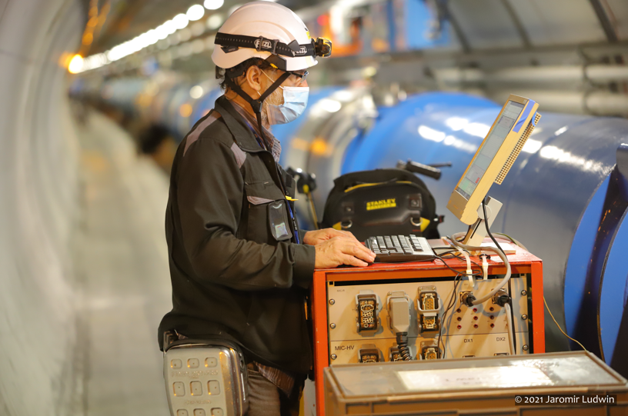
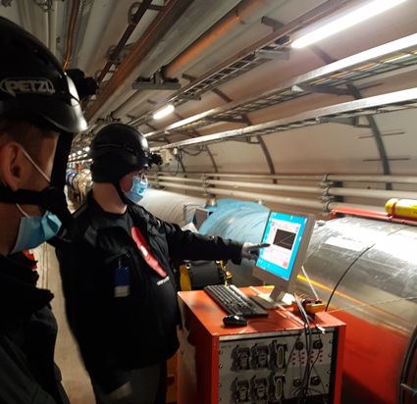
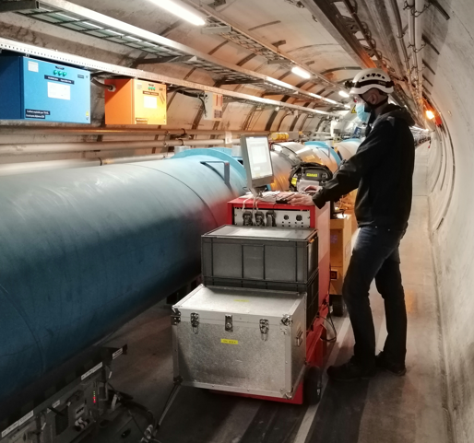
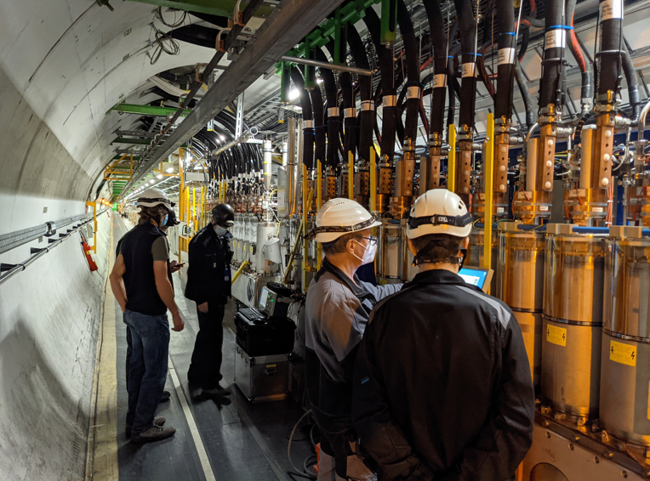
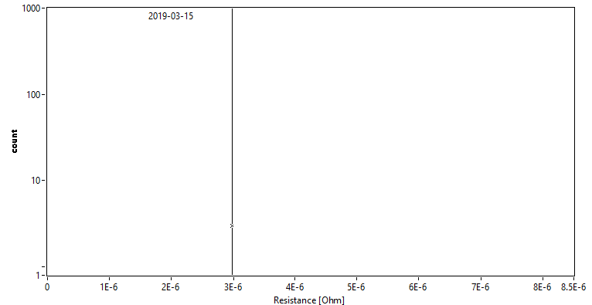
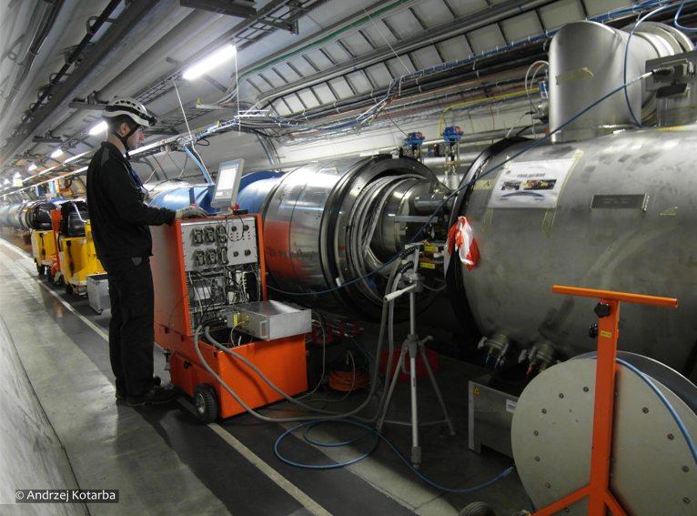
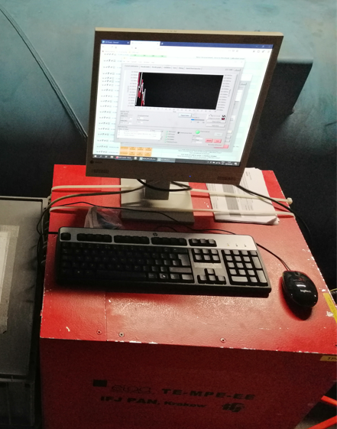
ELQA in action – LS2

Slide 12
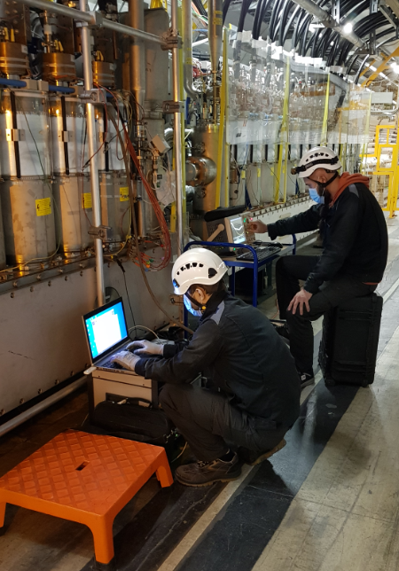
Identified non-conformities during LS2
Total number of NCs detected in LS2: 228
Similar number of NCs as in LS1
Last update: 06.10.2021
228 NCs
More details in this LMC meeting: https://indico.cern.ch/event/1085327/

Slide 13
ELQA steps in the construction of a magnet
For HL magnets and components a set of „Electrical Design Criteria” documents was released
All main manufacturing and test stages are taken into account
HL-LHC magnets are often very sensitive and test voltage levels and conditions are strictly defined

Slide 14
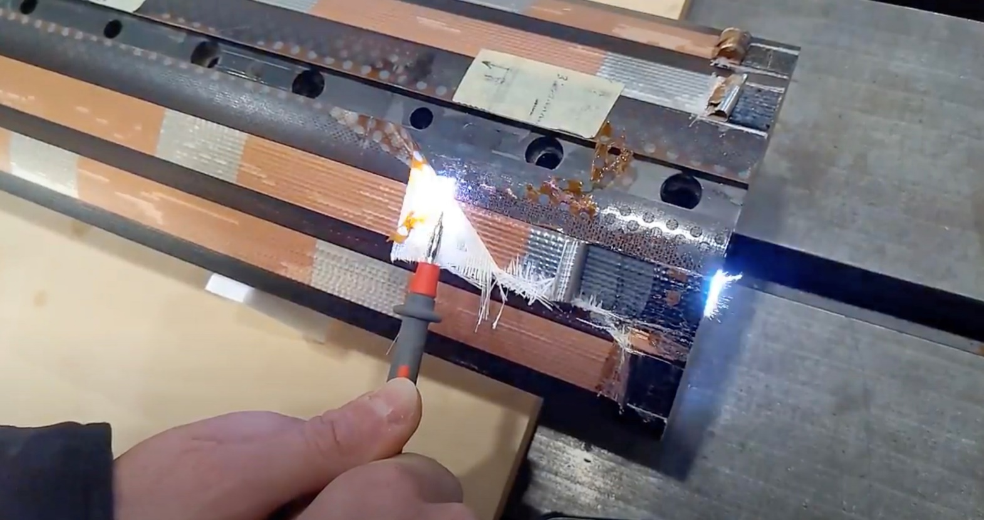
Definition of voltage levels
Test voltage levels definition and validation is a topic for another presentation

Slide 15
ELQA plan post-LS2
Run 3
HL-LHC
LHC
LS3
Development of new test benches to cover the needs of new HL-LHC magnets and installations
Follow-up of HL magnets and other cold powering assemblies (DCM, link, DFH, DFX etc.) design, manufacturing and related tests
Reception tests of those assemblies
Tests in IT string during
  Reception, installation, commissioning and operation
Activities in the machine
  TSs
  YETS
  Operation
Preparation for LS3
  Test systems maintenance and upgrades
Tests during:
HL-LHC new magnets and cold powering components installation
Interconnection of new components
Installation of instrumentation cables
Commissioning of complete HL-LHC infrastructure
Special investigations and diagnostics
Standard campaigns
  Large amount of work at the begining and at the end of LS
Special investigations

Slide 16
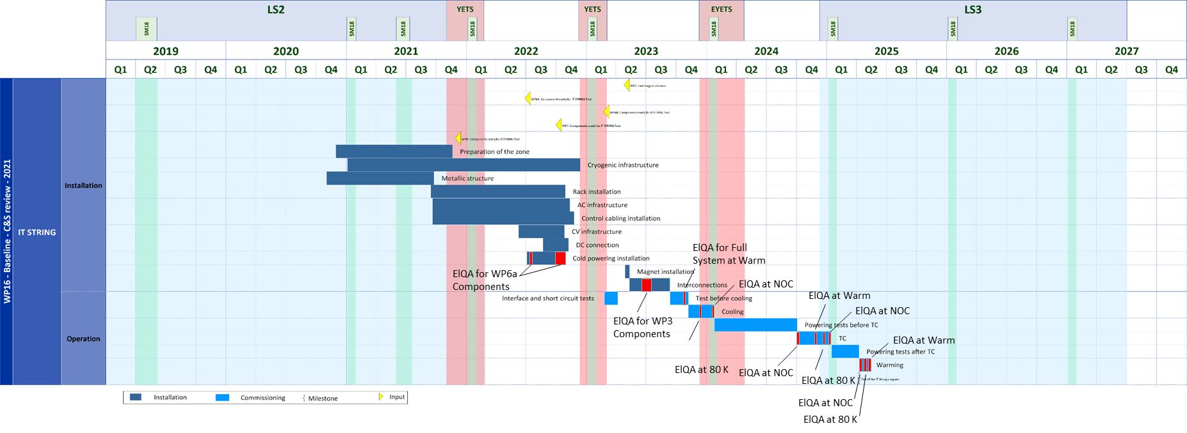
IT String planning
ELQA during assembly
ELQA during commissioning and operation

Slide 17
Tests for IT string/HL installations
Reception
  Take over components from WP3/WP6a
  Reference for future tests
Assembly
Commissioning

Slide 18
Reminder of acronyms
ELQA „building blocks”
HVQ – High Voltage Qualification
TFM – Transfer Function Measurement
IRC – Instrumentation Resistance Check
ICC – Instrumentation Configuration Check
TDR – Time Domain Reflectometry
COC – Continuity of Conductor check
QHR – Quench Heater Resistance measurement
DVC – Diode opening Voltage Check
TSQ – Temperature Sensor Qualification

Slide 19
HL-LHC assembly
MIC-0 – Reference Magnet Instrumentation Check
PAQ-0 – Reference Partial Qualification
SLC – Superconducting Link Check
TP3 – Test Procedure 3
MIC-1 – Magnet Instrumentation Check – after transport
IT-PAQ – Inner Triplet Partial Qualification – after transport
ITIV – Inner Triplet Interconnection Verification
ITIC – Inner Triplet Instrumentation Check

Slide 20
HL-LHC commissioning
TP4-A – Test Procedure 4 type A
MIC-W – Magnet Instrumentation Check at warm
TP4-B – Test Procedure 4 type B
TP4-C – Test Procedure 4 type C
TP4-D – Test Procedure 4 type D
MIC-D – Magnet Instrumentation Check at 80 K
MIC-C – Magnet Instrumentation Check at cold
TP4-E – Test Procedure 4 type E

Slide 21
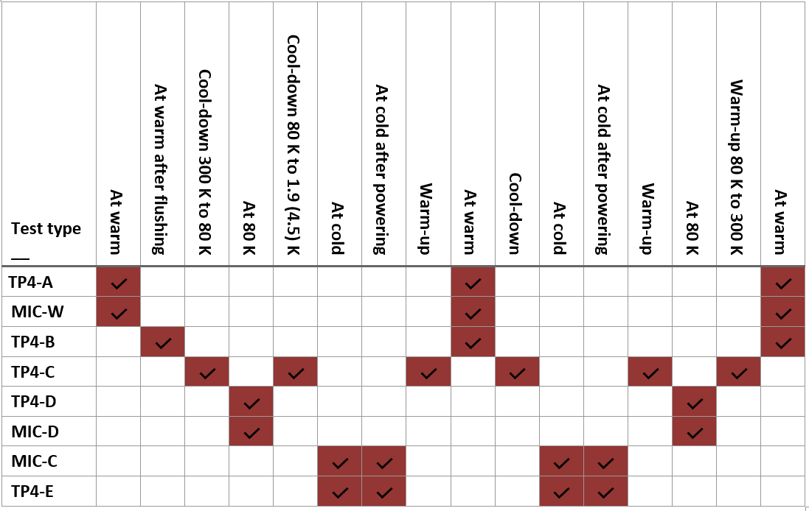
IT String commissioning and operation

Slide 22
Other topics for future presentations related to this topic
Maintenance of ELQA hardware after years of heavy operation
Development of new ELQA systems for HL-LHC specific needs
Test voltage levels definition and validation
Analysis of test results obtained during ELQA
Analysis of TFM (impedance measurements)
Non conformities detected by ELQA
Methods for diagnosing and localising faults in superconducting magnets

Slide 23
Summary
ELQA on HL-LHC installations (including the IT string test) will be performed by the LHC ELQA team (TE-MPE-PE)
Reception tests of magnets and cold powering components will be performed by the ELQA team so that there is a reference for the tunnel qualification and that the experience with the new equipment is gained as early as possible
ELQA test program on the IT String is defined and is being approved
Development and implementation of new test bench functionalities needed for HL-LHC needs to start soon

Slide 24
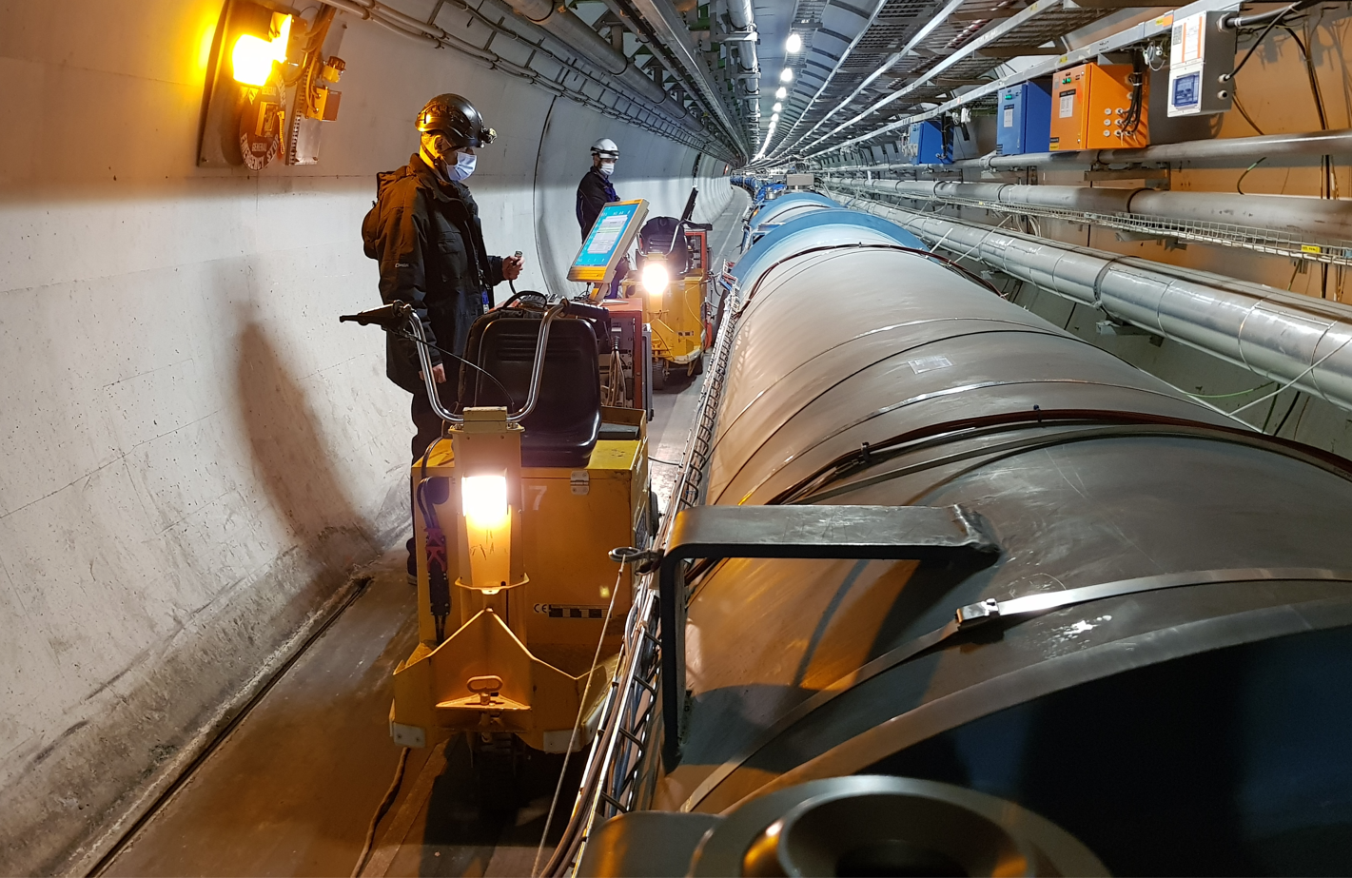
Thank you for your attention!

