Slide 1
IFJ PAN Kraków
ELQA Activities
Jaromir Ludwin
Division of Scientific Equipment and Infrastructure Construction

Slide 2
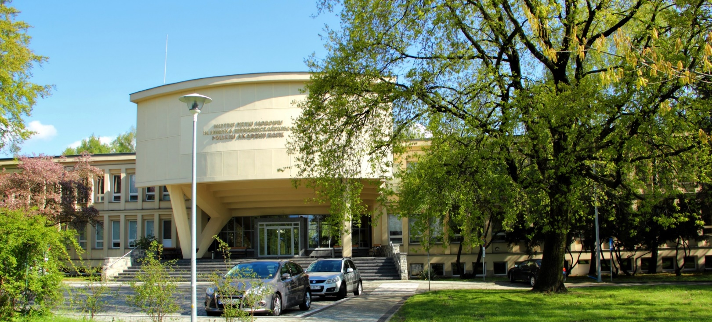
The Institute
Established in Krakow in 1955
First cyclotron built in 1958 (14.5 MeV deuterons and 29 MeV alpha particles)
See more: https://www.ifj.edu.pl/en/institute/history.php

Slide 3
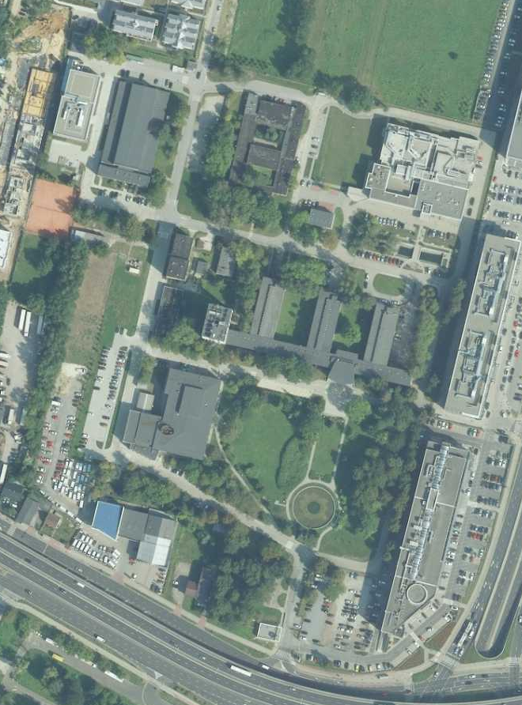
The Institute
Currently one of the biggest institutes of the Polish Academy of Sciences
Conducting research in fields of
  Particle physics
  Nuclear and strong interaction physics
  Condensed matter physics
  Bio-physics
Two special divisions
  Cyclotron Centre Bronowice (hadron therapy centre – 250 MeV proton beam, 2 gantries, ocular radiotherapy facility)
  Division of Scientific Equipment and Infrastructure Construction (cryogenic infrastructure, mechanical workshop, design office)
Image: geoportal.gov.pl

Slide 4
Examples of our projects

Slide 5
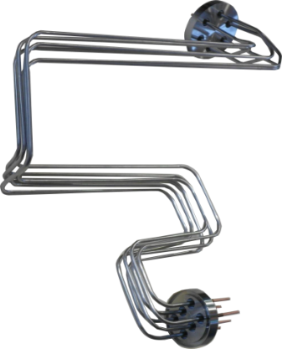
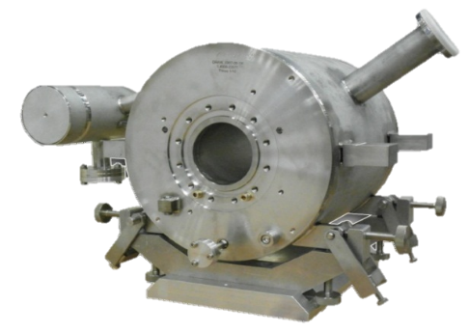
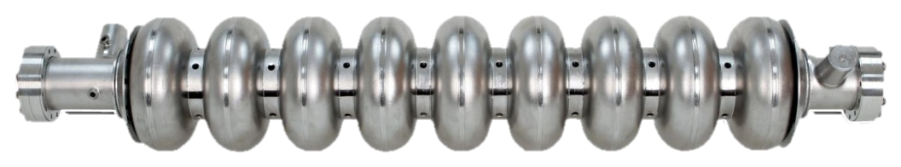
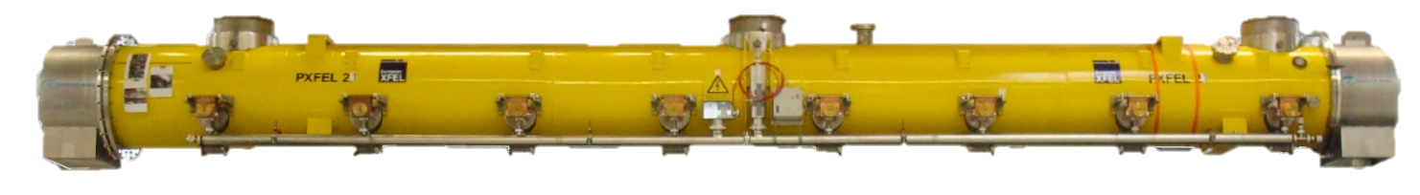
Division of Scientific Equipment and Infrastructure Construction
Qualification tests of superconducting components of the accelerator E-XFEL (2010 – 2015)
Cold magnet
103 x
Current Lead
Cavity
840 x
103 x
Cryomodule

Slide 6
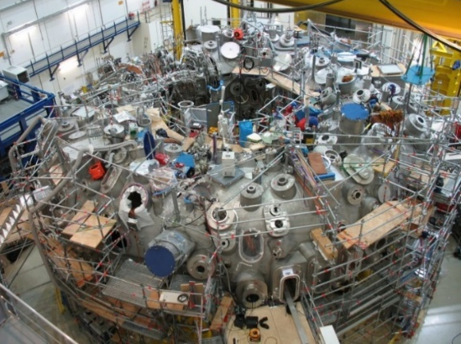
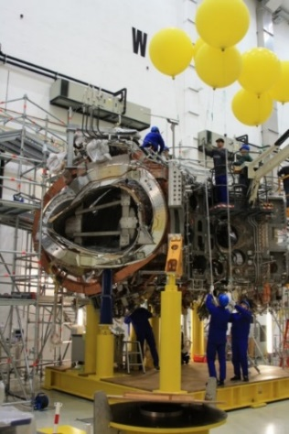
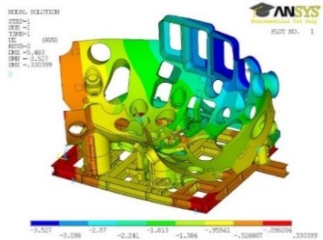
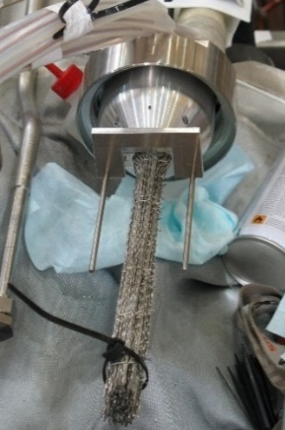
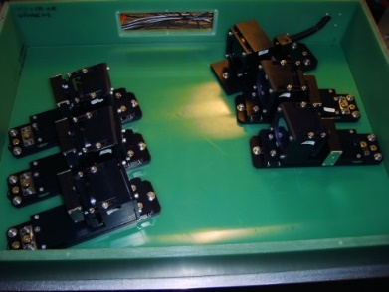
Division of Scientific Equipment and Infrastructure Construction
Wendelstein 7-X Stellarator assembly (2007 – 2012)
Preparation and installation of 120 systems supplying superconducting coils.
Completing of 220 splices of superconducting cables.
Manufacturing of 30 sets of mechanical elements for polychromators.
Verification calculations (FEM) of the designed equipment for the assembly, storage and transport of external module tanks.

Slide 7
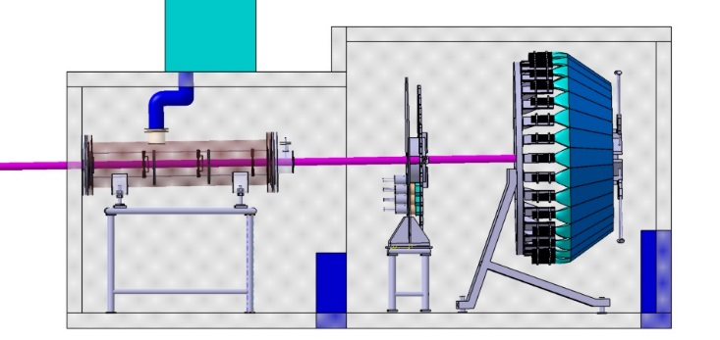
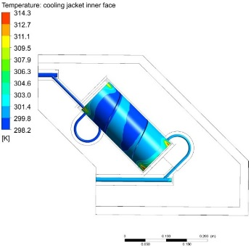
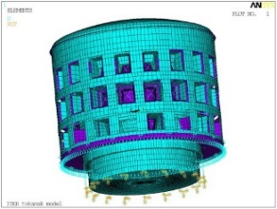
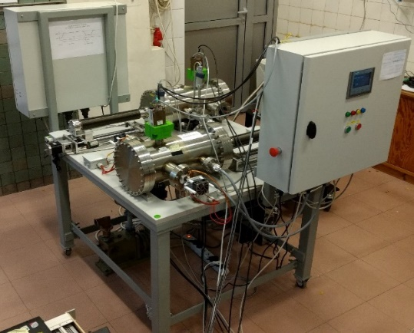
Division of Scientific Equipment and Infrastructure Construction
ITER – design and prototype works (2010 – 2024)
2010-2013: FEM calculations of ITER infrastructure elements
static analyses for nonlinear effects (buckling) and fatigue
dynamic analysis for seismic loads.
2013-2024: Radial Neutron Camera (RNC)
Thermo-hydraulic design and analysis (detector cooling system)
Electromagnetic analyses (dynamic loads and electromagnetic shields)
Design of RNC components (adjustable collimators and rotary detectors)
CAD design support
2014-2016: High Resolution Neutron Spectrometer (HRNS)
Coordination of the engineering part of the project
Leading role in CAD design
Thermo-hydraulic design and analysis - detector cooling system
Electromagnetic analysis – detector shielding system against the influence of magnetic field

Slide 8
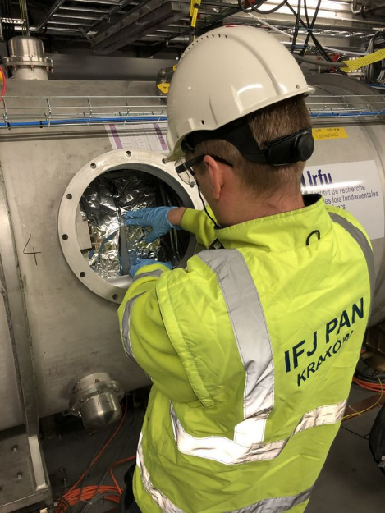
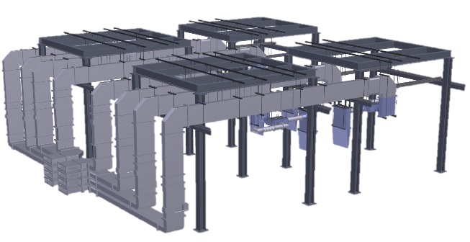
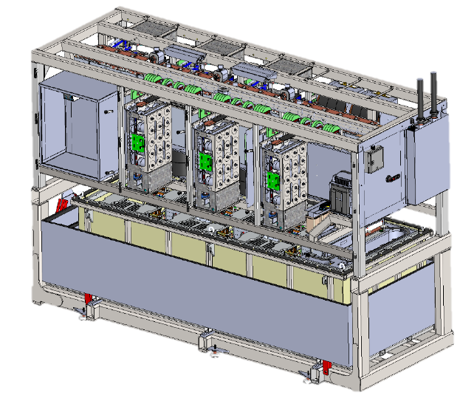
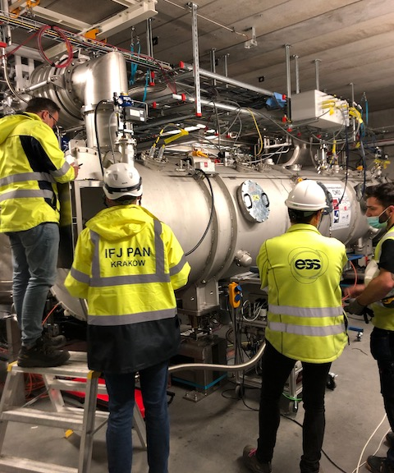
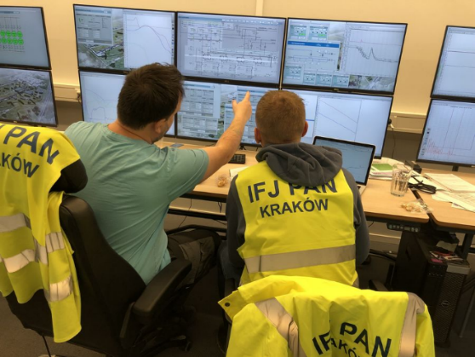
Division of Scientific Equipment and Infrastructure Construction
ESS – Installations and testing (2017 – 2027)
RF installations
S-tub installations
LLRF installations
Local protection system installations
RF power distribution installations
Power converter installations
Klystrons Modulators for RFQ and DTL
Klystron Modulators for Medium / High Beta
Power converters for magnets
RF Cryomodule Tests
Preparation and execution of qualification tests of 30 cryomodules

Slide 9
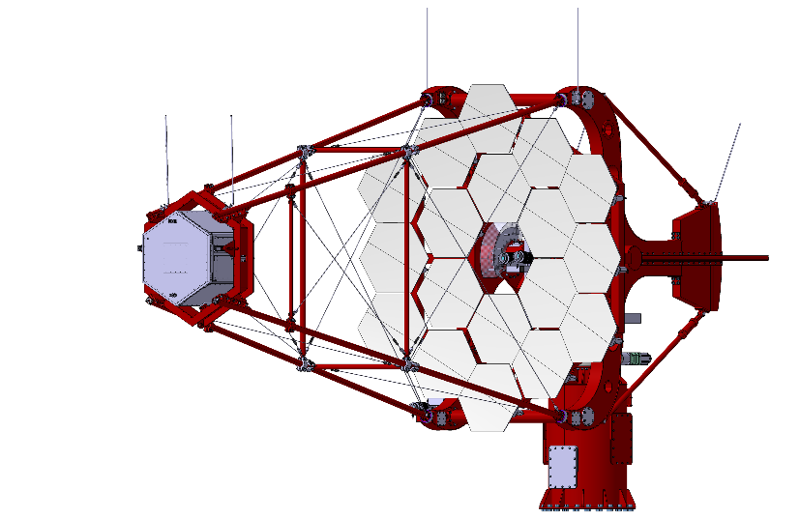
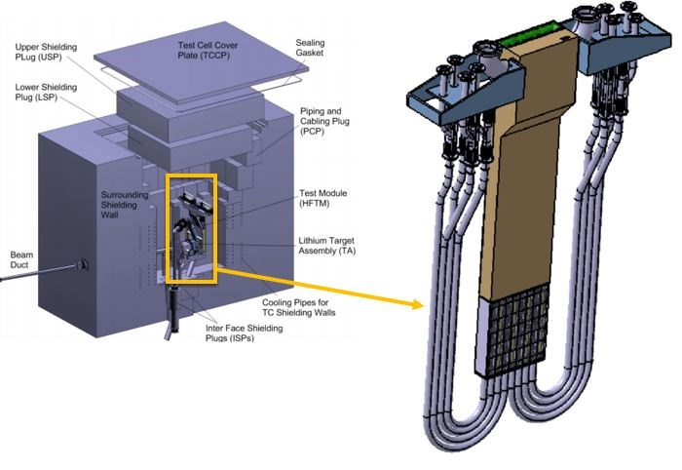
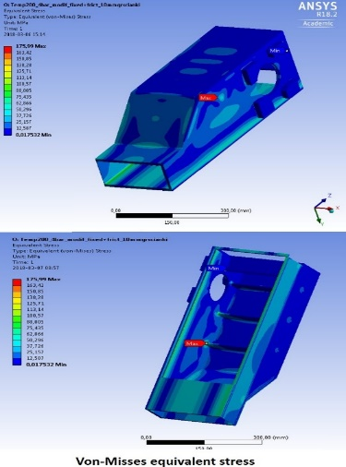
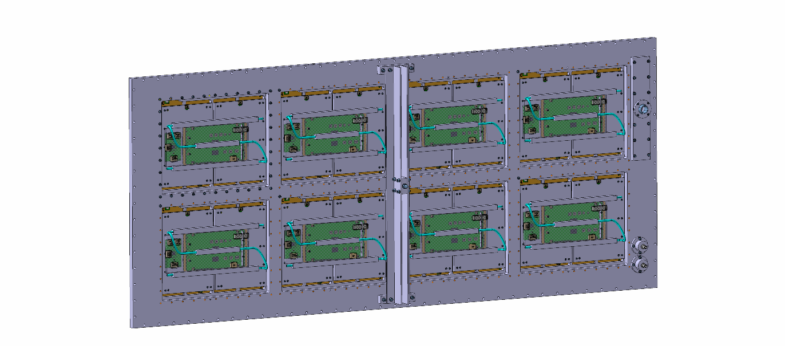
Division of Scientific Equipment and Infrastructure Construction
Many projects done in collaboration with scientific divisions of the Institute
Building of 2nd prototype and installation of two Cherenkov telescopes in Czech Republic – collaboration with Department of Gamma-Ray Astrophysics
STUMM (IFMIF-DONES) in collaboration with Department of Radiation Transport Physics
T2K (ND280 detector upgrade) – collaboration with Department of Cosmic Ray Research and Neutrino Studies
IFJ PAN contribution
  Design and manufacturing
  4 full-size modular frames
  36 supports for MicroMegas

Slide 10
History of CERN – IFJ PAN
ELQA collaboration

Slide 11
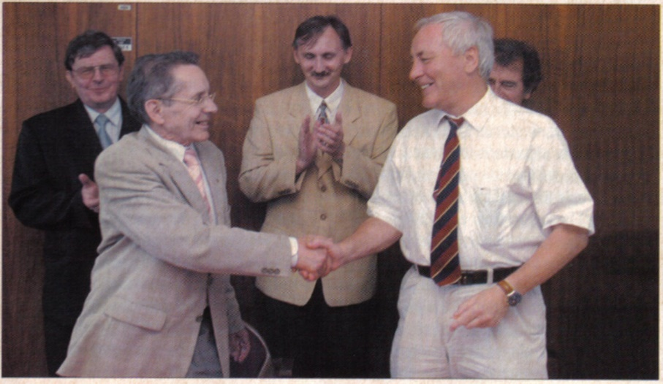
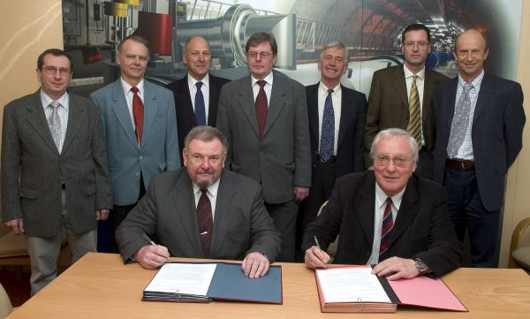
First Collaboration Agreement between
CERN and IFJ PAN related to ELQA activities singed on 2003 (left photo)
and updated in 2005 (right photo)
Source: A. Kotarba

Slide 12
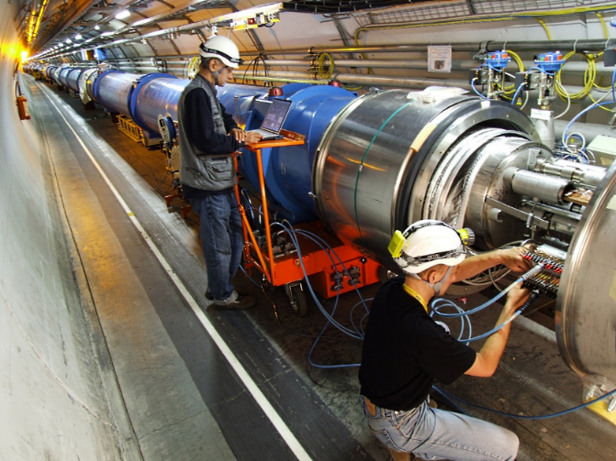
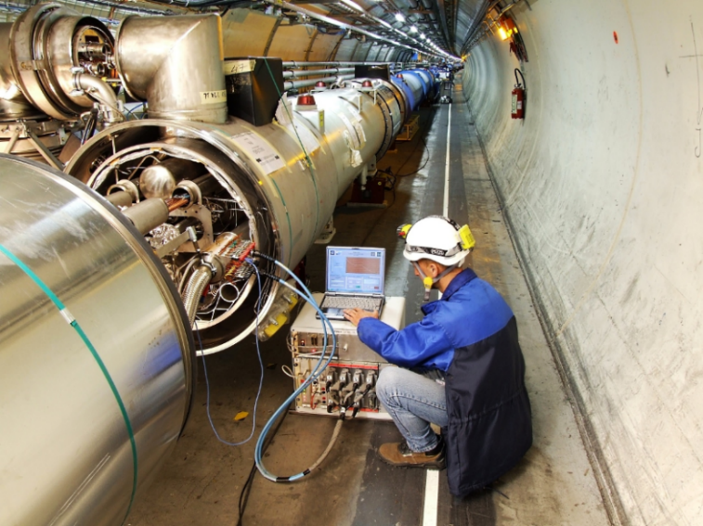
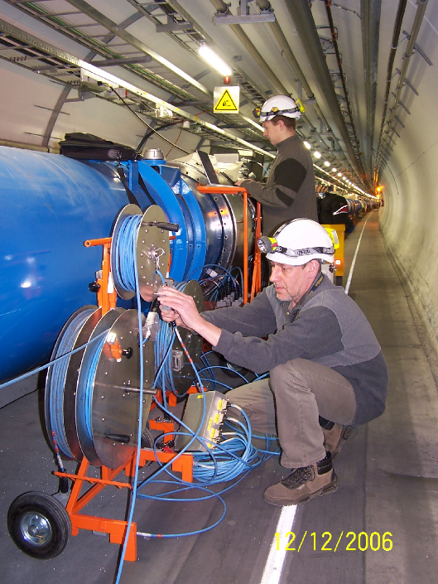
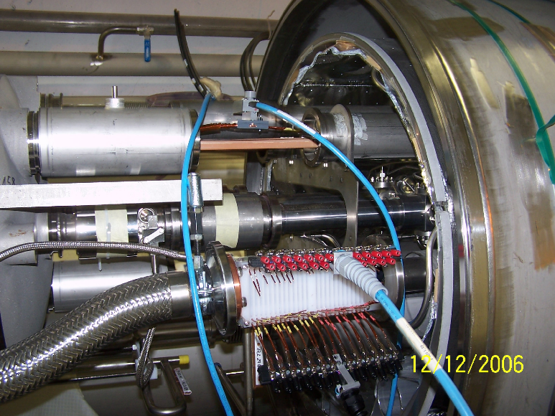
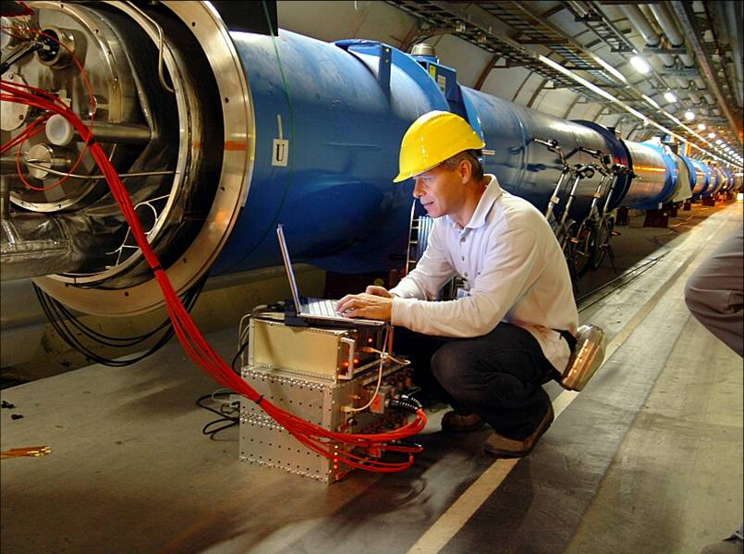
IFJ PAN ELQA Team at CERN – Arc Interconnection Verification
Source: A. Kotarba

Slide 13
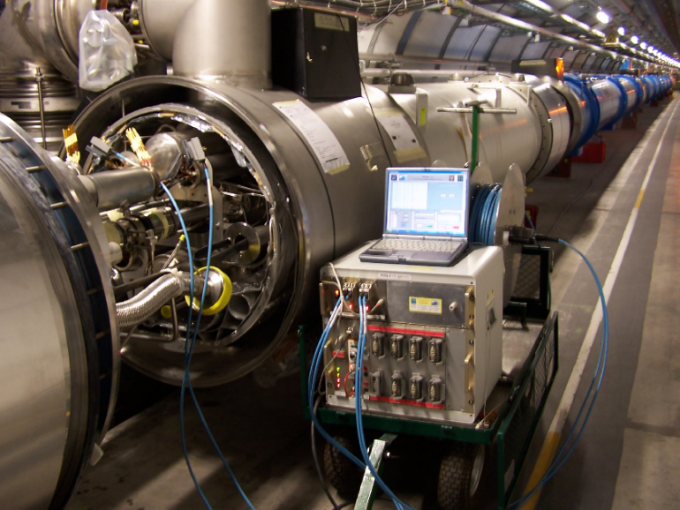
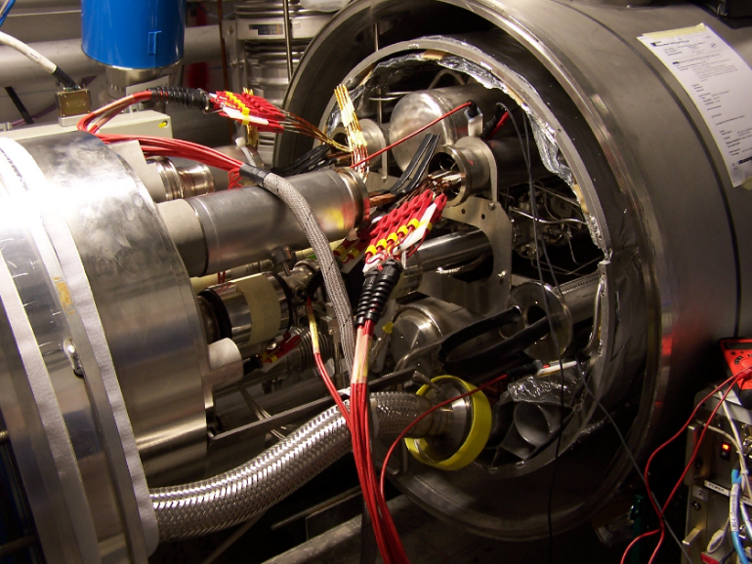
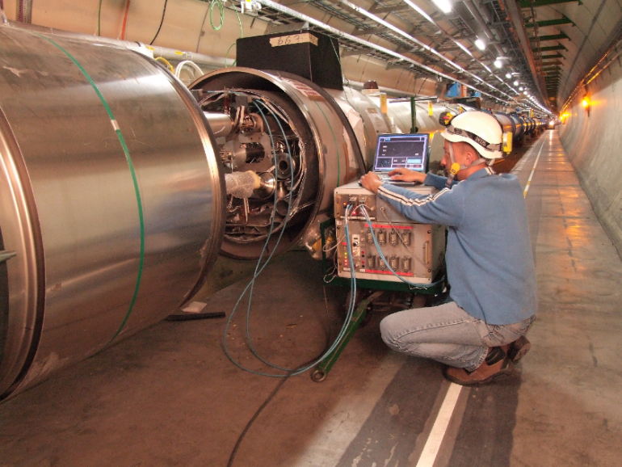
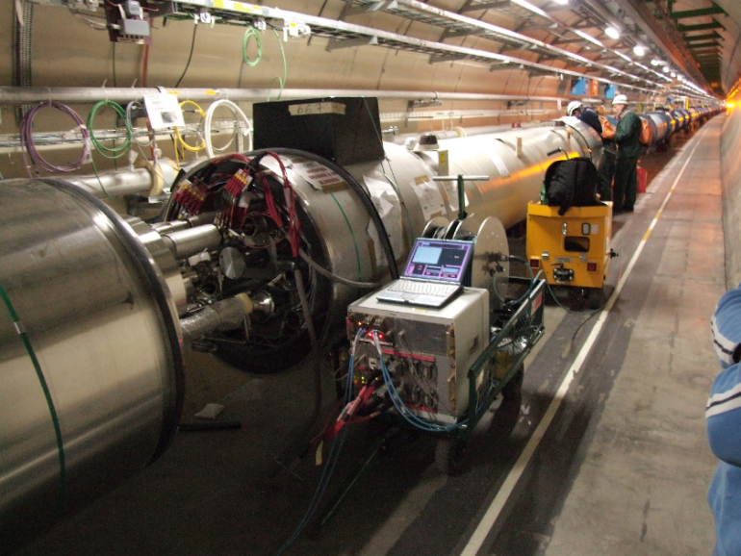
Partial Arc Qualification
Source: A. Kotarba

Slide 14
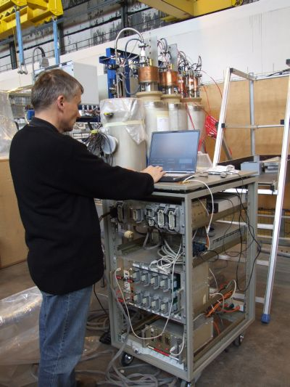
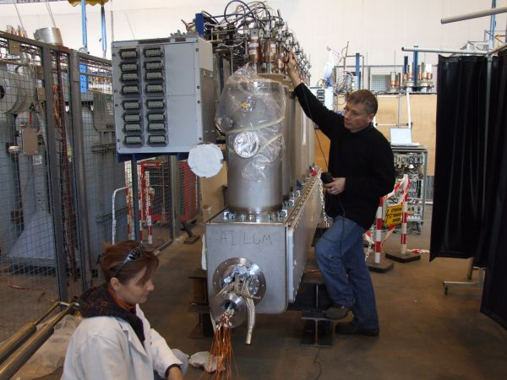
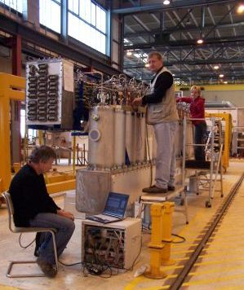
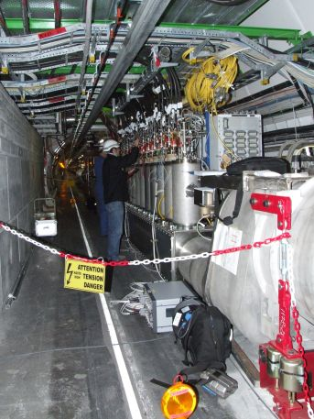
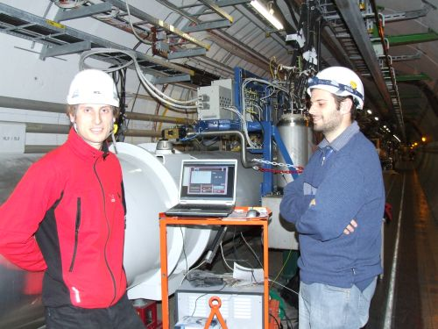
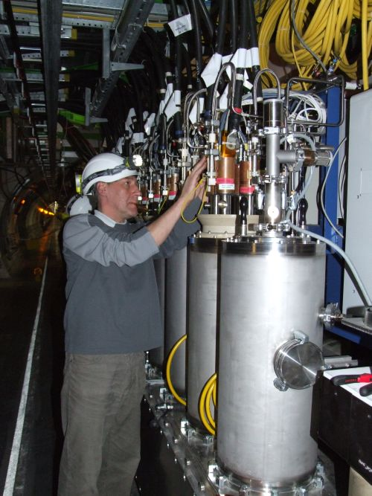
First TP2 - TP4 tests
Source: A. Kotarba

Slide 15
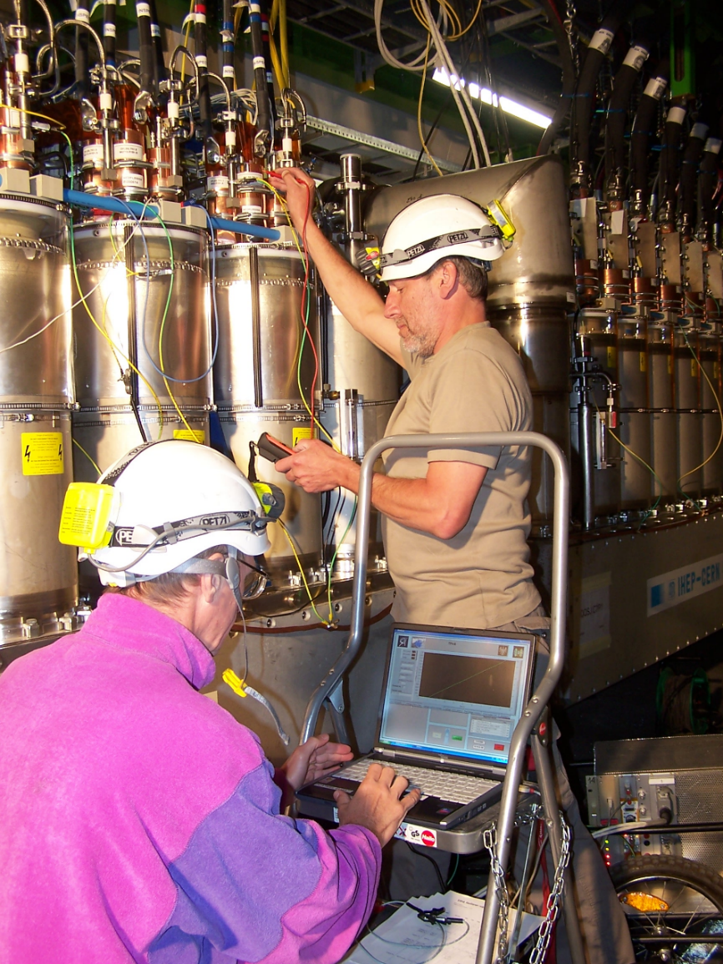
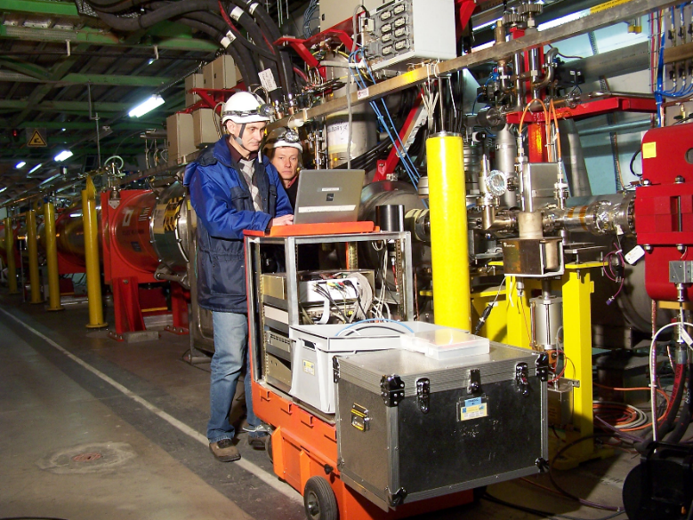
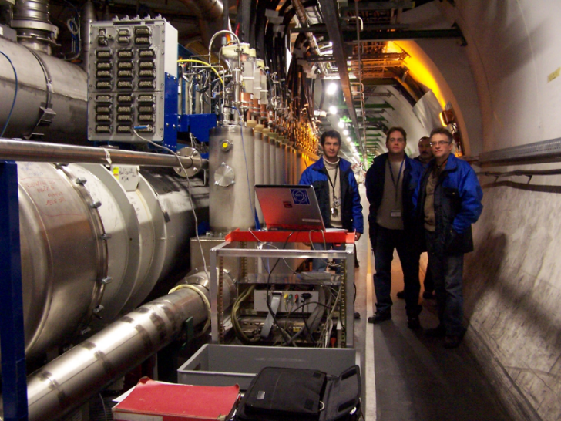
First TP4 tests
Source: A. Kotarba

Slide 16
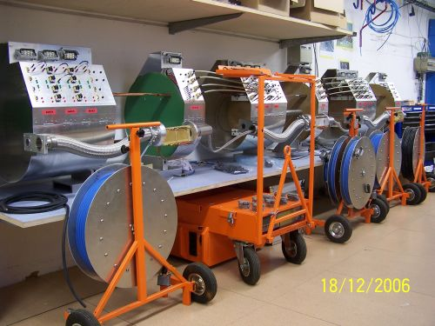
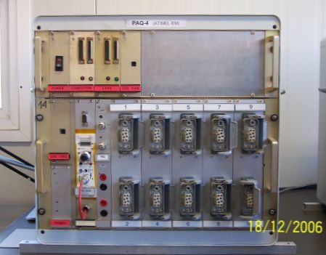
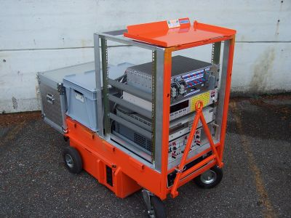
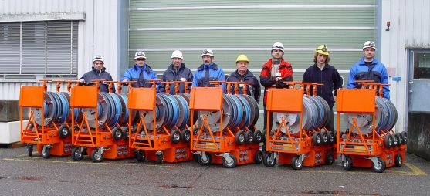
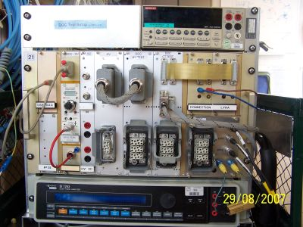
Equipment used during LHC assembly and early HC
Source: A. Kotarba

Slide 17
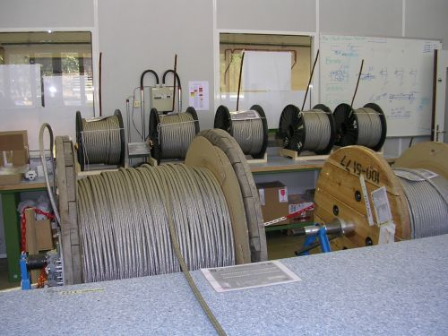





Line-N Factory
Source: A. Kotarba

Slide 18
Summary of the collaboration
We have been working together since the beginning of the LHC, during:
LHC assembly
Hardware commissioning
Recovery after 2008 incident
Long Shutdowns 1 and 2
Technical stops
ELQA hardware and software are our basic tools, which we (Institute and CERN) have created on our own. This provides the tightest possible feedback loop between user and developer.

Slide 19

Maintenance of
the TP4 measurement system
SQLite DB
SQLite DB

Slide 20
Maintenance of TP4 system
Hardware
General hardware maintenance
Upgrade of gain/phase analyser (EoL of currently used device)
Software
Universal test and measurement application
ELQA database optimisation
Full implementation of local TFM
Upgrade of MIC QHR application
ELQA test plan web application
Additional PXI based monitoring applications

Slide 21


Hardware
Initial system check
Removal of all devices and cleaning
Upgrade of power distribution box and check of grounding system
Preparation of fasteners for new and relocated devices
Replacement of all connectors
Retightening of all screws
Replacement of broken cables
Design and production of new PCBs for external TFM reference and TFM isolation amplifier

Slide 22

TP4 instruments rearrangement
24 VDC to 230 VAC converter
Power supply for the TP4 crate
TP4 Crate (multiplexers
and reference resistors)
PXI computer with two DMM cards
Powertek amplifier (output +/-12V, 700 mA RMS, 1A peak)
Agilent 6643A DC Power Supply (0-35V, 0-6.0A)
Powertek GP102 gain phase analyser with dual analysis channels and generator

Slide 23


TP4 instruments rearrangement
Agilent 6643A DC Power Supply (0-35V, 0-6.0A)
Space for new device (2U)
Power supply for the TP4 crate
TP4 Crate (multiplexers
and reference resistors)
PSM1700 gain phase analyser with dual analysis channels and generator
PXI computer with two DMM cards
Powertek amplifier (output +/-12V, 700 mA RMS, 1A peak)
24 VDC to 230 VAC converter

Slide 24


Replacement of all connectors
Harting pins after few thousand mating cycles

Slide 25
Conclusions
There is a huge record of fruitful collaboration between CERN and IFJ PAN, in particular in the field of Electrical Quality Assurance.
TP4 maintenance project started with a significant delay, but we are catching up with the schedule.
Our experts are working on many projects, ranging from accelerator technology to fusion.
We are really good at building and testing.

