Slide 1

Co-simulation of quench transients in the HiLumi recombination dipole magnet combining STEAM-LEDET and STEAM-PyBBQ
Lennard Bender (CERN / Hochschule Karlsruhe)
16 September 2022
Acknowledgements
Special thanks to:
B.Caiffi, P.Fabbricatore and MBRD team (INFN-Genoa),
A. Foussat, T.Mulder, E.Ravaioli, G.Willering, M.Wozniak and SM18 team (CERN)

Slide 2
Presentation outline
Including longitudinal quench propagation for QH protected magnets
Validation process of co-simulation
Alternative protection of MBRD magnet to decrease hot-spot temperature and voltage to ground

Slide 3
What is the goal of quench protection?

Slide 4
STEAM tools - 2022
BBQ(Comsol) → PyBBQ BBQ(GetDP)
SIGMA
LEDET
PROTECCT
SING → PySING
COSIM
FiQuS
Conductor
Magnet
Circuit
E. Ravalioli and M. Wozniak, “STEAM framework – MPE-PE section meeting,” CERN, 07.19.2022, Available: https://indico.cern.ch/event/1183524/

Slide 5
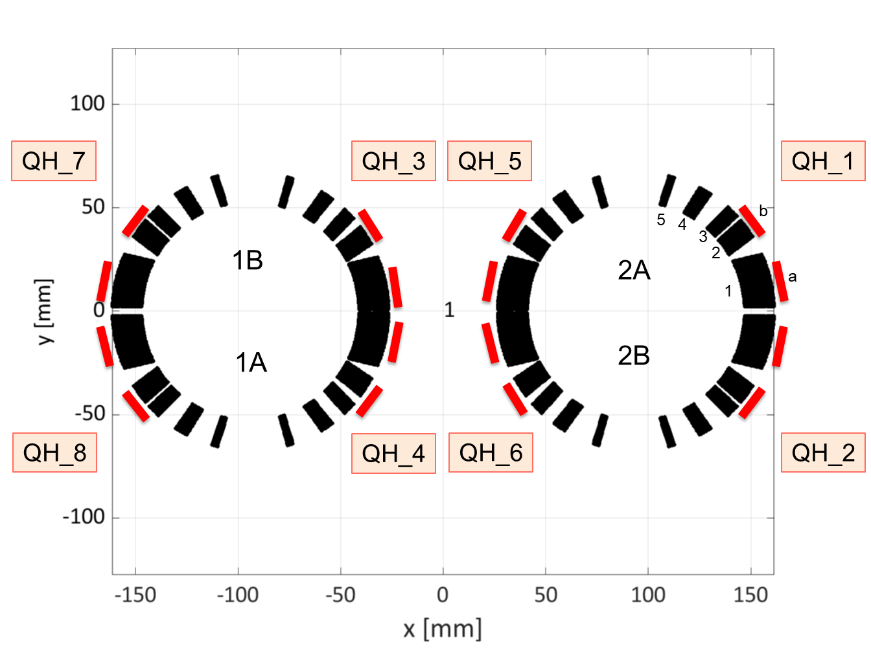
Recombination dipole magnet MBRD
Parameter | Value
Bore magnetic field | 4.5 T
Peak magnetic field | 5.28 T
Nominal current | 12340 A
Ultimate current | 13357 A
Magnetic length | 7.78 m / 1.378 m
Number of blocks | 5

Slide 6

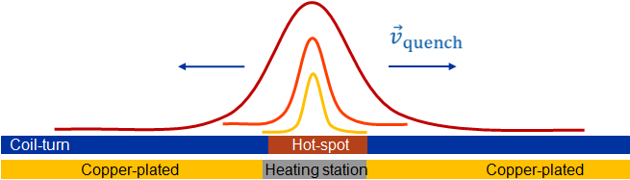
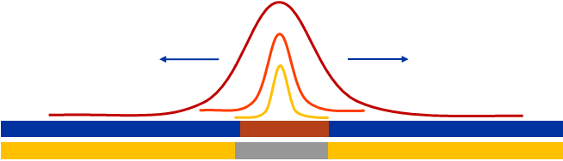


Quench heaters and quench propagation
After the QH firing, the normal zone is propagating from each heating station into both, longitudinal directions
$$T$$
$$x$$
120 mm
400 mm
400 mm
Example MBRDP1 magnet:
vQ @ nominal current: ~15 m/s
All turns, attached to QH would quench in ~13.3 ms at nominal current
13.3 ms
13.3 ms
vQ @ 2 kA: 0.39 m/s
All turns, attached to QH would quench in ~510 ms at nominal current
Note: quench propagation
velocity calculated with
PyBBQ including cooling
510 ms
510 ms
Marvin Janitschke: 2nd STEAM Workshop (11-October 15, 2021): Thermal analysis of quench-heater heating stations using STEAM-BBQ · Indico (cern.ch)
6

Slide 7
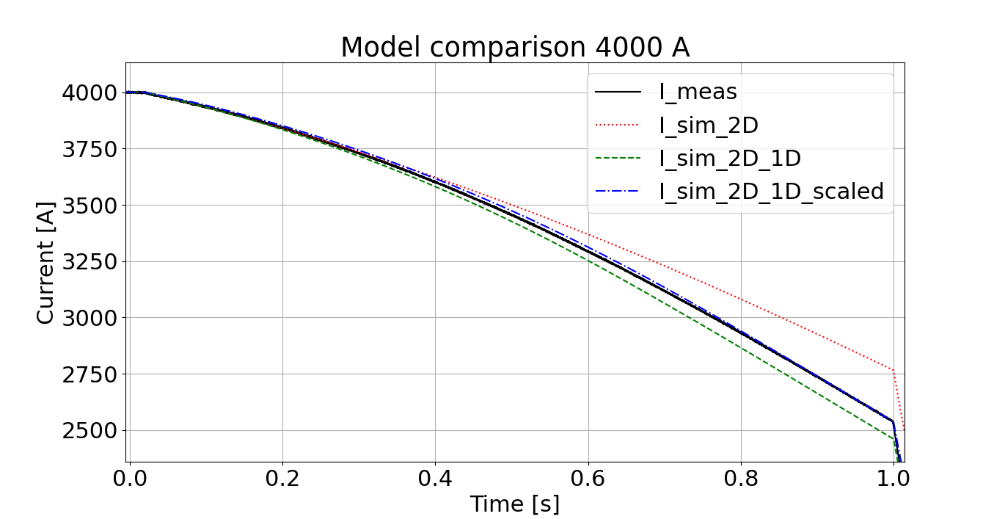
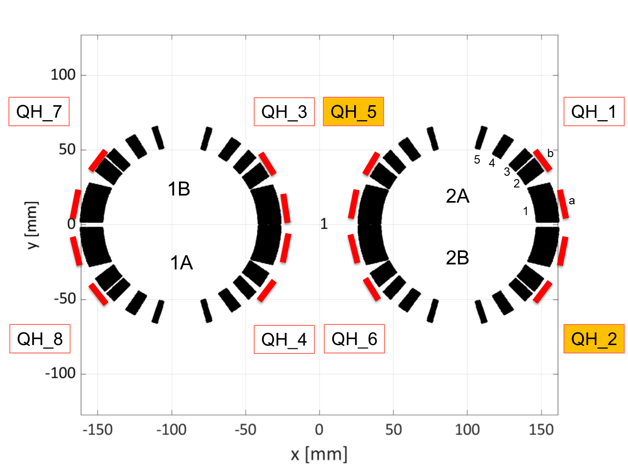
Introduction of quench propagation scaling at low currents
Poor fit for STEAM-LEDET 2D model
at low currents [1]
Improvement by implementing 2D+1D
extension [2]
2D+1D includes longitudinal quench
propagation between heating stations [3]
Improved simulation by including scaled quench propagation due to helium cooling
[1] E. Ravaioli, B. Auchmann, M. Maciejewski, H. ten Kate, and A. Verweij, “Lumped-element dynamic
electro-thermal model of a superconducting magnet,” Cryogenics, 2016. [Online].
Available: http://www.sciencedirect.com/science/article/pii/S0011227516300832
[2] M. Janitschke, M. Mentink, F. Murgia, D. Pracht, E. Ravaioli, A.P. Verweij, "A simplified approach
to simulate quench development in a superconducting magnet", IEEE Trans. on Appl. SC, 2021
[3] Marvin Janitschke: 2nd STEAM Workshop (11-October 15, 2021): Thermal analysis of
quench-heater heating stations using STEAM-BBQ · Indico (cern.ch)

Slide 8
Presentation outline
Including longitudinal quench propagation for QH protected magnets
Validation process of co-simulation
Alternative protection of MBRD magnet to decrease hot-spot temperature and voltage to ground

Slide 9
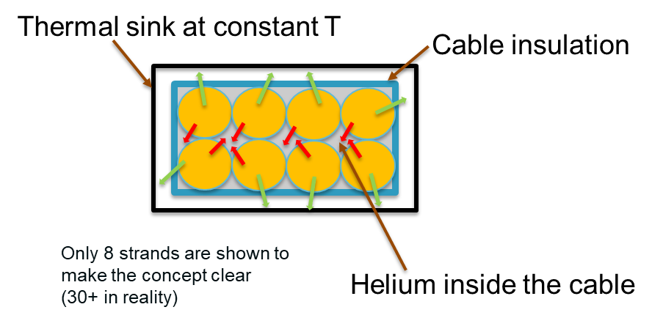
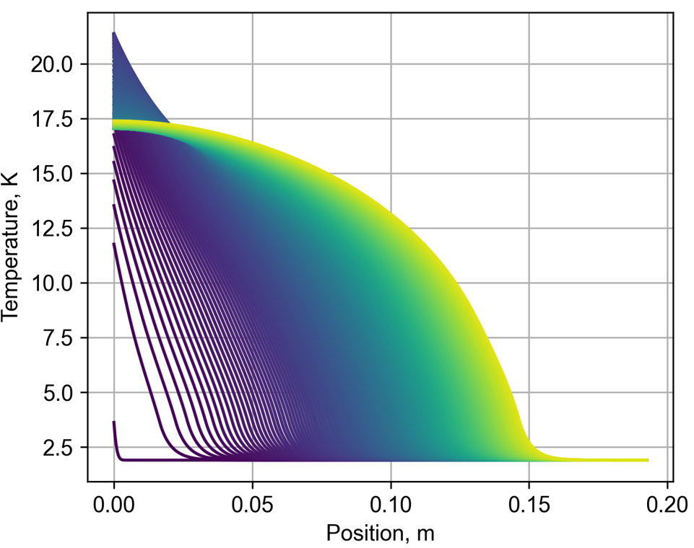
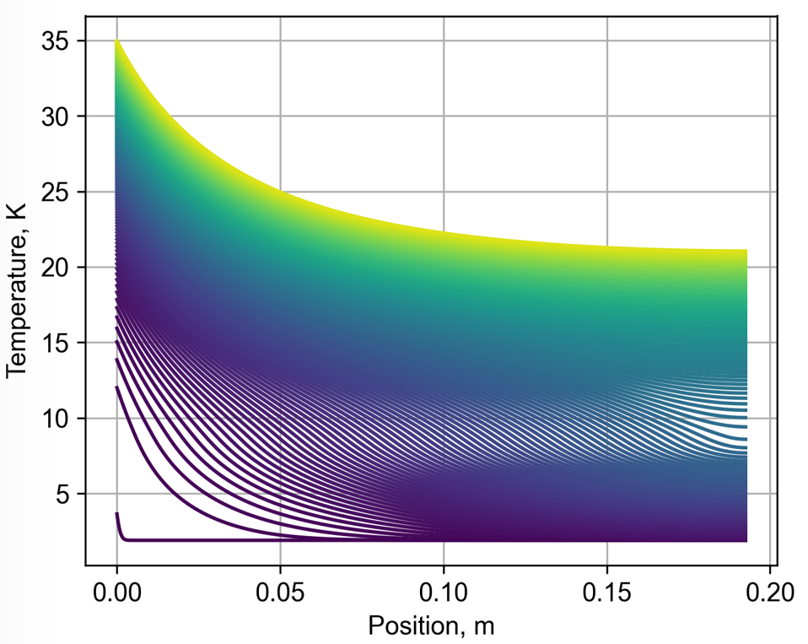
STEAM-PyBBQ (BusBar Quench in python)
STEAM-PyBBQ implemented tool in
python by T. Mulder [4]
Able to simulate quench propagation in
a cable with and without helium cooling
Quench initiation through power input at
one conductor side
Crucial to include external and internal
cooling of the cable to simulate quench
propagation at low currents
[4] T. Mulder, “Documentation”, Available: STEAM / steam-pyBBQ · GitLab (cern.ch)

Slide 10
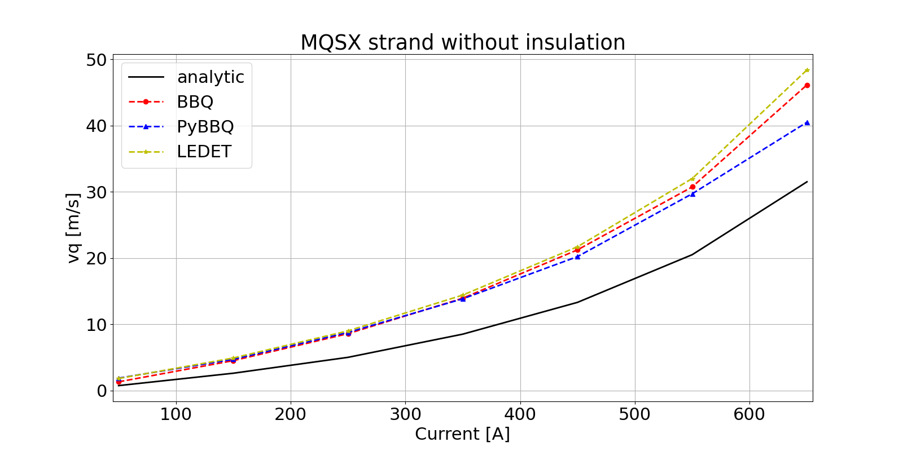
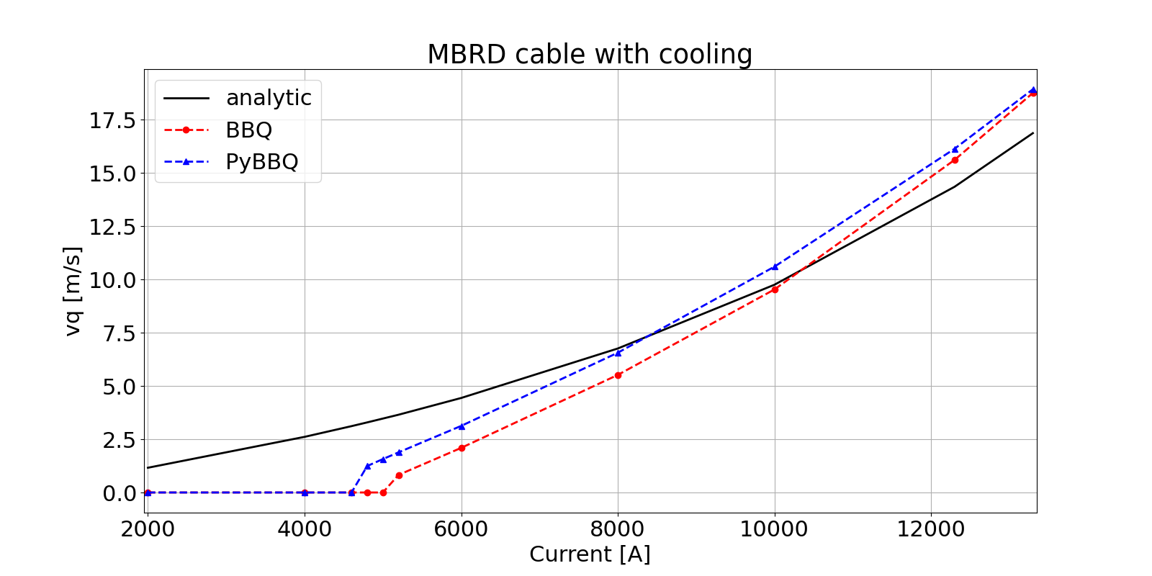
Validation of PyBBQ
Comparison to STEAM-LEDET 3D and
STEAM-BBQ [5], [6]
Good fit for basic case without insulation and cooling
Analytical calculation not applicable, further investigations
necessary
STEAM-PyBBQ and STEAM-BBQ show similar behaviour
for multi-strand cable and cooling
STEAM-PyBBQ can be seen as validated
[5] E. Ravaioli, O. Tranum Arnegaard, A. Verweij, M. Wozniak, "Quench Transient Simulation in a Self-Protected
Magnet With a 3-D Finite-Difference Scheme", IEEE Trans. on Appl. SC, 2022.
[6] M. Mentink et al., “Quench Behavior of the HL-LHC Twin Aperture Orbit Correctors”,
IEEE Trans. on Appl. Supercond. 28, p 4004806 (2018)

Slide 11
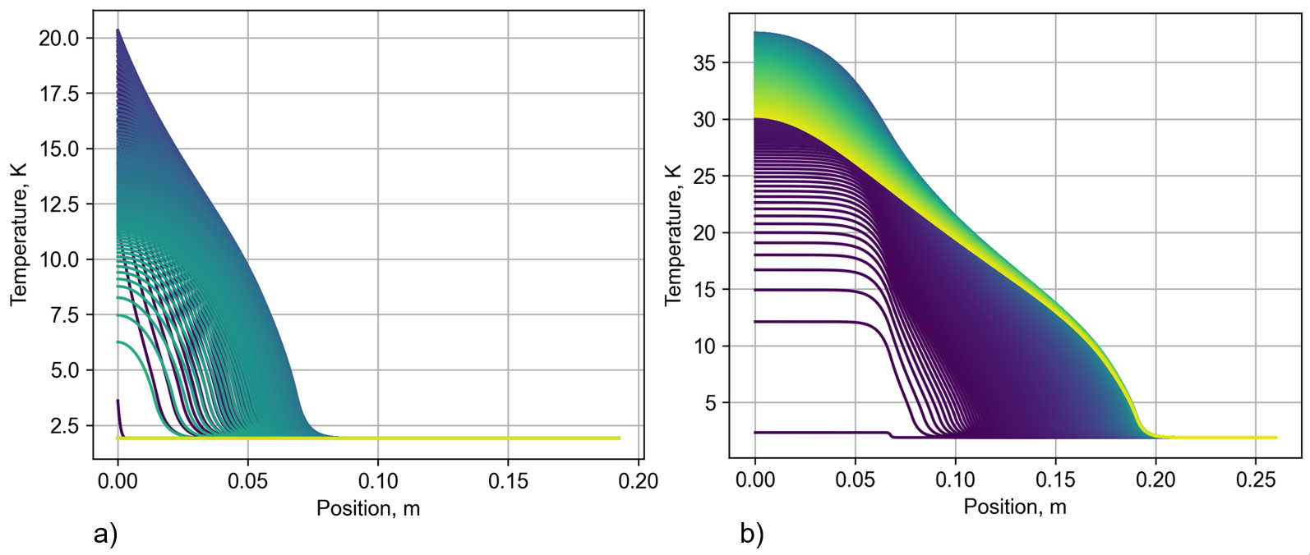
QH heating stations in STEAM-PyBBQ
No quench propagation simulated by STEAM-PyBBQ for low current
Implementing a heating station leads to detectable
quench propagation in the cable at low current

Slide 12
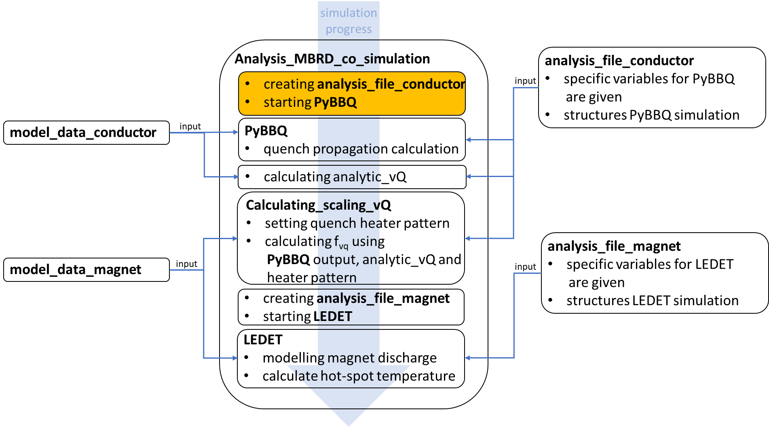
Co-simulation; setting conductor simulation

Slide 13
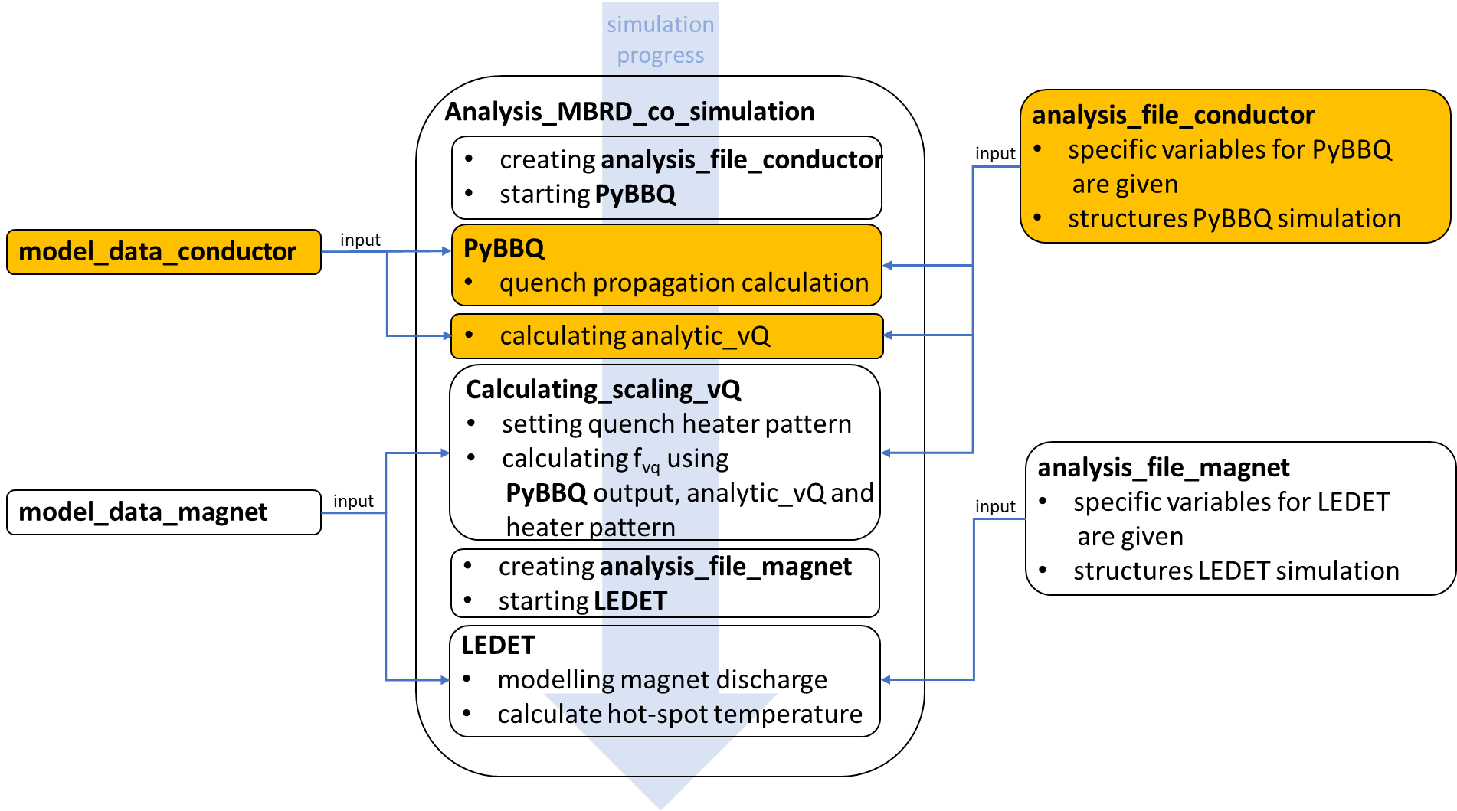
Co-simulation; running conductor simulation

Slide 14
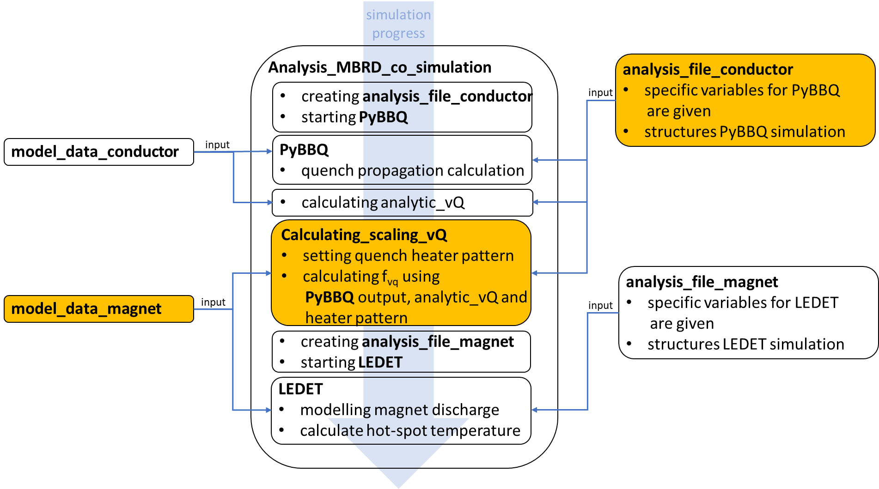
Co-simulation; calculating quench propagation scaling

Slide 15
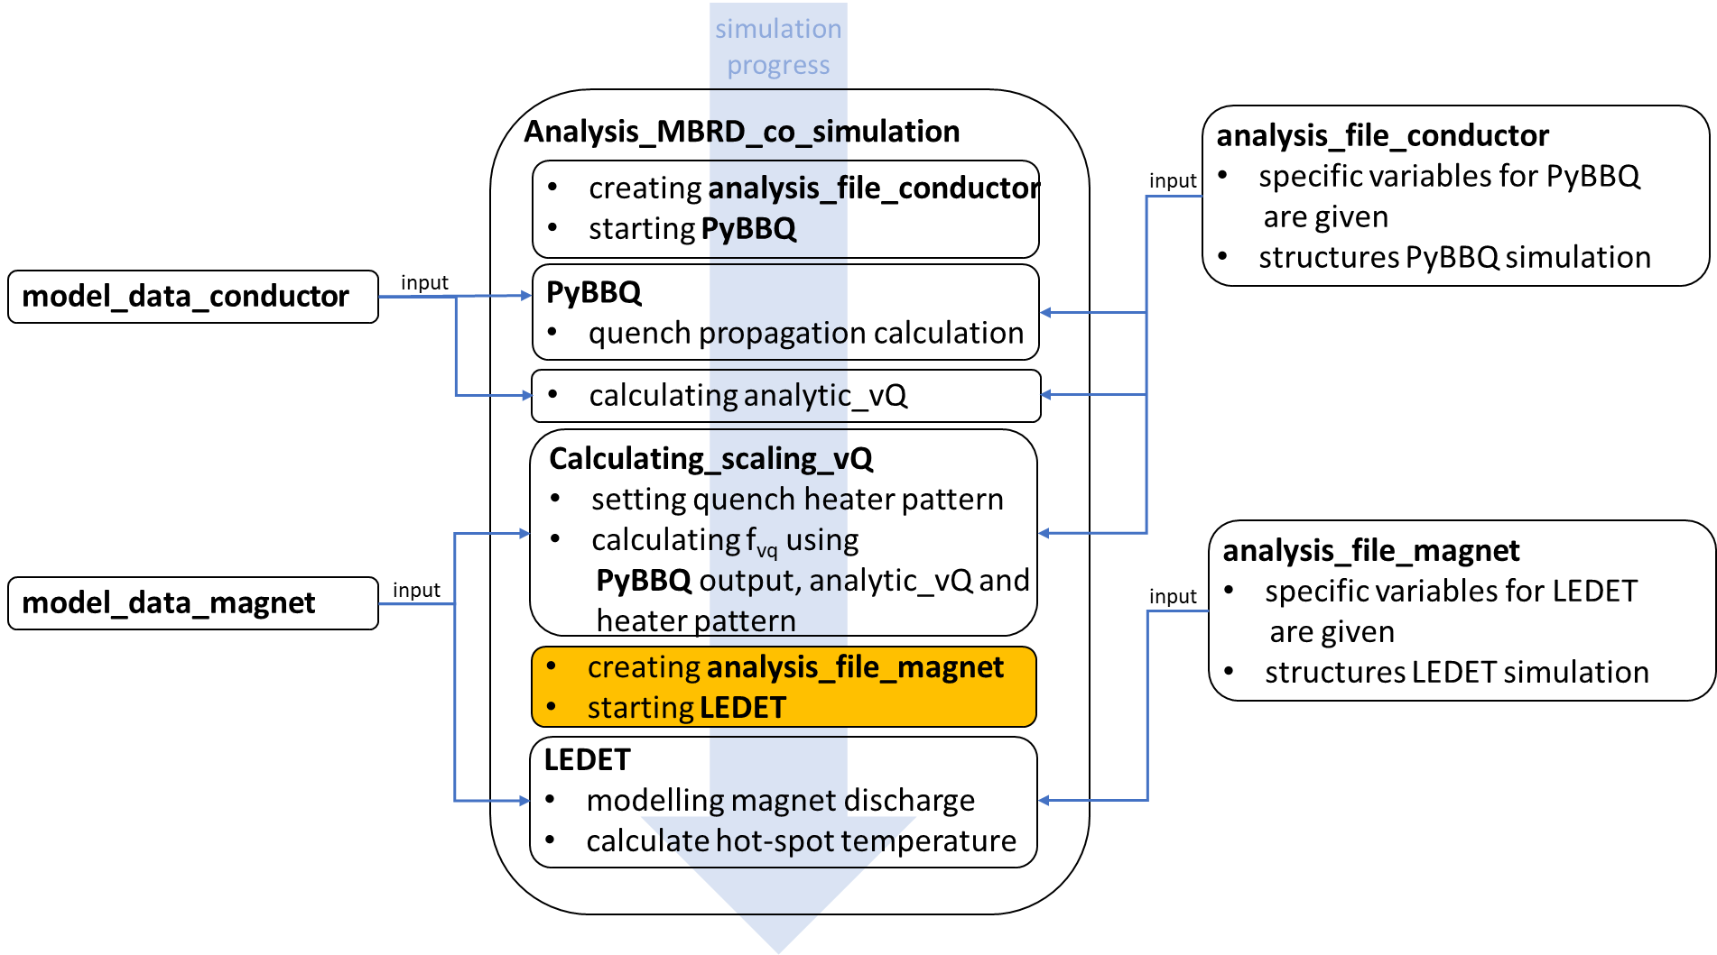
Co-simulation; setting magnet simulation

Slide 16
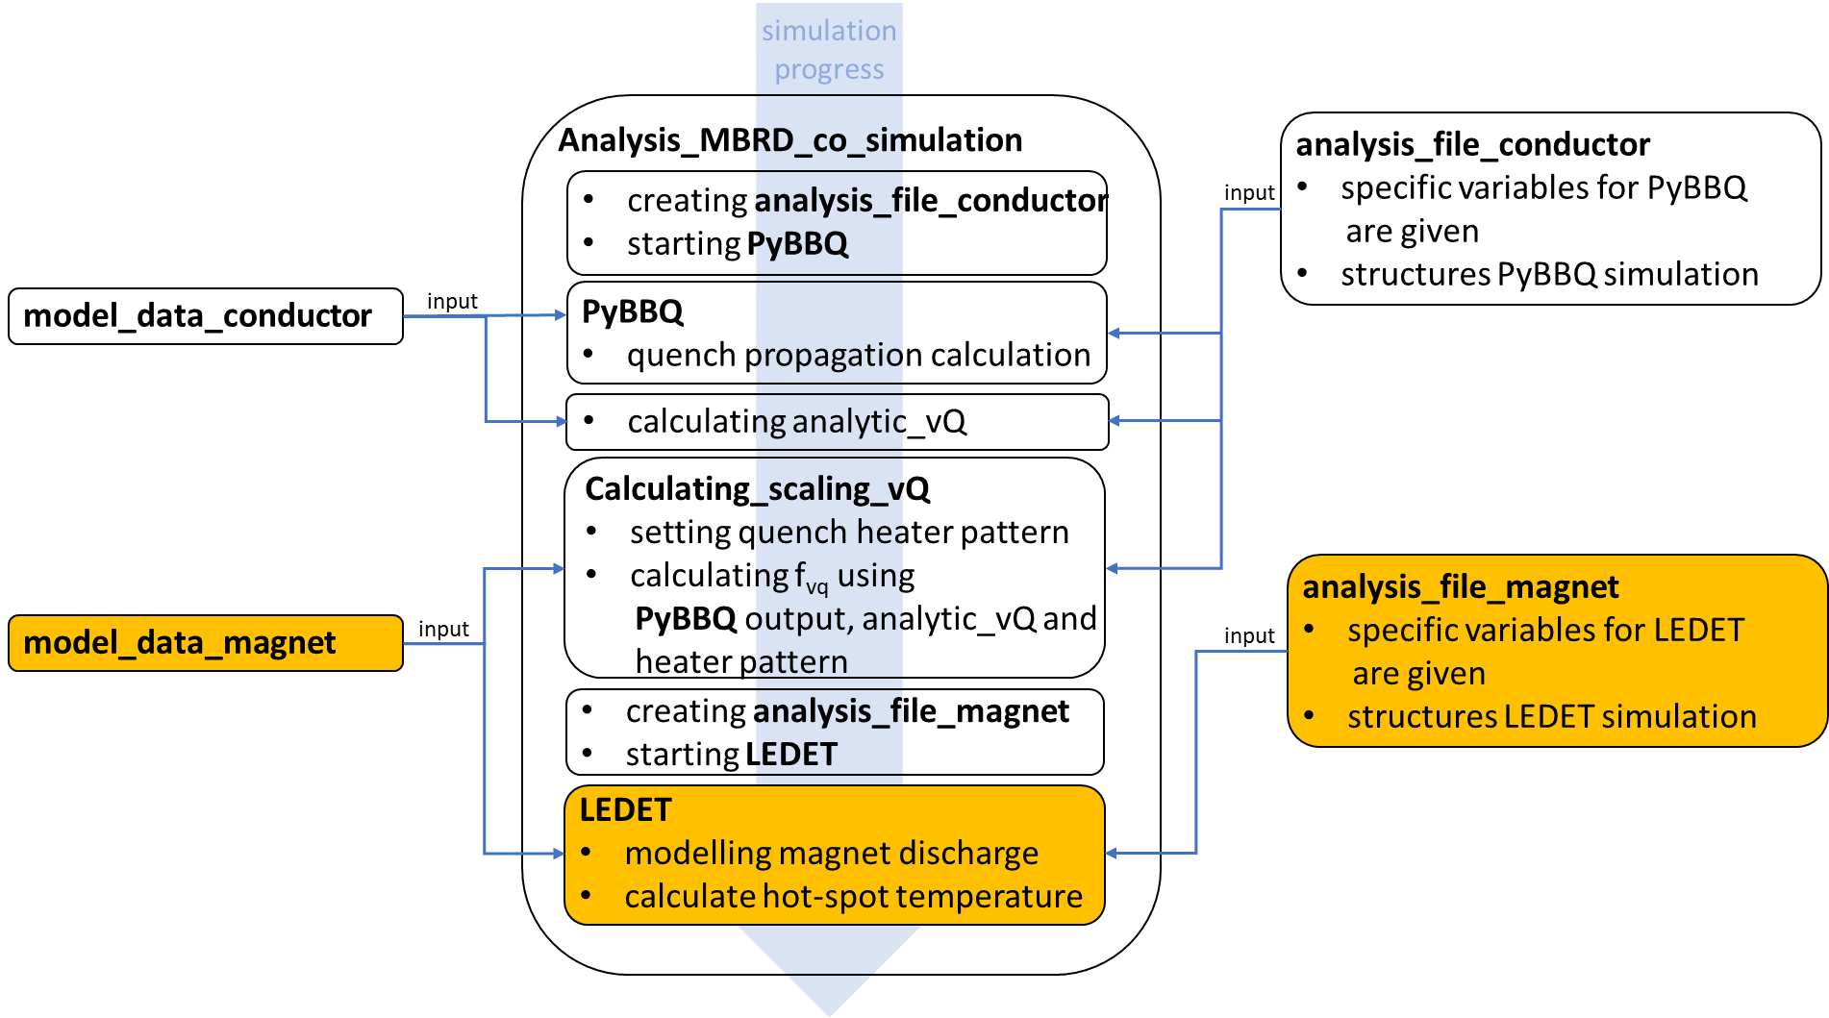
Co-simulation; running magnet simulation
Consistent, repeatable and traceable
co-simulation based on YAML files

Slide 17
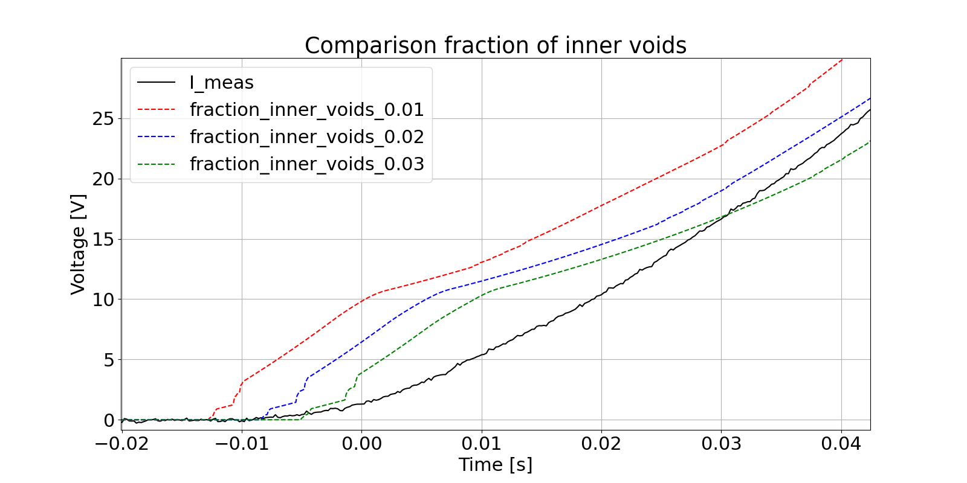
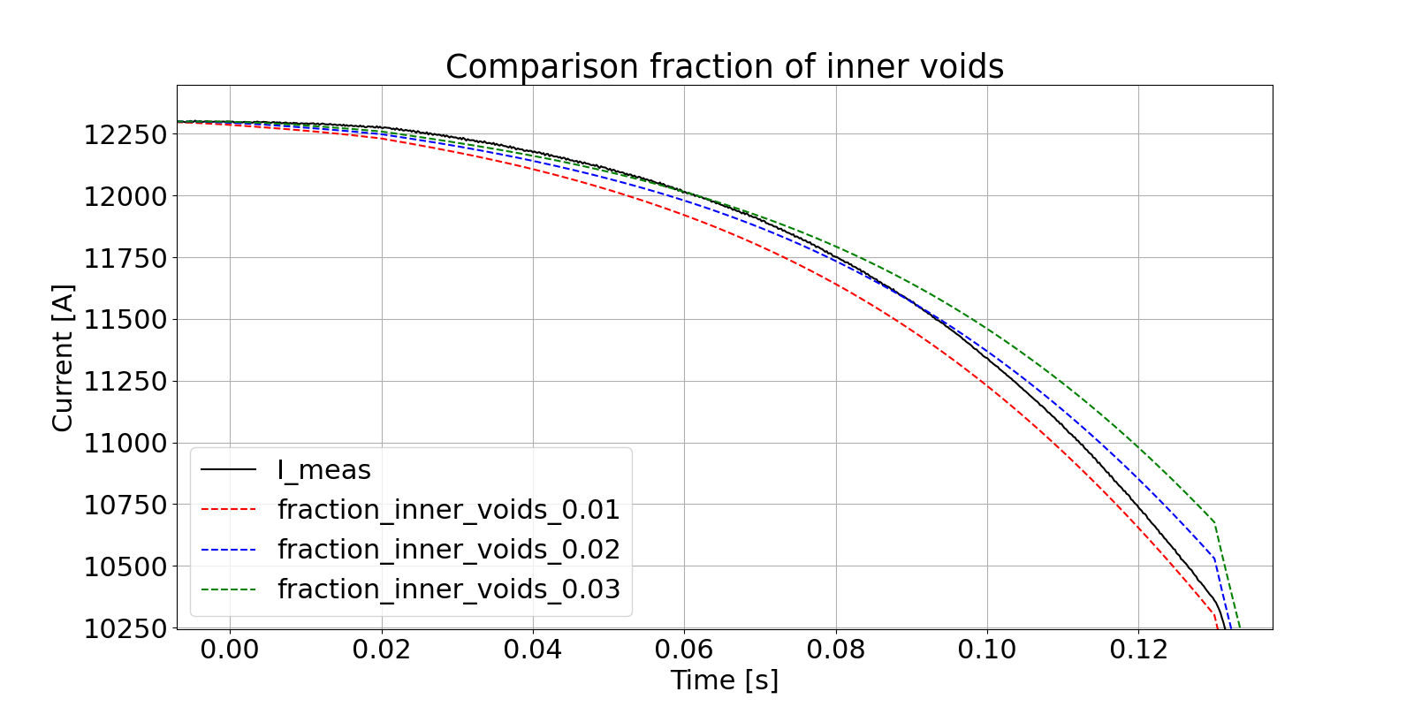
Quench start at high current
Variation of the amount of helium inside the cable
Voltage jumps caused by quench heaters
Manipulation of heater contact to strands possible

Slide 18
Quench start at high current
Variation of the amount of helium inside the cable
Voltage jumps caused by quench heaters
Manipulation of heater contact to strands possible
Matching quench start for fraction_inner_voids at 2 %
Best fitting discharge at fraction_inner_voids = 2 %
Faster discharge at quench start, slower discharge
before energy extraction triggering

Slide 19
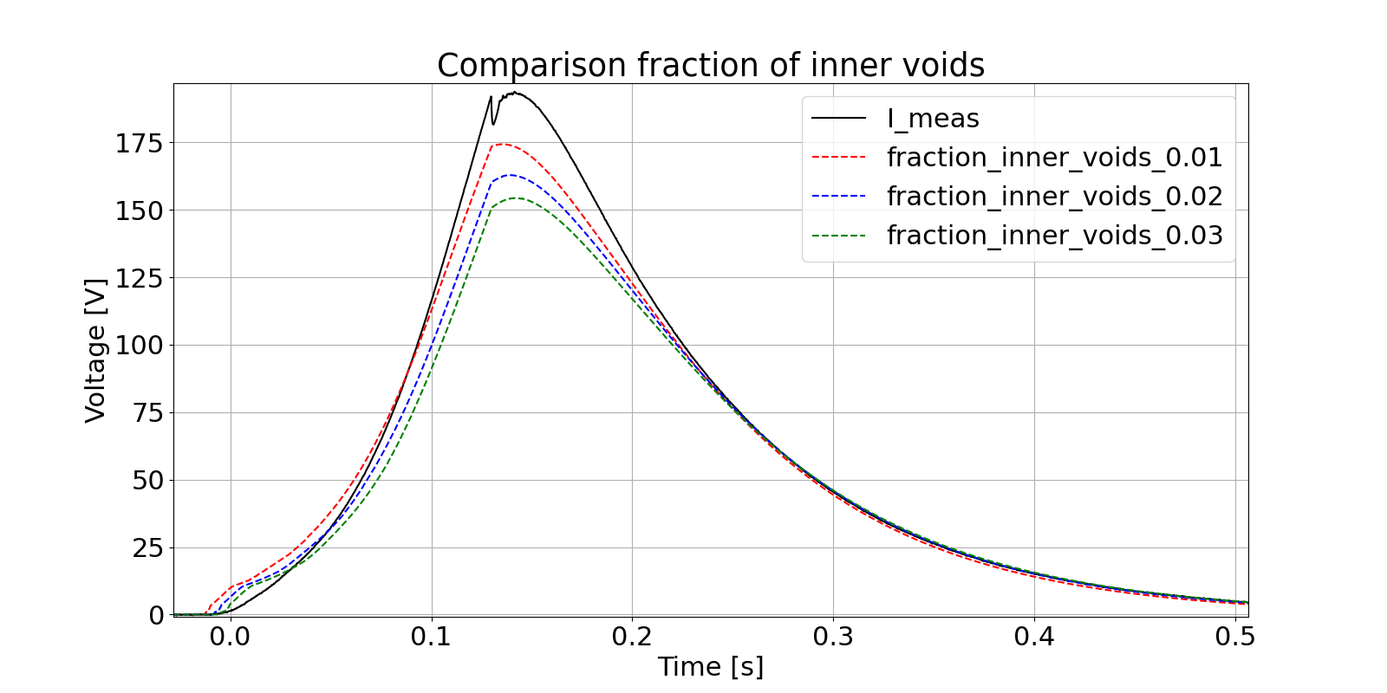
Behaviour of differential voltage
Variation of the amount of helium inside the cable
Voltage jumps caused by quench heaters
Manipulation of heater contact to strands possible
Matching quench start for fraction_inner_voids at 2 %
Best fitting discharge at fraction_inner_voids = 2 %
Faster discharge at quench start, slower discharge
before energy extraction triggering
Similar behaviour visible in global differential voltage

Slide 20
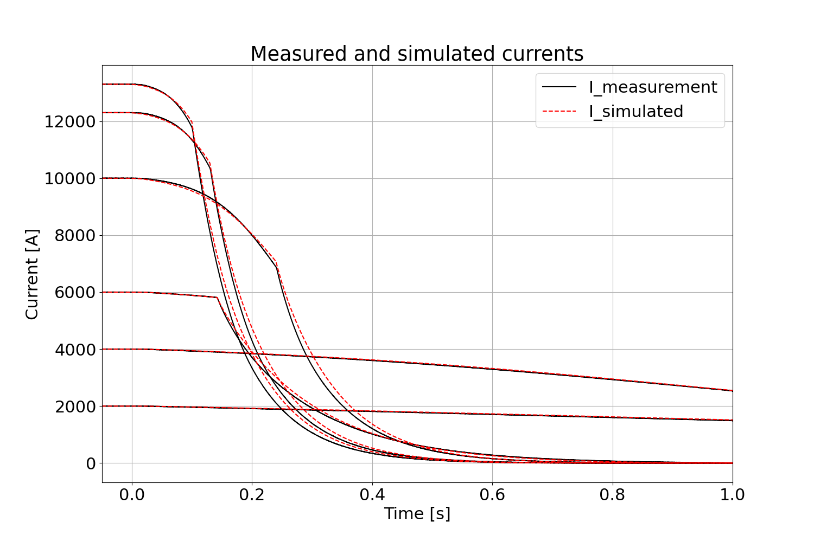
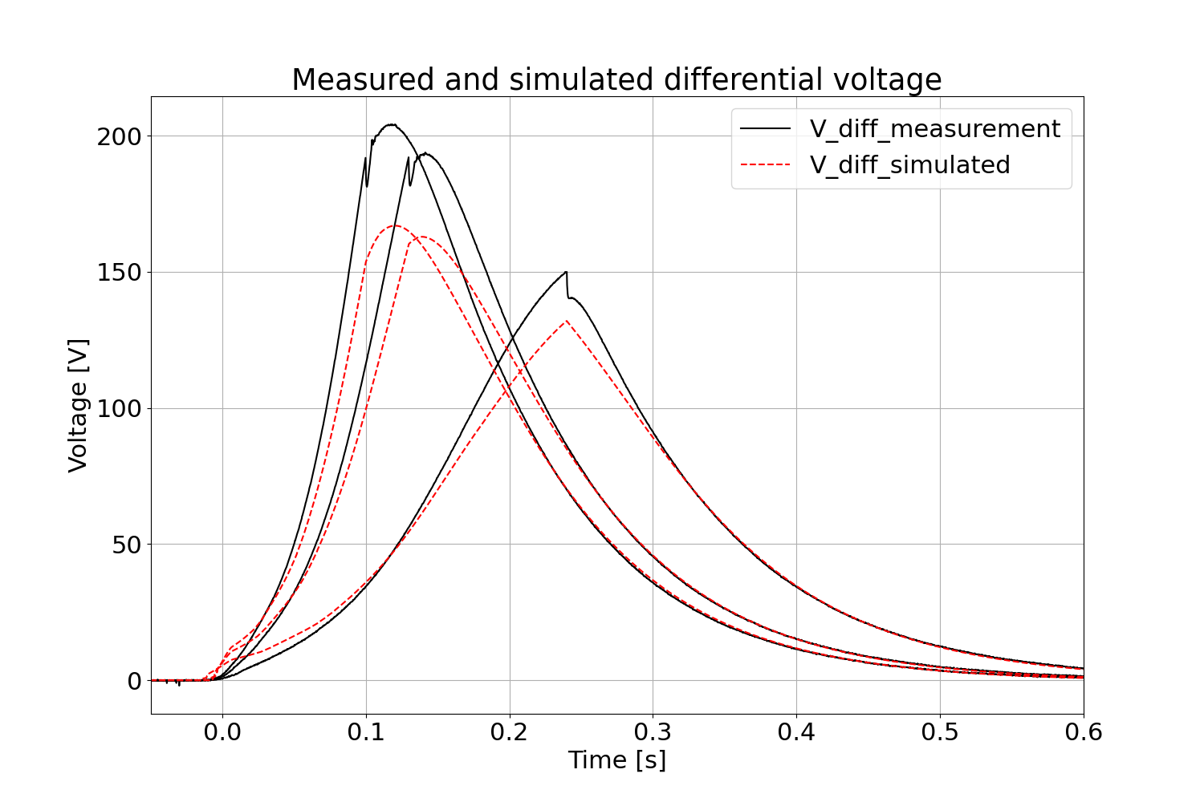
Simulation results of the MBRD
Validated STEAM-LEDET model of the MBRD magnet
Using the 2D+1D option including quench propagation between heating stations and
to turns that are not yet quenched
Typical RMS error divided by peak value: 1 % for the current and 2-10 % for the voltage
High current:

Slide 21
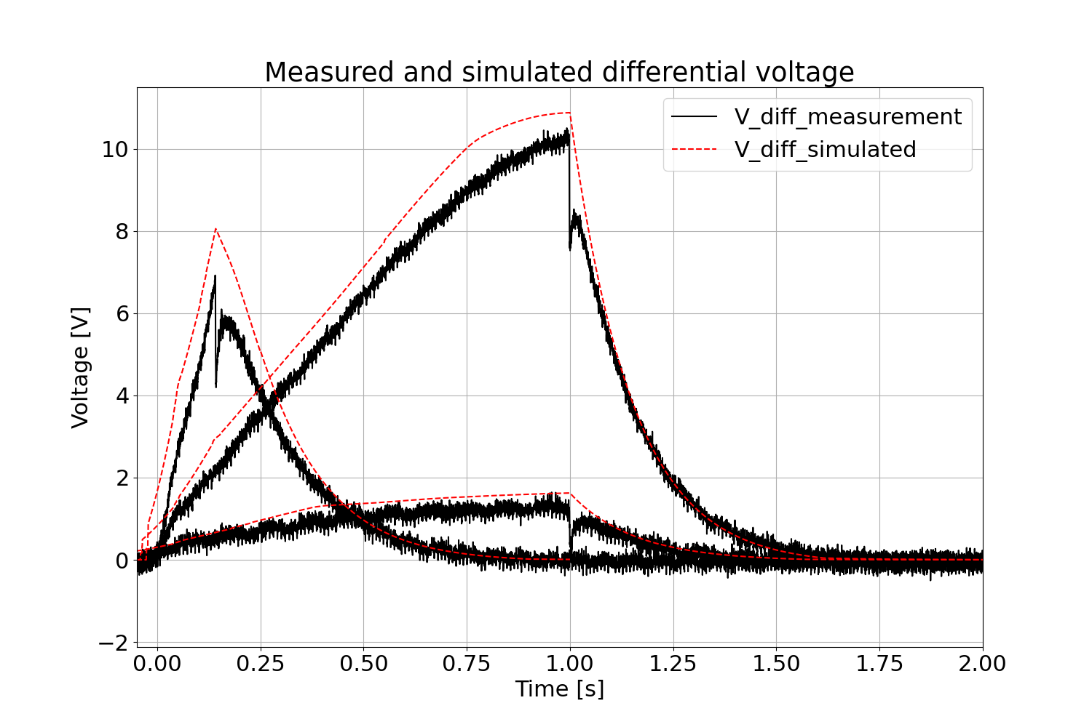
Simulation results of the MBRD
Validated STEAM-LEDET model of the MBRD magnet
Using the 2D+1D option including quench propagation between heating stations and
to turns that are not yet quenched
Typical RMS error divided by peak value: 1 % for the current and 2-10 % for the voltage
Low current:

Slide 22
Presentation outline
Including longitudinal quench propagation for QH protected magnets
Validation process of co-simulation
Alternative protection of MBRD magnet to decrease hot-spot temperature and voltage to ground

Slide 23
MBRD prototype; Baseline
Baseline:
Case | QH firing
Nominal | QH_1; QH_3; QH_6; QH_8
Ultimate | QH_1; QH_3; QH_6; QH_8
Failure 1 | QH_1; QH_3; QH_6
Failure 2 | QH_1; QH_3
Failure 3 | QH_1; QH_6
QH_7
QH_3
QH_5
QH_1
5
4
b
3
1B
2A
2
a
1
1A
2B
QH_8
QH_4
QH_6
QH_2

Slide 24
MBRD prototype; Failure 1
Baseline:
Case | QH firing
Nominal | QH_1; QH_3; QH_6; QH_8
Ultimate | QH_1; QH_3; QH_6; QH_8
Failure 1 | QH_1; QH_3; QH_6
Failure 2 | QH_1; QH_3
Failure 3 | QH_1; QH_6
QH_7
QH_3
QH_5
QH_1
5
4
b
3
1B
2A
2
a
1
1A
2B
QH_8
QH_4
QH_6
QH_2

Slide 25
MBRD prototype; Failure 2
Baseline:
Case | QH firing
Nominal | QH_1; QH_3; QH_6; QH_8
Ultimate | QH_1; QH_3; QH_6; QH_8
Failure 1 | QH_1; QH_3; QH_6
Failure 2 | QH_1; QH_3
Failure 3 | QH_1; QH_6
QH_7
QH_3
QH_5
QH_1
5
4
b
3
1B
2A
2
a
1
1A
2B
QH_8
QH_4
QH_6
QH_2

Slide 26
MBRD prototype; Failure 3
Baseline:
Case | QH firing
Nominal | QH_1; QH_3; QH_6; QH_8
Ultimate | QH_1; QH_3; QH_6; QH_8
Failure 1 | QH_1; QH_3; QH_6
Failure 2 | QH_1; QH_3
Failure 3 | QH_1; QH_6
QH_7
QH_3
QH_5
QH_1
5
4
b
3
1B
2A
2
a
1
1A
2B
QH_8
QH_4
QH_6
QH_2

Slide 27
Simulation results of the MBRD prototype
Failure 1
In the baseline 8 QH strips out of 16 are used
Failure cases simulated at nominal current
Case | T_adiabatic [K] | Peak voltage to ground [V] | Peak turn to turn voltage [V]
Nominal | 292 | 76 | 48
Ultimate | 348 | 95 | 64
Failure 1 | 336 | 303 | 56
Failure 2 | 410 | 335 | 70
Failure 3 | 410 | 713 | 70
Failure 2
Failure 3
→ T_adiabatic is calculated
by assuming that a quench
occurred 27 ms before the
quench detection is triggered
27

Slide 28
Alternative protection; Baseline
Alternative:
Case | QH firing
Nominal | QH_1-8
Ultimate | QH_1-8
Failure 1 | QH_8 fails
Failure 2 | QH_2; QH_6 failing
Failure 3 | QH_3; QH_7 failing
QH_7
QH_3
QH_5
QH_1
5
4
b
3
1B
2A
2
a
1
1A
2B
QH_8
QH_4
QH_6
QH_2

Slide 29
Alternative protection; Failure 1
Alternative:
Case | QH firing
Nominal | QH_1-8
Ultimate | QH_1-8
Failure 1 | QH_8 fails
Failure 2 | QH_2; QH_6 failing
Failure 3 | QH_3; QH_7 failing
QH_7
QH_3
QH_5
QH_1
5
4
b
3
1B
2A
2
a
1
1A
2B
QH_8
QH_4
QH_6
QH_2

Slide 30
Alternative protection; Failure 2
Alternative:
Case | QH firing
Nominal | QH_1-8
Ultimate | QH_1-8
Failure 1 | QH_8 fails
Failure 2 | QH_2; QH_6 failing
Failure 3 | QH_3; QH_7 failing
QH_7
QH_3
QH_5
QH_1
5
4
b
3
1B
2A
2
a
1
1A
2B
QH_8
QH_4
QH_6
QH_2

Slide 31
Alternative protection; Failure 3
Alternative:
Case | QH firing
Nominal | QH_1-8
Ultimate | QH_1-8
Failure 1 | QH_8 fails
Failure 2 | QH_2; QH_6 failing
Failure 3 | QH_3; QH_7 failing
QH_7
QH_3
QH_5
QH_1
5
4
b
3
1B
2A
2
a
1
1A
2B
QH_8
QH_4
QH_6
QH_2

Slide 32
Alternative protection for the MBRD prototype
Significant improvement of hot-spot temperature and voltage to ground
Alternative: 16 QH strips out of 16 are used
Failure cases simulated at nominal current
Case | T_adiabatic [K] |  | Peak voltage to ground [V] |  | Peak turn to turn voltage [V]
 | 8/16 | 16/16 | 8/16 | 16/16 | 8/16 | 16/16
Nominal | 292 | 219 | 76 | 64 | 48 | 30
Ultimate | 348 | 259 | 95 | 83 | 64 | 43
Failure 1 | 336 | 232 | 303 | 158 | 56 | 34
Failure 2 | 410 | 250 | 335 | 352 | 70 | 38
Failure 3 | 410 | 250 | 713 | 396 | 70 | 38
→ T_adiabatic is calculated
by assuming that a quench
occurred 27 ms before the
quench detection is triggered
32

Slide 33
Conclusion and lessons learned
Simulation of QH discharges can be made more accurate, especially at low current, if the quench
propagation between heating stations is included in the simulation

Slide 34
Conclusion and lessons learned
Simulation of QH discharges can be made more accurate, especially at low current, if the quench
propagation between heating stations is included in the simulation
STEAM-PyBBQ: New tool is now validated for
cases with and without cooling

Slide 35
Conclusion and lessons learned
Simulation of QH discharges can be made more accurate, especially at low current, if the quench
propagation between heating stations is included in the simulation
STEAM-PyBBQ: New tool is now validated for
cases with and without cooling
Co-simulation analysis based on YAML files to be
consistent, repeatable, versioned and traceable

Slide 36
Conclusion and lessons learned
Simulation of QH discharges can be made more accurate, especially at low current, if the quench
propagation between heating stations is included in the simulation
STEAM-PyBBQ: New tool is now validated for
cases with and without cooling
Co-simulation analysis based on YAML files to be
consistent, repeatable, versioned and traceable
HL-LHC MBRD STEAM-LEDET model validated
against experimental results

Slide 37
Conclusion and lessons learned
Simulation of QH discharges can be made more accurate, especially at low current, if the quench
propagation between heating stations is included in the simulation
STEAM-PyBBQ: New tool is now validated for
cases with and without cooling
Co-simulation analysis based on YAML files to be
consistent, repeatable, versioned and traceable
HL-LHC MBRD STEAM-LEDET model validated
against experimental results
Studied nominal and failure cases for the HL-LHC baseline case, and an alternative protection with double the
QH units, which allows reducing the hot-spot temperature by 160 K and the peak voltage to ground by 44 %

Slide 38
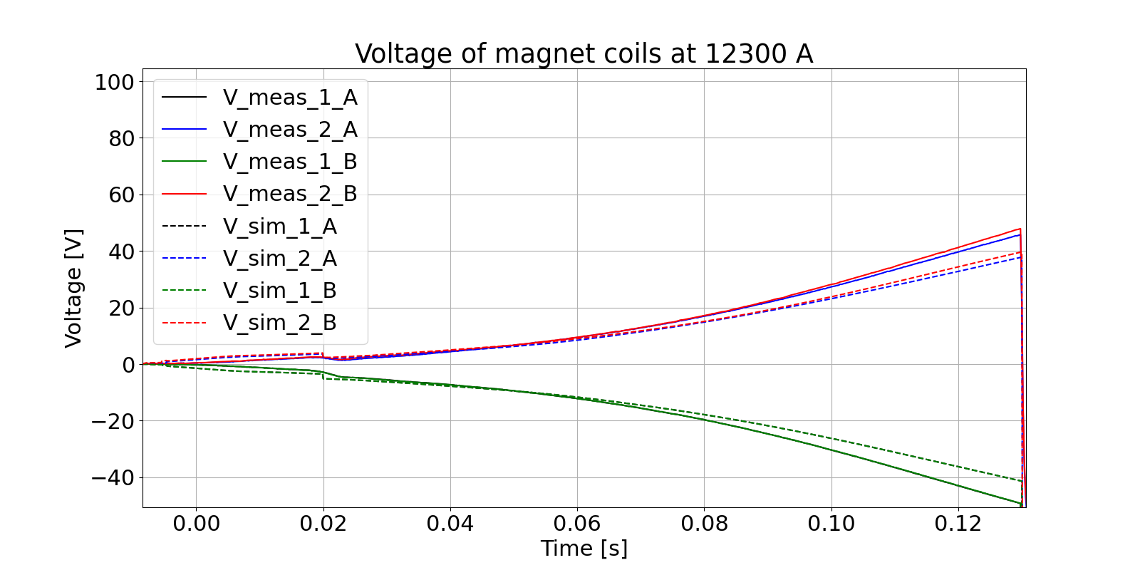
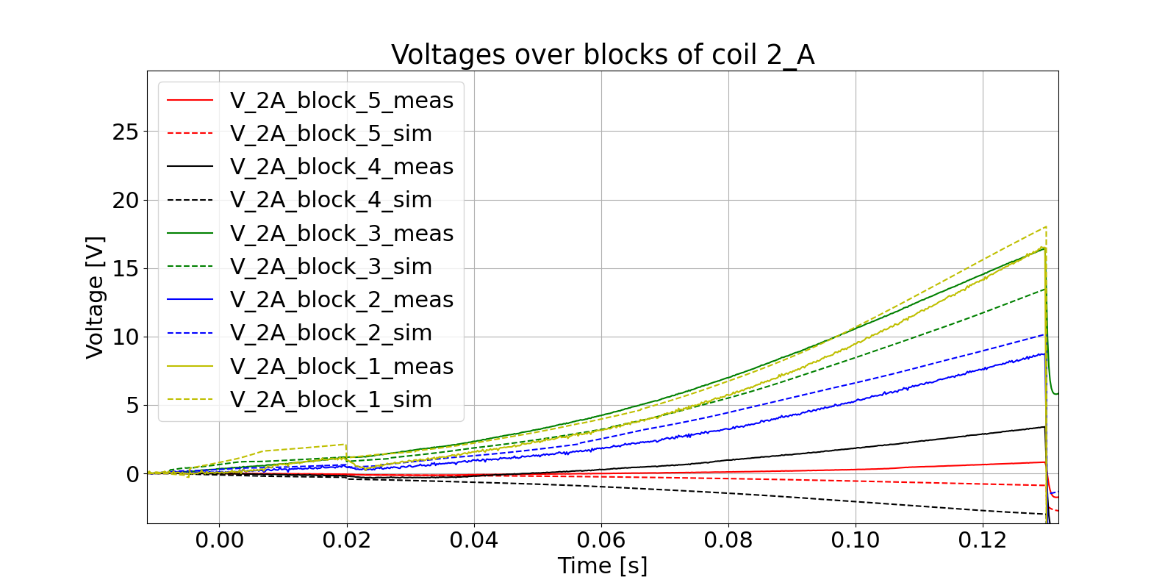
Annex: Coil and block voltages
Coil voltages show similar behaviour as
differential voltage
Underestimation before energy extraction triggering
not yet understood
Block voltages of coil 2A show good overall agreement
for blocks in contact to quench heaters
Outer blocks don’t quench but develop inductive voltage
38

Slide 39
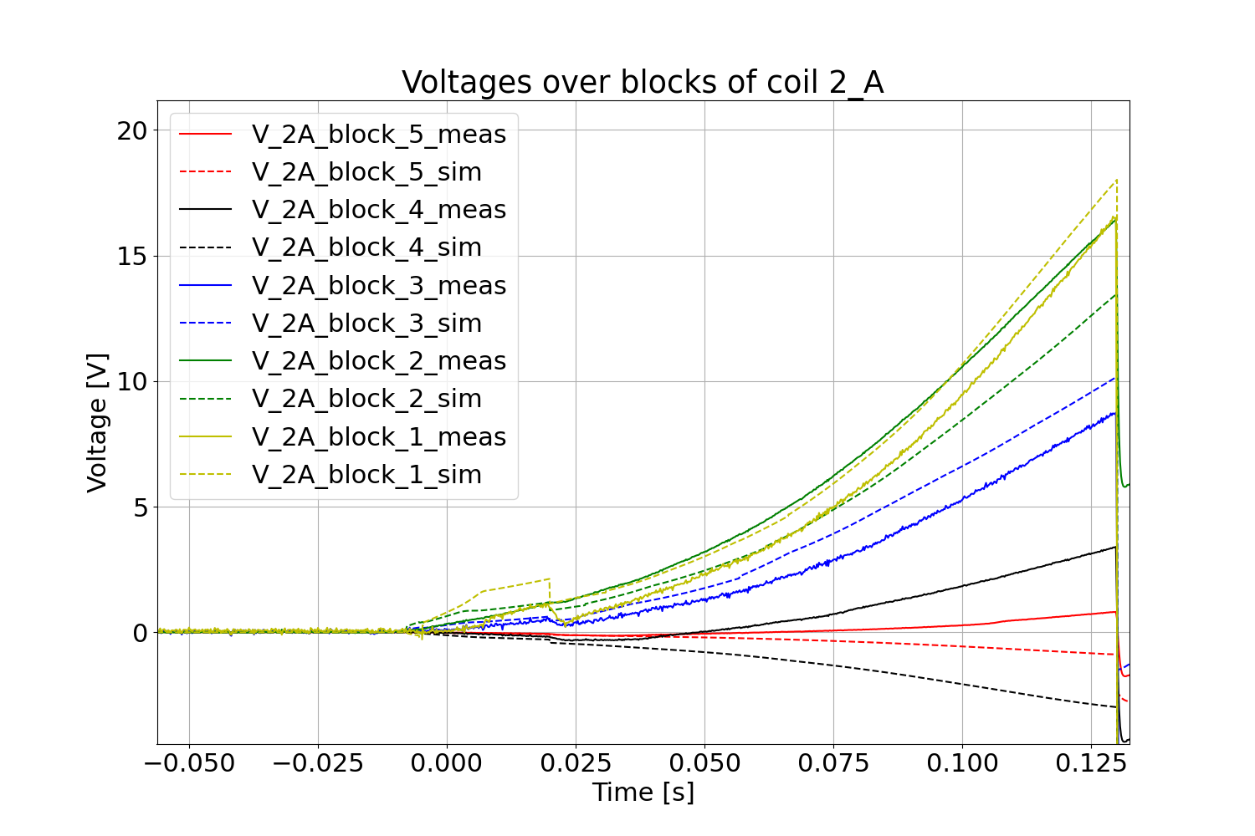
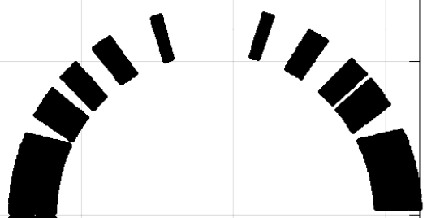
Block voltages
5
4
3
2
Coil 2A
1
39
39

Slide 40
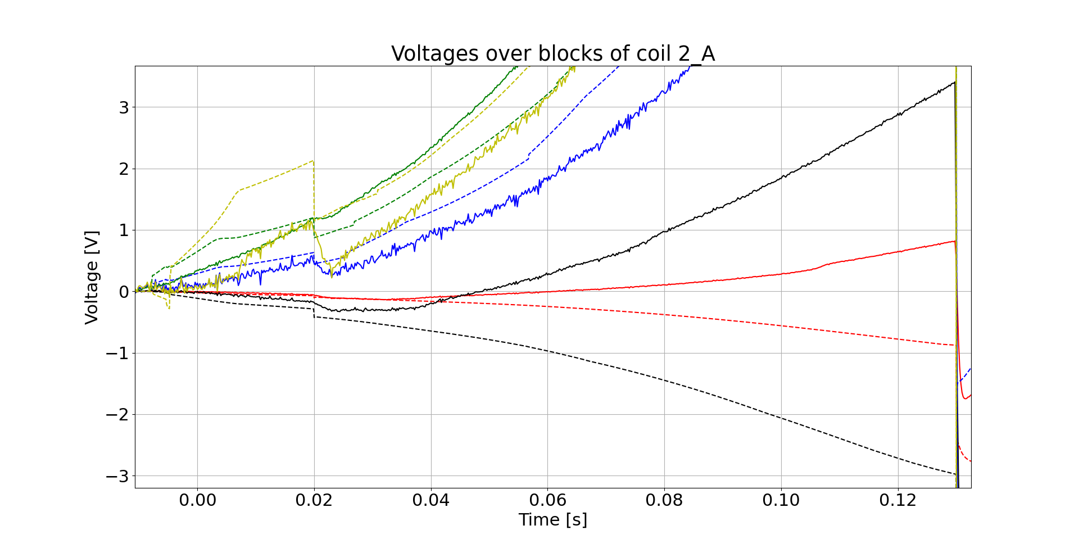
Voltage block 4 and 5
5
4
3
2
Coil 2A
1
approximated quench start
40
40

Slide 41
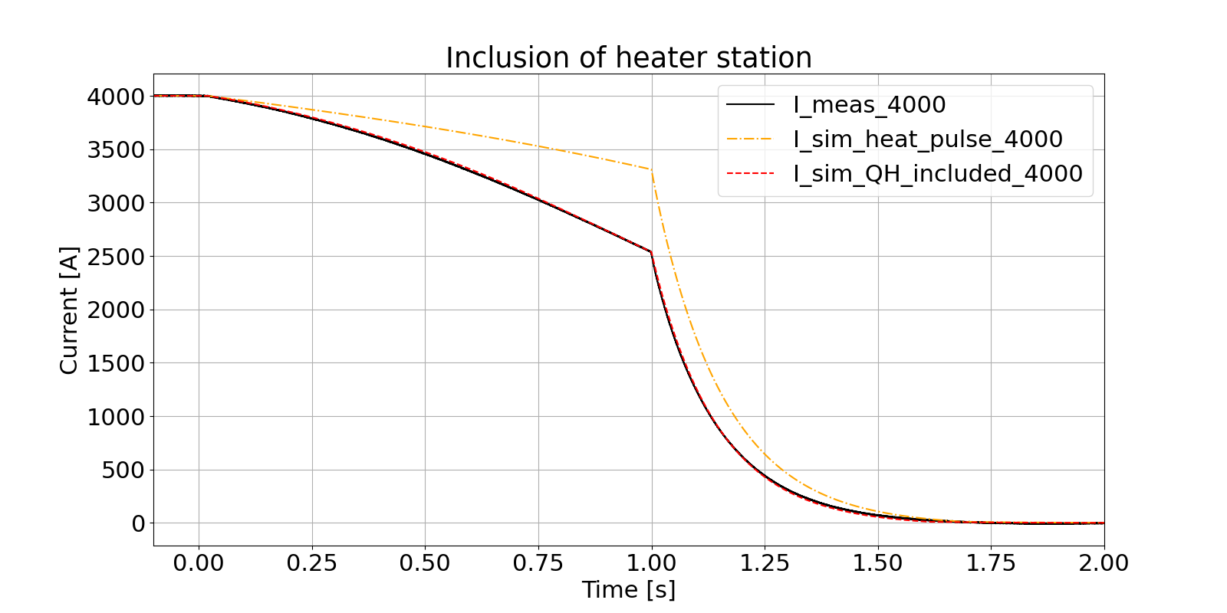
Annex: Improvements at low currents
Major improvement of simulated discharge
at low currents by including QH in the
PyBBQ simulation
No changes at high currents due to
including QH in PyBBQ

Slide 42
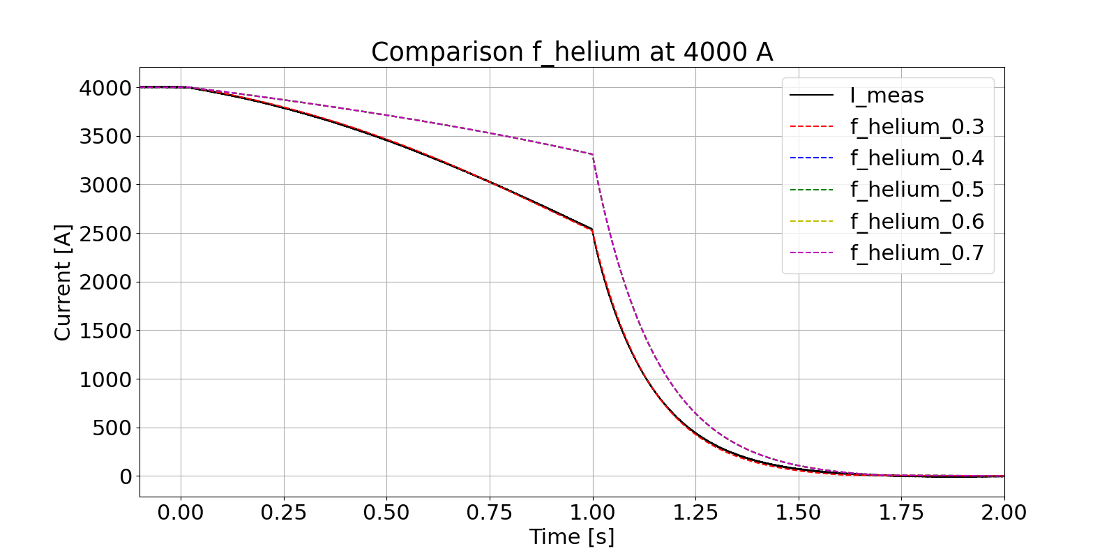
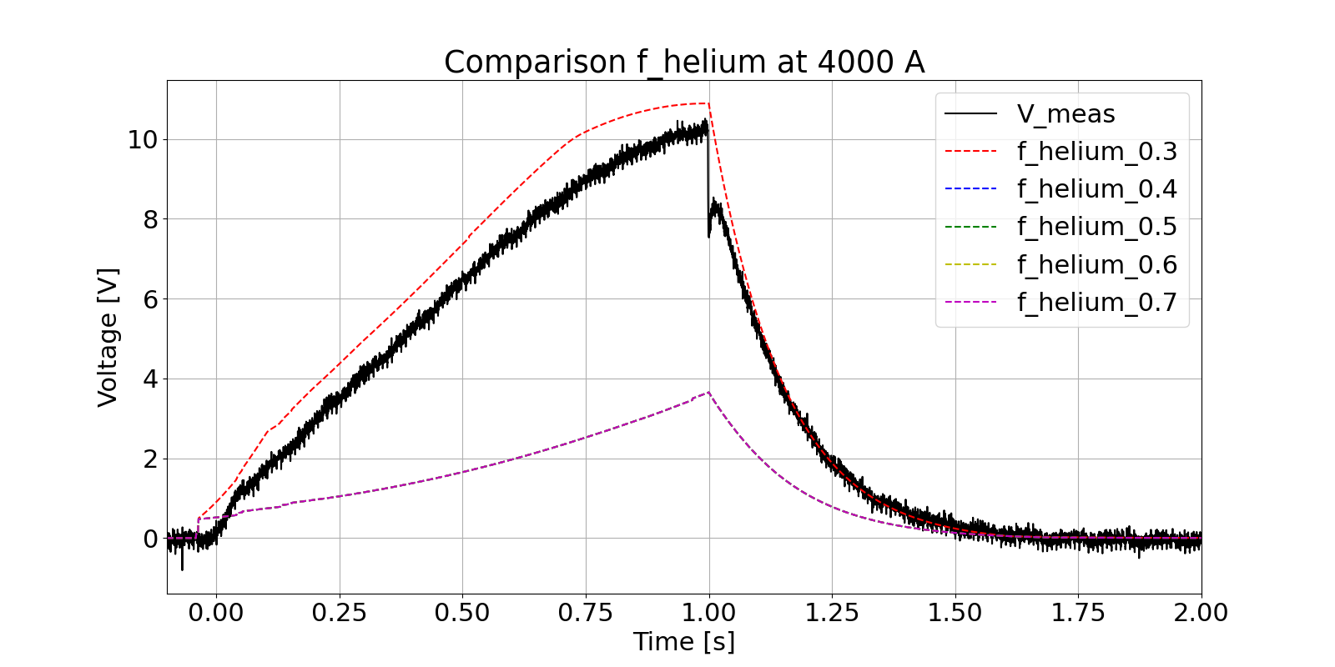
Annex: Variation of f_helium at low currents
No impact on discharge current and differential voltage
at low currents for high f_helium
From certain f_helium quench propagation occurs

Slide 43
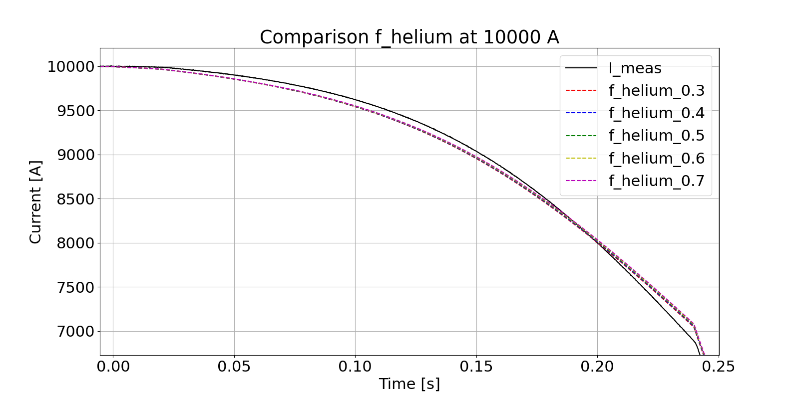
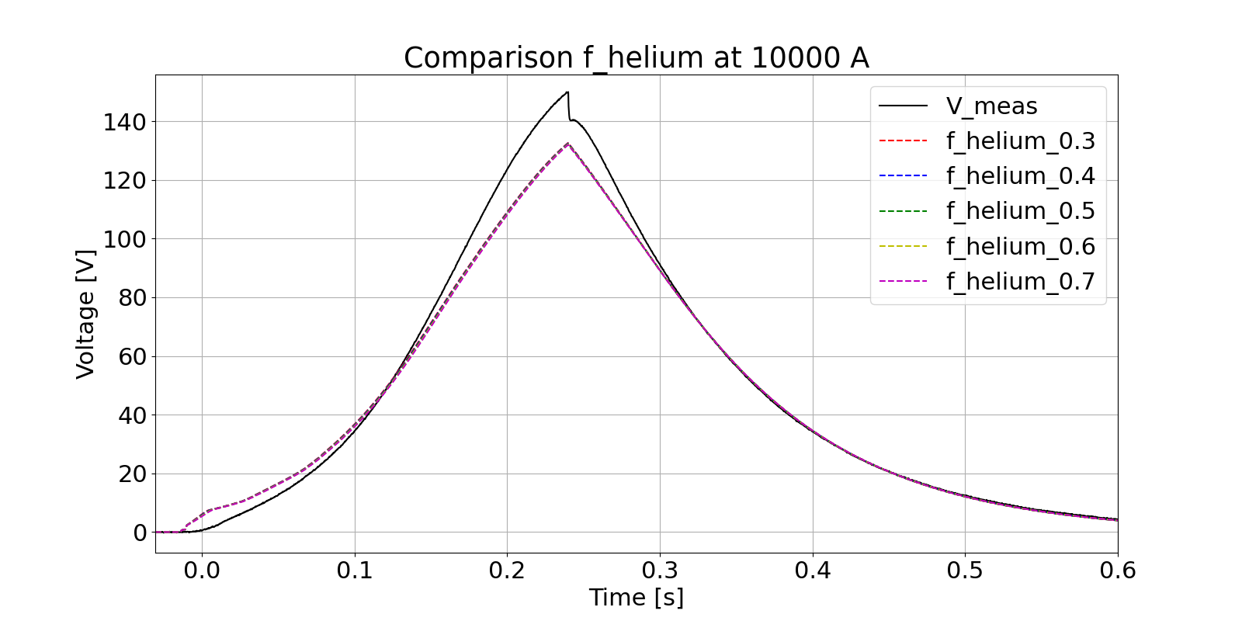
Annex: Variation of f_helium at high currents
No impact at low currents for high f_helium
From certain f_helium quench propagation occurs
Negligible impact on high currents

Slide 44
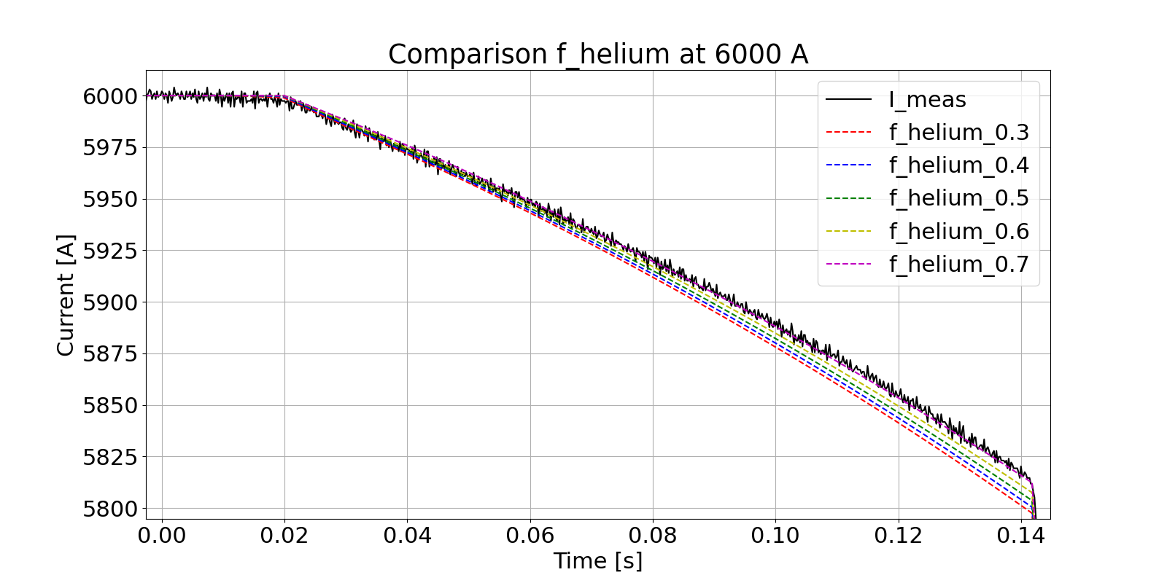
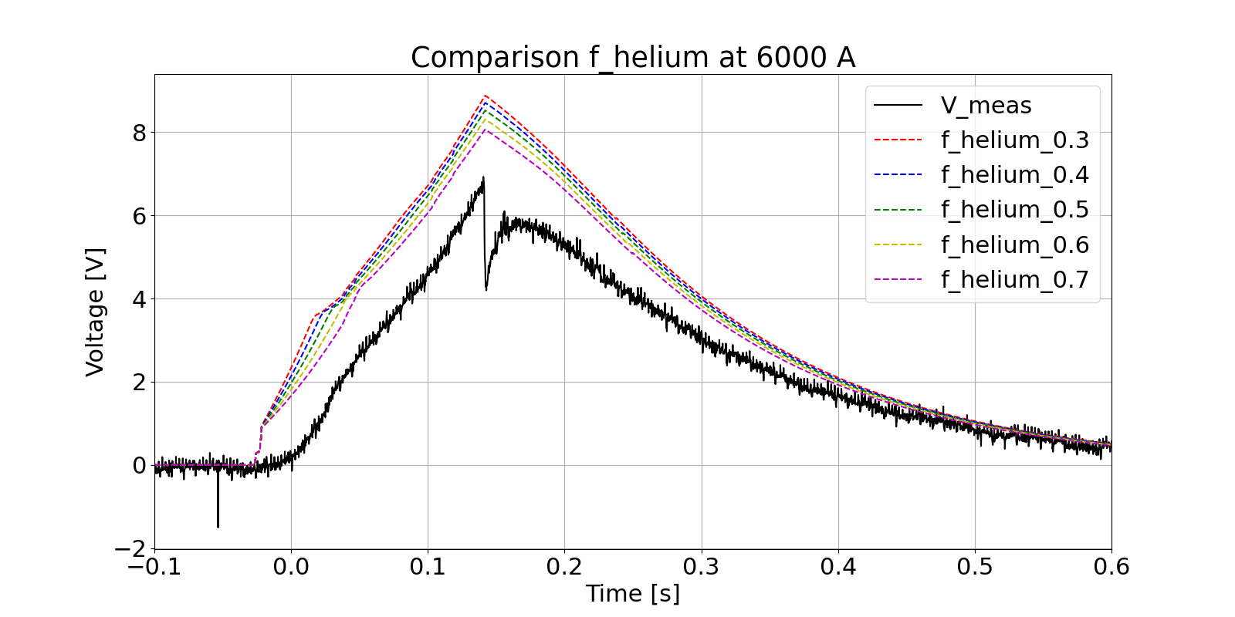
Annex: Identifying value of f_helium
No impact at low currents for high f_helium
From certain f_helium quench propagation occurs
Negligible impact on high currents
Highest visible impact at 6000 A
Less helium cooling accelerates discharge
Best fit for f_helium at 0.7

Slide 45
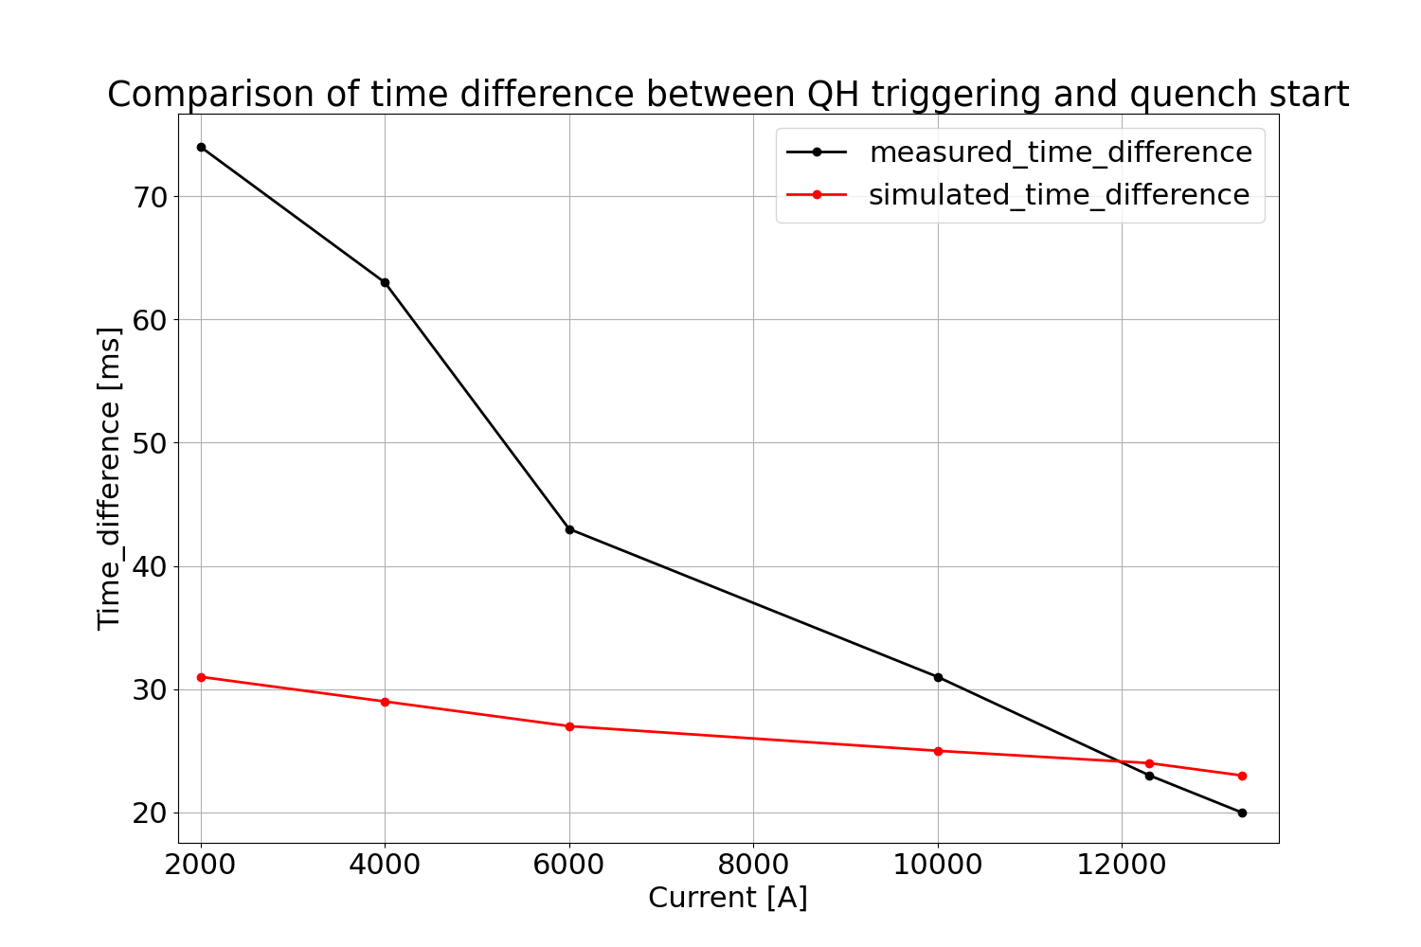
Annex: Difference of simulated and measured quench start
Time of quench at high current is
simulated well
At low current, the quench start is
simulated too early
Earlier start maybe due to underestimating
the cooling along the longitudinal direction
of a half turn

