Slide 1
e+ injector RF and solenoid technology
Riccardo Zennaro:: Paul Scherrer Institut
Joint WP1/W3/WP6 meeting 29/04/2022

Slide 2
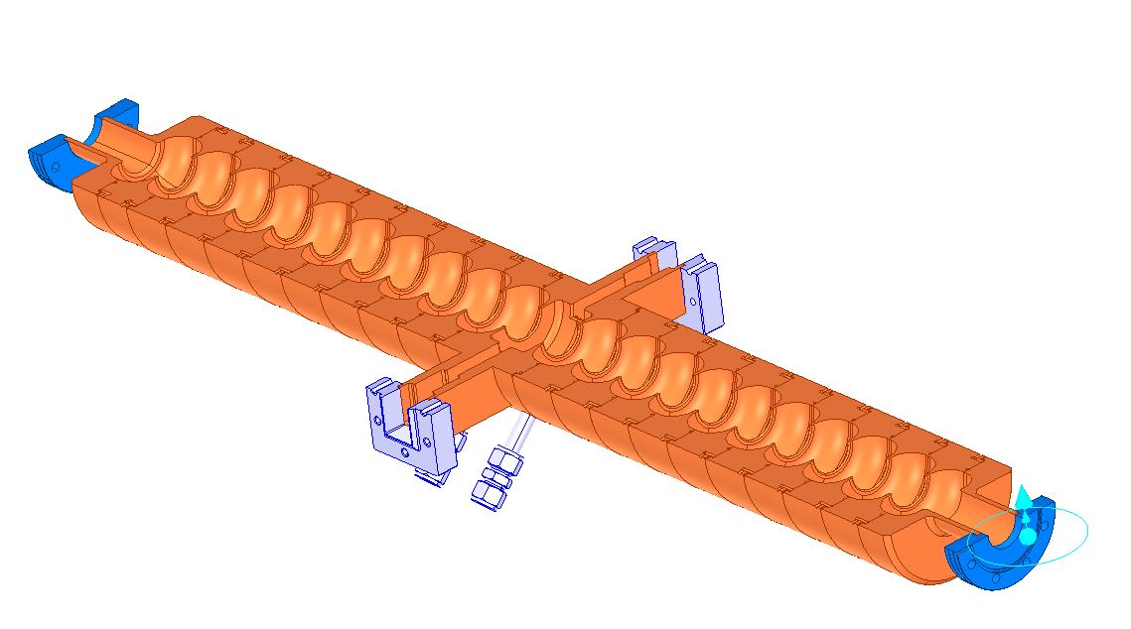
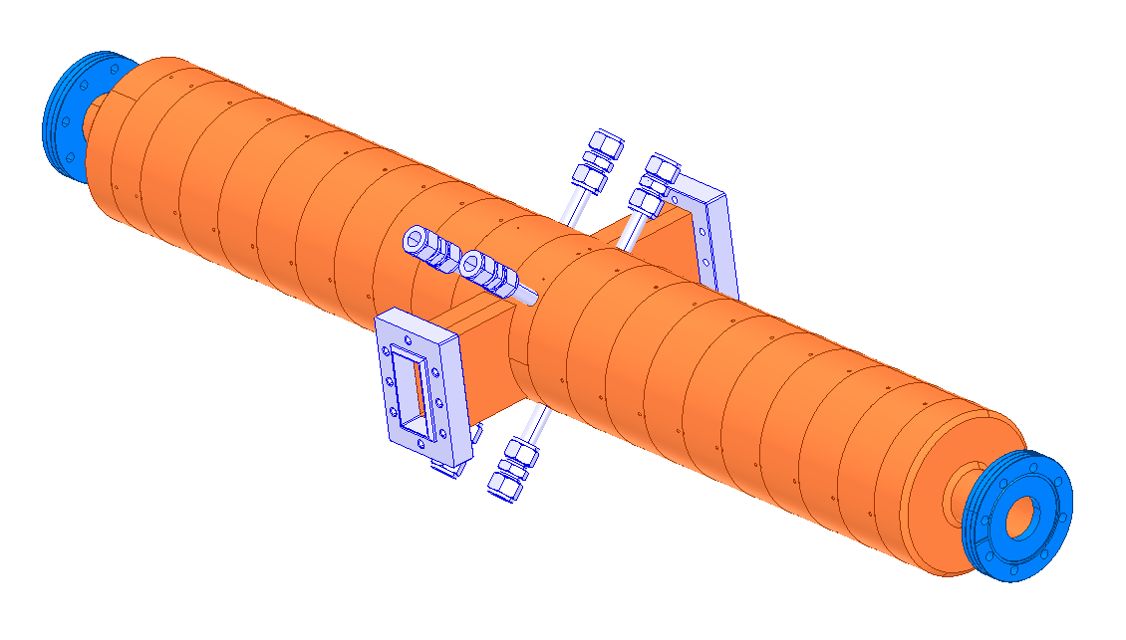
3 GHz SW cavity for P³
Cavity length | 1.2 | m
Cavity frequency | 2.9988 | GHz
Operational gradient | 18 | MV/m
Number of cells | 21
Quality factor | 21600
Shunt impedance | 13.9 | MOhm/m
Coupling factor | 2
Filling time | 3 | μs
Mode separation | 5.3 | MHz
Max. repetition rate | 100 | Hz
Frequency available klystron
SW large aperture operation, no pulse compressor
Length min. mode separation
β reduced filling time

Slide 3
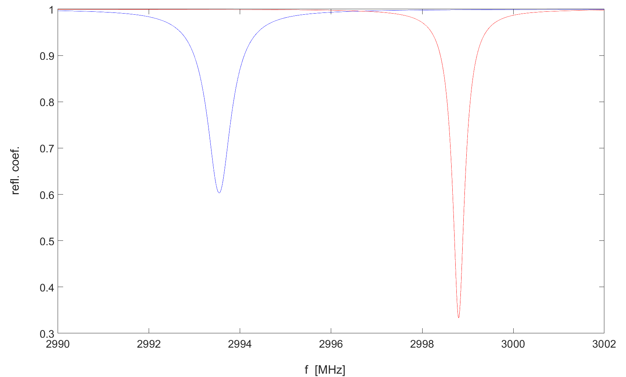
Mode separation (3 GHz), stady state
f=2993.54 MHz
β=4
Q₀=21000
ρ=0.985
f=2998.8 MHz
β=2
Q₀=21500
Mode separation is a limiting parameter in the design of standing wave π mode cavities

Slide 4
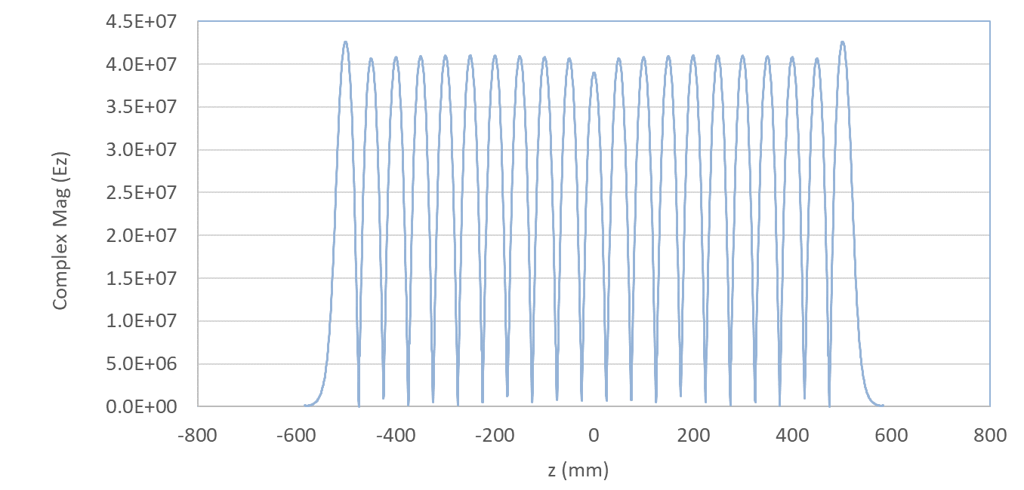
Ez (3 GHz; 15 MW input power) steady state

Slide 5
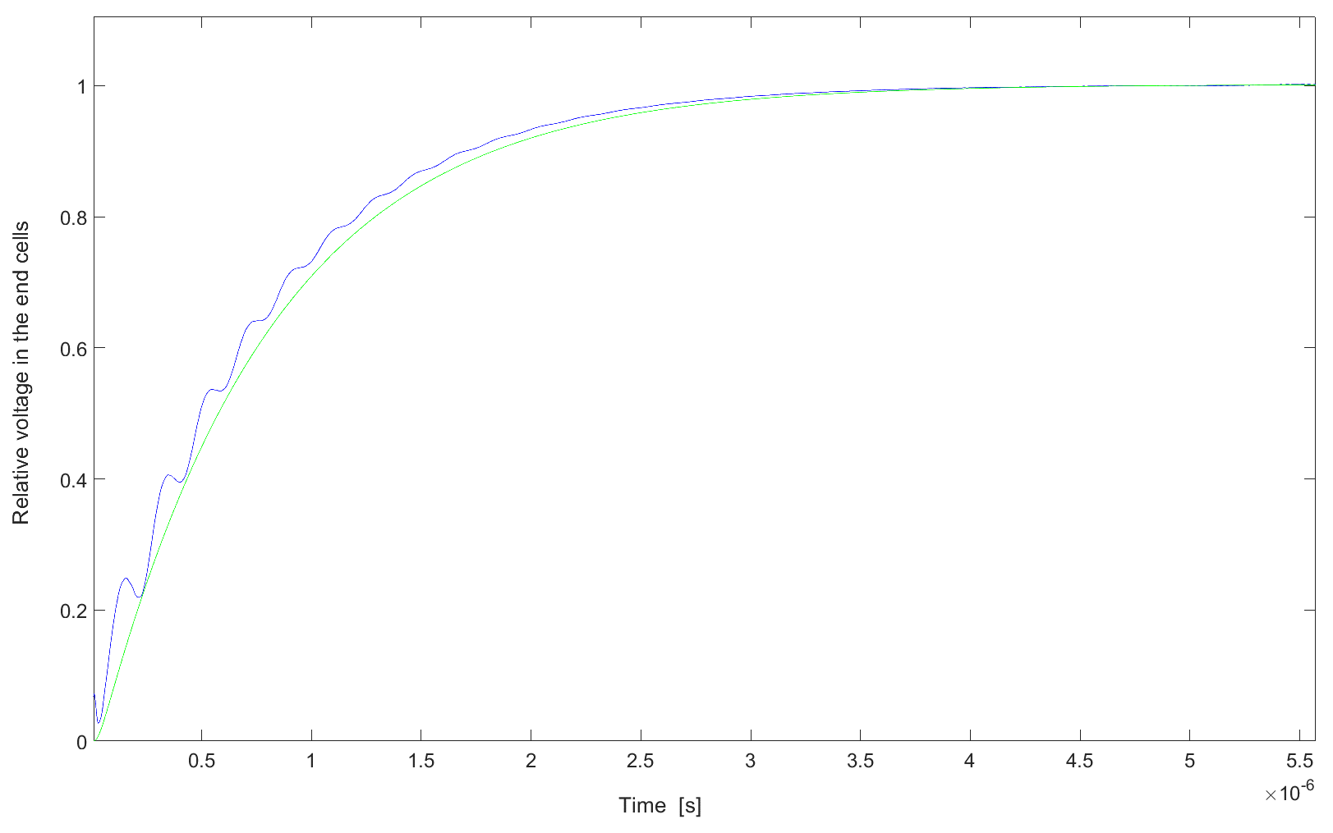
Mode separation and transient (filling time)
Pin
Pout
Model as function of β, Q, f, k:
Differential equation system based on power flow conservation
Possibility to integrate beam loading in the model
Good prediction of the filling time from the model
the next mode introduce a time modulation of the voltage which is negligible after a couple of μs.
The other modes have no effect
5 MHz seems to be an acceptable frequency separation also in the transient case
Blue: HFSS including next mode
Green: model

Slide 6
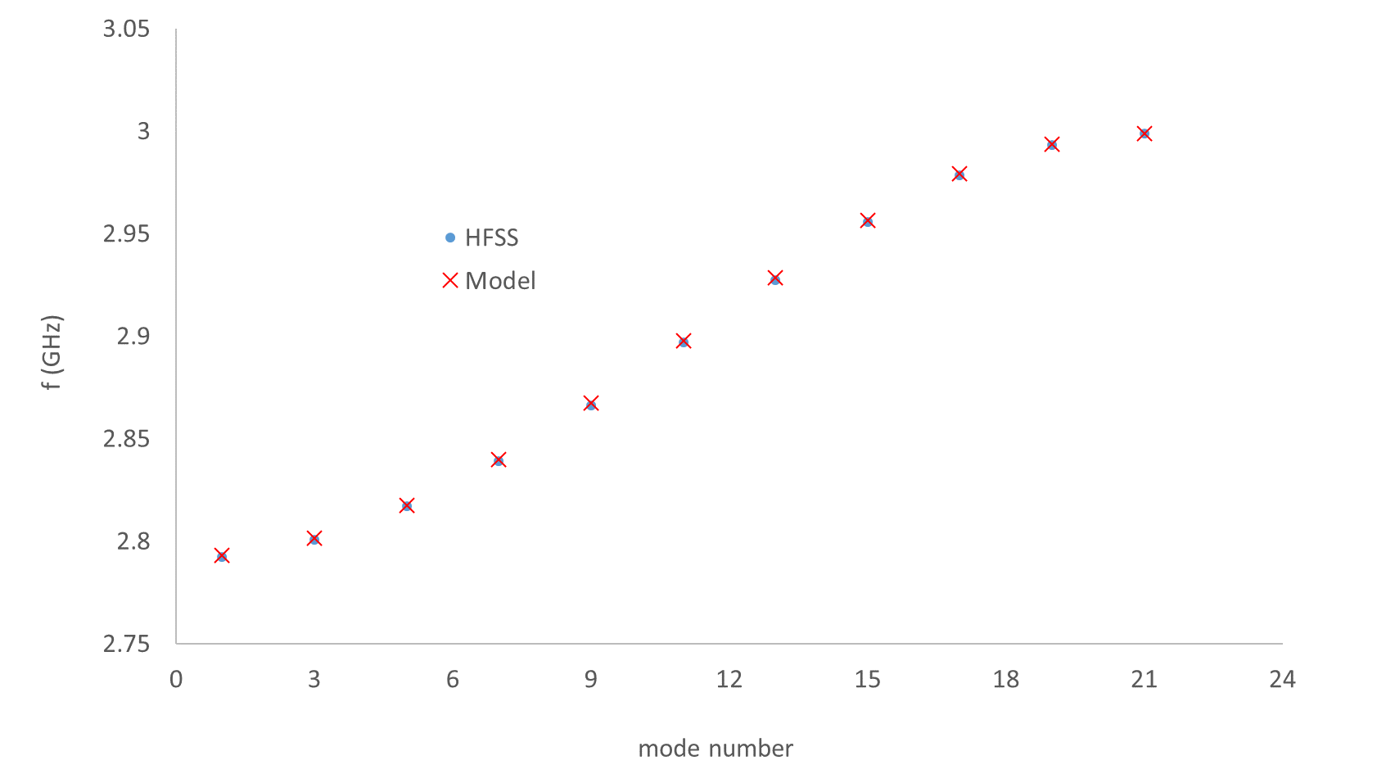
Dispersion curve (3 GHz)
f_{n}=f₀/sqrt(1+k*cos(πn/N))
K=7%
N=21 (tot. cell #)

Slide 7
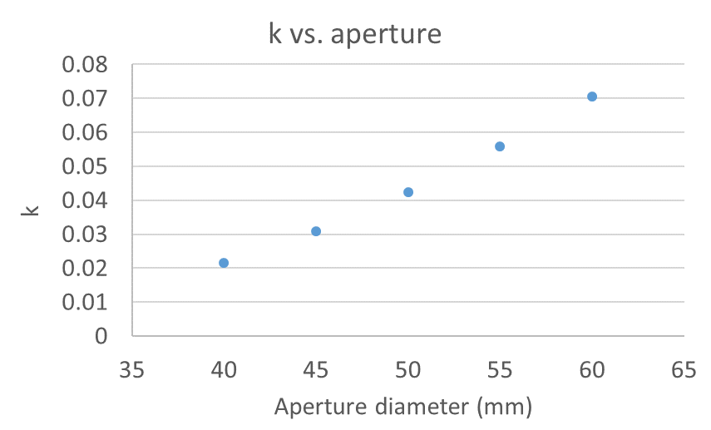
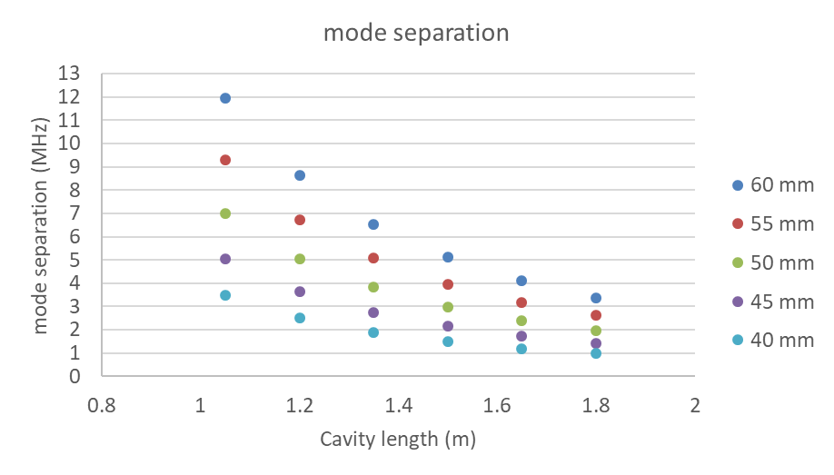
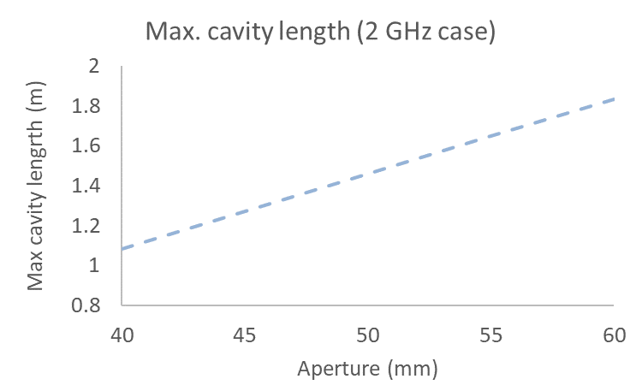
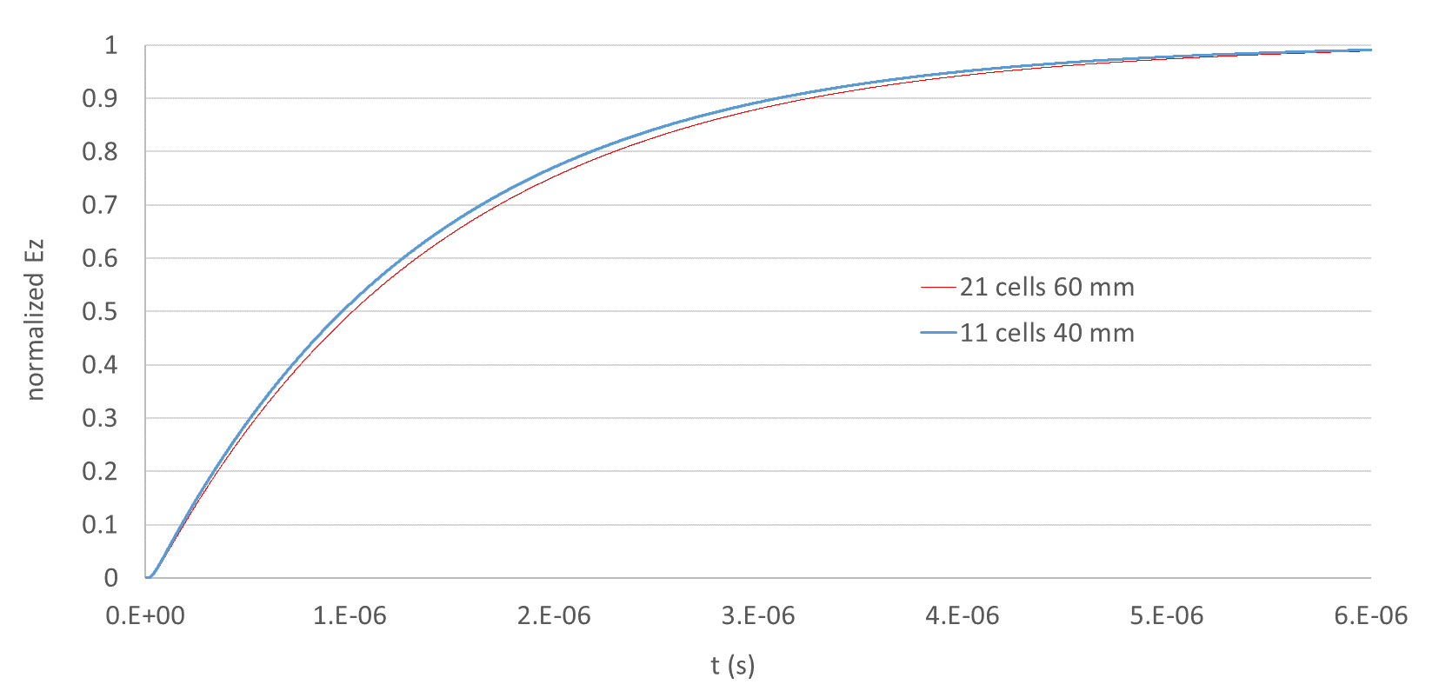
2 GHz (study based on single cell design plus filling time and dispersion curve models)
Arbitrary minimum mode separation
21 cells
Working region
11 cells

Slide 8
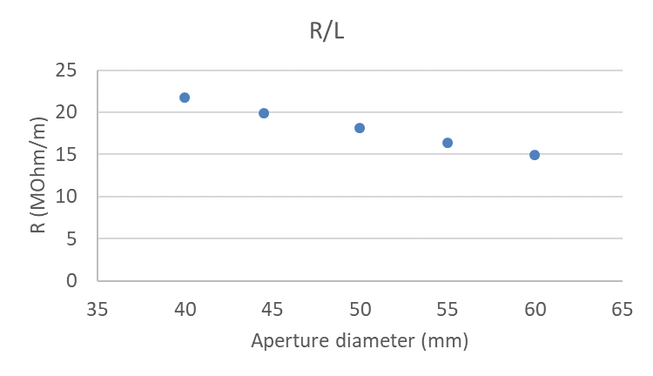
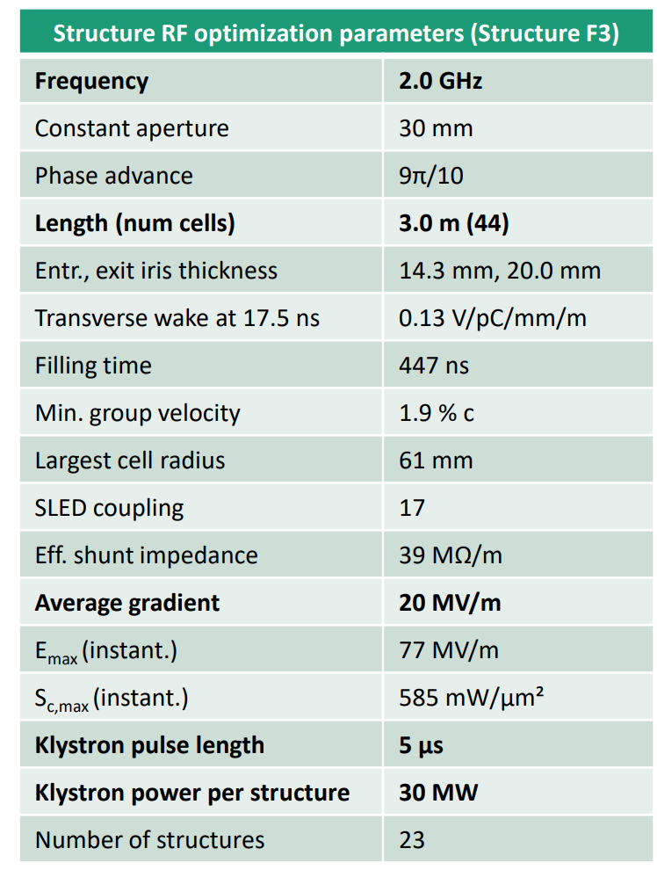
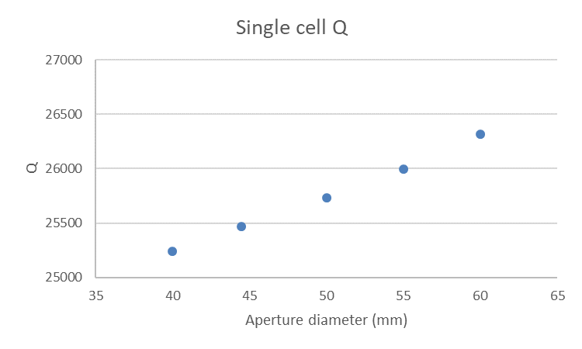
Cavity parameter (2 GHz case)
Two 1.5 m 60 mm SW structures
2.0
30
π
3.0 (22)
5.25
0.05
14.9 (29.8)
20
88
5 (β=2)
45 (β=2)
NB: R=V²/2*P

Slide 9
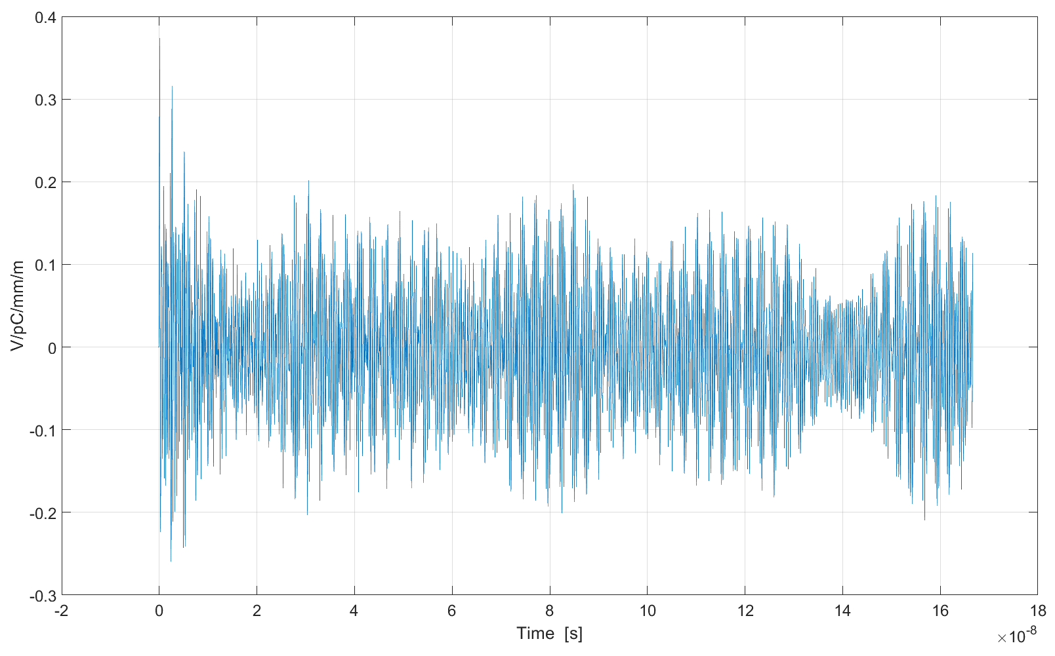
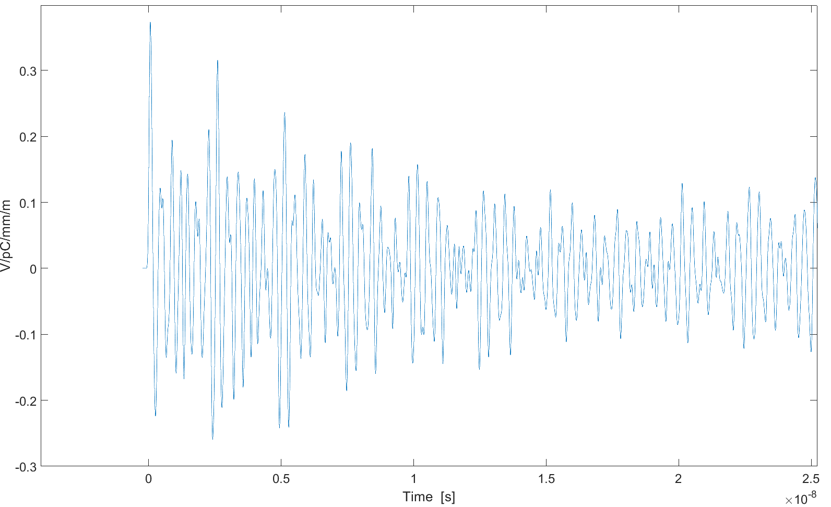
2 GHz trans. wake
~0.05 V/pC/mm/m @ 17.5 ns

Slide 10
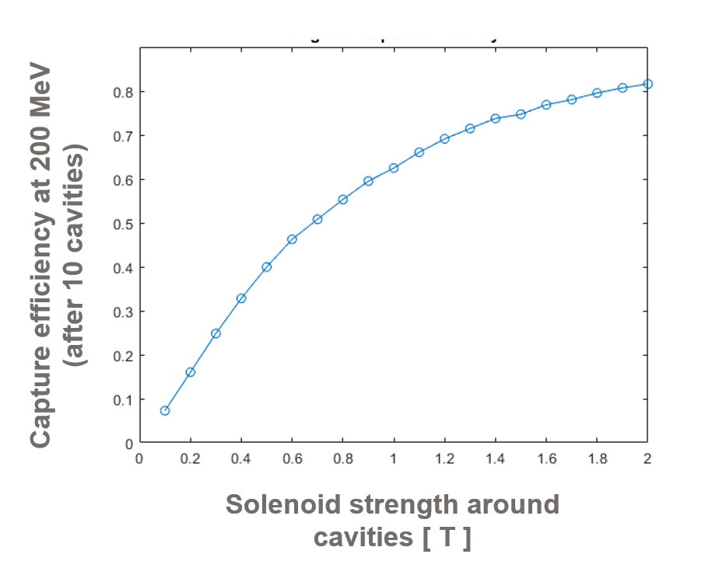
Solenoid technology
Capture efficiency and yield are strongly affected by the strength of solenoid field.
Size, cost and power requirements for normal conducting solenoid become critical over ~0.4 T.
A cost and performance comparison between NC and SC technology is required.
Courtesy of Nicolas Vallis

Slide 11
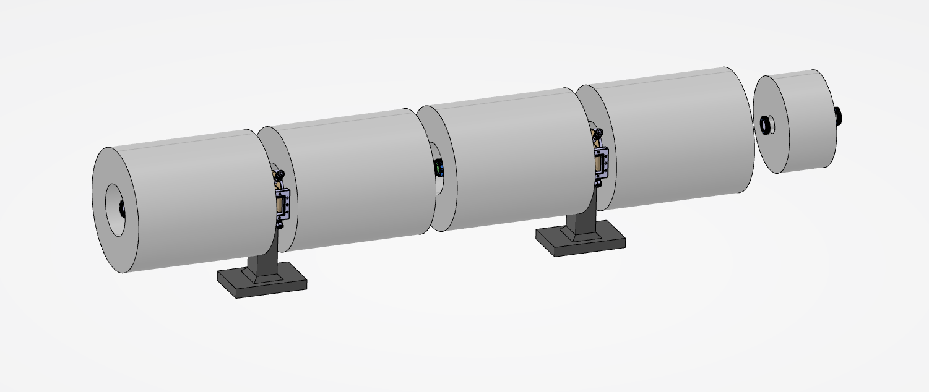
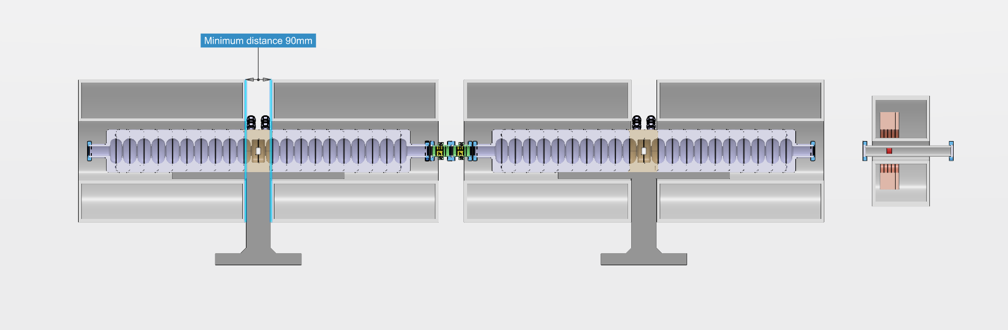
P3 SC solenoids and spacing
Specified field uniformity ±10%
Cooling design, support design and interfaces design to minimize solenoid spacing
No pumping ports on beam axis

Slide 12
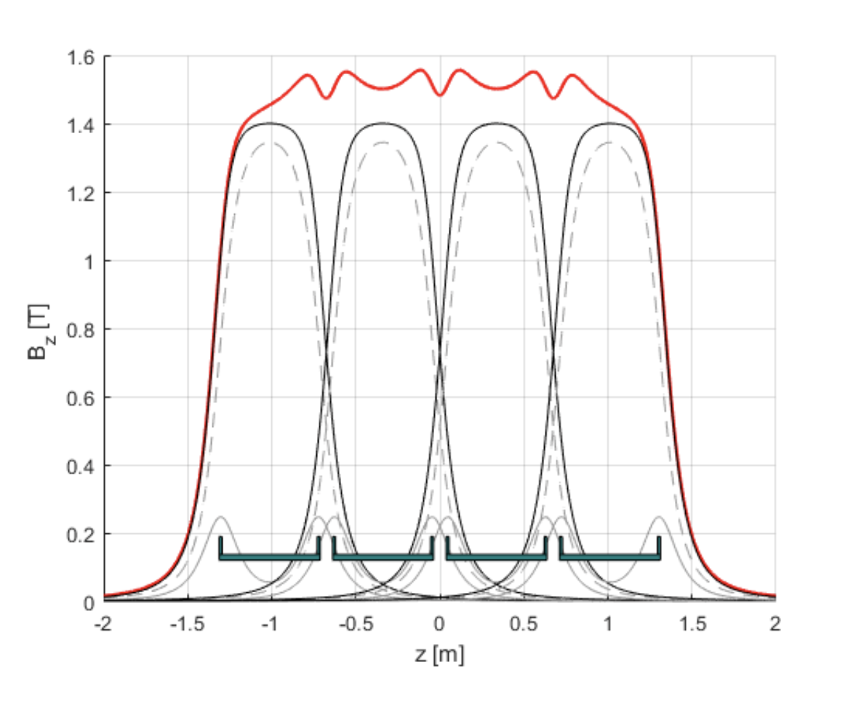
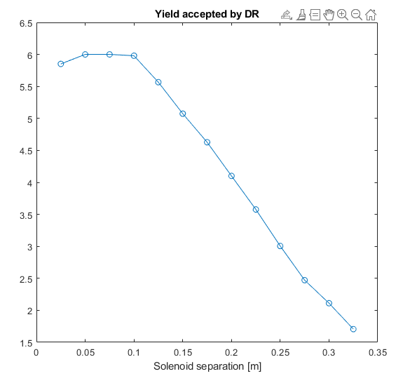
B field discontinuity due to solenoid separation
RF cavity accessibility (RF input, RF output, vacuum connection and assembly) requires discontinuity between solenoids.
This has an impact on the magnetic field uniformity.
Uniformity can be improved by appropriate design of the solenoid coils and/or increasing the solenoid bore aperture (SC solution).
Courtesy of Nicolas Vallis

Slide 13
Solenoid separation, SW vs. TW
TW solution requires large space between structures.
The problem could be solved with a special design of the input/output coupler (?) or with extra solenoid in between structures (cost and length impact).
The TW solution could require less and longer solenoids around the cavities, this can significantly reduce the cost for SC technology (dedicate cryostat for each solenoid)
SW option
b
a
c
a
e
TW option
TW option with extra solenoid
a waveguide spacing
b assembly spacing
c 2*a+b
e a+b
P³ project: a=b=90mm*
(*) LIL flange 81 mm, vacuum pumping only from waveguide

Slide 14
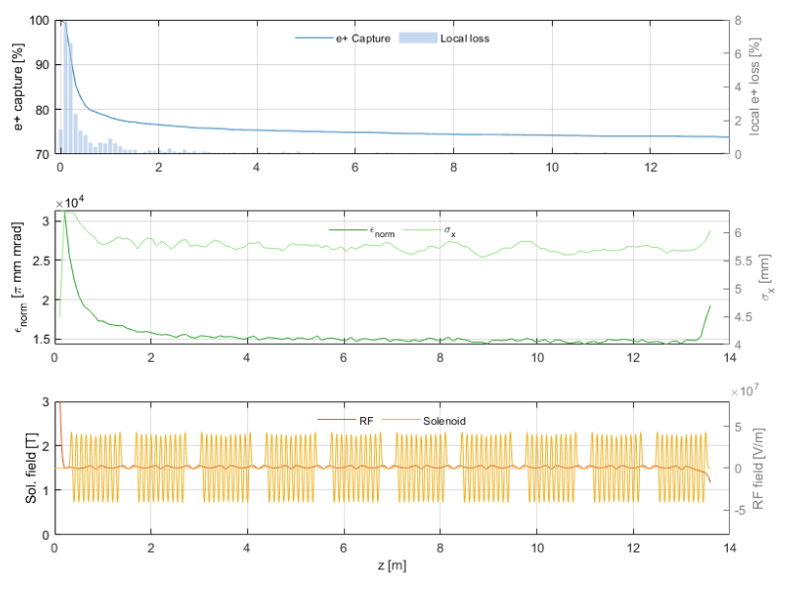
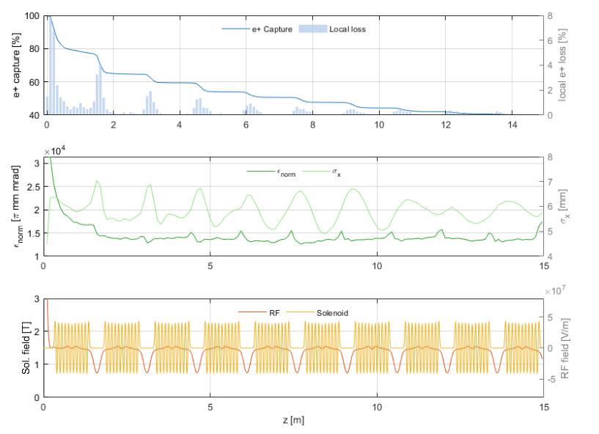
Comparison between TW and SW
100 mm solenoid separation
250 mm solenoid separation
Courtesy of Nicolas Vallis

Slide 15
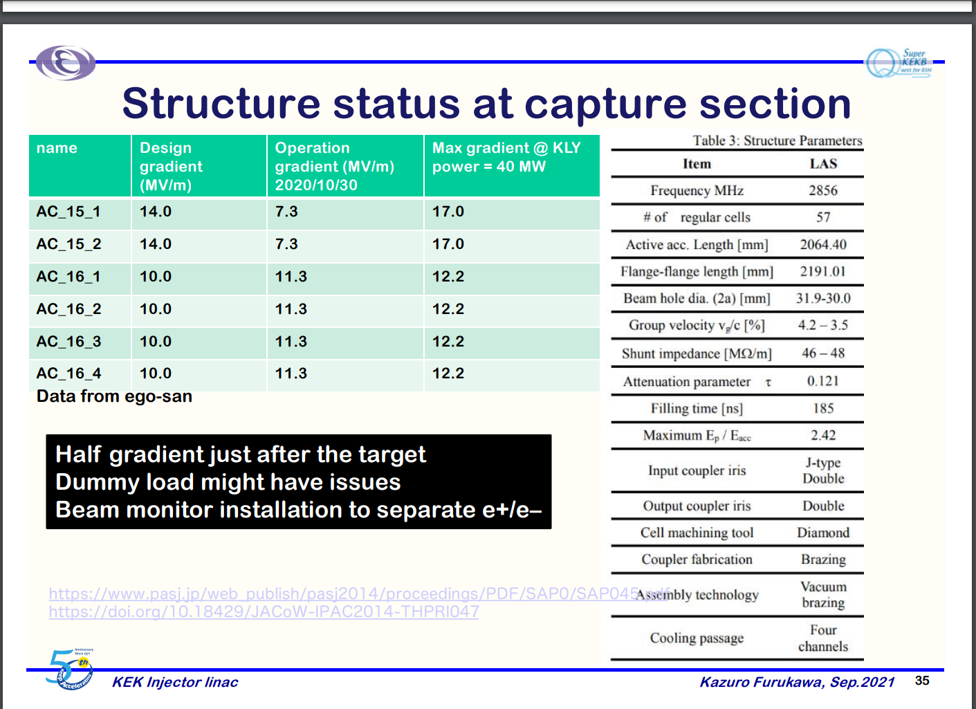
Radiation problems for the RF loads
Kazuro Furukawa (KEK)
FCC-ee Injector Seminar:
Injector Linac Experiences at SuperKEKB
https://indico.cern.ch/event/1074040/
Loads placed just after the e+ target can suffer from radiation

Slide 16
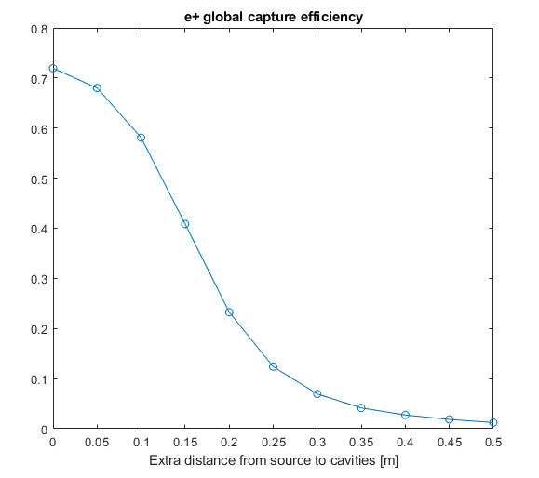
Mask for 1st RF cavity protection
In the present design for P3 the space from target output surface to the flange of the first RF cavity is 25 cm.
An additional space of few centimeters (~<5 cm) for the shielding placed in front of the first RF cavity seems to have moderate effect on the yield.
Courtesy of Nicolas Vallis

Slide 17
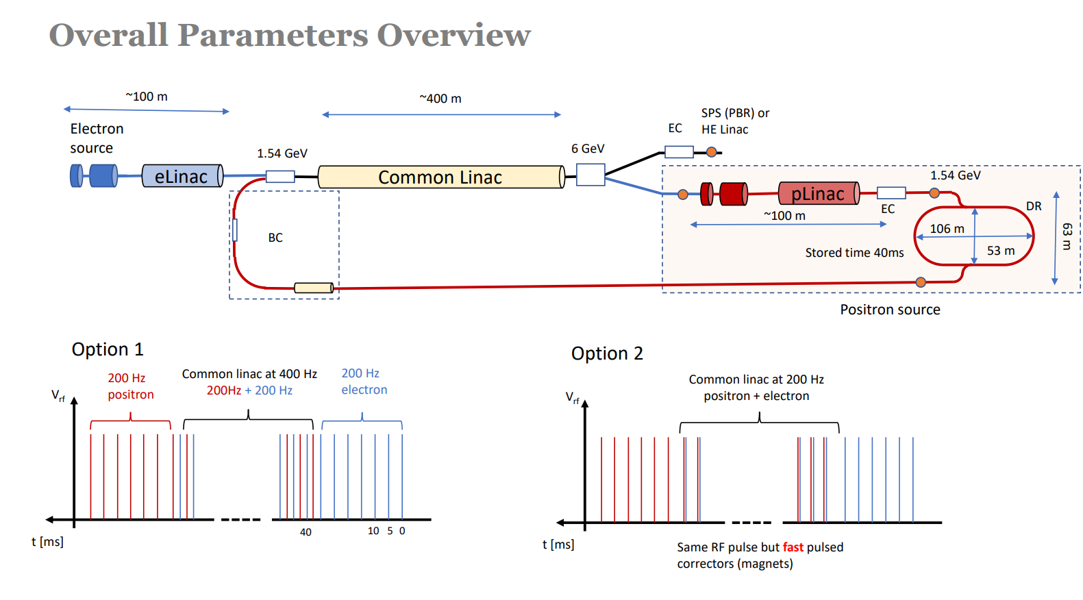
Latest layout
With the new layout there is not clear definition of e+ injector and e+ Linac.
Should we consider the transition from solenoid to quadrupole as interface (if any…)?

Slide 18
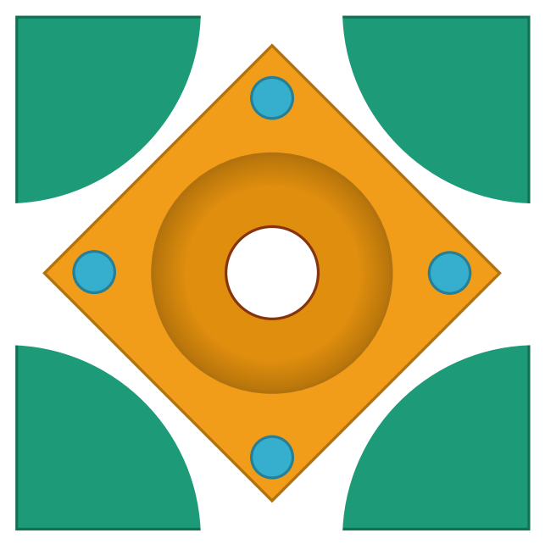
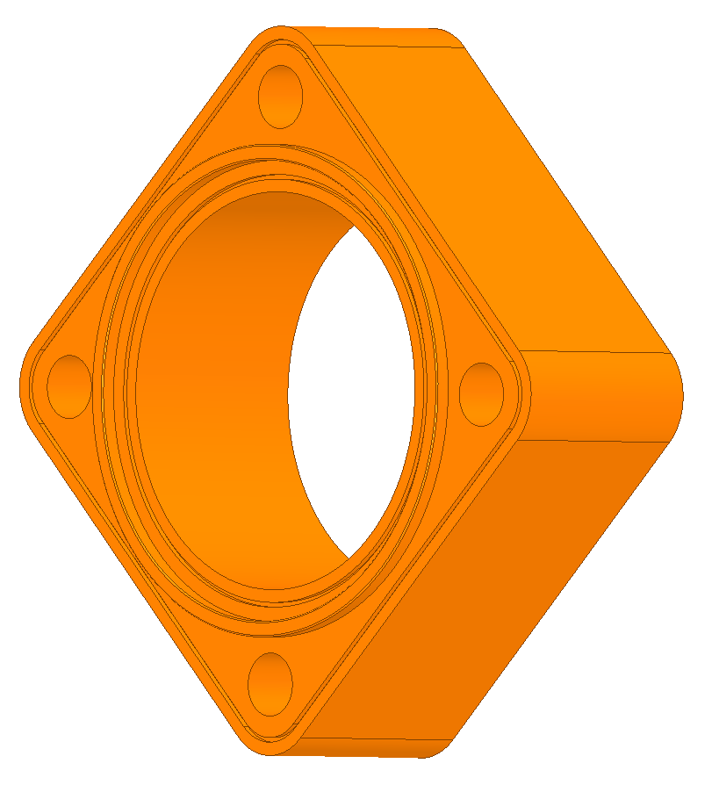
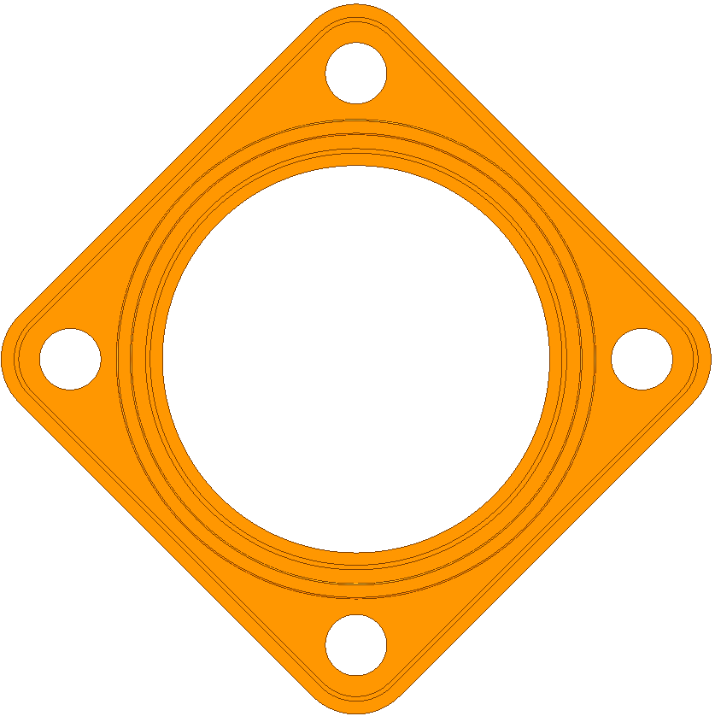
Possible cell design for linac1, solution 1
Squared shape of the disks, circular housing included in the design. Brazing and machining to be tested
175
126
F3 structure

Slide 19
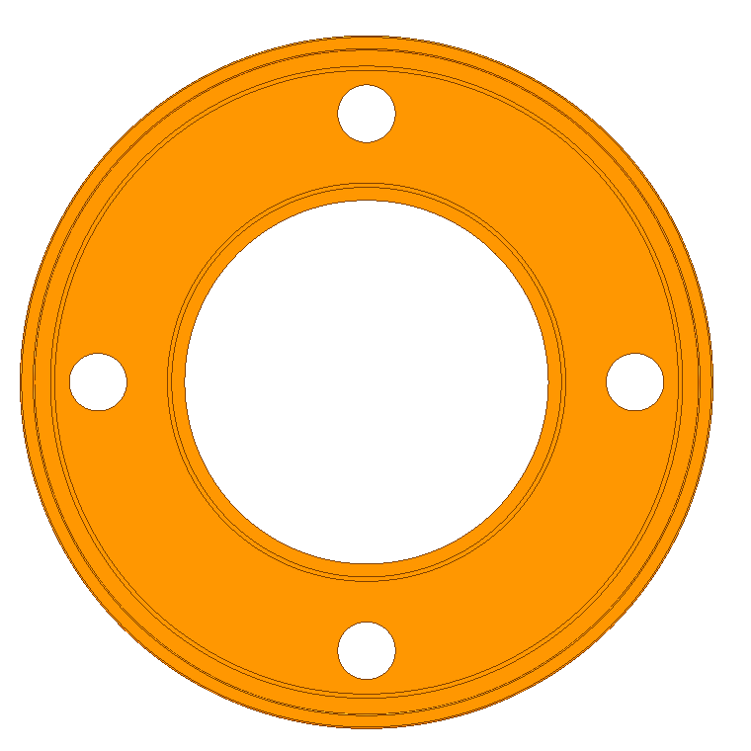
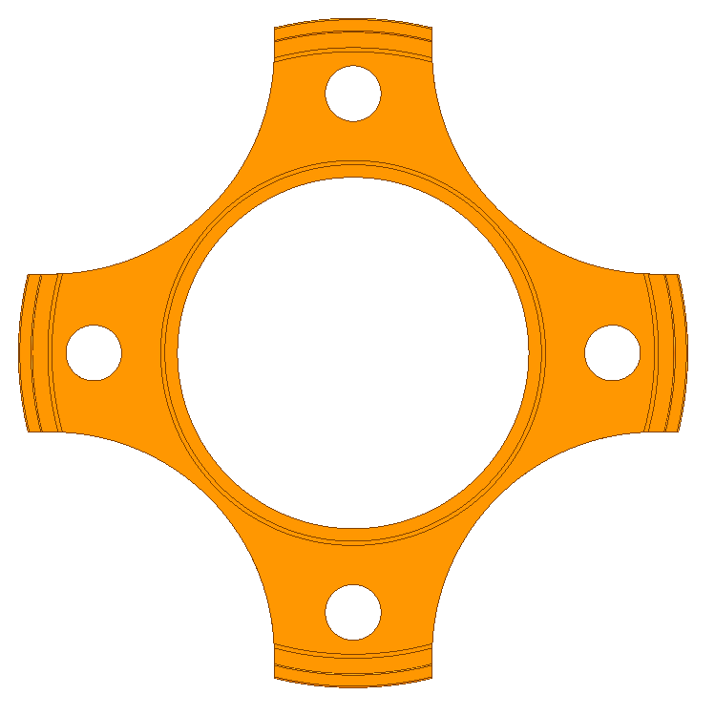
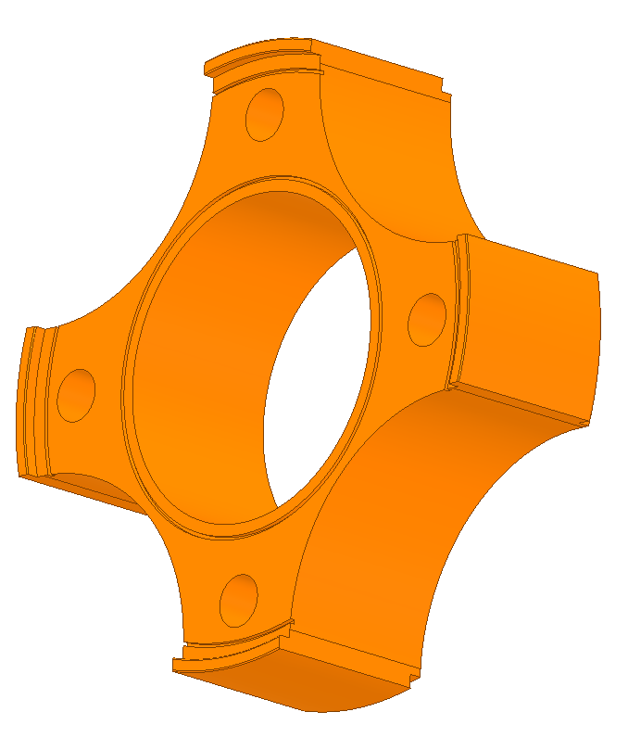
Possible cell design for linac1; solution 2
Conventional circular cup design, conventional brazing. Machining of the cavity after brazing. Requires final machining tests.
126
146
F3 structure

Slide 20
Conclusions
P³ is providing us the opportunity to optimize the e+ injector facing and possibly solving several technical problems.
Solenoid technology is a key aspect of the injector/linac system. A clear cost/benefits NC to SC comparison must be made.
TW has clearly a larger efficiency if compared to SW, it is a good choice also for injector.
TW structures interfaces and spacing require optimization, very strong effect on yield.
For the first and eventually the second cavity a specific shorter version of TW cavity could be required.
Independently from the cavity technology 30 mm radius aperture must be assumed in beam dynamics studies.

