Slide 1
Traveling-wave Structures for the Positron Linac
FCC-ee Injector Collaboration, Joint WP1/WP3/WP6 meeting
RF structures for capture and positron Linacs
Hermann Pommerenke, Alexej Grudiev
29 April 2022

Slide 2
Outline
Basics & methodology
  Convex and reentrant cell geometry, lookup tables
  long-range wake damping by detuning
  rf pulse compressor
Parameter studies
  20 mm aperture, various frequencies and phases,
  30 mm aperture, various frequencies and phases
  comparison & few selected structures
  current baseline structure for Linac1

Slide 3
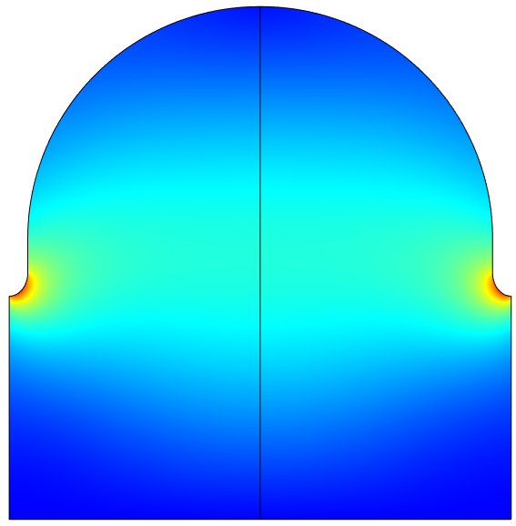
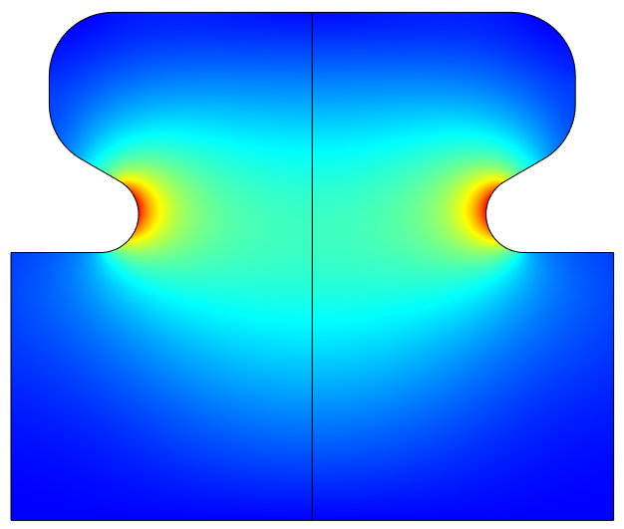
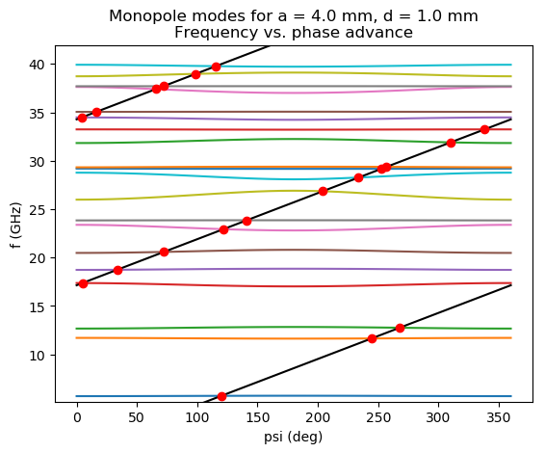
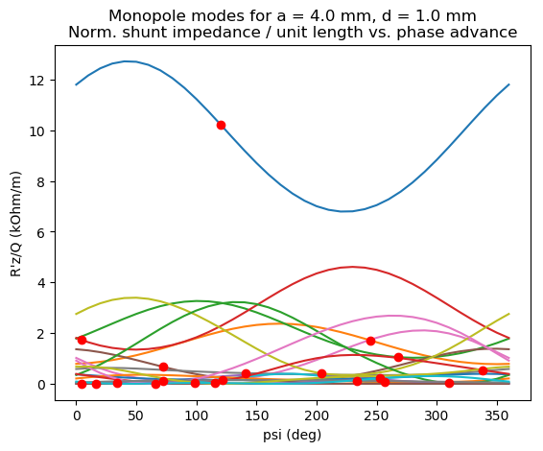
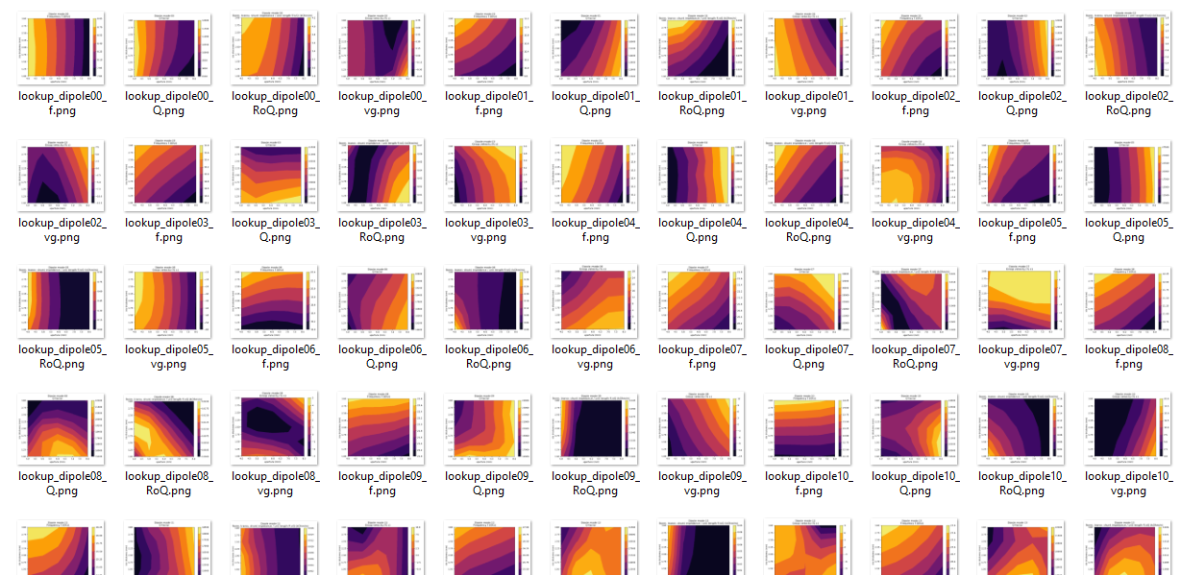
convex
reentrant
Cell geometries and lookup table
consider both convex and reentrant geometries
cells with large phase advance and reentrant geometry
have low group velocities at large apertures → interesting for positron linac
rapidly compute many structures:
lookup table based on ~200 reference cells & analytic formulas
lookup table parameter space:
  rf phase advance: ψ = 2π/3 … 9π/10
  aperture: a = 0.08 λ … 0.34 λ
  iris thickness: d = 0.02 λ … 0.19 λ
d/2
a
find synchronous phase advance of modes
get f, R/Q, Q, vg at synchronous phase advance
lookup tables for f, R/Q, Q, v_{g}, E_{max}, …. + first 20 HOMs
as functions of aperture and iris thickness

Slide 4
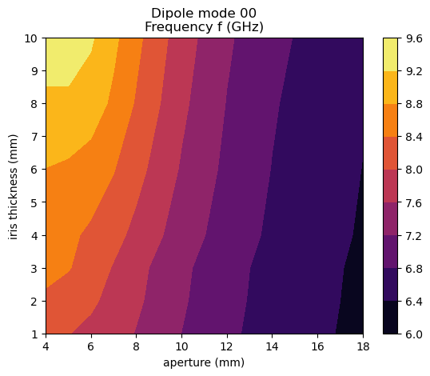
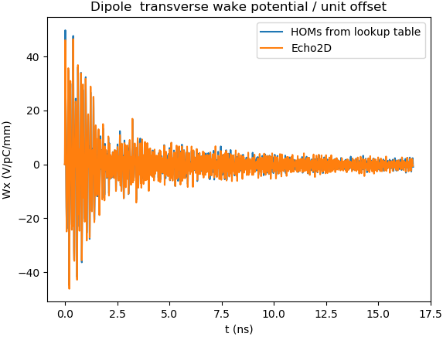

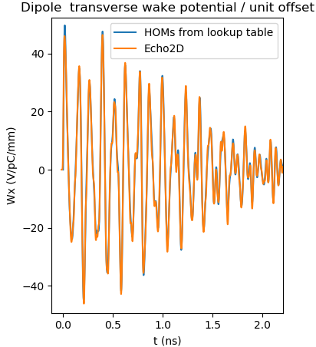
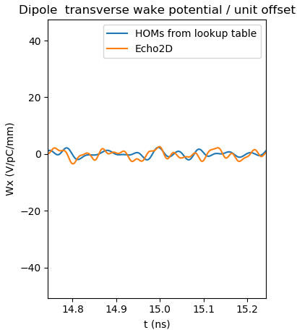
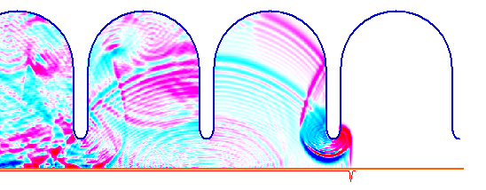
Long-range wake damping by dipole mode detuning
Long-range wake from frequency-domain parameters (R/Q, Q, ω)
Benchmark: Lookup table vs. Echo2D
detuning is effective by tapering both aperture and iris thickness
Echo2D: time-domain wakefield solver by I. Zagorodnov

Slide 5
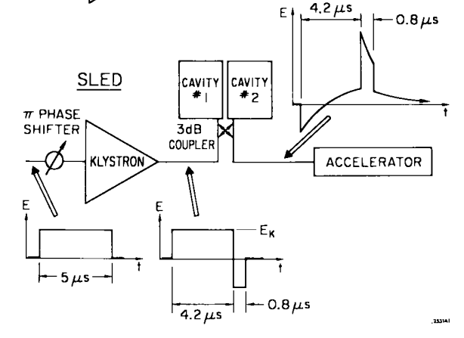
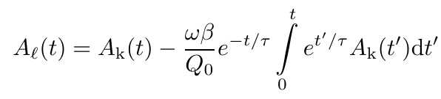

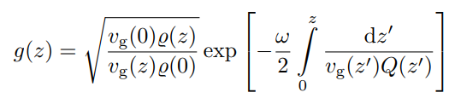
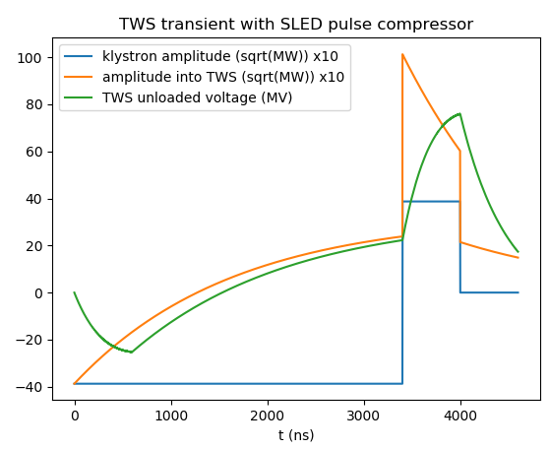
SLED-type rf pulse compressor
increase peak pulse amplitude and reduce pulse length by charging storage cavity
output pulse A_{L} given by
where A_{K}: klystron pulse, β, Q₀, τ: storage cavity coupling, Q-factor, filling time
for rectangular klystron pulse, gradient at injection can also be derived analytically:
where
we define an effective shunt impedance R_{eff} = V²(T_{k})/P_{k}/L_{structure} [MΩ/m]
Farkas et al., A method of doubling SLAC‘s energy, Proc. HEACC 1974
Example:
inject beam here, one filling time after phase reversal (at end of klystron pulse),
when voltage (avg. gradient) is maximum

Slide 6
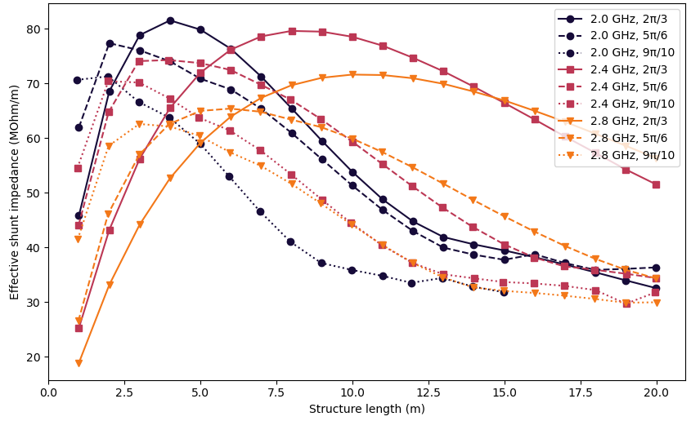
Structures with 20 mm aperture, various frequencies & phase advances
reentrant, constant aperture, iris thickness tapered
|Wx| at 17.5 ns < 0.2 V/pC/mm/m
sweep of iris thickness tapering and length
Klystron pulse lengths:
2.0 GHz: 5 µs
2.4 GHz: 4 µs
2.8 GHz: 3 µs
best structures: 2.0 GHz, 2π/3 and 2.4 GHz, 2π/3
optimum w.r.t. structure length is generally wide
→ can significantly reduce length while sacrificing only few % shunt impedance
Eff. shunt impedance vs. length

Slide 7
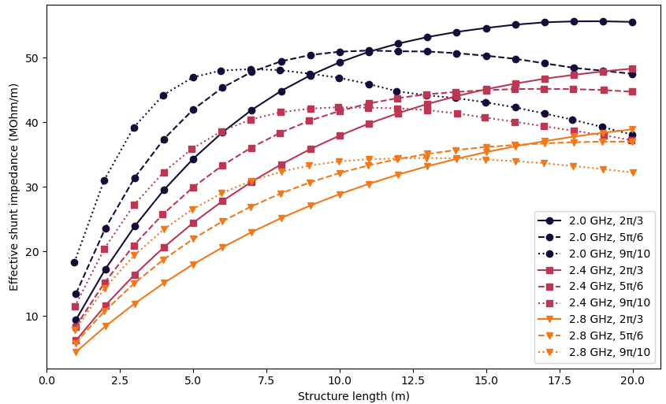
Structures with 30 mm aperture, various frequencies & phase advances
reentrant, constant aperture, iris thickness tapered
|Wx| at 17.5 ns < 0.2 V/pC/mm/m
sweep of iris thickness tapering and length
Klystron pulse lengths:
2.0 GHz: 5 µs
2.4 GHz: 4 µs
2.8 GHz: 3 µs
best structures: clearly 2.0 GHz due to large aperture
high phase advance required to get
reasonable structure length
optimum w.r.t. structure length is generally wide
→ can significantly reduce length while sacrificing only few % shunt impedance
Eff. shunt impedance vs. length

Slide 8
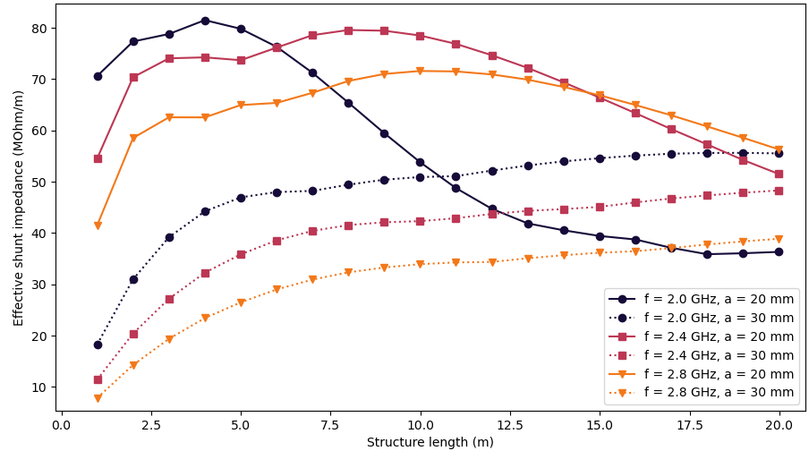
Summary: Structures with 20 mm & 30 mm aperture, various frequencies
combination of previous two plots, joining different phase advances
for 20 mm, 2.0 GHz is preferred but higher frequency is an option
for 30 mm, 2.0 GHz is definitely preferred

Slide 9
Summary: Structures with 20 mm & 30 mm aperture, various frequencies
combination of previous two plots, joining different phase advances
for 20 mm, 2.0 GHz is preferred but higher frequency is an option
for 30 mm, 2.0 GHz is definitely preferred
A
C
E
F3
current „baseline“ structure: 2.0 GHz, 30 mm aperture, 3 m long

Slide 10
A few selected structures
Constant aperture 20 mm and 30 mm, reentrant, iris thickness tapered, average gradient 15 MV/m
High-gradient limits: Emax < 100 MV/m and Sc < 2300 mW/μm² (1 µs pulse)
 | A | C | E | F3 („baseline“)
Frequency | 2.0 GHz | 2.0 GHz | 2.0 GHz | 2.0 GHz
Constant aperture | 20 mm | 20 mm | 30 mm | 30 mm
Phase advance | 2π/3 | 9π/10 | 5π/6 | 9π/10
Length (num cells) | 3.0 m (60) | 0.9 m (14) | 6.0 m (96) | 3.0 m (44)
Entr., exit iris thickness | 10.6 mm, 20.0 mm | 14.3 mm, 20.0 mm | 12.4 mm, 20.0 mm | 14.3 mm, 20.0 mm
Transverse wake at 17.5 ns | 0.21 V/pC/mm/m | 0.16 V/pC/mm/m | 0.15 V/pC/mm/m | 0.13 V/pC/mm/m
Filling time | 678 ns | 702 ns | 544 ns | 447 ns
Min. group velocity | 1.1 % c | 0.4 % c | 3.1 % c | 1.9 % c
Largest cell radius | 63 mm | 59 mm | 63 mm | 61 mm
SLED coupling | 14 | 14 | 15 | 17
Eff. shunt impedance | 79 MΩ/m | 71 MΩ/m | 45 MΩ/m | 39 MΩ/m
Average gradient | 15 MV/m | 15 MV/m | 15 MV/m | 15 MV/m
E_{max} (instant.) | 59 MV/m | 58 MV/m | 58 MV/m | 58 MV/m
S_{c,max} (instant.) | 233 mW/μm² | 208 mW/μm² | 305 mW/μm² | 329 mW/μm²
Klystron pulse length | 5 µs | 5 µs | 5 µs | 5 µs
Klystron power per structure | 8 MW | 3 MW | 30 MW | 17 MW
Number of structures* | 30 | 100 | 16 | 30
* 200 MeV → 1.54 GeV, approx

Slide 11
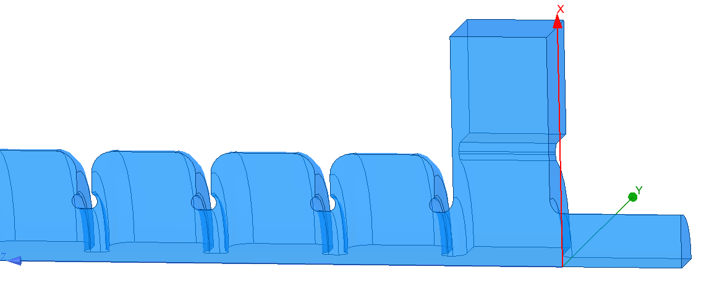
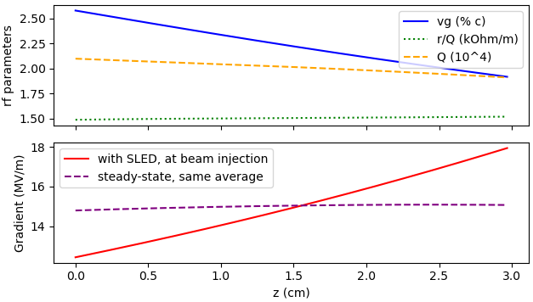
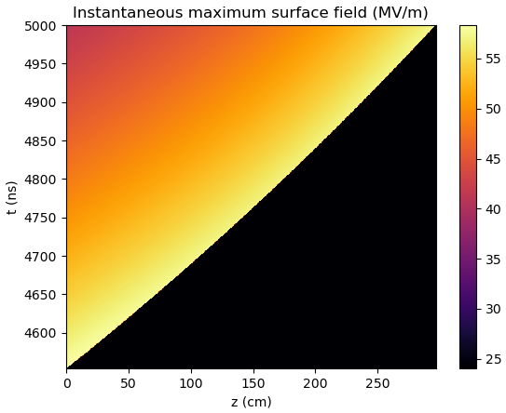
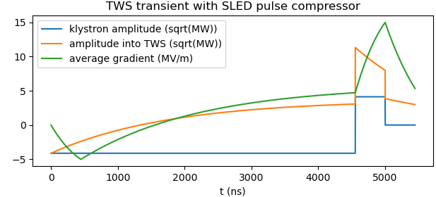
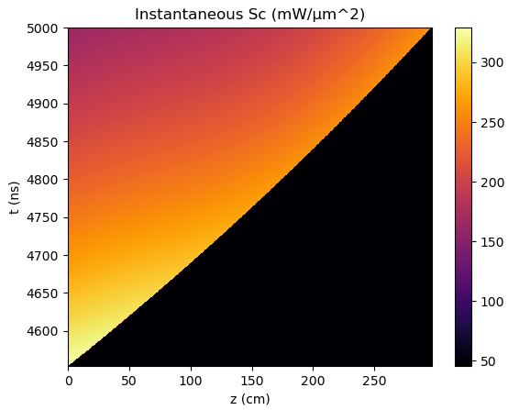
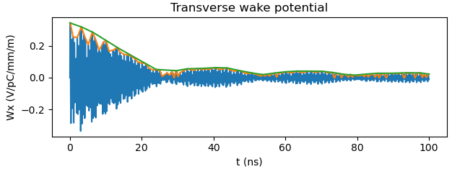
Current „baseline“ structure for Linac1
positron beam size demands large aperture (30 mm)
→ low frequency, reentrant geometry,
high phase advance
3 m for integration into current lattice iteration
(a bit longer is more efficient)
constant aperture structure
 | F3 („baseline“)
Frequency | 2.0 GHz
Constant aperture | 30 mm = 0.2 λ
Phase advance | 9π/10
Length | 3.0 m = 44 cells
Entr., exit iris thickness | 14.3 mm, 20.0 mm
Transverse wake at 17.5 ns | 0.13 V/pC/mm/m
Filling time | 447 ns
Min. group velocity | 1.9 % c
Largest cell radius | 61 mm
SLED coupling | 17
Eff. shunt impedance | 39 MΩ/m
Average gradient | 15 MV/m
E_{max} (instant.) | 58 MV/m
S_{c,max} (instant.) | 329 mW/μm²
Klystron pulse length | 5 µs
Klystron power per structure | 17 MW

