Slide 1
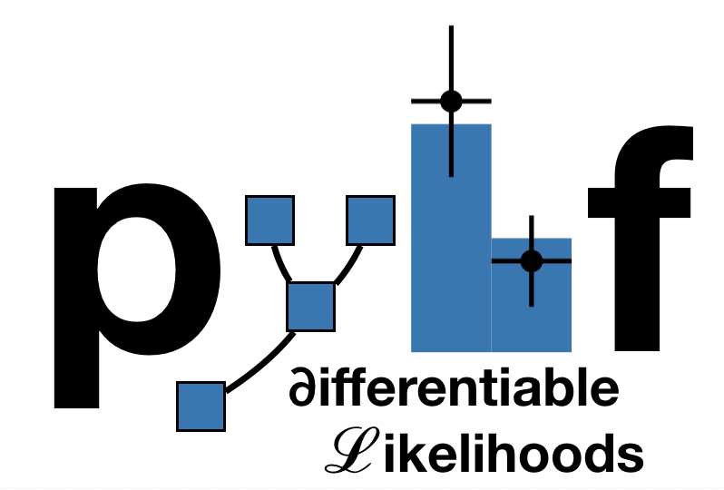

Pyhf and Combine Converter
Peter Ridolfi
Mentored by Alexander Held and Matthew Feickert
GitHub repository: https://github.com/peterridolfi/Pyhf-to-Combine-converter.git

Slide 2
Motivation
Analyses done on ATLAS and CMS experiments are very similar
  In many cases, an analysis done by pyhf on ATLAS data can be done by Combine on the same data
pyhf is much more “lightweight” than Combine, so it may be easier, faster, or more efficient for an analysis of CMS data
Combine offers many more options for statistical inference and analysis, so it may be advantageous for a more involved analysis of ATLAS data
However, people in the CMS experiment are not trained to use pyhf, and vise versa
To take advantage of these nuances, a conversion is necessary

Slide 3
Project overview
Bidirectional translation between pyhf and CMS Combine
Different formats for model specifications (HistFactory JSON specifications vs Datacard text specifications)
Specifications in both models require many histograms and counts to be given for accurate inferences
Different “building blocks” that need to be converted
Some parts are not supported, must be handled in the translation

Slide 4
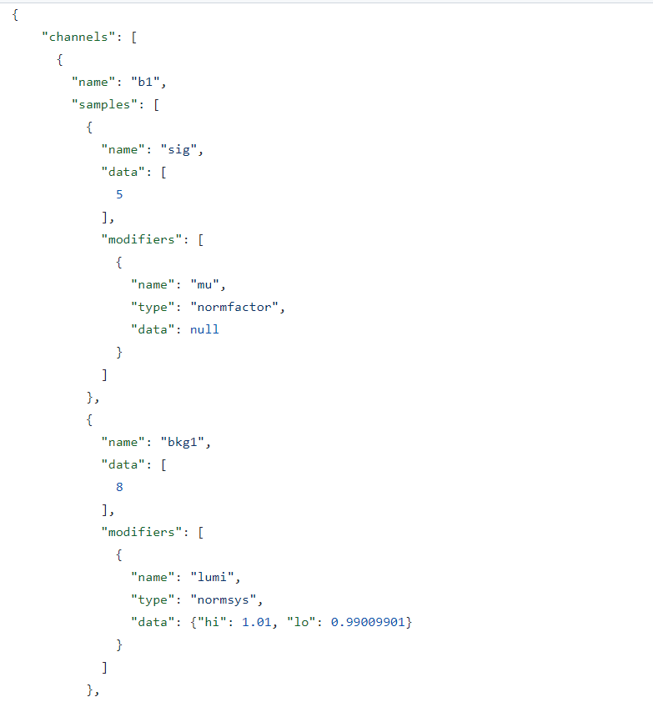
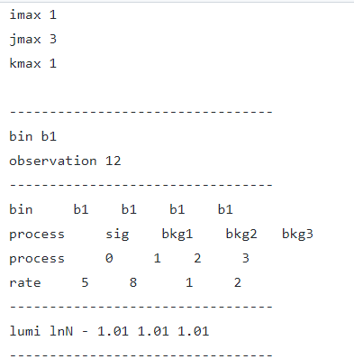
Workspace examples
Figure 1 (left): A simple Combine datacard specification
Figure 2 (right): An excerpt from pyhf json specifications for the same model

Slide 5
How to run the translation
Designed to be run in an environment with both Combine and pyhf supported
A docker container is recommended, instructions on the GitHub page
Run from the CLI, only the JSON file or the datacard.txt file is necessary to input
If using shapes (multiple bins for Combine->pyhf, the shapes root file is also required to be in the same directory

Slide 6
Pyhf->Combine
Parse through JSON model and translate to a Datacard object
After Datacard object is populated, manually write datacard file
Generate histograms and put them in a shapes root file for Combine
  I used Hist and uproot for this
Identify samples that are signal based on the presence of certain modifiers

Slide 7
Combine->pyhf
Generate Datacard object with DatacardParser
Build JSON spec from scratch using this object
Must read histograms in the shapes file to put binned data in the JSON
  Using uproot
Generate signal strength modifiers to act on signal in the JSON spec, add as measurements
Combine systematics like lnU are not supported, must raise an error to the user

Slide 8
Important differences
Uncertainty modifiers ‘staterror’ and ‘shapesys’ are handled differently in Combine (autoMCStats) – fits must be converted before comparing them
  Pyhf values centered at 1, Combine centered at 0
Combine implements a “shape/norm split”, whereas pyhf does not
  By default, Combine adds a normalization systematic to any shape systematic (unless this is directly turned off)
  In pyhf, a normalization modifier must be added by the user
  Combine does not allow separate normalization and shape uncertainties-> normalizations must be specified with ‘shape?’ and the split must be turned off

Slide 9
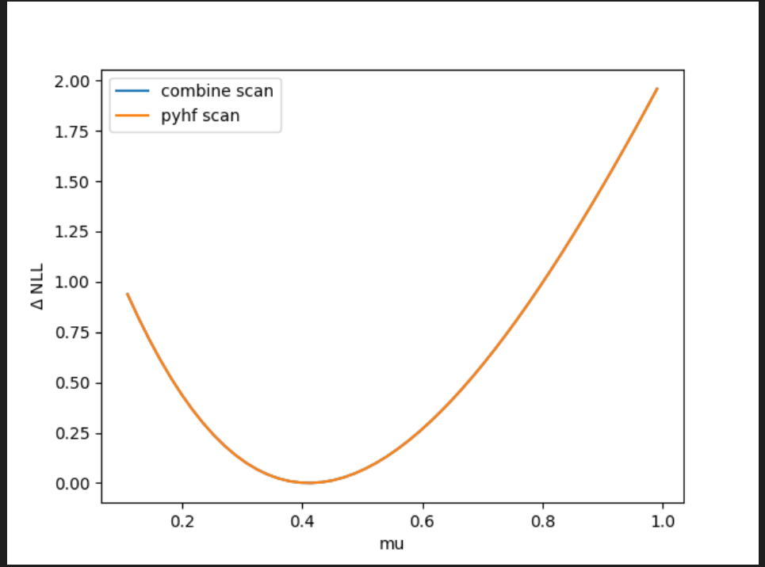
Validation of the translation
Figure 3: NLL scan for pyhf and Combine with “profiled” parameters (refits at each point)
NLL plots generated for converted models to compare inferences
  Many speedbumps
Found perfect agreement for these scans (except for autoMCStats parameters, which is attributed to the difference in how it is implemented)
Expected yields were calculated in converted models and shown to agree
“Round trip” translation was done and the specs match

Slide 10
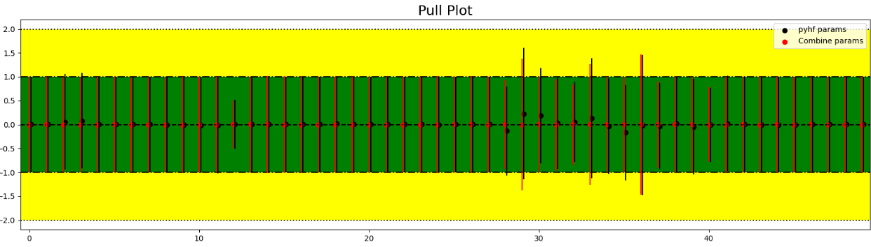
Validation cont.
Translation and fits were done on a realistically sized model, agreement persisted
Pull plots were generated on the fitted parameter values to further prove model agreement
  ‘Staterror’ and ‘shapesys’ have been omitted due to fundamental differences in value
  Note: The miniscule pulls that were created for the Combine spec seems to be due to the prefit parameters that Combine created, as they were very close to the actual fit value, as opposed to the base prefit values (0 or 1) used by pyhf
Figure 4: Pull plot of modifiers for a large model, with the pulls calculated from the pyhf spec in black and the Combine spec in red

Slide 11
Closing remarks
The success of this project is big for the HEP community
  There are many more options for how to analyze and display data, with no additional time spent learning new model specifications
The script is currently available for public use on GitHub
  https://github.com/peterridolfi/Pyhf-to-Combine-converter
The project is also available as a python package on PyPI, so it can be easily installed using pip
  pip install pyhf-combine-converter

Slide 12
Questions?
Thank you for listening!

