Slide 2
Report on Ongoing
MQXFB Actions
I - Introduction
EDMS: 2732247 V2-0
A. Devred
CERN TE-MSC
29 April 2022

Slide 3
Main Changes since Reorganization
Prioritization of TE-MSC Group Activities
Internalization of MQXFB Production
Strengthening of Human Resources for HL-LHC
Evolution in Modus Operandi of HL-LHC Matrix Organization
Emphasis on Good Engineering Practices

Slide 4
1) Prioritization of TE-MSC Group Activities
TE-MSC Group has been given clear mandate and priorities by TE and ATS managements, which have guided decisions, in particular, on resources
Main concern is now to secure and preserve the resources allocated to HL-LHC until issues with prototypes are overcome and WP3 production achieves a cruising speed (~end of 2023).
  (1) Support to operation, maintenance and consolidation of superconducting and resistive magnets, current leads and ancillary systems in CERN accelerator complex and experimental areas.
  (2) Contributions to HL-LHC Project: management and execution of Work Packages 11 (11 T Dipole), 3 (IR Magnets) and 6a (Cold Powering) and support to Work Packages 5 (HEL), 15 (Integration/(de)-installation) and 16 (IT String & Commissioning); responsible for the timely delivery of compliant magnets and cold powering systems and participation to their installation and commissioning.
  (3) Operation, maintenance and upgrade of infrastructures and test facilities to preserve and expand unique capabilities in the field of superconductors and accelerator magnets.
  (4) R&D and New Studies
    (4.1) Definition, implementation and follow-up of conductor and magnet R&D, in the framework of High Field Magnet (HFM) program and of other accelerator projects at CERN and at partner institutes, such as FCC-ee, CLIC, muon collider and ISRS;
    (4.2) Development of innovative diversification programs to valorize know-how and infrastructures, such as medical applications and superconducting power transmission.
  (5) Preservation and development of competency poles to consolidate/increase in-house expertise and form the central nodes of collaboration networks within CERN and with partner institutes.

Slide 5
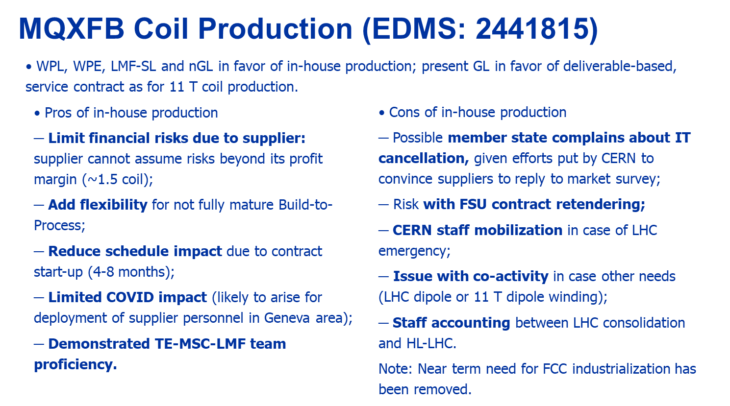
2) Internalization of MQXFB Production
Decision taken in early 2021 to internalize MQXFB production
Instrumental in keeping direct oversight/control of production at a detailed level; it enabled to put a stop order since April 2021, to resume activities step-by-step in Q4 of 2021 and to carry out critical and continuous reviews of all manufacturing processes.
23 November 2021

Slide 6
3) Strengthening of Human Resources for HL-LHC
A significant effort was deployed last year in strengthening human resources in support of HL-LHC activities within the TE-MSC Group; it was done in two ways
    (1) by redistribution of roles and responsibilities (aiming at putting the right people at the right place);
    (2) by filling up gaps in the competency matrices of sections.
For (1): departures and mobilities over the last few years have offered opportunities to achieve a better match between Project needs and Group competences and to build a strong and robust team, e.g.
  Conductor WPE, MQXF WPE, coil manufacture and magnet assembly PEs, referents for electrical engineering within WP3 and TE-MSC Group, referent for mechanical engineering within TE-MSC Group.
For (2): additional HL-LHC posts have enabled a restructuration of productions poles across the Group with the same scheme: one production engineer, one workshop manager (technical engineer) and a team of technicians with a reasonable staff vs. FSU ratio; five production poles have been identified in the Group
  Cabling (SCD), Coil Manufacture (LMF), Magnet Assembly (LMF), Cold Mass Assembly (LMF), and Cryostating (CMI).
Hiring of new LD staff has proven difficult (impact of COVID, but also some self-inflected pains in the recruitment process); CMI pole not yet constituted; impact of mobilities on SMT has been more severe than anticipated generating impatience for HFM and diversification programs.

Slide 7
4) Modus Operandi of HL-LHC Matrix Organization
Evolution towards a modus operandi where organic management line (TE-MSC Section and Group Leaders) is fully engaged in the preparation, implementation and follow up of strategic and technical decisions regarding HL-LHC magnet tasks.
TE-MSC Group QA Plan defines parallel lines of roles and responsibilities for HL-LHC Task Leaders, Work Package Engineers and Work Package Leaders and for TE-MSC Project Engineers, Section Leaders and Group Leader, in particular, for resolution of non-conformities.
Deliberate choice of having 4 out of 6 technical presentations in this meeting given by TE-MSC Section Leaders, to emphasize the importance and high priority given to MQXF (in conformity to Group mandate).
The involvement of the organic management line is also thought to be beneficial for the preparation of R&D and diversification programs that integrate and address lessons learned from HL-LHC.
Strategy and scope of HL-LHC collaborations remain the Project responsibility, e.g.: go ahead given by Project to AUP to proceed with MQXFA (pre-)series cold mass assembly despite TE-MSC Group reluctance.
Modus operandi is now well established with a clear and efficient decision making-process.
Concerns have been expressed about risks of authoritarian drifts and excessive personification; may the upcoming presentations demonstrate that there is a concerted team-work transverse to the Group and that issues and proposals are the object of intensive “constructive confrontation” and peer reviews.

Slide 8
5) Emphasis on Good Engineering Practices
“Design to Requirements” Culture
  USA and China have a culture of trials and errors and of “design to requirements”.
  Non-conformities are only considered serious and addressed if they have a proven impact (usually assessed by analysis) on performances.
  Optimistic “frontier” mindset: glass is “half full”; triumph of “better is the enemy of good”; main threat: overlooking issues that backfire at a later stage.
  It is well suited for matured technologies, where the impact of design and process parameters on performances are well understood and mastered.
“Design to Good Engineering Practices” Culture
  EU and Japan have a culture of “design to good engineering practices”.
  All non-conformities are considered serious and addressed, as their impact on performances cannot be properly assessed.
  Conservative mindset: glass is half empty, risk of failures is anticipated and back-up plans are drawn from the start; main threat: putting margins on top of margins.
  It is better suited for technologies under development, where the impact of design and process parameters on performances are not well understood.
11 T and MQXFB designs and manufacturing processes largely inherited from LARP, LBNL and Fermilab in the early 2010s; more emphasis given in the past year on “good engineering practices”.

Slide 9
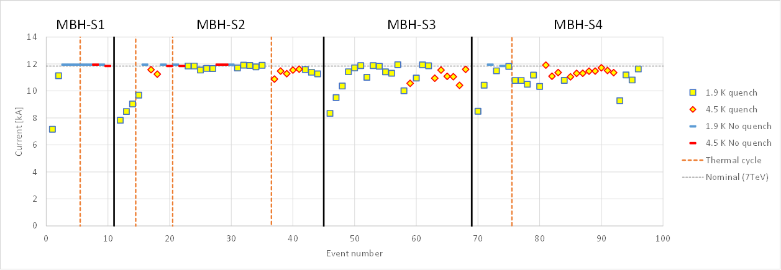
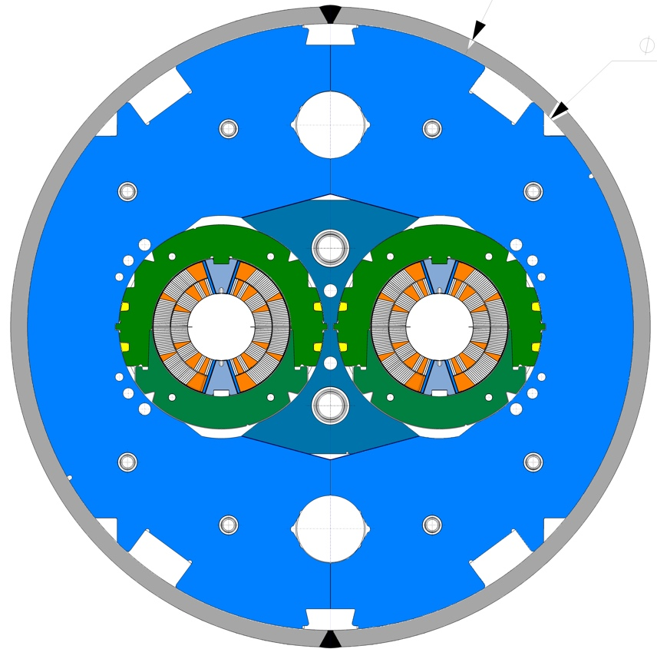
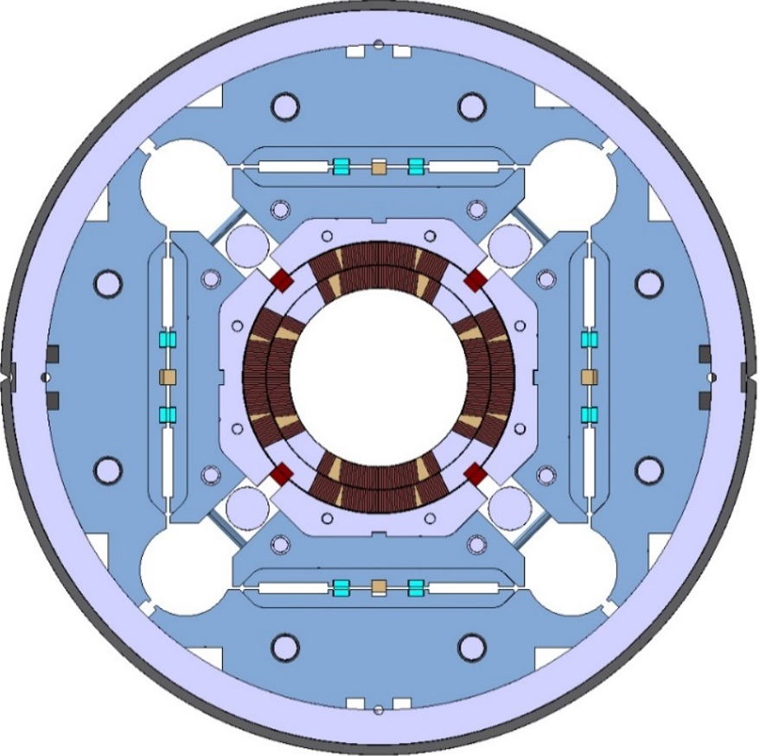
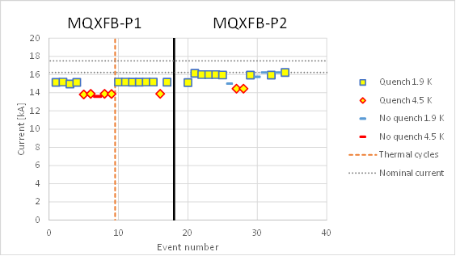
Why Are We Here?
Quench history plot of four 5.3-m-long, 60-mm-twin-aperture
MBH series dipole magnets
Degradation after a sequence
of EM and thermal cycles
(Courtesy of F. Mangiarotti and G. Willering, TE-MSC-TM)
Quench history plot of two 7.15-m-long, 150-mm-single-aperture MQXFB quadrupole magnet prototypes.
Similar quench start localization (inner layer pole turn, near magnet center)
Limitation below
nominal current

Slide 10
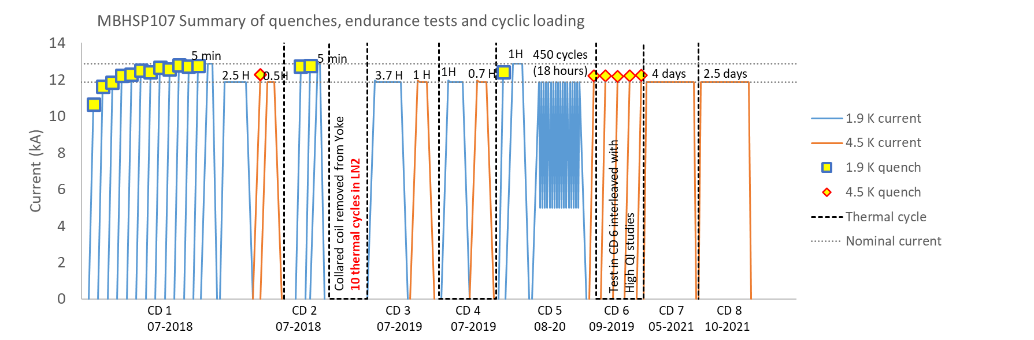
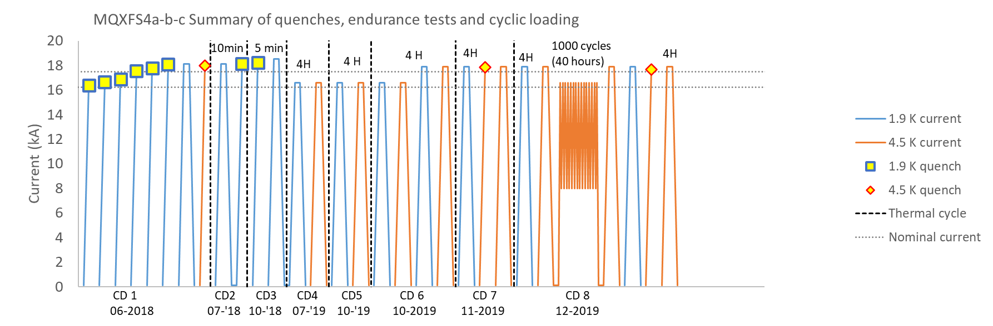
Why There is Hope? (see Ezio’s Talk)
Endurance testing of short, single aperture dipole magnet model SP107
Quench history plot of four 5.3-m-long, 60-mm-twin-aperture
MBH series dipole magnets
+ 4 x AUP 4.2-m-long MQXFA quadrupole magnets tested vertically without stainless shell.
(Courtesy of F. Mangiarotti and G. Willering, TE-MSC-TM)
Quench history plot of two 7.15-m-long, 150-mm-single-aperture MQXFB quadrupole magnet prototypes
Endurance testing of short quadrupole magnet model MQXFS4

Slide 11
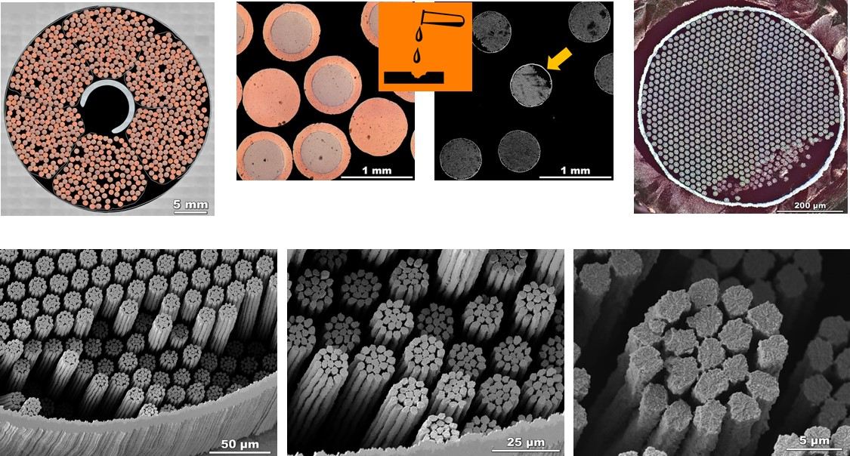
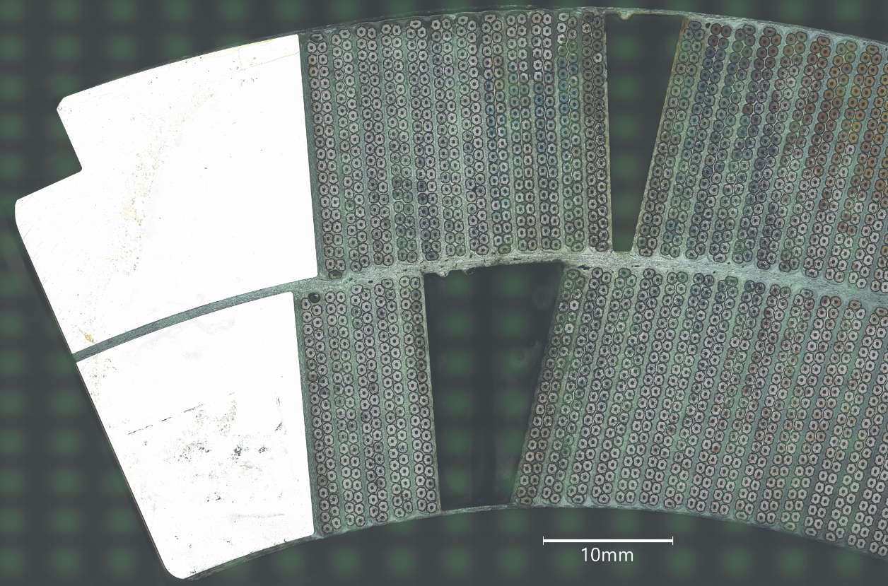
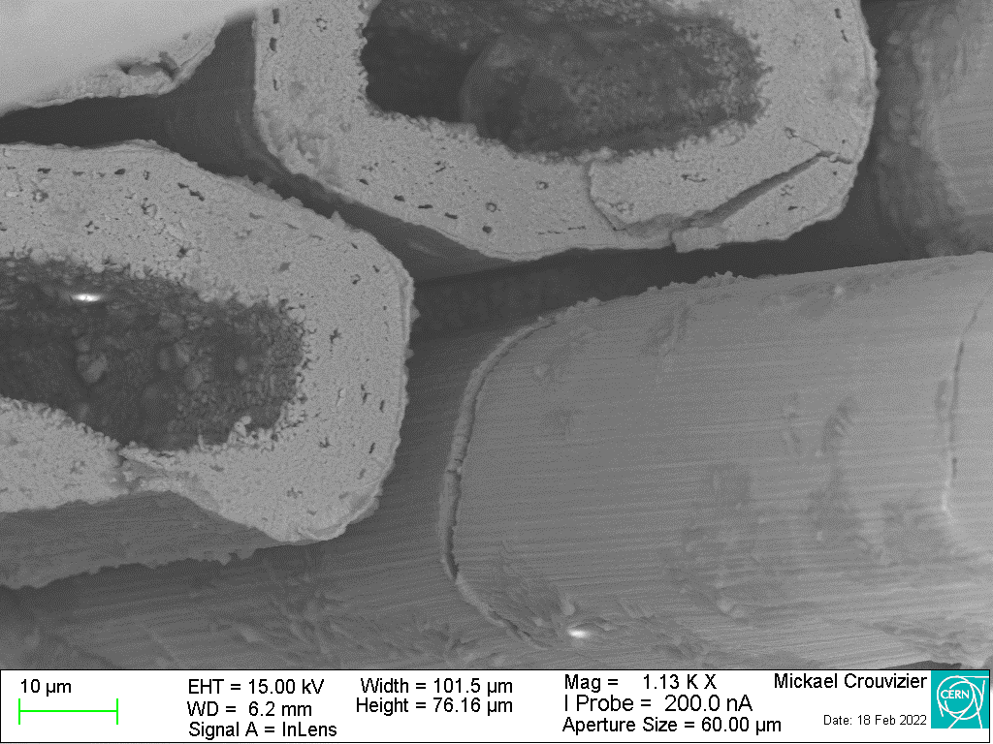
Not a New Issue with Nb₃Sn
Different conductors (cable-in-conduit conductor with direct, forced-flow helium cooling vs. resin-impregnated, Rutherford-type cable), but similar observations (e.g., performance degradation and strand cracking).
(Courtesy of P. Lee, et al.
ASC-NHMFL-FSU)
HL-LHC 2020s
ITER 2010s
In the case of ITER CICC, the root cause of degradation was attributed to strand bending and was solved by providing stronger strand mechanical support and stability (tightening of cable twist pitches).
(Courtesy of S. Sgobba, et al. (EN-MME-MM)

Slide 12
Present Standing on 11 T & MQXF
Performance limitation (repeatable quench performance at a level below nominal) and performance degradation (progressive degradation of quench performance as a function of electromagnetic and thermal cycling) are two recurrent issues with Nb₃Sn coils and magnets.
The limitation and degradation can usually be traced back to defects of mechanical origin induced after coil heat treatment which may give rise to various types of electrical and/or electromagnetic phenomenon; these phenomena are a consequence and not a cause.
Performance limitation has been observed on short 11 T dipole magnet models and on full-length MQXFB quadrupole magnets; the root cause is likely to be excessive transverse stresses or local bending applied by external loading during coil manufacture and handling or magnet/cold mass assembly.
Performance degradation has been observed on ITER CICCs and on full-length 11 T dipole magnets; the root cause is likely to be improper mechanical support of Nb₃Sn conductors enabling local strand bending and/or displacement under the effects of Lorentz forces and thermal shrinkage differentials, which cumulate and induce fatigue effects.
Both root causes point to issues with detailed engineering design and manufacturing processes which prevent achievement in a reproducible manner of Nb₃Sn conductor potentials; it is an engineering problem and not a superconductor performance issue.

Slide 13
Report on Ongoing Actions
11 T
  Phase 1: draft investigation report to be issued today (29 April 2022) by F. Savary.
  Phase 2: TE-TM presentation by D. Perini on 14 April 2022.
MQXFB
  Novel Coil Inspections & findings: S. Sgobba (EN-MME-MM)
  Assessment of Conductor Limits: A. Ballarino (MSC-SCD)
  Assessment of Insulation Limits & Improvement in Electrical Robustness: H. Felice (TE-MSC-SMT)
  Improvement in Coil Manufacture: A. Milanese (TE-MSC-LMF)
  Improvement in Magnet Assembly: S. Izquierdo-Bermudez (TE-MSC-LMF)
  Improvement in Cold Mass Assembly: H. Prin (TE-MSC-LMF)
  Test and Measurement Readiness: S. Russenschuck (TE-MSC-TM)
  Relevant Feedbacks from MQXFA and Overall Plan & Timeline: E. Todesco (TE-MSC-GLO)

