Slide 1

Assessing Resin and insulation limits and improving electrical robustness
Helene Felice, Susana Izquierdo Bermudez, Ezio Todesco, Davide Tommasini
April 29th 2022 – Report on Ongoing actions for MQXFB

Slide 2
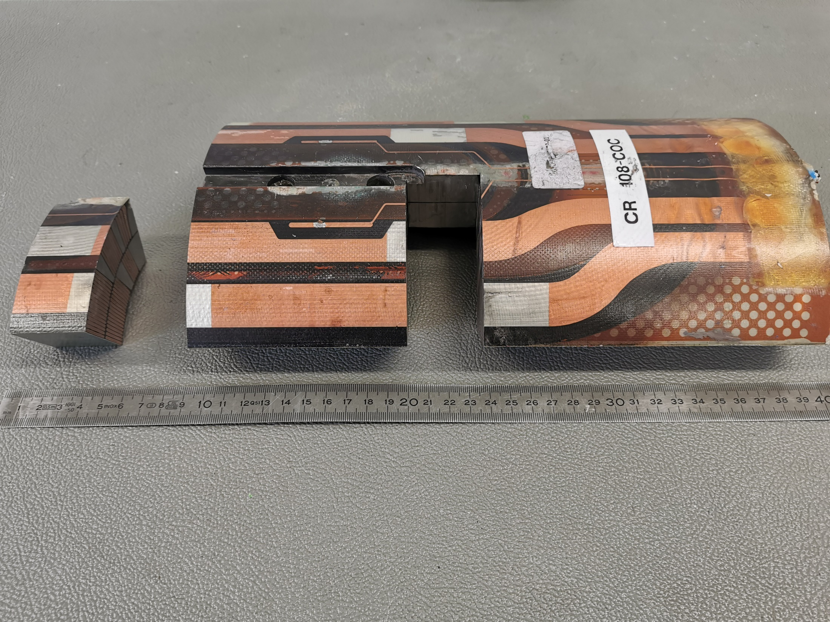
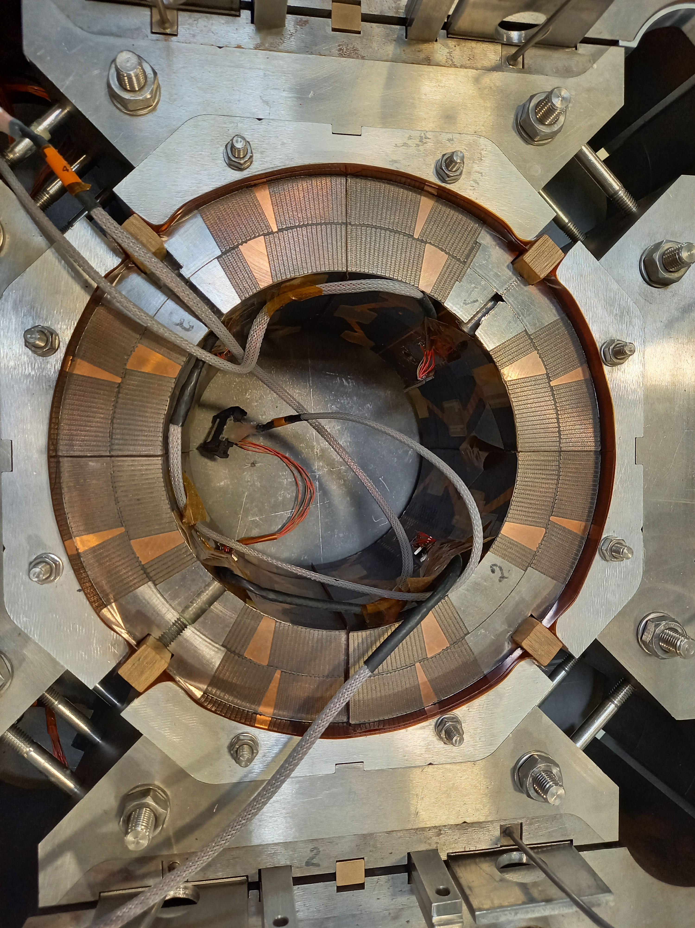
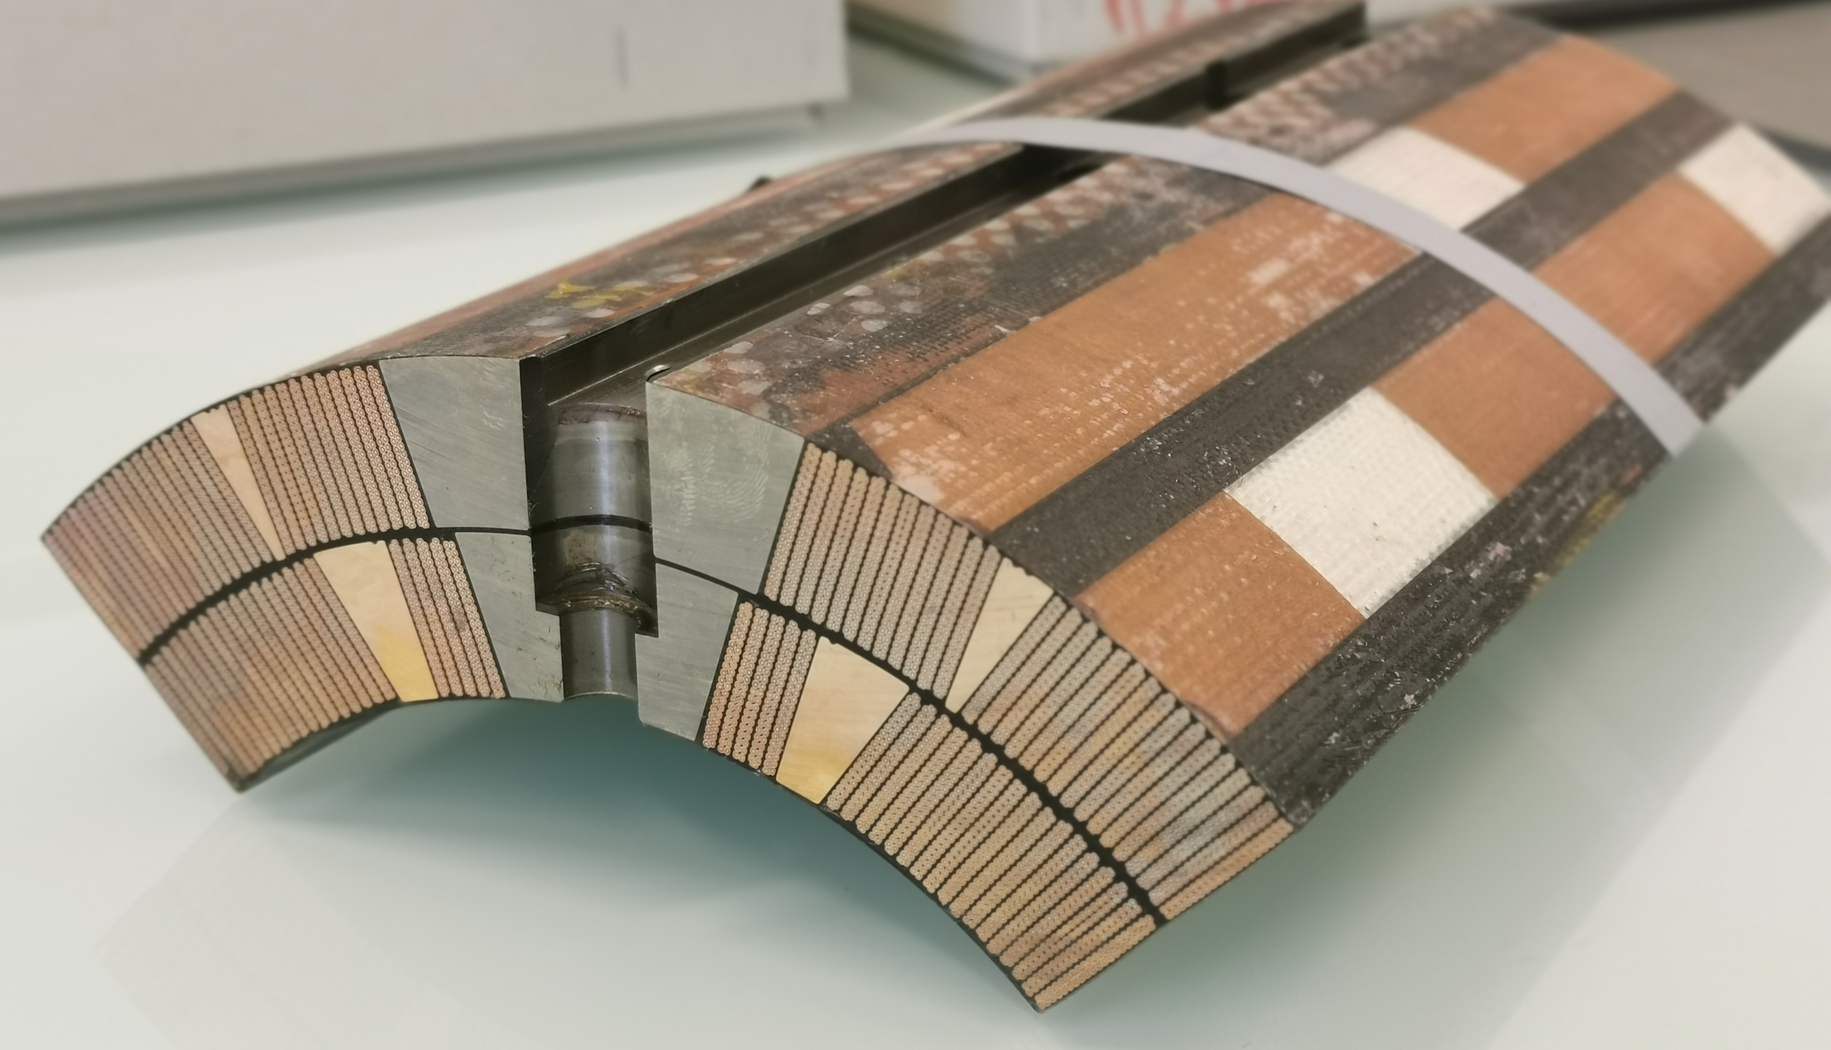
MQXF: dielectric challenges in a nutshell
Coil to pole
5x125 microns S2 glass
Coil to endshoe
Coil to Structure
Interlayer insulation
Fiberglass layers (2x250+2x175 microns) impregnated with binder CTD1202
Quench heater to coil
+ vacuum impregnation with CTD 101K
Coil to Coil
Dielectric strength in the coil depends on our ability to preserve the mechanical integrity of the insulation at each stage of the coil, magnet fabrication and magnet operation

Slide 3
Context
Coil to pole
5x125 microns S2 glass
MQXFS : short model – 1.2 m magnetic length
MQXFA : USA magnet – 4.2 m magnetic length
MQXFB : CERN magnet – 7.15 m magnetic length
Key processes and materials inherited from LARP
Interlayer insulation
Fiberglass layers (2x250+2x175 microns) impregnated with binder CTD1202
Quench heater to coil
CTD 1202 Binder used in the interlayer insulation and during the winding to stiffen the fiberglass. Impact on fiber mechanical integrity
QH technology impregnated with the coil: Cu/Stainless steel/polyimide laminate
CTD 101K for vacuum impregnation
=> Production based on these processes and materials. Some improvements have been implemented during the MQXFB production

Slide 4
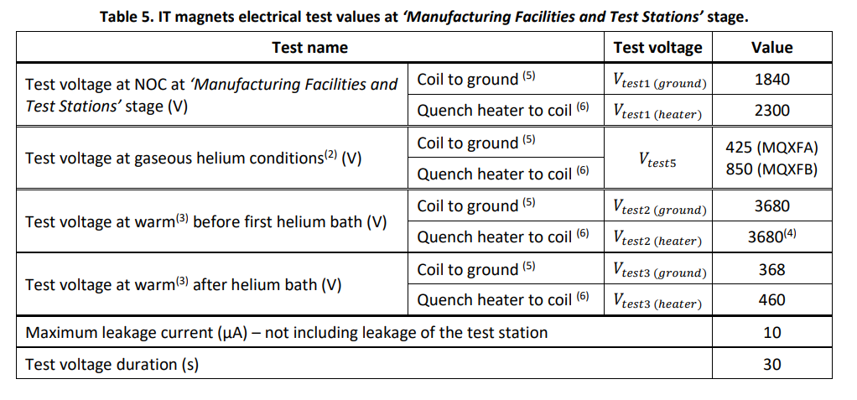
Dielectric status of fabricated coils/magnets (1/4)
Coil to Ground
Electrical Acceptance based on a series of tests performed during coil, magnet, cold mass and cryostated magnet fabrication Flowchart of the electrical tests throughout the production - 2447487-v3
Voltage withstand levels for the magnet are set based on the HL-LHC Electrical Design Criteria for the IT magnets - 1963398 v6
At 100 K during warm-up

Slide 5
Dielectric status of fabricated coils/magnets (2/4)
Coil to Ground
Electrical Acceptance based on a series of tests performed during coil, magnet, cold mass and cryostated magnet fabrication Flowchart of the electrical tests throughout the production - 2447487-v3
Voltage withstand levels for the magnet are set based on the HL-LHC Electrical Design Criteria for the IT magnets - 1963398 v6
At 100 K during warm-up
Coil to ground
All the MQXF magnets passed these tests
except MQXFAP1 due to heater failure (see slide xx)

Slide 6
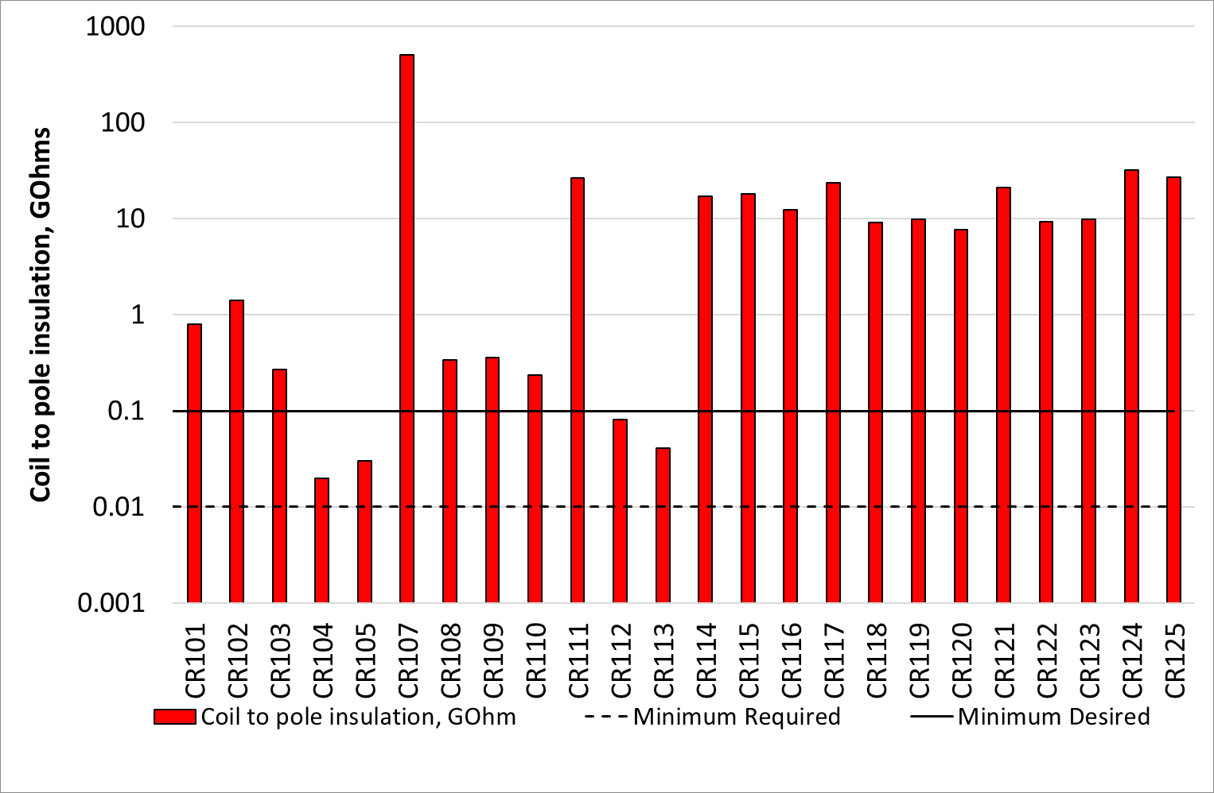
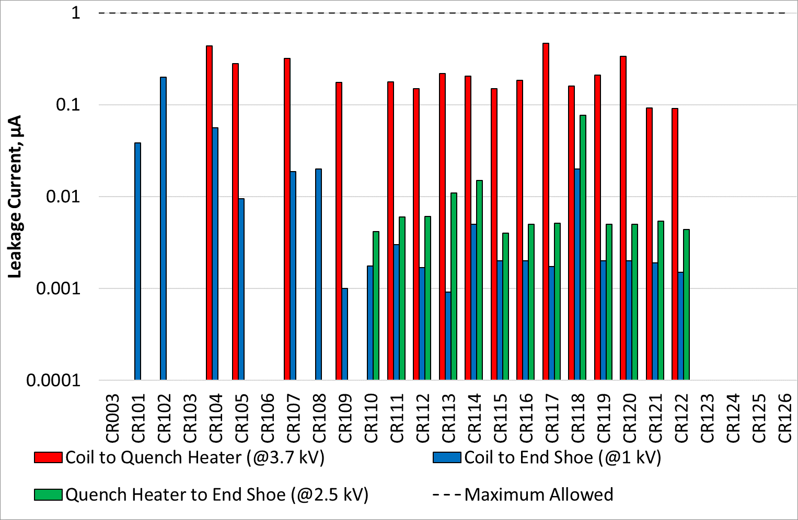
Dielectric status of fabricated coils/magnets (3/4)
Coils after impregnation before assembly
MQXFB Coil winding to Pole – 100 V – 30 s
MQXFB - Coil winding to Endshoe/QH and QH to endhsoe
Improvement by reducing amount of ceramic binder in the coil and by the use of desized fiber glass(heat treated) around the pole
repaired
Coil to pole / coil to endshoe / endshoe to QH: leakage test passed for all coils after fabrication
Coil to QH:
MQXFB: 1 coil out of 35 coils showed a defect after coil fabrication (including PIT and Cu coils)
MQXFA: 2 coils out of 72 coils showed a defect after coil fabrication

Slide 7
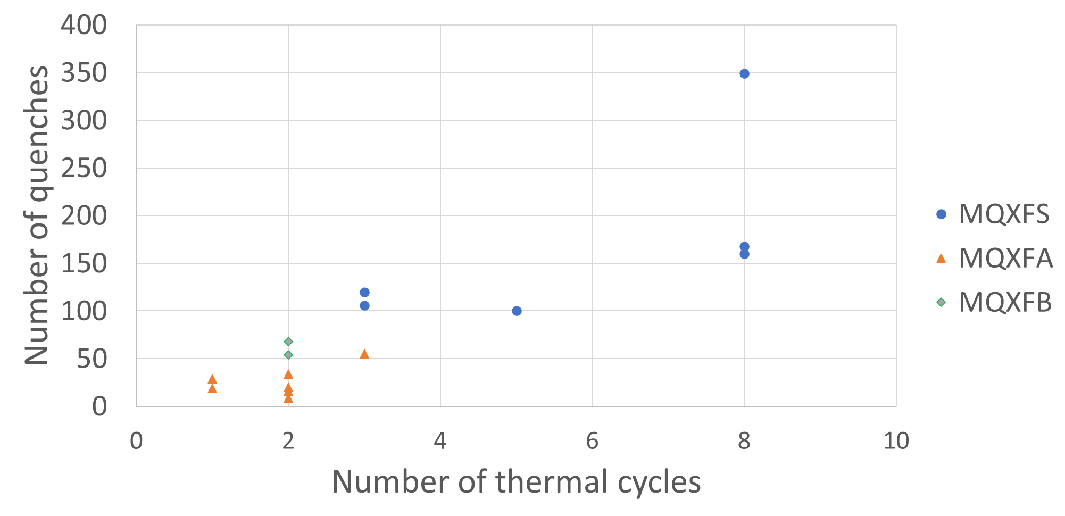
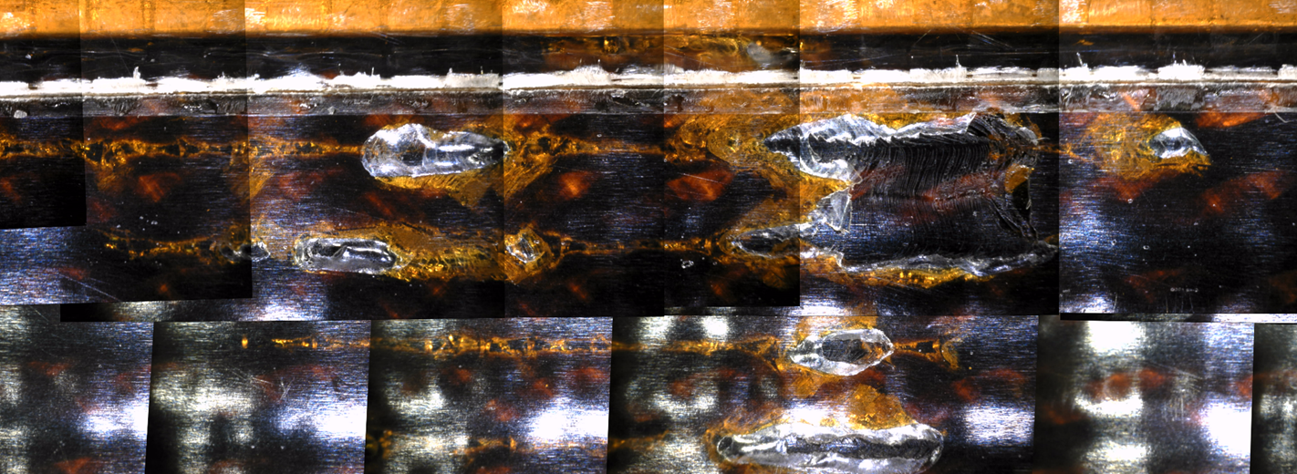
Dielectric status of fabricated coils/magnets (4/4) the specific case of QH
At least 253 heaters experienced cooldown and training, assembled in short and long magnets
  All passed 2.3 kV in LHe
  All passed 460 V in air at room temperature after test
1 heater failure detected before test in MQXFAP1a
  isolated but causing a short to ground
Investigation on MQXFAP1a heater failure https://ieeexplore.ieee.org/document/9366979
Additional tests at high voltage to probe the limit of the dielectric insulation between coil and heaters were performed on tested coils EDMS 2229465 v.3
Blistering effect:
  polyimide gets thinner by a rapid expansion of GHe trapped in bubbles in the impregnation => requires quenching and impregnation defects.
MQXFAP1
Decision to act on impregnation and QH design
V breakdown values do not seem to be affected by the number of quenches or thermal cycles
EDMS 2229465 v.3

Slide 8
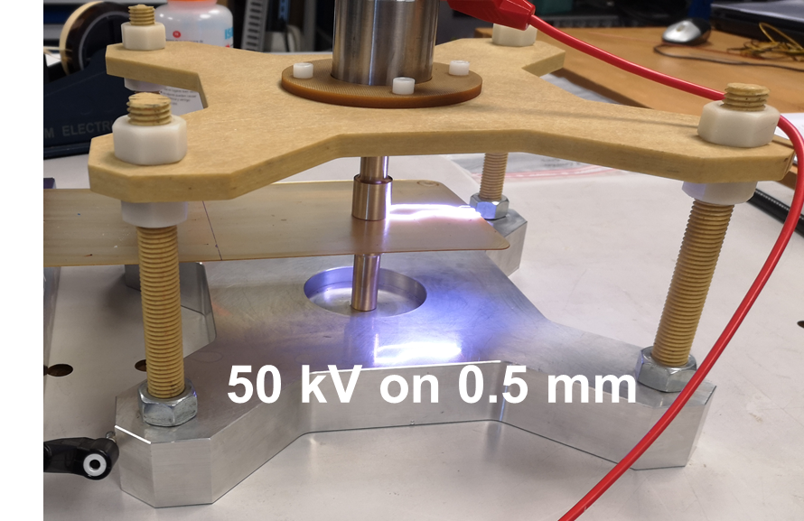
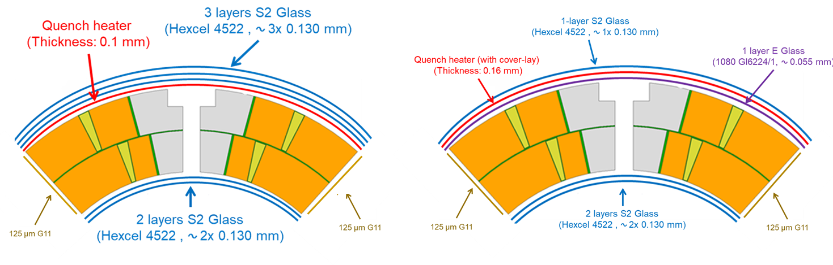
Improvements in QH robustness
To improve the reliability of the Quench heaters:
Sandwich construction: addition of a Polyimide coverlay to improve the mechanical robustness of the QH (heaters circuit on the neutral axis)
0.055 mm E-glass (EDMS 2519642 (v.1)) added after reaction between heater and coil to :
  Facilitate resin impregnation
  Provide additional dielectric insulation heater to coil
HV qualification tests on QH before installation from 3.7 kV to 5 kV
Initial Design
New Design
Presently implemented in coils 115/116 for MQXFS8
To be implemented in MQXFB from coil 126
Already implemented in 2 MQXFB Cu coils 004 and 005
MQXF QH Technical Meeting
https://indico.cern.ch/event/1077589/

Slide 9
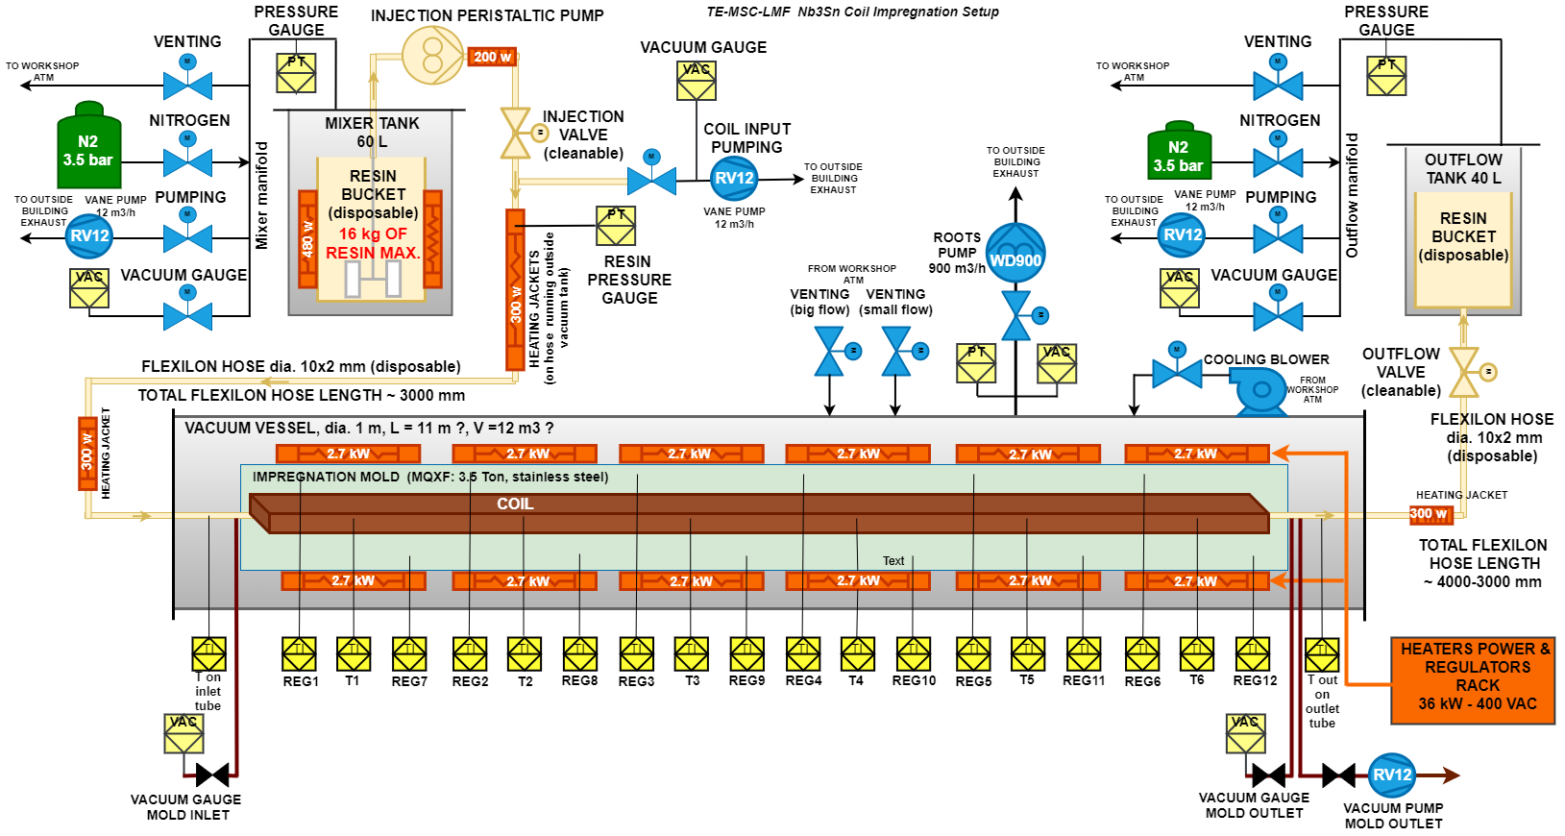
Improvement of the impregnation process starting from coil 120
Better degassing
  installation of an additional pumping unit at the mould exit
  better monitoring of local mould pressures with the introduction of local (at the mould inlet and outlet) pressure pickups and, consequently, adjustment of degassing time
  better conditioning of the injection tank
Increase of degassing temperature (coil + mould) from 80°C to 110°C
Tighter monitoring and control of the impregnation process, new rule of iteration of the milking process based on 100% absence of bubbles at the outlet resin tank
All these improvements are implemented from coil 120
(i.e., coils for MQXFB02 already produced)

Slide 10
In summary: status in MQXFB
In MQXFB
CTD 1202 Binder used in the interlayer insulation and during the winding to stiffen the fiberglass. Impact on fiber mechanical integrity => minimization of amount of binder use
QH technology : Cu/Stainless steel/polyimide laminate => increase robustness of QH
CTD 101K for vacuum impregnation => improvement of impregnation process
A few numbers
  89 out of 91 long coils passed the required HV test before assembly (as of 10/2021)
  38 long coils have been assembled in a magnet and tested at 1.9 K (as of 10/2021)
    30 for MQXFA => 1 out of 30 showed a defect QH2coil which became coil2GND defect
    8 for MQXFB => no defect
  MQXFB prototypes (P1 and P2) had 2 thermal cycles each and respectively 68 and 50 quenches
Improvements implemented
Low rejection rate for MQXF but additional possible improvement looking ahead

Slide 11
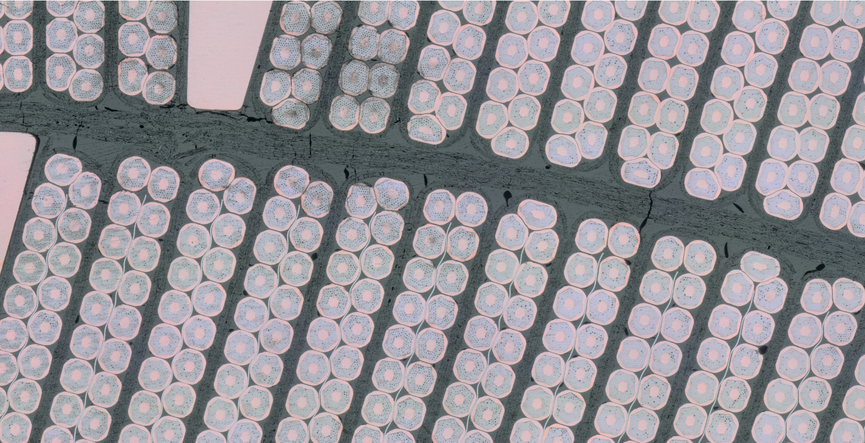
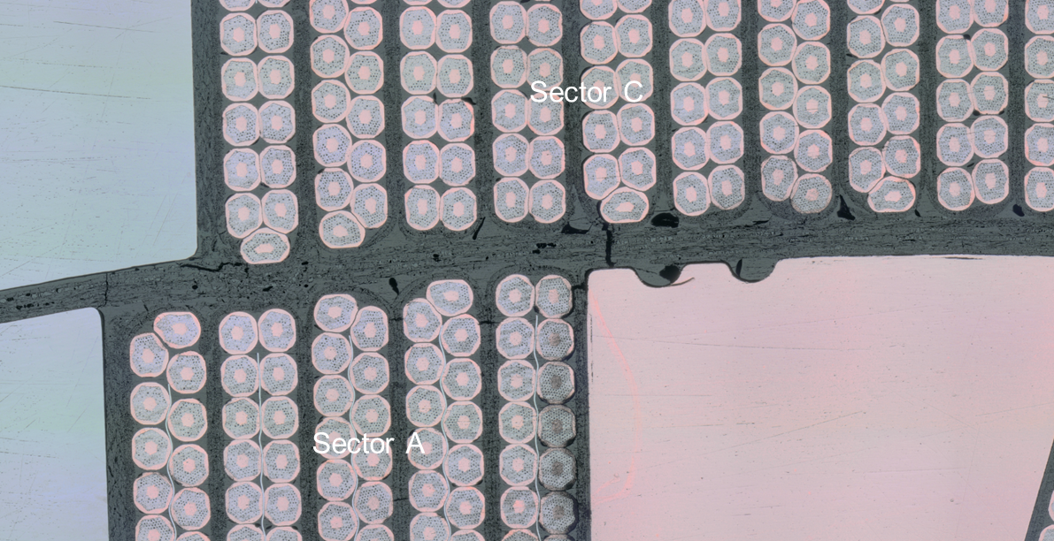
Recent observations
Courtesy of M. Crouvizier
Sector D
Recent in-depth observations show:
Interlayer and various cracks
Resin to components decohesion
Sector B
Problematics to investigate:
Impregnation process
Mechanical and dielectric strength of the interlayer insulation and of the cable insulation
Adhesion resin to components
Resin thoughness
Systematic characterization of material
Tight connexion with HFM

Slide 12
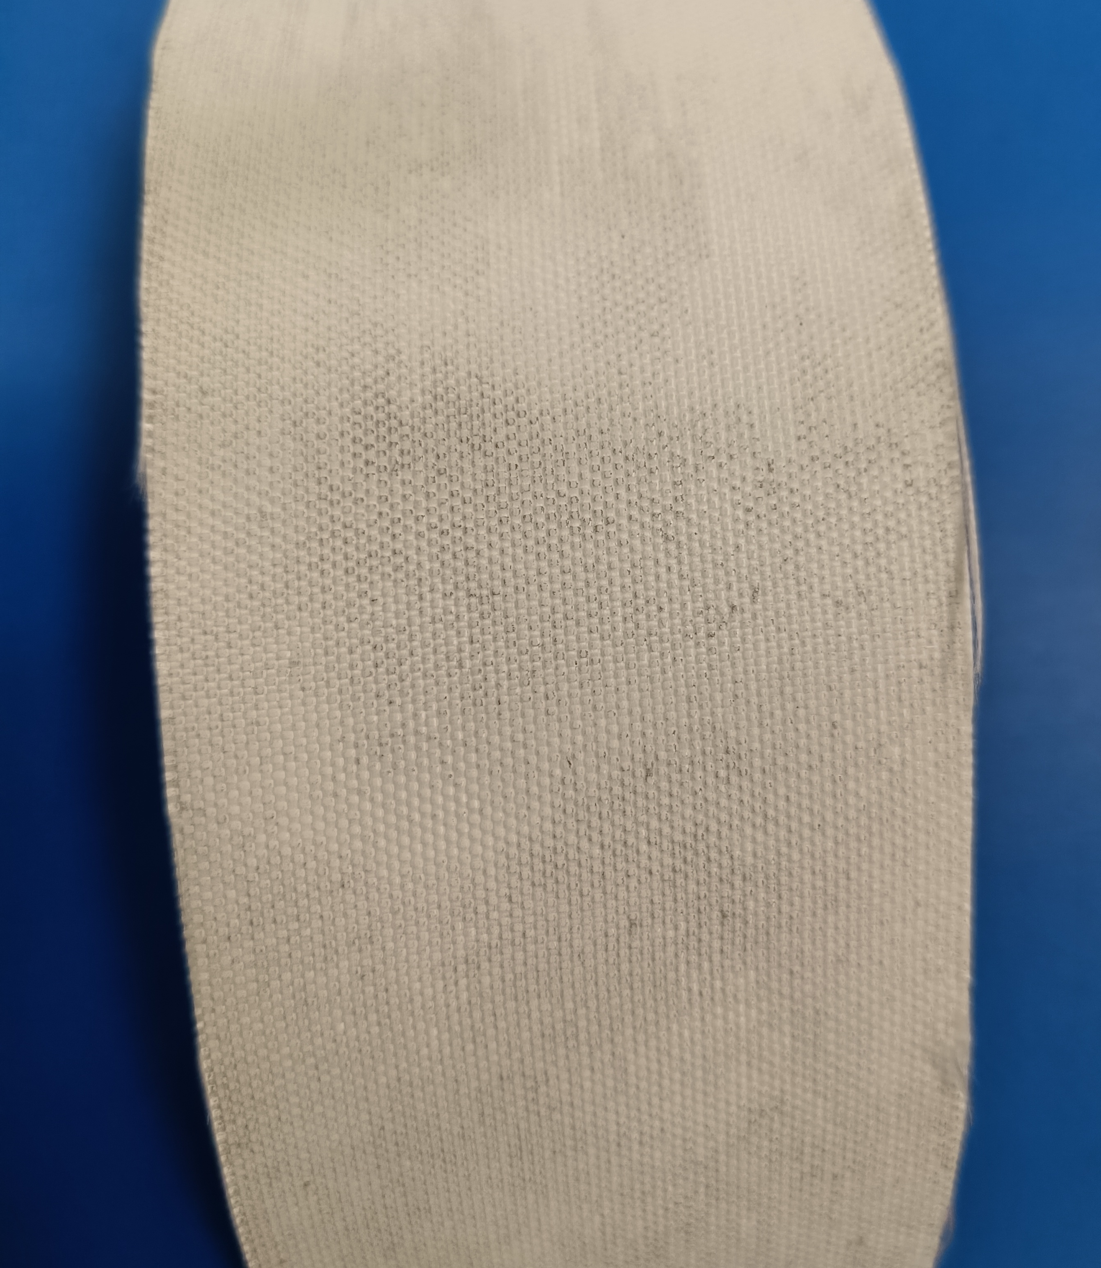
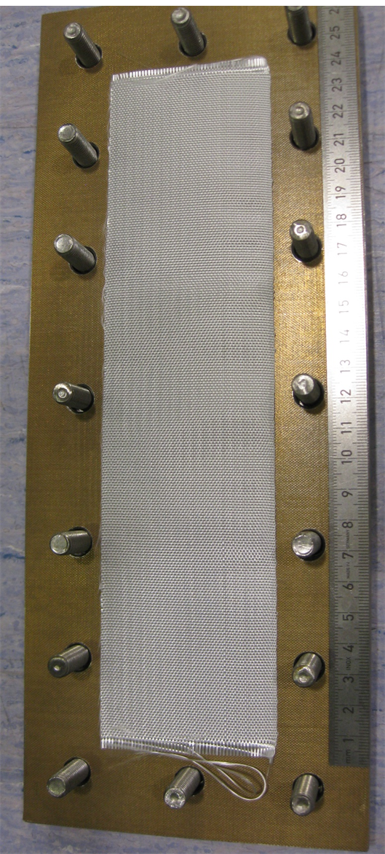
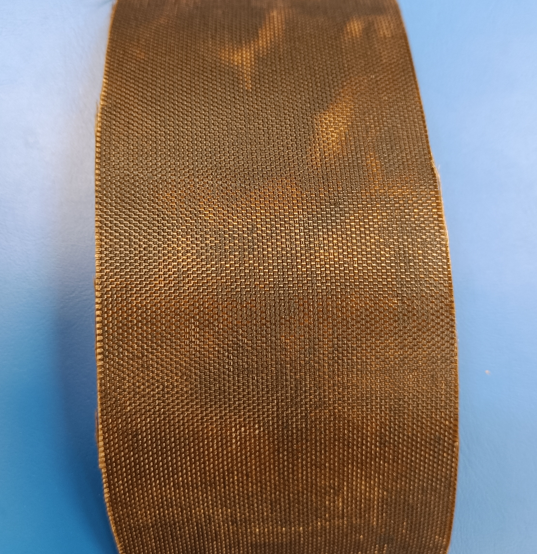
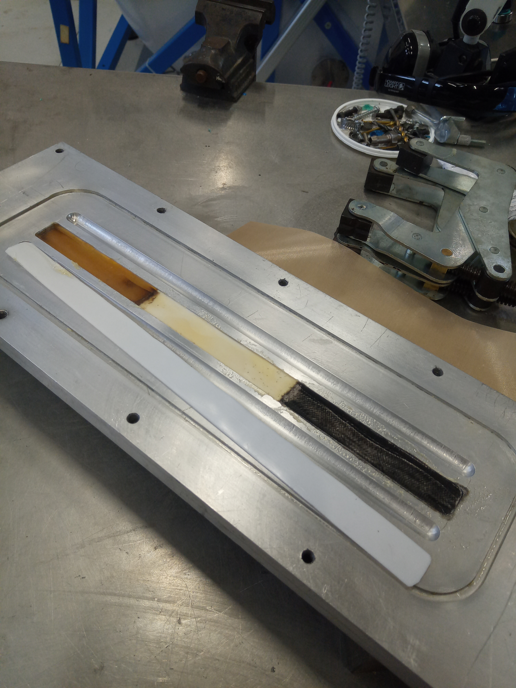
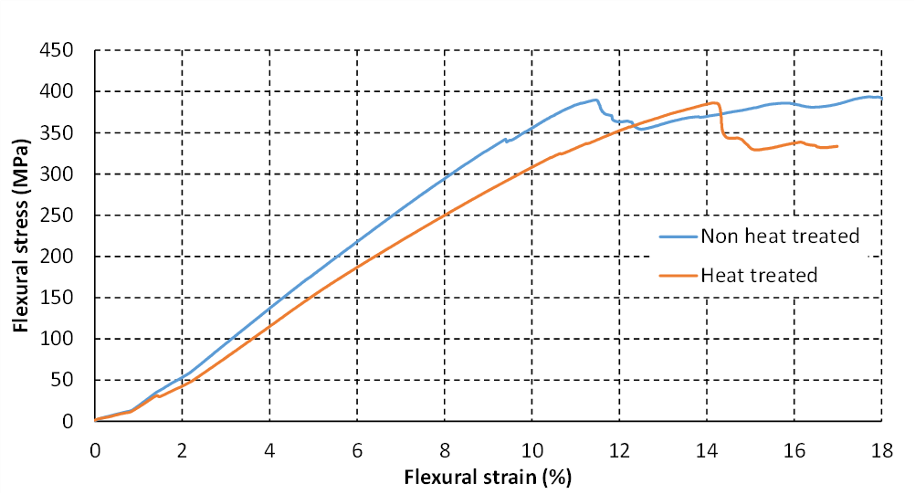
Interlayer and cable insulation dielectric strength
HT in air @ 650°C
Interlayer insulation
Questions to address:
What happens to the organic part of the binder during heat treatment?
Is the binder preventing a satisfying impregnation?
Ongoing studies: Dielectric, mechanical and chemical characterizations
HT in argon
@ 650°C
Understand the effect of the binder on the fiber
Optimize the fabrication process of the interlayer
On going mold set-up
Cable insulation (braided fibre)
Ongoing studies
Dielectric characterization before and after heat treatment
Mechanical characterization (flexural tests)
Preliminary results indicate that the cable insulation dielectric strength and mechanical strength is not affected by the HT
Impact of the binder to be evaluated

Slide 13
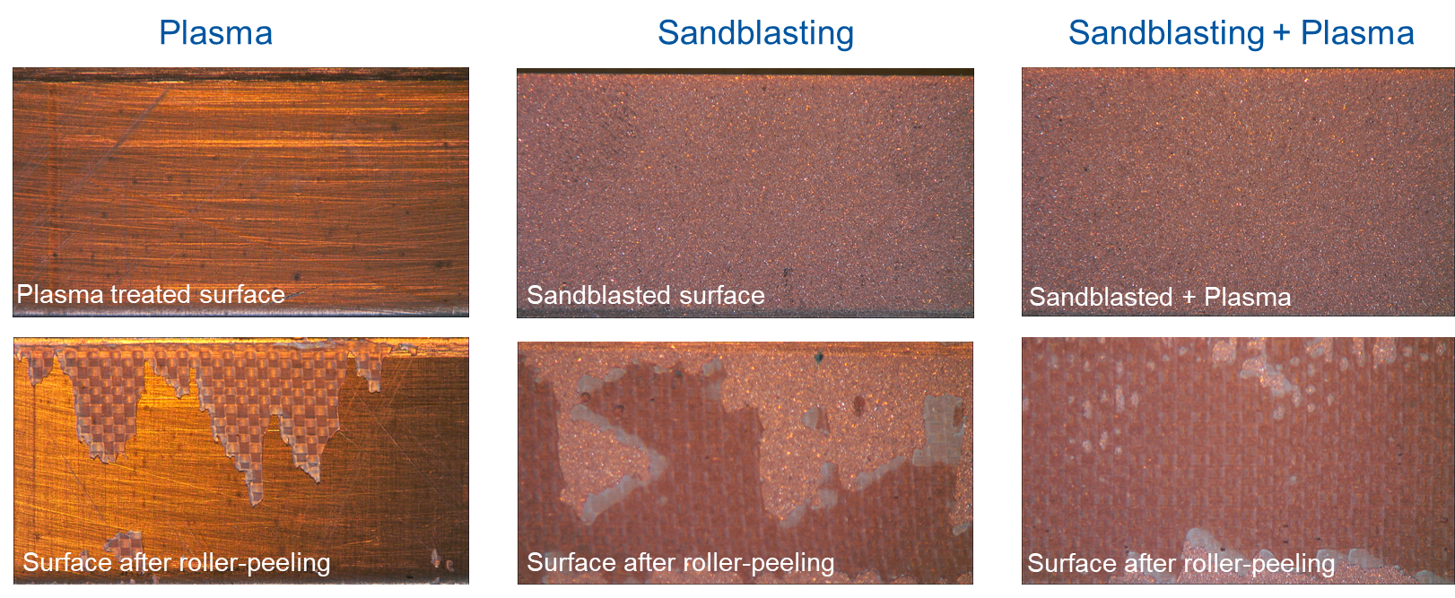
Adhesion
Ongoing Phase 1 activities
Sample design and test methods:
  Discussion with TE-VSC-SCC (Surfaces, Chemistry and Coatings)
  peel-off strength, shear strength, pull-off strength
Phase 1: benchmarking
understand how to measure and characterize the adhesion strength of impregnation systems
Production of reference samples: copper, stainless steel, glass tissue, polyimide…
Phase 2: characterization of adhesion in the coil components
characterize of adhesion strength towards, virgin and heat treated cable insulation, interlayer material (with binder), pole material, wedge material, mica sheets, Teflon coating…
Identify and measure parameters which can be exploited in FEM
Example of adhesion of CTD101K to copper, fiberglass-copper impregnated sandwich with various surface preparation
Courtesy of B. Verma
Adhesion studies are going on with first results expected by Q4 2022

Slide 14
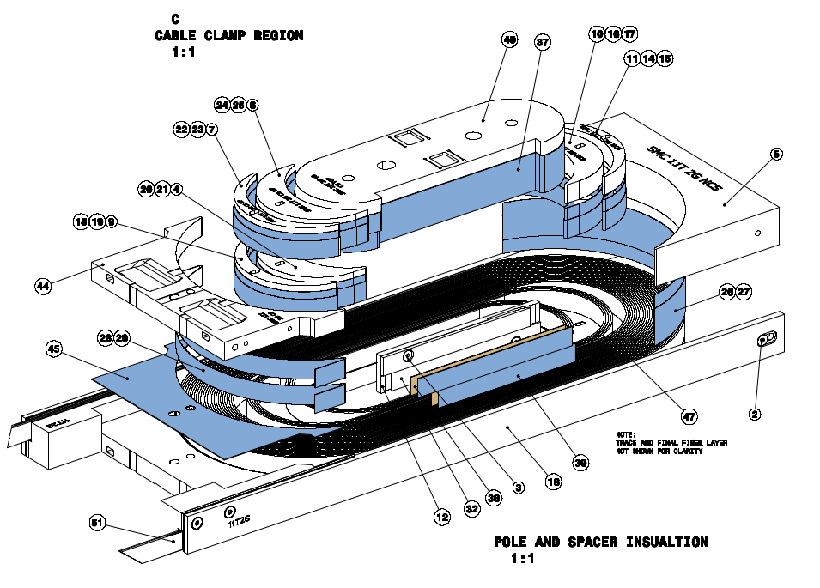
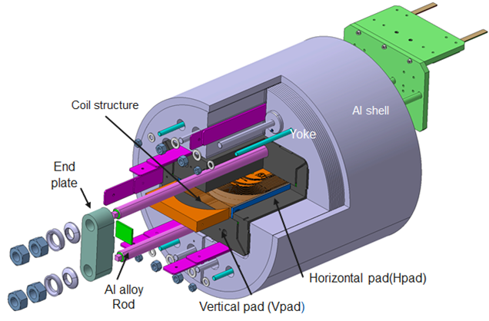
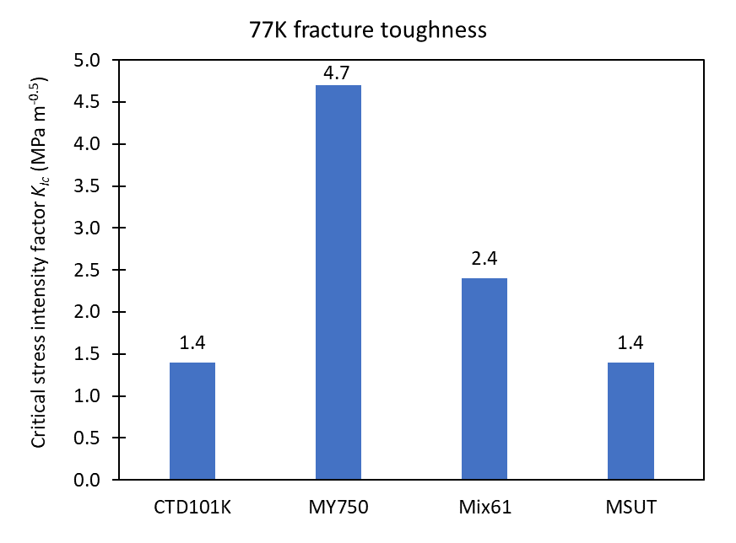
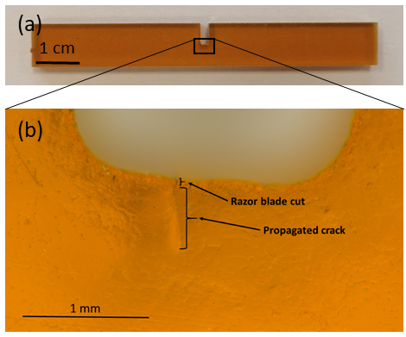
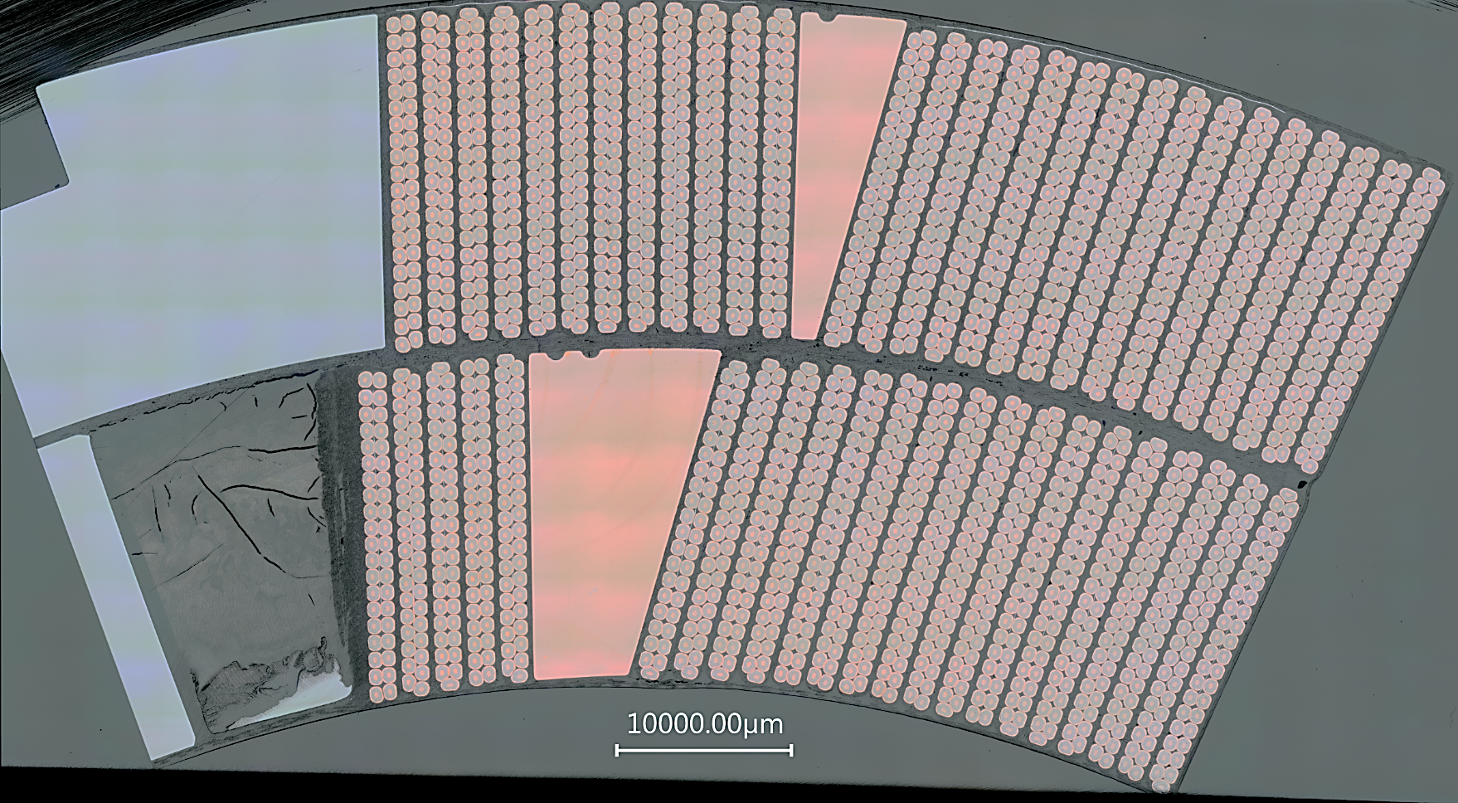
Resin Fracture Toughness
The Fracture Toughness describes the ability of a material to resist fracture propagation when a defect is present.
Beyond the measurement of the fracture toughness for each resin, the challenge is to understand the role of this parameter in the magnet performance
SMC - HFM
Courtesy of JC Perez
Resin rich area observed
Importance to reinforce with fibres
Issue with accessibility of some areas => Crushed S2 glass to fill in the gaps
Minimization of the resin rich areas
Resin Fracture thoughness is not the only parameter which matters, radiation hardness and processability are also being investigated
Courtesy of A. Garuud
Example of CTD101 K single edge notched bending (SENB) specimen for 3-point bending experiment
Cut 3b
https://edms.cern.ch/document/2715073/1
Courtesy of M. Crouvizier

Slide 15
Timeline for improvements
Adhesion
Interim report 1 on adhesion studies
Interim report 2 on adhesion studies
In case of convincing results, compatible with HL-LHC timescale
Interlayer
Report on HT coil interlayer
Q2 2022
Q3 2022
Q4 2022
Q1 2023
Q2 2023
HFM
Cable insulation
Report on HT impregnated braid
Resin development
Interim report 1 on tougher resin
Prelim report on irradiation of impregnation system in air
Interim report 1 on tougher resin
Start of irradiation campaign at cold

Slide 16
In Summary
Coils and magnets are meeting the dielectric requirements
Along the production, improvements have been made to increase the mechanical robustness and therefore the dielectric strength inside the coils
  Additional studies on interlayer and adhesion are ongoing and could lead to further improvements in the timescale of HL-LHC MQXFB coil production.
  Characterization of resins are ongoing but the switch to another resin than CTD101K is not considered in the timescale of HL-LHC
Irradiation tests under various radiation sources, temperatures and atmospheres have been initiated but timeline to get meaningful results is of the order of about 2 years.
So far, tests performed on short model magnets and MQXFA05 (endurance test) do not show evidence of degradation. Importance to perform this type of tests (thermal and powering cycles) in upcoming short models and long magnets.

