Slide 1

Report on Ongoing Actions for MQXFB
Improvements in coil manufacture
A. Milanese, on behalf of the MQXFB team
(special acknowledgements to J. Ferradas Troitino, S. Izquierdo Bermudez and N. Lusa)
29 Apr. 2022

Slide 2
Making a MQXFB coil takes months, winding is only a (relatively small) phase of the production
dashboard updated 27 Oct. 2021

Slide 3
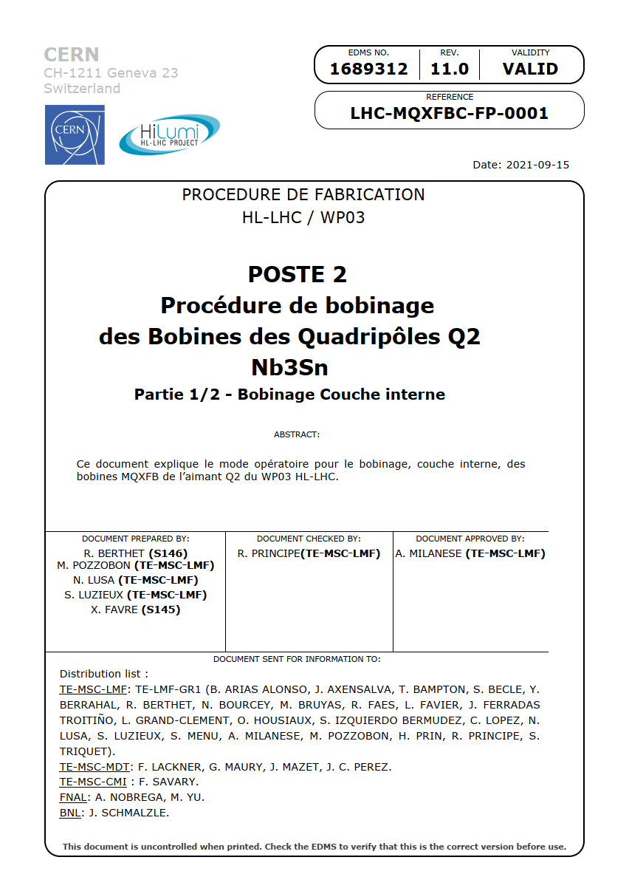
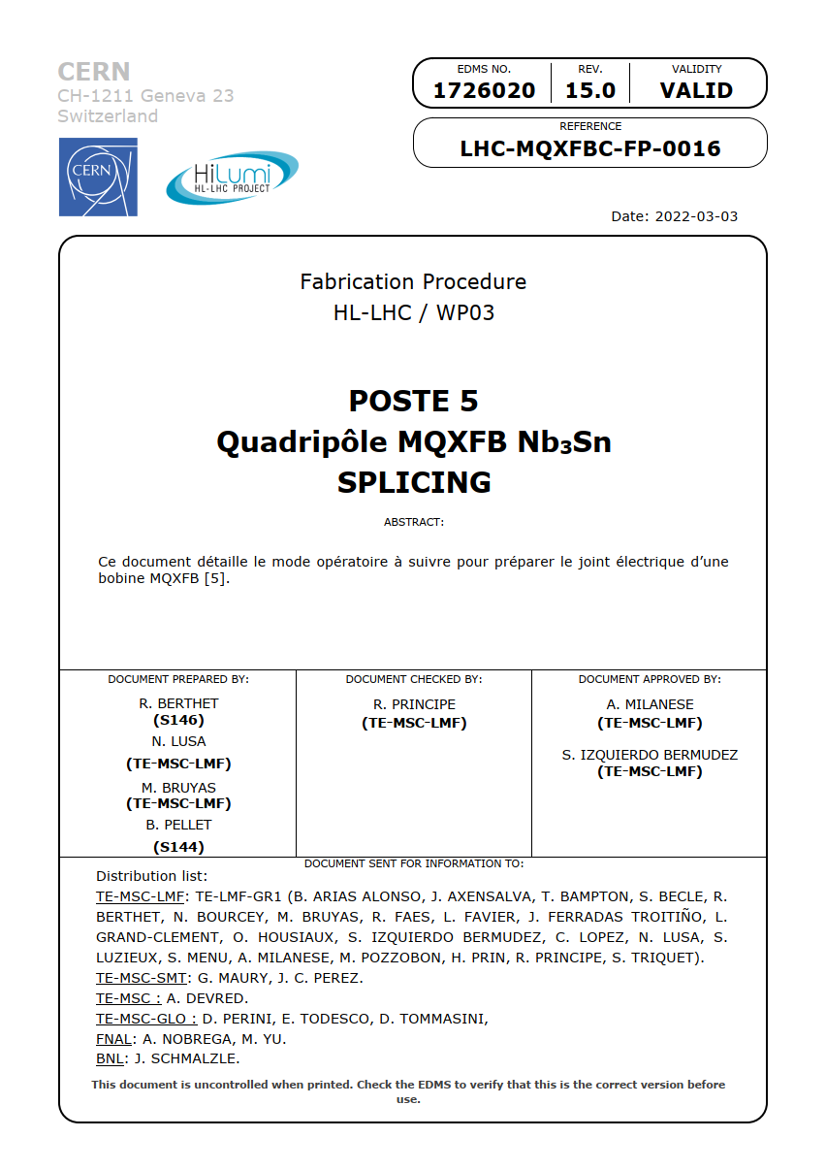
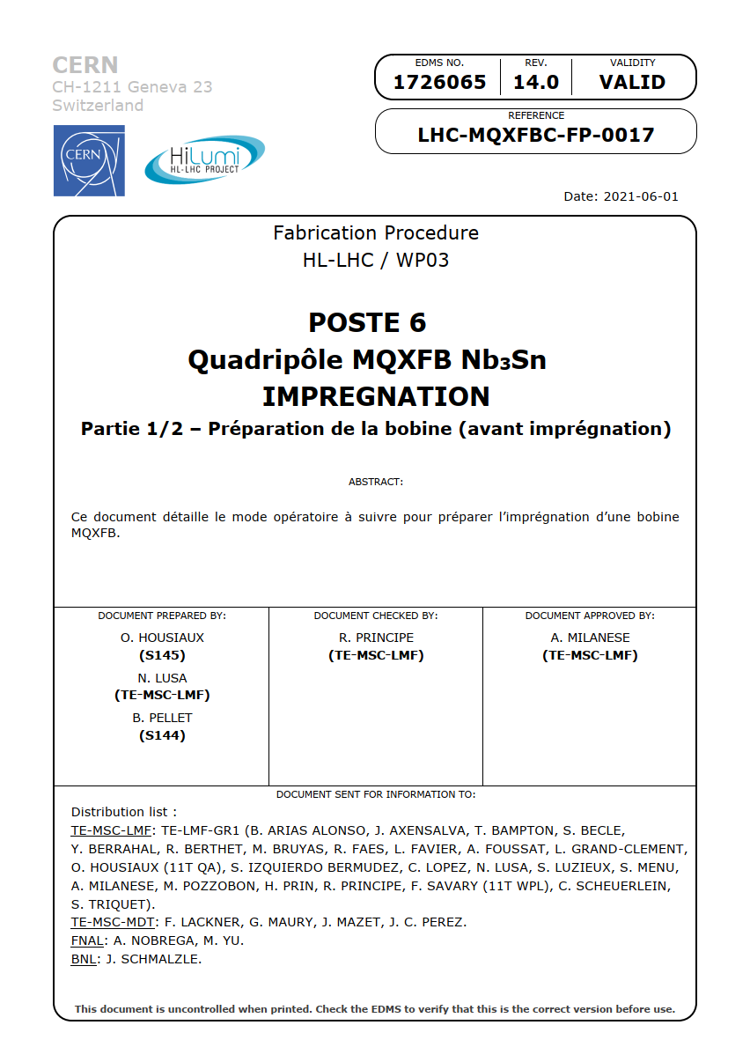
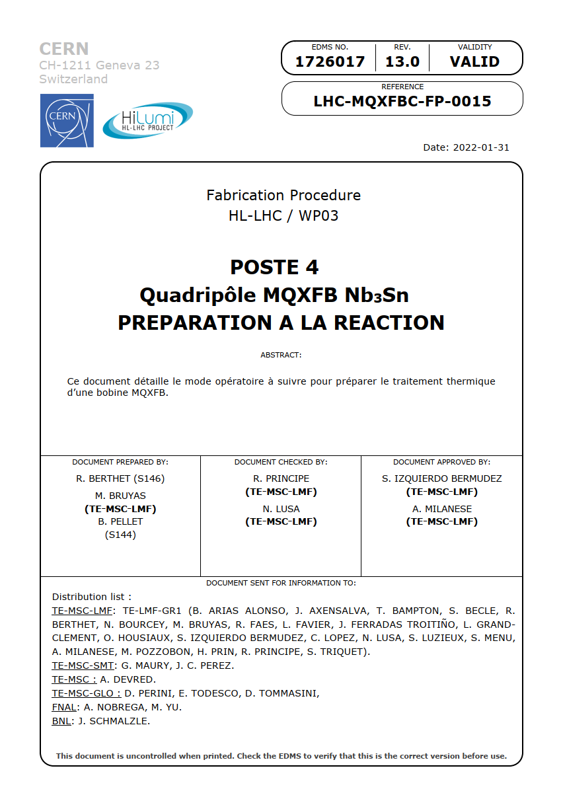
Since Sept. 2019, we have been continuously improving our fabrication and control procedures

Slide 4
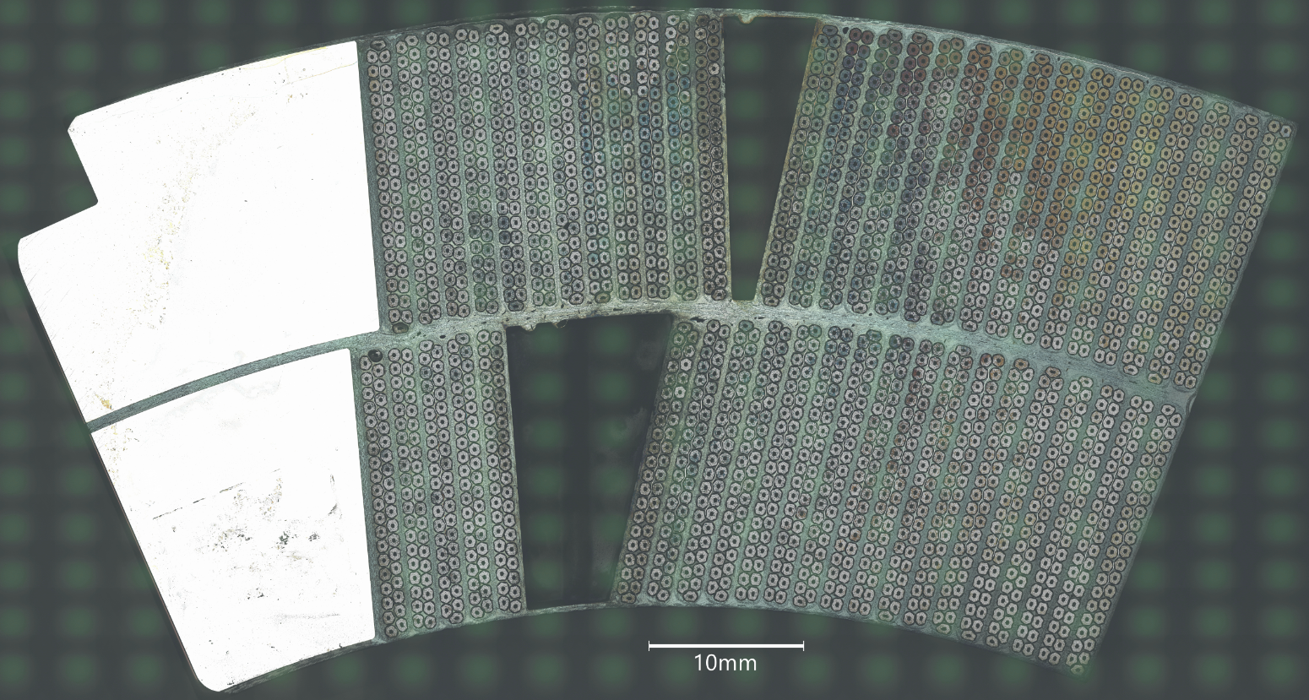
A timeline of MQXFB events puts this analysis more in context
BP1
1st tomography CR108 head
Jan. 2020
Jul. 2020
Jan. 2021
Jul. 2021
Jan. 2022
BP2
CR108 broken strands

Slide 5
Main findings from review of tooling, manufacturing processes and quality control data
Selection of improvements already implemented
1
Popped strands
Reaction and impregnation tooling
Variation of coil azimuthal size
Elastic deflection during handling
Residual energy after reaction
Inner layer pole turn protrusion after reaction
2
3
4
5
6
see also
MQXF website: cern.ch\mqxf
Topical meetings on MQXF: indico.cern.ch\category\10520

Slide 6
Popped strands – as found with tomographies – are present in MQXFS / MQXFA / MQXFB coils
1
coil | end | events IL / OL
MQXFB CR108 | CS & NCS | 21 / 22
MQXFS 107 | CS & NCS | 2 / 2
MQXFA P06 | NCS | 0 / 0
MQXFS 106 | CS & NCS | 11 / 27
MQXFB CR120 | CS & NCS | 2 / n.a.
MQXFA 108 | CS & NCS | 2 / 7
MQXFA 214 | CS & NCS | 4 / 8
tomography timeline
S. Sgobba’s talk
  Considering MQXFB vs. MQXFA (and also MQXFS):
    the mechanical behaviour of the bare / insulated cable is similar (more in MQXF cable mechanical tests)
    some details of the winding process differ, mainly due to different architectures of the hardware (more in EDMS 2680200)
    the geometry of the end spacers is nominally the same

Slide 7
Popped strands – what did we decided to do?
1
    We decided not to introduce at this stage radical changes in the winding for MQXFB coils
      the LMF team recently participated in winding two MQXFS coils in B927
      our operators are aware of this effect and attentive about popped strands when winding
      we are taking additional measurements during winding / curing for the transition coils
      we improved the tooling to constrain the ends during the transfer of the cured coil to the reaction fixture baseplate

Slide 8
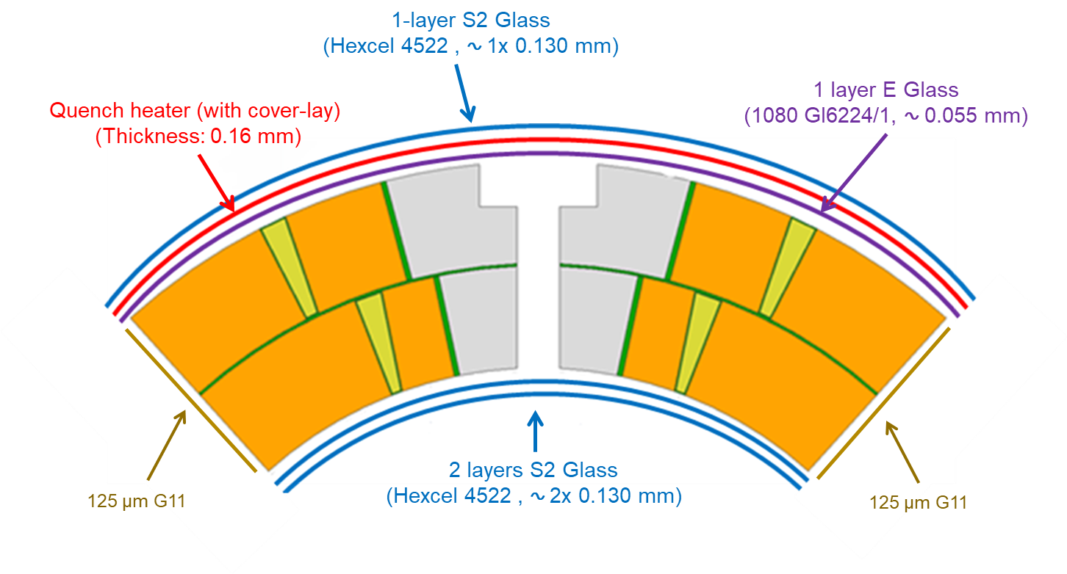
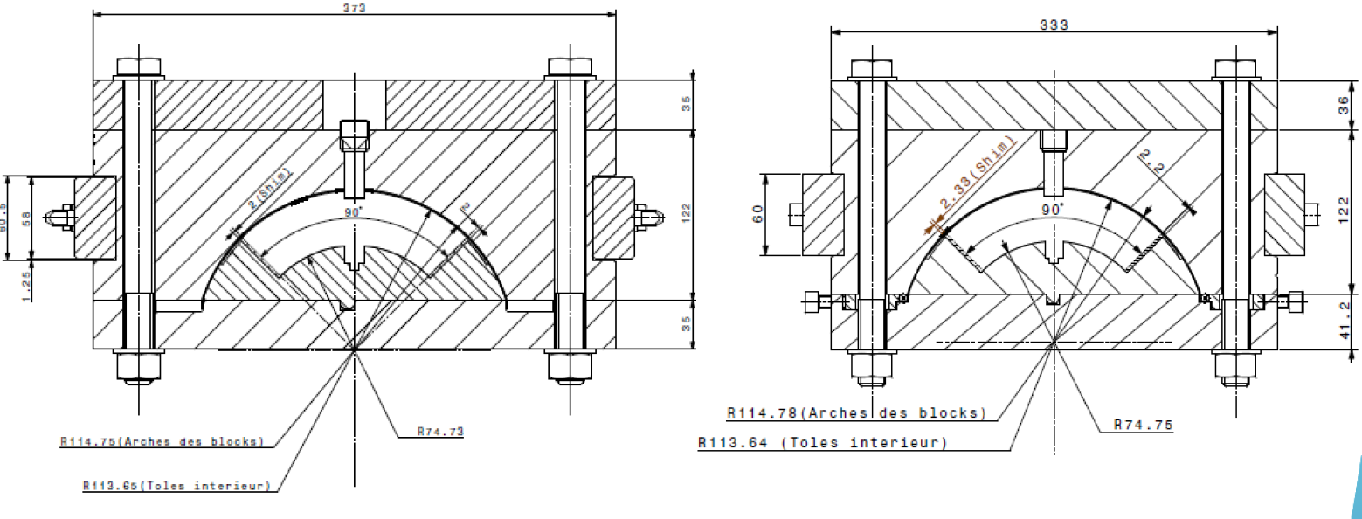
We report here on three main findings for the reaction and impregnation fixtures
2
    The cavity size and what we put inside for both reaction and impregnation are the same for MQXFB / MQXFA
    MQXFB
    MQXFA
    The MQXFB / MQXFA fixtures are different (in terms of transversal stiffness and longitudinal modularity) – analyses, including FE models, do not show a significant impact for the coil
    The MQXFB moulds (reaction and impregnation) are bent, with a gradual sagitta of 1.5-1.7 mm: we decided not to procure new plates – also because the root cause of the deformation is not identified – and monitor further geometrical deviations

Slide 9
The azimuthal size of the coils tends to be larger in the central part (big belly effect)
3
    This implies a pressure difference along the length of the order of ±15 MPa
    the big belly might be related to the dromedary hump (see later) and to the insulation thickness
    we decided to shift the cable insulation thickness target towards the lowest bound, and to address the dromedary hump
    a mitigation is to lower the coil preload target during magnet assembly

Slide 10
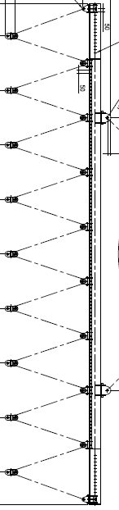
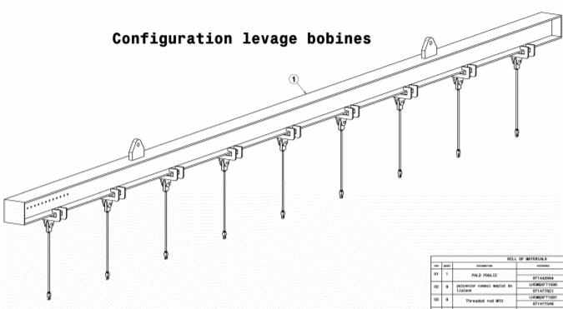
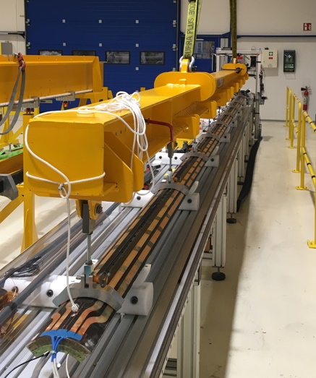
We modified the lifting girder to decrease the elastic deflection of finished coils during handling
4
BEFORE (constant force)
AFTER (constant displacement)
    Improvement demonstrated in relative (with respect to before) and in absolute (measuring strains < 10 με)

Slide 11
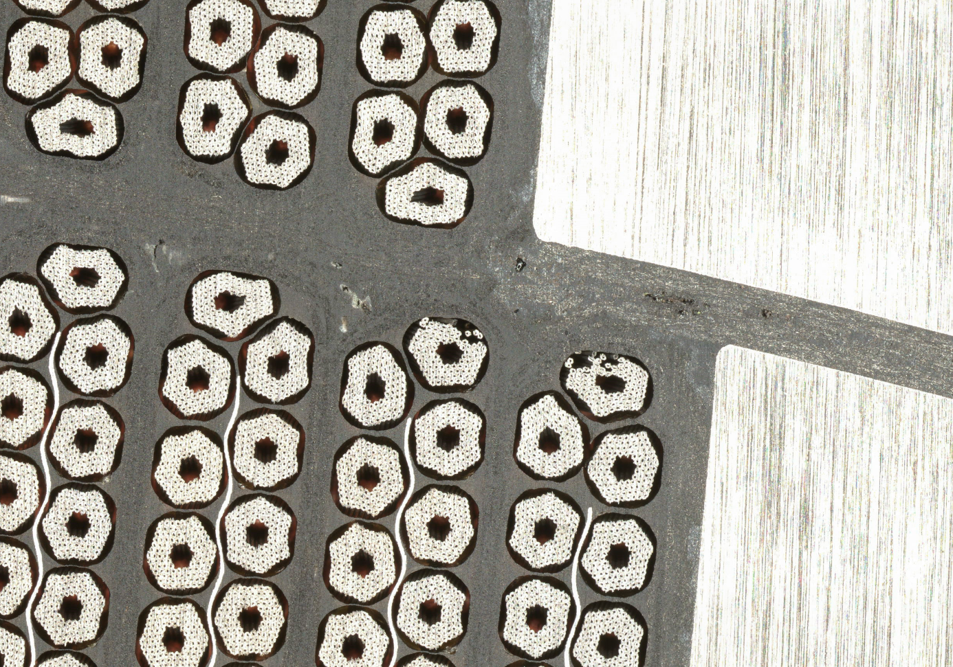
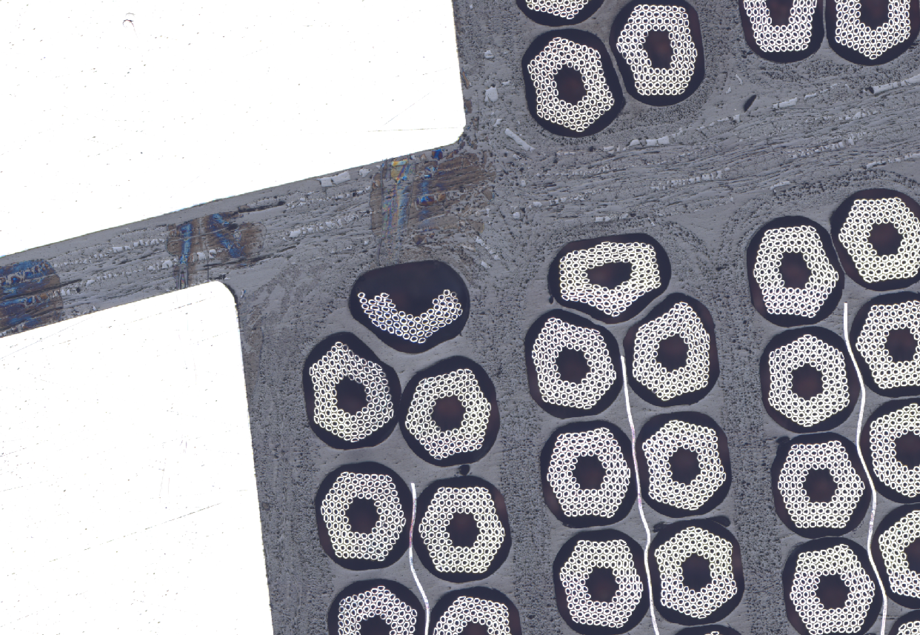
The inner layer pole turn – and the poles in general – is where we focus more our attention in this moment
    CR108 micrographies after Cu etching
outer layer Ti pole
inner layer Ti pole
outer layer Ti pole
inner layer Ti pole
S. Sgobba’s talk

Slide 12
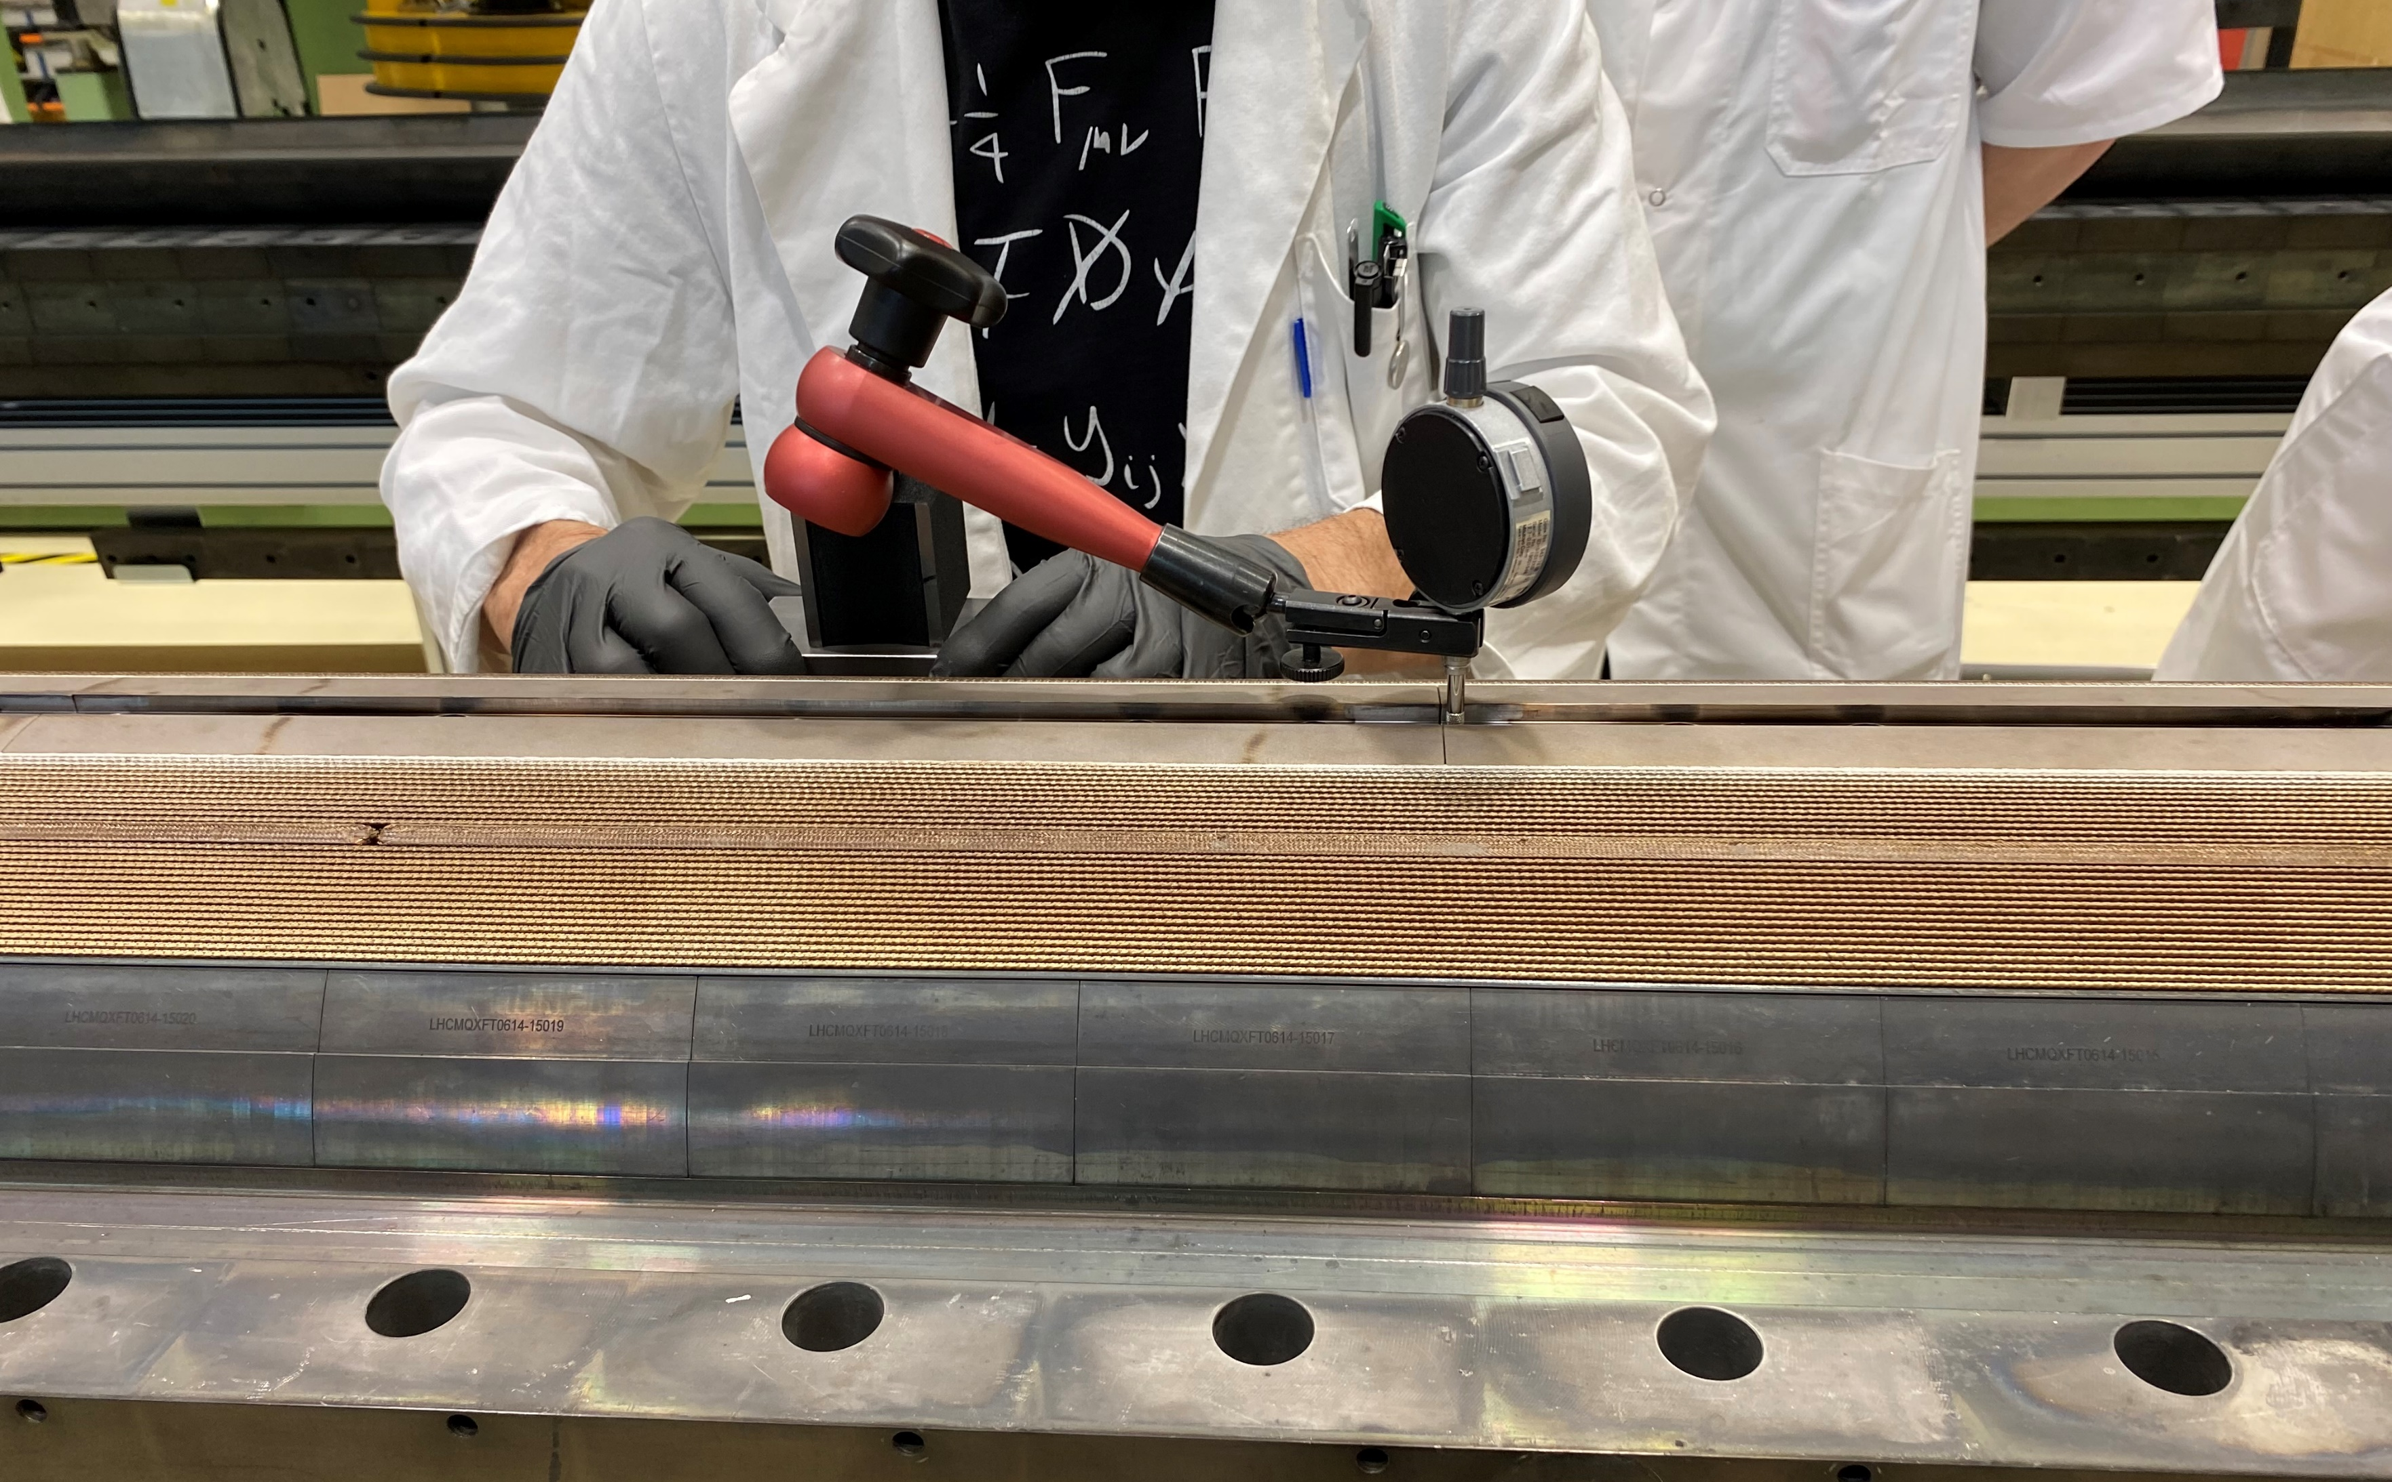
The pole (and coil) lifts up from the baseplate after reaction (dromedary hump effect)
5
    This hump is:
    related to stored energy during reaction
    potentially inducing deleterious movements in a reacted-not-yet-impregnated coil
    possibly linked to the big belly effect
    Similar measurements
    have been performed on MQXFS coil 116, finding 0.7-0.8 mm
    are planned for MQXFA coils

Slide 13
This hump could be caused by residual constraints in the reacted coil and to the (lack of) pole gaps
5
MQXFB
MQXFA
FNAL
MQXFA
BNL
    The pole gap after reaction, for MQXFA and MQXFB coils
    is similar for the total, at 2-4 mm
    is different for the longitudinal distribution
      MQXFA gaps are larger in the center
      MQXFB gaps are larger at the extremities

Slide 14
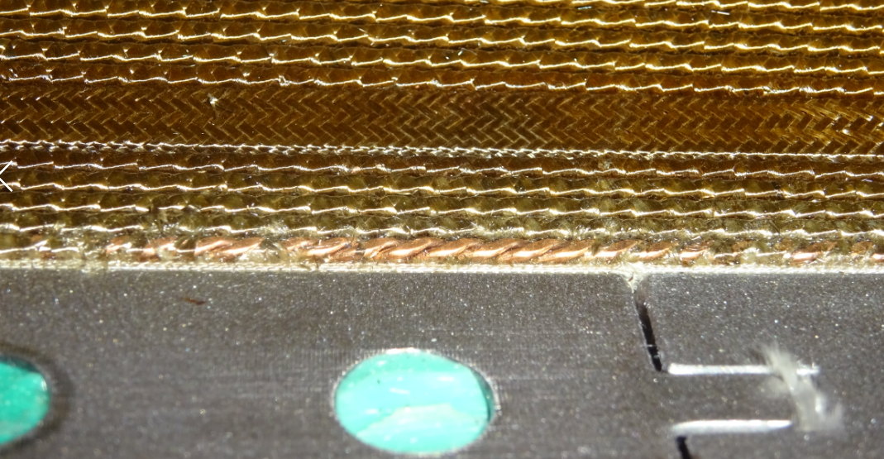
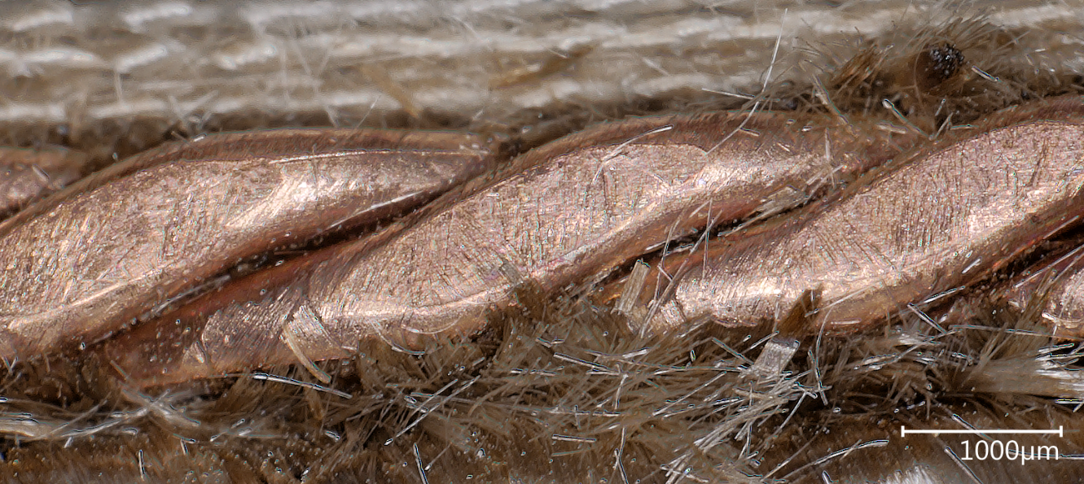
On coil CR122, we observed an inner layer pole turn protrusion (towards the aperture)
6
inner layer pole turn
inner layer Ti pole
    0.8 – 1 mm protrusion of the pole turn with respect to the pole piece observed after reaction, at 5200 mm
      NCR EDMS 2469659 (including Fuji paper analysis)
      inspection with the microscope did not reveal any specific deformation or degradation on the cable
      this coil will not be assembled in next magnet
    dedicated inspection added on all coils afterwards
    for previous coils, visual inspection based on pictures
    when we observe something, this is always at the segmented Ti pole junctions (pole length is 400 mm)

Slide 15
Inner layer pole turn inspection in CR121 and CR122
6

Slide 16
Inner layer pole turn inspection in CR123
6

Slide 17
Inner layer pole turn inspection in CR124 and CR125
6

Slide 18
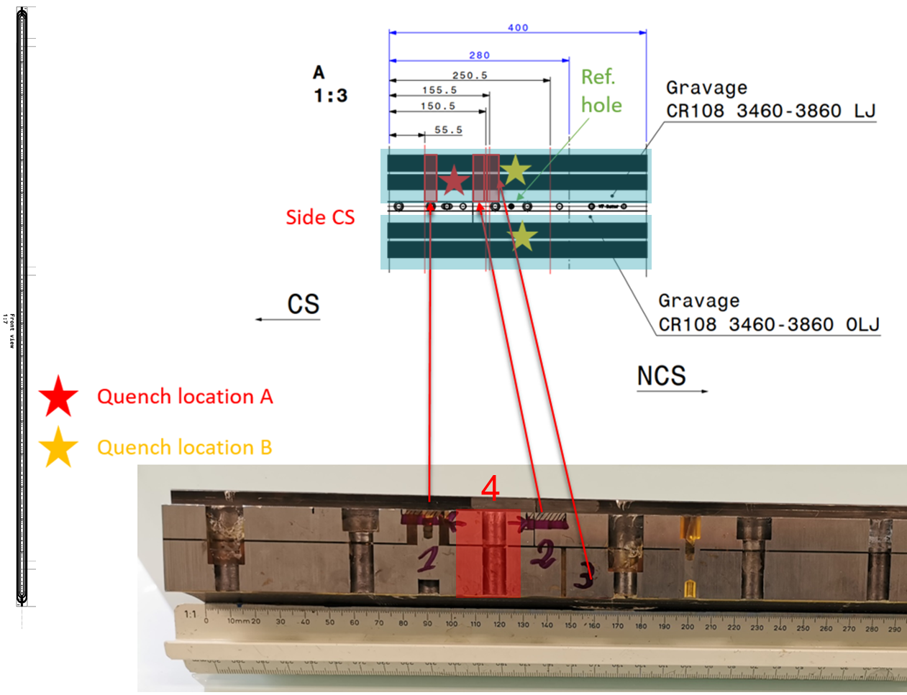
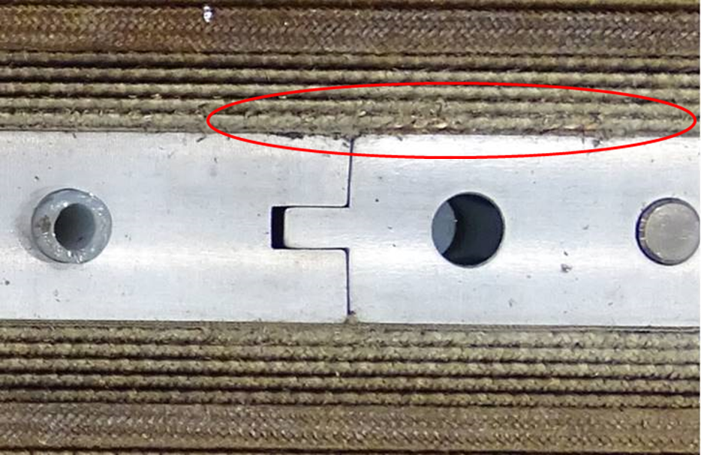
Inner layer pole turn inspection in CR108
6
defect at 3680 mm
OLJ
    Metallography inspections in the quench location show a defect in the region 3560-3800 mm
    Visual inspection shows degradation of the pole turn insulation at 3680 mm
    For coil CR108, we have a correlation between quench location, broken strands and insulation damage
      though the insulation damage is only on one side of the pole

Slide 19

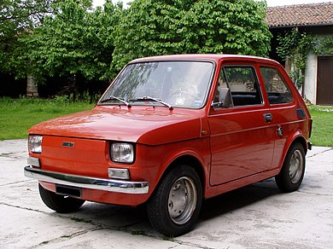

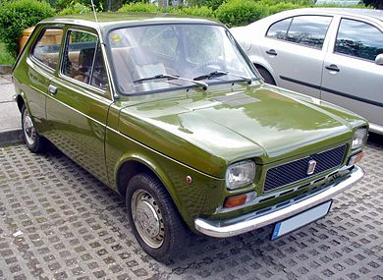
Short term plan for further improvements
CR128
(not yet started)
CR126
(prep. impregnation)
1970
CR127
(winding and curing)
1972

Slide 20
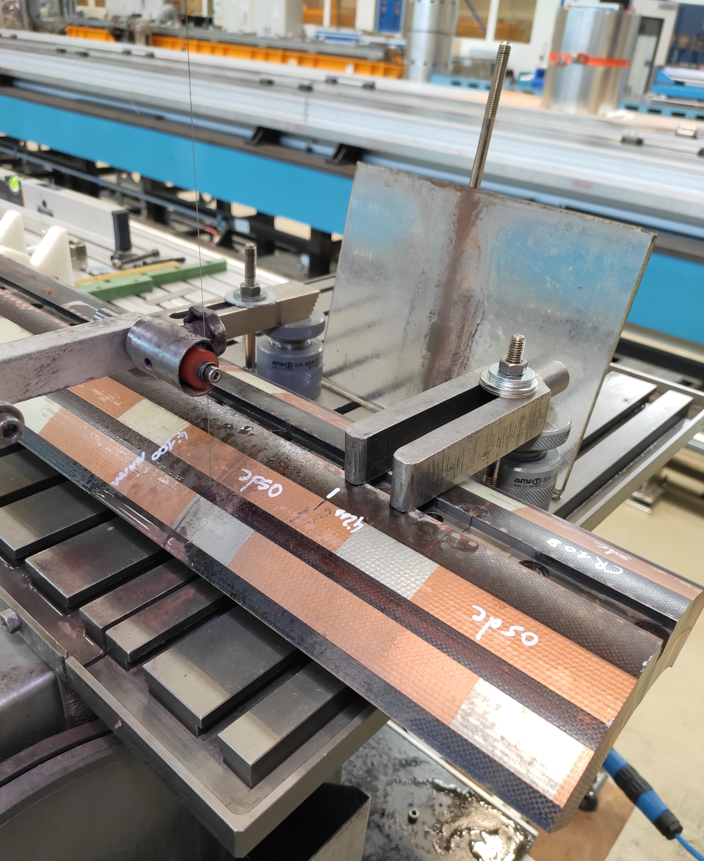
We keep slicing up CR108, to check in particular whether the broken strands are local or distributed

Slide 21
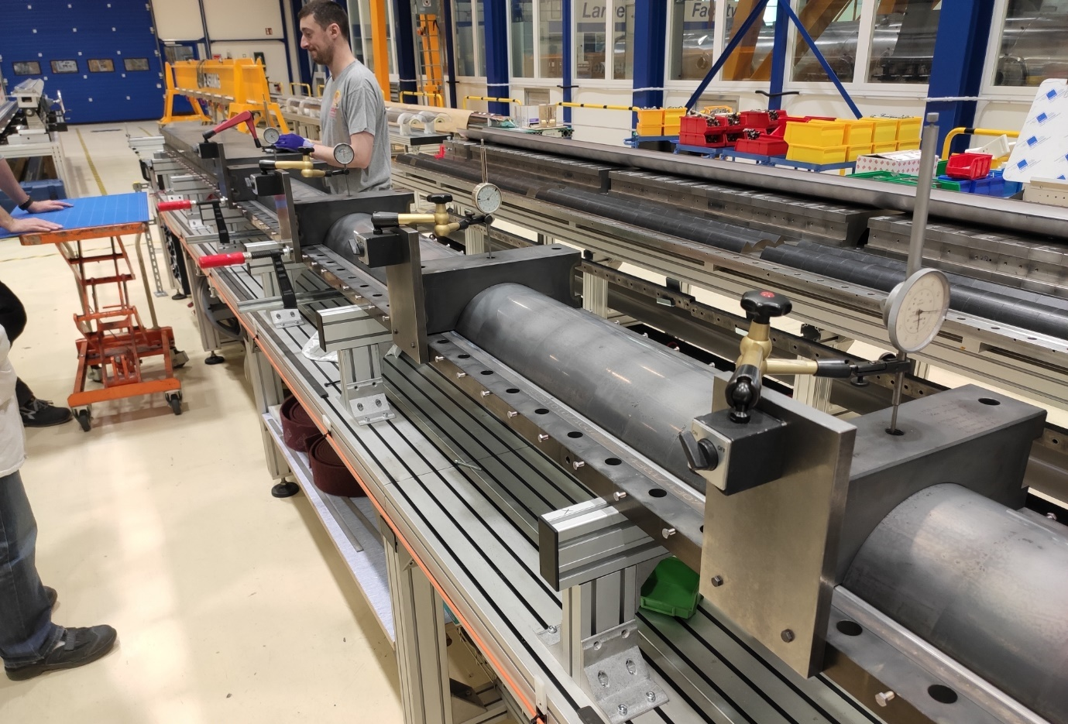
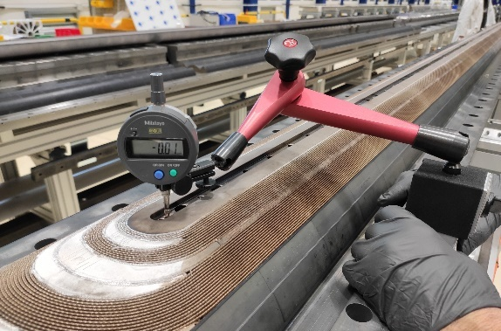
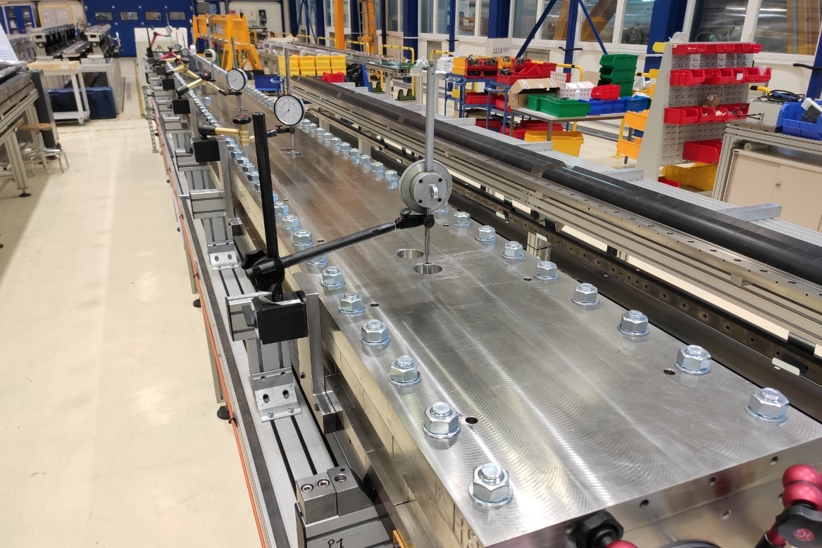
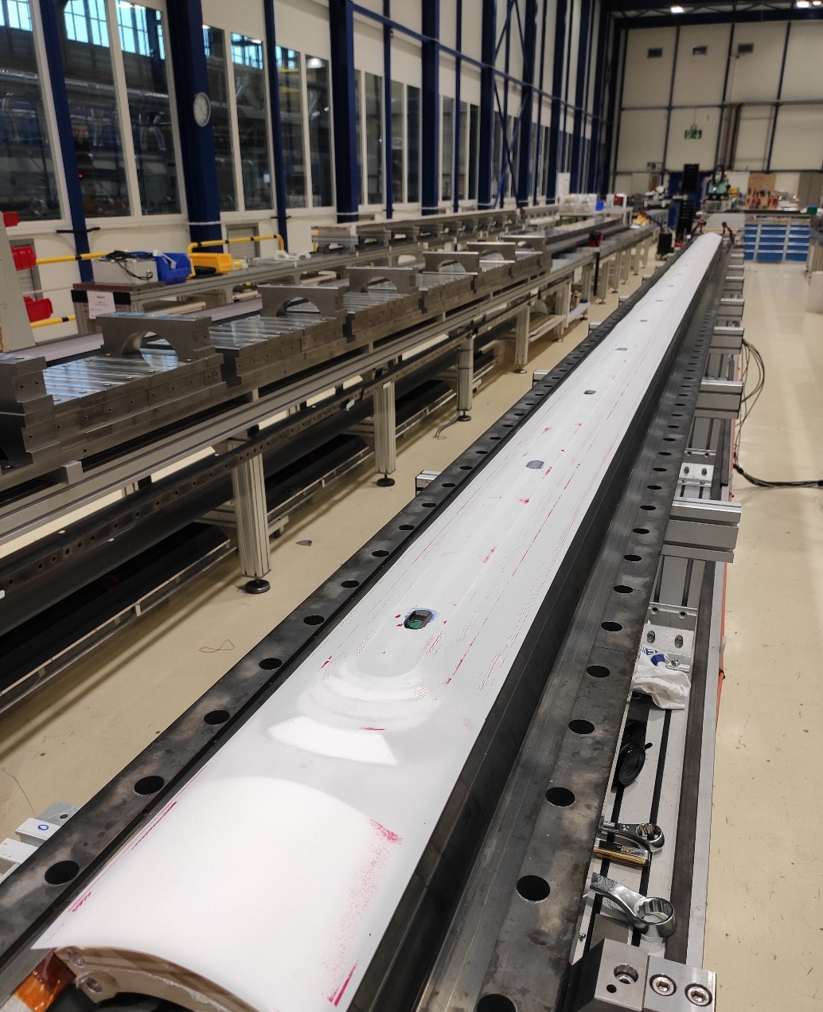
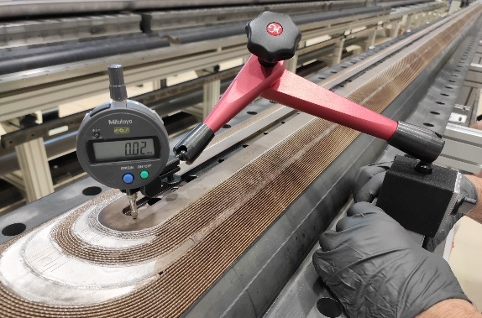
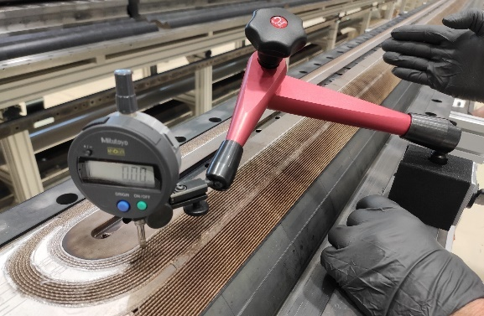
CR126 – extra measurements taken when closing / opening the reaction / impregnation fixtures

Slide 22
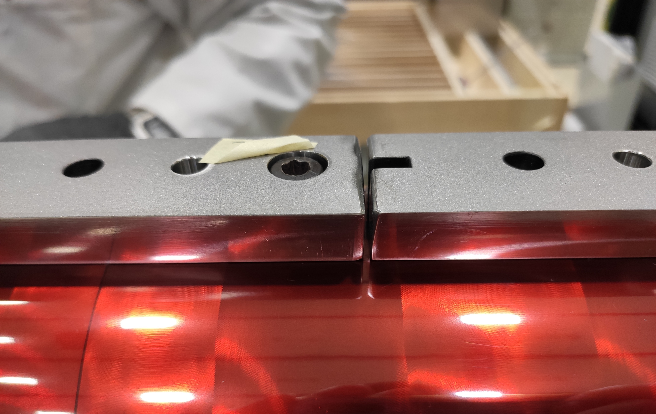
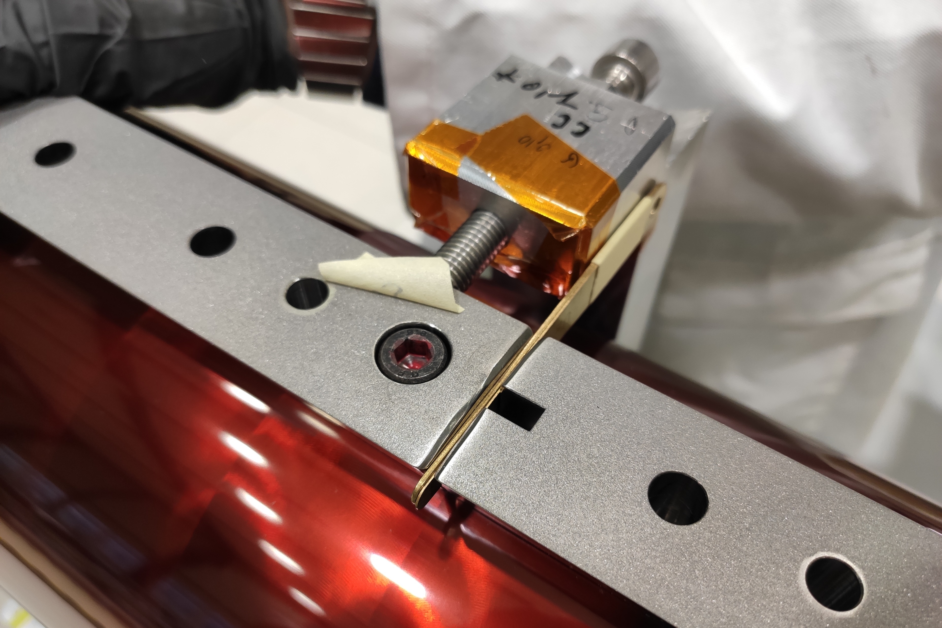
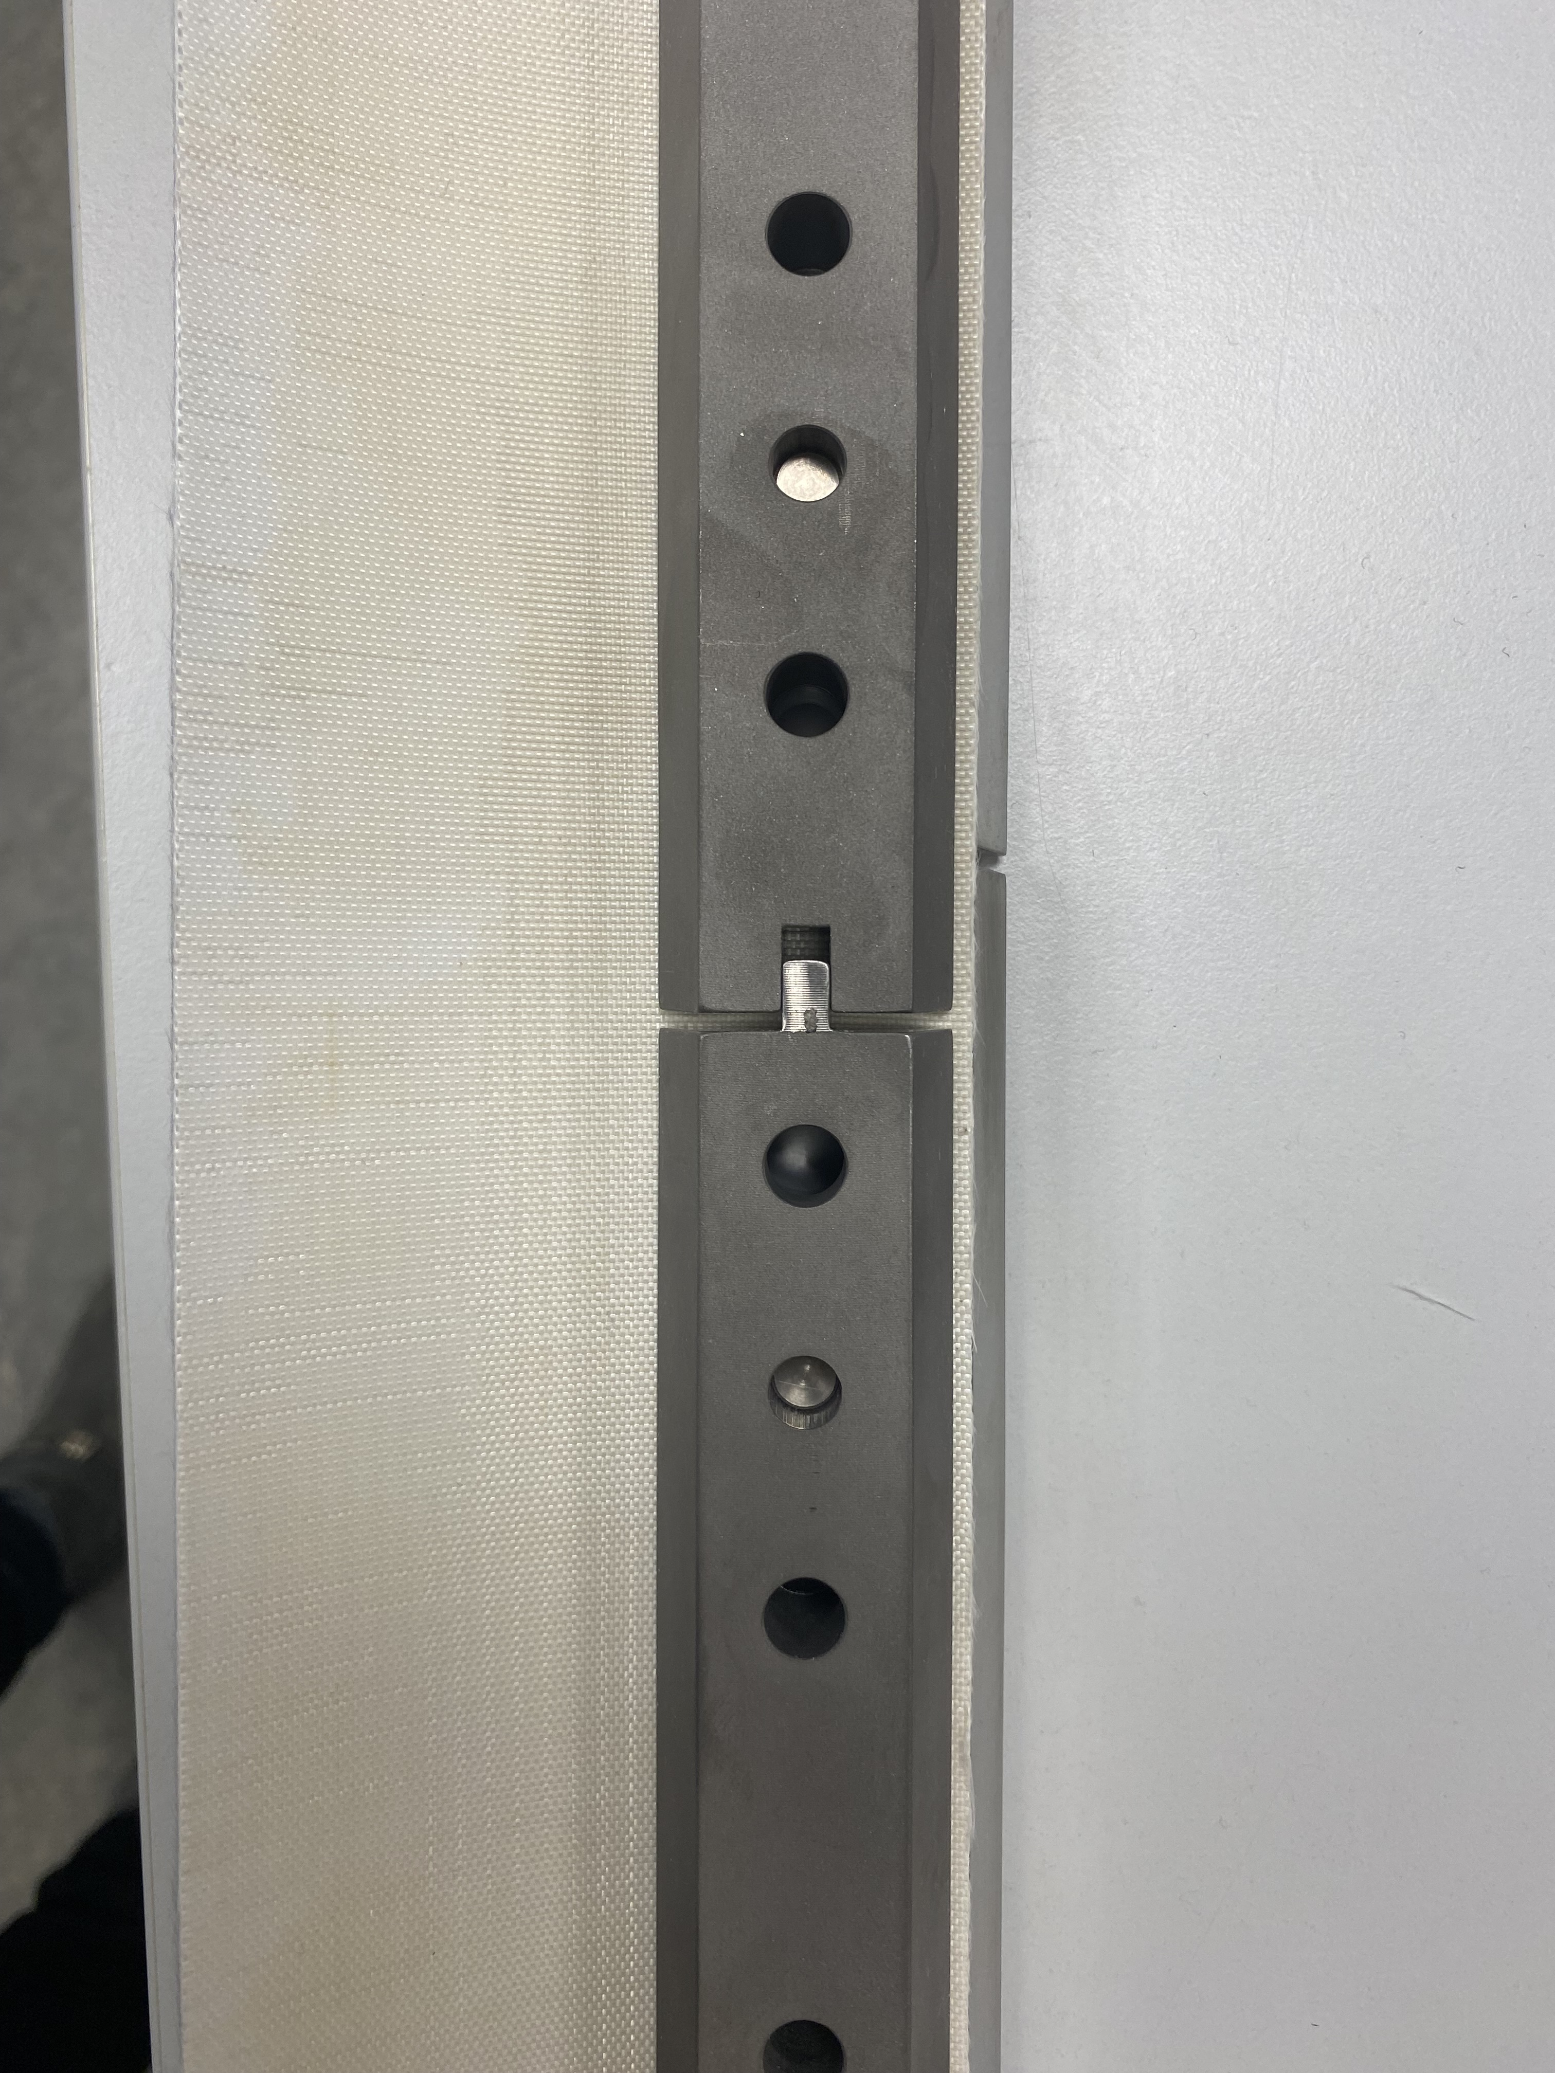
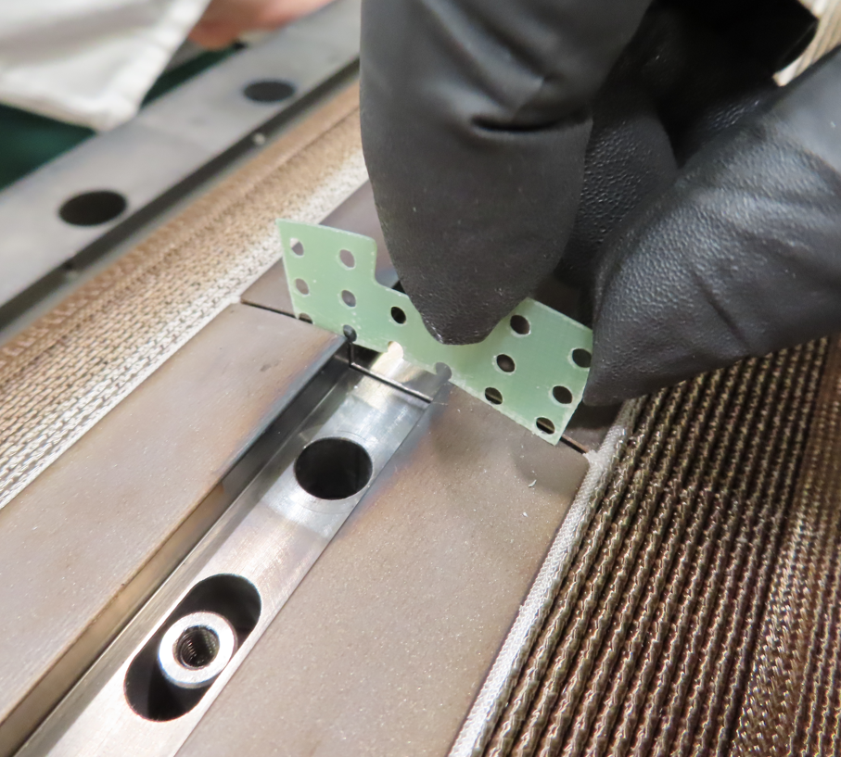
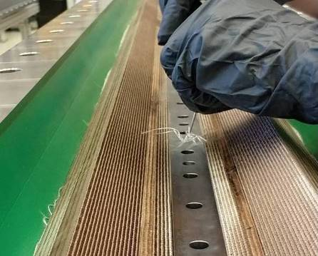
CR127 – Several actions to give more room to the coil during heat treatment and decrease the stored energy
    Pole gaps increase from 0.9 mm to 1.5 mm
    Removal of T-slot in poles
      to avoid any possible lack of longitudinal sliding
    Rounding of all edges of the poles
      to address effect of pinching of fiberglass
    Removal of one layer of fiberglass on OL during reaction
    Reduction of winding tension in the OL
      scaled with the ratio of IL / OL turns (28 / 22)
    Residual gaps are filled before impregnation

Slide 23
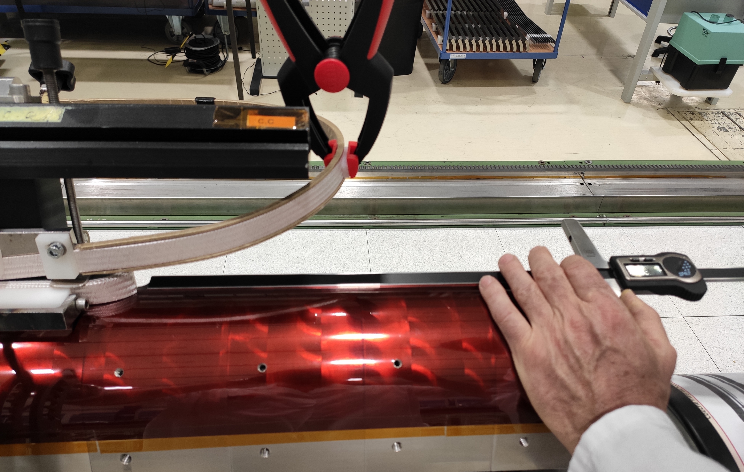
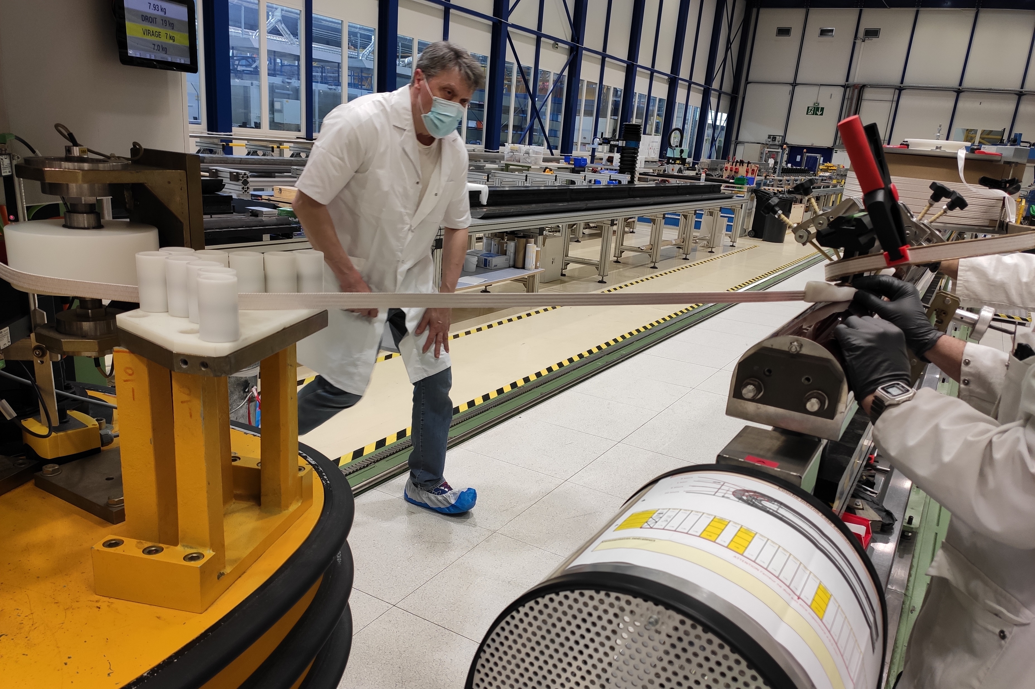
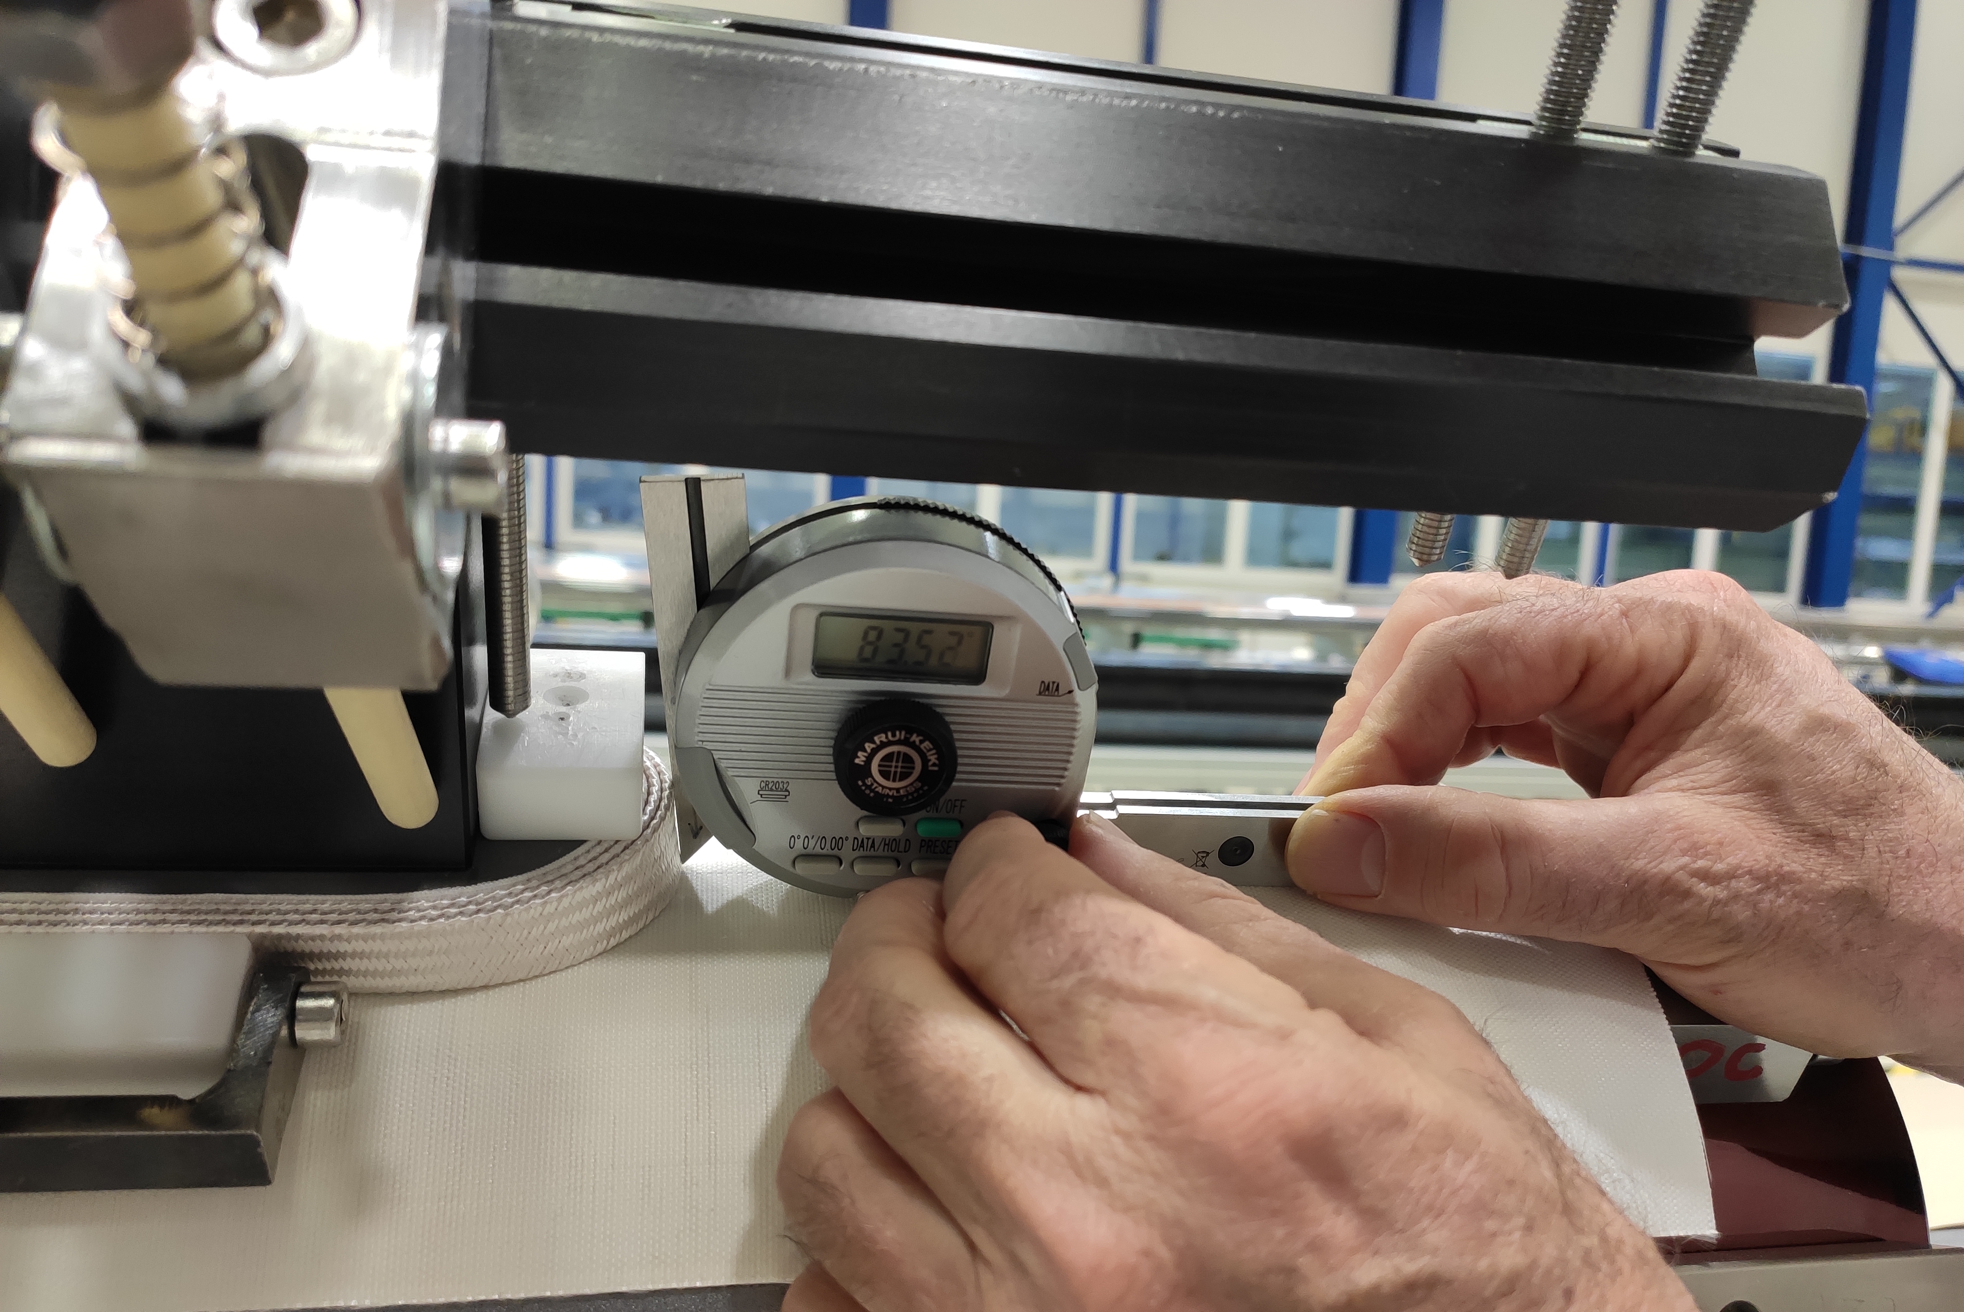
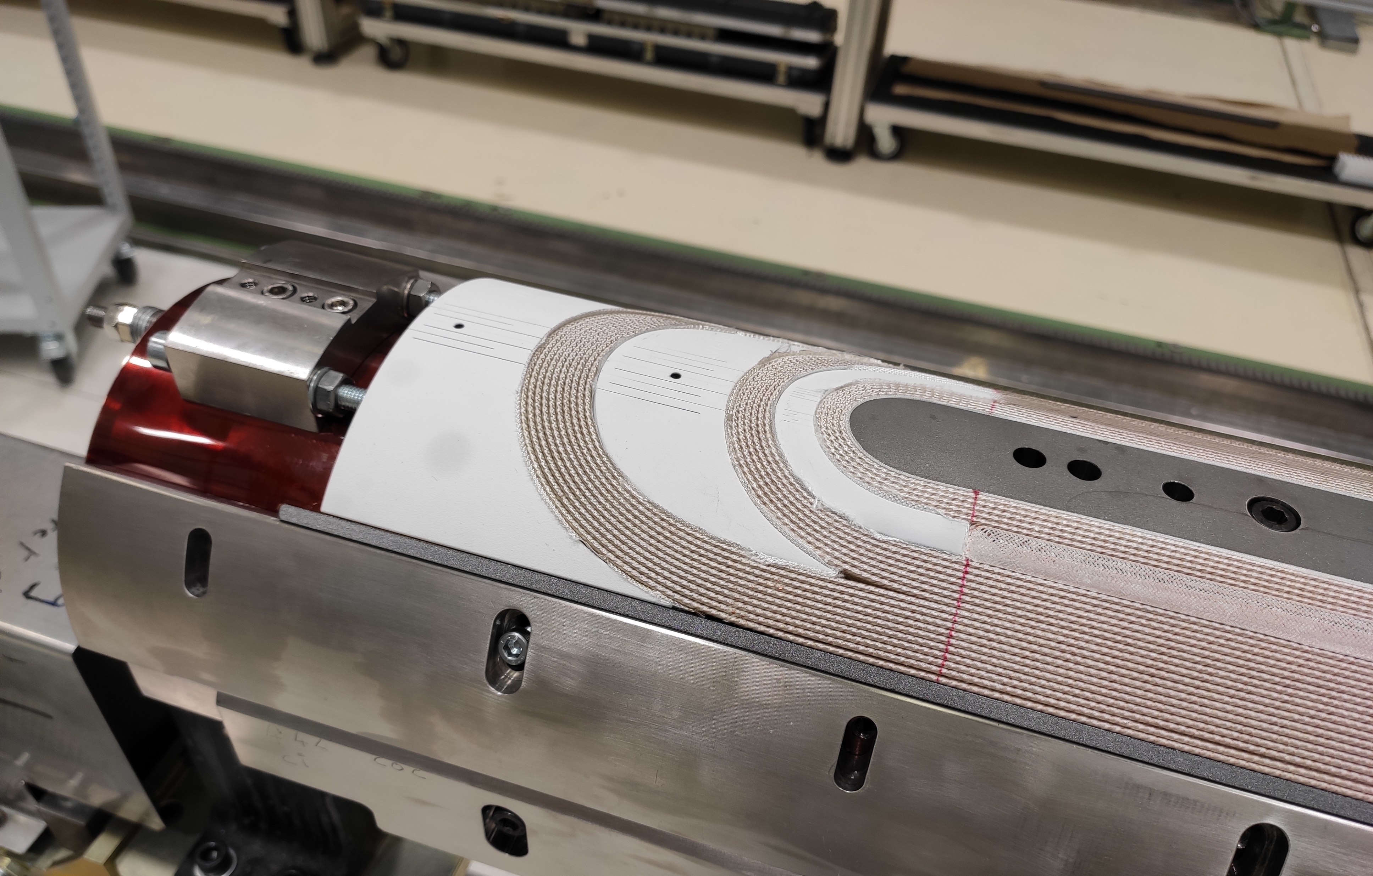
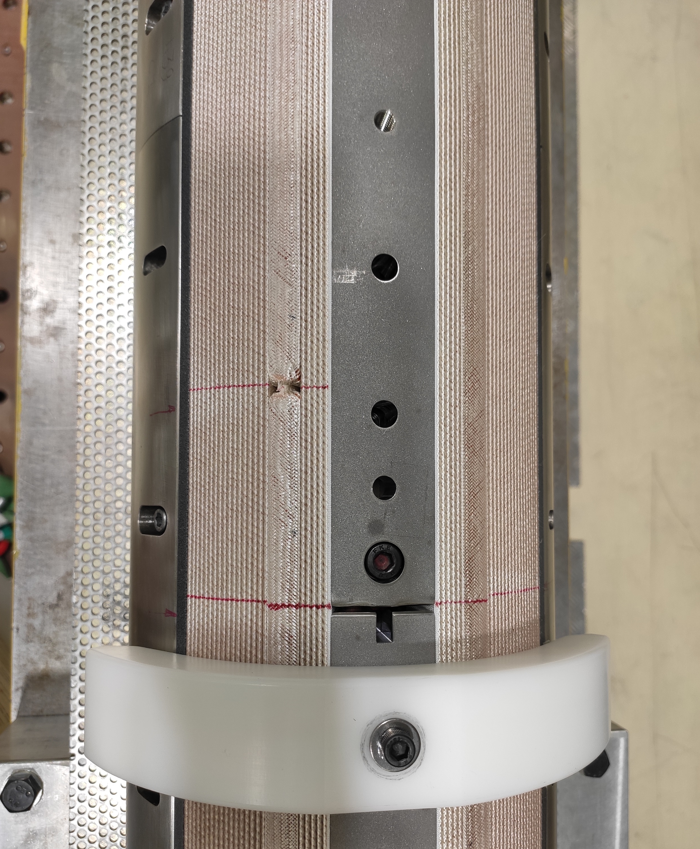
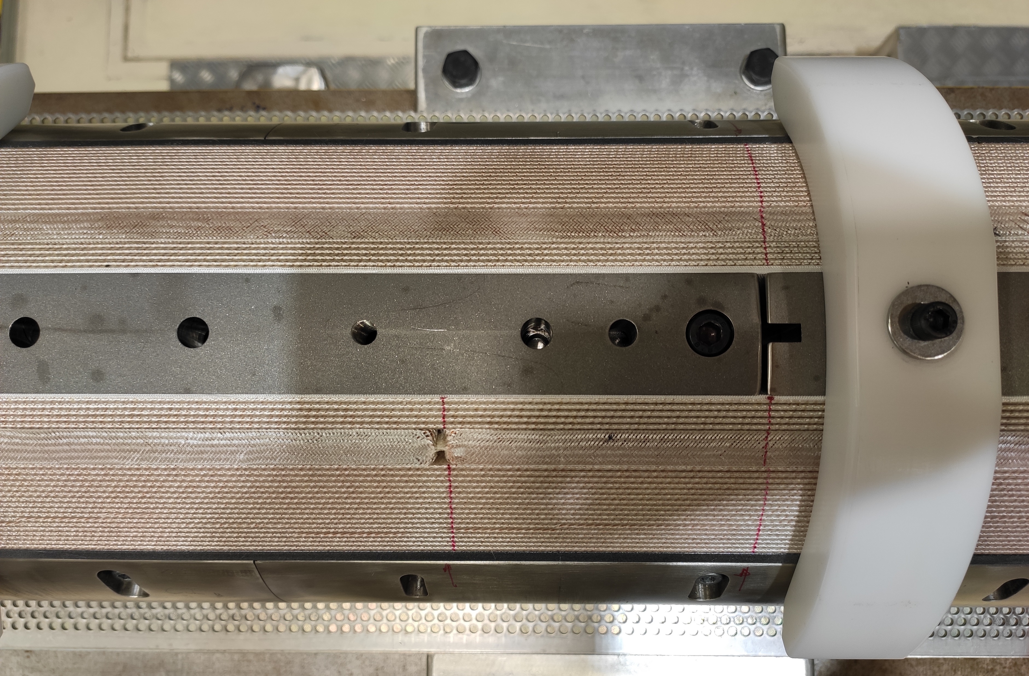
CR127 – additional measurements during winding and curing, also related to the popped strand analysis

Slide 24
The plan for the coils is part of a more general strategy (see E. Todesco’s talk)
    CR126
      continue the fabrication with the standard procedure and additional measurements (ex. displacements, torques on bolts, geometry with laser tracker, intermediate closures of mould with Fuji paper)
    CR127
      implement selected changes in the procedures, checking in particular the impact on the dromedary hump, the pole turn protrusion and the big belly
      candidate for destructive analyses, focussed on broken strand issue
    CR128
      winding on hold till CR127 is reacted
      candidate for fast-track testing in a magnet (MQXFBP1b or similar), to confirm performance
    Continue the destructive analyses in CR108
    Keep alert, keep sharing and discussing with colleagues, including AUP

Slide 25
Thank you

