Slide 1

Improvement in cold mass assembly
H. Prin
According to discussions and contributions from:
Design: E. Todesco (WPL), P. Ferracin & S. Izquierdo (MQXFB WPE),
D. Duarte Ramos (cryostat WPE), A. Milanese (SL),
J. Ferradas and J.L. Rudeiros (FEM), A. Temporal (Design Office)
Assembly & procedure developments: T. Bampton, N. Bourcey
Welding improvements and qualifications: T. Bampton, P. Freijedo, J. Debeux, A. Crochemore, I. Aviles
Procedures writing and QA/QC: R. Principe, LMF-QA
Report on Ongoing Actions for MQXFB 29/04/2022

Slide 2
Outline
Cold mass
  HL-LHC cold masses
  Link between the magnets and the envelope LHC vs HL-LHC
  The LMQXFBT cold mass concept to test MQXFB magnets
  Observations during disassembly of LMQXFBT01, 2 and 3
  More information about LMQXFBT01 to 03
Requirements update after MQXFBP2 cold test
  Determination of the shell developed length
  Fixed point necessity and design
  Outcome of Technical Review of MQXFB Cold Mass
Additional QC and improvements for next cold masses
Summary

Slide 3
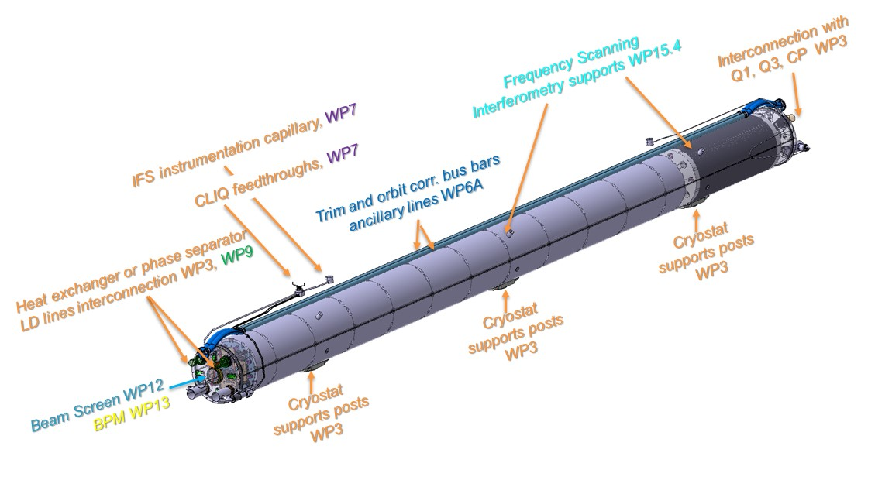
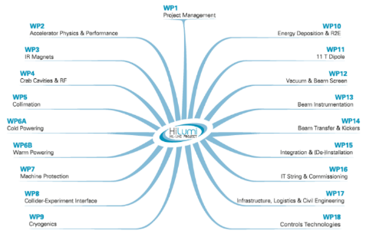



HL-LHC Cold Masses
Cold Mass:
Leak tight envelope surrounding one or more superconducting magnets which acts as a helium pressure vessel and provide the mechanical rigidity to align the magnetic element(s). It can be composed of two welded half-shells (main dipoles, insertion cold masses...) or by an "inertia tube" (arc SSS) closed by two end covers in the extremities.
https://espace.cern.ch/HiLumi/TCC/SiteAssets/LHC_Glossary_high_resolution.pdf
Close collaboration with many work packages:
WP3: weekly meeting at CERN, regular meetings and exchanges with US and Japan
WP6A, WP7: Magnet Circuit Forum (MCF) every other week
WP9, WP12, WP13: meetings when necessary
WP2, WP15: HL-LHC Integration meeting
Q2 LMQXFB Cold Mass
  Q2 A or B (LMQXFB)
  D2 (LMBRD)
  CP (LMCXF)
  Q1 and Q3 (LMQXFA)
  D1 (LMBXF)
Standardisation of the components and procedures (assembly, welding, electrical testing, QA/QC…)
Standardisation of the components delivered by CERN
Regular discussions and exchanges concerning procedures

Slide 4
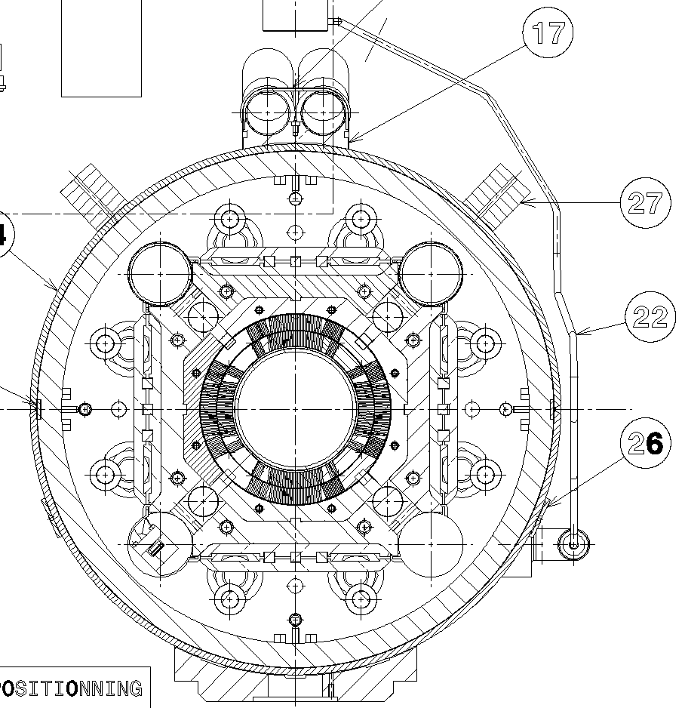
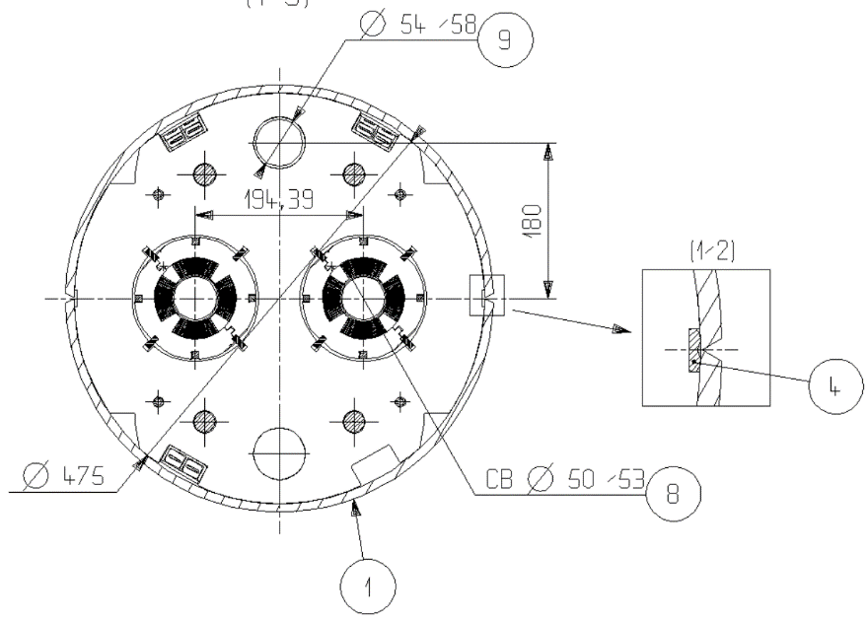
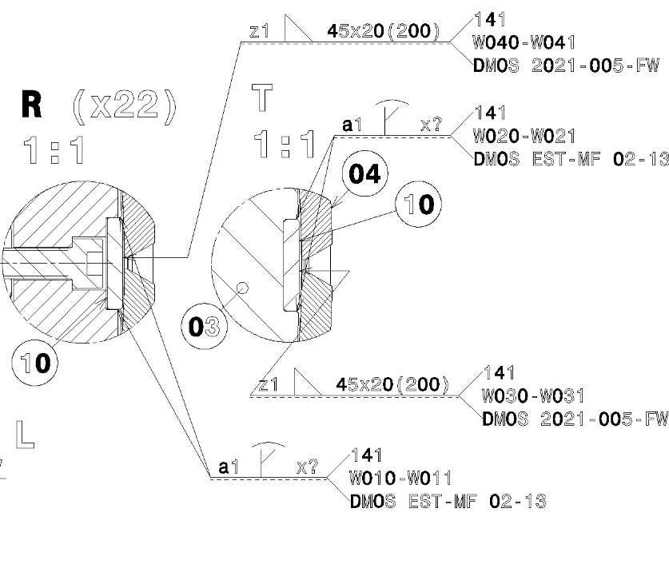
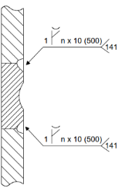
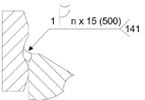
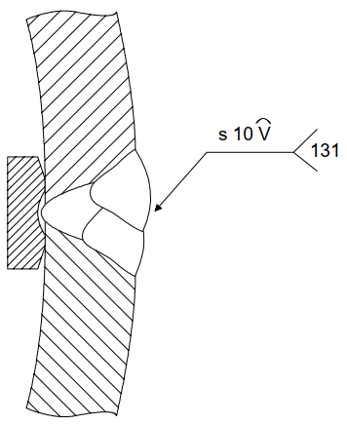
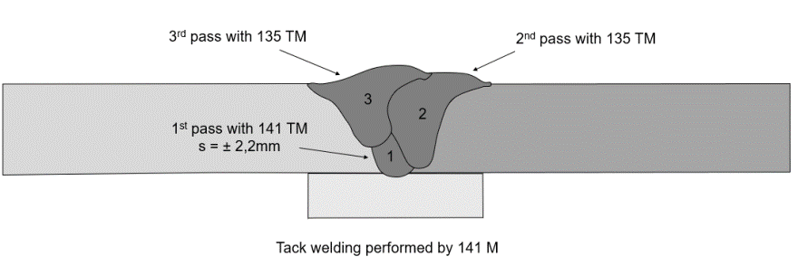
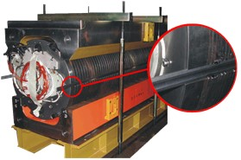
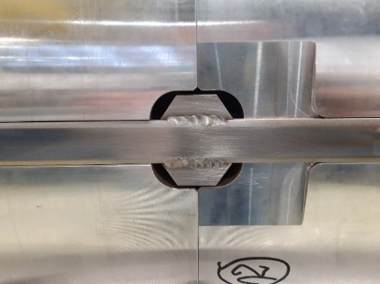
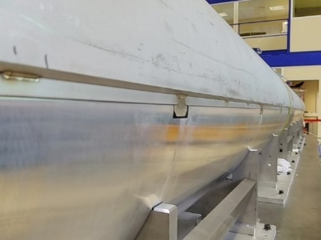
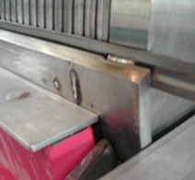
Link between the magnets and the envelope
LHC MQM/MQY vs HL-LHC
  3 MIG passes
  Backing strip not part of the weld structure
  Dual welding process
  TIG root +2 MIG filling passes
  Backing strip melted during the longitudinal welding to become part of the structure

Slide 5
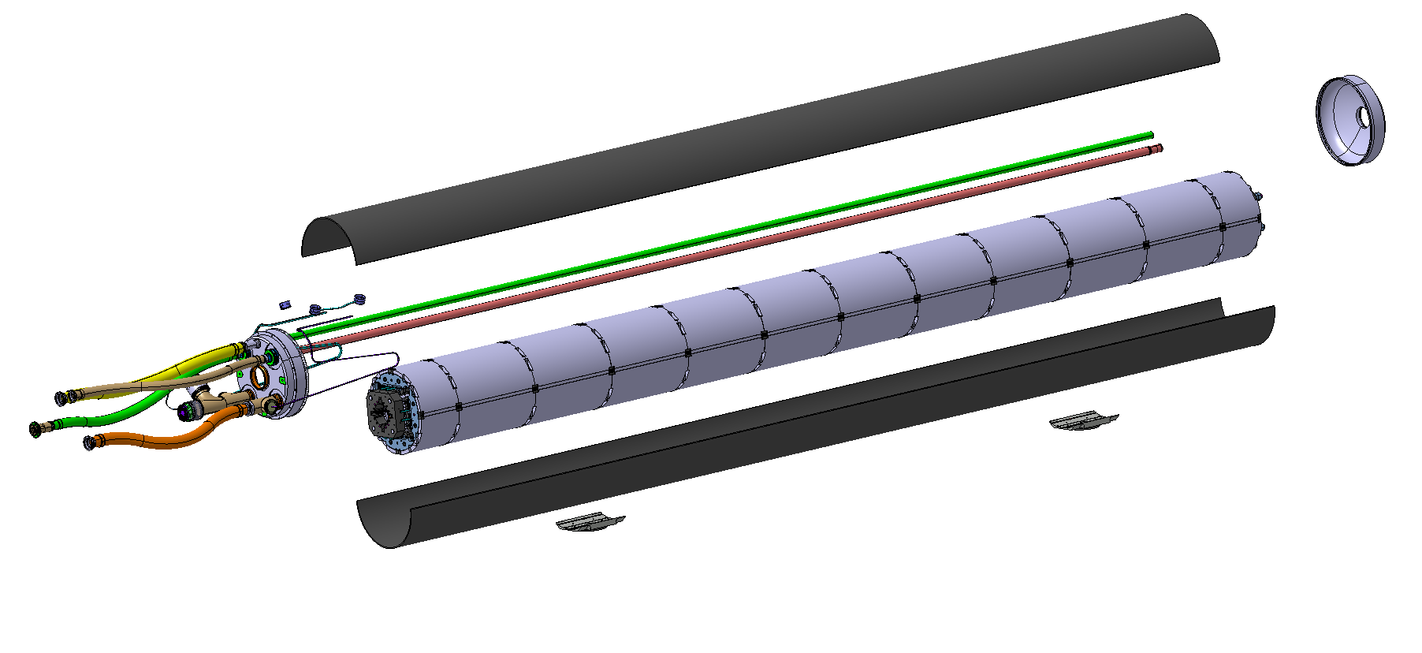
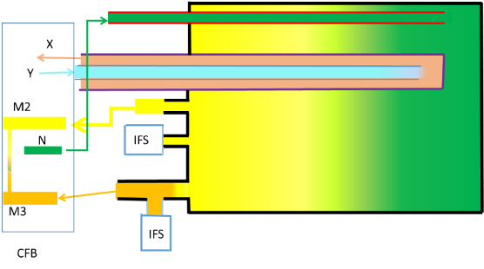
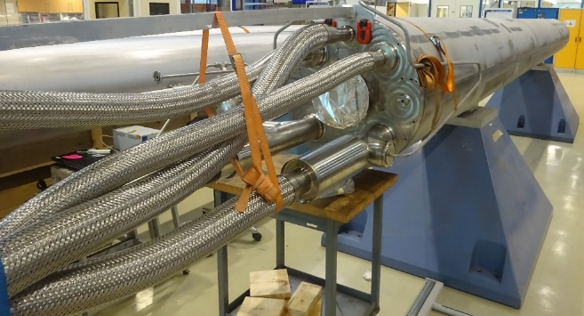
The LMQXFBT cold mass to test stand-alone MQXFB magnets
Providing a leak tight envelope surrounding the MQXFB magnet to perform cold test horizontally,
Providing mechanical inertia, rigidity and alignment in between aluminium shells,
Fitting and integrating inside the existing spare vacuum vessel for the Q9
Connecting to the existing test bench in SM18
Enabling magnetic measurements at cold, eventually with the beam screen inserted,
Housing electrical protection and mechanical instrumentation and providing interfaces to route the signals from 1.9K to RT,

Slide 6
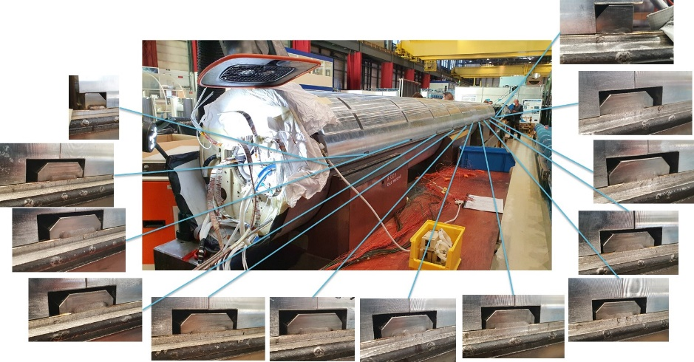
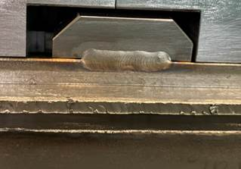
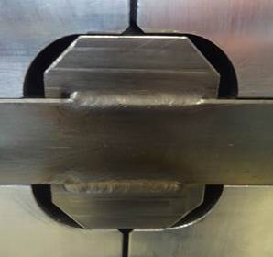
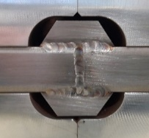
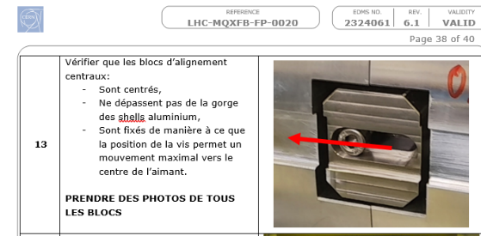
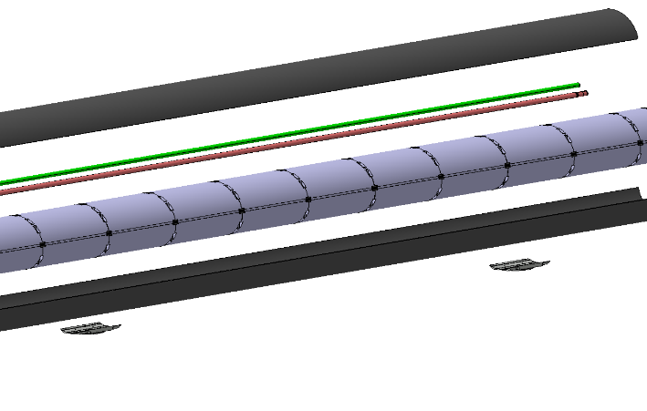
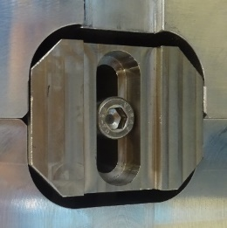
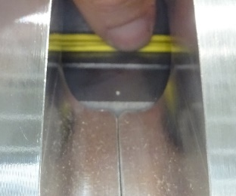
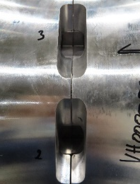
Observations during LMQXFBT01 disassembly
Procedures enhancement for future assemblies
Tack welding blocks centered in the aluminum shell pockets
  Design evolved to maximize the clearance
  Only one screw is installed per block, with a bias towards the centre to allow maximum movement
  Systematic measurements of gaps and relative positions of all elements
MQXFBP1
MQXFBP2
MQXFBP3
Longitudinal shrinkage along the cold mass axis was observed after cutting the half shells.
All tacking blocks moved towards the magnet centre.
Tack welds on the blocks in the extremities were broken.
α_{SST shells} = 3mm/m
7.5m
α_{SST backing strip} = 3mm/m
α_{Al shells} = 4mm/m
α_{ARMCO yoke} = 2mm/m

Slide 7
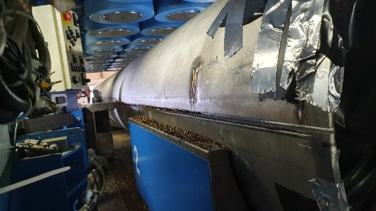
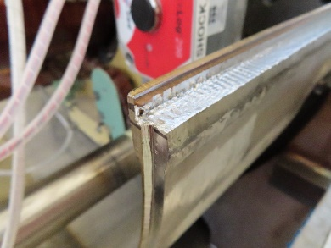
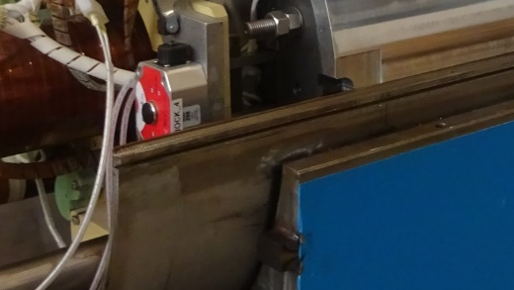
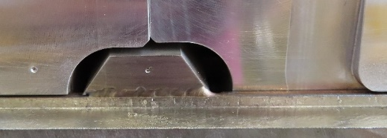
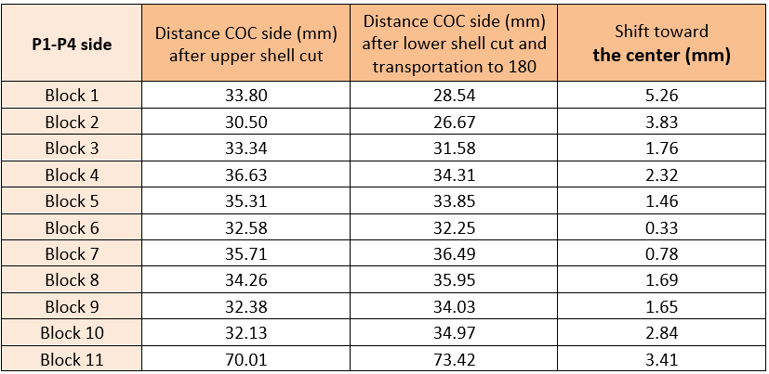
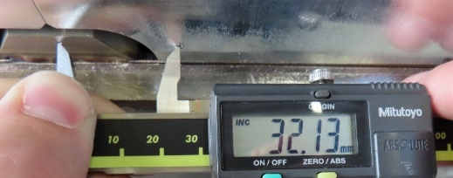
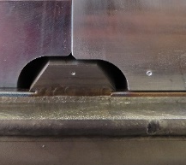
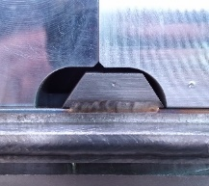
Among observations during
LMQXFBT02 & LMQXFBT03 disassembly
The longitudinal cut was performed in two steps. Initially the upper shell was dissociated from the backing strip. Then the lower one.
Tack welding blocks positions before and after longitudinal cutting
Measurements on LMQXFBT03 (very similar for LMQXFBT02)
All blocks move towards the magnet centre after the second cut
Motion is due to stress accumulated during the longitudinal welding

Slide 8
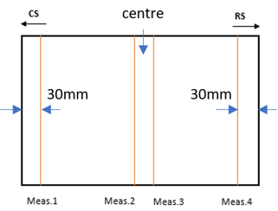
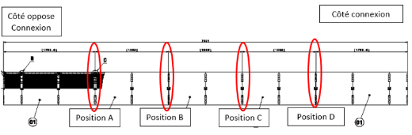
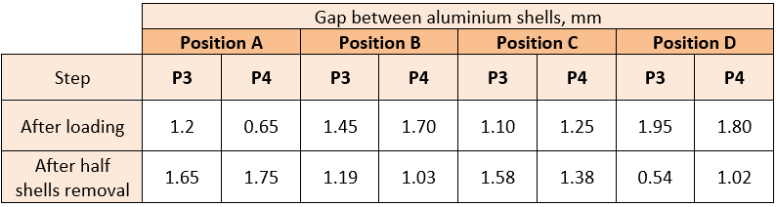
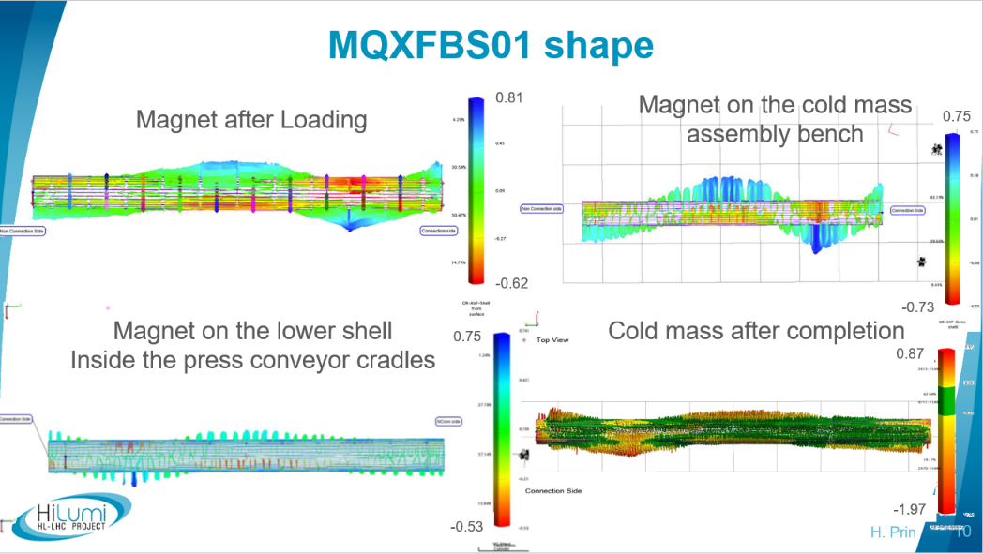
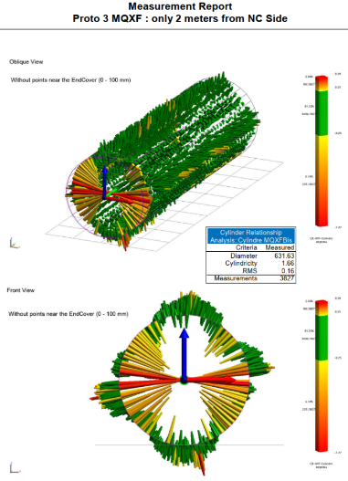
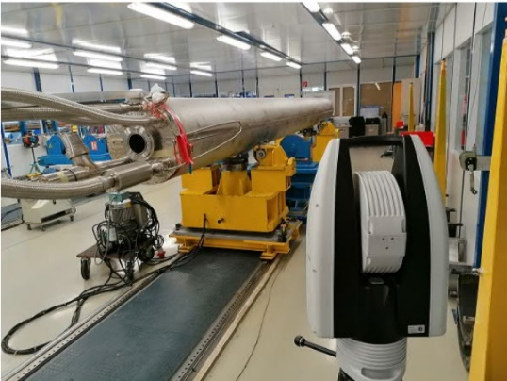
Among observations during
LMQXFBT03 (not cold tested) disassembly
Al shell developed lengths
Gaps between Al shells
Differences between -0.1 and 0.2mm
within Pi tape measurement accuracy
Differences up to 1.4mm that are not uniform on both sides of the magnet
Any realignment after the magnet was welded inside its envelope?

Slide 9
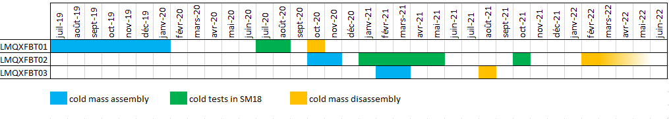
More information about
LMQXFBT01 to 03 cold masses
LMQXFBT01:
  MIP EDMS 23096431 including all links to inspection reports, pictures and procedures
  Disassembly report EDMS 2422353
  MTF HCLMQXFBT01-CR000001
LMQXFBT02:
  MIP EDMS 2524279
  Disassembly report EDMS 2719687 (ongoing)
  MTF HCLMQXFBT01-CR000002
LMQXFBT03:
  MIP EDMS 2524279
  Disassembly report EDMS 2620240
  MTF HCLMQXFBT01-CR000003

Slide 10
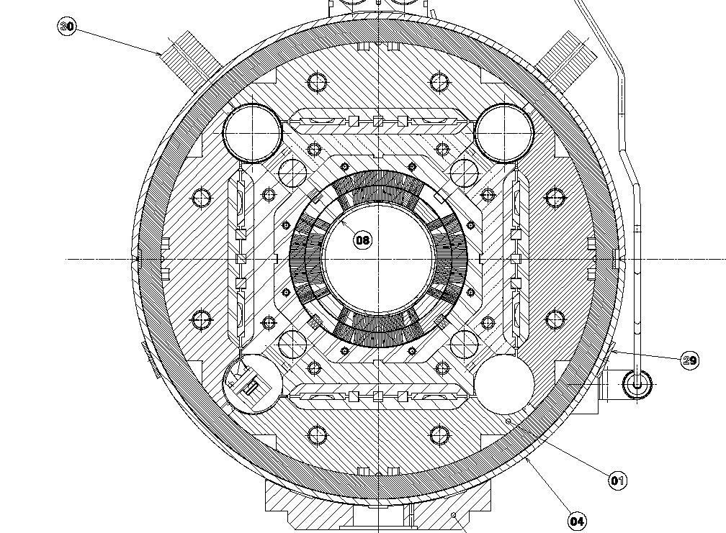
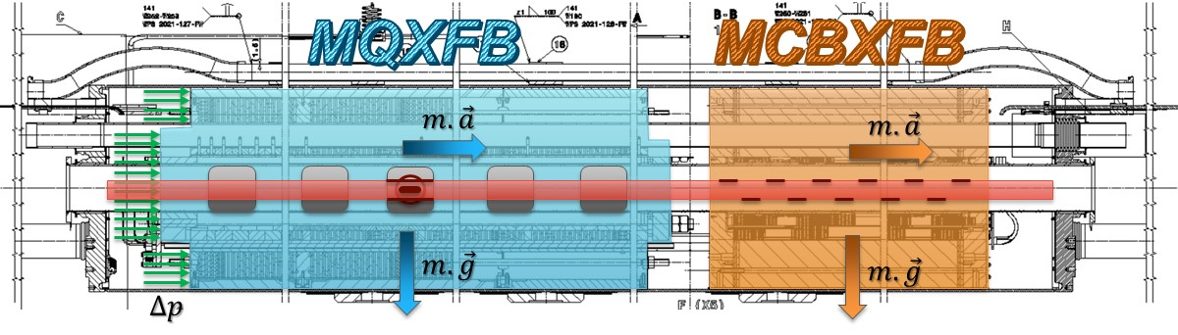
Requirements update after MQXFBP2 cold test
Coupling between magnet
and stainless steel shell
Magnets longitudinal fixed point
The design should minimize the mechanical coupling between the Stainless-Steel shell and the Aluminum segmented shells.
The fixed point (and the magnet components in contact) must withstand the loads appearing:
During transport, the maximum load that shall be carried by the fixed point is 0.5 g resulting in a load of 55 kN for the MQXFB.
During operation of the cryogenic system, the MQXFB magnet inside the cold mass shall withstand 4 bar differential pressure between its ends (induced by cryogenic operation or by quench of other magnets) resulting in a load of 96 kN.
Target on the increase of stress in the coil at room temperature after welding has been decreased from 8±8 MPa to 0+8 MPa

Slide 11
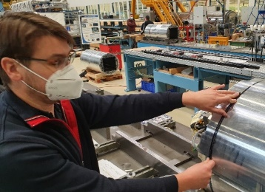
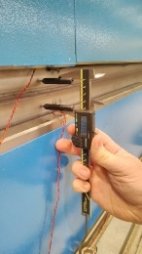
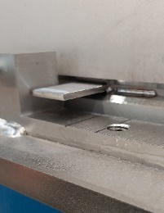
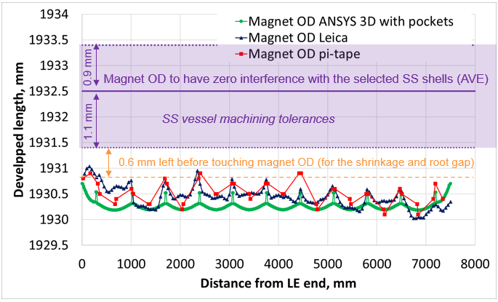
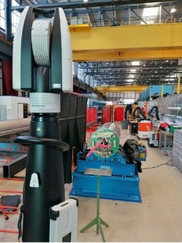
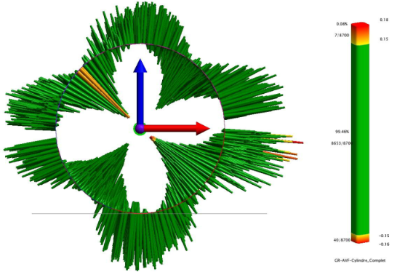
Determination of the shell developed length
gap
Ldev_{Shells}= Ldev_{Magmax} + 2x shrinkage – 2x root gap
Root gap
Shell pairing for LMQXFBT04, the second cold mass with MQXFBP3:
(Max)
Pairing of shells 5 and 102 (Average)
(Min)
Courtesy of Susana

Slide 12
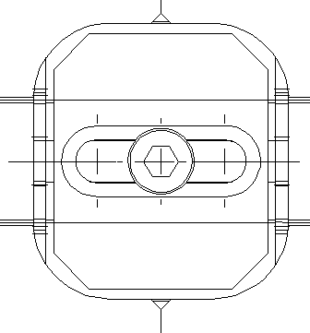
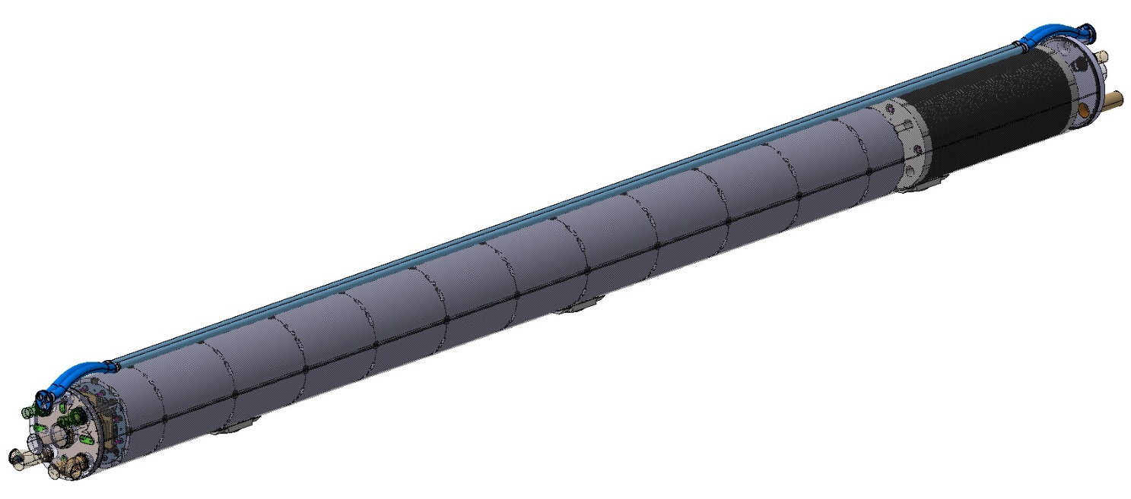















MQXFB fixed-point
Middle yoke plate enlarged design for the series (91.4mm)
Plug weld according to EN 1993-1-8 : 2005(E)
Middle yoke plate machined for MQXBP2 and 3 (45mm)

Slide 13



Outcome of Technical Review of MQXFB Cold Mass
https://indico.cern.ch/event/1142636/
Are the designs and procedures to determine the developed length and gap size, to assemble and to weld the stainless-steel outer half shells around the magnet structure consistent with the requirements of minimizing the coupling between the outer stainless-steel shell and the magnet structure?
Yes, assuming the vendor can meet the strict shell manufacturing tolerances proposed. A complete set of procedures has been developed and is implemented (or is under implementation) both at the shell supplier premises and at CERN. As a general comment, the proposed loose stainless-steel shell, requires a careful assembly and control sequence. It can be done since these are small series of quadrupoles to be manufactured in very controlled conditions.
Are the design of the fixed points and the procedures to implement them satisfying the requirements at room temperature given by transport and the requirements at cryogenic temperatures given by LHC operation?
Yes, in the case of the quadrupoles that will be manufactured starting from new modified components.
In the case of the existing prototypes already assembled, the proposed solution is quite at the limit and there are risks associated to their operation. These magnets will be used in the string and not in LHC machine. For this reason, the proposed configuration is not ideal but seems acceptable providing a risk analysis in case of fixed point failure is carried out and, in case of need, mitigation measures are defined.
The committee discussed if four fixed points (instead of two), machined on place, on the same plane could help in the case of BP2 and BP3. For This might help in cases where stress re-distribution occurs after local deformations.
Recommendation N1: We suggest carrying out a risk analysis to clarify the consequences of the failure of the fixed point components; both for the string cryomagnets and for the series.
Recommendation N2: For the prototype magnet, we recommend investigating any improvements that may significantly reduce the stress level in the Armco central plate. We understand that increasing the depth of the rod could slightly improve the stresses in the brittle Armco support. We recommend checking this possibility and implementing it in case the simulations confirm the stress decrease. We recommend as well to introduce a chamfer or a rounded shape at the bottom of the rod cavity.
Recommendation N3: The life cycle of the quadrupoles was not given in the presentations. It is most likely not an issue during transport: low stress and high ductility of the material. At cold, a minimum number of expected quenches and life cycle requirement should be specified. It is important to assess the resistance of the parts for more than one single quench event. We recommend performing several cyclic tests, consistent with expected lifetime, at cryogenic temperature to check the resistance to crack propagation.
Is the expected variability due to parts tolerances and assembly properly considered?
Yes.
Judge the level of validation and maturity of the proposed solution for both prototypes and series production.
Extensive FEM computations and engineering considerations have been carried out and presented. For the series production the situation is well understood, and the solution is feasible. As said before, the prototypes are at the limit and the presented analysis seems not fully conservative (laminations accounted as solid block, no stress redistribution for the fracture analysis). Recommendations 1, 2 and 3 applies particularly to this case.
Assess the suitably of the proposed QC procedures to ensure that the manufactured cold mass is conform to the design.
QC procedures are well defined.
Assess the robustness and durability of the proposed solutions with respect to the life expectancy of the cryomagnets.
Solution proposed for the series production is fine. The solution for the prototypes, considering their limited use in the string, is acceptable providing the recommendations 1 to 3 are applied.

Slide 14







Implementations on MQXFS7
Shell welding
Fixed point machining
Shell welding
Additional loading
Shell Cutting
Shell welding, then cutting and bore machining in the model yoke does not affect its performance
Fixed point
Machining

Slide 15




Additional QC and improvements for next cold masses
Weekly meeting with the half shell manufacturer for a close follow-up.
Magnet developed length measurements (+shape) using different technics (like pi tape, dedicated tooling or laser tracker).
Shell re-measurements during reception at CERN, ultimate adjustment envisaged either by pairing or machining using a portable machine developed in house
Possible adjustment of the developed length thanks to a portable milling machine developed in house.
Systematic root gap checks and measurements after tack welding
Welding power sources upgraded in 2021, improved repeatability by requalification with amended parameters.
  Shim and shell tack-up procedure defined
  TIG pass fixed parameters
  Defined values to fine tune the WPS range according to given welding preparation geometry (wire speed automatically adjusting current and voltage, voltage trim minor adjustment)
Welding shrinkage measurement improvement in terms of accuracy and automation developed in house using a probe like the ones used in the CMM.

Slide 16
Summary
After MQXFBP2 cold test, the target of mechanical coupling magnet to cold mass shells was reviewed.
Coupling minimisation between the stainless steel and aluminium shells obtained by:
  SST shell developed length increase and tolerancing review,
  Welding developments to define and control parameters,
  Welding shrinkage characterisation and root gap control with calibrated shims.
Minimised coupling between magnets and their envelope generated a need to fix the magnets inside the cold mass to cope with acceleration during transport and against pressure waves.
The fixed-point proposed design was presented during a technical review the 31st of March, it received very positive conclusions. All recommendations are being implemented.
The proposed design was, or will be, also implemented on:
  MQXFS07, bores drilled inside the yoke without any effect on the model performance,
  LMBRDP2, the D2 prototype cold mass, cylinders welded with new nominal developed lengths
  LMQXFBT04, 4th cold mass to test the 3rd MQXFB prototype, presently being assembled
  LMQXFB01, first Q2 cold mass with MQXFBP2 2nd prototype magnet, staring in May
Procedures are being refined and additional tooling being developed to cope with the effects and impacts of the proposed changes.

Slide 17

LMQXFBT04 with MQXFBP3
First TIG pass of the longitudinal welding will start on Tuesday the 3rd

Slide 18
Spares slides

Slide 19




Applicable Documents for HL-LHC cold masses
Flowcharts: cold mass assembly process from the magnets delivery up to its acceptation by the WPE
  Q2 flowchart: LHC-LMQXFB-FP-0002 2366861
  D2 flowchart: LHC-LMBRD-FP-0002 2263493 v0.2
  CP flowchart: LHC-LMCXF-FP-0008 2711593 V0.1 (draft)
MIPs: cold mass Manufacturing and Inspection Plan
  Q2 MIP: LHC-LMQXFB-FP-0001 2315780
  D2 MIP: LHC-LMBRDP-FR-0013 2716556 v1.0 (ongoing)
  CP MIP: LHC-LMCXF-FP-0009 2711595 V0.1 (ongoing)
Production report:
  D2 production report :
  Prototype cold mass LHC-LMBRDP-FR-0015 2679760
  D2 prototype cylinder LHC-LMBRDP-FR-0021 2706834
  CP production report: LHC-LMCXF-FR-0019 2682730
Triplet interface specification: 2131281

Slide 20



LHC CERN IR cold mass assembly principle
(MQM and MQY types)
LHC Project Report 713
Two half-shells:
serve for positioning of the various magnetic elements (quad. and dipole orbit corr.)
provide the rigidity for their alignment
serve as a helium pressure vessel closed with two end covers
Magnets Alignment:
Align the magnet yokes individually using precision alignment cradles
Tack welding the alignment keys to the laminations under compression.
Aligned magnets are placed in the half-shell.
Align magnets relative to each other using the cradles.
Tack weld the alignment keys to the chamfer of the half-shell.
1
2
3
4
5

Slide 21








HL-LHC magnets particularities
MCBXFA/B
MBRD (D2)
MCBRD (CCT)
MQXFA/B
MQXSF
HO corr. n≥6
MQXF dictates parameters for other magnets on one side:
Øext = 614mm
Backing strip: 4 x 24
Vacuum vessel installation constraints fix the cold mass dimensions:
Lmax ≤ 15160mm from the main dipole
Øext ≤ 630mm ⇨ shell thickness ≤ 8mm
-0.1
-0.2

Slide 22









Assembly procedure 1/2
1
2
3

Slide 23










Assembly procedure 2/2
4
5
6

Slide 24



Shell design
  Developed length history (LHCLMQXF_S0001):
  Mar 2017: 966.04 -0.25/+0.5
  Nov 2018: 964.47 -0.25/+0.5 ⇦ Coil 8 MPa [±8]
  Aug 2019: 963.04 -0.25/+0.5 ⇦ Dual WP
  Now: 964.5 -0/+1.5 ⇦ 0 MPa [+8]
It is agreed with the manufacturer that shells could be combined to reach the defined 1929mm length for the pair

Slide 25







Shell production improvements
Before enhancements
  12m press, 3’000 tons capacity, fully revised in March 21 to improve the quality of the forming
After proposed improvements:
Last shell #6-2 to be paired with shell #6 machined after process improvement. Target developed length was the maximum value
  Forming process in three steps rather than two used previously to improve shaping accuracy.
  Machining jig modified to insert two compressing C clamps in the shell centre.
  Estimation of the compressive force is about 2 tons.
  Additional screws added to fix the shell extremities and prevent movements.

Slide 26






Fixed point machining procedure
(To be used only on already assembled magnets MQXFBP2 and 3)
Tested on MQXFS7
Check parallelism magnet / y axis of the machine
Centering in the existing thread with a 6.8mm drill
STEP 1 | STEP 2 | STEP 3 | STEP 4 | STEP 5
Tool: Drill ø16 Cutting speed: 200 rpm on 10mm then 400 rpm Depth: 36.5 mm | Tool: Milling cutter ø16 with central cut Cutting speed: 250 rpm Depth: 37 mm | Tool: Counterbore ø29 with centering ø16 and 35mm length Cutting speed: 250 rpm Depth: 33mm, then remove centering and go to 37mm | Tool: Reamer ø30H7 Cutting speed: 80 rpm Depth: max | Tool: Counterbore ø45 with centering ø30 Cutting speed: 200 rpm Depth: 0.5mm

Slide 27






Slide 28




Welding over aluminium: a potential issue?
Welding trials using existing procedure qualification records have be performed using a stainless steel backing strip and a longitudinal groove for gaseous protection machined in the aluminium support.
 X-rays show no inacceptable defect on both samples.
Further developments in collaboration with EN-MME (Welding, Material and NDT):
Monitoring of the temperature during welding on several locations
Metallographic section and EDS analysis (Energy Dispersive X Rays Spectrometer) to determine the presence of Aluminium, Manganese or other gaseous deposition on the weld or shell surfaces
Tensile tests to confirm no mechanical degradation.
Leak tests on the root pass

Slide 29

Radiographic Testing Report over the first sample (EDMS 1460432)

Slide 30





Tack blocks and backing strips installation
LHC-MQXFB-FP-0020 – Controls before assembly
Tack blocks should be centered inside the aluminum shell pockets.
Dot marking on the tack blocks and the magnet yoke in line with the aluminum cylinders junctions.
Screws are installed on the magnet with a bias towards the center to allow maximum movement.
All blocks are photographed in position before placing the backing bars.
Tack blocks are welded in position using filler material.
Excess is removed so the shell can locate correctly.

Slide 31




Shell adjustment milling machine

Slide 32










  New dev. lengths implemented on LMBRDP02 (D2 prototype)
Lower shell #4 and shims tack welding to the baking strips
Upper shell #101 dev length machining
$$\hat{L_{4}}={967.2}_{−0.7}^{+0.8}$$
$$\hat{L_{101}}={961.8}_{−0.8}^{+1}$$
$$\hat{L_{4}}+\hat{L_{101}}={1928.96}_{−1.2}^{+1.3}$$
Upper shell installation on top of the magnet
Upper shell sitting on top of the shims surface
Slide 11
3.2mm
2.7mm
Upper shell tight adjustment to the magnet yoke and backing strip
Upper shell #101 and shims tack welding to the baking strips
Root gap measurements after tack welding and shims removal
Side A 3.8mm [3.6, 4]
Side B 3.9mm [3.8, 4.1]
Upper shell/retrains gap measurements in the extremities:
CS 3.2mm
RS 2.7mm

Slide 33









New dev. lengths implemented on LMBRDP02 (D2 prototype)
Dual welding process:
Root pass TIG
2 filling passes MIG
Welding shrinkage after the 3 passes:
Side A = 2.4mm [1.82, 2.77]
Side B = 2.57mm [2, 3.38]
Shell extremities after orbital cutting.
Gap measurements between 0.5mm on top
and 0.95mm at 2 and 10 o’clock
No gaps on the lower shell
Shells elliptical shape in the extremities
Rotational movement noted on the backing strip in the extremities
Stainless steel shape re-rounding using a jack in the extremities

Slide 34






Welding shrinkage determination
MQXFS7
MBRDP03
MBRDP02
Side A = 2.2mm [1.9, 2.6]
Side B = 2.7mm [2.6, 2.8]
Side A = 2.1mm [1.9, 2.3]
Side B = 2.4mm [2, 3]
Side A = 2.4mm [1.8, 2.8]
Side B = 2.6mm [2, 3.4]
New automated system to be mounted on the welding press to increase the measurement accuracy of the welding shrinkage (available for next cold mass)

Slide 35


Fixed point traction tests
Initial test beginning of March 2022
Second setup to be tested in week 18

